Slide 1
Basis of the BOLD Signal
Walter Muruet
Kaitlin Wilcoxen

Slide 2
Overview
History
Physics
Physiology

Slide 3
History

Slide 4
History
A Brief History of MRI
  In 1882 Nikola Tesla discovered the Rotating Magnetic Field
  In 1937 Professor Isidor I. Rabi observed Nuclear Magnetic Resonance (NMR) in gases
  In 1945 Feliz Bloch and Edward Mills Purcell demonstrated NMR in solids and liquids
  In 1956 The “Tesla Unit” was officially proclaimed in Munich, Germany
  In 1971 Raymond Damadian Suggested the use of NMR to diagnose cancer

Slide 5
History
A Brief History of MRI (Cont’d)
  In 1973 Paul Lauterbur Produced the first NMR image; Following this, Peter Mansfield developed the echo-planar imaging protocol.
  In 1974 Raymond Damadian patented the design and use of NMR
  On July 3, 1977, after nearly 5 hours after the start of the first MRI test, the first human scan was made with the first MRI Prototype
  On 2003 Paul Lauterbur and Peter Mansfield were awarded the Nobel prize in Physiology or Medicine for their “Discoveries Concerning Magnetic Resonance Imaging”

Slide 6
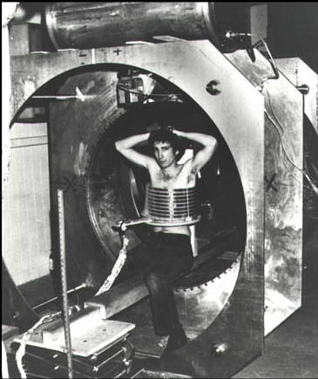
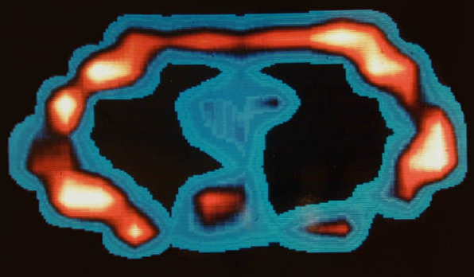
First anatomical MRI
106 voxels
www.fonar.com

Slide 7
History
Early Observations that linked Blood Flow and Neural Activation
  In1896 Roy and Sherrington → Increases in brain activity resulted in increased blood flow to active areas.
  In 1950 Penfield and Rasmusen→ Conducted a systematic study of functional neuroanatomy. They reported that brain areas surrounding the stimulating electrode were red in color. (i.e. Increased supply in arterial blood)

Slide 8
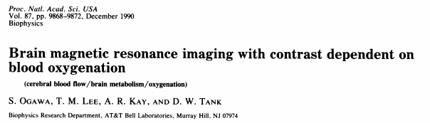
History

Slide 9
Physics

Slide 10
Physics
Basic Physics of Magnetic Resonance Imaging
Magnetic Flux density is measured in Tesla
Clinical MRI are performed generally at 1.5-3T
(in comparison, Earth magnetic field is 0.00003T)
MRI relies on the magnetic properties of hydrogen atoms to produce images

Slide 11
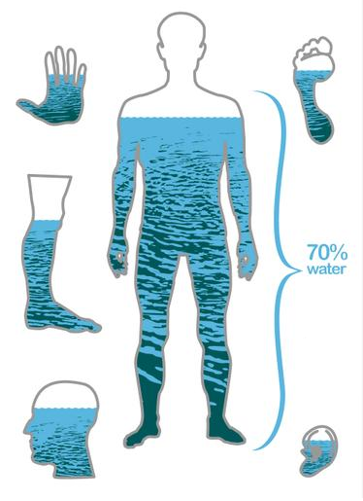
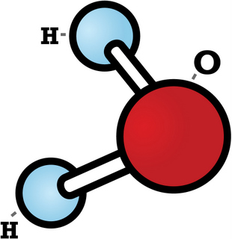
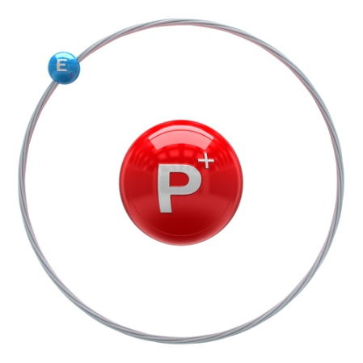
Physics

Slide 12
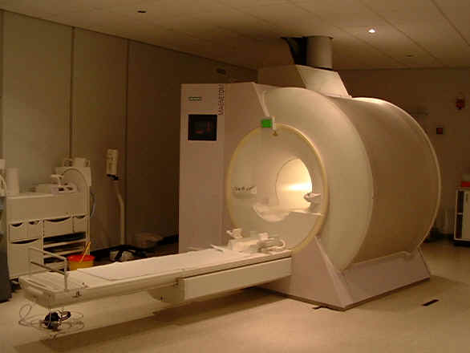
Physics
Medicalpicturesinfo.com

Slide 13
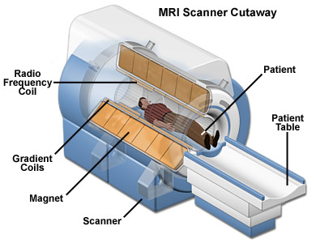
Physics
National High Magnetic Field Laboratory (http://www.magnet.fsu.edu/)

Slide 14
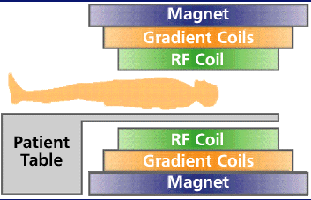
Physics
Pulse Accelerator Science in Medicine (www.fnal.gov)

Slide 15
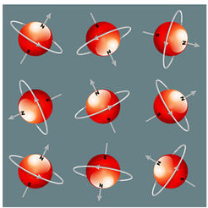
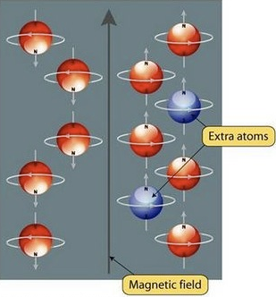
Physics
B₀
http://www.ece.neu.edu/

Slide 16
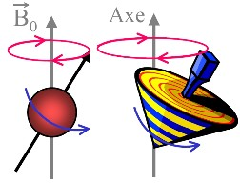
Physics
  Precession
    Protons spin around the long
    Axis of the primary magnetic
    Field= Precession
    Larmor frequency
    When protons precess
    together → in phase
    When protons precess
    separately→ out of phase
    Frequency of Precession
    Changes in proportion to the
    Magnetic field strength

Slide 17
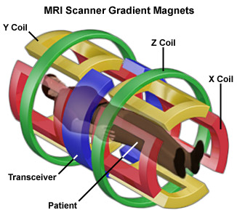
Physics
  Gradient Coils
    They alter the strength of the primary magnetic field
    They change the precession frequency between slices
    They allow Spatial encoding for MRI images

Slide 18
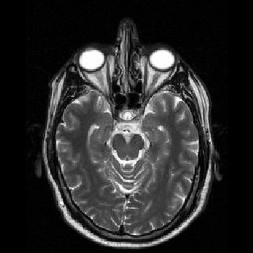
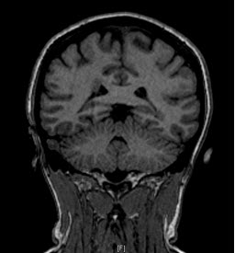
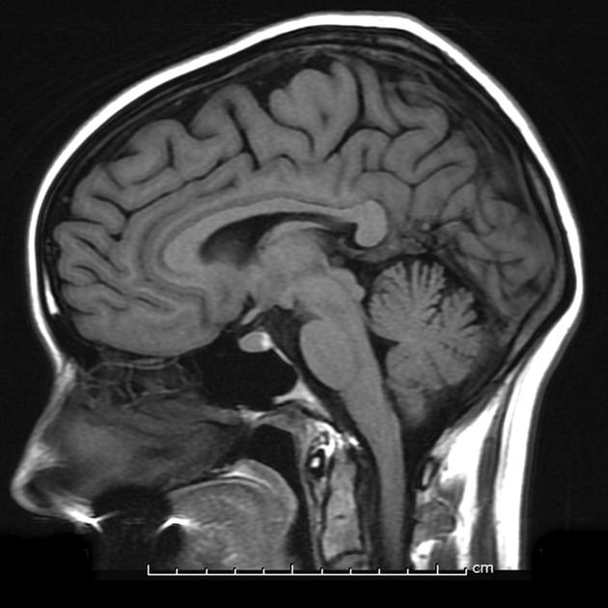
Physics
Z Gradient runs along the long axis, and produces Axial Images
Y Gradient runs along the vertical axis, and produces Coronal Images
X Gradient runs along the horizontal axis, and produces Sagittal Images

Slide 19
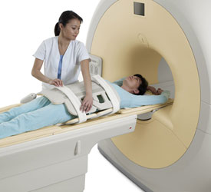
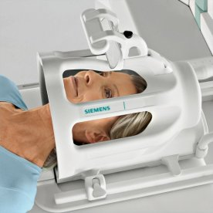
Physics
  Radiofrequency Coil (RF Coils)
    Transmit RF Pulse and Receive Signals
    The RF Coil produces a second Magnetic
    Field (B₁) with the same
    precession frequency
    Causes disturbances in the
    protons’ alignment
      Low energy parallel protons flip to a high
      energy state
      Protons become synchronized and precess in
      Phase
      Transverse magnetization

Slide 20
Physics
  RF Coils (Cont’d)
    When the B₁ is turned off, protons gradually resume their normal state prior to the RF pulse→ Relaxation
      Longitudinal Relaxation (T1) → Parallel to B0 (Z axis)
      Transverse Relaxation (T2) → Perpendicular to B0 (x-y axis)
T2* = T2 + field inhomogeneities

Slide 21
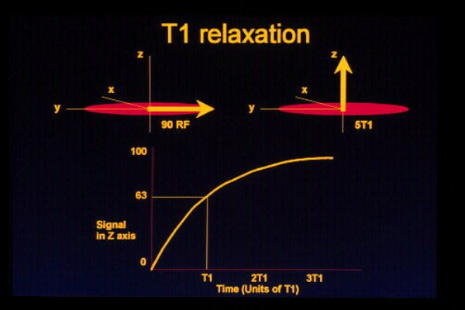
Physics

Slide 22
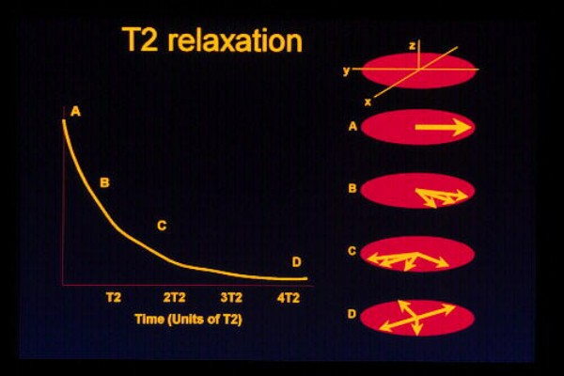
Physics

Slide 23
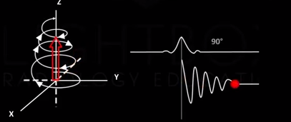
Physics
Net Magnetic Vector
  Sum of longitudinal & transverse magnetisation
  Net Magnetic vector spirals around the Z Axis
  Free Induction decay (FID)→ Changing magnetic moment
    Induces an electrical signal
    Signal is received by the RF coil in transverse plane

Slide 24
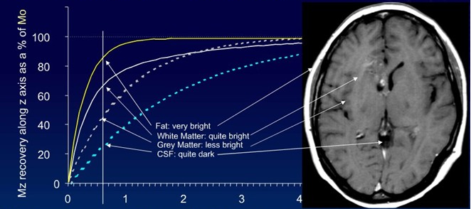
Physics

Slide 25
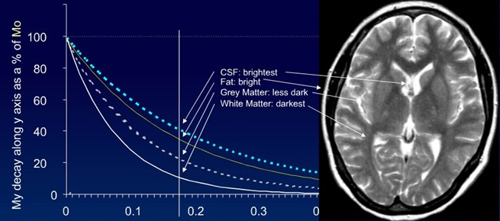
Physics

Slide 26
Image Formation
MR signals are received by the RF coil
MR signal depends on the time it takes a proton spin to relax and if they completely flipped back before the next pulse
The computer system perform an analog to digital conversion
  The raw data is held in K-space before reconstruction
  Reconstruction (image in real space) is obtained using Fourier transforms

Slide 27
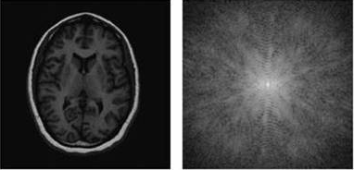
Image Formation
http://scien.stanford.edu/

Slide 28
Physiology
Notes:
Now that we’ve discussed the physics of how the BOLD signal is created let’s get into the physiology.

Slide 29
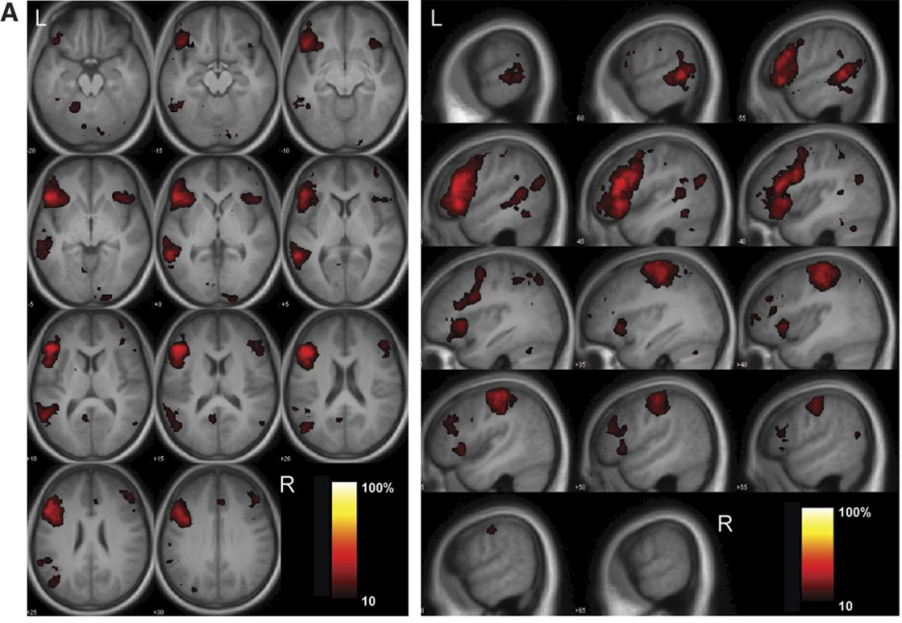
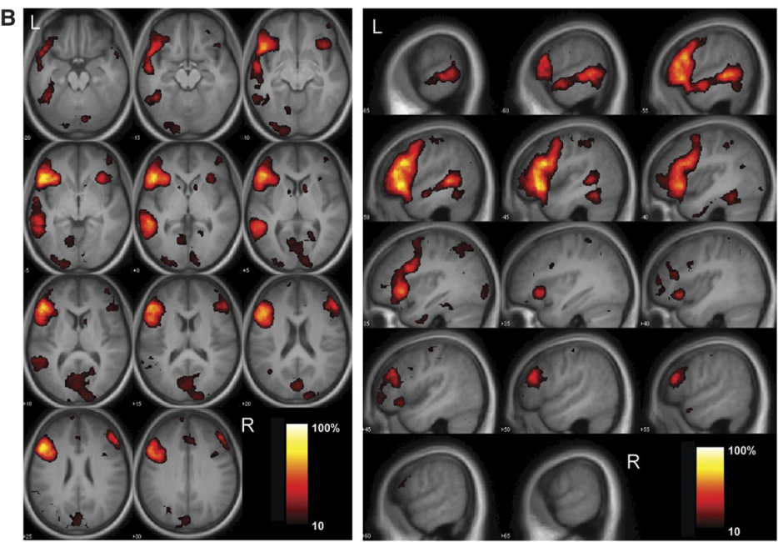
Physiology
Language Localization
Patients with Epilepsy
Healthy Controls
Genetti et. al., Neurosurgery 2013
Notes:
This is the ultimate goal with fMRI and the whole point of the physics and physiology of the BOLD signal. We’re trying to see where different functions occur in the brain and the networks that do it.

Slide 30
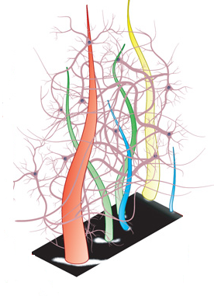
Physiology
Voxel = the fMRI version of a pixel
Logothetis et.al., Nature, 2008
Notes:
To make up those images we have hundreds of thousands of little tiny units called “voxels”. They’re the units of space from which signal is detected.
Each voxel is about 1mm by 1 mm by 2mm. There are hundreds of thousands of voxels that make up an fMRI.
Within each voxel there are a few capillaries and thousands of neurons associated with those capillaries.
When you add up the signal from all of them you get an image of the entire brain.

Slide 31
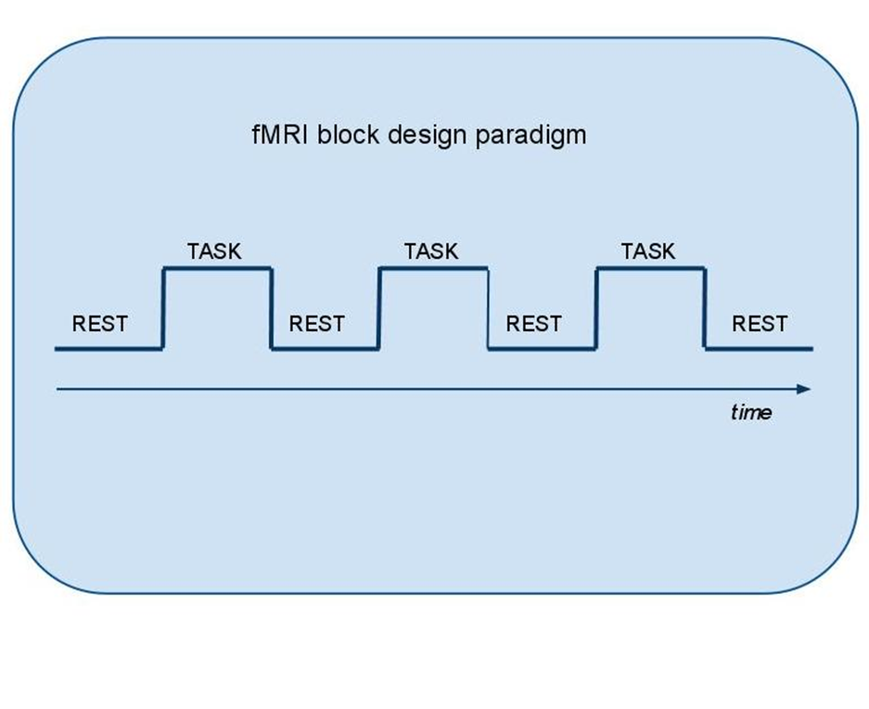
Physiology
Stanislavsky, Radiopaedia, 2010
Notes:
Typical fMRI block design.
The subject is placed in the MRI machine- all the magnets are turned on and all that. And then you alternate rest periods with task periods. The subject could be doing something as simple as looking at a visual stimulus during the task period and looking at a black screen during the rest period. Or they could be doing something more complicated like producing as many words that start with the letter “s” as they can in the given period.
All this time you’re recording the radio waves emitted as the protons in the head fall back to their normal position.
End up with a ton of images of the brain while it’s “resting” and while it’s performing a “task” and the areas with increased signal compared to the resting phase are where that task is localized in the brain.

Slide 32
Physiology
Stimulus
Neural Response
Hemodynamic Response
BOLD
Neurovascular Coupling
Notes:
How do we see this?
After an initial stimulus we expect to see a neural response. Because the neurons are activated they have a greater need for oxygen and glucose, so we see an increased blood flow to the region, or hemodynamic response. The connection between the neurons and the nearby vessels is called neurovascular coupling. And ultimately from the hemodynamic response we can record a BOLD signal.
What we’re really interested in seeing is the neural response. We want to know what’s happening in the brain and where. But, for an average experiment you can’t drill into people’s skulls and insert electrodes into their brain, so we have to use a second best approximation and look at changes in blood flow.

Slide 33
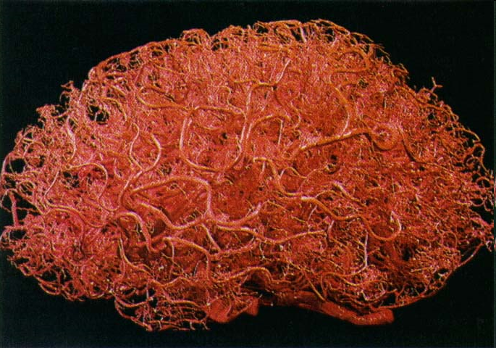
Physiology
BOLD = Blood Oxygen Level Dependent
Capillaries branch throughout the brain- bring needed oxygen and glucose
Zlokovic & Apuzzo, 1998
Notes:
BOLD stands for Blood Oxygen Level Dependent- so clearly we care about the vascular system
This is just an image of the vascular network within the brain. Taken from a mold of blood vessels in an actual brain. You can see there’s a ton of branching to send capillaries all over.
We assume that when neurons are activated they have higher energy demands and so require more blood flow than when at rest.
So how does this relate to all the physics we were talking about earlier?

Slide 34
Physiology
Magnetic properties
  Hemoglobin (Hb) = diamagnetic
  Deoxyhemoglobin (dHb) = paramagnetic
Active neuron uses oxygen → More dHb = more inhomogeneity = faster T₂* signal decay
Notes:
It all depends on hemoglobin.
The oxygentation or deoxygenation of hemoglobin has a small influence on the magnetic field and this affects the T₂ signal we see.
Regular hemoglobin, when it’s bound to oxygen, is diamagnetic which for all intents and purposes means it has no magnetic influence.
On the other hand, deoxyhemoglobin is paramagnetic. Paramagnetic means that when you put it in a magnetic field, like the one created by the permanent MRI magnet, it creates its own small induced magnetic field. So deoxyhemoglobin causes inhomogeneity in the magnetic field and results in faster signal decay in its area.

Slide 35
Physiology
Thanks to Dr. Samira Kazan for the images
Oxygenated Hb
B₀
voxel
Vessel
Tissue
Deoxygenated Hb
35
Notes:
So let’s look at that in a bit more detail. The top image is of a hypothetical vessel near inactive neurons, so there’s plenty of oxygenated hemoglobin in it. Now you’ve turned on the MRI scanner and you get this green magnetic field. It’s hard to tell but there are very small differences in the field- if you can see it, it’s a bit yellower in some places- however overall, the field around the blood vessel is very uniform.
The image on the bottom is of a vessel that has lots of deoxyhemoglobin present in it. The color differences represent changes in the strength of the magnetic field because of the presence of dHb.
Now we’ll zoom in on one small voxel in each image. You can clearly see the difference in the magnetic field in the deoxygenated case.
So, with the initial RF pulse, all the protons are lined up and in phase and we have a strong signal.
If we look a few milliseconds later the protons are coming out of phase with each other and the signal is weakening.
And even a few milliseconds later and the signal has decayed much more.
Because the magnetic field is so much more inhomogeneous when there is deoxyhemoglobin around the protons come out of phase much faster and the signal decays a lot faster.
So, you would expect a weaker BOLD signal when neurons are activated compared to when they’re at rest.

Slide 36
Physiology
Thanks to Dr. Samira Kazan for the images
Oxygenated Hb
B₀
voxel
Vessel
Tissue
Deoxygenated Hb
36

Slide 37
Physiology
Thanks to Dr. Samira Kazan for the images
Oxygenated Hb
B₀
voxel
Vessel
Tissue
Deoxygenated Hb
37

Slide 38
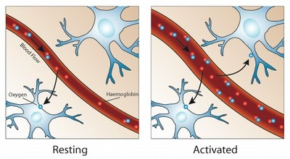
Physiology
Overcompensation of cerebral blood flow compared to increased oxygen demands
Reas and Brewer, JEP, 2013
Notes:
However, if you know anything about MRI that’s not what we see. We see more signal in areas that are activated.
This happens because there’s an increase in blood flow that overcompensates for the increase in deoxyhemoglobin
If you look at the picture it shows you a good representation- in a resting state the blood vessel is relatively small and there’s some hemoglobin and some deoxyhemoglobin. Hemoglobins are red and oxygens are blue.
When the neurons become active they start using more oxygen- so you see more deoxyhemoglobin circulating, but there’s such a vast increase in oxygenated hemoglobin sent to the area, that the ratio of deoxyhemoglobin to hemoglobin actually decreases.
So overall you do get signal increase in areas of the brain that are active.

Slide 39
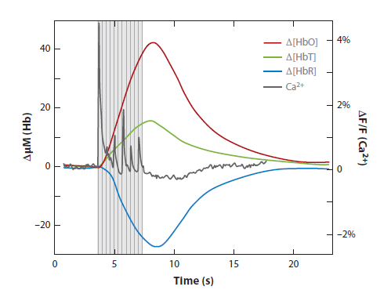
Physiology
Hillman, Annu. Rev. Neurosci., 2014
Notes:
If you’re a visual here’s a figure showing concentration changes in hemoglobin after a stimulus. The green line is total hemoglobin concentration increases. There’s a huge increase in the concentration of oxygentated hemoglobin. And a corresponding decrease in concentration of deoxyhemoglobin.

Slide 40
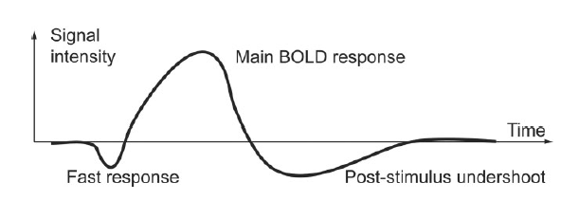
Physiology
Typical hemodynamic response to single short stimulus
Norris, JMRI, 2006
~5 - 6 sec
~4 sec
~10 - 30 sec
<1 sec
Fast response: increase in metabolic consumption
Main BOLD response: increased local blood flow
Post-stimulus undershoot: metabolic consumption remains elevated after blood flow subsides
Norris, JMRI 2006
Thanks to Dr. Samira Kazan for the slide
Notes:
Okay, so this is a typical hemodynamic response to a short stimulus.
In the first 1-2 seconds you see a fast initial drop in signal intensity- that’s due to the increased use of oxygen by activated neurons, before the blood vessels can respond.
Then, after about 2 seconds you get blood flow change and you get a big signal intensity increase that peaks around 5 or 6 seconds post-stimulus.
Eventually that signal fades, as the neurons return to resting and you sometimes see a post-stimulus undershoot, that’s poorly understood.

Slide 41
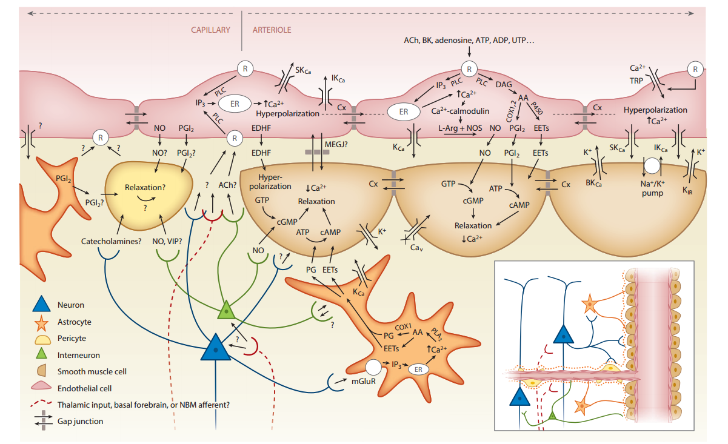
Physiology
Hillman, Annu. Rev. Neurosci., 2014
Notes:
This slide is basically to show you that we don’t exactly understand the mechanism controlling neurovascular coupling and the hemodynamic response. There are a lot of potentially important factors, like nitric oxide, which can act as a vasodilator, acetylcholine, or calcium release from astrocytes. Different labs all have their own perspective.

Slide 42
Physiology- Problems
What does the BOLD signal actually measure?
Interpreting negative BOLD signal
Disorders
Notes:
Because we’re measuring blood flow and not actual neural activity there are some potential problems with fMRI.
For example the BOLD signal seems to be linked to presynaptic activity, but not necessarily to actual actions and neurons firing. Also, we assume that the metabolic rate, the rate neurons use oxygen, is perfectly tied to the amount of blood flow, even though it may not be, and it may not be the same across all brain regions
There’s something called negative BOLD signal, which lots of people simply ignore. It’s when you see areas of decreased BOLD signal when performing a task. We’re not really sure why that happens, if it’s because blood flow gets diverted or if there’s concerted suppression occurring.
The last thing worth pointing out is that we often use BOLD contrast to compare people with various disorders to healthy controls and claim that they have different brain activity than normal individuals. However, there’s some emerging research, with autism for example, that suggests that maybe the difference we see in BOLD signal between normal people and people with autism is not due to differences in neural activity, but it due to differences in the mechanisms that control blood flow and activity. Like there’s some evidence that nitric oxide signaling is different in the autistic brain than in normal controls and it could be the different action of NO causing a different blood flow response, not an inherent difference in brain activity.

Slide 43
Physiology- Benefits
Many benefits of fMRI:
Very safe- doesn’t require high energy radiation
Function localization
Clinical Diagnosis and Treatment
Notes:
Despite all these potential problems or areas of investigation there are many benefits to using fMRI.
It’s very safe- unlike other imaging methods there’s no high energy radiation used so there are no health risks to repeated exposure
In that same vein, you can do repeated experiments with the same subjects or many subjects without health risk
It allows you to localize where a particular task is dealt with in the brain which is useful for understanding in general how we think and also how different diseases affect brain and behavior.
It’s also becoming extremely useful in the clinic for diagnosis and treatment. For example you can perform an fMRI scan to identify the language or motor areas of the brain to make sure it’s safe to resect a tumor.

Slide 44
Summary
Main magnetic field aligns protons
Gradient coils scale the field so you can eventually localize where signal comes from
RF pulse knocks protons into different plane
T₁ and T₂ signals produced
Compare resting state T₂ signal to active state T₂ signal
Areas that show an increase in signal are receiving more blood and are more active
Colorful pictures!
Notes:
So, in summary, you use a permanent magnetic to align all the protons.
Gradient coils scale the field so eventually you can tell where your signal is coming from.
Then you apply an RF pulse that knocks all the protons into a different plane.
As they come back to their normal alignment you get T1 signal and T2 signal.
For fMRI the t2 signal is influenced by hemoglobin
More active neurons need more oxygen so you get increased blood flow and increased signal.
This creates differences between resting states and task activated states and you get pretty pictures.

