Slide 1
Issues with analysis & interpretation
Type I / type II errors & Double Dipping
Antonia Eisenkoeck & Rosy Southwell

Slide 2
Recap: Hypothesis testing
Null hypothesis (H₀): Observation is a result of chance
Alternative hypothesis (H_{A}): Real effect
T Statistics
P-value: Chance of rejected H₀ although it is true
Significance level α: set a priori, usually 0.05

Slide 3
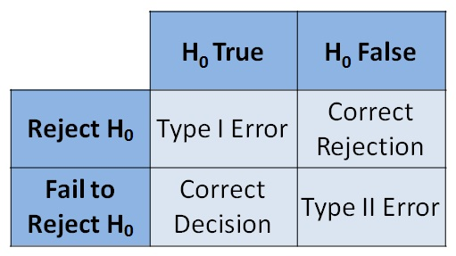

Slide 4
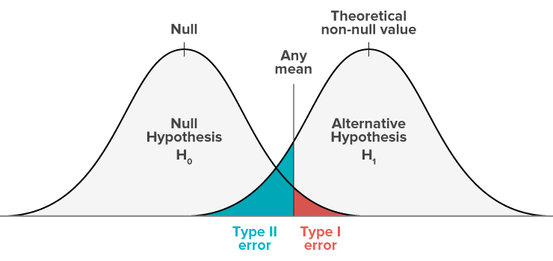
Type I & II errors:

Slide 5
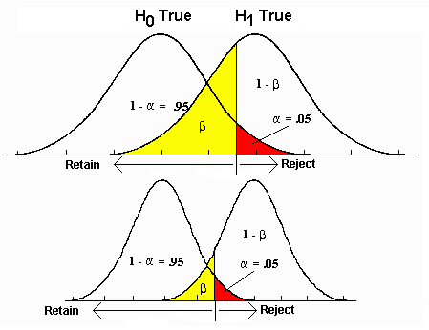
Shifting α:

Slide 6
… BUT there is not just one comparison!

Slide 7
Multiple comparisons:
~ 60 000 voxels
60 000 t-tests with α=0.05 3000 type I errors
α has to be adjusted!

Slide 8
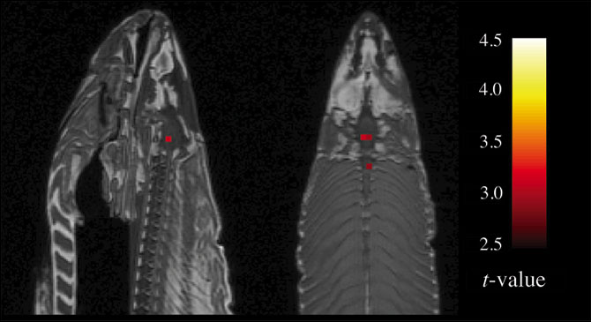
Bennett et al. (2010)
Notes:
Importance of correcting!
The salmon was shown a series of photographs depicting human individuals in social situations. The salmon was asked to determine what emotion the individual in the photo must have been experiencing.”
Are falso positives or false negatives more dangerous? Bennett argues false positives are more dangerous.

Slide 9
Correcting for multiple comparisons:
Family-wise Error Rate (FWER)
Probability of making 1 or more false discoveries
FWER of 0.05 means 5% chance of Type l error
Bonferroni correction:
Divide p by number of tests
Assumes spatial independence of voxels
Downside: loss of statistical power
Gaussian Random Field Theory

Slide 10
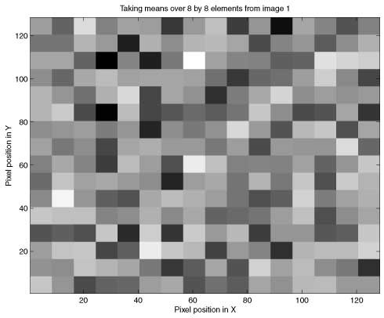
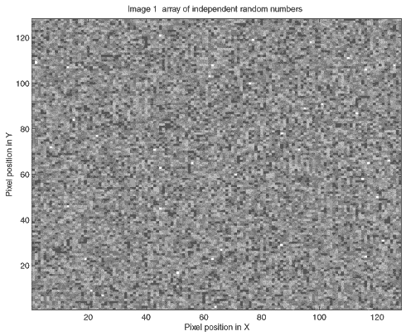
Random Field Theory

Slide 11
False Discovery Rate (FDR)
Less conservative
FDR = proportion of false discoveries
FDR of 0.05 means no more than 5% of detected results are false positives
Greater statistical power

Slide 12
Bennett et al. (2010): no significant voxels after controlling FWER or FDR

Slide 13
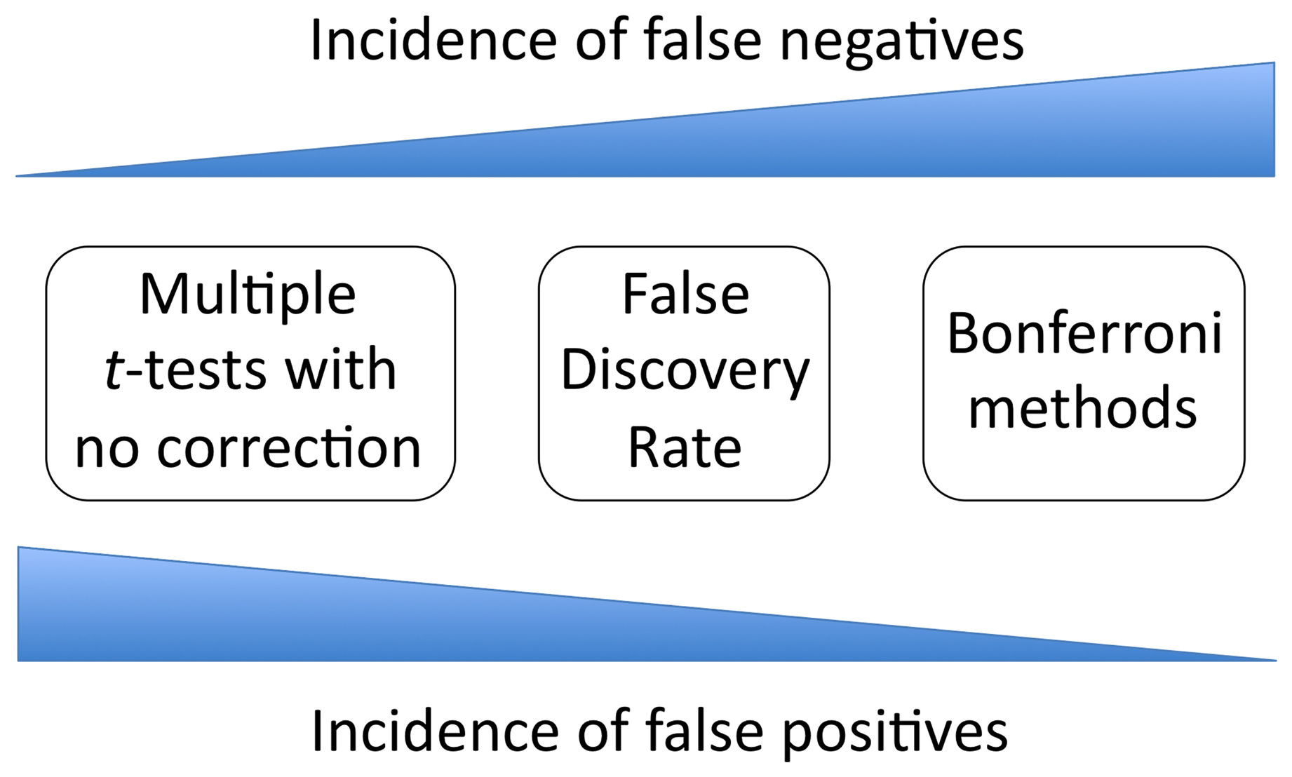

Slide 14
The “costs” of controlling of trying to control type l errors:
Increased chance of type ll error
Bias towards studying large effects over small
Bias towards sensory/motor processes rather than complex cognitive/affective behaviours
Deficient meta-analyses
Liebermann et al. (2009)
Notes:
Measures to control Type I errore increase disproportionally the type II error in studies on higher order cognitive processes
Liebermann et al. argue that making type II error is far from being catastrophic and more useful for a young discipline such as neuroscience
Bias towards sensory/motor processes -> more complex functions (e.g. decision making) offer more possible solutions

Slide 15
“For a young science to impose stricter self-standards than its parent discipline, when doing so would increase Type II errors and lead us to miss important neural landmarks for future investigations, is not wise.”
Lieberman et al. (2009)

Slide 16
What to consider:
Increasing statistical power:
Larger sample sizes
Study design that takes into account the slow nature of fMRI signal
Take meta-analyses into account:
  “We recommend a greater focus on replication and meta-analysis rather than emphasizing single studies as the unit of analysis for establishing scientific truth. From this perspective, Type I errors are self-erasing because they will not replicate, thus allowing for more lenient thresholding to avoid Type II errors.” (Liebermann et al., 2009)
Notes:
-slow signal of fMRI signal??

Slide 17

Notes:
Ultimately, avoiding Type I/II errors is all about balance! Must consider the desired statistical power, type and purpose of study, in considering whether to do a multiple comparisons correction (and within that, FWER vs FDR) or intensity/cluster thresholding.

Slide 18
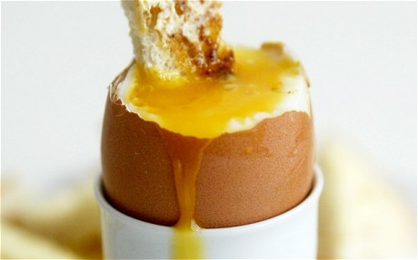
Issues with Analysis and Interpretation Part II:
Double Dipping
Rosy Southwell

Slide 19
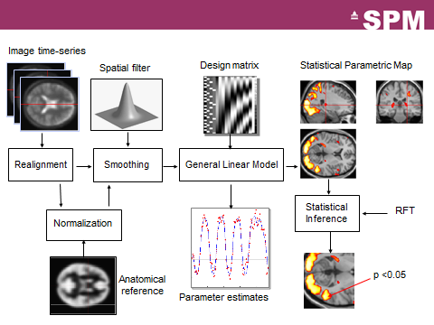
Notes:
We’ve seen how to design your study,
We’ve seen all the preprocessing,

Slide 20
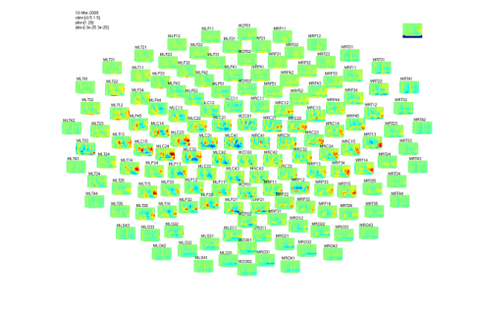
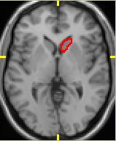
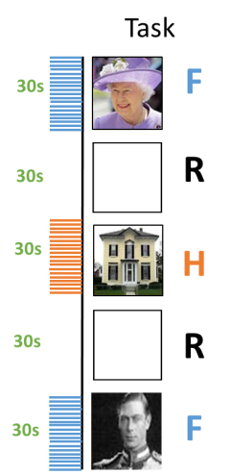
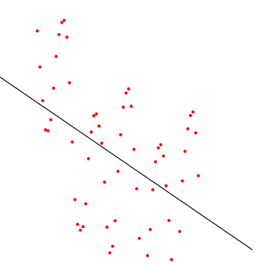
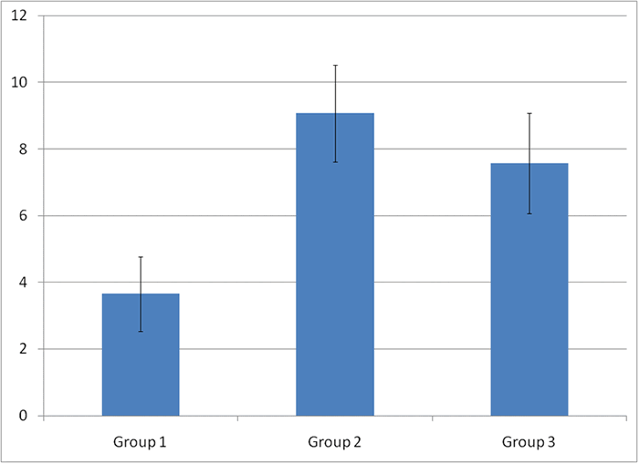
Notes:
And we’ve learnt about analysing within and between subjects.
Maybe next you might select a ROI based on your contrasts for further analysis, maybe a subset of channels in MEG, and have a look at how brain activity correlates with a behavioural task.

Slide 21
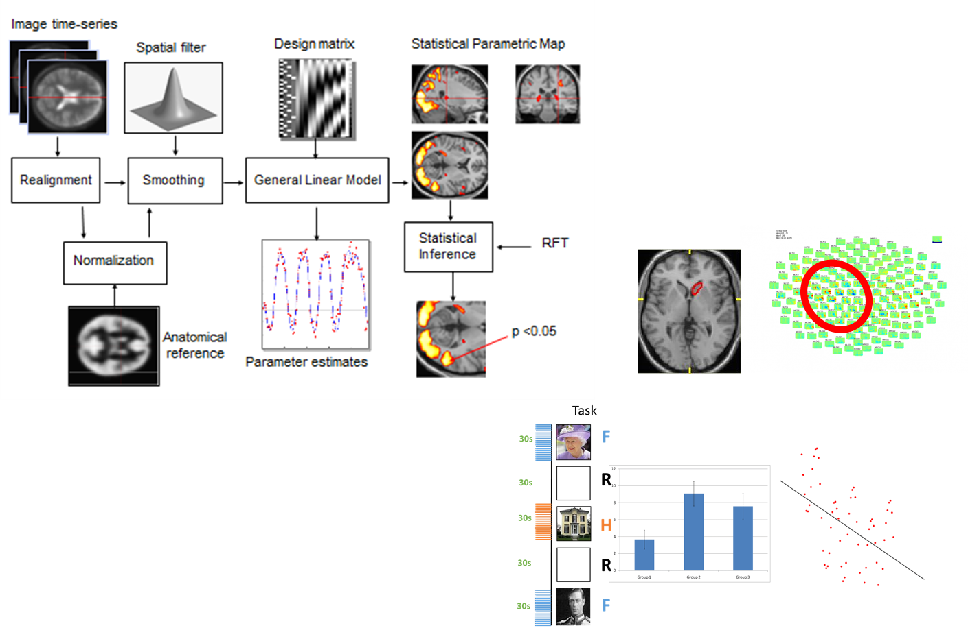
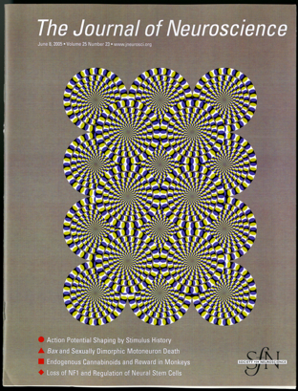


Notes:
That’s a lot of complex statistical analysis with a lot of assumptions and choices to make before you can publish your ground-breaking study in Nature.

Slide 22
What is all this data analysis for?
Huge datasets
Irrelevant information
Analyse & present a subset
selective analysis
Notes:
The datasets we get from neuroimaging are huge.
There is a lot of irrelevant information in the raw data.
Typically, we would select some relevant subset of the data to analyse in detail,
This is what is presented in the final paper.

Slide 23
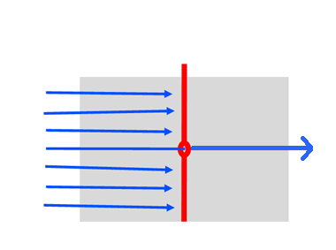
Deriving meaningful results…
Results ≠ Data
data
results
selective
analysis
Adapted from Kriegeskorte et.al., 2009
Notes:
Therefore, the results are NOT the same as the data.
This is not inherently a bad thing, of course.
But ideally, the results should represent faithfully some aspect of the data, without distortion.

Slide 24
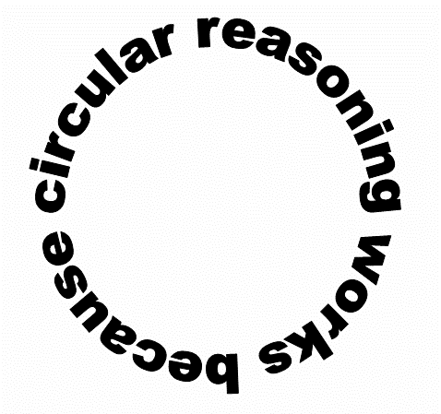
Double Dipping
Selective analysis can distort results
Problem arises from circularity between selection criteria and selective analysis
Notes:
Double dipping is something we must be careful to avoid when we perform selective analyses.
It arises when there is a dependency between our selection criteria and the statistics performed on the data
This can seriously distort the result, and can lead you to completely spurious conclusions, as I am about to show you

Slide 25
An Example Circular Analysis
Hypothesis: Bold signal in the brain region relevant to this task will differ significantly between condition A and condition B
Notes:
Imagine a generic fMRI experiment.

Slide 26
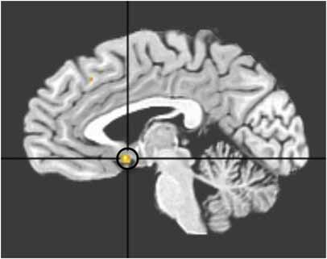

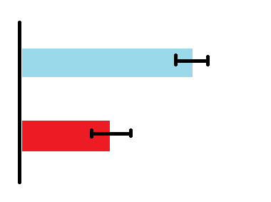

Analysis
Select a ROI
stats to find area of activation A > Ctrl
Within ROI
look at these voxels for average activation in response to two conditions A & B
Notes:
First step in our analysis is to select a brain region which we think is relevant to the task – our ROI.
We look at the whole brain and do a contrast to find which areas had significantly greater activation in conditions A than an control condition
Now we perform further analysis on only the voxels within the region of interest.
and compare the difference in activation in this region between two conditions, A and B.

Slide 27
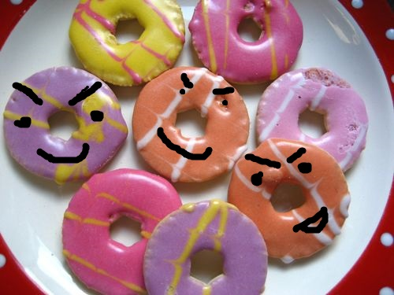
CIRCULAR!
Notes:
Can you see how this analysis could be circular?
We used the same data to decide our ROI and to analyse the response within that ROI.
Of course we are likely to find greater activation for condition A than for B, because we asked for voxels where A was significantly more active than the control condition.

Slide 28
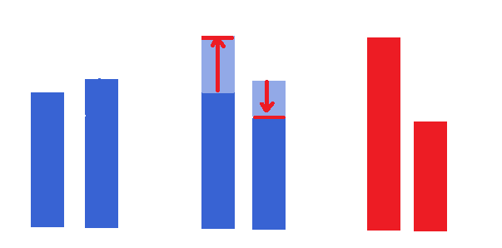
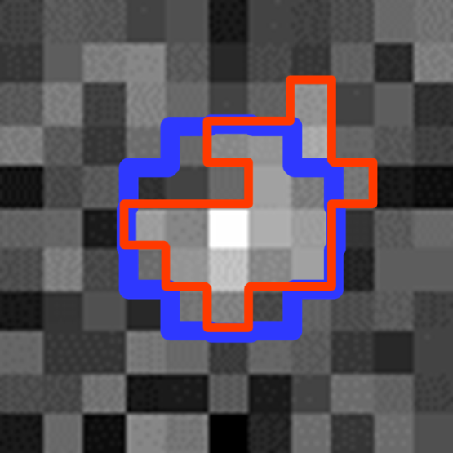
In more detail…
Data = signal + noise
A Ctrl A Ctrl A Ctrl
True activity in voxel
Measured activity in voxel
Contrast image A-Ctrl
ROI drawn from contrast image
“True” ROI
Adapted from Kriegeskorte et.al., 2009
Notes:
Let’s examine more explicitly how double dipping can bias results: the following slides are based on simulated data from
If the data were perfect and noise-free, then our result of our ROI showing greater activation in A than in B could be perfectly valid.
However this is obviously not the case. Data contain noise.
Imagine looking at the activation in a single voxel to condition A and Ctrl
On the left is the “true” activation in this voxel – not very different. Including the effect of noise could give us significantly greater activation in A.
Therefore we include this voxel in the ROI.

Slide 29
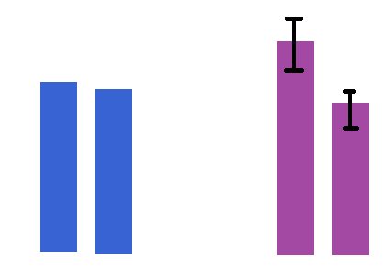
In more detail…
Calculate mean activation in ROI & fit GLM
Look at contrast A-B
Contrast image A-Ctrl
ROI drawn from contrast image
“True” ROI
A B A B
TRUE activation Our data
Adapted from Kriegeskorte et.al., 2009
Notes:
Now we calculate the average timecourse in this ROI for conditions A and B, and fit the GLM .
We have overestimated the difference in activation by overfitting our ROI.
In general, we can average over many instances to reduce the effect of noise. However, if we use the same data to choose an ROI as in selective analysis, we are including the same noise. We cannot separate out noise and signal.
Here, the same noise for our data for condition A contributes to our ROI and our GLM parameter estimates.

Slide 30
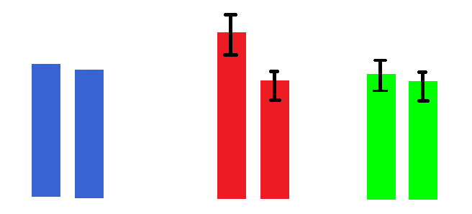
Solution 1
Use an independent dataset to estimate ROI
A B A B A B
TRUE activation
Overfitted ROI
Independent data for ROI
Adapted from Kriegeskorte et.al., 2009
Notes:
The solution is to use different data for estimating the ROI and for selective analysis within that ROI.
A problem with this is you are losing power by partitioning the data in this way.

Slide 31
Solution 2
Ensure contrast vectors are orthogonal
A-CTRL and A-B are not orthogonal contrasts
Why not use A+B for ROI and A-B for contrast?
  c₁ = [1 1] c₂ = [1 -1] c₁.c₂ = 0
Notes:
Wait, surely we can avoid the problem if we didn’t use such related contrasts for the ROI and the SA?
If you can show the ROI selection and SA are orthogonal, then go ahead and use all data in both stages.

Slide 32
Make sure they are truly orthogonal…
selection using c₁ may bias analysis using c₂ because of hidden bias in the design matrix X
e.g. more trials for A than B
  noise in B has greater effect on c₁ than noise in A
  c₂ will be negatively biased
Notes:
Not enough to have orthogonal vectors for selection and SA
Bias for selecting voxels with positive noise greater for condition B
Contrast A-B will be negatively biased

Slide 33
Make sure they are truly orthogonal…
Still possible that errors have some temporal dependence S
This could contribute differently to noise in different conditions
Orthogonality requirement:
c₁ · (X^{T}X)⁻¹ · X^{T} · S · S^{T} · X · (X^{T}X) ⁻¹ · c₂ = 0
contrasts
design matrix
noise dependencies
Notes:
Ok then, what if A and B weren’t unbalanced for n trials?
need to take into account temporal dependency also
if altogether all three are orthogonal we are OK and can use all data for selection criteria as well as selective analysis

Slide 34
Make sure they are truly orthogonal…
X and S will not be significant sources of bias if the task is designed sensibly
Analysing at group level further minimises these sources of bias, and limits bias to magnitude rather than direction of effect
Notes:
Really this is probably not an issue if you define ROI at the group level, and design your experiment sensibly as we have learnt in previous weeks!

Slide 35
More solutions
Use a structural-based ROI
Use a functional localiser
Notes:
Could define ROI on structure
Could use functional localiser, but this can be inefficient as you need a separate task in the scanner – more scanner time!

Slide 36
Other examples of circular analysis
M/EEG:
Select channels where we see an expected response difference between conditions
Further analysis on these (ERP, Time frequency etc.)
Pattern Classifier:
Use all data to define ROI
Train a classifier using odd runs
Assess classifier using even runs
Single-unit recordings
Select units based on desired response difference to two conditions, then selective analysis
Notes:
The following use the same circularity – it’s not limited to fMRI, or indeed to neuroscience at all!

Slide 37

How often does this really happen?
“…we examined all fMRI studies published in five prestigious journals (Nature, Science, Nature Neuroscience, Neuron, Journal of Neuroscience) in 2008. Of these 134 fMRI papers, 42% contained at least one nonindependent selective analysis...”
Notes:
Loads… 42% of neuro papers in 2008 in the 5 high impact journals (nature etc) used at least one circular analysis
That’s a lot of highly esteemed papers…

Slide 38
But…
“For a given paper, the overall claim may not depend on the distorted result.”
“…we have no way of assessing the severity of the distortions. They might be small in many cases.”
Often the circular analysis may simply be an illustrative figure rather than the basis of the paper’s main claims.
Notes:
We don’t need to disregard them
may only have small impact on their main results
They won’t be as bad as the blatant examples used in this ppt.

Slide 39
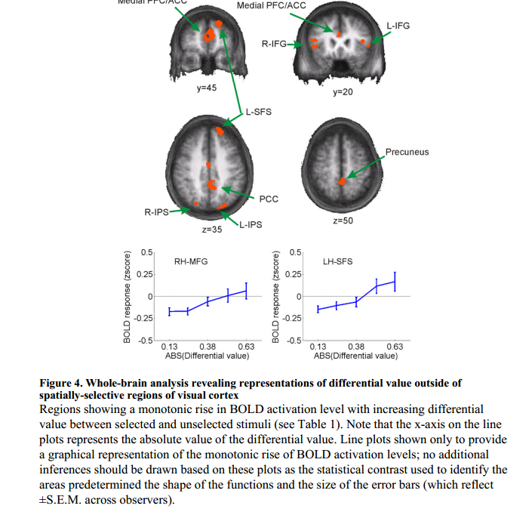
Serences JT (2008).
Notes:
Here, bold response is shown on y axis as a function of some stimulus property.
These plots are based on an ROI with a non-orthogonal contrast, but this is included just for illustration of a monotonic rise in BOLD in an ROI as the stimulus parameter changes.

Slide 40
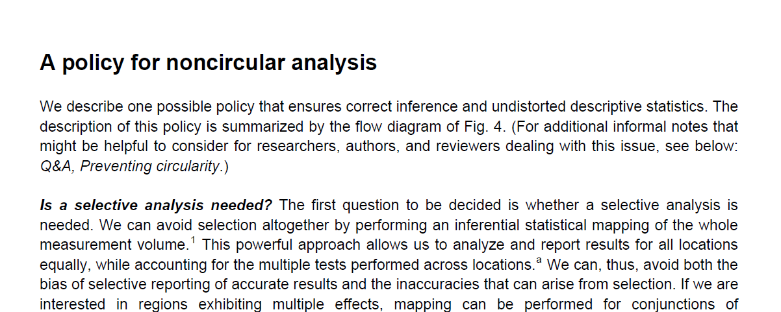
More ways to avoid circularity…
Kriegeskorte et.al., 2009
Notes:
We have seen that DD has the potential to seriously bias our results
Don’t worry there are several simple ways we can avoid this in our work

Slide 41
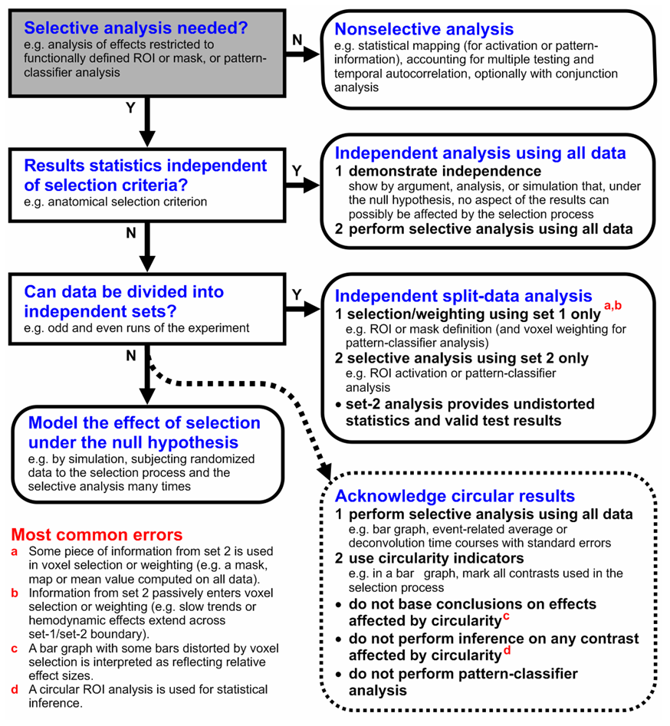
Kriegeskorte et.al., 2009
Notes:
Here is a detailed flow chart to follow to ensure your study doesn’t inadvertently double dip.

Slide 42
How to not double dip
Is a selective analysis really necessary?
Other options:
Perform statistical mapping on whole volume, correcting for multiple comparisons
Pattern-information analysis

Slide 43
How to not double dip
If using selective analysis:
Result statistics must be independent of selection criteria under H₀
either
independent (i.e. fully orthogonal)
or
computed on independent data
Notes:
It’s simple really - selective analysis is fine, you just need to be sure that there is negligible bias resulting from your ROI selection.

Slide 44
How to get the results you want from your data…
1. Run some scans
2. Analyse circularly with Double Dipping
3. ???
4. PROFIT!!!

Slide 45
References & resources
Bennett, C. M., Miller, M. B., & Wolford, G. L. (2009). Neural correlates of interspecies perspective taking in the post-mortem Atlantic Salmon: An argument for multiple comparisons correction. Neuroimage, 47(Suppl 1), S125.
Kriegeskorte N, Simmons WK, Bellgowan PS, Baker CI. Circular analysis in systems neuroscience – the dangers of double dipping. Nature neuroscience 2009;12(5):535-540. doi:10.1038/nn.2303.
(supplementary also very useful)
Lieberman, M. D., & Cunningham, W. A. (2009). Type I and Type II error concerns in fMRI research: re-balancing the scale. Social cognitive and affective neuroscience, nsp052.

