Slide 1
Basis of the M/EEG Signal
Methods for Dummies Jan 28th 2015
Clare Palmer & Brianna Beck

Slide 2
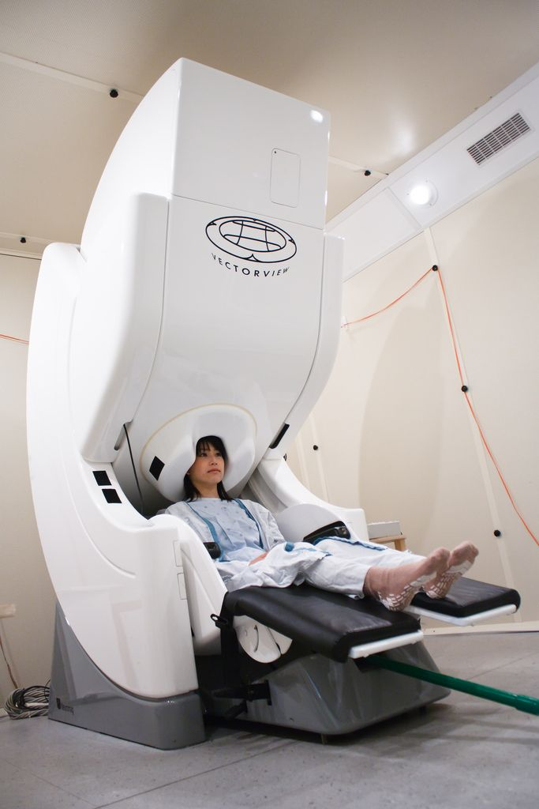
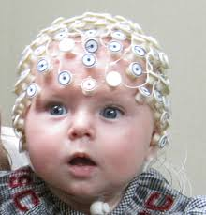
VS
EEG
MEG
Notes:
Can’t chage head size in MEG

Slide 3
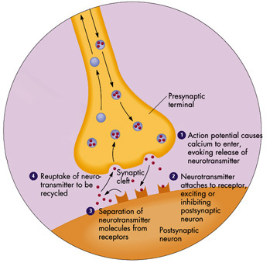
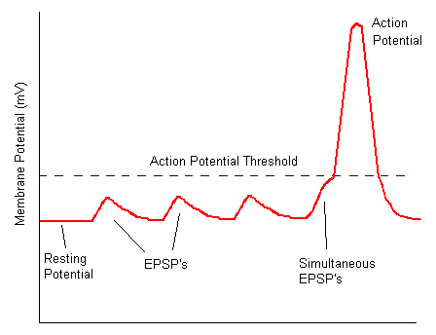
M/EEG: neural correlates
What is happening at a cellular level?
Action potential reaches axon terminal
Neurotransmitter released diffuses across synaptic cleft
Binds to post-synaptic receptors
Influx of positive (Na⁺/Ca²⁺) or negative (Cl⁻)
Generates EPSP/IPSP
Notes:
IMP talking about EPSPs/IPSPs NOT action potentials

Slide 4
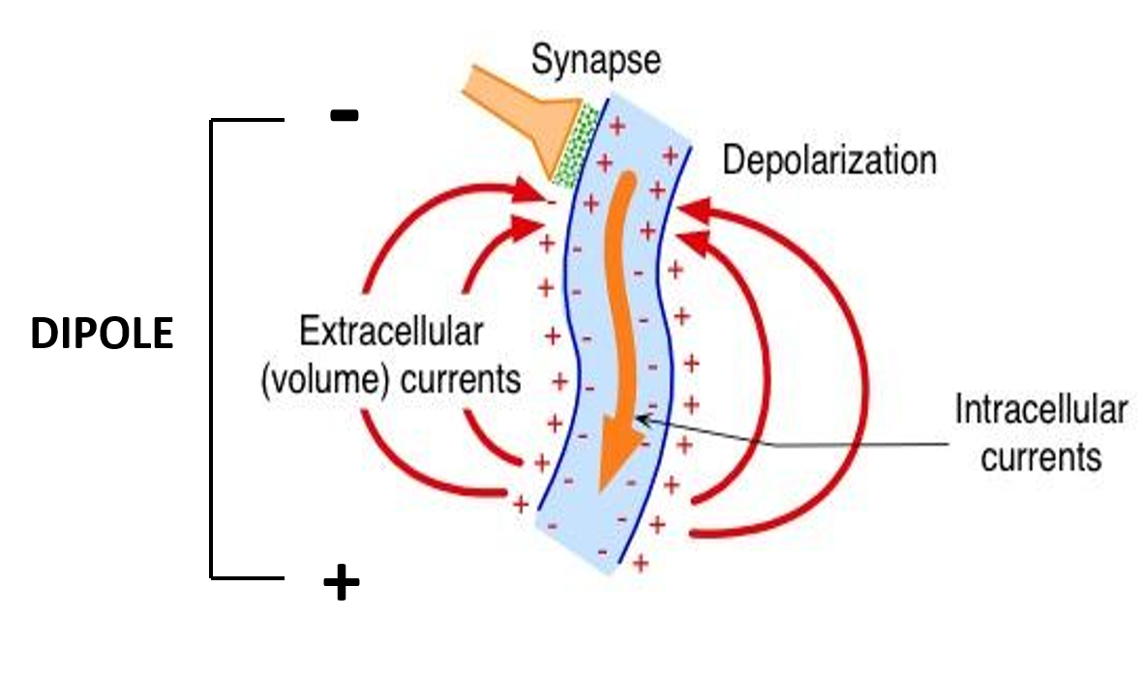
M/EEG: neural correlates
Influx of +ve ions (EPSP)
Extracellular charge: negative
Ions flow out of neuron
Extracellular charge: positive

Slide 5
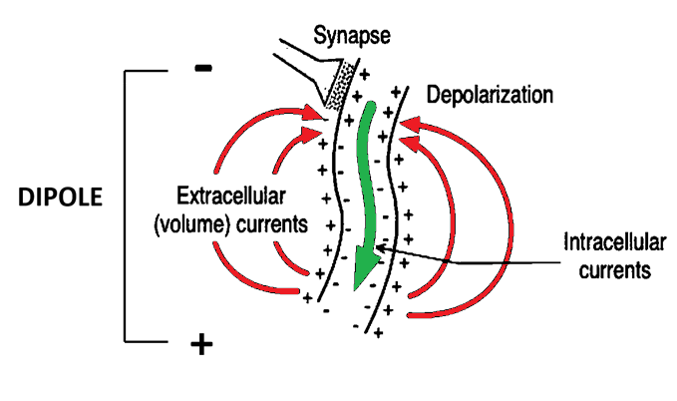
M/EEG: neural correlates
Influx of +ve ions (EPSP)
Extracellular charge: negative
Ions flow out of neuron
Extracellular charge: positive
Notes:
When there is a difference in charge – either rend of the dipole – charge will move to aim to equalise this charge = CURRENT – so an EPSP causes a PRIMARY intracellular current and SECONDARY extracellular currents

Slide 6
M/EEG: neural correlates
MEG = magnetic field from intracellular currents
EEG = electrical potential difference (V) between 2 electrodes on the scalp from volume conduction of extracellular currents
Same underlying neuronal phenomenon – but M/EEG measure different aspects of it.
Notes:
Measuirng the same underlying neural phenomenon – BUT measuring different aspects of it!
Of note – but Brianna will talk about more – EEG currents need to move to the scalp through a number if different media eg cortical tissue, CSF, before reaching the electrodes – therefore the different conductive properties of these different media can affect the current flow and this adds an additional problem to source localisation in EEG which is not apparent in MEG as the magnetic field is not affected as readily by this.

Slide 7
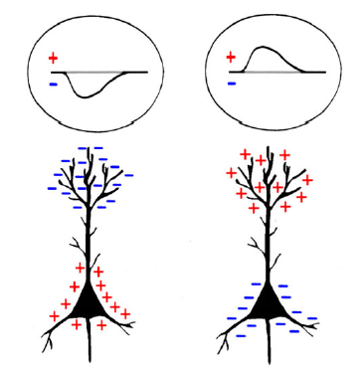
EEG: neural correlates
Excitatory synapse on apical dendrites (EPSP)
Excitatory synapse near soma (EPSP)
Images from: Jackson & Bolger (2014) The neurophysiological bases of EEG and EEG measurement: A review for the rest of us

Slide 8
EEG: neural correlates
Inhibitory synapse on apical dendrites (IPSP)
Inhibitory synapse near soma (IPSP)
Images from: Jackson & Bolger (2014) The neurophysiological bases of EEG and EEG measurement: A review for the rest of us

Slide 9
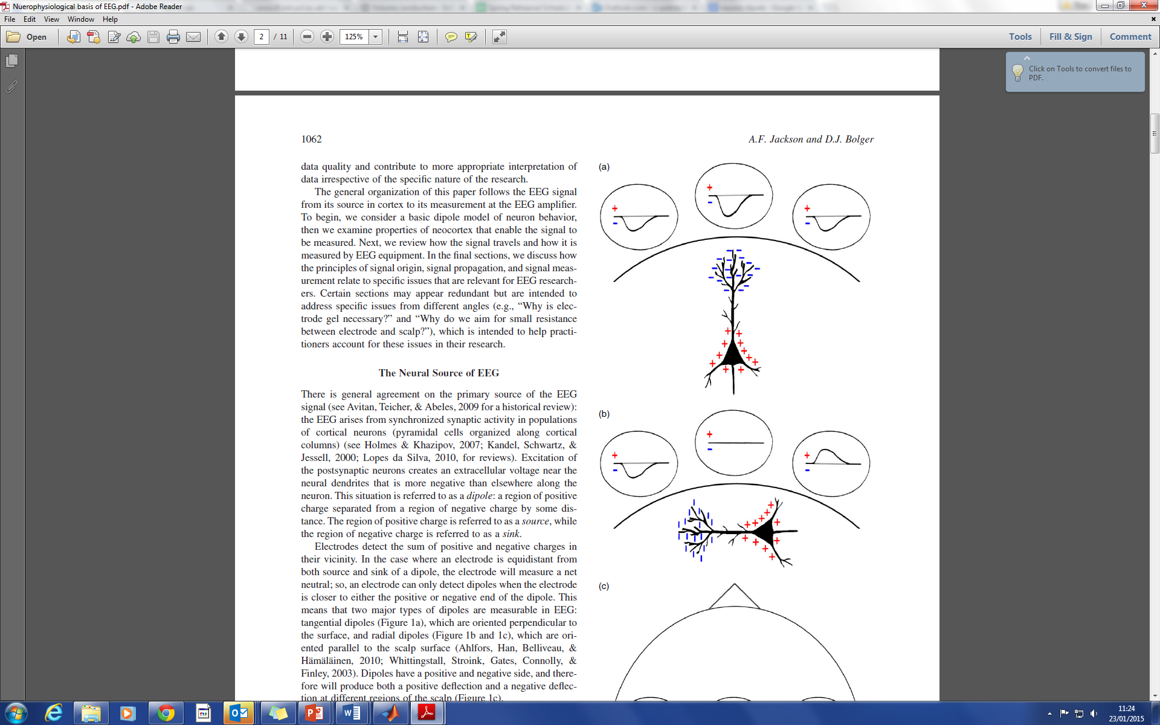
EEG: neural correlates
Electrodes measure the sum of positive/negative charges in their vicinity
Depending on the position of the neuron relative to the scalp you will record different changes in voltage
Further away the dipole is from the scalp the lower the amplitude of the sum of charges + the broader the distribution
RADIAL
TANGENTIAL
Images from: Jackson & Bolger (2014) The neurophysiological bases of EEG and EEG measurement: A review for the rest of us
Notes:
Further away the dipole is from the scalp – towards the centre – the lower the amplitude of the sum of the charges and the broader the distribution.

Slide 10
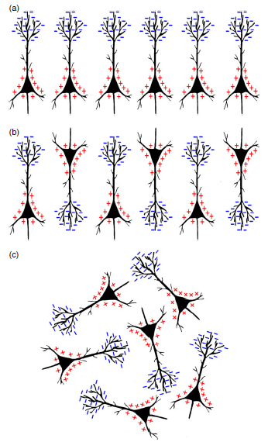
EEG: neural correlates
+
+
+
The signal from a single dipole is too small to be recorded on the scalp
Need to sum the charges from many neurons (approx. 10,000-50,000 pyramidal cells)
To generate a detectable signal, neurons MUST be:
Arranged in parallel = so charges do not cancel out
Synchronously active = creates a large enough signal to measure


-
-
-

Images from: Jackson & Bolger (2014) The neurophysiological bases of EEG and EEG measurement: A review for the rest of us
Notes:
Signal from single dipole is too small to be measured on the scalp
Need to sum charges from many neurons
Approx 110,000-50,000 – murakami 2006 journal physiology
PYRAMIDAL

Slide 11
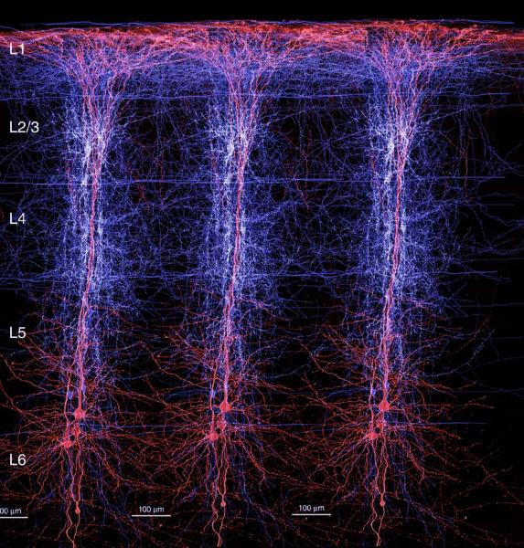
EEG: neural correlates
The signal from a single dipole is too small to be recorded on the scalp
Need to sum the charges from many neurons (approx. 10,000-50,000 pyramidal cells)
To generate a detectable signal, neurons MUST be:
Arranged in parallel = so charges do not cancel out
Synchronously active = creates a large enough signal to measure
Image from http://biomedicalcomputationreview.org/
Notes:
Approx 110,000-50,000 – murakami 2006 journal physiology
Structure of cortrex allows us to record eeg in this way – lots of pyramidal cells organised in parallel perpendicular to the cortical surface and they have lateral connections between therefore in general neighbouring neurons are synchronously active – IMP talking about EPSPs/IPSPs NOT action potentials

Slide 12
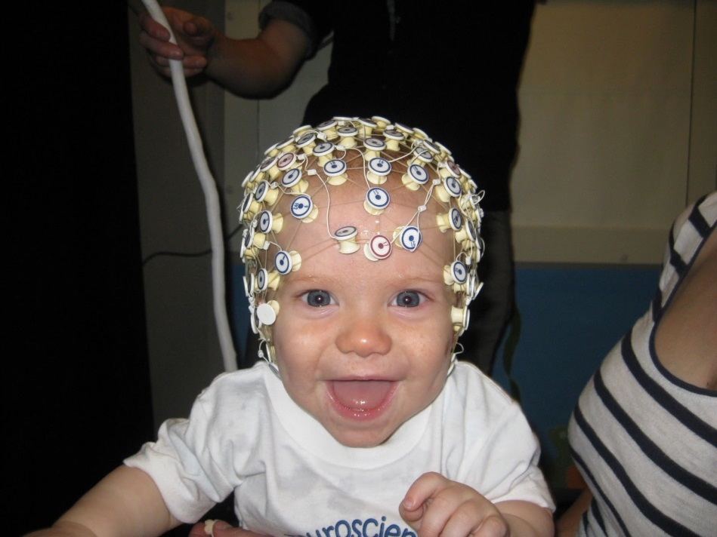
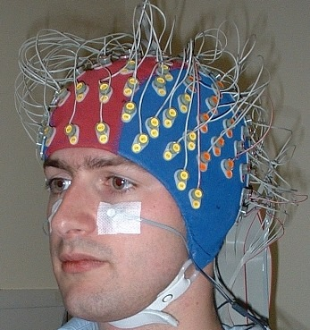
EEG: instrumentation
(specialneedsdigest.com)
(biosemi.com)
Cap (different numbers of electrodes)
Gel
Amplifier
Reference montage
14
Notes:
WHOLE SET UP WITH AMPLIFIER

Slide 13
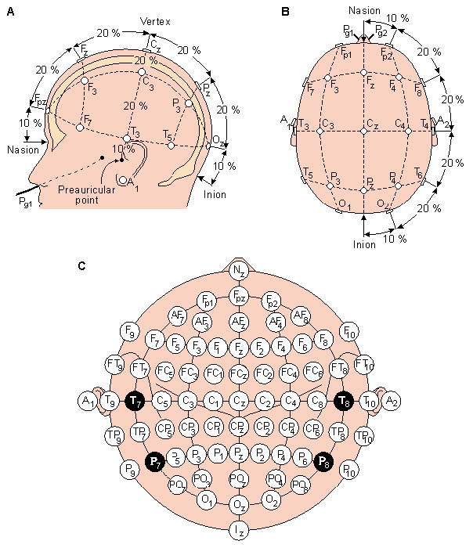
EEG: instrumentation
10-20 electrode system = standardised method of aligning electrode location with the underlying area of cerebral cortex
  F = frontal
  O = occipital
  P = parietal
  T = temporal
  [C = central]
Notes:
10-20 system is an internationally recpgnised method of standardising the location of electrodes on the scalp with reference to the undelrying cortical areas
“The "10" and "20" refer to the fact that the actual distances between adjacent electrodes are either 10% or 20% of the total front–back or right–left distance of the skull.”]
Reference montage
CZ – posiiton electrodes – 10-20 – 128 channels

Slide 14
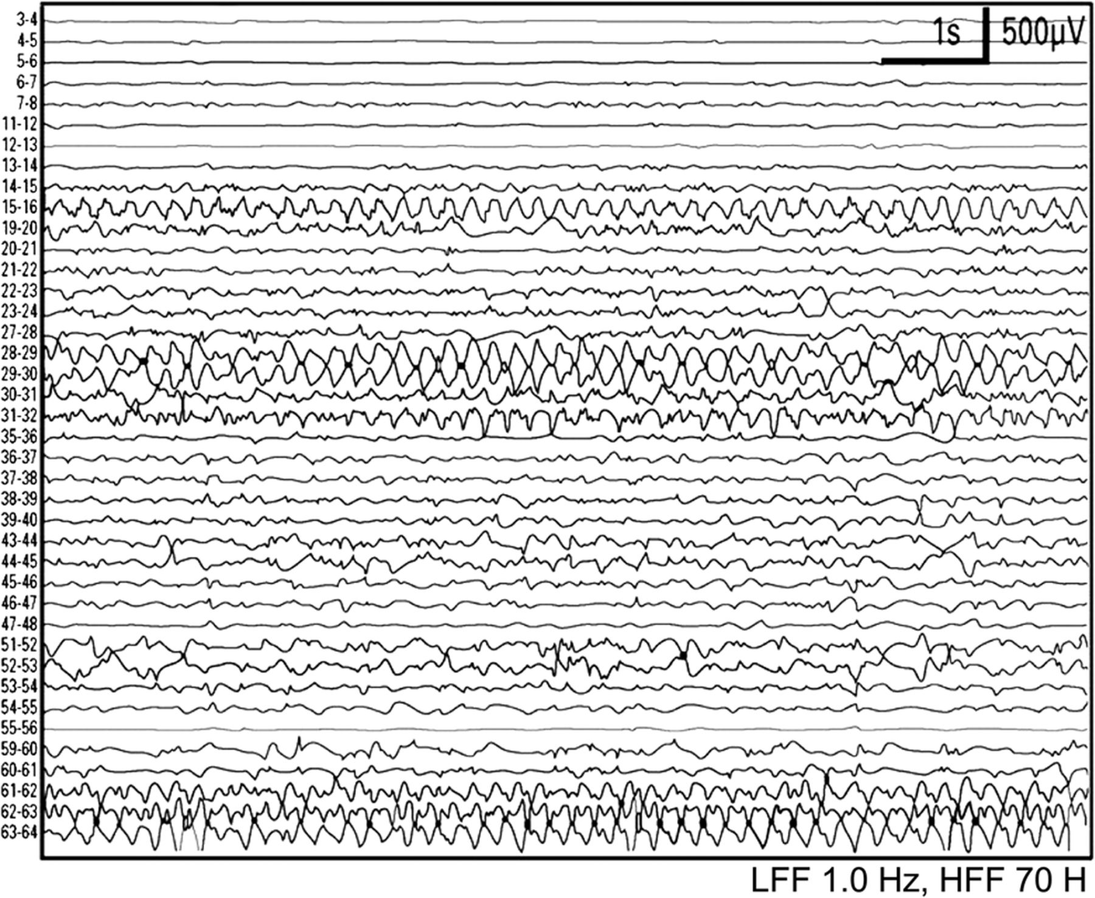
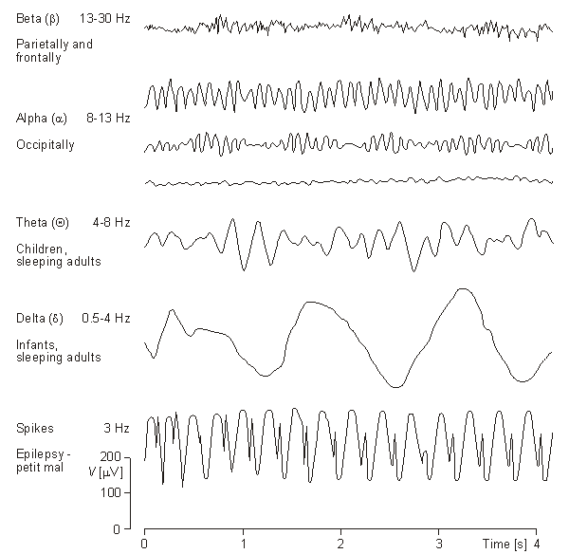
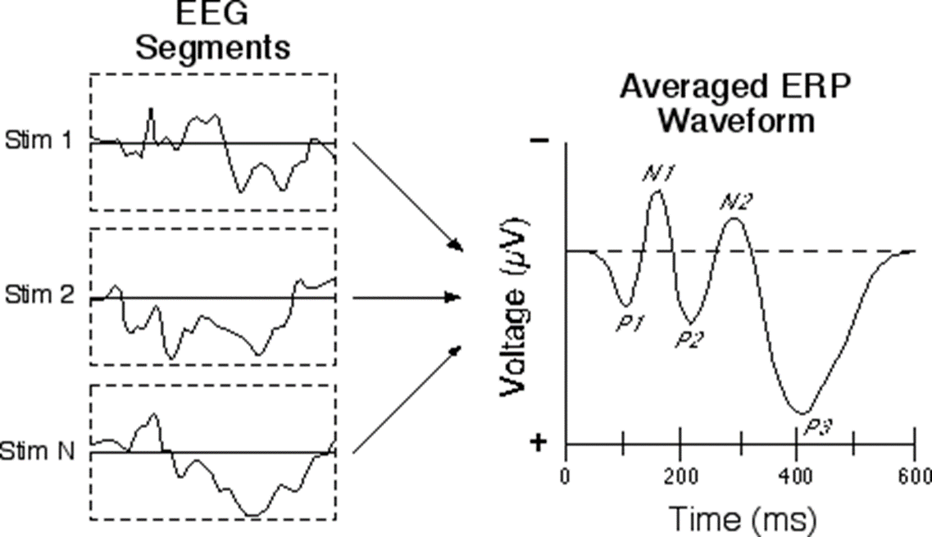
EEG data
Compared to fMRI, M/EEG is a very rich dataset
TIME
FREQUENCY

Slide 15
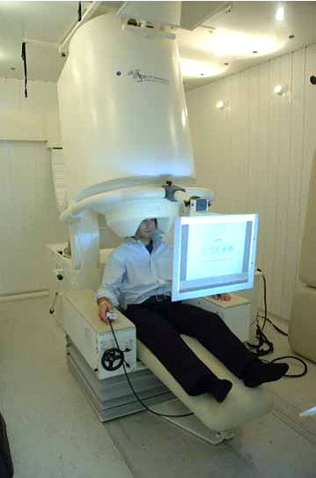
MEG (Magnetoencephalography)
What is it?
MEG measures magnetic fields at the scalp surface produced by electric currents in the brain
Helmet with array of sensors; magnetically shielded room
http://www.nimh.nih.gov/news/science-news/2008/brains-response-to-scary-faces-imaged-faster-than-you-can-say-boo.shtml

Slide 16
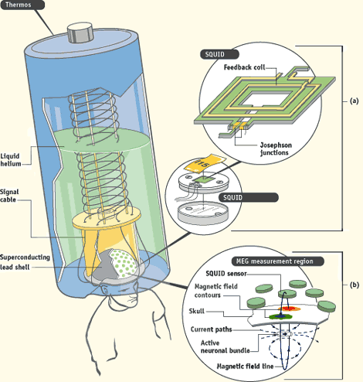
How does MEG work?
SQUIDs: Superconducting QUantam Interference Devices
Cooled by liquid helium
Array of SQUID sensors that measure magnetic fields as small as 1 femtoTesla
SQUID coupled to superconducting pickup coil to enhance sensitivity
http://www.lanl.gov/quarterly/q_spring03/meg_helmet_measurements.shtml

Slide 17
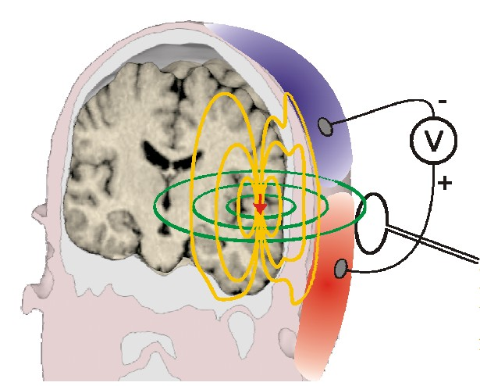
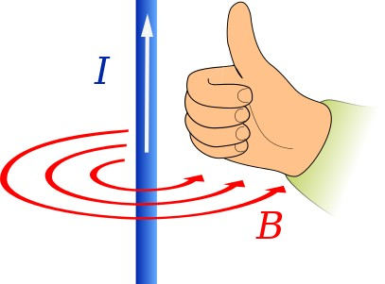
What are we measuring with MEG?
Magnetic field from summed electric current produced by synchronously active neurons organised in parallel (mostly pyramidal cells)
Whereas EEG measures volume currents, MEG measures mainly primary (intracellullar) currents
Magnetic field approx. perpendicular to electric current – right-hand rule
S. Helbling, SPM Course, 2014
Notes:
Right-hand rule: If thumb is pointing in the direction of current flow (+ to -), then the other fingers point in the direction of the magnetic field.

Slide 18
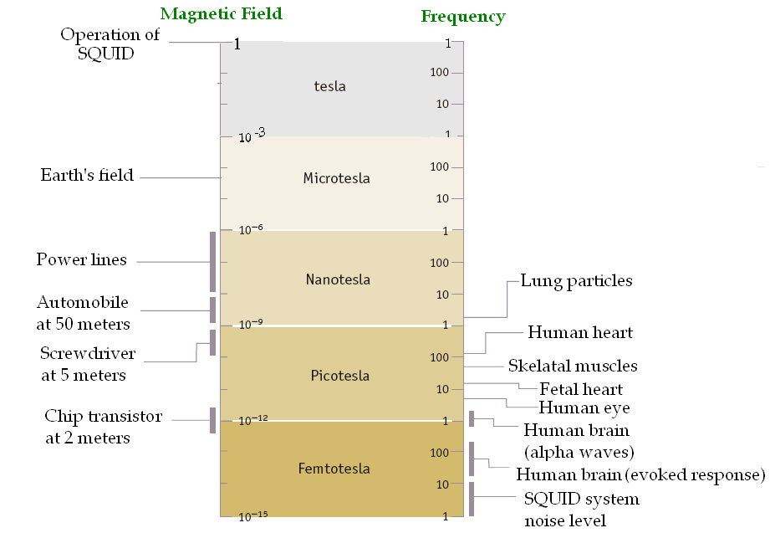
Comparison of magnetic field sizes – brain responses and noise
Spontaneous brain activity: about 1 picoTesla
Evoked responses: about 100 femtoTesla (i.e., one million times smaller than magnetic fields from urban environment)
http://www.intechopen.com/books/applications-of-high-tc-superconductivity/some-contemporary-and-prospective-applications-of-high-temperature-superconductors

Slide 19
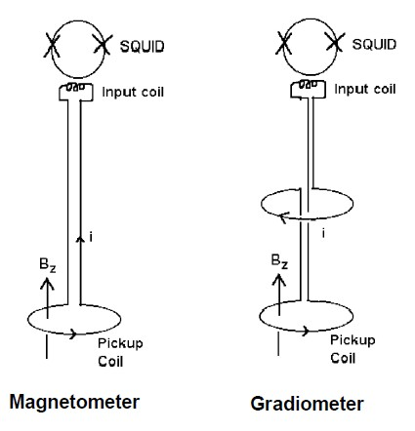
Flux transformers:
Magnetometers
Single pickup coil
Highly sensitive to magnetic fields from neural activity, but also to environmental noise
S. Helbling, SPM Course, 2014

Slide 20
Flux transformers:
Gradiometers
Two or more pickup coils
Less sensitive to distant noise sources, e.g., heart, electrical equipment. (Distant sources have similar field strength at all coils.)
S. Helbling, SPM Course, 2014

Slide 21
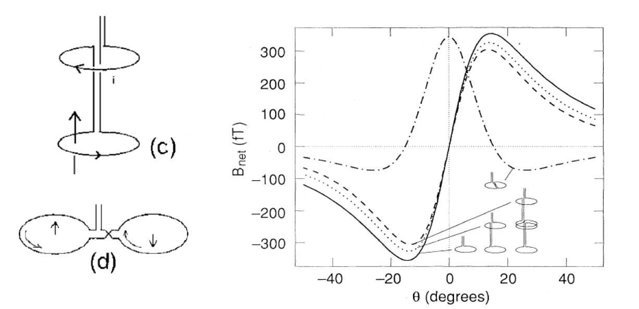
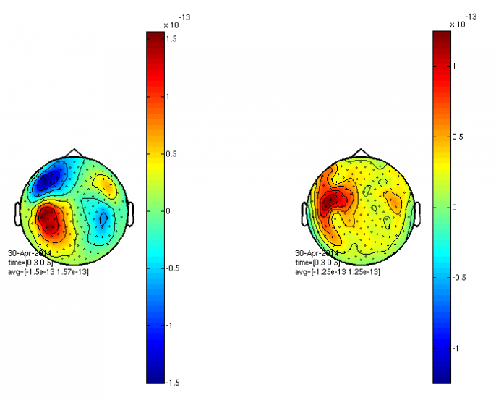
Axial vs. planar gradiometers
Axial gradiometers measure gradient of magnetic field orthogonal to the scalp
Planar gradiometers measure gradient of magnetic field tangential to the scalp
Gradiometer configuration crucial for data interpretation
Planar
Axial
Axial
Planar
S. Helbling, SPM Course, 2014; M. Hämäläinen et al., Rev. Mod. Phys., 1993; http://fieldtrip.fcdonders.nl/tutorial/eventrelatedaveraging

Slide 22
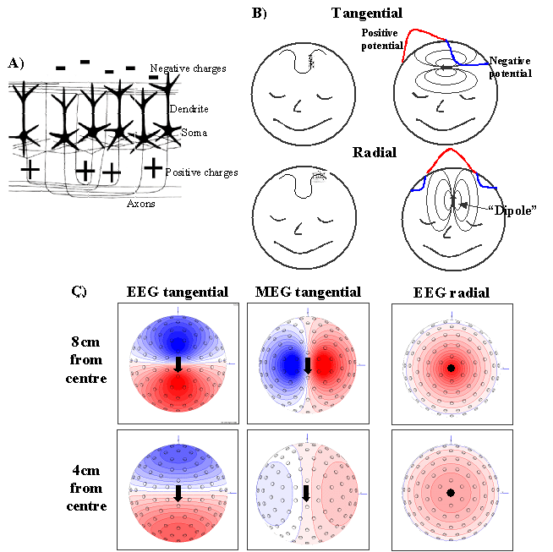
Which sources are picked up by MEG?
Mainly picks up tangential sources (parallel to the scalp)
Less sensitive to…
  radial sources (oriented toward/away from the scalp)
  deep sources (magnetic field strength drops off rapidly with distance from sensors)
http://imaging.mrc-cbu.cam.ac.uk/meg/IntroEEGMEG
Notes:
Hillebrand and Barnes 2001, NeuroImage

Slide 23
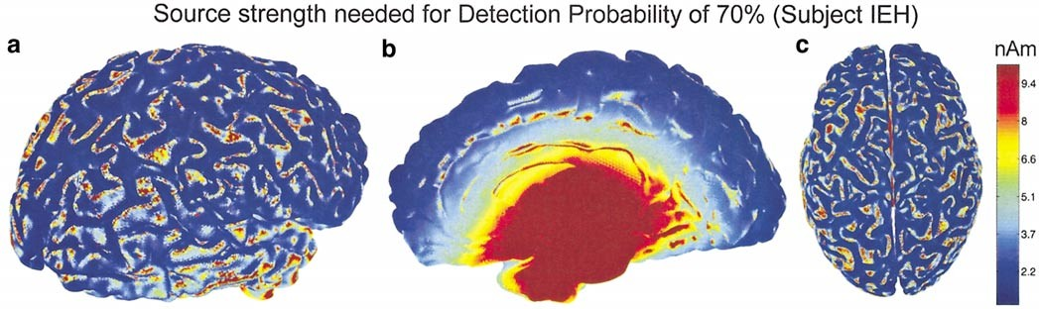
Which sources are picked up by MEG? (2)
Sources in the gyri are detectable despite being radial – proximity to the sensors
Hillebrand & Barnes, NeuroImage, 2002

Slide 24
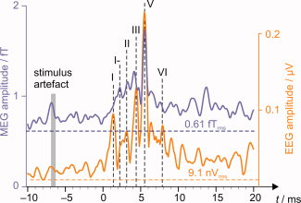
Which sources are picked up by MEG? (3)
Recording from auditory brainstem with EEG/MEG
Parkkonen et al., Hum Brain Mapp, 2009
Notes:
Lauri Parkonenen – auditory brainstem MEG

Slide 25
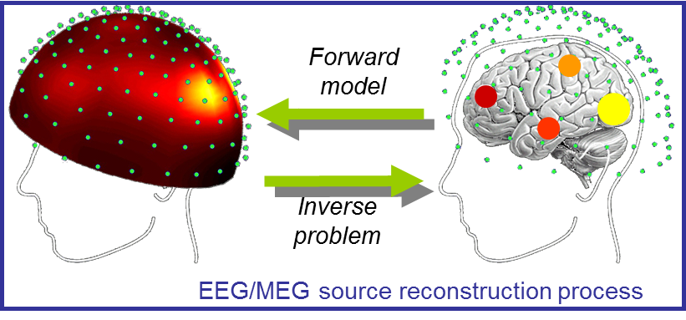
Source Localisation
FORWARD MODEL = estimation of the potential or field distribution for a known source and known model of the head
Notes:
Forward model - Method of predicting what the observed data should look like from a particular source – predicting what the potential difference on sclap/magnetic field will looks like

Slide 26
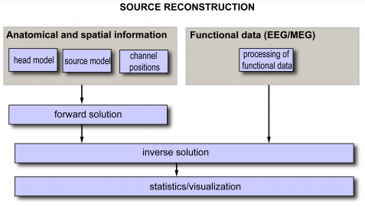
Source Localisation
Notes:
Head model needs to be better for eeg than meg to get the same accuracy
EEG – conductivity of tissues important – adds uncertainty
EEG sees everything difficult to know where its coming from

Slide 27
Source Localisation
FORWARD MODEL = estimation of the potential or field distribution for a known source and known model of the head
INVERSE MODEL = estimation of unknown sources from measured M/EEG data
Notes:
Forward model - Method of predicting what the observed data should look like from a particular source – predicting what the potential difference on sclap/magnetic field will looks like
COMPARE collected data to predicted data from forward model to determine what the source is

Slide 28
Source Localisation
SIMPLISTIC: Predict what data should look like from source A, B + C then compare it to what the data does look like to decide if the neural signals recorded have come from source A, B or C – problem solved!
Notes:
Head model needs to be better for eeg than meg to get the same accuracy
EEG – conductivity of tissues important – adds uncertainty
EEG sees everything difficult to know where its coming from

Slide 29
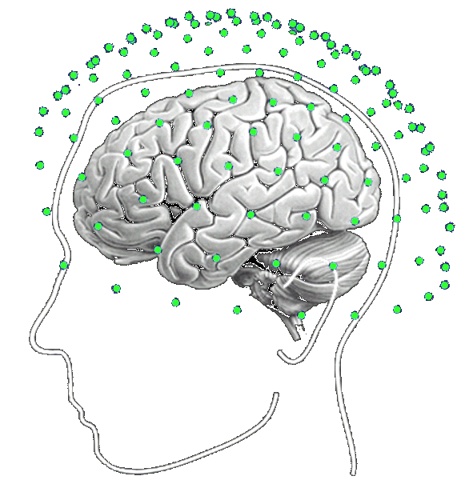
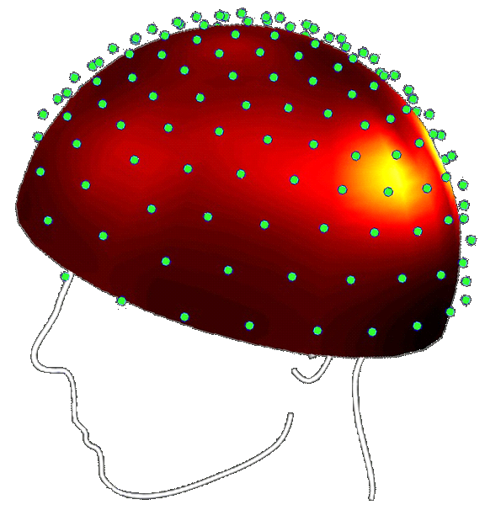
Bayesian Inference
PREDICTED data
model
Forward
model
LIKELIHOOD
current
LIKELIHOOD = probability of the predicted data given a set of assumptions
e.g. what the M/EEG data from the scalp will look like given a known source in the brain using anatomical (head model) and spatial (channel position) information
Where did these signals come from in the brain?
Collect functional data
INVERSE PROBLEM
Notes:
PRIOR – eg single source, or specific lobe
Jose David Lopez
Rik Henson – using priors from fmri to solve inverse problem
Add picture of brain and signal
Kilner + Press

Slide 30
Bayesian Inference
OBSERVED data
model
Inverse
problem
current
POSTERIOR
POSTERIOR = probability of a given state (source) given the functional data recorded
LIKELIHOOD
PRIOR
POSTERIOR
MODEL EVIDENCE
Notes:
PRIOR – eg single source, or specific lobe
Jose David Lopez
Rik Henson – using priors from fmri to solve inverse problem
Add picture of brain and signal
Kilner + Press

Slide 31
Bayesian Inference: Summary
PRIOR
Selective
Based on specific hypotheses
?
Bayesian inference estimates weights of PRIOR info wrt to observed data
FORWARD MODEL
(likelihood)
VS
INVERSE SOLUTION
OBSERVED DATA
(posterior)
PREDICTED DATA
Using anatomical/spatial info
General

Slide 32
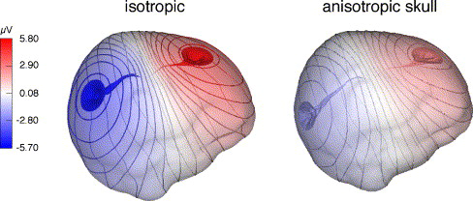
Head models / skull anisotropy
Skull is anisotropically conductive, i.e., does not conduct current equally in all directions
Skull anisotropy distorts EEG, but hardly affects MEG
Head (forward) model more important for EEG than MEG
Wolters et al., NeuroImage, 2006
Notes:
MEG – just need to know boundary between skull and CSF
EEG – need to also know conductivity of skull and CSF

Slide 33
EEG vs. MEG – Which should I use?
MEG
EEG
High temporal resolution (ms)
Poor spatial resolution
Picks up tangential and radial sources
Picks up superficial and deep sources
Relatively inexpensive to set up and maintain
Mobile, less sensitive to movement artifacts
Less sensitive to environmental noise
Requires conductive gel, mild scalp abrasion
Sensitive to forward model (skull anisotropy)
High temporal resolution (ms)
Better spatial resolution
Picks up mainly tangential sources
More sensitive to superficial sources
Requires expensive equipment, higher maintenance costs
Requires magnetically shielded environment
Very sensitive to environmental noise
No conductive gel or abrasion needed
Less sensitive to forward model (skull anisotropy)

Slide 34
Thanks to Gareth Barnes for all his help!
☺

