Slide 1
1st Level Analysis: design matrix, contrasts, GLM
Clare Palmer & Misun Kim
Methods for Dummies 2014-2015

Slide 2
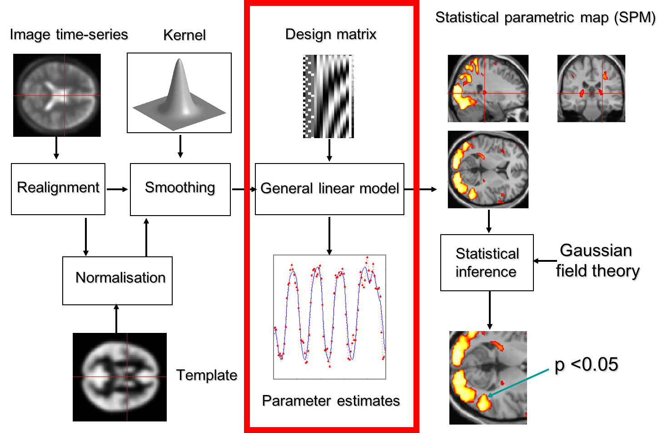

Slide 3
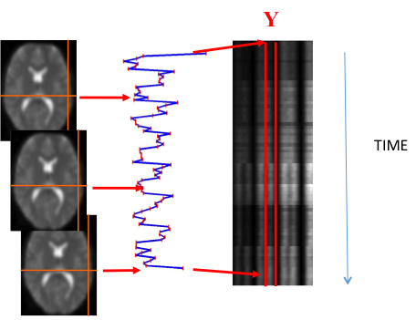
1st Level Analysis (within-subjects)
Analyse how the BOLD signal changes over time with respect to an experimental variable(s) within a single subject.
Observed data (Y) = matrix of BOLD signal recorded at each time-point
Each column (i) is a vector of the BOLD signal at a single voxel over time
Notes:
Series of scans over time (e.g. TR=3s)
Record the BOLD signal from all voxels at each successive time-point
This produces a vector of responses from each voxel

Slide 4
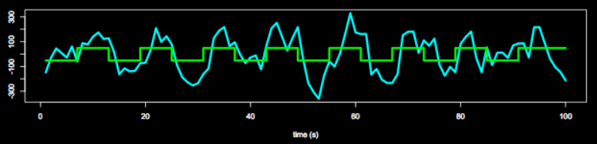
General Linear Model (GLM)
To quantify the effect of the experimental variable on BOLD signal, we build the General Linear Model.
Notes:
GLM used to generate a model using your observed data which is the best fit to what you would expect your data to look like given your specific hypotheses – how you expect a given experimental variable to affect the BOLD signal
Error = difference between what the model predicts and the observed data

Slide 5
General Linear Model (GLM)
To quantify the effect of the experimental variable on BOLD signal, we build the General Linear Model.
Y = X * β + ε
Observed data
(What you collect)
Design matrix
(Experiment variables – specifies what data should look like)
Matrix parameters
(These need to be estimated)
Error matrix
(residual error)
Notes:
GLM used to generate a model using your observed data which is the best fit to what you would expect your data to look like given your specific hypotheses – how you expect a given experimental variable to affect the BOLD signal
Error = difference between what the model predicts and the observed data

Slide 6
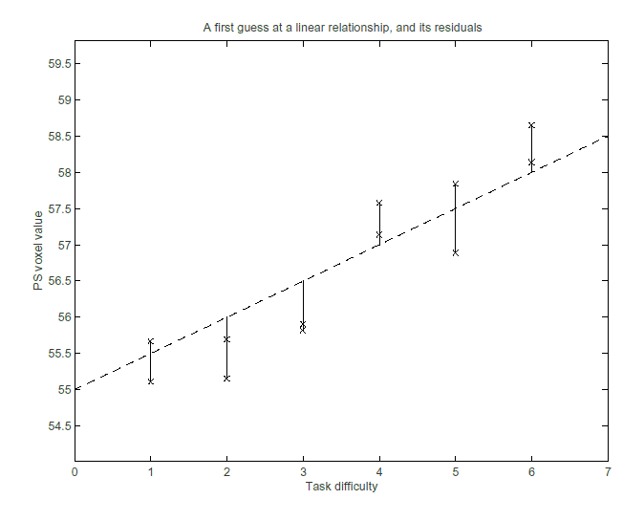
GLM = linear regression
Y_{i} = β0 + β1_{i}X1_{i} + ε_{i}
β0: intercept (constant)
  Value of Y when X=0
This line is a 'model' of the data
slope β1 = 0.23
Intercept β0 = 54.5
Notes:
“How much a change in BOLD signal can be predicted by task difficulty”
The model is selected as it minimises the sum of squared errors (SSE) – i.e. if you square each of the residuals (how far each data point deviates from the line of best fit) – model produces a line in which that figure is at its smallest

Slide 7
GLM = Linear Regression
Y_{i} = β0 + β1_{i}X1_{i} + ε_{i}
β0: intercept (constant)
  Value of Y when X=0
β1: slope of line relating x to y
  For every 1 unit change in X what is the predicted change in Y?
This line is a 'model' of the data
slope β1 = 0.23
Intercept β0 = 54.5
Notes:
“How much a change in BOLD signal can be predicted by task difficulty”
The model is selected as it minimises the sum of squared errors (SSE) – i.e. if you square each of the residuals (how far each data point deviates from the line of best fit) – model produces a line in which that figure is at its smallest

Slide 8
GLM = Linear Regression
Y_{i} = β0 + β1_{i}X1_{i} + ε_{i}
β0: intercept (constant)
  Value of Y when X=0
β1: slope of line relating x to y
  For every 1 unit change in X what is the predicted change in Y?
ε = residual error
  How far each data point deviates from the model
The model is selected as it minimizes the sum of squared errors (SSE)
  Assumed to be independently, identically and normally distributed
This line is a 'model' of the data
residual
ε_{i}
slope β1 = 0.23
Intercept β0 = 54.5
Notes:
The model is selected as it minimises the sum of squared errors (SSE) – i.e. if you square each of the residuals (how far each data point deviates from the line of best fit) – model produces a line in which that figure is at its smallest

Slide 9
GLM = Linear Regression
Y_{i} = β0 + β1_{i}X1_{i} + ε_{i}
β0: intercept (constant)
  Value of Y when X=0
β1: slope of line relating x to y
  For every 1 unit change in X what is the predicted change in Y?
ε = residual error
  How far each data point deviates from the model
The model is selected as it minimizes the sum of squared errors (SSE)
  Assumed to be independently, identically and normally distributed
This line is a 'model' of the data
residual
ε_{i}
slope β1 = 0.23
Intercept β0 = 54.5
Notes:
The model is selected as it minimises the sum of squared errors (SSE) – i.e. if you square each of the residuals (how far each data point deviates from the line of best fit) – model produces a line in which that figure is at its smallest

Slide 10
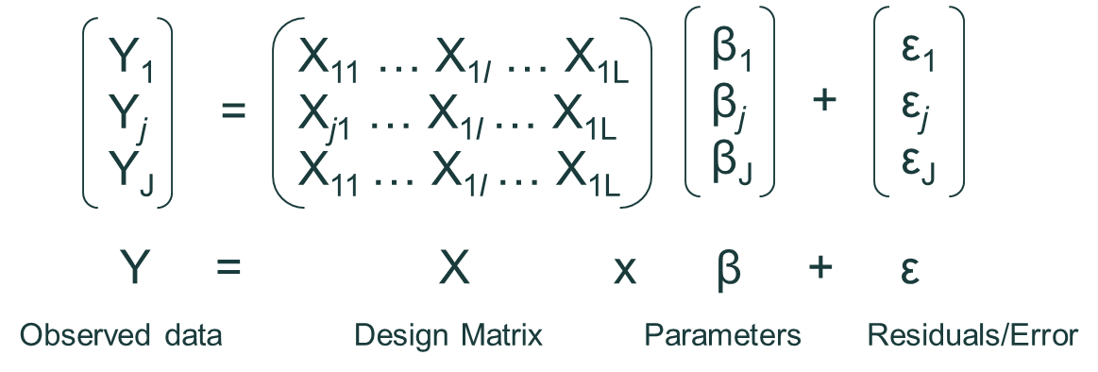
GLM = Multiple Regression
More than one predictor (condition/exp var)
Write out equation for each observation of dep variable Y (BOLD signal) from 1 to J:
Y₁ = X₁₁β₁ +…+X_{1l}β_{l} +…+ X_{1L}β_{L} + ε₁
Y_{j} = X_{j1}β₁ +…+X_{jl}β_{l} +…+ X_{jL}β_{L} + ε_{j}
Y_{J} = X_{J1}β₁ +…+X_{Jl}β_{l} +…+ X_{JL}β_{L} + ε_{J}
Can turn these simultaneous equations into matrix form to get a single equation:

Slide 11
Research Question
Is there an area of the brain selective for processing faces?
Kanwisher et al, 1997
Notes:
How does the coding work with increased variables?

Slide 12




Design Matrix: Block Design
Task
X1 = Faces
X2 = Houses
time
F
R
H
R
F
30s
1
0
0
0
1
0
0
1
0
0
30s
30s
30s
30s
Notes:
How does the coding work with increased variables?

Slide 13
Design Matrix: Block Design
Task
time
X1 X2 Constant (β0)
F
R
H
R
F
X1 (faces) | X2 (houses)
1 | 0
0 | 0
0 | 1
0 | 0
1 | 0
30s
30s
30s
30s
30s
Regressors/predictors (X_{i})

Slide 14
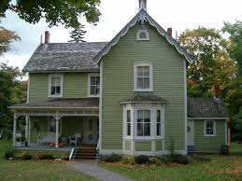
Design Matrix: Event-related Design
Task
Pseudorandomised order of stimuli
Need to know:
  Stimulus duration
  ISI (jitter)
Determine onset time for each stimulus
Use this to form design matrix
F
F
R
R
H
R
R
F
H
F
R
Notes:
Jitter = varying the timing of your TR relative to your stimulus presentation – ensures you sample diff points of the BOLD signal each yim

Slide 15
Design Matrix: Event-related Design
Task
X1 = Faces
X2 = Houses
time
F
F
R
R
H
R
R
F
H
F
R
1
1
0
0
0
0
0
1
0
1
0
0
0
0
0
1
0
0
0
1
0
0
Notes:
How does the coding work with increased variables?

Slide 16
Design Matrix: Event-related Design
Task
time
X1 X2 Constant (β0)
X1 (faces) | X2 (houses)
1 | 0
1 | 0
0 | 0
0 | 0
0 | 1
0 | 0
0 | 0
1 | 0
0 | 1
1 | 0
0 | 0
F
F
R
R
H
R
R
F
H
F
R
Regressors/predictors (X_{i})

Slide 17
Block vs Event-related Designs
BLOCK DESIGN | EVENT RELATED DESIGN
✓ Higher statistical power | ✗ Lower statistical power
✗ Limited use – specific questions | ✓ Wider questions can be used (e.g. oddball/task switching)
✗ Predictable + non-randomised | ✓ Randomised trial order
Notes:
ER
Randomised – will not trigger expectations or cognitive sets
More accurate model – BOLD signal may not be constant throughout block but this is assumed in model
What are the main advantages and disadvantages of block designs?
The main advantage of block designs is their high statistical power: rapid repetition of stimuli of interests has an additive effect on the measured BOLD signal. The main disadvantage is their limited use, because block designs can only be exploited for some research questions due to their highly artificial nature, e.g., the fact that events within these designs are always predictable and non-randomized (for example, oddball paradigm can not be investigated using a block design). These designs are in principle limited to the use of the subtraction paradigm.
What are the main advantages and disadvantages of event-related designs?
A disadvantage of event-related designs is their lower statistical power in comparison to block designs. Their main advantage is related to a much wider scope of research questions which can be addressed using this type of design (e.g., oddball paradigm, task switching or paradigms in which only the subject can indicate an event can be investigated exclusively using event-related designs). These designs allow inclusion and removal of certain types of trials, e.g., catch trials whose one potential purpose can be testing / ensuring participants' attention on the task at hand. Furthermore, they allow separation of trials based on participant's behavior, e.g., erroneous and correct responses within a certain condition. Most importantly, the fact that event-related designs allow randomization of events within an experiment is very important as it minimizes strategy, as well as anticipation and habituation effects.

Slide 18
Improving your model
Regressors “of no interest” include any variables that may affect your data but are not manipulated directly in your task design
It is important that these are also modelled within the GLM to decrease the amount of error + improve your model
You specify which ones you want to include
For example:
  HEAD MOVEMENT = 6 regressors within SPM that you can include (rotations x3 & translations x3 )
  PHYSIOLOGICAL FACTORS e.g. heart rate, breathing
Notes:
Currently model only takes into account task-related regressors – how your experimental variables affect the data – however there are other factors that may be affecting the data and adding noise – therefore by including them you can improve your model and reduce the error

Slide 19
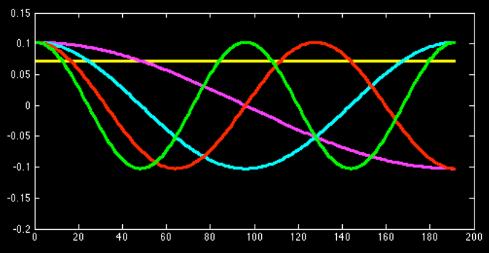
Scanner Drift
SPM has a built-in high pass filter to remove any low frequency noise
A number of cosine regressors combine linearly and remove drift – included in design matrix
Notes:
Is this automatic?

Slide 20
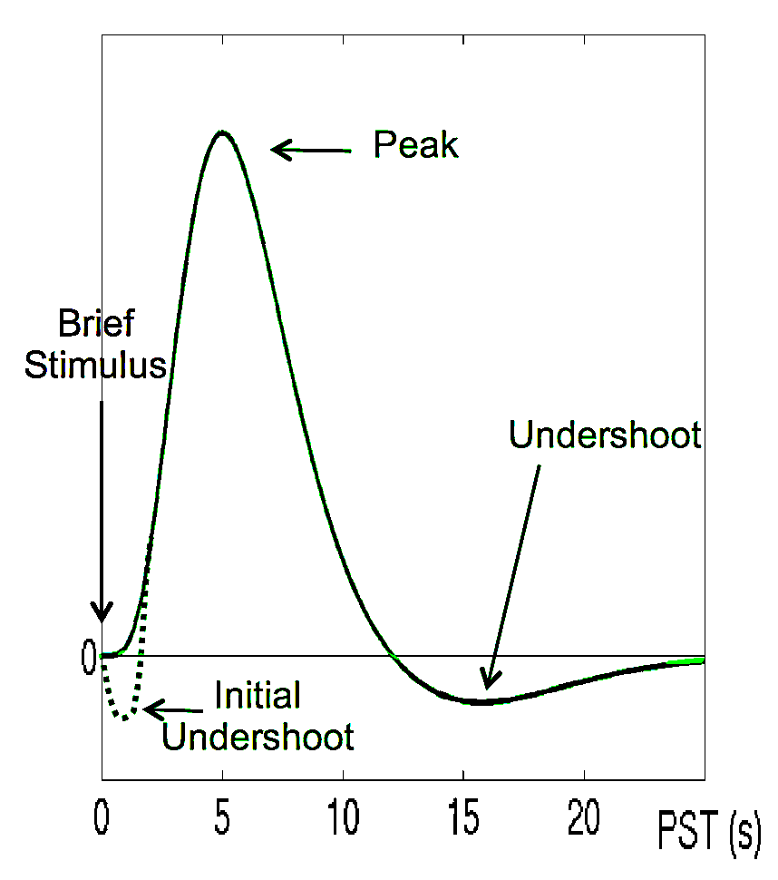
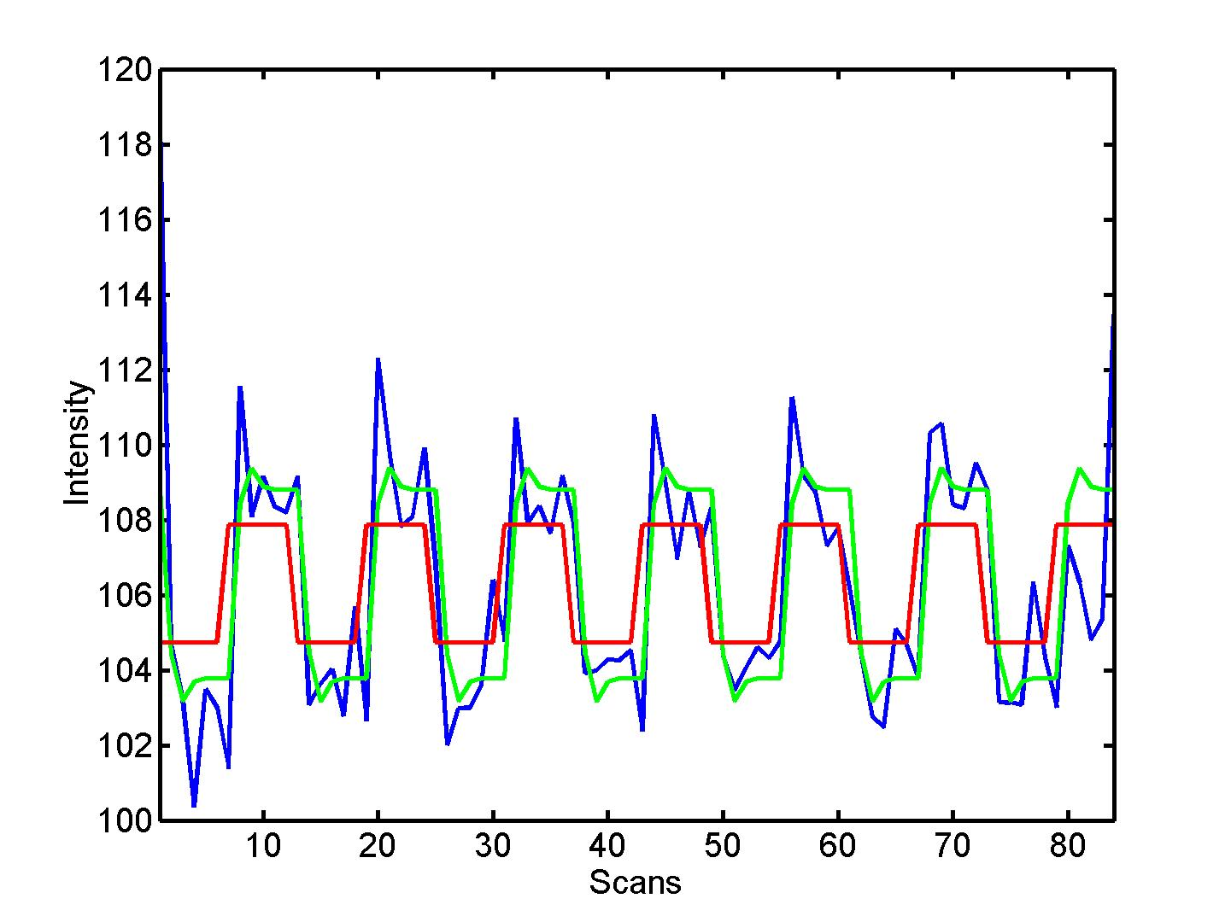


Convolution with HRF
Hemodynamic response function (HRF)
Original design matrix
Convolved design matrix
Notes:
Design matrix shows abrupt ON and OFF of neural activity with stimulus onset and offset BUT BOLD response has a delay as demonstarted
Need to convolve the design matrix with a canonical HRF
Shifts design matrix and makes it include a gradual onset and offset more reflective of the BOLD signal to make a better model for obs data
Even with this, not always a perfect fit so can include temporal derivatives (shift the signal slightly) or dispersion derivatives (change width of the HRF response) *more later in this course

Slide 21
Interim Summary
To quantify the effect of the experimental variable on BOLD signal, we build the General Linear Model.
The design matrix informs the GLM on how the BOLD signal should change with respect to each experimental variable + generates a predicted model.
It includes 3 types of regressors, which improve the model by reducing error:
  Task-related regressors of interest – experimental variables/conditions.
  User-specified regressors – (“of no interest”) e.g. movement, physiological factors
  Drift regressors – remove low-frequency noise
Design matrix is convolved with the HRF to make the predicted model more representative of observed data
Design matrix is then used to estimate specific parameters (β) using GLM (next part of presentation…)

Slide 22
Recap
We want to test whether and where in the brain, our experimental variable affects the neural signal.
To quantify the effect of the experimental variable on BOLD signal, we build the General Linear Model.
Let’s understand this model with hypothetical simple experiment.
Y = X * β + ε
Observed data
(What you collect)
Design matrix
(Experiment variable)
Matrix parameters
(These need to be estimated)
Error matrix
(residual error)

Slide 23
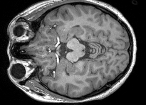
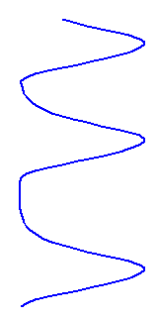
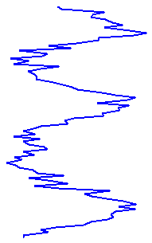
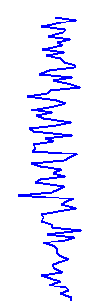

‘Face’-related voxel
If neural activity is well explained by experimental variable, β will be large and ε will be small
=
X
*
β
+
ε
Y
0.1
Visual cortex
=
1
+
Time (s)
*
Observed BOLD (a.u.)
‘face’ regressor (a.u.)
Residual error
(a.u.)
Notes:
We want to find the brain region that are activated by face stimuli relative to white blank stimuli. So, we simply present pictures of famous people at random interval. If a brain region is activated by face stimuli, its BOLD signal will be explained by our face regressor. So, regression coefficient, beta will be large and residual error, epsilonnn will be small.

Slide 24
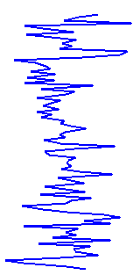
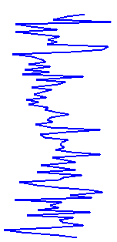
Random voxel
If neural activity is independent of experimental variable, β will be small and ε will be large
0.3
Frontal temporal
Time (s)
=
*
0.1
+
Observed BOLD (a.u.)
‘face’ regressor (a.u.)
Residual error
(a.u.)
Notes:
If a brain region is not associated with these face stimuli, its BOLD signal cannot be explained by the face regrssors. So that, beta will be small and residual error will be large.

Slide 25


Goodness of fitting
Remember! The ratio of β and ε is important. Even when the model X does not explain the data Y well, β can be large.
=
X
β
+
ε
Y
*
10
Outside the brain
=
5
+
Time (s)
*
Observed BOLD (a.u.)
‘face’ regressor (a.u.)
Residual error
(a.u.)
Notes:
I just want to reemphasize that not the absolute value of beta, but the ratio of beta and epsilon is important. For example, in this case, Y is not well explained by X, but beta is big as 5. Epsilon is even bigger like 10.

Slide 26
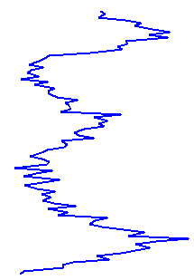
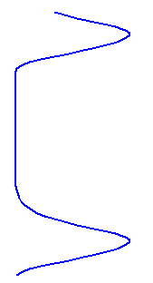
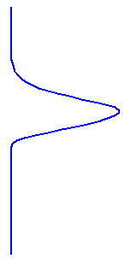
‘Face > house’ voxel
If this voxel is more activated by ‘face’ compared to ‘house’, β1 will be greater than β2
Y = X1 * β1 + X2 * β2 + ε
fusiform
Time (s)
=
1 +
*
0.5 +
*
Observed BOLD (a.u.)
‘face’ regressor (a.u.)
‘house’ regressor (a.u.)
Residual error
(a.u.)
Notes:
Let’s look at slightly more comploex experiment? In this case, we have two experimental condition, face and house. So two regressors. We want to find the brain region which is selectively activated by face. Then, regression coefficient beta1 will be larger than beta2.

Slide 27
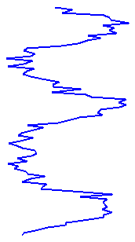
‘Face ≈ house’ voxel
If this voxel responds to any visual stimuli (no selectivity for face), β1 will be similar to β2
Y = X1 * β1 + X2 * β2 + ε
Primary visual
Time (s)
=
1 +
1 +
*
*
Observed BOLD (a.u.)
‘face’ regressor (a.u.)
‘house’ regressor (a.u.)
Residual error
(a.u.)

Slide 28
T-contrast
Y = X1 * β1 + X2 * β2 + β3 + ε
Contrast is our research hypothesis.
If we are interested in the effect of X1 (e.g. face), we will test the β1. (We don’t care any other regressors, e.g. β2, house or β3,constant)
If we are interested in comparing the effect of X1 and X2, we will test the β1- β2
In matrix form,
β1
β2
β3
C^{T}=[1, 0, 0]
β=
C^{T} β= β1
-Face effect
β1
β2
β3
-Face>house effect
C^{T}=[1,-1, 0]
β=
C^{T} β= β1- β2
Notes:
Contrast is a way to formulate our research hypothesis.

Slide 29
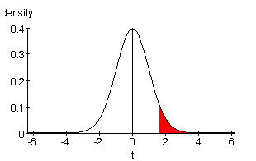
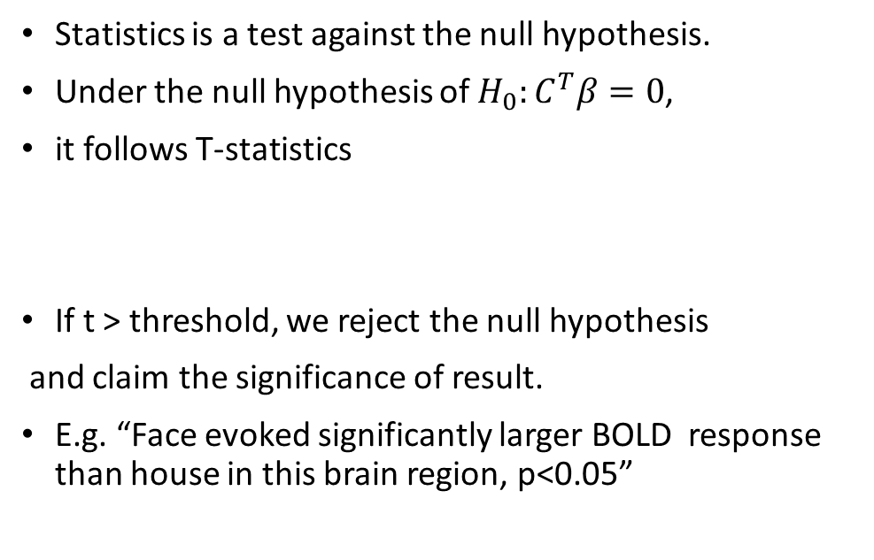
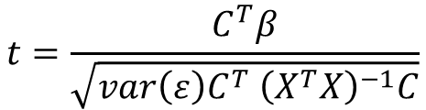
T-statistic
Y = X1 * β1 + X2 * β2 + β3 + ε
Statistics is a test against the null hypothesis.
Under the null hypothesis of $H_{0}:C^{T}β=0$,
it follows T-statistics
If t > threshold, we reject the null hypothesis
and claim the significance of result.
E.g. “Face evoked significantly larger BOLD response than house in this brain region, p<0.05”
E.g. If effect of face and house are equivalent, C^{T}β=β1-β2=0
$$t=\frac{C^{T}β}{\sqrt{var\left(ε\right)C^{T} {\left(X^{T}X\right)}^{−1}C}}$$
p=0.05
-Assumption: the variance are independent and homogenous over time
-Degrees of freedom=(length of data)-(length of β)
Notes:
How C^{T} * β should be large?

Slide 30
T-test summary
T-test is a simple signal-to-noise ratio measures
H₀: C^{T} β=0 vs H₁: C^{T} β>0
“One” linear hypothesis testing.
We can’t test both β1=0 and β2=0 at a same time
What if we have many interrelated experimental conditions, e.g. factorial design?
How can we test multiple linear hypothesis?
Y = X1 * β1 + X2 * β2 + β3 + ε

Slide 31
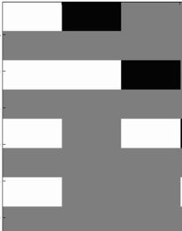
F-statistic
F-statistic is a model comparison approach
How much additional variance can be explained by my model compared to a model with null hypothesis?
A model allowing different activation for face, house, and object
VS
A model assuming same activation for all three condition
Any stimuli
Object-face
Any stimuli
Object-face
House-face
House-face
β1
β2
β3
β1
0
0
X=
β=
X₀=
β=
RSS=residual square sum of error
RSS₀=Residual square sum of error

Slide 32
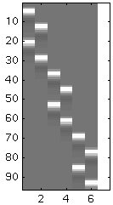
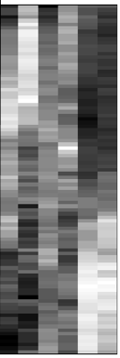
Factorial design
Design
Motion
Static
We have 2X3 design (motion/attention)
1) main effect of ‘motion’
2) main effect of ‘attention’
3) interaction of ‘motion’ and ‘attention’
Not simple t-test, but ANOVA (F-test) is needed
High Middle Low High Middle Low
MH MM ML SH SM SL
C scanner drift

Slide 33
F-contrast
 | high | middle | low
motion | β1 | β2 | β3
static | β4 | β5 | β6
Is their main effect of attention?
Null hypothesis: no attention effect
  (β1+ β4)-(β2+β5)=0 // no difference between high and middle attention
  (β2+ β5)-(β3+β6)=0 // no difference between middle and low attention
In matrix form,
Constant: β7
Scanner drift: β8
β1 β2 β3 β4
β5 β6
β7
β8
β1+β4-β2-β5
β2+β5-β3-β6
C=
1 -1 0 1 -1 0 0 0
0 1 -1 0 1 -1 0 0
β=
Cβ=
Notes:
ANOVA uses sum-of-square variance principle:
Is between-group variance greater than within-group variance?

Slide 34
F-contrast
 | high | middle | low
motion | β1 | β2 | β3
static | β4 | β5 | β6
Is their interaction effect between motion and attention?
Null hypothesis: no interaction
  (β1- β4)-(β2- β5)=0
  (β2- β5)-(β3- β6)=0
In matrix form,
Constant: β7
Scanner drift: β8
β1 β2 β3 β4
β5 β6
β7
β8
β1-β2-β4+β5
β2- β3-β5+ β6
C=
1 -1 0 -1 1 0 0 0
0 1 -1 0 -1 1 0 0
β=
Cβ=
Notes:
ANOVA uses sum-of-square variance principle:
Is between-group variance greater than within-group variance?

Slide 35
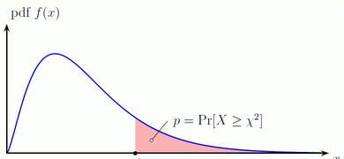
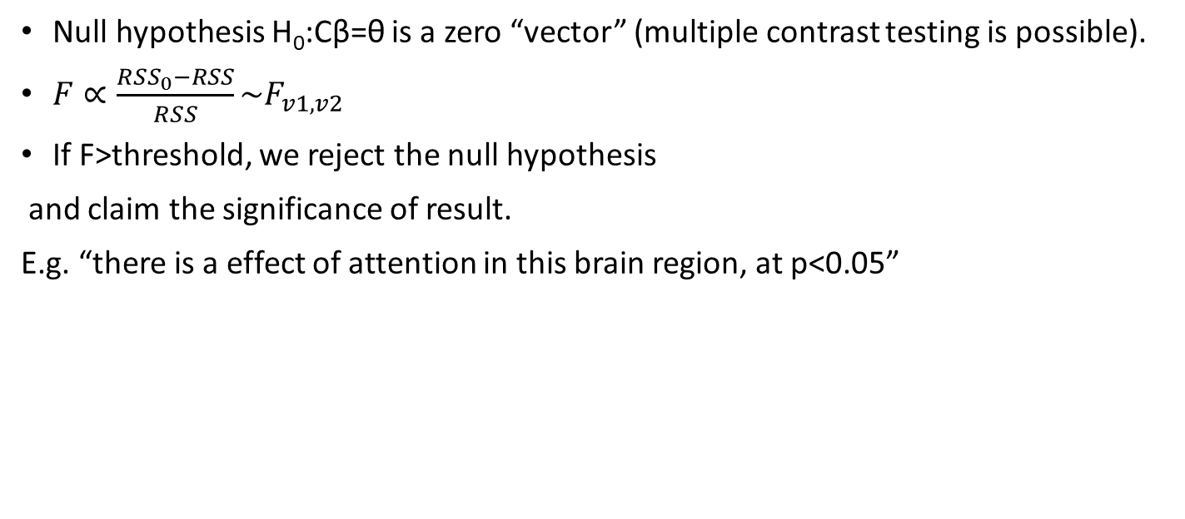
F-statistic
β1+β4-β2-β5
β2+β5-β3-β6
0
0
Cβ=
= θ =
Null hypothesis H₀:Cβ=θ is a zero “vector” (multiple contrast testing is possible).
$F∝\frac{{RSS}_{0}−RSS}{RSS}\sim F_{v1,v2}$
If F>threshold, we reject the null hypothesis
and claim the significance of result.
E.g. “there is a effect of attention in this brain region, at p<0.05”
p=0.05
-Assumption: the variance-covariance matrix are independent and homogenous over time (identity vector)
-Degrees of freedom: ν₁ = rank(X) – rank(X₀), ν₂ = N – rank(X)

Slide 36
F-test summary
The F-test evaluates whether any combination of contrasts explains a significant amount of variability in the measured data
H₀: C β=0 vs H₁: C β≠0
More flexible than T-test
F-test can tell the existence of significant contrasts. It does not tell which contrast drives the significant effect or what is the direction of the effect.

Slide 37
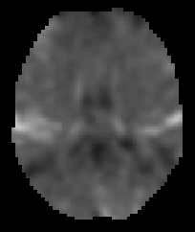
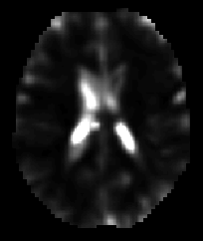
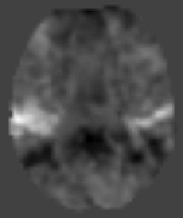
What does the SPM do?
SPM calculates beta, residual error, T-statistic, F-statistic value for each voxel
Typical fMRI image has 10,000~30,000 voxels in the brain
Statistic values of each voxel are saved in ‘image’ format
We call SPM (Statistical Parameter Map), because this is literally the map of statistic parameter value.
Beta_0001.img
ResMS.img
spmT_0001.img
T=0.87
T=4.80

Slide 38
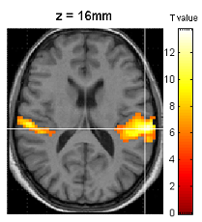
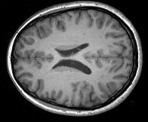
Display of result
We simply overlay the thresholded T or F-statistic map on anatomical template brain (e.g. p<0.05, T>1.96)
Bright color indicates smaller p value (hardly occur by chance) and dark color indicates larger p value(relatively more likely to occur by chance)
+
=
threshold

Slide 39
Demonstration

Slide 40
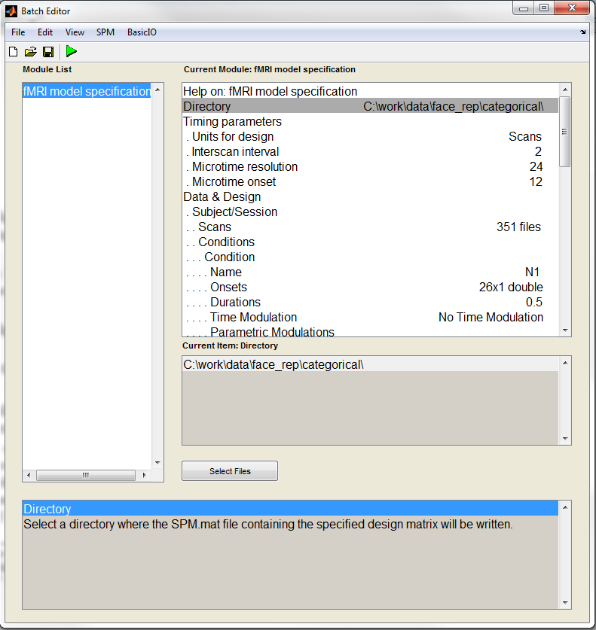
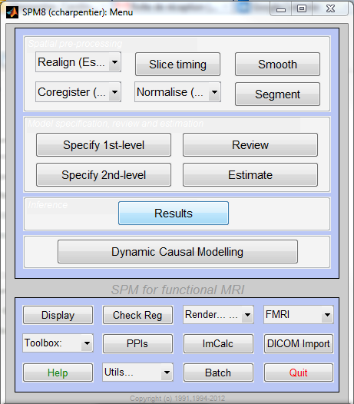
Build a design matrix

Slide 41
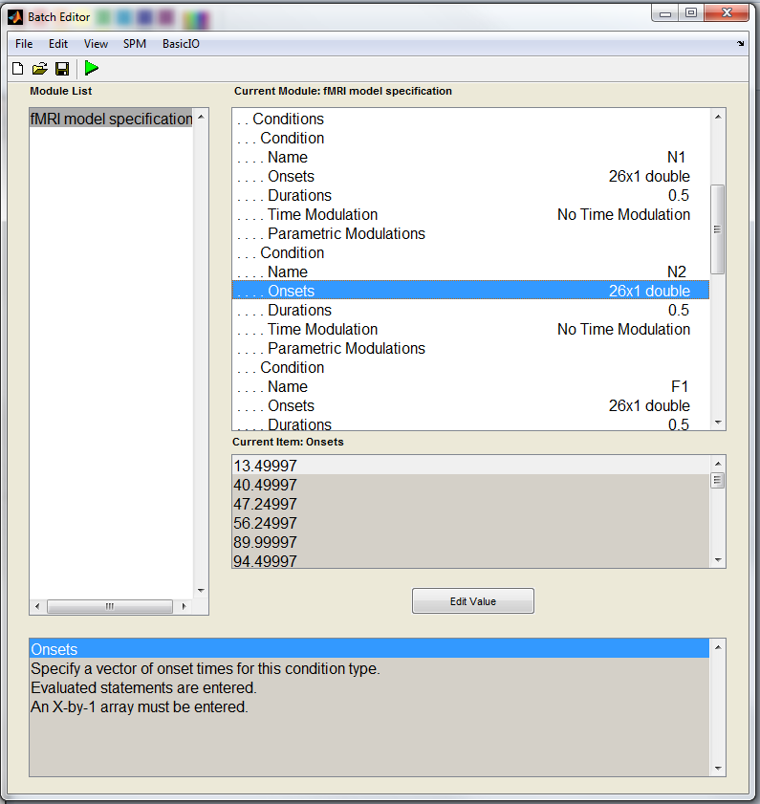
Specification of each condition to be modelled: N1, N2, F1, and F2
Name
Onsets
Duration

Slide 42
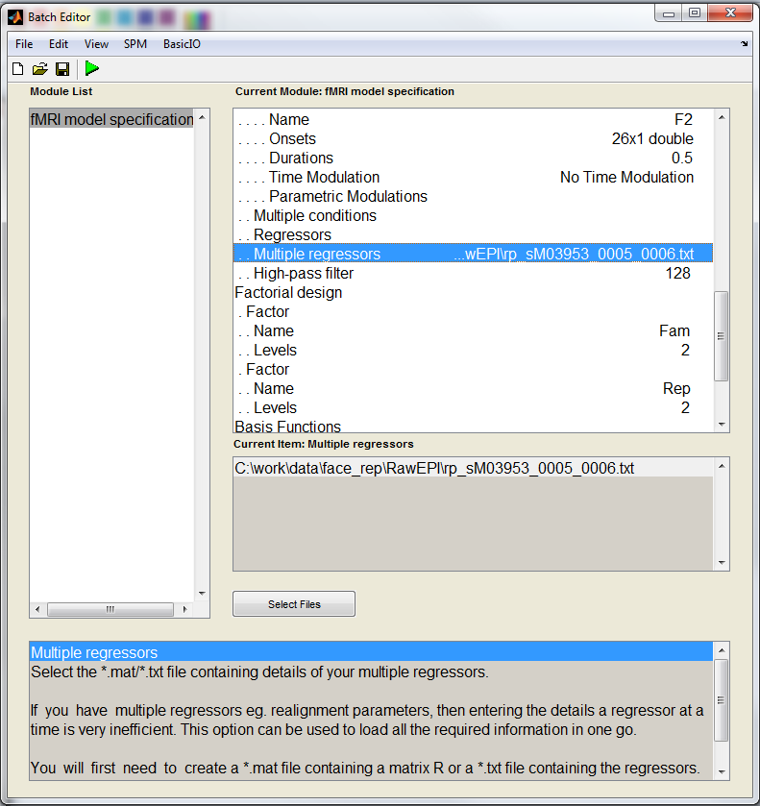
Add movement regressors in the model
Filter out low-frequency noise
Define 2*2 factorial design (for automatic contrasts definition)

Slide 43
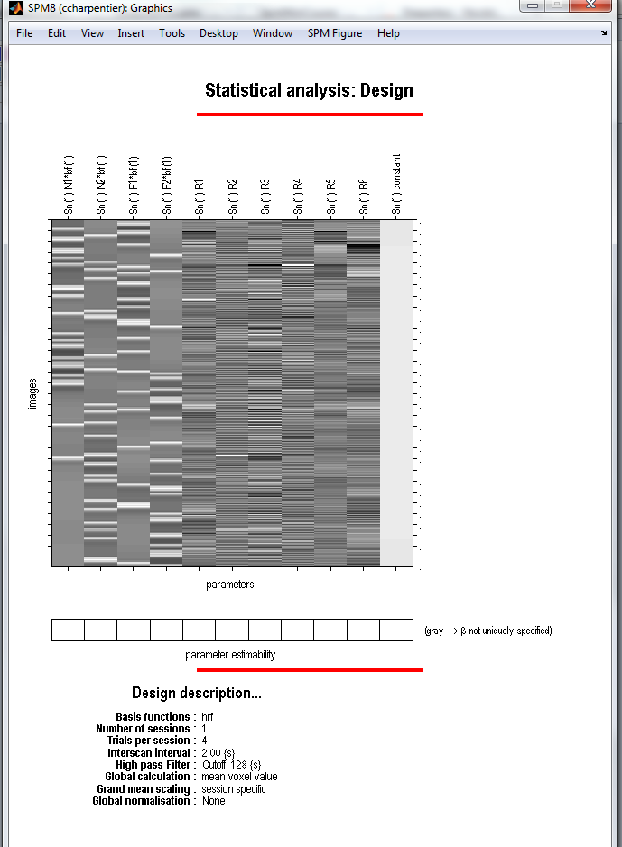
The Design Matrix
Regressors of interest:
β1 = N1 (non-famous faces, 1st presentation)
β2 = N2 (non-famous faces, 2nd presentation)
β3 = F1 (famous faces, 1st presentation)
β4 = F2 (famous faces, 2nd presentation)
Regressors of no interest:
Movement parameters (3 translations + 3 rotations)

Slide 44
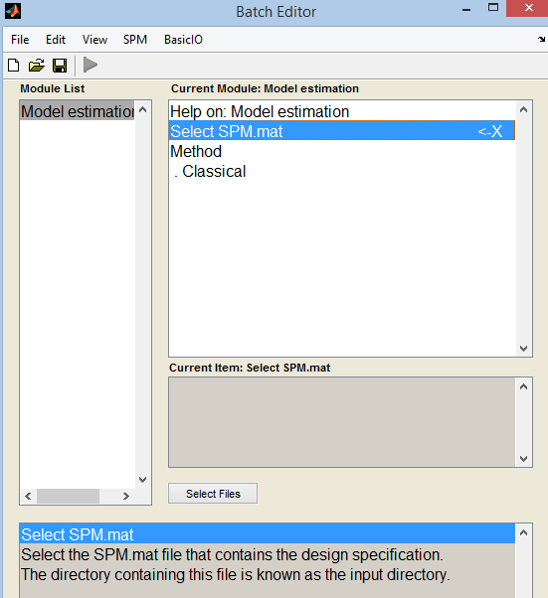
Estimate the parameter
Y=X*beta+err
Calculate beta and error for every voxels in the brain

Slide 45
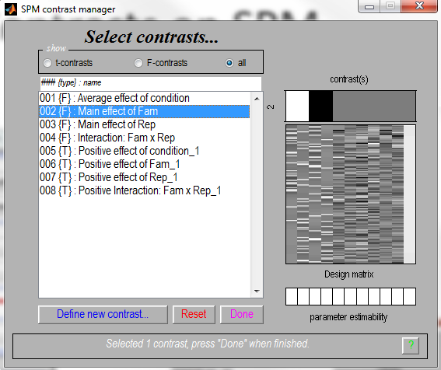
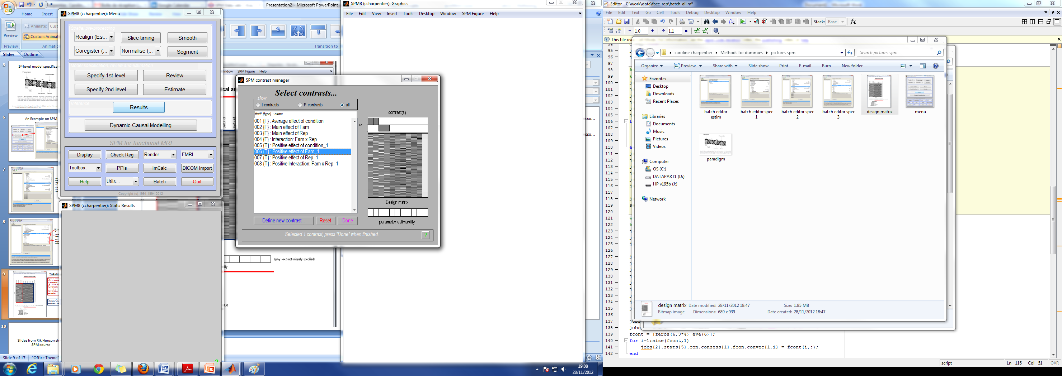
Contrasts on SPM
F-Test for main effect of fame: difference between famous and non –famous faces?
T-Test specifically for Non-famous > Famous faces (unidirectional)

Slide 46
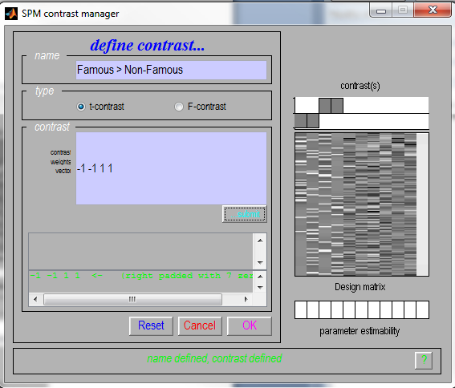
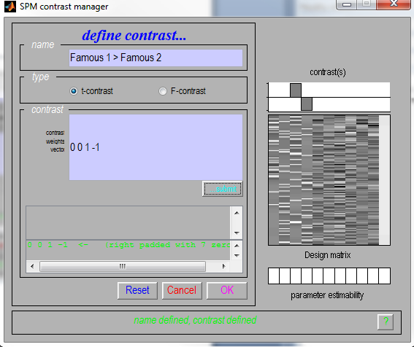
Contrasts on SPM
Possible to define additional contrasts manually:

Slide 47
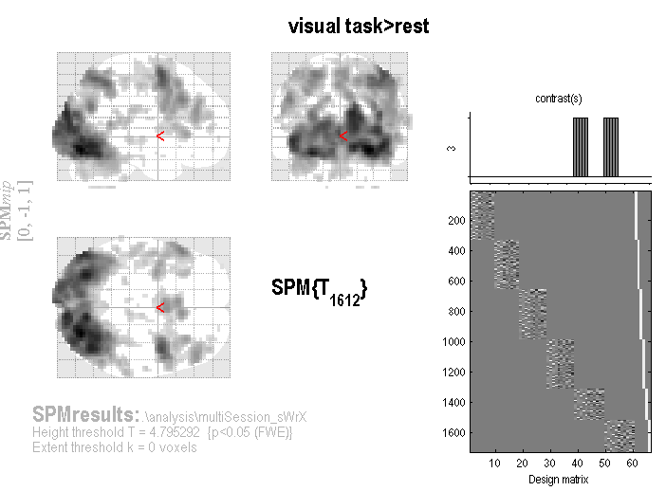
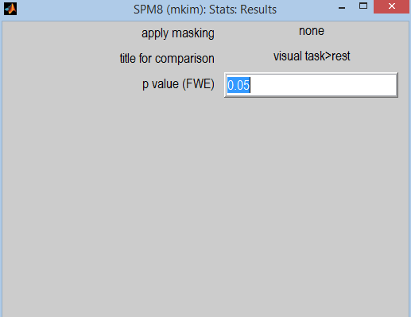
Displaying result

Slide 48
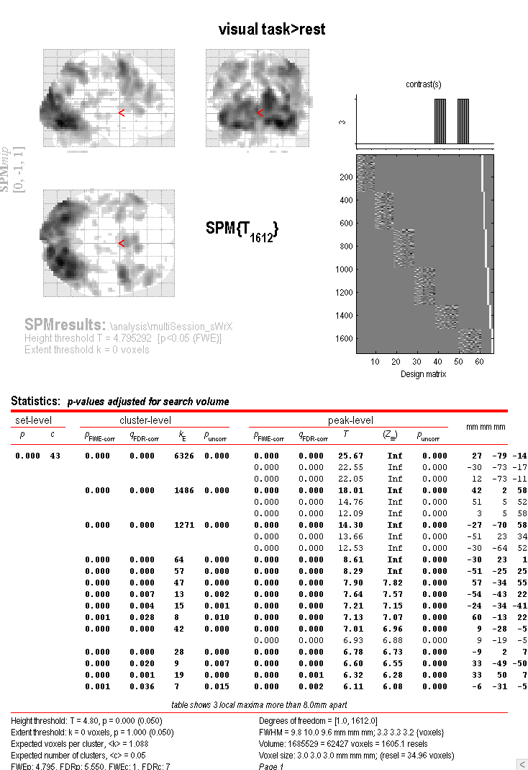
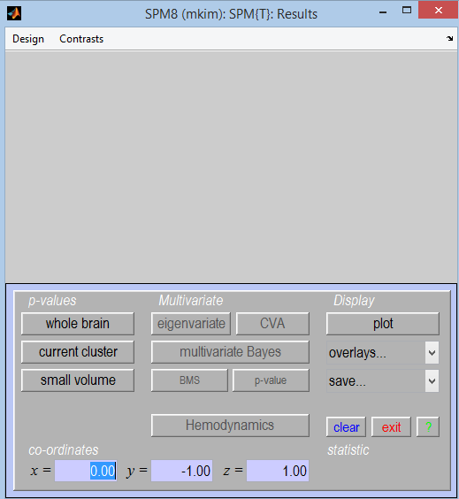
Statistic table

Slide 49
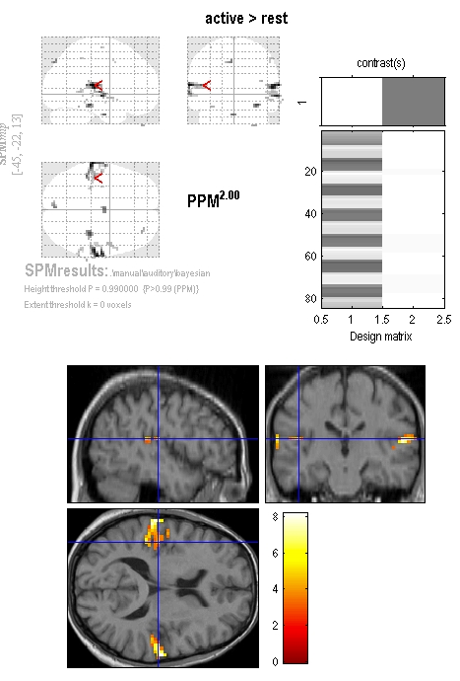
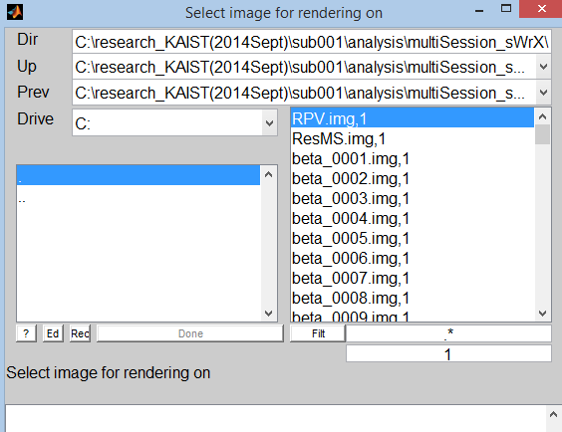
Overlay the result

Slide 50
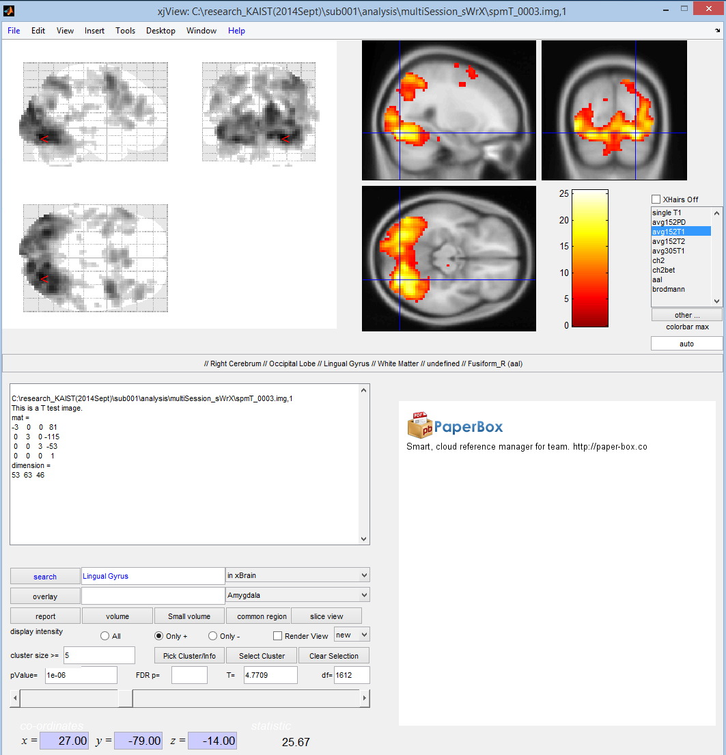
xjView
Nice viewer for SPM image
Anatomical label
Both positive/negative T-value
Quick overlay
Easy to adjust the p-value

Slide 51
Thanks! Any questions?
Reference
  Previous MfD slides, SPM course, SPM manual
  Friston et al (2007), Statistical Parametric Mapping: the analysis of functional brain images, Academic Press
  Ashby (2011), Statistical Analysis of fMRI Data, MIT press

