Slide 1
Random Field Theory
07/01/15
MfD 2014
Xin You Tai & Misun Kim

Slide 2
Content
Overview
Hypothesis testing
Multiple comparisons problem
Family-wise error rate and Bonferroni correction
Random field theory

Slide 3

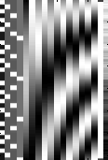
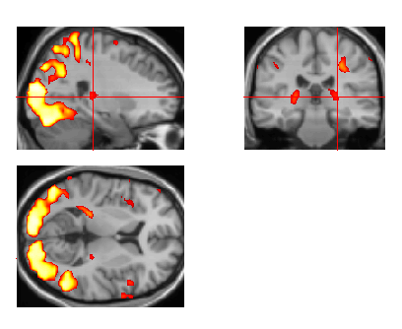
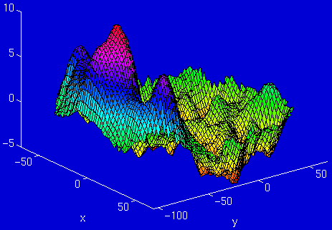
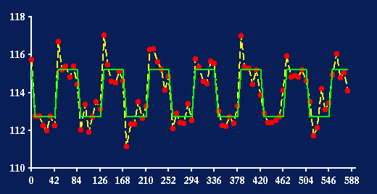
fMRI time-series
Kernel
Design matrix
Thresholding and for multiple comparisons
Motion
Correction
(Realign & Unwarp)
Smoothing
General Linear Model
Co-registration
Spatial normalisation
Parameter Estimates
Standard
template
Notes:
Overview on we are:
We’ve acquired our images – consecutive sets of many many voxels
May have corrected for motion artfacts
Done some co-registration
Applied a smoothing kernel
We have modelled our data using the general linear model
We have fit the model that we are interested in
fMRI model – created statistic image
Now we need to decide what is stastiscally relevant or simply noise
>100 000 voxels in the image
That’s over 100 thousand statistical tests to be done

Slide 4
Hypothesis testing
Null Hypothesis
  H0 = Hypothesis that there is no effect
  Test against the null hypothesis
  Type 1 error rate = chance that we are wrong when we reject the null hypothesis
Alternate hypothesis
T statistic
  Test statistic against the null hypothesis
  Likelihood of the statistic to occur by chance
T statistic can be described against fixed alpha levels or using p-values
Notes:
Lets just recap some basic statistics
We are trying to measure our hypothesis against the null hypothesis whereby the null hypothesis is there is no effect
We use the t-statistic to measure the evidence against the null.
This can be described against a fixed alpha level
= > I want to ensure that only 5% of the time, I want to falsely detect something – creating a fixed threshold and if the test statistic falls above it, it’s real and you can reject the null hypothesis
Or you can use a p-value approach where you take the observed data and you find the probability of observing this under the null hypothesis
t-statistic is a ratio of the departure of an estimated parameter from its notional value and its standard error
Alpha level
I want to be sure that only 5% of the time I will falsely detect something
P-value
Taking observed data, what is the probability that this could be observed under the null hypothesis

Slide 5
Further hypothesis testing
u_{α}
α level
  Fixed
  Acceptable false positive rate
⇨ determined by threshold u_{α}
P-Value
  Probability of observing t assuming H0
α
Null Distribution of T
t
P-val
Null Distribution of T
Notes:
This can be described against a fixed alpha level
= > I want to ensure that only 5% of the time, I am falsely detect something – creating a fixed threshold and if the test statistic falls above it, it’s real and you can reject the null hypothesis
Or you can use a p-value approach where you take the observed data and you find the probability of observing this under the null hypothesis
So this is standard statistics, standard hypothesis testing.

Slide 6
Multiple comparisons Problem
Many voxels
Many statistics
Large volume of statistics in our brain image
Functional imaging
Consider a 100 000 voxel image,
Each voxel had separate t-test applied
For an α = 0.05 threshold, there is a 5% false positive rate
5% of time → 5000 voxels → false positive (type 1 errors)
How do we come up with an appropriate threshold?
Notes:
fMRI model – created statistic image
Now we need to decide what is stastiscally relevant or simply noise
>100 000 voxels in the image
That’s over 100 thousand statistical tests to be done
If a 5% alpha level is used, then at 5% of the time, you’re going to get a false positive.

Slide 7

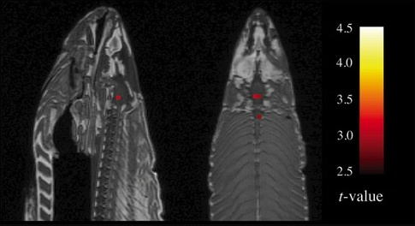
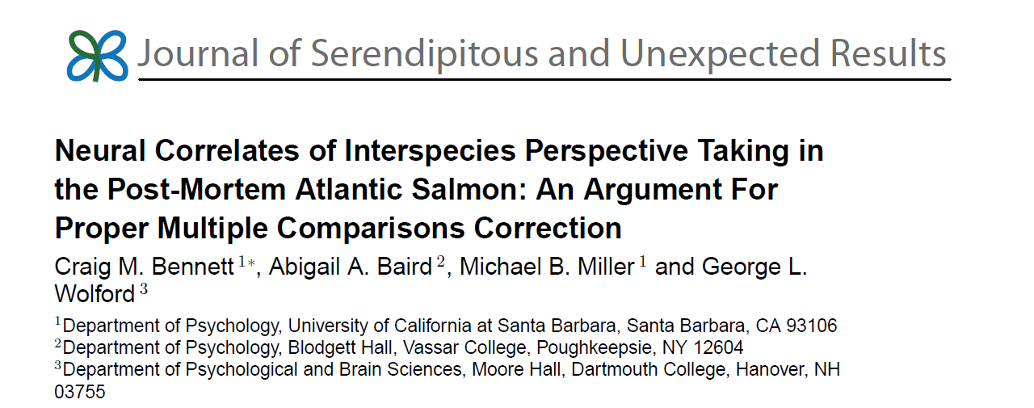
Notes:
From the authors’ acceptance speech (Annals of Improbable Research, 18(6), pp. 16-17):
“we…found that up to 40% of papers were using an incorrect statistical approach. And many other people had argued that they should be doing it correctly, but it wasn’t sticking. So we decided: can we use the tools of humor and absurdity to change a scientific field? Nay, to put a dent in the universe. And the truth is that you can. Through a dead salmon, you can get the number of people who use the incorrect statistic under 10%. So we’ve had a real impact.”

Slide 8
One mature Atlantic Salmon (Salmo salar). Not alive at the time of scanning.
Completing an open-ended mentalizing task
Photographic stimuli were presented in a block design
p(uncorrected) < 0.001, 3 voxel extent threshold.
Active voxels were found in the salmon brain cavity and spinal cord
Out of a search volume of 8064 voxels a total of 16 voxels were significant.
Argument for statistical analysis controlling for multiple comparison or zombie fish?
Notes:
One mature atlantic salmon – not alive at time of study (to the knowledge of the investigators)
Image acquistion using a 1.5 T MRI
Foam padding was placed within the head coil to limit salmon movement during the scan but the authorscommented that it was largenly unnecessary as subject motion was excptionally low
Open-ended mentalisation task – salmon was shown a series of photgraphs depicting humans in social situations with specified emotions and the salmon was asked to determine which emotion the person in the photo was feeling. Photo stimuli was presented in a block design.
SPM2 was used for the analysis
Processing steps were takin inclyding coregistration of the functional data to a t1 weightedanatomical image
8mm full width at half-maximum (FWHM) gaussian smoothing kernal was aplied
Voxel wise statistics were performed using the GLM
T-contrast was used to test regions with significant BOLD signal during presentation of photos vs rest
Parameters included a p value of <0.001, 3 voxel extent threshold.
Random noise may yield spurious reslts if multiple testing is not controlled for

Slide 9
Familywise Error Rate (FWER)
Common measure of type 1 error over multiple tests
Familywise error – existence of one (or more) errors
FWER – likelihood of one (or more) familywise error occurring across the population
  i.e likelihood of family of voxel values could have arisen by chance
False discovery rate (FDR)
FDR = 0.05, at he most 5% of the detected results are expected to be false positives
Notes:
FWER represents the probability of observing one or more false positives after carrying out multiple significance testing
Using a FWER = 0.05, 5% of one or more false positives across the entire set of hypothesis testing
Various methods to control for FWER, one of which is the Gaussian Random Field Theory
- The most widely known FWER control is the Bonferroni correction

Slide 10
Bonferroni Correction
Classical approach to multiple comparison
Method of setting the significance threshold to control the Family-wise Error Rate (FWER)
If all test values are drawn from a null distribution, each of the n probability values has a probability α of being greater than threshold
Probability that all n tests are less than α = (1- α)^{n}
Notes:
If all the test values are drawn from a null distribution, then each of
our n probability values has a probability α of being greater than threshold.
The probability of all the tests being less than α is therefore (1 − α) n
.

Slide 11
Bonferroni Correction
Probability that one or more tests are greater than α:
  P_{FWER} = 1 – (1- α)^{n}
Because α is small, this can be approximated to:
  P_{FWER} ≤ n . α
Finding a single-voxel probability threshold α:
  α = P_{FWE} / n
Notes:
The family-wise error rate (P FWE) is the probability that one or more values will be greater than α
Because α is small this can be approximated by the simpler expression

Slide 12
Bonferroni Correction
Example using our 100 000 voxel image,
If we want a FWER = 0.05, then the required probability threshold for a single voxel:
= P_{FWE} / n
= 0.05/100000
= 0.0000005
Corresponding t statistic = 5.77
Therefore if any voxel statistic is above 5.77, there is only a 5% chance of it arising from ANYWHERE in a volume of 100 000 t-statistics drawn from the null distribution

Slide 13
Bonferroni Correction
The Bonferroni procedure allows you to set a corrected p value threshold for your multiple comparisons by deriving an uncorrected p value for a single voxel in your population of voxels
Notes:
Take desired false postive rate and divide by the number of tests
Standard hypothesis tests designed to control ‘per comparison rate’ and are not meant to be used repetitively for a set of related tests
Bonferroni correction which allows you to find a suitable threshold for a large large set of related data i.e. the voxels

Slide 14
Spatial correlation & Smoothing
Data from one voxel in functional imaging will tend to be similar to data from nearby voxels
  even with no modelling effects
Errors from the statistical model tend to be correlated for nearby voxels
Smoothing before statistical analysis
The signal of interest usually extends over several voxels
Distributed nature of neuronal sources and spatial extended nature of haemodynamic response
Notes:
Proportion of noise in functional images is independent from voxel to voxel whereas the signal of interest usually extends over several voxels
The value of one voxel is not an independent estimate of local signal
- rather, it is highly orrelated with valuesof surrounding voxels due to intrinsic spatial correlation of BOLD sigals and due to gaussian smoothing applied furing preprocessing

Slide 15
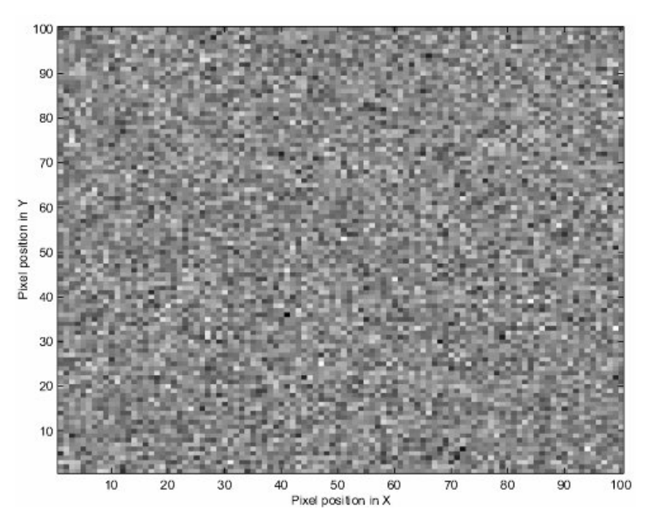
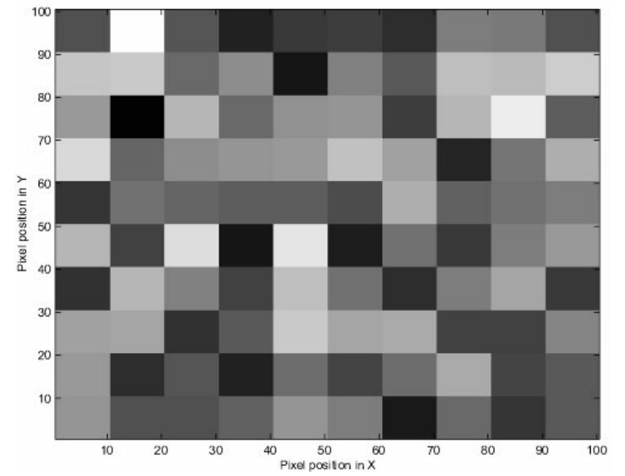
Bonferroni correction and independent observations
Spatial correlation + Smoothing → fewer independent observations in the data than voxels
Bonferroni correction will be too conservative
Consider a 10000 voxel image,
Notes:
This leads to the argument that the bonferroni corection is then too conservative and the thresholds become unnecessarily high – leading to type 2 errors and elimination of valid results.
So this leads nicely onto the Gaussan Random Field FWER estimation as an effective method for correcting for multiple comparisons in fMRI

Slide 16
Figure 1: Simulated image slice using independent random numbers from
the normal distribution
Random number image from figure 1 after replacing values in the
10 by 10 squares by the value of the mean within each square

Slide 17
(Mini-)Conclusion
Multiple comparisons over large voxel images can lead to false postive results
Statistical analysis should correct for multiple comparisons
Bonferonni correction is the most widely known method for FWER control
- May be too conservative for fMRI

Slide 18
Recap
Problem of multiple comparison test: testing thousands of independent statistical test across the brain (~30,000voxels)
We want to control the total number of false-positive.
Bonferroni correction is one way to deal with, but Bonferroni assumes independence across every voxel and this makes the Bonferroni correction often too conservative (too high threshold)
Random field theory is the mathematical theory about smooth statistical map, which can be applied to find the threshold of T, F value for certain family-wise error rate
Notes:
Too high threshold is not good because it will increase the chance of not detecting the true effect. There’s always a trade-off between false positive and false negative and we want to find optimal cut-off. Random field theory help us to find the right threshold by taking into account the non-independent, smooth property of fMRI data.

Slide 19

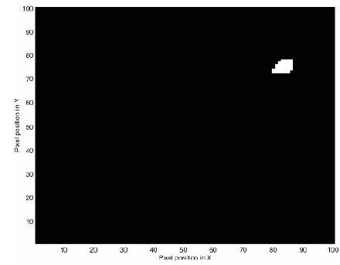
Individual voxel threshold and Family-wise error rate
2D example:100 x 100 voxel = 10,000 statistic values
Null hypothesis: data is derived from random Gaussian distribution
Random Z map
Z>2.5
3 clusters survive
Z>2.75
1 cluster survives
Mean:0, Std=1
Notes:
Let’s first see the relationship between individual voxel threshold and family-wise error rate in this 2D case. The data is derived from random Gaussian distribution. Brighter color means higher value. If we apply threshold of Z>2.5, three top most blobs survive. But if we increase the threshold to 2.75, only one cluster is above this threshold. If we increase threshold even further like Z> 5, there will be no false-positive voxel at all.

Slide 20

FWER = Expected number of clusters
Family-wise error rate=Expected number of clusters above threshold
We want to find a threshold where expected number of cluster above the threshold is less than 0.05
Less than 5 clusters
100 random Z map
0 cluster
1 cluster
0 cluster
Z>2.75
1 cluster survive
Notes:
A common norm is to control FWER at 0.05. What does it mean? If there are 100 data set derived from random Gaussian distribution, there will be less than 5 false positive. In this case, false positive is the cluster or blob above the threshold. Therefore, FWER is equal to the expected number of cluster above a threshold in this smooth field.

Slide 21
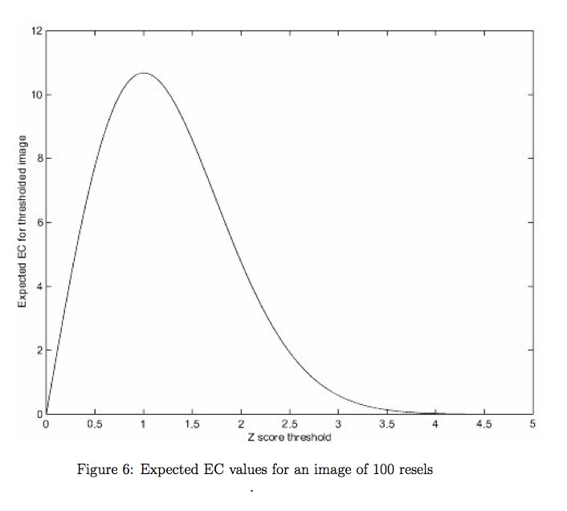

Euler Characteristic
Euler characteristic (EC) counts the number of clusters above threshold Z_{t} → expected family-wise error rate
We can simply calculate the EC using the formula of RFT.
For two dimensional case,
R is the number of “resels”
We are only interested in Z score higher than 1. In this case, higher threshold means smaller EC.

Slide 22
Resel
Resolution Element, coined by K. Worsley
Number of resels=Volume/smoothness
100 random numbers
=100 resels
100 numbers, but smoothed by FWHM=10
=10 resels

Slide 23
Euler characteristic= p-value
If number of resels (R) is big, E(EC) is big.
More statistical tests, more chance to find false-positive
Once we know R and we have target E(EC), we can find threshold value, Z_{t} , which corresponds to target family-wise error rate.

Slide 24
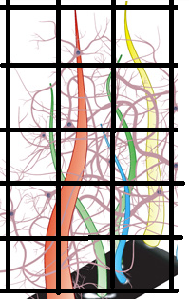
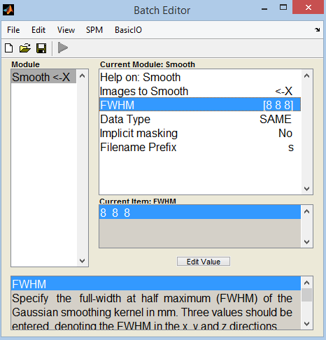
Estimating spatial smoothness
Various source of smoothness
First, inherent anatomical connection, hemodynamic smearing
Second, preprocessing step (realign, normalization involves some interpolation)
Third, explicit smoothing
Therefore, smoothness is always bigger than the smoothing kernel you put during preprocessing steps
Notes:
The only thing we have to know is the number of resel. And the number of resel is inversely proportional to smoothness of the data.

Slide 25
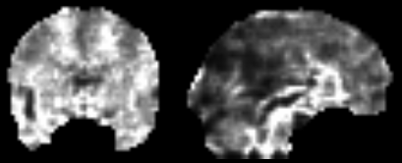
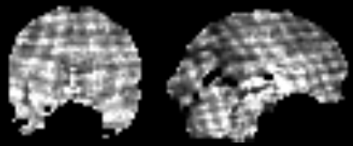
Estimating spatial smoothness
SPM estimates the smoothness from residual of general linear model.
Spatial derivative of residual gives the estimated value of spatial correlation or smoothness.
Saved in RPV.img (Resels Per Volume)
FWHM=6mm
Value 0.01-0.1
No smoothing
Value 0.1-0.2

Slide 26
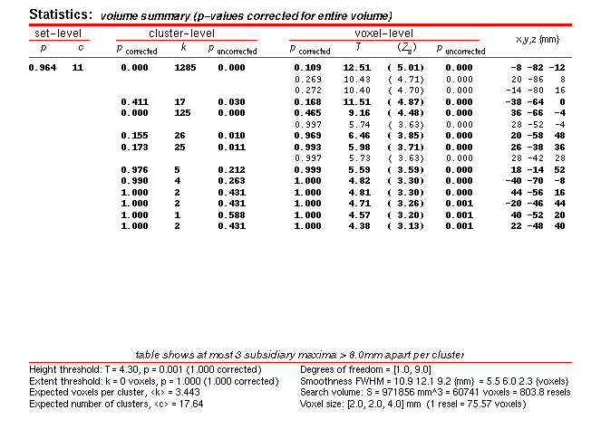
Example SPM result
P_corrected comes from EC calculation

Slide 27
Random field theory assumption
Error field should be reasonably smooth Gaussian distribution
2nd-level random effect analysis with small number of subject can have non-smooth error fields, in this case a threshold from RFT can be even higher (conservative) than Bonferroni correction.
  SPM automatically chooses more liberal threshold between Bonferroni and RFT.
  Alternatively, non-parametric test which does not assume specific null distribution can be used (computationally costly)
  Bayesian inference (explicitly includes smoothness into prior)
Notes:
-Regular sampling frequency comparable to smoothing kernel (discrete sampling, approximate to continuous random field)

Slide 28
Thanks & Question?
Guilliaum Flandin
Previous MfD slides
SPM book

