Slide 1
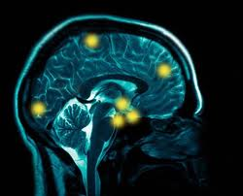
Preprocessing: Coregistration and Spatial Normalisation
Cassy Fiford and Demis Kia
Methods for Dummies 2014
With thanks to Gabriel Ziegler

Slide 2
1. Preprocessing Recap
2. Coregistration
3. Spatial Normalisation
4. Smoothing
5. SPM help

Slide 3
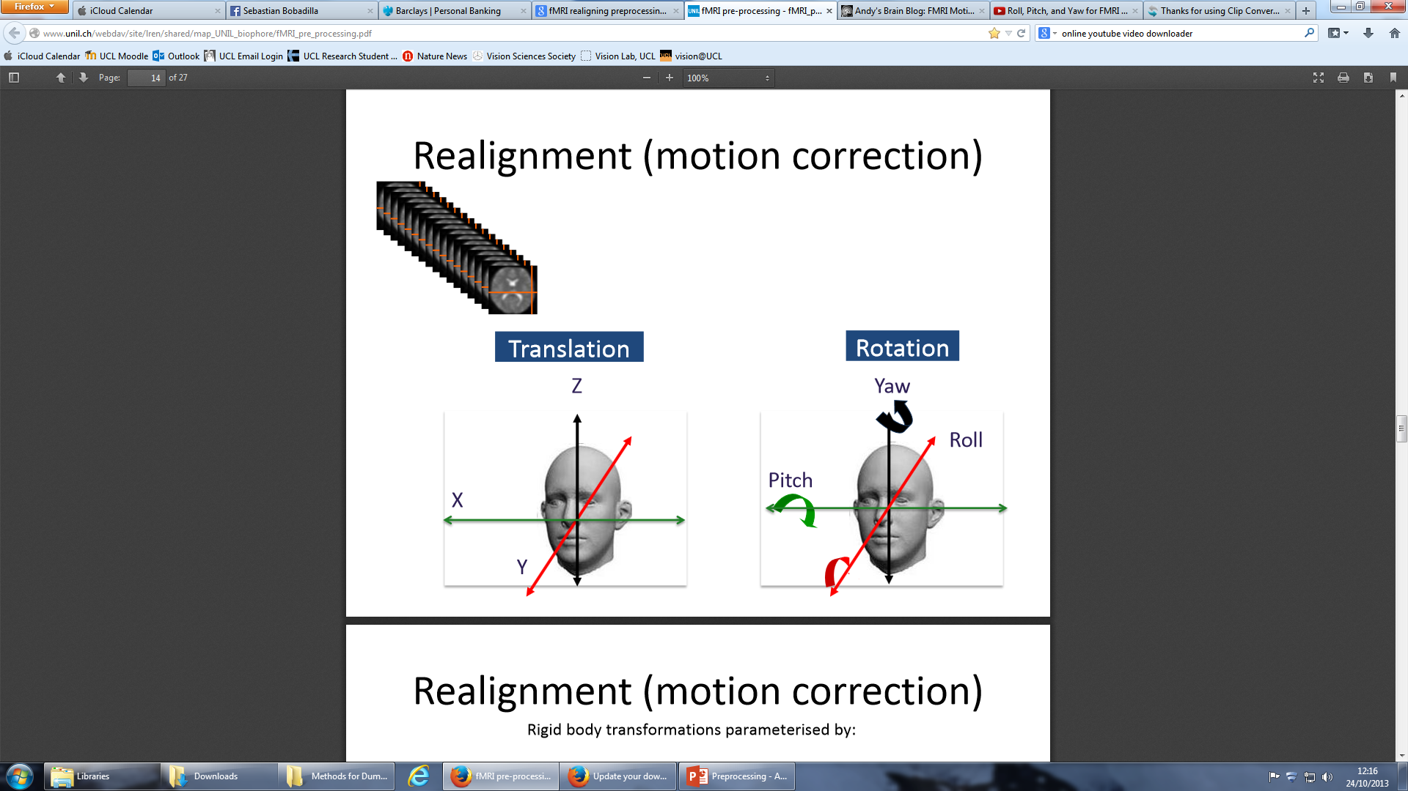
Preprocessing Recap: Realignment
Motion Correction
Within subjects
Aligning to a template
fct
fct
fct
fct
fct
fMRI
fMRI

Slide 4
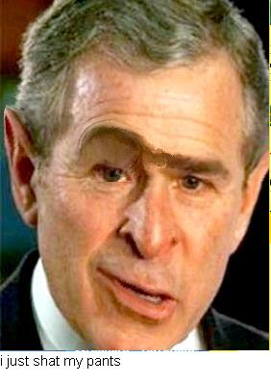
Preprocessing Recap: Unwarping
Adjusts for changes in field strength
Non linear

Slide 5
Preprocessing Final Steps:
Coregistration
fct
strMRI
fMRI
Matching modalities in individual subjects
Normalisation
Matching images to a template (e.g. MNI) across subjects
MNI
Smoothing
fMRI
Adjusts for residual differences and alignment errors

Slide 6
Preprocessing Final Steps:
Coregistration
fct
strMRI
fMRI
Matching modalities in individual subjects
Normalisation
Matching images to a template (e.g. MNI) across subjects
MNI
Smoothing
fMRI
Adjusts for residual differences and alignment errors

Slide 7
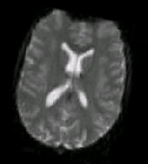
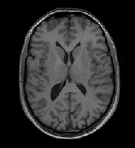
Coregistration
Intermodal
  Link anatomical information of functional images (few seconds) with a structural image (few minutes)
Intrasubject
Why?
  Superior anatomical localisation
  More precise spatial normalisation
Mean functional
Image
(source)
Anatomical
Image
(reference)
Coregister

Slide 8
Coregistration
Cannot rely on simply using intensity difference
Identifying individual landmarks too labour intensive

Slide 9
Seek to measure shared information
  Quantify how well one image predicts the other
Two-step process
  Registration (Fitting source image with reference image)
  Interpolation
    Estimates the intensity of surrounding voxels in functional image → correspond with structural voxels

Slide 10
    Registration
      Fitting source image (functional) with reference image (structural)

Slide 11
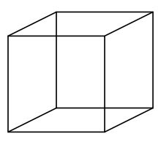
  Interpolation
    Estimates the intensity of surrounding voxels in functional image → correspond with structural voxels

Slide 12
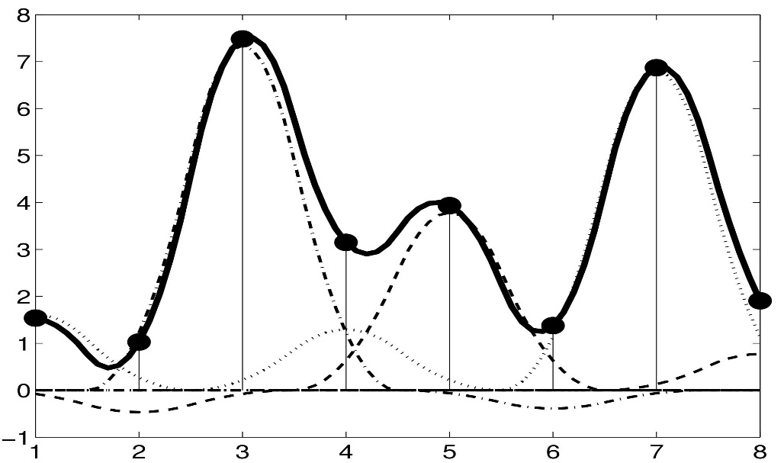
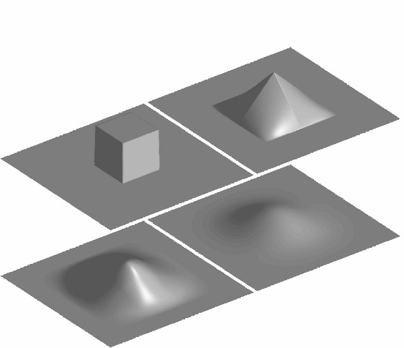
Interpolation
Methods include:
Nearest neighbour
Linear interpolation
B-spline interpolation (higher order)
  Same as nearest neighbour and linear in degrees of 0 and 1

Slide 13
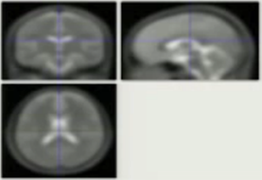
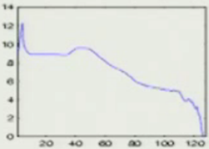
Plotting intensities

Slide 14
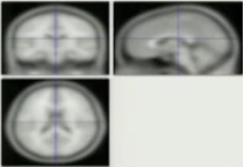
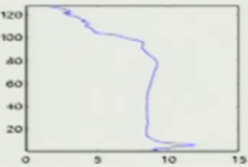

Slide 15
Forming a joint histogram

Slide 16
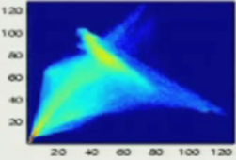
Forming a joint histogram

Slide 17
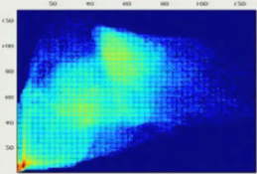
Registered joint histogram
Misregistered joint histogram

Slide 18
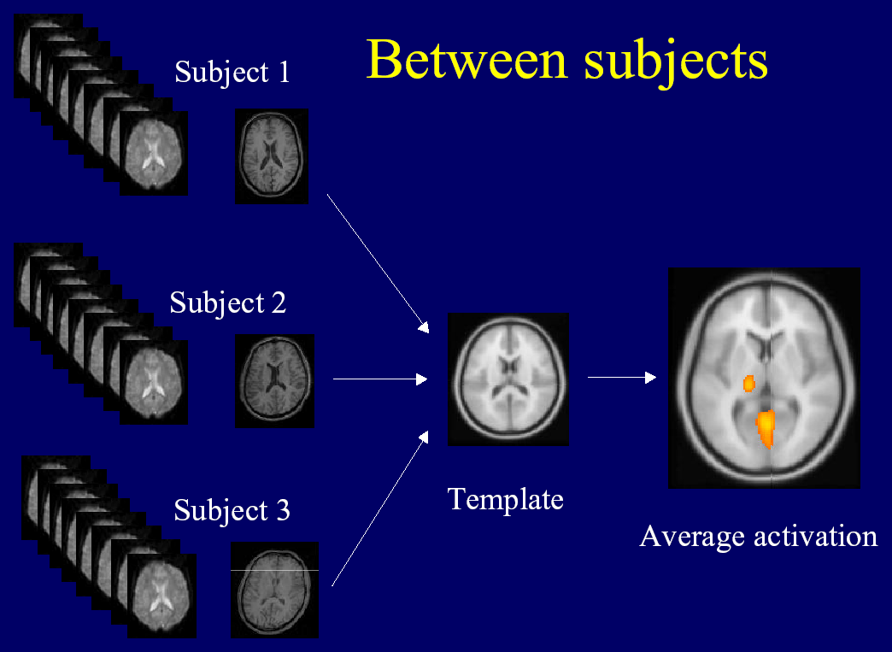
Normalisation: Motivation
Motivation: A shared space is required to enable us to compare subjects.
Aim: Voxel to voxel correspondence between the brains of subjects

Slide 19
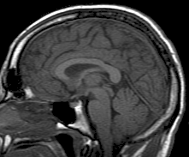
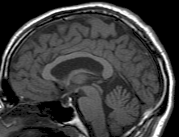
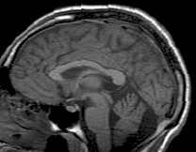
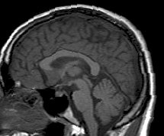
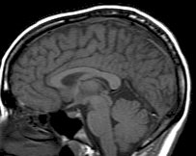
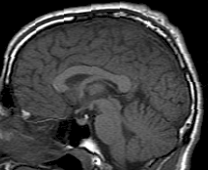
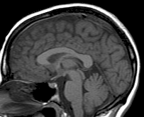
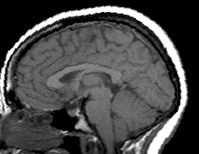
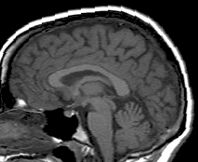
Why normalise?

Slide 20
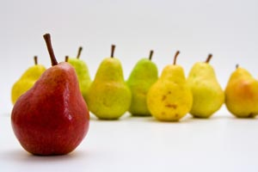
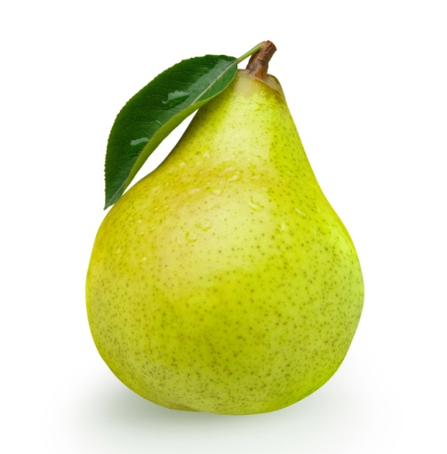
Why normalise cont…
Increases statistical power
Group analysis
Generalisability
Allows cross study comparisons

Slide 21
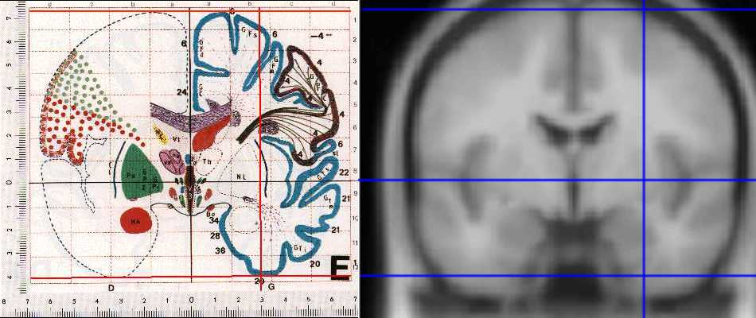
Normalisation
Native Space → Standard Space
Talairach
Montreal Neurological Insitute (MNI) Space
SPM uses MNI space!

Slide 22
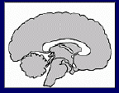
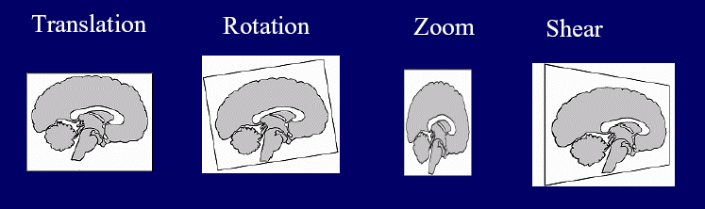
Normalisation: Procedure
Affine registration 12 dof
  Translations across axes (3 dof)
  Rotations around axes (3 dof)
  Scaling or Zooming (3 dof)
  Shearing or Skewing (3 dof)
A good start…

Slide 23
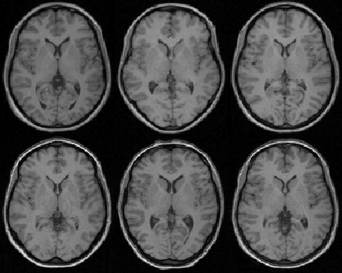
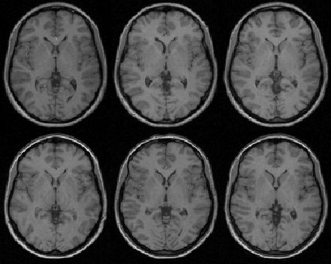
Normalisation- Warping
Applies non linear deformations/ displacements from original location to template location
Very Flexible
1000s of dof
Affine Registration
Non-linear Registration

Slide 24
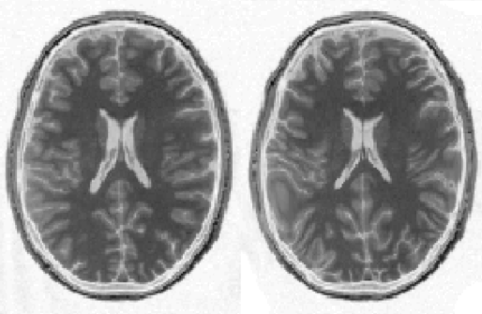
Normalisation- Overfitting
Flexibility of warping can lead to unrealistic results
Regularisation applies constraints
Non-linear registration
using regularisation.
Non-linear registration
without regularisation.

Slide 25
Normalisation- Compromise
We need to look at measures of similarity:
Mean squared difference
Squared difference between parameter and expected outcome
The ‘best’ parameters may be unrealistic
Important to use regularisation, to ensure a realistic outcome is found.

Slide 26
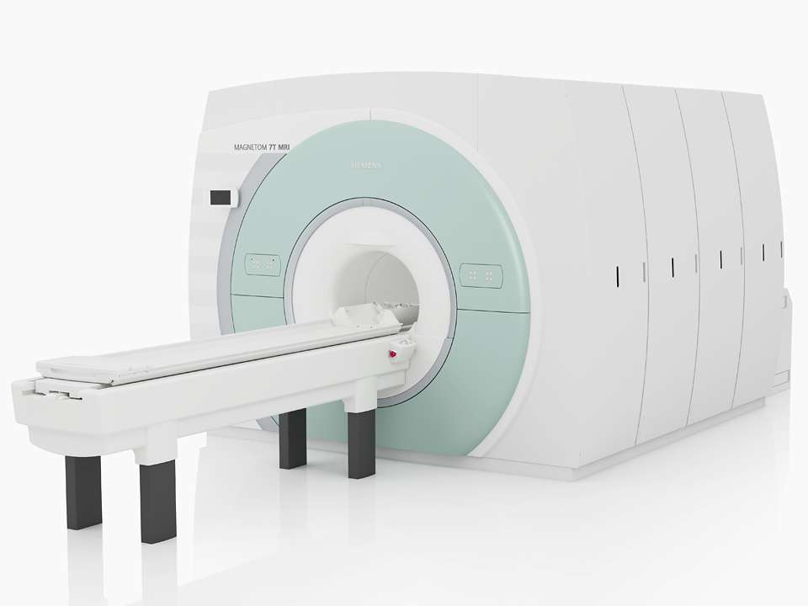
Unified Segmentation
MRI imperfections increase the difficulty of normalisation.
Noise artefacts
Intensity inhomogeneity, bias field
Differences in sequences
Partial Volume

Slide 27
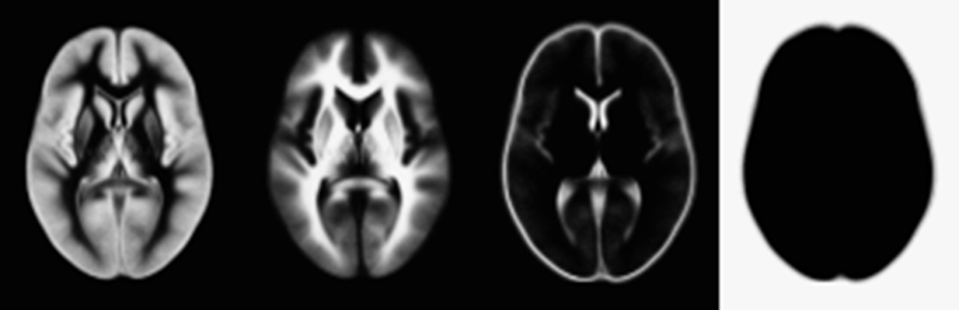
Unified Segmentation- TPMs
Segmenting subject images before normalising facilitates the normalisation process
Tissue Probability Maps- Standard space structural estimates of the location of GM and WM.
Based on multiple previous segmentations

Slide 28
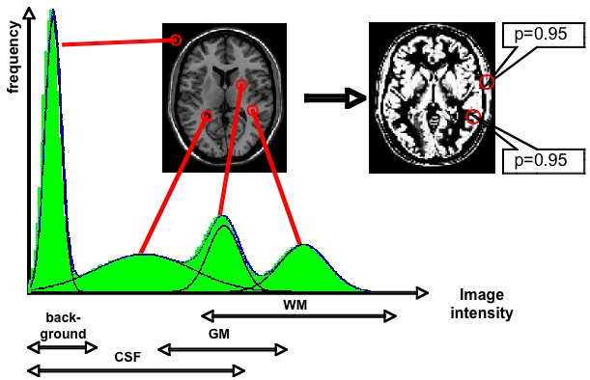

Gaussian Mixture Models
Tissue Probability Maps
+
Take each voxel and look at both it’s intensity and prior spatial knowledge, to make normalisation an easier problem to solve.

Slide 29
Unified Segmentation
Normalising segmented tissue maps to a template a much easier issue to solve than just matching image to template
Helps resolve MRI issues
Bias correction included to combat intensity inhomogeneity

Slide 30


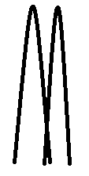
Smoothing
  Blurs over residual anatomical differences and registration errors
  Why?
  Suppresses noise
    signal reinforced and noise averaged out
  Superior special overlap
  Data becomes more normally distributed
  Increases sensitivity to effects of similar scale to kernel
VS

Slide 31
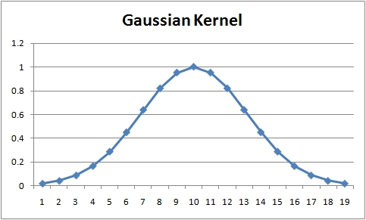
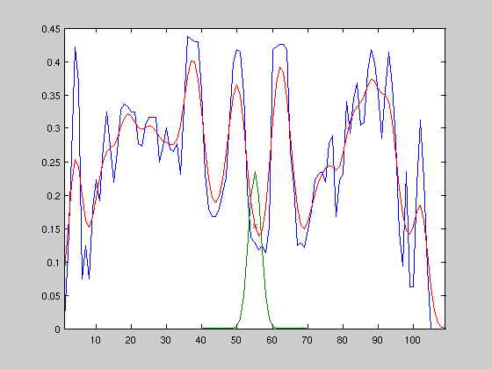
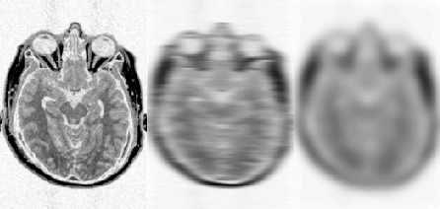
Smoothing
How?
Weighted averaging of neighbouring voxels
  → Each voxel replaced by the weighted average of itself and its neighbours

Slide 32
Smoothing: disadvantages
Reduction of spatial resolution of the data
Edge Artifacts
Merging
Extinction
Mislocalization of activation peaks

Slide 33
Keep in mind
Multiple data adjustments are made during fMRI analysis, and these alter the raw data considerably
  → Therefore, large sample sizes and appropriate statistical analyses are required for reliable and robust inferences

Slide 34
Summary
Coregistration links functional data with a structural image
  →Intrasubject
Normalisation links images from one subject to standardised space
→Intersubject
Smoothing blurs over any residual errors and anatomical differences

Slide 35
SPM
spm fmri (to open)
Ensure you have the correct version! (SPM 12) newest update October 2014
If in doubt start by pressing ‘Batch’
All these tools can be found under Batch→SPM→Spatial
Any images you input make sure are in the correct order (e.g. all prefixed by unique subject identifier, as SPM can’t order your data for you)
Save your batch files so you can retrace your steps
Ensure you have good file structure; SPM spews out tons of files….

Slide 36
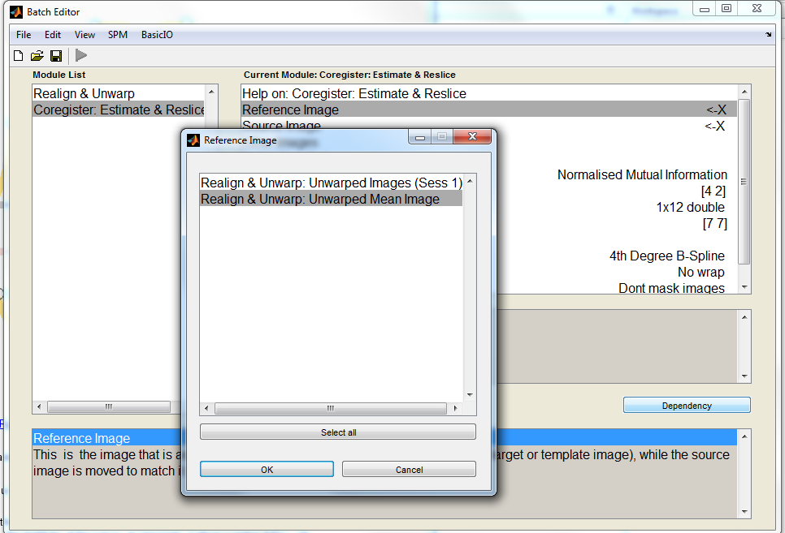
SPM
Reference image- (mean functional DEP image) that is assumed to remain stationary while source is moved to match it.
Source- structural MRI
-----------------------------Unless stated use defaults--------------------------

Slide 37
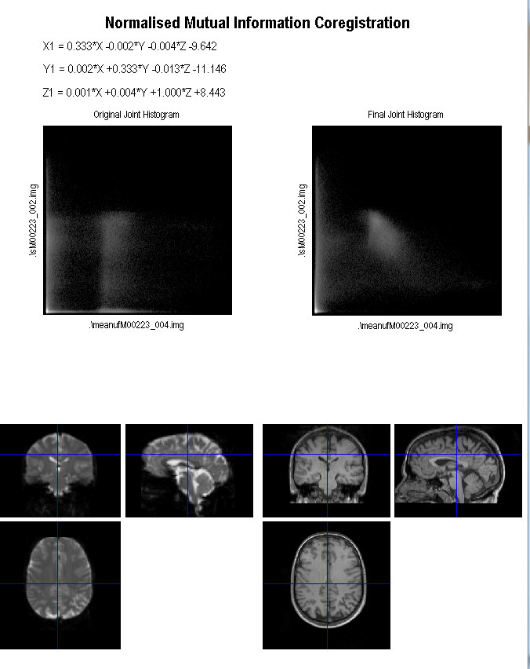
SPM- Coregistration Output
Very important to check your images- it automatically loads these up for you!

Slide 38
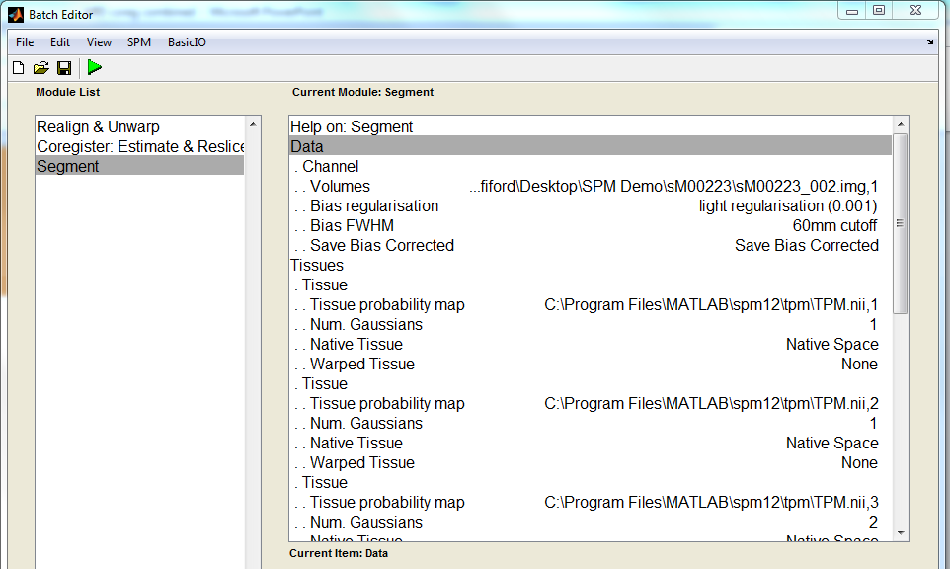
SPM- Segment 1
Data- use your structural image.
If using multiple inputs (e.g. T1 and PD weighted image) then ensure all are entered in in the same order.
Tissue 1=GM
Tissue 2=WM
Tissue 3=CSF
Save Bias Corrected.
TBC next slide

Slide 39
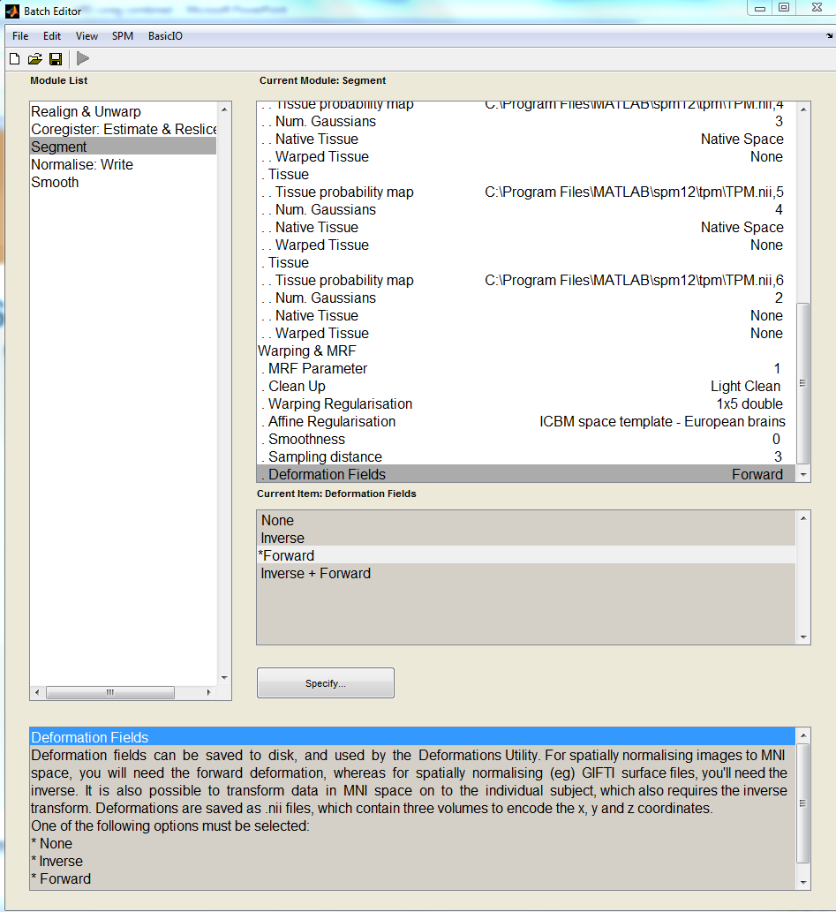
SPM- Segment 2
Scroll down
Data- Forward deformation fields needed for MNI normalisation

Slide 40
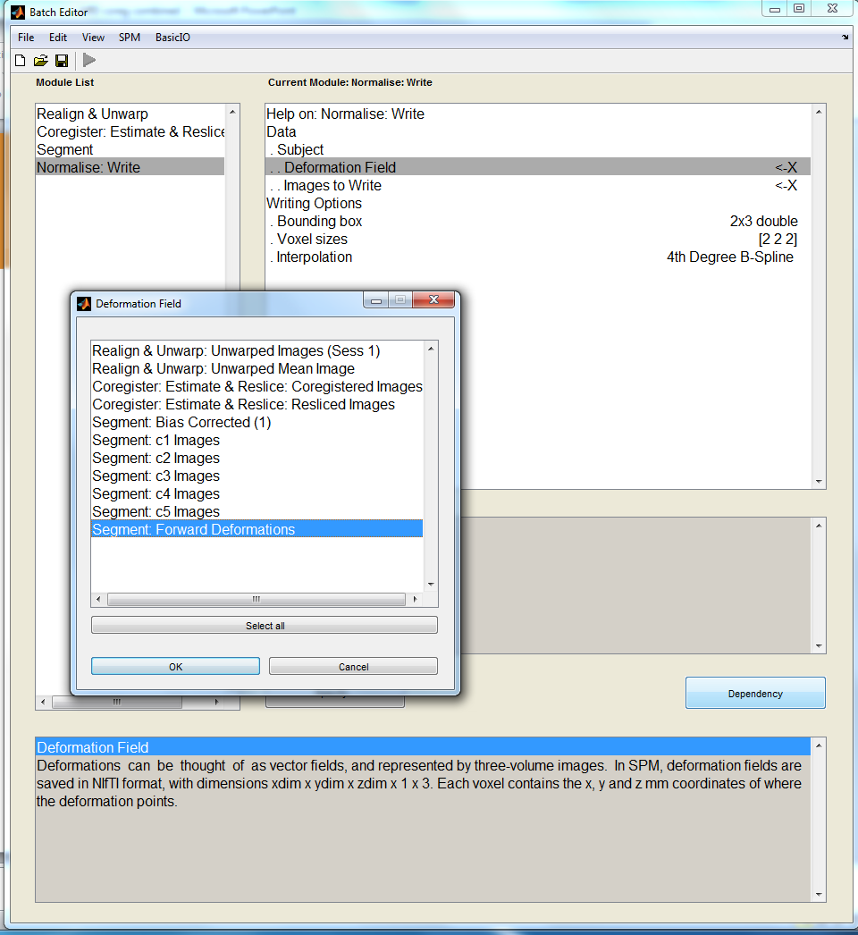
SPM
Use these forward deformations during the normalisation process.
Images to write= co-registered functionals

Slide 41
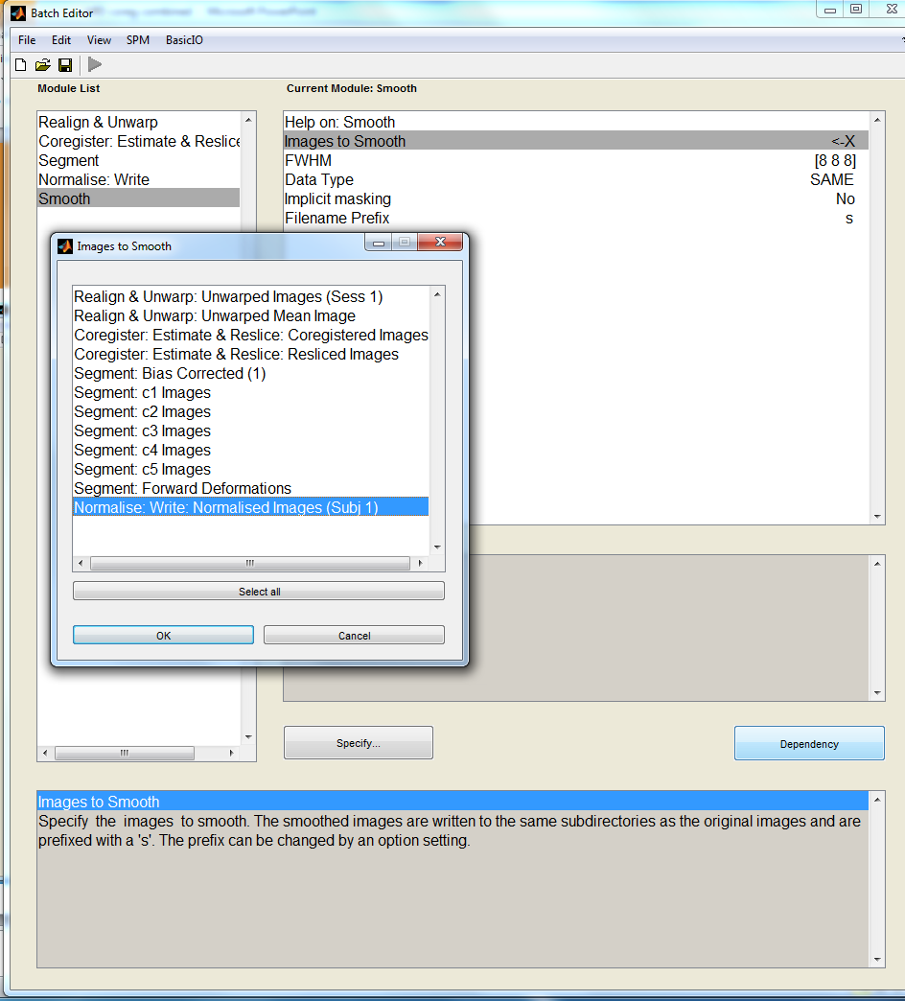
SPM
Smooth your normalised images
Choose your kernel width here

Slide 42
References
TPM
Ged’s Lecture
SPM Homepage
Mfd Resources 2013

Slide 43
THANK YOU Gabriel

