Slide 1

fMRI data pre-processing
Realigning and unwarping
Joaquín Navajas
Sarah Buck
2014
Methods for Dummies

Slide 2
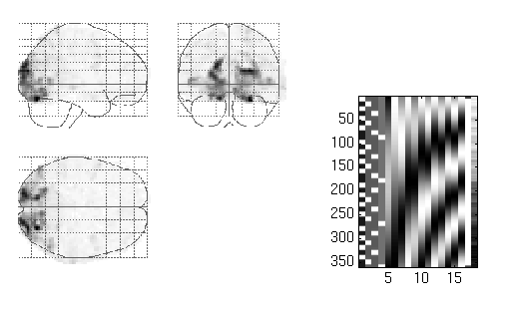
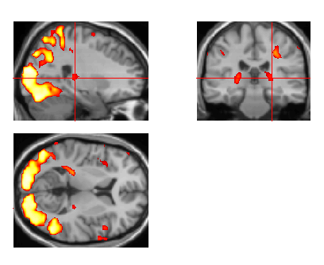

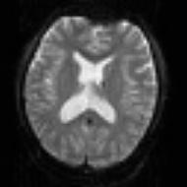
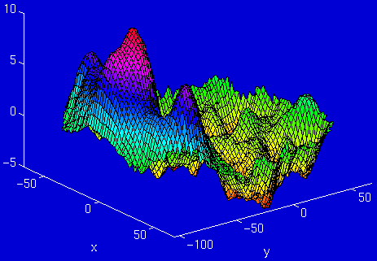
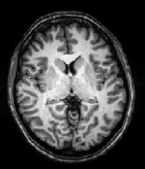
|
|
|
|
|
|
|
|
|
|
|
|
|
|
Pre-processing
fMRI time-series
Design matrix
Statistical Parametric Map
Motion
Correction
(and unwarping)
Smoothing
General Linear Model
Spatial
Normalisation
(including co-registration)
Parameter Estimates
Anatomical reference

Slide 3
Pre-processing in fMRI
4 pre-processing steps:
Realignment
Unwarping
Co-registration
  Linear transformation to combine functional and anatomical images for the same subject
Spatial normalisation
  Non-linear transformation to combine images from multiple subjects
  MNI space
  Make sure we look at the same brain over time
Notes:
Compare activations corresponding to the same part of the brain

Slide 4
Pre-processing in fMRI
4 pre-processing steps:
Realignment
Unwarping
Co-registration
  Linear transformation to combine functional and anatomical images for the same subject
Spatial normalisation
  Non-linear transformation to combine images from multiple subjects
  MNI space
  Make sure we look at the same brain over time
Notes:
Compare activations corresponding to the same part of the brain

Slide 5
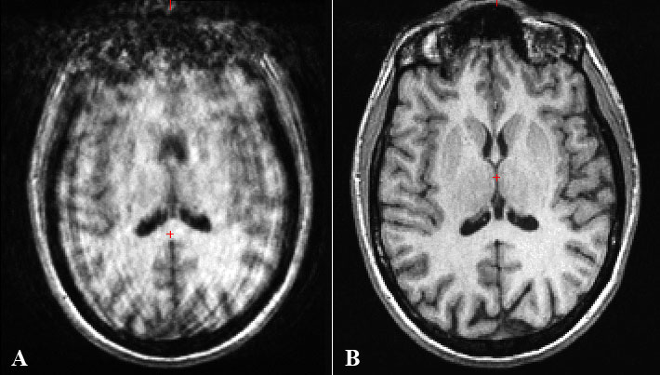
Pre-processing in fMRI
Signal in raw fMRI data is influenced by many factors other than brain activity
  Heart beat, respiration, head movement, etc.

Slide 6
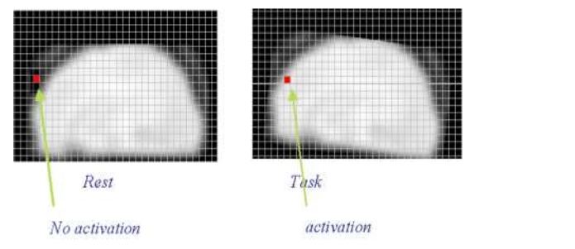
Motion in fMRI
Problem
  Increase residual variance
  Movement can be correlated with the conditions
  Reduce sensitivity

Slide 7
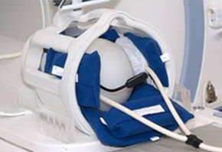
Motion in fMRI
Solution: Reduce movement
How?
  Prevention
    Short scanning sessions, instructions not to move, swallow etc., make subject comfortable, padding
  Correction
    Filter the data to remove these artefacts
    →Realigning
Soft padding

Slide 8
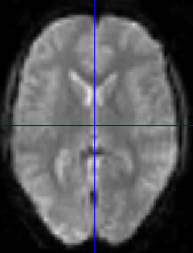
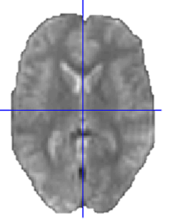
Realigning
Realign images acquired from the same subject over time
3D rigid-body transformation – size and shape of the brain images do not change
Images can be spatially matched
Two steps:
  Registration (estimate)
  Transformation (reslice)

Slide 9

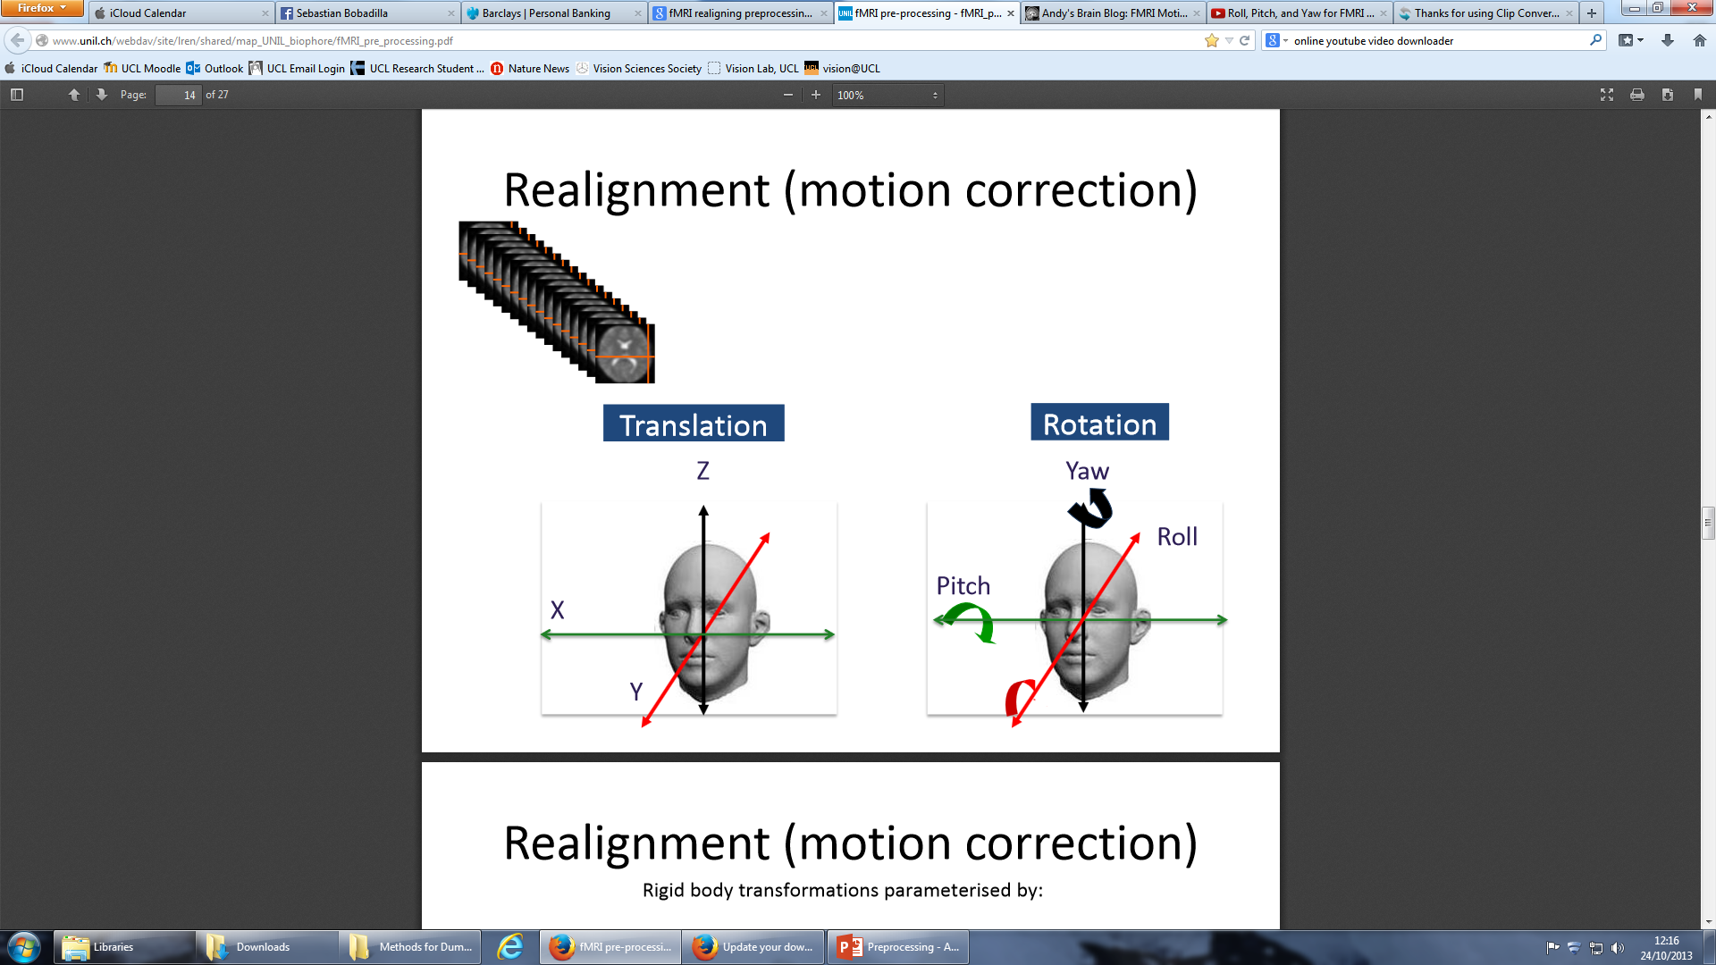
Realigning:
1. Registration
→Estimate 6 parameters for transformation between the source images and a reference image (1st image)
  3 translations (mm)
  3 rotations (degrees)
Rotation
Translation

Slide 10
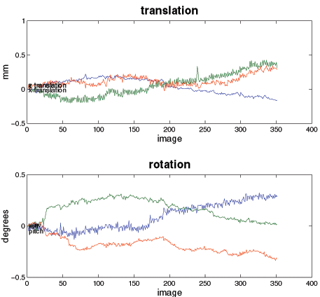
Realigning:
1. Registration
Estimation of the transformation parameters for each image, in SPM
The transformations can be represented as matrices, and are multiplied together
Translations
Pitch
about X axis
Roll
about Y axis
Yaw
about Z axis

Slide 11
Realigning:
2. Transformation
→Apply the transformations to the functional images
Each image is matched to the first image of the time series
Mean of these aligned images
fMRI time series
Motion corrected
Mean functional
Notes:
Mean functional image will also be used at a later stage (coregistration) to combine functional and anatomical images

Slide 12
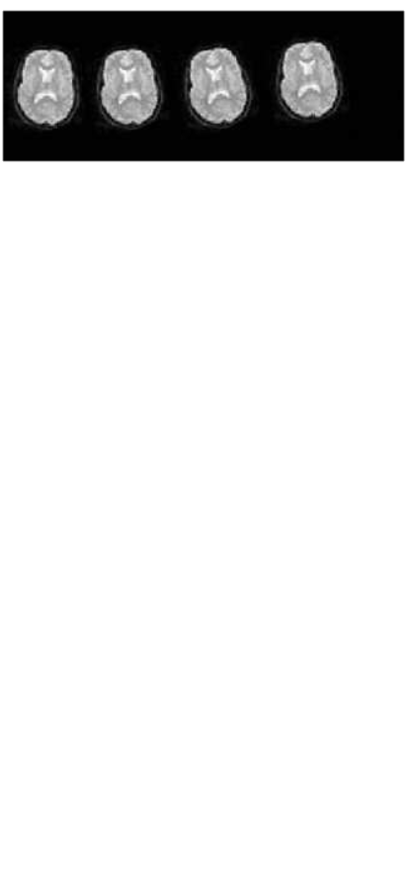
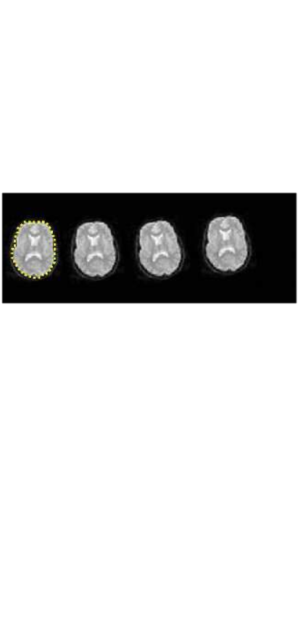
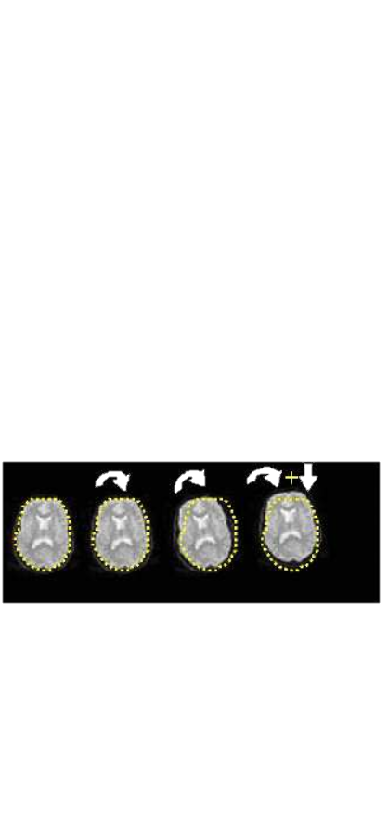
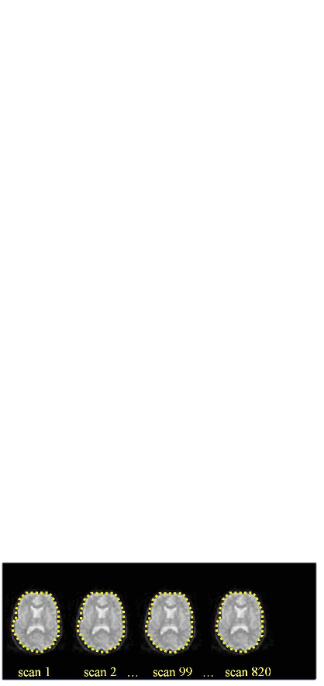
Realigning:
2. Transformation
Head movement
Calculate position of the brain for the 1st slice
Estimate transformation parameters based on 1st slice
Apply the transformation parameters on each slice

Slide 13
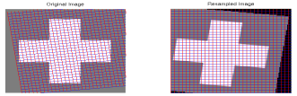
Realigning:
2. Transformation
Re-sample (re-slice) source image onto the same grid of voxels as the reference image
Need to fill in the gaps
Determine values of the new voxels
    →Interpolation

Slide 14
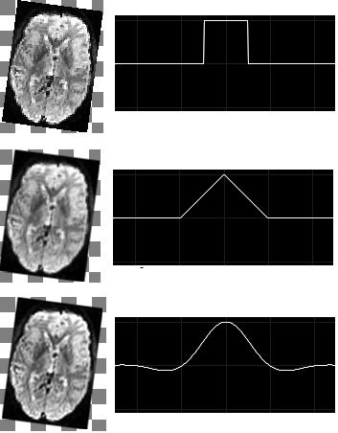
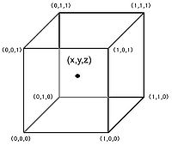
Realigning:
2. Transformation - Interpolation
Simple interpolation
  Nearest neighbour: take the intensity of the closest voxel
  Tri-linear: take the average of the neighbouring voxels
B-spline
  Better solution
  Used in SPM
Notes:
→ The voxel that we are trying to determine with interpolation

Slide 15
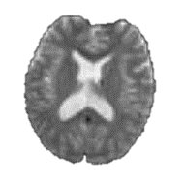
Realigning:
2. Transformation
Put in slideshow mode to understand the process!
Original image
Resampled image
After having realigned, we need to determine the intensity of each new voxel
Realign
Original voxels
New voxels to determine after realigning
For example, want to determine this voxel
3 types of interpolation possible:
  Nearest Neighbour
  Trilinear
  B-Spline
Original voxel
New voxel to identify

Slide 16
Pre-processing in fMRI
4 pre-processing steps:
Realignment
Unwarping
Co-registration
  linear transformation to combine functional and anatomical images for the same subject
Spatial normalisation
  Non-linear transformation to combine images from multiple subjects
  Make sure we look at the same brain over time

Slide 17
After realignment…we’re not quite done
Even after realignment, there is still a lot of variance that is explained by movement (“movement-related residual variance”, or just “residual variance”)
This can lead to two problems, especially if movements are correlated with the task:
  Loss of sensitivity (we might miss “true” activations)
  Loss of specificity (we might have false positives)

Slide 18
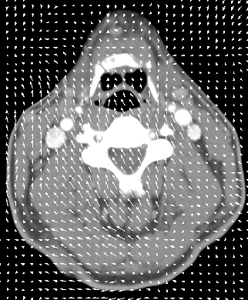
Why do we have “residual variance”?
Many different sources of movement-related variance
  SPM tackles one of them
Different materials (e.g., air, gray matter, white matter) have different susceptibility (χ), producing a field inhomogeneity
A deformation field gives you the strength and direction of deflections in the magnetic field relative to the object
This deformation is particularly large when there is an air-tissue interface
  Orbitofrontal cortex
  Medial temporal lobe

Slide 19

Why do we have “residual variance”?

Slide 20
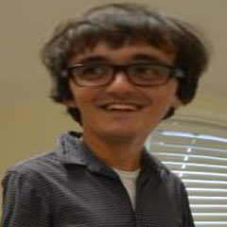
Why do we have “residual variance”?

Slide 21
Why do we have “residual variance”?

Slide 22
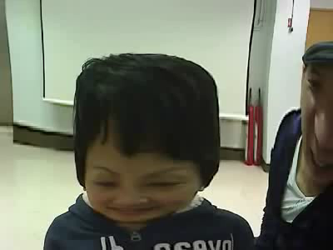
“Susceptibility-by-movement” unwarping
How to reduce these distortions?
  → Measure the distortion field with Fieldmap
What does the Unwarp toolbox of SPM?
  → Eliminate the variance that comes from “moving in front of the funny mirror” (susceptibility-by-movement variance)

Slide 23
“Susceptibility-by-movement” unwarping
Direct Problem
How much the deformation field changes with movement (i.e., spatial derivatives of the deformation field)
Variance in the Time Series
+
Movements
Inverse Problem
How much the deformation field changes with movement (i.e., spatial derivatives of the deformation field)
(Estimated)
Movements
Variance in the Time Series
+

Slide 24
What derivatives should we model?
B₀(θ, ϕ) = B₀ (Δθ, Δϕ) + [(δB₀/ δϕ) Δϕ + (δB₀/ δθ ) Δθ]
Static Field
Derivatives with respect to “Pitch” and “Roll”
x
Laws of Physics tell you that only θ and ϕ matter, but for a constant field!
y
B₀
ϕ
θ
z
In practice, adding any of the other 4 degrees of freedom (3 translations + “Yaw”) doesn’t add much (i.e., most of the variance is explained by “Pitch” and “Roll”)
UNWARP in SPM let you include the second derivatives in this model, but in practice this is rarely useful

Slide 25
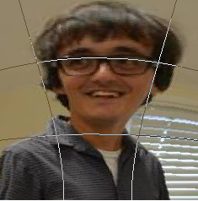
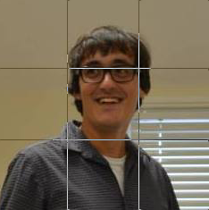
What derivatives should we model?
B₀(θ, ϕ) = B₀ (Δθ, Δϕ) + [(δB₀/ δϕ) Δϕ + (δB₀/ δθ ) Δθ]
Static Field
Derivatives with respect to “Pitch” and “Roll”
The image is therefore re-sampled
assuming voxels, corresponding to
the same bits of brain tissue under such deformation field

Slide 26
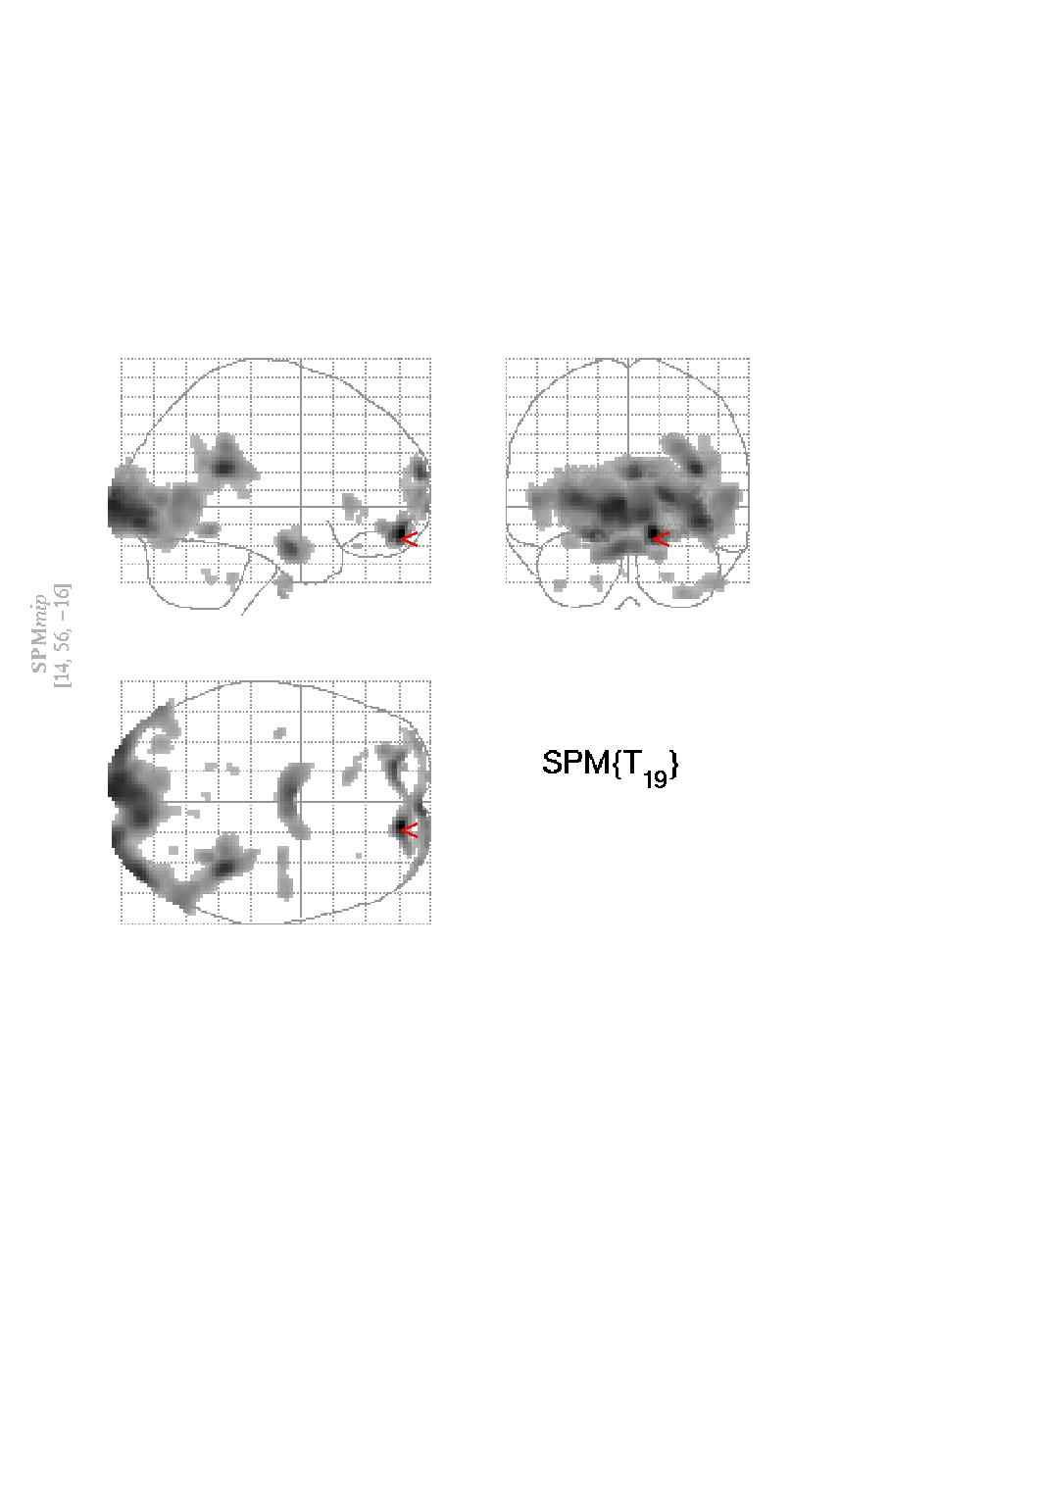
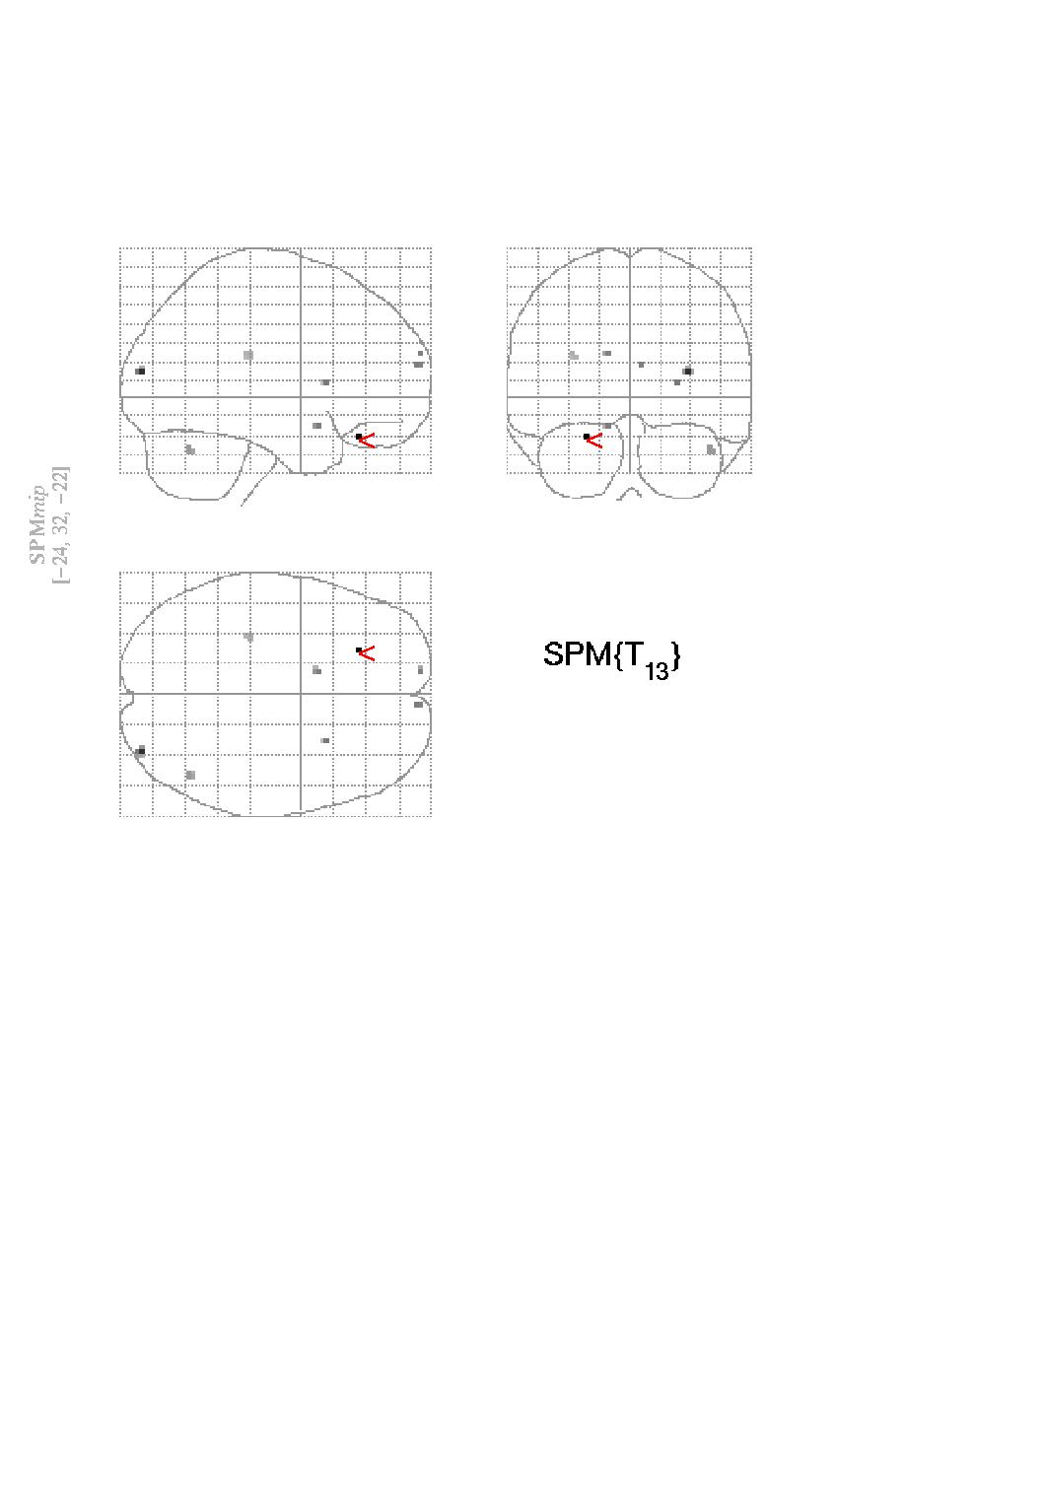
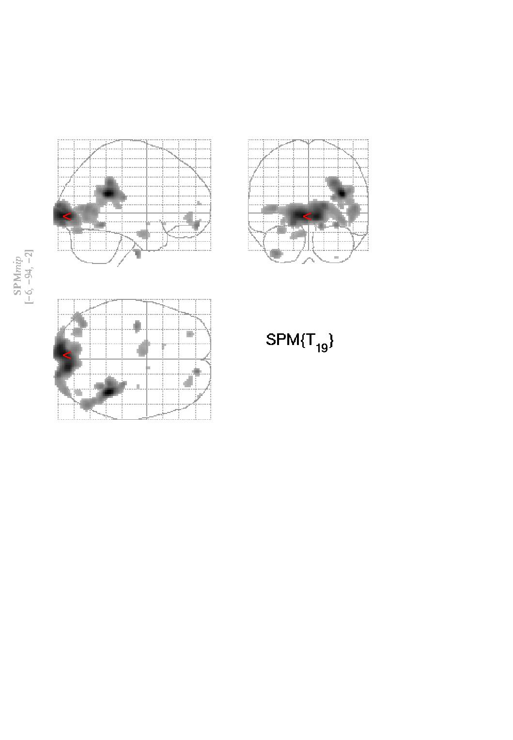
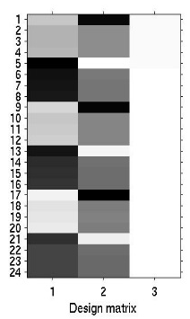
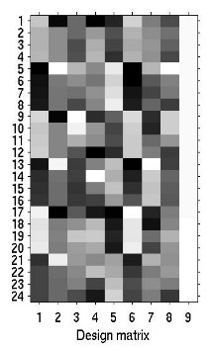

When and why should I use UNWARP?
If there is considerable movement in your data (> 1 mm or > 1 deg) then UNWARP can remove SOME of the unwanted variance without removing “true” activations.
No correction
Correction by covariation
Correction by Unwarp
t_{max}=13.38
t_{max}=5.06
t_{max}=9.57

Slide 27
When and why should I use UNWARP?
If there is considerable movement in your data (> 1 mm or > 1 deg) then UNWARP can remove SOME of the unwanted variance without removing “true” activations.
Limitations
It doesn’t remove movement-related residual variance coming from other sources, such as:
Susceptibility-dropout-by-movement interaction
Spin-history effects
Slice-to-vol effects

Slide 28
Realign & Unwarp Summary
3 issues covered:
  Rigid-Body Motion (Realign)
  Deformations (Field Map)
  Interactions Movement-Deformation (Unwarp)

Slide 29
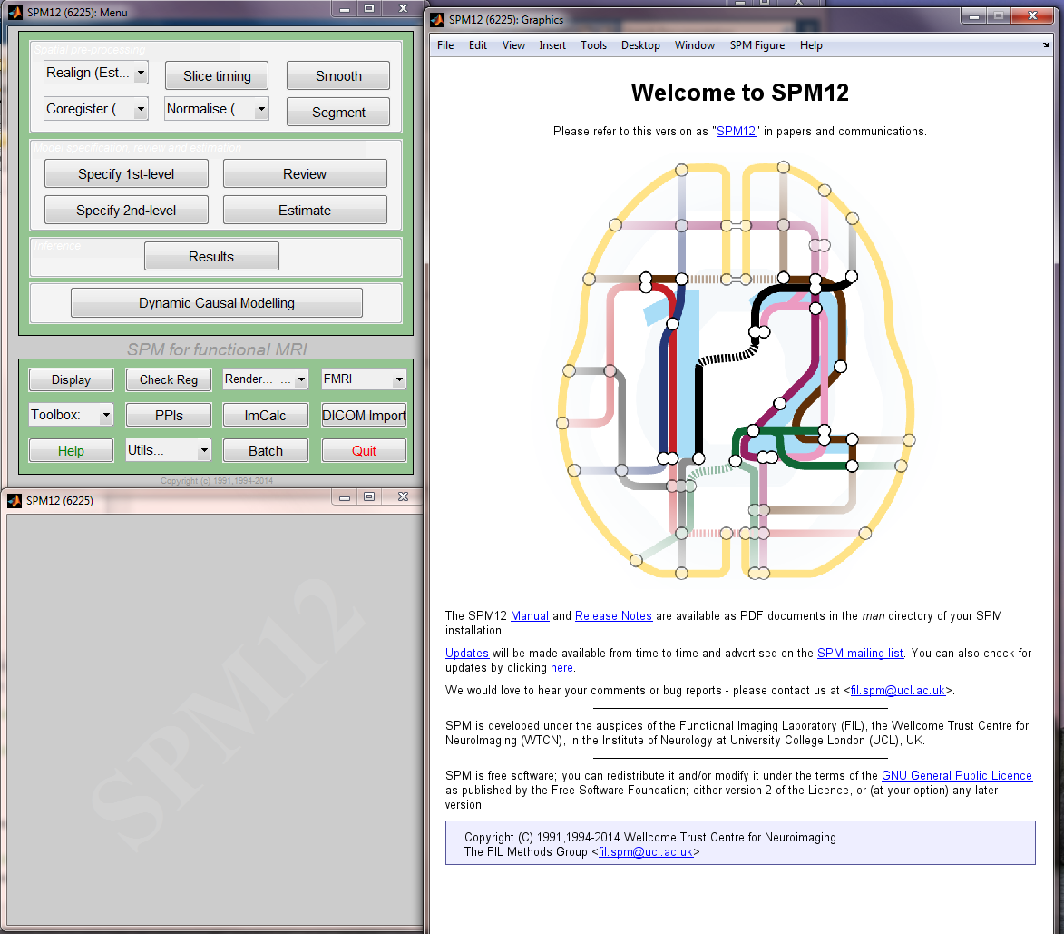
Realign & Unwarp Summary

Slide 30
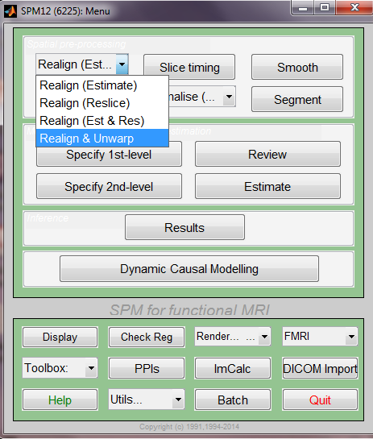
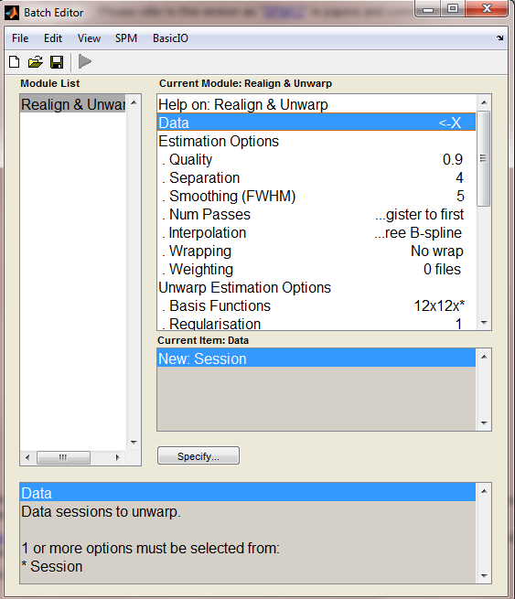
Realign & Unwarp Summary

Slide 31
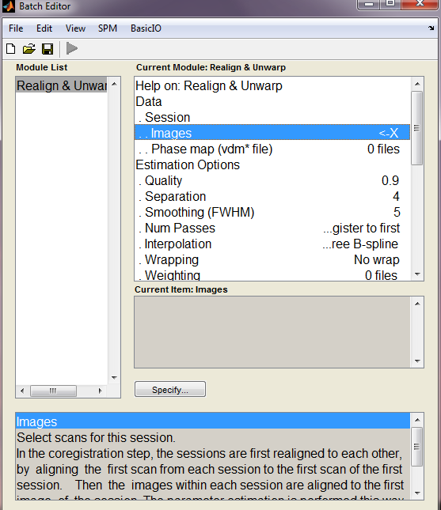
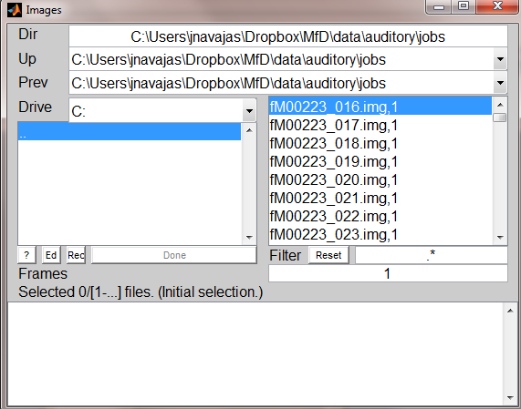
Realign & Unwarp Summary

Slide 32
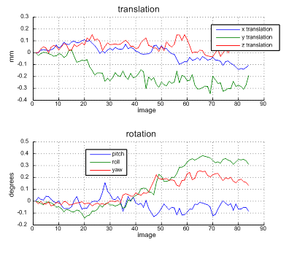
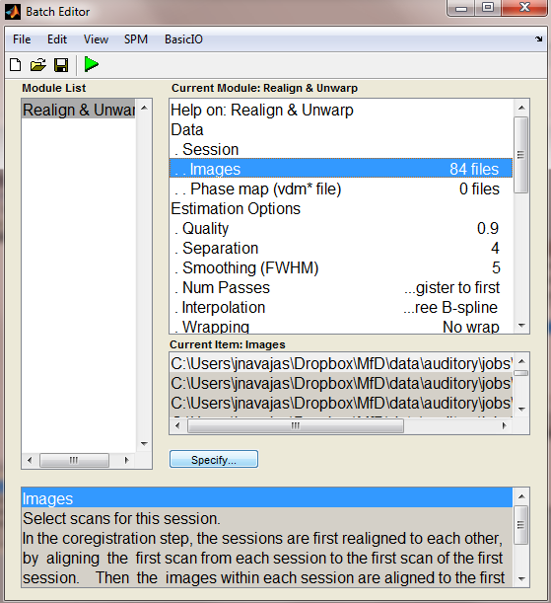
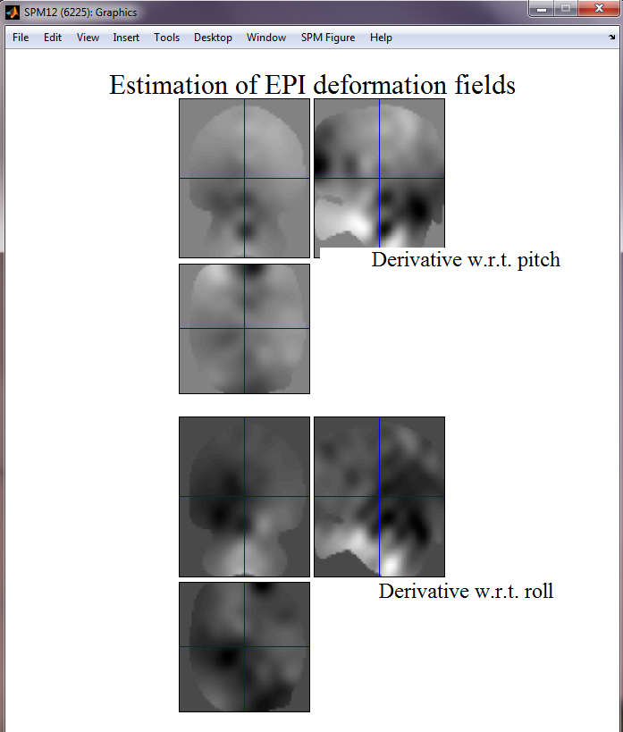
Realign & Unwarp Summary

Slide 33
References - Realigning
Ashburner & Friston. Rigid Body Registration. Chapter.
Previous years’ MdF presentations
Ged Ridgway (2010). UBC SPM Course 2010. http://www.pet.ubc.ca/sites/default/files/01_Spatial_Preprocessing.pdf
Guillaume Flandin (2012). fMRI Preprocessing http://info.vtc.vt.edu/spmclass/01_Preprocessing.pdf
Andrew Jahn. Andy’s Brain Blog http://andysbrainblog.blogspot.co.uk/2012/10/fmri-motion-correction-afnis-3dvolreg.html
Matthijs Vink (2007). Preprocessing and Analysis of Functional MRI data. Rudolf Magnus Institute of Neuroscience.

Slide 34
References - Unwarping
SPM toolbox tutorial: http://www.fil.ion.ucl.ac.uk/spm/toolbox/unwarp/
Paper presenting the method behind UNWARP:
Andersson JLR, Hutton C, Ashburner J, Turner R, Friston K (2001). Modelling geometric deformations in EPI time series. NeuroImage 13:90-919
Previous years’ MfD slides
General about movement-relates issues:
Friston KJ, Williams SR, Howard R, Frackowiak RSJ and Turner R (1995). Movement-related effect in fMRI time-series. Magn Reson Med 35:346-355

