Slide 1
Methods for Dummies 2014/2015
fMRI Experiment Design & Efficiency
Evan Wright-Goff & Cheng Chen
14/01/2015

Slide 2
fMRI Experiment Design & Efficiency
Design for Experimental Paradigm
Design for Timing Protocol
Design Efficiency

Slide 3
fMRI Experiment Design & Efficiency
Design for Experimental Paradigm
Subtraction Design
Factorial Design
Parametric Design
Repetition Suppression
Multi-voxel Pattern Analysis
Design for Timing Protocol
Design Efficiency

Slide 4
fMRI Experiment Design
Design for Experimental Paradigm
Subtraction Design
Activity for P = Activity for task ( P+P₀ ) - Activity for task ( P₀ )
P, P₀ : cognitive component
Factorial Design
Factor M
M1
M2
Main effect for M: (C+D) – (A+B)
N1
Task A | Task D
Task B | Task C
Main effect for N: (B+C) – (A+D)
Factor N
N2
Interaction between M and N: (C-D) – (B-A)
Parametric Design
X, stimulus parameters or model-based variables
Activity = F(X)
F, function, either linear, or non-linear

Slide 5
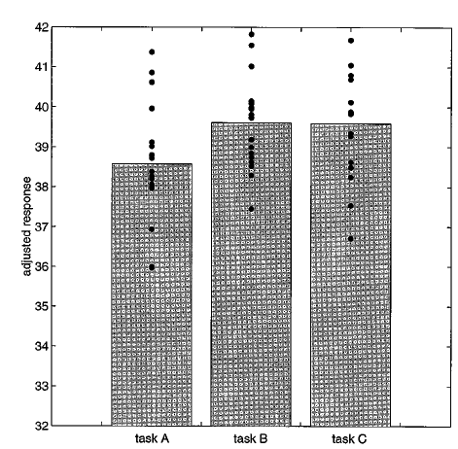
Example for Subtraction & Factorial Design
Research question:
Is the inferotemporal region implicated in
phonological retrieval during object naming?
Subtraction Design
Say yes
Naming
Visual analysis (V)
Task A = S + V
Colored shape
Task A
Task B | Task C
Object recognition (O)
Task B = S + V + O
Speech (S)
Colored object
Phonological retrieval (P)
Task C = S + V + O + P
Area responsible for O: B-A
Area responsible for P: C-B
Conclusion: Inferotemporal cortex is not responsible
for the phonological retrieval.
The assumption of ‘pure insertion’ ! True or not?
(object recognition is the same, irrespective of whether
phonological retrieval is present or not ? )
(Friston et al, 1996)

Slide 6
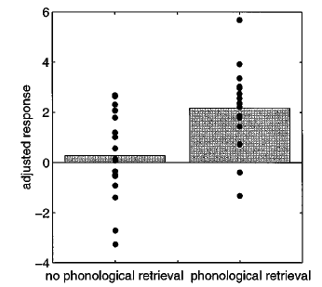
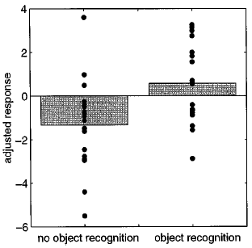
Example for Subtraction & Factorial Design
Research question:
Is the inferotemporal region implicated in
phonological retrieval during object naming?
ç
Factorial Design
Say yes
Naming
Visual analysis (V)
Task A = S + V
Colored shape
Task A | Task D
Task B | Task C
Object recognition (O)
Task B = S + V + O
Speech (S)
Task C = S + V + O + P
Colored object
Phonological retrieval (P)
Task D = S + V + P
Interaction between O and P:
(C-D) – (B-A)
Main effect for object recognition:
(B+C) – (A+D)
Main effect for phonological
retrieval: (C+D) – (A+B)
B-A
C-D
D-A
C-B
Conclusion: the inferotemporal region is involved in phonological retrieval,
during object naming, despite P itself does not activate this region.
(Friston et al, 1996)

Slide 7
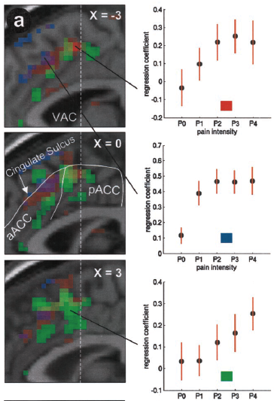
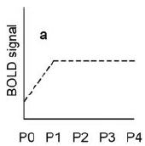
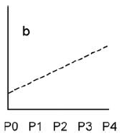
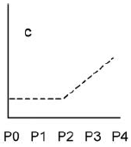
X, stimulus parameters or model-based variables
ç
Activity = F(X)
F, function, either linear, or non-linear
Example for Parametric Design (Stimulus Parameter)
Research question: How to dissociate the neural responses related to pain intensity, stimulus intensity, and stimulus awareness within the anterior cingulate cortex?
Stimulus Response Function (SRF)
stimulus
awareness
BOLD signal
stimulus
intensity
BOLD signal
pain intensity
(Büchel et al, 2002)

Slide 8
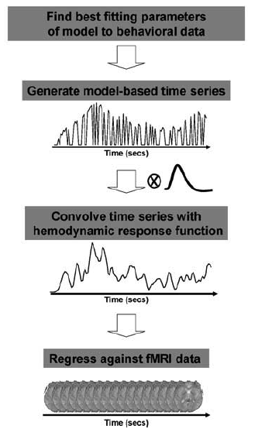
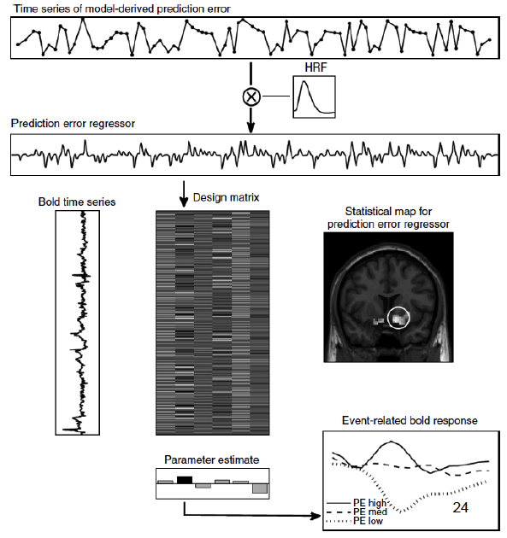
Example for Parametric Design (Model-based fMRI)
Research question: Encoding of prediction error in human brain?
(O’Doherty JP,2007)
(Gläscher JP & O’Doherty JP,2010)

Slide 9
fMRI Experiment Design
Design for Experimental Paradigm
Subtraction Design
Activity for P = Activity for task ( P+P₀ ) - Activity for task ( P₀ )
P, P₀ : cognitive component
Factorial Design
Factor M
M1
M2
Main effect for M: (C+D) – (A+B)
N1
Task A | Task D
Task B | Task C
Main effect for N: (B+C) – (A+D)
Factor N
N2
Interaction between M and N: (C-D) – (B-A)
Parametric Design
X, stimulus parameters or model-based variables
Activity = F(X)
F, function, either linear, or non-linear

Slide 10
fMRI Experiment Design & Efficiency
Design for Experimental Paradigm
Subtraction design
Factorial design
Parametric design
Repetition Suppression
Multi-voxel Pattern Analysis
Design for Timing Protocol
Design Efficiency

Slide 11
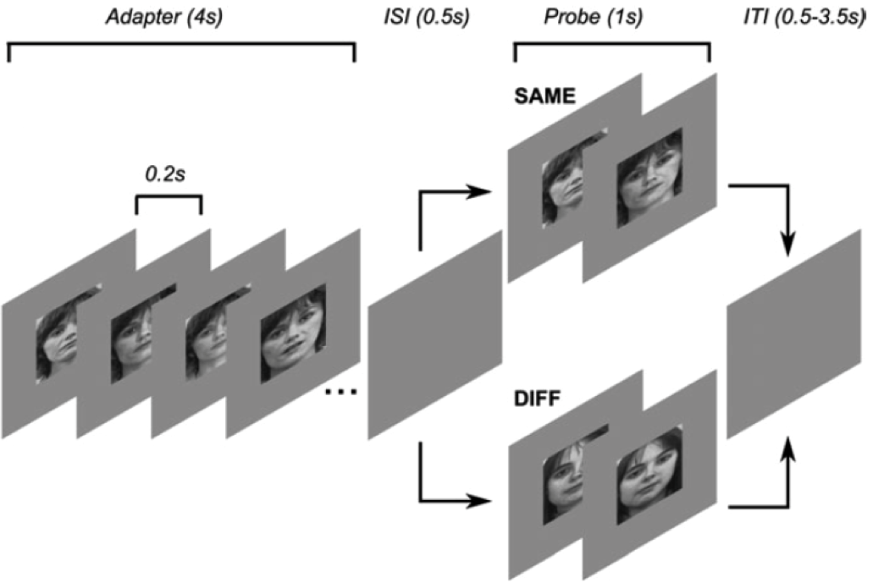
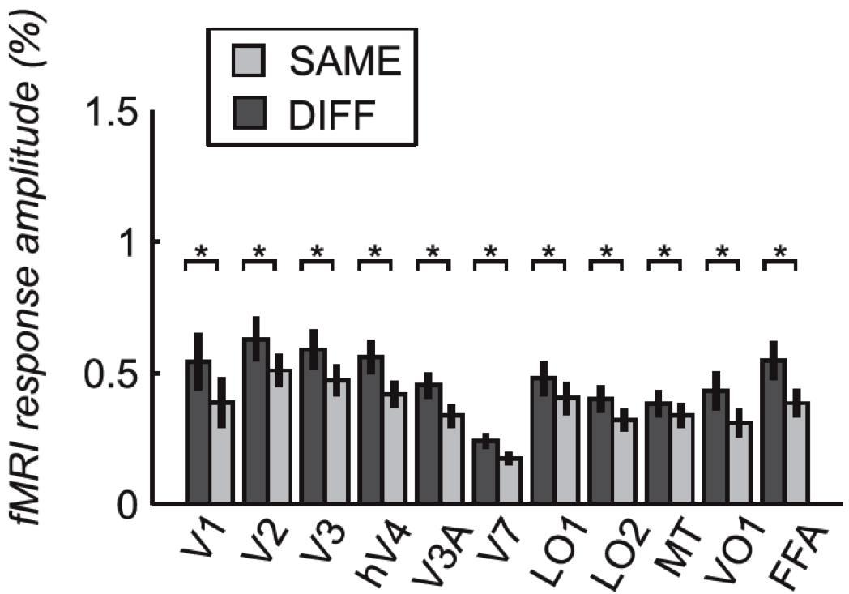
Repetition Suppression
The assumption of neural adaptation.
Compare the response for stimulus pairs:
A•A < A•B ~ Response Selectivity
Research question: where are the areas responding to face ?
Face A
A•A
A•B
Face B
Face A
(Larsson & Smith, 2012)

Slide 12
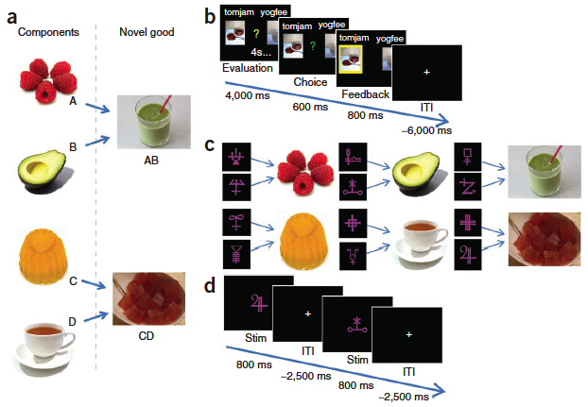
Repetition Suppression (Another Example)
Research question: whether subjects constructed a novel representation of the new compound
by explicitly combining the representations of each component and, if so, which brain regions
support this construction process ?
A. AB ? C. AB
A. B ? C. B
(Barron HC, et al, 2013)

Slide 13
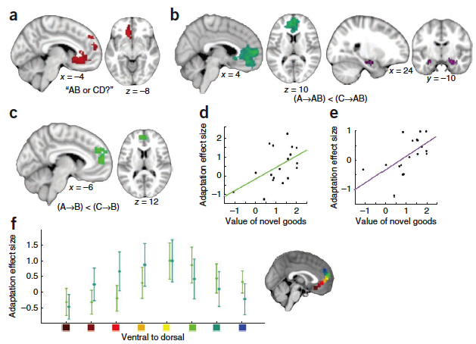
Repetition Suppression (Another Example)
Research question: whether subjects constructed a novel representation of the novel compound
by explicitly combining the representations of each component and, if so, which brain regions
support this construction process ?
Response Suppression
Response Suppression
(Barron HC, et al, 2013)

Slide 14
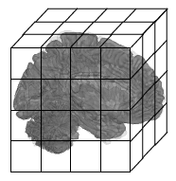
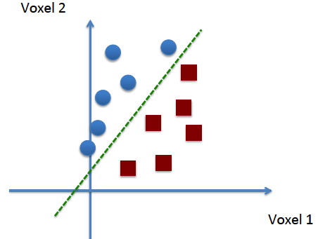
Multi-voxel Pattern Analysis (MVPA)
f, classifier
Stim./State Class A
Stim./State Class B
Class A or B?
(f, classifier; y, class label)
(w, weight; b, threshold)
(Adapted from Martin Lindquist’s fMRI course on Cousera)

Slide 15
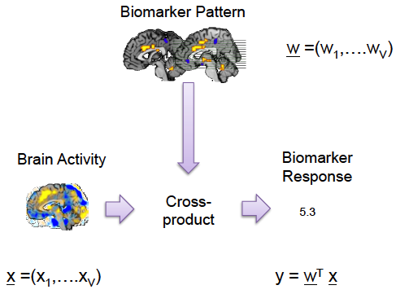
Multi-voxel Pattern Analysis (MVPA)
Step 1. Decide the f, classifier
(w, vector of weight for selected voxels)
Step 2. Predict the class label
threshold
(x, vector of activity for selected voxels)
(y, class label)
(Adapted from Martin Lindquist’s fMRI course on Cousera)

Slide 16
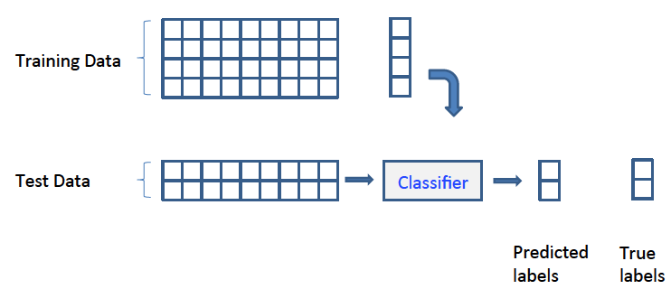
Multi-voxel Pattern Analysis (MVPA)
(f, classifier; y, class label)
Step 1. Decide the f, classifier
A
B
B
A
Step 2. Predict the class label
A
A
B
B
(Adapted from Martin Lindquist’s fMRI course on Cousera)

Slide 17
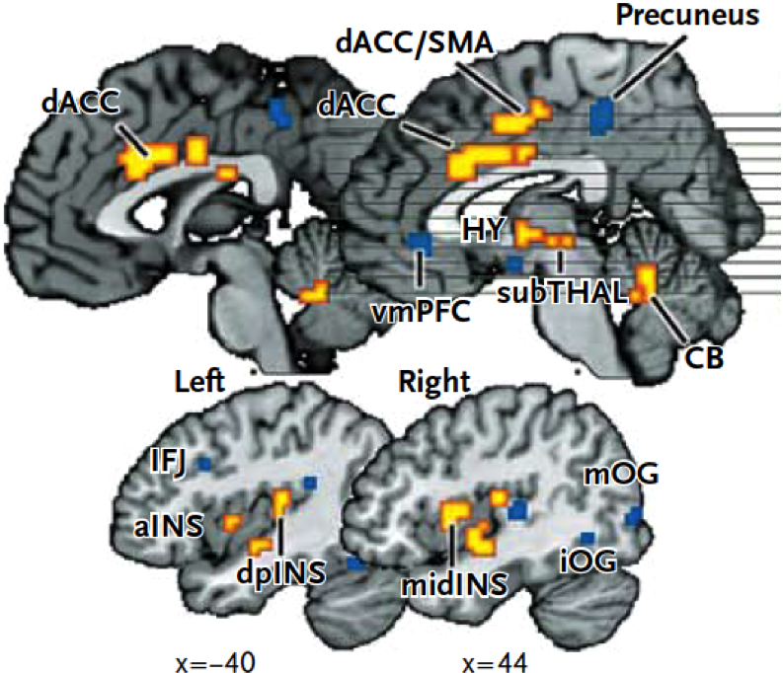
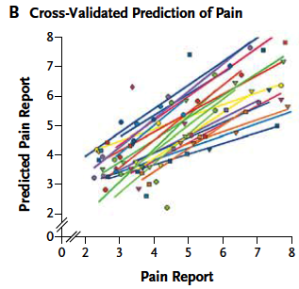
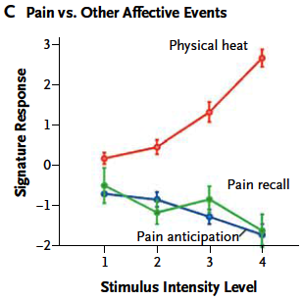
Multi-voxel Pattern Analysis (MVPA)
(Wager TD, et al, 2013)

Slide 18
fMRI Experiment Design & Efficiency
Design for Experimental Paradigm
Subtraction Design
Factorial Design
Parametric Design
Repetition Suppression
Multi-voxel Pattern Analysis
Design for Timing Protocol
Design Efficiency

Slide 19
fMRI Experiment Design & Efficiency
Design for Experimental Paradigm
Design for Timing Protocol
Block Design
Event-related Design
Mixed Design ( block + event )
Design Efficiency

Slide 20
Block Design
Event-related Design
Task Block 1
Task Block 2
Achieve high efficiency by
collapsing across many trials
to attain an adequate signal-to-noise ratio.
Suited for detecting regions of interest (ROI) for particular tasks.
Good for experimental tasks that do not fit into a trial-by-trial framework.
PROS
Good at detecting trial/event related activity within a task, eg correct & incorrect trials, and different
components within a trial, eg cue onset, decision, et al.
Can not distinguish between trial types within a block (e.g., correct versus error trials), nor can they identify interesting within trial or across trial events.
Average both positive and negative
response
Ignore the sustained activity that begins and ends with the performance of the task.
Decrease of signal-to-noise.
More dependent on accurate HRF modelling.
CONS
(Petersen & Dubis, 2012; Donaldson, 2004)

Slide 21
Mixed design ( block + event )
A combination of block and event-related designs can provide information relating to ‘maintained’ versus ‘transient’ neural activity during paradigm performance.
Cons:
Involves more assumptions than other designs.
Issues associated with poorer HRF shape estimation.
Post hoc analysis of behaviour correlated activation.
Power considerations.
Pros:
Item-related pattern of information processing (transient activity).
Task-related information processing (sustained activity).
(Petersen & Dubis, 2012, MfD 23/01/2013 slide)

Slide 22
fMRI Experiment Design & Efficiency
Design for Experimental Paradigm
Design for Timing Protocol
Design Efficiency
Signal Processing
Fourier Transformation
High-pass Filtering
Timing
General Advice

Slide 23
Terminology
Trial- Replications of an experimental condition.
Inter-Trial Interval (ITI)- Time between onset of successive trials.
Stimulus Onset Asynchrony (SOA)- Time between the onset of components.
Inter-Stimulus Interval (ISI)- Time between the offset of one component and the onset of the next.

Slide 24
Efficiency Equation
Y = x . β + ε
Efficiency is measured by our ability to estimate β, given the design matrix for a chosen contrast (c)
e(σ², c, X) = {σ²c^{T}(X^{T}X)⁻¹c}⁻¹
σ² noise variance, (X^{T}X)⁻¹ design variance
Observed Data
Design Matrix
Parameters
Error

Slide 25
BOLD Impulse Response
A BOLD response to an impulse (brief stimulus) typically has a
Peak at ~4-6seconds
Undershoot from 10-30 seconds (approximately)
Peak Response
Undershoot

Slide 26
Predicted Response
The BOLD response predicted by convolving the neural signal with a Canonical HRF.

Slide 27
Linear Convolution Model- Fixed SOA
Fixed SOA- 16s
Fixed SOA- 4s

Slide 28
Linear Convolution Model- Stochastic Design
Random Design
Blocked Design

Slide 29
Fourier Transformation
Notes:
Fourier transform time and frequency domains (small)" by Lucas V. Barbosa - Own work. Licensed under Public Domain via Wikimedia Commons - http://commons.wikimedia.org/wiki/File:Fourier_transform_time_and_frequency_domains_(small).gif#mediaviewer/File:Fourier_transform_time_and_frequency_domains_(small).gif
Convolution in time equivalent to multiplication in frequency space

Slide 30
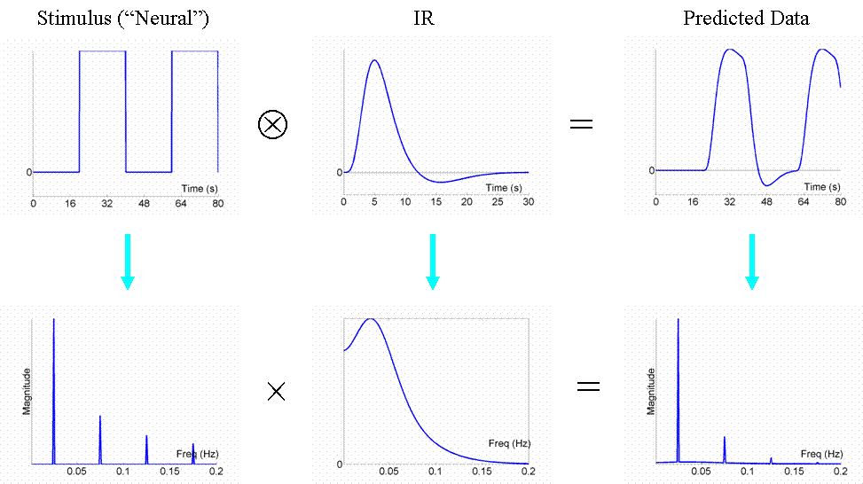
Fourier Transformation
Can regard the neural activity as our original data and the IR as a "filter”
filter will "pass" low frequencies, but attenuate higher frequencies

Slide 31
Most Efficient Design
Modulate neural activity in sinusoidal fashion with a frequency that matches the amplitude spectrum of the IR filter.

Slide 32
Most Efficient Design

Slide 33
Highpass Filtering
fMRI noise has 2 main components:
Low-frequency "1/f" noise
Background "white" noise

Slide 34
Result of Filtering
"chunk" of low-frequencies removed from the IR filter
in this design (1/160s ~ 0.006 Hz) is lower than the highpass cutoff, a large proportion of signal energy is lost

Slide 35
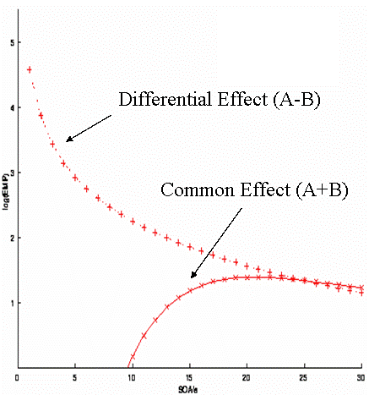
Timing
In randomised, stochastic design:
short SOA is optimal for Differential effect
Longer SOA is optimal for main/common effect

Slide 36
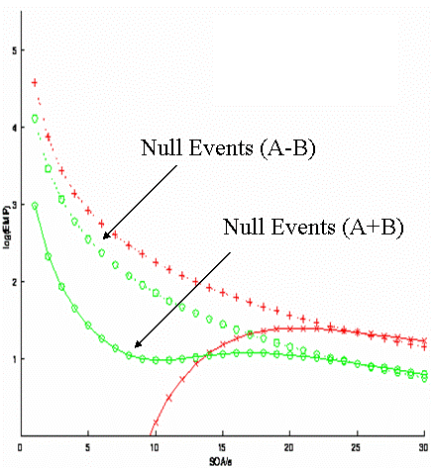
Timing: Null Events
‘Buy’ us efficiency

Slide 37
General Advice
Scan for as long as possible
Keep the subject as busy as possible
Do not contrast trials far apart in time
Randomise the SOA of trials close together in time

Slide 38
fMRI Experiment Design & Efficiency
Design for Experimental Paradigm
Subtraction Design
Factorial Design
Parametric Design
Repetition Suppression
Multi-voxel Pattern Analysis
Design for Timing Protocol
Block Design
Event-related Design
Mixed Design ( block + event )
Design Efficiency
Signal Processing
Fourier Transformation
High-pass Filtering
Timing
General Advice

Slide 39
Acknowledgements
Thank you to Dr Tom Fitzgerald for his guidance on the preparation of this presentation.

Slide 40
References
http://imaging.mrc-cbu.cam.ac.uk/imaging/DesignEfficiency
Previous MfD Slides
Friston, K. J., C. J. Price, P. Fletcher, C. Moore, R. S. Frackowiak and R. J. Dolan (1996). "The trouble with cognitive subtraction." Neuroimage 4(2): 97-104.
Buchel, C., K. Bornhovd, M. Quante, V. Glauche, B. Bromm and C. Weiller (2002). "Dissociable neural responses related to pain intensity, stimulus intensity, and stimulus awareness within the anterior cingulate cortex: a parametric single-trial laser functional magnetic resonance imaging study." J Neurosci 22(3): 970-976.
O'Doherty, J. P., A. Hampton and H. Kim (2007). "Model-based fMRI and its application to reward learning and decision making." Ann N Y Acad Sci 1104: 35-53.
Gläscher, J. P. and J. P. O'Doherty (2010). "Model‐based approaches to neuroimaging: combining reinforcement learning theory with fMRI data." Wiley Interdisciplinary Reviews: Cognitive Science 1(4): 501-510.
Larsson, J. and A. T. Smith (2012). "fMRI repetition suppression: neuronal adaptation or stimulus expectation?" Cereb Cortex 22(3): 567-576.
Barron, H. C., R. J. Dolan and T. E. Behrens (2013). "Online evaluation of novel choices by simultaneous representation of multiple memories." Nat Neurosci 16(10): 1492-1498.
Petersen, S. E. and J. W. Dubis (2012). "The mixed block/event-related design." Neuroimage 62(2): 1177-1184.
Donaldson, D. I. (2004). "Parsing brain activity with fMRI and mixed designs: what kind of a state is neuroimaging in?" Trends Neurosci 27(8): 442-444.
https://www.coursera.org/course/fmri
Wager, T. D., L. Y. Atlas, M. A. Lindquist, M. Roy, C. W. Woo and E. Kross (2013). "An fMRI-based neurologic signature of physical pain." N Engl J Med 368(15): 1388-1397.

