Slide 1
1st level analysis: basis functions and correlated regressors
Methods for Dummies 03/12/2014
Steffen Volz
Faith Chiu

Slide 2
Overview
Part 1: basis functions (Steffen Volz)
Modeling of the BOLD signal
What are basis functions
Which choice of basis functions
Part 2: correlated regressors (Faith Chiu)
…

Slide 3



Where are we?
Image time-series
Spatial filter
Design matrix
Statistical Parametric Map
Realignment
Smoothing
General Linear Model
Statistical
Inference
RFT
Normalisation
Anatomical
reference
p <0.05
Parameter estimates

Slide 4
Modeling of the BOLD signal
BOLD signal is not a direct measure of neuronal activity, but a function of the blood oxygenation, flow and volume (Buxton et al, 1998) → hemodynamic response function (HRF)
The response is delayed compared to stimulus
The response extends over about 20s → overlap with other stimuli
Response looks different between regions (Schacter et al 1997) and subjects (Aguirre et al, 1998)
→ Model signal within General Linear Model (GLM)

Slide 5
Modeling of the BOLD signal
Properties of BOLD response:
Initial undershoot (Malonek & Grinvald, 1996)
Peak after about 4-6s
Final undershoot
Back to baseline after 20-30s
Peak
Brief
Stimulus
Undershoot
Initial
Undershoot

Slide 6
Temporal basis functions
BOLD response can look different between ROIs and subjects
To account for this temporal basis functions are used for modeling within General Linear Model (GLM)
every time course can be constructed by a set of basis functions
D

Slide 7
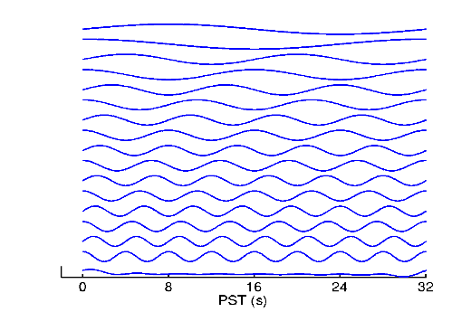
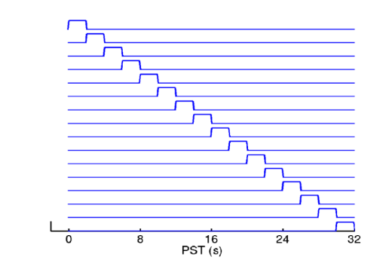
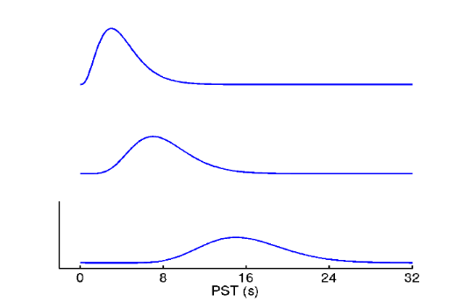
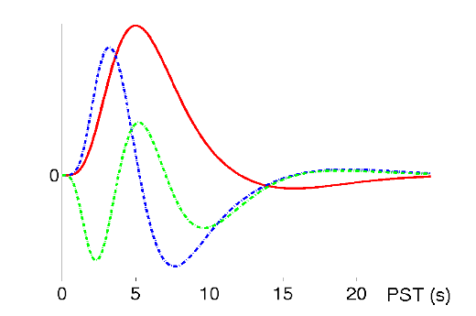
Temporal basis functions
BOLD response can look different between ROIs and subjects
To account for this temporal basis functions are used for modeling within General Linear Model (GLM)
every time course can be constructed by a set of basis functions
Different basis functions:
Fourier basis
Finite impulse response
Gamma functions
Informed basis set

Slide 8

Temporal basis functions
Finite Impulse Response (FIR):
poststimulus timebins (“mini-boxcars”)
Captures any shape (bin width)
Inference via F-test

Slide 9
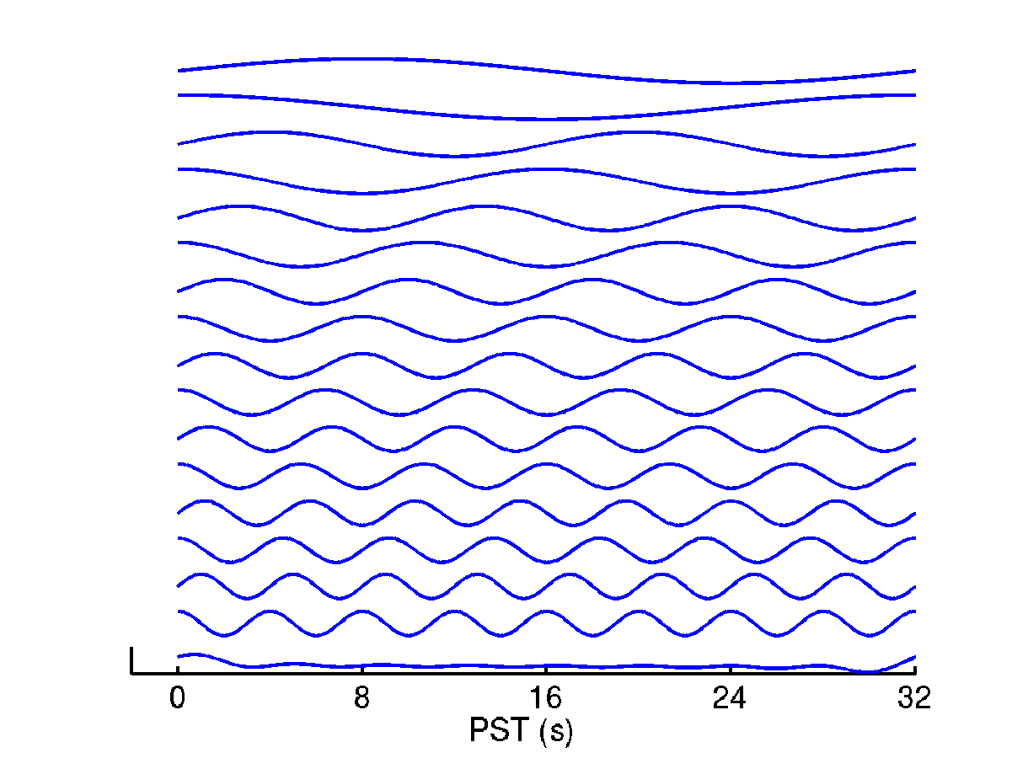
Temporal basis functions
Finite Impulse Response (FIR):
poststimulus timebins (“mini-boxcars”)
Captures any shape (bin width)
Inference via F-test
Fourier Base:
Windowed sines & cosines
Captures any shape (frequency limit)
Inference via F-test

Slide 10
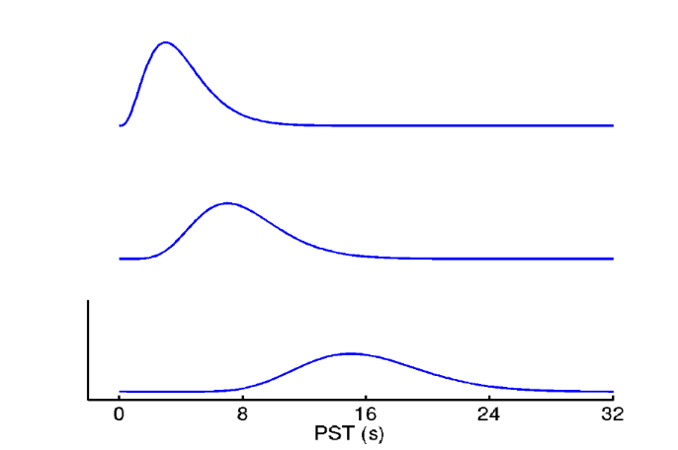
Temporal basis functions
Gamma Functions:
Bounded, asymmetrical (like BOLD)
Set of different lags
Inference via F-test

Slide 11
Informed Basis Set (Friston et al. 1998)
Canonical HRF: combination of 2 Gamma functions (best guess of BOLD response)

Slide 12
Informed Basis Set (Friston et al. 1998)
Canonical HRF: combination of 2 Gamma functions (best guess of BOLD response)
Variability captured by Taylor expansion:
Temporal derivative (account for differences in the latency of response)

Slide 13
Informed Basis Set (Friston et al. 1998)
Canonical HRF: combination of 2 Gamma functions (best guess of BOLD response)
Variability captured by Taylor expansion:
Temporal derivative (account for differences in the latency of response)
Dispersion derivative (account for differences in the duration of response)

Slide 14
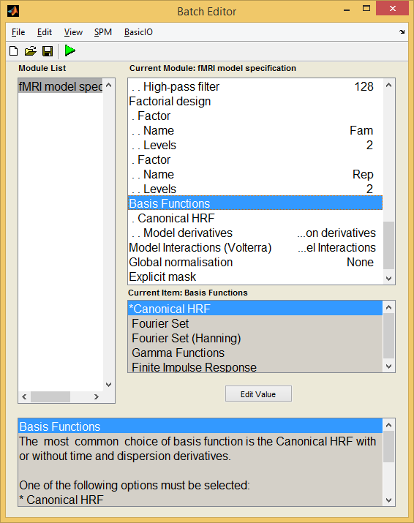
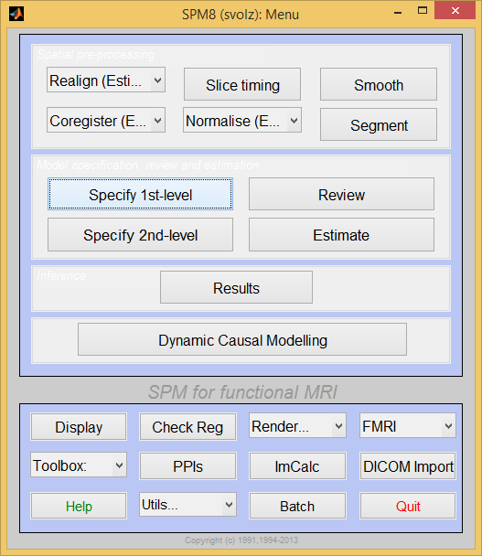
Basis functions in SPM

Slide 15
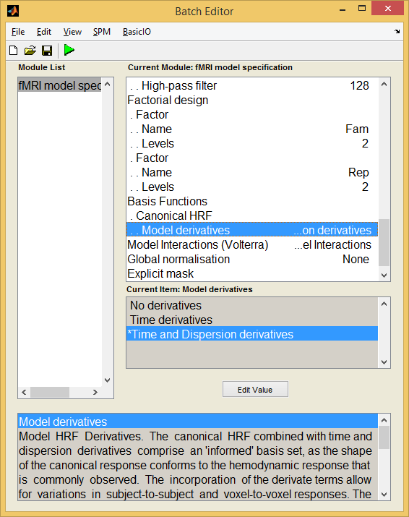
Basis functions in SPM

Slide 16
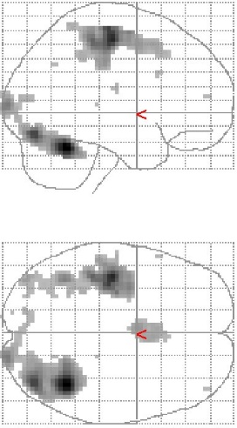
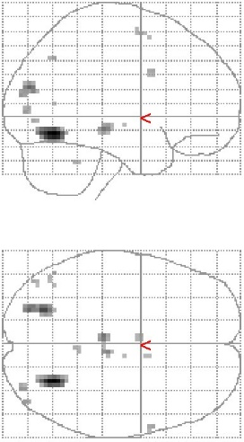
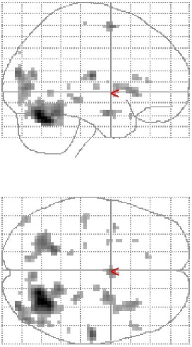
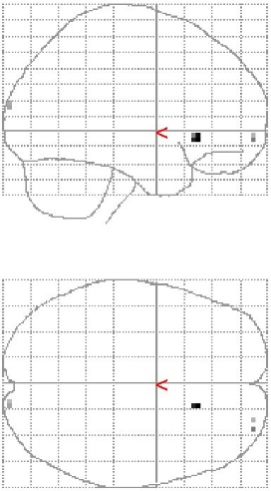
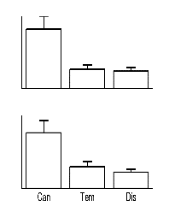
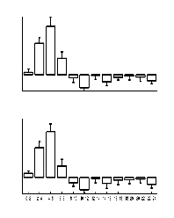
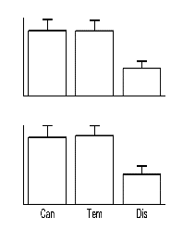
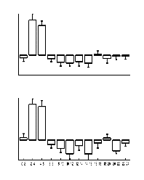
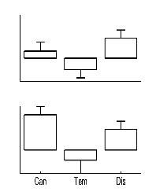
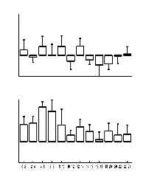
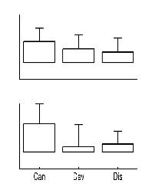
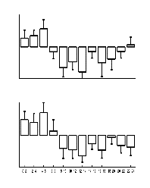
Which basis to choose?
Example: rapid motor response to faces (Henson et al, 2001)
canonical HRF alone insufficient to capture full range of BOLD responses
significant additional variability captured by including partial derivatives
combination appears sufficient (little additional variability captured by FIR set)
More complex with protracted processes (eg. stimulus-delay-response) could not be captured
by canonical set, but benefit from FIR set
Canonical
+ Temporal
+ Dispersion
+ FIR

Slide 17
Summary part 1
Basis functions are used in SPM to model the hemodynamic response either using a single basis function or a set of functions.
The most common choice is the “Canonical HRF” (Default in SPM)
time and dispersion derivatives additionally account for variability of signal change over voxels

Slide 18
Correlated Regressors
Faith Chiu

Slide 19
>1 x-value
Linear regression
  y = X.b + e
  Only 1 x-variable
Multiple regression
  Y = β₁X₁ + β₂X₂ + … + β_{L}X_{L} + ε
  >1 x-variable

Slide 20
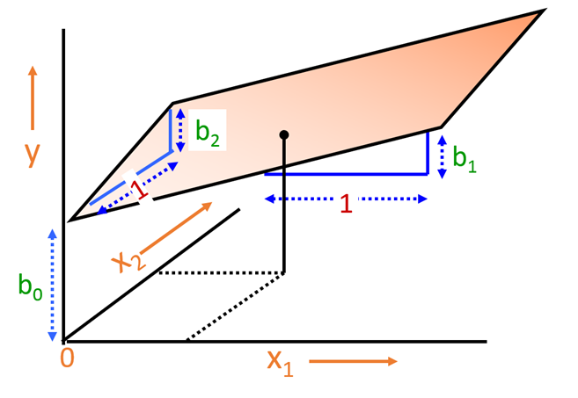
Multiple regression
^
y = b₀ + b₁.x₁ + b₂.x₂

Slide 21
Why are you telling me about this?
In the General Linear Model (GLM) of SPM,
Coefficients (b/β) are parameters which weight the value of your…
Regressors (x₁, x₂), the design matrix
GLM deals with the time series in voxel in a linear combination
Y = X . β + ε
Observed data
Design matrix
Parameters
Error/residual

Slide 22
>1 y-value
Linear regression
  y = X.b + e
Single dependent variable y
y = scalar
General linear model (GLM)
  Y = X . β + ε
Multiple y variables: time series in voxel
Y = vector

Slide 23
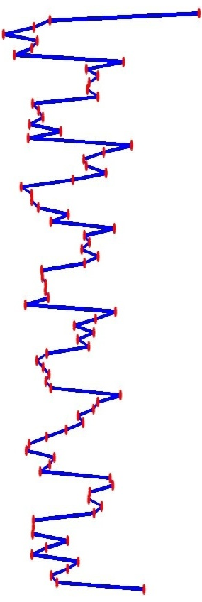
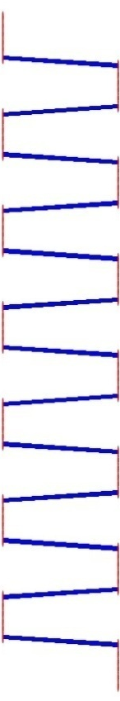

Single voxel regression model
error
=
β₁
+
β₂
+
Time
x₁
x₂
e
BOLD signal

Slide 24
Mass-univariate analysis: voxel-wise GLM
X
y
+
=
Model is specified by both
Design matrix X
Assumptions about e
N: number of scans
p: number of regressors
The design matrix embodies all available knowledge about experimentally controlled factors and potential confounds.

Slide 25



Parameter estimation
Objective:
estimate parameters to minimize
=
+
y
X
Ordinary least squares estimation (OLS) (assuming i.i.d. error):

Slide 26
A geometric perspective on the GLM
Smallest errors (shortest error vector)
when e is orthogonal to X
y
e
x₂
x₁
Design space defined by X
Ordinary Least Squares (OLS)

Slide 27
Orthogonalisation
y
x₂
x₂*
x₁
When x₂ is orthogonalized w.r.t. x₁, only the parameter estimate for x₁ changes, not that for x₂!
Correlated regressors =
explained variance is shared between regressors

Slide 28
Practicalities re: multicollinearity
Interpreting results of multiple regression can be difficult:
the overall p-value of a fitted model is very low
  i.e. the model fits the data well
but individual p values for the regressors are high
  i.e. none of the X variables has a significant impact on predicting Y
How is this possible?
caused when two (or more) regressors are highly correlated: problem known as multicollinearity

Slide 29
Multicollinearity
Are correlated regressors a problem?
No
When you want to predict Y from X1 & X2, because R² and p will be correct
Yes
When you want to assess the impact of individual regressors
Because individual p-values can be misleading: a p-value can be high, even though the variable is improtant

Slide 30
Final word
When you have correlated regressors, it is very rare that orthogonalisation will be a solution.
  You usually don't have an a priori hypothesis about which regressor should be given the shared variance.
The solution is rather at the stage of the experiment definition where you would make sure by experimental design to decorrelate as much as possible the regressors that you want to look at independently.

Slide 31
Thanks
Guillaume
SPM course video on GLM
Slides from previous years
Rik Henson’s MRC CBU page:
http://imaging.mrc-cbu.cam.ac.uk/imaging/SpmMiniCourse?action=AttachFile&do=view&target=SPM-Henson-3-design.ppt
http://imaging.mrc-cbu.cam.ac.uk/imaging/DesignEfficiency#Correlation_between_regressors

