Slide 1
Basis of the BOLD signal
Ryan Oakeson & Helen Olawole-Scott
Expert: Nadine Graedel

Slide 2
overview
MRI basics
The MRI scanner
Precession
Excitation (Radio Frequency)
T1, T2, T2* weighted images
Gradient coils
BOLD signal
Hemoglobin
Hemodynamic response function (HRF)
Magnetic susceptibility
fMRI pros and cons
fNIRS
fNRIS pros and cons

Slide 3
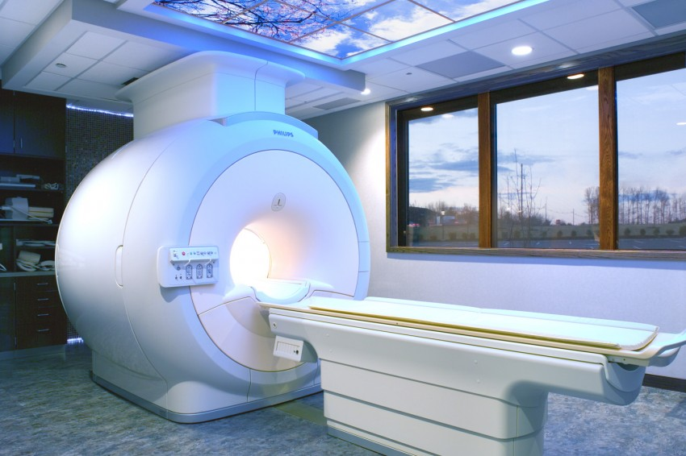
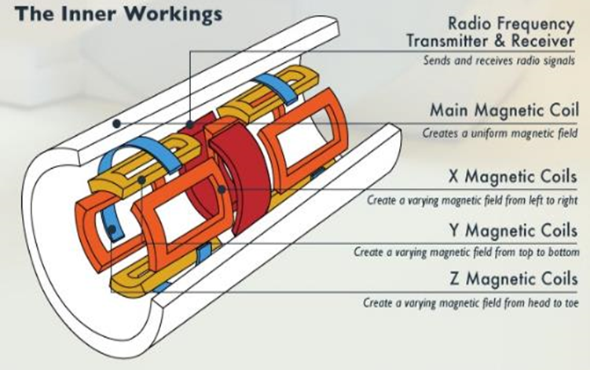
Magnetic Resonance imaging (MRI)
Non-invasive imaging method used for detection, diagnosis and treatment monitoring
MRI - uses spatial difference in resonance frequencies in different locations to form anatomical images
fMRI - uses magnetic properties of haemoglobin to create images illustrating changes in cortical blood flow
MRI strength between 1.5-7 tesla (**now 11.7T!**)
Scanner has many coils to produce different magnetic fields

Slide 4
The benefits of water
72% water
Hydrogen atoms (protons) spin and have an overall positive charge
Net Magnetization Vector (M) = net direction of the protons’ magnetic fields in one unit of volume
Resonant characteristics
Absorbing and re-radiating resonant (Larmor) frequency radiation
Magnetic resonance (MR) signal

Slide 5
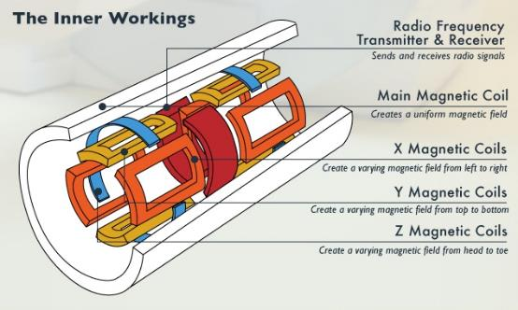
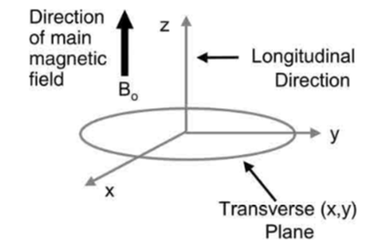
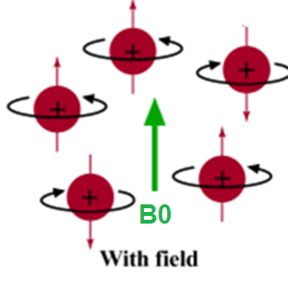
What happens inside the scanner?
M = the net direction of the protons’ magnetic fields in one unit of volume
M

Slide 6
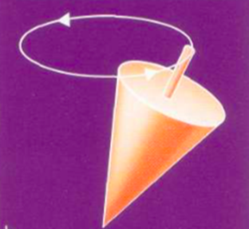
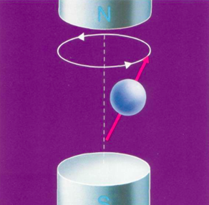
Precession
Spins rotate or precess about an applied magnetic field, at the Larmor Frequency
ω₀ = γ Β₀
ω₀ resonant frequency (e.g., 63.87 Hz for 1.5 T scanner)
γ gyromagnetic ratio (42.58Hz for Hydrogen)
Β₀ magnetic field strength (1.5-7 T)
Precession frequency depends on the strength of the magnetic field

Slide 7
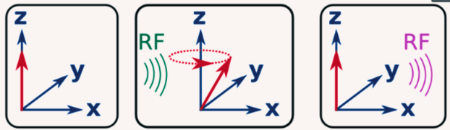
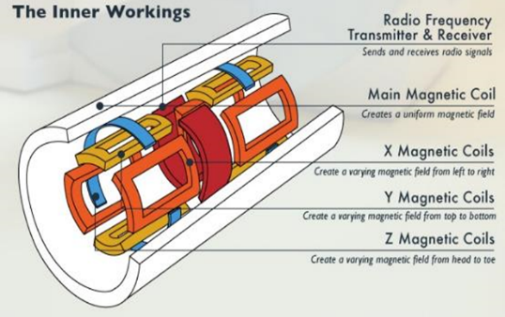
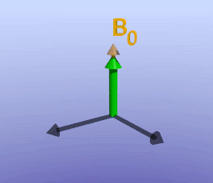
Excitation - Radio Frequency (B1)
The Radio Frequency (RF) transmitter introduces a second field – B1
RF pulses knock the precessing protons in the transverse (X/Y) plane
When RF pulses stop, protons precess back to their original alignment with B0, releasing the absorbed energy = MR signal
Spin recovery (T1) – precession back towards B0 (longitudinal component o M)
Phase decay (T2) – Dephasing of spins along the transverse component of M

Slide 8
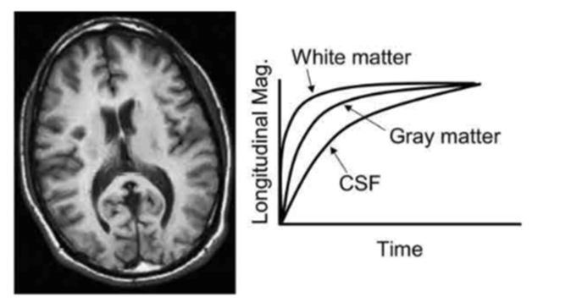
T1 weighted images
The T1 (i.e. the rate at which protons transfer energy to the environment) depends on tissue composition
MRI contrast is determined by the relaxation times as well as experimental timing (TE and TR)
T1-weighting is typically achieved using short repetition time, such that tissues are at different stages of T1-recovery when the RF pulse is played
Repetition times (TR) = is the amount of time between successive RF pulses applied to the same slice
Echo times (TE) = is the time between the delivery of the RF pulse and the receipt of the echo signal

Slide 9
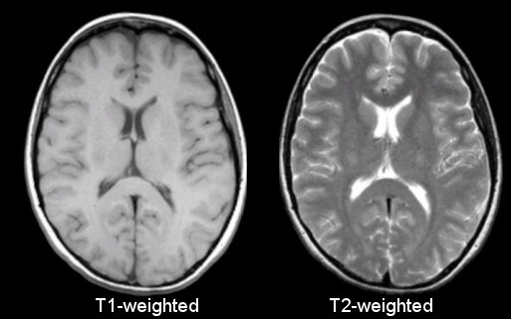
T2 weighted images
M
Dephasing
The RF pulse “knocks” the magnetisation vector M out of alignment with B0
The MRI signal measured is proportional to the length of the magnetization vector M in the transverse plane
Over time interactions between the spins mean they lose coherence and dephase, resulting in lower MRI signal.
This process is called T2-relaxation and is governed by the time-constant T2.
Like for T1, T2 is tissue-dependent and with appropriate choice of TE/TR T2-weighted images can be generated.

Slide 10
T2* weighted images
M
Dephasing
Magnetic field inhomogeneities also cause dephasing
Time constant T2* describes signal decay caused by T2 as well as field inhomogeneities
T2* is defined as the time for the transverse component of the magnetisation to loose 63% of its value
T2* imaging is the contrast typically used in BOLD fMRI

Slide 11
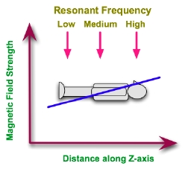
Gradient Coils give us Spatial Localisation
Gradient coils produce gradient magnetic field in X/Y/Z planes
Alter the strength of the primary magnetic field
Change the precession frequency of slices
Allows for spatial encoding for MRI images

Slide 12
Any questions so far…?

Slide 13
Basis of the BOLD signal

Slide 14
Blood Oxygen-level Dependent
Part 1 – Hemoglobin and metabolism (Cerebral Metabolic Rate of O2)
One of blood’s main functions is to deliver oxygen and nutrients through the body
Much like the muscles in our body, neurons require oxygen to function
Part 2 – Hemodynamic response function and BOLD
Oxygenated and deoxygenated blood have different magnetic properties
This change in oxygenation and magnetic property in blood is the BOLD signaling
Active vs resting contrasts

Slide 15
Hemoglobin
Protein that contains iron in red blood cells which carry oxygen
Oxyhemoglobin (HbO2)
Red
Unstable bond
Diamagnetic (less magnetic effect on its environment)
Deoxyhemoglobin (HbR)
Blue/purple
Paramagnetic (more magnetic effect on its environment)
Blood becomes deoxygenated due to increased metabolic processes involved in neural activation

Slide 16
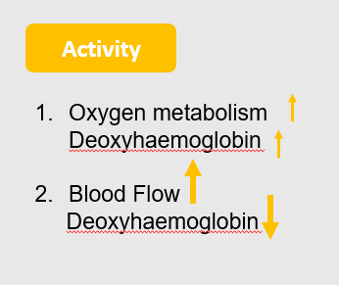
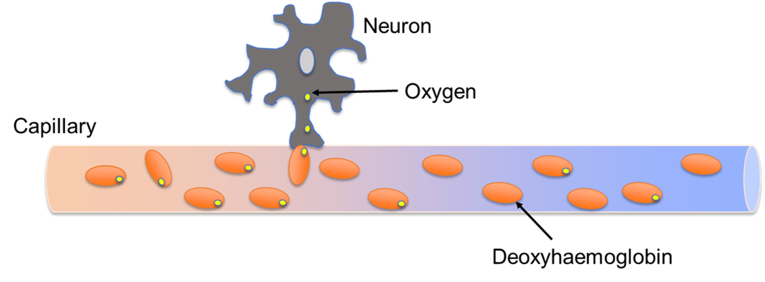
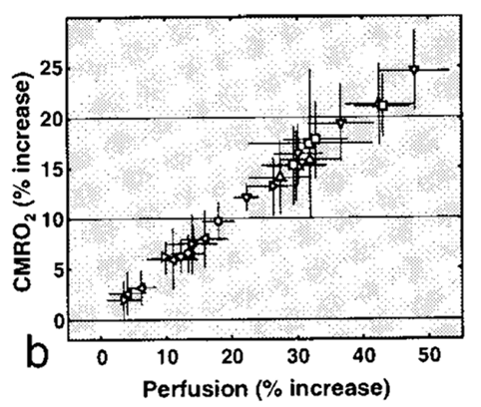
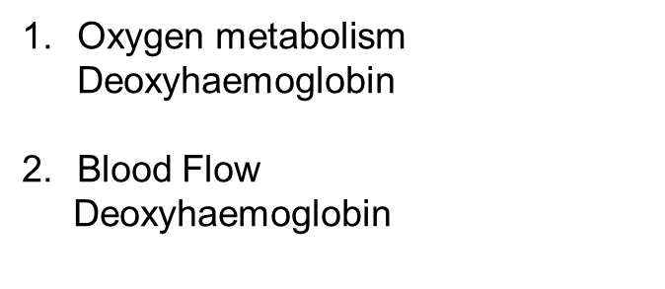
Resting
Active

Slide 17
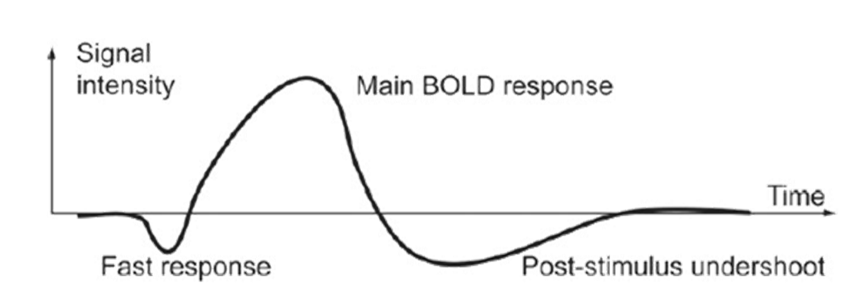
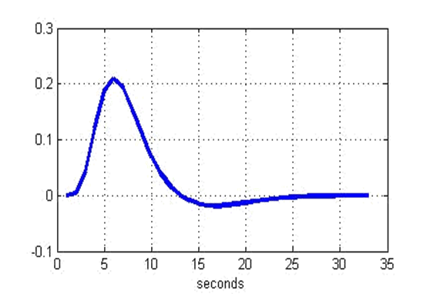
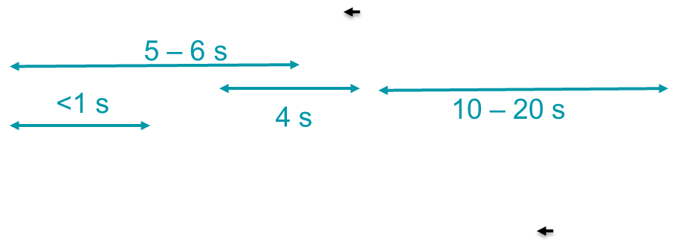
Hemodynamic Response Function (HRF)

Slide 18
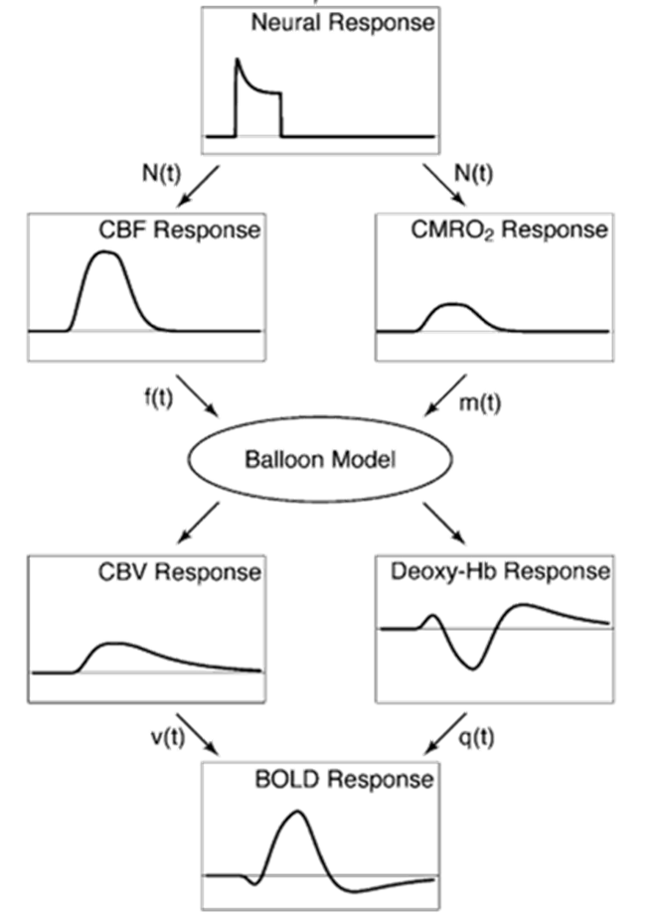
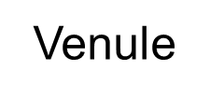
Interplay of:
CBF (cerebral blood flow)
CMRO2 (cerebral metabolic rate of oxygen)
CBV (cerebral blood volume)
Balloon model: CBV inflates venule during activation and the slowly deflates during the undershoot.

Slide 19
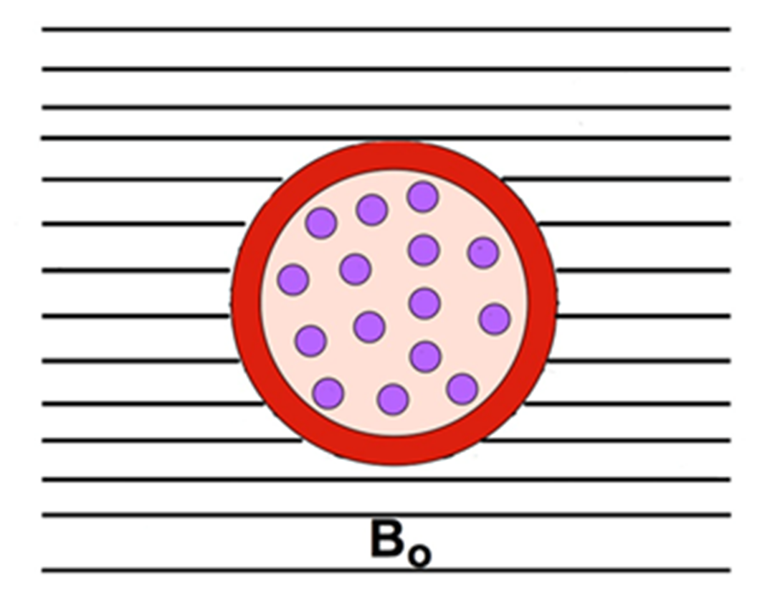
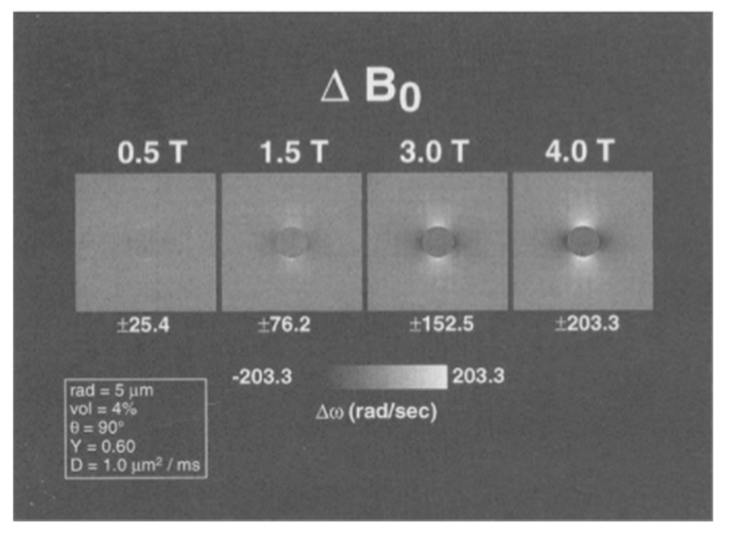
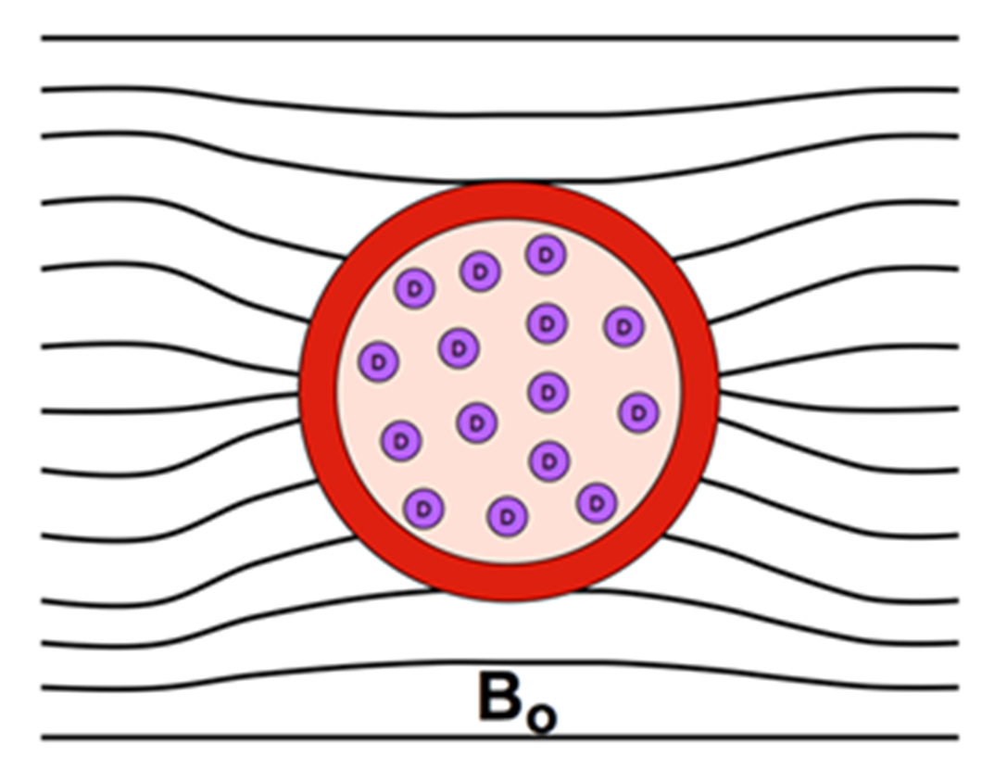
Oxygenated and deoxygenated blood have different magnetic susceptibility
Oxyhemoglobin
Diamagnetic
less magnetic effect on its environment
weak field inhomogeneities in high concentrations
slower dephasing
Deoxyhemoglobin
Paramagnetic
more magnetic effect on its environment
strong field inhomogeneities in high concentrations
faster dephasing
HbR is paramagnetic and causes a local field distortion
Bandettini and Wong, 1995

Slide 20
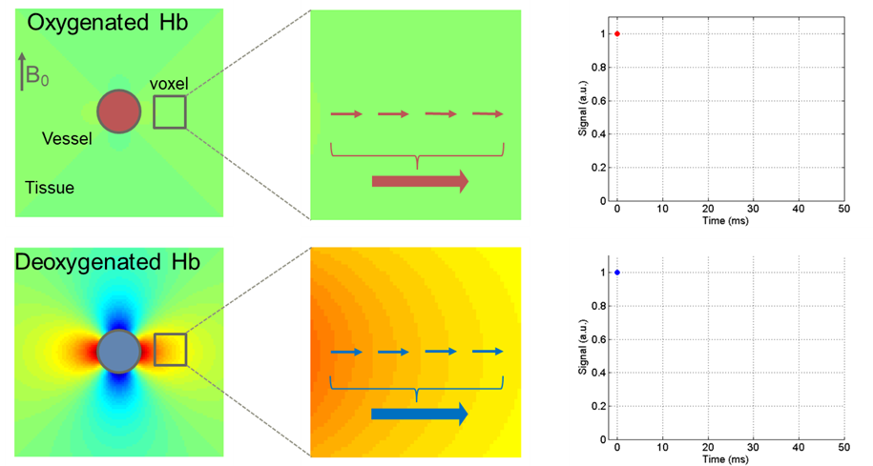
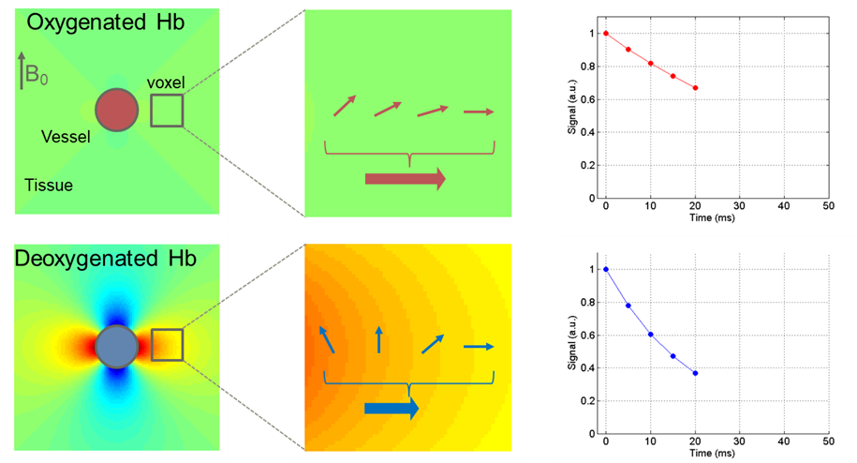
Impact Of Magnetic Susceptibility
HbO2 relaxes slower maintaining and has higher BOLD signal over time (less field distortion, longer T2*)

Slide 21
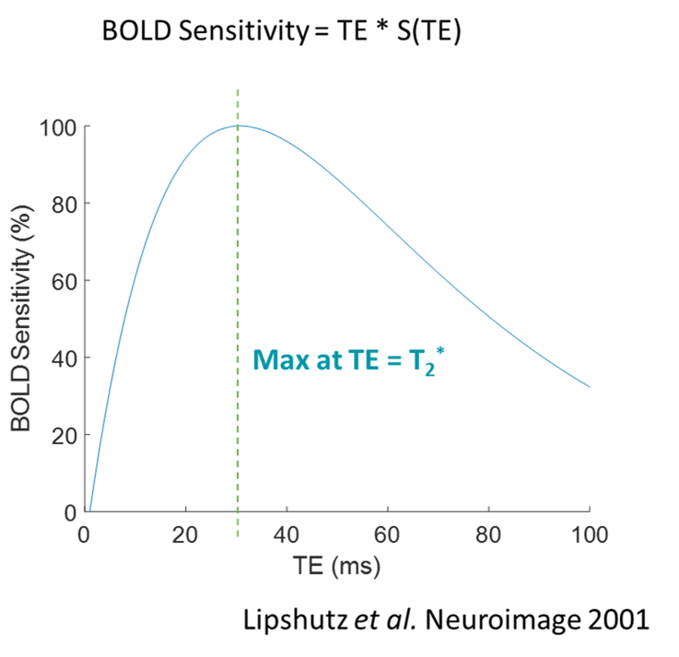
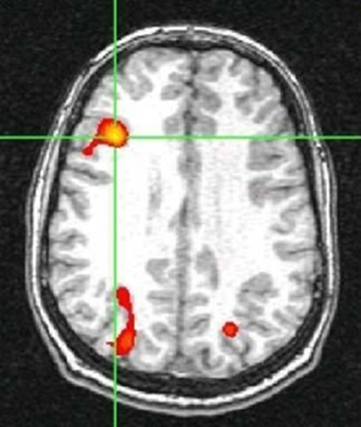
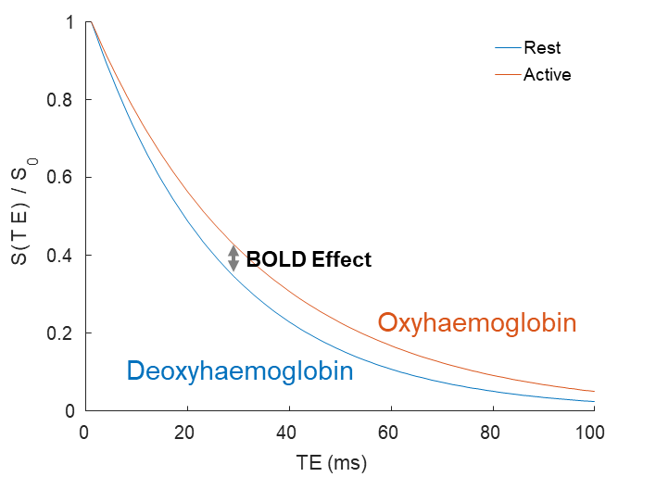
This change in oxygenation and magnetic property in blood is the BOLD signaling
Active vs resting contrasts
*At 3T

Slide 22
fMRI Pros and Cons
High spatial resolution
Non-invasive
Not a direct measure of neural activity (BOLD signal)
Poor temporal resolution
Loud
Can’t have metal in or on body
Claustrophobic
Movement artifacts

Slide 23
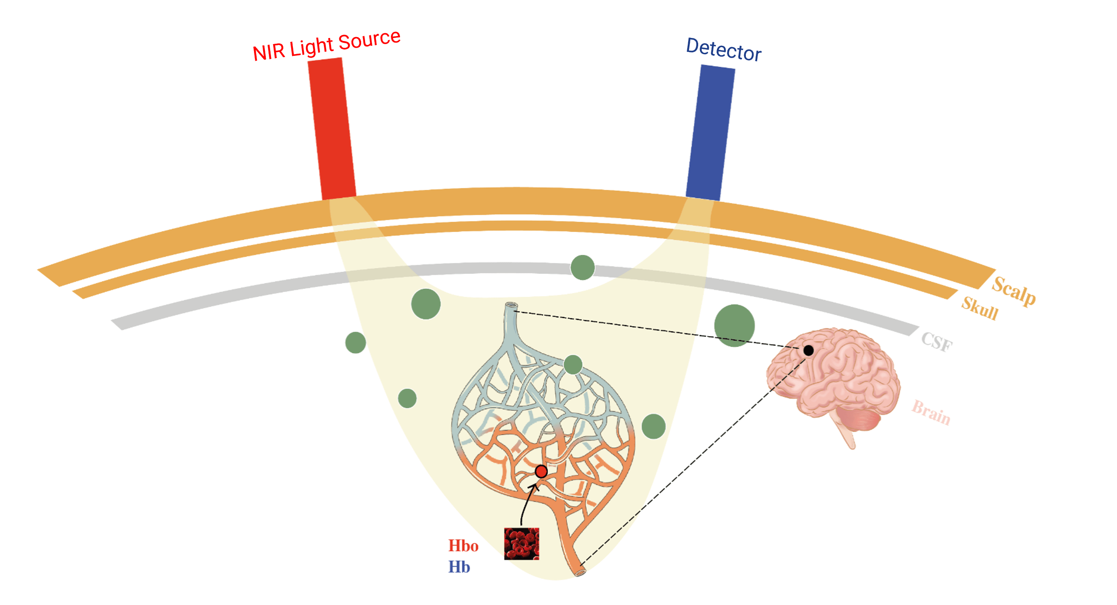
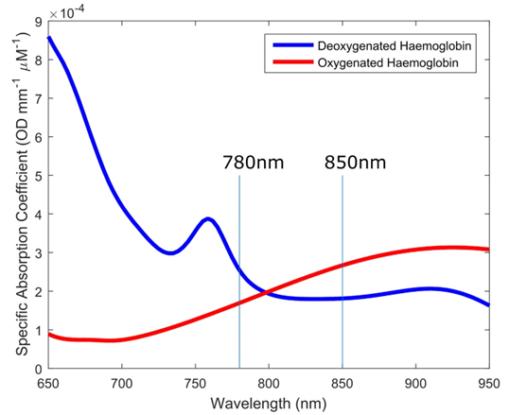
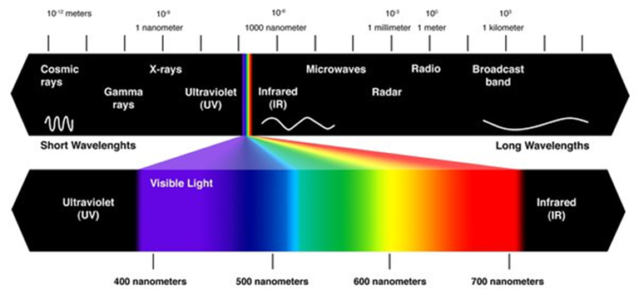
fNIRS (Functional Near-infrared Spectroscopy)

Slide 24
fNIRS Pros and Cons
High temporal resolution
Low cost
Quiet
Less movement artifacts
Not a direct measure of neural activity (BOLD)
Poor spatial resolution
Really only good for the cortex

Slide 25
Thank you for listening! Any questions?

