Slide 1
T-tests, ANOVAs and Regression
Wanjun Lin
Florencia Calderon Ventura

Slide 2
Contents
T-test
One-sample t-test
Regression
ANOVA
Paired t-test
Two-sample t-test
One-way
Repeated
Linear Regression
Two/More-way

Slide 3
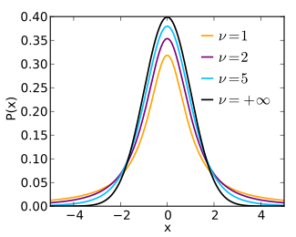


ONE-SAMPLE T-TEST:
Examines whether the mean of a population is statistically different from/higher/lower than a fixed value.
The distributions of the sample means
v=n-1 degrees of freedom
https://en.wikipedia.org/wiki/Student%27s_t-distribution

Slide 4
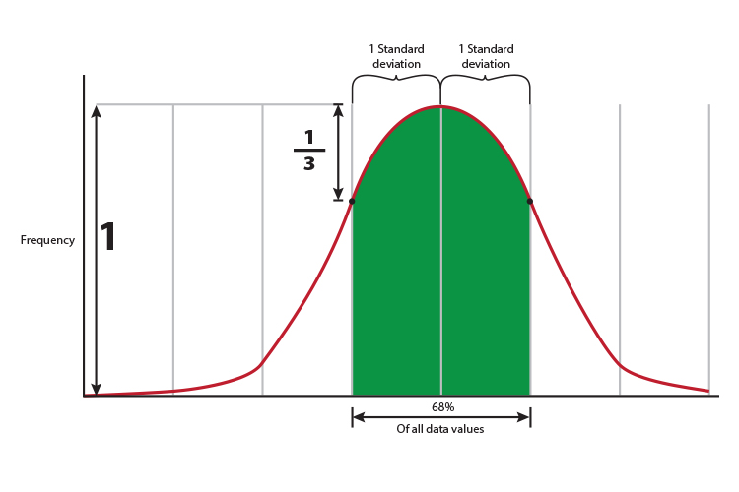

From distribution to probability
The distributions of the sample means
N=100
MEAN=1.03
STD=0.96
df=N-1=99
MEAN=1.03
SE=s/sqrt(n)=0.096
t=(mean-fixed value)/se
https://mammothmemory.net/maths/statistics-and-probability/standard-deviation/what-does-standard-deviation-really-mean.html

Slide 5
H0: no lower than x
H1: lower than x
One tailed
Hypothesis
t=(mean-fixed value)/se > critical t
H0: no higher than x:
H1: higher than x
One tailed
t=(mean-fixed value)/se < critical t
H0: no differ from x
H1: differ from x
Two tailed
t=(mean-fixed value)/se < critical t (α/2)
Or t=(mean-fixed value)/se > critical t(α/2)
Notes:
Talk about 1 or 2 tailed

Slide 6
Paired t-test: examines whether the mean differences between pairs of measurements is statistically different from/higher/lower than a fixed value.

Slide 7
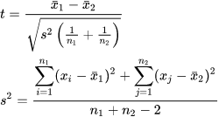
Two sample t-test: examines if two population means are significantly different

Slide 8
Compute the t-value

Slide 9
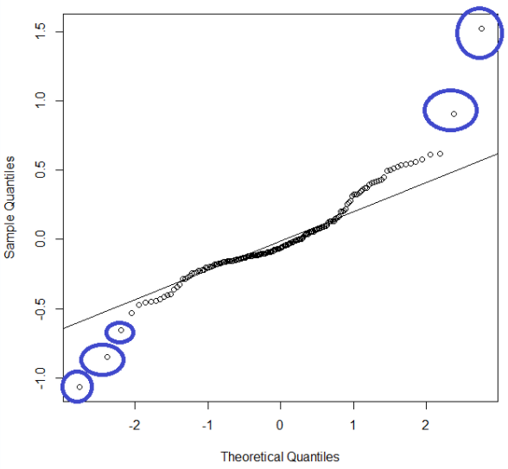
T-test: Assumptions
Continuous dependent variable
One sample and paired:
normally distributed
Two independent samples:
Similar size groups
Normally distributed
Variances equal

Slide 10
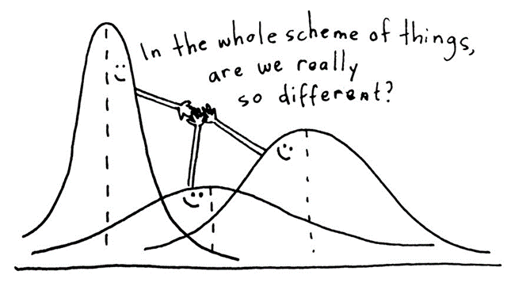
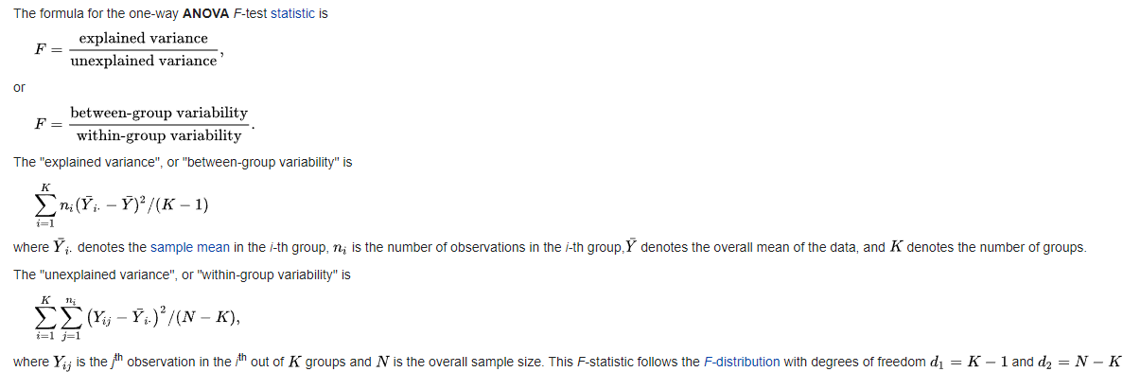
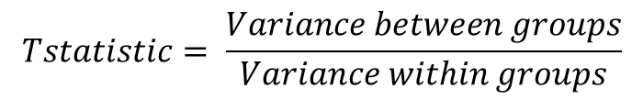
Analysis of variance – ANOVA: an ANOVA allows us to test the differences between 2+ groups
$$Tstatistic= \frac{Variance between groups}{Variance within groups}$$
When k=2, F=t²
https://en.wikipedia.org/wiki/F-test

Slide 11
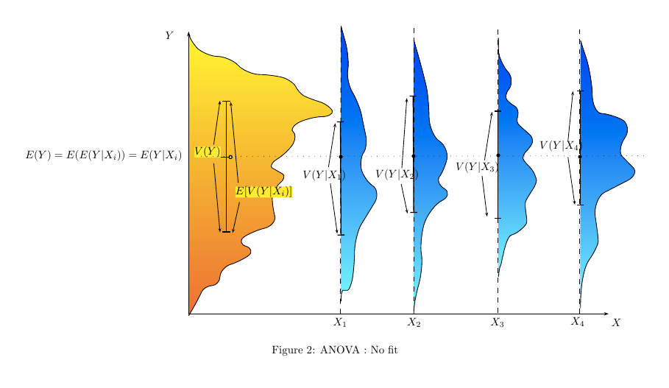
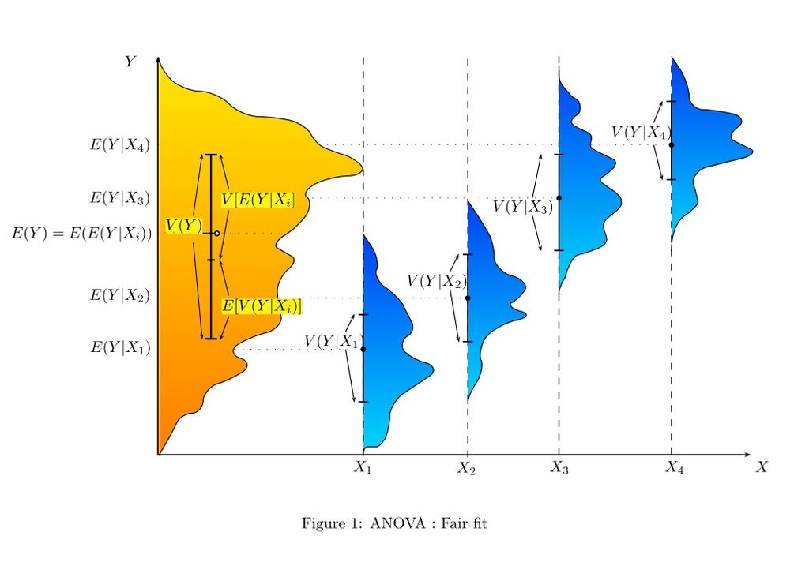
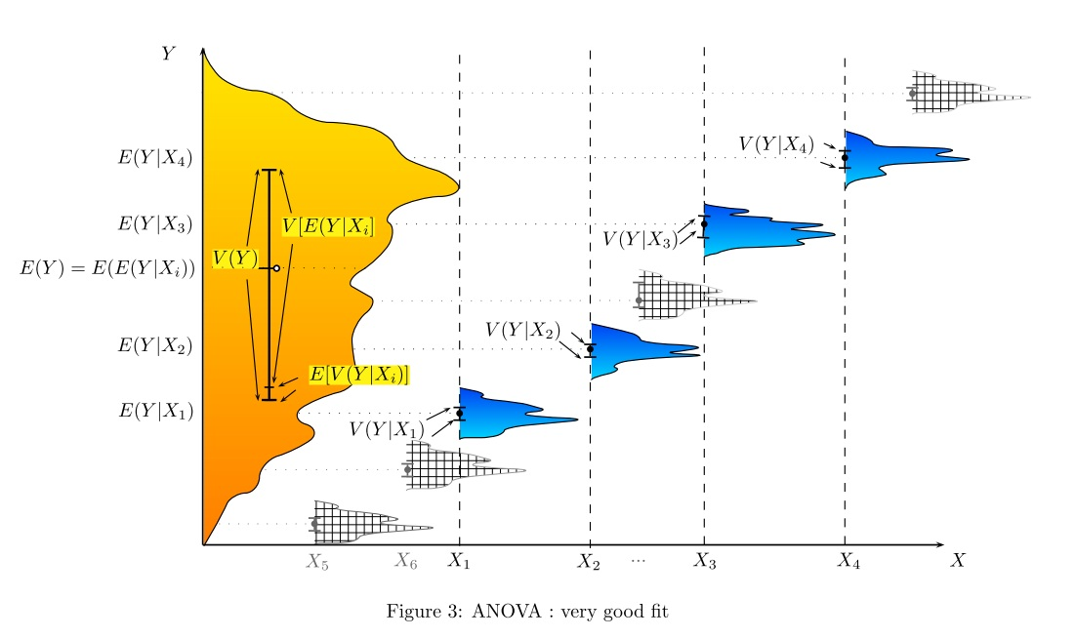
Example
Age: Young/old
Hair-length: short/long
job: pet/working breed
athletic: less/more
By breed: Chihuahuas/haski/mastiff/……
https://en.wikipedia.org/wiki/Analysis_of_variance

Slide 12
One way ANOVA:
Used to compare means from 2+ independent groups
Dog weight by breed: Chihuahuas/haski/mastiff/……

Slide 13
Two/More way ANOVA:
If there are more than one way that each subjects can be divided into meaningful categories
job: pet/working breed
athletic: less/more

Slide 14
Repeated measures ANOVA

Slide 15
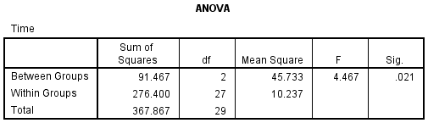
The model
An example software output
Height
The results of the ANOVA shows
F(2, 27) = 4.467, p = 0.021
H0: all group means are equal
H1: not all group means are equal
Total DF=n-1=30-1=29
Between groups DF=K-1=3-1=2
Within groups DF=n-K=30-3=27
H0: a=b=c
H1: a≠b or a≠c or b≠c
Post-hoc tests: multiple comparisons to identify which pair(s) of groups are significantly different
given a family-wise error rate

Slide 16
ANOVA assumptions
Continuous dependent variable
Normally distributed
Equal variances
One and two/More way:
Independent groups
Repeated measures:
Related groups

Slide 17
LINEAR Regression
Florencia Calderón

Slide 18

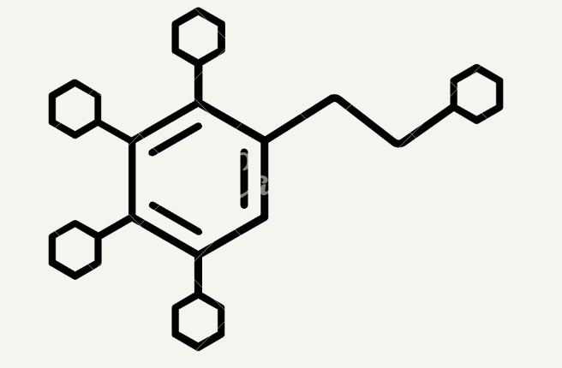
What is Regression
Analisis that defines the relationship between a dependant (Y) and an independent variable (X).
It determines the degree to which a dependent variable can be predicted by one or more independent variables
Example, if we know there is a relationship between grams of ice cream eaten and dopamine levels and we know how that relationship behaves we can predict the one, starting from the other

Slide 19
Types of regression
Simple Linear regression
Multiple Linear regression
Logistic regression
Other type of regression

Slide 20


Simple Linear regression
grams | [D]
200 | 0.2
300 | 0.5
400 | 0.6
Notes:
Find a ,one that can predict the Y

Slide 21
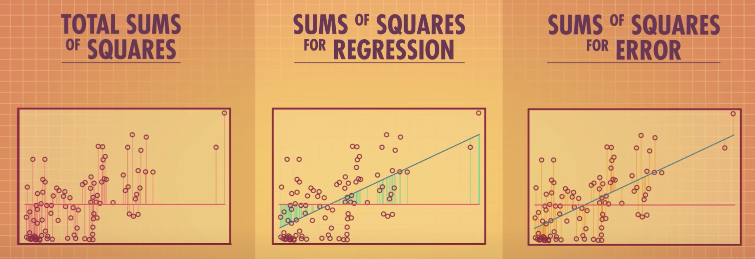
Sources of variance
MODEL--- Y= bX+ c
The world is not linear- there is always unexplained sources of variability MODEL + ERROR = bX + c + ε
But reality not always follows the model perfectly.
There is always some ERROR (ε)
Var (Y) = Var (bx) + Var (ε)
This is an unexpected source of variance that cannot be explained by our model- it is known as residual variance. It can be represented with the sum of squares error
Notes:
For example in our ice-crem example, some people may just haveh higer natural liberation of dopamine,or maybe the sun was out that day we dont know. Of course in experimentacl conditions we try to minimice this external sources of variance, but there is anly so much you can do.
In linear regression we draw a line that minimises these residual errors. The line where the SSE is the lowest value possible

Slide 22
What is R²?

Slide 23
Strength of the relationship
R²= coefficient of determination = the proportion of the variance in the dependant variable that is predicted in the independent variable. Var (bx)/ Var (Y)
RSS= sum of squares for regression = variation explained by the regression model (where Y_{hat} = predicted value of Y)
TSS = Total sum of squares. Total variation in our data set (where Y = actual value of Y)

Slide 24
Value of r²
Var (y) = Var (bx) + Var (ε)
If R² is closer to one then the relationship between Var (bx) and Var (y) is strong. This is because the ERROR or source of residual variation is low: Var (ε) is low
If R=1 then the model perfectly defines the relationship between X and Y
If R² is closer to cero then it means that one then the relationship between Var (bx) and Var (y) is weak. Var (ε) is high, the variation in Y levels cannot be explained by changes in X
If R=0 the model does not predict the behaviour of Y
Notes:
V¡How Y varies is related to how x vaires

Slide 25
When can I say that the relationship is significant?

Slide 26
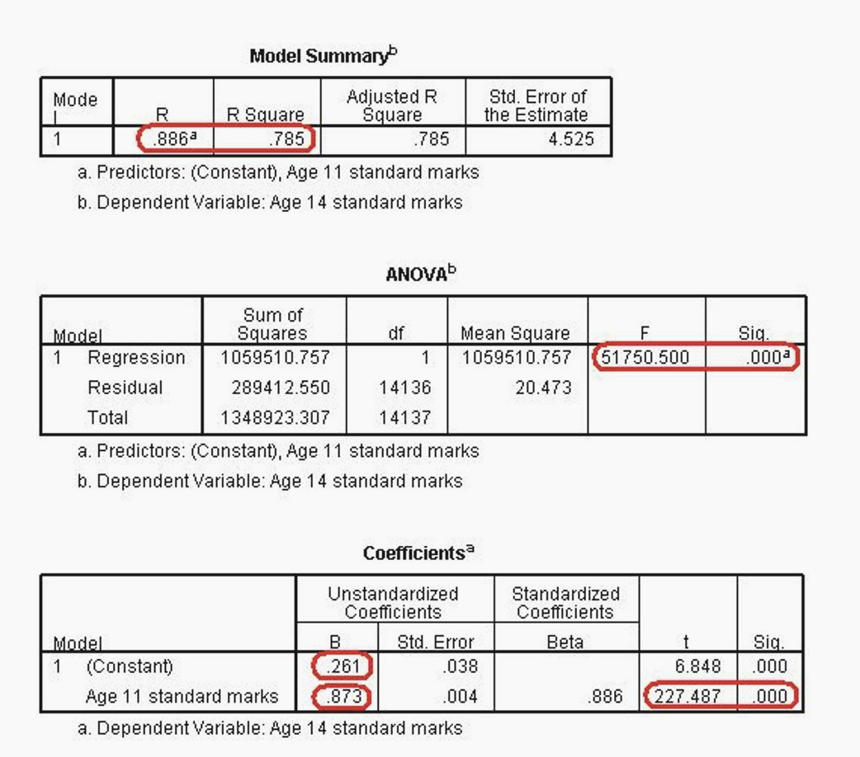
F-test= (SSR/DFM)
(SSE/DFE)
If the variance that can be explained by our model is the same as the variance that cannot be explained by it then F will be closer to one, and the model will be able to forecast Y values
Test weather the slope is significantly different from 0

Slide 27
As with Correlations, a regression does not imply causality

Slide 28
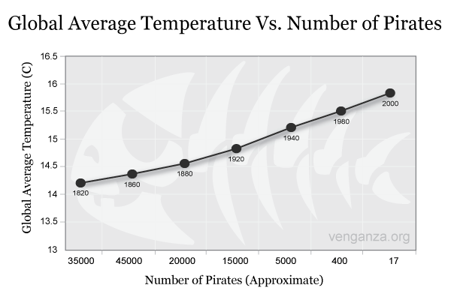

Slide 30
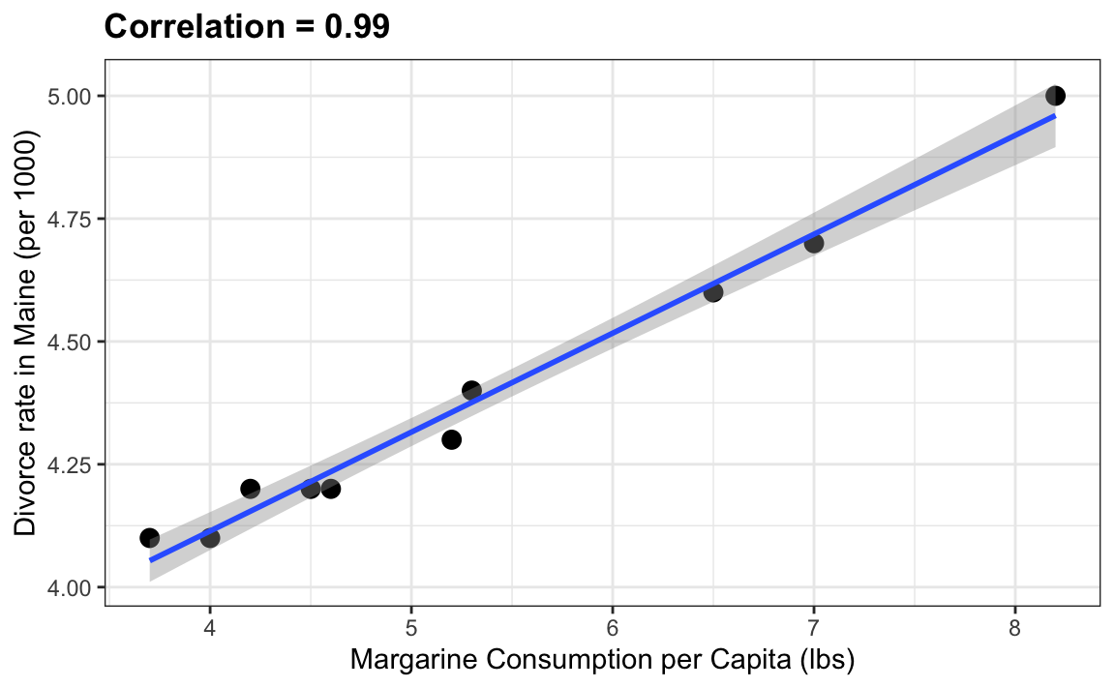

Slide 31
Asumptions
Linearity
Homocedatisity
Independance
Normality
Notes:
Indpendance: the Xs have to be independat from eachother.
residual varience; ie. sourse of variation that cannot be explained by the variables in the model (changes in dopamine that cannot be explined grams of ice cream), is constant.

Slide 32
Questions?

Slide 33
Thank you for your attention

Slide 34
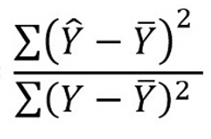
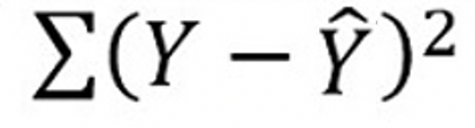
We can do a nulL hypothesis test
We can run an F-Test to see if of variation of Y that our model can explain is significant
H₀= The amount of ice cream grams eaten do not predict dopamine levels.
H₁= The amount of ice cream grams eaten predict dopamine levels.
F-test= (SSR/DFM)
(SSE/DFE)
If the variance that can be explained by our model is the same as the variance that cannot be explained by it, then F will be closer to one.
Find the P-value and reject or accept the null hypothesis (P lower than 0.05)
Notes:
We want the variance of Y that can be explaind by our model to be grater than the one who cant and so we ant the value od F to be different from 1
Preguntar aca wue es el F critico bien como definito y como definir el P value Bien

Slide 35
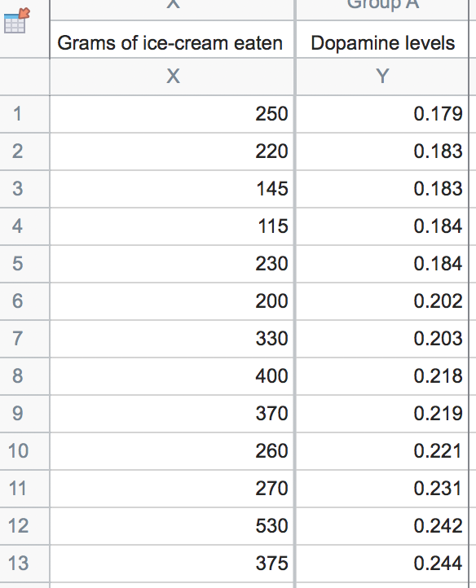
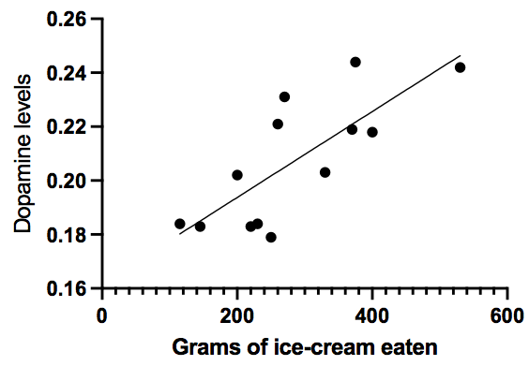
Example
DFM = number of parameters= 1
DFE= n-p-1= 13-1-1= 11
Calculate the mean sum of squares
RSS/DFM = 256855.033
ESS/DFE = 7945.99
MRS/MES = 32.325
The next step will be to find out the critical value of F-statistics at the level of significance as 0.05 with the degree of freedom as 1, 11. F distribution changes with the degrees of freedom
Critical value for F = 2.6
F-observed is greater than F critical we can reject the null hypothesis and so:
The amount of ice cream grams eaten influences dopamine levels
Notes:
Ask abt DFM – how to explain well
Critical value for F

