Slide 1
Model Selection
Methods for Dummies 2023

Slide 2
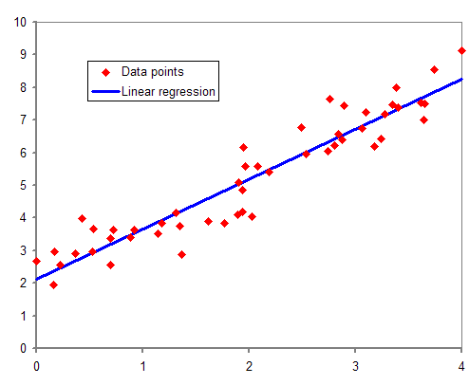
What is a model?
A simplification of reality
Relationship between variables (how x predicts y)
Equation could tell us about data we haven’t acquired yet
An approximation of the real data/complex processes
- Describes patterns in data in reduced dimensions
Intensity of Headaches
Hours Spent Studying Stats
Notes:
4: what is a model? A model is simplification of reality, it helps us plotting reality in simpler terms to understand how something works or will work.
Models could be exploring relationships between variables such as how x predicts y (how height predicts weight)
Models could also equations, with the data we already have, we can build equations and they can tell us about data we haven’t acquired yet, it is an approximation of reality. For example, climate change models can be very useful when predicting future behaviour because it allows us to take action, they can guide policies even when not very precise!
Through model comparison and statistics, we can determine whether the model makes a good approximation of the real data, is it a good approximation of reality?

Slide 3
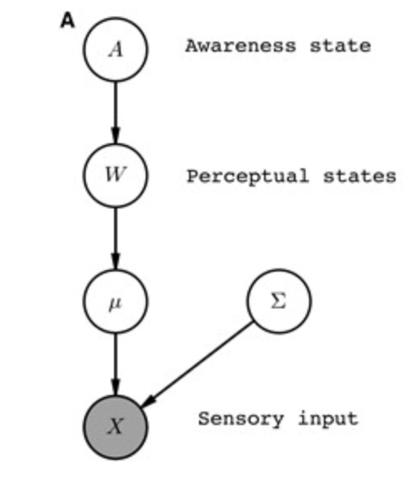
Why is it useful?
Identifies and disentangles influences
Generates hypotheses
“All models are wrong, but some are useful”
Notes:
Importantly, a model is representation for a purpose; such that it allows you to identify and disentangle relevant influences for the question about the real world that you want to ask, and allows you to create hypotheses about how the system being modelled actually works, and finally classify existing observations into conclusions or evaluations
So in a sense, all models are are approximations of reality - like abstractions. If they were perfect, then they would be the system we are modelling. If we explain all aspects of something – it isn’t very useful as it can’t be generalized to other situations.
As a model of a complex system becomes more complete, it becomes less understandable. Alternatively, as a model grows more realistic, it also becomes just as difficult to understand as the real-world processes it represents
So actually, useful models are those that find the balance between how complex and how generalisable they are.

Slide 4
Example of psychological models
Model One – Random Responding
Subject decides randomly, with a slight bias towards one machine
$p_{t}^{1}=b and{ p}_{t}^{2}=1 −b$
Random Responding model has just one free parameter
$θ_{1}=b$
Model Two – Noisy Win-Stay-Lose-Shift
Repeat rewarded action, switch away from unrewarded actions (with noise)
Model 2 also has one free parameter
$θ_{1}= ε$
Notes:
It is our job to find the value for these parameters that help us best describe the data.
I.e. which one can predict subject’s resopnses in the task better

Slide 5
Model Fitting
Finding the parameter values that best describe our data

Slide 6
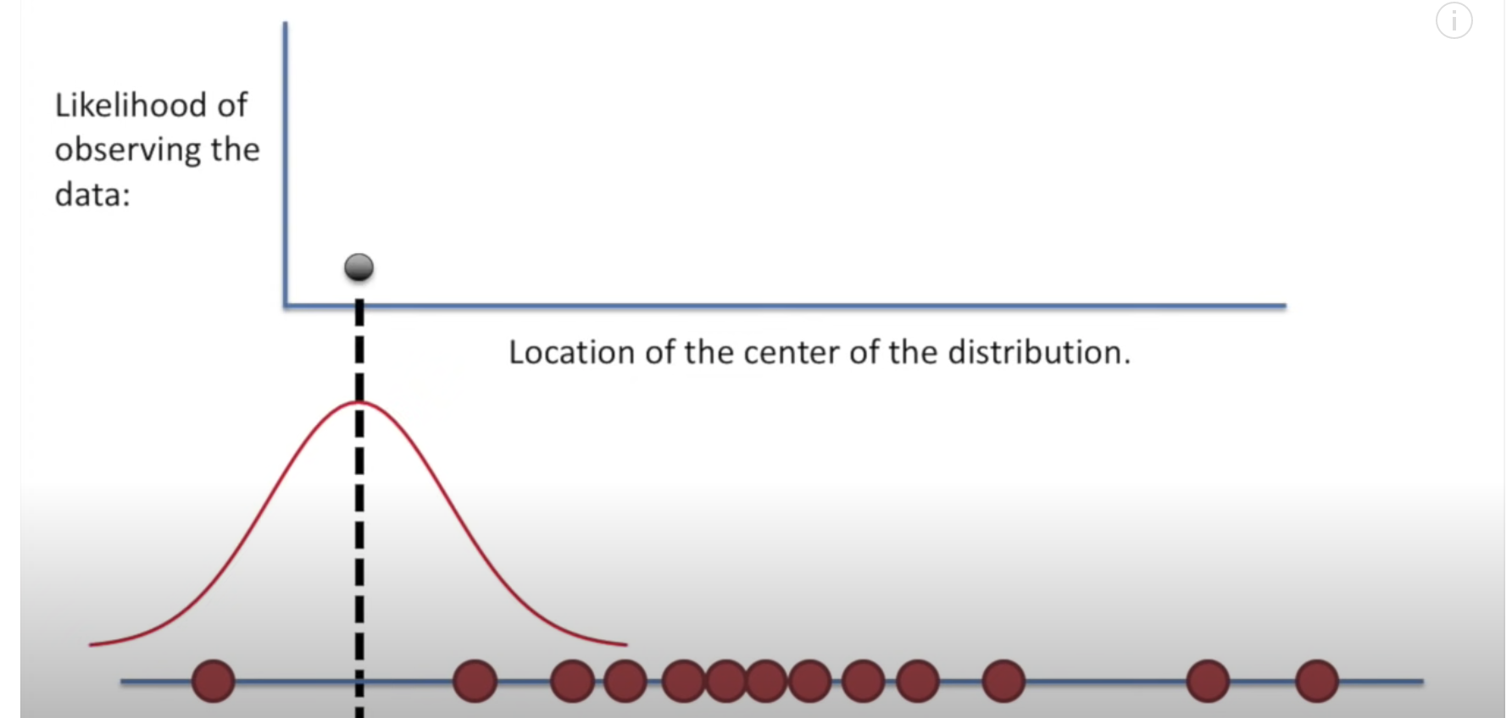
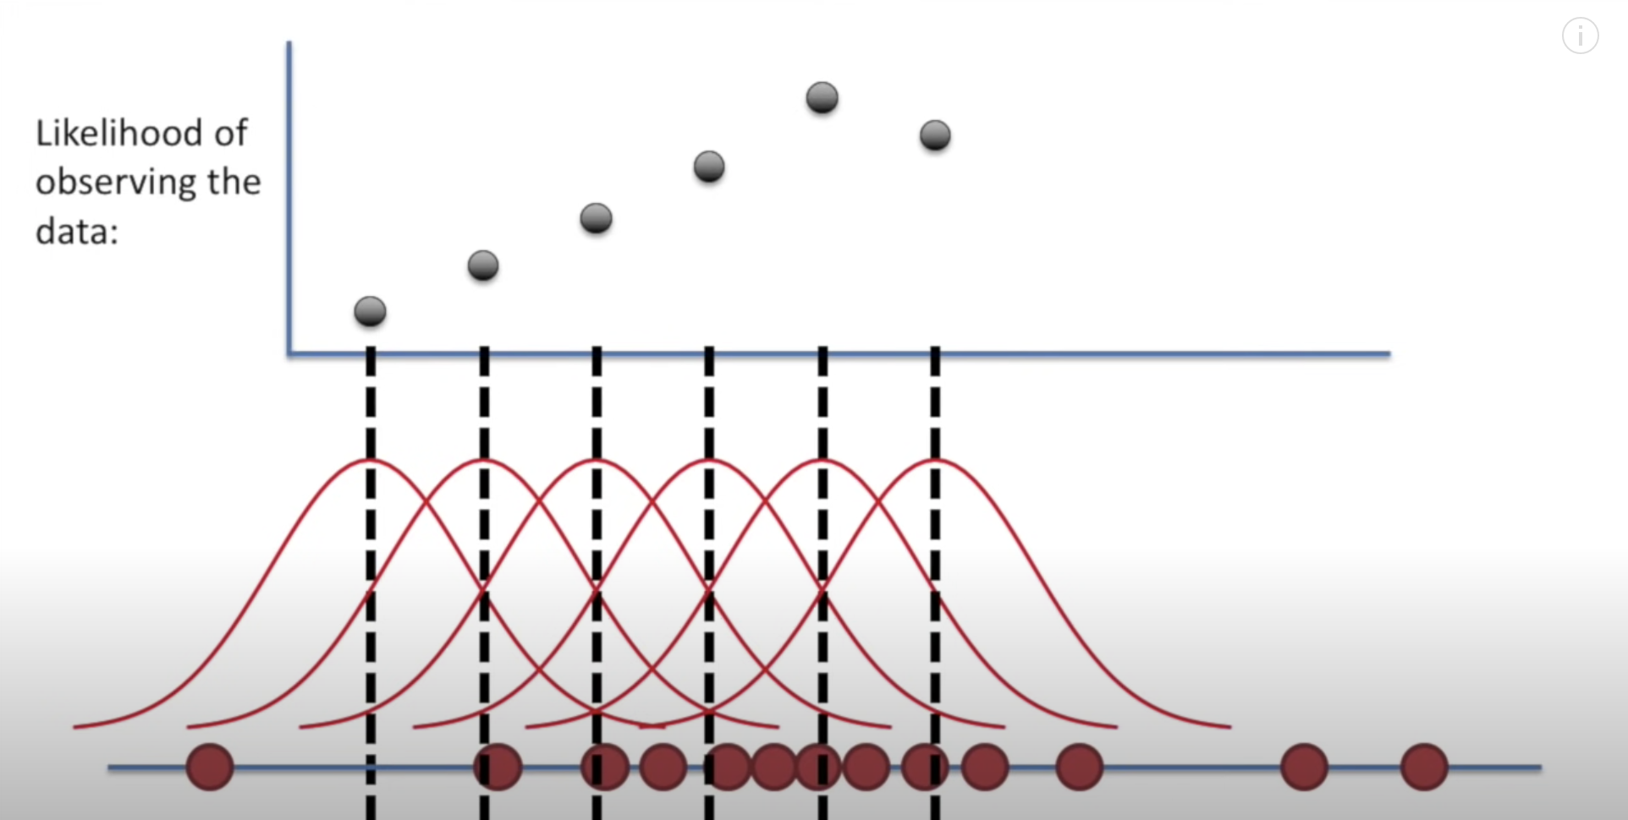
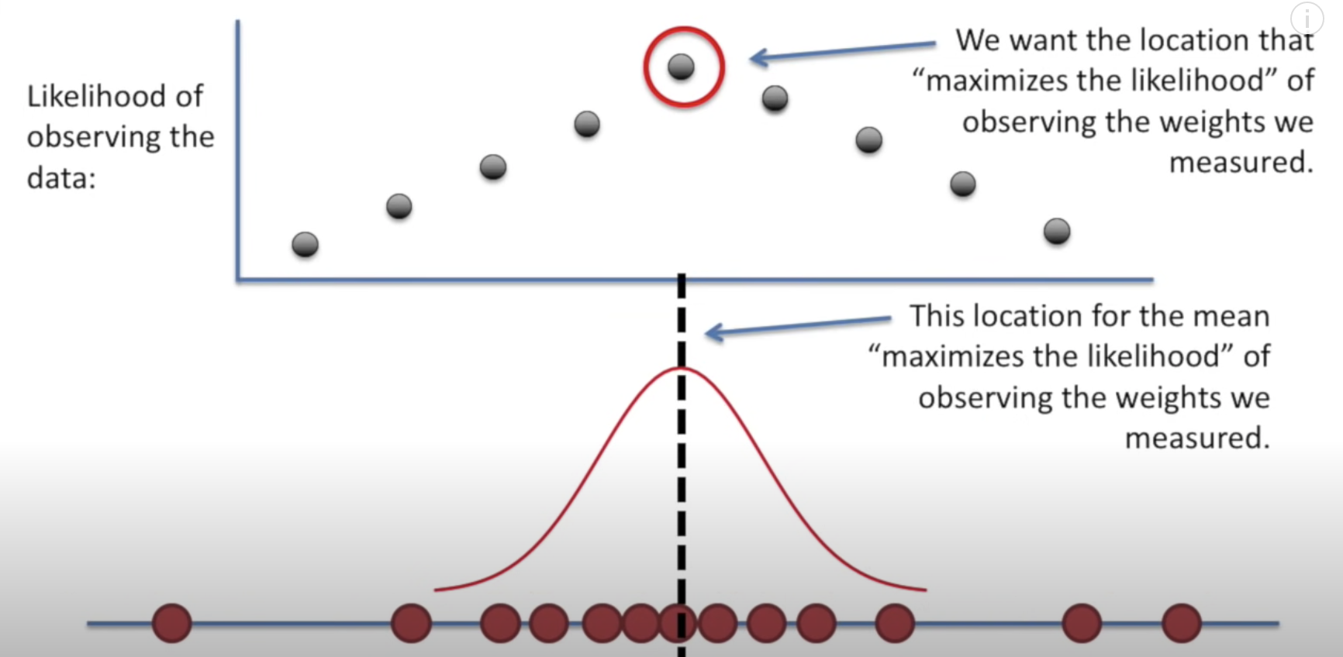
Maximum Likelihood Estimation (MLE)
Likelihood function
Describes the likelihood of observing the parameter values ($θ$) given the data ($y$)
$L(θ|y)$
MLE
We find the parameter values that make the likelihood as big as possible
Convention
We usually do this using the log of the likelihood function

Slide 7
Bayesian Parameter Estimation
We can combine the likelihood with prior beliefs about the parameters’ values using Bayes Theorem
Generates a Posterior Distribution
The probability of observing certain parameter values given the data

Slide 8
Model Selection and Comparison

Slide 9
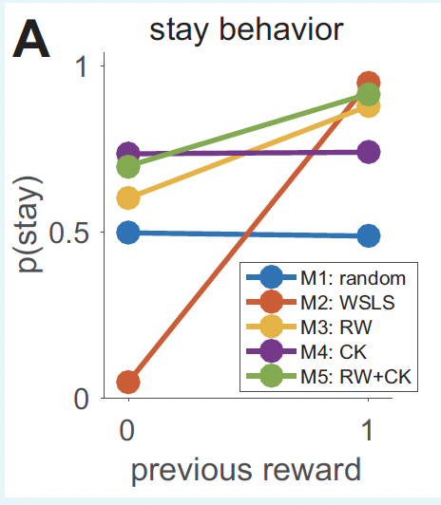
Why Compare Models?
Model One – Random Responding
Subject decides randomly, with a slight bias towards one machine
$p_{t}^{1}=b and{ p}_{t}^{2}=1 −b$
Random Responding model has just one free parameter
$θ_{1}=b$
Model Two – Noisy Win-Stay-Lose-Shift
Repeat rewarded action, switch away from unrewarded actions (with noise)
Model 2 also has one free parameter
$θ_{1}= ε$
Notes:
TO see which explains our data better
This might seem unnecessary in this example, since the M1 and M2 give qualitivatively different results
We can imaging that the random model wont explain our behavioural data and that we’d be able to see that just by eye
But what about comparing between model 3 and 5? They make qualitatively similar predictions, but differ quantitatively.
This is when we need tehcniques to compare between models

Slide 10
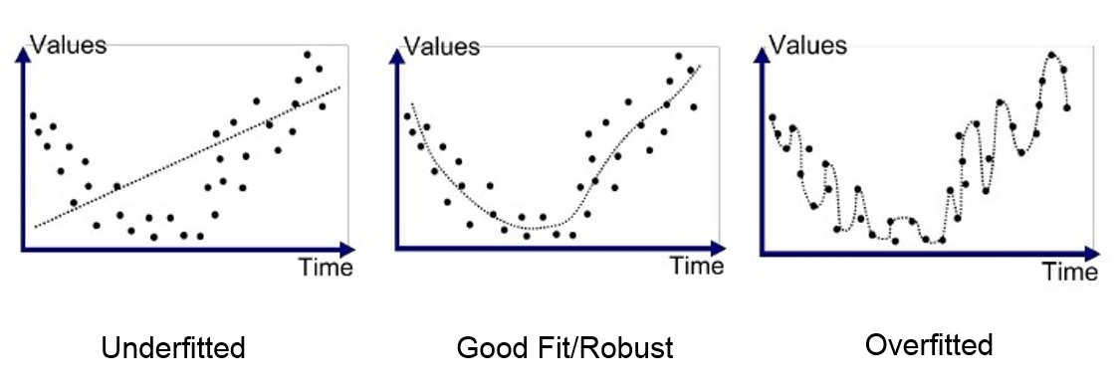
Model Selection
What is a good model?
One that has high accuracy but low complexity
$model evidence=accuracy −complexity$
Overly complex models will overfit data
Meaning they will not generalise to new datasets and will not explain underlying behavioural mechanisms

Slide 11
Approximations of model evidence
$$model evidence=accuracy −complexity$$
Akaike information criterion AIC = $2k−2ln⁡\left(\hat{L}\right)$
Bayesian information criterion BIC = $kln⁡\left(n\right)−2ln⁡\left(\hat{L}\right)$
Both penalise for the number of parameters $k$to address overfitting
Lower AIC and BIC values indicate lower penalty terms hence a better model.
BIC has a greater penalty for complexity than AIC
Notes:
Click
First let’s look at AIC and BIC.
They both define accuracy as -2 times the the negative log of the maximum likelihood function of the model. This is the likelihood of the best fitting parameters given the data. They both define complexity in terms of k, which is the number of parameters in the model.
Click
Both penalize for the number of parameters to address overfitting
Click
As you can see in their equations, a lower number of parameters would result in a lower AIC and BIC, and so lower AIC and BIC values indicate lower penalty terms and hence a better model
Click
BIC has a greater penalty for complexity than AIC
Calculate BIC individually for each subject and then sum it together to get the BIC for the model over the whole group

Slide 12
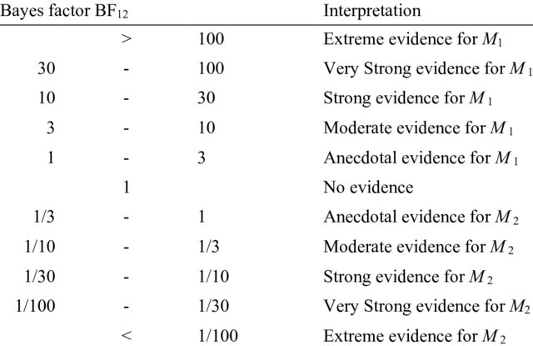
Which model has the higher evidence?
Likelihood Ratio
We can directly compare the maximised likelihood with the likelihood of the null hypothesis
$\frac{L(H_{0}|y) }{L(H_{1}|y)}$
Can only compare models that are special cases of each other
E.g. they share various parameters
Bayes Factor
Compares two models based on the marginalised likelihood function for each model
Can indicate positive evidence for the null
Notes:
The Bayes factor can be thought of as a Bayesian analog to the likelihood-ratio test, but since it uses the (integrated) marginal likelihood instead of the maximized likelihood, both tests only coincide under simple hypotheses (e.g., two specific parameter values)

