Slide 1
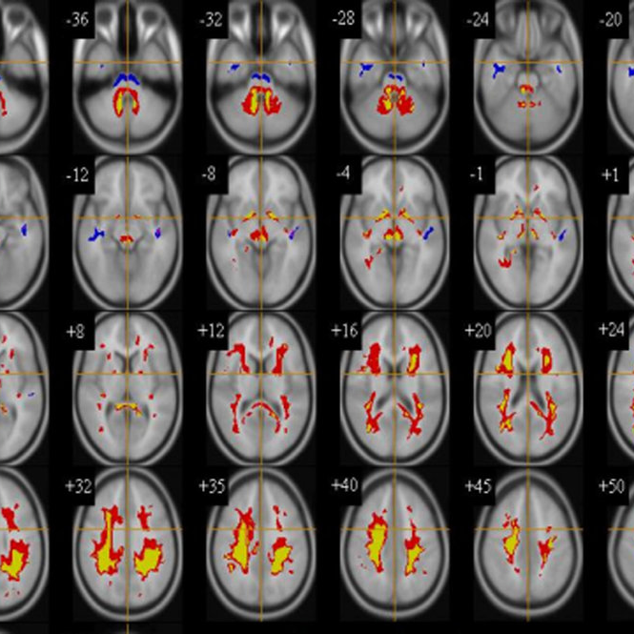
Voxel–Based Morphometry - Methods for Dummies- 2023
ALICIA ROMERO GARCÍA
Notes:
1

Slide 2
Contents
1. Pre-processing Overview
Normalization
Segmentation
Modulation
Smoothing
2. Pre-processing tutorial
3. Statistical analysis
Notes:
2

Slide 3
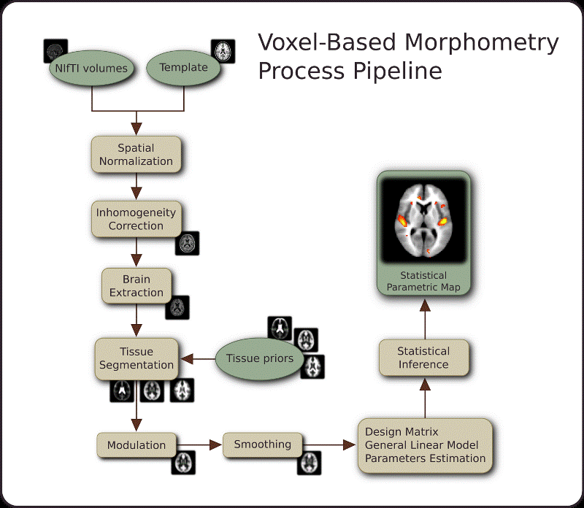
Introduction
VBM is an objective approach that enables a voxel-wise estimation of the local amount of a specific tissue
Pre-processing goals:
To minimize the influence of data acquisition and physiological artifacts
To check statistical assumptions and transform the data to meet assumptions
To standardize the locations of brain regions across subjects to achieve validity and sensitivity in group analysis
Notes:
Voxel Based Morphometry (VBM) is a computational approach to neuroanatomy that measures differences in local concentrations of brain tissue, through a voxel-wise comparison of multiple brain images. VBM aims to reveal the differences between different populations’ brains by making voxel-based comparisons on MR brain images. SPM is used extensively for VBM analyses. Before making statistical comparisons, a pre-processing run is needed. This involves a series of steps aimed at identifying and removing artifacts and ensuring the validity of model assumptions.

Slide 4
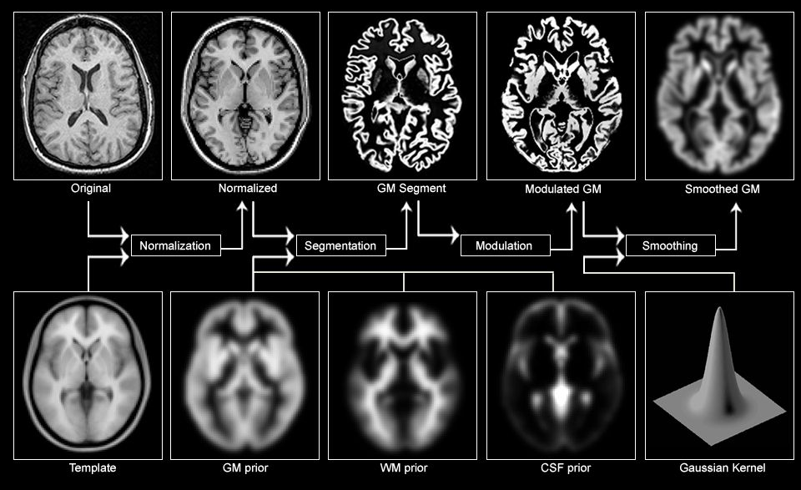
Pre-processing Overview
Notes:
For aiming these goals, VBM involves four fundamental preprocessing steps:
The spatial normalization of subject images into a standard space, segmentation of tissue classes using a priori probability maps, the modulation of the potential errors and smoothing to correct noise and small variations.
Following these preprocessing steps, the data is then ready for the actual statistical analysis.
4

Slide 5
Pre-processing Overview
Segmentation
Normalization
Modulation
Smoothing
Notes:
5

Slide 6
Tissue Segmentation
Gray matter
White matter
Cerebrospinal fluid
Classifies tissues
Very likely
WM
Each of this tissues
has diferents voxels
intensity = volume
¿ ?
Very likely
GM
Notes:
Tissue classification is based on intensity values and basically serves to segment the brain into gray matter, white matter, and cerebrospinal fluid. The classification is based on the intensity values of voxels, where the intensity reflects the volume of each tissue class contained within the voxel.
The signal intensity of the voxel can reflect purely gray matter or white matter. However, for voxels with intermediate intensity values that overlap multiple tissue classes, a probabilistic approach becomes necessary.
6

Slide 7
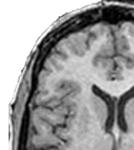
Tissue Segmentation
Tissue Probability Map (TPM) = Gaussians distribution. Represent the prior probability of any voxel belonging to a particular tissue class.
Notes:
In the segmentation process it is important to consider the organized distribution of tissue types within the brain. Tissue probability maps are constructed by registering many brains to a common space. These maps represent the prior probability of a voxel belonging to a specific tissue class.
One way to approach voxel intensities is to view them as a distribution across the entire brain, represented by a histogram like this. Peaks in the histogram correspond to different tissues, and the challenge lies in separating the curve into these tissues. To address this a Gaussian mixture modeling, is applied, but, what is this model? Well, each tissue class is modeled using a specific Gaussian distribution so the resulting histogram is then the sum of these three Gaussians.
*So, if you look at a particular voxel on the brain like this one, it has a particular value of intensity and if you look that the histogram you can determine the likelihood of belonging to a particular tissue class.

Slide 8
Pre-processing Overview
Segmentation
Normalization
Modulation
Smoothing
Notes:
8

Slide 9
Spatial Normalization
Normalization allows one to stretch, squeeze and warp each brain so that it is the same as some standard brain.
Linear transformation
Nonlinear transformation
Pros:
1. Consistent interpretation of spatial locations
2. Generalization to a larger population
3. Comparison across studies
4. Averaging across subjects
Cons:
Reduces spatial resolutions and introduces potential errors
e.g MNI SPACE
Notes:
As you know, every brain is unique, with variations in size and shape so there can be substantial differences in brain shapes. Normalization is a process that addresses these variations by stretching, squeezing, and warping each individual brain to match a standard brain template. This is essential for group analysis because it enables the comparison of different brains and allows for the examination of specific voxels across the entire population.
9

Slide 10
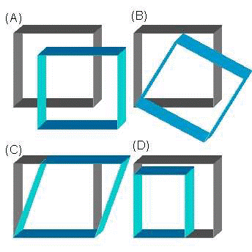
Spatial Normalization
1st Takes the parameter files from previous segmentation
2nd Rigid registration of images to be aligned with TPM
3rd Mean of all images created as initial template
4th Deformations of each image to the template are computed
5th Template is regenerated and averaged
6th Warped images are generated
Translation
Rotation
(C) Shearing
(D) Scaling
Rigid body transformation
Notes:
To illustrate the need for correction, consider the issue of head motion during an experiment. Even small movements of the head can introduce significant errors in the analysis. To address this, a technique called rigid body transformation is employed, by assuming that the brain is a rigid body that may experience movement. The goal is to correct this motion by finding the best alignment between an input image and a target image.
This transformation involves a linear normalization, which includes translation, rotation, scaling, and shearing, and is commonly used to register brains to a template space. However, linear transformations cannot capture local differences in size and shape as the same transformation is applied to every voxel. In contrast, nonlinear transformations can account for local variations in position, size, and shape, providing a more precise correction for interindividual differences on a local scale.
For example, if after the linear transformation a brain structure with a certain amount of gray matter becomes larger, it may appear to have higher local gray matter values than it truly possesses. So, Jacobian determinants are used to quantify the difference between true gray matter and apparent gray matter, allowing for the correction of measured gray matter values.

Slide 11
Pre-processing Overview
Segmentation
Normalization
Modulation
Smoothing
Notes:
11

Slide 12
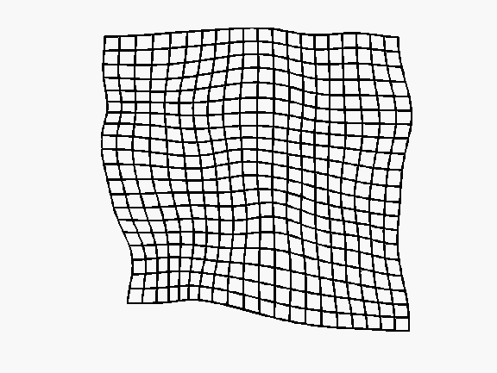
Modulation
Corrects for changes in volume induced by normalization
Voxel intensities can be further modulated by determinant of Jacobean of warps
Allows us to make inferences about volume, instead of concentration
Intensity now represents relative volume at that point
CHANGE IN INTENSITY
=
CHANGE IN VOLUME
i
i
i / δV
X δV
normalisation
modulation
Notes:
The modulation step plays a crucial role in correcting these changes induced by normalization.
To achieve this, voxel intensities (which can be seen as volumes) are multiplied by the local values obtained from the Jacobian of the deformation field generated during normalization.
The outcome of this modulation step ensures that the total gray matter/white matter signal remains unchanged. This preservation of the overall signal allows for inferences to be made about volume rather than concentration. In other words, at this stage, the intensity values of voxels represent relative volume, providing valid information for analyzing and interpreting brain data in terms of volume differences.

Slide 13
Pre-processing Overview
Segmentation
Normalization
Modulation
Smoothing
Notes:
13

Slide 14
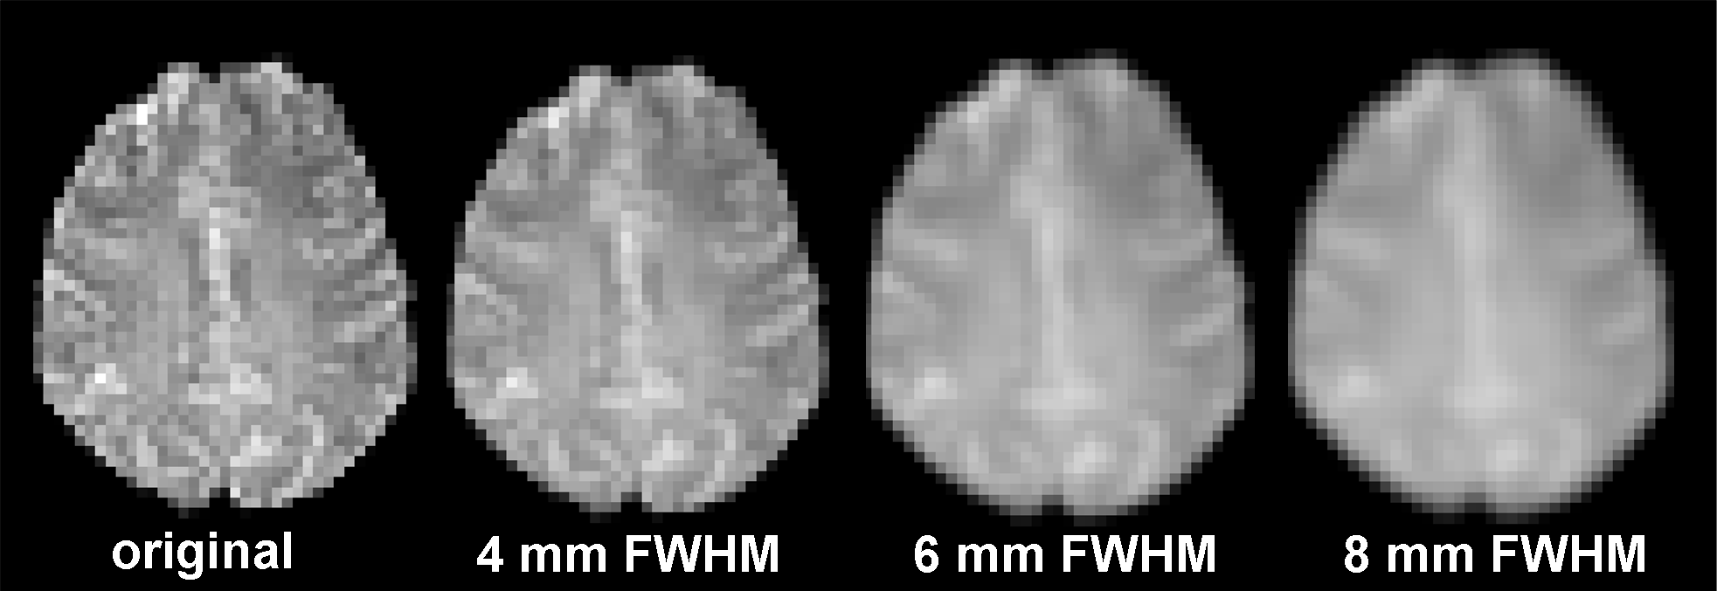
Smoothing
Become data more normally distributed and makes a parametric test a valid choice.
May overcome limitations in the normalization by blurring any residual anatomical differences
Could increase the signal-to-noise ratio (SNR)
May increase the validity of the statistical analysis
Required for Gaussian random fields which is usually used for multiple comparison.
8 mm
FWHM
Notes:
So for spatial filtering, is used a Gaussian Kernel and the size of the kernel is determined by a parameter known as the full width at half maximum (FWHM), which measures the width of the kernel at 50% of its peak value.
14

Slide 15
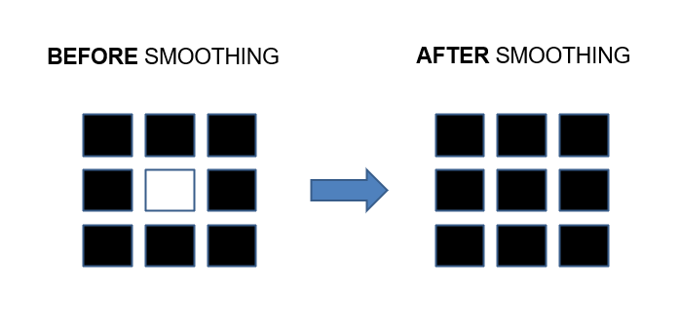
Smoothing
Each voxel represents a sphere similar to the smoothing kernel
= a weighted mean of its own and its neighbors’ values
Notes:
Determining the appropriate width for spatial smoothing depends on the desired outcome. Ideally, the filter should match the spatial extent of the signal to optimize the signal-to-noise ratio (usually between 8-14 mm). In practice, each voxel becomes weighted average of surrounding voxels and as a result we have a blurred image.
Additionally, the same amount of smoothing is typically applied uniformly across the entire image, even though the spatial extent of activation may vary across different brain regions.
15

Slide 16
TUTORIAL

Slide 17
Pre-processing tutorial
Notes:
First of all, it is necessary to convert the images formats into niftis file format. For doing this use the DICOM Import bottom in the main SPM menu. Here you can select the images, the output directory and the output file format.

Slide 18
Pre-processing tutorial
Notes:
Once you have done this, before starting any analysis, you should visually check your data and see if there is not any error that could affect to the analysis. To do this, use the “Check Registration” function in the spm main menu.

Slide 19
Segmentation tutorial
Data -> Volumes: “example.nii file”
Tissues:
GM
Native Tissue -> Native + Dartel imported
Warped Tissue -> None
WM
Native Tissue -> Native + Dartel imported
Warped Tissue -> None
CSF
Native tissue -> Native space
Warped tissue -> None
Warping and MRF
Random fields -> None
Notes:
Assuming the data hasn´t any issues and it has the correct format, the next step is to segment the brain into different tissue types, so you must select the segment bottom of the spm menu. This will open the GUI were you will see a lot of options that you can change and customize but it gives you default recommendations so you just have to change a few things:
- First double click on volumes. This will open a file select box, where we will select all of the T1 images we want to analyse.
- Then you will now need to modify the following options (summarized on the figure over): I let you here all the changes you must do.

Slide 20
Segmentation tutorial
c1[filename].nii
c2[filename].nii
“example.nii”
• c1[filename].nii – Native space grey matter segmentation
• c2[filename].nii – Native space white matter segmentation
• c3[filename].nii – Native space CSF segmentation
• rc1[filename].nii – Dartel import space grey matter segmentation
• rc2[filename].nii – Dartel import space white matter segmentation
• rc3[filename].nii – Dartel import space CSF segmentation
c3[filename].nii
Notes:
The output in each file directory will be different files where you could find the data segmented by wm , gm, csf. *Basically, Dartel import images means that they are orientated (rigidly aligned) with MNI space.

Slide 21
Dartel Normalization tutorial
rc1[filename].nii
rc2[filename].nii
- Template_x.nii
- u_rc1example.nii
Notes:
The next step is DARTEL Normalization to align GM and WM generating its own average template data. For doing this, check in the batch menu the SPM botton and look for the Tools. Then click on the dartel tools and then choose the run dartel “create template” option.
Then in the Images option you must choose the rc1 images (the Dartel importation ones) and the outputs you will find in the directory are: Template_x.nii and u_rc1example.nii

Slide 22
Dartel Normalization tutorial
u_rc1example.nii
Template_x.nii

Slide 23
Normalization and modulation tutorial
Template_6.nii
u_rc1example.nii
c1example.nii
Notes:
So, this new files are use to generate smoothed spatially normalized jacobian scaled GM images in MNI space. This will be done by clicking again in the Tools botton, then dartel tools and now instead of create template (because we have already have it), we have to go to normalize into MNI space.
Now we have to introduce the different fiels that we have obtain in the previous steps:
- In the dartel template select the template_6.nii image
- In according to, select many subjects and introduce the u_rc1 image in the flow fields option and the c1.nii we obtained at the beginning in the images option.
Then is necessary to preserve amount instead of concentrations for the correct modulation. And finally in the Gaussian FWHM that I explained before, you can choose the mm you consider opportune. But letting it in 8 it works for me.

Slide 24
Normalization and modulation tutorial
Template_6.nii
u_rc1example.nii
c1example.nii
smwcexample.nii
Notes:
So finally, after running it, the output is the smooth image that will be call “smwcexample.nii”
Now with this image we can start the statistical analysis.

Slide 25
Statistical Analysis
General Linear Model (GLM) Mass univariate approach
Specify model: Simplification, explain the relationship betweeen the predictor and the outcome
Estimate the model: Find the slope (or amplitude) and the intercept
Statistical inference: Test the slope with a p-value
Scientific interpretation: What´s the meaning of that relationship?
Matrix design
Statistical
parametric
maps
Notes:
So, once we have our Normalized, warped and smoothed images to MNI space, we can start the statistical analysis.
Voxel-Based Morphometry (VBM) employs a mass univariate approach for statistical analysis. This means that each voxel in the brain is treated as a separate unit of analysis, allowing for the examination of local differences in brain structure.
Now, we need to fit a model to the pre-processed data. In other words, how much BOLD activity there was for each condition within each voxel of the brain image.
To perform this we need to design a matrix which represents the experimental design and includes predictor variables that capture the conditions or groups being compared.
The general linear model (GLM) is then applied to the design matrix. The GLM allows us to estimate the relationship between the predictor variables and brain structure at each voxel.
For doing that, a parameter estimation is essential in the GLM analysis. It involves estimating the parameters that quantify the strength and direction of the relationship between the predictor variables and brain structure at each voxel. These coefficients represent the effect of how much each predictor variable contributes to explaining the observed brain structural differences.
Depending on the sample and the hypothesis, the statistical inference to evaluate the significance of the estimated parameters could be a t-test or F-test.
The results of the statistical inference are often represented using statistical parametric maps (SPMs). This maps display the statistical significance or effect sizes at each voxel across the entire brain. They provide a visual representation of the regions showing significant differences in brain structure between groups or conditions.

Slide 26
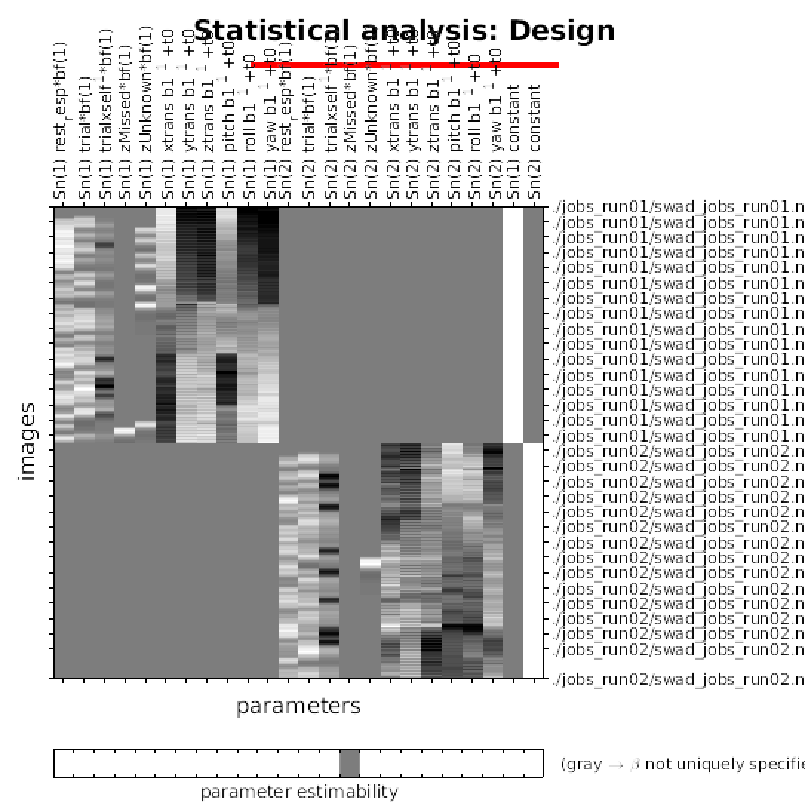
Statistical Analysis
Y = Constant + X * β + ε
Notes:
In summary, VBM analysis utilizes a mass univariate approach, where each voxel is independently analyzed. It involves constructing a design matrix, applying the general linear model to estimate parameters that capture the relationship between predictor variables and brain structure. Statistical inference is then used to determine the significance of the estimated parameters, and the results are often presented using statistical parametric maps.

Slide 27
Thank you

Slide 28
References
Previous MfD Slides
Kurth, F., Luders, E., & Gaser, C. (2015). Voxel-based morphometry. In A. W. Toga (Ed.), Brain mapping (pp. 345-349). Waltham: Academic Press. doi:10.1016/B978-0-12-397025-1.00304-3
Kurth, F., Luders, E., & Gaser, C. (2015). Voxel-based morphometry. In A. W. Toga (Ed.), Brain mapping (pp. 345-349). Waltham: Academic Press. doi:10.1016/B978-0-12-397025-1.00304-3
Ashburner, J. (2010). VBM tutorial
Lambert, C. (2018). Voxel based morphometry tutorial using the geodesic shooting toolbox.

