Slide 1
General Linear Model

Slide 2
General Linear Model
regressors
Y₁
Y₂
.
.
.
Y_{J}
X₁₁ … X_{1l} … X_{1L}
X₂₁ … X_{2l} … X_{2L}
.
.
.
X_{J1} … X_{Jl} … X_{JL}
β₁
β₂
.
.
.
β_{L}
ε₁
ε₂
.
.
.
ε_{J}
=
+
time
points
time
points
regressors
time
points
Y = X * β + ε
Observed data
Design Matrix
Parameters
Residuals/Error

Slide 3

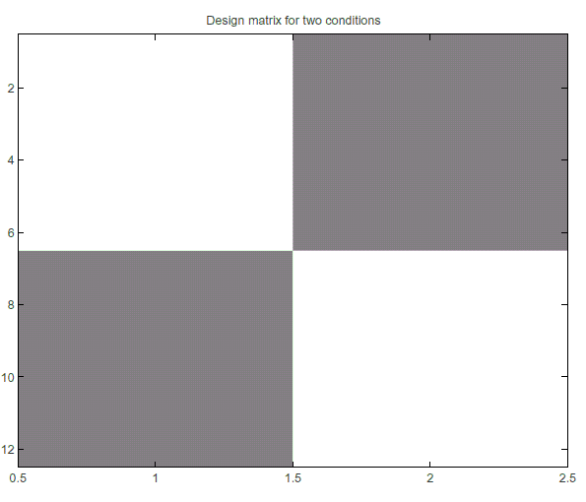
Design Matrix
0
0
0
0
0
0
0
rest
task
Conditions
    On Off
    Off On
1
1
1
1
1
1
1
Use ‘dummy codes’ to
label different levels of
an experimental factor
(eg. On = 1, Off = 0).
time

Slide 4

Design Matrix
5
4
4
2
3
1
6
3
1
6
5
2
Covariates
Parametric variation
of a single variable
(eg. Task difficulty = 1-6)
or measured values of
a variable (eg. Movement).

Slide 5
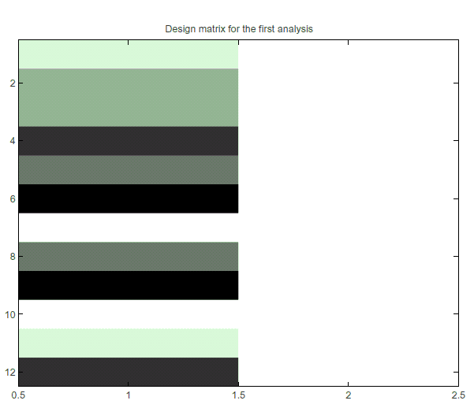
Design Matrix
1
1
1
1
1
1
1
1
.
.
.
Constant
Variable
Models the
baseline activity
(eg. Always = 1)

Slide 6
Design Matrix
Time
Regressors
The design matrix should include everything
that might explain the data.

Slide 7
General Linear Model
regressors
Y₁
Y₂
.
.
.
Y_{J}
X₁₁ … X_{1l} … X_{1L}
X₂₁ … X_{2l} … X_{2L}
.
.
.
X_{J1} … X_{Jl} … X_{JL}
β₁
β₂
.
.
.
β_{L}
ε₁
ε₂
.
.
.
ε_{J}
=
+
time
points
time
points
regressors
time
points
Y = X * β + ε
Observed data
Design Matrix
Parameters
Residuals/Error

Slide 8
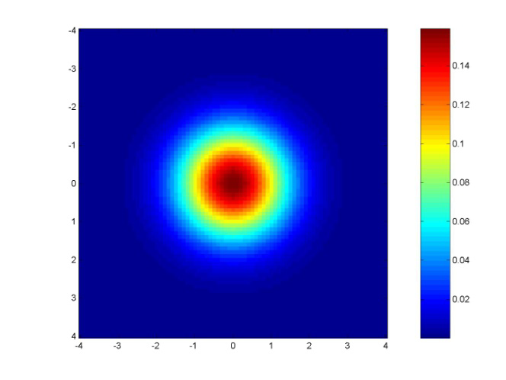
Error
Independent and identically distributed
iid

Slide 9
Ordinary Least Squares
Residual sum of square:
The sum of the square difference between actual value and fitted value.
e

Slide 10
Ordinary Least Squares
N
∑
2
e
= minimum
t
t
=
1
e

Slide 11
Ordinary Least Squares
Y = Xβ+e
e = Y-Xβ
X^{T}e=0
=> X^{T}(Y-Xβ)=0
=> X^{T}Y-X^{T}Xβ=0
=> X^{T}Xβ=X^{T}Y
=> β=(X^{T}X)⁻¹X^{T}Y
y
e
Xβ
x₁β₁
x₂β₂

Slide 12
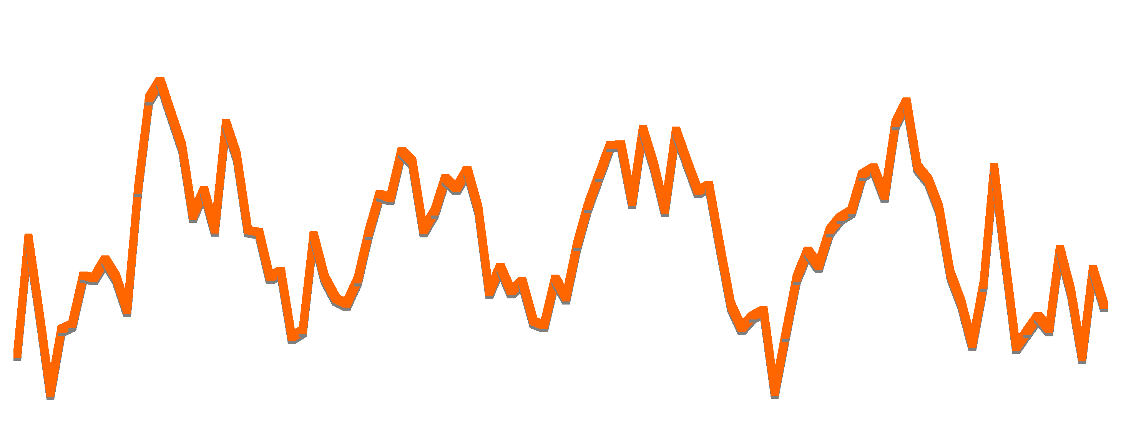

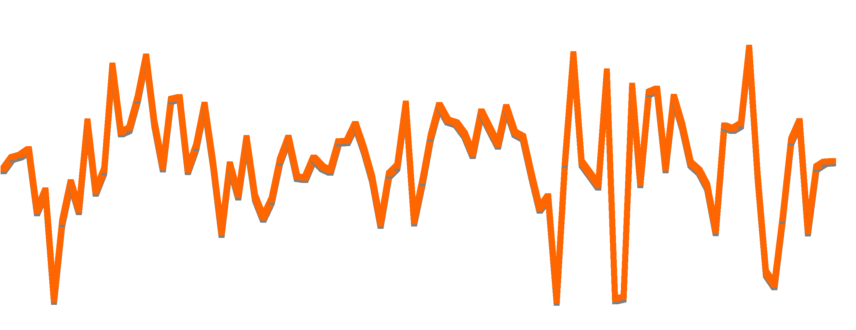
fMRI
Y = X * β + ε
Observed data
Design Matrix
Parameters
Residuals/Error

Slide 13
Problems with the model

Slide 14
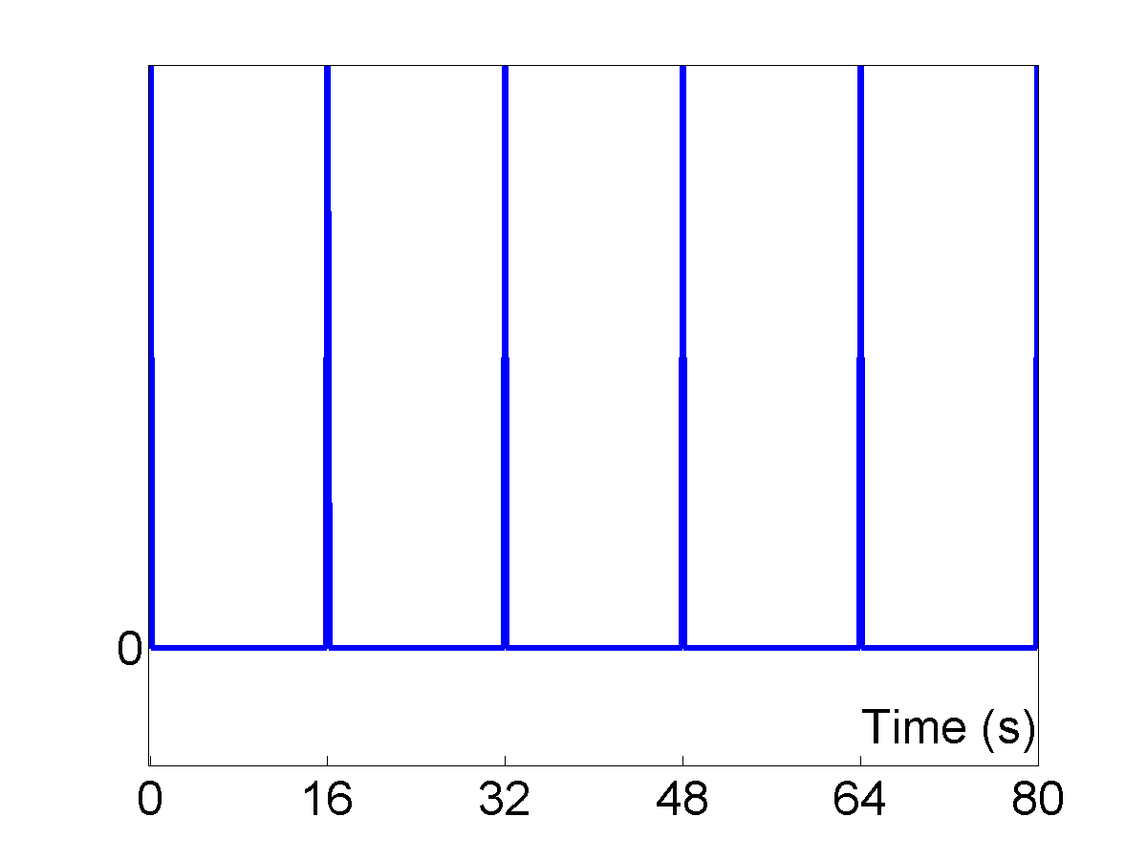
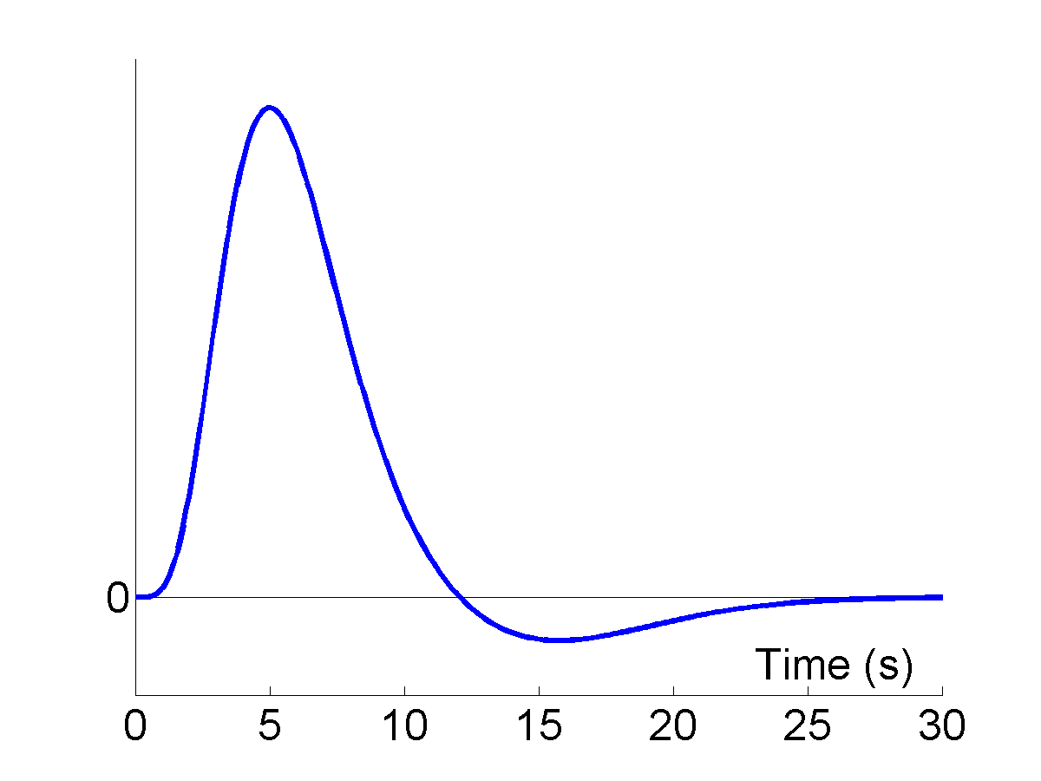
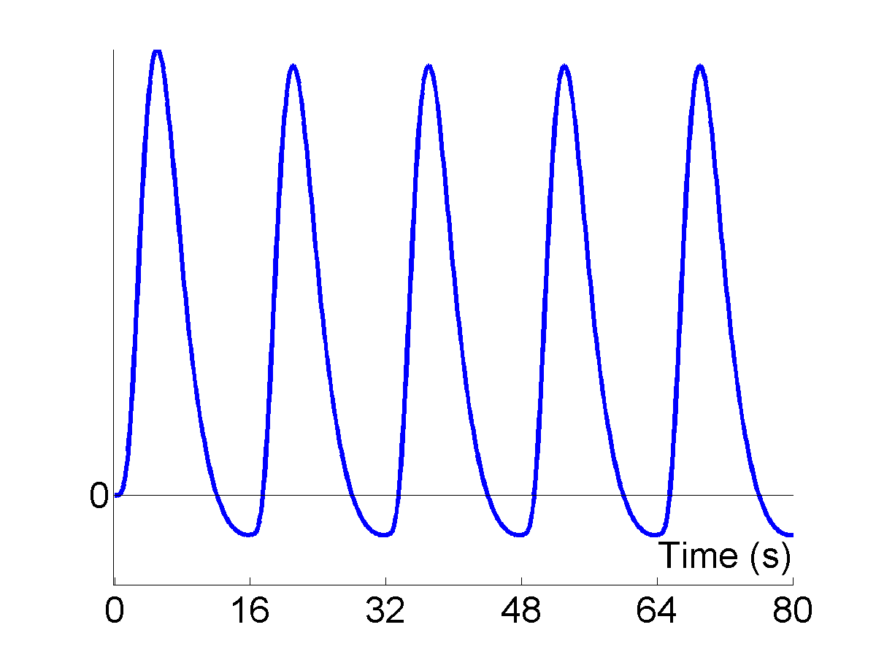
The Convolution Model
Impulses
HRF
Expected BOLD
⊗
=
Notes:
The BOLD signal does not respond immediately and it responds in this shape (middle picture), but the impulses or conditions change in a 0 to 1 or on/off way (left-hand picture). The model needs to be altered to accommodate the haemodynamic response function (right-hand picture). This is termed the convolution model.

Slide 15
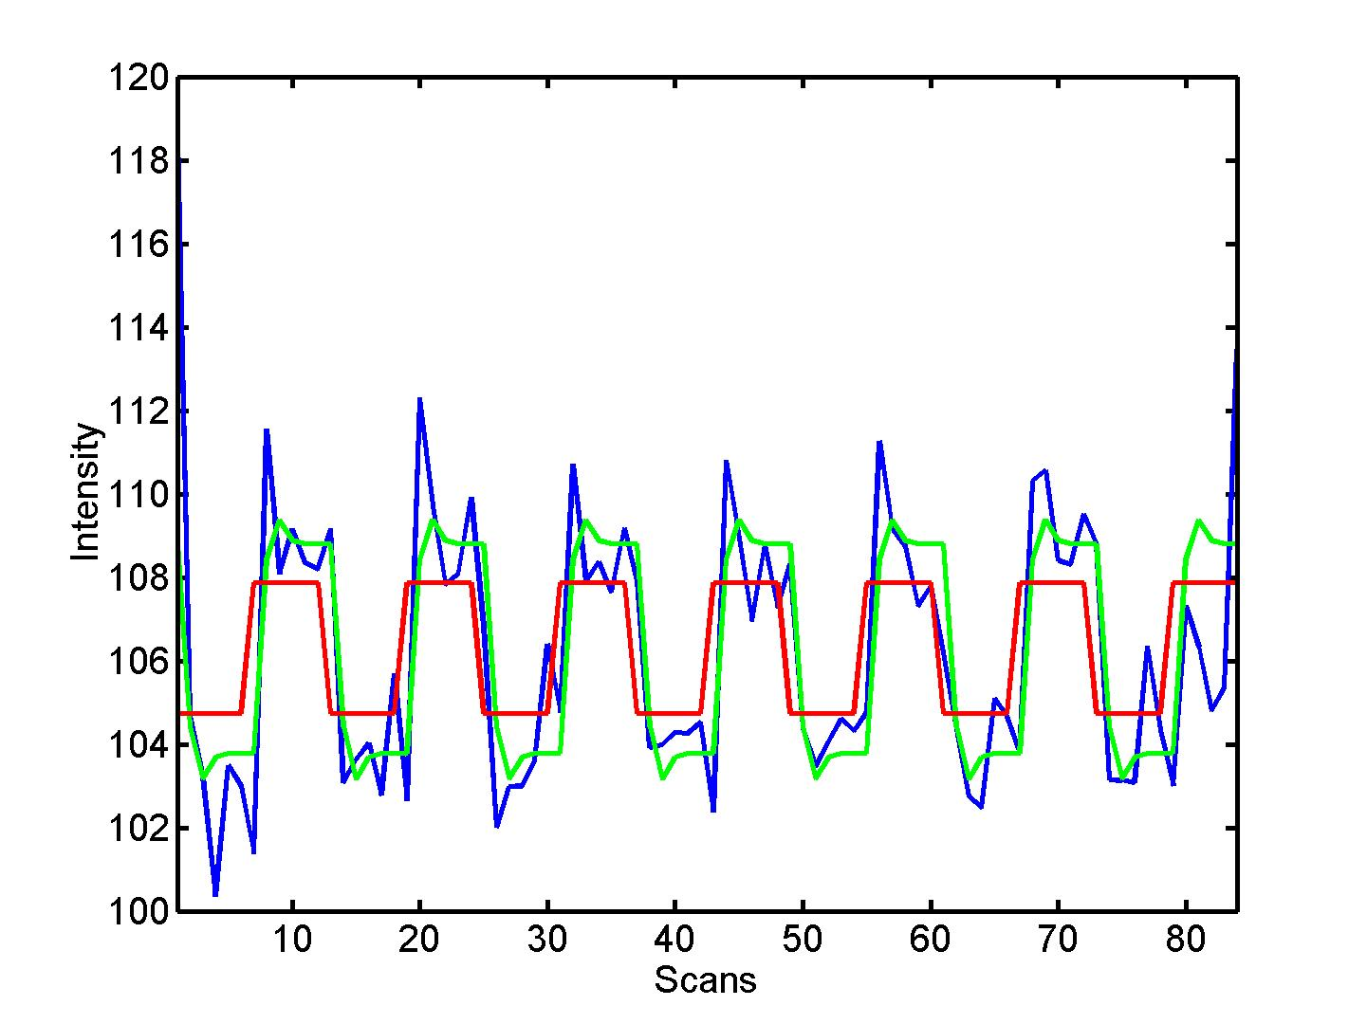


Convolve stimulus function with a canonical hemodynamic response function (HRF):
Original
Convolved
HRF
⊗ HRF
Notes:
So you alter the model from being an on-off (red column on left) to a more smoothed convolved model (green column on left). This graph (right hand side) shows the BOLD response against scan number and shows how the model can be adjusted to have a closer match with the actual HRF.

Slide 16
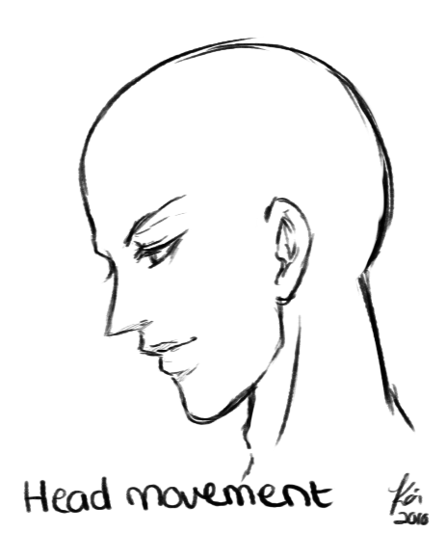
Physiological Problems
Notes:
http://fc02.deviantart.net/fs70/f/2010/226/e/c/Animation__Head_Movement_by_Kai_tun.gif

Slide 17
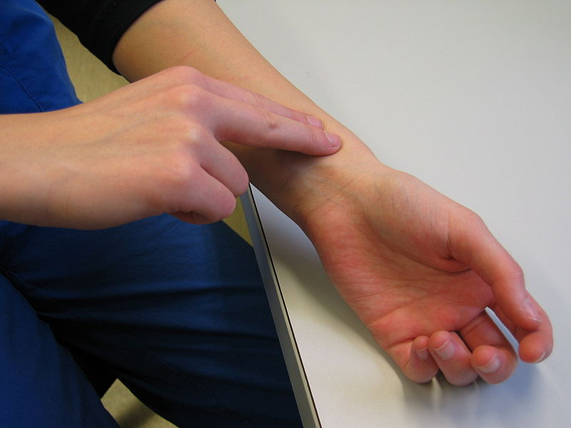
Notes:
http://upload.wikimedia.org/wikipedia/commons/thumb/b/b2/Pulse_evaluation.JPG/800px-Pulse_evaluation.JPG

Slide 18
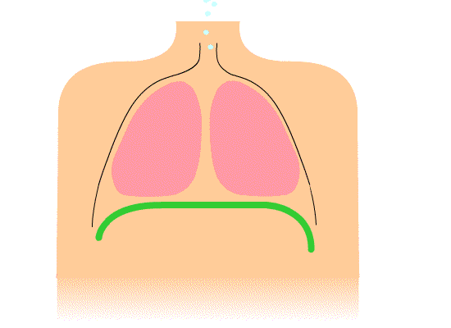
Notes:
http://upload.wikimedia.org/wikipedia/commons/9/9c/Diaphragmatic_breathing.gif

Slide 19
Noise
Low-frequency noise
Solution: High pass filtering
Notes:
biorhythms, coil heating, etc…

Slide 20
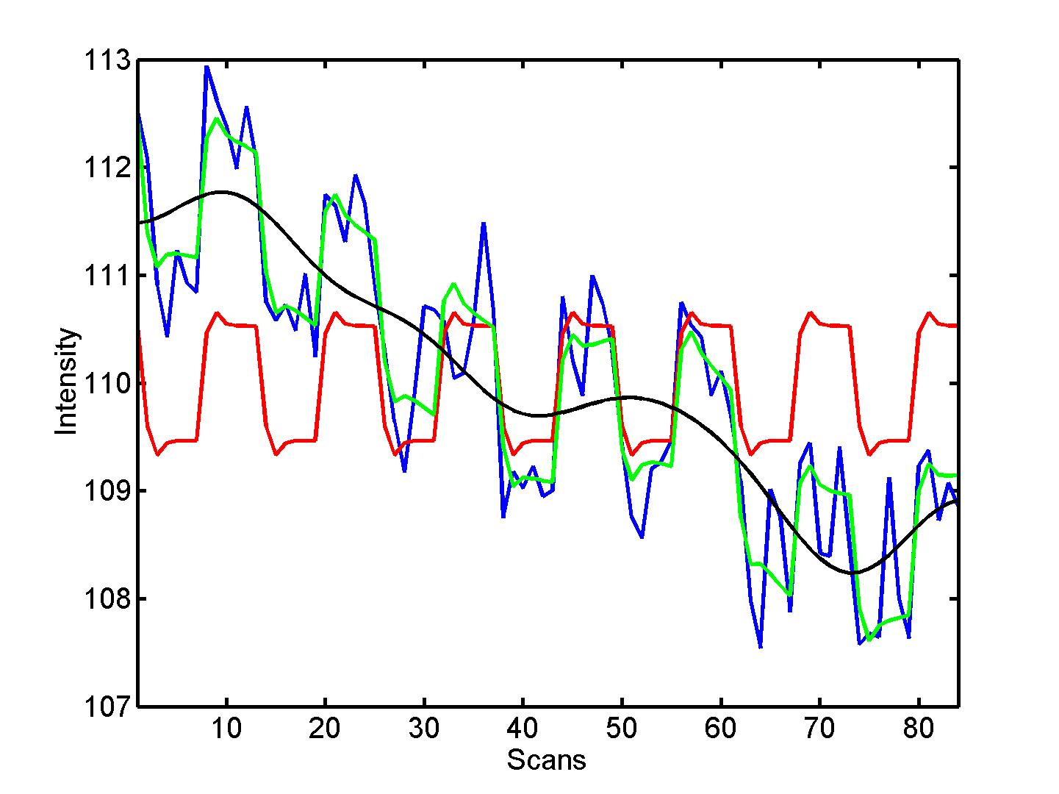
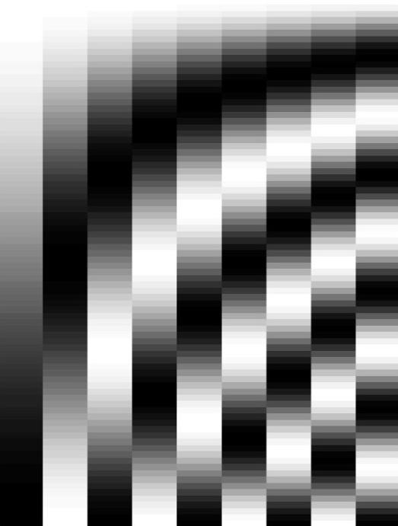
discrete cosine transform (DCT) set
blue = data
black = mean + low-frequency drift
green = predicted response, taking into account low-frequency drift
red = predicted response, NOT taking into account low-frequency drift
Notes:
In order to remove this we can add a high-pass filter. This figure shows columns in the matrix that are very low frequency which can be modelled in the data in order to take account of this low-frequency noise.

Slide 21
Assumptions of GLM using OLS
All
About
Error

Slide 22
Unbiasedness
  Expected value of beta
  =
  beta
Notes:
Mean of zero

Slide 23

Normality

Slide 24
Sphericity

Slide 25
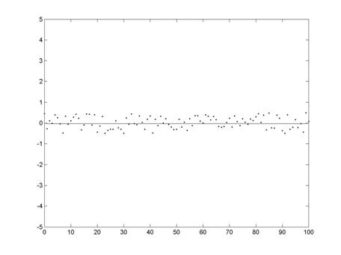
Homoscedasticity
Notes:
http://www.elderlab.yorku.ca/~aaron/Classes/Stats/Correlation%20and%20Regression_files/image093.jpg
has constant variance

Slide 26
not

Slide 27
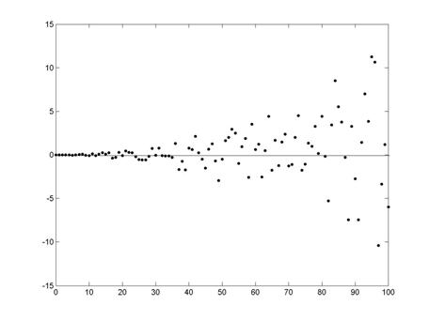
Notes:
http://www.elderlab.yorku.ca/~aaron/Classes/Stats/Correlation%20and%20Regression_files/image096.jpg

Slide 28
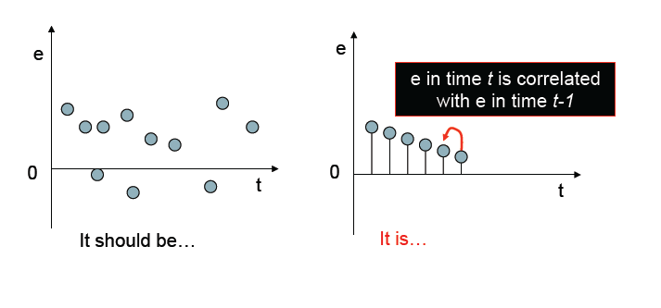
Independence

Slide 29
Autoregressive Model
y = Xβ + e over time
e_{t} = ae_{t-1} + ε
autocovariance function
a should = 0
Notes:
In order to correct this, SPM uses something called an autoregressive model. This equation simply shows that for an error at time t, there is an autocovariance function a which shows its correlation with error at time t-1. The error at one point is correlated to the previous time point and to a lesser degree the time point before that but it slopes off quickly. So it is possible to use this equation to calculate to what degree the error is correlated and then remove it from the GLM equation. All you basically need to understand is that: GLM assumes that the error is not correlated but it is, SPM is able to perform an ‘autoregressive model’ which is able to calculate this correlation and then remove it from the data so it is no longer a problem.

Slide 30
Thanks to…
Dr. Guillaume Flandin

Slide 31
References
http://www.fil.ion.ucl.ac.uk/spm/doc/books/hbf2/pdfs/Ch7.pdf
http://www.fil.ion.ucl.ac.uk/spm/course/slides10-vancouver/02_General_Linear_Model.pdf
Previous MfD presentations

