Slide 1
Methods for Dummies
Second level analysis
By Samira Kazan and Bex Bond
Expert: Ged Ridgway
Notes:
Hi. Today, Samira and I will be discussing second level analysis – taking the data we got from individual subjects and analysing the effects demonstrated throughout the group.

Slide 2
Today’s talk
What is second level analysis?
  Building on our first level analysis – look at a group
Explaining fixed and random effects
  How do we generalise our findings to the population at large?
Implementing random effects analysis
  Hierarchical models vs. summary statistics approach
Implementing second-level analyses in SPM
Notes:
So first, I’ll be going through the theory – zooming through what we did in first level analysis, and then how we can see what activations are consistent/seen on average in our participants, and the extent to which we might generalise our findings to the wider population. I’ve tried to put most of the information on the slides, so it’s easy for you to look back and understand them in your own time. Then we’ll go on to how to run these analyses – and Samira will be showing you how this works in SPM.

Slide 3
1st level analysis – single subject
For each participant individually:
Spatial preprocessing
    accounting for movement in the scanner
    fitting individuals’ scans into a standard space
    smoothing and so on for statistical power
…
Notes:
So, let’s recap first level analysis. In first level analysis, we took each participant in turn, first doing our spatial preprocessing – realigning, standardising and smoothing individuals’ scans so we can identify the regions of activation in relation to e.g. MNI space, and can easily compare the effects seen across subjects and between groups of subjects.

Slide 4
1st level analysis – single subject
  For each participant individually:
  Set up a General Linear Model for each individual voxel
    Y=βX + ε
    Y is the activity in the voxel – βX is our prediction of this activity, εis the error of our model in its predictions.
    X represents the variables we use to predict the data – mainly, we use the design matrix to specify X, so we can change our predictions between different trial types (levels of X), e.g. seeing famous faces and seeing non-famous faces. Thus need to incorporate stimulus onset times.
    We estimate β: how much X affects Y – its significance indicates the predictive value of X
Notes:
For each voxel, we set up a GLM to model the activity in that voxel, and how it changes with different types of trial – we can only do this as we synchronise the scan data with our stimulus presentations. We can test the effects of trial types here, by seeing if beta, the effect of X on Y, is significantly different from zero.

Slide 5
1st level analysis – single subject
  In the above GLM, we can also incorporate other predictor variables to improve the model:
    Movement parameters
      we can measure and thus account for this known error – thus increasing our power
    Physiological functions, e.g. Haemodynamic Response Function
      modelling how neuronal activity may be transformed into a haemodynamic response by neurophysiology may improve our ability to claim that our data based on the BOLD signal represents ‘activity’
Notes:
…and we just generally try to make our model useful – reducing any known error to increase statistical power, incorporating the haemodynamic response function and so on.

Slide 6
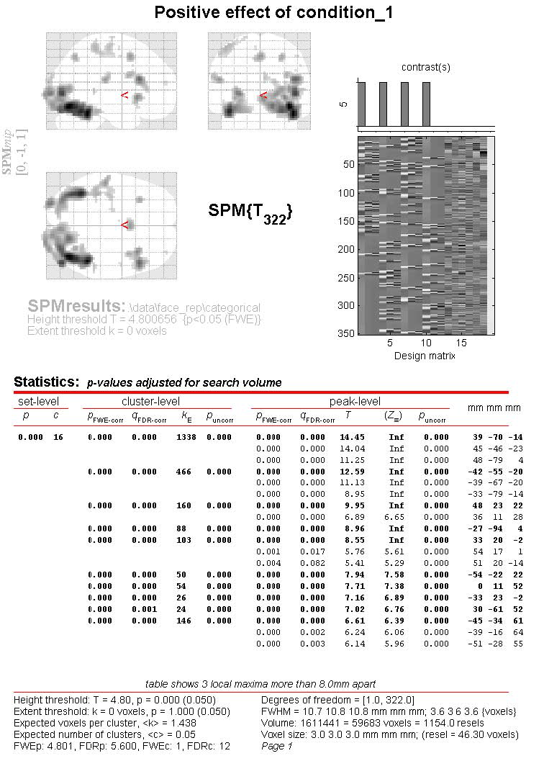
1st level analysis – single subject
For each participant, we get a Maximum Intensity Projection for our contrasts tested
  We can see where, on average, this individual showed a significant difference in activation. Can overlay this with structural images.
  Remember, the voxels are each analysed individually to build up this map. Also beware multiple comparisons inflating α.
Notes:
So for each participant we can, through modelling activity at each individual voxel separately, build up a map of where there is a significant effect of X – i.e. of trial conditions. Bear in mind there are lots of comparisons going on!

Slide 7
2nd level analysis – across subjects
Significant differences in activation between different levels of X are unlikely to be manifest identically in all individuals. We might ask:
  Is this contrast in activation seen on average in the population?
  Is this contrast in activation different on average between groups? e.g. males vs. females?
Notes:
2nd level analysis is when we try to see how often the effects we see in a participant are observed across a group. This could be within our sample, but we almost always want to see if the effects are likely to be found in the population generally.

Slide 8
2nd level analysis – across subjects
We need to look at which voxels are showing a significant activation difference between levels of X consistently within a group.
To do this, we need to consider:
    the average contrast effect across our sample
    the variation of this contrast effect
    t tests involve mean divided by standard error of mean
Notes:
To see how strong these effects found are beyond a single participant, we need to consider the average effect in our sample (the beta I showed you earlier), and how much the effect varies.

Slide 9
2nd level analysis –
Fixed effects analysis (FFX)
Each subject repeats trials of each type many times – the variation amongst the responses recorded for each level of the design matrix (X) for a given subject gives us the within-subjects variance,σ_{w}²
If we take the group effect size as the mean of responses across our subjects, and analyse it with respect to σ_{w}², we can infer which voxels on average show a significant difference in activation between levels of X in our sample…
  …and ONLY in our specific sample. We cannot infer anything about the wider population unless we also consider between-subjects variation. This is called fixed-effects analysis.
Notes:
So the GLM from each participant is a model of how they act, based on lots of repetitions of each trial type given. Responses won’t always be the same for a given trial type; the variation in a subject’s responses gives us the within-subjects variance.
If we just want to look at how strong an effect is within our sample, we can analyse the average effect per participant, in relation to the within-subs variance – this tells us which voxels on average show a significant difference in activation for different levels of the design matrix – but only within our specific sample. This is fixed effects analysis – to generalize to the wider population, we need to also consider the variation between subjects: this is called mixed or random effects analysis.
[In our 1st level analysis, the observations that vary are the individual repetitions of trials of a certain type, occurring many times in a session.]

Slide 10
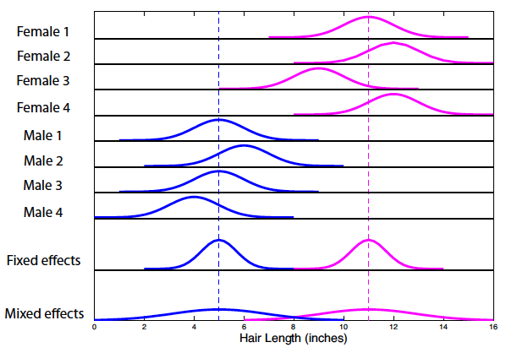
An illustration (from Poldrack, Mumford and Nichol’s ‘Handbook of fMRI analyses’)
Random effects
Notes:
Here’s an illustration. For the first 8 rows, we can see the distribution of each individual’s responses – the mean is at the peak, and the width of the curve indicates the within-subject variance. So, in the fixed effects analysis, the mean of the individuals is taken as the peak, and the variance is the mean variance among the individuals [check this]. If we look at the random (aka mixed) effects bit at the bottom, which estimates the variance of responses across the population, we can see that the variance is much greater. This means that our statistical tests will be more conservative – we will only infer that an effect is a likely true population effect if it is large enough to be seen when the distributions of the two populations, males and females, overlap more.

Slide 11
2nd level analysis –
Random effects analysis (RFX)
In order to make inferences about the population from which we assume our subjects are randomly sampled from, we must incorporate this assumption into our model.
  To do this, we must consider the between-subject variance (σ_{b}²), as well as within subject-variance (σ_{w}²) – and estimate the likely variance of the population from which our sample is derived.
  This is referred to as “random effects analysis”, as we are assuming that our sample is a random set of individuals from the population.
Notes:
In order to generalise our findings to the wider population, we need to consider how our subjects differ from each other, and the likely variance of the population that we have sampled from – which is what we’re interested in. The population variance will be greater than the variance within our sample, so to make these generalised inferences we need to use an estimate of the population variance to test the significance of the mean differences in activation that we see in our sample. This is dubbed “random effects analysis”, as we assume that our sample is a random set of individuals from the population of interest.
Go back to previous slide to show this stuff again. Observe how the increase in variance means there is more overlap in the male/female distributions – so an effect must be significantly great for us to be able to distinguish male from female.

Slide 12
Take home message
In fMRI, between-subject variance is much greater than within-subject variance. We need to consider both aspects of variance to make any inferences about the wider population, rather than just our sample.
As the population variance is much greater than the within-subjects variance, fixed effects analysis ‘overestimates’ the significance of effects – random effects analysis is more conservative, highlighting the greater effects, that may be seen across the population. Fixed effects may be swayed by outliers.

Slide 13
2nd level analysis –
Methods for RFX analysis
Hierarchical model
  Estimates subject and group stats at once via iterative looping
  Ideal method in terms of accuracy…
  …but computationally intensive, and not always practical!
    (e.g. adding in subjects means the entire estimation process has to start from scratch again)
  Can we get a good, quick approximation? A valid one?
Notes:
So, there are a couple of methods for running your random effects analysis. The most accurate method is to use a hierarchical model – this involves setting up a GLM containing parameters for the effects and variances at both the subject and group levels, to all be estimated at once. This happens via iterative looping, and though I haven’t run it myself, it’s apparently often seen to be a bit too much of a faff, really. Because using a hierarchical model is so computationally intensive, it would be ideal to use a quicker method, that might not be as accurate but good enough for us to be confident in our findings…

Slide 14
2nd level analysis –
Methods for RFX analysis
Summary Statistics Approach
  This is what SPM uses!
  Involves bringing sample means forward from 1st level analysis. Less computationally demanding!
  Generally valid; quite robust
    valid when the 1st level design is the same for all subjects (e.g. number of trials)
    exact same results as a hierarchical model when the within-subject variance is the same for all subjects – so it’s a good approximation when they are roughly the same
    validity undermined by extreme outliers
Notes:
…and such a method seems to exist. What SPM uses is known as the summary statistics approach, where you estimate effects at each level in turn and use this in modeling the next level – so essentially we bring the means forward from the 1st level analysis. This method generally does the trick, if the 1st level design is the same for all subjects, and there aren’t crazy outliers. If the within-subject variance is the same for all subjects, the results of the summary stats analysis will be the same as if we used a hierarchical model.
…next up: Samira with the SPM analyses.

Slide 15
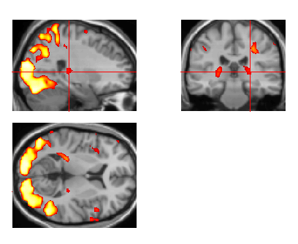

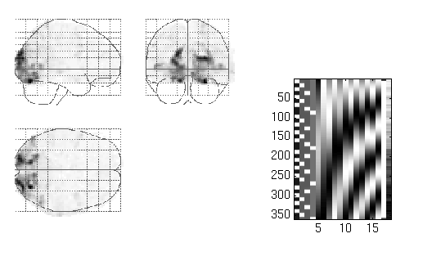
Overview of SPM
Statistical parametric map (SPM)
Image time-series
Kernel
Design matrix
Realignment
Smoothing
General linear model
Statistical
inference
Gaussian
field theory
Normalisation
p <0.05
Template
Parameter estimates

Slide 16
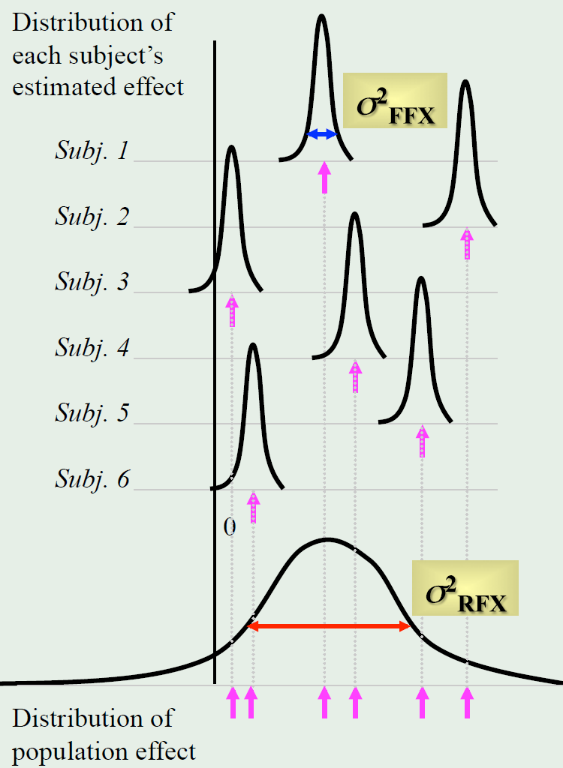
Fixed vs. Random Effects in fMRI
Fixed-effects
Intra-subject variation
  Inferences specific to the group
Random-effects
Inter-subject variation
  Inferences generalised to the population
Courtesy of [1]

Slide 17
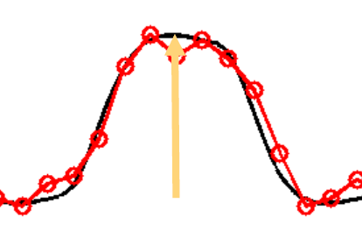
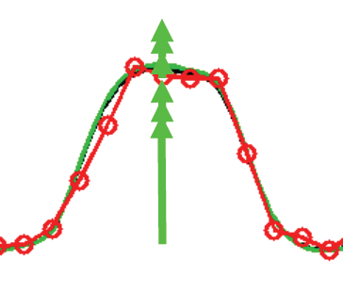
Fixed vs. Random Effects in fMRI
Fixed-effects
Is not of interest across a population
Used for a case study
Only source of variation is measurement error (Response magnitude is fixed)
Random-effects
If I have to take another sample from the population, I would get the same result
Two sources of variation
  Measurement error
  Response magnitude is random (population mean magnitude is fixed)
Courtesy of [1]

Slide 18
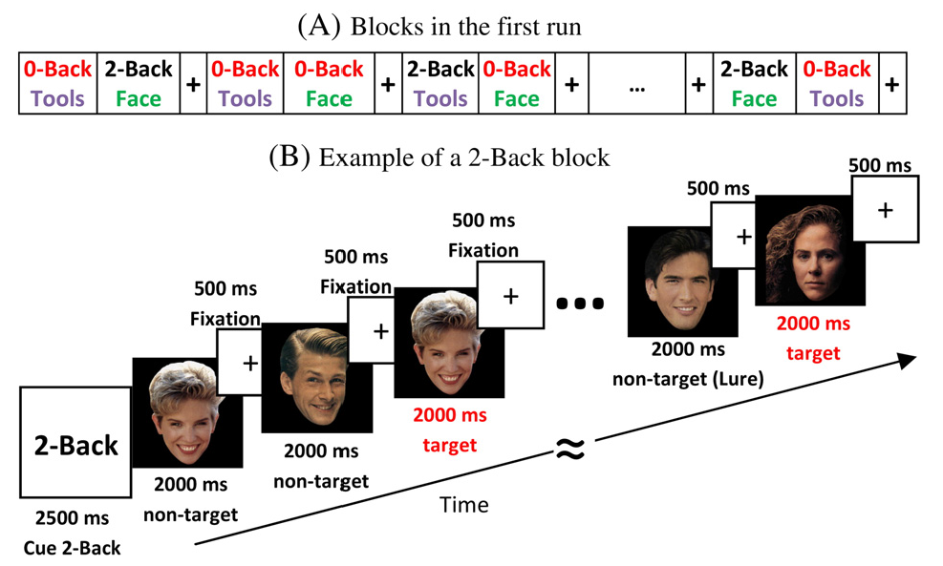
Data set from the Human Connectume Project
Courtesy of [2]

Slide 19
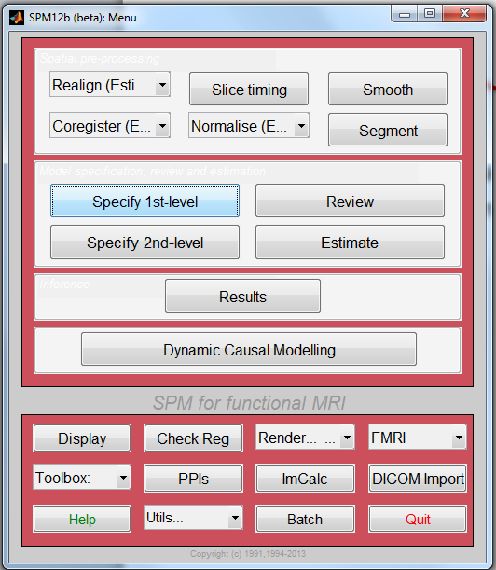
SPM 1st Level

Slide 20
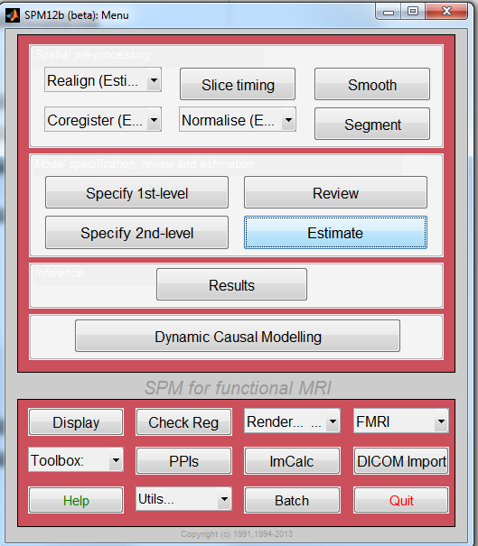
SPM 1st Level

Slide 21
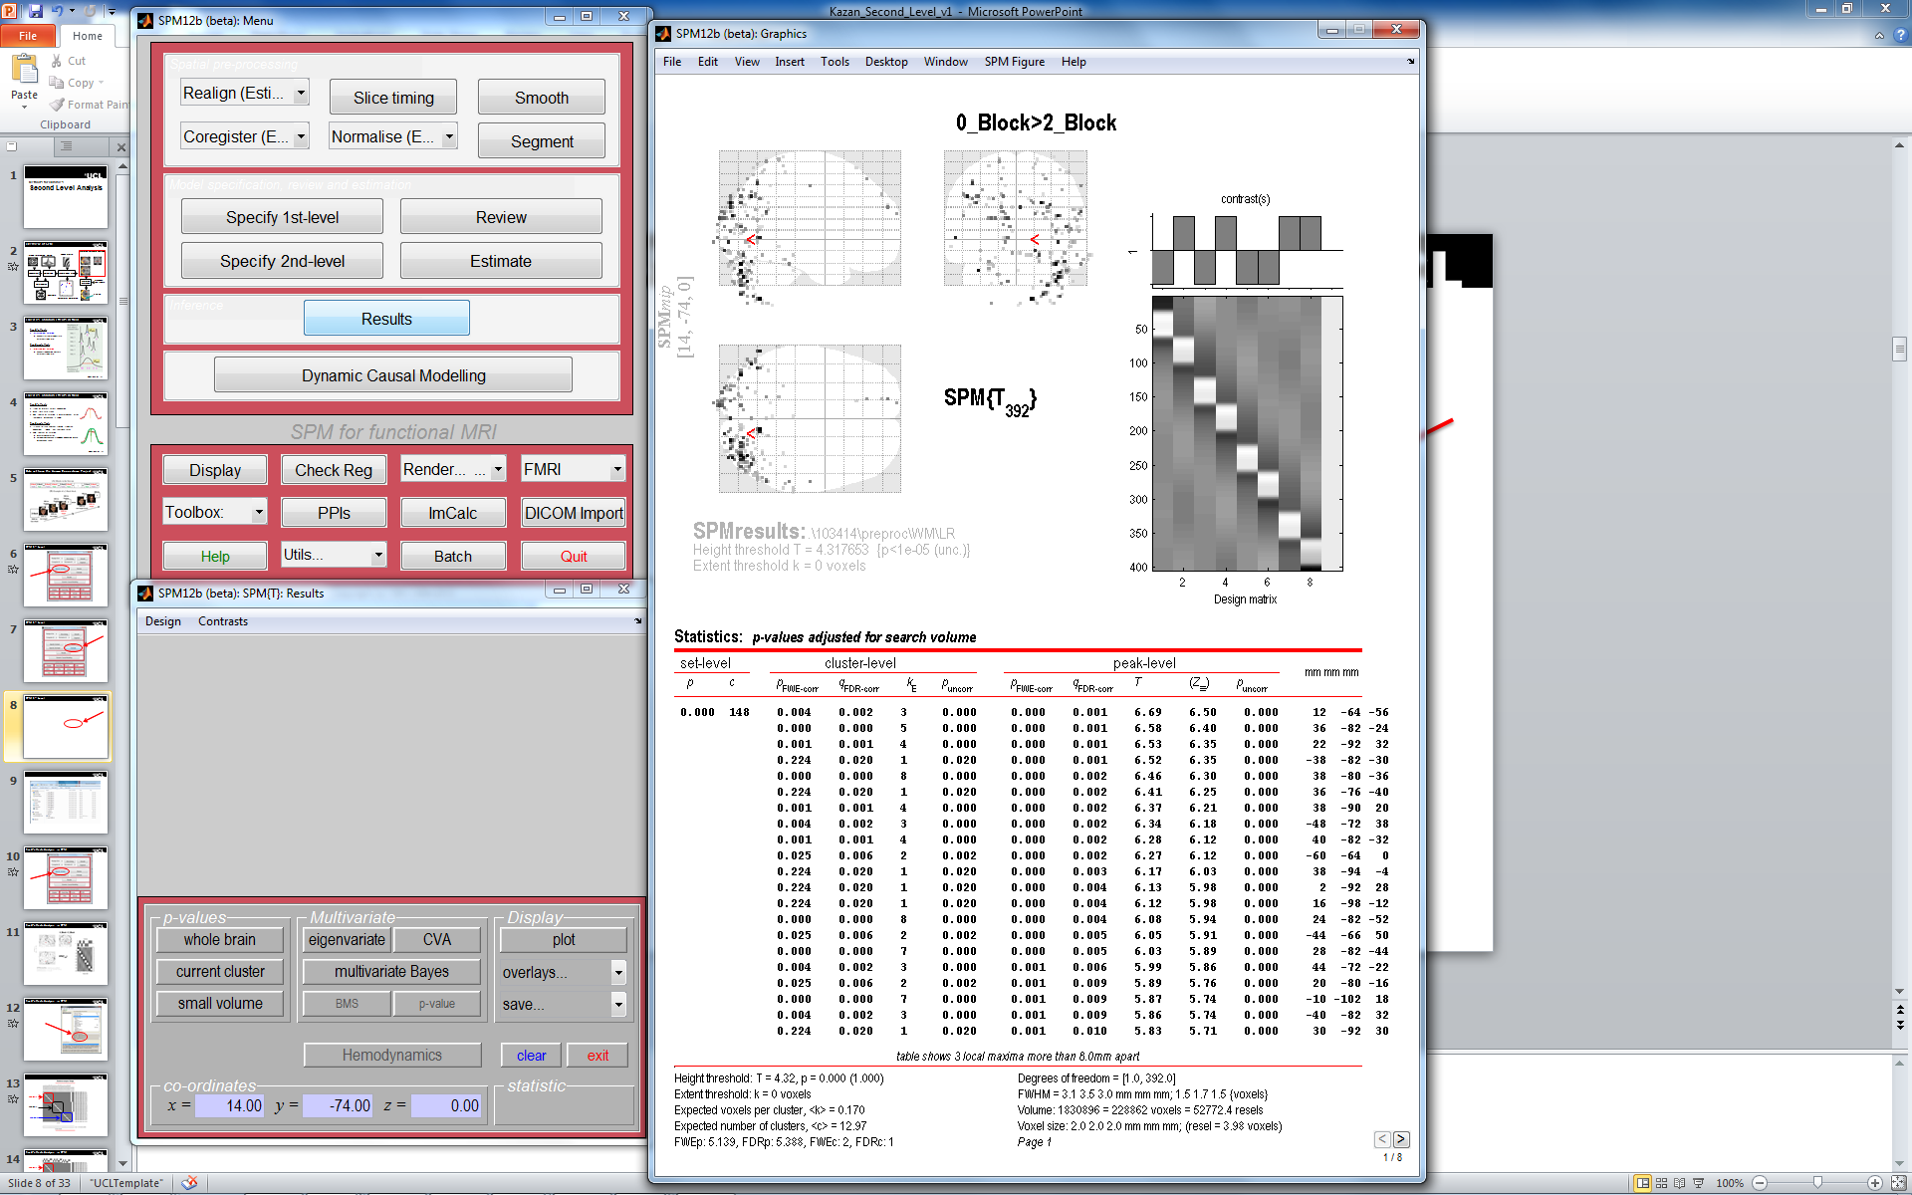
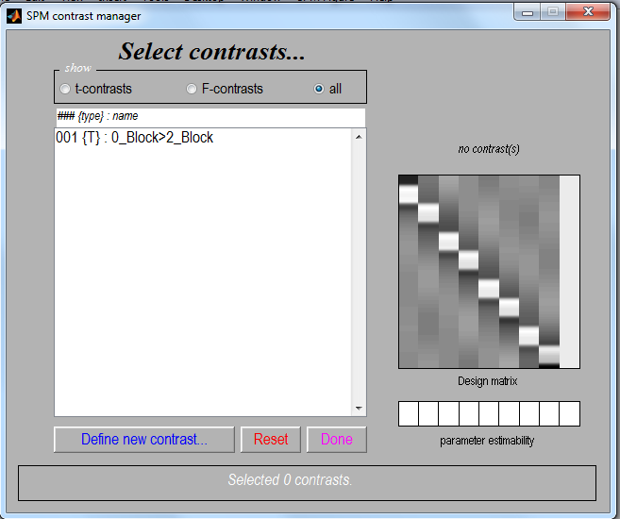
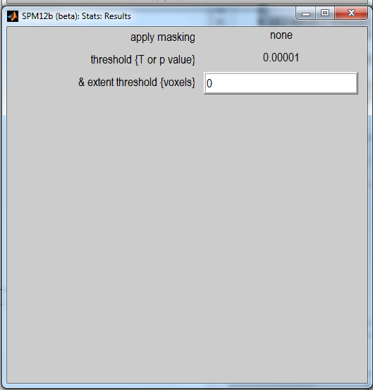
SPM 1st Level

Slide 22
SPM 1st Level

Slide 23
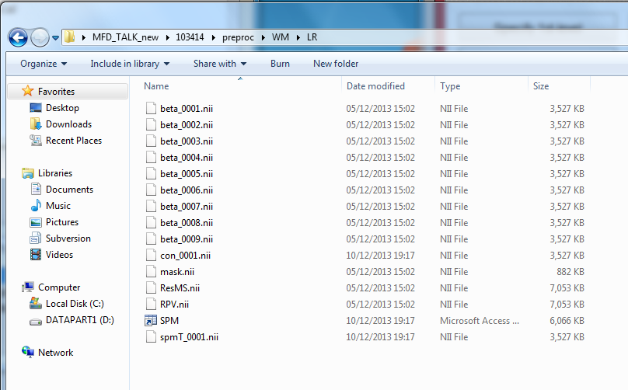
beta. images of estimated regression coefficients (parameter estimate). Combined to produce con. images.
This defines the search space for the statistical analysis.
Image of the variance of the error and is used to produce spmT images.
The estimated resels per voxel (not currently used).

Slide 24
Fixed-effects Analysis in SPM

Slide 25
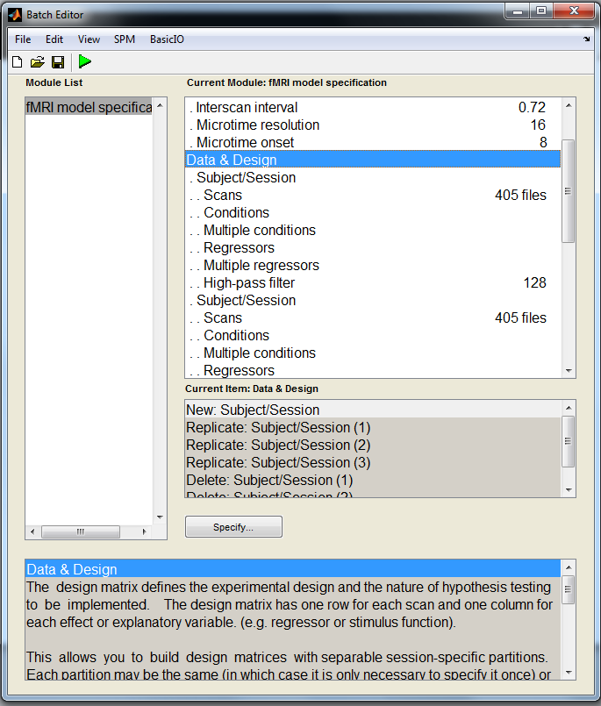
Fixed-effects Analysis in SPM

Slide 26
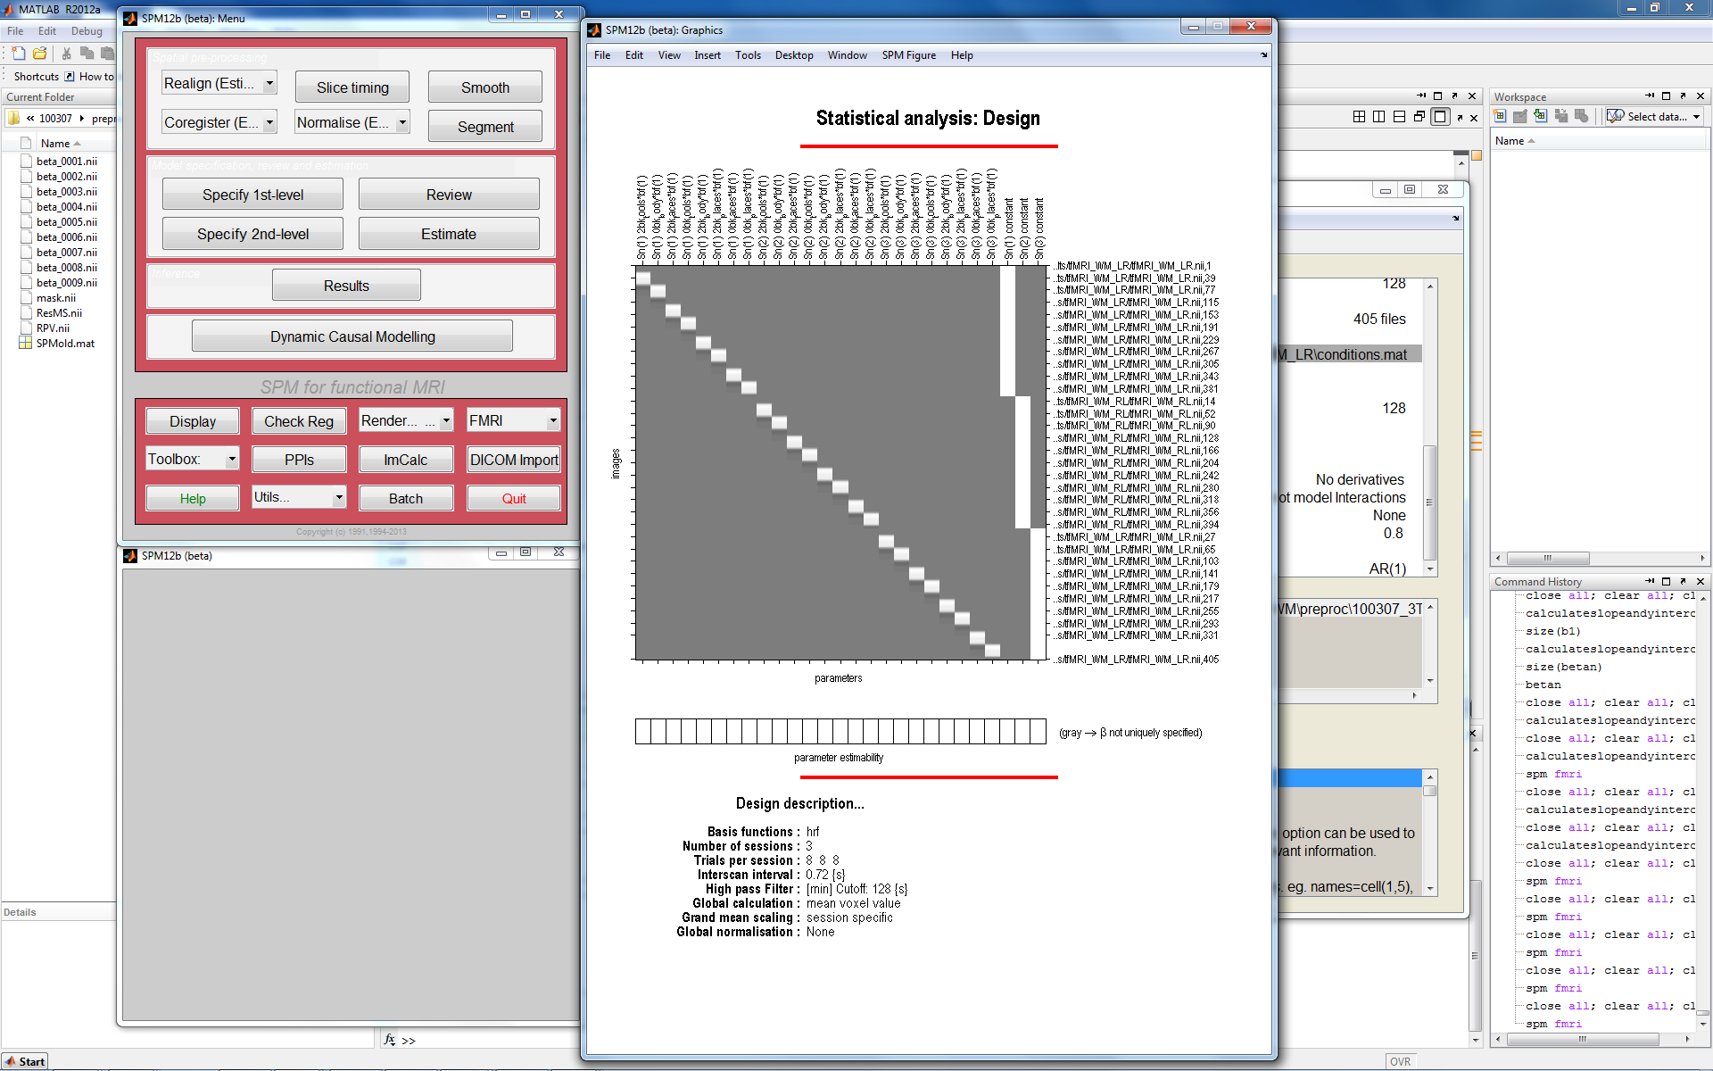
Subject 1
Subject 2
Subject 3

Slide 27
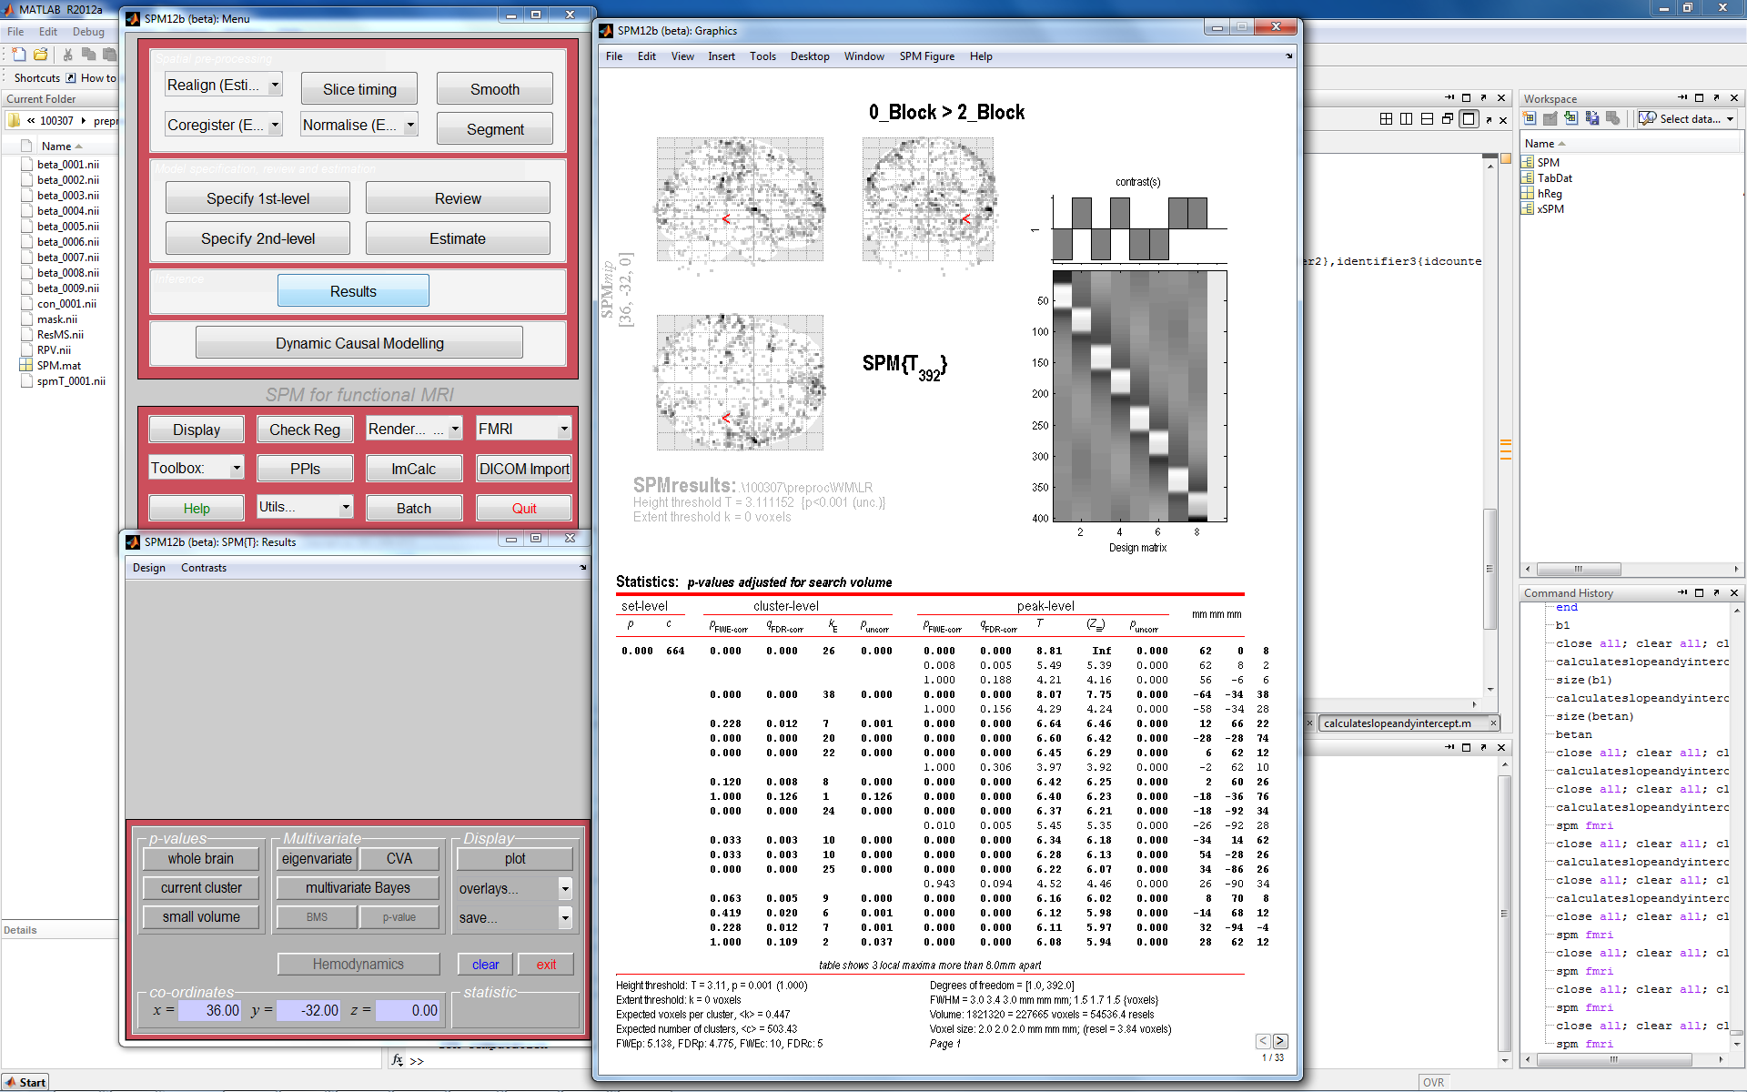
Fixed-effects Analysis in SPM
Subject 1
Subject 2
Subject 3
multi-subject 1st level design
each subjects entered as separate sessions
create contrast across all subjects
c = [ -1 1 -1 1 -1 1 -1 1 -1 1 -1 1 -1 1 -1 1 -1 1 -1 1 -1 1 -1 1]
perform one sample t-test
Notes:
Each subject is then entered as a separate session before contrast images are generated across all subjects before proceeding to a one sample t test.

Slide 28
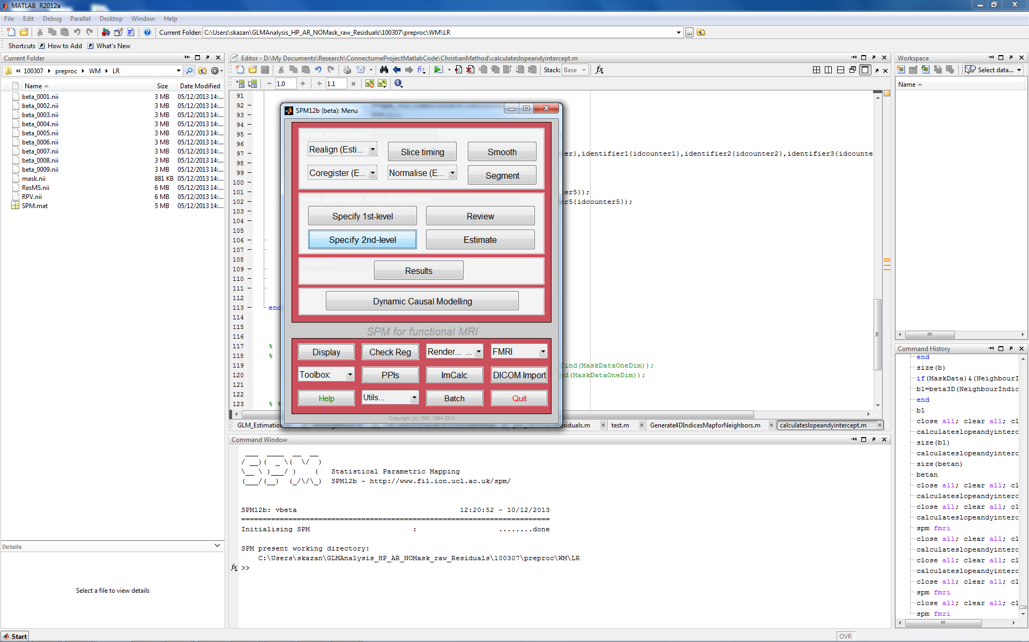
Random-effects in SPM
Used for:
Setting up analysis for random effects

Slide 29
Methods for Random-effects
Hierarchical model
Estimates subject & group stats at once
Variance of population mean contains contributions
from within- & between- subject variance
Iterative looping ➔ computationally demanding
Summary statistics approach ⬅ Most commonly used!
1st level design for all subjects must be the SAME
Sample means brought forward to 2nd level
Computationally less demanding
Good approximation, unless subject extreme outlier
Notes:
Now we will look in a bit more detail at the two methods that can be used for random effects. The first and gold standard method is a hierarchical model where the variance of the population mean contains contributions from within and between subject variance. At each level, distribution of parameters is given by the level above. What we don’t know is the exact distribution and variance of the parameters so we estimate the effect size and variance at the level of the subject and the group simultaneously. It is computationally more demanding because it works by using iterative loops. It is used for epilepsy research where the number of seizures/trials is not under experimental control and highly variable over subjects.
The alternative is the summary statistics approach which is quicker because it does not iterate back and forth. The results are only exactly the same as the hierarchical model if for each session or subject the variances are the same and the number of and design of the trials at the first level is the same.

Slide 30
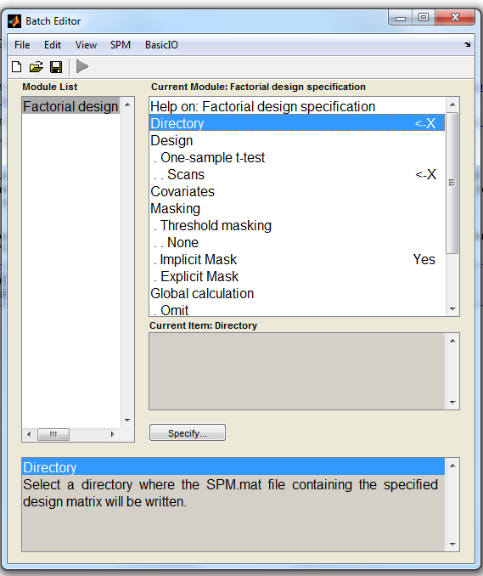
SPM 2nd Level: How to Set-Up
Directory for the results of the second level analysis

Slide 31
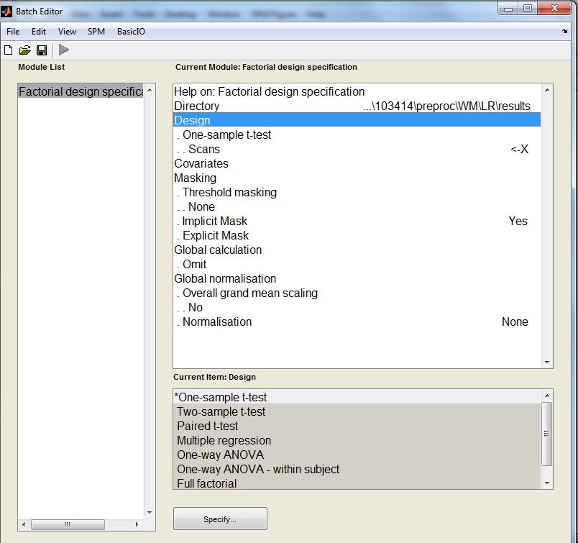
SPM 2nd Level: How to Set-Up
Design
- several design types
  one sample t-test
  two sample t-test
  paired t-test
  multiple regression
  one way ANOVA
  (+/-within subject)
  full factorial

Slide 32
Two sample T test
Group 1 mean
Contrasts
(1 0)➔ mean group 1
(0 1) ➔ mean group 2
(1 -1) ➔ mean group 1 - mean group 2
(0.5 0.5) ➔ mean (group 1, group 2)
Group 2 mean

Slide 33
One way between subject ANOVA
Consider a one-way ANOVA with 4 groups and each group having 3 subjects, 12 observations in total
SPM rule
  Number of regressors = number of groups

Slide 34
One way ANOVA
H₀= G1-G2
C=[1 -1 0 0]

Slide 35
One way ANOVA
H₀= G1=G2=G3=G4=0
c=

Slide 36
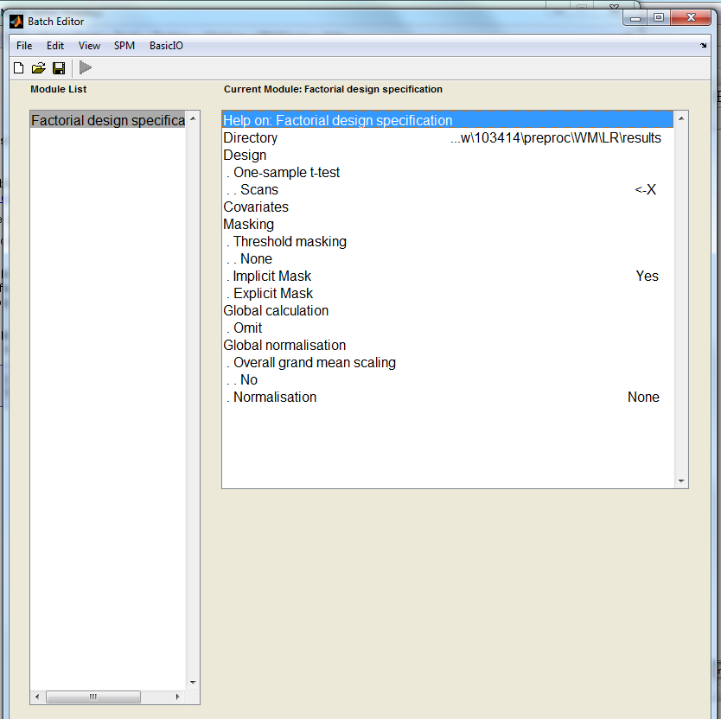
Specifies voxels within image which are to be assessed
- 3 masks types:
  threshold (voxel > threshold used)
  implicit (voxels >0 are used)
  explicit (image for implicit mask)
- covariates & nuisance variables
- 1 value per con*.img

Slide 37
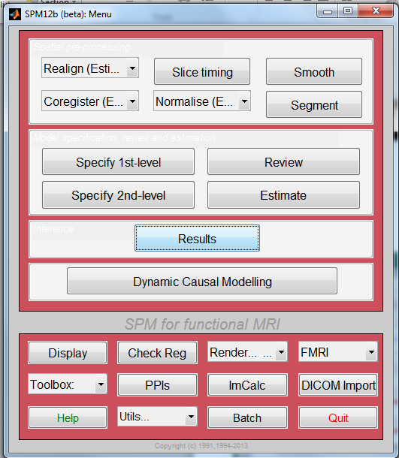
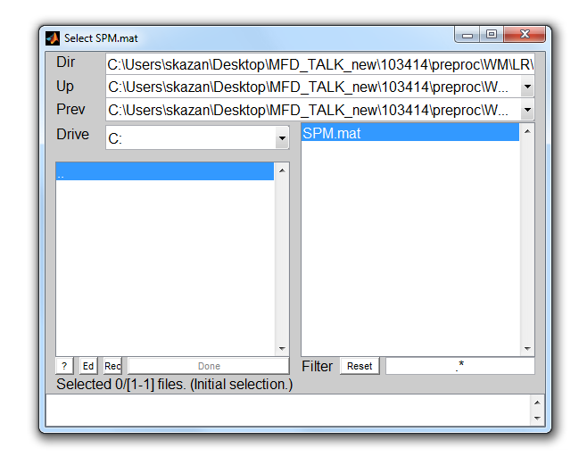
SPM 2nd Level: Results
Click RESULTS
Select your 2nd Level SPM

Slide 38
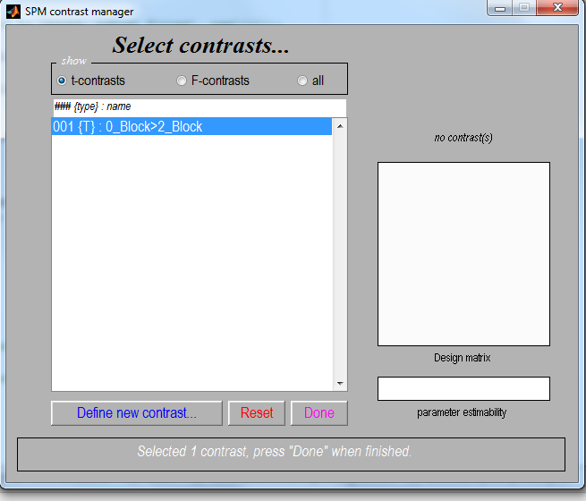
SPM 2nd Level: Results
2nd level one sample t-test
Select t-contrast
Define new contrast ….
  c = +1 (e.g. A>B)
  c = -1 (e.g. B>A)
Select desired contrast

Slide 39
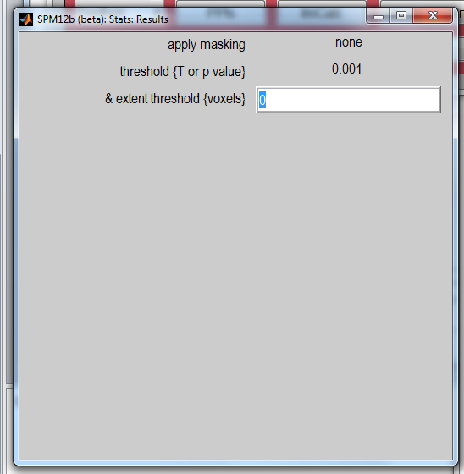
SPM 2nd Level: Results
Select options for displaying result:
  Mask with other contrast
  Title
  Threshold (p_{FWE}, p_{FDR} p_{UNC})
  Size of cluster

Slide 40
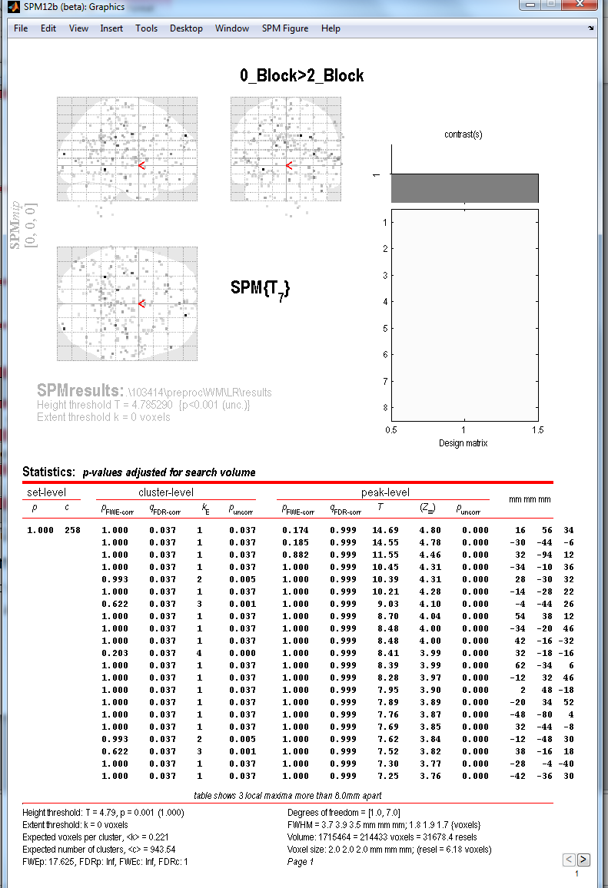
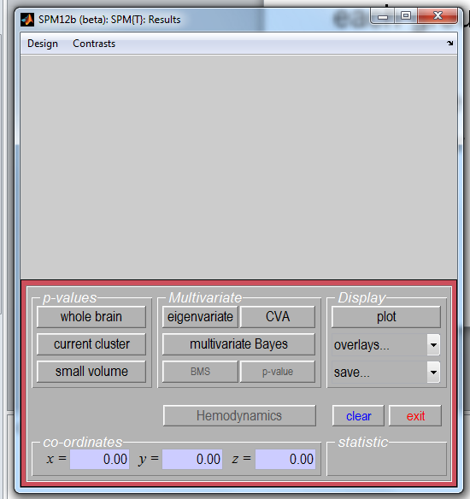
SPM 2nd Level: Results
Here are your results…
Now you can view:
Table of results [whole brain]
  Look at t-value for a voxel of choice
  Display results on anatomy [ overlays ]
    SPM templates
    mean of subjects
  Small Volume Correct

Slide 41
Thank you
Resources:
http://www.fil.ion.ucl.ac.uk/spm/course/slides10-vancouver/04_Group_Analysis.pdf
Humman Connectome Project (Working Memory example)
http://www.humanconnectome.org/documentation/Q1/Q1_Release_Reference_Manual.pdf
3) Previous MFD slides
Thanks to Ged Ridgway

