Slide 1
MfD Co-registration and Normalisation in SPM
Ziyuan Pan and Ruth-Mary deSouza
With thanks to Ged Ridgway
December 2015

Slide 2
Co-registration – the theory

Slide 3
Recap of pre-pre-processing
Recap of pre-processing steps so far:
NIFTI files or (.hdr +.img) - .hdr contains the file “admin” and .img the image
Check reg function – visual check that images grossly normal
Create dummy file – first 6 volumes to be essentially discarded (but not deleted) due to a heavy T1 effect
Now ready to start pre-processing

Slide 4
Recap of pre-processing
Decide now if you want to do each stage as a batch or individually
To use the batch function, it is the “modules” bar on the screen
Realignment (remember this is for f.MRI and only works intra-subject for motion correction (intra-subject and intra-modality). The structural scan is not involved in this process and remains untouched). Unwarping adjusts for local differences in field strengths.
Co-reg is to achieve functional structural matching (intra-subject)
Normalisation is to fit the image to standard space and facilitate inter-subject analyses

Slide 5
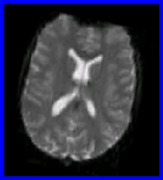
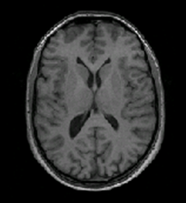
Co-registration
The next stage is co-registration.
Function is to achieve matching of inter-modality intra-subject data.
The realigned functional images need to be linked to the structural – the structural has superior anatomical localisation, the functional has the BOLD signal – need the two overlaid together
Paves the way for improved translation into MNI (standard) space - which is the next pre-processing step
CO-REGISTATION
FUNCTIONAL – T2* – note the poor structural definition
STRUCTURAL – T1

Slide 6
Co-registration
Of course, it is not as simple as merging the two types of images!
We need to know how well one set of images matches the other – this is achieved by fitting the source image with a fixed reference image (ie fitting the functional to the fixed, anatomically superior structural) and then looking at the intensity of the voxels in the functional w.r.t the structural. This works by estimating the intensity of groups of voxels in functional image and relating to the structural – interpolation. Cannot do a voxel by voxel match as fMRI and sMRI completely different.
Principle is affine registration and maximisation of mutual data
Notes:
Meaning of affine: In many imaging systems, detected images are subject to geometric distortion introduced by perspective irregularities wherein the position of the camera(s) with respect to the scene alters the apparent dimensions of the scene geometry. Applying an affine transformation to a uniformly distorted image can correct for a range of perspective distortions by transforming the measurements from the ideal coordinates to those actually used. (For example, this is useful in satellite imaging where geometrically correct ground maps are desired.)
An affine transformation is an important class of linear 2-D geometric transformations which maps variables (e.g. pixel intensity values located at position Eqn:eqnxy1 in an input image) into new variables (e.g. Eqn:eqnxy2 in an output image) by applying a linear combination of translation, rotation, scaling and/or shearing (i.e. non-uniform scaling in some directions) operations.

Slide 7
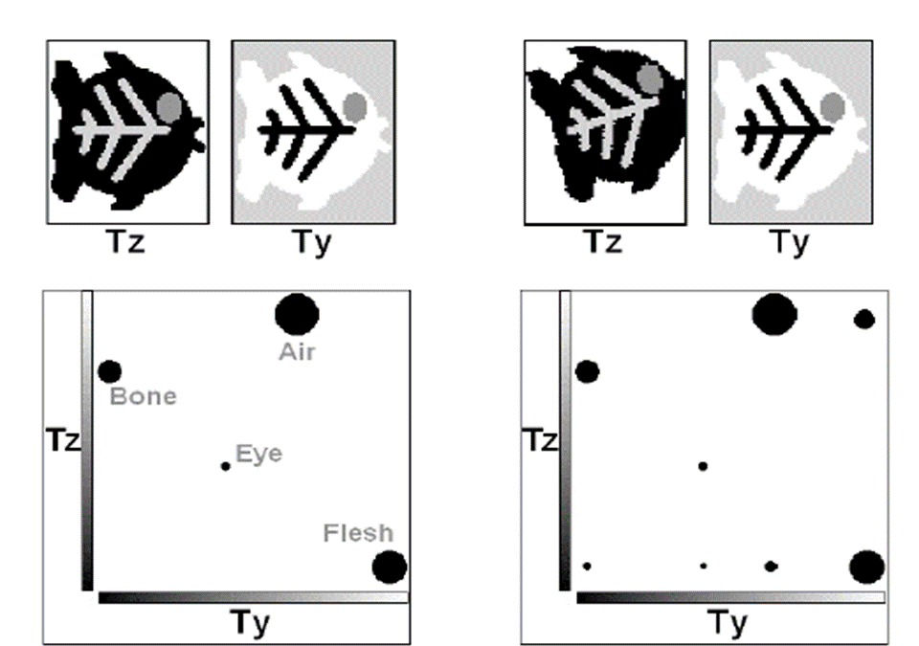
Formation of a joint histogram
Tissues with similar properties in T2* and T1 such as CSF are assigned the highest “matching” values and appear bright on the joint histogram

Slide 8
Reslicing
Changes image dimensions from 3x3x3 to 2x2x2 or plane, eg coronal/axial
Useful if two images have significantly different voxel sizes
Not so much an issue with MRI data, so rarely need to choose this option from the module menu

Slide 9
Normalisation – the theory

Slide 10
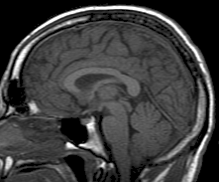
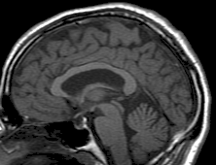
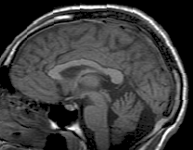
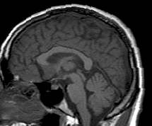
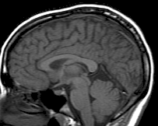
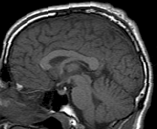
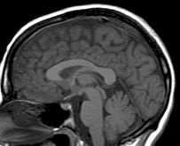
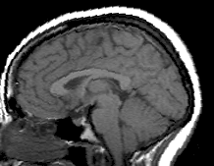
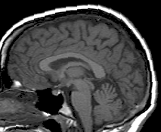
Spatial Normalization

Slide 11
What is Spatial Normalization?
A form of coregistration: between subjects
To warp images from individuals into the same standard space(a template) to allow averaging across subjects. (Ashburner & Karl J, 1999)

Slide 12
Why normalise?
Is important for analyzing fMRI data at the between-subject level.
To transform the brain images from each individual in order to reduce the variability between individuals and allow meaningful group analyses to be successfully performed
Improve the statistical power of the analysis
Generalize findings to the population level
Facilitates cross-study comparison

Slide 13
How to perform Spatial Normalization?
The template of each brain is squashed or stretched to fit into the standard space(voxel to voxel correspondence)
Each brain is divided up into thousands of small volumes, called voxels.
Each voxel can be given three-dimensional spatial coordinated(x,y,z).

Slide 14
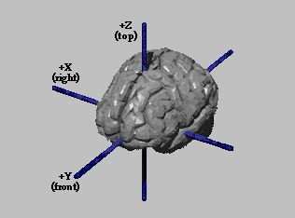
How to perform Spatial Normalization?
Template fitting:
The x-coordinate: left and right;
The y-coordinate: anterior and posterior;
The z-coordinate: superior and inferior.
Every x,y,z coordinate on the brain maps onto the corresponding coordinate on any other brain.

Slide 15
Standard space: Talairach Atlas
A commonly used space for normalisation of fMRI data
Its coordinates are based on measurements from a single brain

Slide 16
Standard space: MNI Template
A commonly used space for Normalization of fMRI data
Its coordinates are derived from an average of MRI structural images from more than one hundred individuals

Slide 17
Methods of Spatial Normalisation
Affine Transformation
Determines the optimum 12-parameter affine transformation to match the size and position of the images
12 parameters =
3df translation
3 df rotation
3 df scaling/zooming
3 df for shearing or skewing
Fits the overall position, size and shape

Slide 18
Methods of Spatial Normalisation
2. Non-linear Registration (warping)
Warp images, by constructing a deformation map (a linear combination of low-frequency periodic basis functions)
For every voxel, we model what the components of displacement are
Gets rid of small-scale anatomical differences

Slide 19
Drawbacks of Spatial Normalisation
May mask important group differences between different subject groups
Small but meaningful variation among different subjects' functional anatomy may be lost

Slide 20
How to do it

Slide 21
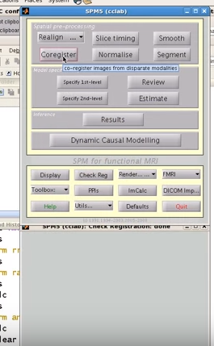
SELECT CO-REGISTRATION

Slide 22
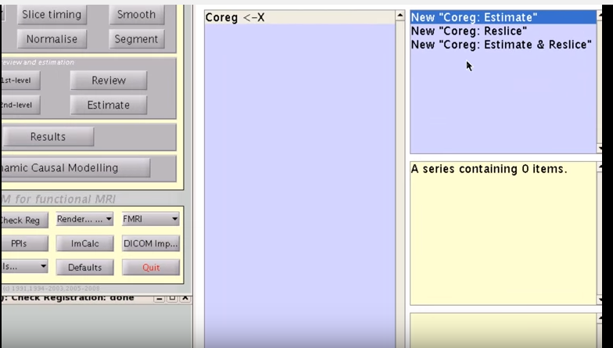
AFTER YOU HAVE SELECTED “COREGISTER” FROM THE PREVIOUS SLIDE, THE WINDOW IN GREEN WILL POP UP. SELECT “NEW COREG: ESTIMATE”
Remember reslice option is not always needed

Slide 23
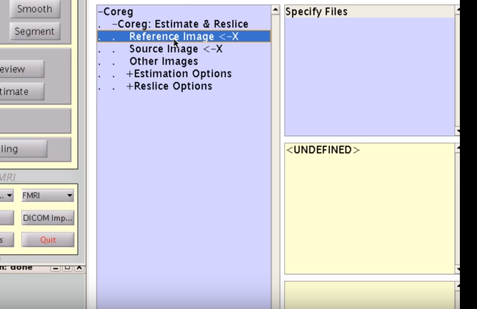
REFERENCE IMAGE IS THE STRUCTURAL
SOURCE IMAGE IS THE MEAN IMAGE GENERATED AS A RESULT OF THE REALIGNMENT PROCESS
OTHER IMAGES ARE THE MULTIPLE F.MRI FILES (IE EACH VOLUME – SELECT WHOLE LIST OF FILES)
DON’T CHANGE ANY OTHER PARAMETERS AT THIS POINT (can for example increase interpolation spline for increased accuracy but will be slow)
ANTERIOR COMMISURE SHOULD BE SELECTED POINT ON THE STRUCTURAL IMAGE (DONE DURING EARLIER PRE-PROCESSING)

Slide 24
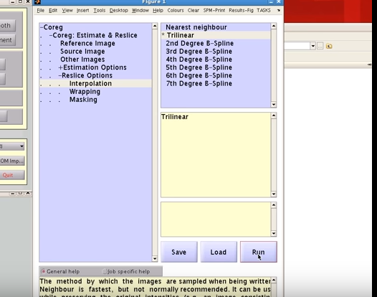
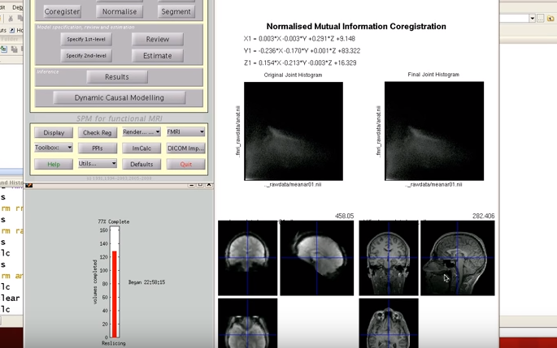
NOW YOU HAVE SET ALL YOUR CO-REG PARAMETERS – SOURCE, REF AND OTHER IMAGES, WHETHER YOU WANT TO RESLICE AND ANY PARAMETER CHANGES.
NOW HIT RUN
THE CO-REGISTRATION WILL BE DEMONSTRATED ON THE SCREEN AND YOU WILL BE READY TO MOVE ON TO NORMALISATION
REMEMBER ALL PRE-PROCESSING CAN BE DONE AS A BATCH WHERE YOU PUT IN THE PRE-SETS FOR EACH STEP AS A DEPENDENCY

Slide 25
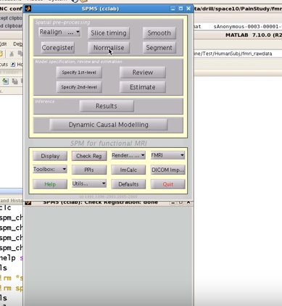
SELECT NORMALISATION

Slide 26
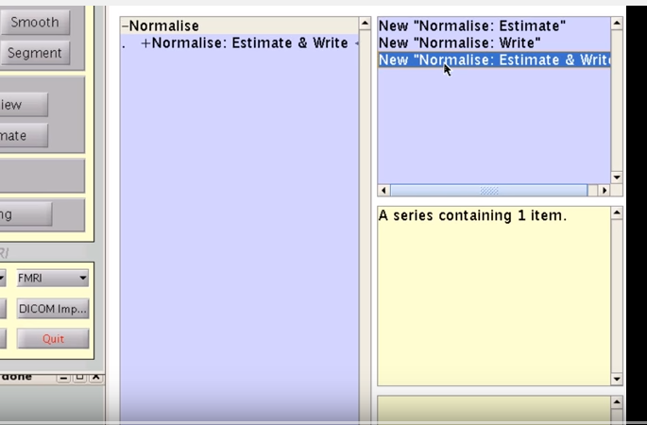
SELECT NORMALISE AND REWRITE
The structural is the best image to use for normalisation as it has the best spatial definition
UNDER THE PROMPT “IMAGE TO ALIGN”, CHOOSE THE STRUCTURAL
UNDER THE PROMPT “IMAGE TO WRITE” CHOOSE THE STRUCTURAL AGAIN
So, by this point in normalisation, you have only used the structural image
LEAVE THE PARAMETERS ALONE
NOW CHOOSE NORMALISE AGAIN
NOW CHOOSE “NORMALISE WRITE” – this is bringing the images into MNI space

Slide 27
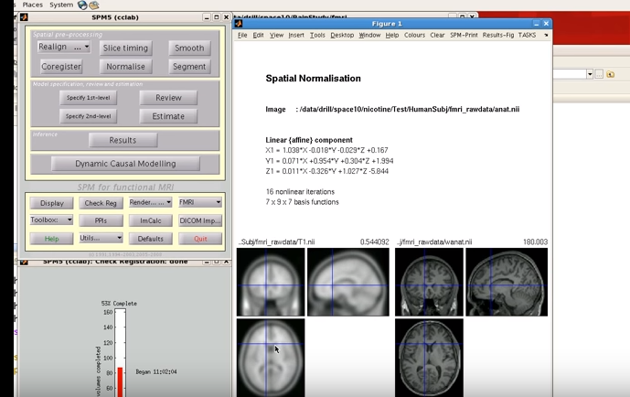
NOW YOU ARE READY FOR YOUR PRE-PROCESSED REALIGNED AND COREGISTERED FUNCTIONAL IMAGES
YOU WILL BE PROMPTED AGAIN FOR “IMAGES TO WRITE” (note this is second time you will see this command). CHOOSE THE PRE-PROCESSED IMAGES
CLICK RUN
SMOOTHING:
CHOOSE SMOOTHING
CHOOSE YOUR RELAIGNED, COREGSITERED AND NORMALISED DATA
CLICK RUN
THIS IS THE LAST PRE-PROCESSING STEP

