Slide 1
Multiple testing
Justin Chumbley
Laboratory for Social and Neural Systems Research
Institute for Empirical Research in Economics
University of Zurich
With many thanks for slides & images to:
FIL Methods group

Slide 2
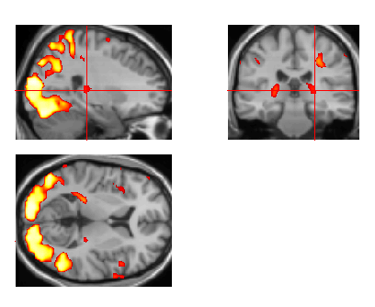
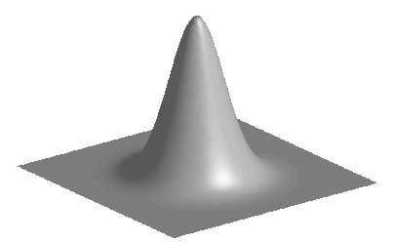
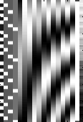
Overview of SPM
Image time-series
Kernel
Design matrix
Statistical parametric map (SPM)
Realignment
Smoothing
General linear model
Statistical
inference
Gaussian
field theory
Normalisation
p <0.05
Template
Parameter estimates
Notes:
Describe thresholded images
One number for each spatial location (that gives the estimated effect size).
Two schools: 1) decide on voxels 2) decide on regions/blobs
(voxels are arbitrary in number and location, and smoothing means that effects are blurred and don’t really have voxel resolution).

Slide 3
Inference at a single voxel
t
contrast of
estimated
parameters
t =
variance
estimate

Slide 4
Inference at a single voxel
H₀ , H₁: zero/non-zero activation
α
t
contrast of
estimated
parameters
t =
variance
estimate

Slide 5
Inference at a single voxel
Decision:
H₀ , H₁: zero/non-zero activation
h
α
t
contrast of
estimated
parameters
t =
variance
estimate
Notes:
Aim: Deciding which dn the data came from
How? Decision rule

Slide 6
Inference at a single voxel
Decision:
H₀ , H₁: zero/non-zero activation
h
α
t
contrast of
estimated
parameters
t =
variance
estimate
Notes:
LIKE THROWING A DICE. YOU CAN CONTROL THE FALSE POSITIVE RATE.

Slide 7
Inference at a single voxel
Decision:
H₀ , H₁: zero/non-zero activation
h
α
t
contrast of
estimated
parameters
t =
variance
estimate
Notes:
LIKE THROWING A DICE. YOU CAN CONTROL THE FALSE POSITIVE RATE.

Slide 8
Inference at a single voxel
Decision:
H₀ , H₁: zero/non-zero activation
h
α
t
Decision rule (threshold) h,
determines related error rates ,
Convention: Choose h to give acceptable
under H₀
contrast of
estimated
parameters
t =
variance
estimate
Notes:
LIKE THROWING A DICE. YOU CAN CONTROL THE FALSE POSITIVE RATE.

Slide 9
Types of error
Actual condition
H₀
H₁
False positive (FP)
True positive (TP)
Decide H₁
True negative (TN)
False negative (FN)
Decide H₀
specificity: 1-
= TN / (TN + FP)
= proportion of actual negatives which are correctly identified
sensitivity (power): 1-
= TP / (TP + FN)
= proportion of actual positives which are correctly identified
Notes:
Deciding which distribution the data comes from (between two probability models) .

Slide 10
Multiple tests
h
h
h
h
What is the problem?
α
α
α
α
t
t
t
contrast of
estimated
parameters
t =
variance
estimate
Notes:
LIKE THROWING A DICE. YOU CAN CONTROL THE FALSE POSITIVE RATE.

Slide 11
Multiple tests
h
h
h
h
α
α
α
α
t
t
t
contrast of
estimated
parameters
t =
variance
estimate
Notes:
LIKE THROWING A DICE. YOU CAN CONTROL THE FALSE POSITIVE RATE.

Slide 12
Multiple tests
h
h
h
h
α
α
α
α
t
t
t
Convention: Choose h to limit
assuming family-wise H₀
contrast of
estimated
parameters
t =
variance
estimate
Notes:
LIKE THROWING A DICE. YOU CAN CONTROL THE FALSE POSITIVE RATE.

Slide 13
Spatial correlations
Bonferroni assumes general dependence
→ overkill, too conservative
Assume more appropriate dependence
Infer regions (blobs) not voxels
Notes:
Suprathreshold BLOBS not voxels, under the null
Not really interested in infering voxels anyway

Slide 14
Smoothness, the facts
roughness = 1/smoothness
intrinsic smoothness
  MRI signals are aquired in k-space (Fourier space); after projection on anatomical space, signals have continuous support
  diffusion of vasodilatory molecules has extended spatial support
extrinsic smoothness
  resampling during preprocessing
  matched filter theorem
  → deliberate additional smoothing to increase SNR
described in resolution elements: "resels"
resel = size of image part that corresponds to the FWHM (full width half maximum) of the Gaussian convolution kernel that would have produced the observed image when applied to independent voxel values
# resels is similar, but not identical to # independent observations
can be computed from spatial derivatives of the residuals

Slide 15
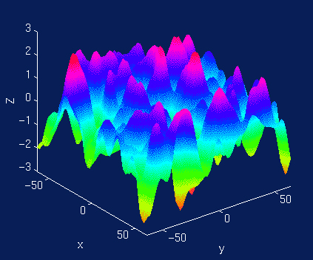
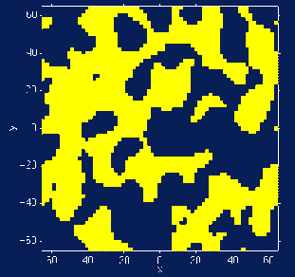
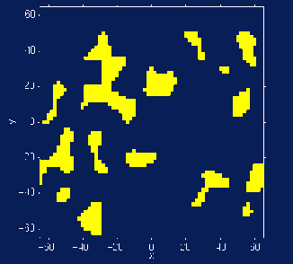
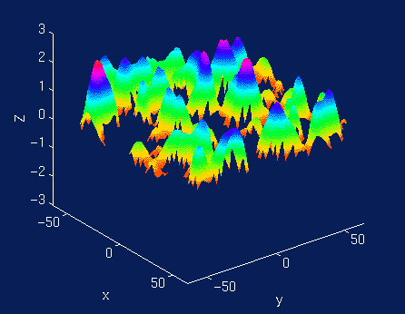
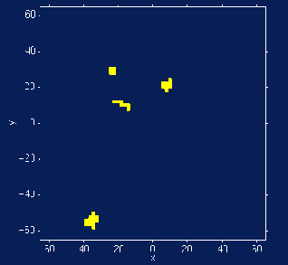
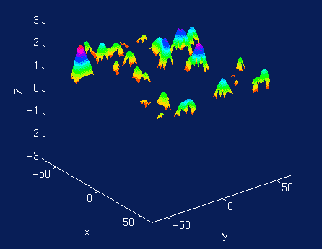
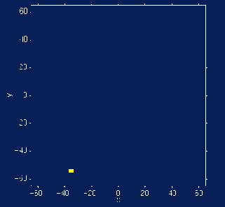
Notes:
Two surprising features!
Two thresholds!

Slide 16
Height
Spatial extent
Total number
Notes:
Two surprising features!
Two thresholds!

Slide 17
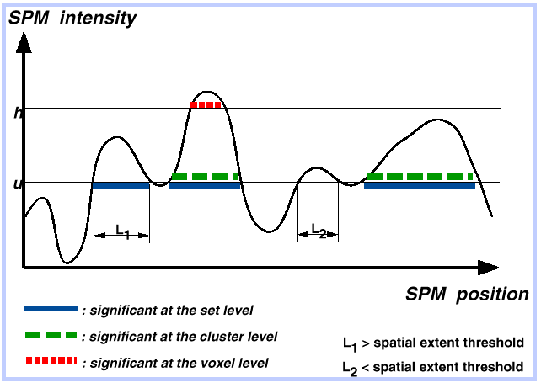
Notes:
Two surprising features!
Two thresholds!

Slide 18
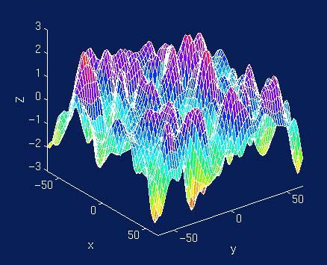
Random Field Theory
Consider a statistic image as a discretisation of a
continuous underlying random field with a certain smoothness
Use results from continuous random field theory
Discretisation
(“lattice approximation”)

Slide 19
Euler characteristic (EC)
  threshold an image at h
  EC ∝ # blobs
  at high h:
  Aprox:
  E [EC] = p (blob)
  = FWER

Slide 20
Euler characteristic (EC) for 2D images
R = number of resels
Z_{T} = Z value threshold
We can determine that Z threshold for which E[EC] = 0.05
Example: For 100 resels, E [EC] = 0.049 for a Z threshold of 3.8. That is, the probability of getting one or more blobs where Z is greater than 3.8, is 0.049.
Expected EC values for an image of 100 resels

Slide 21
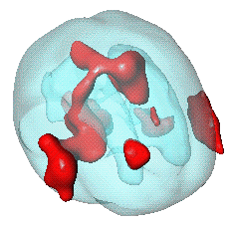
Euler characteristic (EC) for any image
E[EC] for volumes of any dimension, shape and size (Worsley et al. 1996).
A priori hypothesis about where an activation should be, reduce search volume:
  mask defined by (probabilistic) anatomical atlases
  mask defined by separate "functional localisers"
  mask defined by orthogonal contrasts
  (spherical) search volume around previously reported coordinates
Worsley et al. 1996. A unified statistical approach for determining significant signals in images of cerebral activation. Human Brain Mapping, 4, 58–83.
small volume correction (SVC)

Slide 22
Computing EC wrt. search volume and threshold
E(χ_{u}) ≈ λ(Ω) |Λ|^{1/2} (u ² -1) exp(-u ²/2) / (2π)²
  Ω → Search region Ω ⊂ R³
  λ(Ω) → volume
  |Λ|^{1/2} → roughness
Assumptions
  Multivariate Normal
  Stationary*
  ACF twice differentiable at 0
Stationarity
  Results valid w/out stationarity
  More accurate when stat. holds

Slide 23
Voxel, cluster and set level tests
Sensitivity
Regional specificity
Voxel level test:
intensity of a voxel
Cluster level test:
spatial extent above u
Set level test:
number of clusters above u



Slide 24
Conclusions
There is a multiple testing problem
  (From either ‘voxel’ or ‘blob’ perspective)
‘Corrections’ necessary to counterbalance this
  FWE
    Very specific, not so sensitive
    Random Field Theory
      Inference about blobs (peaks, clusters)
      Excellent for large sample sizes (e.g. single-subject analyses or large group analyses)
      Afford littles power for group studies with small sample size → consider non-parametric methods (not discussed in this talk)
  FDR
    Less specific, more sensitive
      represents false positive risk over whole set of selected voxels
Height, spatial extent, total number

Slide 25
Further reading
Friston KJ, Frith CD, Liddle PF, Frackowiak RS. Comparing functional (PET) images: the assessment of significant change. J Cereb Blood Flow Metab. 1991 Jul;11(4):690-9.
Genovese CR, Lazar NA, Nichols T. Thresholding of statistical maps in functional neuroimaging using the false discovery rate. Neuroimage. 2002 Apr;15(4):870-8.
Worsley KJ Marrett S Neelin P Vandal AC Friston KJ Evans AC. A unified statistical approach for determining significant signals in images of cerebral activation. Human Brain Mapping 1996;4:58-73.

Slide 26
Thank you

