Slide 1
DCM: Advanced topics
Klaas Enno Stephan
Laboratory for Social & Neural Systems Research
Institute for Empirical Research in Economics
University of Zurich
Wellcome Trust Centre for Neuroimaging
Institute of Neurology
University College London
SPM Course 2010
University of Zurich, 17-19 February 2010

Slide 2
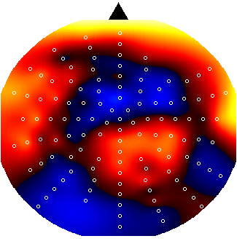
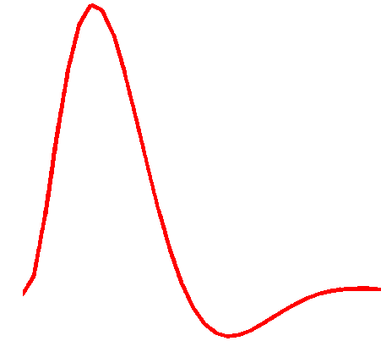
Dynamic Causal Modeling (DCM)
Hemodynamic
forward model:
neural activity→BOLD
Electromagnetic
forward model:
neural activity→EEG
MEG
LFP
Neural state equation:
fMRI
EEG/MEG
simple neuronal model
complicated forward model
complicated neuronal model
simple forward model
inputs

Slide 3
Overview
Bayesian model selection (BMS)
Nonlinear DCM for fMRI
Embedding computational models in DCMs
Integrating tractography and DCM

Slide 4
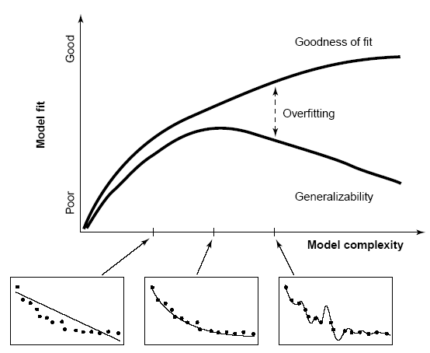
Model comparison and selection
Given competing hypotheses on structure & functional mechanisms of a system, which model is the best?
Which model represents the
best balance between model
fit and model complexity?
For which model m does p(y|m) become maximal?
Pitt & Miyung (2002) TICS

Slide 5
Bayesian model selection (BMS)
Model evidence:
Gharamani, 2004
p(y|m)
y
all possible datasets
accounts for both accuracy and complexity of the model
Various approximations, e.g.:
negative free energy, AIC, BIC
allows for inference about structure (generalisability) of the model
McKay 1992, Neural Comput.
Penny et al. 2004, NeuroImage
Stephan et al. 2007, NeuroImage

Slide 6
Approximations to the model evidence in DCM
Logarithm is a monotonic function
Maximizing log model evidence
= Maximizing model evidence
Log model evidence = balance between fit and complexity
No. of
parameters
In SPM2 & SPM5, interface offers 2 approximations:
Akaike Information Criterion:
No. of
data points
Bayesian Information Criterion:
AIC favours more complex models,
BIC favours simpler models.
Penny et al. 2004, NeuroImage

Slide 7
The negative free energy approximation
Under Gaussian assumptions about the posterior (Laplace approximation), the negative free energy F is a lower bound on the log model evidence:

Slide 8
The complexity term in F
In contrast to AIC & BIC, the complexity term of the negative free energy F accounts for parameter interdependencies.
The complexity term of F is higher
  the more independent the prior parameters (↑ effective DFs)
  the more dependent the posterior parameters
  the more the posterior mean deviates from the prior mean
NB: SPM8 only uses F for model selection !

Slide 9
Bayes factors
To compare two models, we could just compare their log evidences.
But: the log evidence is just some number – not very intuitive!
A more intuitive interpretation of model comparisons is made possible by Bayes factors:
positive value, [0; ∞[
B₁₂ | p(m₁|y) | Evidence
1 to 3 | 50-75% | weak
3 to 20 | 75-95% | positive
20 to 150 | 95-99% | strong
≥ 150 | ≥ 99% | Very strong
Kass & Raftery classification:
Kass & Raftery 1995, J. Am. Stat. Assoc.

Slide 10
BMS in SPM8: an example
attention
M1
M2
PPC
PPC
M2 better than M1
attention
BF ≈ 2966
ΔF = 7.995
stim
V1
V5
stim
V1
V5
M1
M2
M3
M4
M3
attention
PPC
M3 better than M2
BF ≈ 12
ΔF = 2.450
stim
V1
V5
M4
attention
PPC
M4 better than M3
BF ≈ 23
ΔF = 3.144
stim
V1
V5
Notes:
Posterior model probability in lower plot is a normalised probability:
p(m_i|y) = p(y|m_i)/sum(p(y|m_i))
Note that under flat model priors p(m_i|y) = p(y|m_i)

Slide 11
Fixed effects BMS at group level
Group Bayes factor (GBF) for 1...K subjects:
Average Bayes factor (ABF):
Problems:
blind with regard to group heterogeneity
sensitive to outliers

Slide 12
Random effects BMS for group studies
Dirichlet parameters
= “occurrences” of models in the population
Dirichlet distribution of model probabilities
Multinomial distribution of model labels
Model inversion by Variational Bayes (VB)
Measured data y
Stephan et al. 2009, NeuroImage

Slide 13
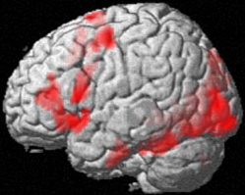
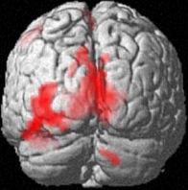
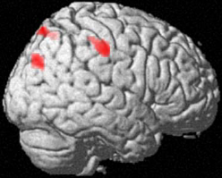
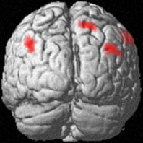
Task-driven lateralisation
Does the word contain the letter A or not?
letter decisions > spatial decisions
•
•
group analysis (random effects),
n=16, p<0.05 corrected
analysis with SPM2
•
time
Is the red letter left or right from the midline of the word?
spatial decisions > letter decisions
Stephan et al. 2003, Science

Slide 14
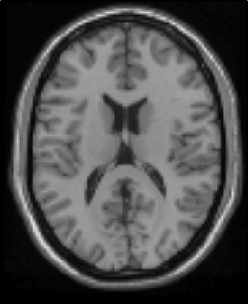
Theories on inter-hemispheric integration during lateralised tasks
Information transfer
(for left-lateralised task)
Hemispheric recruitment
Inhibition/Competition
|RVF
T
T
T
±
+
−
+
+
−
T
|LVF
T
T
LVF
RVF
Predictions:
modulation by task
conditional on visual field
asymmetric connection
strengths
Predictions:
modulation by task only
positive & symmetric
connection strengths
Predictions:
modulation by task only
negative & symmetric
connection strengths

Slide 15
A
FG
left
FG
right
C
FG
left
FG
right
VF
RVF
LVF
LD
LD
LD
LG
left
LG
right
B_{ind}
LD,RVF
LD,LVF
B_{cond}
LD|RVF
LD|LVF
LG
left
LG
right
RVF
stim.
LVF
stim.
B
intra
D
VF
LD
B_{ind}
B_{cond}
VF
LD
B_{ind}
B_{cond}
LVF
LD
LVF
LD
LD|LVF
VF
FG
left
FG
right
LD
inter
B_{ind}
16 models
B_{cond}
LG
left
LG
right
RVF
RVF
LD|RVF

Slide 16
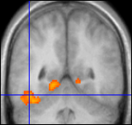
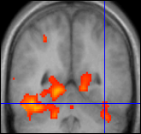
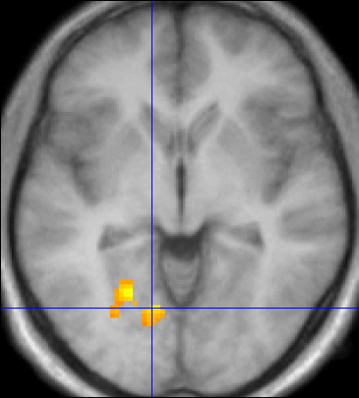
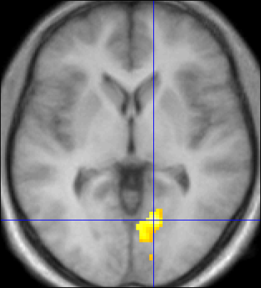
Ventral stream & letter decisions
LD|LVF
Left fusiform gyrus
(FG)
-44,-52,-18
0.12
± 0.02
0.25
± 0.04
Right fusiform gyrus
(FG)
38,-52,-20
FG
left
FG
right
LD>SD, p<0.05 cluster-level corrected
(p<0.001 voxel-level cut-off)
LD
LD
p<0.01 uncorrected
0.36
± 0.06
0.16
± 0.05
LG
left
LG
right
Left lingual gyrus
(LG)
-12,-64,-4
Right lingual gyrus
(LG)
14,-68,-2
0.02
± 0.02
0.03
± 0.03
RVF
stim.
LD|RVF
LVF
stim.
mean parameter estimates ± SE (n=12)
LD>SD masked incl. with RVF>LVF
p<0.05 cluster-level corrected
(p<0.001 voxel-level cut-off)
significant modulation (p<0.05, Bonferroni-corrected)
LD>SD masked incl. with LVF>RVF
p<0.05 cluster-level corrected
(p<0.001 voxel-level cut-off)
significant modulation (p<0.05, uncorrected)
non-significant modulation
Stephan et al. 2007, J. Neurosci.

Slide 17
Asymmetric modulation of LG callosal connections is consistent across subjects
Stephan et al. 2007, J. Neurosci.

Slide 18
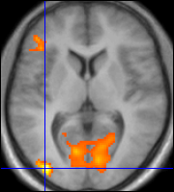

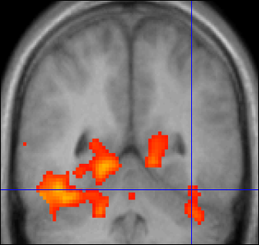
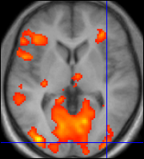
Ventral stream & letter decisions
Left MOG
-38,-90,-4
Left FG
-44,-52,-18
Right FG
38,-52,-20
Right MOG
-38,-94,0
LD|LVF
0.20
± 0.04
0.07
± 0.02
LD>SD, p<0.05 cluster-level corrected
(p<0.001 voxel-level cut-off)
p<0.01 uncorrected
MOG
left
FG
left
FG
right
MOG
right
0.27
± 0.06
0.11
± 0.03
LD
LD
Left LG
-12,-70,-6
LG
left
LG
right
Left LG
-14,-68,-2
RVF
stim.
LVF
stim.
LD>SD masked incl. with RVF>LVF
p<0.05 cluster-level corrected
(p<0.001 voxel-level cut-off)
LD>SD masked incl. with LVF>RVF
p<0.05 cluster-level corrected
(p<0.001 voxel-level cut-off)
Stephan et al. 2007, J. Neurosci.

Slide 19
m₂
LD
LD|LVF
m₁
MOG
FG
FG
MOG
MOG
FG
FG
MOG
LD|RVF
LD|LVF
LD
LD
LG
LG
LG
LG
RVF
stim.
LD
LVF
stim.
RVF
stim.
LD|RVF
LVF
stim.
m₂
m₁
Stephan et al. 2009, NeuroImage

Slide 20
m₂
m₁

Slide 21
Simulation study: sampling subjects from a heterogenous population
LD|LVF
m₁
MOG
FG
FG
MOG
Population where 70% of all subjects' data are generated by model m₁ and 30% by model m₂
Random sampling of subjects from this population and generating synthetic data with observation noise
Fitting both m₁ and m₂ to all data sets and performing BMS
LD
LD
LG
LG
RVF
stim.
LD|RVF
LVF
stim.
LD
m₂
MOG
FG
FG
MOG
LD|RVF
LD|LVF
LG
LG
RVF
stim.
LD
LVF
stim.
Stephan et al. 2009, NeuroImage

Slide 22
true values:
α₁=22×0.7=15.4
α₂=22×0.3=6.6
mean estimates:
α₁=15.4, α₂=6.6
true values:
r₁ = 0.7, r₂=0.3
mean estimates:
r₁ = 0.7, r₂=0.3
α
<r>
m₁
m₂
m₁
m₂
true values:
ϕ₁ = 1, ϕ₂=0
mean estimates:
ϕ₁ = 0.89, ϕ₂=0.11
ϕ
m₁
m₂

Slide 23
Model space partitioning:
comparing model families
m₂
m₁
m₁
m₂
Stephan et al. 2009, NeuroImage

Slide 24
Bayesian Model Averaging (BMA)
abandons dependence of parameter inference on a single model
uses the entire model space considered (or an optimal family of models)
computes weighted averages of each parameter, where the weighting is given by posterior model probabilities
represents a particularly useful alternative, particularly when none of the models (or model subspaces) considered clearly outperforms all others
NB: p(m|y_{1..N}) can be obtained by either FFX or RFX BMS
Penny et al. 2010, PLoS Comput. Biol.

Slide 25
definition of model space
inference on model structure or inference on model parameters?
inference on
individual models or model space partition?
inference on
parameters of an optimal model or parameters of all models?
optimal model structure assumed to be identical across subjects?
comparison of model families using
FFX or RFX BMS
optimal model structure assumed to be identical across subjects?
BMA
yes
no
yes
no
FFX BMS
RFX BMS
FFX BMS
RFX BMS
FFX analysis of parameter estimates
(e.g. BPA)
RFX analysis of parameter estimates
(e.g. t-test, ANOVA)
Stephan et al. 2010, NeuroImage

Slide 26
Overview
Bayesian model selection (BMS)
Nonlinear DCM for fMRI
Embedding computational models in DCMs
Integrating tractography and DCM

Slide 27
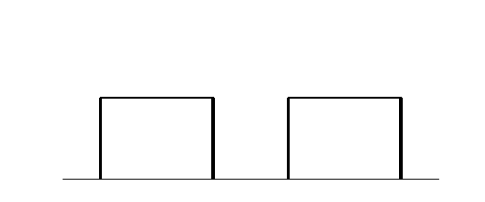
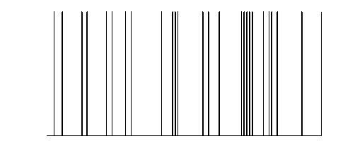
y
y
y
BOLD
y
−
−
λ
−
hemodynamic
model
activity
x₂(t)
activity
x₃(t)
activity
x₁(t)
neuronal
states
x
modulatory
input u₂(t)
integration
driving
input u₁(t)
t
Neural state equation
intrinsic connectivity
t
modulation of
connectivity
direct inputs
Stephan & Friston (2007),
Handbook of Brain Connectivity

Slide 28
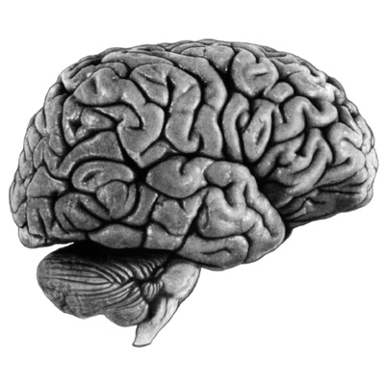
bilinear DCM
non-linear DCM
modulation
driving
input
driving
input
modulation
Two-dimensional Taylor series (around x₀=0, u₀=0):
Bilinear state equation:
Nonlinear state equation:

Slide 29
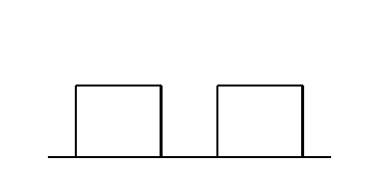
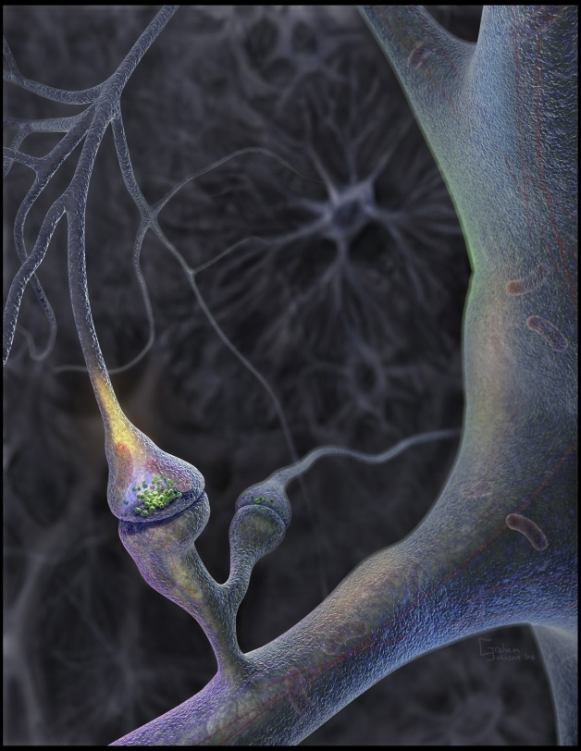
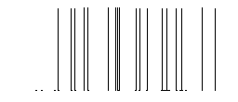
Neural population activity
u₂
u₁
x₃
fMRI signal change (%)
x₁
x₂
Nonlinear dynamic causal model (DCM):
Stephan et al. 2008, NeuroImage

Slide 30
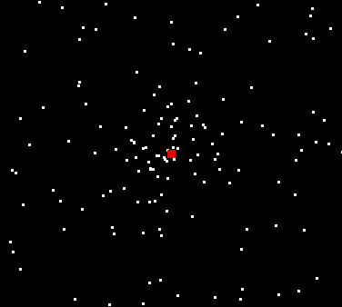
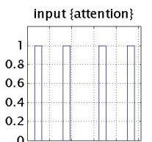
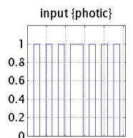

Nonlinear DCM: Attention to motion
Stimuli + Task
Previous bilinear DCM
Attention
Photic
.52 (98%)
.37
(90%)
SPC
.42
(100%)
.56
(99%)
Büchel & Friston (1997)
.69 (100%)
V1
.47
(100%)
IFG
Motion
.82
(100%)
250 radially moving dots
(4.7 °/s)
V5
.65 (100%)
Friston et al. (2003)
Conditions:
F – fixation only
A – motion + attention
(“detect changes”)
N – motion without attention
S – stationary dots
Friston et al. (2003):
attention modulates backward connections IFG→SPC and SPC→V5.
Q: Is a nonlinear mechanism (gain control) a
better explanation of the data?

Slide 31
attention
❶
M1
M2
modulation of back-
ward or forward
connection?
PPC
PPC
M2 better than M1
attention
BF = 2966
stim
V1
V5
stim
V1
V5
❷
additional driving
effect of attention
on PPC?
M3
attention
PPC
BF = 12
M3 better than M2
stim
V1
V5
❸
bilinear or nonlinear
modulation of
forward connection?
M4
attention
PPC
BF = 23
M4 better than M3
stim
V1
V5
Stephan et al. 2008, NeuroImage

Slide 32
attention
MAP = 1.25
0.10
PPC
0.26
1.25
0.39
stim
0.26
V1
0.13
V5
0.46
0.50
motion
Stephan et al. 2008, NeuroImage

Slide 33
motion &
attention
motion &
no attention
static
dots
V1
V5
PPC
observed
fitted

Slide 34
Overview
Bayesian model selection (BMS)
Nonlinear DCM for fMRI
Embedding computational models in DCMs
Integrating tractography and DCM

Slide 35
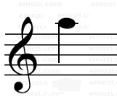
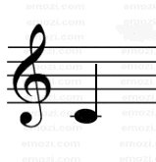
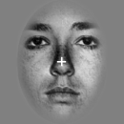
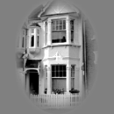
Learning of dynamic audio-visual associations
Conditioning Stimulus
Target Stimulus
1
CS
1
CS
2
0.8
or
or
0.6
p(face)
0.4
CS
TS
Response
0.2
0
200
400
600
800
2000 ± 650
Time (ms)
0
0
200
400
600
800
1000
trial
den Ouden et al. 2010, J. Neurosci .

Slide 36
Bayesian learning model
k
volatility
v_{t-1}
v_{t}
probabilistic association
r_{t}
r_{t+1}
observed events
u_{t}
u_{t+1}
Behrens et al. 2007, Nat. Neurosci.

Slide 37
Random effects BMS
true probabilities
Bayesian learner
den Ouden et al. 2010, J. Neurosci .

Slide 38
Comparison with competing learning models
1
True
Bayes Vol
Alternative learning models:
Rescorla-Wagner
HMM (2 variants)
True probabilities
0.8
HMM fixed
HMM learn
RW
p(F)
0.6
0.4
0.2
0
400
440
480
Trial
520
560
600
BMS:
hierarchical Bayesian learner performs best
den Ouden et al. 2010, J. Neurosci .

Slide 39

Stimulus-independent prediction error
Putamen
Premotor cortex
p < 0.05
(cluster-level whole- brain corrected)
p < 0.05 (SVC)
0
0
-0.5
-0.5
BOLD resp. (a.u.)
-1
BOLD resp. (a.u.)
-1
-1.5
-1.5
-2
p(F)
p(H)
-2
p(F)
p(H)
den Ouden et al. 2010, J. Neurosci .

Slide 40
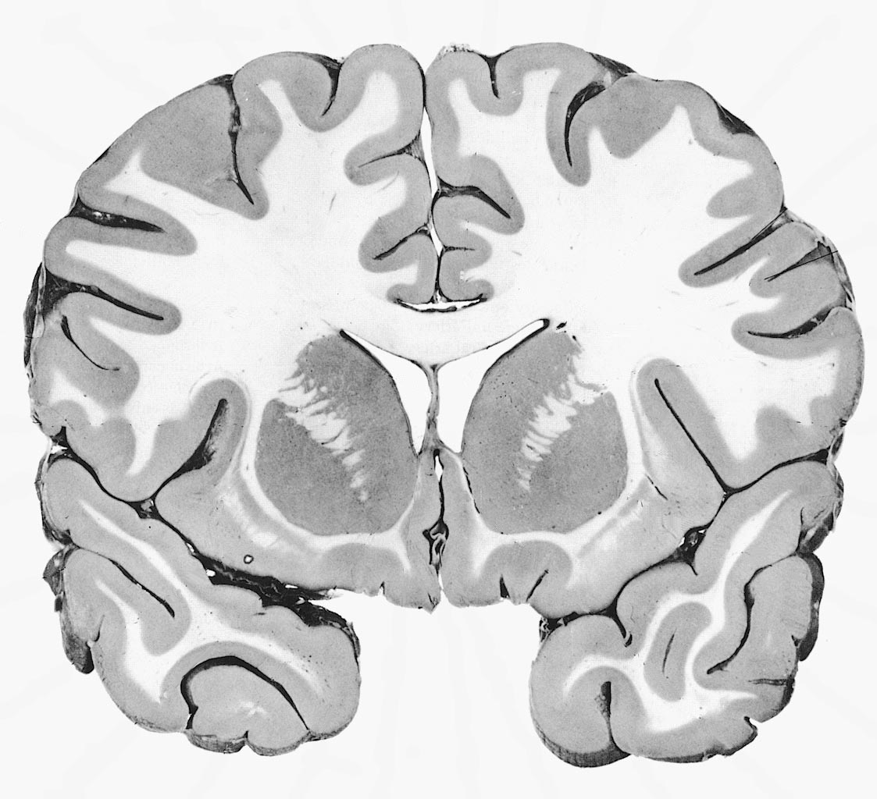
Prediction error (PE) activity in the putamen
PE during
reinforcement learning
O'Doherty et al. 2004, Science
PE during
incidental
sensory learning
den Ouden et al. 2009, Cerebral Cortex
According to the free energy principle (and other learning theories):
synaptic plasticity during learning = PE dependent changes in connectivity

Slide 41


Prediction error gates visuo-motor connections
Modulation of visuo-motor connections by striatal PE activity
Influence of visual areas on premotor cortex:
  stronger for surprising stimuli
  weaker for expected stimuli
p(H)
p(F)
PUT
d = 0.010 ± 0.003
p = 0.010
d = 0.011 ± 0.004
p = 0.017
PMd
PPA
FFA
den Ouden et al. 2010, J. Neurosci .

Slide 42
Prediction error in PMd: cause or effect?
Model 1
Model 2
den Ouden et al. 2010, J. Neurosci .

Slide 43
Overview
Bayesian model selection (BMS)
Nonlinear DCM for fMRI
Embedding computational models in DCMs
Integrating tractography and DCM

Slide 44
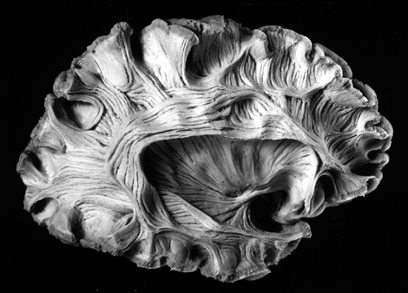
Diffusion-weighted imaging
Parker & Alexander, 2005,
Phil. Trans. B

Slide 45
Probabilistic tractography: Kaden et al. 2007, NeuroImage
computes local fibre orientation density by spherical deconvolution of the diffusion-weighted signal
estimates the spatial probability distribution of connectivity from given seed regions
anatomical connectivity = proportion of fibre pathways originating in a specific source region that intersect a target region
If the area or volume of the source region approaches a point, this measure reduces to method by Behrens et al. (2003)

Slide 46
Integration of tractography and DCM
R₁
R₂
low probability of anatomical connection
→ small prior variance of effective connectivity parameter
R₁
R₂
high probability of anatomical connection
→ large prior variance of effective connectivity parameter
Stephan, Tittgemeyer et al. 2009, NeuroImage

Slide 47
LD|LVF
probabilistic
tractography
FG
(x₃)
FG
(x₄)
FG
left
FG
right
LD
LD
LG
(x₁)
LG
(x₂)
LG
left
LG
right
◆ DCM structure
LD|RVF
❖ anatomical connectivity
RVF
stim.
BVF
stim.
LVF
stim.
⬥ connection-specific priors for coupling parameters
Stephan, Tittgemeyer et al. 2009, NeuroImage

Slide 48
Connection-specific prior variance Σ as a function of anatomical connection probability ϕ
64 different mappings by systematic search across hyper-parameters α and β
yields anatomically informed (intuitive and counterintuitive) and uninformed priors

Slide 50
Stephan, Tittgemeyer et al. 2009, NeuroImage

Slide 51
Methods papers on DCM for fMRI and BMS – part 1
Chumbley JR, Friston KJ, Fearn T, Kiebel SJ (2007) A Metropolis-Hastings algorithm for dynamic causal models. Neuroimage 38:478-487.
Daunizeau J, David, O, Stephan KE (2010) Dynamic Causal Modelling: A critical review of the biophysical and statistical foundations. NeuroImage, in press.
Friston KJ, Harrison L, Penny W (2003) Dynamic causal modelling. NeuroImage 19:1273-1302.
Kasess CH, Stephan KE, Weissenbacher A, Pezawas L, Moser E, Windischberger C (2010) Multi-Subject Analyses with Dynamic Causal Modeling. NeuroImage 49: 3065-3074.
Kiebel SJ, Kloppel S, Weiskopf N, Friston KJ (2007) Dynamic causal modeling: a generative model of slice timing in fMRI. NeuroImage 34:1487-1496.
Marreiros AC, Kiebel SJ, Friston KJ (2008) Dynamic causal modelling for fMRI: a two-state model. NeuroImage 39:269-278.
Penny WD, Stephan KE, Mechelli A, Friston KJ (2004a) Comparing dynamic causal models. NeuroImage 22:1157-1172.
Penny WD, Stephan KE, Mechelli A, Friston KJ (2004b) Modelling functional integration: a comparison of structural equation and dynamic causal models. NeuroImage 23 Suppl 1:S264-274.
Penny WD, Stephan KE, Daunizeau J, Joao M, Friston K, Schofield T, Leff AP (2010) Comparing Families of Dynamic Causal Models. PLoS Computational Biology, in press.

Slide 52
Methods papers on DCM for fMRI and BMS – part 2
Stephan KE, Harrison LM, Penny WD, Friston KJ (2004) Biophysical models of fMRI responses. Curr Opin Neurobiol 14:629-635.
Stephan KE, Weiskopf N, Drysdale PM, Robinson PA, Friston KJ (2007) Comparing hemodynamic models with DCM. NeuroImage 38:387-401.
Stephan KE, Harrison LM, Kiebel SJ, David O, Penny WD, Friston KJ (2007) Dynamic causal models of neural system dynamics: current state and future extensions. J Biosci 32:129-144.
Stephan KE, Weiskopf N, Drysdale PM, Robinson PA, Friston KJ (2007) Comparing hemodynamic models with DCM. Neuroimage 38:387-401.
Stephan KE, Kasper L, Harrison LM, Daunizeau J, den Ouden HE, Breakspear M, Friston KJ (2008) Nonlinear dynamic causal models for fMRI. NeuroImage 42:649-662.
Stephan KE, Penny WD, Daunizeau J, Moran RJ, Friston KJ (2009) Bayesian model selection for group studies. NeuroImage 46:1004-1017.
Stephan KE, Tittgemeyer M, Knösche TR, Moran RJ, Friston KJ (2009) Tractography-based priors for dynamic causal models. NeuroImage 47: 1628-1638.
Stephan KE, Penny WD, Moran RJ, den Ouden HEM, Daunizeau J, Friston KJ (2010) Ten simple rules for Dynamic Causal Modelling. NeuroImage 49: 3099-3109.

Slide 53
Thank you

