Slide 1
The General Linear Model (GLM)
Klaas Enno Stephan Laboratory for Social & Neural Systems Research
Institute for Empirical Research in Economics
University of Zurich
Functional Imaging Laboratory (FIL)
Wellcome Trust Centre for Neuroimaging
University College London
With many thanks for slides & images to:
FIL Methods group
SPM Course 2010
University of Zurich, 17-19 February 2010

Slide 2
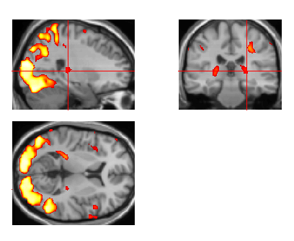
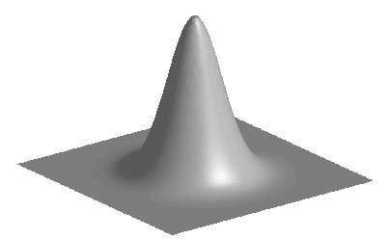
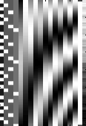
Overview of SPM
Image time-series
Kernel
Design matrix
Statistical parametric map (SPM)
Realignment
Smoothing
General linear model
Statistical
inference
Gaussian
field theory
Normalisation
p <0.05
Template
Parameter estimates

Slide 3
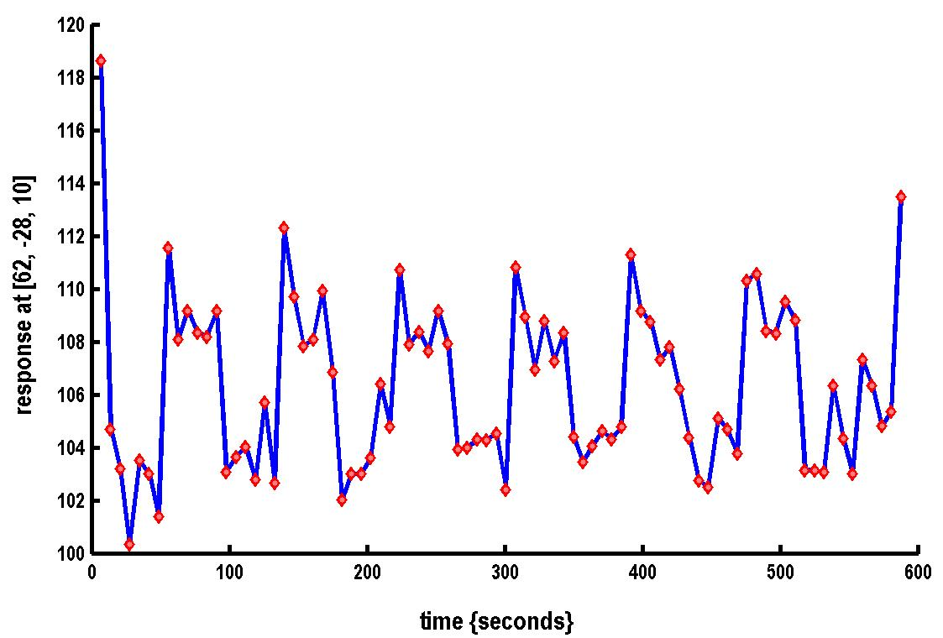

A very simple fMRI experiment
One session
Passive word listening
versus rest
7 cycles of
rest and listening
Blocks of 6 scans
with 7 sec TR
Stimulus function
Question: Is there a change in the BOLD response between listening and rest?

Slide 4


Modelling the measured data
Why?
Make inferences about effects of interest
Decompose data into effects and error
Form statistic using estimates of effects and error
How?
stimulus function
effects estimate
linear
model
statistic
data
error estimate

Slide 5
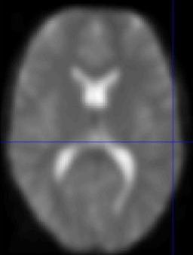
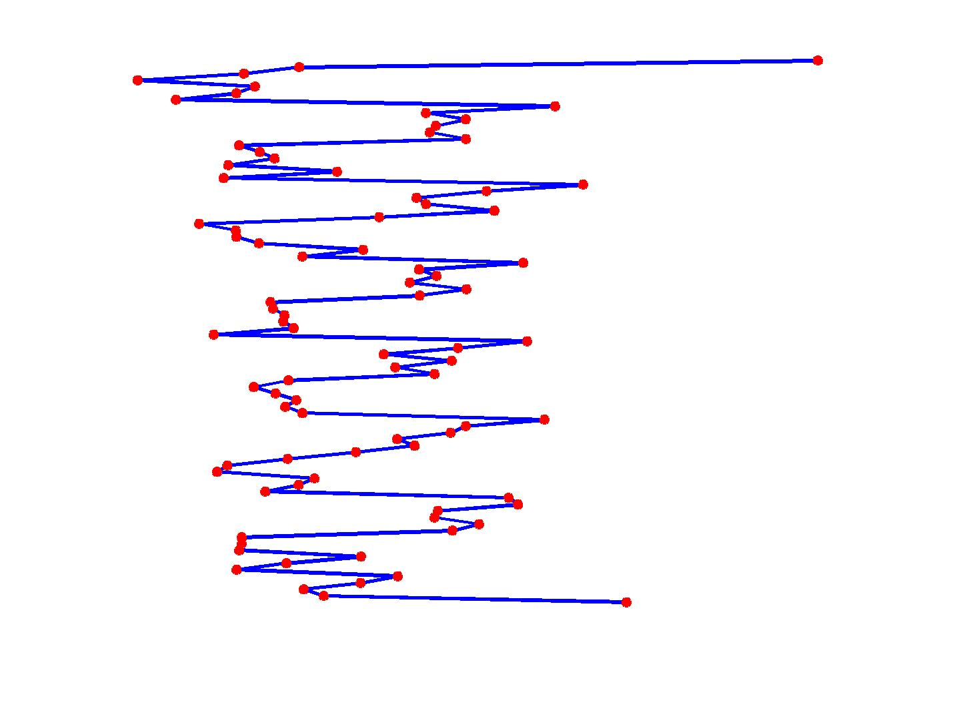
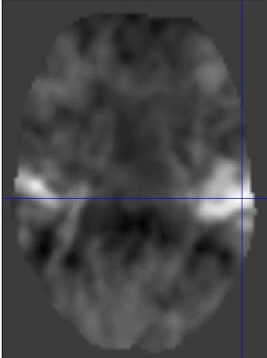
Voxel-wise time series analysis
model
specification
parameter
estimation
Time
hypothesis
statistic
Time
BOLD signal
single voxel
time series
SPM

Slide 6
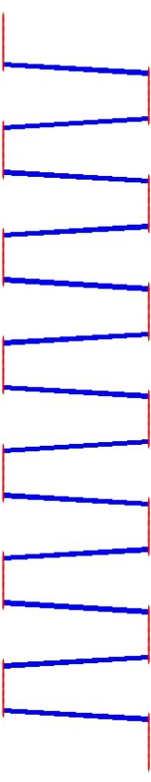
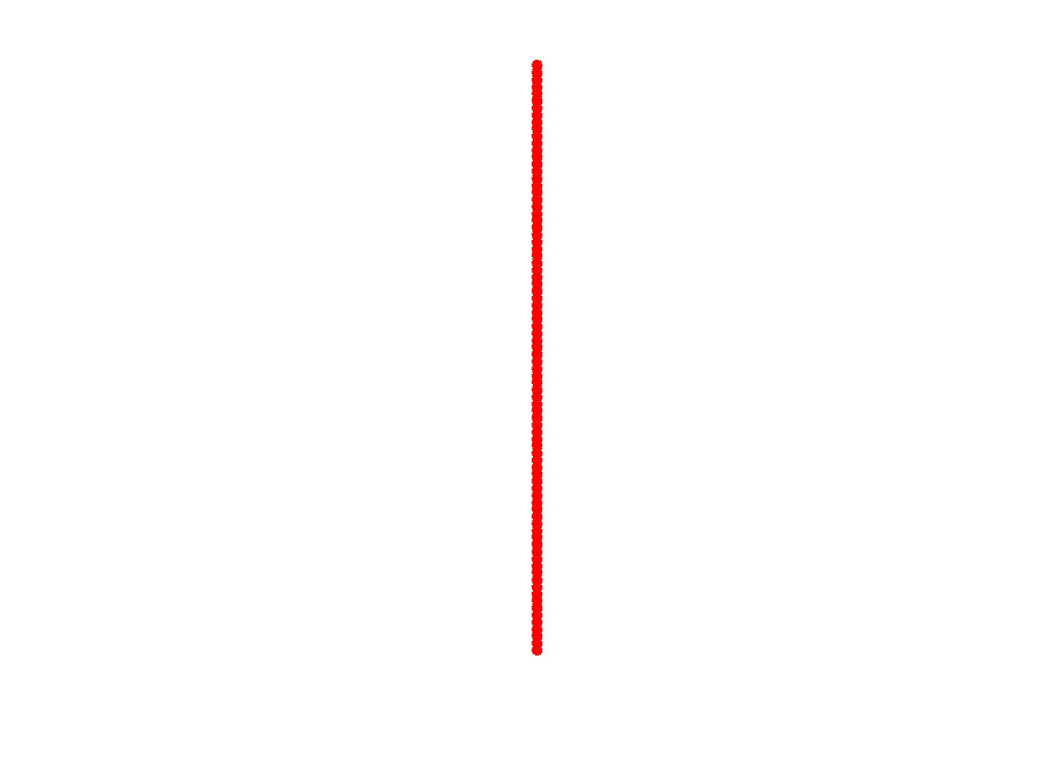
Single voxel regression model
error
=
β₁
+
β₂
+
Time
x₁
x₂
e
BOLD signal

Slide 7
Mass-univariate analysis: voxel-wise GLM
X
y
+
=
Model is specified by
Design matrix X
Assumptions about e
N: number of scans
p: number of regressors
The design matrix embodies all available knowledge about experimentally controlled factors and potential confounds.

Slide 8
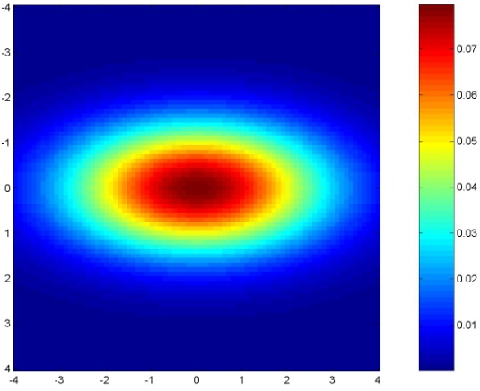
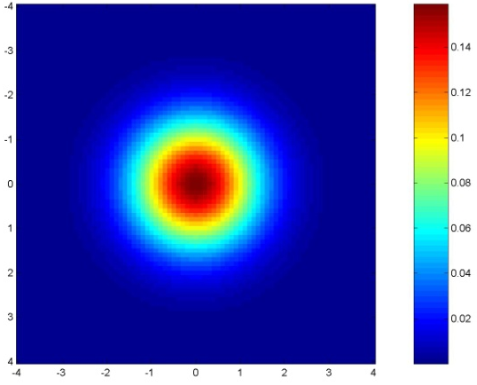
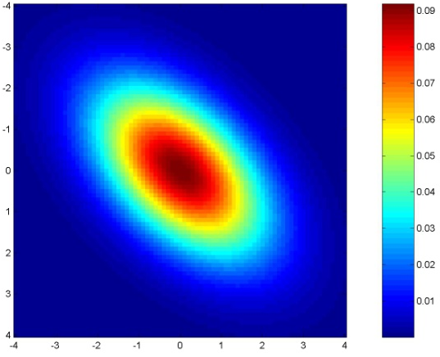
GLM assumes Gaussian “spherical” (i.i.d.) errors
sphericity = i.i.d. error covariance is scalar multiple of identity matrix:
Cov(e) = σ²I
Examples for non-sphericity:
non-identity
non-independence

Slide 9



Parameter estimation
Objective:
estimate parameters to minimize
=
+
y
X
Ordinary least squares estimation (OLS) (assuming i.i.d. error):

Slide 10
A geometric perspective on the GLM
Residual forming matrix R
OLS estimates
y
e
x₂
x₁
Projection matrix P
Design space defined by X

Slide 11
Deriving the OLS equation
OLS estimate

Slide 12
Correlated and orthogonal regressors
y
x₂
x₂*
x₁
Correlated regressors =
explained variance is shared between regressors
When x₂ is orthogonalized with regard to x₁, only the parameter estimate for x₁ changes, not that for x₂!

Slide 13
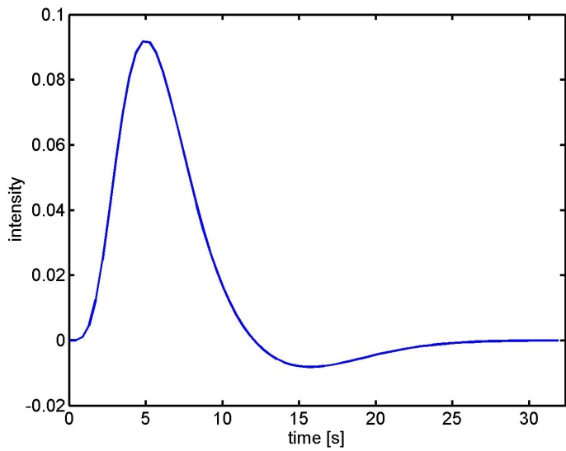
What are the problems of this model?
BOLD responses have a delayed and dispersed form.
HRF
The BOLD signal includes substantial amounts of low-frequency noise.
The data are serially correlated (temporally autocorrelated) → this violates the assumptions of the noise model in the GLM

Slide 14
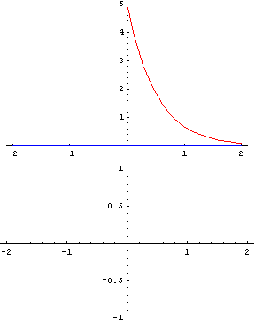
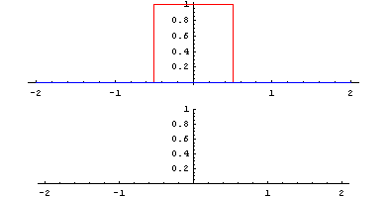
Problem 1: Shape of BOLD response Solution: Convolution model
hemodynamic response function (HRF)
The response of a linear time-invariant (LTI) system is the convolution of the input with the system's response to an impulse (delta function).
expected BOLD response
= input function ⊗ impulse response function (HRF)

Slide 15
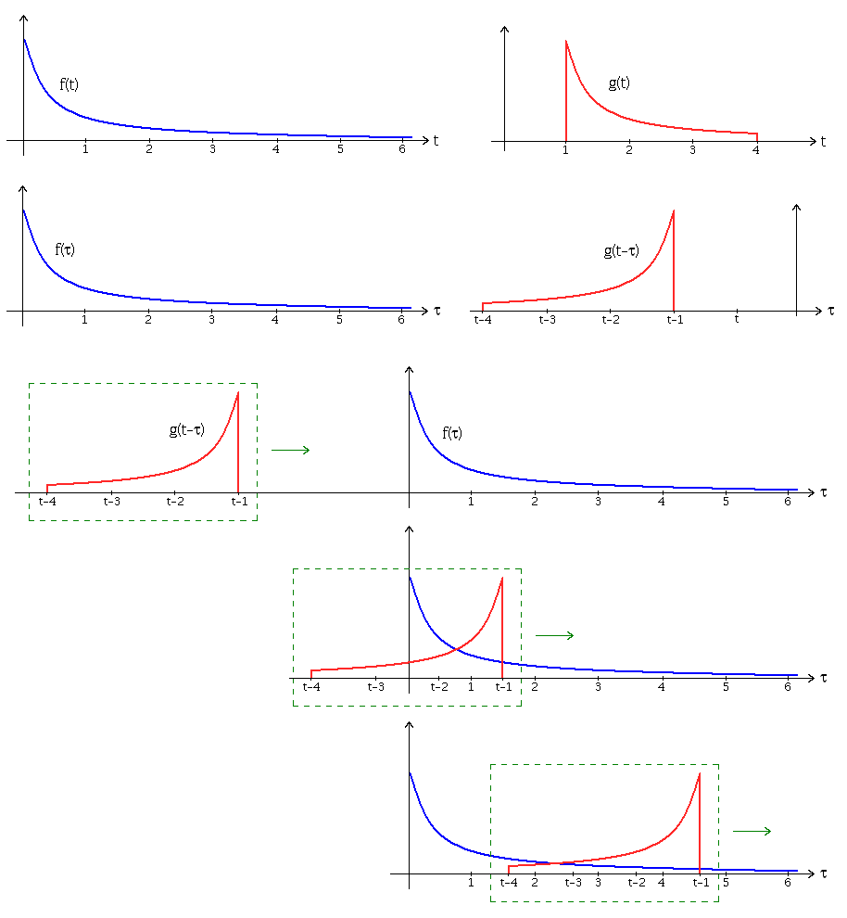
Convolution step-by-step (from Wikipedia):
Express each function in terms of a dummy variable τ.
2. Reflect one of the functions: g(τ)→g( − τ).
3. Add a time-offset, t, which allows g(t − τ) to slide along the τ-axis.
4.Start t at -∞ and slide it all the way to +∞. Wherever the two functions intersect, find the integral of their product. In other words, compute a sliding, weighted-average of function f(τ), where the weighting function is g( − τ).
The resulting waveform (not shown here) is the convolution of functions f and g. If f(t) is a unit impulse, the result of this process is simply g(t), which is therefore called the impulse response.

Slide 16
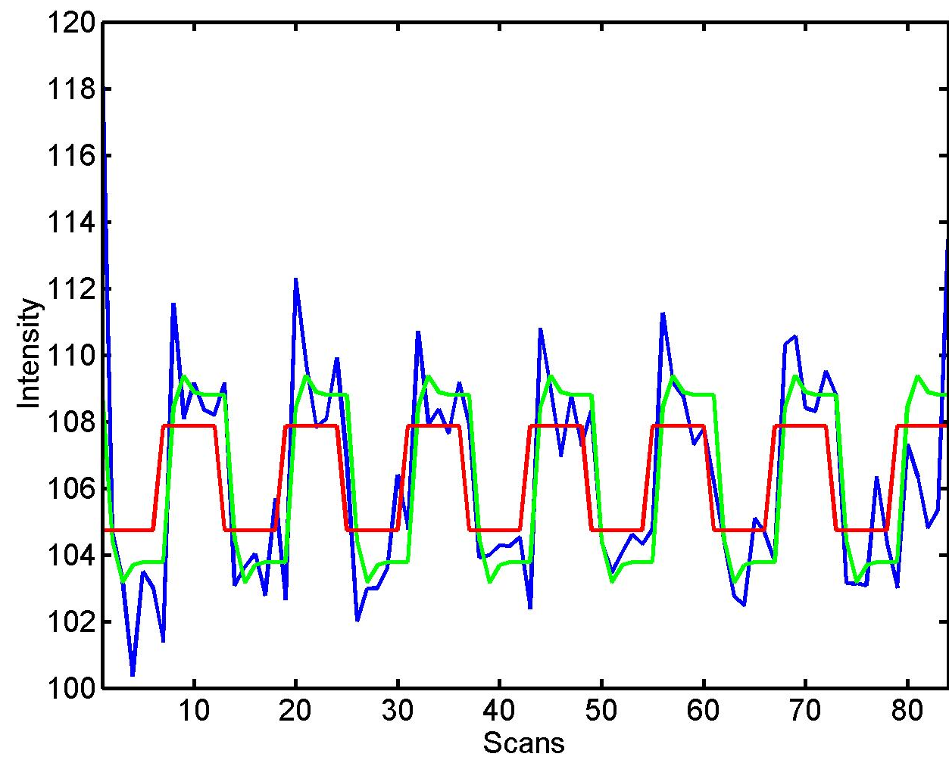


Convolution model of the BOLD response
Convolve stimulus function with a canonical hemodynamic response function (HRF):
⊗ HRF

Slide 17
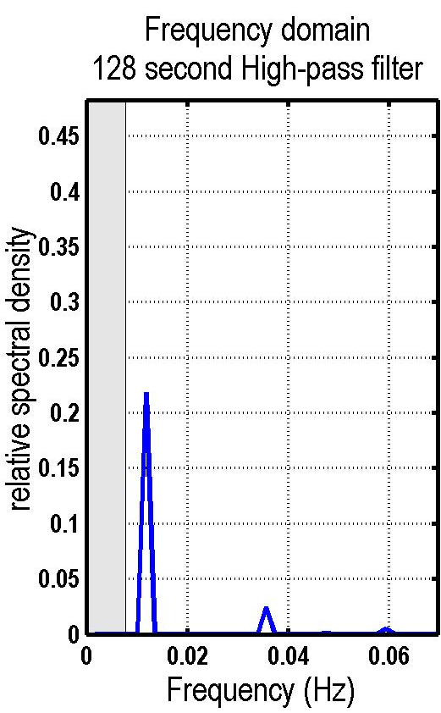
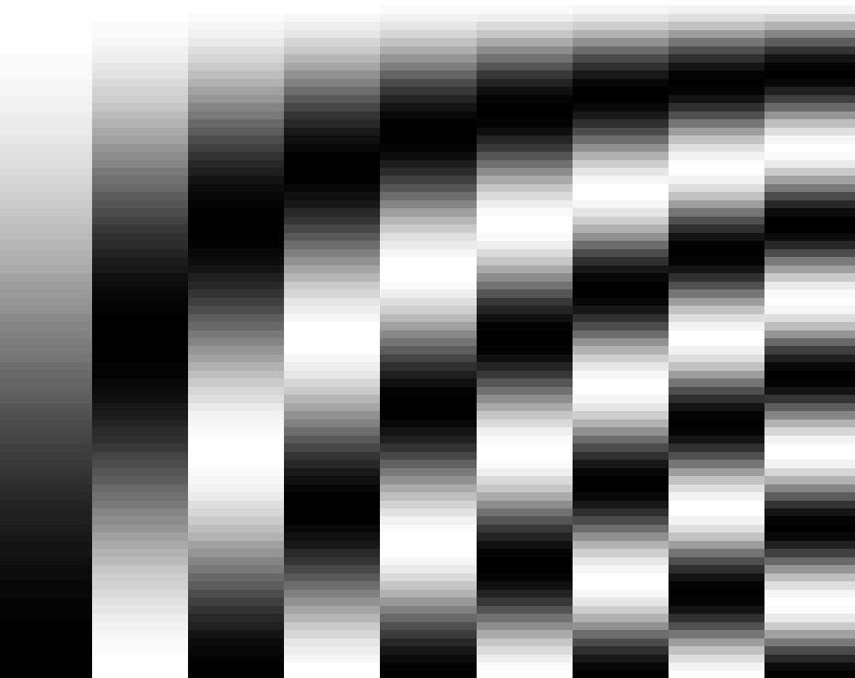
Problem 2: Low-frequency noise Solution: High pass filtering
S = residual forming matrix of DCT set
discrete cosine transform (DCT) set

Slide 18
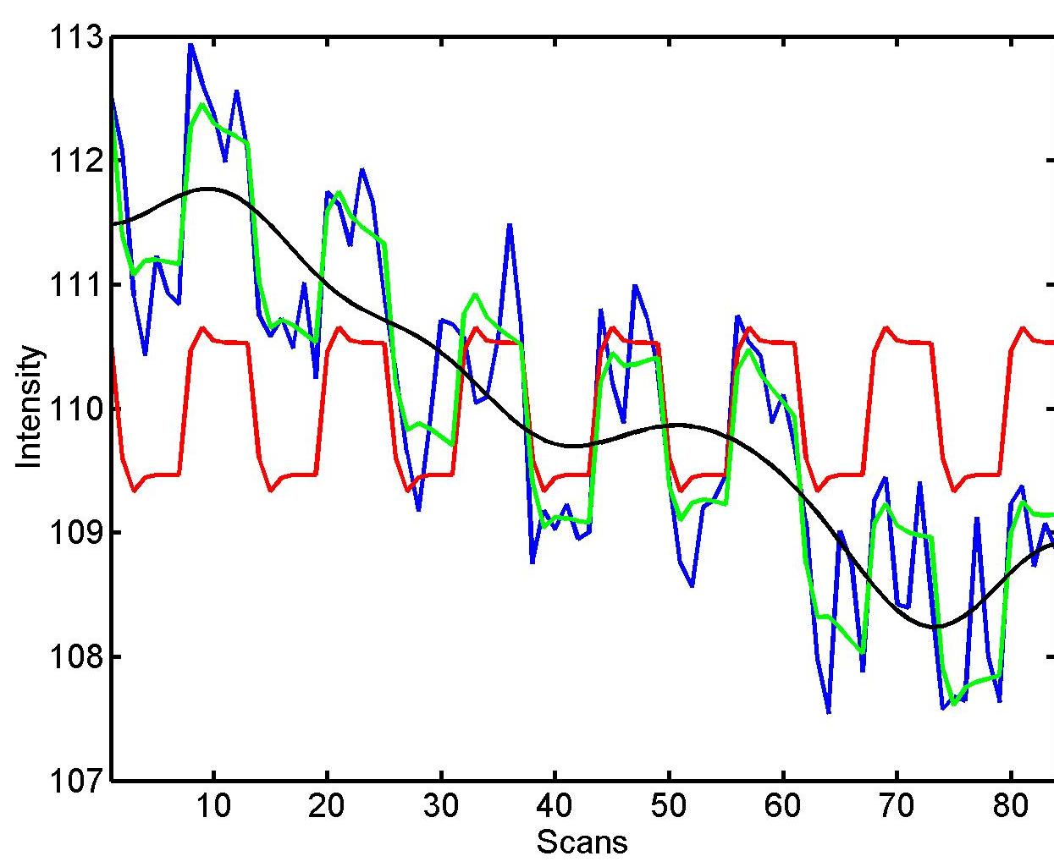


High pass filtering: example
blue = data
black = mean + low-frequency drift
green = predicted response, taking into account low-frequency drift
red = predicted response, NOT taking into account low-frequency drift

Slide 19
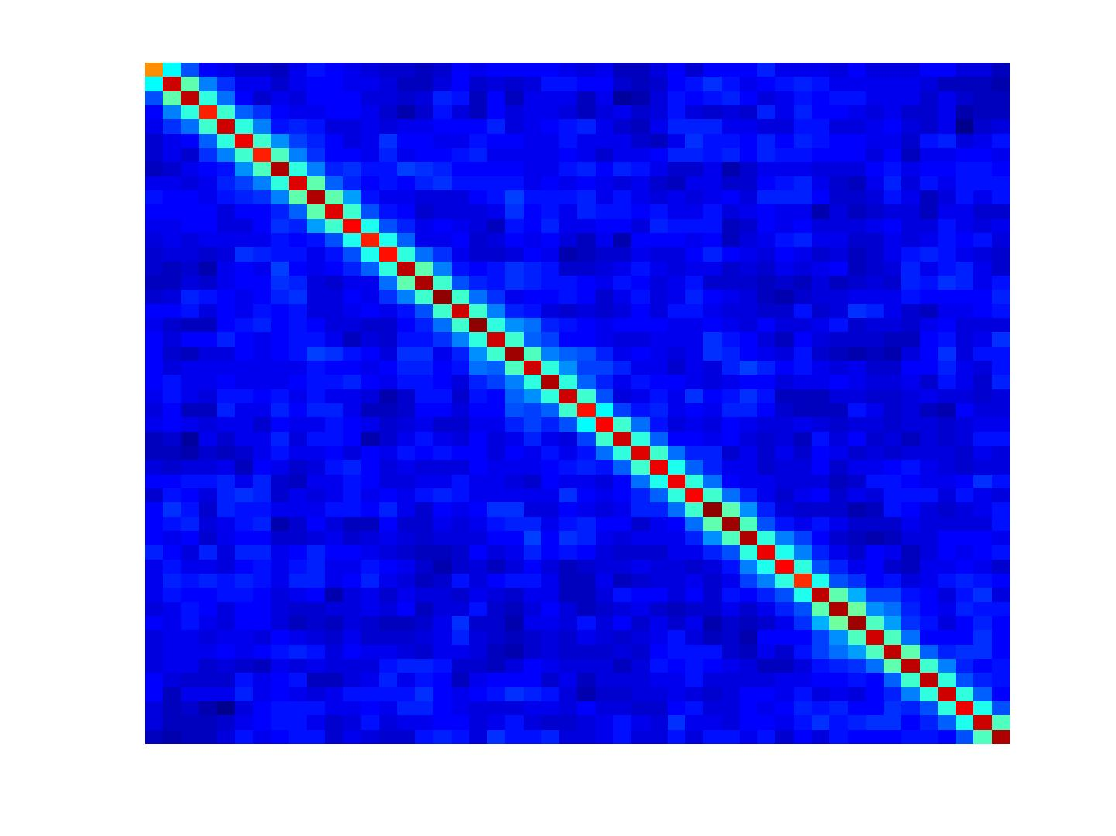
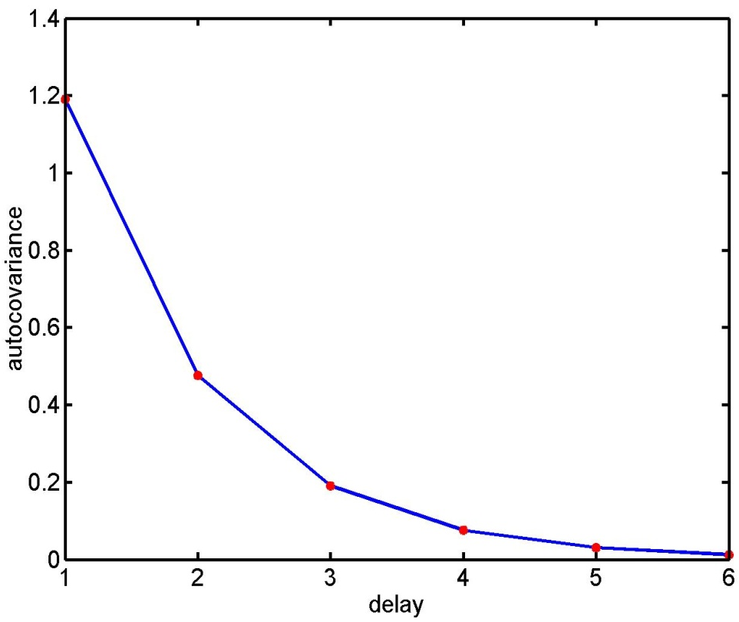
Problem 3: Serial correlations
with
1st order autoregressive process: AR(1)
autocovariance
function

Slide 20
Dealing with serial correlations
Pre-colouring: impose some known autocorrelation structure on the data (filtering with matrix W) and use Satterthwaite correction for df’s.
Pre-whitening: 1. Use an enhanced noise model with multiple error covariance components, i.e. e ~ N(0, σ²V) instead of e ~ N(0, σ²I). 2. Use estimated serial correlation to specify filter matrix W for whitening the data.

Slide 21
How do we define W ?
Enhanced noise model
Remember linear transform for Gaussians
Choose W such that error covariance becomes spherical
Conclusion: W is a simple function of V ⇒ so how do we estimate V ?

Slide 22
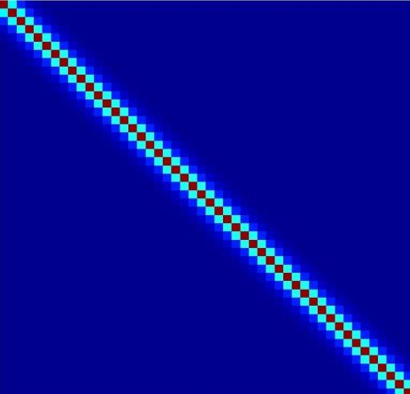
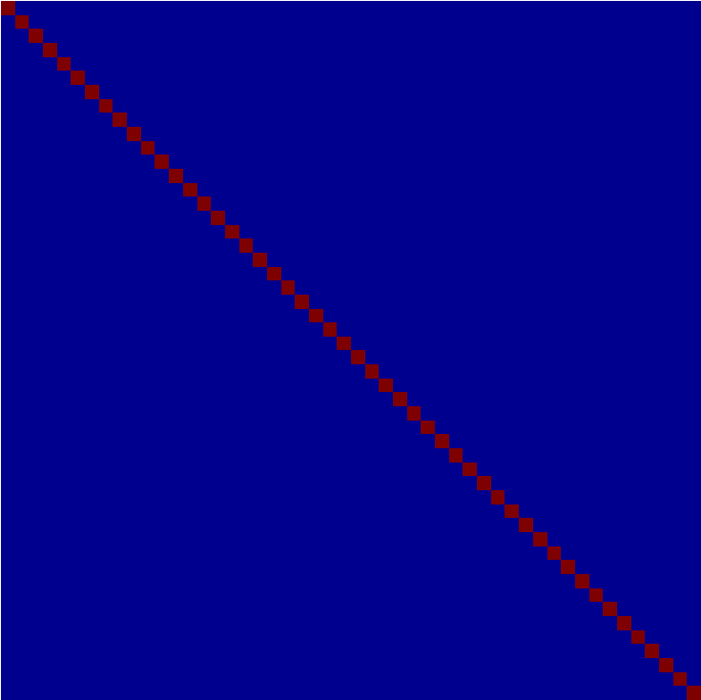
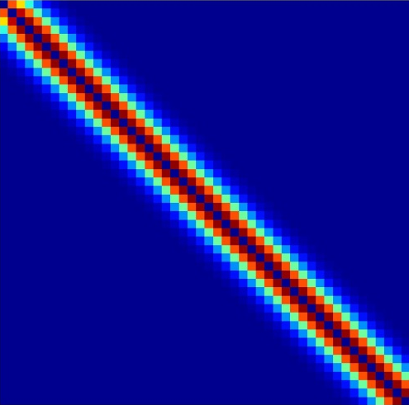
Estimating V:
Multiple covariance components
enhanced noise model
error covariance components Q
and hyperparameters λ
V
Q₁
Q₂
=
λ₁
+ λ₂
Estimation of hyperparameters λ with ReML (restricted maximum likelihood).

Slide 23
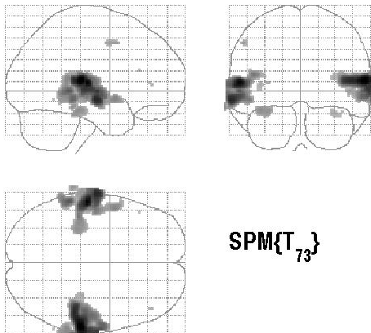

Contrasts & statistical parametric maps
c = 1 0 0 0 0 0 0 0 0 0 0
Q: activation during listening ?
Null hypothesis:

Slide 24


t-statistic based on ML estimates
c = 1 0 0 0 0 0 0 0 0 0 0
For brevity:
ReML-estimates

Slide 25
Physiological confounds
head movements
arterial pulsations (particularly bad in brain stem)
breathing
eye blinks (visual cortex)
adaptation affects, fatigue, fluctuations in concentration, etc.

Slide 26
Outlook: further challenges
correction for multiple comparisons
variability in the HRF across voxels
slice timing
limitations of frequentist statistics → Bayesian analyses
GLM ignores interactions among voxels → models of effective connectivity
These issues are discussed in future lectures.

Slide 27
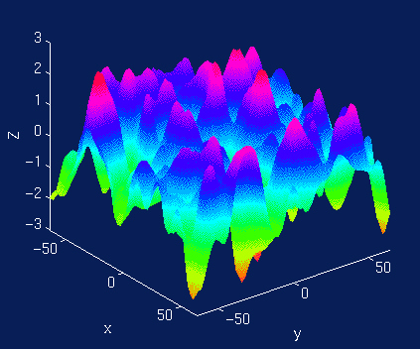
Correction for multiple comparisons
Mass-univariate approach: We apply the GLM to each of a huge number of voxels (usually > 100,000).
Threshold of p<0.05 → more than 5000 voxels significant by chance!
Massive problem with multiple comparisons!
Solution: Gaussian random field theory

Slide 28
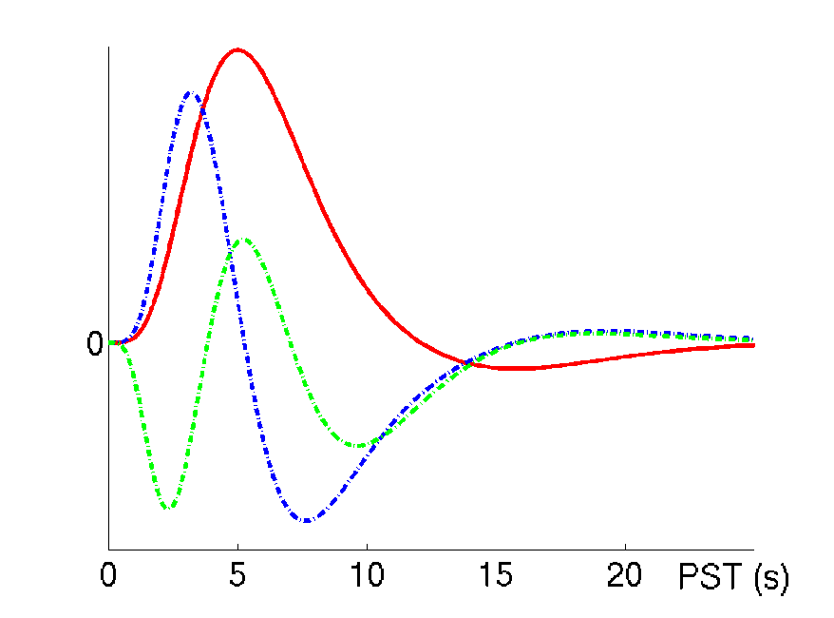
Variability in the HRF
HRF varies substantially across voxels and subjects
For example, latency can differ by ± 1 second
Solution: use multiple basis functions
See talk on event-related fMRI

Slide 29
Summary
Mass-univariate approach: same GLM for each voxel
GLM includes all known experimental effects and confounds
Convolution with a canonical HRF
High-pass filtering to account for low-frequency drifts
Estimation of multiple variance components (e.g. to account for serial correlations)

Slide 30
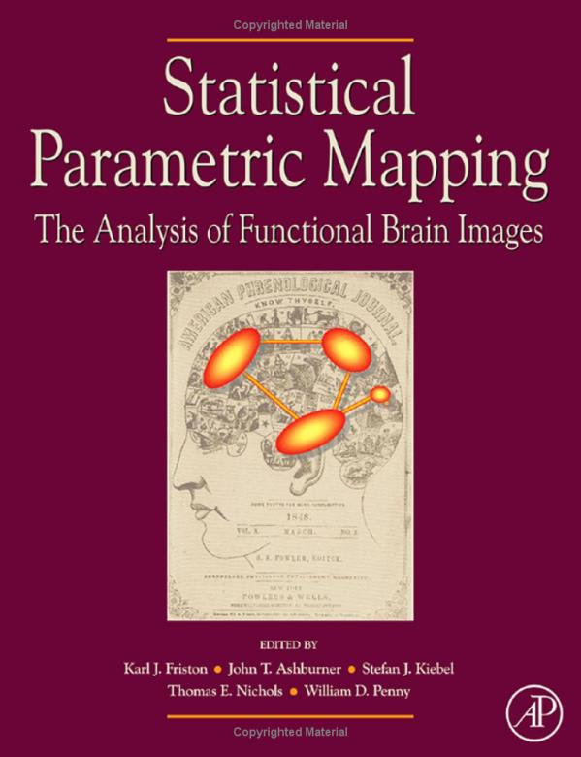
Bibliography
Friston, Ashburner, Kiebel, Nichols, Penny (2007) Statistical Parametric Mapping: The Analysis of Functional Brain Images. Elsevier.
Christensen R (1996) Plane Answers to Complex Questions: The Theory of Linear Models. Springer.
Friston KJ et al. (1995) Statistical parametric maps in functional imaging: a general linear approach. Human Brain Mapping 2: 189-210.

