Slide 1
Zurich SPM Course 2011
Voxel-Based Morphometry
& DARTEL
Ged Ridgway
With thanks to John Ashburner
and the FIL Methods Group

Slide 2
Aims of computational neuroanatomy
Many interesting and clinically important questions might relate to the shape or local size of regions of the brain
For example, whether (and where) local patterns of brain morphometry help to:
  Distinguish schizophrenics from healthy controls
  Explain the changes seen in development and aging
  Understand plasticity, e.g. when learning new skills
  Find structural correlates (scores, traits, genetics, etc.)
  Differentiate degenerative disease from healthy aging
    Evaluate subjects on drug treatments versus placebo

Slide 3
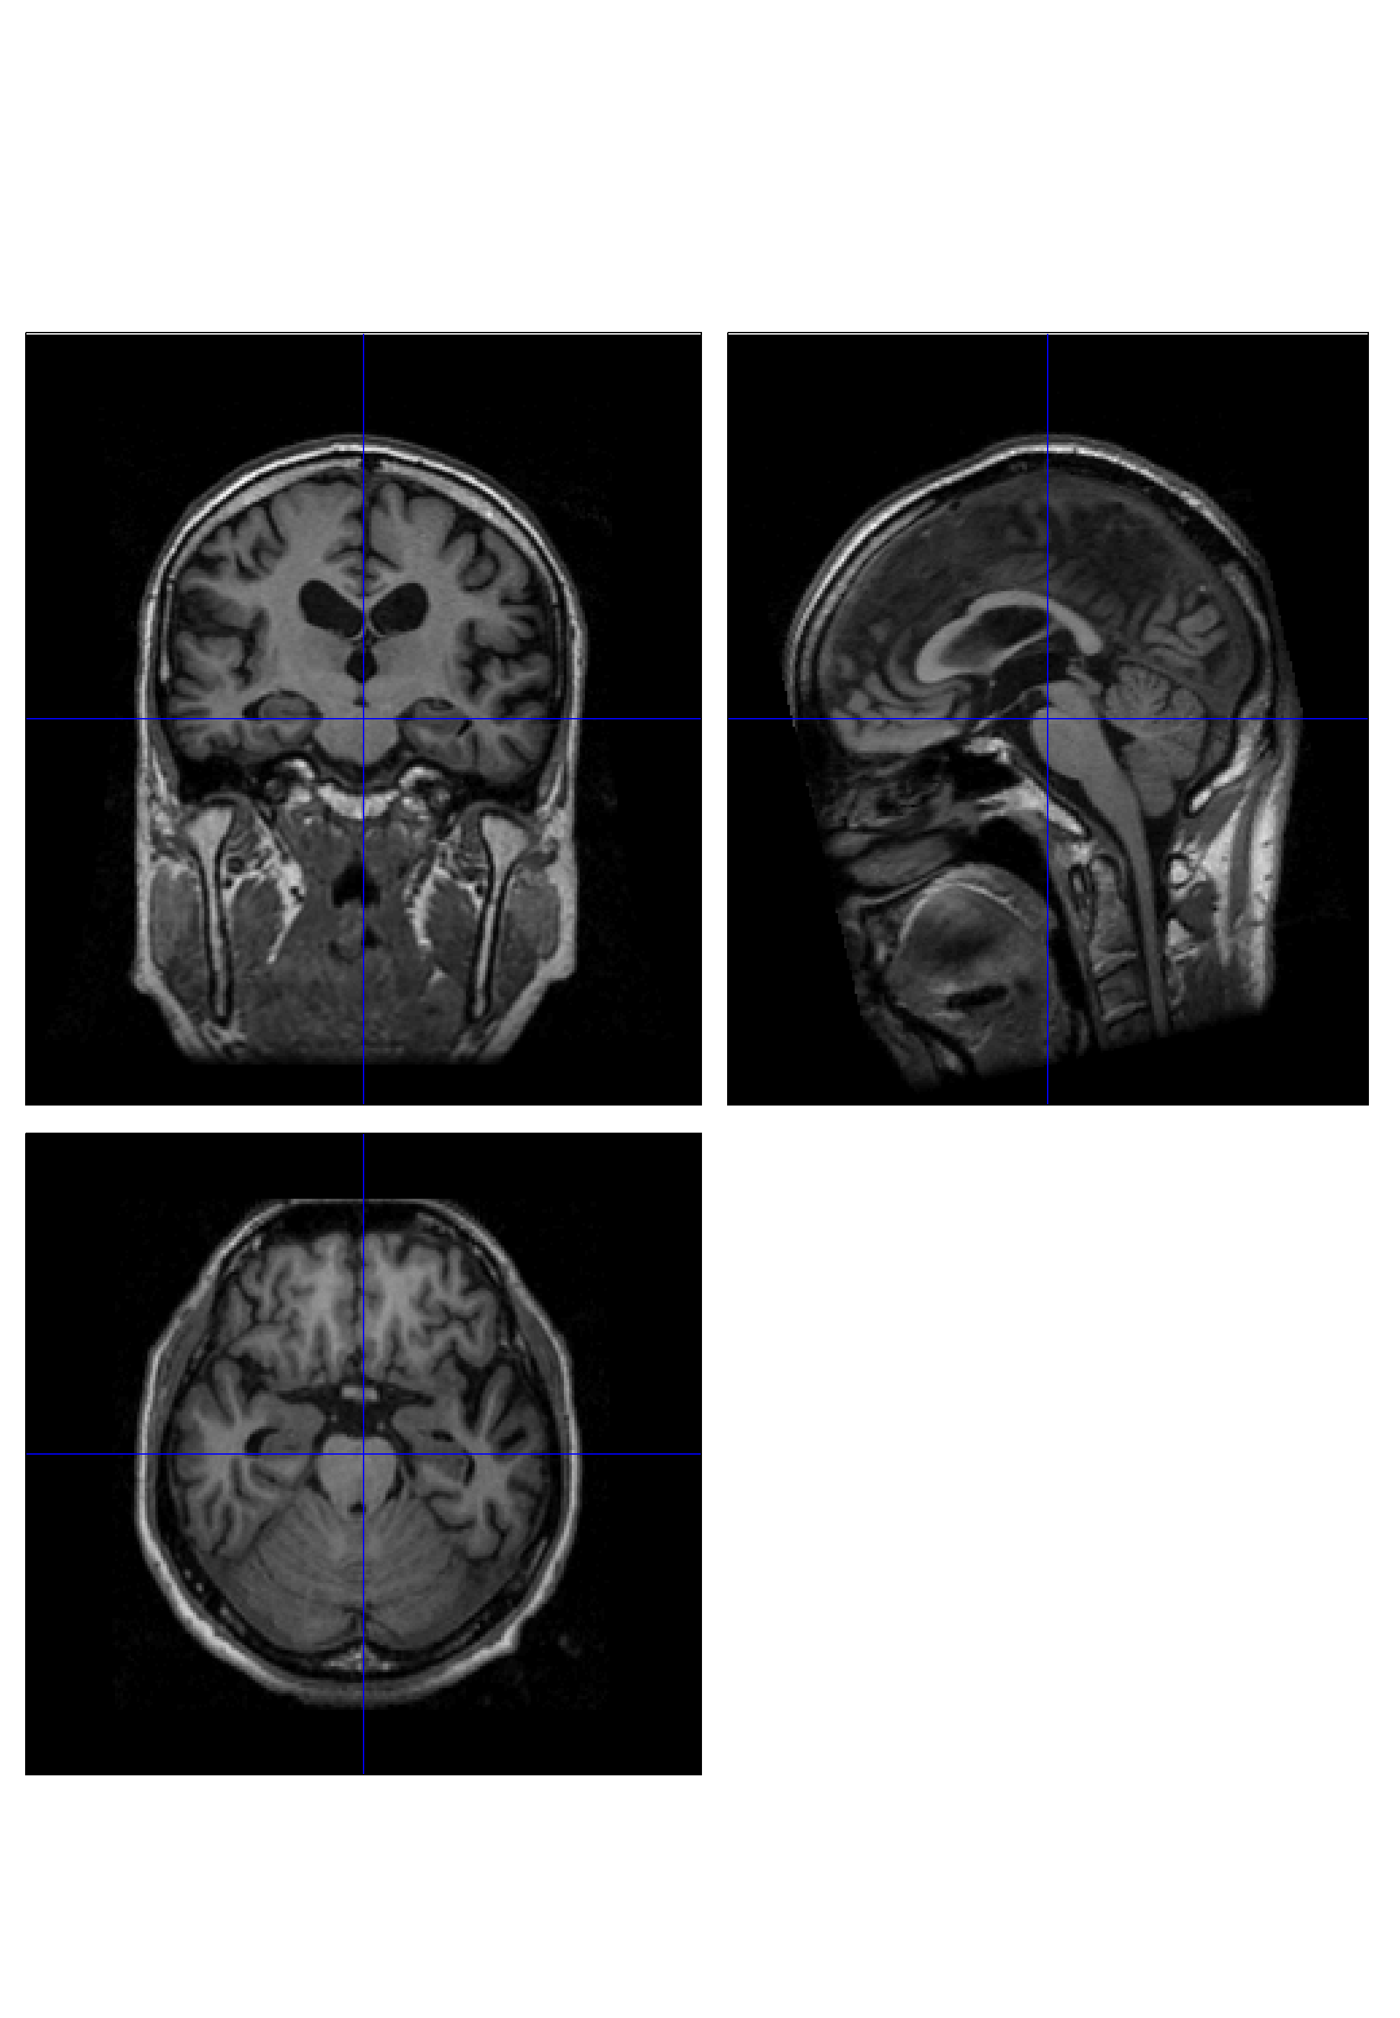
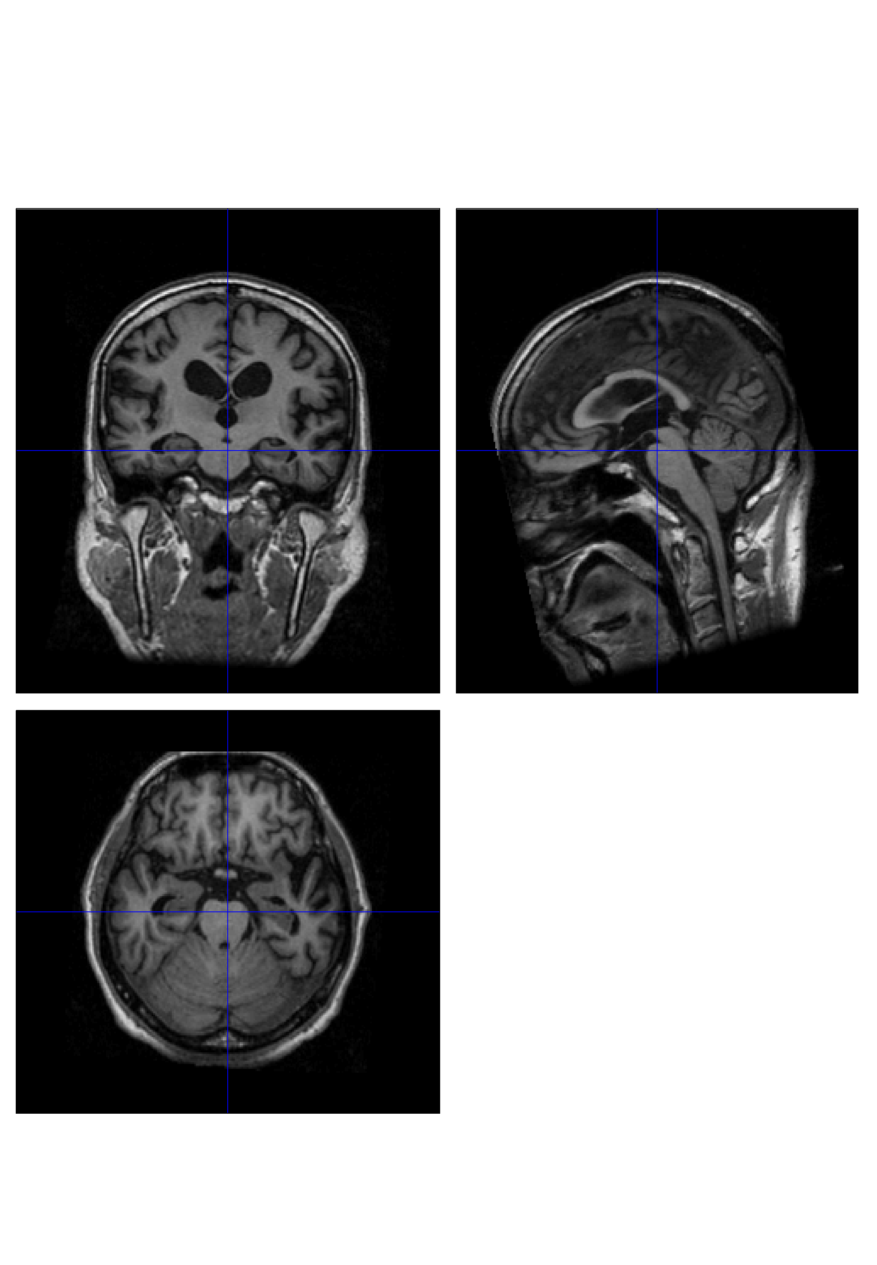
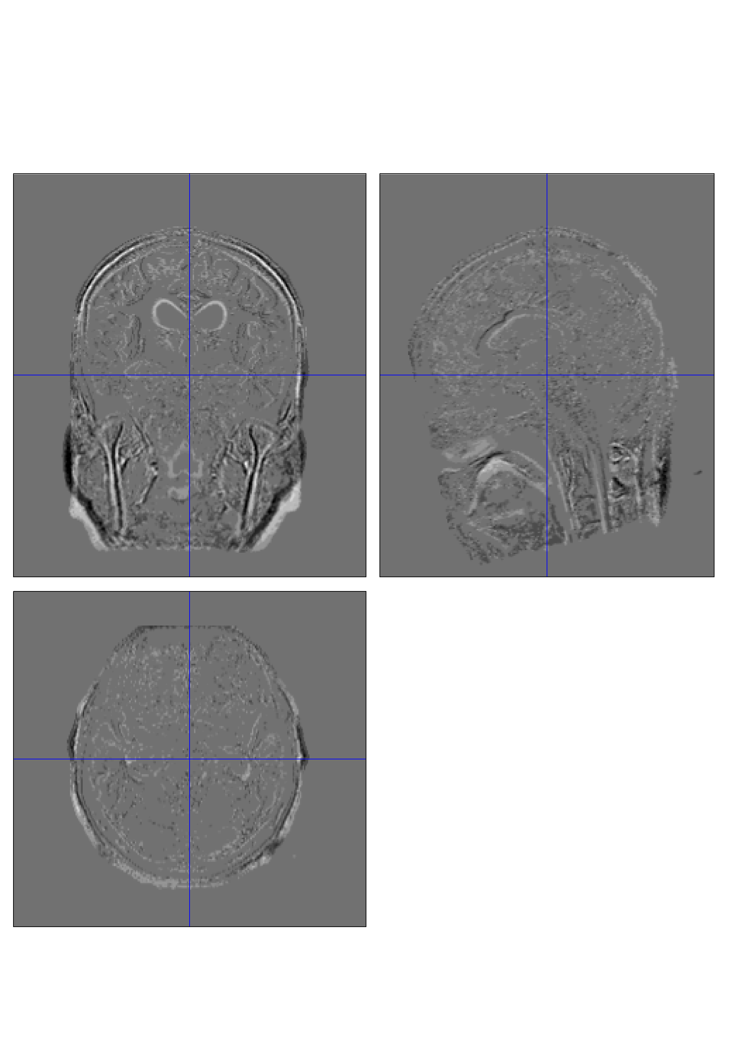
Alzheimer’s Disease example
Baseline Image
Standard clinical MRI
1.5T T1 SPGR
1x1x1.5mm voxels
Repeat image
12 month follow-up
rigidly registered
Subtraction image

Slide 4
Alzheimer’s Disease example
Some changes are apparent in this patient...
  Some might be noise or misregistration
  Perhaps confounding biological effects like hydration changes
  But some might genuinely reflect underlying AD pathology...
If we acquired more than two time-points, we could rule out some of the potential confounds
  Would changes generalise from the patient to the disease?
  Many morphological questions are not longitudinal, e.g. IQ, sex
It is appealing to try a “second-level” SPM analysis of structural data variation over subjects
  E.g. AD vs. healthy, male vs. female or a correlation with IQ

Slide 5
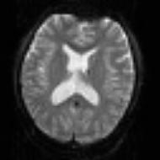
SPM for group fMRI
Group-wise
statistics
fMRI time-series
Preprocessing
Stat. modelling
Results query
spm T
Image
“Contrast”
Image
fMRI time-series
Preprocessing
Stat. modelling
Results query
“Contrast”
Image
fMRI time-series
Preprocessing
Stat. modelling
Results query
“Contrast”
Image

Slide 6
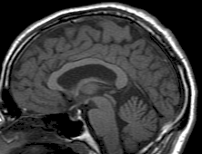
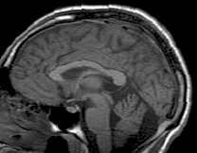
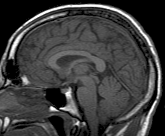
SPM for structural MRI
?
Group-wise
statistics
High-res T1 MRI
?
High-res T1 MRI
?
High-res T1 MRI
?

Slide 7
The benefits of tissue segmentation
High-resolution MRI reveals fine structural detail in the brain, but not all of it reliable or interesting
  Noise, intensity-inhomogeneity, vasculature, …
MR Intensity is usually not quantitatively meaningful (in the same way that e.g. CT is)
  fMRI time-series allow signal changes to be analysed statistically, compared to baseline or global values
Regional volumes of the three main tissue types: gray matter, white matter and CSF, are well-defined and potentially very interesting
  Other aspects (and other sequences) can also be of interest

Slide 8
Voxel-Based Morphometry
In essence VBM is Statistical Parametric Mapping of regional segmented tissue density or volume
The exact interpretation of gray matter density or volume is complicated, and depends on the preprocessing steps used
  It is not interpretable as neuronal packing density or other cytoarchitectonic tissue properties
  The hope is that changes in these microscopic properties may lead to macro- or mesoscopic VBM-detectable differences

Slide 9
A brief history of VBM
A Voxel-Based Method for the Statistical Analysis of Gray and White Matter Density… Wright, McGuire, Poline, Travere, Murrary, Frith, Frackowiak and Friston. NeuroImage 2(4), 1995 (!)
  Rigid reorientation (by eye), semi-automatic scalp editing and segmentation, 8mm smoothing, SPM statistics, global covars.
Voxel-Based Morphometry – The Methods. Ashburner and Friston. NeuroImage 11(6 pt.1), 2000
  Non-linear spatial normalisation, automatic segmentation
  Thorough consideration of assumptions and confounds

Slide 10
A brief history of VBM
A Voxel-Based Morphometric Study of Ageing… Good, Johnsrude, Ashburner, Henson and Friston. NeuroImage 14(1), 2001
  Optimised GM-normalisation (“a half-baked procedure”)
Unified Segmentation. Ashburner and Friston. NeuroImage 26(3), 2005
  Principled generative model for segmentation using
  deformable priors
A Fast Diffeomorphic Image Registration Algorithm. Ashburner. Neuroimage 38(1), 2007
  Large deformation normalisation to average shape templates
…

Slide 11
VBM overview
Unified segmentation and spatial normalisation
  More flexible groupwise normalisation using DARTEL
[Optional] modulation with Jacobian determinant
Optional computation of tissue totals/globals
Gaussian smoothing
Voxel-wise statistical analysis

Slide 12
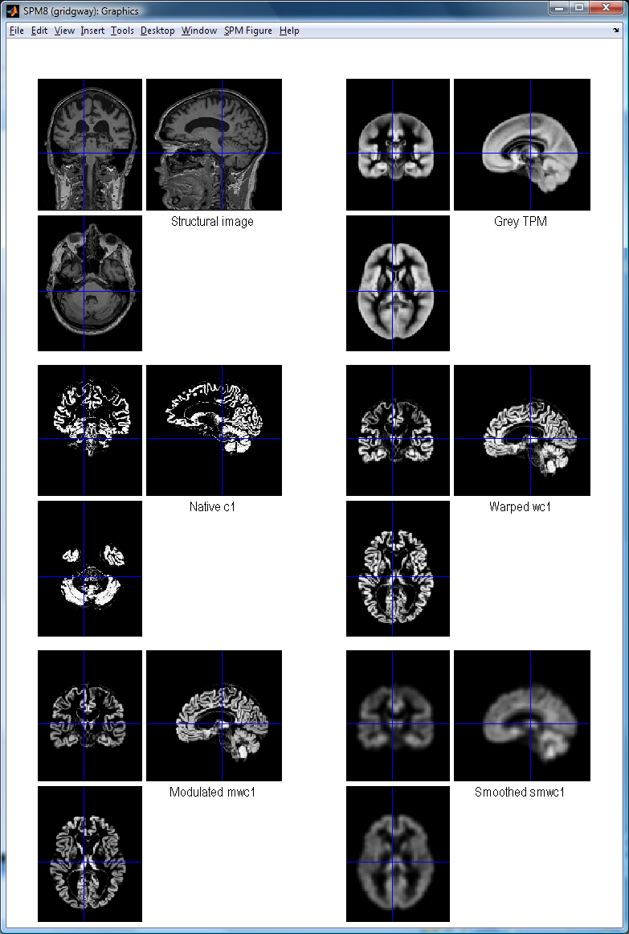
VBM in pictures
Segment
Normalise

Slide 13
VBM in pictures
Segment
Normalise
Modulate
Smooth

Slide 14
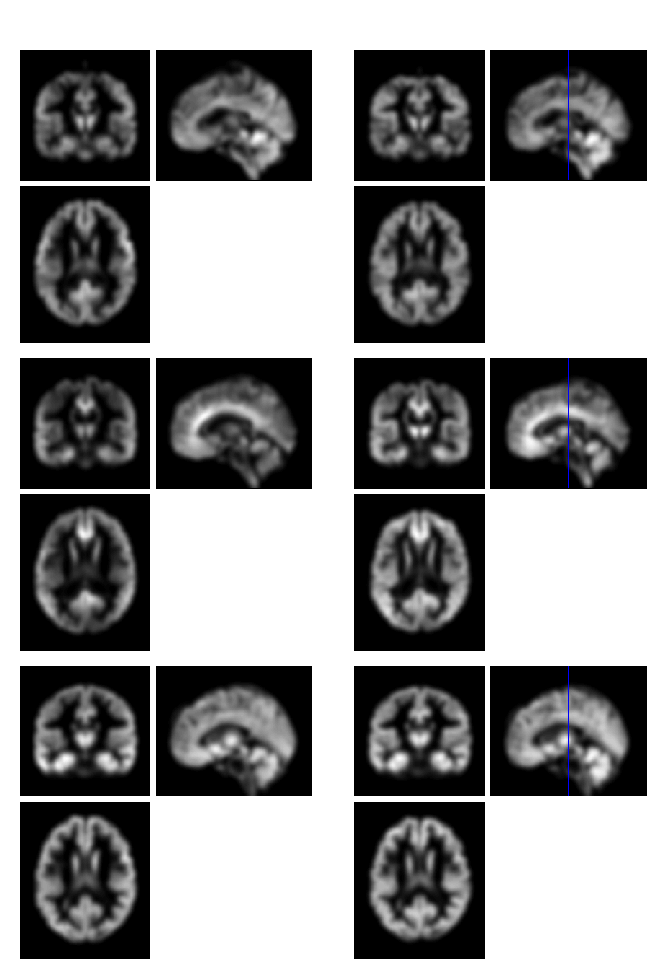
VBM in pictures
Segment
Normalise
Modulate
Smooth
Voxel-wise statistics

Slide 15
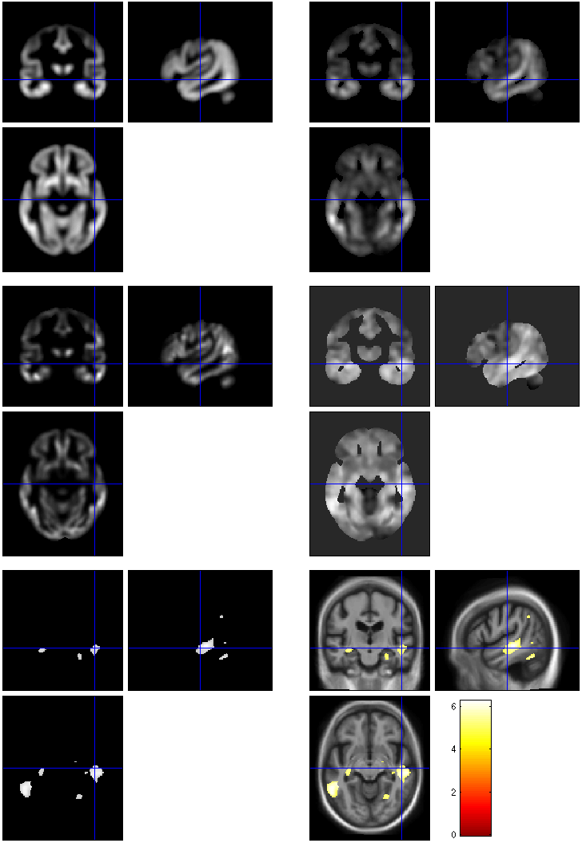
VBM in pictures
beta_0001
con_0001
Segment
Normalise
Modulate
Smooth
Voxel-wise statistics
ResMS
spmT_0001
FWE < 0.05

Slide 16
VBM Subtleties
Whether to modulate
How much to smooth
Interpreting results
Adjusting for total GM or Intracranial Volume
Limitations of linear correlation
Statistical validity

Slide 17
Modulation
1 1
Native
intensity = tissue density
Multiplication of the warped (normalised) tissue intensities so that their regional or global volume is preserved
  Can detect differences in completely registered areas
Otherwise, we preserve concentrations, and are detecting mesoscopic effects that remain after approximate registration has removed the macroscopic effects
  Flexible (not necessarily “perfect”) registration may not leave any such differences
Unmodulated
1 1 1 1
Modulated
2/3 1/3 1/3 2/3
Notes:
Clarify, modulation not a step (as spm2) but an option in the segment and the normalise GUIs

Slide 18
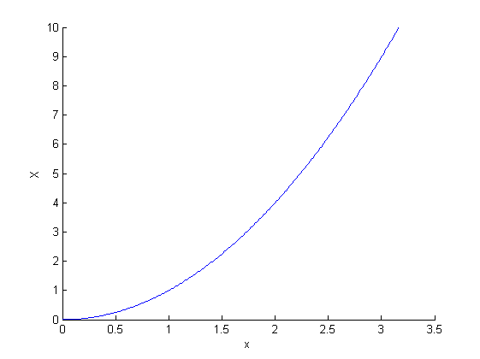
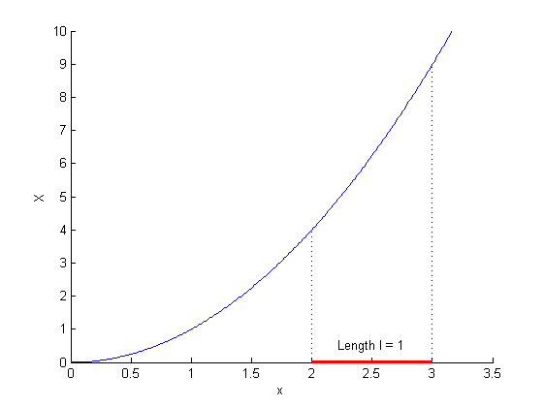
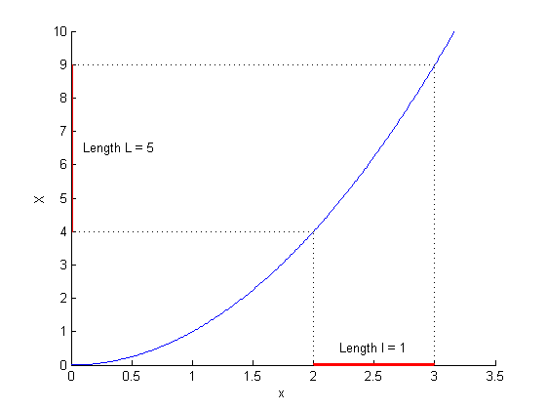
Modulation tutorial
X = x²
X’ = dX/dx = 2x
X’(2.5) = 5
Available from http://www.mathworks.co.uk/matlabcentral/fileexchange/26884

Slide 19
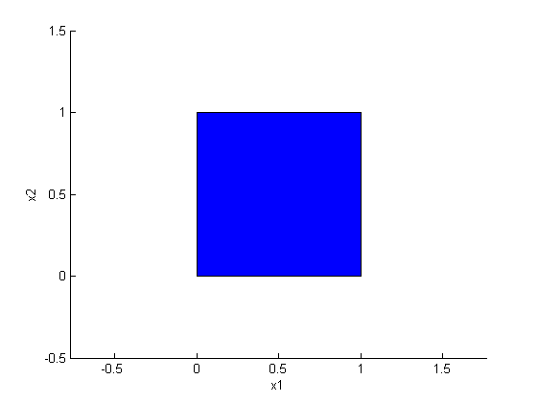
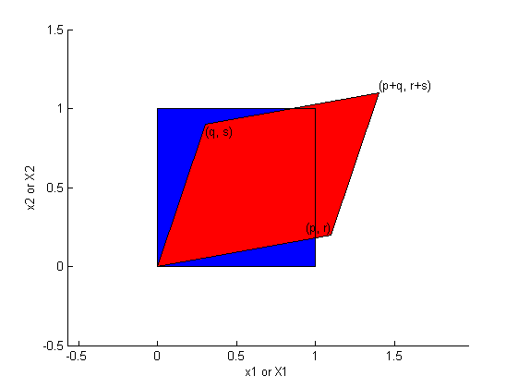
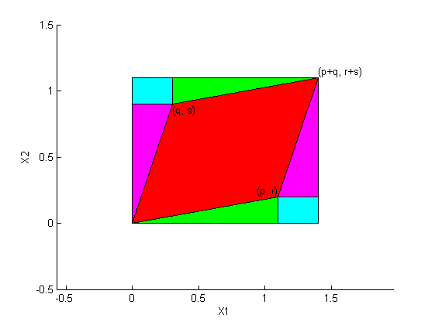
Modulation tutorial
Square area =
(p+q)(r+s) =
pr+ps+qr+qs
Red area =
Square – cyan – magenta – green =
pr+ps+qr+qs – 2qr – qs – pr = ps – qr

Slide 20
Smoothing
The analysis will be most sensitive to effects that match the shape and size of the kernel
The data will be more Gaussian and closer to a continuous random field for larger kernels
Results will be rough and noise-like if too little smoothing is used
Too much will lead to distributed, indistinct blobs

Slide 21
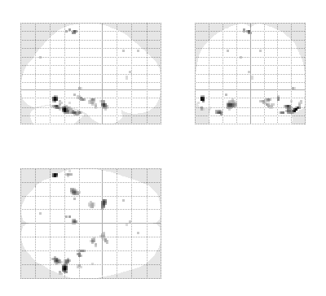
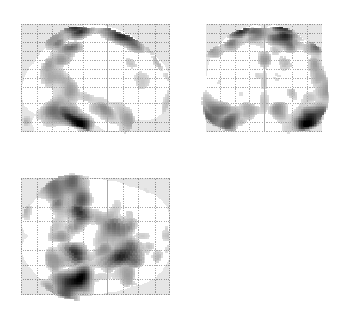
Smoothing
Between 7 and 14mm is probably reasonable
  (DARTEL’s greater precision allows less smoothing)
  The results below show two fairly extreme choices, 5mm on the left, and 16mm, right

Slide 22
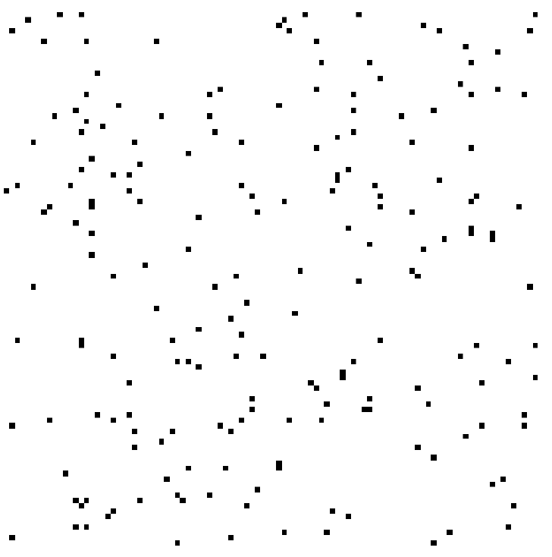
Interpreting findings
Mis-classify
Mis-register
Folding
Thinning
Thickening
Mis-register
Mis-classify

Slide 23
“Globals” for VBM
Shape is really a multivariate concept
  Dependencies among volumes in different regions
SPM is mass univariate
  Combining voxel-wise information with “global” integrated tissue volume provides a compromise
  Using either ANCOVA or proportional scaling
(ii) is globally thicker, but locally thinner than (i) – either of these effects may be of interest to us.
Fig. from: Voxel-based morphometry of the human brain… Mechelli, Price, Friston and Ashburner. Current Medical Imaging Reviews 1(2), 2005.
Notes:
Note globals don’t help distinguish the thickened or folded cortex...

Slide 24
Total Intracranial Volume (TIV/ICV)
“Global” integrated tissue volume may be correlated with interesting regional effects
  Correcting for globals in this case may overly reduce sensitivity to local differences
  Total intracranial volume integrates GM, WM and CSF, or attempts to measure the skull-volume directly
    Not sensitive to global reduction of GM+WM (cancelled out by CSF expansion – skull is fixed!)
  Correcting for TIV in VBM statistics may give more powerful and/or more interpretable results
    See also Pell et al (2009) doi:10.1016/j.neuroimage.2008.02.050

Slide 25

Nonlinearity
Caution may be needed when interpreting linear relationships between grey matter concentrations and some covariate of interest.
Circles of uniformly increasing area.
Plot of intensity at circle centres versus area
Smoothed

Slide 26
VBM’s statistical validity
Residuals are not normally distributed
  Little impact on uncorrected statistics for experiments comparing reasonably sized groups
  Probably invalid for experiments that compare single subjects or tiny patient groups with a larger control group
  Mitigate with large amounts of smoothing
  Or use nonparametric tests that make fewer assumptions, e.g. permutation testing with SnPM

Slide 27
VBM’s statistical validity
Correction for multiple comparisons
  RFT correction based on peak heights is fine
Correction using cluster extents is problematic
  SPM usually assumes that the smoothness of the residuals is spatially stationary
    VBM residuals have spatially varying smoothness
    Bigger blobs expected in smoother regions
  Cluster-based correction accounting for nonstationary smoothness is under development
    See also Satoru Hayasaka’s nonstationarity toolbox
    http://www.fmri.wfubmc.edu/cms/NS-General
  Or use SnPM…

Slide 28
VBM’s statistical validity
False discovery rate
  Less conservative than FWE
  Popular in morphometric work
    (almost universal for cortical thickness in FreeSurfer)
  Recently questioned…
Topological FDR (for clusters and peaks)
  See SPM8 release notes and Justin’s papers
  http://dx.doi.org/10.1016/j.neuroimage.2008.05.021
  http://dx.doi.org/10.1016/j.neuroimage.2009.10.090

Slide 29
Longitudinal VBM
The simplest method for longitudinal VBM is to use cross-sectional preprocessing, but longitudinal statistical analyses
  Standard preprocessing not optimal, but unbiased
  Non-longitudinal statistics would be severely biased
    (Estimates of standard errors would be too small)
  Simplest longitudinal statistical analysis: two-stage summary statistic approach (common in fMRI)
    Within subject longitudinal differences or beta estimates from linear regressions against time

Slide 30
Longitudinal VBM variations
Intra-subject registration over time is much more accurate than inter-subject normalisation
  Different approaches suggested to capitalise
A simple approach is to apply one set of normalisation parameters (e.g. Estimated from baseline images) to both baseline and repeat(s)
  Draganski et al (2004) Nature 427: 311-312
“Voxel Compression mapping” – separates expansion and contraction before smoothing
  Scahill et al (2002) PNAS 99:4703-4707

Slide 31
Longitudinal VBM variations
Can also multiply longitudinal volume change with baseline or average grey matter density
  Chételat et al (2005) NeuroImage 27:934-946
  Kipps et al (2005) JNNP 76:650
  Hobbs et al (2009) doi:10.1136/jnnp.2009.190702
Note that use of baseline (or repeat) instead of average might lead to bias
  Thomas et al (2009) doi:10.1016/j.neuroimage.2009.05.097
  Unfortunately, the explanations in this reference relating to interpolation differences are not quite right... there are several open questions here...

Slide 32
Spatial normalisation with DARTEL
VBM is crucially dependent on registration performance
  The limited flexibility of DCT normalisation has been criticised
  Inverse transformations are useful, but not always well-defined
  More flexible registration requires careful modelling and regularisation (prior belief about reasonable warping)
  MNI/ICBM templates/priors are not universally representative
The DARTEL toolbox combines several methodological advances to address these limitations

Slide 33
Mathematical advances in registration
Large deformation concept
  Regularise velocity not displacement
    (syrup instead of elastic)
Leads to concept of geodesic
  Provides a metric for distance between shapes
  Geodesic or Riemannian average = mean shape
If velocity assumed constant computation is fast
  Ashburner (2007) NeuroImage 38:95-113
  DARTEL toolbox in SPM8
    Currently initialised from unified seg_sn.mat files

Slide 34
Motivation for using DARTEL
Recent papers comparing different approaches have favoured more flexible methods
DARTEL usually outperforms DCT normalisation
  Also comparable to the best algorithms from other software packages (though note that DARTEL and others have many tunable parameters...)
Klein et al. (2009) is a particularly thorough comparison, using expert segmentations
  Results summarised in the next slide

Slide 35
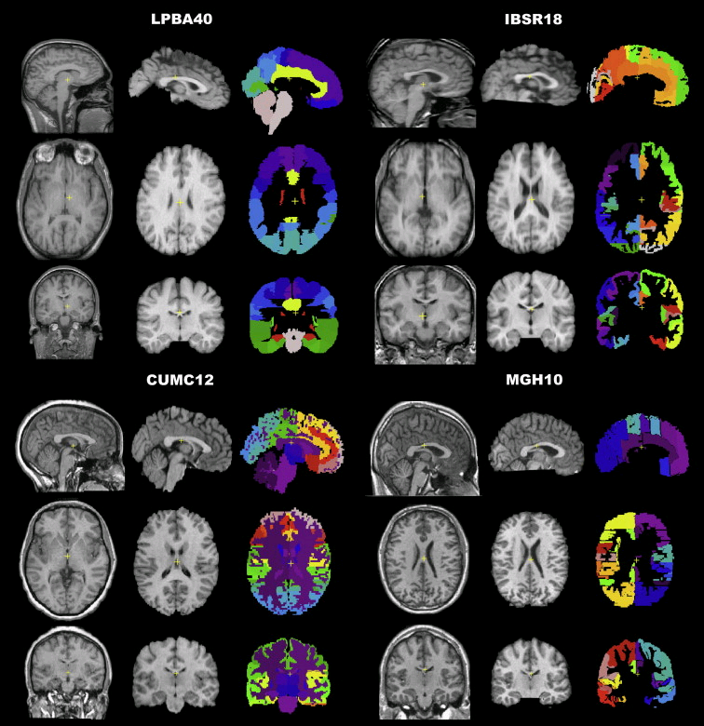
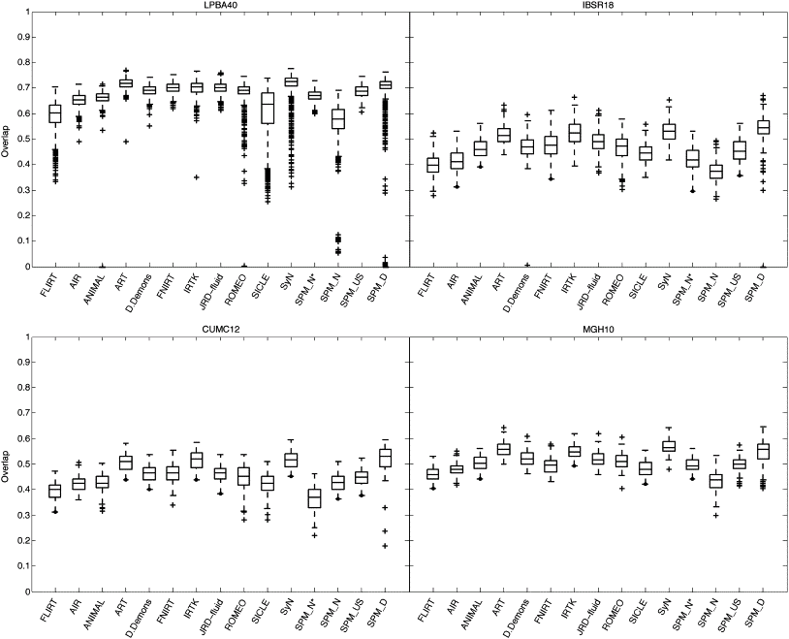
Part of Fig.1 in Klein et al.
Part of Fig.5 in Klein et al.

Slide 36
Spatial normalisation with DARTEL
VBM is crucially dependent on registration performance
  The limited flexibility of DCT normalisation has been criticised
  Inverse transformations are useful, but not always well-defined
  More flexible registration requires careful modelling and regularisation (prior belief about reasonable warping)
  MNI/ICBM templates/priors are not universally representative
The DARTEL toolbox combines several methodological advances to address these limitations

Slide 37
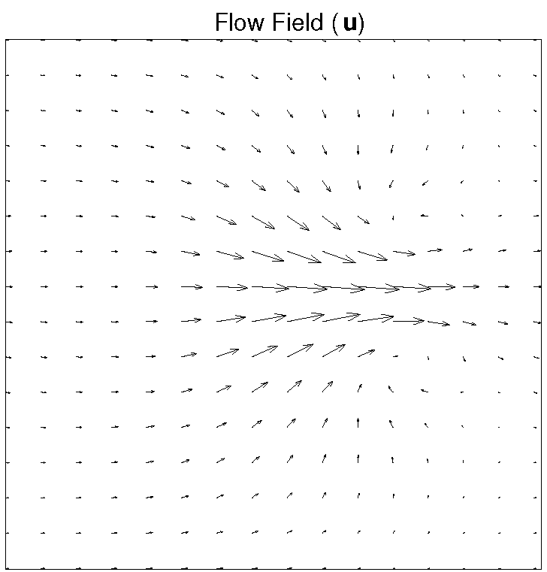
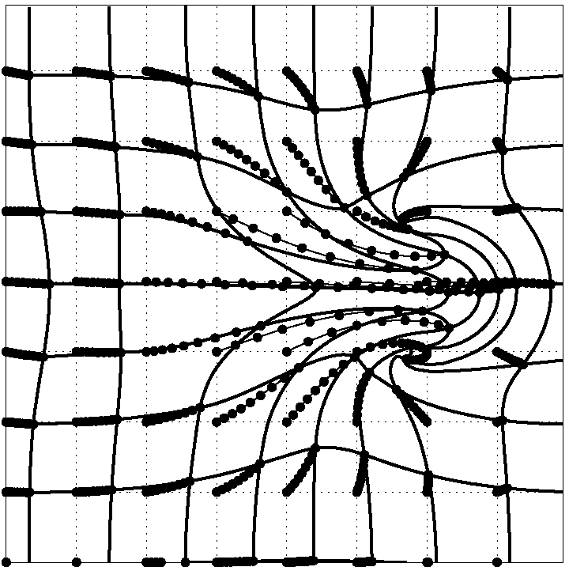
DARTEL Transformations
Parameterising the deformation
u is a flow field to be estimated
  3 (x,y,z) DF per 1.5mm cubic voxel
  10^6 DF vs. 10^3 DCT bases
φ⁽⁰⁾(x) = x
φ⁽¹⁾(x) = ∫ u(φ^{(t)}(x))dt
Scaling and squaring is used to generate deformations
Inverse simply integrates -u
1
t=0

Slide 38
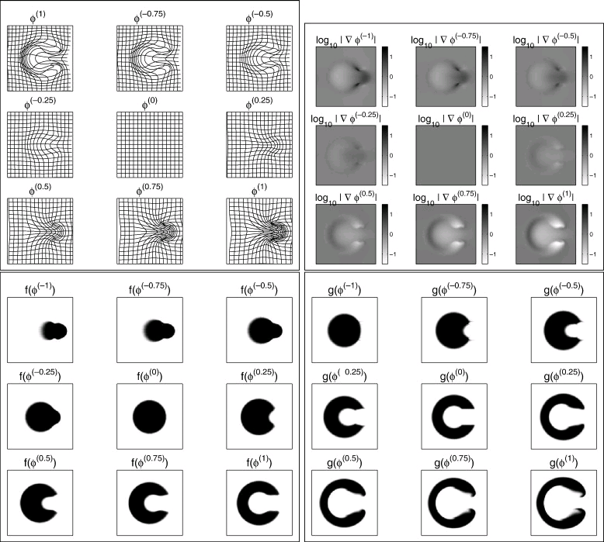
Fig.5 in DARTEL paper

Slide 39
DARTEL objective function
Likelihood component (matching)
  Specific for matching tissue classes
  Multinomial assumption (cf. Gaussian)
Prior component (regularisation)
  A measure of deformation (flow) roughness = ½u^{T}Hu
Need to choose H and a balance between the two terms
  Defaults usually work well (e.g. even for AD)

Slide 40
Likelihood Model
Current DARTEL model is multinomial for matching tissue class images.
Template represents probability of obtaining different tissues at each point.
log p(t|μ,ϕ) = Σ_{j}Σ_{k} t_{jk} log(μ_{k}(ϕ_{j}))
  t – individual GM, WM and background
  μ – template GM, WM and background
  ϕ – deformation

Slide 41

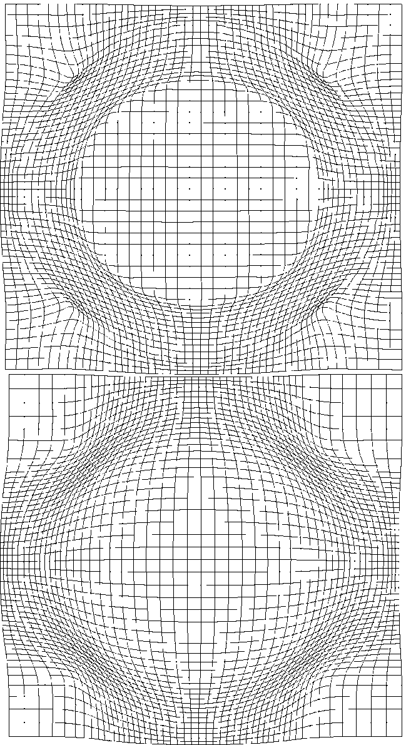
Prior Models

Slide 42
A word of caution…
Different models have different parameterisations and will therefore give different findings
Shape models (image registration models) are no exception
Need to have a good model to reliably report details about differences among parameters
Not always easy to determine good/best model
  Bayesian model comparison not yet feasible for Dartel
  Classification or prediction are useful; work in progress...

Slide 43
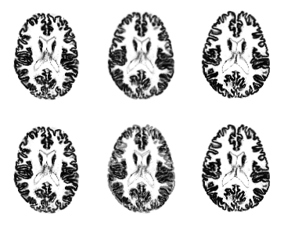
Example geodesic shape average
Uses average flow field
Average on Riemannian manifold
Linear Average
(Not on Riemannian manifold)

Slide 44
Simultaneous registration of GM to GM and WM to WM, for a group of subjects
Grey matter
Subject 1
White matter
Grey matter
Subject 3
White matter
Grey matter
White matter
Grey matter
Template
Grey matter
White matter
White matter
Subject 2
Subject 4

Slide 45
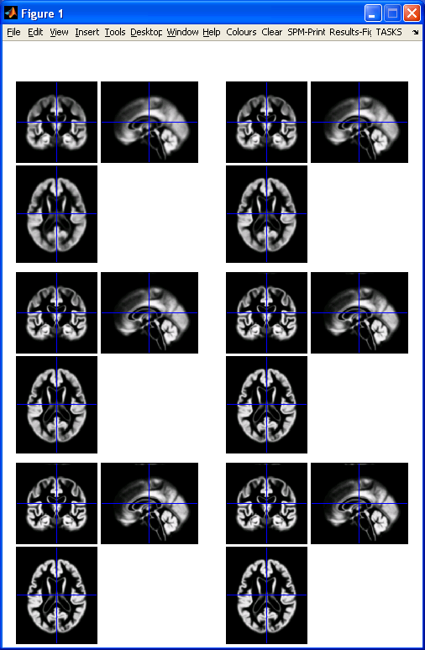
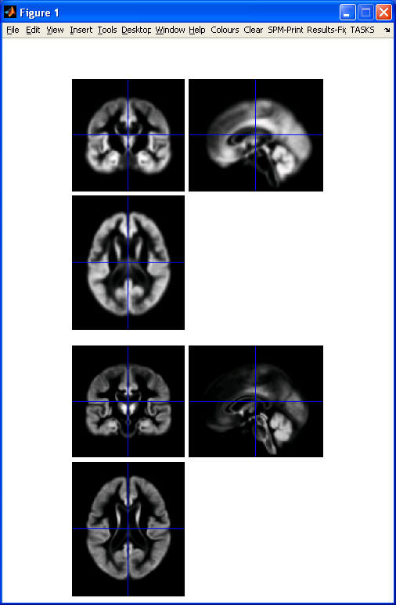
DARTEL average template evolution
Template
1
Rigid average
(Template_0)
Average of
mwc1 using
segment/DCT
Template
6
Notes:
60 images from OASIS cross-sectional data (as in VBM practical)

Slide 46
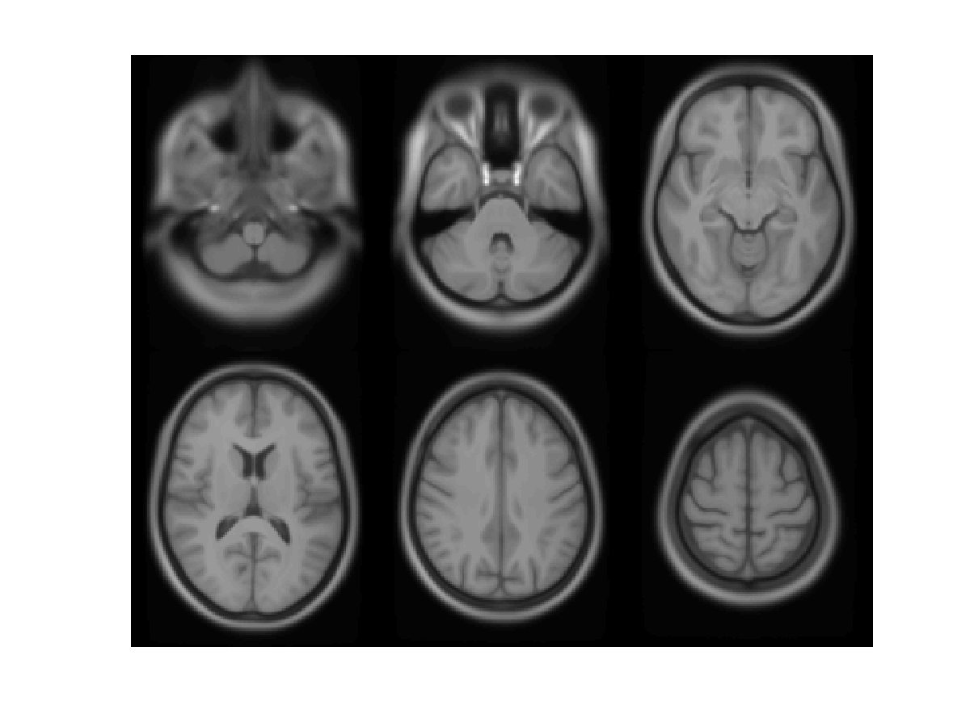

Slide 47
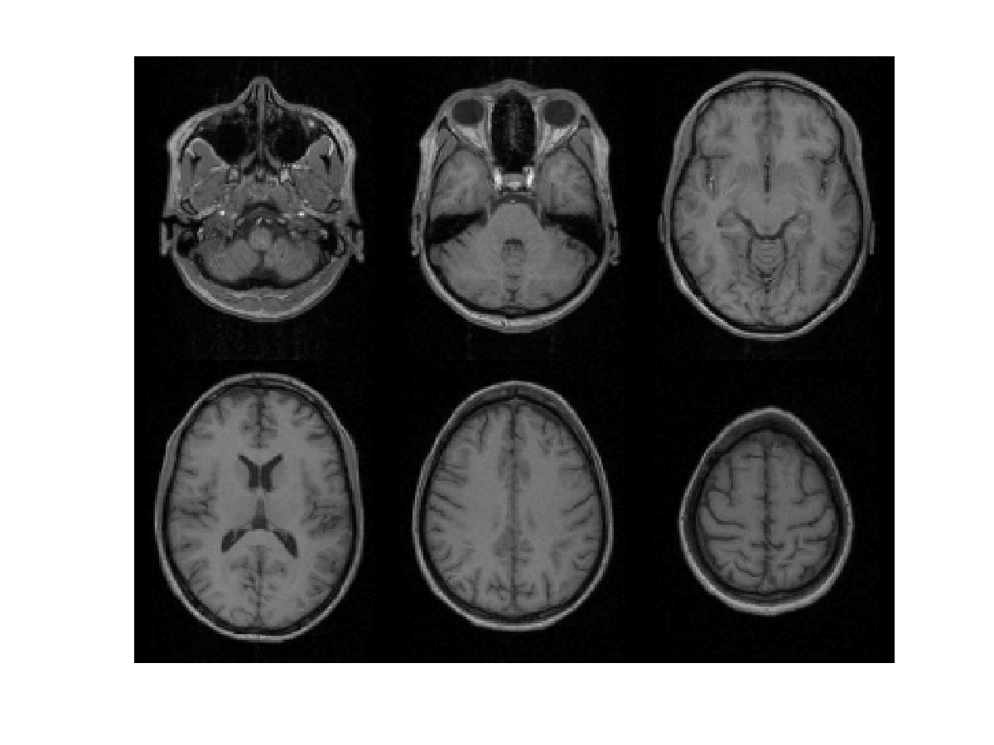

Slide 48
Summary
VBM performs voxel-wise statistical analysis on smoothed (modulated) normalised tissue segments
SPM8 performs segmentation and spatial normalisation in a unified generative model
  Based on Gaussian mixture modelling, with DCT-warped spatial priors, and multiplicative bias field
  The new segment toolbox includes non-brain priors and more flexible/precise warping of them
Subsequent (currently non-unified) use of DARTEL improves normalisation for VBM
  And perhaps also fMRI...

Slide 49
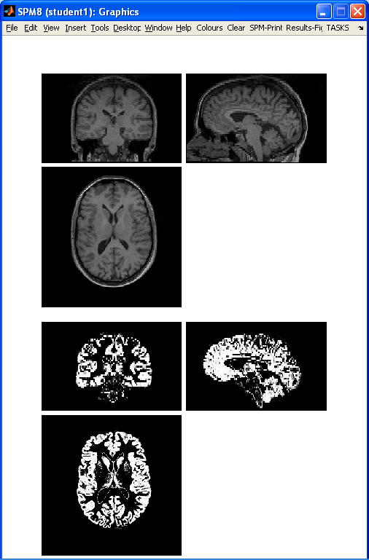
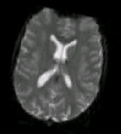
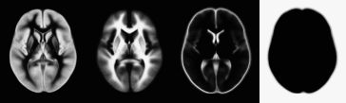
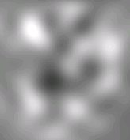
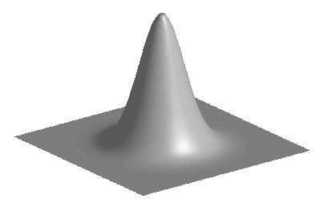
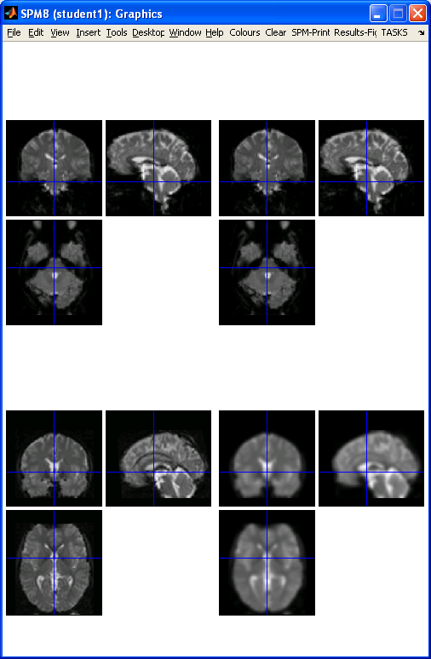
Preprocessing overview
Input
Output
fMRI time-series
Anatomical MRI
TPMs
Segmentation
Transformation
(seg_sn.mat)
Kernel
REALIGN
COREG
SEGMENT
NORM WRITE
SMOOTH
Mean functional
(Headers changed)
Motion corrected
MNI Space
ANALYSIS

Slide 50
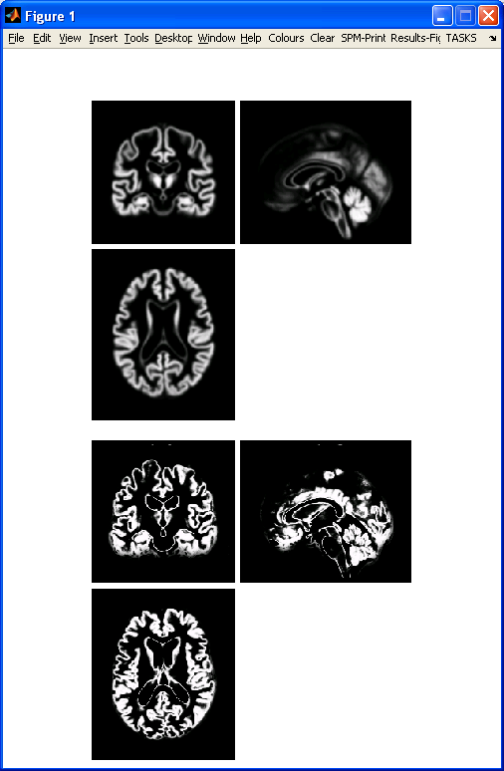
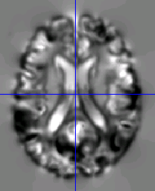
Preprocessing with Dartel
...
fMRI time-series
Anatomical MRI
TPMs
DARTEL CREATE TEMPLATE
REALIGN
COREG
SEGMENT
DARTEL NORM 2 MNI & SMOOTH
Mean functional
(Headers changed)
Motion corrected
ANALYSIS

Slide 51
Mathematical advances in computational anatomy
VBM is well-suited to find focal volumetric differences
Assumes independence among voxels
  Not very biologically plausible
  But shows differences that are easy to interpret
Some anatomical differences can not be localised
  Need multivariate models
  Differences in terms of proportions among measurements
  Where would the difference between male and female faces be localised?

Slide 52
Mathematical advances in computational anatomy
In theory, assumptions about structural covariance among brain regions are more biologically plausible
  Form influenced by spatio-temporal modes of gene expression
Empirical evidence, e.g.
  Mechelli, Friston, Frackowiak & Price. Structural covariance in the human cortex. Journal of Neuroscience 25:8303-10 (2005)
Recent introductory review:
  Ashburner & Klöppel. “Multivariate models of inter-subject anatomical variability”. NeuroImage, In press.

Slide 53
Conclusion
VBM uses the machinery of SPM to localise patterns in regional volumetric variation
  Use of “globals” as covariates is a step towards multivariate modelling of volume and shape
More advanced approaches typically benefit from the same preprocessing methods
  New segmentation and DARTEL close to state of the art
  Though possibly little or no smoothing
Elegant mathematics related to transformations (diffeomorphism group with Riemannian metric)
VBM – easier interpretation – complementary role

Slide 54
Key references for VBM
Ashburner & Friston. Unified Segmentation.
NeuroImage 26:839-851 (2005).
Mechelli et al. Voxel-based morphometry of the human brain… Current Medical Imaging Reviews 1(2) (2005).
Ashburner. A Fast Diffeomorphic Image Registration Algorithm. NeuroImage 38:95-113 (2007).
Ashburner & Friston. Computing average shaped tissue probability templates. NeuroImage 45(2): 333-341 (2009).

Slide 55
References for more advanced computational anatomy
Ashburner, Hutton, Frackowiak, Johnsrude, Price & Friston. “Identifying global anatomical differences: deformation-based morphometry”. Human Brain Mapping 6(5-6):348-357, 1998.
Bishop. Pattern recognition and machine learning. 2006.
Younes, Arrate & Miller. “Evolutions equations in computational anatomy”. NeuroImage 45(1):S40-S50, 2009.
Ashburner & Klöppel. “Multivariate models of inter-subject anatomical variability”. NeuroImage, In press.

Slide 56
Extra Material

Slide 57
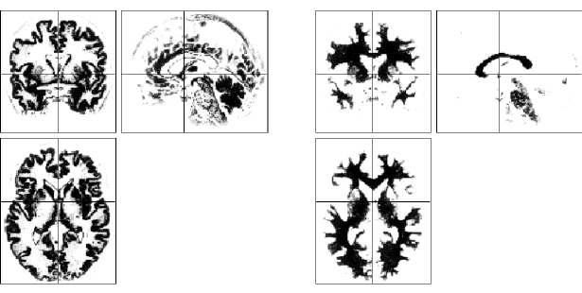
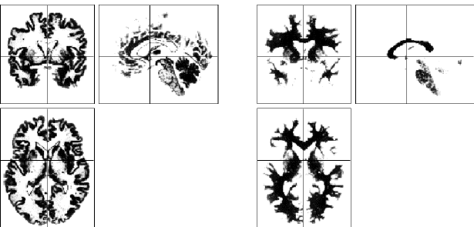
Segmentation clean-up
Results may contain some non-brain tissue (dura, scalp, etc.)
This can be removed
automatically using
simple morphological
filtering operations
  Erosion
  Conditional dilation
Lower segmentations
have been cleaned up

Slide 58
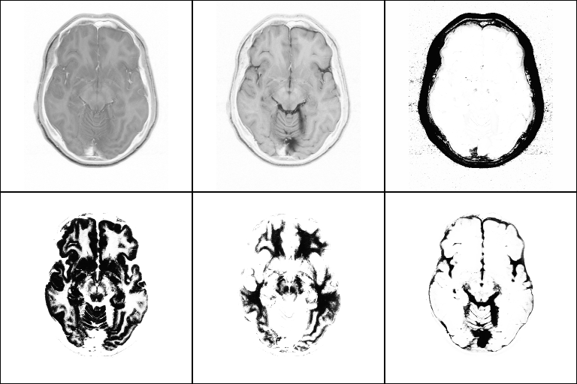
The new segmentation toolbox
An extended work-in-progress algorithm
Multi-spectral
New TPMs including
different tissues
  Reduces problems in
  non-brain tissue
New more flexible
warping of TPMs
  More precise and more “sharp/contrasty” results

Slide 59
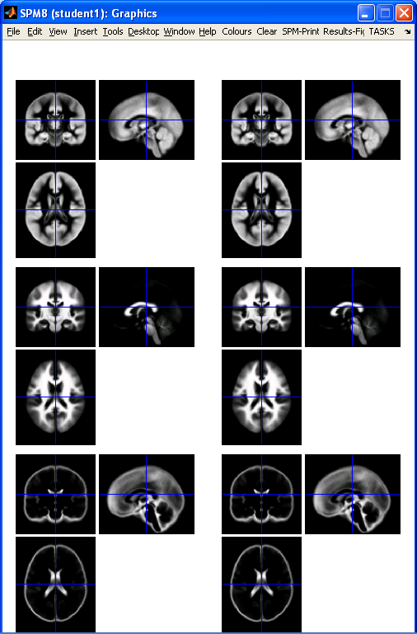
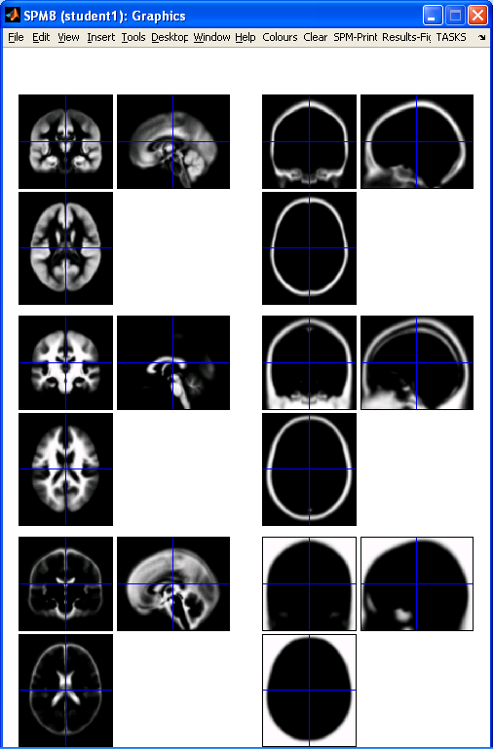
New Segmentation – TPMs
Segment button
New Seg Toolbox

Slide 60
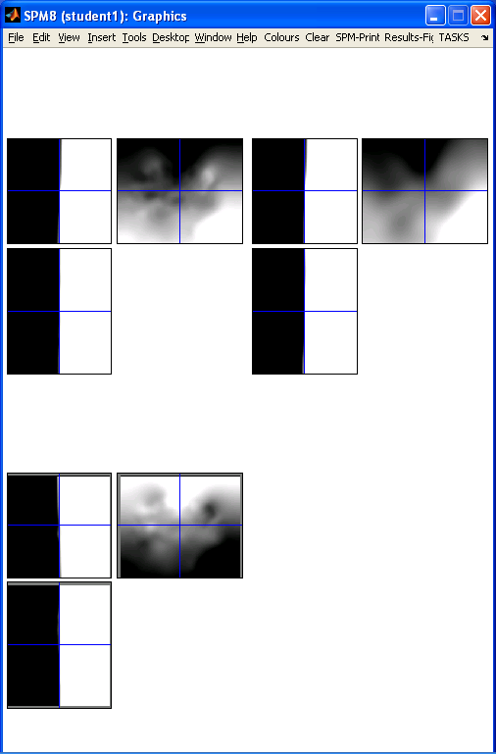
New Segmentation – registration
Segment button
New Seg Toolbox
9*10*9 * 3 = 2430
59*70*59 * 3 = 731010

Slide 61
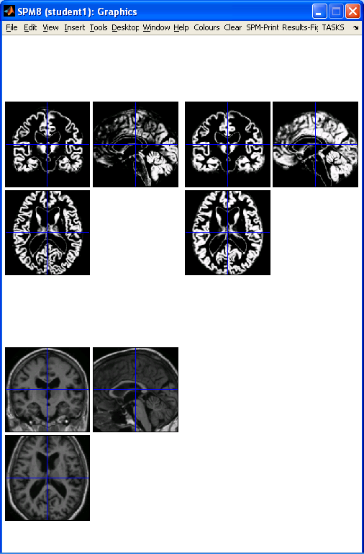
New Segmentation – results
Segment button
New Seg Toolbox

Slide 62
Limitations of the current model
Assumes that the brain consists of only the tissues modelled by the TPMs
  No spatial knowledge of lesions (stroke, tumours, etc)
Prior probability model is based on relatively young and healthy brains
  Less appropriate for subjects outside this population
Needs reasonable quality images to work with
  No severe artefacts
  Good separation of intensities
  Good initial alignment with TPMs...

Slide 63
Possible future extensions
Deeper Bayesian philosophy
  E.g. priors over means and variances
  Marginalisation of nuisance variables
  Model comparison, e.g. for numbers of Gaussians
Groupwise model (enormous!)
Combination with DARTEL (see later)
More tissue priors e.g. deep grey, meninges, etc.
Imaging physics
  See Fischl et al. (2004), as cited in A&F (2005) introduction

