Slide 1
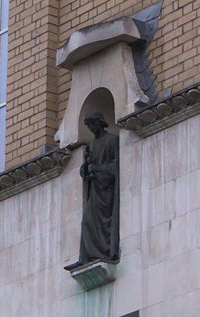
Voxel-Based Morphometry
John Ashburner
Wellcome Trust Centre for Neuroimaging,
12 Queen Square, London, UK.

Slide 2
Overview
Voxel-Based Morphometry
  Morphometry in general
  Volumetrics
  VBM preprocessing followed by SPM
Segmentation
Dartel
Recap

Slide 3
Measuring differences with MRI
What are the significant differences between populations of subjects?
What effects do various genes have on the brain?
What changes occur in the brain through development or aging?
A significant amount of the difference (measured with MRI) is anatomical.
  You need to discount the larger anatomical differences before giving explanations about brain function.

Slide 4
There are many ways to model differences.
Usually, we try to localise regions of difference.
  Univariate models.
  Using methods similar to SPM
  Typically localising volumetric differences
Some anatomical differences can not be localised.
  Need multivariate models.
  Differences in terms of proportions among measurements.
  Where would the difference between male and female faces be localised?
Need to select the best model of difference to use, before trying to fill in the details.

Slide 5
Some 2D Shapes

Slide 6
Spatially normalised shapes

Slide 7
Deformations
Could do a multivariate analysis of these (“Deformation-Based Morphometry”).

Slide 8
Relative Volumes
Could do a mass-univariate analysis of these (“Tensor-Based Morphometry”).

Slide 9
Voxel-Based Morphometry
Based on comparing regional volumes of tissue.
Produce a map of statistically significant differences among populations of subjects.
  e.g. compare a patient group with a control group.
  or identify correlations with age, test-score etc.
The data are pre-processed to sensitise the tests to regional tissue volumes.
  Usually grey or white matter.
Suitable for studying focal volumetric differences of grey matter.

Slide 10
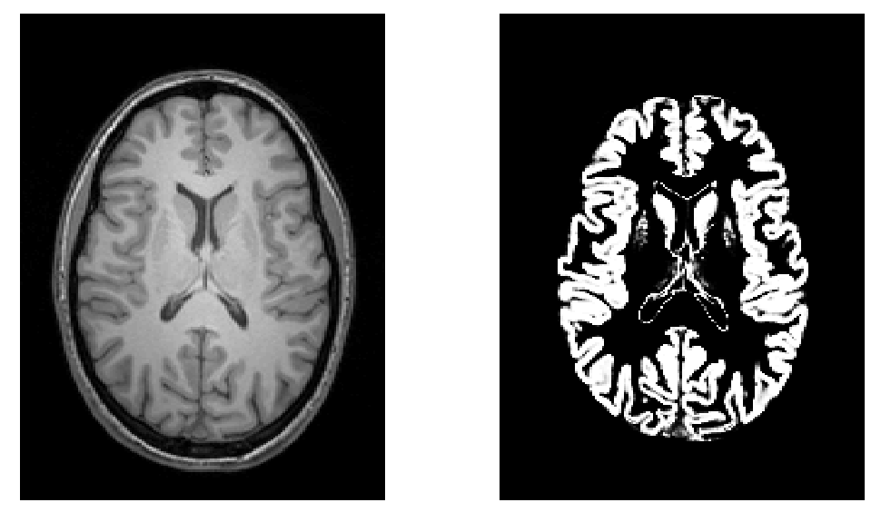
Volumetry
T1-Weighted MRI
Grey Matter

Slide 11
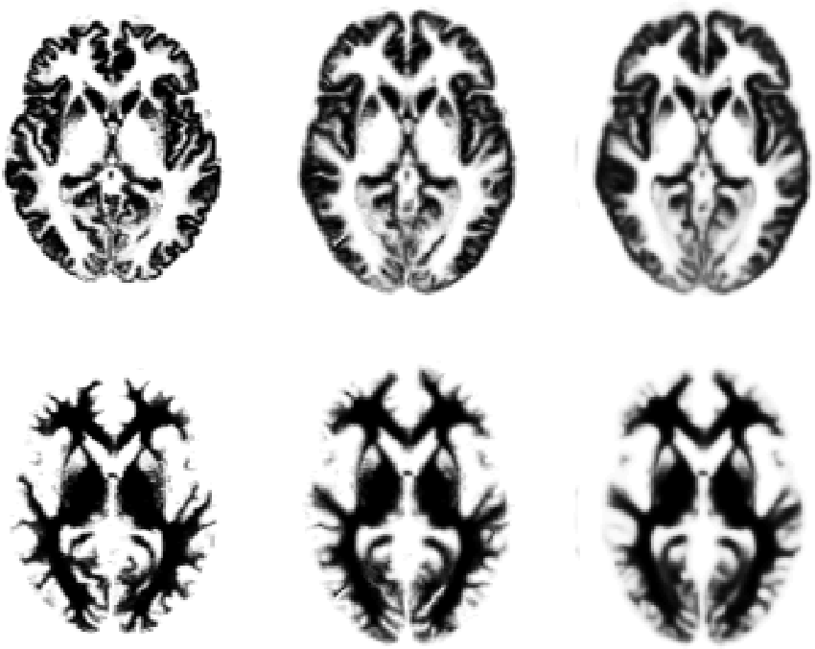
Original
Warped
Template

Slide 12
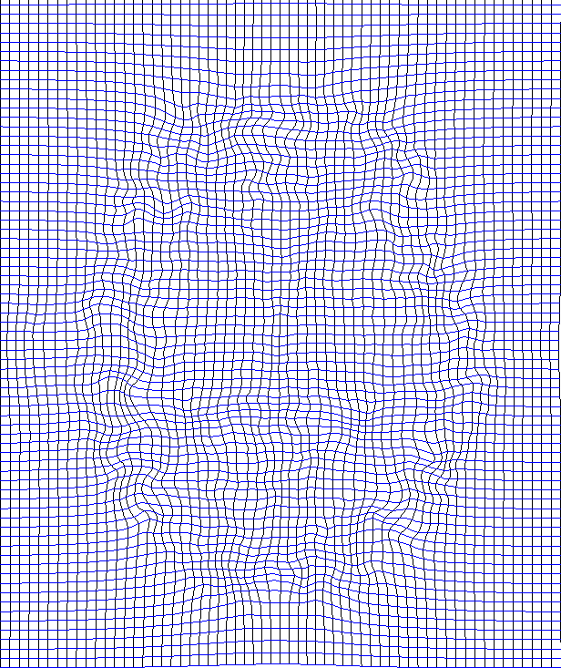
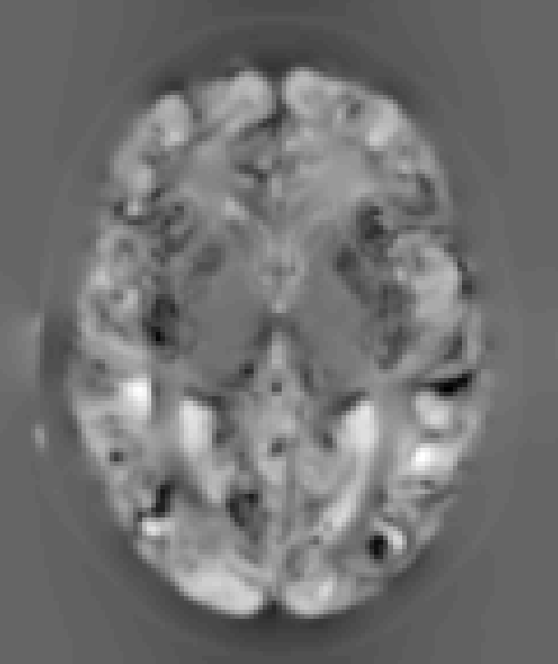
“Modulation” – change of variables.
Deformation Field
Jacobians determinants
Encode relative volumes.

Slide 13

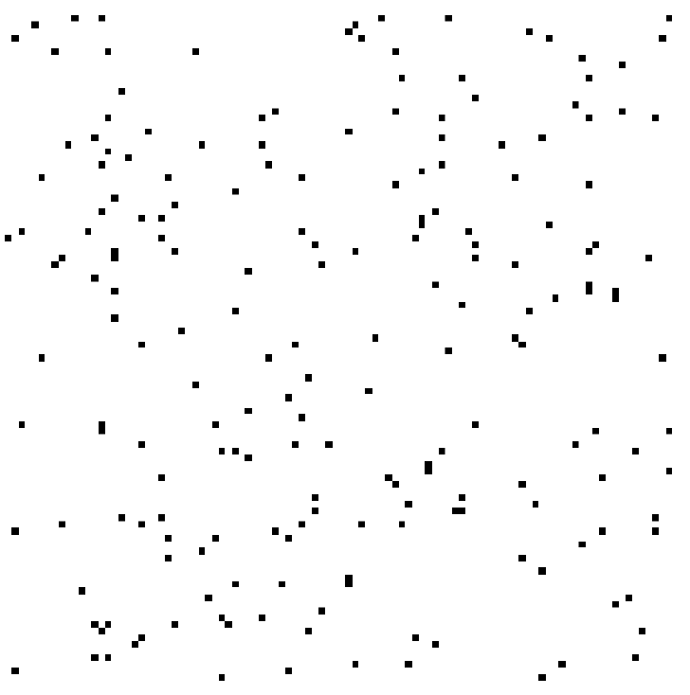

Smoothing
Each voxel after smoothing effectively becomes the result of applying a weighted region of interest (ROI).
Before convolution
Convolved with a circle
Convolved with a Gaussian

Slide 14
VBM Pre-processing in SPM8
Use New Segment for characterising intensity distributions of tissue classes, and writing out “imported” images that DARTEL can use.
Run DARTEL to estimate all the deformations.
DARTEL warping to generate smoothed, “modulated”, warped grey matter.
Statistics.

Slide 15
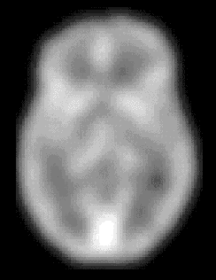
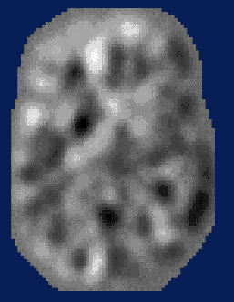
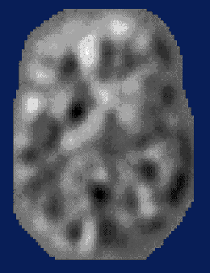
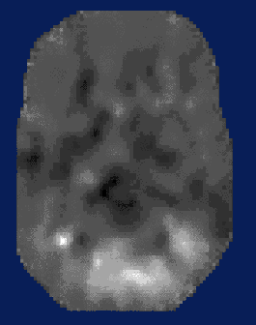
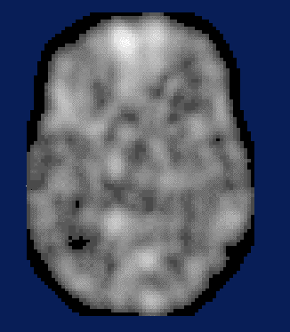
Statistical Parametric Mapping…
–
parameter estimate
standard error
group 1
group 2
statistic image
or
SPM
=
voxel by voxel
modelling

Slide 16
“Globals” for VBM
Shape is really a multivariate concept
  Dependencies among volumes in different regions
SPM is mass univariate
  Combining voxel-wise information with “global” integrated tissue volume provides a compromise
  Using either ANCOVA or proportional scaling
(ii) is globally thicker, but locally thinner than (i) – either of these effects may be of interest to us.
Notes:
Note globals don’t help distinguish the thickened or folded cortex...

Slide 17
Total Intracranial Volume (TIV/ICV)
“Global” integrated tissue volume may be correlated with interesting regional effects
  Correcting for globals in this case may overly reduce sensitivity to local differences
  Total intracranial volume integrates GM, WM and CSF, or attempts to measure the skull-volume directly
    Not sensitive to global reduction of GM+WM (cancelled out by CSF expansion – skull is fixed!)
  Correcting for TIV in VBM statistics may give more powerful and/or more interpretable results
    See also Pell et al (2009) doi:10.1016/j.neuroimage.2008.02.050

Slide 18
Some Explanations of the Differences
Mis-classify
Mis-register
Folding
Thinning
Thickening
Mis-register
Mis-classify

Slide 19
Overview
Voxel-Based Morphometry
Segmentation
  Use segmentation routine for spatial normalisation
  Gaussian mixture model
  Intensity non-uniformity correction
  Deformed tissue probability maps
Dartel
Recap

Slide 20
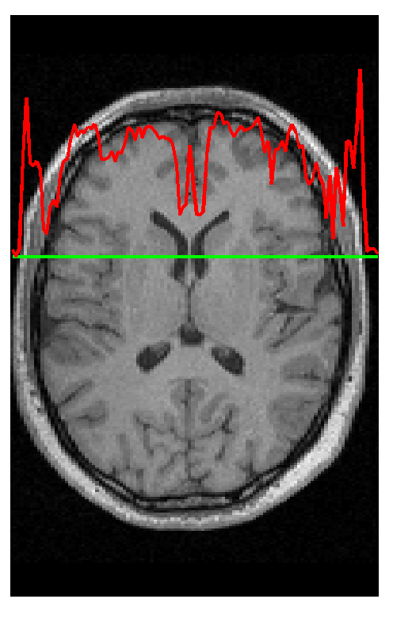
Segmentation
Segmentation in SPM8 also estimates a spatial transformation that can be used for spatially normalising images.
It uses a generative model, which involves:
  Mixture of Gaussians (MOG)
  Bias Correction Component
  Warping (Non-linear Registration) Component

Slide 21
Extensions for New Segment of SPM8
Additional tissue classes
  Grey matter, white matter, CSF, skull, scalp.
Multi-channel Segmentation
More detailed nonlinear registration
More robust initial affine registration
Extra tissue class maps can be generated

Slide 22
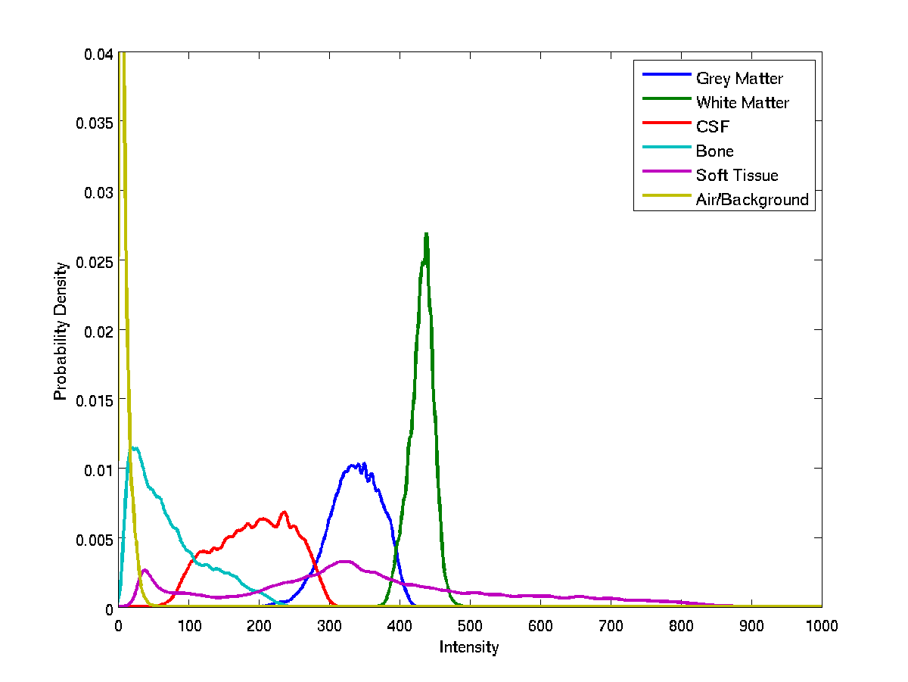
Image Intensity Distributions (T1-weighted MRI)

Slide 23
Mixture of Gaussians (MOG)
Classification is based on a Mixture of Gaussians model (MOG), which represents the intensity probability density by a number of Gaussian distributions.
Frequency
Image Intensity

Slide 24
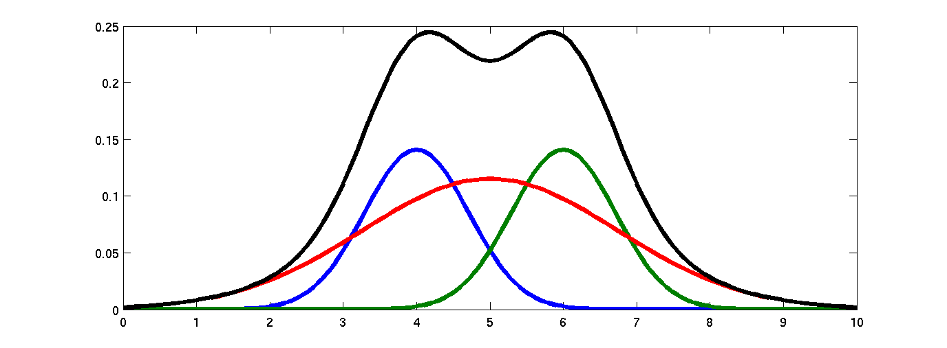
Belonging Probabilities
Belonging probabilities are assigned by normalising to one.

Slide 25
Non-Gaussian Intensity Distributions
Multiple Gaussians per tissue class allow non-Gaussian intensity distributions to be modelled.
  E.g. accounting for partial volume effects

Slide 26
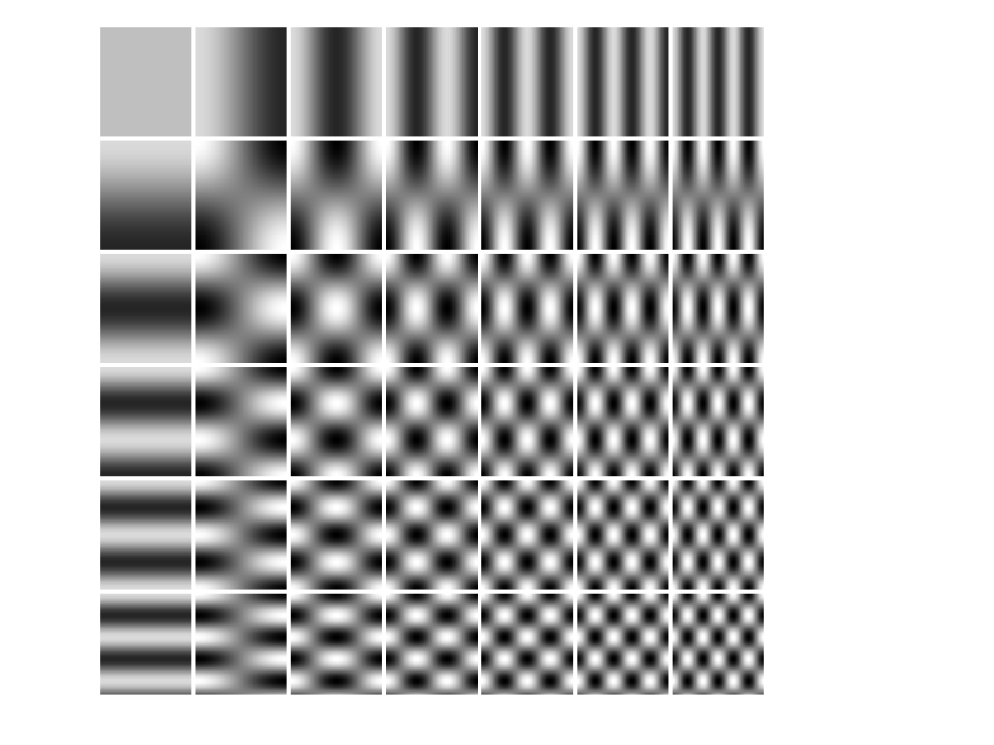
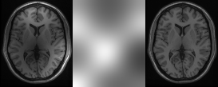
Modelling a Bias Field
A bias field is modelled as a linear combination of basis functions.
Corrupted image
Bias Field
Corrected image

Slide 27
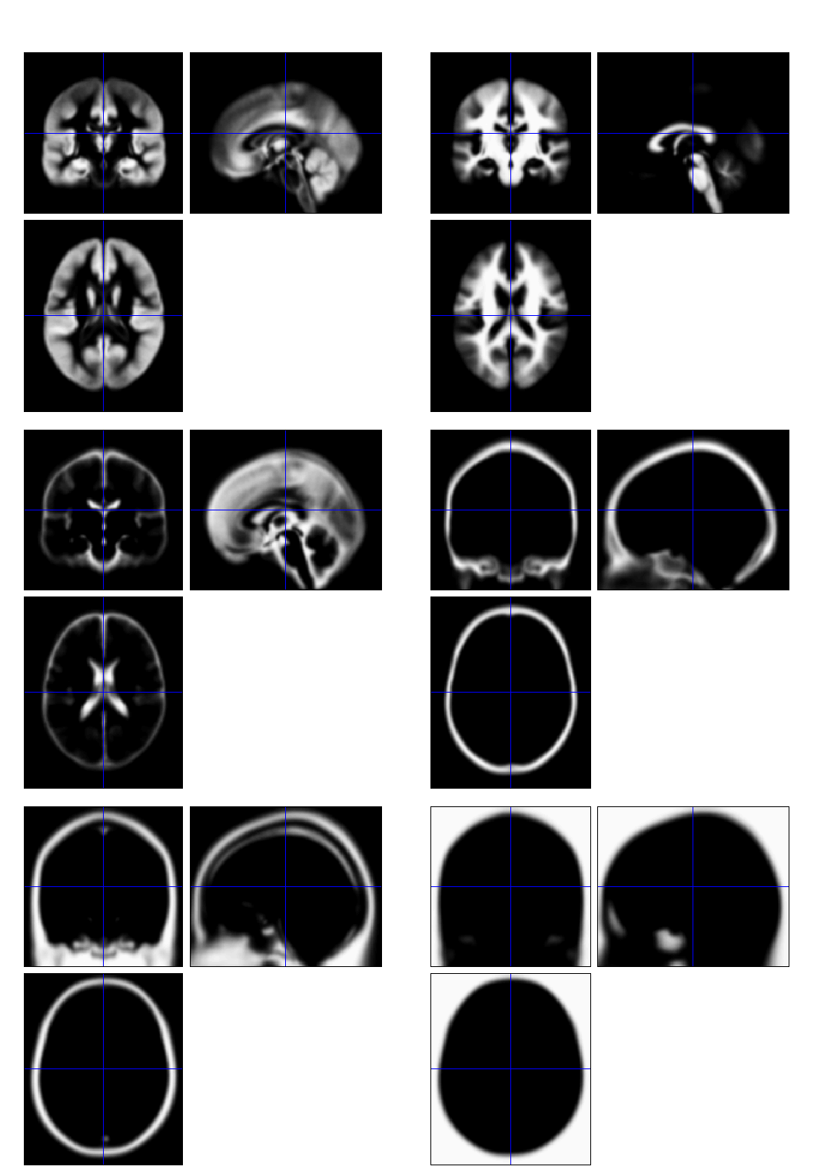
Tissue Probability Maps for “New Segment”
Includes additional non-brain tissue classes (bone, and soft tissue)

Slide 28
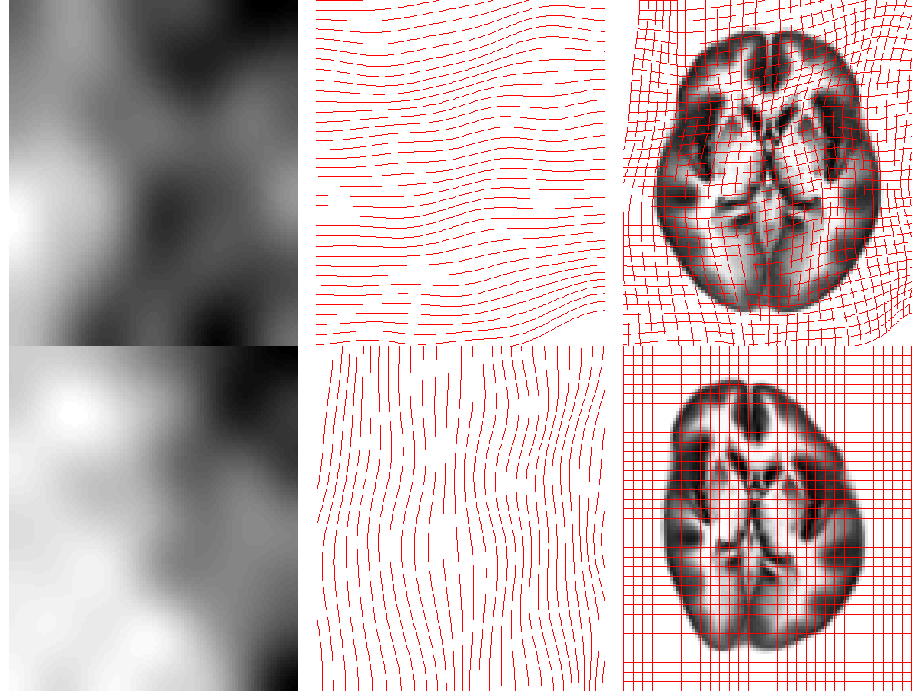
Deforming the Tissue Probability Maps
Tissue probability images are deformed so that they can be overlaid on top of the image to segment.

Slide 29
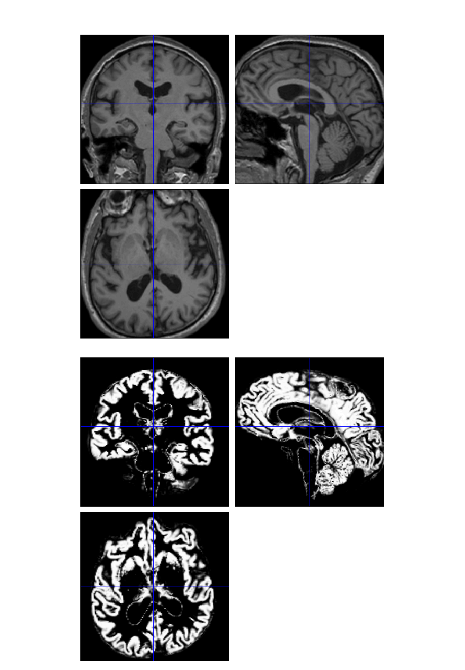
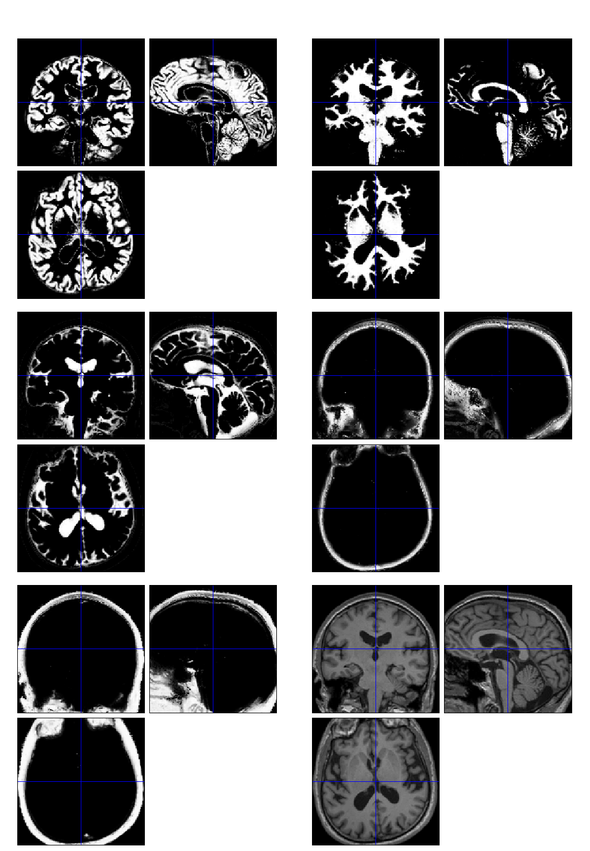

Slide 30
Optimisation
The “best” parameters are those that maximise the log-probability.
Optimisation involves finding them.
Begin with starting estimates, and repeatedly change them so that the objective function decreases each time.

Slide 31
Steepest Descent
Start
Optimum
Alternate between optimising different groups of parameters

Slide 32
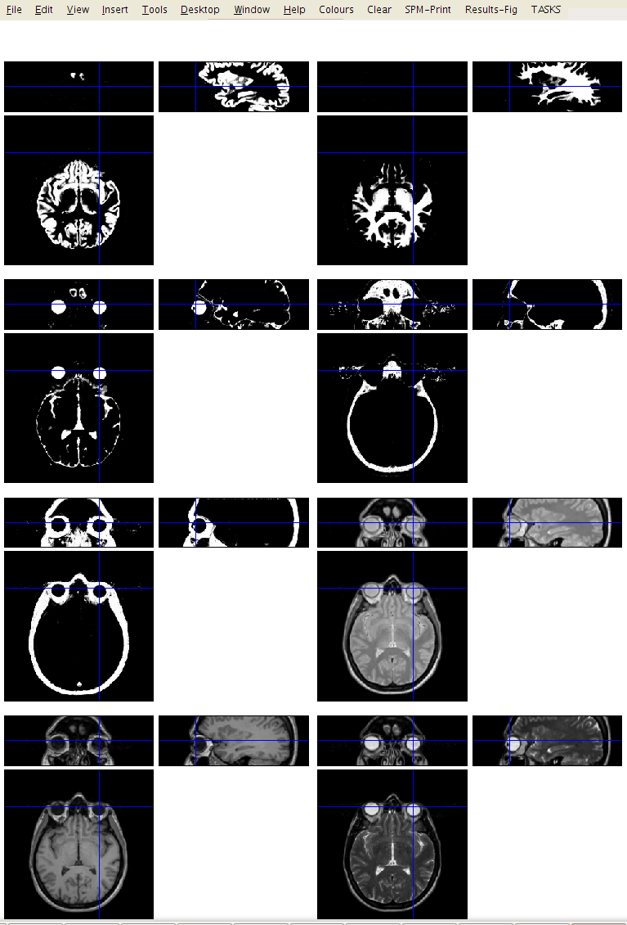

Multi-spectral

Slide 33
Limitations of the current model
Assumes that the brain consists of only the tissues modelled by the TPMs
  No spatial knowledge of lesions (stroke, tumours, etc)
Prior probability model is based on relatively young and healthy brains
  Less accurate for subjects outside this population
Needs reasonable quality images to work with
  No severe artefacts
  Good separation of intensities
  Reasonable initial alignment with TPMs.

Slide 34
Overview
Morphometry
Voxel-Based Morphometry
Segmentation
Dartel
  Flow field parameterisation
  Objective function
  Template creation
  Examples
Recap

Slide 35
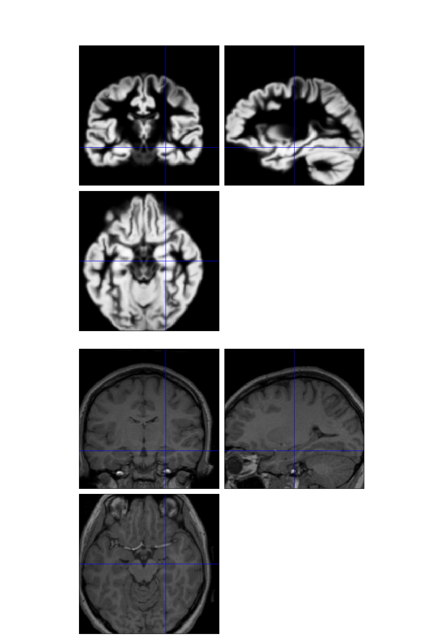
DARTEL Image Registration
Uses fast approximations
  Deformation integrated using scaling and squaring
Uses Levenberg-Marquardt optimiser
  Multi-grid matrix solver
Matches GM with GM, WM with WM etc
Diffeomorphic registration takes about 30 mins per image pair (121×145×121 images).
Grey matter template warped to individual
Individual scan

Slide 36
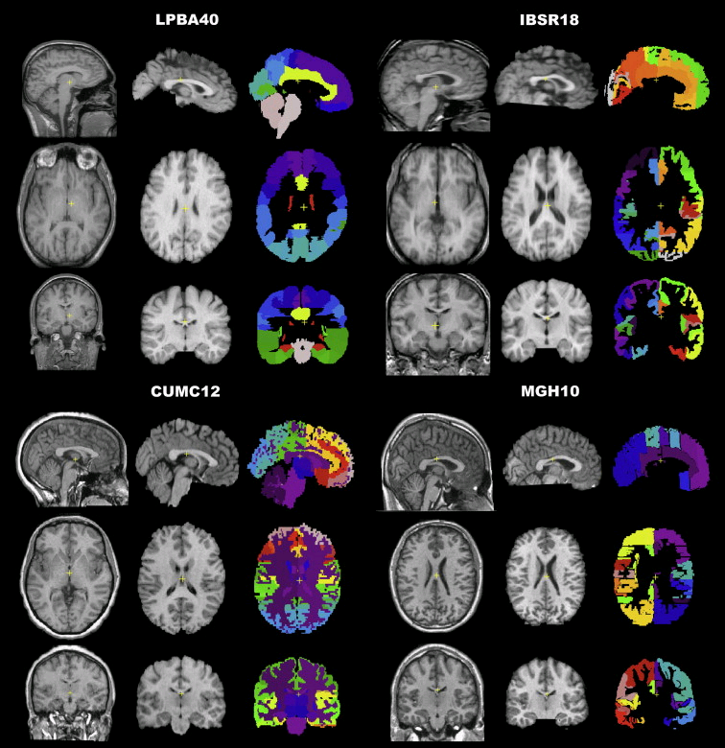
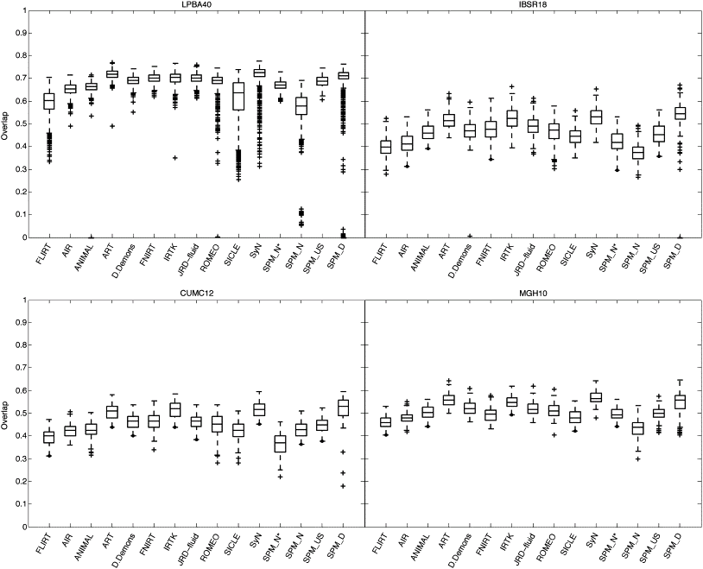
Evaluations of nonlinear registration algorithms

Slide 37
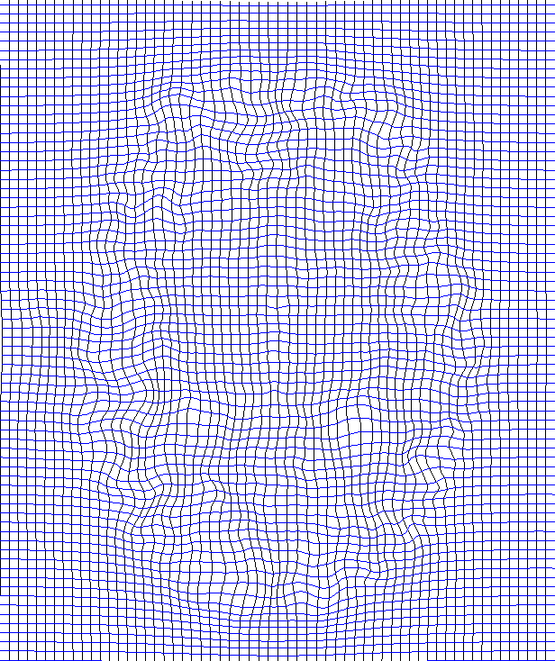
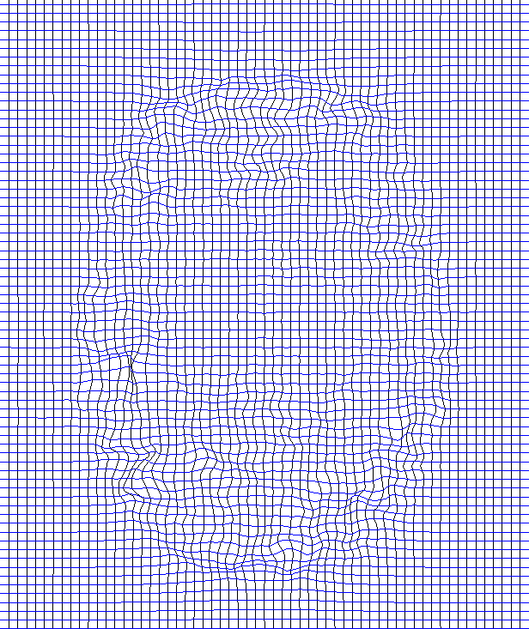

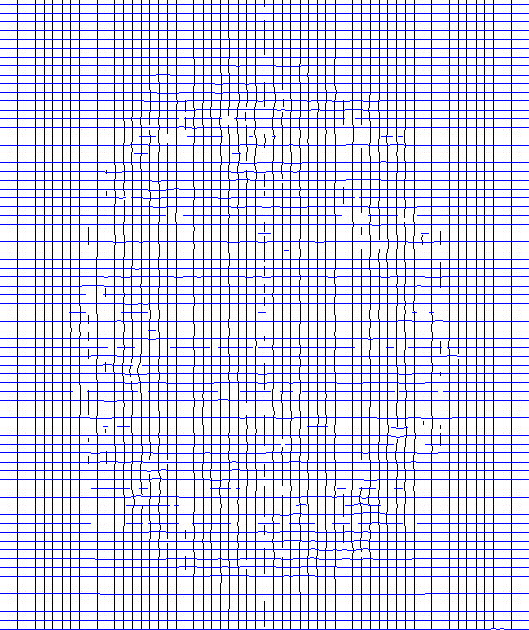
Displacements don’t add linearly
Forward
Inverse
Subtracted
Composed

Slide 38
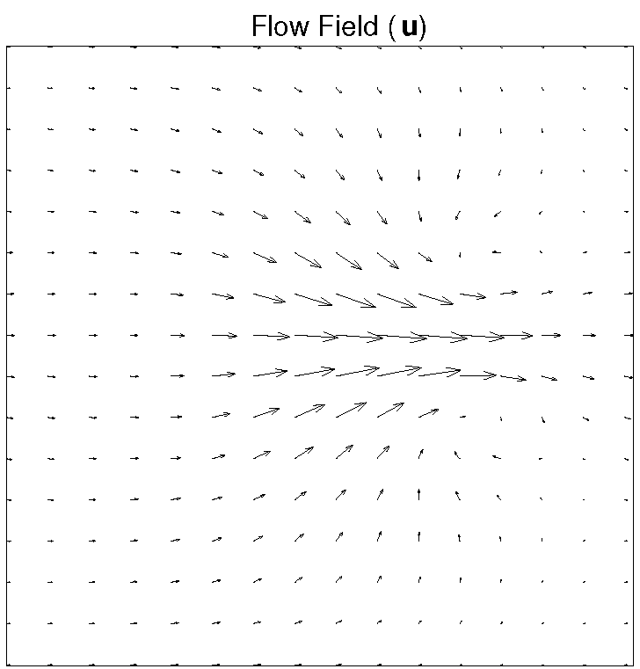
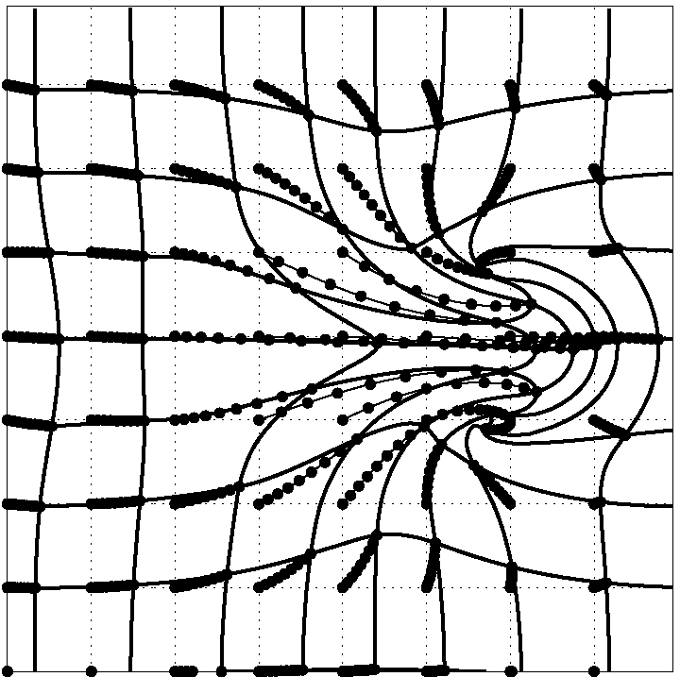
DARTEL
Parameterising the deformation
φ⁽⁰⁾ = Identity
φ⁽¹⁾ = ∫ u(φ^{(t)})dt
u is a velocity field
Scaling and squaring is used to generate deformations.
1
t=0

Slide 39
Scaling and squaring example

Slide 40
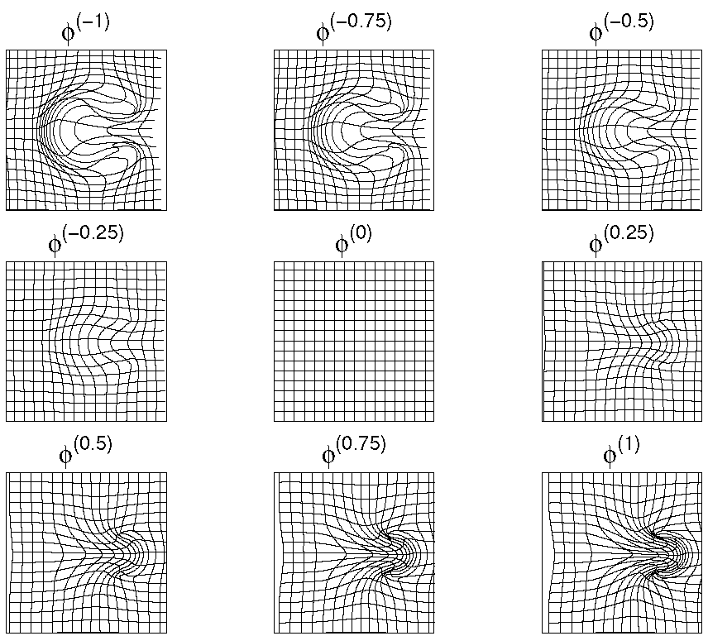
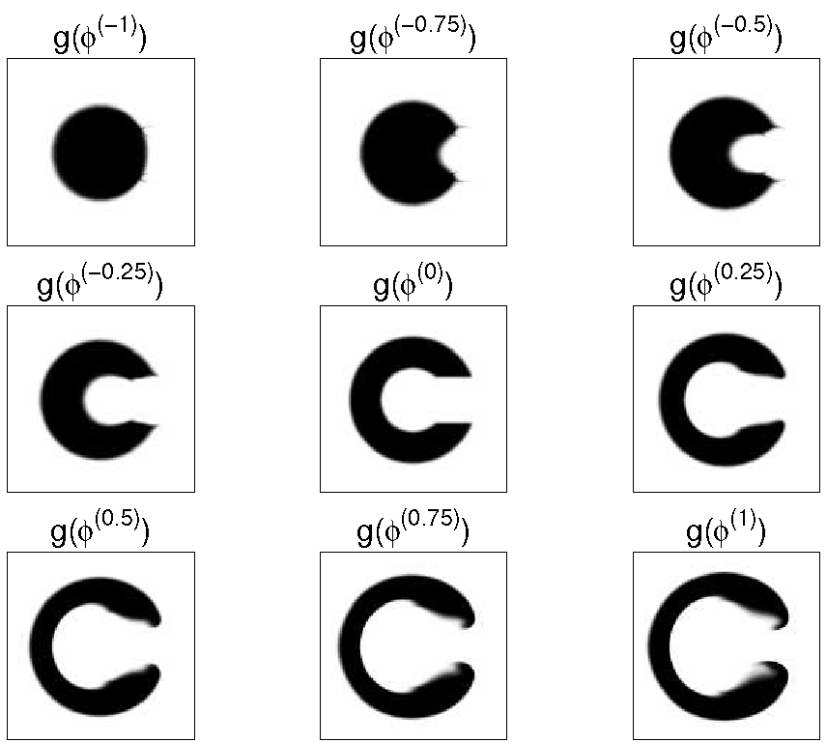
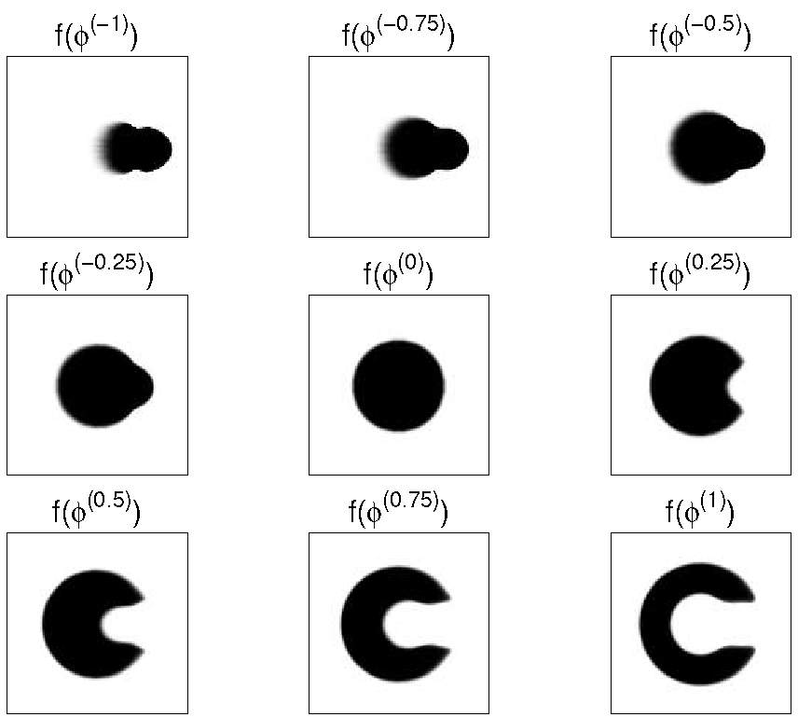
Forward and backward transforms

Slide 41
Registration objective function
Simultaneously minimize the sum of:
  Matching Term
    Drives the matching of the images.
    Multinomial assumption
  Regularisation term
    A measure of deformation roughness
    Regularises the registration.
A balance between the two terms.

Slide 42

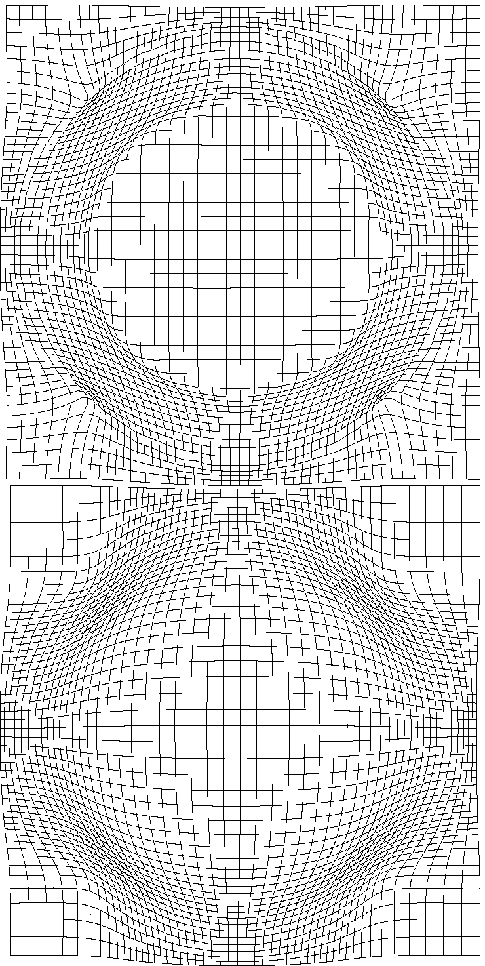
Effect of Different Regularisation Terms

Slide 43
Simultaneous registration of GM to GM and WM to WM
Grey matter
Subject 1
White matter
Grey matter
Subject 3
White matter
Grey matter
White matter
Grey matter
Template
Grey matter
White matter
White matter
Subject 2
Subject 4

Slide 44
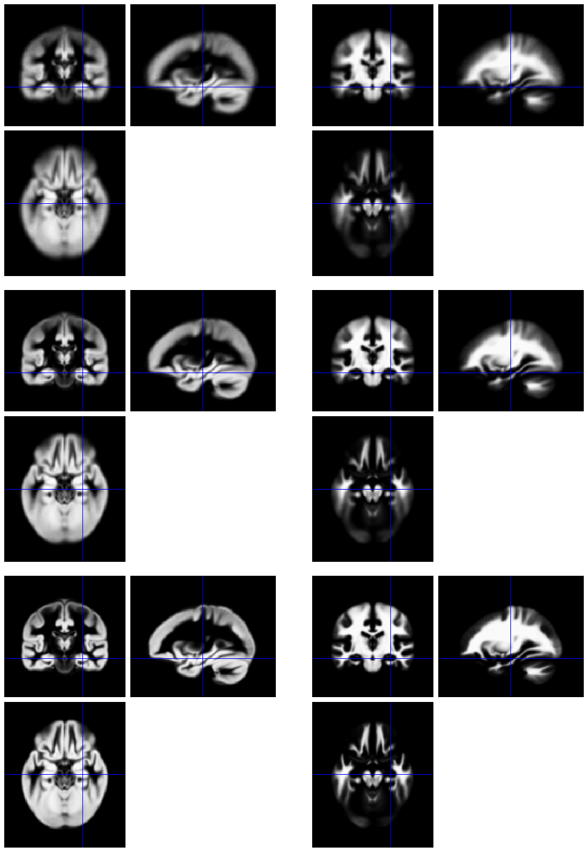
Template
Initial Average
Iteratively generated from 471 subjects
Began with rigidly aligned tissue probability maps
Used an inverse consistent formulation
After a few iterations
Final template

Slide 45
Grey matter average of 452 subjects – affine

Slide 46
Grey matter average of 471 subjects

Slide 47
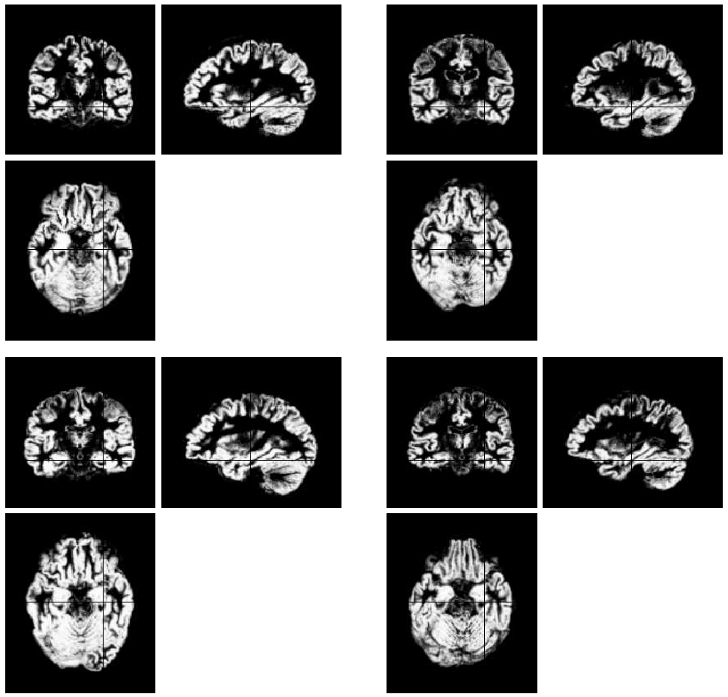
Initial
GM images

Slide 48
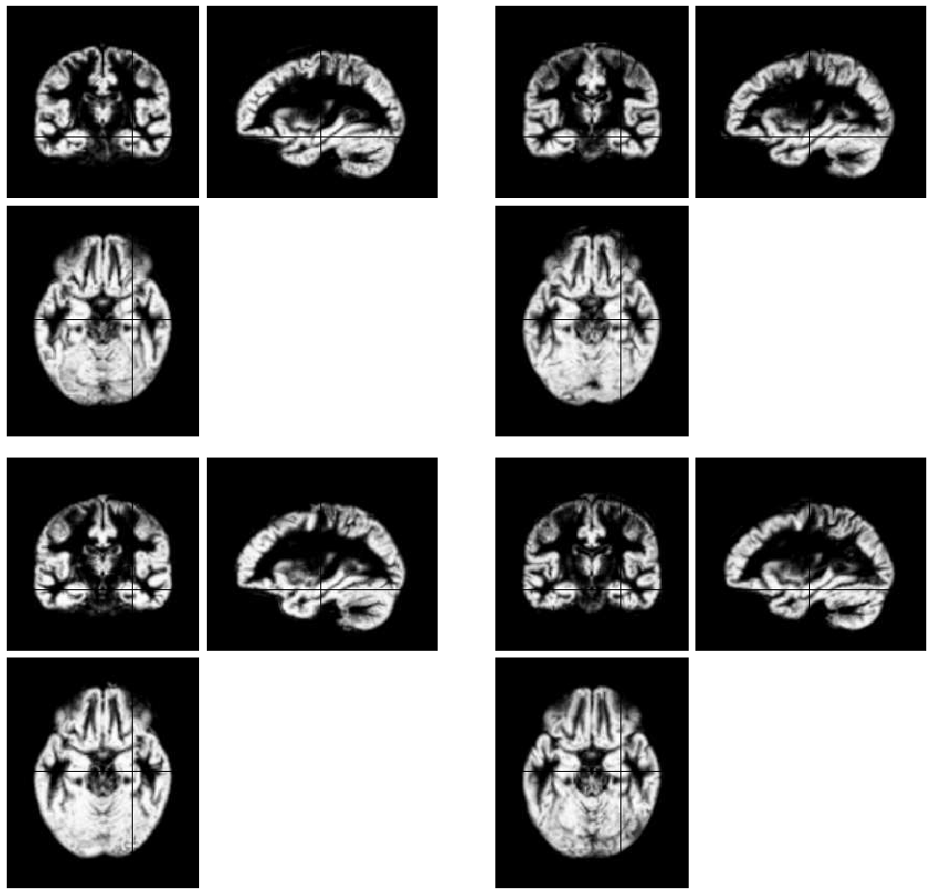
Warped
GM images

Slide 49
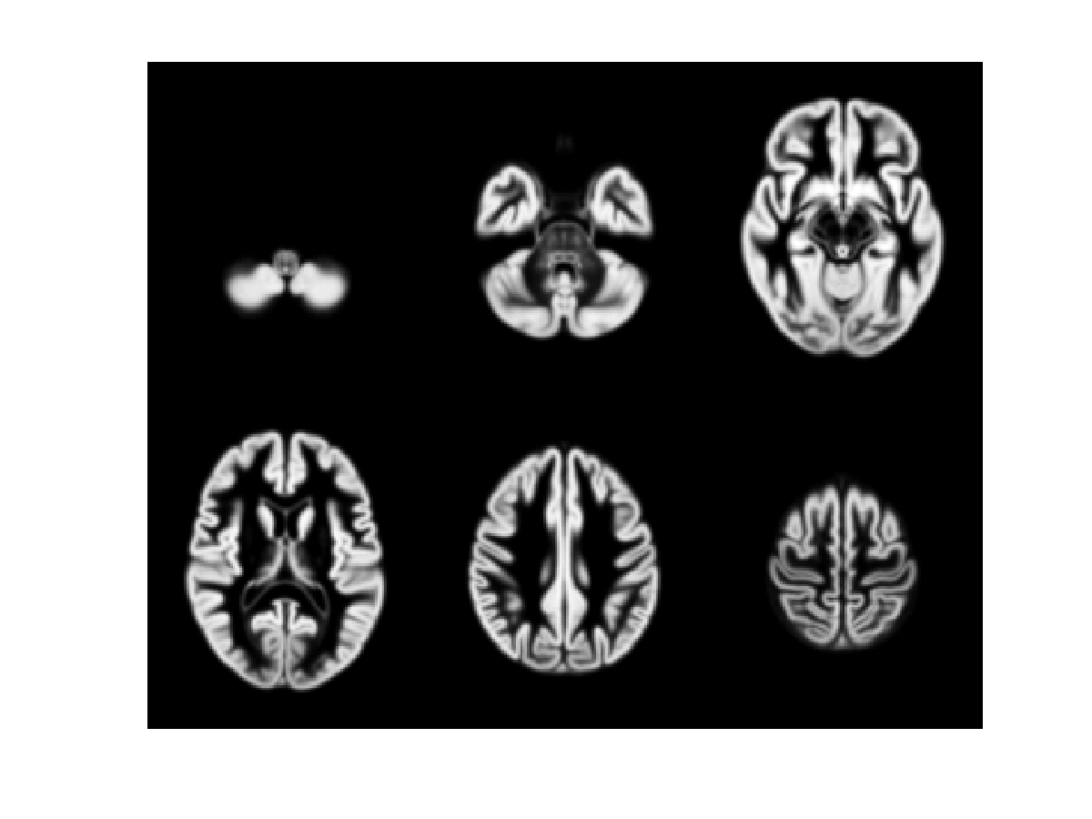
471 Subject Average

Slide 50
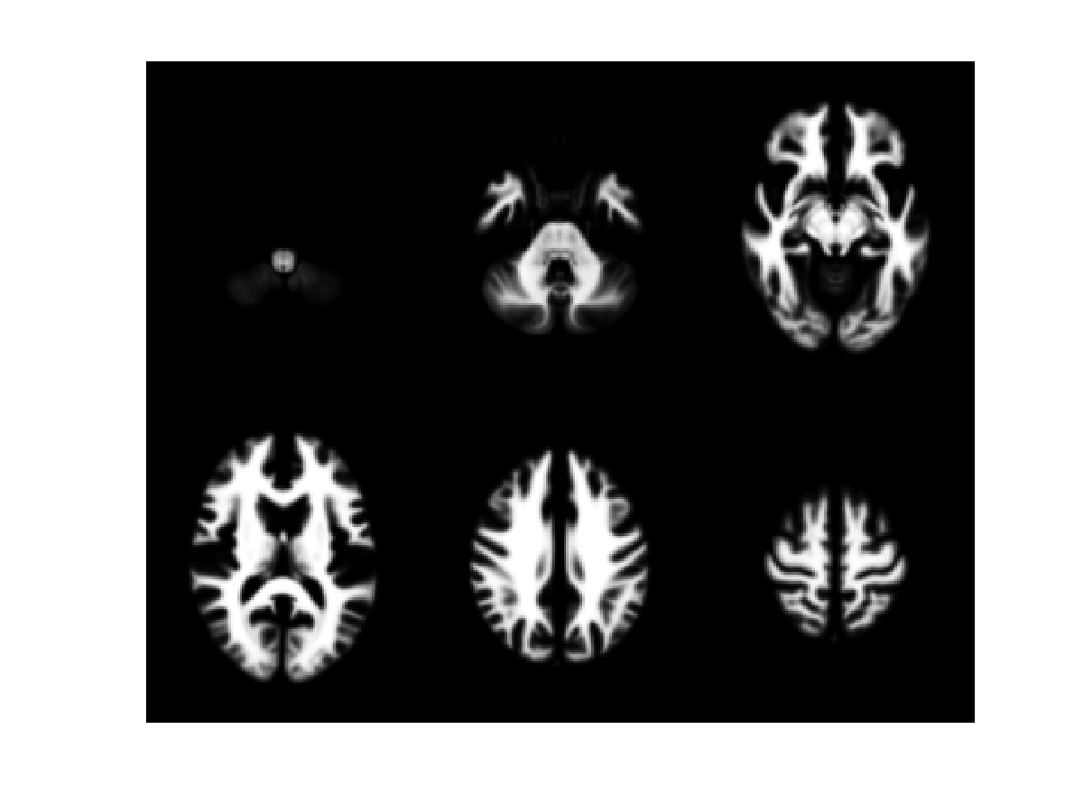
471 Subject Average

Slide 51
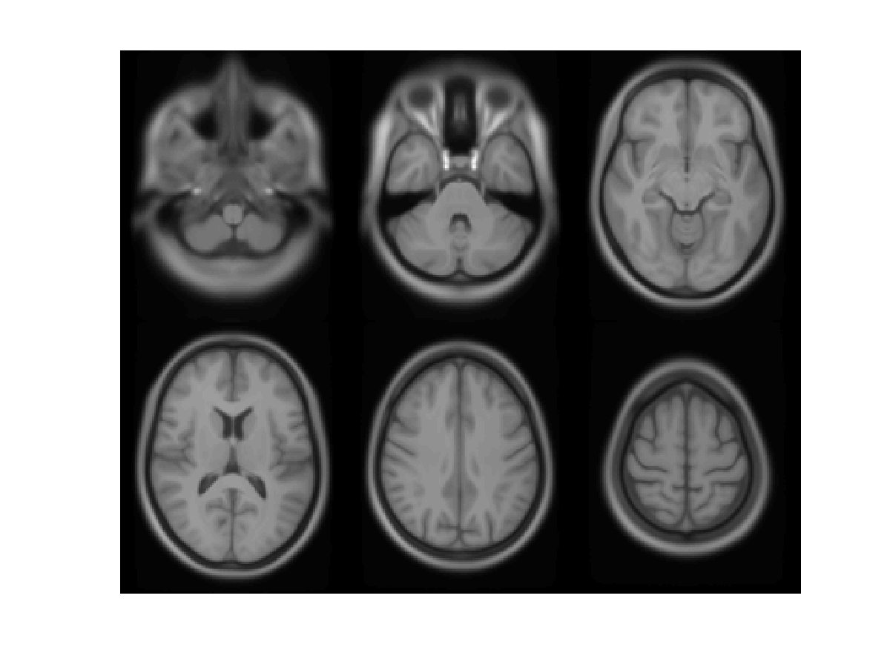
471 Subject Average

Slide 52
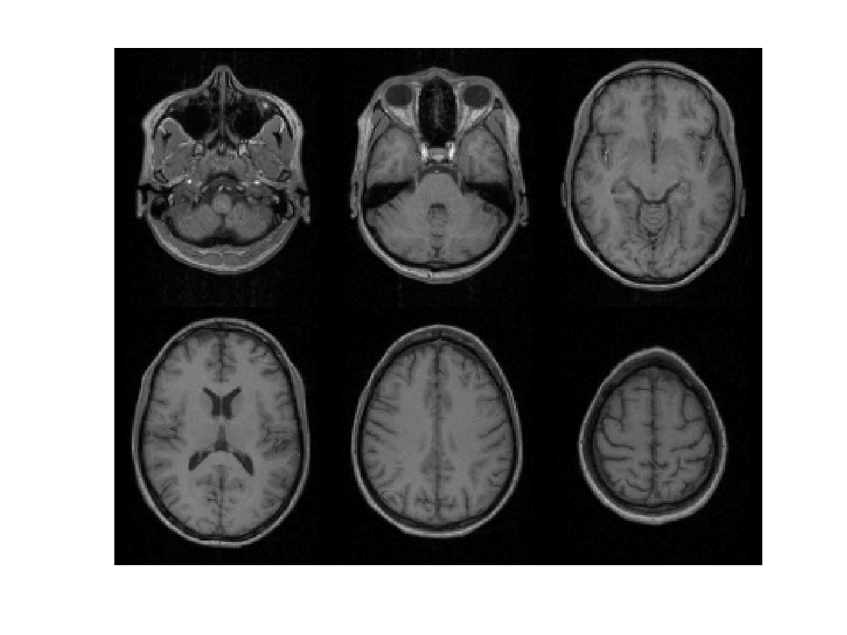
Subject 1

Slide 53
471 Subject Average

Slide 54
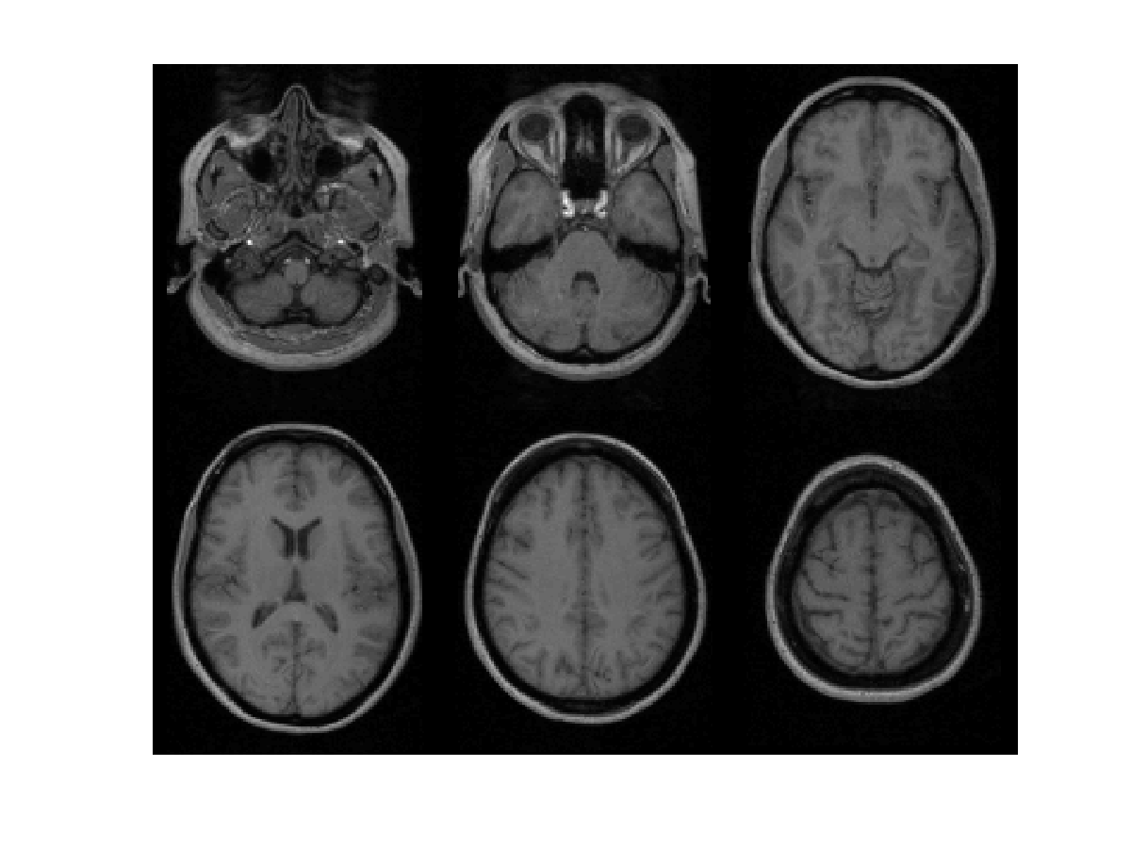
Subject 2

Slide 55
471 Subject Average

Slide 56
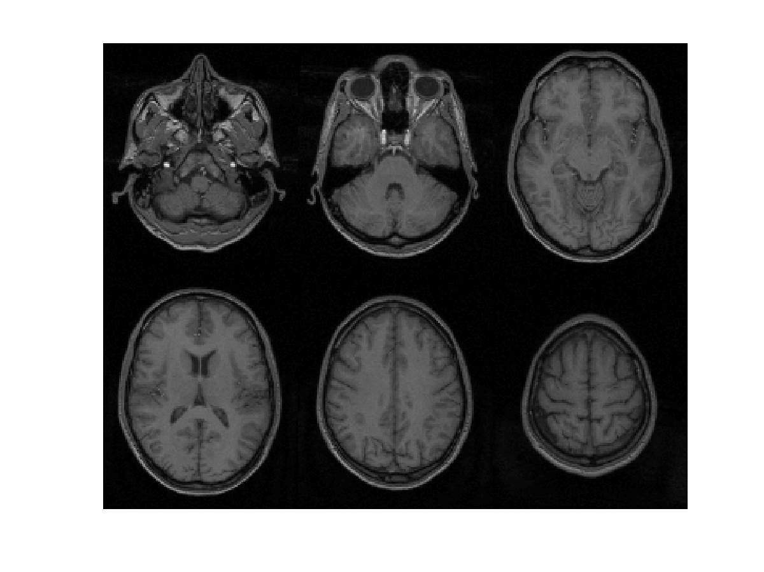
Subject 3

Slide 57
471 Subject Average

Slide 58
Overview
Voxel-Based Morphometry
Segmentation
Dartel
Recap

Slide 59
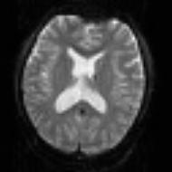
SPM for group fMRI
Group-wise
statistics
fMRI time-series
Preprocessing
Spatially Normalised
“Contrast” Image
spm T
Image
fMRI time-series
Preprocessing
Spatially Normalised
“Contrast” Image
fMRI time-series
Preprocessing
Spatially Normalised
“Contrast” Image

Slide 60
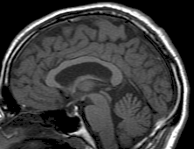
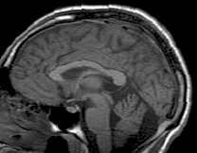
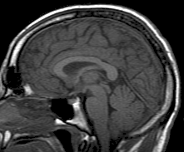
SPM for Anatomical MRI
Group-wise
statistics
Anatomical MRI
Preprocessing
Spatially Normalised
Grey Matter Image
spm T
Image
Anatomical MRI
Preprocessing
Spatially Normalised
Grey Matter Image
Anatomical MRI
Preprocessing
Spatially Normalised
Grey Matter Image

Slide 61
VBM Pre-processing in SPM8
Use New Segment for characterising intensity distributions of tissue classes, and writing out “imported” images that DARTEL can use.
Run DARTEL to estimate all the deformations.
DARTEL warping to generate smoothed, “modulated”, warped grey matter.
Statistics.

Slide 62
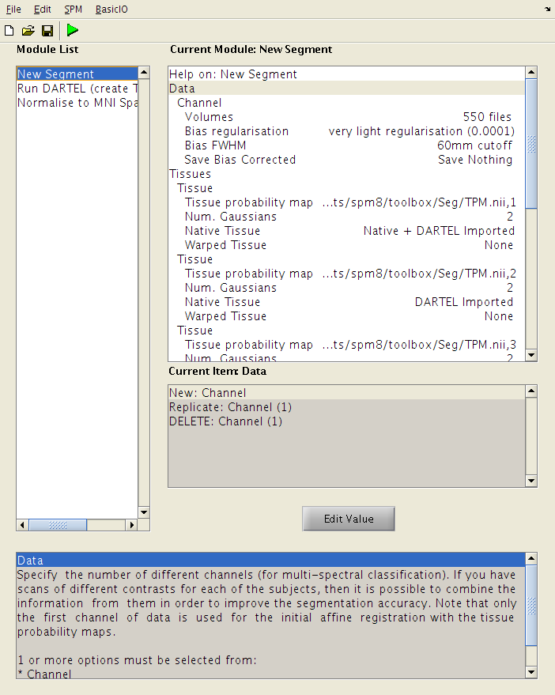
New Segment
Generate low resolution GM and WM images for each subject (“DARTEL imported”).
Generate full resolution GM map for each subject.

Slide 63
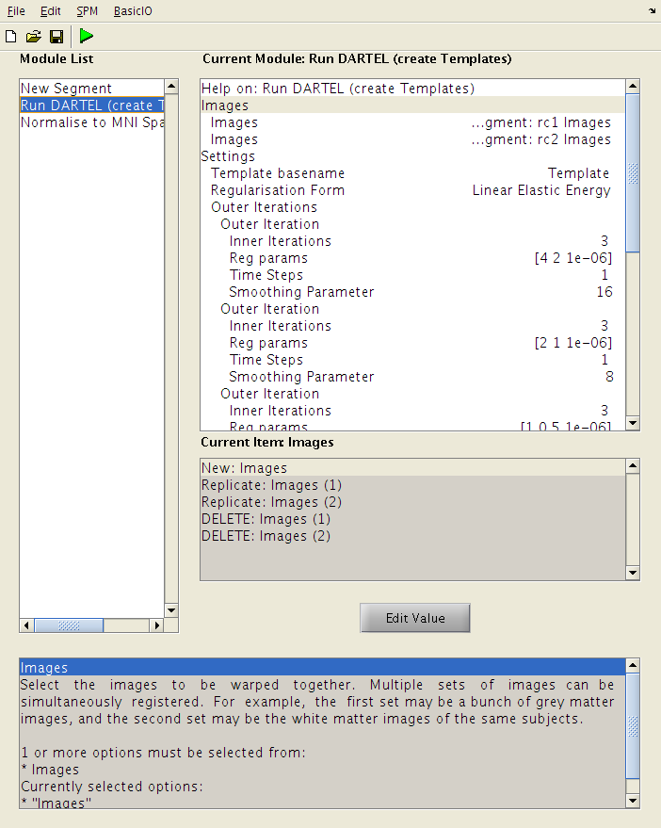
Run DARTEL (create Templates)
Simultaneously align “DARTEL imported” GM and WM for all subjects.
Generates templates and parameterisations of relative shapes.

Slide 64
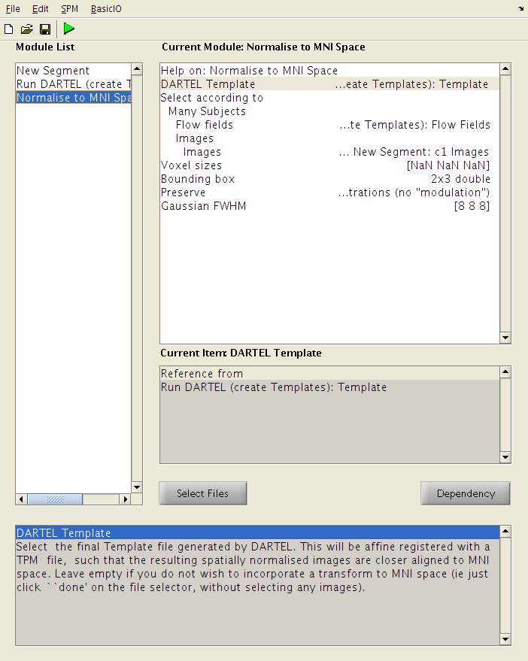
Normalise to MNI Space
Use shape parameterisations to generate smoothed Jacobian scaled and spatially normalised GM images for each subject.

Slide 65
Some References
Wright, McGuire, Poline, Travere, Murray, Frith, Frackowiak & Friston. A voxel-based method for the statistical analysis of gray and white matter density applied to schizophrenia. Neuroimage 2(4):244-252 (1995).
Ashburner & Friston. “Voxel-based morphometry-the methods”. Neuroimage 11(6):805-821, (2000).
Mechelli et al. Voxel-based morphometry of the human brain… Current Medical Imaging Reviews 1(2) (2005).
Ashburner & Friston. “Unified Segmentation”. NeuroImage 26:839-851, 2005.
Ashburner. “A Fast Diffeomorphic Image Registration Algorithm”. NeuroImage 38:95-113 (2007).
Ashburner & Friston. “Computing Average Shaped Tissue Probability Templates”. NeuroImage 45:333-341 (2009).
Klein et al. Evaluation of 14 nonlinear deformation algorithms applied to human brain MRI registration. NeuroImage 46(3):786-802 (2009).
Ashburner. “Computational Anatomy with the SPM software”. Magnetic Resonance Imaging 27(8):1163-1174 (2009).
Ashburner & Klöppel. “Multivariate models of inter-subject anatomical variability”. NeuroImage 56(2):422-439 (2011).

