Slide 1
DCM for fMRI: Advanced topics
Klaas Enno Stephan
Laboratory for Social & Neural Systems Research (SNS)
University of Zurich
Wellcome Trust Centre for Neuroimaging
University College London
SPM Course, London
13 May 2011

Slide 2
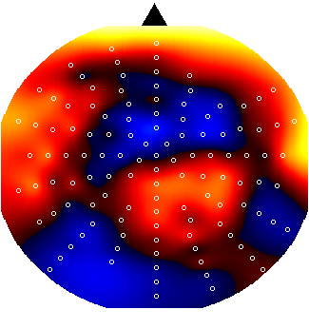
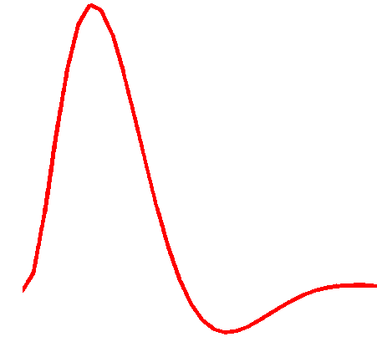
Dynamic Causal Modeling (DCM)
Hemodynamic
forward model:
neural activity→BOLD
Electromagnetic
forward model:
neural activity→EEG
MEG
LFP
Neural state equation:
fMRI
EEG/MEG
simple neuronal model
complicated forward model
complicated neuronal model
simple forward model
inputs

Slide 3
Overview
Bayesian model selection (BMS)
Neurocomputational models:
Embedding computational models in DCMs
Integrating tractography and DCM

Slide 4
definition of model space
inference on model structure or inference on model parameters?
inference on
individual models or model space partition?
inference on
parameters of an optimal model or parameters of all models?
optimal model structure assumed to be identical across subjects?
comparison of model families using
FFX or RFX BMS
optimal model structure assumed to be identical across subjects?
BMA
yes
no
yes
no
FFX BMS
RFX BMS
FFX BMS
RFX BMS
FFX analysis of parameter estimates
(e.g. BPA)
RFX analysis of parameter estimates
(e.g. t-test, ANOVA)
Stephan et al. 2010, NeuroImage

Slide 5
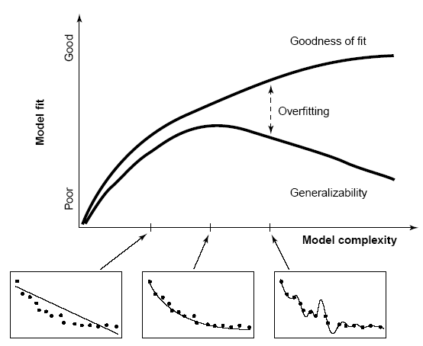
Model comparison and selection
Given competing hypotheses on structure & functional mechanisms of a system, which model is the best?
Which model represents the
best balance between model
fit and model complexity?
For which model m does p(y|m) become maximal?
Pitt & Miyung (2002) TICS

Slide 6
Bayesian model selection (BMS)
Model evidence:
Gharamani, 2004
p(y|m)
y
all possible datasets
accounts for both accuracy and complexity of the model
Various approximations, e.g.:
negative free energy, AIC, BIC
allows for inference about structure (generalisability) of the model
McKay 1992, Neural Comput.
Penny et al. 2004a, NeuroImage

Slide 7
Approximations to the model evidence in DCM
Logarithm is a monotonic function
Maximizing log model evidence
= Maximizing model evidence
Log model evidence = balance between fit and complexity
No. of
parameters
In SPM2 & SPM5, interface offers 2 approximations:
Akaike Information Criterion:
No. of
data points
Bayesian Information Criterion:
AIC and BIC only take into account the number of parameters, but not the flexibility they provide (prior variance) nor their interdependencies.

Slide 8
The (negative) free energy approximation
Under Gaussian assumptions about the posterior (Laplace approximation), the negative free energy F is a lower bound on the log model evidence:
F can also be written as the difference between fit and complexity:

Slide 9
The complexity term in F
In contrast to AIC & BIC, the complexity term of the negative free energy F accounts for parameter interdependencies.
The complexity term of F is higher
  the more independent the prior parameters (↑ effective DFs)
  the more dependent the posterior parameters
  the more the posterior mean deviates from the prior mean
NB: Since SPM8, only F for is used for model selection !

Slide 10
Bayes factors
To compare two models, we could just compare their log evidences.
But: the log evidence is just some number – not very intuitive!
A more intuitive interpretation of model comparisons is made possible by Bayes factors:
positive value, [0; ∞[
B₁₂ | p(m₁|y) | Evidence
1 to 3 | 50-75% | weak
3 to 20 | 75-95% | positive
20 to 150 | 95-99% | strong
≥ 150 | ≥ 99% | Very strong
Kass & Raftery classification:
Kass & Raftery 1995, J. Am. Stat. Assoc.

Slide 11
BMS in SPM8: an example
attention
M1
M2
PPC
PPC
M2 better than M1
attention
BF ≈ 2966
ΔF = 7.995
stim
V1
V5
stim
V1
V5
M1
M2
M3
M4
M3
attention
PPC
M3 better than M2
BF ≈ 12
ΔF = 2.450
stim
V1
V5
M4
attention
PPC
M4 better than M3
BF ≈ 23
ΔF = 3.144
stim
V1
V5
Stephan et al. 2008, NeuroImage
Notes:
Posterior model probability in lower plot is a normalised probability:
p(m_i|y) = p(y|m_i)/sum(p(y|m_i))
Note that under flat model priors p(m_i|y) = p(y|m_i)

Slide 12
Fixed effects BMS at group level
Group Bayes factor (GBF) for 1...K subjects:
Average Bayes factor (ABF):
Problems:
blind with regard to group heterogeneity
sensitive to outliers

Slide 13
Random effects BMS for heterogeneous groups
Dirichlet parameters α
= “occurrences” of models in the population
Dirichlet distribution of model probabilities r
Multinomial distribution of model labels m
Model inversion by Variational Bayes (VB) or MCMC
Measured data y
Stephan et al. 2009a, NeuroImage
Penny et al. 2010, PLoS Comp. Biol.

Slide 14
m₂
LD
LD|LVF
m₁
MOG
FG
FG
MOG
MOG
FG
FG
MOG
LD|RVF
LD|LVF
LD
LD
LG
LG
LG
LG
RVF
stim.
LD
LVF
stim.
RVF
stim.
LD|RVF
LVF
stim.
m₂
m₁
Data: Stephan et al. 2003, Science
Models: Stephan et al. 2007, J. Neurosci.

Slide 15
m₂
m₁
Stephan et al. 2009a, NeuroImage

Slide 16
Model space partitioning:
comparing model families
m₂
m₁
m₁
m₂
Stephan et al. 2009, NeuroImage

Slide 17
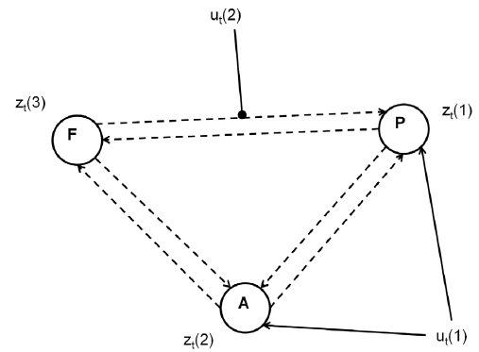
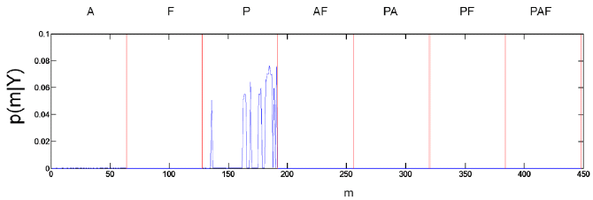
Comparing model families – a second example
data from Leff et al. 2008, J. Neurosci
one driving input, one modulatory input
2⁶ = 64 possible modulations
2³ – 1 input patterns
7×64 = 448 models
integrate out uncertainty about modulatory patterns and ask where auditory input enters
Penny et al. 2010, PLoS Comput. Biol.

Slide 18
Bayesian Model Averaging (BMA)
abandons dependence of parameter inference on a single model
computes average of each parameter, weighted by posterior model probabilities
represents a particularly useful alternative
  when none of the models (or model subspaces) considered clearly outperforms all others
  when comparing groups for which the optimal model differs
NB: p(m|y_{1..N}) can be obtained by either FFX or RFX BMS
Penny et al. 2010, PLoS Comput. Biol.

Slide 19
BMS for large model spaces
10
5
Number of models
10
4
for less constrained model spaces, search methods are needed
fast model scoring via the Savage-Dickey density ratio:
10
3
10
2
10
1
assuming reciprocal connections
10
0
2
3
4
5
6
number of nodes
Log-evidence
100
0
-100
-200
Free-energy
-300
-400
Friston et al. 2011, NeuroImage
Friston & Penny 2011, NeuroImage
-500
-600
-600
-500
-400
-300
-200
-100
0
100
Savage-Dickey

Slide 20
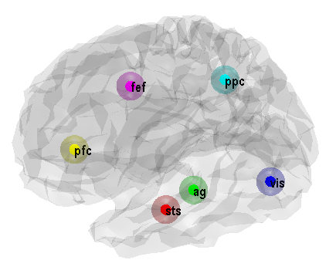
BMS for large model spaces
Log-posterior
Model posterior
empirical example:
comparing all 32,768 variants of a 6-region model
(under the constraint of reciprocal connections)
100
0.9
0.8
0
0.7
-100
0.6
log-probability
0.5
probability
-200
0.4
0.3
-300
0.2
0.1
-400
0
0.5
1
1.5
2
2.5
3
3.5
0
0
0.5
1
1.5
2
2.5
3
3.5
model
4
model
4
x 10
x 10
MAP connections (full)
MAP connections (sparse)
0.8
0.8
0.6
0.6
0.4
0.4
0.2
0.2
0
0
-0.2
-0.2
-0.4
-0.4
-0.6
0
5
10
15
20
25
30
35
-0.6
0
5
10
15
20
25
30
35
Friston et al. 2011, NeuroImage

Slide 21
Overview
Bayesian model selection (BMS)
Neurocomputational models:
Embedding computational models in DCMs
Integrating tractography and DCM

Slide 22
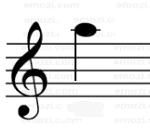

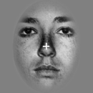
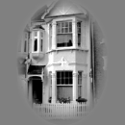
Learning of dynamic audio-visual associations
Conditioning Stimulus
Target Stimulus
1
CS
1
CS
2
0.8
or
or
0.6
p(face)
0.4
CS
TS
Response
0.2
0
200
400
600
800
2000 ± 650
Time (ms)
0
0
200
400
600
800
1000
trial
den Ouden et al. 2010, J. Neurosci.

Slide 23
Explaining RTs by different learning models
Reaction times
1
True
450
Bayes Vol
0.8
HMM fixed
440
HMM learn
RW
430
p(F)
0.6
RT (ms)
420
410
0.4
400
0.2
390
0.1
0.3
0.5
0.7
0.9
0
p(outcome)
400
440
480
Trial
520
560
600
5 alternative learning models:
categorical probabilities
hierarchical Bayesian learner
Rescorla-Wagner
Hidden Markov models
(2 variants)
Bayesian model selection:
hierarchical Bayesian model performs best
den Ouden et al. 2010, J. Neurosci.

Slide 24
Hierarchical Bayesian learning model
k
volatility
v_{t-1}
v_{t}
probabilistic association
r_{t}
r_{t+1}
observed events
u_{t}
u_{t+1}
1
0.8
0.6
p(F)
0.4
0.2
0
400
440
480
Trial
520
560
600
Behrens et al. 2007, Nat. Neurosci.

Slide 25

Stimulus-independent prediction error
Putamen
Premotor cortex
p < 0.05
(cluster-level whole- brain corrected)
p < 0.05 (SVC)
0
0
-0.5
-0.5
BOLD resp. (a.u.)
-1
BOLD resp. (a.u.)
-1
-1.5
-1.5
-2
p(F)
p(H)
-2
p(F)
p(H)
den Ouden et al. 2010, J. Neurosci .

Slide 26
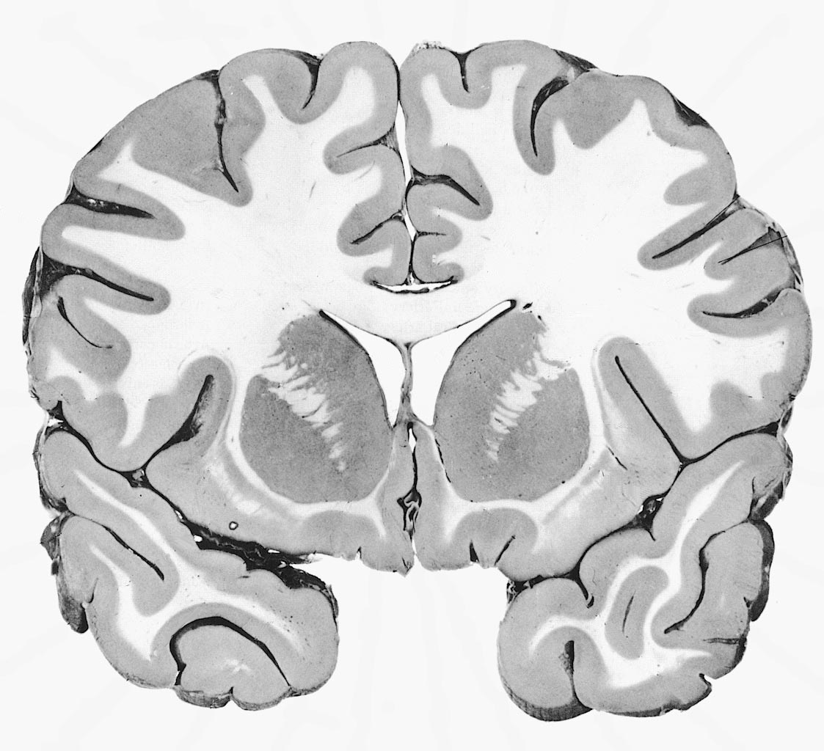
Prediction error (PE) activity in the putamen
PE during
reinforcement learning
O'Doherty et al. 2004, Science
PE during
incidental
sensory learning
den Ouden et al. 2009, Cerebral Cortex
According to current learning theories (e.g., free energy principle):
synaptic plasticity during learning = PE dependent changes in connectivity

Slide 27


Plasticity of visuo-motor connections
Hierarchical Bayesian learning model
Modulation of visuo-motor connections by striatal prediction error activity
Influence of visual areas on premotor cortex:
  stronger for surprising stimuli
  weaker for expected stimuli
PUT
p = 0.010
p = 0.017
PMd
PPA
FFA
den Ouden et al. 2010, J. Neurosci .

Slide 28
Prediction error in PMd: cause or effect?
Model 1
Model 2
model 2
model 1
den Ouden et al. 2010, J. Neurosci .

Slide 29
Overview
Bayesian model selection (BMS)
Neurocomputational models:
Embedding computational models in DCMs
Integrating tractography and DCM

Slide 30
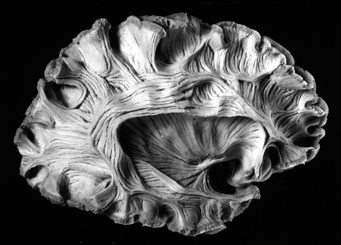
Diffusion-weighted imaging
Parker & Alexander, 2005,
Phil. Trans. B

Slide 31
Probabilistic tractography: Kaden et al. 2007, NeuroImage
computes local fibre orientation density by spherical deconvolution of the diffusion-weighted signal
estimates the spatial probability distribution of connectivity from given seed regions
anatomical connectivity = proportion of fibre pathways originating in a specific source region that intersect a target region
If the area or volume of the source region approaches a point, this measure reduces to method by Behrens et al. (2003)

Slide 32
Integration of tractography and DCM
R₁
R₂
low probability of anatomical connection
→ small prior variance of effective connectivity parameter
R₁
R₂
high probability of anatomical connection
→ large prior variance of effective connectivity parameter
Stephan, Tittgemeyer et al. 2009, NeuroImage

Slide 33
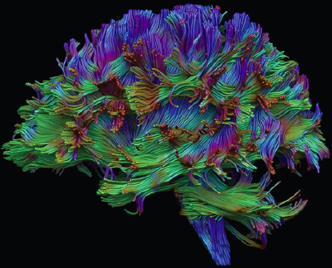
probabilistic
tractography
Proof of concept study
FG
left
FG
right
FG
FG
LG
LG
left
LG
right
LG
◆ DCM
❖ anatomical connectivity ϕ
⬥ connection-specific priors for coupling parameters
Stephan, Tittgemeyer et al. 2009, NeuroImage

Slide 34
Connection-specific prior variance Σ as a function of anatomical connection probability ϕ
64 different mappings by systematic search across hyper-parameters α and β
yields anatomically informed (intuitive and counterintuitive) and uninformed priors

Slide 35
Models with anatomically informed priors (of an intuitive form)

Slide 36
Models with anatomically informed priors (of an intuitive form) were clearly superior than anatomically uninformed ones: Bayes Factor >10⁹

Slide 37
Methods papers: DCM for fMRI and BMS – part 1
Chumbley JR, Friston KJ, Fearn T, Kiebel SJ (2007) A Metropolis-Hastings algorithm for dynamic causal models. Neuroimage 38:478-487.
Daunizeau J, Friston KJ, Kiebel SJ (2009) Variational Bayesian identification and prediction of stochastic nonlinear dynamic causal models. Physica, D 238, 2089–2118.
Daunizeau J, David, O, Stephan KE (2011) Dynamic Causal Modelling: A critical review of the biophysical and statistical foundations. NeuroImage, in press.
Friston KJ, Harrison L, Penny W (2003) Dynamic causal modelling. NeuroImage 19:1273-1302.
Friston KJ, Mattout J, Trujillo-Barreto N, Ashburner J, Penny W (2007) Variational free energy and the Laplace approximation. NeuroImage 34: 220-234.
Friston KJ, Stephan KE, Li B, Daunizeau J (2010) Generalised filtering. Mathematical Problems in Engineering 2010: 621670.
Friston KJ, Li B, Daunizeau J, Stephan KE (2011) Network discovery with DCM. NeuroImage 56: 1202-1221.
Friston KJ, Penny WD (2011) Post hoc model selection. NeuroImage, in press.
Kasess CH, Stephan KE, Weissenbacher A, Pezawas L, Moser E, Windischberger C (2010) Multi-Subject Analyses with Dynamic Causal Modeling. NeuroImage 49: 3065-3074.
Kiebel SJ, Kloppel S, Weiskopf N, Friston KJ (2007) Dynamic causal modeling: a generative model of slice timing in fMRI. NeuroImage 34:1487-1496.
Li B, Daunizeau J, Stephan KE, Penny WD, Friston KJ (2011). Stochastic DCM and generalised filtering. NeuroImage, in press.
Marreiros AC, Kiebel SJ, Friston KJ (2008) Dynamic causal modelling for fMRI: a two-state model. NeuroImage 39:269-278.

Slide 38
Methods papers: DCM for fMRI and BMS – part 2
Penny WD, Stephan KE, Mechelli A, Friston KJ (2004a) Comparing dynamic causal models. NeuroImage 22:1157-1172.
Penny WD, Stephan KE, Mechelli A, Friston KJ (2004b) Modelling functional integration: a comparison of structural equation and dynamic causal models. NeuroImage 23 Suppl 1:S264-274.
Penny WD, Stephan KE, Daunizeau J, Joao M, Friston K, Schofield T, Leff AP (2010) Comparing Families of Dynamic Causal Models. PLoS Computational Biology 6: e1000709.
Stephan KE, Harrison LM, Penny WD, Friston KJ (2004) Biophysical models of fMRI responses. Curr Opin Neurobiol 14:629-635.
Stephan KE, Weiskopf N, Drysdale PM, Robinson PA, Friston KJ (2007) Comparing hemodynamic models with DCM. NeuroImage 38:387-401.
Stephan KE, Harrison LM, Kiebel SJ, David O, Penny WD, Friston KJ (2007) Dynamic causal models of neural system dynamics: current state and future extensions. J Biosci 32:129-144.
Stephan KE, Weiskopf N, Drysdale PM, Robinson PA, Friston KJ (2007) Comparing hemodynamic models with DCM. NeuroImage 38:387-401.
Stephan KE, Kasper L, Harrison LM, Daunizeau J, den Ouden HE, Breakspear M, Friston KJ (2008) Nonlinear dynamic causal models for fMRI. NeuroImage 42:649-662.
Stephan KE, Penny WD, Daunizeau J, Moran RJ, Friston KJ (2009a) Bayesian model selection for group studies. NeuroImage 46:1004-1017.
Stephan KE, Tittgemeyer M, Knösche TR, Moran RJ, Friston KJ (2009b) Tractography-based priors for dynamic causal models. NeuroImage 47: 1628-1638.
Stephan KE, Penny WD, Moran RJ, den Ouden HEM, Daunizeau J, Friston KJ (2010) Ten simple rules for Dynamic Causal Modelling. NeuroImage 49: 3099-3109.

Slide 39
Thank you

