Slide 1
DCM: Advanced Topics
Klaas Enno Stephan
Translational Neuromodeling Unit (TNU)
Institute for Biomedical Engineering
University of Zurich & Swiss Federal Institute of Technology (ETH) Zurich
Wellcome Trust Centre for Neuroimaging
Institute of Neurology
University College London
SPM Course 2012 @ FIL
19 October 2012

Slide 2
Overview
Bayesian model selection (BMS)
Extended DCM for fMRI: nonlinear, two-state, stochastic
Embedding computational models in DCMs
Integrating tractography and DCM
Applications of DCM to clinical questions

Slide 3
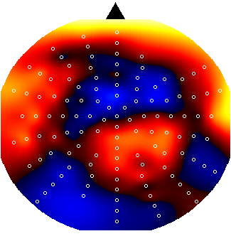
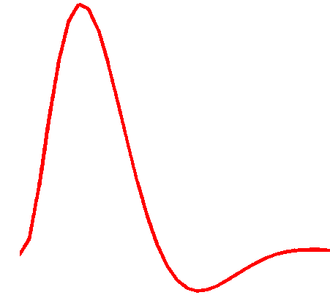
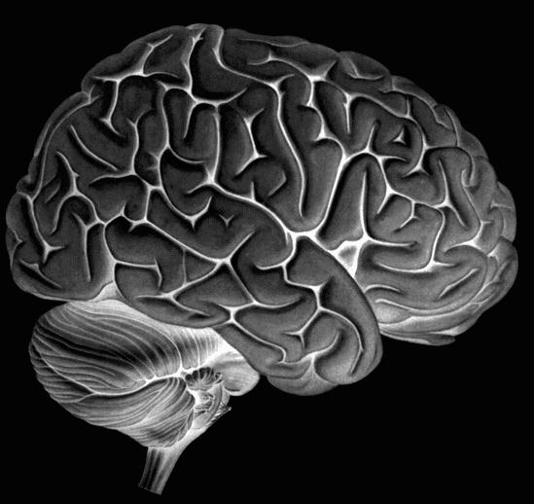
Dynamic Causal Modeling (DCM)
Hemodynamic
forward model:
neural activity→BOLD
Electromagnetic
forward model:
neural activity→EEG
MEG
LFP
Neural state equation:
fMRI
EEG/MEG
simple neuronal model
complicated forward model
complicated neuronal model
simple forward model
inputs

Slide 4
Generative models & model selection
any DCM = a particular generative model of how the data (may) have been caused
modelling = comparing competing hypotheses about the mechanisms underlying observed data
  a priori definition of hypothesis set (model space) is crucial
  determine the most plausible hypothesis (model), given the data
model selection ≠ model validation!
  model validation requires external criteria (external to the measured data)

Slide 5
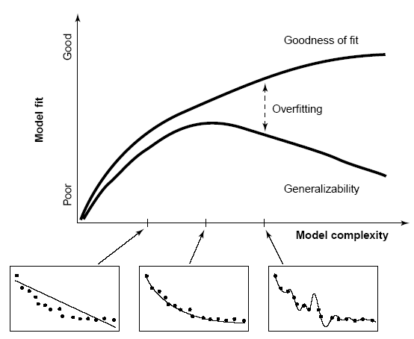
Model comparison and selection
Given competing hypotheses on structure & functional mechanisms of a system, which model is the best?
Which model represents the
best balance between model
fit and model complexity?
For which model m does p(y|m) become maximal?
Pitt & Miyung (2002) TICS

Slide 6
Bayesian model selection (BMS)
Model evidence:
Gharamani, 2004
p(y|m)
accounts for both accuracy and complexity of the model
y
all possible datasets
allows for inference about structure (generalisability) of the model
Various approximations, e.g.:
negative free energy, AIC, BIC
McKay 1992, Neural Comput.
Penny et al. 2004a, NeuroImage

Slide 7
Approximations to the model evidence in DCM
Logarithm is a monotonic function
Maximizing log model evidence
= Maximizing model evidence
Log model evidence = balance between fit and complexity
No. of
parameters
SPM2 & SPM5 offered 2 approximations:
Akaike Information Criterion:
No. of
data points
Bayesian Information Criterion:
Penny et al. 2004a, NeuroImage
Penny 2012, NeuroImage

Slide 8
The (negative) free energy approximation
Under Gaussian assumptions about the posterior (Laplace approximation):

Slide 9
The complexity term in F
In contrast to AIC & BIC, the complexity term of the negative free energy F accounts for parameter interdependencies.
The complexity term of F is higher
  the more independent the prior parameters (↑ effective DFs)
  the more dependent the posterior parameters
  the more the posterior mean deviates from the prior mean
NB: Since SPM8, only F is used for model selection !

Slide 10
Bayes factors
To compare two models, we could just compare their log evidences.
But: the log evidence is just some number – not very intuitive!
A more intuitive interpretation of model comparisons is made possible by Bayes factors:
positive value, [0; ∞[
B₁₂ | p(m₁|y) | Evidence
1 to 3 | 50-75% | weak
3 to 20 | 75-95% | positive
20 to 150 | 95-99% | strong
≥ 150 | ≥ 99% | Very strong
Kass & Raftery classification:
Kass & Raftery 1995, J. Am. Stat. Assoc.

Slide 11
BMS in SPM8: an example
attention
M1
M2
PPC
PPC
M2 better than M1
attention
BF ≈ 2966
ΔF = 7.995
stim
V1
V5
stim
V1
V5
M1
M2
M3
M4
M3
attention
PPC
M3 better than M2
BF ≈ 12
ΔF = 2.450
stim
V1
V5
M4
attention
PPC
M4 better than M3
BF ≈ 23
ΔF = 3.144
stim
V1
V5
Notes:
Posterior model probability in lower plot is a normalised probability:
p(m_i|y) = p(y|m_i)/sum(p(y|m_i))
Note that under flat model priors p(m_i|y) = p(y|m_i)

Slide 12
Fixed effects BMS at group level
Group Bayes factor (GBF) for 1...K subjects:
Average Bayes factor (ABF):
Problems:
blind with regard to group heterogeneity
sensitive to outliers

Slide 13
Random effects BMS for heterogeneous groups
Dirichlet parameters α
= “occurrences” of models in the population
Dirichlet distribution of model probabilities r
Multinomial distribution of model labels m
Model inversion by Variational Bayes (VB) or MCMC
Measured data y
Stephan et al. 2009a, NeuroImage
Penny et al. 2010, PLoS Comp. Biol.
Notes:
Although Bayesian model selection was already introduced in the early 90s, for a long time it had been a major problem to deal with heterogeneous groups where different models best explain subject-specific data. We recently proposed a solution to this problem which rests on a hierarchical Bayesian model and allows one to estimate the distribution of model probabilities in the population.

Slide 14
m₂
LD
LD|LVF
m₁
MOG
FG
FG
MOG
MOG
FG
FG
MOG
LD|RVF
LD|LVF
LD
LD
LG
LG
LG
LG
RVF
stim.
LD
LVF
stim.
RVF
stim.
LD|RVF
LVF
stim.
m₂
m₁
Data: Stephan et al. 2003, Science
Models: Stephan et al. 2007, J. Neurosci.
Notes:
I would like to illustrate the importance of model selection methods which account for group heterogeneity by a concrete example. This plot uses fMRI data and models from studies on lateralised decision tasks I published previously. It shows the relative evidence for a model m1 that is compared to another model m2 in all 12 subjects. While m1 is superior in 11 subjects, m2 is preferred so strongly in the remaining subject that a conventional group analysis would conclude that m2 is superior.

Slide 15
m₂
m₁
Stephan et al. 2009a, NeuroImage
Notes:
However, the random effects BMS is robust against this strong outlier, showing that m1 is a much more likely model at the group level than m2.

Slide 16
definition of model space
inference on model structure or inference on model parameters?
inference on
individual models or model space partition?
inference on
parameters of an optimal model or parameters of all models?
optimal model structure assumed to be identical across subjects?
comparison of model families using
FFX or RFX BMS
optimal model structure assumed to be identical across subjects?
BMA
yes
no
yes
no
FFX BMS
RFX BMS
FFX BMS
RFX BMS
FFX analysis of parameter estimates
(e.g. BPA)
RFX analysis of parameter estimates
(e.g. t-test, ANOVA)
Stephan et al. 2010, NeuroImage

Slide 17
Model space partitioning:
comparing model families
m₂
m₁
m₁
m₂
Stephan et al. 2009, NeuroImage

Slide 18
Bayesian Model Averaging (BMA)
abandons dependence of parameter inference on a single model
uses the entire model space considered (or an optimal family of models)
computes average of each parameter, weighted by posterior model probabilities
represents a particularly useful alternative
  when none of the models (or model subspaces) considered clearly outperforms all others
  when comparing groups for which the optimal model differs
NB: p(m|y_{1..N}) can be obtained by either FFX or RFX BMS
Penny et al. 2010, PLoS Comput. Biol.

Slide 19
Overview
Bayesian model selection (BMS)
Extended DCM for fMRI: nonlinear, two-state, stochastic
Embedding computational models in DCMs
Integrating tractography and DCM
Applications of DCM to clinical questions

Slide 20
DCM10 in SPM8
DCM10 was released as part of SPM8 in July 2010 (version 4010).
Introduced many new features, incl. two-state DCMs and stochastic DCMs
This led to various changes in model defaults, e.g.
  inputs mean-centred
  changes in coupling priors
  self-connections estimated separately for each area
For details, see: www.fil.ion.ucl.ac.uk/spm/software/spm8/SPM8_Release_Notes_r4010.pdf
Further changes in version 4290 (released April 2011) to accommodate new developments and give users more choice (e.g., whether or not to mean-centre inputs).

Slide 21
The evolution of DCM in SPM
DCM is not one specific model, but a framework for Bayesian inversion of dynamic system models
The default implementation in SPM is evolving over time
  improvements of numerical routines (e.g., for inversion)
  change in priors to cover new variants (e.g., stochastic DCMs, endogenous DCMs etc.)
To enable replication of your results, you should ideally state which SPM version (release number) you are using when publishing papers.
In the next SPM version, the release number will be stored in the DCM.mat.

Slide 22
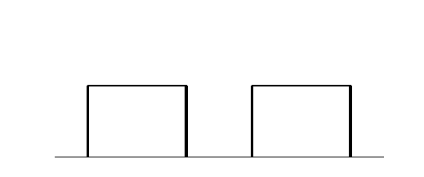
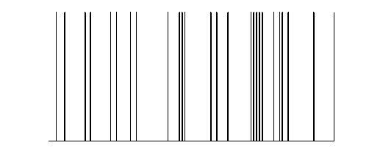
y
y
y
BOLD
y
−
−
λ
−
hemodynamic
model
activity
x₂(t)
activity
x₃(t)
activity
x₁(t)
neuronal
states
x
modulatory
input u₂(t)
integration
driving
input u₁(t)
t
Neural state equation
endogenous connectivity
t
modulation of
connectivity
The classical DCM:
a deterministic, one-state, bilinear model
direct inputs

Slide 23
Factorial structure of model specification in DCM10
Three dimensions of model specification:
  bilinear vs. nonlinear
  single-state vs. two-state (per region)
  deterministic vs. stochastic
Specification via GUI.

Slide 24
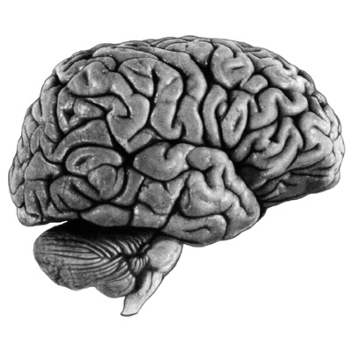
bilinear DCM
non-linear DCM
modulation
driving
input
driving
input
modulation
Two-dimensional Taylor series (around x₀=0, u₀=0):
Bilinear state equation:
Nonlinear state equation:

Slide 25
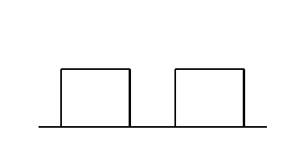
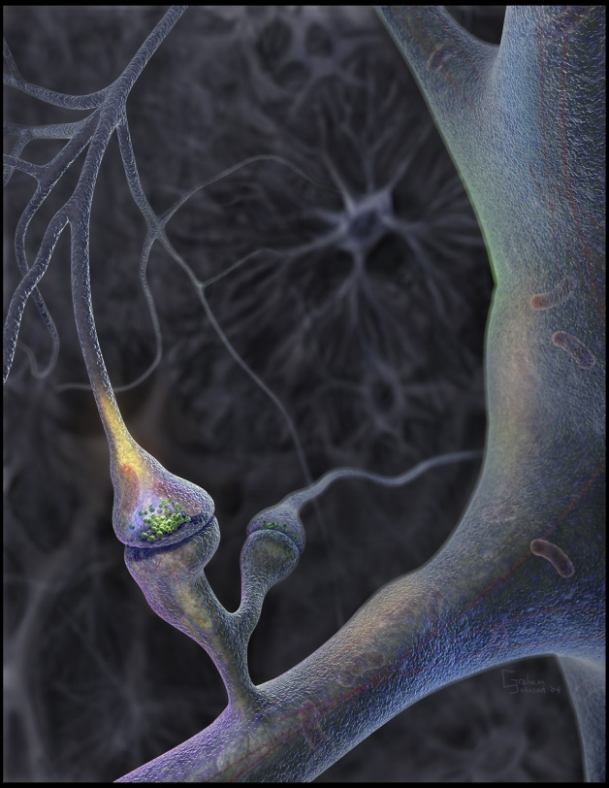
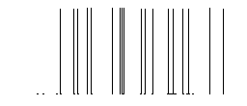
Neural population activity
u₂
u₁
x₃
fMRI signal change (%)
x₁
x₂
Nonlinear dynamic causal model (DCM)
Stephan et al. 2008, NeuroImage

Slide 26
attention
MAP = 1.25
0.10
PPC
0.26
1.25
0.39
stim
0.26
V1
0.13
V5
0.46
0.50
motion
Stephan et al. 2008, NeuroImage

Slide 27
motion &
attention
motion &
no attention
static
dots
V1
V5
PPC
observed
fitted

Slide 28
Two-state DCM
Single-state DCM
Two-state DCM
input
Extrinsic (between-region) coupling
Intrinsic (within-region) coupling
Marreiros et al. 2008, NeuroImage

Slide 29
Estimates of hidden causes and states
(Generalised filtering)
Stochastic DCM
all states are represented in generalised coordinates of motion
random state fluctuations w^{(x)} account for endogenous fluctuations,
have unknown precision and smoothness
→ two hyperparameters
fluctuations w^{(v)} induce uncertainty about how inputs influence neuronal activity
can be fitted to resting state data
Li et al. 2011, NeuroImage

Slide 30
Overview
Bayesian model selection (BMS)
Extended DCM for fMRI: nonlinear, two-state, stochastic
Embedding computational models in DCMs
Integrating tractography and DCM
Applications of DCM to clinical questions

Slide 31
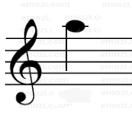

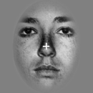
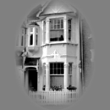
Learning of dynamic audio-visual associations
Conditioning Stimulus
Target Stimulus
1
CS
1
CS
2
0.8
or
or
0.6
p(face)
0.4
CS
TS
Response
0.2
0
200
400
600
800
2000 ± 650
Time (ms)
0
0
200
400
600
800
1000
trial
den Ouden et al. 2010, J. Neurosci.
Notes:
How I intend to study these questions in the future is perhaps best illustrated using a previously published study. Subjects performed a simple discrimination task on faces and houses. They could speed up their responses by learning the predictive strength of immediately preceding auditory cues. To enforce ongoing learning, the associative strength of the auditory cues were changing unpredictably over time.

Slide 32

Hierarchical Bayesian learning model
prior on volatility
k
volatility
v_{t-1}
v_{t}
probabilistic association
r_{t}
r_{t+1}
observed events
u_{t}
u_{t+1}
Behrens et al. 2007, Nat. Neurosci.

Slide 33
Explaining RTs by different learning models
Reaction times
1
True
450
Bayes Vol
0.8
HMM fixed
440
HMM learn
RW
430
p(F)
0.6
RT (ms)
420
410
0.4
400
0.2
390
0.1
0.3
0.5
0.7
0.9
0
p(outcome)
400
440
480
Trial
520
560
600
5 alternative learning models:
categorical probabilities
hierarchical Bayesian learner
Rescorla-Wagner
Hidden Markov models
(2 variants)
Bayesian model selection:
hierarchical Bayesian model performs best
den Ouden et al. 2010, J. Neurosci.
Notes:
The behavioral data showed a very nice learning effect: responses accelerated significantly with increasing predictive strengths of the cues. Using Bayesian model selection, we tested which of five commonly used learning models best explained the trial-by-trial reaction times. We found that a hierarchical Bayesian model performed best across the group.

Slide 34

Stimulus-independent prediction error
Putamen
Premotor cortex
p < 0.05
(cluster-level whole- brain corrected)
p < 0.05 (SVC)
0
0
-0.5
-0.5
BOLD resp. (a.u.)
-1
BOLD resp. (a.u.)
-1
-1.5
-1.5
-2
p(F)
p(H)
-2
p(F)
p(H)
den Ouden et al. 2010, J. Neurosci .

Slide 35
Prediction error (PE) activity in the putamen
PE during active
sensory learning
PE during incidental
sensory learning
p < 0.05 (SVC)
den Ouden et al. 2009, Cerebral Cortex
PE during
reinforcement learning
PE = “teaching signal” for synaptic plasticity during learning
O'Doherty et al. 2004, Science
Could the putamen be regulating trial-by-trial changes of
task-relevant connections?

Slide 36


Prediction errors control plasticity during adaptive cognition
Hierarchical Bayesian learning model
Modulation of visuo-motor connections by striatal prediction error activity
Influence of visual areas on premotor cortex:
  stronger for surprising stimuli
  weaker for expected stimuli
PUT
p = 0.010
p = 0.017
PMd
PPA
FFA
den Ouden et al. 2010, J. Neurosci .
Notes:
There is a longstanding hypothesis by several learning theories that synaptic plasticity should be determined by prediction errors. We tested this hypothesis by embedding the computational learning model into a DCM of interactions between visual and motor cortex. Specifically, we used the Bayesian model to represent how trial-by-trial prediction error activity in the putamen gated the information flow from stimulus-specific visual areas to the premotor cortex. Indeed, we found that the strength of the visuo-motor connections increased with trial-specific prediction error.

Slide 37
Hierarchical variational Bayesian learning
volatility
association
events in the world
sensory stimuli
Mean-field decomposition
Mathys et al. (2011), Front. Hum. Neurosci.
Notes:
Motivated by these limitations, I have been working, together with a student of mine, on a new type of hierarchical Bayesian learning model. This model represents hierarchical causal relations between perceived stimuli, underlying causes in the world, their probabilistic associations, and the volatility of the environment. Critically, we use a variational approximation that results in update equations with very attractive properties.

Slide 38
Overview
Bayesian model selection (BMS)
Extended DCM for fMRI: nonlinear, two-state, stochastic
Embedding computational models in DCMs
Integrating tractography and DCM
Applications of DCM to clinical questions

Slide 39
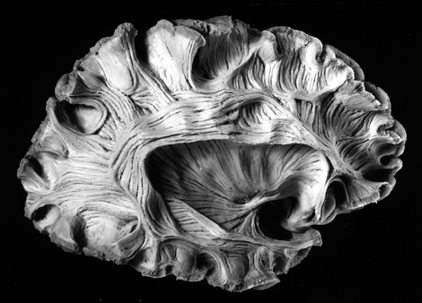
Diffusion-weighted imaging
Parker & Alexander, 2005,
Phil. Trans. B

Slide 40
Probabilistic tractography: Kaden et al. 2007, NeuroImage
computes local fibre orientation density by spherical deconvolution of the diffusion-weighted signal
estimates the spatial probability distribution of connectivity from given seed regions
anatomical connectivity = proportion of fibre pathways originating in a specific source region that intersect a target region
If the area or volume of the source region approaches a point, this measure reduces to method by Behrens et al. (2003)

Slide 41
Integration of tractography and DCM
R₁
R₂
low probability of anatomical connection
→ small prior variance of effective connectivity parameter
R₁
R₂
high probability of anatomical connection
→ large prior variance of effective connectivity parameter
Stephan, Tittgemeyer et al. 2009, NeuroImage

Slide 42
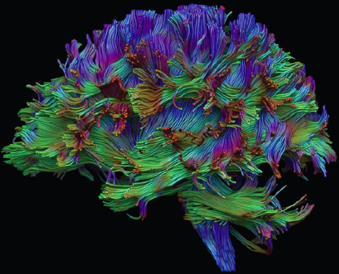
probabilistic
tractography
Proof of concept study
FG
left
FG
right
FG
FG
LG
LG
left
LG
right
LG
◆ DCM
❖ anatomical connectivity ϕ
⬥ connection-specific priors for coupling parameters
Stephan, Tittgemeyer et al. 2009, NeuroImage
Notes:
In a recent proof of concept study that I performed in collaboration with the Max Planck Institute at Leipzig, we demonstrated that this approach may be useful. We took a simple DCM of interacting visual areas and performed probabilistic tractography at the corresponding locations in a group of subjects. We then used the resulting relative probabilities of the anatomical connections to define connection-specific priors for the coupling parameters of the DCM.

Slide 43
Connection-specific prior variance Σ as a function of anatomical connection probability ϕ
64 different mappings by systematic search across hyper-parameters α and β
yields anatomically informed (intuitive and counterintuitive) and uninformed priors

Slide 44
Models with anatomically informed priors (of an intuitive form)

Slide 45
Models with anatomically informed priors (of an intuitive form) were clearly superior to anatomically uninformed ones: Bayes Factor >10⁹

Slide 46
Overview
Bayesian model selection (BMS)
Extended DCM for fMRI: nonlinear, two-state, stochastic
Embedding computational models in DCMs
Integrating tractography and DCM
Applications of DCM to clinical questions

Slide 47
Model-based predictions for single patients
model structure
BMS
set of
parameter estimates
model-based decoding
Notes:
Overall, Bayesian model selection is a generic and powerful procedure that has found widespread application in machine learning and neuroimaging. However, as every method, it has limitations and there are cases when it cannot be used at all. For these cases, we have been developing a new approach which we colloquially refer to as “model-based decoding”. This approach rests on using a model for theory-guided dimensionality reduction and selecting those data features which are used subsequently for classification. Here, different models can be compared, by cross-validation, in terms of how well their parameters preserve information about the relevant class labels.

Slide 48
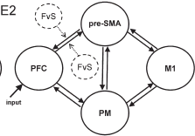
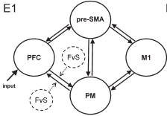
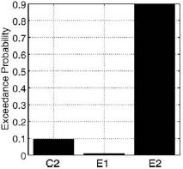
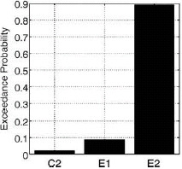
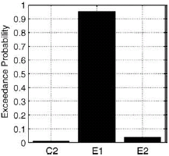
BMS: Parkison‘s disease and treatment
Age-matched controls
PD patients
on medication
PD patients
off medication
Rowe et al. 2010,
NeuroImage
Selection of action modulates
connections between PFC and SMA
DA-dependent functional disconnection
of the SMA

Slide 49
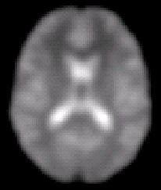





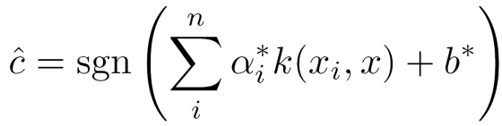
Model-based decoding by generative embedding
step 1 —
model inversion
A
step 2 —
kernel construction
A → B
A → C
B → B
B → C
B
C
measurements from an individual subject
subject-specific
inverted generative model
subject representation in the generative score space
A
step 4 —
interpretation
step 3 —
support vector classification
B
C
jointly discriminative
model parameters
separating hyperplane fitted to discriminate between groups
Brodersen et al. 2011, PLoS Comput. Biol.

Slide 50
Discovering remote or “hidden” brain lesions

Slide 51
Discovering remote or “hidden” brain lesions
detect “down-stream” network changes
→ altered synaptic coupling among healthy regions

Slide 52
Model-based decoding of disease status: mildly aphasic patients (N=11) vs. controls (N=26)
Connectional fingerprints from a 6-region DCM of auditory areas during speech perception
Brodersen et al. 2011, PLoS Comput. Biol.

Slide 53
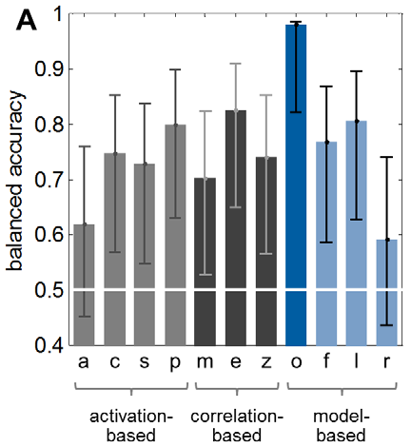
Model-based decoding of disease status: aphasic patients (N=11) vs. controls (N=26)
Classification accuracy
PT
PT
HG
(A1)
HG
(A1)
MGB
MGB
auditory stimuli
Brodersen et al. 2011, PLoS Comput. Biol.

Slide 54
Multivariate searchlight
classification analysis
Generative embedding
using DCM

Slide 55
×
×
×
Brodersen et al. 2011, PLoS Comput. Biol.

Slide 56
Key methods papers: DCM for fMRI and BMS – part 1
Brodersen KH, Schofield TM, Leff AP, Ong CS, Lomakina EI, Buhmann JM, Stephan KE (2011) Generative embedding for model-based classification of fMRI data. PLoS Computational Biology 7: e1002079.
Daunizeau J, David, O, Stephan KE (2011) Dynamic Causal Modelling: A critical review of the biophysical and statistical foundations. NeuroImage 58: 312-322.
Friston KJ, Harrison L, Penny W (2003) Dynamic causal modelling. NeuroImage 19:1273-1302.
Friston K, Stephan KE, Li B, Daunizeau J (2010) Generalised filtering. Mathematical Problems in Engineering 2010: 621670.
Friston KJ, Li B, Daunizeau J, Stephan KE (2011) Network discovery with DCM. NeuroImage 56: 1202–1221.
Friston K, Penny W (2011) Post hoc Bayesian model selection. Neuroimage 56: 2089-2099.
Kasess CH, Stephan KE, Weissenbacher A, Pezawas L, Moser E, Windischberger C (2010) Multi-Subject Analyses with Dynamic Causal Modeling. NeuroImage 49: 3065-3074.
Kiebel SJ, Kloppel S, Weiskopf N, Friston KJ (2007) Dynamic causal modeling: a generative model of slice timing in fMRI. NeuroImage 34:1487-1496.
Li B, Daunizeau J, Stephan KE, Penny WD, Friston KJ (2011). Stochastic DCM and generalised filtering. NeuroImage 58: 442-457
Marreiros AC, Kiebel SJ, Friston KJ (2008) Dynamic causal modelling for fMRI: a two-state model. NeuroImage 39:269-278.
Penny WD, Stephan KE, Mechelli A, Friston KJ (2004a) Comparing dynamic causal models. NeuroImage 22:1157-1172.
Penny WD, Stephan KE, Mechelli A, Friston KJ (2004b) Modelling functional integration: a comparison of structural equation and dynamic causal models. NeuroImage 23 Suppl 1:S264-274.

Slide 57
Key methods papers: DCM for fMRI and BMS – part 2
Penny WD, Stephan KE, Daunizeau J, Joao M, Friston K, Schofield T, Leff AP (2010) Comparing Families of Dynamic Causal Models. PLoS Computational Biology 6: e1000709.
Penny WD (2012) Comparing dynamic causal models using AIC, BIC and free energy. Neuroimage 59: 319-330.
Stephan KE, Harrison LM, Penny WD, Friston KJ (2004) Biophysical models of fMRI responses. Curr Opin Neurobiol 14:629-635.
Stephan KE, Weiskopf N, Drysdale PM, Robinson PA, Friston KJ (2007) Comparing hemodynamic models with DCM. NeuroImage 38:387-401.
Stephan KE, Harrison LM, Kiebel SJ, David O, Penny WD, Friston KJ (2007) Dynamic causal models of neural system dynamics: current state and future extensions. J Biosci 32:129-144.
Stephan KE, Weiskopf N, Drysdale PM, Robinson PA, Friston KJ (2007) Comparing hemodynamic models with DCM. NeuroImage 38:387-401.
Stephan KE, Kasper L, Harrison LM, Daunizeau J, den Ouden HE, Breakspear M, Friston KJ (2008) Nonlinear dynamic causal models for fMRI. NeuroImage 42:649-662.
Stephan KE, Penny WD, Daunizeau J, Moran RJ, Friston KJ (2009a) Bayesian model selection for group studies. NeuroImage 46:1004-1017.
Stephan KE, Tittgemeyer M, Knösche TR, Moran RJ, Friston KJ (2009b) Tractography-based priors for dynamic causal models. NeuroImage 47: 1628-1638.
Stephan KE, Penny WD, Moran RJ, den Ouden HEM, Daunizeau J, Friston KJ (2010) Ten simple rules for Dynamic Causal Modelling. NeuroImage 49: 3099-3109.

Slide 58
Thank you

