Slide 1
Multiple testing
Justin Chumbley
Laboratory for Social and Neural Systems Research
Institute for Empirical Research in Economics
University of Zurich
With many thanks for slides & images to:
TNU/FIL Methods group

Slide 2
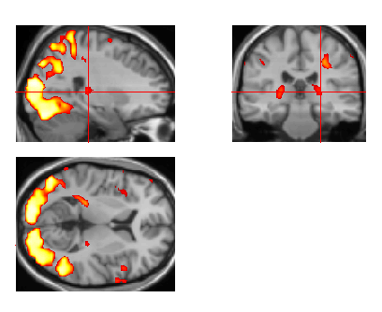
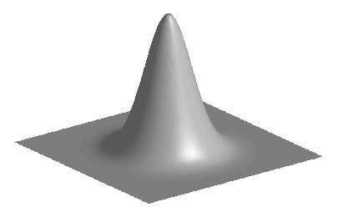
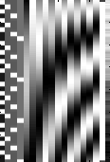
Overview of SPM
Image time-series
Kernel
Design matrix
Statistical parametric map (SPM)
Realignment
Smoothing
General linear model
Statistical
inference
Gaussian
field theory
Normalisation
p <0.05
Template
Parameter estimates
Notes:
Describe thresholded images
One number for each spatial location (that gives the estimated effect size).
Two schools: 1) decide on voxels 2) decide on regions/blobs
(voxels are arbitrary in number and location, and smoothing means that effects are blurred and don’t really have voxel resolution).

Slide 3
Inference at a single voxel
t
contrast of
estimated
parameters
t =
variance
estimate

Slide 4
Inference at a single voxel
H₀ , H₁: zero/non-zero activation
α
t
contrast of
estimated
parameters
t =
variance
estimate

Slide 5
Inference at a single voxel
Decision:
H₀ , H₁: zero/non-zero activation
h
α
t
contrast of
estimated
parameters
t =
variance
estimate
Notes:
Aim: Deciding which dn the data came from
How? Decision rule

Slide 6
Inference at a single voxel
Decision:
H₀ , H₁: zero/non-zero activation
h
α
t
contrast of
estimated
parameters
t =
variance
estimate
Notes:
LIKE THROWING A DICE. YOU CAN CONTROL THE FALSE POSITIVE RATE.

Slide 7
Inference at a single voxel
Decision:
H₀ , H₁: zero/non-zero activation
h
α
t
contrast of
estimated
parameters
t =
variance
estimate
Notes:
LIKE THROWING A DICE. YOU CAN CONTROL THE FALSE POSITIVE RATE.

Slide 8
Inference at a single voxel
Decision:
H₀ , H₁: zero/non-zero activation
h
α
t
Decision rule (threshold) h,
determines related error rates ,
Convention: Choose h to give acceptable
under H₀
contrast of
estimated
parameters
t =
variance
estimate
Notes:
LIKE THROWING A DICE. YOU CAN CONTROL THE FALSE POSITIVE RATE.

Slide 9
Types of error
Reality
H₀
H₁
False positive (FP)
True positive (TP)
H₁
Decision
True negative (TN)
False negative (FN)
H₀
specificity: 1-
= TN / (TN + FP)
= proportion of actual negatives which are correctly identified
sensitivity (power): 1-
= TP / (TP + FN)
= proportion of actual positives which are correctly identified
Notes:
Deciding which distribution the data comes from (between two probability models) .

Slide 10
Multiple tests
h
h
h
h
What is the problem?
α
α
α
α
t
t
t
contrast of
estimated
parameters
t =
variance
estimate
Notes:
LIKE THROWING A DICE. YOU CAN CONTROL THE FALSE POSITIVE RATE.

Slide 11
Multiple tests
h
h
h
h
α
α
α
α
t
t
t
contrast of
estimated
parameters
t =
variance
estimate
Notes:
LIKE THROWING A DICE. YOU CAN CONTROL THE FALSE POSITIVE RATE.

Slide 12
Multiple tests
h
h
h
h
α
α
α
α
t
t
t
Convention: Choose h to limit
assuming family-wise H₀
contrast of
estimated
parameters
t =
variance
estimate
Notes:
LIKE THROWING A DICE. YOU CAN CONTROL THE FALSE POSITIVE RATE.

Slide 13
Spatial correlations
Bonferroni assumes general dependence
→ overkill, too conservative
Assume more appropriate dependence
Infer regions (blobs) not voxels
Notes:
Suprathreshold BLOBS not voxels, under the null
Not really interested in infering voxels anyway

Slide 14
Smoothness, the facts
intrinsic smoothness
  MRI signals are aquired in k-space (Fourier space); after projection on anatomical space, signals have continuous support
  diffusion of vasodilatory molecules has extended spatial support
extrinsic smoothness
  resampling during preprocessing
  matched filter theorem
  → deliberate additional smoothing to increase SNR
roughness = 1/smoothness
described in resolution elements: "resels"
# resels is similar, but not identical to # independent observations
  resel = size of image part that corresponds to the FWHM (full width half maximum) of the Gaussian convolution kernel that would have produced the observed image when applied to independent voxel values
  can be computed from spatial derivatives of the residuals

Slide 15
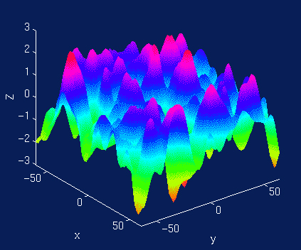
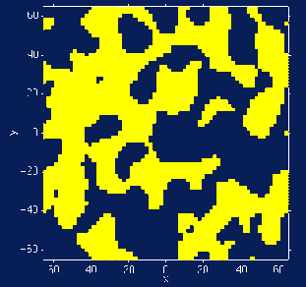
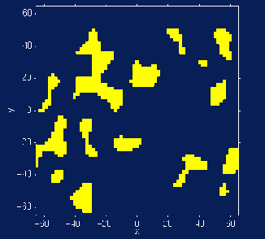
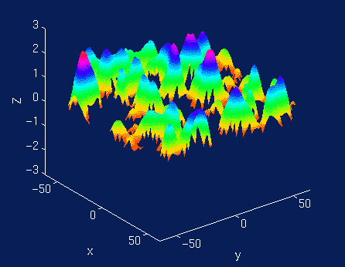
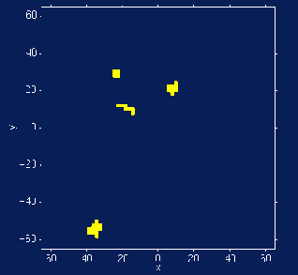
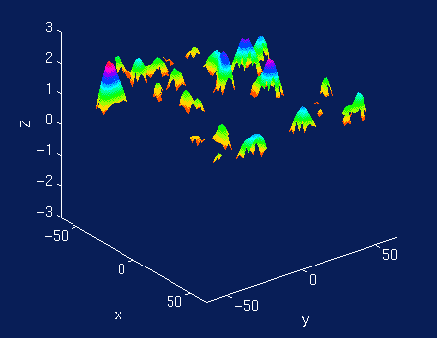
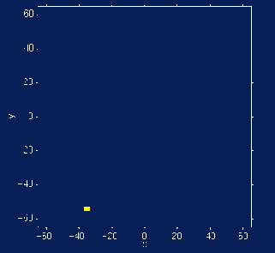
Aims:
Apply high threshold: identify improbably high peaks
Apply lower threshold: identify improbably broad peaks
Notes:
Return to inference on smooth images
Aims: identify surprising/improbable landscape features in this smooth null image.
Apply high threshold: identify improbably high peaks
Apply low threshold: identify improbably fat peaks
Two surprising features: Two thresholds.

Slide 16
Height
Spatial extent
Total number
Need a null distribution:
1. Simulate null experiments
2. Model null experiments
Notes:
Improbability statements require a null distribution:
1. Simulations of null experiments
2. A model for null experiments.

Slide 17
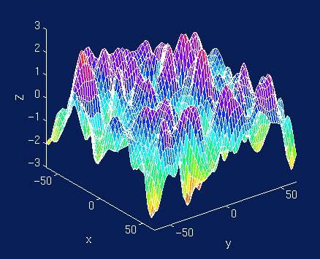
Gaussian Random Fields
Statistical image = discretised continuous random field (approximately)
Use results from continuous random field theory
Discretisation
(“lattice approximation”)
Notes:
What is a grf?

Slide 18
Euler characteristic (EC)
  threshold an image at h
  EC ∝ # blobs
  at high h:
  Aprox:
  E [EC] = p(blob)
  = FWER
Notes:
Why use grf: because of these results.
EC is an integer defined on excursion set for any threshold.

Slide 19
Euler characteristic (EC) for 2D images
R = number of resels
h = threshold
Set h such that E[EC] = 0.05
Example: For 100 resels, E [EC] = 0.05 for a threshold of 3.8. That is, the probability of getting one or more blobs above 3.8, is 0.05.
Expected EC values for an image of 100 resels
Notes:
R depends on search volume and smoothness
Assumptions
Multivariate Normal
Stationary*
ACF twice differentiable at 0
Stationarity
Results valid w/out stationarity
More accurate when stat. holds

Slide 20
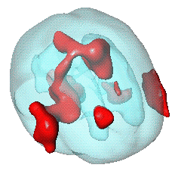
Euler characteristic (EC) for any image
E[EC] for volumes of any dimension, shape and size (Worsley et al. 1996).
A priori hypothesis about where an activation should be, reduce search volume:
  mask defined by (probabilistic) anatomical atlases
  mask defined by separate "functional localisers"
  mask defined by orthogonal contrasts
  (spherical) search volume around previously reported coordinates
Worsley et al. 1996. A unified statistical approach for determining significant signals in images of cerebral activation. Human Brain Mapping, 4, 58–83.
small volume correction (SVC)

Slide 21
Spatial extent: similar

Slide 22
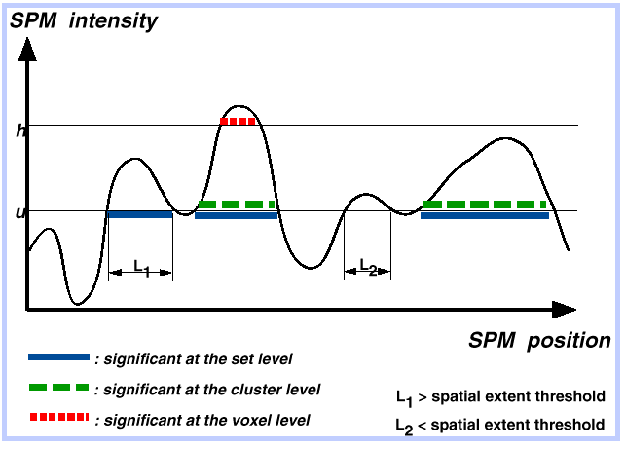
Voxel, cluster and set level tests
e
u
h

Slide 23
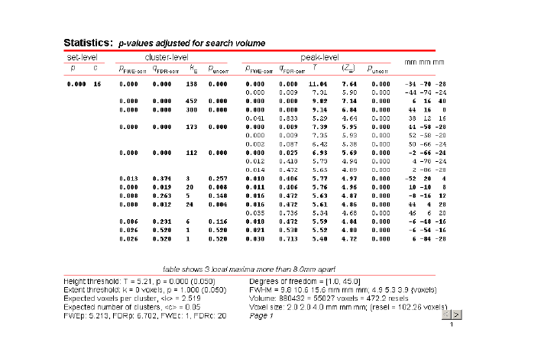
Notes:
And finally, in 3 dimensions…. Can’t visualize so easily…

Slide 24
Conclusions
There is a multiple testing problem
  (‘voxel’ or ‘region’ perspective)
‘Corrections’ necessary
  FWE
    Random Field Theory
      Inference about blobs (peaks, clusters)
      Excellent for large samples (e.g. single-subject analyses or large group analyses)
      Little power for small group studies → consider non-parametric methods (not discussed in this talk)
  FDR
    More sensitive, More false positives
Height, spatial extent, total number

Slide 25
Further reading
Friston KJ, Frith CD, Liddle PF, Frackowiak RS. Comparing functional (PET) images: the assessment of significant change. J Cereb Blood Flow Metab. 1991 Jul;11(4):690-9.
Genovese CR, Lazar NA, Nichols T. Thresholding of statistical maps in functional neuroimaging using the false discovery rate. Neuroimage. 2002 Apr;15(4):870-8.
Worsley KJ Marrett S Neelin P Vandal AC Friston KJ Evans AC. A unified statistical approach for determining significant signals in images of cerebral activation. Human Brain Mapping 1996;4:58-73.

Slide 26
Thank you

