Slide 1
Experimental design of fMRI studies
Sandra Iglesias Translational Neuromodeling Unit
University of Zurich & ETH Zurich
With many thanks for slides & images to:
Klaas Enno Stephan,
FIL Methods group,
Christian Ruff
SPM Course 2012

Slide 2
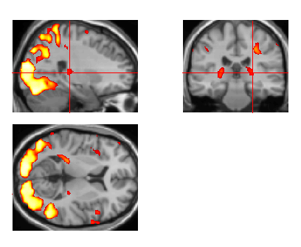
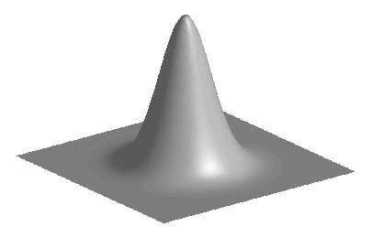
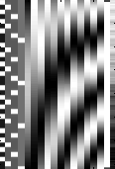
Overview of SPM
Statistical parametric map (SPM)
Image time-series
Kernel
Design matrix
Realignment
Smoothing
General linear model
Statistical
inference
Gaussian
field theory
Normalisation
Template
p <0.05
Parameter estimates

Slide 3
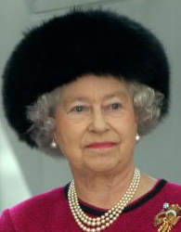
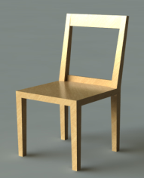
Overview of SPM
Research question:
Which neuronal structures support face recognition?
Hypothesis:
The fusiform gyrus is implicated in face recognition
Experimental design
Statistical parametric map (SPM)
Design matrix
General linear model
Statistical
inference
Gaussian
field theory
p <0.05
Parameter estimates

Slide 4
Overview
Categorical designs
Subtraction - Pure insertion, evoked / differential responses
Conjunction - Testing multiple hypotheses
Parametric designs
Linear - Adaptation, cognitive dimensions
Nonlinear - Polynomial expansions, neurometric functions
Factorial designs
Categorical - Interactions and pure insertion
Parametric - Linear and nonlinear interactions
- Psychophysiological Interactions

Slide 5
Cognitive subtraction
Aim:
Neuronal structures underlying a single process P?
Procedure:
Contrast: [Task with P] – [control task without P ] = P
the critical assumption of „pure insertion“
[Task with P] – [task without P ] = P
Example:
– =

Slide 6
Cognitive subtraction
Aim:
Neuronal structures underlying a single process P?
Procedure:
Contrast: [Task with P] – [control task without P ] = P
the critical assumption of „pure insertion“
[Task with P] – [task without P ] = P
Example:
– =
– =

Slide 7


Cognitive subtraction: Baseline problems
Which neuronal structures support face recognition ?
„Distant“ stimuli
- ➔ Several components differ!
„Related“ stimuli
- ➔ P implicit in control condition?
„Queen!“ „Aunt Jenny?“
Same stimuli, different task
- ➔ Interaction of task and stimuli (i.e. do task differences depend on stimuli chosen)?
Name Person! Name Gender!

Slide 8
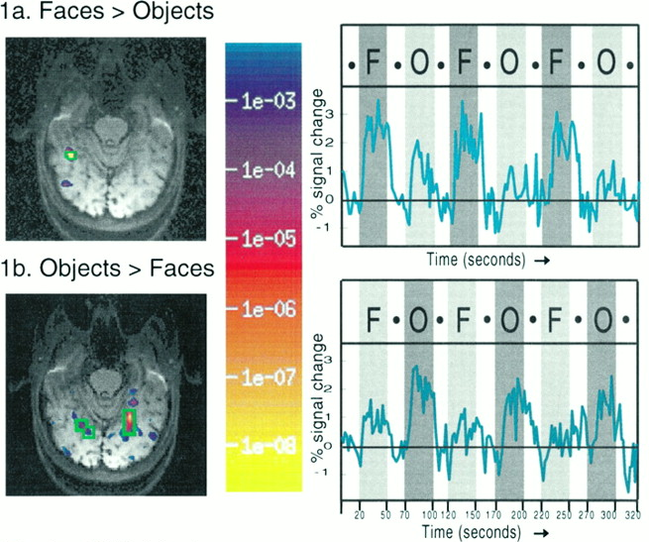
A categorical analysis
Experimental design
Face viewing F
Object viewing O
F - O = Face recognition
O - F = Object recognition
…under assumption of pure insertion
Kanwisher N et al. J. Neurosci. 1997;

Slide 9
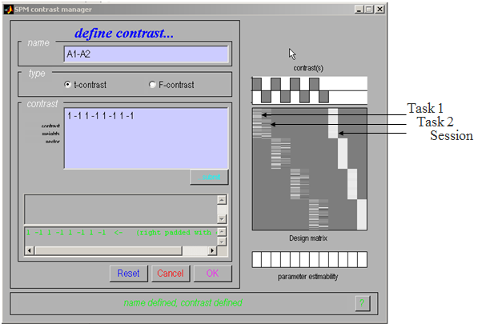
Categorical design

Slide 10
Overview
Categorical designs
Subtraction - Pure insertion, evoked / differential responses
Conjunction - Testing multiple hypotheses
Parametric designs
Linear - Adaptation, cognitive dimensions
Nonlinear - Polynomial expansions, neurometric functions
Factorial designs
Categorical - Interactions and pure insertion
Parametric - Linear and nonlinear interactions
- Psychophysiological Interactions

Slide 11
Conjunctions
One way to minimize the baseline/pure insertion problem is to isolate the same process by two or more separate comparisons, and inspect the resulting simple effects for commonalities
A test for such activation common to several independent contrasts is called “conjunction”
Conjunctions can be conducted across a whole variety of different contexts:
tasks
stimuli
senses (vision, audition)
etc.
Note: the contrasts entering a conjunction must be orthogonal (this is ensured automatically by SPM)

Slide 12
Conjunctions
Example: Which neural structures support object recognition, independent of task (naming vs. viewing)?
Task (1/2)
Viewing Naming
A1
A2
Objects Colours
Visual Processing V
Object Recognition R
Phonological Retrieval P
Stimuli (A/B)
B1
B2

Slide 13
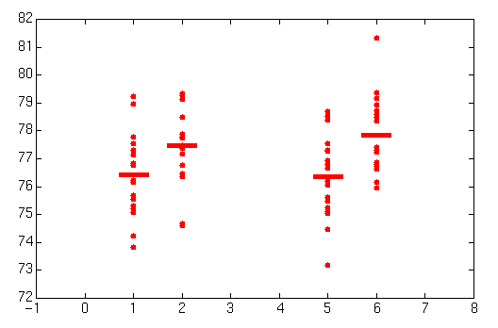
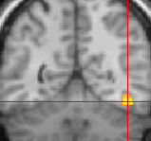
Conjunctions
Task (1/2)
Viewing Naming
A1
Visual Processing V
A2
Visual Processing V
Phonological Retrieval P
Objects Colours
Stimuli (A/B)
B1
Visual Processing V
Object Recognition R
B2
Visual Processing V
Phonological Retrieval P
Object Recognition R
Which neural structures support
object recognition?
Price et al. 1997
Common object
recognition response (R)
(Object - Colour viewing) [B1 - A1]
&
(Object - Colour naming) [B2 – A2]
[ V,R - V ] & [ P,V,R - P,V ] = R & R = R
A1 B1 A2 B2

Slide 14
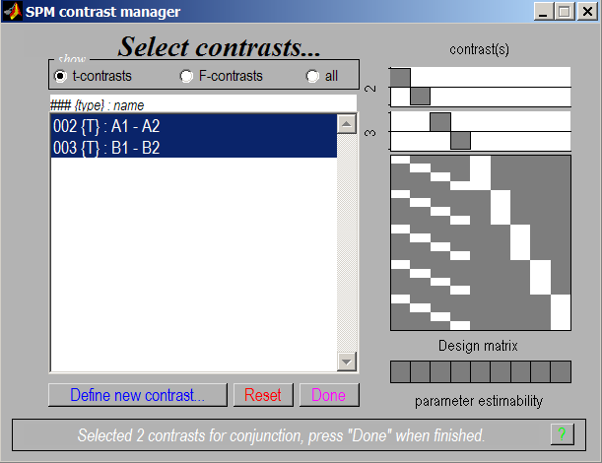
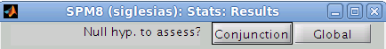
Conjunctions

Slide 15
Two types of conjunctions
Test of global null hypothesis: Significant set of consistent effects
“Which voxels show effects of similar direction (but not necessarily individual significance) across contrasts?”
Null hypothesis: No contrast is significant: k = 0
does not correspond to a logical AND !
Test of conjunction null hypothesis: Set of consistently significant effects
“Which voxels show, for each specified contrast, significant effects?”
Null hypothesis: Not all contrasts are significant: k < n
corresponds to a logical AND
p(A1-A2) < α
B1-B2
+
+
p(B1-B2) < α
A1-A2
Friston et al. (2005). Neuroimage, 25:661-667.
Nichols et al. (2005). Neuroimage, 25:653-660.

Slide 16
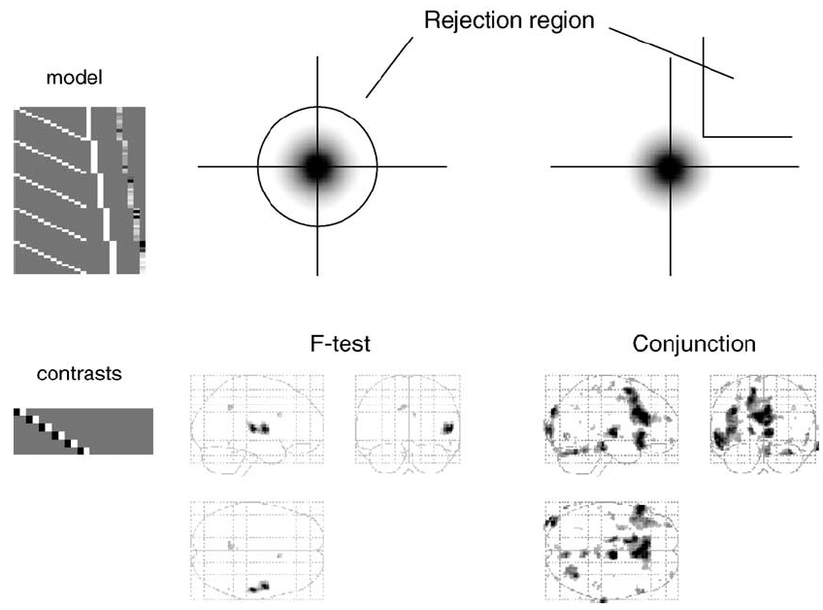
F-test vs. conjunction based on global null
grey area:
bivariate t-distriution
under global null hypothesis
Friston et al. 2005, Neuroimage, 25:661-667.

Slide 17
Overview
Categorical designs
Subtraction - Pure insertion, evoked / differential responses
Conjunction - Testing multiple hypotheses
Parametric designs
Linear - Adaptation, cognitive dimensions
Nonlinear - Polynomial expansions, neurometric functions
Factorial designs
Categorical - Interactions and pure insertion
Parametric - Linear and nonlinear interactions
- Psychophysiological Interactions

Slide 18
Parametric designs
Parametric designs approach the baseline problem by:
Varying the stimulus-parameter of interest on a continuum, in multiple (n>2) steps...
... and relating measured BOLD signal to this parameter
Possible tests for such relations are manifold:
Linear
Nonlinear: Quadratic/cubic/etc. (polynomial expansion)
Model-based (e.g. predictions from learning models)

Slide 19
“User-specified” parametric modulation of regressors
Polynomial expansion
&
orthogonalisation
Büchel et al. 1998, NeuroImage 8:140-148

Slide 20
Investigating neurometric functions (= relation between a stimulus property and the neuronal response)
Stimulus
awareness
Stimulus
intensity
Pain
intensity
Pain threshold: 410 mJ
P0-P4: Variation of intensity of a laser stimulus applied to the right hand (0, 300, 400, 500, and 600 mJ)
P0
P1
P2
P3
P4
Büchel et al. 2002, J. Neurosci. 22:970-976

Slide 21
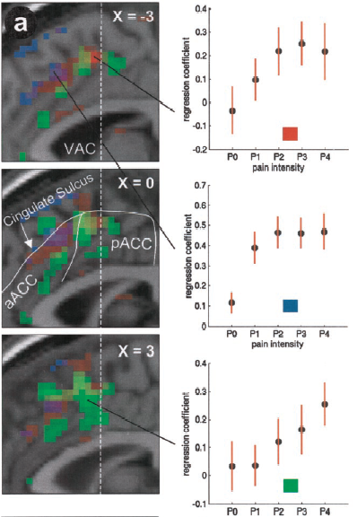
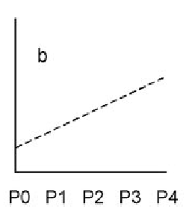
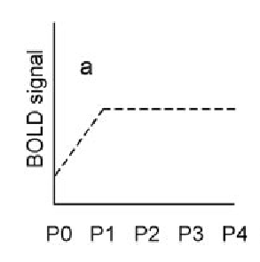
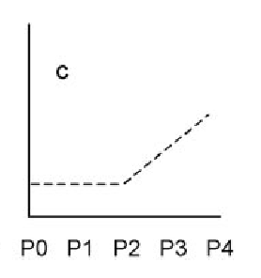
Neurometric functions
 Stimulus intensity
 Stimulus presence
 Pain intensity
Büchel et al. 2002, J. Neurosci. 22:970-976

Slide 22
Model-based regressors
general idea: generate predictions from a computational model, e.g. of learning or decision-making
Commonly used models:
Rescorla-Wagner learning model
temporal difference (TD) learning model
Bayesian learners
use these predictions to define regressors
include these regressors in a GLM and test for significant correlations with voxel-wise BOLD responses

Slide 23
Model-based fMRI analysis
Gläscher & O‘Doherty 2010, WIREs Cogn. Sci.

Slide 24
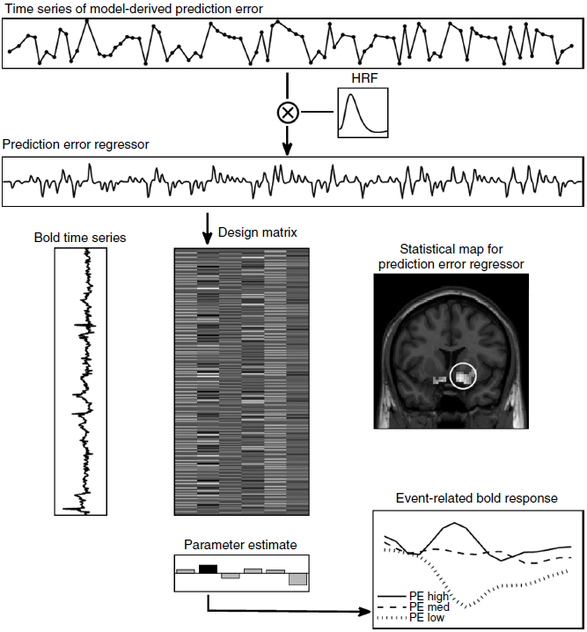
Model-based fMRI analysis
Gläscher & O‘Doherty 2010, WIREs Cogn. Sci.

Slide 25
Overview
Categorical designs
Subtraction - Pure insertion, evoked / differential responses
Conjunction - Testing multiple hypotheses
Parametric designs
Linear - Adaptation, cognitive dimensions
Nonlinear - Polynomial expansions, neurometric functions
Factorial designs
Categorical - Interactions and pure insertion
Parametric - Linear and nonlinear interactions
- Psychophysiological Interactions

Slide 26
Main effects and interactions
Task (1/2)
Main effect of task: (A1 + B1) – (A2 + B2)
Main effect of stimuli: (A1 + A2) – (B1 + B2)
Interaction of task and stimuli: Can show a failure of pure insertion
(A1 – B1) – (A2 – B2)
Viewing Naming
A1
A2
Objects Colours
Stimuli (A/B)
B1
B2

Slide 27
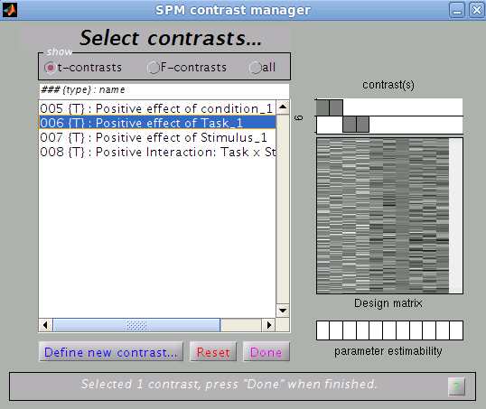
Factorial design
A1 B1 A2 B2
Task (1/2)
Viewing Naming
A1
A2
Objects Colours
Stimuli (A/B)
B1
B2
Main effect of task:
(A1 + B1) – (A2 + B2)

Slide 28
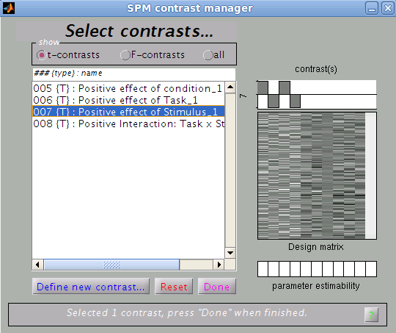
Factorial design
A1 B1 A2 B2
Task (1/2)
Viewing Naming
A1
A2
Objects Colours
Stimuli (A/B)
B1
B2
Main effect of stimuli:
(A1 + A2) – (B1 + B2)

Slide 29
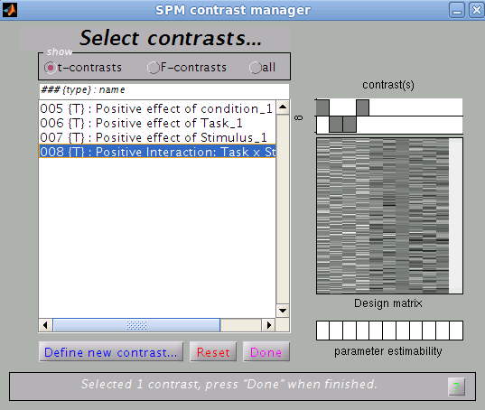
Factorial design
A1 B1 A2 B2
Task (1/2)
Viewing Naming
A1
A2
Objects Colours
Stimuli (A/B)
B1
B2
Interaction of task and stimuli: (A1 – B1) – (A2 – B2)

Slide 30
Main effects and interactions
Task (1/2)
Main effect of task: (A1 + B1) – (A2 + B2)
Main effect of stimuli: (A1 + A2) – (B1 + B2)
Interaction of task and stimuli: Can show a failure of pure insertion
(A1 – B1) – (A2 – B2)
Viewing Naming
A1
A2
Objects Colours
Stimuli (A/B)
B1
B2
Is the inferotemporal region implicated in
phonological retrieval during object naming?
interaction effect
(Stimuli x Task)
Colours Objects
Colours
Objects
Viewing
Naming

Slide 31
Example: evidence for inequality-aversion
Tricomi et al. 2010, Nature

Slide 32
Psycho-physiological interactions (PPI)
Task factor
GLM of a 2x2 factorial design:
Task A
Task B
main effect
of task
Stim 1
T_{A}/S₁
T_{B}/S₁
main effect
of stim. type
Stimulus factor
interaction
Stim 2
T_{A}/S₂
T_{B}/S₂
We can replace one main effect in the GLM by the time series of an area that shows this main effect.
E.g. let's replace the main effect of stimulus type by the time series of area V1:
main effect
of task
V1 time series ≈ main effect
of stim. type
psycho-
physiological
interaction

Slide 33
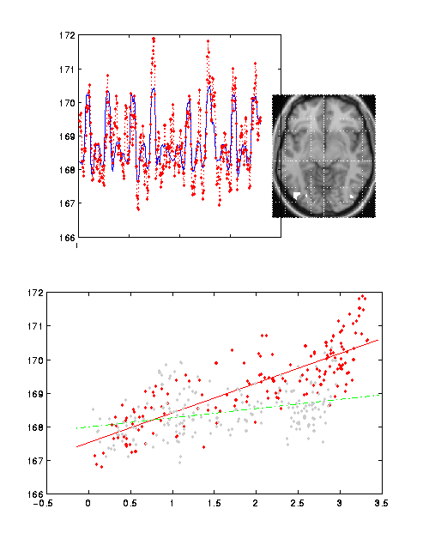
PPI example: attentional modulation of V1→V5
SPM{Z}
Attention
V5 activity
V1
V5
time
=
attention
V1 x Att.
V5
V5 activity
no attention
Friston et al. 1997, NeuroImage 6:218-229
Büchel & Friston 1997, Cereb. Cortex 7:768-778
V1 activity

Slide 34
PPI: interpretation
Two possible interpretations of the PPI term:
attention
attention
V1
V5
V1
V5
V1
V1
Modulation of V1→V5 by attention
Modulation of the impact of attention on V5 by V1.

Slide 35
Thank you

