Slide 1
Zurich SPM Course 2012
Voxel-Based Morphometry
& DARTEL
Ged Ridgway, London
With thanks to John Ashburner
and the FIL Methods Group

Slide 2
Aims of computational neuroanatomy
Many interesting and clinically important questions might relate to the shape or local size of regions of the brain
For example, whether (and where) local patterns of brain morphometry help to:
  Distinguish schizophrenics from healthy controls
  Explain the changes seen in development and aging
  Understand plasticity, e.g. when learning new skills
  Find structural correlates (scores, traits, genetics, etc.)
  Differentiate degenerative disease from healthy aging
    Evaluate subjects on drug treatments versus placebo

Slide 3
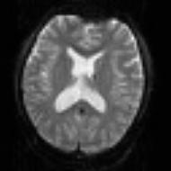
SPM for group fMRI
Group-wise
statistics
fMRI time-series
Preprocessing
Stat. modelling
Results query
spm T
Image
“Contrast”
Image
fMRI time-series
Preprocessing
Stat. modelling
Results query
“Contrast”
Image
fMRI time-series
Preprocessing
Stat. modelling
Results query
“Contrast”
Image

Slide 4
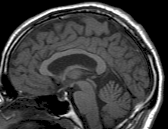
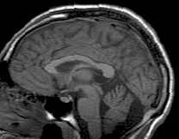
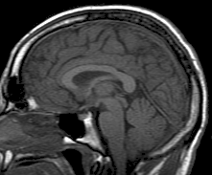
SPM for structural MRI
?
Group-wise
statistics
High-res T1 MRI
?
High-res T1 MRI
?
High-res T1 MRI
?

Slide 5
Importance of tissue segmentation
High-resolution MRI reveals fine structural detail in the brain, but not all of it reliable or interesting
  Noise, intensity-inhomogeneity, vasculature, …
MR Intensity is usually not quantitatively meaningful (in the same way that e.g. CT is)
  fMRI time-series allow signal changes to be analysed statistically, compared to baseline or global values
Regional volumes of the three main tissue types: gray matter, white matter and CSF, are well-defined and potentially very interesting
  Other aspects (and other sequences) can also be of interest

Slide 6
Voxel-Based Morphometry
In essence VBM is Statistical Parametric Mapping of regional segmented tissue density or volume
The exact interpretation of gray matter density or volume is complicated, and depends on the preprocessing steps used
  It is not interpretable as neuronal packing density or other cytoarchitectonic tissue properties
  The hope is that changes in these microscopic properties may lead to macro- or mesoscopic VBM-detectable differences

Slide 7
VBM overview
Unified segmentation and spatial normalisation
  More flexible groupwise normalisation using DARTEL
Modulation to preserve tissue volume
  Otherwise, tissue “density”
Optional computation of tissue totals/globals
Gaussian smoothing
Voxel-wise statistical analysis

Slide 8
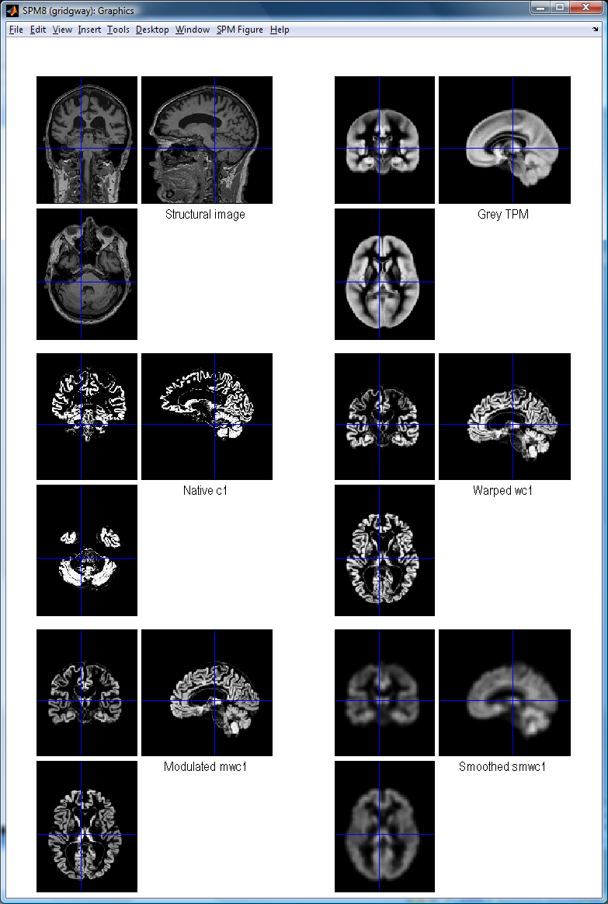
VBM in pictures
Segment
Normalise

Slide 9
VBM in pictures
Segment
Normalise
Modulate
Smooth

Slide 10
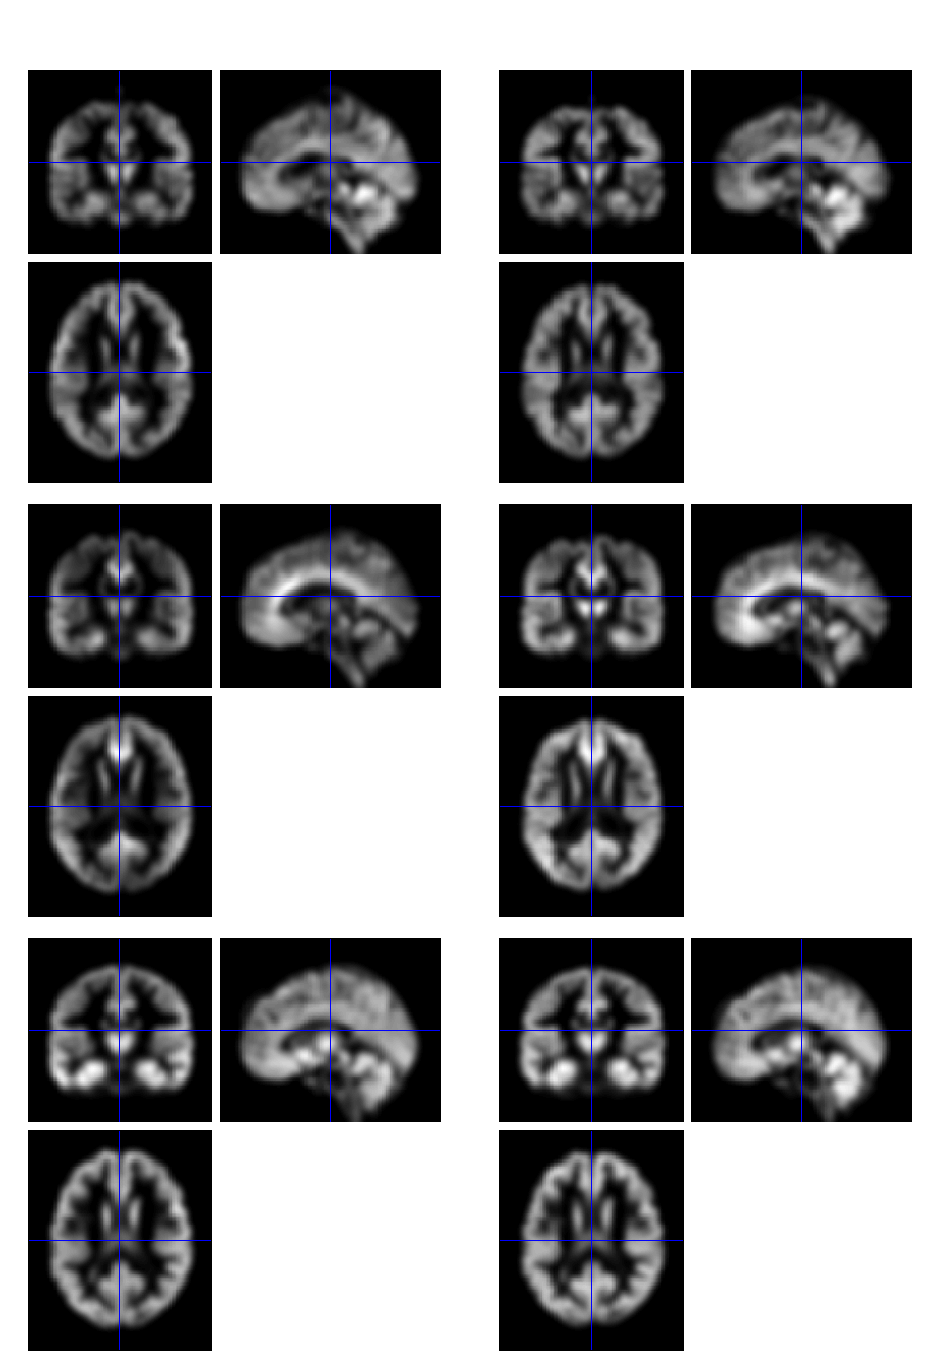
VBM in pictures
Segment
Normalise
Modulate
Smooth
Voxel-wise statistics

Slide 11
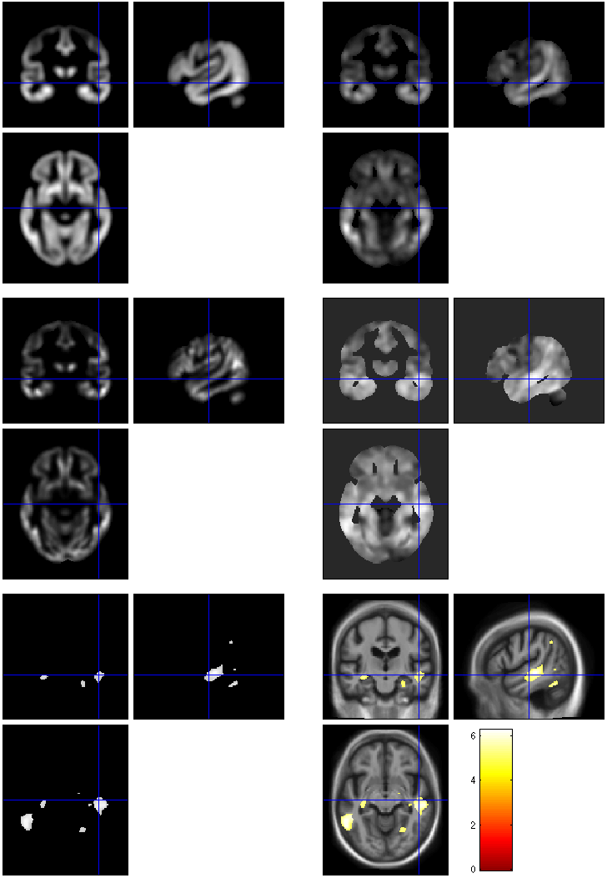
VBM in pictures
beta_0001
con_0001
Segment
Normalise
Modulate
Smooth
Voxel-wise statistics
ResMS
spmT_0001
FWE < 0.05

Slide 12
VBM Subtleties
Whether to modulate
How much to smooth
Interpreting results
Adjusting for total GM or Intracranial Volume
Statistical validity

Slide 13
Modulation
1 1
Native
intensity = tissue density
Multiplication of the warped (normalised) tissue intensities so that their regional or global volume is preserved
  Can detect differences in completely registered areas
Otherwise, we preserve concentrations, and are detecting mesoscopic effects that remain after approximate registration has removed the macroscopic effects
  Flexible (not necessarily “perfect”) registration may not leave any such differences
Unmodulated
1 1 1 1
Modulated
2/3 1/3 1/3 2/3
Notes:
Clarify, modulation not a step (as spm2) but an option in the segment and the normalise GUIs

Slide 14
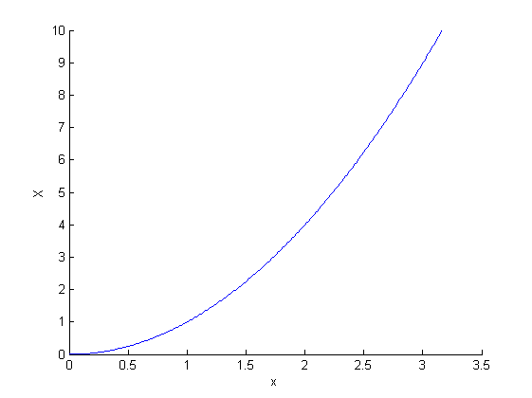
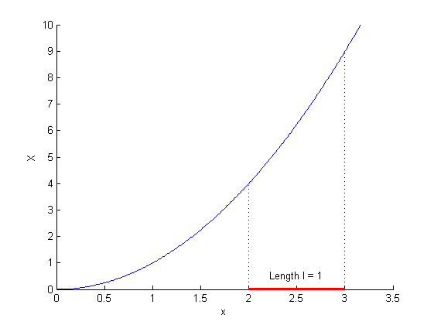
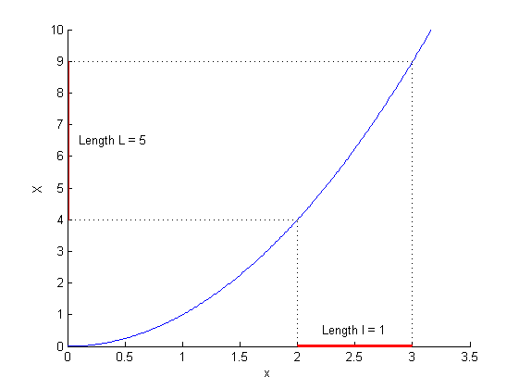
Modulation tutorial
X = x²
X’ = dX/dx = 2x
X’(2.5) = 5
More on http://tinyurl.com/ModulationTutorial

Slide 15
Smoothing
The analysis will be most sensitive to effects that match the shape and size of the kernel
The data will be more Gaussian and closer to a continuous random field for larger kernels
Results will be rough and noise-like if too little smoothing is used
Too much will lead to distributed, indistinct blobs

Slide 16
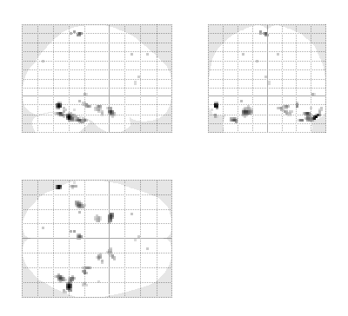
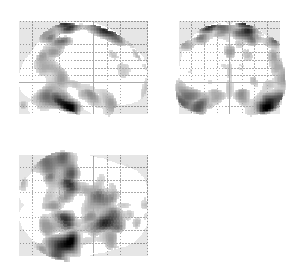
Smoothing
Between 7 and 14mm is probably reasonable
  (DARTEL’s greater precision allows less smoothing)
  The results below show two fairly extreme choices, 5mm on the left, and 16mm, right

Slide 17
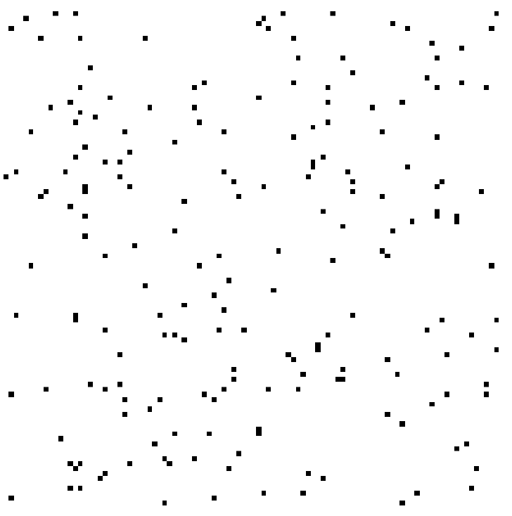
Interpreting findings
Mis-classify
Mis-register
Folding
Thinning
Thickening
Mis-register
Mis-classify

Slide 18
“Globals” for VBM
Shape is really a multivariate concept
  Dependencies among volumes in different regions
SPM is mass univariate
  Combining voxel-wise information with “global” integrated tissue volume provides a compromise
  Using either ANCOVA or proportional scaling
(ii) is globally thicker, but locally thinner than (i) – either of these effects may be of interest to us.
Fig. from: Voxel-based morphometry of the human brain… Mechelli, Price, Friston and Ashburner. Current Medical Imaging Reviews 1(2), 2005.
Notes:
Note globals don’t help distinguish the thickened or folded cortex...

Slide 19
Total Intracranial Volume (TIV/ICV)
“Global” integrated tissue volume may be correlated with interesting regional effects
  Correcting for globals in this case may overly reduce sensitivity to local differences
  Total intracranial volume integrates GM, WM and CSF, or attempts to measure the skull-volume directly
    Not sensitive to global reduction of GM+WM (cancelled out by CSF expansion – skull is fixed!)
  Correcting for TIV in VBM statistics may give more powerful and/or more interpretable results
    See e.g. Barnes et al. (2010) doi:10.1016/j.neuroimage.2010.06.025

Slide 20
VBM’s statistical validity
Residuals from VBM models are not normally distributed
Little impact on uncorrected statistics for experiments comparing reasonably sized groups
Probably invalid for experiments that compare single subjects or very small patient groups with a larger control group
Can be partially mitigated with larger amounts of smoothing

Slide 21
VBM’s statistical validity
Correction for multiple comparisons
  RFT correction based on peak heights (FWE or FDR) is fine
Correction using cluster extents can be problematic
  SPM usually assumes that the roughness/smoothness of the random field is the same throughout the brain
    VBM residuals typically have spatially varying smoothness
    Bigger blobs expected in smoother regions
  Cluster-based correction accounting for “nonstationary” smoothness is under development
    See also Satoru Hayasaka’s nonstationarity toolbox
    http://www.fmri.wfubmc.edu/cms/NS-General
    Or use SnPM

Slide 22
Longitudinal VBM
The simplest method for longitudinal VBM is to use cross-sectional preprocessing, but longitudinal statistics
  Standard preprocessing not optimal, but unbiased
  Non-longitudinal statistical analysis would be severely biased
    (Estimates of standard errors would be too small)
Simplest longitudinal statistical analysis: two-stage summary statistic approach (like in fMRI)
  Contrast on the slope parameter for a linear regression against time within each subject
  For two time-points with interval approximately constant over subjects, equivalent to simple time2 – time1 difference image

Slide 23
Longitudinal VBM variations
Intra-subject registration over time is much more accurate than inter-subject normalisation
  Different approaches suggested to capitalise
A simple approach is to apply one set of normalisation parameters (e.g. Estimated from baseline images) to both baseline and repeat(s)
  Draganski et al (2004) Nature 427: 311-312
“Voxel Compression mapping” – separates expansion and contraction before smoothing
  Scahill et al (2002) PNAS 99:4703-4707

Slide 24
Longitudinal VBM and “TBM”
Can also combine longitudinal volume change (tensor) with baseline or average grey matter prob.
  Chételat et al (2005) NeuroImage 27:934-946
  Kipps et al (2005) JNNP 76:650
  Hobbs et al (2009) doi:10.1136/jnnp.2009.190702
Note that use of baseline (or repeat) instead of average might lead to bias
  Thomas et al (2009) doi:10.1016/j.neuroimage.2009.05.097
  Fox et al. (2011) doi:10.1016/j.neuroimage.2011.01.077

Slide 25
Spatial normalisation with DARTEL
VBM is crucially dependent on registration performance
  The limited flexibility of DCT normalisation has been criticised
  Inverse transformations are useful, but not always well-defined
  More flexible registration requires careful modelling and regularisation (prior belief about reasonable warping)
  MNI/ICBM templates/priors are not universally representative
The DARTEL toolbox combines several methodological advances to address these limitations

Slide 26
Mathematical advances in registration
Large deformation concept
  Regularise velocity not displacement
    (syrup instead of elastic)
Leads to concept of geodesic
  Provides a metric for distance between shapes
  Geodesic or Riemannian average = mean shape
If velocity assumed constant computation is fast
  Ashburner (2007) NeuroImage 38:95-113
  DARTEL toolbox in SPM8
    Currently initialised from unified seg_sn.mat files

Slide 27
Motivation for using DARTEL
Recent papers comparing different approaches have favoured more flexible methods
DARTEL usually outperforms DCT normalisation
  Also comparable to the best algorithms from other software packages (though note that DARTEL and others have many tunable parameters...)
Klein et al. (2009) is a particularly thorough comparison, using expert segmentations
  Results summarised in the next slide

Slide 28
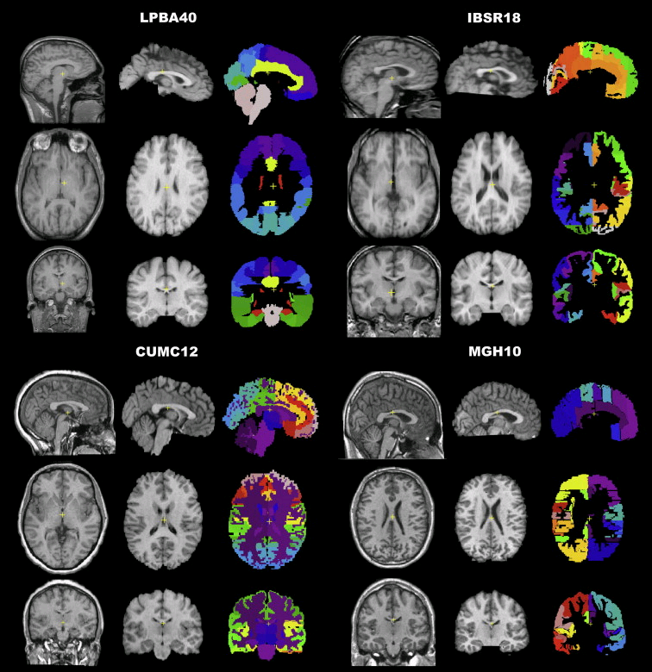
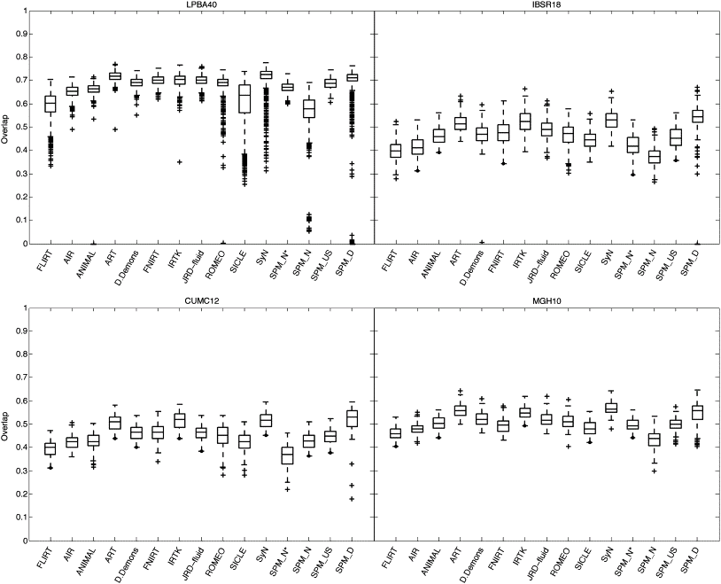
Part of Fig.1 in Klein et al.
Part of Fig.5 in Klein et al.

Slide 29
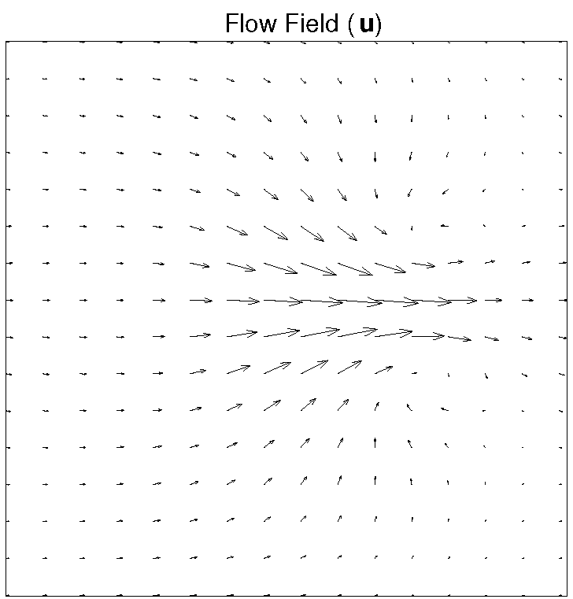
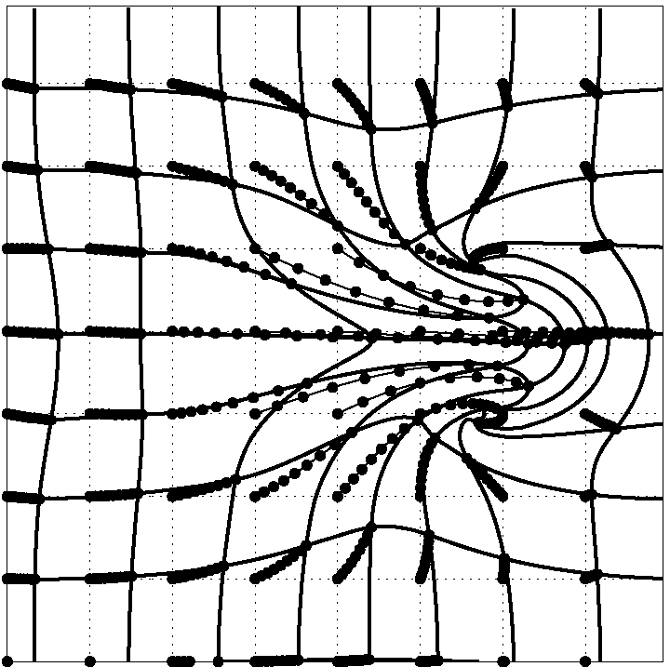
DARTEL Transformations
Displacements come from integrating velocity fields
  3 (x,y,z) DF per 1.5mm cubic voxel
  10^6 DF vs. 10^3 DCT bases
Scaling and squaring is used in DARTEL, more complicated again in latest work (Geodesic Shooting)
Consistent inverse transformation is easily obtained, e.g. integrate -u

Slide 30
DARTEL objective function
Likelihood component (matching)
  Specific for matching tissue classes
  Multinomial assumption (cf. Gaussian)
Prior component (regularisation)
  A measure of deformation (flow) roughness = ½u^{T}Hu
Need to choose H and a balance between the two terms
  Defaults usually work well (e.g. even for AD)

Slide 31
Simultaneous registration of GM to GM and WM to WM, for a group of subjects
Grey matter
Subject 1
White matter
Grey matter
Subject 3
White matter
Grey matter
White matter
Grey matter
Template
Grey matter
White matter
White matter
Subject 2
Subject 4

Slide 32
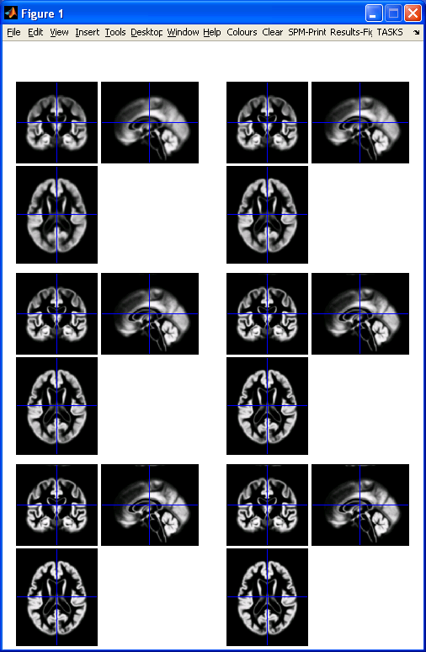
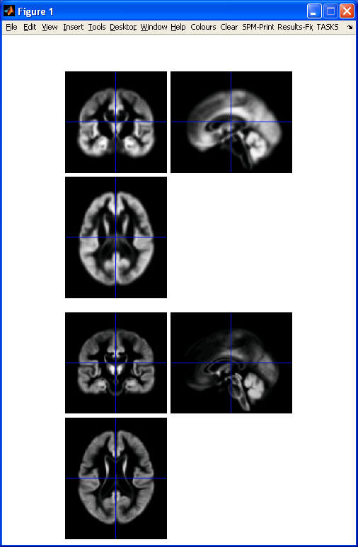
DARTEL average template evolution
Template
1
Rigid average
(Template_0)
Average of
mwc1 using
segment/DCT
Template
6
Notes:
60 images from OASIS cross-sectional data (as in VBM practical)

Slide 33
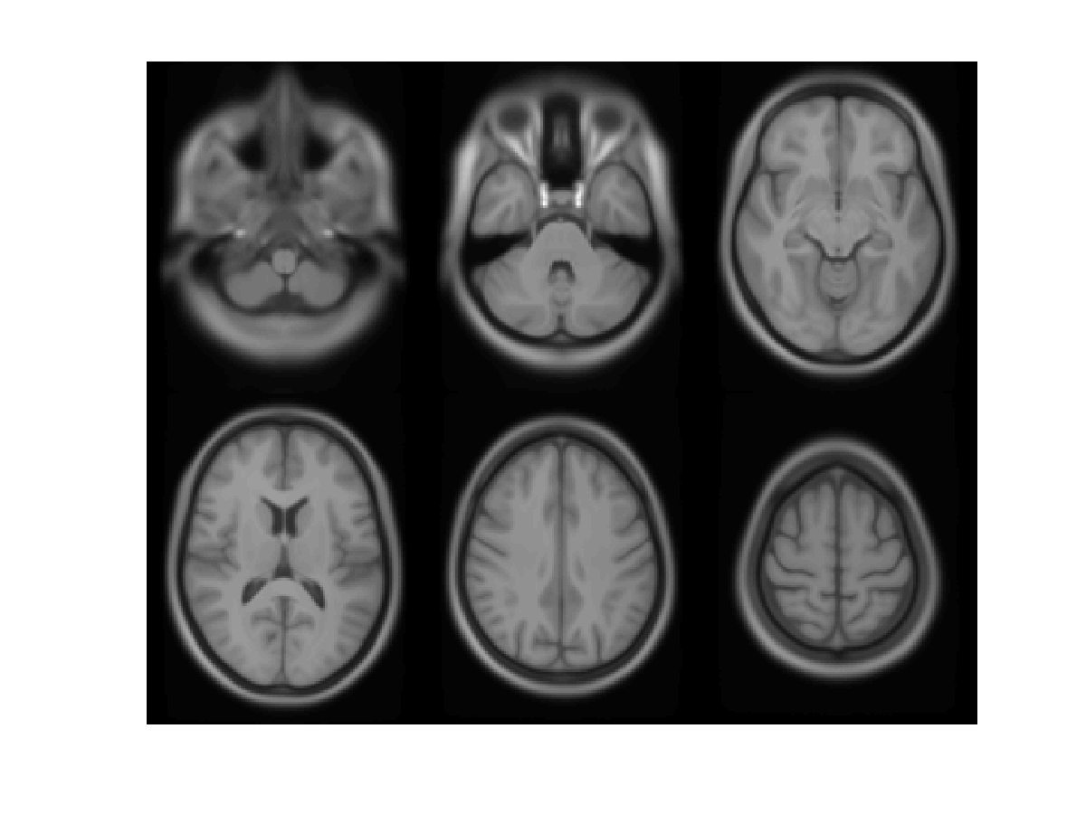

Slide 34
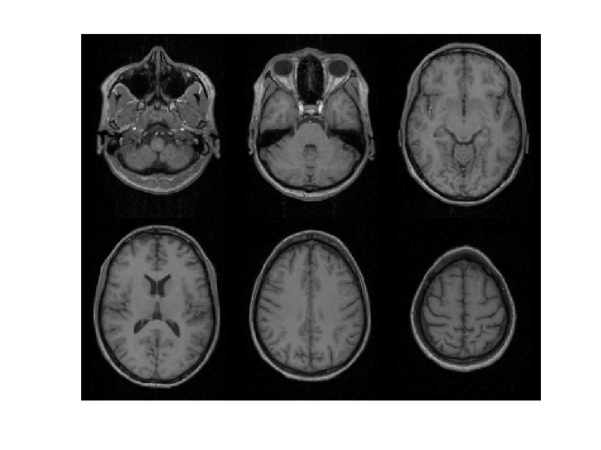

Slide 35
Summary
VBM performs voxel-wise statistical analysis on smoothed (modulated) normalised tissue segments
SPM8 performs segmentation and spatial normalisation in a unified generative model
  Based on Gaussian mixture modelling, with DCT-warped spatial priors, and multiplicative bias field
Subsequent (currently non-unified) use of DARTEL improves normalisation for VBM
  And probably also fMRI...

Slide 36
Mathematical advances in computational anatomy
VBM is well-suited to find focal volumetric differences
Assumes independence among voxels
  Not very biologically plausible
  But shows differences that are easy to interpret
Some anatomical differences can not be localised
  Need multivariate models
  Differences in terms of proportions among measurements
  Where would the difference between male and female faces be localised?

Slide 37
Mathematical advances in computational anatomy
In theory, assumptions about structural covariance among brain regions are more biologically plausible
  Form influenced by spatio-temporal modes of gene expression
Empirical evidence, e.g.
  Mechelli, Friston, Frackowiak & Price. Structural covariance in the human cortex. Journal of Neuroscience 25:8303-10 (2005)
Recent introductory review:
  Ashburner & Klöppel. “Multivariate models of inter-subject anatomical variability”. NeuroImage, 2011.

Slide 38
Conclusion
VBM uses the machinery of SPM to localise patterns in regional volumetric variation
  Use of “globals” as covariates is a step towards multivariate modelling of volume and shape
More advanced approaches typically benefit from the same preprocessing methods
  Though possibly little or no smoothing
Elegant mathematics related to transformations (diffeomorphism group with Riemannian metric)
VBM – easier interpretation – complementary role

Slide 39
Key references for VBM
Ashburner & Friston. Unified Segmentation.
NeuroImage 26:839-851 (2005).
Mechelli et al. Voxel-based morphometry of the human brain… Current Medical Imaging Reviews 1(2) (2005).
Ashburner. A Fast Diffeomorphic Image Registration Algorithm. NeuroImage 38:95-113 (2007).
Ashburner & Friston. Computing average shaped tissue probability templates. NeuroImage 45(2): 333-341 (2009).

Slide 40
References for more advanced computational anatomy
Ashburner, Hutton, Frackowiak, Johnsrude, Price & Friston. “Identifying global anatomical differences: deformation-based morphometry”. Human Brain Mapping 6(5-6):348-357, 1998.
Bishop. Pattern recognition and machine learning. 2006.
Younes, Arrate & Miller. “Evolutions equations in computational anatomy”. NeuroImage 45(1):S40-S50, 2009.
Ashburner & Klöppel. “Multivariate models of inter-subject anatomical variability”. NeuroImage 56(2):422-439, 2011. DOI:10.1016/j.neuroimage.2010.03.059

