Slide 1
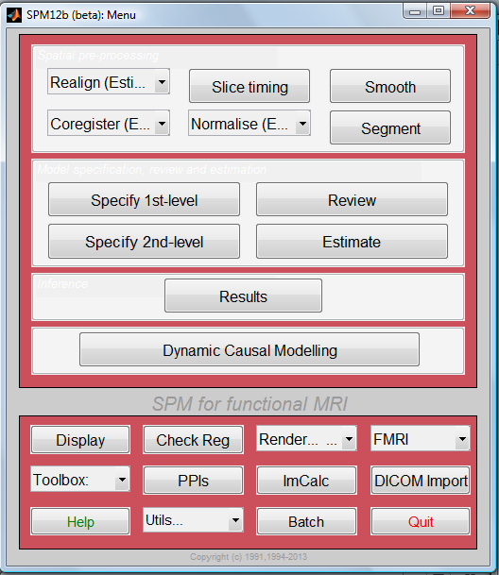


DCM: Dynamic Causal Modelling for fMRI
SPM-Course October 2013
Mohamed Seghier
Wellcome Trust Centre for Neuroimaging, University College London, UK
Wellcome Trust Centre for Neuroimaging

Slide 2
Functional segregation:
What regions respond to a particular
experimental input?
Functional integration:
How do regions influence each other?
➔ Brain Connectivity
?
?
?

Slide 3
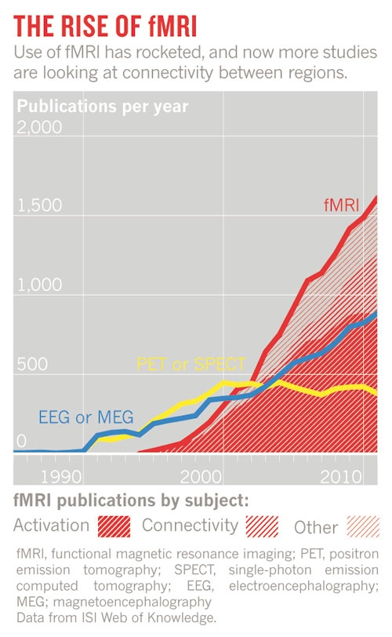
Connectivity is an important facet of brain function:
** Regions don’t operate in isolation **
Neurodegenerative and psychiatric disorders
= a disorder of brain connectivity.
E.g.: Schizophrenia and autism
[Smith 2012 Nature]

Slide 4
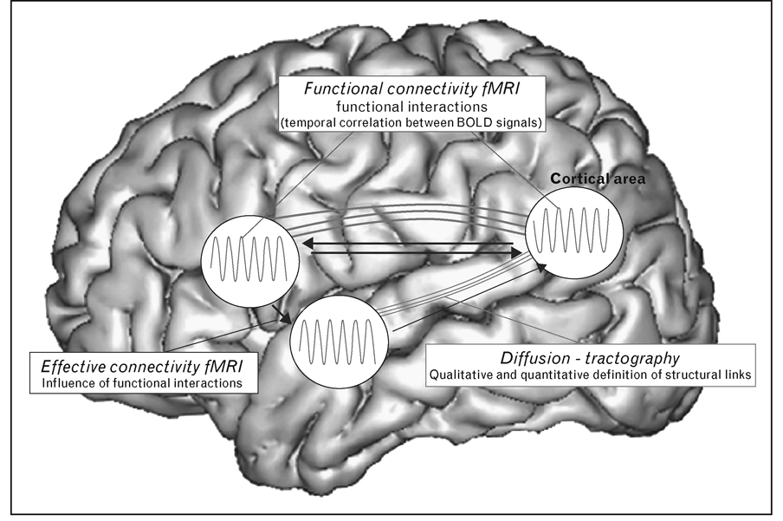
anatomical/structural connectivity
= presence of axonal connections.
functional connectivity
= statistical dependencies between regional time series.
effective connectivity
= causal (directed) influences between neurons or neuronal populations.
[Sporns 2007, Scholarpedia]

Slide 5
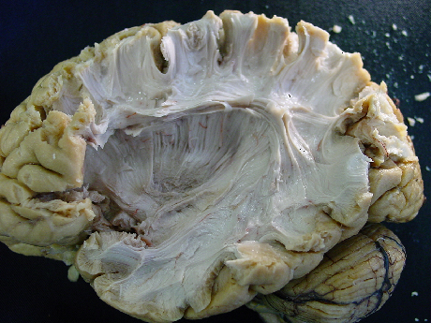
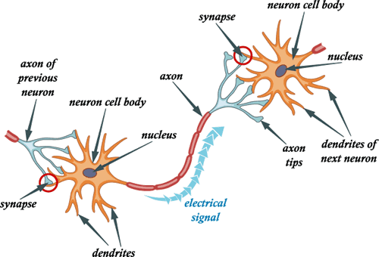
Structural connectivity
- Presence of axonal connections:
➔ relay and coordinate communication between different brain regions
The function of the axon is to transmit information to different neurons
c.f. Els Fieremans
Dissected white matter
- E.g. measured with tracing techniques or diffusion tensor/spectrum imaging (DTI/DSI)

Slide 6
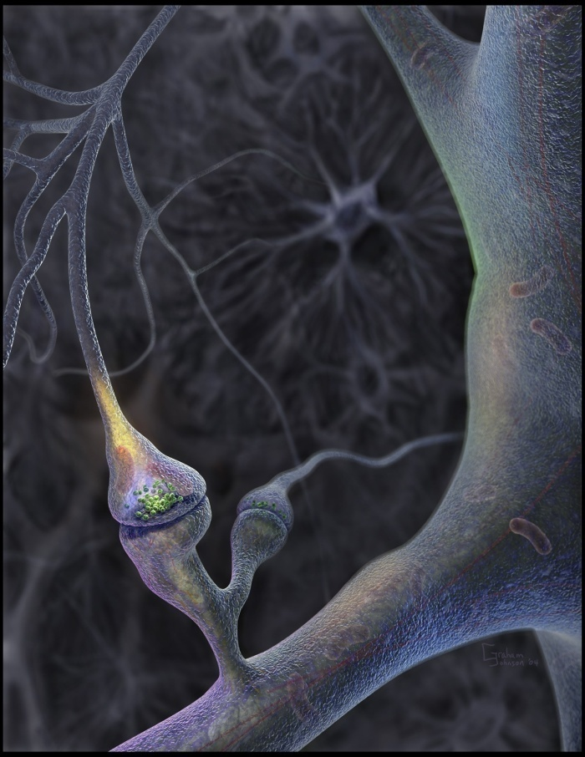
But:
Knowing anatomical connectivity is not enough...
Connections are recruited in a context-dependent fashion:
  Local functions depend on network activity
Connections show synaptic plasticity
  Critical for learning
  Can occur both rapidly and slowly
Need to look at functional/effective connectivity.
** Anatomo-functional connectivity: combine functional with structural connectivity.

Slide 7
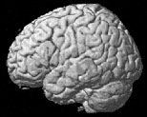
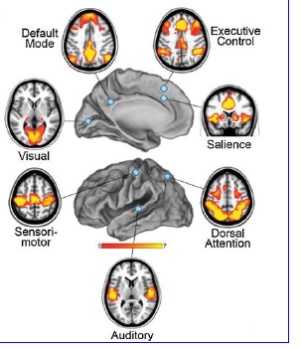
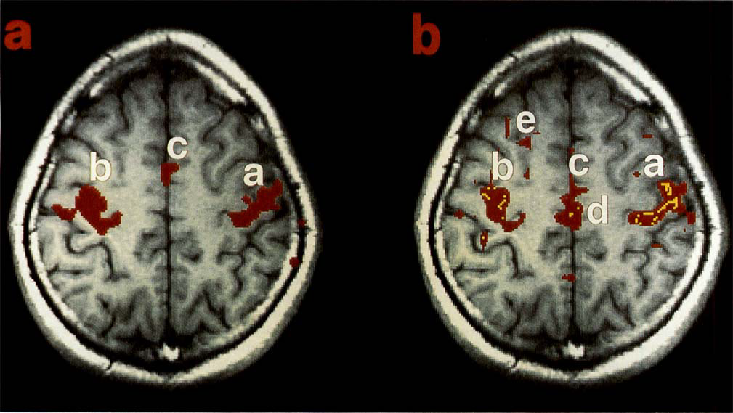
Functional connectivity
= statistical dependencies (temporal correlations) between activations.
seed region
[Biswal et al. 1995 MRM]
- Seed-based correlation analysis - Coherence analysis
- Eigen-decomposition (e.g. SVD) - Clustering (e.g. FCM)
- Independent component analysis (ICA)

Slide 8
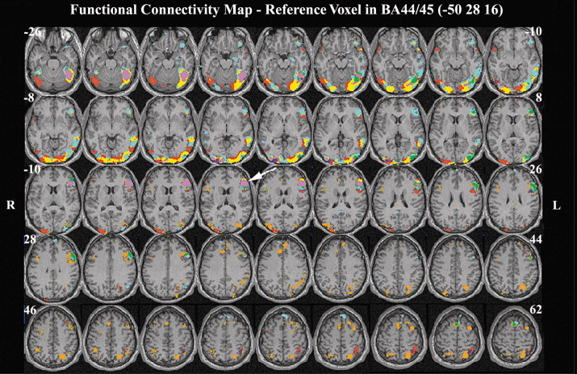
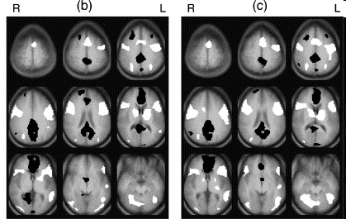
♣ Whole-brain regression with seed regions:
➔ functional connectivity maps
seed region
♦ Controlled task:
reading words, pseudowords, letter strings.
[Bokde et al. 2001 Neuron]
♦ Uncontrolled task (= unlocked onsets):
continuous sentence reading.
[Hampson et al. 2006 Neuroimage]
Seed ROI = left angular gyrus.
Functional connectivity maps vary during
(natural) reading of sentences.
Seed ROI = left inferior frontal gyrus.
Functional connectivity maps vary
with word type.
E.g. watching movies / sleep / hallucinations

Slide 9
Pros & Cons of functional connectivity analysis
** Pros:
  - Easy to compute;
  - useful when we have no experimental control over the system of interest and no model of what caused the data (e.g. sleep, hallucinations, natural vision).
** Cons:
  - interpretation of resulting patterns is difficult / arbitrary;
  - no mechanistic insight.
→ Effective connectivity

Slide 10
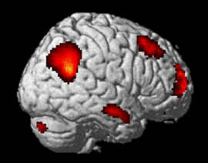
Effective connectivity
fMRI experiment;
task contrasts
Can we go beyond this “static” picture?
➔ Dynamics or interactions between regions…
For understanding brain function mechanistically, we need models of effective connectivity,
= causal (directed) influences between neurons or neuronal populations.
➔ explain regional effects in terms of interregional connectivity.

Slide 11
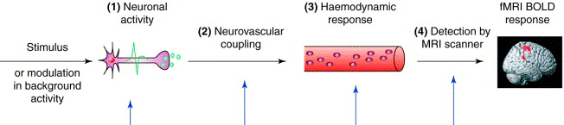
FMRI response = indirect + slow
[Arthurs & Boniface 2002 TINS]
→ parameterise effective connectivity in terms of coupling among unobserved brain states (e.g., neuronal activity in different regions).
Neuronal:
Unobserved interactions
BOLD:
Measured responses
DCM
** simple neuronal model;
** complicated hemodynamic forward model (neural activity → BOLD).

Slide 12
The hemodynamics
Deterministic dynamical systems
[Friston et al. 2000 Neuroimage]
[Friston 2002 Neuroimage]
[Friston et al. 2003 Neuroimage]

Slide 13

DCM is a generative model
= a quantitative/mechanistic description of how observed data are generated/caused.
Key features:
1- Dynamic
2- Causal
3- Neuro-physiologically motivated
4- Operate at hidden neuronal interactions
5- Bayesian in all aspects
6- Hypothesis-driven
7- Inference at multiple levels.
[Stephan et al. 2010 Neuroimage]
DCM [default] implementation:
Deterministic Stochastic [Daunizeau et al. 2009]
Bilinear Nonlinear [Stephan et al. 2008]
The one-state neuronal The two-state [Marreiros et al. 2008]

Slide 14




Slide 15
Basic idea of DCM for fMRI
♣ A cognitive system is modelled at the neuronal level (not directly accessible for fMRI).
♣ The modelled neuronal dynamics (z) is transformed into area-specific BOLD signals (y) by a hemodynamic forward model (λ).
z
λ
y
Aim: to estimate the parameters of a reasonably realistic neural model such that the predicted/modelled BOLD responses correspond as closely as possible to the observed/measured BOLD responses.

Slide 16
What is a system?
System =
a set of elements which interact in a spatially and temporally specific fashion
Input u(t)
connectivity parameters θ
system states z(t)
State changes of a system are dependent on:
  the current state z
  external inputs u
  its connectivity θ
(evolution equation)

Slide 17
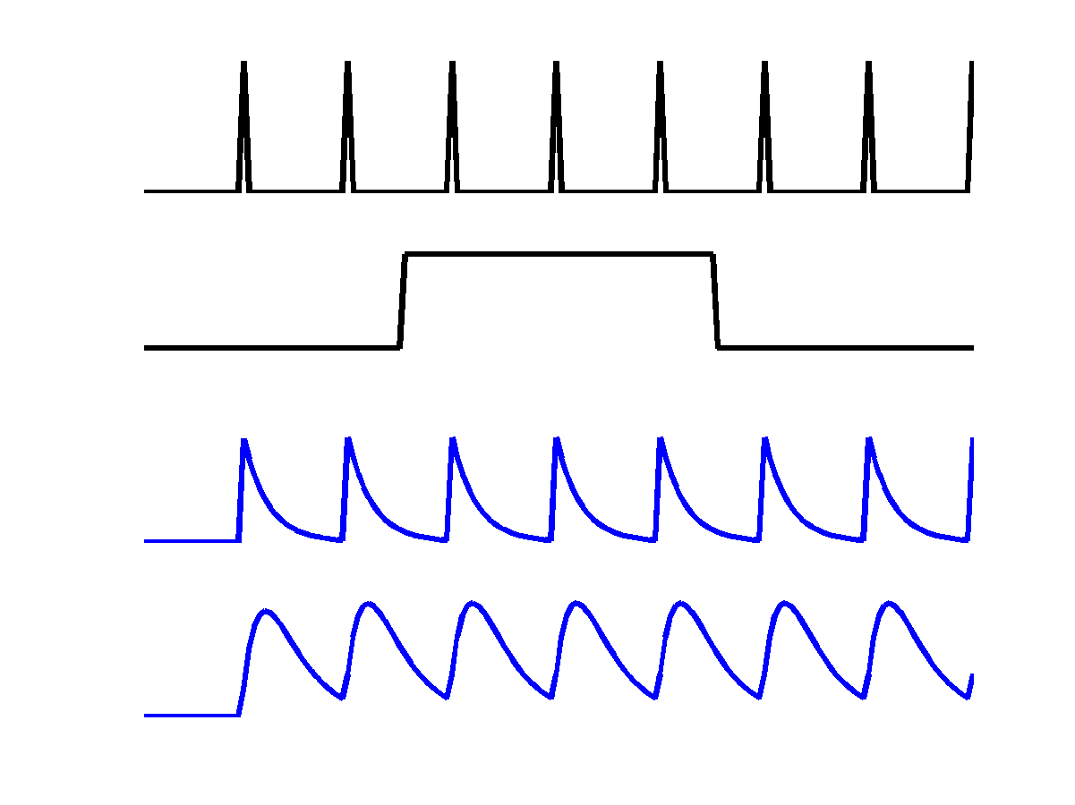
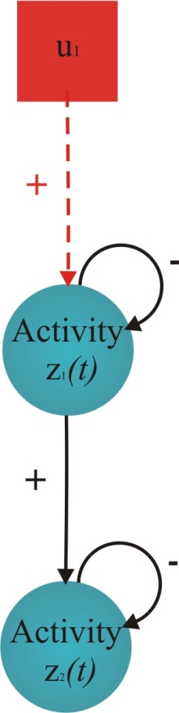
Neurodynamics: 2 nodes with input
u₁
u₂
R1
z₁
z₂
R2
activity in is coupled to via
coefficient

Slide 18
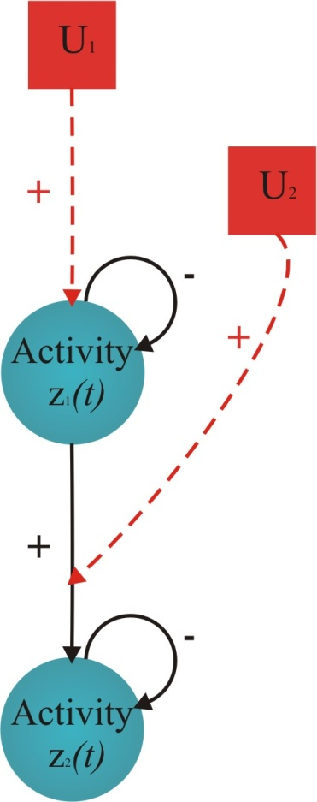
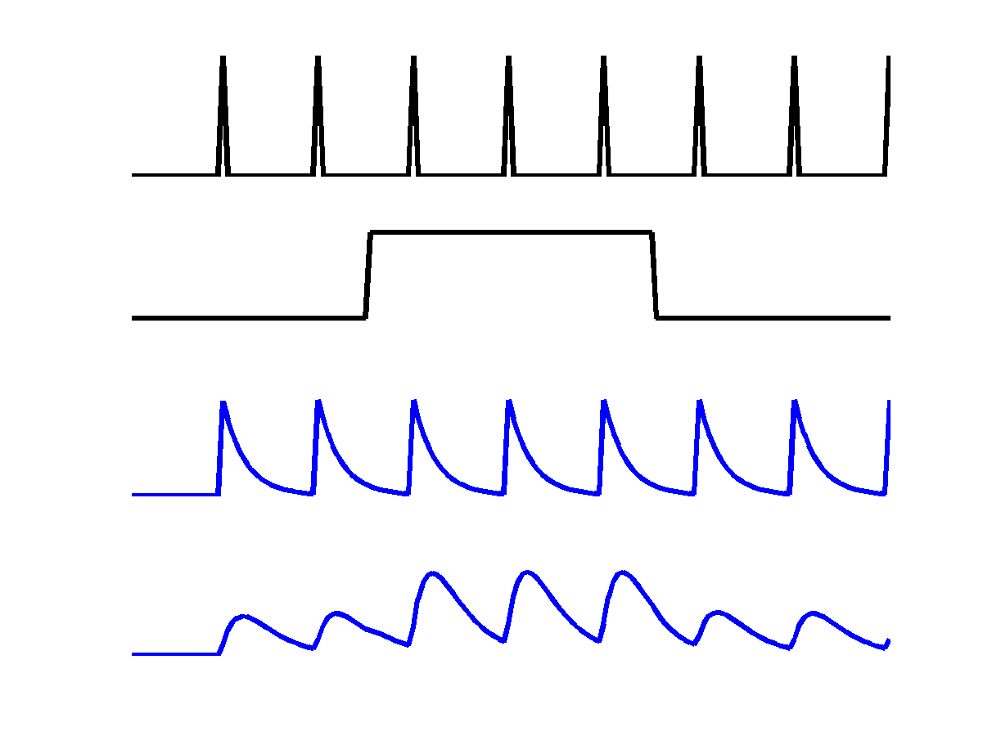
Neurodynamics: positive modulation
u₁
u₂
R1
z₁
z₂
R2
modulatory input u2 activity through the coupling

Slide 19
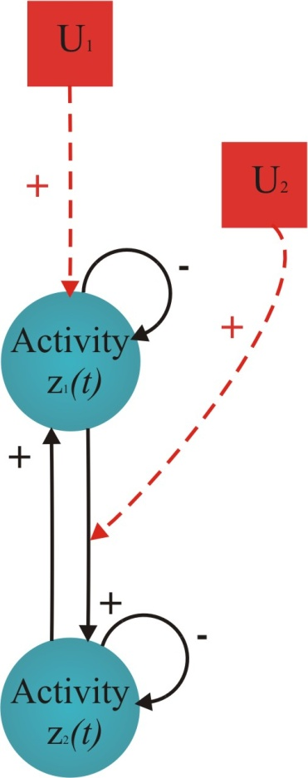
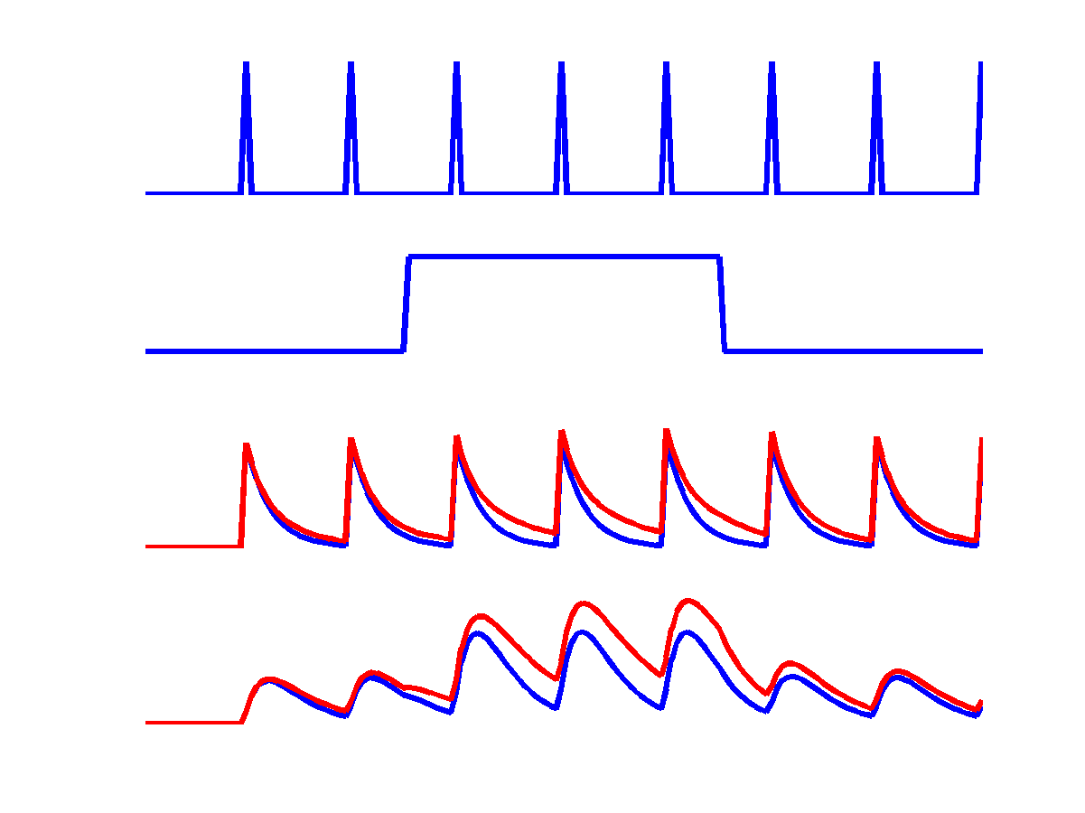
Neurodynamics: reciprocal connections
u₁
u₂
z₁
z₂
reciprocal
connection
disclosed by
u₂

Slide 20
bilinear dynamic system
z₃
R3
left
R4
right
z₄
z₁
R1
left
R2
right
z₂
u₂
CONTEXT
u₁
u₃

Slide 21

Bilinear state equation in DCM for fMRI
The neural state equation
state
changes
modulation of
connectivity
state vector
direct
inputs
external
inputs
connectivity
n regions
m inputs (mod.)
m inputs (driv.)

Slide 22
“C”, the direct or driving effects:
- extrinsic influences of inputs on neuronal activity.
“A”, the endogenous coupling or the latent connectivity:
- fixed or intrinsic effective connectivity;
first order connectivity among the regions in the absence of input;
average/baseline connectivity in the system.
“B”, the bilinear term, modulatory effects, or the induced connectivity:
context-dependent change in connectivity;
- eq. a second-order interaction between the input and activity in a source region when causing a response in a target region.
[Units]: rates, [Hz];
Strong connection = an effect that is influenced quickly or with a small time constant.

Slide 23
DCM parameters = rate constants
Integration of a first-order linear differential equation gives an exponential function:
z₁
Decay function
If A→B is 0.10 s⁻¹ this means that, per unit time, the increase in activity in B corresponds to 10% of the activity in A
1
A
0.8
0.10
0.6
0.4
B
0.2
0
-0.1
0
0.1
0.2
0.3
0.4
0.5
0.6
0.7
0.8
0.9

Slide 24
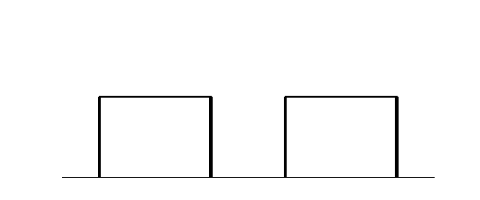
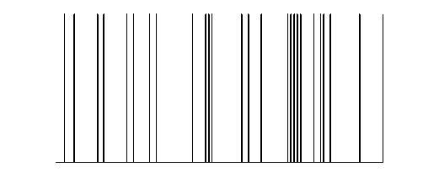
y
y
y
BOLD
y
λ
hemodynamic
model
activity
x₂(t)
activity
x₃(t)
activity
x₁(t)
neuronal
states
z
modulatory
input u₂(t)
integration
Neuronal state equation
driving
input u₁(t)
t
The bilinear model
endogenous connectivity
t
modulation of
connectivity
[Stephan & Friston (2007),
Handbook of Brain Connectivity]
direct inputs

Slide 25

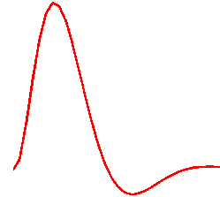
u
inputs
The hemodynamic model
t
Hemodynamic parameters:
neural state equation
neuronal input z(t)
important for model fitting, but of no interest for statistical inference
hemodynamic state equations
Empirically determined
a priori distributions.
Area-specific estimates
(like neural parameters)
→ region-specific HRFs !!
Balloon model
BOLD signal y(t)
[Friston et al. 2000, NeuroImage]
[Stephan et al. 2007, NeuroImage]
BOLD signal change equation

Slide 26
Example: modelled BOLD signal
R3
left
R4
right
Recap:
The aim of DCM is to estimate:
Neuronal parameters [A, B, C];
Hemodynamic parameters;
Such that modelled/predicted and measured/observed BOLD signals are maximally similar.
Multiple-input multiple-output system
R1
left
R2
right
u2
u1
black: observed BOLD signal red: modelled BOLD signal

Slide 27
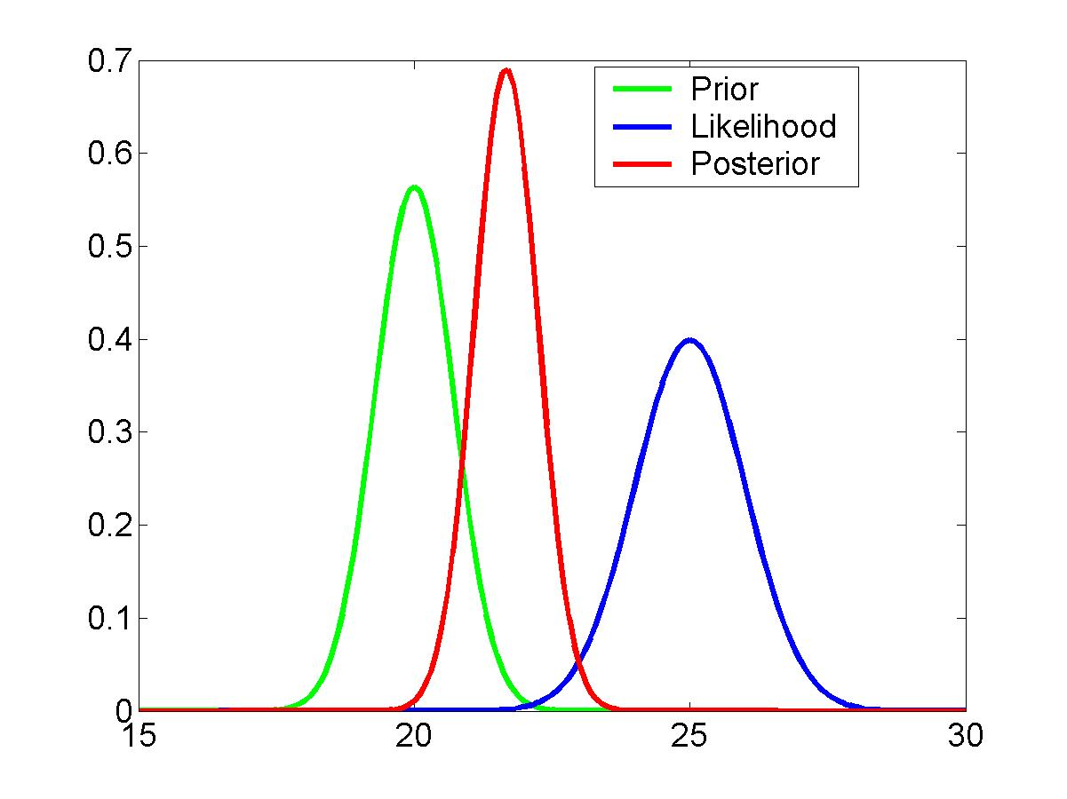
Priors & parameter estimation
Based on a Bayesian framework.
Bayes theorem allows us to express our prior knowledge or “belief” about parameters of the model.
new data
prior knowledge
posterior ∝ likelihood ∙ prior
The posterior probability of the parameters given the data is an optimal combination of prior knowledge and new data, weighted by their relative precision.
Priors in DCM
Constraints on parameter estimation:
  - hemodynamic parameters: empirical priors
  - coupling parameters other connections: shrinkage priors

Slide 28
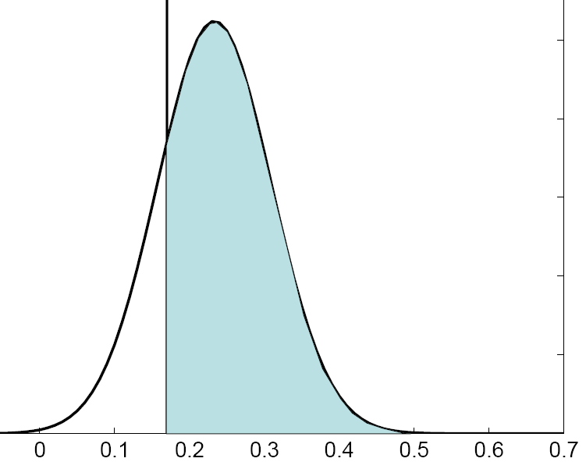
Inference about DCM parameters:
Bayesian inversion
Gaussian assumptions about the posterior distributions of the parameters (mean η_{θ|y} and covariance C_{θ|y}).
Use of the cumulative normal distribution to test the probability that a certain parameter (or contrast of parameters c^{T} η_{θ|y}) is above a chosen threshold γ:
By default, γ is chosen as zero ("does the effect exist?").
γ
η_{θ|y}
** Parameter estimation by means of Variational Bayes under the Laplace approximation scheme (VL).
[Friston et al. 2007 Neuroimage]

Slide 29
DCM: practical steps
Select areas you want to model
Extract timeseries of these areas (x(t))
Specify at neuronal level
  what drives areas (c)
  how areas interact (a)
  what modulates interactions (b)
State-space model with 2 levels:
  Hidden neural dynamics
  Predicted BOLD response
Estimate model parameters:
Gaussian a posteriori parameter distributions, characterised by
mean η_{θ|y} and covariance C_{θ|y}.
Modulatory input
(e.g. context/learning/drugs)
Driving input
(e.g. sensory stim)
b₁₂
c₁
neuronal
states
c₂
activity
x₁(t)
a₁₂
activity
x₂(t)
y
BOLD
y
η_{θ|y}

Slide 30
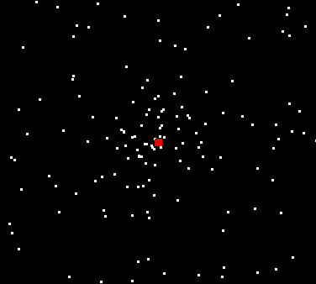
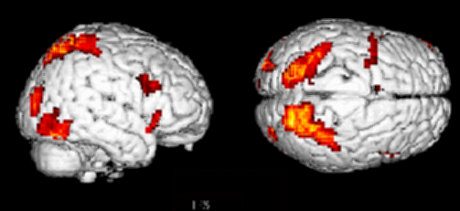
Attention to motion in the visual system
Stimuli 250 radially moving dots at 4.7 degrees/s
Pre-Scanning
5 x 30s trials with 5 speed changes (reducing to 1%)
Task - detect change in radial velocity
Scanning (no speed changes)
6 normal subjects, 4 x 100 scan sessions;
each session comprising 10 scans of 4 different
conditions
F A F N F A F N S .................
F - fixation point only
A - motion stimuli with attention (detect changes)
N - motion stimuli without attention
S - no motion
Attention – No attention
[Büchel & Friston 1997, Cereb. Cortex]
[Büchel et al. 1998, Brain]

Slide 31
How we can interpret, mechanistically, the increase in activity of area V5 by attention when motion is physically unchanged.
SPC
V5
Attention – No attention
Choice of areas and time series extraction.
➔ Three ROIs: V1, V5, and SPC.
Definition of driving inputs.
➔ All visual stimuli/conditions (photic: A N S)
Definition of modulatory inputs.
➔ The effects of motion and attention (A N)
Building the model:
1- how to connect regions (intrinsic connections “A”);
2- how the driving inputs enter the system (extrinsic effects “C”);
3- define the context-dependent connections (modulatory effects “B”).

Slide 32
Visual inputs drive V1.
Activity then spreads to hierarchically arranged visual areas.
Motion modulates the strength of the V1→V5 forward connection.
Attention modualtes the strength of the SPC→V5 backward connection.
Attention
SPC
Motion
V5
Photic
V1
Re-analysis of data from
[Friston et al., 2003 NeuroImage]

Slide 33
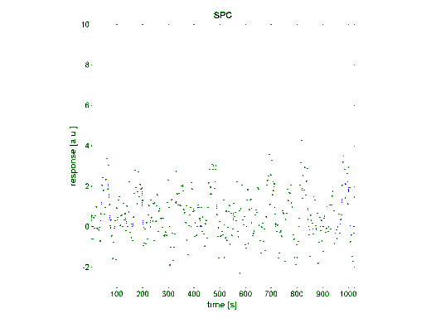
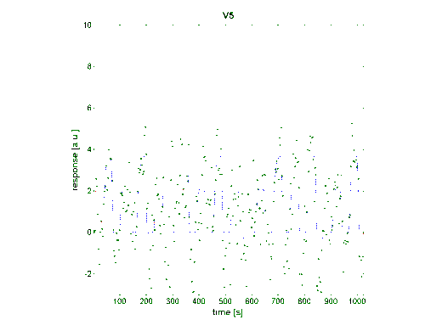
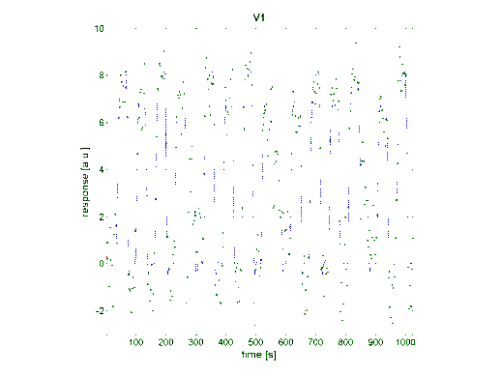
After DCM estimation:
Attention
Re-analysis of data from
Friston et al., NeuroImage 2003
Motion modulates the strength of the V1→V5 forward connection.
Attention increases the backward-connection SPC→V5.
SPC
0.37
0.56
0.42
Motion
V5
0.66
0.88
Photic
-0.05
V1
Are there other plausible/alternative models?
0.48

Slide 34
Alternative models (hypothesis-driven approach):
Model 1:
attentional modulation
of V1→V5
Model 2:
attentional modulation
of SPC→V5
Model 3:
attentional modulation
of V1→V5 and SPC→V5
Photic
Attention
Photic
Photic
Attention
0.55
SPC
0.85
SPC
0.03
SPC
0.86
0.75
0.70
0.85
0.70
1.42
1.36
0.84
1.36
V1
0.89
V1
V1
0.85
0.56
-0.02
0.57
-0.02
V5
0.57
-0.02
V5
V5
Motion
Motion
0.23
Motion
0.23
Attention
Attention
How we can compare between competing hypotheses?
➔ BMS (Bayesian Model Selection)

Slide 35
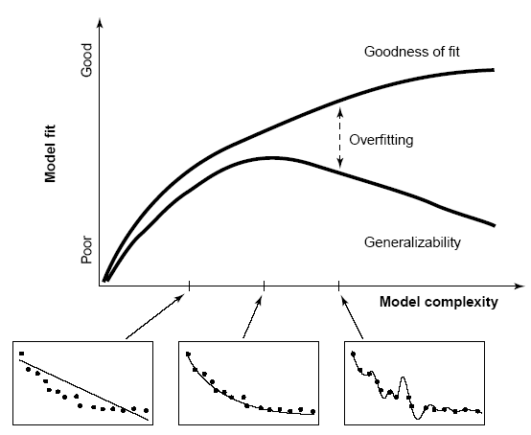
Model evidence and selection
Given competing hypotheses, which model is the best?
Which model represents the
best balance between model
fit and model complexity?
For which model m does p(y|m) become maximal?
[Pitt and Miyung 2002 TICS]

Slide 36
Approximations to the model evidence in DCM
Log model evidence = balance between fit and complexity.
[Penny 2012, NeuroImage]
The negative variotional free energy (F) approximation
Under Gaussian assumptions about the posterior (Laplace approximation), the negative free energy F is a lower bound on the log model evidence.
- A better approximation of the complexity term:
F accounts for parameter interdependencies.
** All recent DCM versions use F for model selection !

Slide 37
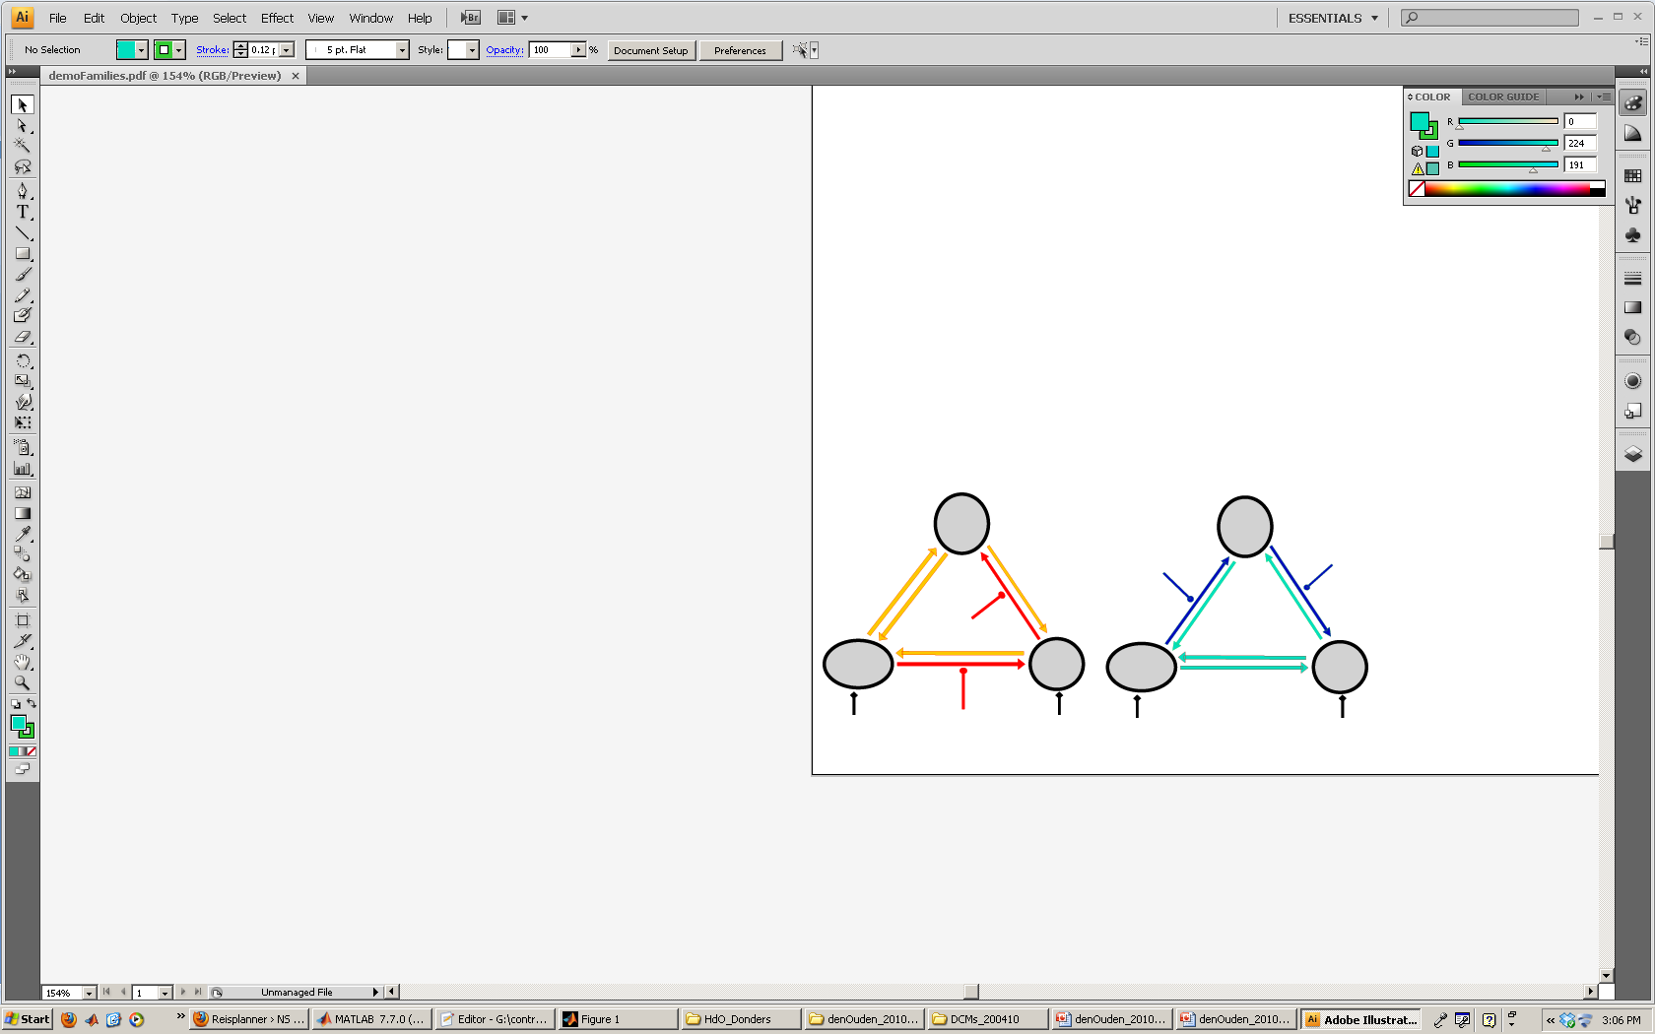
Inference on model space
BMS (Bayesian Model Selection)
An intuitive interpretation of model comparisons is made possible by Bayes factors:
Model m1
Model m2
positive value, [0; ∞[
[Kass & Raftery 1995, J. Am. Stat. Assoc.]
BF₁₂ | p(m₁|y) | Evidence
1 to 3 | 50-75% | weak
3 to 20 | 75-95% | positive
20 to 150 | 95-99% | strong
≥ 150 | ≥ 99% | Very strong
!!# Only compare models with the same data #!!

Slide 38

BMS has nothing to say about the “true” model(s).
find the most useful model, form a set of alternatives, given data.
Best model = best balance between accuracy and complexity.
- model selection with BMS ≠ model validation!
DCM model space: Compatibility // Size // Plausibility.
# BMS cannot be applied to models fitted to different data!
(Only models with the same ROIs can be compared using BMS).
  # It is helpful to constrain your DCM model space.
  number of ROIs limited to 8 in SPM (GUI), but you can include more ROIs.
  (e.g., 6 ROIs, fully connected, 1 Billion alternative modulations!).
  # (if possible) Define sets of models that are plausible, in a systematic way, given prior knowledge (e.g. anatomical, TMS, previous studies).
  # for group comparison (e.g. patients vs. controls) make inferences over the same DCM model space.

Slide 39
Levels of inference: Group level
-- Family level --
-- System/model level --
-- Parameter/connection level --
FFX: subjects assumed to use similar systems.
RFX: best models vary across subjects.
[Penny et al. 2010, PLoS Comp Biol]
[Seghier et al. 2010, Front Syst Neurosci]
♣ Family level:
- Useful when no clear winning model // models have common characteristics.
Models assigned to subsets (families) with shared features.
Inference: a class/type of models that best explains the data.
♣ Model level:
- Useful when a clear winning model can be identified (BMS).
Inference: a useful model structure (inputs & connections) that explains the data.
♣ Connection level:
- Useful when connectivity parameters are of interest (e.g. modulations).
Inference: Bayesian parameters averaging (BPA) or t-test on DCM parameters.
Inference: BMA on the winning family (or over the whole model space).

Slide 40
Which DCM version? DCM5 || DCM8 || DCM10 || DCM12.
Use the latest version (= DCM12).
Keep the same DCM version for your project (over models, sessions, and subjects).
- Indicate the DCM version in your papers.
Extensions in DCM for fMRI:
Bayesian Model Selection BMS [Penny et al. 2004 Neuroimage].
Slice specific sampling [Kiebel et al. 2007 Neuroimage].
Refined hemodynamic model [Stephan et al. 2007 Neuroimage].
The two-state DCM [Marreiros et al. 2008 Neuroimage].
The non-linear DCM [Stephan et al. 2008 Neuroimage].
Random-effects BMS [Stephan et al. 2009 Neuroimage].
Stochastic DCM [Daunizeau et al. 2009 Physica D].
Anatomical-based priors for DCM [Stephan et al. 2009 Neuroimage].
Family level inference BMS [Penny et al. 2010 PLoS Comp Biol].
Bayesian model averaging BMA [Penny et al. 2010 PLoS Comp Biol].
Post-hoc Bayesian optimisation [Friston et al. 2011 Neuroimage].
Stochastic DCM (random fluctuations) [Li et al. 2011 Neuroimage].
Network discovery for large DCMs [Seghier & Friston et al. 2013 Neuroimage].

Slide 41
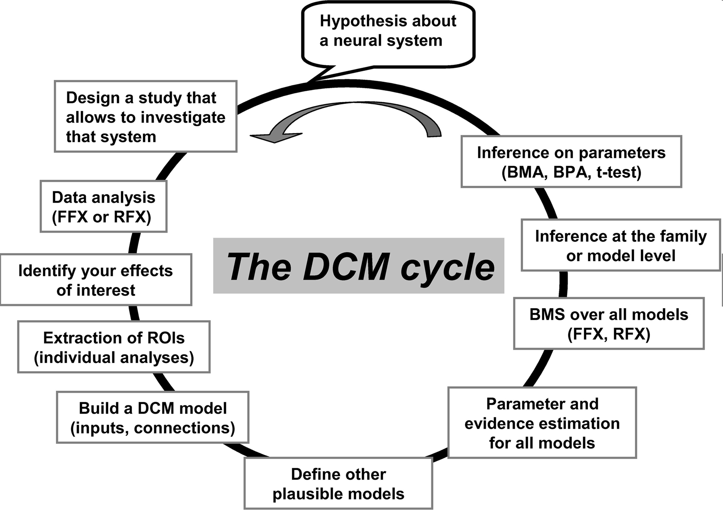
[Seghier et al. 2010, Front Syst Neurosci]

Slide 42
Reviews:
Stephan et al. (2010). Ten simple rules for DCM. NeuroImage.
Daunizeau et al. (2010). DCM: a critical review of the biophysical and statistical foundations. NeuroImage.
Seghier et al. (2010). Identifying abnormal connectivity in patients using dynamic causal modeling of fMRI responses . Front Syst Neurosci.
Friston (2011). Functional and effective connectivity: A review. Brain Connectivity.
Practical examples: (DCM-fMRI at the FIL)
- Inter-hemispheric interactions and laterality for words and pictures:
Seghier et al. (2011) Cerebral Cortex.
- Prediction error and putamen:
den Ouden et al. (2010) J Neurosci.
- Top-down effects on form perception:
Cardin et al. (2011) Cerebral Cortex.
- Multilingual vs. Monolingual monitoring of speech production:
Parker-Jones et al. (2013) J Neurosci.
http://www.fil.ion.ucl.ac.uk/spm/data/

Slide 43
SPM-Course October 2013
Thank you
for your attention!!!
Wellcome Trust Centre for Neuroimaging

