Slide 1
Advanced applications of the GLM: Cross-frequency Coupling
SPM course for MEG & EEG 2016
Bernadette van Wijk
Charité-University Medicine Berlin

Slide 2
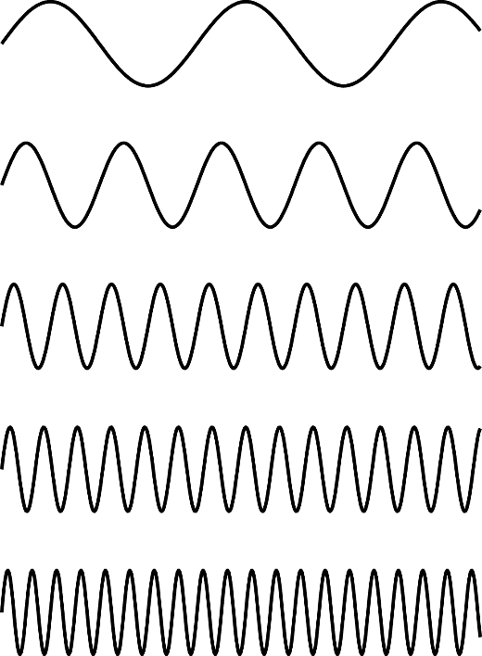
Cross-frequency coupling

Slide 3
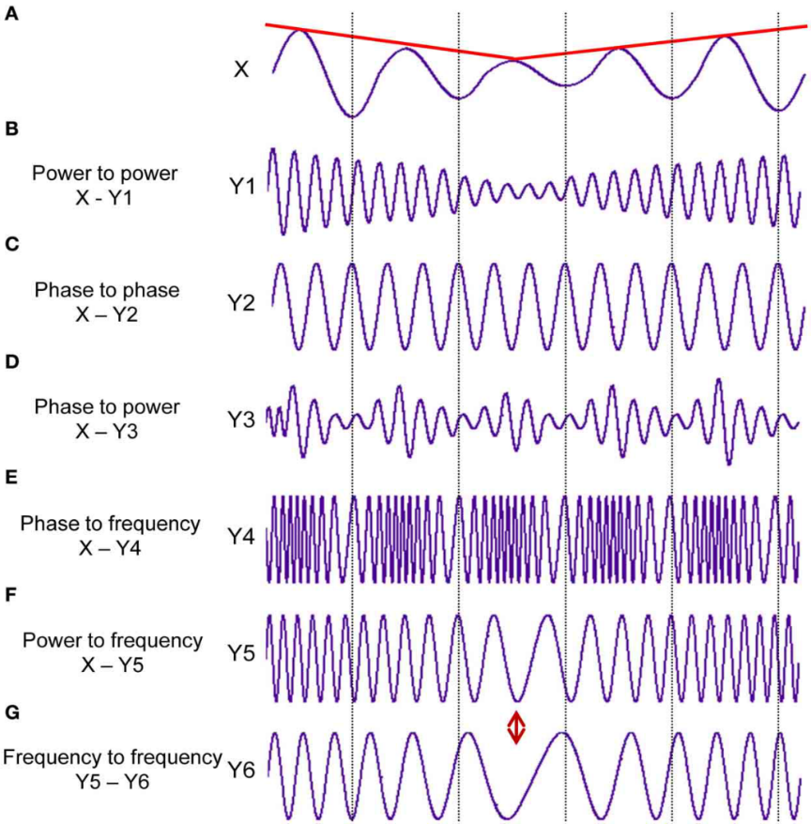
Various forms of cross-frequency coupling
delta-alpha
theta-beta
theta-gamma
alpha-gamma
beta-gamma
etc.
Frequency combinations
Within a recorded signal (brain region)
Between two different signals (brain regions)
Many combinations!
Jirsa & Müller, 2013; Frontiers in Comp Neurosci

Slide 4
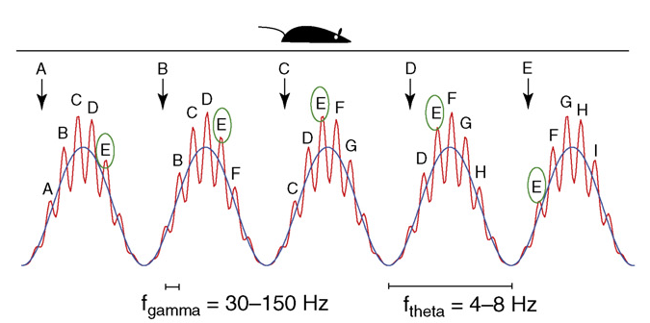
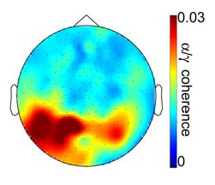
Phase amplitude coupling (PAC)
Amplitude of fast frequency is modulated by phase of slow frequency
Hippocampal theta-gamma coupling
Spatial navigation & working memory
Occipital alpha-gamma coupling
Visual perception

Slide 5
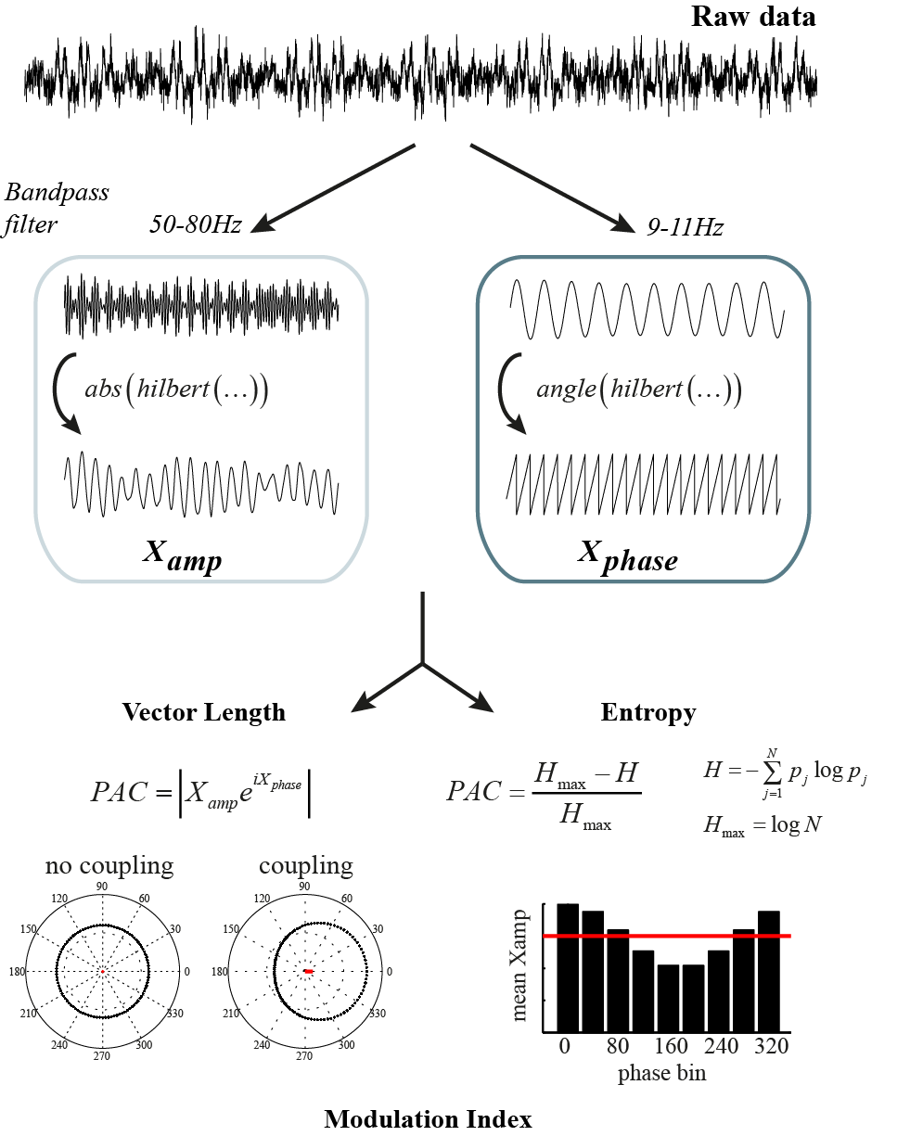
How to detect PAC
e.g., Canolty et al. 2006, Science
e.g., Tort et al. 2008, PNAS

Slide 6
How to detect PAC
Compared against
>100 shuffled time series
e.g., Canolty et al. 2006, Science
e.g., Tort et al. 2008, PNAS

Slide 7
General Linear Model
Penny et al. (2008) J Neurosci Methods
B.C.M. van Wijk, A. Jha, W. Penny , V. Litvak (2015).
Parametric estimation of cross-frequency coupling.
J Neurosci Methods 243:94-102

Slide 8
General Linear Model
Easy to include other predictors:
amplitude correlations
non-linearities
confounding factors
van Wijk et al. (2015) J Neurosci Methods

Slide 9
General Linear Model
Parametric approach
No surrogate time series
van Wijk et al. (2015) J Neurosci Methods

Slide 10
GLM vs permutation tests: simulations
GLM
permutations
Noise level ρ
Slightly lower statistical power for GLM
van Wijk et al. (2015) J Neurosci Methods

Slide 11
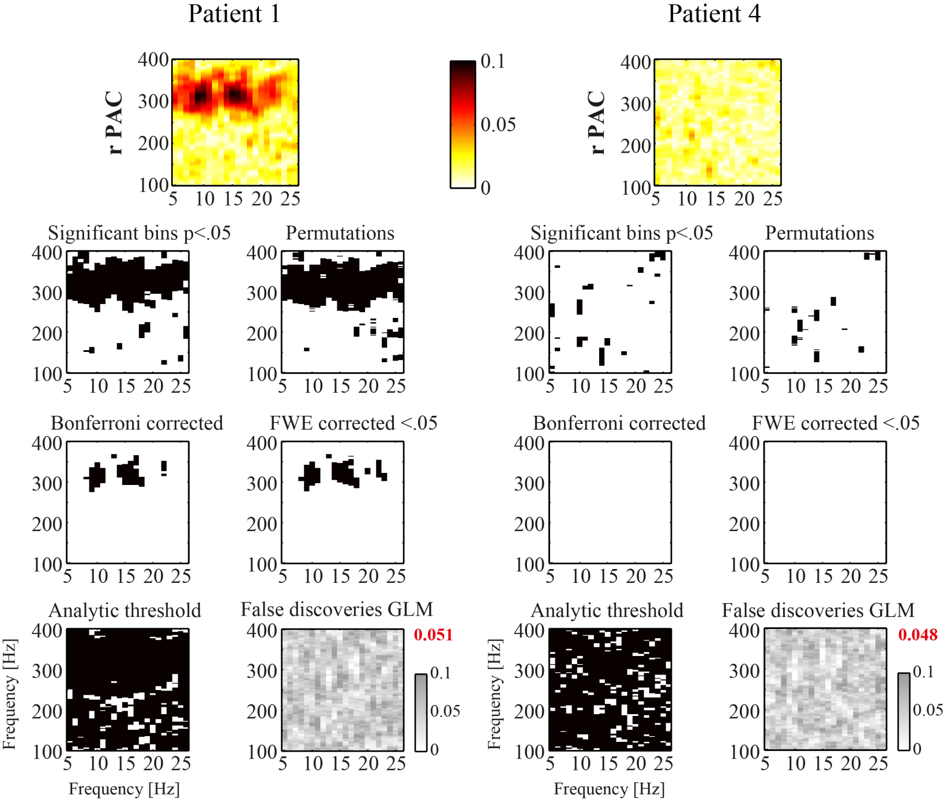
GLM vs permutation tests: real data
GLM 200 permutations
<7min 159min
GLM ~24x faster to compute
van Wijk et al. (2015) J Neurosci Methods

Slide 12
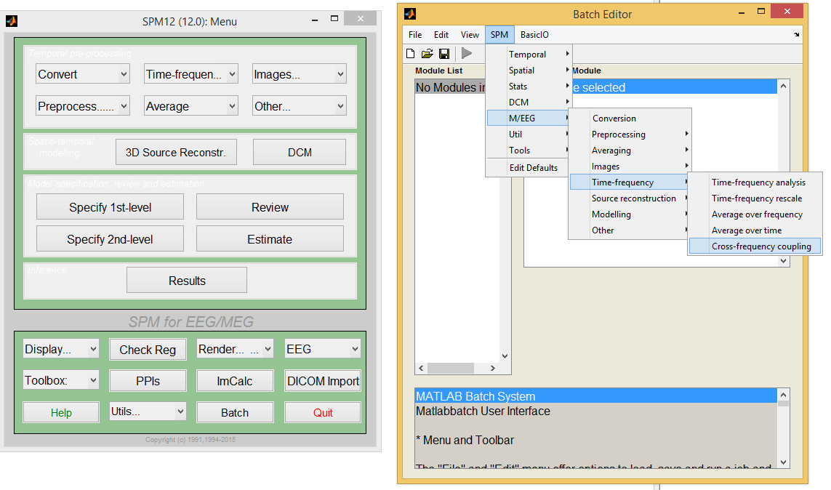

Slide 13
First step: Time-frequency analysis
Compute amplitude time series and phase time series for frequencies of interest
Create two separate files because of filter settings
Amplitude
Phase

Slide 14
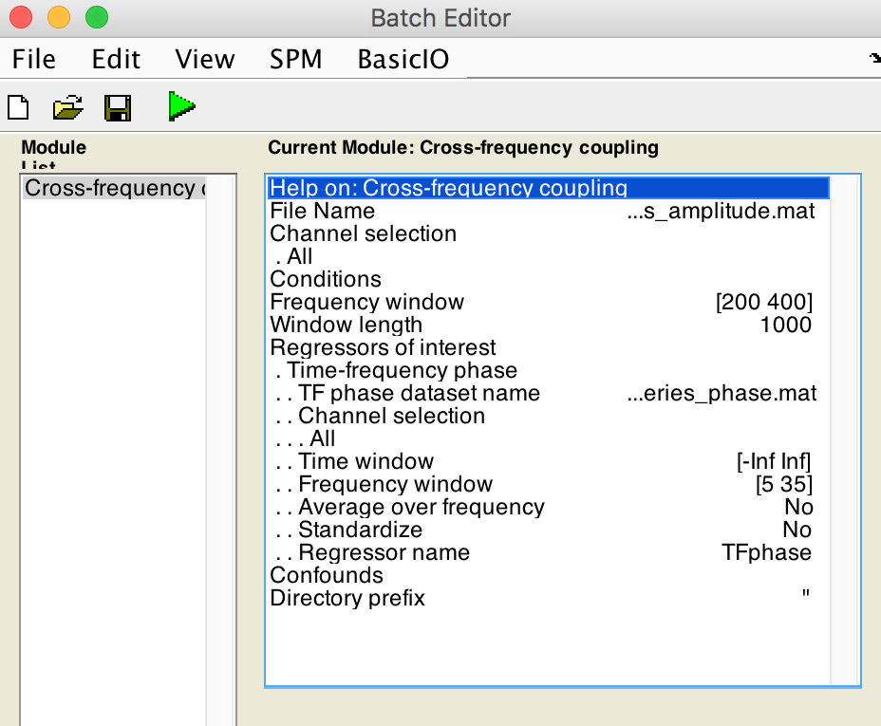
Cross-frequency coupling
Data set with amplitude time series
Select epoch size here (for stats)
Data set with phase time series
Add other time series as regressors
Select phase or amplitude as regressors

Slide 15
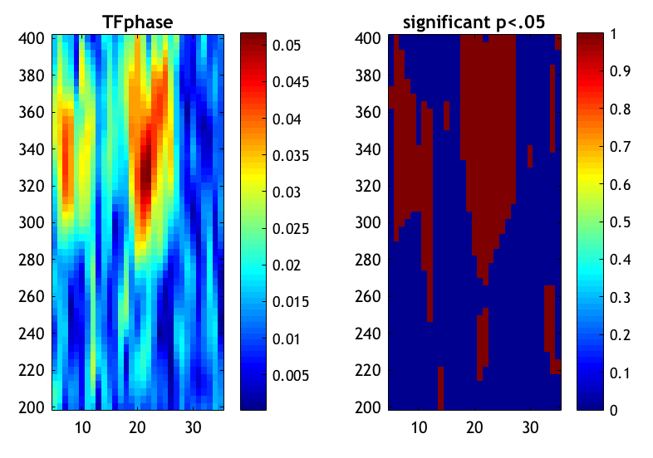
Results
Figure is plotted + .nii images saved

