Slide 1
Bayesian Inference
Chris Mathys
Wellcome Trust Centre for Neuroimaging
UCL
London SPM Course
Thanks to Jean Daunizeau and Jérémie Mattout for previous versions of this talk

Slide 2
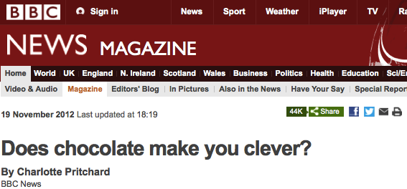
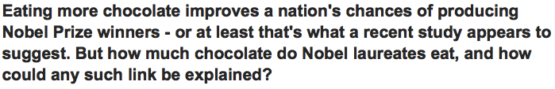
A spectacular piece of information

Slide 3
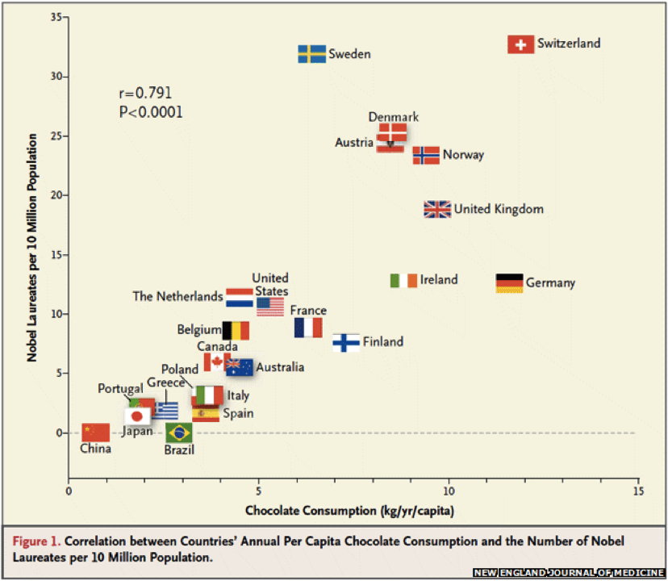
A spectacular piece of information
Messerli, F. H. (2012). Chocolate Consumption, Cognitive Function, and Nobel Laureates. New England Journal of Medicine, 367(16), 1562–1564.

Slide 4
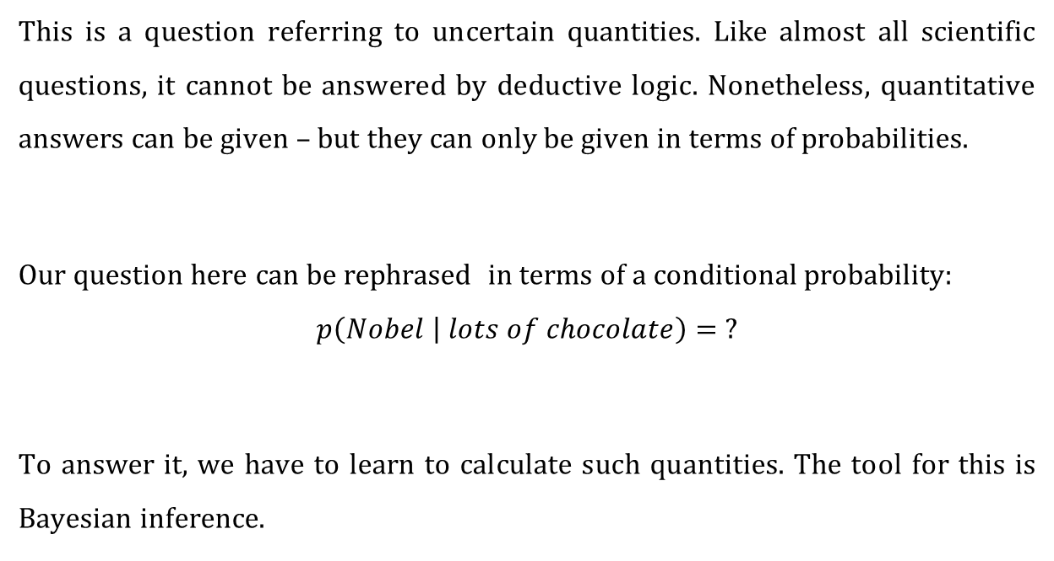
So will I win the Nobel prize if I eat lots of chocolate?
This is a question referring to uncertain quantities. Like almost all scientific questions, it cannot be answered by deductive logic. Nonetheless, quantitative answers can be given – but they can only be given in terms of probabilities.
Our question here can be rephrased in terms of a conditional probability:
$$p\left(Nobel | lots of chocolate\right)= ?$$
To answer it, we have to learn to calculate such quantities. The tool for this is Bayesian inference.

Slide 5
«Bayesian» = logical and logical = probabilistic
«The actual science of logic is conversant at present only with things either certain, impossible, or entirely doubtful, none of which (fortunately) we have to reason on. Therefore the true logic for this world is the calculus of probabilities, which takes account of the magnitude of the probability which is, or ought to be, in a reasonable man's mind.»
— James Clerk Maxwell, 1850

Slide 6
«Bayesian» = logical and logical = probabilistic
But in what sense is probabilistic reasoning (i.e., reasoning about uncertain quantities according to the rules of probability theory) «logical»?
R. T. Cox showed in 1946 that the rules of probability theory can be derived from three basic desiderata:
Representation of degrees of plausibility by real numbers
Qualitative correspondence with common sense (in a well-defined sense)
Consistency

Slide 7
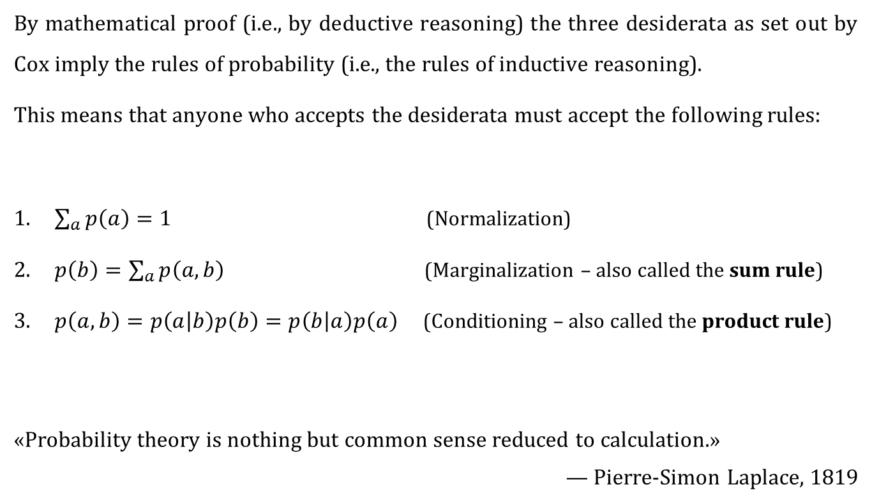
The rules of probability
By mathematical proof (i.e., by deductive reasoning) the three desiderata as set out by Cox imply the rules of probability (i.e., the rules of inductive reasoning).
This means that anyone who accepts the desiderata must accept the following rules:
$\sum_{a}{p\left(a\right)=1}$ (Normalization)
$p\left(b\right)=\sum_{a}{p\left(a,b\right)}$ (Marginalization – also called the sum rule)
$p\left(a,b\right)=p\left(a | b\right)p\left(b\right)=p\left(b | a\right)p\left(a\right)$ (Conditioning – also called the product rule)
«Probability theory is nothing but common sense reduced to calculation.»
— Pierre-Simon Laplace, 1819

Slide 8
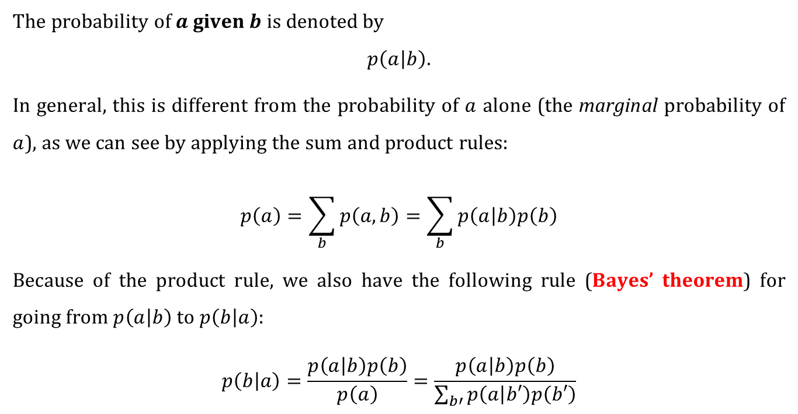
Conditional probabilities
The probability of $a$ given $b$ is denoted by
$$p\left(a | b\right).$$
In general, this is different from the probability of $a$ alone (the marginal probability of $a$), as we can see by applying the sum and product rules:
$$p\left(a\right)=\sum_{b}{p\left(a,b\right)=\sum_{b}{p\left(a | b\right)p\left(b\right)}}$$
Because of the product rule, we also have the following rule (Bayes’ theorem) for going from $p\left(a | b\right)$ to $p\left(b | a\right)$:
$$p\left(b | a\right)=\frac{p\left(a | b\right)p\left(b\right)}{p\left(a\right)}=\frac{p\left(a | b\right)p\left(b\right)}{\sum_{b′}{p\left(a | b′\right)p\left(b′\right)}}$$

Slide 9
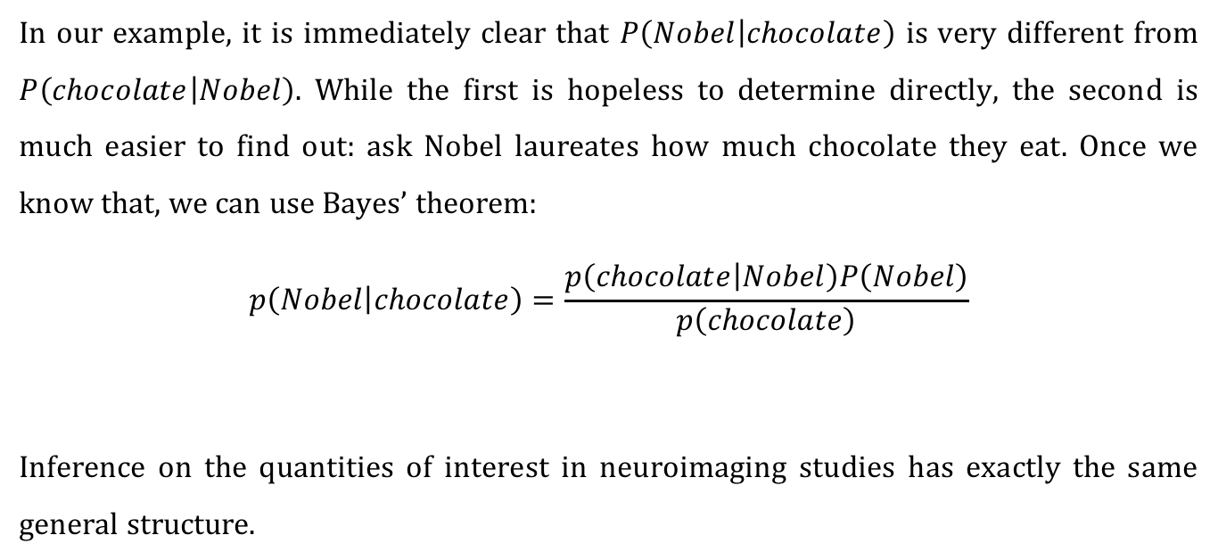
The chocolate example
In our example, it is immediately clear that $P\left(Nobel | chocolate\right)$ is very different from $P\left(chocolate | Nobel\right)$. While the first is hopeless to determine directly, the second is much easier to find out: ask Nobel laureates how much chocolate they eat. Once we know that, we can use Bayes’ theorem:
$$p\left(Nobel | chocolate\right)=\frac{p\left(chocolate | Nobel\right)P\left(Nobel\right)}{p\left(chocolate\right)}$$
Inference on the quantities of interest in neuroimaging studies has exactly the same general structure.
likelihood
model
prior
posterior
evidence

Slide 10
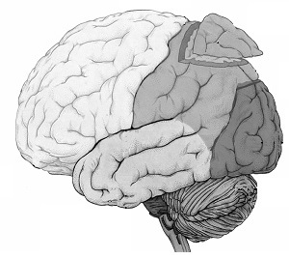
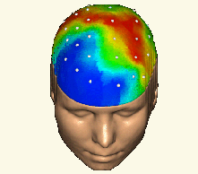


Inference in SPM
forward problem
$$p\left(y | θ,m\right)$$
likelihood
posterior distribution
$$p\left(θ | y,m\right)$$
inverse problem
Notes:
10

Slide 11
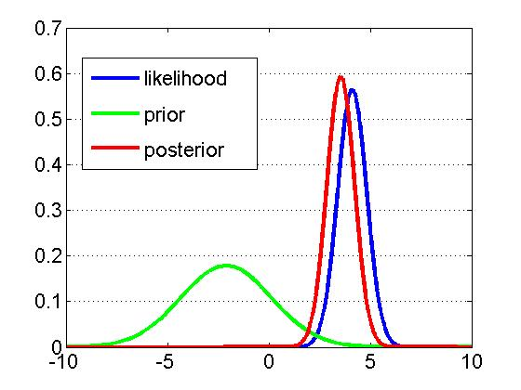


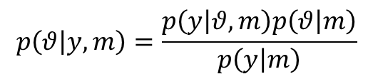

Inference in SPM
Likelihood:
$$p\left(y | θ,m\right)$$
Prior:
$$p\left(θ | m\right)$$
$$p\left(θ | y,m\right)=\frac{p\left(y | θ,m\right)p\left(θ | m\right)}{p\left(y | m\right)}$$
Bayes’ theorem:
generative model $m$

Slide 12


A simple example of Bayesian inference
(adapted from Jaynes (1976))
Two manufacturers, A and B, deliver the same kind of components that turn out to have the following lifetimes (in hours):
A:
B:
Assuming prices are comparable, from which manufacturer would you buy?

Slide 13
A simple example of Bayesian inference
How do we compare such samples?
By comparing their arithmetic means
Why do we take means?
If we take the mean as our estimate, the error in our estimate is the mean of the errors in the individual measurements
Taking the mean as maximum-likelihood estimate implies a Gaussian error distribution
A Gaussian error distribution appropriately reflects our prior knowledge about the errors whenever we know nothing about them except perhaps their variance

Slide 14








A simple example of Bayesian inference
What next?
Let’s do a t-test (but first, let’s compare variances with an F-test):
Is this satisfactory? No, so what can we learn by turning to probability theory (i.e., Bayesian inference)?
Variances not significantly different!
Means not significantly different!

Slide 15
A simple example of Bayesian inference
The procedure in brief:
Determine your question of interest («What is the probability that...?»)
Specify your model (likelihood and prior)
Calculate the full posterior using Bayes’ theorem
[Pass to the uninformative limit in the parameters of your prior]
Integrate out any nuisance parameters
Ask your question of interest of the posterior
All you need is the rules of probability theory.
(Ok, sometimes you’ll encounter a nasty integral – but that’s a technical difficulty, not a conceptual one).

Slide 16
A simple example of Bayesian inference
The question:
What is the probability that the components from manufacturer B have a longer lifetime than those from manufacturer A?
More specifically: given how much more expensive they are, how much longer do I require the components from B to live.
Example of a decision rule: if the components from B live 3 hours longer than those from A with a probability of at least 80%, I will choose those from B.

Slide 17
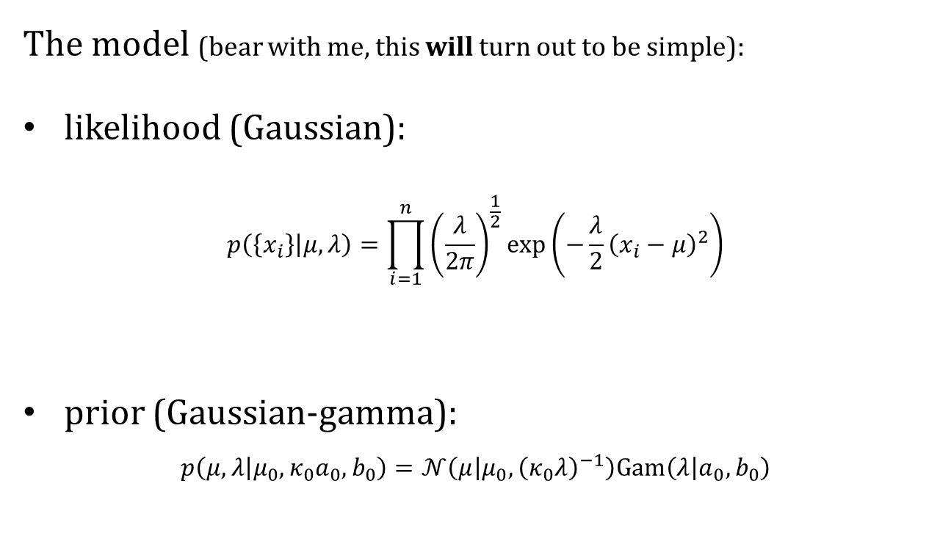
A simple example of Bayesian inference
The model (bear with me, this will turn out to be simple):
likelihood (Gaussian):
$$p\left(\left\{x_{i}\right\} | μ,λ\right)=\prod_{i=1}^{n}{{\left(\frac{λ}{2π}\right)}^{\frac{1}{2}}}\exp\left(−\frac{λ}{2}{\left(x_{i}−μ\right)}^{2}\right)$$
prior (Gaussian-gamma):
$$p\left(μ,λ | μ_{0},κ_{0}a_{0},b_{0}\right)=𝒩\left(μ | μ_{0},{\left(κ_{0}λ\right)}^{−1}\right)Gam\left(λ | a_{0},b_{0}\right)$$

Slide 18

A simple example of Bayesian inference
The posterior (Gaussian-gamma):
$$p\left(μ,λ | \left\{x_{i}\right\}\right)=𝒩\left(μ | μ_{n},{\left(κ_{n}λ\right)}^{−1}\right)Gam\left(λ | a_{n},b_{n}\right)$$
Parameter updates:
$$μ_{n}=μ_{0}+\frac{n}{κ_{0}+n}\left(\overline{x}−μ_{0}\right), κ_{n}=κ_{0}+n, a_{n}=a_{0}+\frac{n}{2}$$
$$b_{n}=b_{0}+\frac{n}{2}\left(s^{2}+\frac{κ_{0}}{κ_{0}+n}{\left(\overline{x}−μ_{0}\right)}^{2}\right)$$
with
$$\overline{x}≔\frac{1}{n}\sum_{i=1}^{n}{x_{i}}, s^{2}≔\frac{1}{n}\sum_{i=1}^{n}{{\left(x_{i}−\overline{x}\right)}^{2}}$$

Slide 19
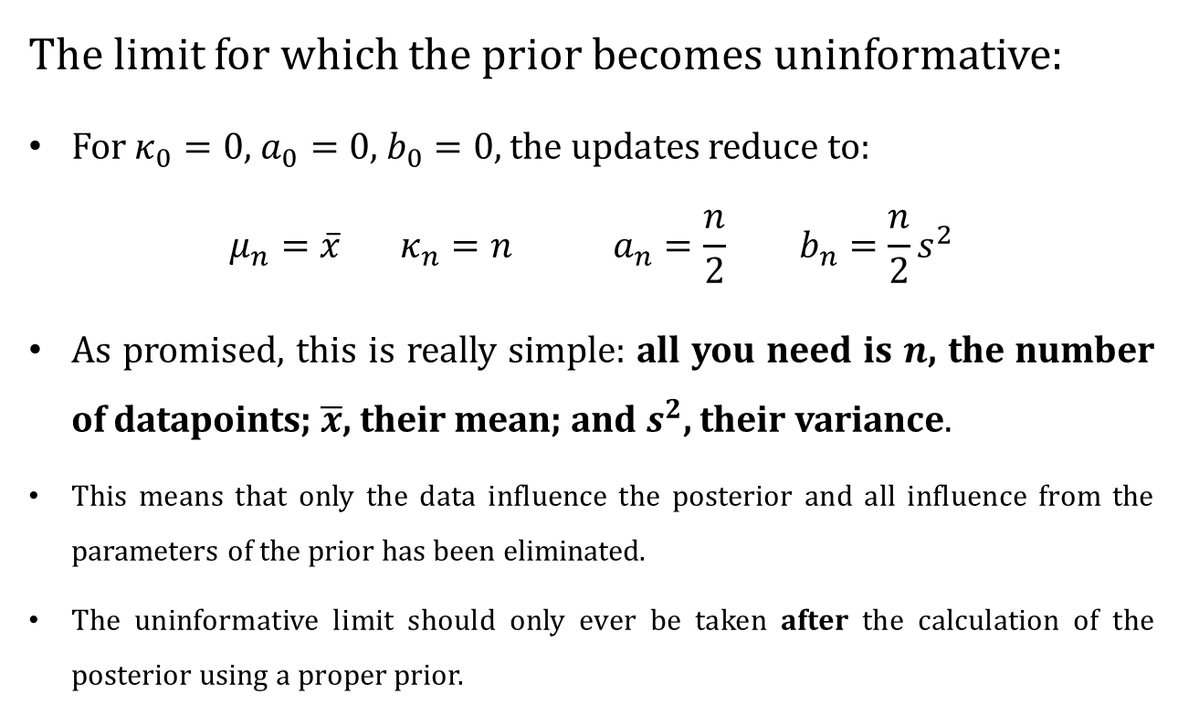
A simple example of Bayesian inference
The limit for which the prior becomes uninformative:
For $κ_{0}=0$, $a_{0}=0$, $b_{0}=0$, the updates reduce to:
$$μ_{n}=\overline{x} κ_{n}=n a_{n}=\frac{n}{2} b_{n}=\frac{n}{2}s^{2}$$
As promised, this is really simple: all you need is $n$, the number of datapoints; $\overline{x}$, their mean; and $s^{2}$, their variance.
This means that only the data influence the posterior and all influence from the parameters of the prior has been eliminated.
The uninformative limit should only ever be taken after the calculation of the posterior using a proper prior.

Slide 20
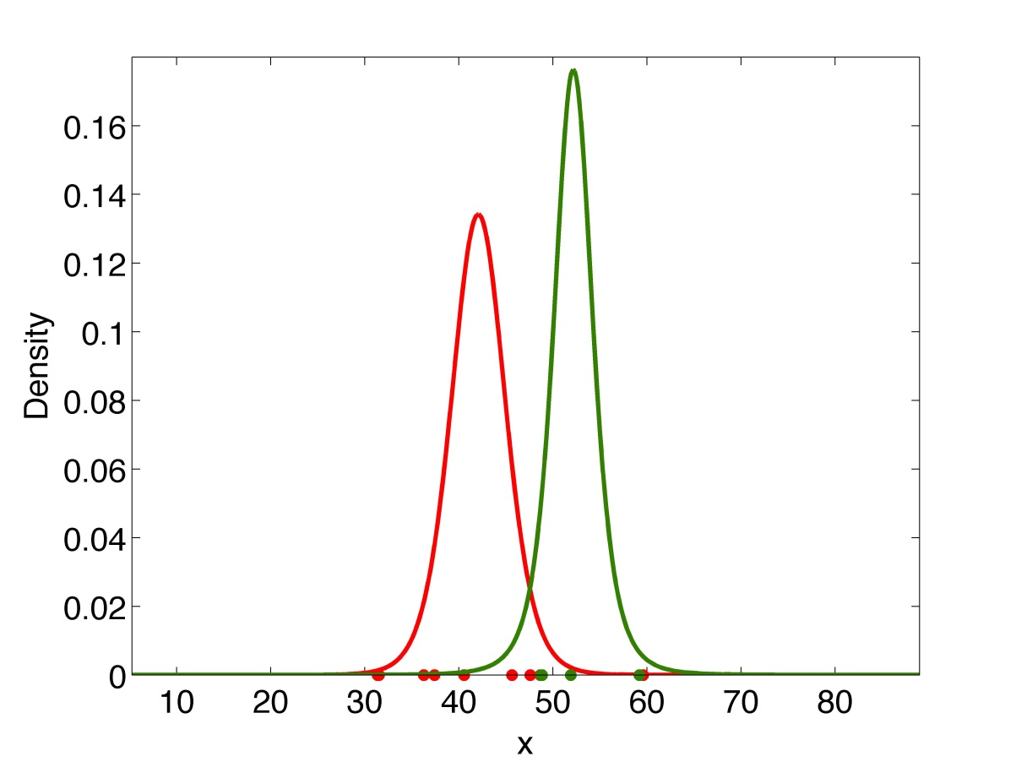
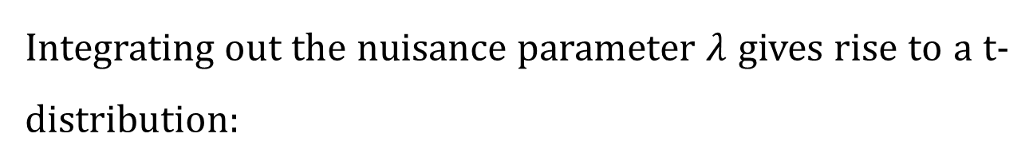
A simple example of Bayesian inference
Integrating out the nuisance parameter $λ$ gives rise to a t-distribution:

Slide 21
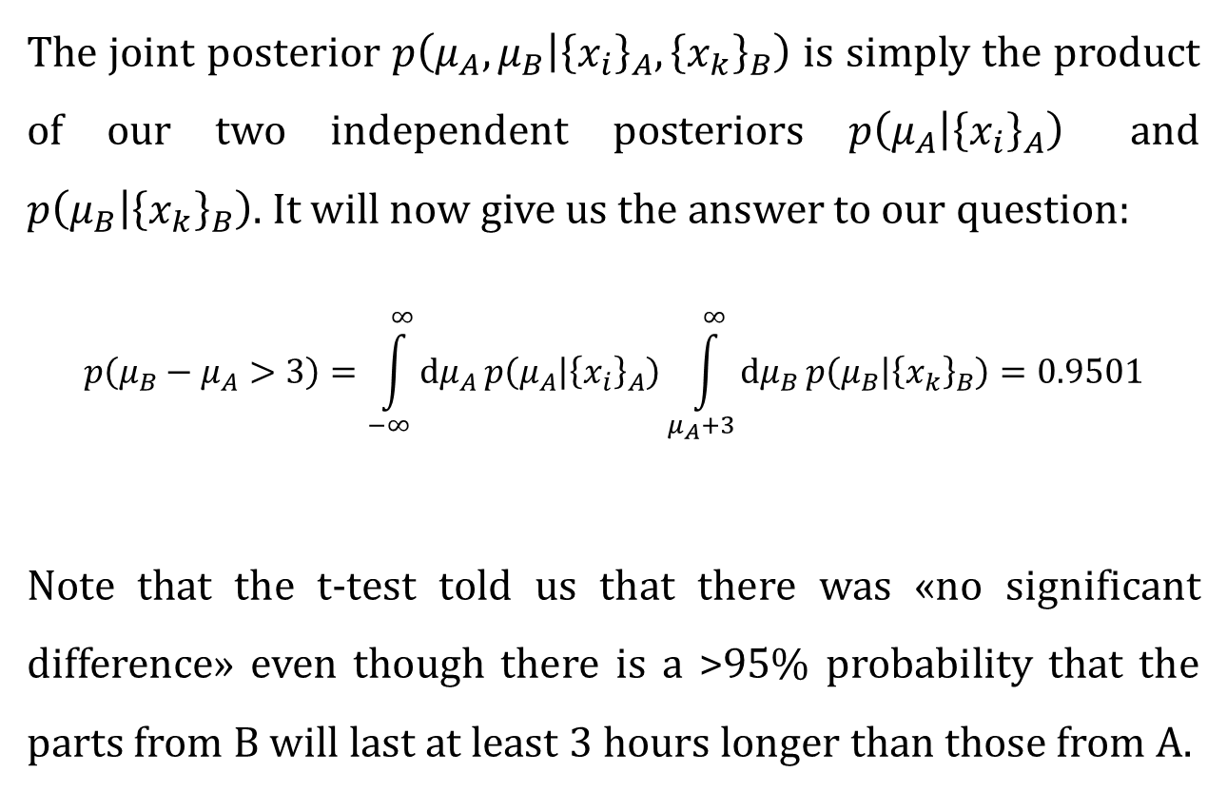
A simple example of Bayesian inference
The joint posterior $p\left(μ_{A},μ_{B} | {\left\{x_{i}\right\}}_{A},{\left\{x_{k}\right\}}_{B}\right)$ is simply the product of our two independent posteriors $p\left(μ_{A} | {\left\{x_{i}\right\}}_{A}\right)$ and $p\left(μ_{B} | {\left\{x_{k}\right\}}_{B}\right)$. It will now give us the answer to our question:
$$p\left(μ_{B}−μ_{A}>3\right)=\int_{−∞}^{∞}{dμ_{A}}p\left(μ_{A} | {\left\{x_{i}\right\}}_{A}\right)\int_{μ_{A}+3}^{∞}{dμ_{B}}p\left(μ_{B} | {\left\{x_{k}\right\}}_{B}\right)=0.9501$$
Note that the t-test told us that there was «no significant difference» even though there is a >95% probability that the parts from B will last at least 3 hours longer than those from A.

Slide 22
Bayesian inference
The procedure in brief:
Determine your question of interest («What is the probability that...?»)
Specify your model (likelihood and prior)
Calculate the full posterior using Bayes’ theorem
[Pass to the uninformative limit in the parameters of your prior]
Integrate out any nuisance parameters
Ask your question of interest of the posterior
All you need is the rules of probability theory.

Slide 23
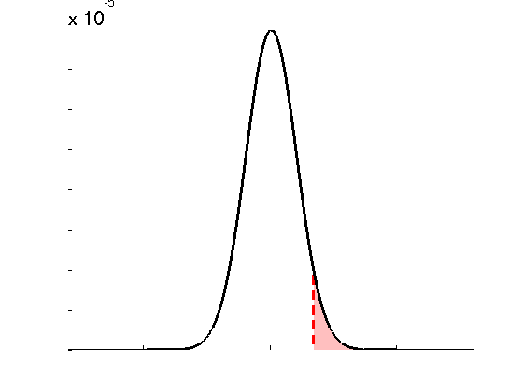
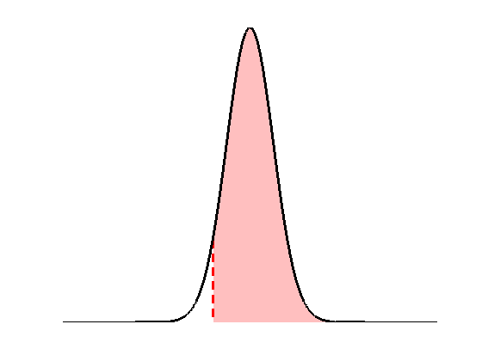













Frequentist (or: orthodox, classical) versus Bayesian inference: hypothesis testing
Classical
Bayesian
• define the null, e.g.:
$$H_{0}:θ=0$$
• invert model (obtain posterior pdf)
$$p\left(t | H_{0}\right)$$
$$p\left(θ | y\right)$$
$$p\left(H_{0} | y\right)$$
$$p\left(t>t^{∗} | H_{0}\right)$$
$$t≡t\left(Y\right)$$
$$θ$$
$$t^{∗}$$
$$θ_{0}$$
• estimate parameters (obtain test stat. $t^{∗}$)
• define the null, e.g.:
$$H_{0}:θ>θ_{0}$$
• apply decision rule, i.e.:
• apply decision rule, i.e.:
if
$$p\left(t>t^{∗} | H_{0}\right)≤α$$
then reject H₀
if
$$p\left(H_{0} | y\right)≥α$$
then accept H₀

Slide 24
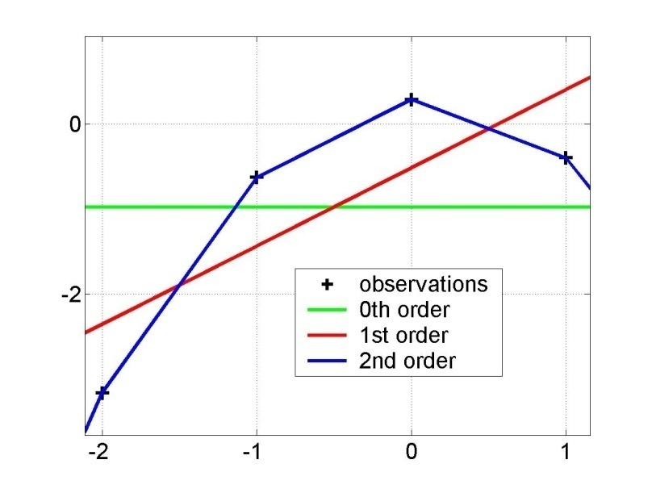
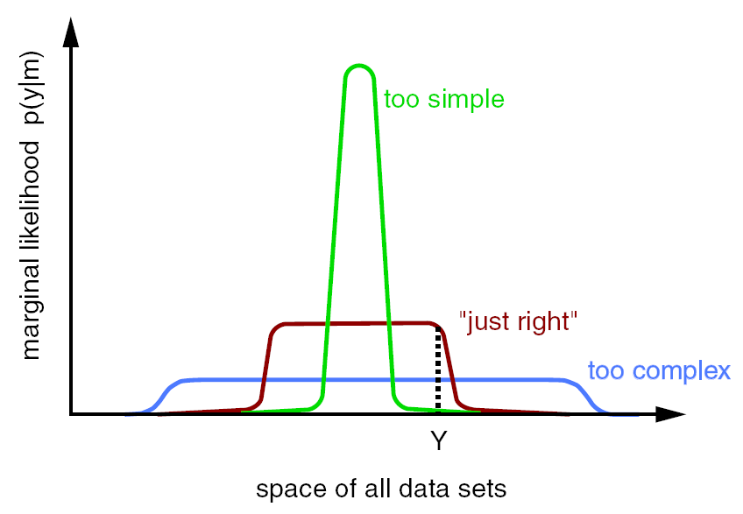
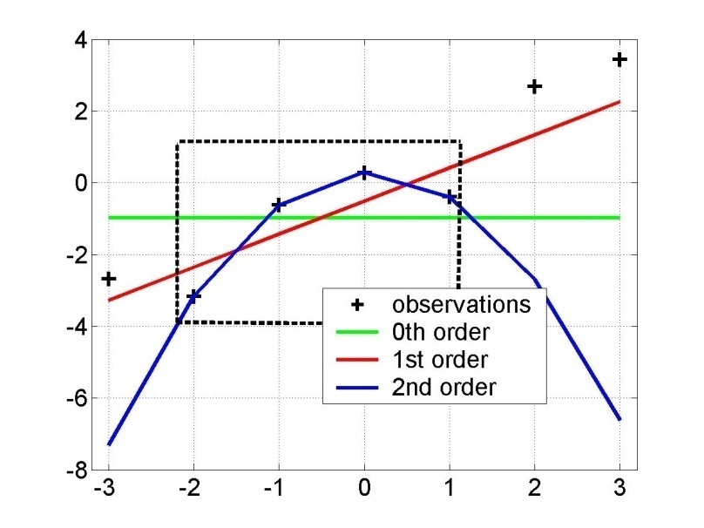
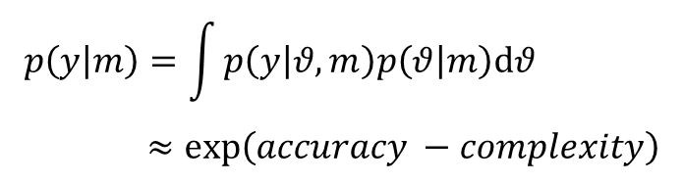
Model comparison: general principles
Principle of parsimony: «plurality should not be assumed without necessity»
Automatically enforced by Bayesian model comparison
Model evidence:
$$p\left(y | m\right)=\int{p\left(y | θ,m\right)p\left(θ | m\right)dθ} \\ ≈exp\left(accuracy −complexity\right)$$
y = f(x)
“Occam’s razor” :
x
model evidence p(y|m)
y=f(x)
space of all data sets

Slide 25
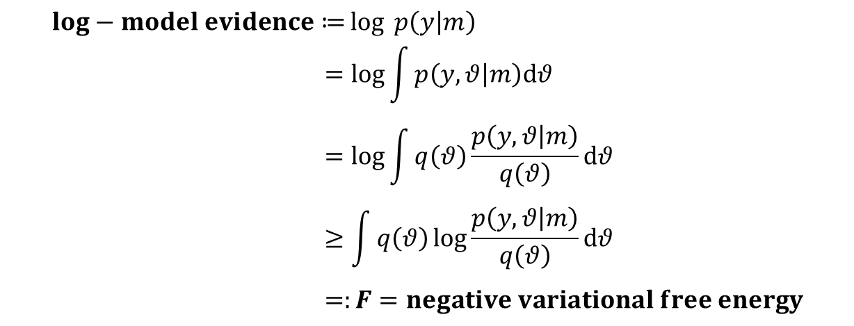

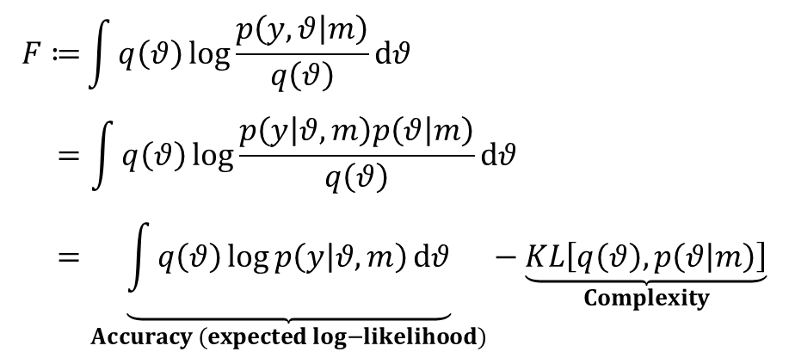
Model comparison: negative variational free energy F
$$log−model evidence≔\log{ p\left(y | m\right)} \\ =\log{\int{p\left(y,θ | m\right)dθ}} \\ =\log{\int{q\left(θ\right)\frac{p\left(y,θ | m\right)}{q\left(θ\right)}dθ}} \\ ≥\int{q\left(θ\right)\log{\frac{p\left(y,θ | m\right)}{q\left(θ\right)}}dθ} \\ =:F=negative variational free energy$$
sum rule
a lower bound on the
log-model evidence
multiply by $1=\frac{q\left(θ\right)}{q\left(θ\right)}$
Jensen’s inequality
$$F≔\int{q\left(θ\right)\log{\frac{p\left(y,θ | m\right)}{q\left(θ\right)}}dθ} \\ =\int{q\left(θ\right)\log{\frac{p\left(y | θ,m\right)p\left(θ | m\right)}{q\left(θ\right)}}dθ} \\ =\underset{Accuracy (expected log−likelihood)}{\underbrace{\int{q\left(θ\right)\log{p\left(y | θ,m\right)}dθ}}}−\underset{Complexity}{\underbrace{KL\left[q\left(θ\right),p\left(θ | m\right)\right]}}$$
Kullback-Leibler divergence
product rule

Slide 26
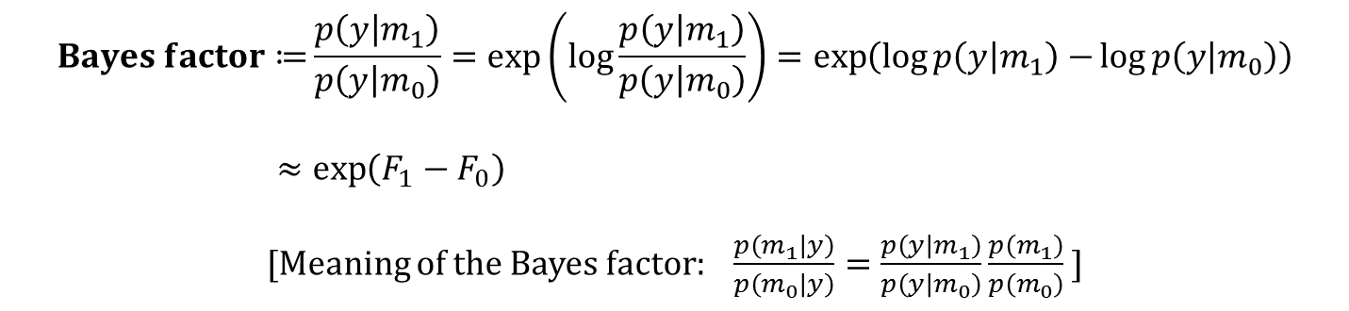
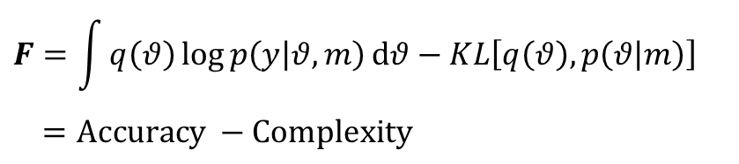
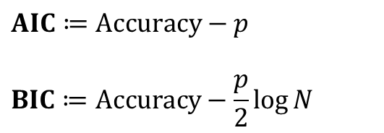
Model comparison: F in relation to Bayes factors, AIC, BIC
$$Bayes factor≔\frac{p\left(y | m_{1}\right)}{p\left(y | m_{0}\right)}=\exp\left(\log{\frac{p\left(y | m_{1}\right)}{p\left(y | m_{0}\right)}}\right)=\exp\left(\log{p\left(y | m_{1}\right)−}\log{p\left(y | m_{0}\right)}\right) \\ ≈\exp\left(F_{1}−F_{0}\right)$$
[Meaning of the Bayes factor: $\frac{p\left(m_{1} | y\right)}{p\left(m_{0} | y\right)}=\frac{p\left(y | m_{1}\right)}{p\left(y | m_{0}\right)}\frac{p\left(m_{1}\right)}{p\left(m_{0}\right)}$ ]
Bayes factor
Posterior odds
Prior odds
$$F=\int{q\left(θ\right)\log{p\left(y | θ,m\right)}dθ}−KL\left[q\left(θ\right),p\left(θ | m\right)\right] \\ =Accuracy −Complexity$$
$$AIC≔Accuracy−p \\ BIC≔Accuracy−\frac{p}{2}\log{N}$$
Number of parameters
Number of data points

Slide 27
A note on informative priors
Any model consists of two parts: likelihood and prior.
The choice of likelihood requires as much justification as the choice of prior because it is just as «subjective» as that of the prior.
The data never speak for themselves. They only acquire meaning when seen through the lens of a model. However, this does not mean that all is subjective because models differ in their validity.
In this light, the widespread concern that informative priors might bias results (while the form of the likelihood is taken as a matter of course requiring no justification) is misplaced.
Informative priors are an important tool and their use can be justified by establishing the validity (face, construct, and predictive) of the resulting model as well as by model comparison.

Slide 28
A note on uninformative priors
Using a flat or «uninformative» prior doesn’t make you more «data-driven» than anybody else. It’s a choice that requires just as much justification as any other.
For example, if you’re studying a small effect in a noisy setting, using a flat prior means assigning the same prior probability mass to the interval covering effect sizes -1 to +1 as to that covering effect sizes +999 to +1001.
Far from being unbiased, this amounts to a bias in favor of implausibly large effect sizes. Using flat priors is asking for a replicability crisis.
One way to address this is to collect enough data to swamp the inappropriate priors. A cheaper way is to use more appropriate priors.
Disclaimer: if you look at my papers, you will find flat priors.

Slide 29
Applications of Bayesian inference

Slide 30
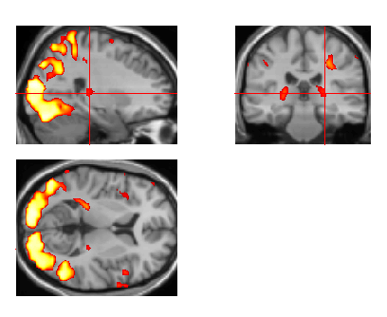

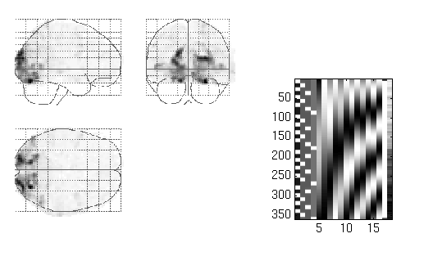
segmentation
and normalisation
posterior probability
maps (PPMs)
dynamic causal
modelling
multivariate
decoding
realignment
smoothing
general linear model
statistical
inference
Gaussian
field theory
normalisation
p <0.05
template

Slide 31
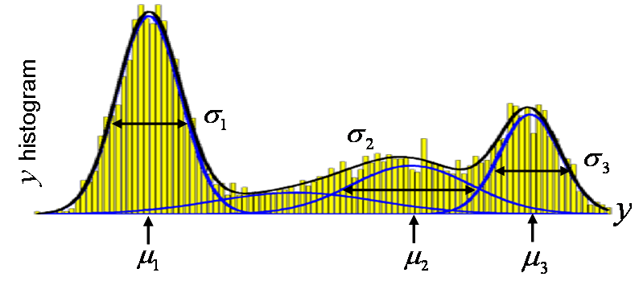
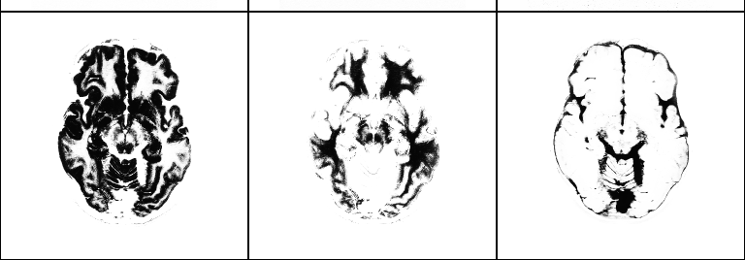
Segmentation (mixture of Gaussians-model)
class variances
…
i^{th} voxel
label
…
i^{th} voxel
value
class
frequencies
class
means
grey matter
white matter
CSF

Slide 32
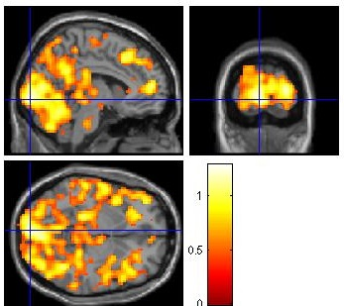
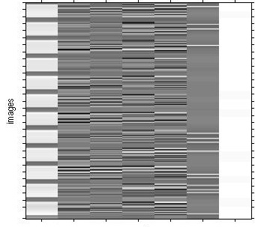
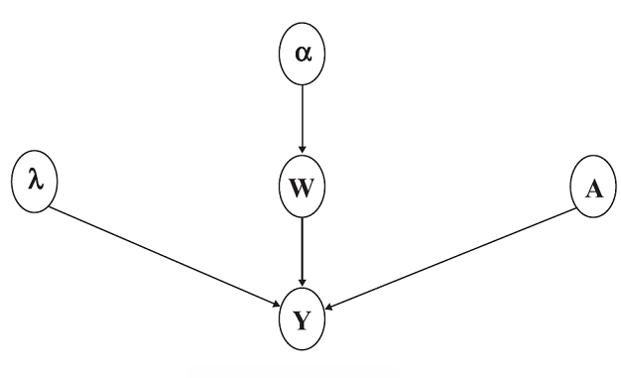
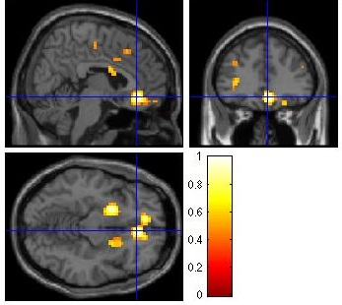
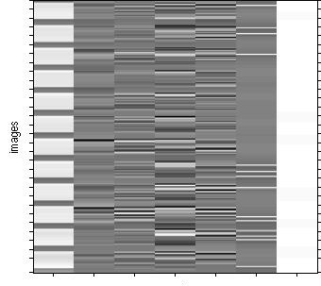
fMRI time series analysis
PPM: regions best explained
by short-term memory model
short-term memory
design matrix (X)
prior variance
of GLM coeff
prior variance
of data noise
AR coeff
(correlated noise)
GLM coeff
PPM: regions best explained by long-term memory model
fMRI time series
long-term memory
design matrix (X)

Slide 33
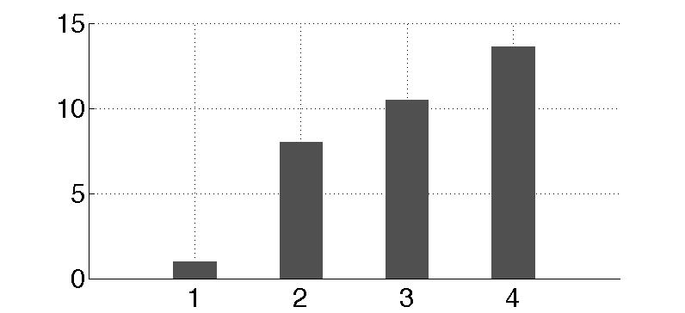
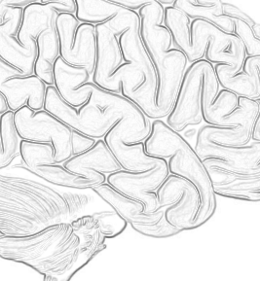
Dynamic causal modeling (DCM)
m₁
m₂
m₃
m₄
attention
attention
attention
attention
PPC
PPC
PPC
PPC
stim
V1
V5
stim
V1
V5
stim
V1
V5
stim
V1
V5
attention
models marginal likelihood
0.10
estimated
effective synaptic strengths
for best model (m₄)
15
PPC
0.39
10
1.25
0.26
stim
0.26
V1
0.13
V5
5
0.46
0
m₁
m₂
m₃
m₄

Slide 34
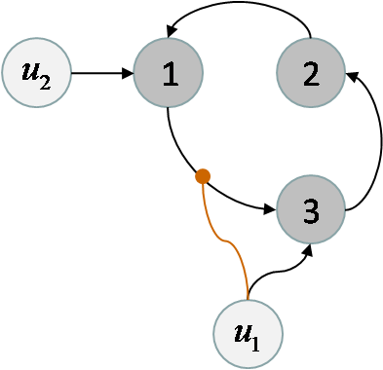
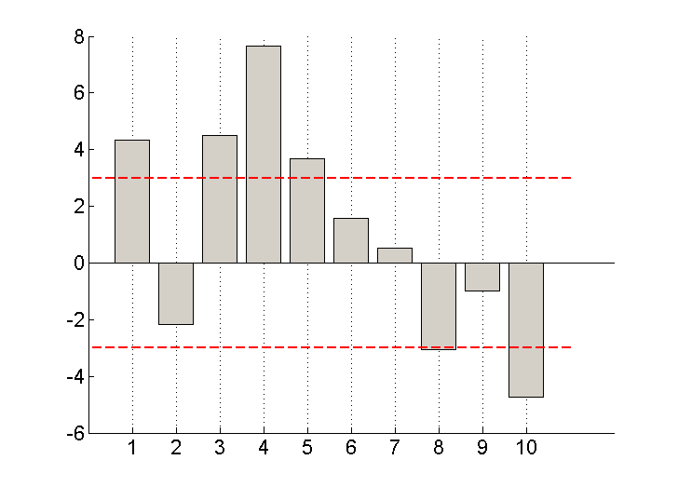
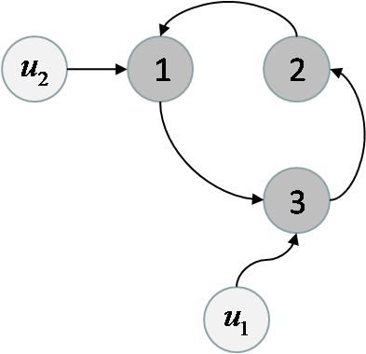
Model comparison for group studies
m₁
differences in log- model evidences
m₂
subjects
Fixed effect
Assume all subjects correspond to the same model
Random effect
Assume different subjects might correspond to different models

Slide 35
Thanks

Slide 36
60% of the time, it works *all* the time...

