Slide 1



DCM for fMRI – Advanced Topics
Klaas Enno Stephan

Slide 2
Overview
DCM: recap of some basic concepts
Evolution of DCM for fMRI
Bayesian model selection (BMS)
Translational Neuromodeling
With many thanks for slides to Peter Zeidman

Slide 3
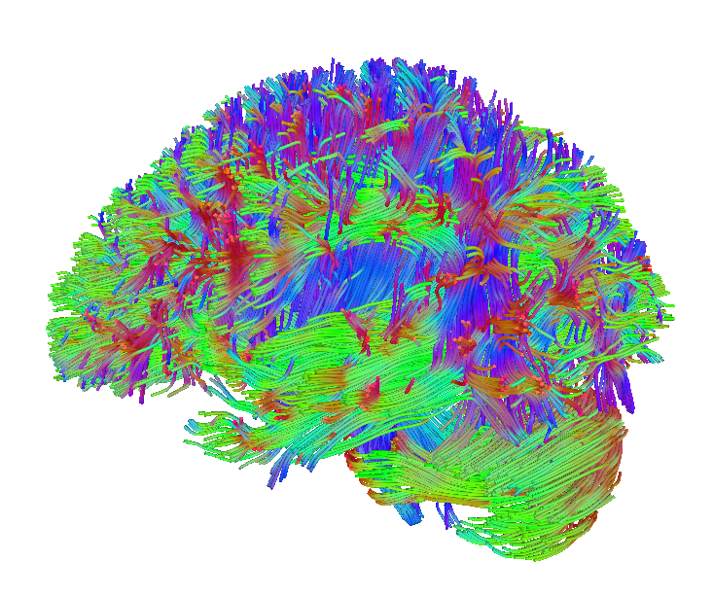
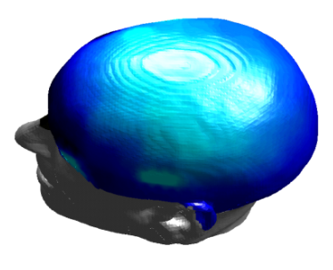
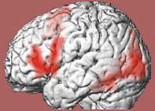
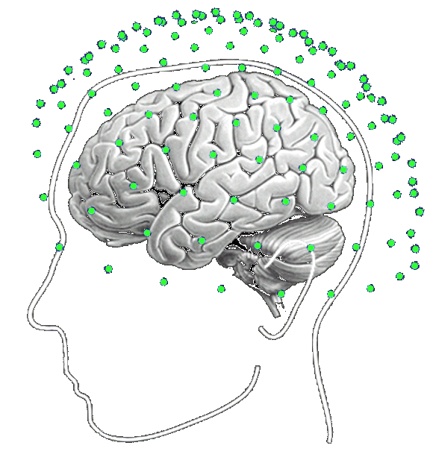
Dynamic causal modeling (DCM)
dwMRI
EEG, MEG
fMRI
structural priors
structural priors
Forward model:
Predicting measured activity
Model inversion:
Estimating neuronal mechanisms
Friston et al. 2003, NeuroImage
Notes:
DWI: http://dsi-studio.labsolver.org/Manual/use-image-data-from-human-connectome-project

Slide 4
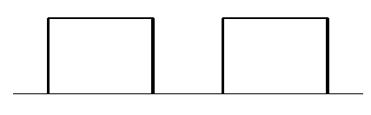
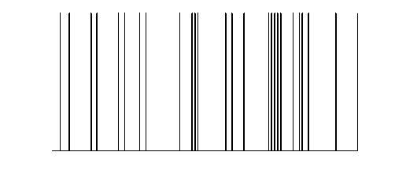
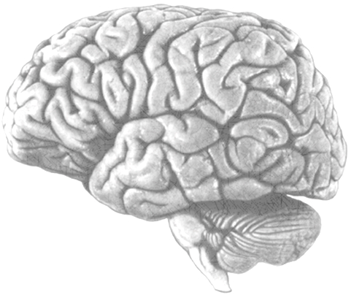
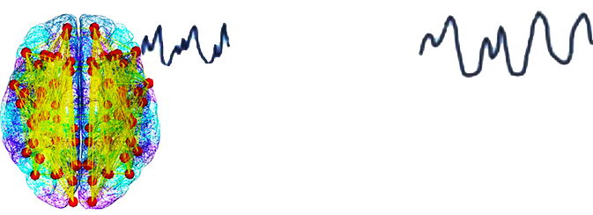
Modulatory input
Driving input
u₂(t)
Neuronal state equation
u₁(t)
t
t
$$\dot{x}=\left(A+\sum{u_{j}B^{\left(j\right)}}\right)x+Cu$$
$$x_{2}(t)$$
endogenous
connectivity
$$A=\frac{∂\dot{x}}{∂x}$$
$$x_{1}(t)$$
modulation of
connectivity
$$B^{(j)}=\frac{∂}{∂u_{j}}\frac{∂\dot{x}}{∂x}$$
$$x_{3}(t)$$
direct inputs
$$C=\frac{∂\dot{x}}{∂u}$$
Local hemodynamic
state equations
Neuronal states
$$x_{i}(t)$$
$$\dot{s}=x−κs−γ\left(f−1\right)$$
vasodilatory
signal and flow
induction (rCBF)
$$\dot{f}=s$$
Hemodynamic model
$$f$$
Balloon model
$$τ\dot{ν}=f−ν^{1/α}$$
$ν_{i}(t)$ and $q_{i}(t)$
$$τ\dot{q}=fE(f,E_{0})/E_{0}−ν^{1/α}q/ν$$
Changes in volume ($ν$)
and dHb ($q$)
BOLD signal change equation
BOLD signal
$$y=V_{0}\left[k_{1}\left(1−q\right)+k_{2}\left(1−\frac{q}{ν}\right)+k_{3}\left(1−ν\right)\right]+e$$
Stephan et al. 2015,
Neuron
y(t)
with $k_{1}=4.3θ_{0}E_{0}TE$, $k_{2}=εr_{0}E_{0}TE$, $k_{3}=1−ε$

Slide 5
Bayesian system
identification
Design experimental inputs
Neural dynamics
Define likelihood model
Observer function
Specify priors
Inference on model structure
Invert model
Inference on parameters
Make inferences

Slide 6
Solutions to previous weaknesses of DCM
vulnerability to local extrema → global optimisation :
  MCMC:
    Sengupta et al 2016, NeuroImage
    Aponte et al. 2016, J Neurosci Methods
  Gaussian processes:
  Lomakina et al. 2015, NeuroImage
choice of priors → hierarchical models (empirical Bayes)
  Friston et al. 2016, NeuroImage
  Raman et al. 2016, J Neurosci Methods
restricted to small systems → regression DCM
  Frässle et al. 2017, NeuroImage

Slide 7
Overview
DCM: basic concepts
Evolution of DCM for fMRI
Bayesian model selection (BMS)
Translational Neuromodeling

Slide 8
The evolution of DCM in SPM
DCM is not one specific model, but a framework for Bayesian inversion of dynamic system models
The implementation in SPM has been evolving over time, e.g.
  improvements of numerical routines (e.g., optimisation scheme)
  change in priors to cover new variants (e.g., stochastic DCMs)
  changes of hemodynamic model
To enable replication of your results, you should state which SPM version (release number) you are using when publishing papers.

Slide 9
Factorial structure of model specification
Three dimensions of model specification:
  bilinear vs. nonlinear
  single-state vs. two-state (per region)
  deterministic vs. stochastic

Slide 10
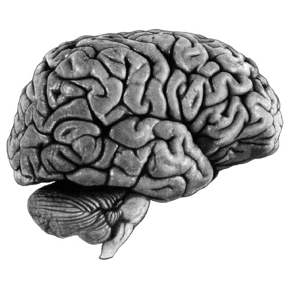
bilinear DCM
non-linear DCM
modulation
driving
input
driving
input
modulation
Two-dimensional Taylor series (around x₀=0, u₀=0):
Bilinear state equation:
Nonlinear state equation:

Slide 11
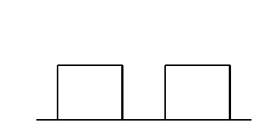
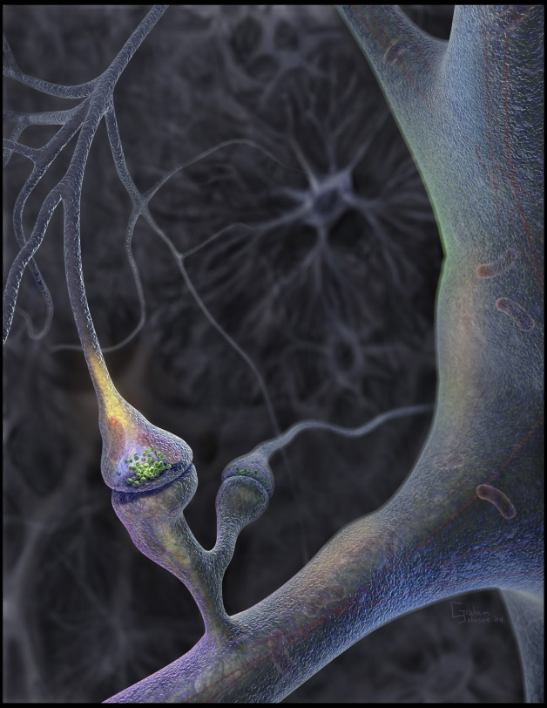
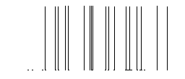
Neural population activity
u₂
u₁
x₃
fMRI signal change (%)
x₁
x₂
Nonlinear Dynamic Causal Model for fMRI
Stephan et al. 2008, NeuroImage

Slide 12
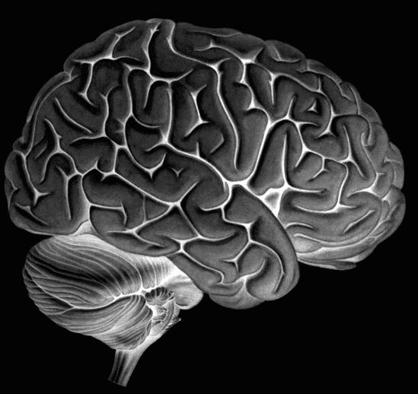
Two-state DCM
Single-state DCM
Two-state DCM
input
Extrinsic (between-region) coupling
Intrinsic (within-region) coupling
Marreiros et al. 2008, NeuroImage

Slide 13
Estimates of hidden causes and states
(Generalised filtering)
Stochastic DCM
all states are represented in generalised coordinates of motion
random state fluctuations w^{(x)} account for endogenous fluctuations,
have unknown precision and smoothness
→ two hyperparameters
fluctuations w^{(v)} induce uncertainty about how inputs influence neuronal activity
can be fitted to resting state data
Li et al. 2011, NeuroImage

Slide 14
Spectral DCM
deterministic model that generates predicted cross-spectra in a distributed neuronal network or graph
  cross-spectra: Fourier transform of cross-correlation
finds the effective connectivity among hidden neuronal states that best explains the observed functional connectivity among hemodynamic responses
advantage: replaces an optimisation problem wrt. stochastic differential equations with a deterministic approach from linear systems theory
→ computationally very efficient
disadvantage: assumes stationarity
Friston et al. 2014, NeuroImage

Slide 15
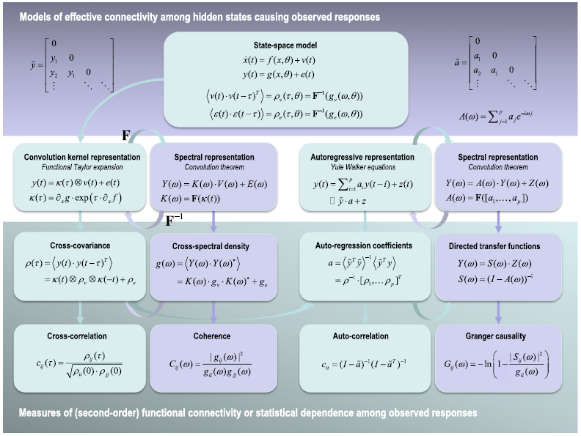
cross-spectra
= Fourier transform of cross-correlation
cross-correlation
= generalized form of correlation (at zero lag, this is the conventional measure of functional connectivity)
Friston et al. 2014, NeuroImage

Slide 16
DCM for fMRI using a canonical microcircuit
Friston et al. 2017, NeuroImage

Slide 17
Generating multimodal predictions from the same neuronal model
Friston et al. 2017, NeuroImage

Slide 18
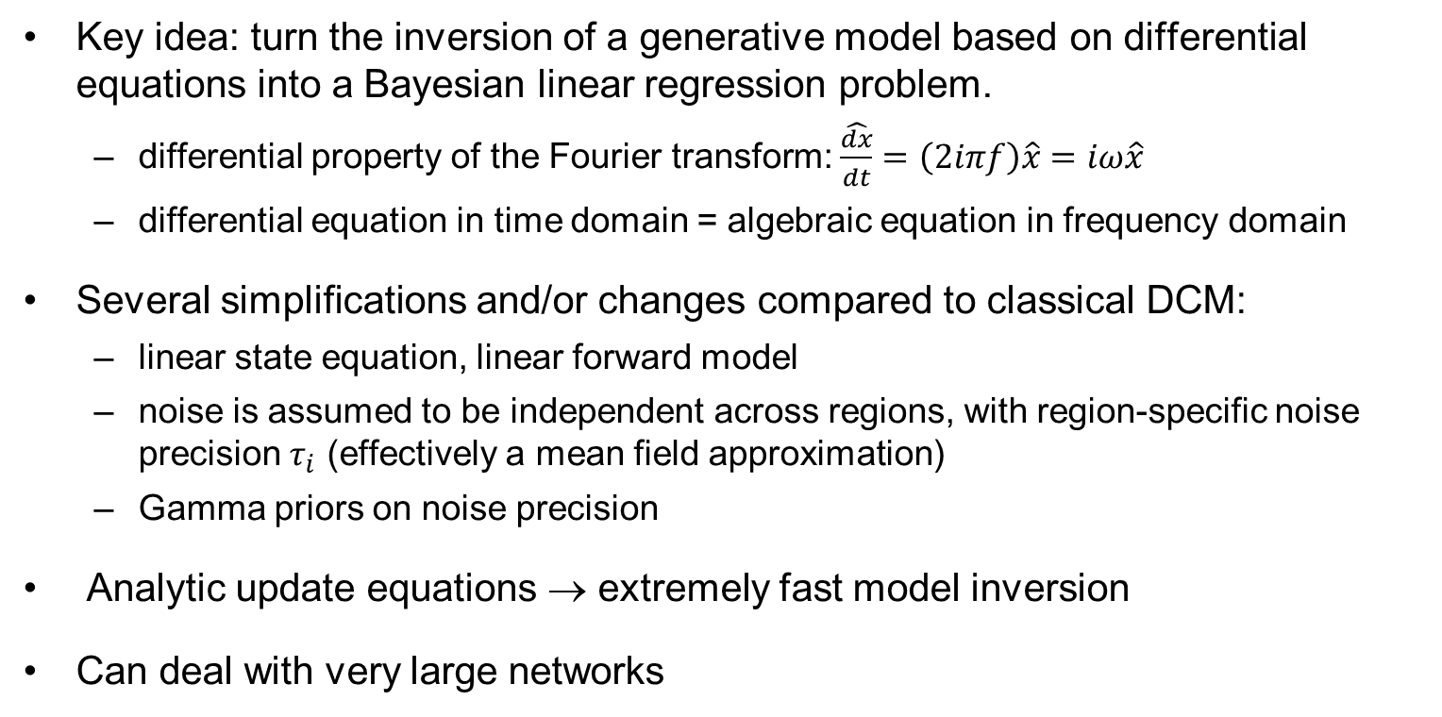
Regression DCM
Key idea: turn the inversion of a generative model based on differential equations into a Bayesian linear regression problem.
  differential property of the Fourier transform: $\hat{\frac{dx}{dt}}=\left(2iπf\right)\hat{x}=iω\hat{x}$
  differential equation in time domain = algebraic equation in frequency domain
Several simplifications and/or changes compared to classical DCM:
  linear state equation, linear forward model
  noise is assumed to be independent across regions, with region-specific noise precision $τ_{i}$ (effectively a mean field approximation)
  Gamma priors on noise precision
Analytic update equations → extremely fast model inversion
Can deal with very large networks
Frässle et al. 2017, NeuroImage

Slide 19
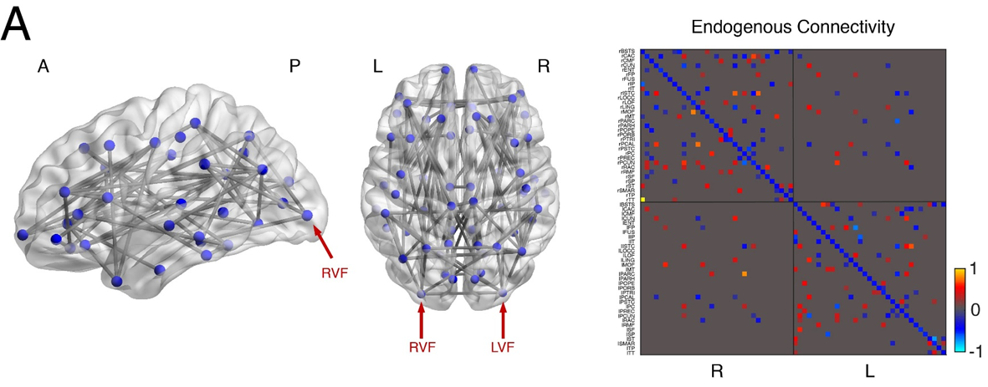
Regression DCM
66 areas
300 parameters
compute time: 1-3 s
Frässle et al. 2017, NeuroImage

Slide 20
Overview
DCM: basic concepts
Evolution of DCM for fMRI
Bayesian model selection (BMS)
Translational Neuromodeling

Slide 21
Generative models & model selection
any DCM = a particular generative model of how the data (may) have been caused
generative modelling: comparing competing hypotheses about the mechanisms underlying observed data
  a priori definition of hypothesis set (model space) is crucial
  determine the most plausible hypothesis (model), given the data
model selection ≠ model validation!
  model validation requires external criteria (external to the measured data)

Slide 22
Bayesian model selection (BMS)
Model evidence:
Gharamani, 2004
p(y|m)
y
“If I randomly sampled from my prior and plugged the resulting value into the likelihood function, how close would the predicted data be – on average – to my observed data?”
all possible datasets
Various approximations to log evidence:
negative free energy, AIC, BIC
accounts for both accuracy and complexity of the model
McKay 1992, Neural Comput.
Penny et al. 2004a, NeuroImage

Slide 23
Bayes factors
To compare two models, we could just compare their log evidences.
But: the log evidence is just some number – not very intuitive!
A more intuitive interpretation of model comparisons is made possible by Bayes factors:
positive value, [0; ∞[
B₁₂ | p(m₁|y) | Evidence
1 to 3 | 50-75% | weak
3 to 20 | 75-95% | positive
20 to 150 | 95-99% | strong
≥ 150 | ≥ 99% | Very strong
Kass & Raftery classification:
Kass & Raftery 1995, J. Am. Stat. Assoc.

Slide 24
Fixed effects BMS at group level
Group Bayes factor (GBF) for 1...K subjects:
Average Bayes factor (ABF):
Problems:
blind with regard to group heterogeneity
sensitive to outliers
Stephan et al. 2007, NeuroImage

Slide 25
Random effects BMS for heterogeneous groups
Dirichlet parameters α
= “occurrences” of models in the population
Dirichlet distribution of model probabilities r
Multinomial distribution of model labels m
Model inversion by Variational Bayes (VB) or MCMC
Measured data y
Stephan et al. 2009a, NeuroImage
Penny et al. 2010, PLoS Comp. Biol.

Slide 26
m₂
LD
LD|LVF
m₁
MOG
FG
FG
MOG
MOG
FG
FG
MOG
LD|RVF
LD|LVF
LD
LD
LG
LG
LG
LG
RVF
stim.
LD
LVF
stim.
RVF
stim.
LD|RVF
LVF
stim.
m₂
m₁
Data: Stephan et al. 2003, Science
Models: Stephan et al. 2007, J. Neurosci.

Slide 27
m₂
m₁
Stephan et al. 2009a, NeuroImage

Slide 28
Overfitting at the level of models
↑ #models ⇒ ↑ risk of overfitting
solutions:
  regularisation: definition of model space = choosing priors p(m)
  family-level BMS
  Bayesian model averaging (BMA)
posterior model probability:
BMA:

Slide 29
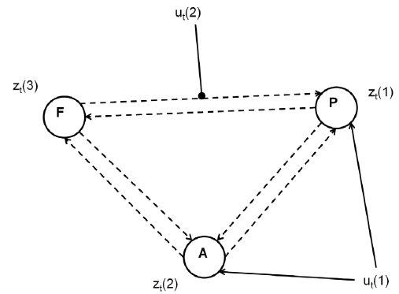
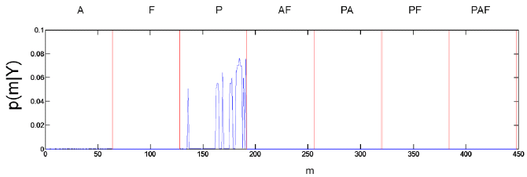
Comparing model families – a second example
data from Leff et al. 2008, J. Neurosci
one driving input, one modulatory input
2⁶ = 64 possible modulations
2³ – 1 input patterns
7×64 = 448 models
integrate out uncertainty about modulatory patterns and ask where auditory input enters
Penny et al. 2010, PLoS Comput. Biol.

Slide 30
Model space partitioning:
comparing model families
m₂
m₁
m₁
m₂
Stephan et al. 2009, NeuroImage

Slide 31
Bayesian Model Averaging (BMA)
abandons dependence of parameter inference on a single model and takes into account model uncertainty
represents a particularly useful alternative
  when none of the models (or model subspaces) considered clearly outperforms all others
  when comparing groups for which the optimal model differs
single-subject BMA:
group-level BMA:
NB: p(m|y_{1..N}) can be obtained by either FFX or RFX BMS
Penny et al. 2010, PLoS Comput. Biol.

Slide 32
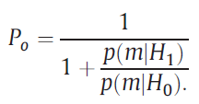
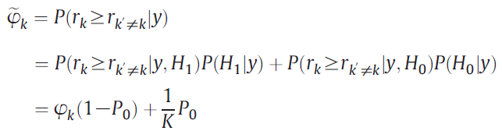
Protected exceedance probability (EP):
Using BMA to protect against chance findings
EPs express our confidence that the posterior probabilities of models are different – under the hypothesis H₁ that models differ in probability: r_{k}≠1/K
does not account for possibility "null hypothesis" H₀: r_{k}=1/K
Bayesian omnibus risk (BOR) of wrongly accepting H₁ over H₀:
protected EP: Bayesian model averaging over H₀ and H₁:
Rigoux et al. 2014, NeuroImage

Slide 33
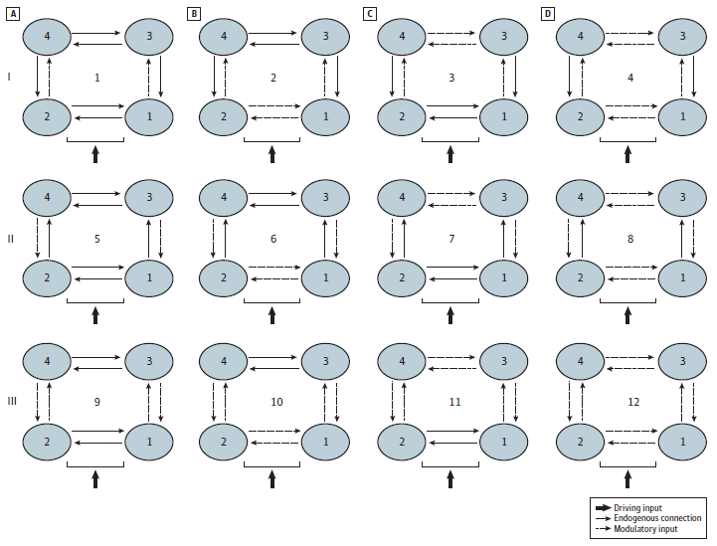
Prefrontal-parietal connectivity during working memory in schizophrenia
17 at-risk mental state (ARMS) individuals
21 first-episode patients
(13 non-treated)
20 controls
Schmidt et al. 2013, JAMA Psychiatry

Slide 34
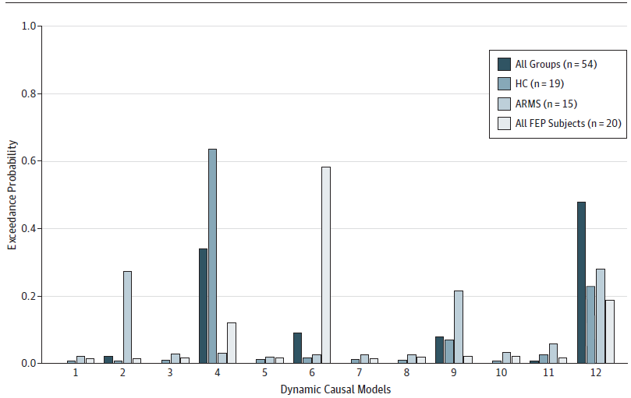
BMS results for all groups
Schmidt et al. 2013, JAMA Psychiatry

Slide 35
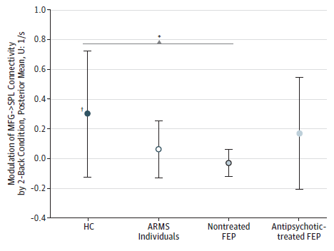
BMA results: PFC → PPC connectivity
17 ARMS, 21 first-episode (13 non-treated), 20 controls
Schmidt et al. 2013, JAMA Psychiatry
Notes:
we cannot be absolutely sure that in this case the B parameters encode synaptic plasticity
clinical scores did not differ between treated and non-treated FEPs: Brief Psychiatric Rating Scale (BPRS)³⁷, the Scale for the Assessment of Negative Symptoms (SANS)³⁸ and the Global Assessment of Functioning (GAF)

Slide 36
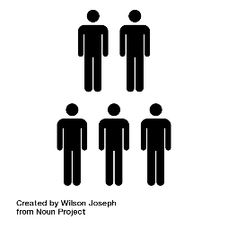
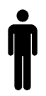


Parametric Empirical Bayes (PEB)
Group
Mean
Disease
First level DCM
Image credit: Wilson Joseph from Noun Project
Friston et al. 2016, NeuroImage
PEB slides courtesy of Peter Zeidman

Slide 37



Parametric Empirical Bayes (PEB)
Priors on second level parameters
Second level
Between-subject error
Second level (linear) model
First level
Measurement noise
DCM for subject i
Friston et al. 2016, NeuroImage

Slide 38


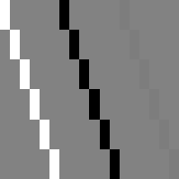
Parametric Empirical Bayes (PEB)
Design matrix
(covariates)
Matrix of DCM
connections
Between-subjects (X)
Within-subjects (W)
(1)
⊗
X
K
5
1
1
10
2
2
3
3
15
Connection
Connection
Subject
20
4
4
25
5
5
30
6
6
1
2
3
2
4
6
5
10
15
Covariate
Connection
PEB Parameter
X (between-subject): overall mean, group differences, age etc.
W (within-subject): parameters that show random effects

Slide 39
Parametric Empirical Bayes (PEB)
model space is defined by specifying which parameters are enabled
Note:
random effects approach in parameters, not models (random parametric effects).
Litvak et al. 2016,
Frontiers

Slide 40
Relative advantages of RFX BMS and PEB
RFX BMS (spm_bms)
  treats models as random effects in the population
  directly applicable to any type of model (DCMs, behavioural models, etc.)
  can deal with non-nested models (structurally different likelihoods)
PEB (spm_dcm_peb)
  treats parameters (of a full model) as random effects in the population
  fast method for exhaustive comparison of a set of nested models
  empirical Bayesian approach reduces problems of choosing priors
Notes:
Also:
RFX BMS can use either MCMC or VB (at subject- and group-level)
RFX BMS has established procedures to deal with overfitting problems (in model space); overfitting in models space may be a problem for PEB (a very large number of models is tested implicitly)

Slide 41
Overview
DCM: basic concepts
Evolution of DCM for fMRI
Bayesian model selection (BMS)
Translational Neuromodeling

Slide 42
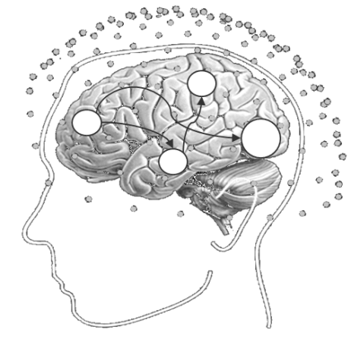





❶
Computational assays:
Models of disease mechanisms
Translational Neuromodeling
❹
Individual treatment prediction
❸
Detecting physiological subgroups
(based on inferred mechanisms)
❷
Application to brain activity and behaviour of individual patients
• disease mechanism A
• disease mechanism B
• disease mechanism C
Stephan et al. 2015, Neuron

Slide 43
Model-based predictions for single patients
model structure
DA
BMS
parameter estimates
model-based decoding
(generative embedding)
Notes:
Overall, Bayesian model selection is a generic and powerful procedure that has found widespread application in machine learning and neuroimaging. However, as every method, it has limitations and there are cases when it cannot be used at all. For these cases, we have been developing a new approach which we colloquially refer to as “model-based decoding”. This approach rests on using a model for theory-guided dimensionality reduction and selecting those data features which are used subsequently for classification. Here, different models can be compared, by cross-validation, in terms of how well their parameters preserve information about the relevant class labels.

Slide 44
Model-based differential diagnosis
SYMPTOM
(behaviour
or physiology)
HYPOTHETICAL
MECHANISM
...
...
Stephan et al. 2017, NeuroImage

Slide 45
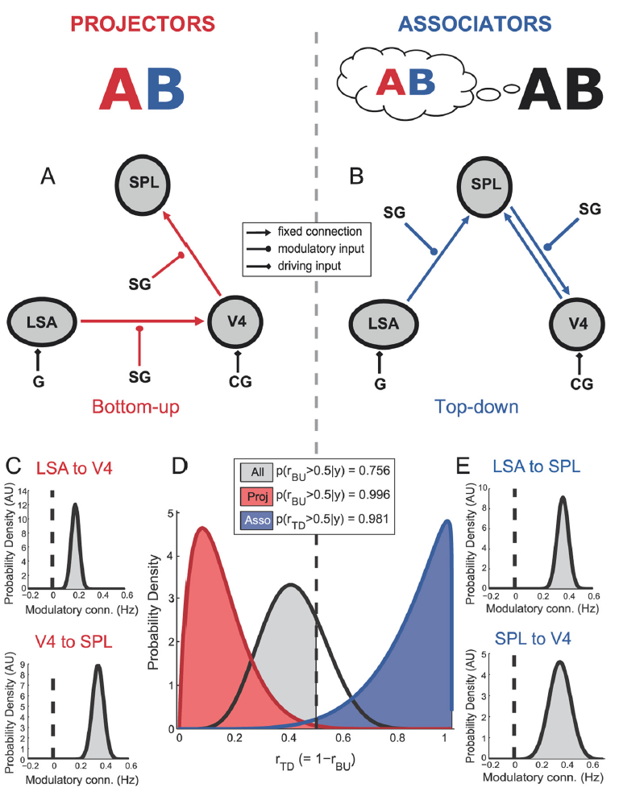
Synaesthesia
“projectors” experience color externally colocalized with a presented grapheme
“associators” report an internally evoked association
across all subjects: no evidence for either model
but BMS results map precisely onto projectors (bottom-up mechanisms) and associators (top-down)
van Leeuwen et al. 2011, J. Neurosci.

Slide 46
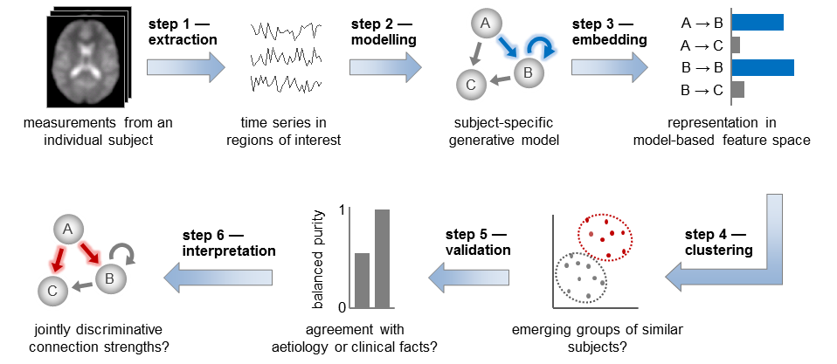
Generative embedding (unsupervised): detecting patient subgroups
Brodersen et al. 2014, NeuroImage: Clinical

Slide 47
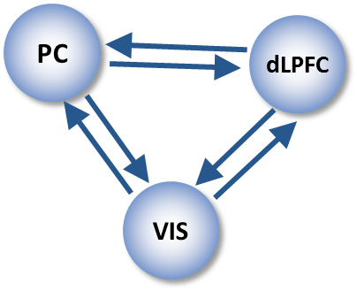
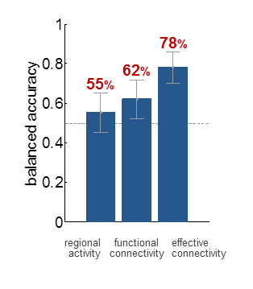
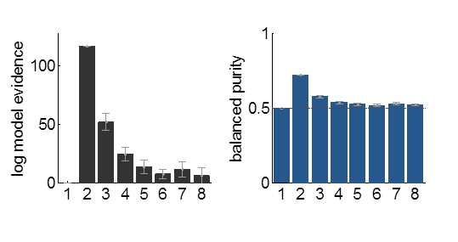
Generative embedding of variational Gaussian Mixture Models
Supervised:
SVM classification
Unsupervised:
GMM clustering
71%
number of clusters
number of clusters
42 controls vs. 41 schizophrenic patients
fMRI data from working memory task (Deserno et al. 2012, J. Neurosci)
Brodersen et al. (2014) NeuroImage: Clinical

Slide 48
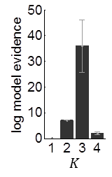
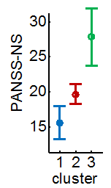
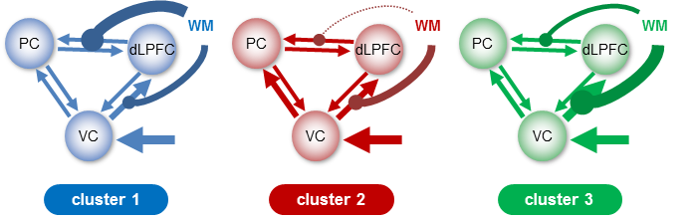
Detecting subgroups of patients in schizophrenia
Optimal cluster solution
three distinct subgroups (total N=41)
subgroups differ (p < 0.05) wrt. negative symptoms on the positive and negative symptom scale (PANSS)
Brodersen et al. (2014) NeuroImage: Clinical

Slide 49
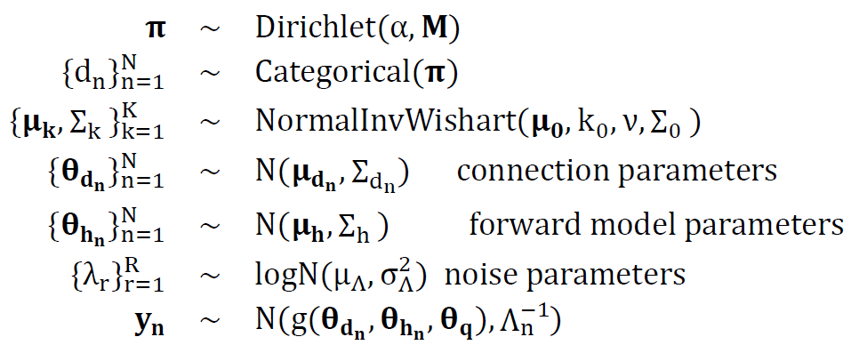
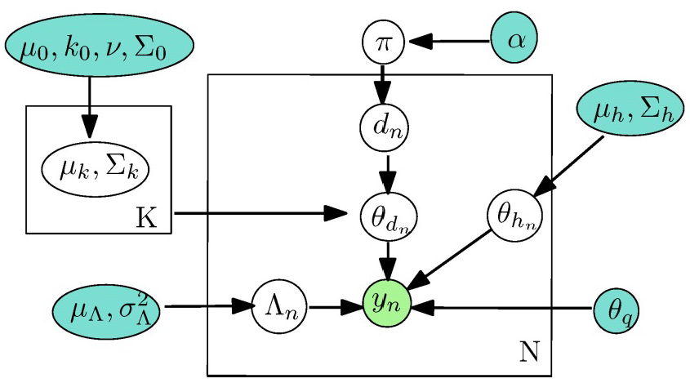
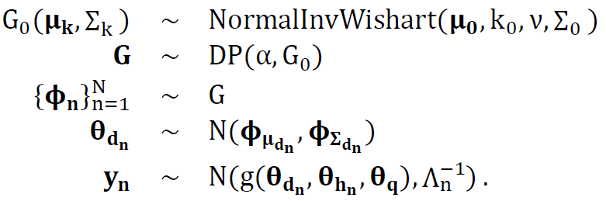
A hierarchical model for unsupervised generative embedding and empirical Bayes
Finite mixture model:
Infinite mixture model:
Raman et al. 2016, J. Neurosci. Methods

Slide 50
Further reading: DCM for fMRI and BMS – part 1
Aponte EA, Raman S, Sengupta B, Penny WD, Stephan KE, Heinzle J (2016) mpdcm: A toolbox for massively parallel dynamic causal modeling. J Neurosci Methods 257:7-16.
Brodersen KH, Schofield TM, Leff AP, Ong CS, Lomakina EI, Buhmann JM, Stephan KE (2011) Generative embedding for model-based classification of fMRI data. PLoS Computational Biology 7: e1002079.
Brodersen KH, Deserno L, Schlagenhauf F, Lin Z, Penny WD, Buhmann JM, Stephan KE (2014) Dissecting psychiatric spectrum disorders by generative embedding. NeuroImage: Clinical 4: 98-111
Daunizeau J, David, O, Stephan KE (2011) Dynamic Causal Modelling: A critical review of the biophysical and statistical foundations. NeuroImage 58: 312-322.
Daunizeau J, Stephan KE, Friston KJ (2012) Stochastic Dynamic Causal Modelling of fMRI data: Should we care about neural noise? NeuroImage 62: 464-481.
Frässle S, Lomakina EI, Razi A, Friston KJ, Buhmann JM, Stephan KE (2017) Regression DCM for fMRI. doi: 10.1016/j.neuroimage.2017.02.090
Friston KJ, Harrison L, Penny W (2003) Dynamic causal modelling. NeuroImage 19:1273-1302.
Friston K, Stephan KE, Li B, Daunizeau J (2010) Generalised filtering. Mathematical Problems in Engineering 2010: 621670.
Friston KJ, Li B, Daunizeau J, Stephan KE (2011) Network discovery with DCM. NeuroImage 56: 1202–1221.
Friston K, Penny W (2011) Post hoc Bayesian model selection. Neuroimage 56: 2089-2099.
Friston KJ, Litvak V, Oswal A, Razi A, Stephan KE, van Wijk BC, Ziegler G, Zeidman P (2016) Bayesian model reduction and empirical Bayes for group (DCM) studies. NeuroImage 128:413-431.
Friston KJ, Preller KH, Mathys C, Cagnan H, Heinzle J, Razi A, Zeidman P (2017) Dynamic causal modelling revisited. NeuroImage, doi: 10.1016/j.neuroimage.2017.02.045.
Heinzle J, Koopmans PJ, den Ouden HE, Raman S, Stephan KE (2016) A hemodynamic model for layered BOLD signals. Neuroimage 125:556-570.
Kiebel SJ, Kloppel S, Weiskopf N, Friston KJ (2007) Dynamic causal modeling: a generative model of slice timing in fMRI. NeuroImage 34:1487-1496.
Li B, Daunizeau J, Stephan KE, Penny WD, Friston KJ (2011) Stochastic DCM and generalised filtering. NeuroImage 58: 442-457
Lomakina EI, Paliwal S, Diaconescu AO, Brodersen KH, Aponte EA, Buhmann JM, Stephan KE (2015) Inversion of Hierarchical Bayesian models using Gaussian processes. NeuroImage 118: 133-145.
Marreiros AC, Kiebel SJ, Friston KJ (2008) Dynamic causal modelling for fMRI: a two-state model. NeuroImage 39:269-278.

Slide 51
Further reading: DCM for fMRI and BMS – part 2
Penny WD, Stephan KE, Mechelli A, Friston KJ (2004a) Comparing dynamic causal models. NeuroImage 22:1157-1172.
Penny WD, Stephan KE, Mechelli A, Friston KJ (2004b) Modelling functional integration: a comparison of structural equation and dynamic causal models. NeuroImage 23 Suppl 1:S264-274.
Penny WD, Stephan KE, Daunizeau J, Joao M, Friston K, Schofield T, Leff AP (2010) Comparing Families of Dynamic Causal Models. PLoS Computational Biology 6: e1000709.
Penny WD (2012) Comparing dynamic causal models using AIC, BIC and free energy. Neuroimage 59: 319-330.
Raman S, Deserno L, Schlagenhauf F, Stephan KE (2016) A hierarchical model for integrating unsupervised generative embedding and empirical Bayes. J Neurosci Methods 269: 6-20.
Rigoux L, Stephan KE, Friston KJ, Daunizeau J (2014) Bayesian model selection for group studies – revisited. NeuroImage 84: 971-985.
Stephan KE, Weiskopf N, Drysdale PM, Robinson PA, Friston KJ (2007) Comparing hemodynamic models with DCM. NeuroImage 38:387-401.
Stephan KE, Kasper L, Harrison LM, Daunizeau J, den Ouden HE, Breakspear M, Friston KJ (2008) Nonlinear dynamic causal models for fMRI. NeuroImage 42:649-662.
Stephan KE, Penny WD, Daunizeau J, Moran RJ, Friston KJ (2009a) Bayesian model selection for group studies. NeuroImage 46:1004-1017.
Stephan KE, Tittgemeyer M, Knösche TR, Moran RJ, Friston KJ (2009b) Tractography-based priors for dynamic causal models. NeuroImage 47: 1628-1638.
Stephan KE, Penny WD, Moran RJ, den Ouden HEM, Daunizeau J, Friston KJ (2010) Ten simple rules for Dynamic Causal Modelling. NeuroImage 49: 3099-3109.
Stephan KE, Iglesias S, Heinzle J, Diaconescu AO (2015) Translational Perspectives for Computational Neuroimaging. Neuron 87: 716-732.
Stephan KE, Schlagenhauf F, Huys QJ, Raman S, Aponte EA, Brodersen KH, Rigoux L, Moran RJ, Daunizeau J, Dolan RJ, Friston KJ, Heinz A.(2017) Computational neuroimaging strategies for single patient predictions. NeuroiIage 145: 180-199.

Slide 52
Thank you

