Slide 1



DCM for resting state fMRI
SPM Course May 2017
Adeel Razi
Wellcome Trust Centre for Neuroimaging
Institute of Neurology
University College London
a.razi@ucl.ac.uk
www.adeelrazi.org
@adeelrazi

Slide 2
OUTLINE
Introduction and background
(Spectral) Dynamic Causal Modelling
Technical / Mathematical Content
Worked example using SPM
DMN connectivity
What’s new?
Large DCMs
Applications
Cognitive / Psychiatric

Slide 3
OUTLINE
Introduction and background
(Spectral) Dynamic Causal Modelling
Technical / Mathematical Content
Worked example using SPM
DMN connectivity
What’s new?
Large DCMs
Applications
Cognitive / Psychiatric

Slide 4
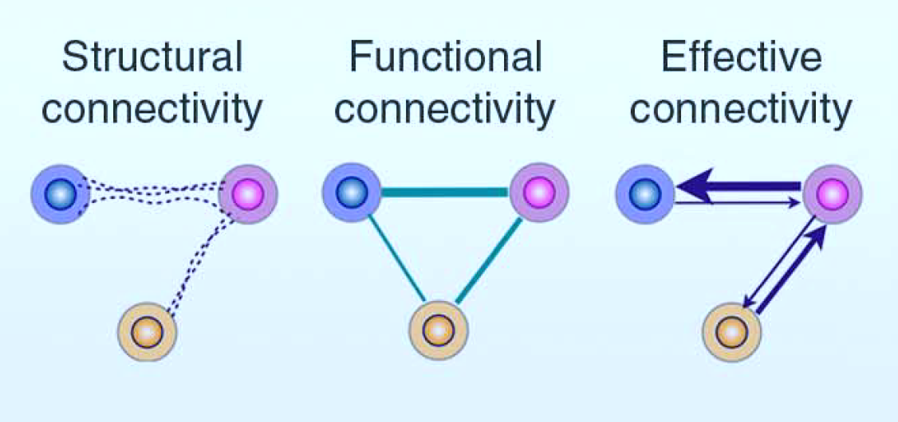
Brain connectivity structural, functional and effective
Structural connectivity
presence of axonal connections
Functional connectivity
statistical dependencies between regional time series
Effective connectivity
causal (directed) influences between neuronal populations
Notes:
Structural connectivity: Which can be measured by using diffusion MRI and probabilistic tractography methods. However, it is not possible with the availbale methods to know the direction of the structural connectivity – they are like two way pathways.
Functional connectivity: represent statistical dependence between the regional time series. The most common example being cross correlations or coherence. These are undirected by definition.
IMPORTANT: It is possible that two regions are not structurally connected but they still have functional dependence.
From now on I will focus on the functional and effective connectivity and the intimate relationships between them.

Slide 5
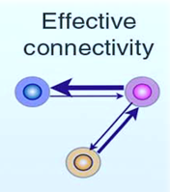
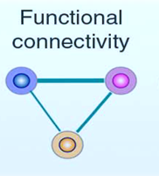
Brain connectivity structural, functional and effective
Relationship between functional and effective connectivity
Mapping
Hidden causes
Measured consequences

Slide 6

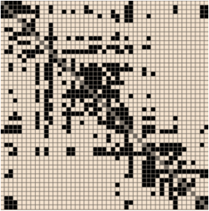
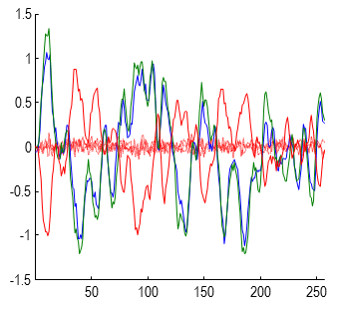
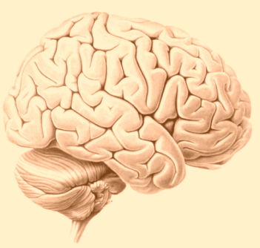
DCM for task fMRI classic DCM
External
stimulus
The forward (dynamic causal) model
Observed timeseries
Deterministic system
Ordinary differential equation (ODE)

Slide 7
DCM for task fMRI classic DCM
External
stimulus
Endogenous fluctuations
+
The forward (dynamic causal) model
Observed timeseries
Stochastic system
Stochastic differential equation (SDE)

Slide 8
DCM for resting state fMRI classic DCM
External stimulus
Endogenous fluctuations
+
The forward (dynamic causal) model
Observed timeseries

Slide 9
DCM for resting state fMRI classic DCM
External stimulus
Endogenous fluctuations
+
The forward (dynamic causal) model
Observed timeseries

Slide 10
DCM for resting state fMRI classic DCM
Endogenous fluctuations
The forward (dynamic causal) model
Observed timeseries
Stochastic system
Stochastic differential equation (SDE)
More parameters to estimate
Slow estimation!

Slide 11
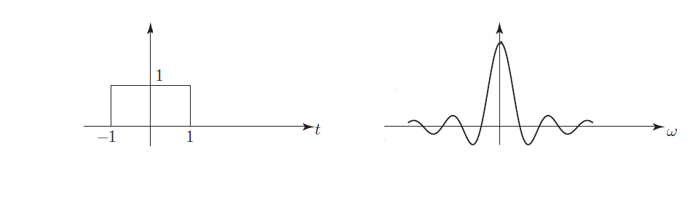
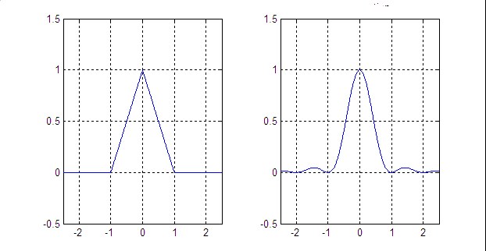
Quick detour..
Fourier transform, cross covariance, cross spectra
Some properties…
Linearity:
Convolution:

Slide 12
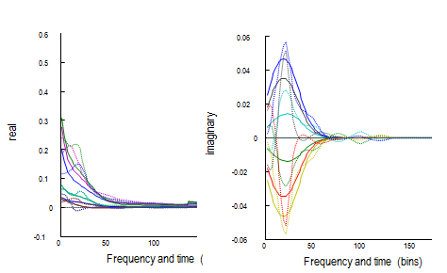
Quick detour..
Fourier transform, cross covariance, cross spectra
Now we are interested in situation where we have multiple time series and explore relationship between them
Cross covariance
Cross spectral density
Cross correlation
Coherence
Measures of functional connectivity

Slide 13
DCM for resting state fMRI classic DCM
Endogenous fluctuations
The forward (dynamic causal) model
Observed timeseries
Stochastic system
Stochastic differential equation (SDE)
More parameters to estimate
Slow estimation!

Slide 14
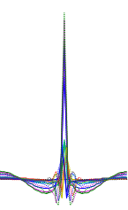
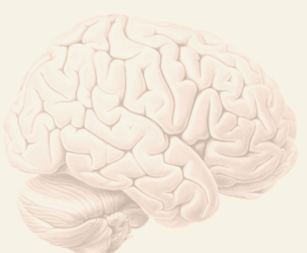
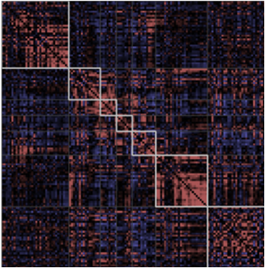
DCM for resting state fMRI classic DCM
Endogenous fluctuations
The forward (dynamic causal) model

Slide 15
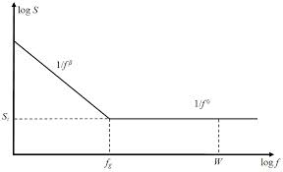
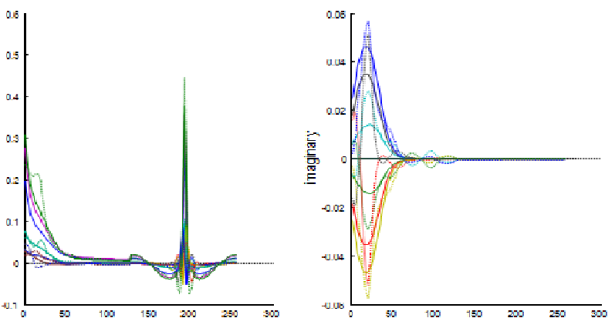
DCM for resting state fMRI spectral DCM
Endogenous fluctuations
The forward (dynamic causal) model
Power law
With amplitude and exponent
Fast estimation
Complex cross-spectra

Slide 16
DCM for resting state fMRI
spectral DCM
The forward (dynamic causal) model
Endogenous fluctuations
Effective connectivity
Observed timeseries
Functional connectivity

Slide 17
DCM for resting state fMRI
spectral DCM
Bayesian model inversion
Endogenous fluctuations
Bayesian model inversion
Posterior density
Posterior density
Effective connectivity
Log model evidence
(Free energy)
Log model evidence
Observed timeseries
Functional connectivity

Slide 18
DCM for resting state fMRI
spectral DCM
Bayesian model inversion
Endogenous fluctuations
Posterior density
Bayesian model comparison
Log model evidence
Bayesian model averaging

Slide 19
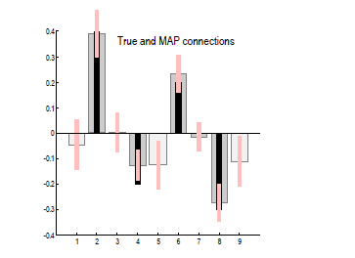
DCM for resting state fMRI
face validity
Friston, Kahan, Biswal, Razi, NeuroImage, 2014
Network or graph generating data
0.2
-0.3
0.4
-0.2
Prediction and response
0.6
0.06
0.5
0.04
0.4
0.02
real
0.3
imaginary
0
0.2
0.1
-0.02
0
-0.04
-0.1
0
50
100
150
200
250
300
-0.06
0
50
100
150
200
250
300
Frequency and time (bins)
Frequency and time (bins)
Notes:
Figure 3 shows the posterior density over the effective connectivity parameters (other panel) in terms of the posterior expectation (grey bar) and 90% confidence intervals (pink bars). For comparison the true values used in the simulations are superimposed (black bars). Happily, the true values of the extrinsic connection strengths fall within the 90% confidence intervals. However, the self connections (light grey) were not estimated so accurately and two areas show a log scaling parameter that is marginally too small. Note from Table 1 that the self connections are modelled as scale parameters, whereas the extrinsic parameters are free to take positive and negative values. This means that the model has underestimated self connectivity by about 10%. This corresponds to an underestimate of self inhibition and may reflect the fact that the sampled cross spectra were generated by a first-order autoregressive process, while the generative model assumes a power law distribution – which is not quite the same (see Figure 1). The sampled (dotted lines) and predicted (solid lines) cross spectra from this example can be seen in the lower panel of Figure 3. The agreement is self evident, if not perfect. The right and left panel is show the imaginary and real parts of the complex cross spectra, superimposed for all pairs of regions. The first half of these functions corresponds to the cross spectra, while the second half corresponds to the cross covariance functions. Note that the cross covariance functions have only real values.

Slide 20
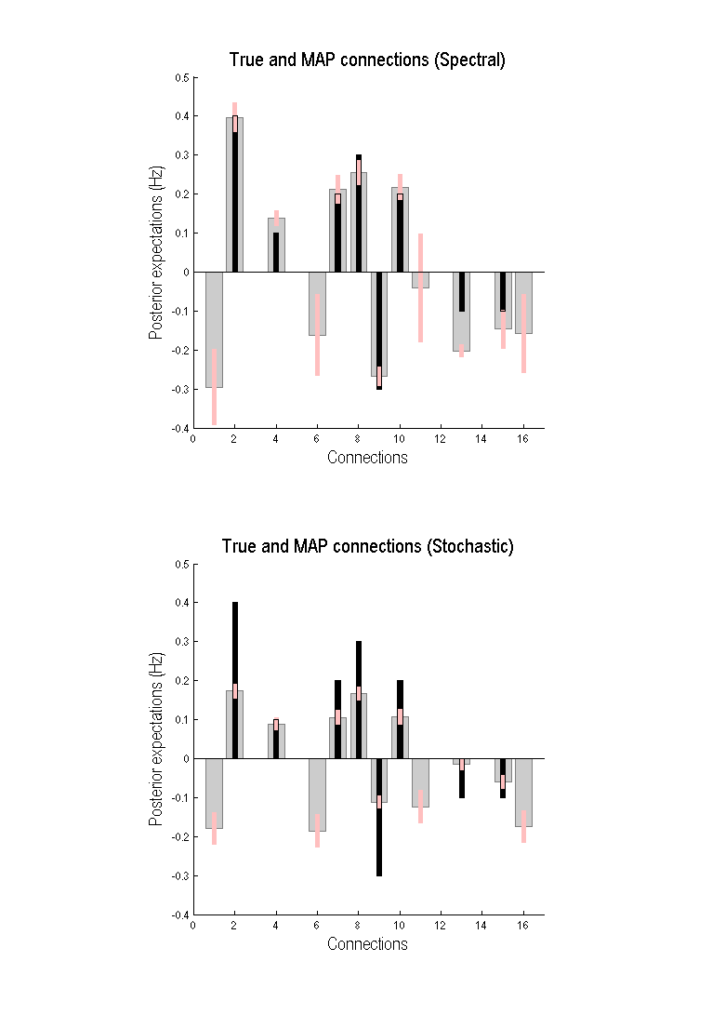
DCM for resting state fMRI
construct validity
Network or graph generating data
0.3
4
-0.1
0.1
0.2
2
3
0.2
0.4
-0.1
-0.3
1
Razi, Kahan, Rees, Friston, NeuroImage, 2015

Slide 21
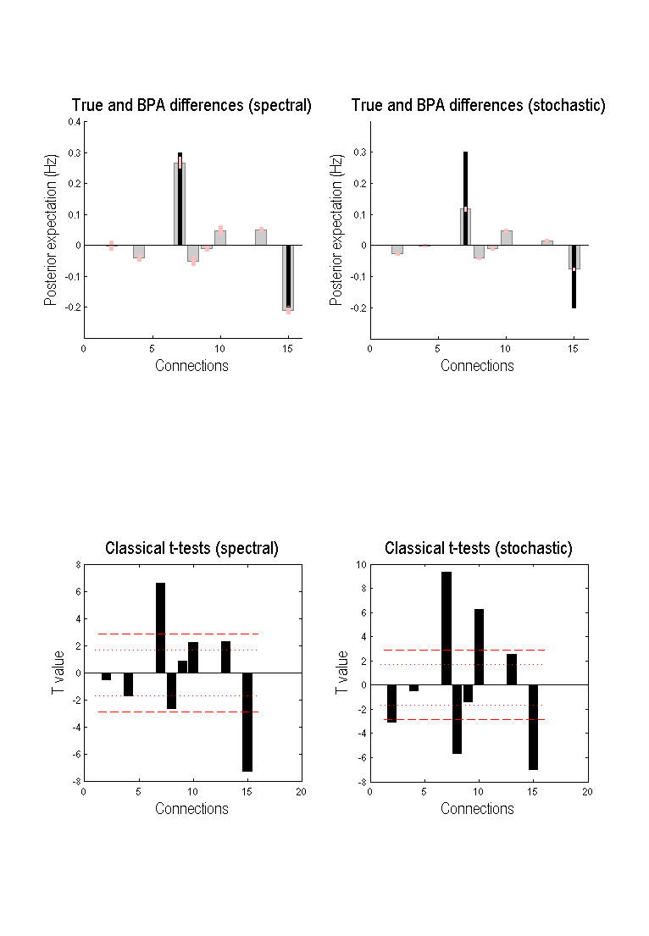
DCM for resting state fMRI
construct validity
Network for first set of 24 subjects
Network for second set of 24 subjects
0.3
4
-0.1
0.3
4
-0.3
0.1
0.1
0.2
0.5
2
3
2
0.2
3
0.2
-0.1
-0.1
0.4
-0.3
0.4
-0.3
1
1
Razi, Kahan, Rees, Friston, NeuroImage, 2015

Slide 22
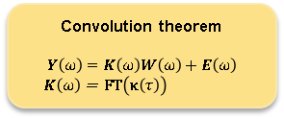
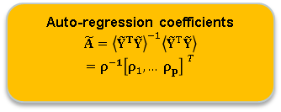

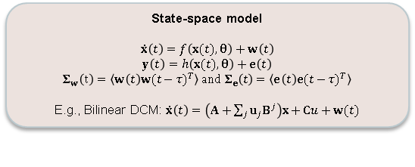
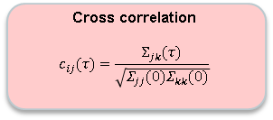
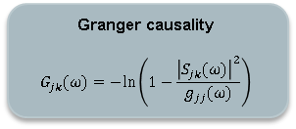

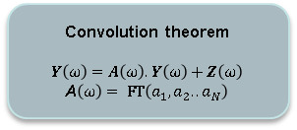
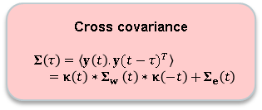
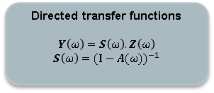
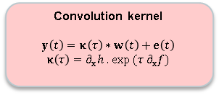
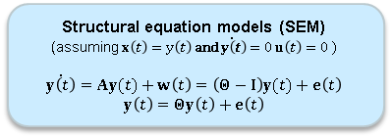
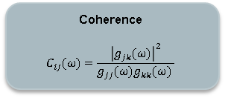
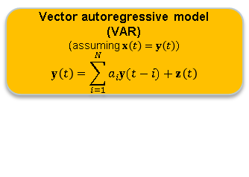
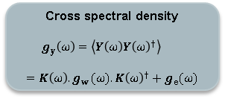
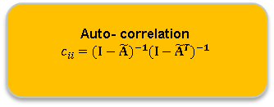
Brain connectivity measures of connectivity
Razi and Friston. IEEE Sig. Proc. Mag, 2016
State-space model
$$\dot{x}\left(t\right)=f\left(x(t),θ\right)+w\left(t\right)$$
$$y\left(t\right)=h\left(x(t),θ\right)+e\left(t\right)$$
$$Σ_{w}\left(t\right)=\left\langle w\left(t\right){w(t−τ)}^{T}\right\rangle and Σ_{e}\left(t\right)=\left\langle e\left(t\right){e(t−τ)}^{T}\right\rangle$$
E.g., Bilinear DCM: $\dot{x}\left(t\right)=\left(A+\sum_{j}{u_{j}B^{j}}\right)x+Cu+w(t)$
Transformation under assumptions
(Inverse) Fourier Transform
$$\tilde{Y}=\left[\begin{matrix}0 & & \\ y(t−1) & 0 & \\ y(t−2) & y(t−1) & 0 \\ ⋮ & ⋱ & ⋱\end{matrix}\right]$$
$$\tilde{A}=\left[\begin{matrix}0 & & \\ a_{1} & 0 & \\ a_{2} & a_{1} & 0 \\ ⋮ & ⋱ & ⋱\end{matrix}\right]$$
Structural equation models (SEM)
(assuming $x\left(t\right)=y\left(t\right) \text{and}\dot{ y\left(t\right)}=0 u\left(t\right)=0 )$
$$\dot{y\left(t\right)}=Ay(t)+w\left(t\right)=\left(Θ−I\right)y(t)+e\left(t\right)$$
$$y\left(t\right)=Θy\left(t\right)+e\left(t\right)$$
Spectral representations
Convolution kernel
$$y\left(t\right)=κ\left(τ\right)∗w\left(t\right)+e\left(t\right)$$
$$κ\left(τ\right)=∂_{x}h\text{ . }\text{exp} (τ{ ∂}_{x}f)$$
Convolution theorem
$$Y\left(ω\right)=K\left(ω\right)W\left(ω\right)+E\left(ω\right)$$
$$K\left(ω\right)\text{ = } \text{FT}\left(κ\left(τ\right)\right)$$
Convolution theorem
$$Y\left(ω\right)=A\left(ω\right).Y\left(ω\right)+Z\left(ω\right)$$
A$\left(ω\right)\text{ = }\text{FT}\left(a_{1},a_{2}..a_{N}\right)$
Vector autoregressive model (VAR)
(assuming $x\left(t\right)=y\left(t\right)$)
$$y\left(t\right)=\sum_{i=1}^{N}{a_{i}y(t−i)}+z\left(t\right)$$
Cross covariance
$$Σ\left(τ\right)=\left\langle y\left(t\right).{y(t−τ)}^{T}\right\rangle$$
$=κ\left(t\right)∗Σ_{w} \left(t\right)∗κ\left(−t\right)+Σ_{e}\left(t\right)$
Cross spectral density
$$g_{y}\left(ω\right)=\left\langle Y\left(ω\right){Y\left(ω\right)}^{†}\right\rangle$$
$$=K\left(ω\right){{.g}_{w}(ω).K\left(ω\right)}^{†}+g_{e}(ω)$$
Directed transfer functions
$$Y\left(ω\right)=S\left(ω\right).Z\left(ω\right)$$
$$S\left(ω\right)={(I−A(ω))}^{−1}$$
Auto-regression coefficients
$$\tilde{A}={\left\langle {\tilde{Y}}^{T}\tilde{Y}\right\rangle }^{−1}\left\langle {\tilde{Y}}^{T}\tilde{Y}\right\rangle$$
$$=ρ^{−1}{\left[ρ_{1},… ρ_{p}\right] }^{T}$$
Cross correlation
$$c_{ij}(τ)=\frac{Σ_{jk}(τ)}{\sqrt{Σ_{jj}(0)Σ_{kk}(0)}}$$
Coherence
$$C_{ij}(ω)=\frac{{\left|g_{jk}(ω)\right|}^{2}}{g_{jj}(ω)g_{kk}(ω) }$$
Granger causality
$$G_{jk}(ω)=−\text{ln}\left(1−\frac{{\left|S_{jk}(ω)\right|}^{2}}{g_{jj}(ω)}\right)$$
Auto- correlation
$$c_{ii}={(I−\tilde{A})}^{−1}{(I−{\tilde{A}}^{T})}^{−1}$$

Slide 23
DCM for resting state fMRI interim summary
State space models – all connectivity measures can be derived from them as approximations
Effective connectivity as what causes observations (functional connectivity)
Spectral DCM is accurate, (computationally) efficient and sensitive relative to stochastic DCM

Slide 24
OUTLINE
Introduction and background
(Spectral) Dynamic Causal Modelling
Technical / Mathematical Content
Worked example using SPM
DMN connectivity
What’s new?
Large DCMs
Applications
Cognitive / Psychiatric

Slide 25
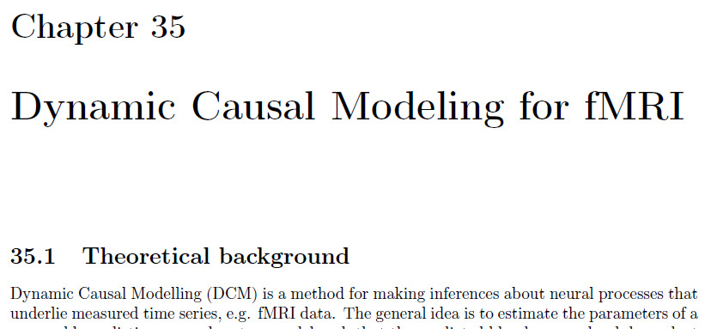
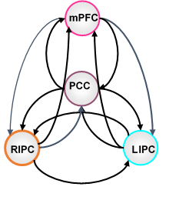
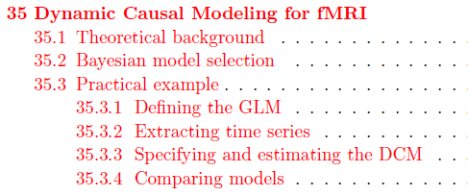
Worked example

Slide 26
Worked example
GLM estimation – to get SPM.mat
CSF/WM signal extraction
GLM estimation – to remove confounds
Extraction of time series from ROIs
PCC [0 -52 26]
mPFC [3 54 -2]
L-IPC [-50 -63 32]
R-IPC [48 -69 35]
Di & Biswal, NeuroImage 2014 and Razi et al NeuroImage, 2015

Slide 27
Worked example
GLM estimation – to get SPM.mat
CSF/WM signal extraction
GLM estimation – to remove confounds
Extraction of time series from ROIs
Specify DCM
Estimate DCM
Review DCM

Slide 28
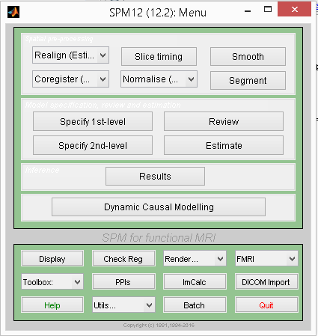
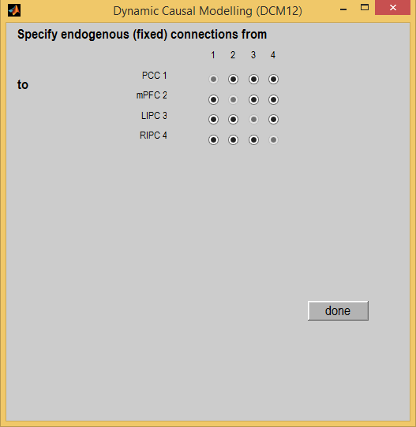
Worked example
Default mode network

Slide 29
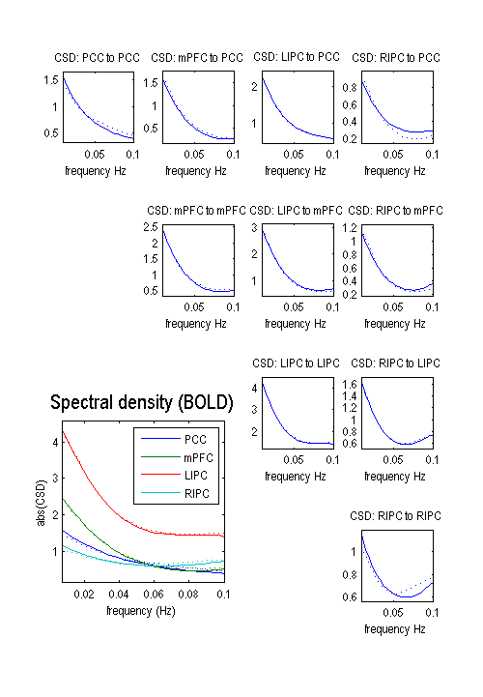
Worked example
Default mode network
Input time series
Data fits for CSD

Slide 30
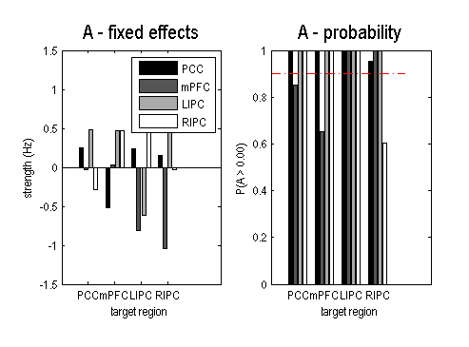
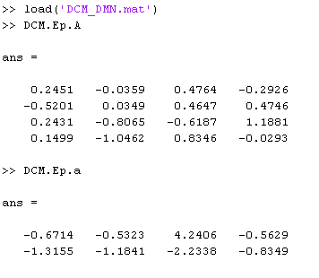
Worked example
Default mode network
Connectivity parameters: DCM.Ep.A
Neural fluctuation parameters: DCM.Ep.a

Slide 31
OUTLINE
Introduction and background
(Spectral) Dynamic Causal Modelling
Technical / Mathematical Content
Worked example using SPM
DMN connectivity
What’s new?
Large DCMs
Applications
Cognitive / Psychiatric

Slide 32
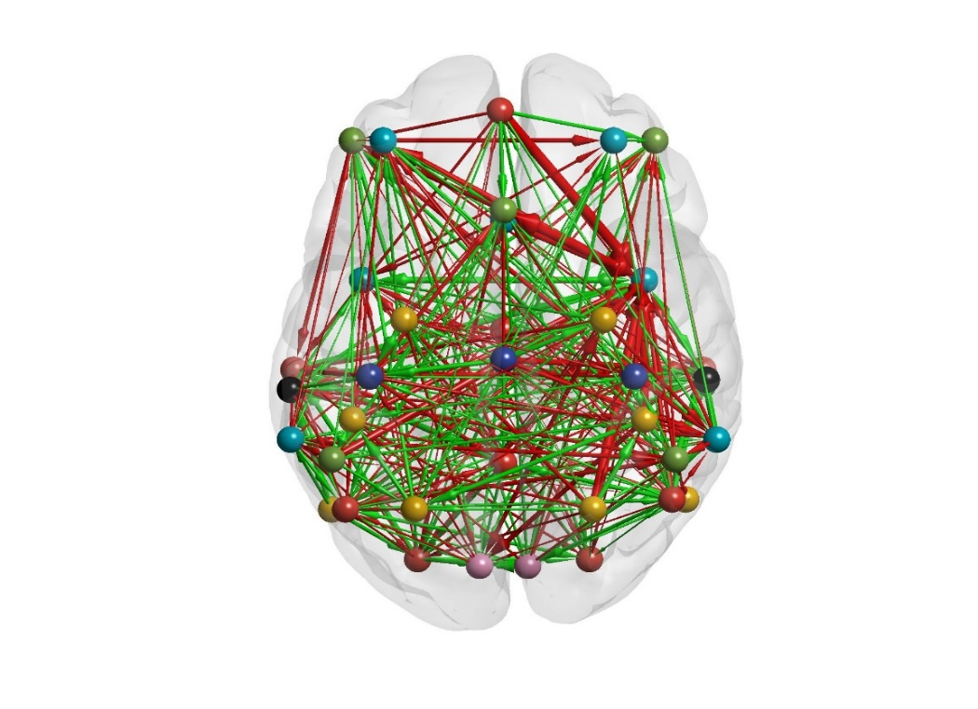
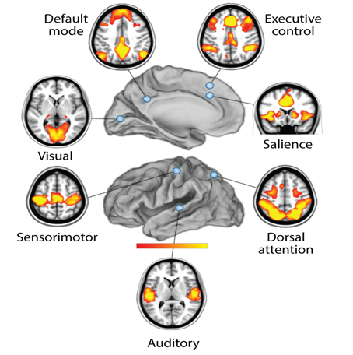
Large-scale DCMs for resting state fMRI
36 nodes network
Raichle Annual Reviews, 2015
Notes:
We could go beyond the usual graph theoretic analyses. We can try to find the sparse models nested within fully connected model. This is done by using Bayesian model reduction

Slide 33
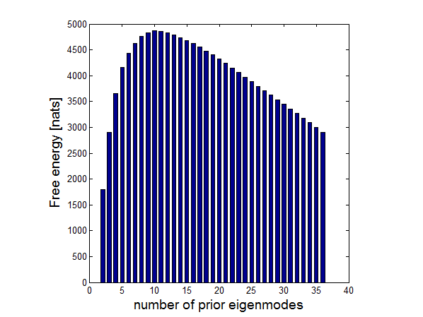
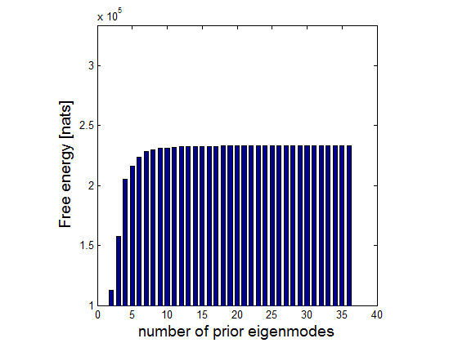
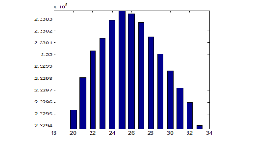
Large-scale DCMs for resting state fMRI
Stochastic DCM
Spectral DCM
36 nodes network
Number of modes (m)
Razi, Seghier, Yuan, McColgan, Zeidman, Park, Sporns, Rees, Friston, Net. Neurosci. In press
Notes:
We could go beyond the usual graph theoretic analyses. We can try to find the sparse models nested within fully connected model. This is done by using Bayesian model reduction

Slide 34
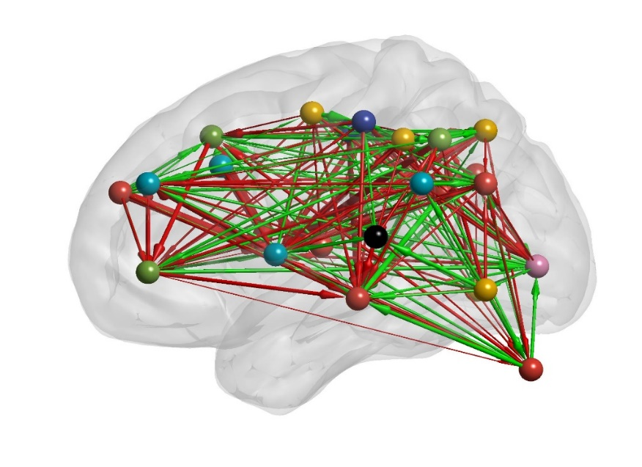
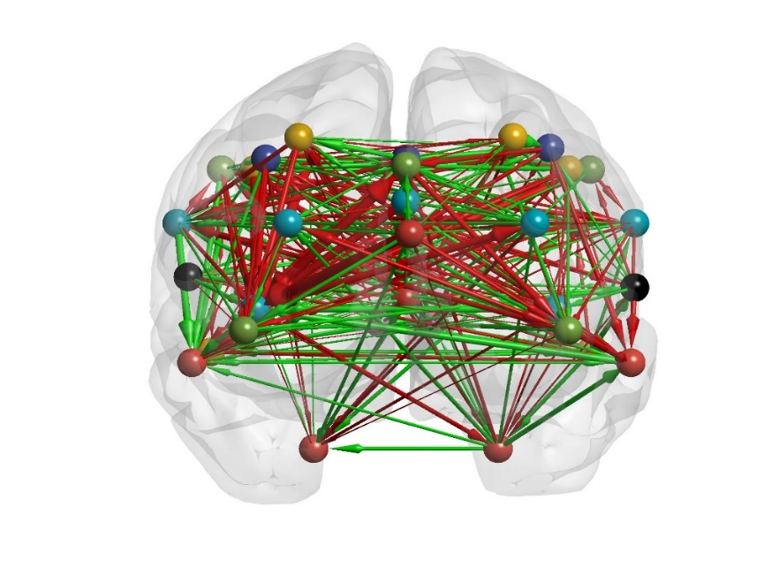

Large-scale DCMs for resting state fMRI
A
B
Default mode network
Excitatory connections
Dorsal attention network
Inhibitory connections
Control executive network
Salience network
Sensorimotor network
Visual network
Auditory network
C
Razi, Seghier, Yuan, McColgan, Zeidman, Park, Sporns, Rees, Friston, Net. Neurosci. In press
Notes:
This figure lists the 36 ROIs (from Raichle 2011) forming 7 large-scale brain modes or intrinsic networks. The right hand graphs show a typical subjects inverted graph (after applying an arbitrary thresholding for visualization purposes). The dark grey balls represents each ROI where the edges or connections are the shown by directed arrows. The width of the arrows is reflective of the strength of the coupling. The colour of the arrows is representative of the excitatory (red) and inhibitory (green) influences of coupling neuronal populations.

Slide 35
Large-scale DCMs for resting state fMRI
Averaged functional connectivity
Averaged effective connectivity
Averaged functional connectivity
Averaged effective connectivity
Averaged binarized adjacency matrix
after BMR
Averaged weighted adjacency matrix
after BMR
Averaged binarised after BMR
Averaged weighted after BMR
Razi, Seghier, Yuan, McColgan, Zeidman, Park, Sporns, Rees, Friston, Net. Neurosci. In press
Notes:
This figure lists the 36 ROIs (from Raichle 2011) forming 7 large-scale brain modes or intrinsic networks. The right hand graphs show a typical subjects inverted graph (after applying an arbitrary thresholding for visualization purposes). The dark grey balls represents each ROI where the edges or connections are the shown by directed arrows. The width of the arrows is reflective of the strength of the coupling. The colour of the arrows is representative of the excitatory (red) and inhibitory (green) influences of coupling neuronal populations.

Slide 36
Large-scale DCMs for resting state fMRI
Razi, Seghier, Yuan, McColgan, Zeidman, Park, Sporns, Rees, Friston, Net. Neurosci. In press
Notes:
This figure lists the 36 ROIs (from Raichle 2011) forming 7 large-scale brain modes or intrinsic networks. The right hand graphs show a typical subjects inverted graph (after applying an arbitrary thresholding for visualization purposes). The dark grey balls represents each ROI where the edges or connections are the shown by directed arrows. The width of the arrows is reflective of the strength of the coupling. The colour of the arrows is representative of the excitatory (red) and inhibitory (green) influences of coupling neuronal populations.

Slide 37
OUTLINE
Introduction and background
(Spectral) Dynamic Causal Modelling
Technical / Mathematical Content
Worked example using SPM
DMN connectivity
What’s new?
Large DCMs
Applications
Cognitive / Psychiatric

Slide 38
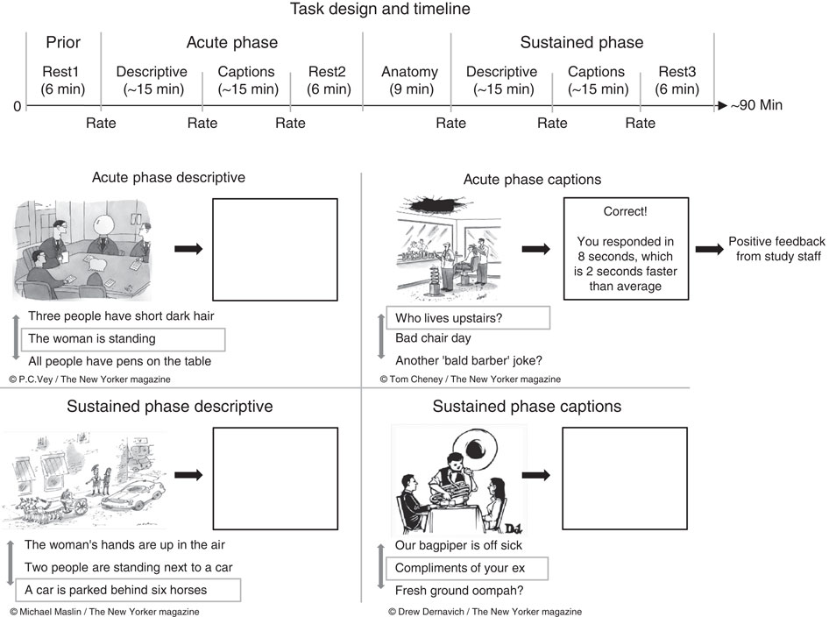
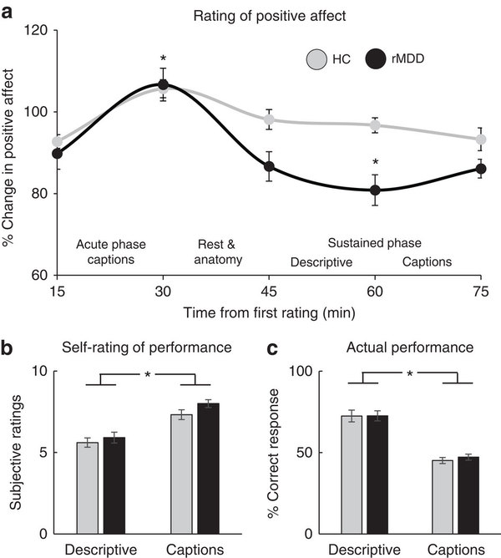
Major Depressive Disorder
Natural time course of positive mood
Admon & Pizzagalli,(2016) Nat. Comm.

Slide 39
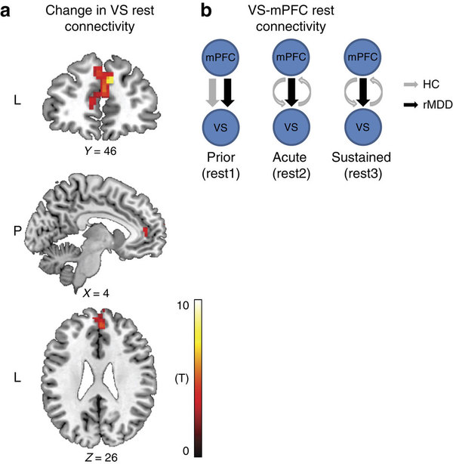
Major Depressive Disorder
Natural time course of positive mood
These findings suggest:
that corticostriatal pathways contribute to the natural time course of positive mood fluctuations
and that disturbances of those neural interactions may characterize individuals with a past history of mood disorders
Spectral DCM analysis
Admon and Pizzagalli,(2016) Nat. Comm.

Slide 40
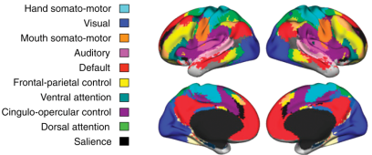



Hierarchical organization of intrinsic brain modes anticorrelated brain modes
  Functional network organization
  Network interactivity important for cognitive function
Dorsal Attention Network
Default Mode Network
Kelly et al. 2008
Power et al. 2011
Dorsal Attention Network
(DAN)
Salience Network
(SN)
Default Mode Network
(DMN)
Tsvetanov et al. 2016

Slide 41


Hierarchical organization of intrinsic brain modes
anticorrelated brain modes
VOIs identified using spatial independent component analysis (ICA) (N=404)
Functional connectivity
Yuan, Friston, Zeidman, Chen, Li, Razi, Submitted
Notes:
Figure 1 VOIs identified using spatial independent component analysis(ICA). The VOIs (green circles) were overlaid in the spatial distribution maps of three interested networks derived from group ICA,i.e.,the default mode network (DMN), the SN (salience network), and the DAN (dorsal attention network).

Slide 42






Hierarchical organization of intrinsic brain modes
anticorrelated brain modes
Regions belonging to the same network grouped together
The task-positive mode (SN, DAN) inhibits the cDN
The task negative mode (cDN) excites the task positive mode (SN, DAN)
Yuan, Friston, Zeidman, Chen, Li, Razi, Submitted
Notes:
Figure 2
Effective connectivity within and between each network. (A) Effective connectivity matrix of the 15 brain regions after Bayesian Model Reduction (without covariates). Connections were retained after pruning any parameters which did not contribute to the free energy (i.e., posterior probabilities with contrast without parameter are larger than 95%). The color presents the connection parameters (in Hz) obtained by Bayesian Model Average. The three networks were highlighted using black lines. Please note the asymmetric nature of these connectivity matrix and the sparse nature of the matrix. (B) The nodes and effective connections within and between each network mapped onto the cortical surfaces using BrainNet Viewer software (http://www.nitrc.org/projects/bnv/). The effective connectivity parameters are the same as those in (A).For visualization, we separated the inhibitory connectivities (cyan) from the excitatory connectivities (yellow). (C) The nodes and functional connections within and between each network mapped onto the cortical surfaces using BrainNet Viewer software. Only significant connections were shown (FDR p<0.05). (D) A schematic showing summarized effective connectivity between each network. The effective connectivity parameters between networks are calculated from a Bayesian viewpoint, which not only consider the connection strengths but also the uncertainty in these estimates.For visualization, we separated the negative connections (cyan) from the positive connections (yellow). Abbreviations: please see also Table 1.

Slide 43
Thank you
And thanks to
FIL Methods Group

