Slide 1

Topological Inference
Guillaume Flandin
Wellcome Centre for Human Neuroimaging
University College London
SPM Course
London, May 2018

Slide 2
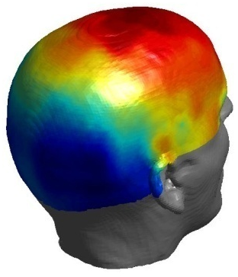
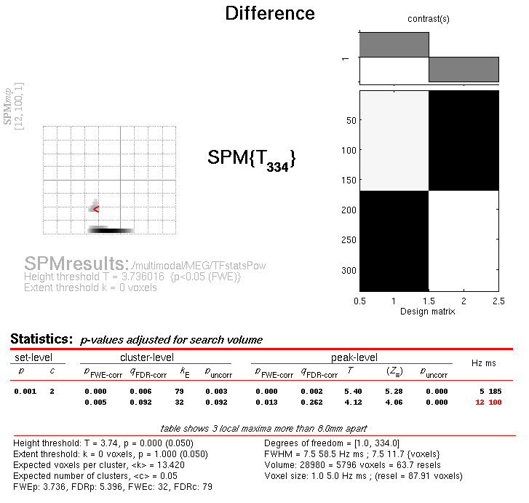
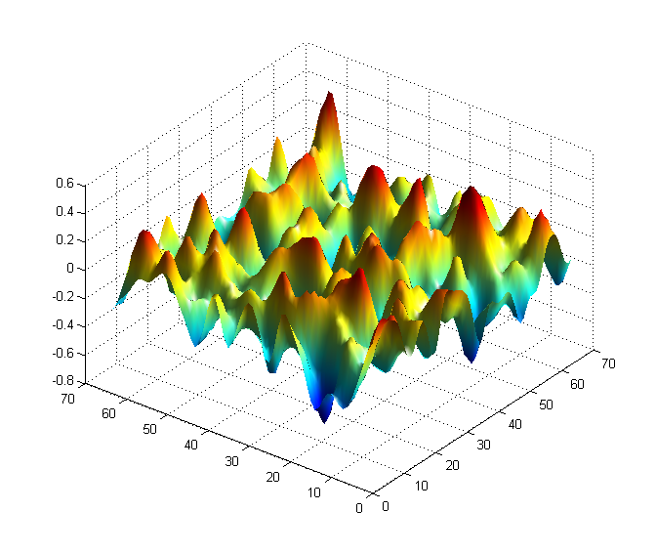
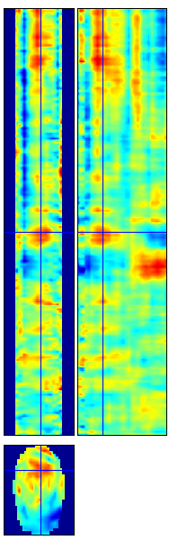
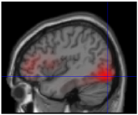
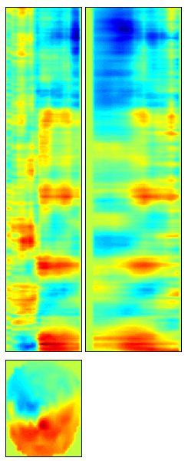
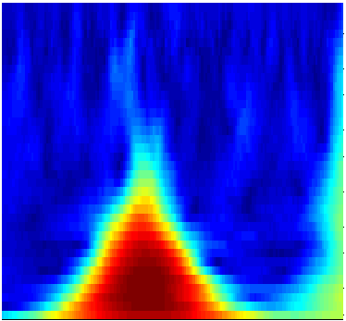
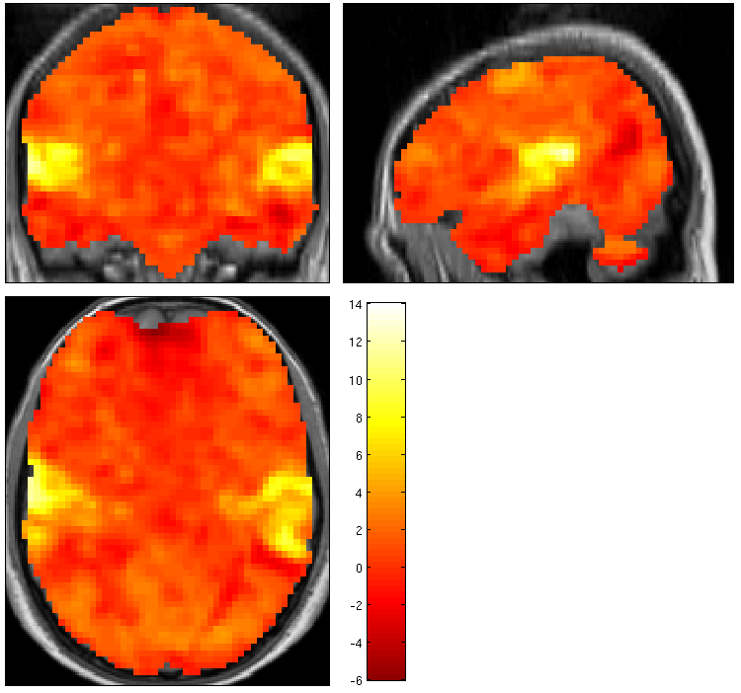
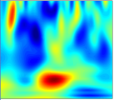
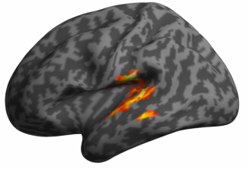

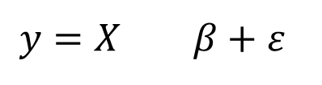
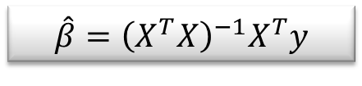
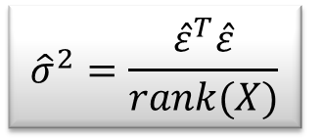
Random
Field Theory
$$y=X β+ε$$
Contrast c
Pre-
processings
General
Linear
Model
Statistical Inference
$$\hat{β}={\left(X^{T}X\right)}^{−1}X^{T}y$$
$${\hat{σ}}^{2}=\frac{{\hat{ε}}^{T}\hat{ε}}{rank(X)}$$
$$SPM\{T,F\}$$

Slide 3

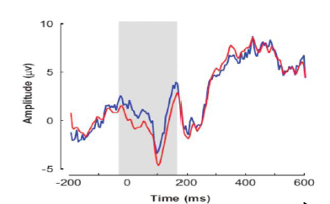

Statistical Parametric Maps
M/EEG 2D time-frequency
fMRI, VBM,
M/EEG source reconstruction
frequency
mm
time
time
M/EEG 1D channel-time
mm
mm
M/EEG
2D+t
scalp-time
mm
mm
time

Slide 4
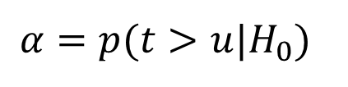
Inference at a single voxel
u
Null Hypothesis H₀:
zero activation
Decision rule (threshold) u:
determines false positive
rate α
⇒ Choose u to give acceptable
α under H₀
Null distribution of test statistic T
$$α=p(t>u|H_{0})$$

Slide 5












Multiple tests
u_{α}
u_{α}
u_{α}
u_{α}
u_{α}
If we have 100,000 voxels,
α=0.05 ⇒ 5,000 false positive voxels.
This is clearly undesirable; to correct for this we can define a null hypothesis for a collection of tests.
u_{α}
α
α
t
α
t
α
t
α
t
α
t
t
Noise
Signal

Slide 6




















Multiple tests
u_{α}
u_{α}
u_{α}
u_{α}
u_{α}
If we have 100,000 voxels,
α=0.05 ⇒ 5,000 false positive voxels.
This is clearly undesirable; to correct for this we can define a null hypothesis for a collection of tests.
u_{α}
α
α
t
α
t
α
t
α
t
α
t
t
Use of ‘uncorrected’ p-value, α =0.1
11.3%
11.3%
12.5%
10.8%
11.5%
10.0%
10.7%
11.2%
10.2%
9.5%
Percentage of Null Pixels that are False Positives

Slide 7










Family-Wise Null Hypothesis
Family-Wise Null Hypothesis:
Activation is zero everywhere
If we reject a voxel null hypothesis at any voxel,
we reject the family-wise Null hypothesis
A FP anywhere in the image gives a Family Wise Error (FWE)
Family-Wise Error rate (FWER) = ‘corrected’ p-value
Use of ‘uncorrected’ p-value, α =0.1
Use of ‘corrected’ p-value, α =0.1
FWE

Slide 8
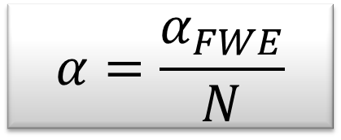
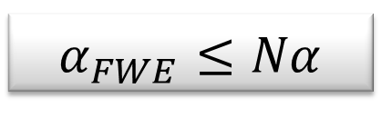
Bonferroni correction
The Family-Wise Error rate (FWER), α_{FWE}, for a family of N tests follows the inequality:
where α is the test-wise error rate.
$$α_{FWE}≤Nα$$
Therefore, to ensure a particular FWER choose:
$$α=\frac{α_{FWE}}{N}$$
This correction does not require the tests to be independent but becomes very stringent if dependence.

Slide 9
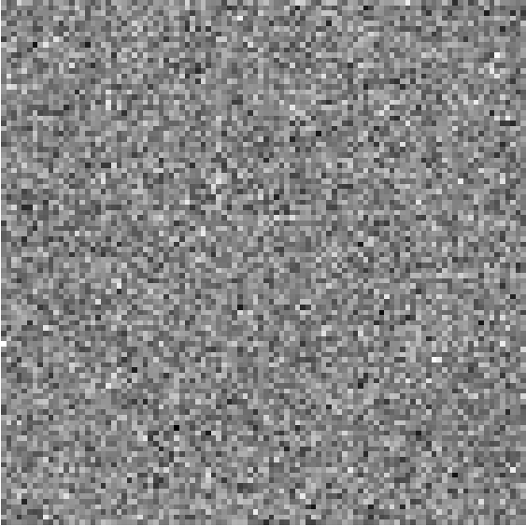
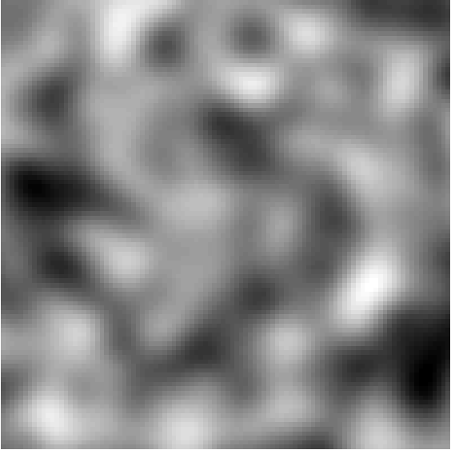
Spatial correlations
100 x 100 independent tests
Spatially correlated tests (FWHM=10)
Discrete data
Spatially extended data
Bonferroni is too conservative for spatial correlated data.
10,000 voxels ⇒ $α_{BONF}=\frac{0.05}{10,000}$⇒$u_{c}=4.42$ (uncorrected $u=1.64$)

Slide 10
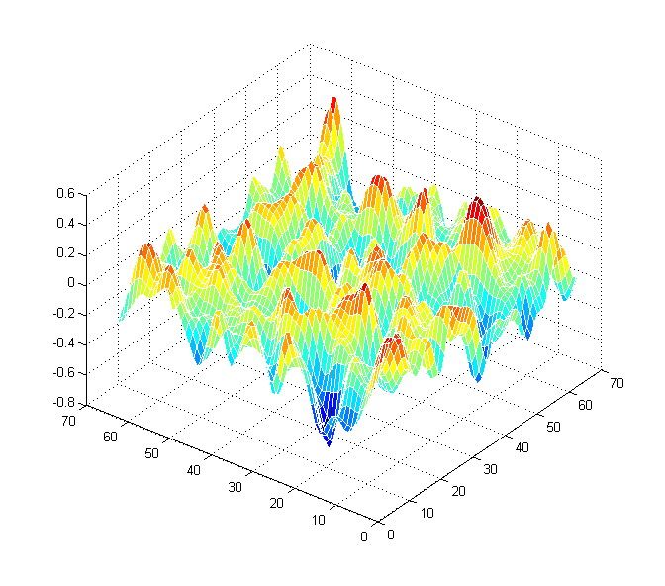
Random Field Theory
⇒ Consider a statistic image as a discretisation of a continuous underlying random field.
⇒ Use results from continuous random field theory.
lattice representation

Slide 11
Topological inference
Peak level inference
Topological feature:
Peak height
intensity
space

Slide 12
Topological inference
Cluster level inference
Topological feature:
Cluster extent
intensity
u_{clus} : cluster-forming threshold
u_{clus}
space

Slide 13
Topological inference
Set level inference
Topological feature:
Number of clusters
intensity
u_{clus} : cluster-forming threshold
u_{clus}
space
c

Slide 14
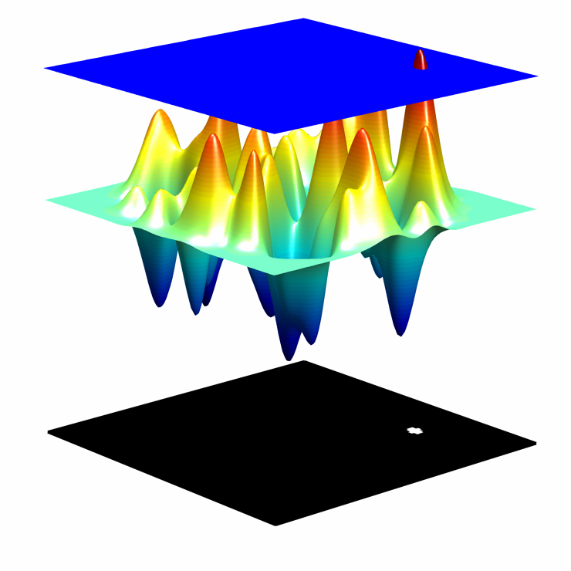
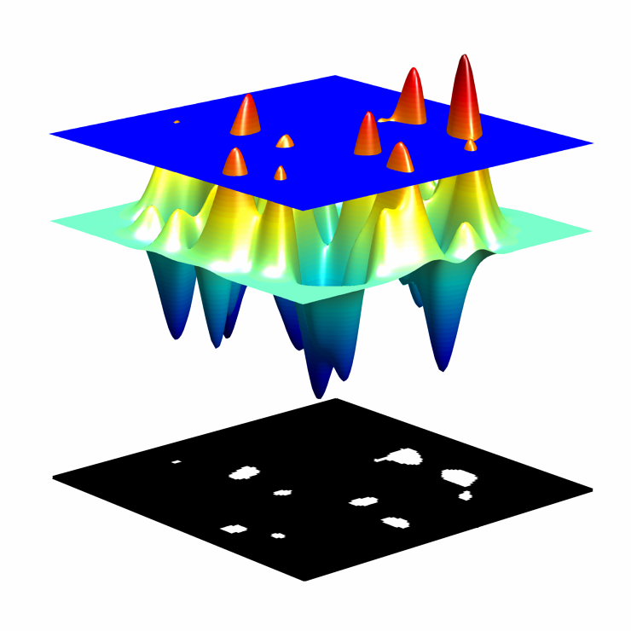
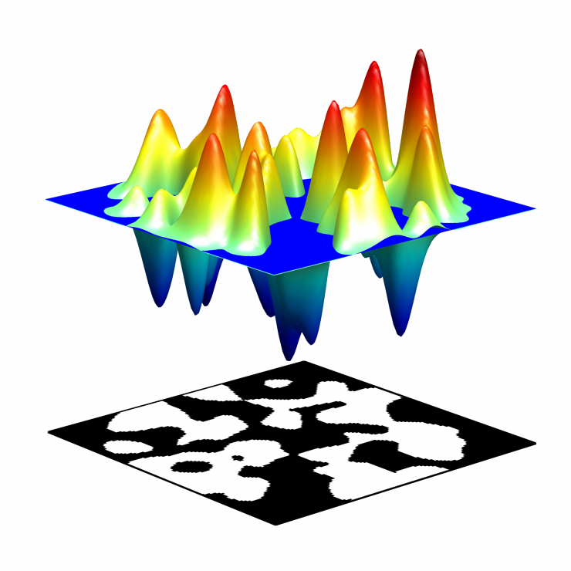
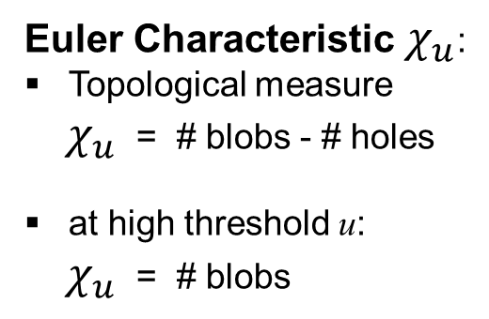
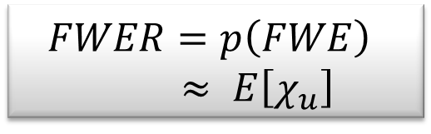
RFT and Euler Characteristic
Euler Characteristic $χ_{u}$:
Topological measure
${ χ}_{u}$ = # blobs - # holes
at high threshold u:
${ χ}_{u}$ = # blobs
$$FWER=p\left(FWE\right)$$
$≈ E\left[χ_{u}\right]$

Slide 15
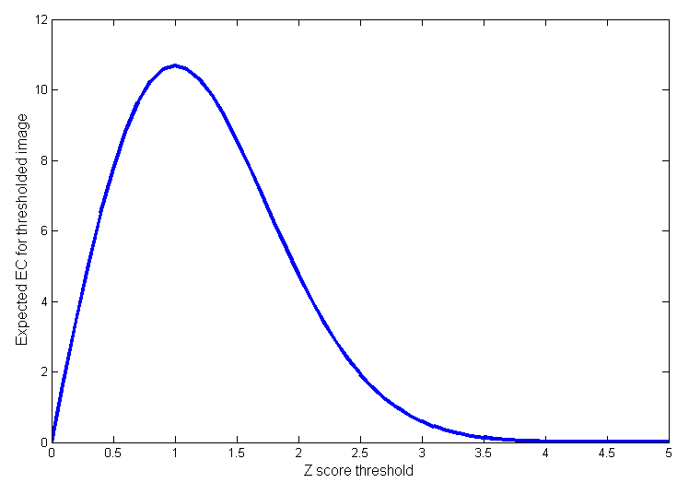
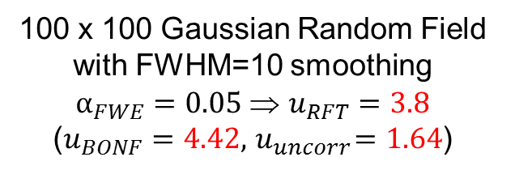
Expected Euler Characteristic
2D Gaussian Random Field
$$E\left[χ_{u}\right]=λ\left(Ω\right){\left|Λ\right|}^{1/2} u exp⁡(−u^{2}/2)/{(2π)}^{3/2}$$
Roughness
(1/smoothness)
Search volume
Threshold
100 x 100 Gaussian Random Field
with FWHM=10 smoothing
$α_{FWE}=0.05$ ⇒ $u_{RFT}=3.8$
($u_{BONF}=4.42, { u}_{uncorr}=1.64$)

Slide 16
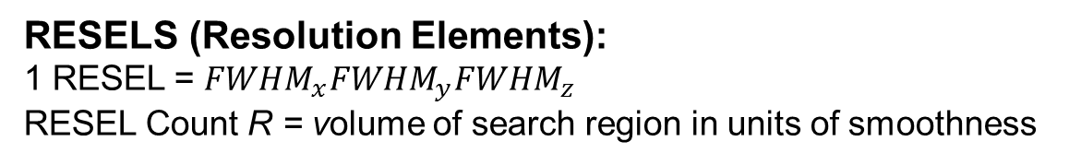
Smoothness
Smoothness parameterised in terms of FWHM:
  Size of Gaussian kernel required to smooth i.i.d. noise to have same smoothness as observed null (standardized) data.
FWHM
RESELS (Resolution Elements):
1 RESEL = ${FWHM}_{x}{FWHM}_{y}{FWHM}_{z}$
RESEL Count R = volume of search region in units of smoothness
1
2
3
4
5
6
7
8
9
10
Eg: 10 voxels, 2.5 FWHM, 4 RESELS
1
2
3
4
The number of resels is similar, but not identical to the number independent observations.
Smoothness estimated from spatial derivatives of standardised residuals:
  Yields an RPV image containing local roughness estimation.

Slide 17
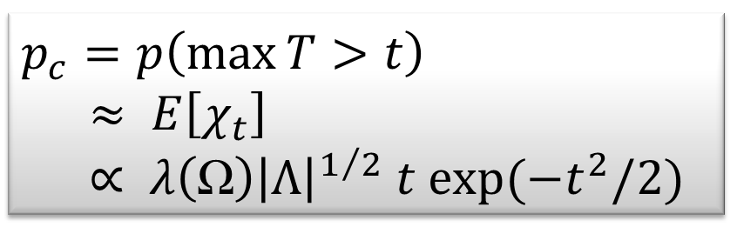
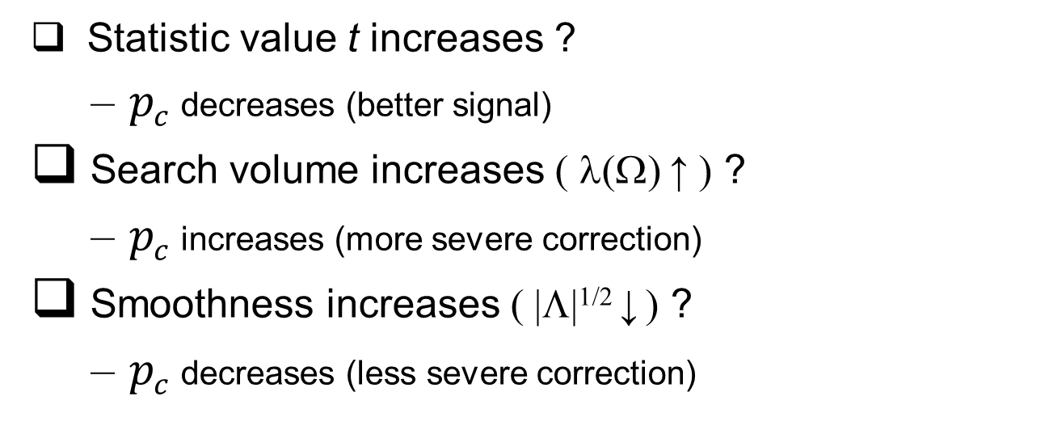
Random Field intuition
Corrected p-value for statistic value t
$$p_{c}=p\left(\max{T>t}\right)$$
$$≈ E\left[χ_{t}\right] \\ ∝ λ\left(Ω\right){\left|Λ\right|}^{1/2} t exp⁡(−t^{2}/2)$$
Statistic value t increases ?
  $p_{c}$ decreases (better signal)
Search volume increases ( λ(Ω) ↑ ) ?
  $p_{c}$ increases (more severe correction)
Smoothness increases ( |Λ|^{1/2} ↓ ) ?
  $p_{c}$ decreases (less severe correction)

Slide 18
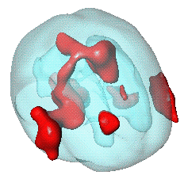

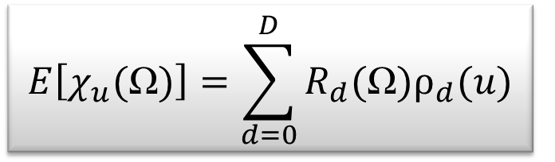
Random Field: Unified Theory
General form for expected Euler characteristic
  • t, F & χ² fields • restricted search regions • D dimensions •
$$E\left[χ_{u}(Ω)\right]=\sum_{d=0}^{D}{R_{d}(Ω)ρ_{d}(u)}$$
R_{d} (Ω): d-dimensional Lipschitz-Killing curvatures of Ω ($≈$ intrinsic volumes):
– function of dimension,
space Ω and smoothness:
R₀(Ω) = χ(Ω) Euler characteristic of Ω
R₁(Ω) = resel diameter
R₂(Ω) = resel surface area
R₃(Ω) = resel volume
ρ_{d} (u) : d-dimensional EC density of the field
– function of dimension and threshold,
specific for RF type:
E.g. Gaussian RF:
ρ₀(u) = 1- Φ(u)
ρ₁(u) = (4 ln2)^{1/2} exp(-u²/2) / (2π)
ρ₂(u) = (4 ln2) u exp(-u²/2) / (2π)^{3/2}
ρ₃(u) = (4 ln2)^{3/2} (u² -1) exp(-u²/2) / (2π)²
ρ₄(u) = (4 ln2)² (u³ -3u) exp(-u²/2) / (2π)^{5/2}
Ω

Slide 19
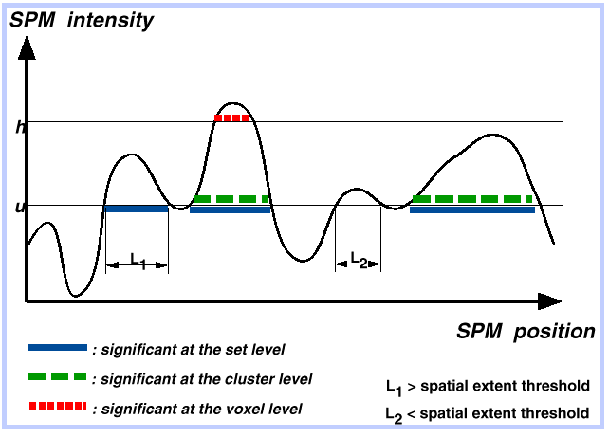
Peak, cluster and set level inference
Sensitivity
Regional specificity
Peak level test:
height of local maxima
Cluster level test:
spatial extent above u
Set level test:
number of clusters above u

: significant at the set level
: significant at the cluster level
L₁ > spatial extent threshold
L₂ < spatial extent threshold

: significant at the peak level

Slide 20
Random Field Theory Assumptions
The statistic image is assumed to be a good lattice representation of an underlying random field with a multivariate Gaussian distribution.
These fields are continuous, with an autocorrelation function twice differentiable at the origin.
The threshold chosen to define clusters is high enough such that the expected EC is a good approximation to the number of clusters.
The lattice approximation is reasonable, which implies the smoothness is relatively large compared to the voxel size.
The errors of the specified statistical model are normally distributed, which implies the model is not misspecified.
Smoothness of the data is unknown and estimated:
very precise estimate by pooling over voxels ⇒ stationarity assumption.

Slide 21
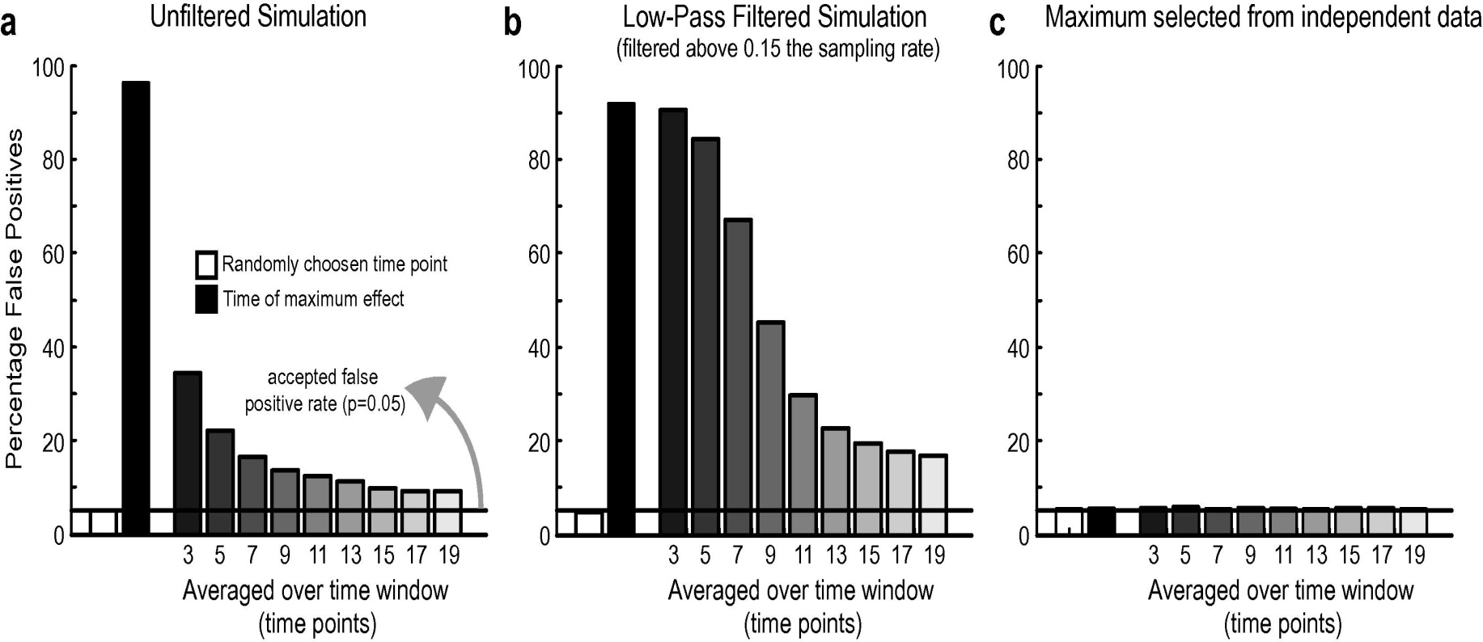
Small Volume Correction
If one has some a priori idea of where an activation should be, one can prespecify a small search space and make the appropriate correction instead of having to control for the entire search space
  mask defined by (probabilistic) anatomical atlases
  mask defined by separate "functional localisers"
  mask defined by orthogonal contrasts
  search volume around previously reported coordinates
With no prior hypothesis:
Test whole volume.
Identify SPM peak.
Then make a test assuming a single time of interest.

Slide 22
Conclusion
There is a multiple testing problem and corrections have to be applied on p-values (for the volume of interest only (see SVC)).
Inference is made about topological features (peak height, spatial extent, number of clusters).
Use results from the Random Field Theory.
Control of FWER (probability of a false positive anywhere in the image) for a space of any dimension and shape.
Many thanks to Justin Chumbley, Tom Nichols and Gareth Barnes for slides

Slide 23
References
Friston KJ, Frith CD, Liddle PF, Frackowiak RS. Comparing functional (PET) images: the assessment of significant change. Journal of Cerebral Blood Flow and Metabolism, 1991.
Worsley KJ, Evans AC, Marrett S, Neelin P. A three-dimensional statistical analysis for CBF activation studies in human brain. Journal of Cerebral Blood Flow and Metabolism. 1992.
Worsley KJ, Marrett S, Neelin P, Vandal AC, Friston KJ, Evans AC. A unified statistical approach for determining significant signals in images of cerebral activation. Human Brain Mapping,1996.
Chumbley J, Worsley KJ , Flandin G, and Friston KJ. Topological FDR for neuroimaging. NeuroImage, 2010.
Kilner J and Friston KJ. Topological inference for EEG and MEG data. Annals of Applied Statistics, 2010.
Kilner J. Bias in a common EEG and MEG statistical analysis and how to avoid it. Clinical Neurophysiology, 2013.
Flandin G and Friston KJ. Topological Inference. Brain Mapping: An Encyclopedic Reference, 2015.

Slide 24
Non-parametric inference: permutation tests
to control FWER
Parametric methods
  Assume distribution of
  max statistic under null
  hypothesis
Nonparametric methods
  Use data to find
  distribution of max statistic
  under null hypothesis
  any max statistic
5%
5%

Slide 25
T test on a single voxel / time point
T value
Test only this
Ignore these
1.66
Task A
T distribution
Task B
P=0.05
u
Threshold
Null distribution of test statistic T

Slide 26
T test on many voxels / time points
T value
Test all of this
Task A
T distribution
Task B
P= ?
u
Threshold ?
Null distribution of test statistic T

Slide 27
Don’t do this :
SPM t
With no prior hypothesis.
Test whole volume.
Identify SPM peak.
Then make a test assuming
a single voxel/ time of interest.
James Kilner. Clinical Neurophysiology 2013.

Slide 28
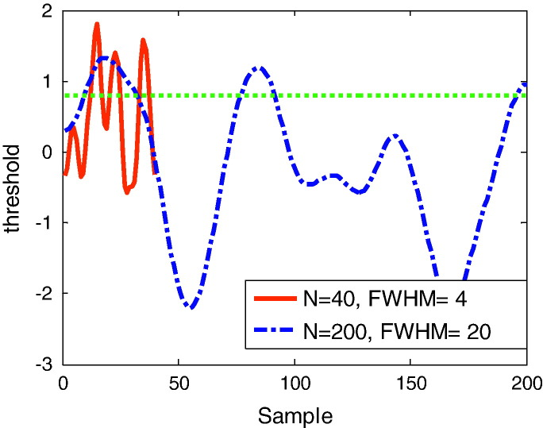
Threshold u
Expected Euler
Characteristic
From
=2.9 (in this example)
Intrinsic volume
(depends on shape and smoothness of space)
Depends only on type
of test and dimension
Notes:
An example of two one-dimensional fields with identical intrinsic volume or Lipschitz–Killing curvature. Both curves are one-sample SPM{t}, based on 200 samples of Gaussian white noise. In one case (red—solid) the noise has smoothness FWHM = 4 and extends over 40 samples, in the other (blue—dotted) has FWHM = 20 and extends over 200 samples. The ‘intrinsic volumes’ of these curves, or the FWHM per unit length, are therefore identical (LKC = [1 16.65] or resels = [1 10]). The dotted green line is some arbitrary threshold u (= 0.8). The observed Euler characteristic for both processes at this threshold is 3 (there are 3 blobs above threshold). The Gaussian Kinematic Formula (Eq. (6)) for a random t-field of this intrinsic volume predicts an Euler characteristic of 2.9.

