Slide 1
M/EEG pre-processing
Ashwini Oswal
Wellcome Trust Centre for Neuroimaging
UCL Institute of Neurology

Slide 2
Steps to cover
Conversion
Filtering
Down-sampling
Epoching
Re-referencing for EEG
Artefacts
Averaging
Co-registration
Generating scalp x time images
Time-frequency analysis

Slide 3
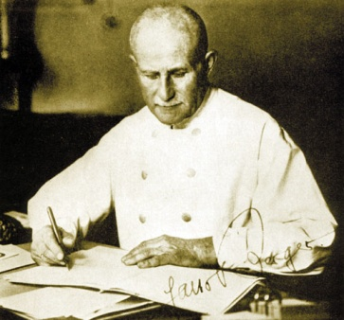
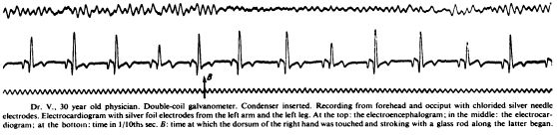
What do we need?
Hans Berger
1873-1941
Events
Possible source
of artefact
EEG
ECG
Time axis
(sampling frequency)
Sensor locations
Notes:
Hans Berger (21 May 1873 – 1 June 1941) was a German psychiatrist, best known as the inventor of electroencephalography (EEG) (the recording of "brain waves") in 1924, coining the name,^{[1]} and the discoverer of the alpha wave rhythm known as "Berger's wave".

Slide 4
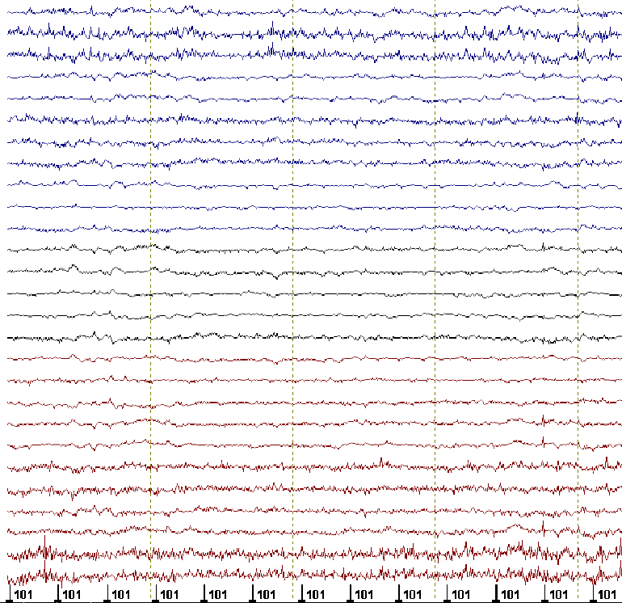
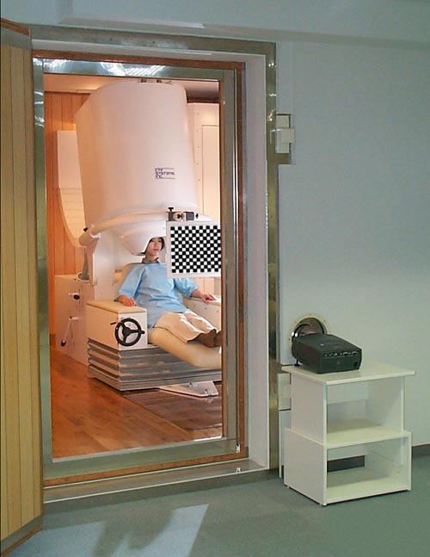
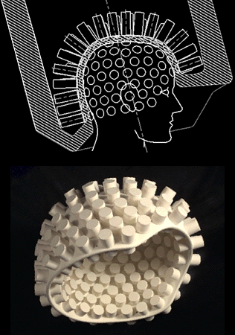
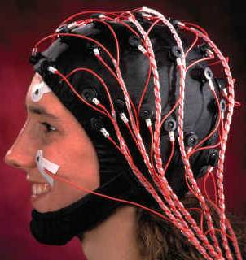
~300 sensors
<256 electrodes
Notes:
With no conductive gel, dry systems are subject to several challenges. First, the sensor must be specially designed to directly touch scalp or skin, even through thick hair. Second, the sensor must remain securely in place in order to minimize artifacts and noise. Finally, the electronics must tolerate high contact impedances - 100-200x higher than wet - while rejecting noise and interference. Therefore, a complete dry solution always involves not just the sensors but mechanics and electronics as well.
The MEG (and EEG) signals derive from the net effect of ionic currents flowing in the dendrites of neurons during synaptic transmission. In accordance with Maxwell's equations, any electrical current will produce a magnetic field, and it is this field that is measured. The net currents can be thought of as current dipoles, i.e. currents with a position, orientation, and magnitude, but no spatial extent. According to the right-hand rule, a current dipole gives rise to a magnetic field that points around the axis of its vector component.
To generate a signal that is detectable, approximately 50,000 active neurons are needed.[7] Since current dipoles must have similar orientations to generate magnetic fields that reinforce each other, it is often the layer of pyramidal cells, which are situated perpendicular to the cortical surface, that gives rise to measurable magnetic fields. Bundles of these neurons that are orientated tangentially to the scalp surface project measurable portions of their magnetic fields outside of the head, and these bundles are typically located in the sulci. Researchers are experimenting with various signal processing methods in the search for methods that detect deep brain (i.e., non-cortical) signal, but no clinically useful method is currently available.
It is worth noting that action potentials do not usually produce an observable field, mainly because the currents associated with action potentials flow in opposite directions and the magnetic fields cancel out. However, action fields have been measured from peripheral nerves.

Slide 5
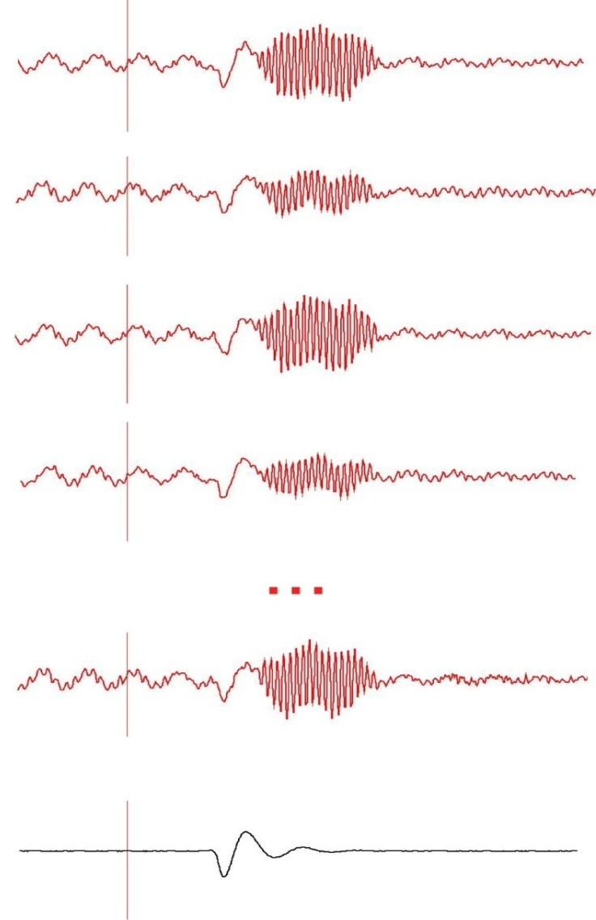
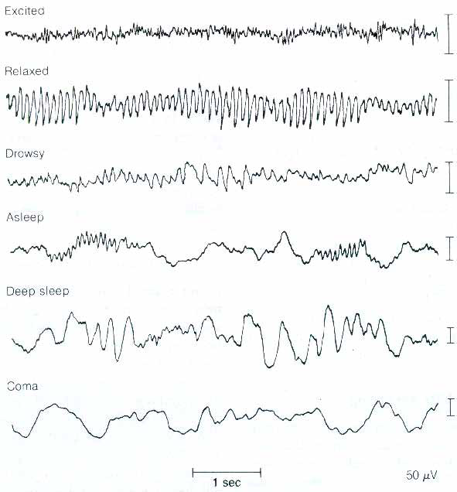
Evoked response vs. spontaneous activity
active
awake state
pre-stim
post-stim
resting state
falling asleep
sleep
deep sleep
coma
50 uV
Averaging
1 sec
evoked response
ongoing rhythms
Notes:
Evoked responses
Steady state – sleep , drug induced, pathology such as tremor or Parkinson's disease

Slide 6
An Introduction to the SPM Interface

Slide 7
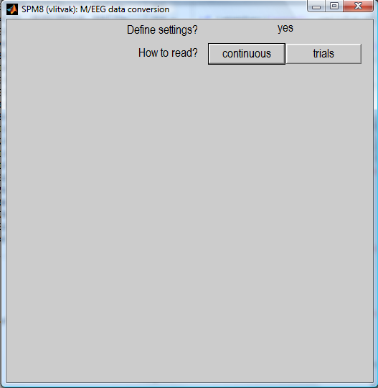
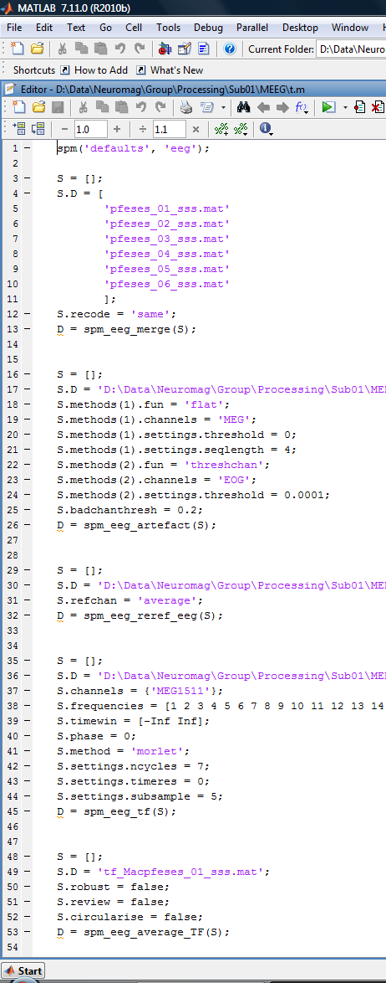
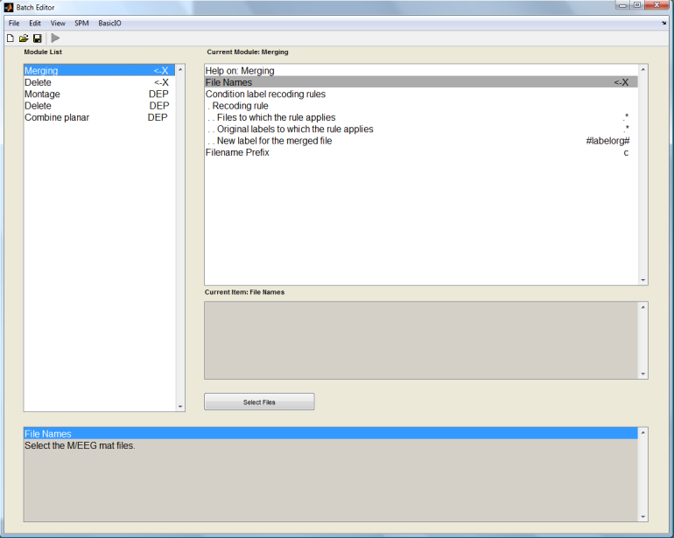
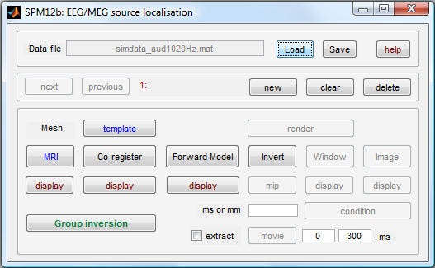
Clarification of terms – SPM speak
GUI
Script
Batch
Notes:
In each script for spm functions, there is a help section at the top or you can type help function in to the command line to get the same information.

Slide 8
Why batch?
As opposed to GUI
  - it is easy to reproduce analyses, apply them to different datasets and make modifications.
  - removing interactive GUI elements from the code makes it cleaner and easier to maintain.
As opposed to script
  complex pipelines can be built without programming expertise
  saved pipelines can be examined without deciphering other people’s code
  batch provides uniform interface for scripting to different parts of SPM code.
Disadvantages of batch
  there is no step-by-step guiding of the user
  the need to prepare all the inputs in advance makes some of the operations less intuitive and requires getting used to.
Notes:
Mention fieldtrip here and that some scripts run by spm are from fieldtrip and they work very well together – however fieldtrip is generally much more command line and does not have a graphical user interface so not easy for beginners but can use for specific functions once you become more experienced with programming. Basically they work very well together.

Slide 9
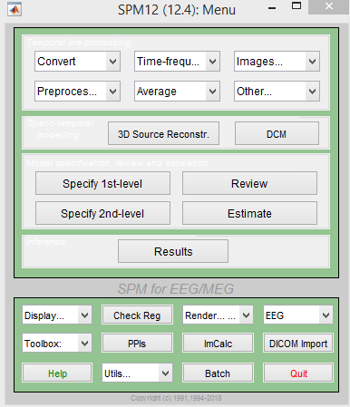
Steps to cover
Conversion
Filtering
Downsampling
Epoching
Re-referencing for EEG
Artefacts
Averaging
Coregistration
Generating scalp x time images
Time-frequency analysis
spm_eeg_convert
Notes:
Every time you run a preprocessing step, it will save a new dataset with a specific letter prepending it for example convert adds spmeeg_ to the front of the filename and filtering adds an f so you can track what steps you have done from the letters of the filename and you can also go back to previous steps and rerun things.

Slide 10
Conversion
MEG
CTF
Neuromag
BTi-4D
Yokogawa
EEG
EEGLAB
Biosemi
Brainvision
Neuroscan
EGI
ANT
SPM5
…
Biosig
Arbitrary
ASCII
Matlab
Fieldtrip
raw
timelock
freq
GUI
script
Prepare
(Import from workspace)
+
Reviewing tool
Convert button
(fileio)
spm_eeg_convert
spm_eeg_ft2spm
SPM dataset
*.dat – binary data file
*.mat – header file
Notes:
The following features are implemented in the fileio module
the API for the functions is transparent to the data format
adding support for new file formats require only little change to the existing functions
Formats
.dat file is a binary datafile which has a matrix of channel x time x trial or channel x time x frequency x trial
.mat file contains all other things associated – time axis, sampling rate, name of channels

Slide 11
Conversion
In GUI you have the option to define settings or ‘just read’
Settings to define…
  Continuous or epoched
  Which channels to include
  etc

Slide 12
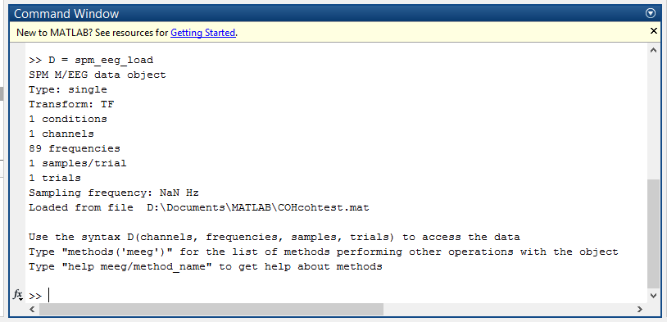
Expert’s corner
The *.mat file contains a struct, named D, which is converted to an meeg object by spm_eeg_load.
The *.dat file contains the data and is memory-mapped and linked to the object in order to save memory.
Typing ’D’ summarises object
Notes:
the data is returned in a 2-D array (Nchans x Nsamples), or in a 3-D array (Ntrials x Nchans x Nsamples)
the header information is represented in a structure that is common to all data formats
Sampling rate, number of samples, number of channels, channel labels ,number of trials etc
the event information is represented in a structure that is common to all data
The event structure allows for various events, that can be coded as numbers (trigger values) or as strings (annotations and trial classifications). Events have a location in the file (sample number) and may have a duration. In the end-user application, it should be easy to search for events of a particular type. Selected events should be used to fetch the data of interest from the file.

Slide 13
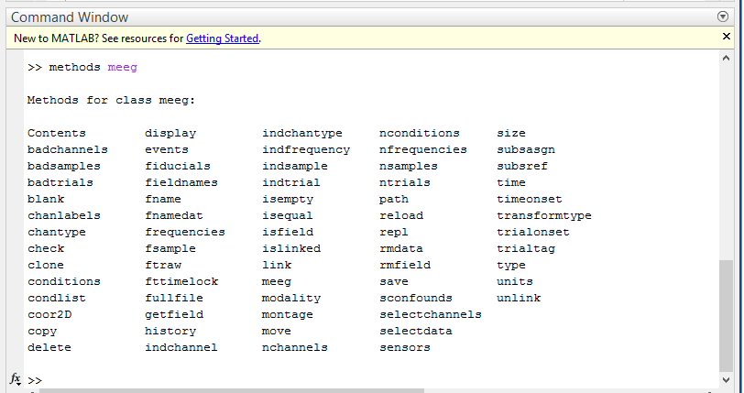
Expert’s corner
MEG object loaded with D = spm_eeg_load(‘file’)
getdata = D(:,:,:);
setdata, D(1,2,3) = 1;
Special functions, ‘methods’ provide an interface for getting information from the object and updating it
Notes:
the data is returned in a 2-D array (Nchans x Nsamples), or in a 3-D array (Ntrials x Nchans x Nsamples)
the header information is represented in a structure that is common to all data formats
Sampling rate, number of samples, number of channels, channel labels ,number of trials etc
the event information is represented in a structure that is common to all data
The event structure allows for various events, that can be coded as numbers (trigger values) or as strings (annotations and trial classifications). Events have a location in the file (sample number) and may have a duration. In the end-user application, it should be easy to search for events of a particular type. Selected events should be used to fetch the data of interest from the file.

Slide 14
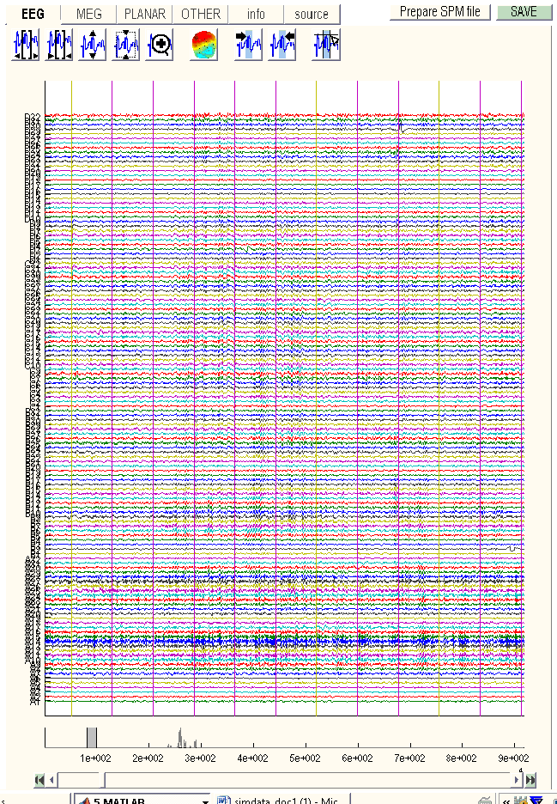
Viewing Data
spm_eeg_review
channels
time

Slide 15
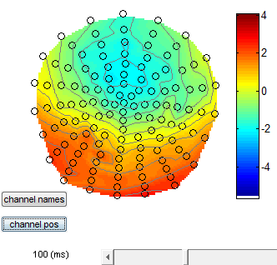
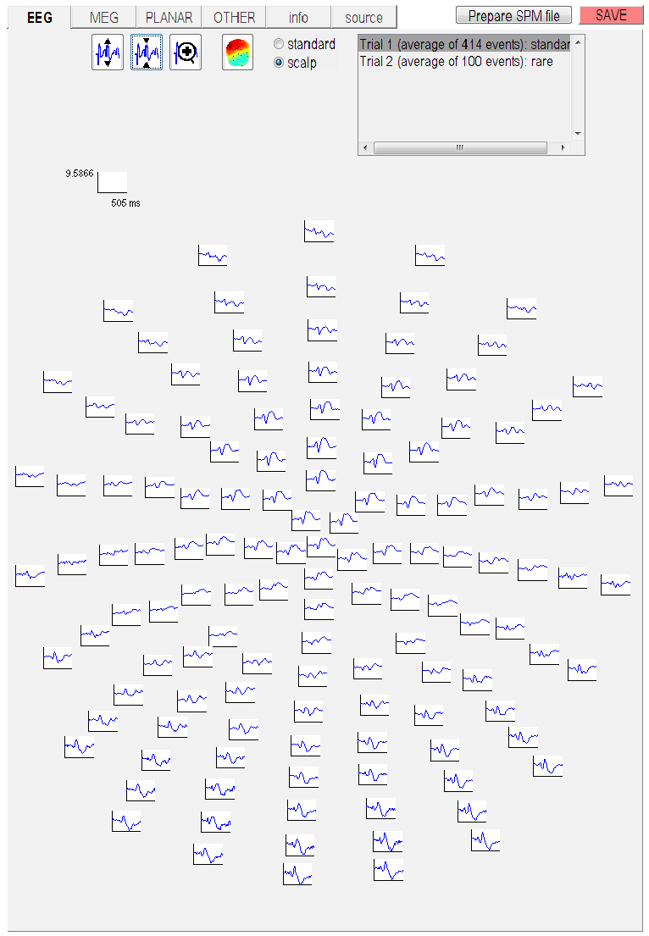
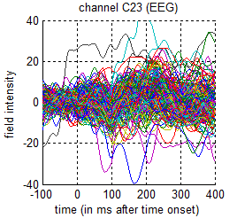
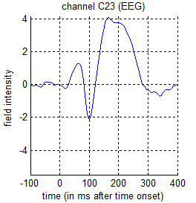
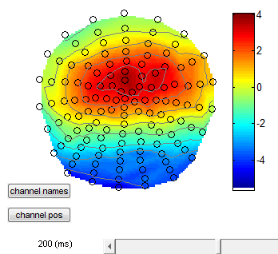

Slide 16
Steps to cover
Conversion
Filtering
Downsampling
Epoching
Re-referencing for EEG
Artefacts
Averaging
Coregistration
Generating scalp x time images
Time-frequency analysis
spm_eeg_filter

Slide 17
Filtering
‘Modifies the spectral content of a signal’
More precisely we can define a filter input-output relationship
Time Domain
Frequency Domain
Notes:
Cannot use frequencies above the Nyquist frequency (half the sampling rate)

Slide 18
Filtering
High-pass – remove the DC offset and slow trends in the data.
Low-pass – remove high-frequency noise. Similar to smoothing.
Notch (band-stop) – remove artefacts limited in frequency, most commonly line noise and its harmonics.
Band-pass – focus on the frequency of interest and remove the rest. More suitable for relatively narrow frequency ranges.
Notes:
Cannot use frequencies above the Nyquist frequency (half the sampling rate)

Slide 19
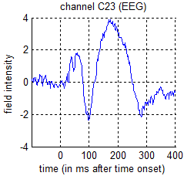
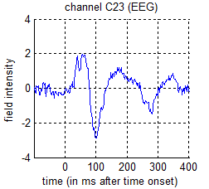
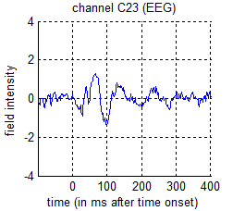
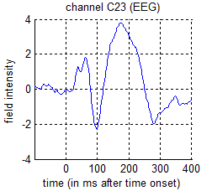
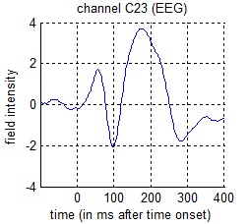
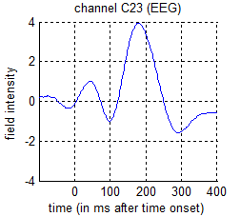
Filtering - examples
Unfiltered
5Hz high-pass
10Hz high-pass
45Hz low-pass
20Hz low-pass
10Hz low-pass
Notes:
Good idea to start with wide frequency band and then perhaps specify smaller frequency band at later stages once you’ve explored your data

Slide 20
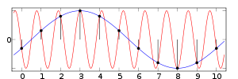
Filtering before downsampling
Aliasing – misidentification of signal frequency
A sinusoid can be distinguished from all others when sampled at least 2x per cycle (Nyquist frequency)
If frequency content > half sampling frequency aliasing occurs
Filtering removes unwanted frequency content before downsampling
Actual Signal – 9 Hz
Sampling Frequency – 10 Hz
Alias of Actual Signal – 1Hz
1 Second
Notes:
Cannot use frequencies above the Nyquist frequency (half the sampling rate)

Slide 21
Steps to cover
Conversion
Filtering
Downsampling
Epoching
Re-referencing for EEG
Artefacts
Averaging
Coregistration
Generating scalp x time images
Time-frequency analysis
spm_eeg_downsample

Slide 22
Steps to cover
Conversion
Filtering
Downsampling
Epoching
Re-referencing for EEG
Artefacts
Averaging
Coregistration
Generating scalp x time images
Time-frequency analysis
spm_eeg_epochs

Slide 23
Epoching
Definition: Cutting segments around events.
Need to know:
What happens (event type, event value)
When it happens (time of the events)
Need to define:
Segment borders
Trial type (can be different triggers => single trial type)
Shift of time zero of the trial with respect to the trigger (no shift by default).
Note:
SPM only supports fixed length trials
The epoching function also performs baseline correction (using negative times as the baseline). You can also do this separately.
Notes:
You can have different types of triggers corresponding to a single trial type

Slide 24
Steps to cover
Conversion
Filtering
Downsampling
Epoching
Re-referencing for EEG
Artefacts
Averaging
Coregistration
Generating scalp x time images
Time-frequency analysis
spm_eeg_montage

Slide 25
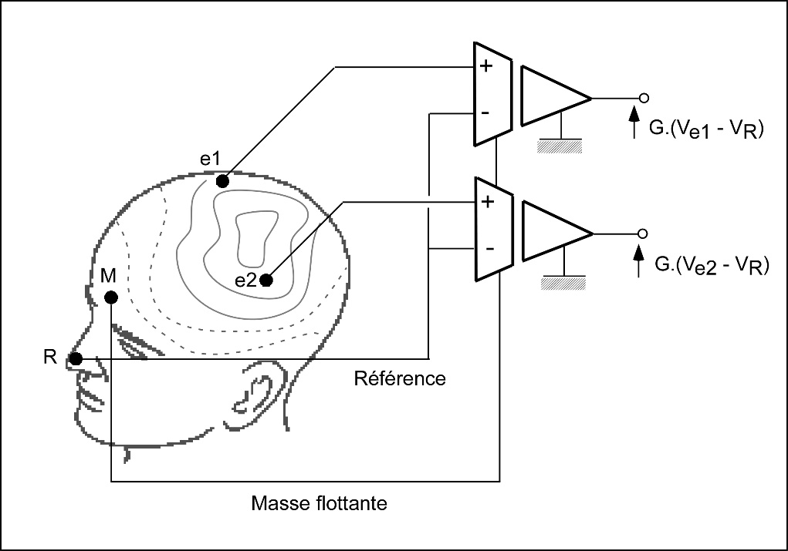
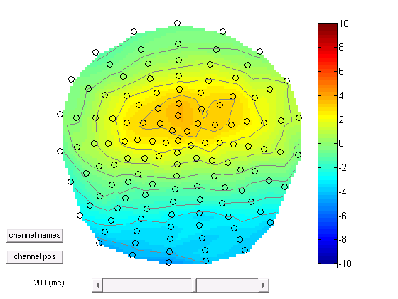
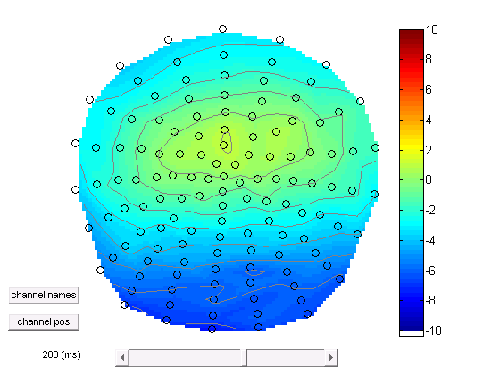
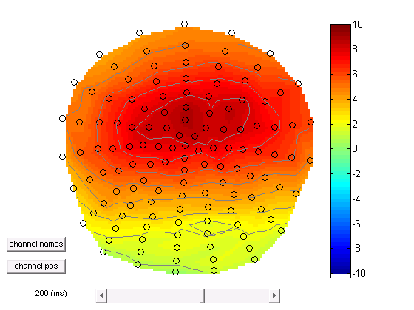
EEG – re-referencing
Average reference
Notes:
Potential difference between 2 points. Can use somewhere on head like nose or mastoid or average across all channels as reference – compromise – bad if few channels might be harder to see subtle changes
Can take most positive channel and make this ref so all else is negative or vice versa – if you then do stats – you can sensitise to particular phenomena.

Slide 26
EEG – re-referencing
Re-referencing can be used to sensitize sensor level analysis to particular sources (at the expense of other sources).
For source reconstruction and DCM it is necessary to specify the referencing of the data. This can be done via the ‘Prepare’ tool.
Re-referencing in SPM is done by the Montage function that can apply any linear weighting to the channels and has a wider range of applications.
Notes:
What else is montage used for? Derive ICA components/source extraction ( in addition to re-referencing)

Slide 27
Steps to cover
Conversion
Filtering
Downsampling
Epoching
Re-referencing for EEG
Artefacts
Averaging
Coregistration
Generating scalp x time images
Time-frequency analysis
spm_eeg_artefact

Slide 28
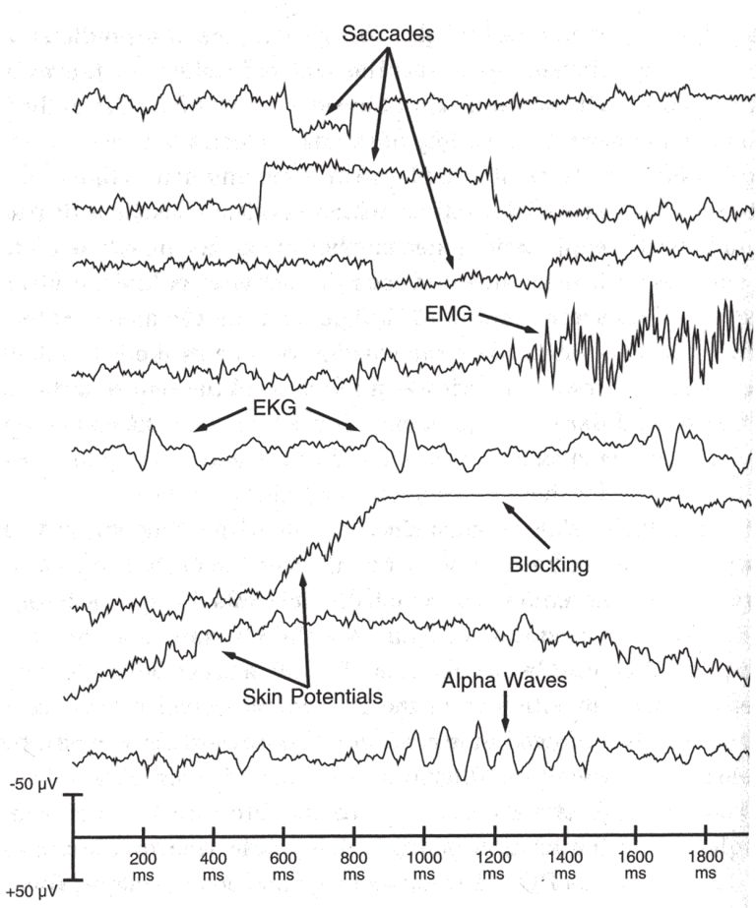
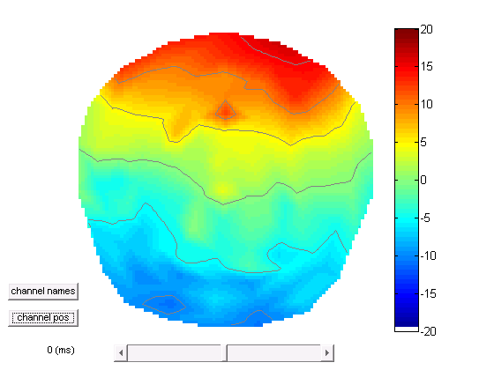
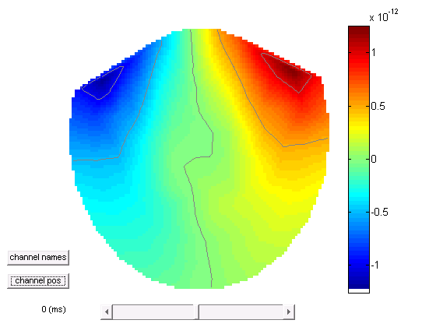
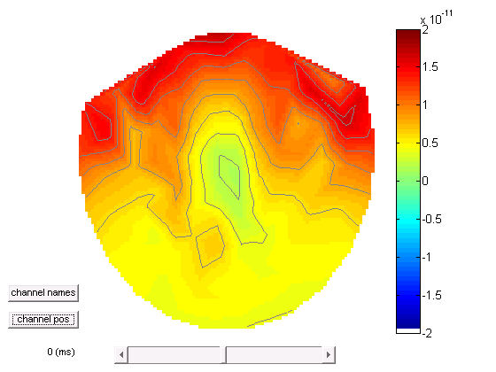
Artefacts
Eye blink
EEG
MEG
Planar
Notes:
Eye movement
Saccades
Muscle artifact (temporal electrodes , muscle artifact )
ECG
Saturated (blocking)
Slow potentials from sweating
Alpha waves
Features in time
Features in sensor space (topography)

Slide 29
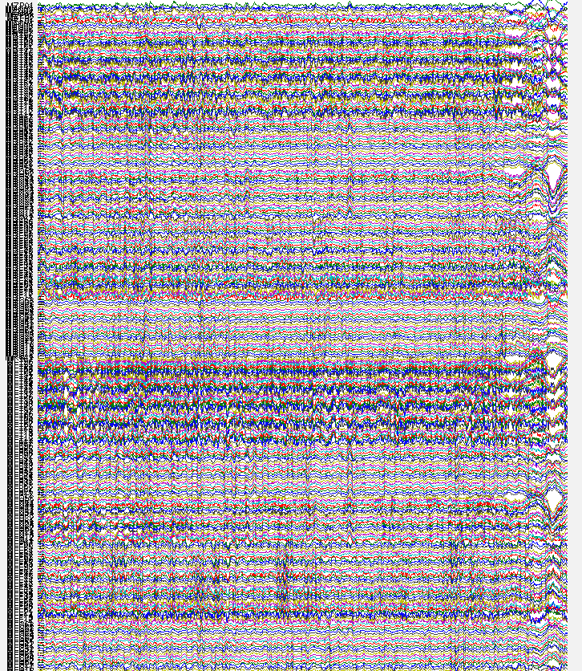
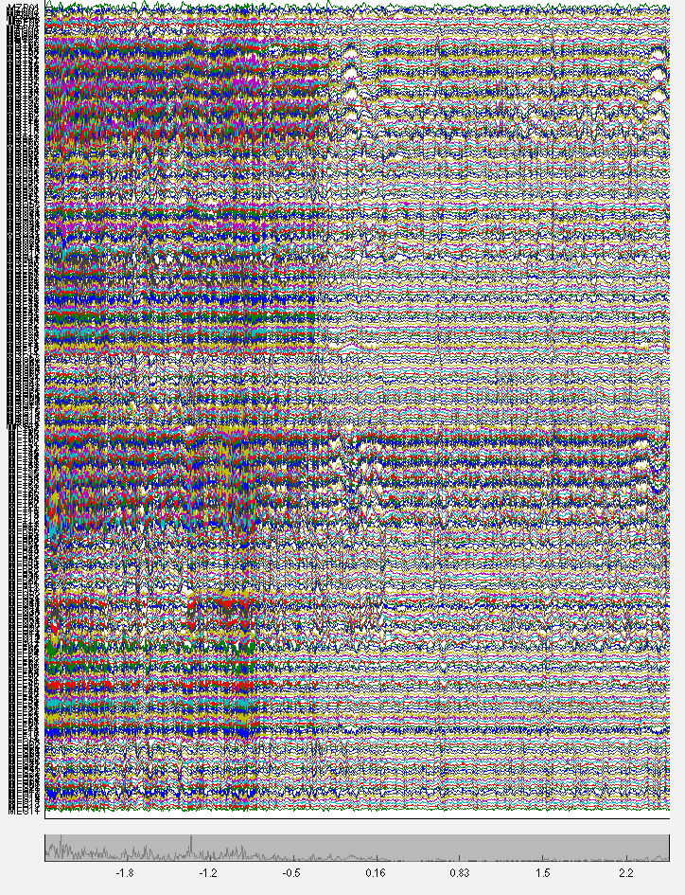
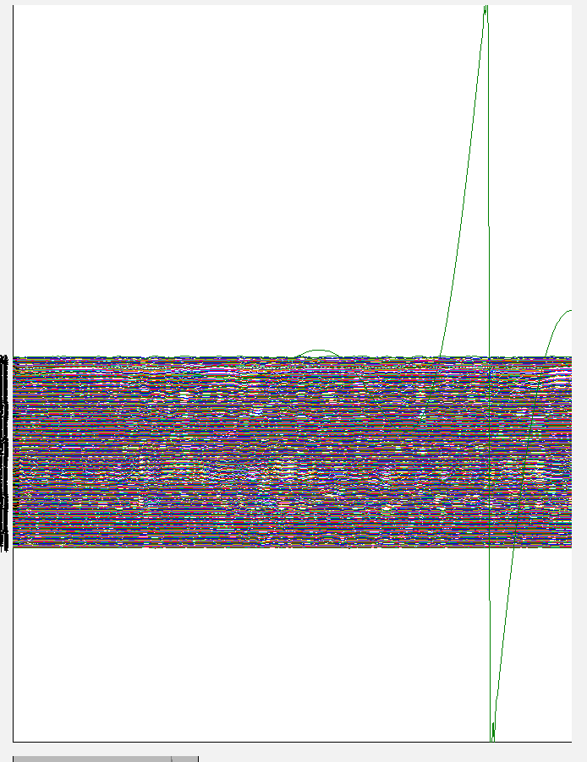
Examples in MEG data muscle artefact, eye blink, sensor jumps

Slide 30
Artefacts
SPM has an extendable artefact detection function where plug-ins implementing different detection methods can be applied to subsets of channels.
A variety of methods are implemented including, amplitude thresholding, jump detection, flat segment detection, ECG and eye blink detection.
In addition, topography-based artefact correction method is available (in MEEGtools toolbox).
Notes:
Similar to what ica does in eeg lab (topography based artefact correction)

Slide 31
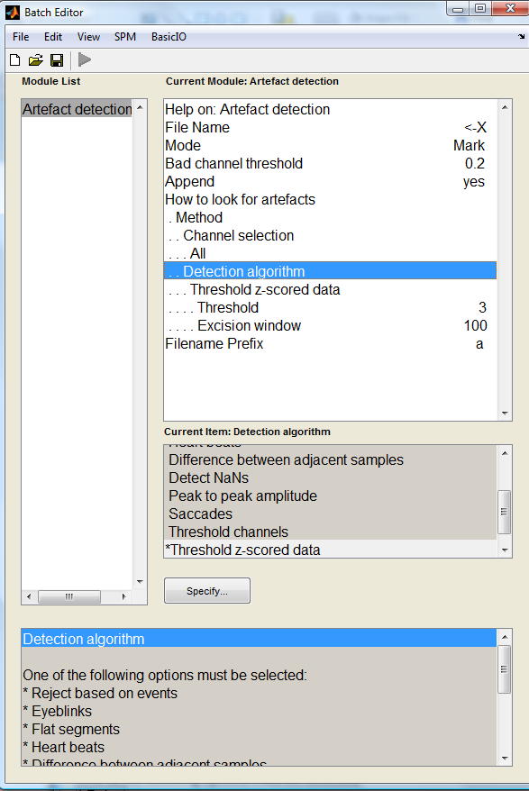
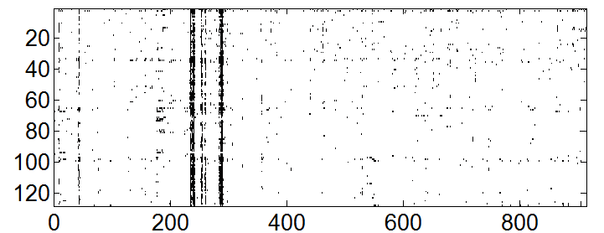
New in SPM12
It is now possible to mark artefacts in continuous data
Marked artefacts are saved as events which are carried over with subsequent processing. So it is possible e.g. to mark artefacts before filtering and keep for later.
Marked artefacts can be used for trial rejection at a later stage (‘Reject based on events’)
>> imagesc(D.badsamples(D.indchantype('EEG'), ':', 1))
Channels
time (s)

Slide 32
Steps to cover
Conversion
Filtering
Downsampling
Epoching
Re-referencing for EEG
Artefacts
Averaging
Coregistration
Generating scalp x time images
Time-frequency analysis
spm_eeg_average

Slide 33
Averaging across trials

Slide 34
Robust averaging
Kilner, unpublished
Wager et al. Neuroimage, 2005
Notes:
Red is robust, blue is standard

Slide 35
Robust averaging
Robust averaging is an iterative procedure that computes the mean, down-weights outliers, re-computes the mean etc. until convergence.
It relies on the assumption that for any channel and time point most trials are clean.
The number of trials should be sufficient to get a distribution (at least a few tens).
Robust averaging can be used either in combination with or as an alternative to trial rejection.
Notes:
Robust averaging is good for artefact suppression – uses the distribution of data to find outliers (distance from median) and suppress them (downweight them)
Need a good number of trials – need most to be clean
If artefact at same time each trial then this is not good – could use ICA instead

Slide 36
So that’s how we got to this point
Converted
Filtered
Downsampled
Epoched
Re-referenced for EEG
Removed artefacts
Averaged

Slide 37
A note about order
There is no single correct order of steps, but here are some considerations for order choices
  It is better to filter continuous data prior to epoching to avoid filter ringing artefacts in every trial. Alternatively the epochs of interest can be padded with more data and then cropped after filtering.
  It is better to do high-pass filtering or baseline correction before other filtering steps to reduce filter ringing.
  It is convenient to put downsampling early in the pipeline to make the subsequent steps faster.
  SPM only filters channels with physiological data. So the channel types should be set correctly before filtering.
  Some artefacts (e.g. discontinuous jumps or saturations) are more difficult to detect after filtering.

Slide 38
Steps to cover
Conversion
Filtering
Downsampling
Epoching
Re-referencing for EEG
Artefacts
Averaging
Coregistration
Generating scalp x time images
Time-frequency analysis

Slide 39
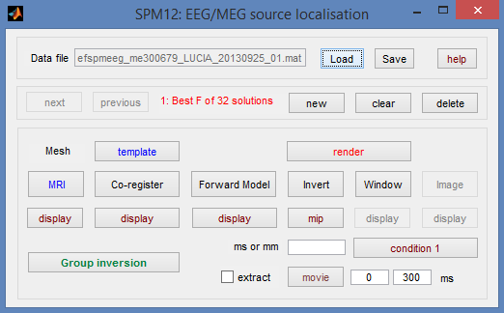
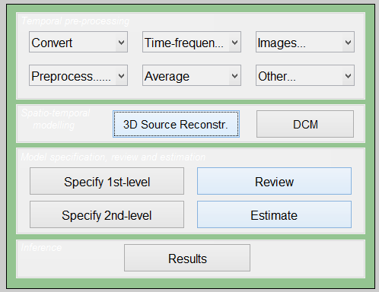
3D Source Reconstruction
Map sensors onto template brain or individual structural MRI
Need template/structural
Need fiducial coordinates if using individual MRI
Need to choose a forward model (e.g. single shell)
Notes:
We now need to obtain a model that explains how neural electric currents (the source space) produce magnetic fields and differences in electrical potentials at external sensors (the sensor space), given the different head tissues (essentially white and grey matter, cerebrospinal fluid (CSF), skull bone and skin).
The process of modeling how data values can be obtained outside of the head with MEG/EEG from electrical current dipoles in the brain is called forward modeling or solving a forward problem.
Available methods for MEG forward modeling
Single sphere: The head geometry is simplified as a single sphere, with homogeneous electromagnetic properties.
Overlapping spheres: Refines the previous model by fitting one local sphere under each sensor.
OpenMEEG BEM: Symmetric Boundary Element Method from the open-source software OpenMEEG. Described in an advanced tutorial: BEM head model.

Slide 40

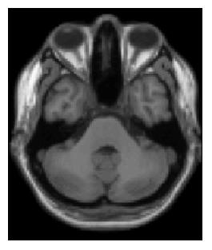
Why do we need fiducials?
Y
Sensory Array
Y
Rigid Body Transform
M
Inverse(M)
X
X
For Forward modelling need to match the co-ordinate system of sensors and anatomy (MRI)
Notes:
We now need to obtain a model that explains how neural electric currents (the source space) produce magnetic fields and differences in electrical potentials at external sensors (the sensor space), given the different head tissues (essentially white and grey matter, cerebrospinal fluid (CSF), skull bone and skin).
The process of modeling how data values can be obtained outside of the head with MEG/EEG from electrical current dipoles in the brain is called forward modeling or solving a forward problem.
Available methods for MEG forward modeling
Single sphere: The head geometry is simplified as a single sphere, with homogeneous electromagnetic properties.
Overlapping spheres: Refines the previous model by fitting one local sphere under each sensor.
OpenMEEG BEM: Symmetric Boundary Element Method from the open-source software OpenMEEG. Described in an advanced tutorial: BEM head model.

Slide 41
Steps to cover
Conversion
Filtering
Downsampling
Epoching
Re-referencing for EEG
Artefacts
Averaging
Coregistration
Generating scalp x time images
Time-frequency analysis

Slide 42
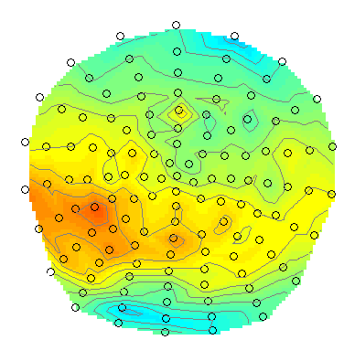
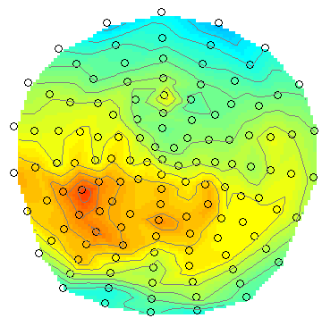
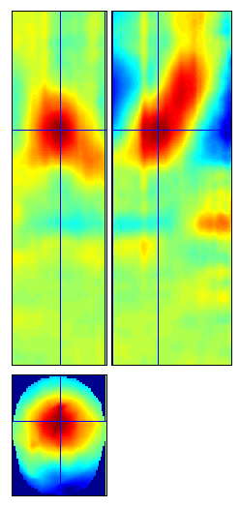
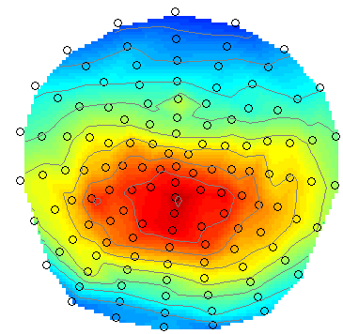
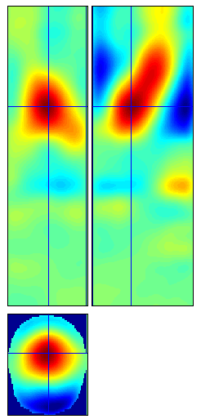
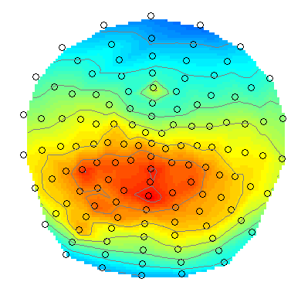











Generating time x scalp images
Notes:
3D image mapped over time – create these images and then can run all sorts of stats on them – 4D images
Y axis is time, x axis is first left to right of brain and second anterior to posterior of brain

Slide 43
Steps to cover
Conversion
Filtering
Downsampling
Epoching
Re-referencing for EEG
Artefacts
Averaging
Coregistration
Generating scalp x time images
Time-frequency analysis
spm_eeg_tf

Slide 44
Fourier analysis
Joseph Fourier (1768-1830)
Any complex time series can be broken down into a series of superimposed sinusoids with different frequencies

Slide 45
Fourier analysis
Original
Different amplitude
Different phase

Slide 46


Time-frequency spectrograms

Slide 47



Methods of spectral estimation
Morlet 3 cycles
Morlet 5 cycles
Morlet 5 cycles
Morlet 7 cycles
Morlet 7 cycles
Morlet 9 cycles
Notes:
Wavelet is a sine wave multiplied by a gaussian kernel
Aim of tapers is to reduce spectral leakage
Tapering is pulling the data at the edges towards 0 to diminish edge effects
Trade off between temporal and frequency resolution
Boxcar, Hanning taper, Hillbert transform, multitaper
Gaussian is narrower and more curved compared to hanning
Higher freq is more usually broadband – multitapes useful for this
Low freq usually better estimated by single (Hanning) taper
Multitaper good for gamma

Slide 48


Robust averaging for TF
Unweighted averaging
Robust averaging

Slide 49






TF rescaling
Raw
Log
Rel [-7 -4]s
Diff [-7 -4]s
LogR [-7 -4]s
Rel [-0.5 0.5]s
Notes:
Log = equates different frequencies
Rel = divides everything by the baseline (similar to LogR – like ratio)
Diff = subtracts baseline (doesn’t help with high frequencies)
LogR = log + baseline correction
Using a Diff baseline time window will effect what you see
Be careful of what activity is present in baseline

Slide 50


Changes to TF data handling in SPM12
TF analysis can be done on continuous data.
Continuous TF data can be filtered, epoched and used as input to convolution modelling.
Notes:
Ask Vladimir about this

Slide 51
Summary
We have covered all these pre-processing steps:
Conversion – Filtering – Downsampling – Epoching - Re-referencing for EEG -
Artefacts – Averaging – Coregistration - Generating scalp x time images -
Time-frequency analysis
From here you can go on to source analysis and stats…

Slide 52
Thanks to:
Vladimir Litvak
Stefan Kiebel
Jean Daunizeau
Gareth Barnes
James Kilner
Robert Oostenveld
Arnaud Delorme
Laurence Hunt
and all the members of the methods group past and present

