Slide 1



What are we measuring with M/EEG?
Mansoureh Fahimi Hnazaee
WCHN, Queen Square Institute of Neurology
University College London
m.hnazaee@ucl.ac.uk
@FahimiMansoureh

Slide 2
CONTENT
Introduction
A brief history
Biophysical origin of M/EEG signals
M/EEG recording and instrumentation
What we can(not) measure with M/EEG
Brief introduction to analysis methods

Slide 3

INTRODUCTION
To study the human brain we are limited by the tools that we have.
The tools introduced in this course are based on the principles of bioelectromagnetism, a discipline that examines the electric, electromagnetic, and magnetic phenomena which arise in biological tissues.
Note that by the same principles we can also use electric and magnetic fields to manipulate biological tissue (brain stimulation) which is beyond the scope of this course.

Slide 4
Refers to the study of the electric and magnetic fields of the “encephalon” (the brain)
EEG and MEG are the most powerful techniques to noninvasively study the electrophysiological dynamics of the brain (Cohen 2017)
Malmivuo, 1995

Slide 5

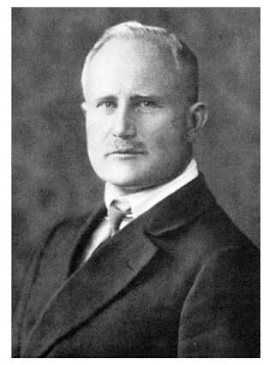

HISTORY OF HUMAN EEG
Hans Berger, in 1929, was the first to describe the human electroencephalogram.
He started experimenting with dog’s, replicating earlier findings but failed to evoke a specific change in the signal through stimulation.
His keen interest in the psychic manifestations of brain functioning led him to the recording of human EEG. His first subjects were patients with skull defects, later he traced signals from subjects with intact crania.
Even in these very early studies, Berger payed attention to: the origin (source) of his recordings, eliminating biological and mechanical source of contamination (artefact), the behavioural correlates
(Gloor, 1969)

Slide 6
HISTORY OF HUMAN MEG
First pioneered by David Cohen in 1968
But it was only since the early 1990’s with the introduction of high-density (200+) sensors covering the whole head that the full potential of MEG has begun to be realized.

Slide 7

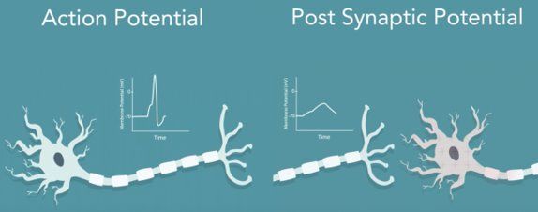
THE BIOPHYSICAL ORIGIN OF M/EEG
Action potentials are:
  Biphasic
  Brief
Postsynaptic potentials (PSPs) are:
  Monophasic
  Sustained
Cell body
Axon
Dendrites
Notes:
Action potentials are:
Biphasic
Brief
Postsynaptic potentials (PSPs) are:
Monophasic
Sustained
EEG reflects summation of synchronous PSPs across a neuronal population
Action potentials (APs) are unlikely to contribute to the M/EEG signal.
APs produce electric quadropoles, which their intensity decline steeply with distance (1/r3). Postsynaptic currents are dipolar, which drop off as 1/r2.
APs have a short duration. Would need to be highly synchronised to be measurable.
The bi-phasic nature of the depolarising and repolarising currents might result in mean field cancellation.

Slide 8
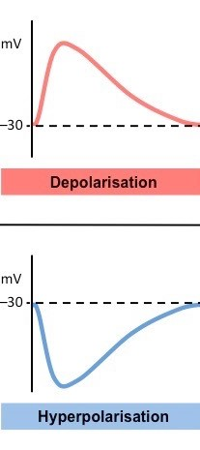
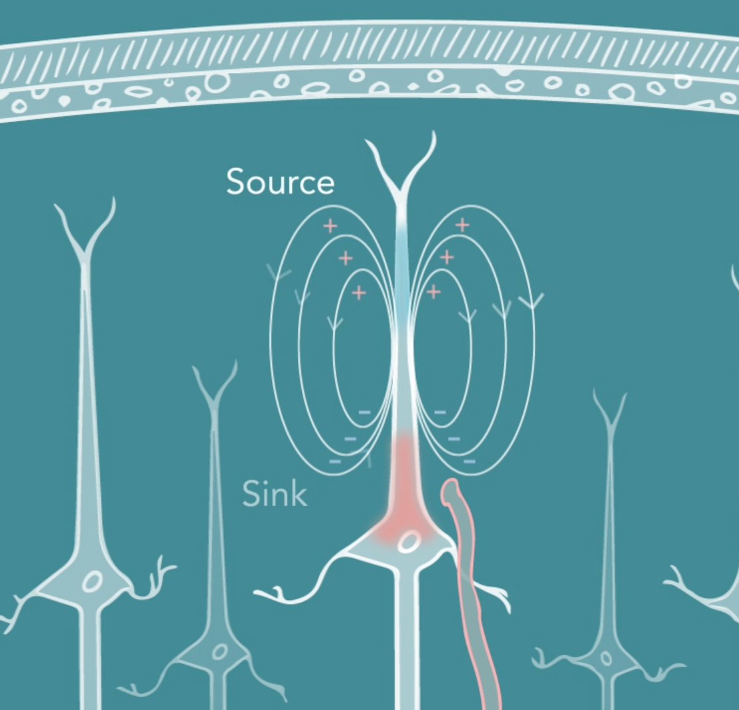
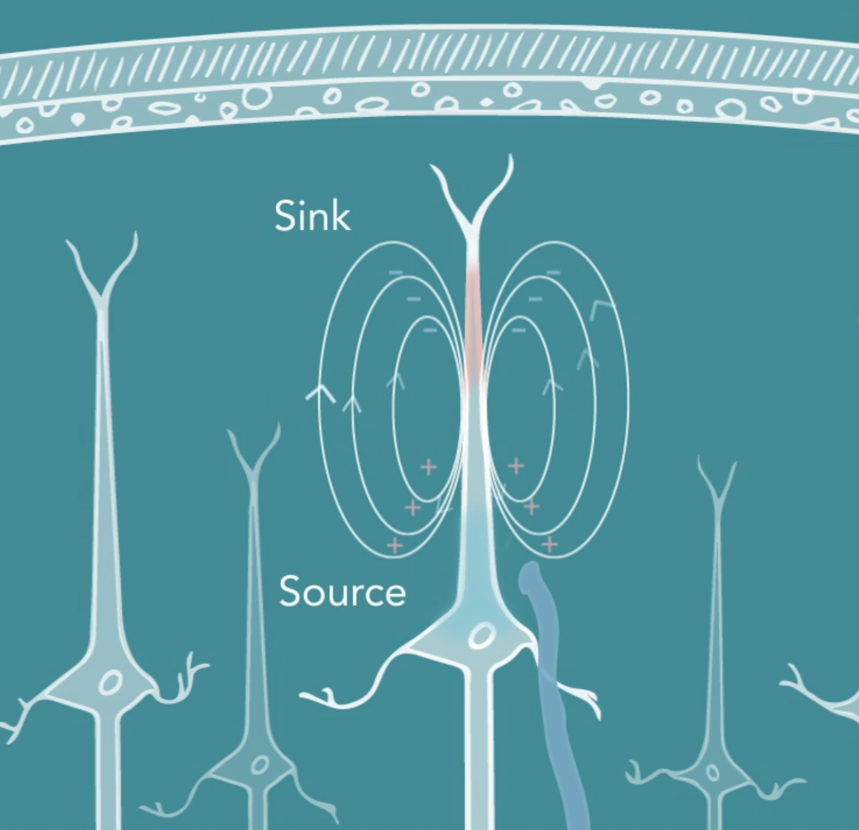
POSTSYNAPTIC POTENTIALS
Excitatory Post-Synaptic Potential (EPSP): influx of positive Na+ ions at apical dendrites causes depolarization of the postsynaptic cell​
Inhibitory Post-Synaptic Potential (IPSP): influx of negative Cl- ions causes hyperpolarization of the postsynaptic cell
Notes:
Contrary to action potentials, PSPs are longer in duration, can have different amplitudes and can be positive or negative amplitude
Note that you cannot tell from the EEG or MEG measurement whether you are recording EPSP or IPSP

Slide 9
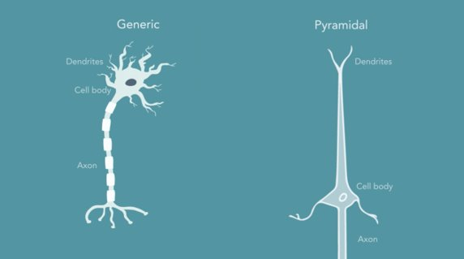
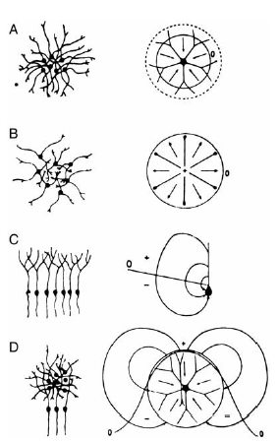
M/EEG GENERATION
Donald et al 2012
The geometry of the neuron must give rise to a net dipole current to contribute to the M/EEG signal
Notes:
Pyramidal cells
Found in layers II/III and V
Organised so primary axis is perpendicular to the cortical surface
Open field layout makes this detectable with M/EEG
Stellate cells
This example from layer IV
Closed fields cancel out, not seen by M/EEG

Slide 10
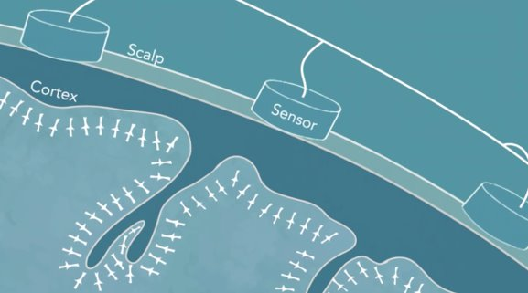
M/EEG GENERATION (CONT’D)
A large number of neurons have to be active simultaneously to generate a measurable M/EEG signal
Jackson and Bolger 2014
Notes:
Layer II/II and V pyramidal cells are ideal as current generators because they are:
spatially aligned
perpendicular to the cortical surface
recurrently connected
receive synchronous inputs

Slide 11
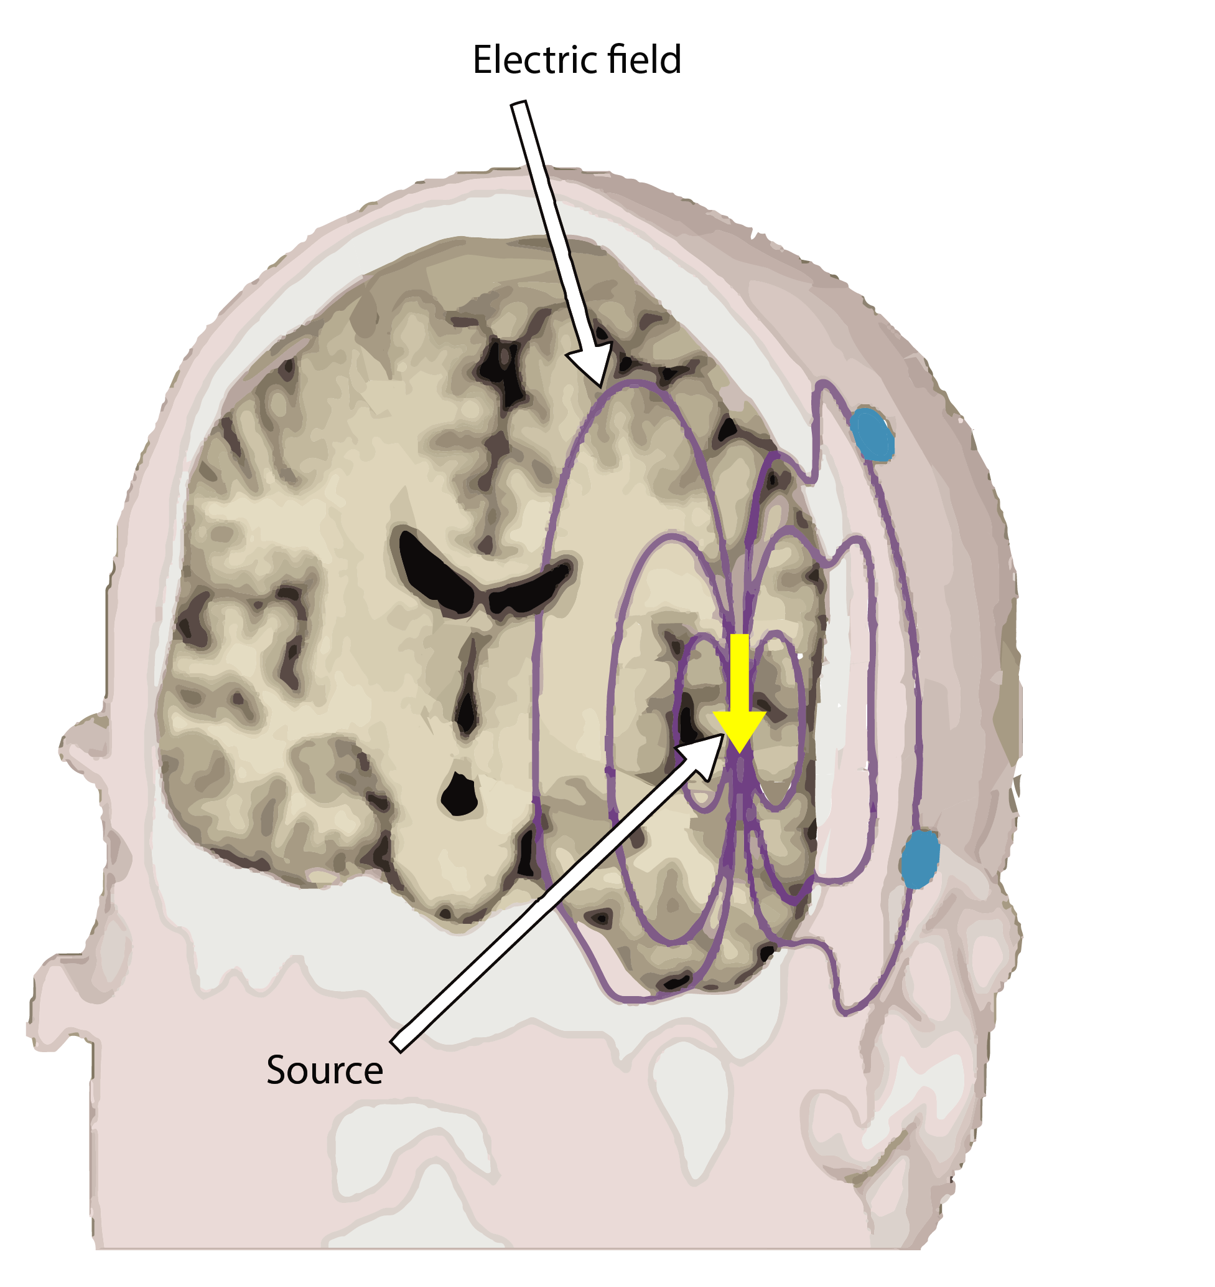
CONDUCTION OF THE ELECTRIC FIELD
EEG: Measures differences in electric potential at the scalp
Volume conduction – primary currents along dendrites of neurons give rise to secondary currents.
These propagate to be detectable at multiple sites on the scalp.
In a uniformly conducting medium, electrical field strength is related to the inverse square of the distance.
Conductivity varies across different tissue types in the head e.g. grey matter, cerebrospinal fluid, skull.

Slide 12
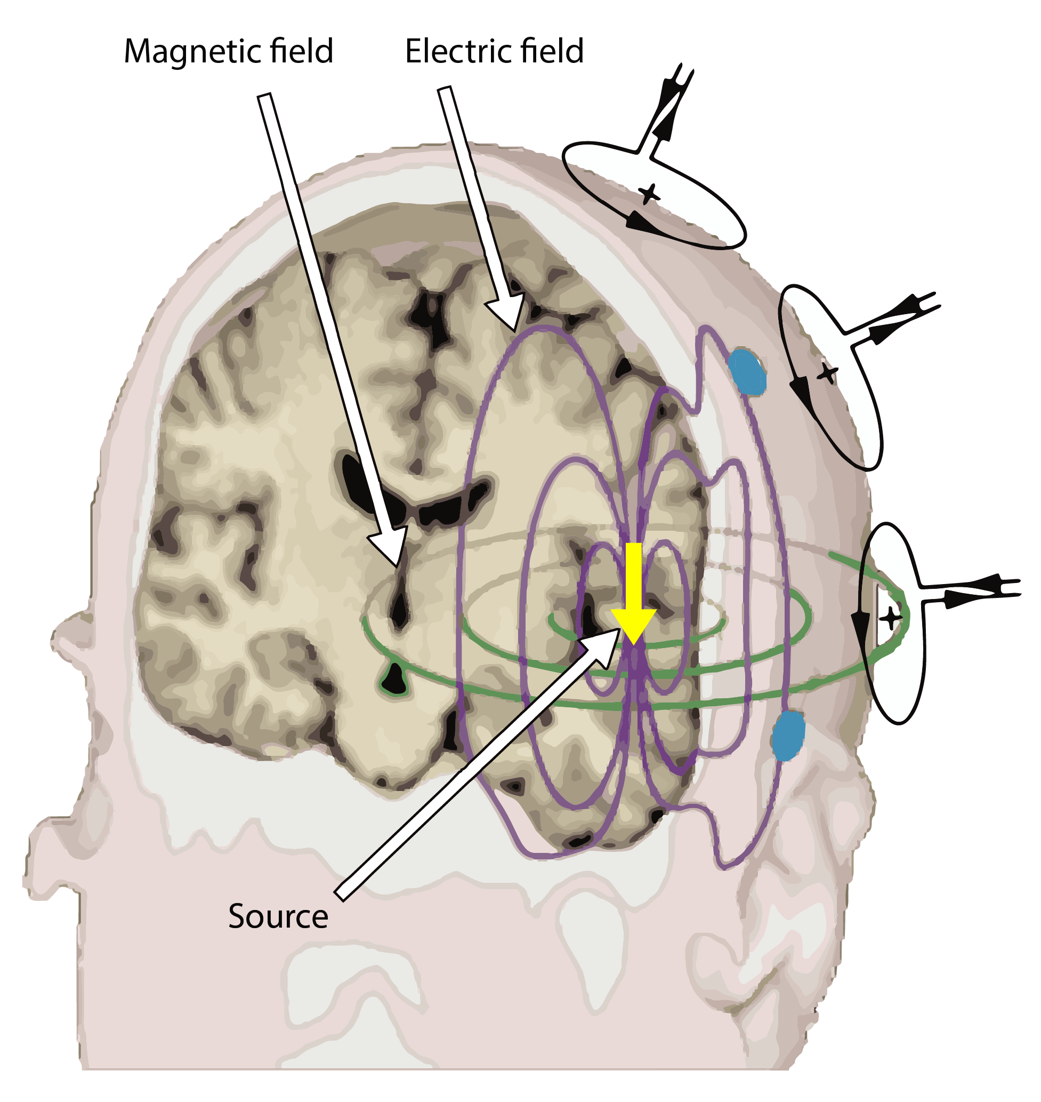
CONDUCTION OF THE MAGNETIC FIELD
MEG: Measures changes in magnetic flux density outside of the head
Magnetic fields are mainly induced by primary currents whereas electric fields are mainly sensitive to secondary (volume) currents
Magnetic field is generated perpendicular to electric field, from both the primary and secondary currents
Magnetic field is not affected by differences in conductivity

Slide 13
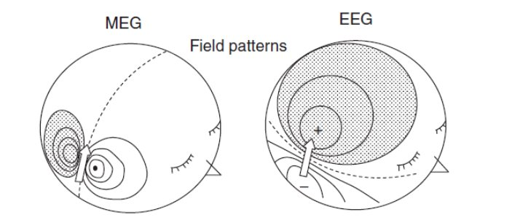
ELECTRIC AND MAGNETIC FIELDS
Hansen et al 2010

Slide 14
THE BIOPHYSICAL ORIGIN OF MEEG: SUMMARY
M/EEG measures the postsynaptic potential (PSP) of neurons, not the action potential.
The PSP creates a separation of charge along the neuron, known as a dipole.
Only certain types of neurons (mostly pyramidal neurons) contribute to the M/EEG.
Measurable M/EEG is produced when the dipoles align both in time and orientation to generate a strong enough field.
Dipoles generate electrical (EEG) and magnetic fields (MEG) perpendicular to each other, therefore they both measure the same underlying neural currents.
Notes:
EEG: Measures differences in electric potential at the scalp
MEG: Measures changes in magnetic flux density outside of the head
Both are non-invasive, cover the whole head, and have very high temporal resolution

Slide 15

M/EEG recording and instrumentation
RECORDING
STIMULATION
INVASIVE
NON-INVASIVE
INVASIVE
NON-INVASIVE
MAGNETIC
X
MEG
X
Transcranial
magnetic
stimulation
INVASIVE
NON-INVASIVE
INVASIVE
NON-INVASIVE
ECoG
Deep Brain
Stimulation
Transcranial
electrical
stimulation
ELECTRIC
Intracranial EEG
EEG
Functional
Brain Mapping
SEEG

Slide 16
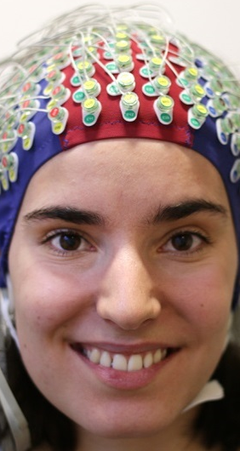
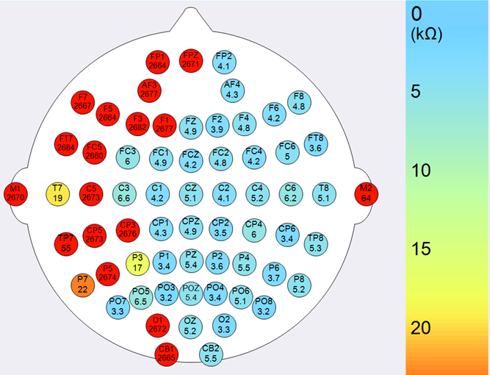
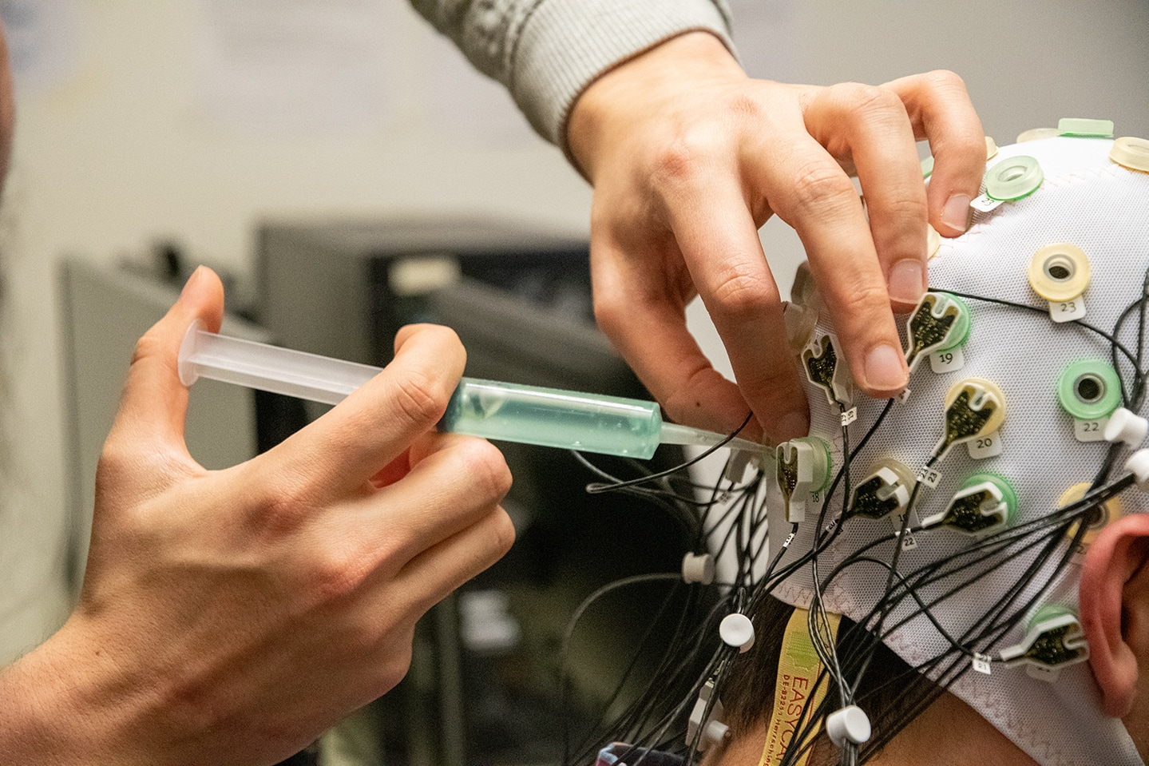
MEASUREMENT OF THE EEG SIGNAL
Cap with 1-256 electrodes
Scalp scrubbed and prepared with conductive gel or saline solution to reduce impedance
Measures voltage fluctuation over time (order of µV)
https://compumedicsneuroscan.com/profusion-eeg-impedance-check/
https://imotions.com/blog/eeg/

Slide 17
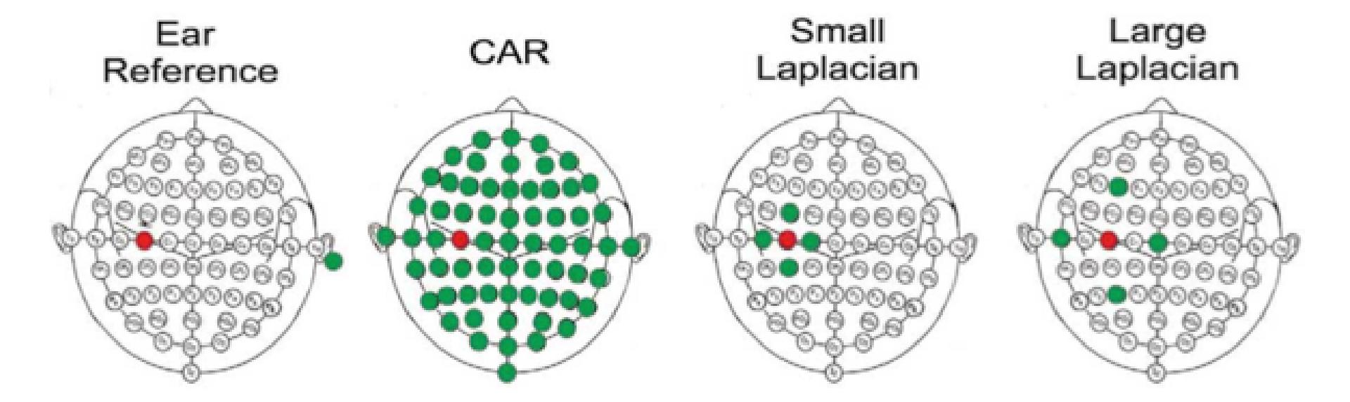
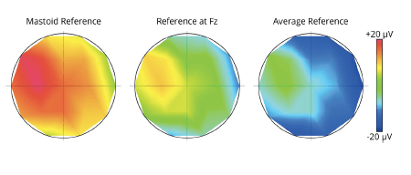
EEG SIGNAL DETECTION: ELECTRODES
EEG records potential differences at the scalp using a set of active electrodes and a reference (ground) electrode.
The reference electrode is important as it eliminates noise from the amplifier circuit
The representation of the EEG channels is referred to as a montage
  Unipolar/Referential ➔ potential difference between an electrode and a designated reference
  Bipolar ➔ represents the difference between a pair of adjacent electrodes (e.g. ECG, EOG, EMG)
Potential differences are amplified, filtered and digitized.
McFarland et al., (1997)

Slide 18
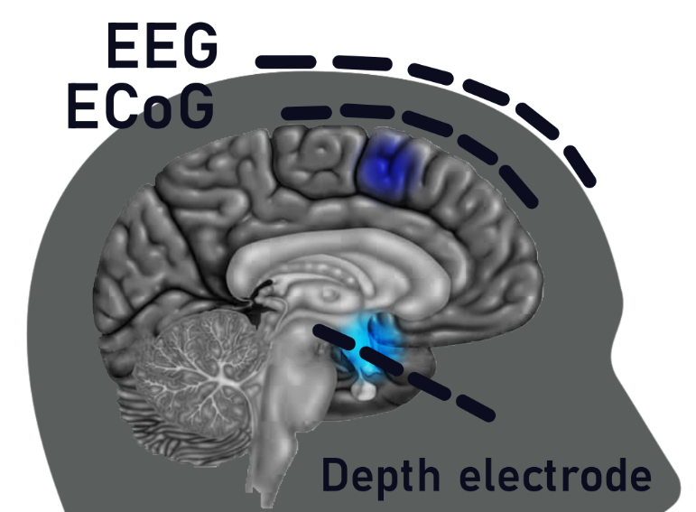
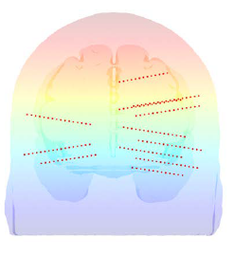
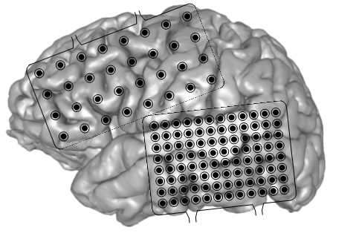
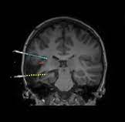
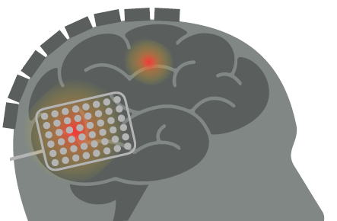
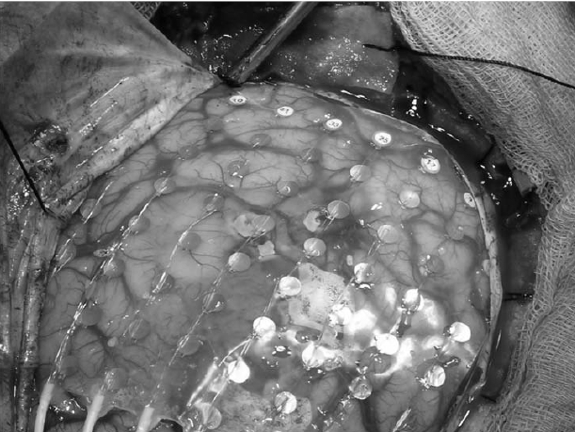
INVASIVE HUMAN NEUROPHYSIOLOGY
Electrocorticography
EEG
ECoG
Stereoelectroencephalography
18

Slide 19
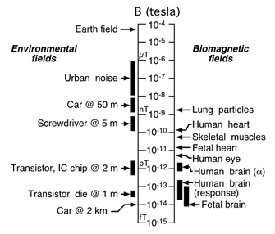
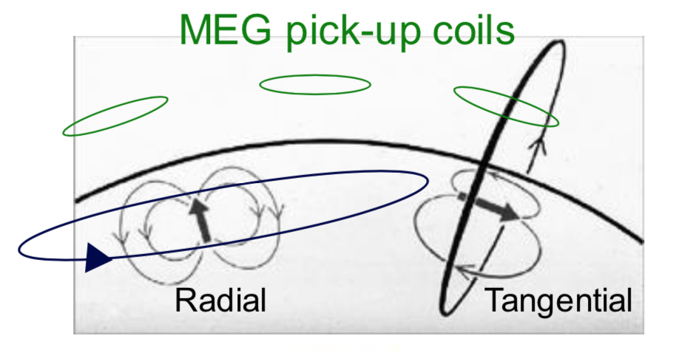
MEASUREMENT OF THE MEG SIGNAL
Tiny magnetic field compared to other sources
Special sensors and environment required to detect the signal
MEG is also most sensitive to tangential sources parallel to the scalp
Vrba (1999)

Slide 20
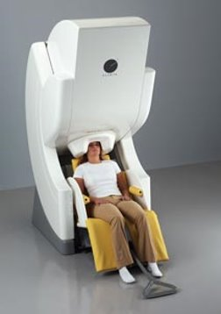
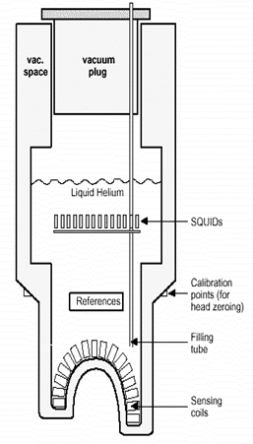
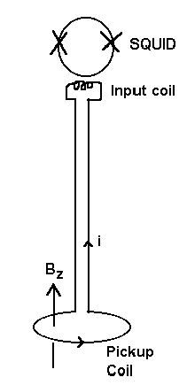
MEG SIGNAL DETECTION: SQUIDs
Superconductors only become superconductors below in a certain temperature. The SQUIDs in a MEG are kept at 4 K (-269.15 °C) using a bath of liquid helium.
This makes SQUID-MEG quite limited in its applications.
Participant has to keep head still relative to sensors!
Bulky instrumentation
Liquid helium is expensive.

Slide 21
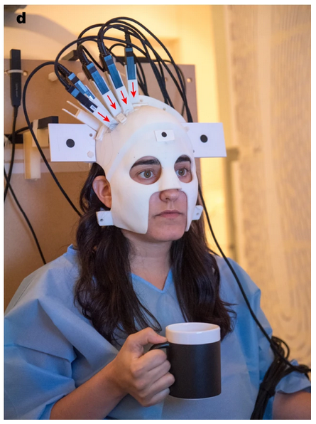
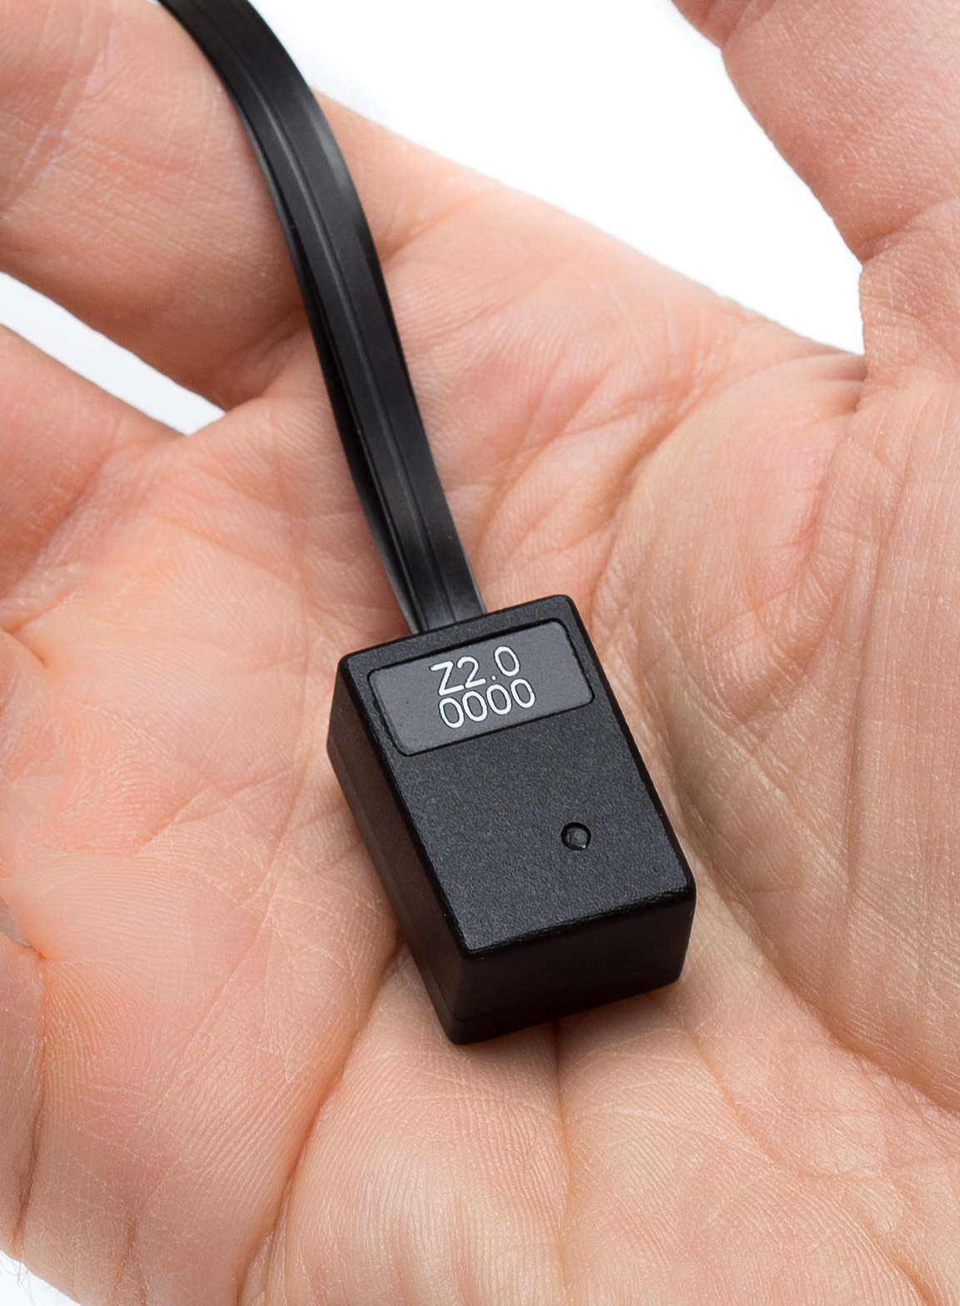
MEG SIGNAL DETECTION: OPMs
A new generation of sensors which are just as sensitive, but can operate safely on the scalp. The most commonplace so far are Optically Pumped Magnetometers.
Theoretical improvements in SNR over SQUID MEG.
Warning
No turn-key OP-MEG solution exits yet. Proceed with caution!
Boto et al. (2018)
QuSpin Inc.
WCHN 2022
Notes:
Recently, a new generation of MEG sensors called optically pumped magnetometers (OPMs) – also known as atomic magnetometers – have been developed (Boto et al., 2017, 2018; Shah and Wakai, 2013), which overcome many of the limitations of SQUID-MEG systems. OPMs exploit the quantum mechanical properties of alkali atoms to measure small changes in a magnetic field (see Tierney et al., 2019, for a review). The current generation of sensors (e.g. QZFM Gen-2, QuSpin Inc.) has achieved impressive sensitivities of 7–15 fT/√Hz from 1 to 100 Hz. Because OPMs do not require cryogenic cooling, individual sensors can be placed very close to the scalp, resulting in up to five times the sensitivity to cortical sources (albeit with an increased noise floor) compared to conventional SQUID systems (Boto et al., 2016; Iivanainen et al., 2017). Lightweight, whole-head sensor arrays of OPMs are now available (Hill et al., 2020) and are capable of measuring resting-state connectivity with the same robustness as a 275-channel CTF system, but using only 50 sensors (Boto et al., 2021).

Slide 22
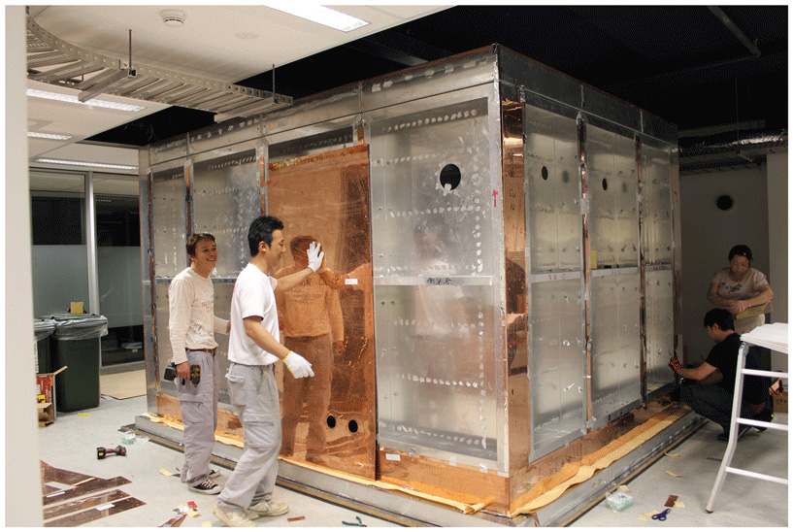
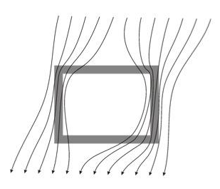
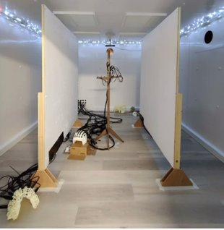
MAGNETICALLY SHIELDED ROOMS
MEG systems are currently housed within Magnetically Shielded Rooms (MSRs), which give passive shielding against noise from the environment. The best rooms can get the residual background fields to the order of a few nanoTeslas.
Concentric shells of mu metal, copper and aluminium bend external fields around the MSR
Notes:
One of the primary technical challenges facing MEG data collection and analysis is that the magnitude of neuromagnetic fields measured outside the head are considerably weaker than interfering signals. Neural fields are typically 10–1000 femtotesla (fT, 1 femtotesla = 10⁻¹⁵ tesla), up to 100,000 times smaller than the Earth's static magnetic field. Additional sources of low-frequency (<20 Hz) interfering noise are common in urban environments, where moving cars, trains and construction work create changes in magnetic field up to 8 orders of magnitude higher than neural signals (Taulu et al., 2014). Narrow-band sinusoidal noise at 50 or 60 Hz is also commonly present in MEG recordings, originating from electrical devices that use alternating current as a power source. Other sources of noise include vibration artefacts from mechanical movement of the MEG device, slight inaccuracies in SQUID design and any irremovable sources of metal on the participant (e.g. dental bridges, cochlear implants).
The primary means of reducing external magnetic interference is to perform MEG recordings inside a magnetically shielded room (MSR), constructed of multiple layers of copper or aluminium and mu-metal, which provide a path for magnetic field lines around the enclosure. For most purposes, two- or three-layer MSRs are sufficient to reduce the remnant field to a few 10′s of nanotesla (nT), providing enough shielding for MEG

Slide 23
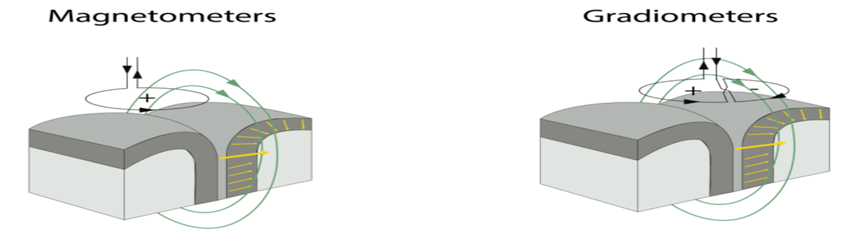
MAGNETOMETERS AND GRADIOMETERS
Gradiometers consist of two coils in parallel with reverse current orientation
A local source enters through one and exits through the other
This gives a summed (stronger) measure
Gradiometers are less sensitive to distant noise sources than magnetometers

Slide 24
COMPARISON OF THE METHODS
 | ADVANTAGES | DISADVANTAGES
EEG | - Cheap - Movement compatible - Can be done anywhere - Sensitive to all orientations of the dipole | - Slow setup - Signal propagation dependent on the medium through which it travels - High frequencies lost
MEG | - Fast setup - Signal propagation dependent on the medium through which it travels - Movement compatible (OPM MEG) - High frequencies can be measured | - Expensive - Movement incompatible (cryogenic MEG) - Requires shielding - High frequencies lost (OPM MEG) - Sensitive to certain orientations of the dipole
INVASIVE RECORDINGS | - Movement compatible (limited by the patient situation) - Unique spatial resolution depending on method (even single unit recordings possible) - High frequencies can be measured | - Is only done for clinical purposes and therefore location of the recording is determined (limited) and signal is affected by the disease

Slide 25
NOISE SOURCES (ARTIFACTS)
EEG
Heartbeat (ECG)
Eye movement and blinks
Muscle activity
Slow drift through e.g. loose contact, sweat
Power line
Removal through:
  Visual inspection
  Automated detection
  Filtering
  Computational methods (Independent components analysis, regression)
MEG
Heartbeat (ECG)
Eye movement and blinks
Muscle activity
Power line
Source of electrical or magnetic fields inside or outside the shielded room
Removal through:
  Visual inspection
  Automated detection
  Filtering
  Computational methods (signal space separation, signal space projection)
  Use of gradiometers
Notes:
1. Interference from sources outside the shielded room
Large moving magnetized objects such as elevators, vehicles, metal doors
Frequent transportation of patients on gurneys or equipment on carts
Motors and power lines
Construction activities
2. Noise sources inside the shielded room
Other people (parent, nurse, neuropsychologist)
Devices (projectors, cameras, stimulators, EEG cables)
3. Physiologic or nonphysiologic sources inside the patient
Electyrocardiogram
Orthodontia, other dental materials
Implants (vagal nerve stimulators [VNS], artificial joints)
4. Noise from inside the head
Shunts
Ferrous particles left in the head after craniotomy
Background brain noise unrelated to the signal of interest
Activity from brain regions not of interest
5. Materials on the patient
Jewelry
Clothing (such as belts, bras, snaps, zippers)
Contact lenses
Mascara and other cosmetics or hair products
6. Intrinsic sensor noise
7. Artifacts from other apparatus
Crosstalk from other recording devices (EEG)
Evoked response stimulators
Monitoring instruments

Slide 26

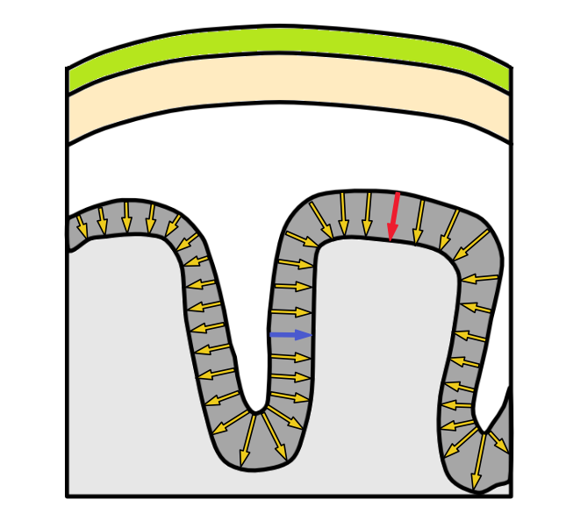
WHAT WE CAN(NOT) MEASURE WITH M/EEG
Orientation of source is important….
EEG can detect both tangential and radial oriented dipoles
MEG can see tangential, but struggles to sense radial dipoles
  If you assume a symmetric sphere for the head, radial dipoles are impossible to detect!
Scalp
Skull
Cortex
Gyrus
Sulcus

Slide 27
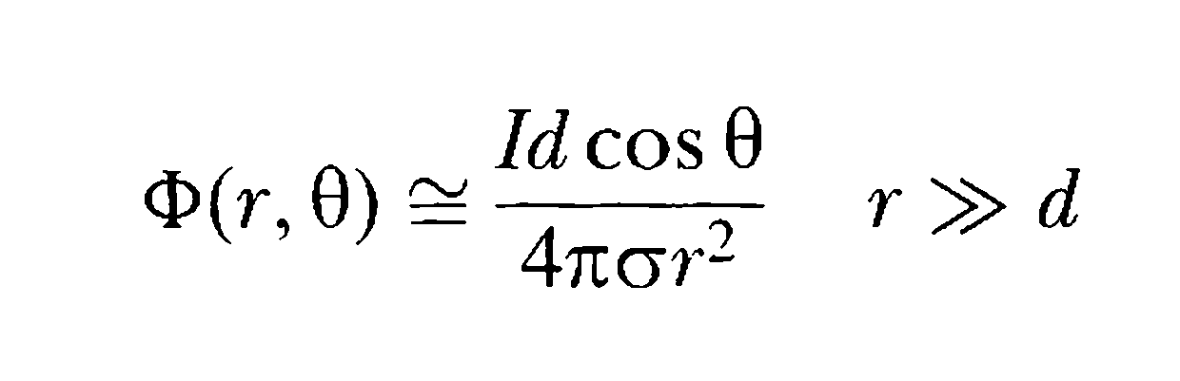
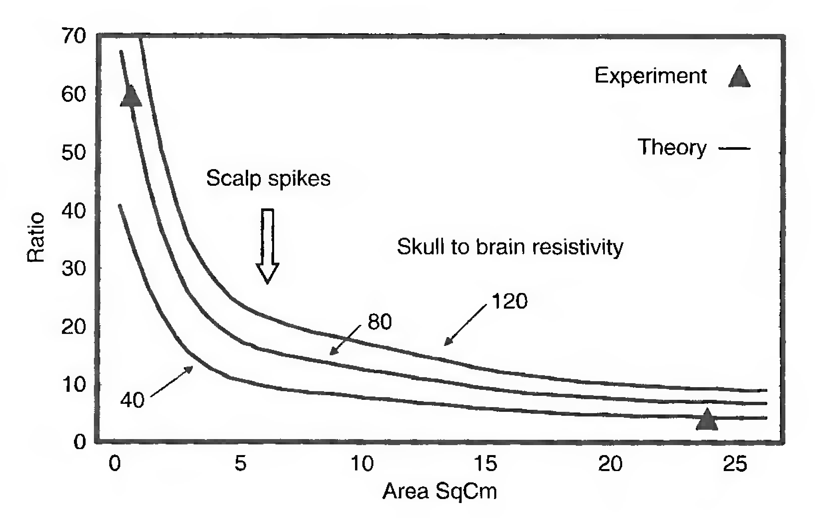
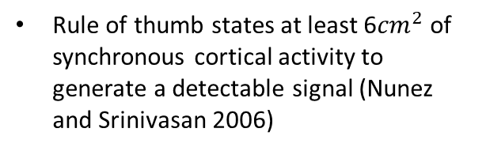
DEEP AND SUB-CORTICAL SOURCES IN M/EEG
Deep or sub-cortical sources are small and are enclosed by cortical activity (low SNR)
Deep or sub-cortical structures have a closed field
A single dipole cannot travel far and attenuates based on inverse-squared law
They do not reach far distances due to the cancellation effect
The scalp acts as a spatial average, cannot gain spatial resolution beyond the point spread
10-12 components typically explain 95% of the variance in EEG (Bigdely-Shamlo et al. 2019)
Rule of thumb states at least 6${cm}^{2}$ of synchronous cortical activity to generate a detectable signal (Nunez and Srinivasan 2006)
Lorente De no, 1947

Slide 28

DEEP SOURCES ARE SMALL
Cortical density of certain subcortical structures is higher than that of neocortex
Higher neuronal density is approximated by a dipole sheet and not a single dipole
A dipole sheet can travel far
In the small distance range that we are observing, attenuation can be linearly approximated (Arnulfo et al. 2015, Scherg 1990)
Niedermeyer, 2012

Slide 29
DEEP SOURces ARE SMALL AND HAVE LOW SNR
SNR can be improved with better recording instruments, experimental paradigm, and more advanced analysis methods
By sufficiently increasing signal to noise ratio, activity as small as brainstem evoked potentials can be picked up by EEG (Picton 2010) and localized to the brainstem (Scherg 1985)

Slide 30
DEEP SOURCES HAVE A CLOSED FIELD
Cancellation is not as much as previously thought, real situation is more complex
Dipole orientation may not be as important as previously assumed
Andersen et al 2019
Notes:
The head isn’t a perfect sphere.
Even if you assume it is very few sources are truly radial
Most sources are not point sources, so will likely contain a tangential component.
tl;dr - it’s not a massive concern.

Slide 31
DEEP SOURCES DETECTED WITH M/EEG

Slide 32
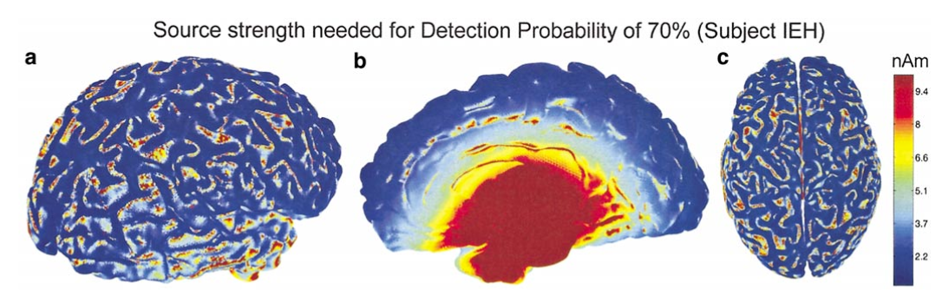
WHICH IS BETTER FOR DEEP SOURCES?
Depth is a limiting factor in MEG measurements.
Hillebrand and Barnes (2002)
Potentially, OPMs are the best for detecting deep sources, as they are placed closely to the scalp (therefore better than SQUIDs) and signal does not get distorted due to different conductivity values of the tissue (therefore better than EEG). But this is still investigated

Slide 33

BRIEF INTRODUCTION TO ANALYSIS METHODS
Time and frequency domain analysis
Analysis of evoked versus induced responses
Functional and Effective Connectivity
Source reconstruction

Slide 34
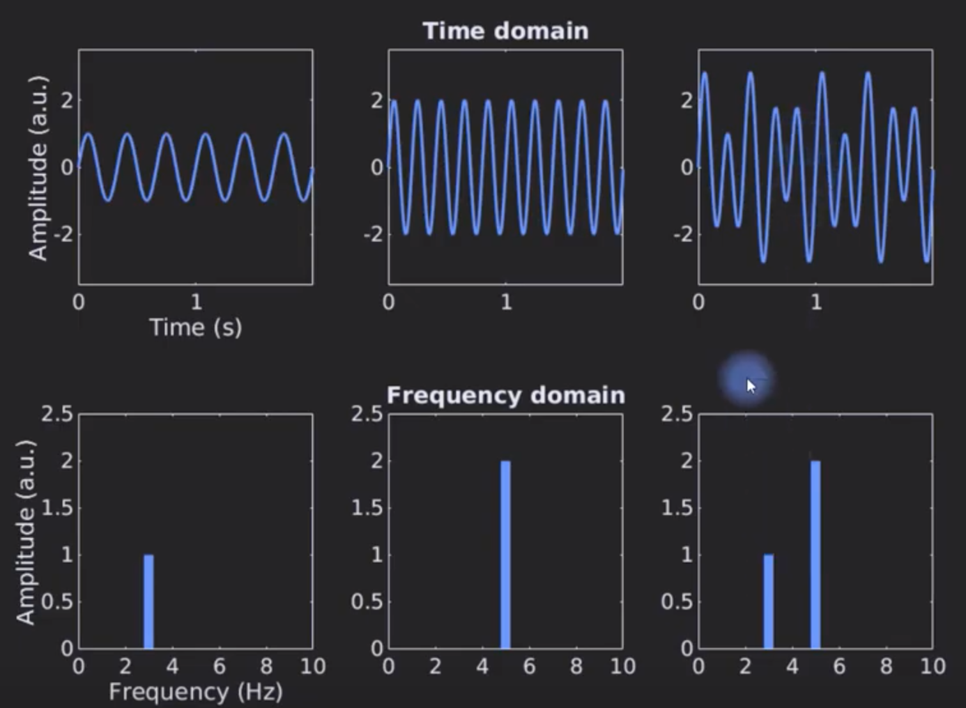
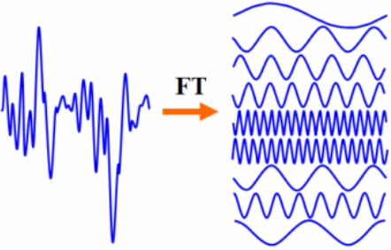
TIME OR FREQUENC DOMAIN ANALYSIS

Slide 35
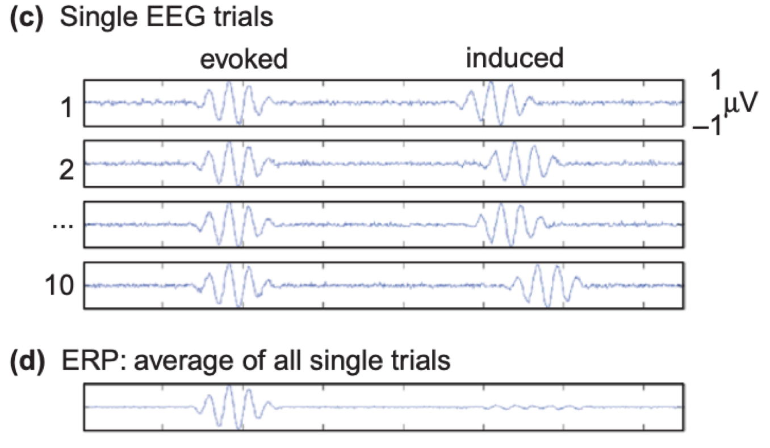
EVOKED AND INDUCED RESPONSES
Not all activity is precisely phase-locked to a stimulus
Averaging the voltage traces across trials cancels out such activity
Hermann et al 2004

Slide 36
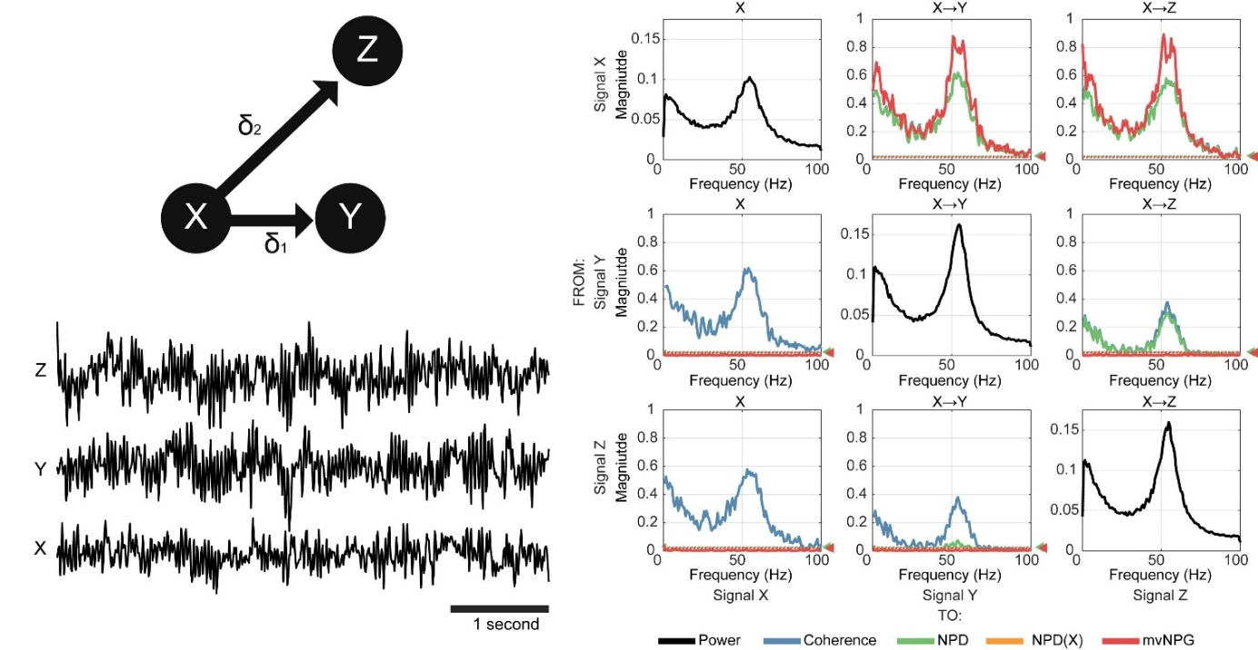
FUNCTIONAL CONNECTIVITY IN M/EEG
West et al., 2020
Bastos et al., 2016
Notes:
Because of the high resolution temporal scale, EEG and MEG offers the possibility to look at connections between regions at the same resolution of the behaviour
Connectivity in EEG/MEG is referred to as functional connectivity, and is defined as the statistical dependency between time series
Function connectivity can be as simple as correlation or measured using more complex methods such as mutual information or granger causality

Slide 37
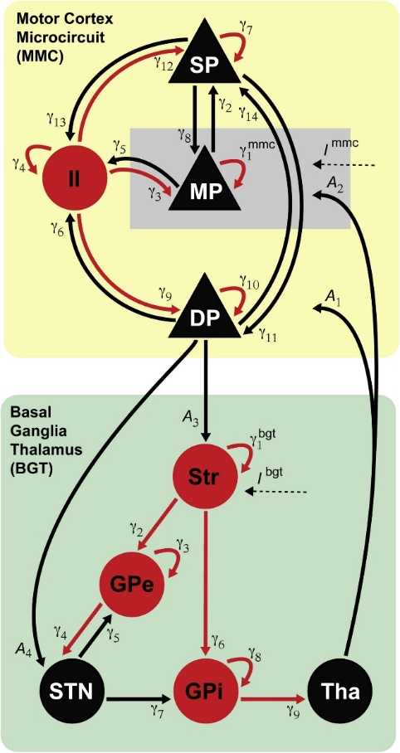
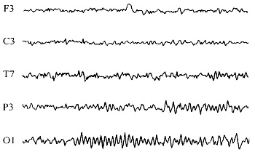
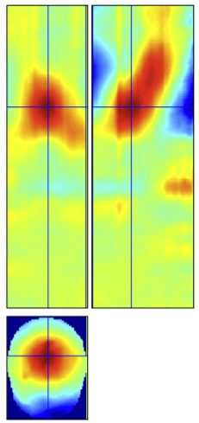
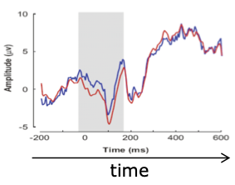
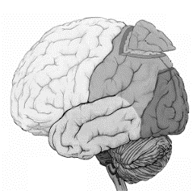
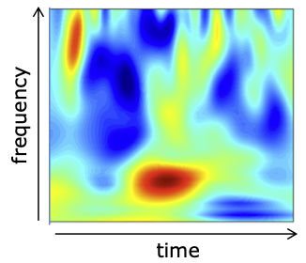
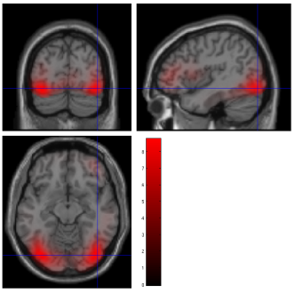
EFFECTIVE CONNECTIVITY IN M/EEG
A generative mechanism to explain how the observed data features are caused
?
Van Wijk et al., 2018
Notes:
Defined as the direct or indirect influence that one neural system exerts over another. Effective connectivity is based on a model specifying the causal links (hypothesis driven)

Slide 38
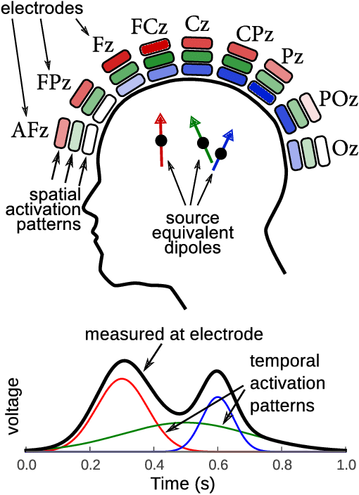
CAVEATS OF M/EEG CONNECTIVITY ANALYSIS
Volume conduction (field spread)
Some possible solutions:
Preferring MEG over EEG.
Using methods that improve the spatial precision (source distribution or other methods).
Using connectivity methods that are capable of dealing with spurious connectivity due to volume conduction.
Van Vliet et al 2015

Slide 39
SOURCE RECONSTRUCTION
Source localization, Source Imaging, is the method devoted to modelling and estimating the configuration of brain sources (their amplitude, orientation of the dipole), given the sensor topography
This is done by first modelling how we think electrical or magnetic fields spread from their origin to where they are measured (the volume conducting or lead field). This is called Forward modelling
From there we can now optimise the parameters to fit our specific sensor topography and infer the source from our sensor data. This is called inverse modeling

Slide 40
SOURCE RECONSTRUCTION
Becker et al., 2015

Slide 41





SOURCE RECONSTRUCTION: HEAD MODELS
Single Sphere
Local Spheres
Corrected Sphere
(a.k.a. single shell)
Boundary Element Model (BEM)
Finite Element Model (FEM)
Simple
Complex
Notes:
EEG requires more complex models which are able to predict electric potential differences better than the simple spherical models (typically a 3-shell BEM or better).

Slide 42


SOURCE RECONSTRUCTION: ALGORITHMS
Equivalent dipole modeling
Equivalent current dipole
Distributed source modeling
Beamformer modeling
42

Slide 43
WORD OF CAUTION
Due to the specific structure of M/EEG (high temporal resolution, low-ish spatial resolution), linear modelling and statistical analysis of M/EEG data has unique characteristics (compared to other neuroimaging methods such as fMRI) that are covered in the first day of this course (afternoon session)

Slide 44
THANK YOU FOR LISTENING!

Slide 45
References
https://www.youtube.com/watch?v=86zIa3pGM50
https://www.youtube.com/watch?v=0_boSag4f8g
Malmivuo, Jaakko, and Robert Plonsey. Bioelectromagnetism: principles and applications of bioelectric and biomagnetic fields. Oxford University Press, USA, 1995.
Cohen, Michael X. "Where does EEG come from and what does it mean?." Trends in neurosciences 40.4 (2017): 208-218.
Gloor, Pierre. "Hans Berger-On the Electroencephalogram of Man." Electroenceph Clin Neurophysiol (1969).
Jackson, Alice F., and Donald J. Bolger. "The neurophysiological bases of EEG and EEG measurement: A review for the rest of us." Psychophysiology 51.11 (2014): 1061-1071.
Schomer, Donald L., and Fernando Lopes Da Silva. Niedermeyer's electroencephalography: basic principles, clinical applications, and related fields. Lippincott Williams & Wilkins, 2012.
Nunez, Paul L., and Ramesh Srinivasan. Electric fields of the brain: the neurophysics of EEG. Oxford University Press, USA, 2006.
Arnulfo, Gabriele, Jonni Hirvonen, Lino Nobili, Satu Palva, and J. Matias Palva. 2015. “Phase and Amplitude Correlations in Resting-State Activity in Human Stereotactical EEG Recordings.” NeuroImage 112:114–27.
Bigdely-Shamlo, Nima, et al. "Automated EEG mega-analysis I: Spectral and amplitude characteristics across studies." BioRxiv (2018): 409631.
Makoto’s pessimism (talk 2019) https://www.youtube.com/watch?v=lRyZxt2WeKk&feature=youtu.be&t=222
Picton, Terence W. Human auditory evoked potentials. Plural Publishing, 2010.
Krishnaswamy, Pavitra, et al. "Sparsity enables estimation of both subcortical and cortical activity from MEG and EEG." Proceedings of the National Academy of Sciences 114.48 (2017): E10465-E10474.
Andersen, Lau M., Karim Jerbi, and Sarang S. Dalal. "Can EEG and MEG detect signals from the human cerebellum?." NeuroImage 215 (2020): 116817.

Slide 46
References (cont’d)
Seeber, Martin, et al. "Subcortical electrophysiological activity is detectable with high-density EEG source imaging." Nature communications 10.1 (2019): 753.
Pizzo, Francesca, et al. "Deep brain activities can be detected with magnetoencephalography." Nature communications 10.1 (2019): 1-13.
Hillebrand, Arjan, and Gareth R. Barnes. "A quantitative assessment of the sensitivity of whole-head MEG to activity in the adult human cortex." Neuroimage 16.3 (2002): 638-650.
Herrmann, Christoph S., Matthias HJ Munk, and Andreas K. Engel. "‘Early’evoked versus ‘late’induced gamma oscillations." Trends in Cognitive Sciences 8.8 (2004): 347-355.
Bastos, André M., and Jan-Mathijs Schoffelen. "A tutorial review of functional connectivity analysis methods and their interpretational pitfalls." Frontiers in systems neuroscience 9 (2016): 175.
West, Timothy O., et al. "Measuring directed functional connectivity using non-parametric directionality analysis: Validation and comparison with non-parametric Granger Causality." NeuroImage 218 (2020): 116796.
van Wijk, Bernadette CM, et al. "Generic dynamic causal modelling: An illustrative application to Parkinson's disease." NeuroImage 181 (2018): 818-830.
Becker, Hanna, et al. "Brain-Source Imaging: From sparse to tensor models." IEEE Signal Processing Magazine 32.6 (2015): 100-112.
Plummer, Chris, A. Simon Harvey, and Mark Cook. "EEG source localization in focal epilepsy: where are we now?." Epilepsia 49.2 (2008): 201-218.
Van Vliet, Marijn, et al. "Single-trial erp component analysis using a spatiotemporal lcmv beamformer." IEEE Transactions on Biomedical Engineering 63.1 (2015): 55-66.

Slide 47

SQUID -Superconducting QUantum Interference Device
Most common way to measure MEG until recently
An ultra sensitive detector of magnetic flux (Φ). Consisting of two superconductors with “insulating” layers, forming two Josephson Junctions in parallel.
The measured voltage across the junctions is dependent on magnetic flux.
Can measure field changes of the order of 10-15 (femto) Tesla (compare to the earth’s field of 10-4 Tesla)

