Slide 1

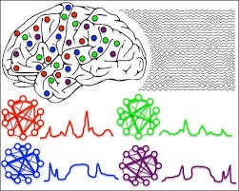
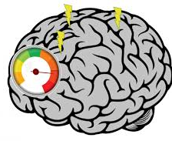
Dynamic Causal Modelling for
Cross Spectral Densities
Dimitris Pinotsis, PhD
City—University of London & MIT
pinotsis@mit.edu

Slide 2
Similar statistical features
Quantitative description in terms of a characteristic frequency
Summarize activity in a compact way (computationally expedient)
Cannot describe nonlinear frequency coupling (DCM for IR)
Notes:
Brain activity retains similar statistical features
(e.g.variance) and frequency content
across measurement period
Cannot describe nonlinear coupling
between frequencies →next talk
Advantages:
Summarize activity in a compact way -
no need to fit long time series (computationally expensive)
Describe brain function in terms of a
characteristic frequency associated with the task under
study

Slide 3
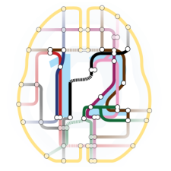
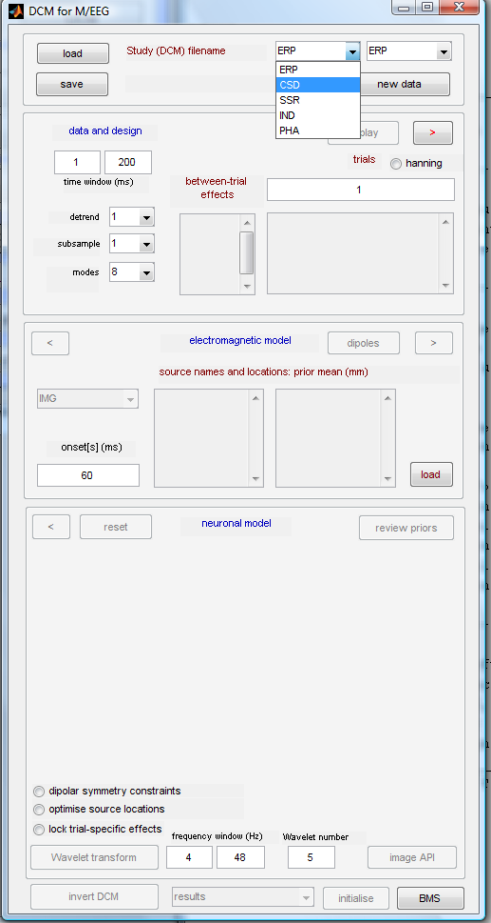
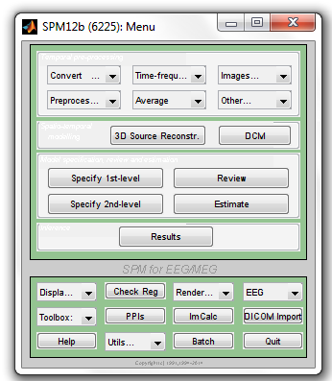
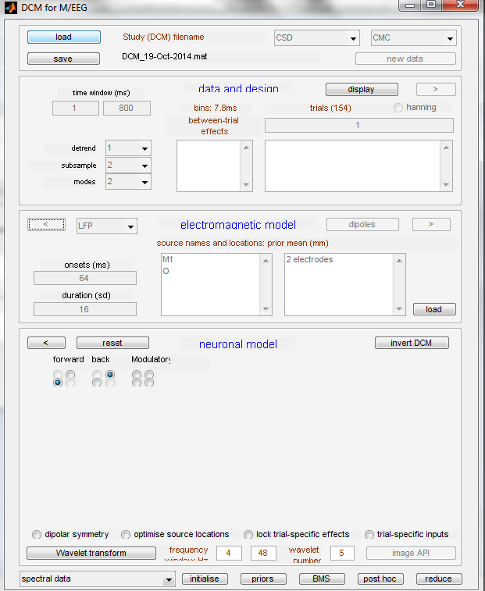
In SPM

Slide 4
Perception, attention, memory, executive control
Highly parallel processing by the brain
Information integration and binding
Synchronized neuronal discharges
Select relevant information
Notes:
Cognitive functions like perception, attention, memory or language are based on highly parallel and distributed information processing by the brain.
One of the major unresolved questions is how information can be integrated and how coherent representational states can be established in the distributed neuronal systems subserving these functions. It has been suggested that this so-called 'binding problem' may be solved in the temporal domain.
The hypothesis is that synchronization of neuronal discharges can serve for the integration of distributed neurons into cell assemblies and that this process may underlie the selection of perceptually and behaviourally relevant information.

Slide 5
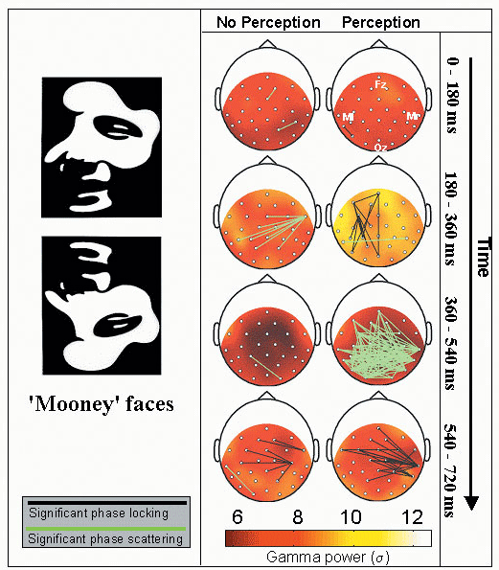
Rodriguez et al.,199
Notes:
Oscillations emerge from the interaction between intrinsic cellular properties and circuit properties.
individual oscillatory neurons
individual non-oscillating neurons that are hooked up in a specific network that produces oscillation.
In many systems electrical coupling by gap junctions tend to produce oscillatory synchronization.
Main results of Rodriguez et al. (1999). By presenting Mooney faces in upright and inverted orientations, they manipulated perceptual awareness. When participants reported seeing a face (perception condition), a transient episode of large-scale phase locking between electrodes was found around 250 ms after stimulus presentation. A period of strong desynchronisation marked the transition between face perception and motor response, which was interpreted as a process of active decoupling of neural ensembles marking the transition between cognitive states.

Slide 6
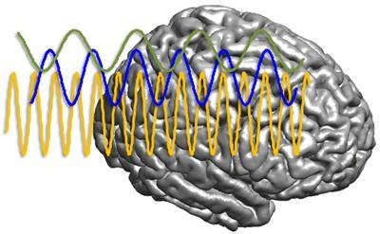
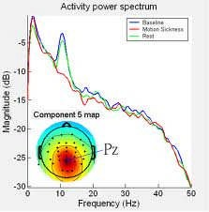
Oscillations
Working memory (Siegel et al. 2009,…)
Visual attention (Feldman and Friston, 2010,…)
Size, contrast (e.g. Pinotsis et al., 2014, Pinotsis et al., 2016,…)
Binding Input to cortical representations (Schoffelen et al., 2005,…)
Information propagation (e.g. Bastos et al. 2012,Tallon-Baudry et al., 1996…)
Psychiatric diseases, Autism… (e.g. Uhlhaas and Singer, 2012, Dickinson et al., 2015,…)
For a review see Pinotsis, D. A., et al, (2019). Bayesian modelling of induced responses and neuronal rhythms. Brain Topography, 32(4), 569-582.
Notes:
Neural rhythms have been associated with a variety of
cognitive functions; including working memory (Pesaran
et al. 2002; Siegel et al. 2009), visual attention (Buschman
and Miller 2007; Fries 2009; Kornblith et al. 2015;
Womelsdorf et al. 2006), cortical representations (Buzsa´ki
and Chrobak 1995; Schoffelen et al. 2005), feature binding
(Tallon-Baudry et al. 1996) and information propagation in
feedforward/feedback directions in cortical hierarchies
(Bastos et al. 2012; Friston et al. 2015). Oscillatory activity
is also thought to be the signature of aberrant neuronal
processing in psychiatric diseases (Uhlhaas and Singer
2012), such as autism (Dickinson et al. 2015) or
schizophrenia (Gonzalez-Burgos and Lewis 2008) and can
be used to disclose mechanisms underlying intersubject
variability (Pinotsis et al. 2013). Gamma band responses in
particular, have been shown to reflect various input attributes,
like the size of visual objects (Pinotsis et al. to
appeara; Perry et al. 2013), luminance (Swettenham et al.
2013) and contrast (Pinotsis et al. 2014; Ray and Maunsell
2010; Roberts et al. 2013).

Slide 7
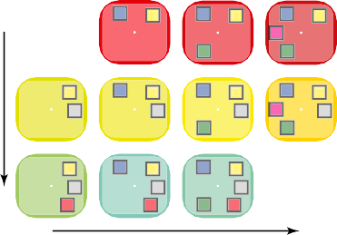

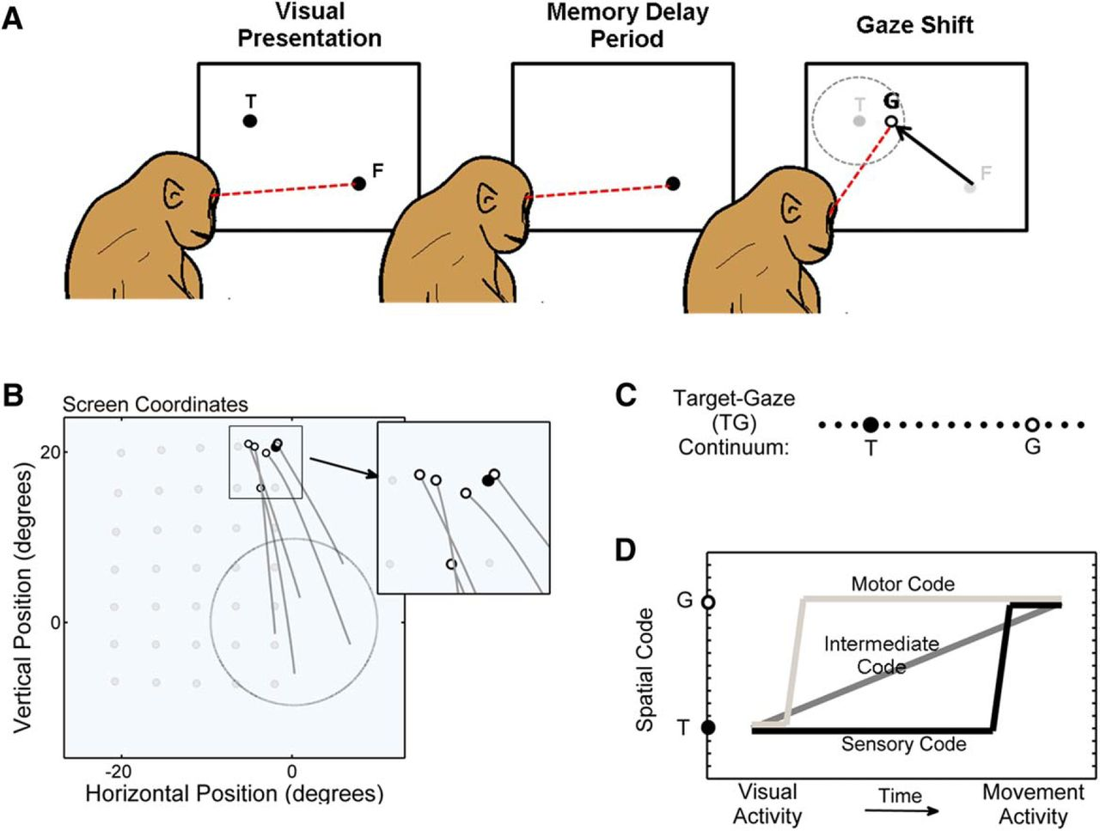

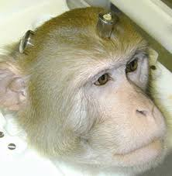
Working Memory Task (Miller Lab, MIT)
Example 1 :
WM performance
Increasing # of Ipsi Stim
Sample Delay Test
Behavioral Performance for All Possible Displays
100%
T T T
80%
T
Increasing # of Contra Stim
T
T
T
60%
Time
T
T
T
40%
20%
Increasing # of Stimuli Contralateral to Target
When more than 2 items
were presented in the same
hemifield, the animal’s
behavioral performance
decreased dramatically
Capacity limit IPSI
Buschman et al., PNAS, 2011
Pinotsis et al.,
Cerebral Cortex, 2018

Slide 8
Contralateral
Ipsilateral
Changes in oscillatory power may not yield information directly
Kornblith et al.,
Cerebral Cortex, 2015
Load effects are weak (1-2% change)
Load effects are similar below and above WM Capacity Limit
Power is not informative about the reduction in performance and the mechanisms/network effects resulting in the WM Capacity Limit

Slide 9
DCM connectivity explains behaviour
(iii)
PFC
a.
b.
c.
300
FEF to PFC
300
FEF to LIP
300
PFC to LIP
)
)
)
FEF
Early Delay
%
%
%
(
(
(
200
h
200
h
200
h
t
t
t
g
g
g
n
n
n
e
e
e
100
r
100
r
100
r
t
t
t
s
s
s
LIP
Ipsilateral
Load
1
2
3
1
2
3
1
2
3
(iv)
load
load
load
a.
FEF to PFC
b.
c.
d.
e.
f.
)
300
)
300
LIP to PFC
)
300
LIP to FEF
)
300
FEF to LIP
)
300
PFC to LIP
)
300
PFC to FEF
%
%
%
%
%
%
Late Delay
(
(
(
(
(
(
h
200
h
200
h
200
h
h
h
200
t
t
t
t
200
t
200
t
g
g
g
g
g
g
n
100
n
n
n
n
n
e
e
100
e
100
e
100
e
100
e
100
r
r
r
r
t
t
t
r
r
t
s
s
s
t
t
s
s
s
1
2
3
1
2
3
1
2
3
1
2
3
1
2
3
1
2
3
load
load
load
load
load
load
Capacity limit IPSI
FB from PFC broke down– Explains reduced performance that power did not explain
Predictive Coding model→ No predictions from areas that contain memories
No memories→ The animal cannot perform the task
Pinotsis et al.,
Cerebral Cortex, 2018

Slide 10

DCM Steps

Slide 11
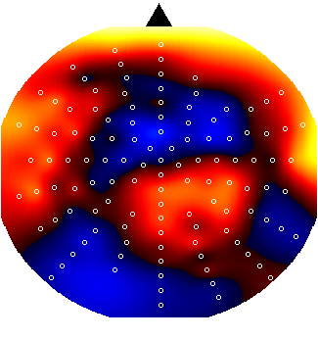
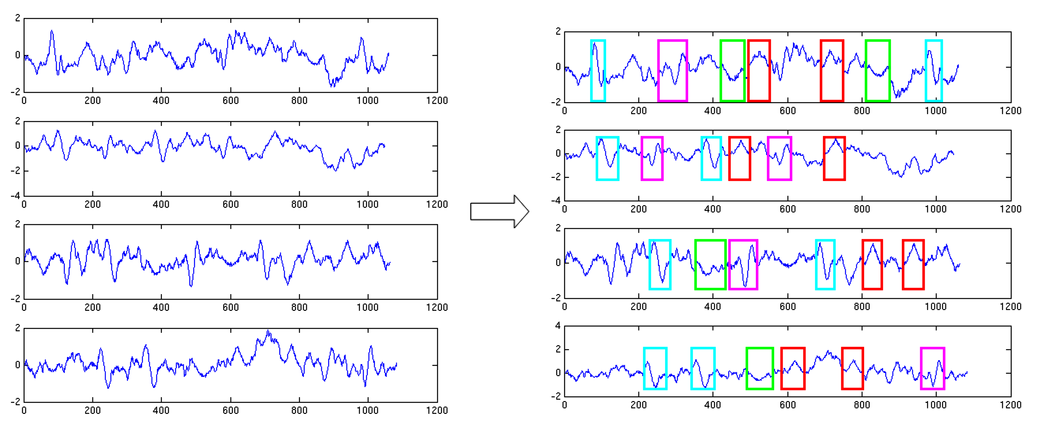
Cross Spectral Density
Power (mV²)
Frequency (Hz)
Summarizes brain response
in terms of power at each
frequency
EEG - MEG – LFP Time Series
1
1
2
2
Cross Spectral Density
3
3
4
4
1
2
3
4
A few LFP channels or EEG/MEG spatial modes
Notes:
power spectral density (PSD) is the energy variation that takes place within a oscillating signal, measured as frequency per unit of mass
Packaging industry → how much energy is transported to packages and goods during their transportation by a truck, a ferry or a plane.
(interesting bc pacages might be damaged, esp if they enter resonance

Slide 12
From Time Series to Cross Spectral Densities
Vector Auto-regression p-order model:
Linear prediction formulas that attempt to predict an output y[n] of a system based on the previous outputs
Resulting in a matrices for c Channels
Cross Spectral Density for channels i,j at frequencies

Slide 13
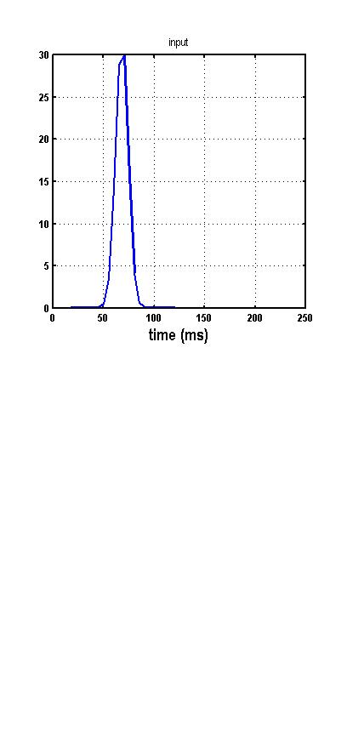
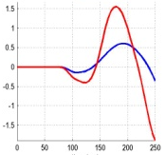
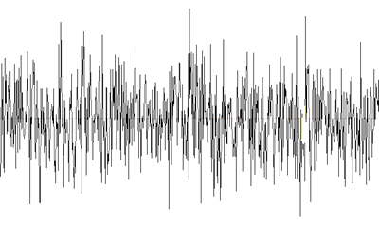
A Brain Region as an Input - Output System
ERP
Neuronal innovations
Predicted responses
(Model) Brain region
CSD
Power (mV²)
Frequency (Hz)

Slide 14
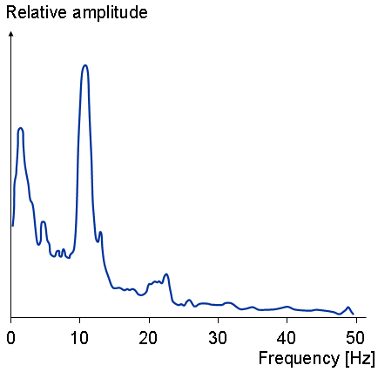
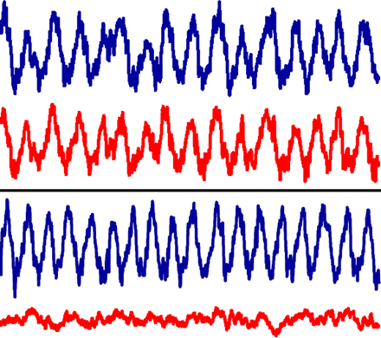
Frequency Domain Generative Model
(Perturbations about a fixed point)
Time Differential
Equations
State Space
Characterisation
Transfer function
Stationary Time Series
Linearise
mV

Slide 15
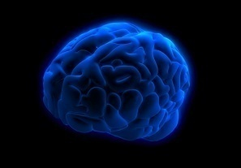
Convolution Neural Mass
(Same Neural Mass Model as ERP)
EEG/MEG/LFP
signal
Tens of thousands of neurons approximated by their average response. Neural mass models describe the interaction of these averages between populations and sources
Intrinsic Connections
inhibitory interneurons
neuronal (source) model
spiny stellate cells
Pyramidal
Cells
Extrinsic Connections
Internal Parameters
State equations

Slide 16
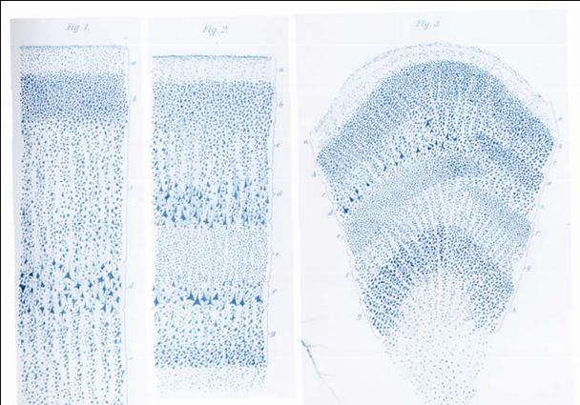

From DCM for ERPs talk in this course (Ryszard Auksztulewicz)
Neural Mass Model: 1st Transformation
Intrinsic
connections
γ
Inhibitory cells in agranular layers
5
: Receptor Density
γ
γ
γ
γ
Synaptic ‘alpha’ kernel
4
4
3
3
Excitatory spiny cells in granular layers
Excitatory spiny cells in granular layers
x
=
x
&
1
4
x
=
κ
H
(
γ
s
(
x
−
a
)
+
u
)
−
2
κ
x
−
κ
2
x
&
4
e
e
1
9
e
4
e
1
Input: presynaptic rate
Output: Average synaptic
depolarization
γ
γ
γ
γ
1
1
2
2
Excitatory pyramidal cells in agranular layers
Extrinsic Connections:
Forward
Backward
Lateral

Slide 17
Neural Mass Model: 2nd Transformation
Intrinsic
connections
γ
Sigmoid function
5
Inhibitory cells in agranular layers
γ
γ
γ
γ
4
4
3
3
Excitatory spiny cells in granular layers
Excitatory spiny cells in granular layers
x
=
x
&
1
4
x
=
κ
H
(
γ
s
(
x
−
a
)
+
u
)
−
2
κ
x
−
κ
2
x
Input: Avg synaptic
depolirization
Output: firing rate
&
4
e
e
1
9
e
4
e
1
γ
γ
γ
γ
1
1
2
2
Excitatory pyramidal cells in agranular layers
Extrinsic Connections:
Forward
Backward
Lateral

Slide 18
Roadmap
Generative model
predicted responses
parameters
Priors
variance
Hyper parameters
Bayesian Inference
  Model evidence
  Posterior estimates of parameters

Slide 19
Bayesian Model Inversion
Bayesian Model Inversion
Notes:
To complete our specification of a generative model, we assume the
observed cross-spectra gY(ω) (denoted by boldface) are a mixture of
predicted cross-spectra gY(ω,θ), channel-noise gN(ω,θ)and Gaussian
error ε(ω) (
The spectra
of channel noise gN(ω,θ), like those of the input gU(ω), are parameterized
in terms of (unknown) white and pink components.
a probabilistic mapping from all unknown parameters
to observed data features. Inversion of this model means estimating,
probabilistically, the free parameters given data

Slide 20
Bayesian Model Inversion
Specify generative forward model
(with prior distributions of parameters)
Measured data
Variational Laplace Algorithm
Maximize a free energy bound to model evidence :
Compute model response using
current set of parameters and
hyperparameters
Compare model response with data
Improve parameters and
hyperparameters
Iterative procedure:
Model comparison via Bayes factor:
Maximum accuracy over complexity constraints
Notes:
20
1- Modelling: capture data tendencies/regularities
But: model quality <-> predictive ability
=> Parameters estimation
2- 2 forms of uncertainty:
- stochastic
- epistemological (=> reducible)
-> Definition of “noise”
3- - Model sufficiently complex -> perfect data fit but suboptimal predictions
- Model too simple -> poor data fit …
4- Link modelling to some measure of the uncertainty which is propagated through the model:
model relevance is related to the quality of the information we can extract from the data about the modelled system…

Slide 21
Data fits have two parts: real and imaginary
prediction and response: E-Step: 32
prediction and response: E-Step: 32
3.5
1
3
0.8
0.6
2.5
0.4
2
0.2
real
0
imaginary
1.5
-0.2
1
-0.4
-0.6
0.5
-0.8
0
0
10
20
30
40
50
-1
0
10
20
30
40
50
Frequency (Hz)
Frequency (Hz)

Slide 22
DCM Steps
1. Get Cross Spectral Density data
2. Select a model (JR, more to come)
3. Invert it and get score and single subject parameters

Slide 23
Summary so far and Outlook
DCM is a generic framework for asking mechanistic questions based on neuroimaging data (e.g. drug-induced changes in the balance of synaptic transmission)
DCM for CSD characterizes multi- channel LFP or M/EEG data in the frequency domain
Neural mass models parameterise intrinsic and extrinsic ensemble connections and synaptic measures (time constants, effective connectivity, neuromodulation…)
Bayesian inversion provides parameter estimates and allows model comparison for competing hypothesised architectures
DCM for CSD uses cross power spectra to make inferences about biophysical parameters. It has been validated using simulations, pharmacological interventions and developmental manipulations

Slide 24
Example 2 : Pharmacological Manipulation of Glutamate and GABA
Question:
Are our estimates of excitation and inhibition truthful?
AIM:
NOT to explain mechanisms of isoflurane BUT
to exploit isoflurane to induce known changes in synaptic transmission and THEN
use LFP recordings and DCM for SSR to infer synaptic changes
Moran et al.,
PLoSONE, 2011
Notes:
He and Hi are parameters that describe the amplitude of population responses to presynaptic glutamate release by PC and GABA by interneurons Sumarize postsynaptic gain
Balance of exc and inh neurotransmission

Slide 25
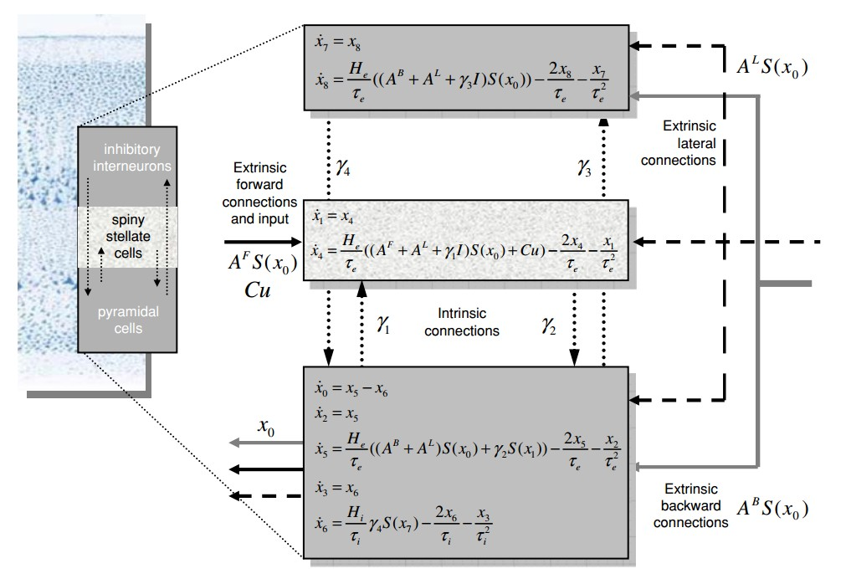
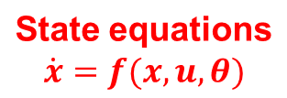
Neuronal (source) model
Convolution Neural Mass
Kiebel et al., Neuroimage, 2008

Slide 26
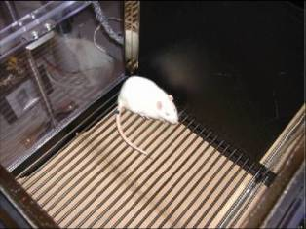
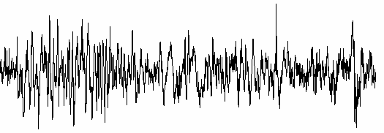
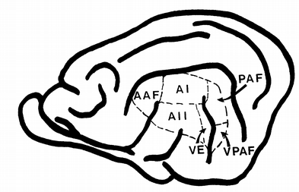
Pharmacological Manipulation of Glutamate and GABA
Use animal LFP recordings from primary auditory cortex (A1) & posterior auditory field (PAF)
Manipulate neurotransmitter processing via anaesthetic agent Isoflurane
4 levels of anaesthesia: each successively decreasing glutamate and increasing GABA (Larsen et al Brain Research 1994; Lingamaneni et al Anesthesiology 2001; Caraiscos et al J Neurosci 2004 ; de Sousa et al Anesthesiology 2000
White noise stimulus & Silence
1.4 % Isoflurane | 1.8 % Isoflurane | 2.4 % Isoflurane | 2.8 % Isoflurane
A1
0.12
0.12
0.06
LFP
0.06
0
mV
0
mV
-
-
0.06
0.06
A2
0.12
0.12
0.06
0.06
0
mV
0
mV
-
-
0.06
0.06
Notes:
LFPs diff levels

Slide 27
Pharmacological Manipulation of Glutamate and GABA
Increased gabaergic
transmission
1
**
Decreased Glutamate
Release
0.5
0
Dose Specific Gain
-0.5
**
-1
**
1.4 % Isoflurane | 1.8 % Isoflurane | 2.4 % Isoflurane | 2.8 % Isoflurane
Inhibitory cells in
agranular layers
Moran et al.,
PLoSONE, 2011
Excitatory spiny cells
in granular layers
Excitatory pyramidal cells
in agranular layers
Synaptic ‘alpha’ kernel
DCM for CSD recovers known drug-induced changes
Notes:
Drug insuced changes bc of isof
Dose response curves produced nonlin saturating increase I ngabaergic release and a decrease in glutamate transmission
DUE TO sensitisation of
GABAA
receptors [18]
and increased presynaptic release of GABA

Slide 28
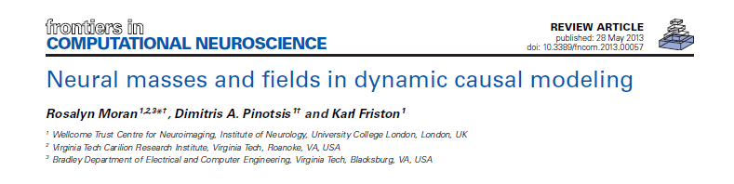
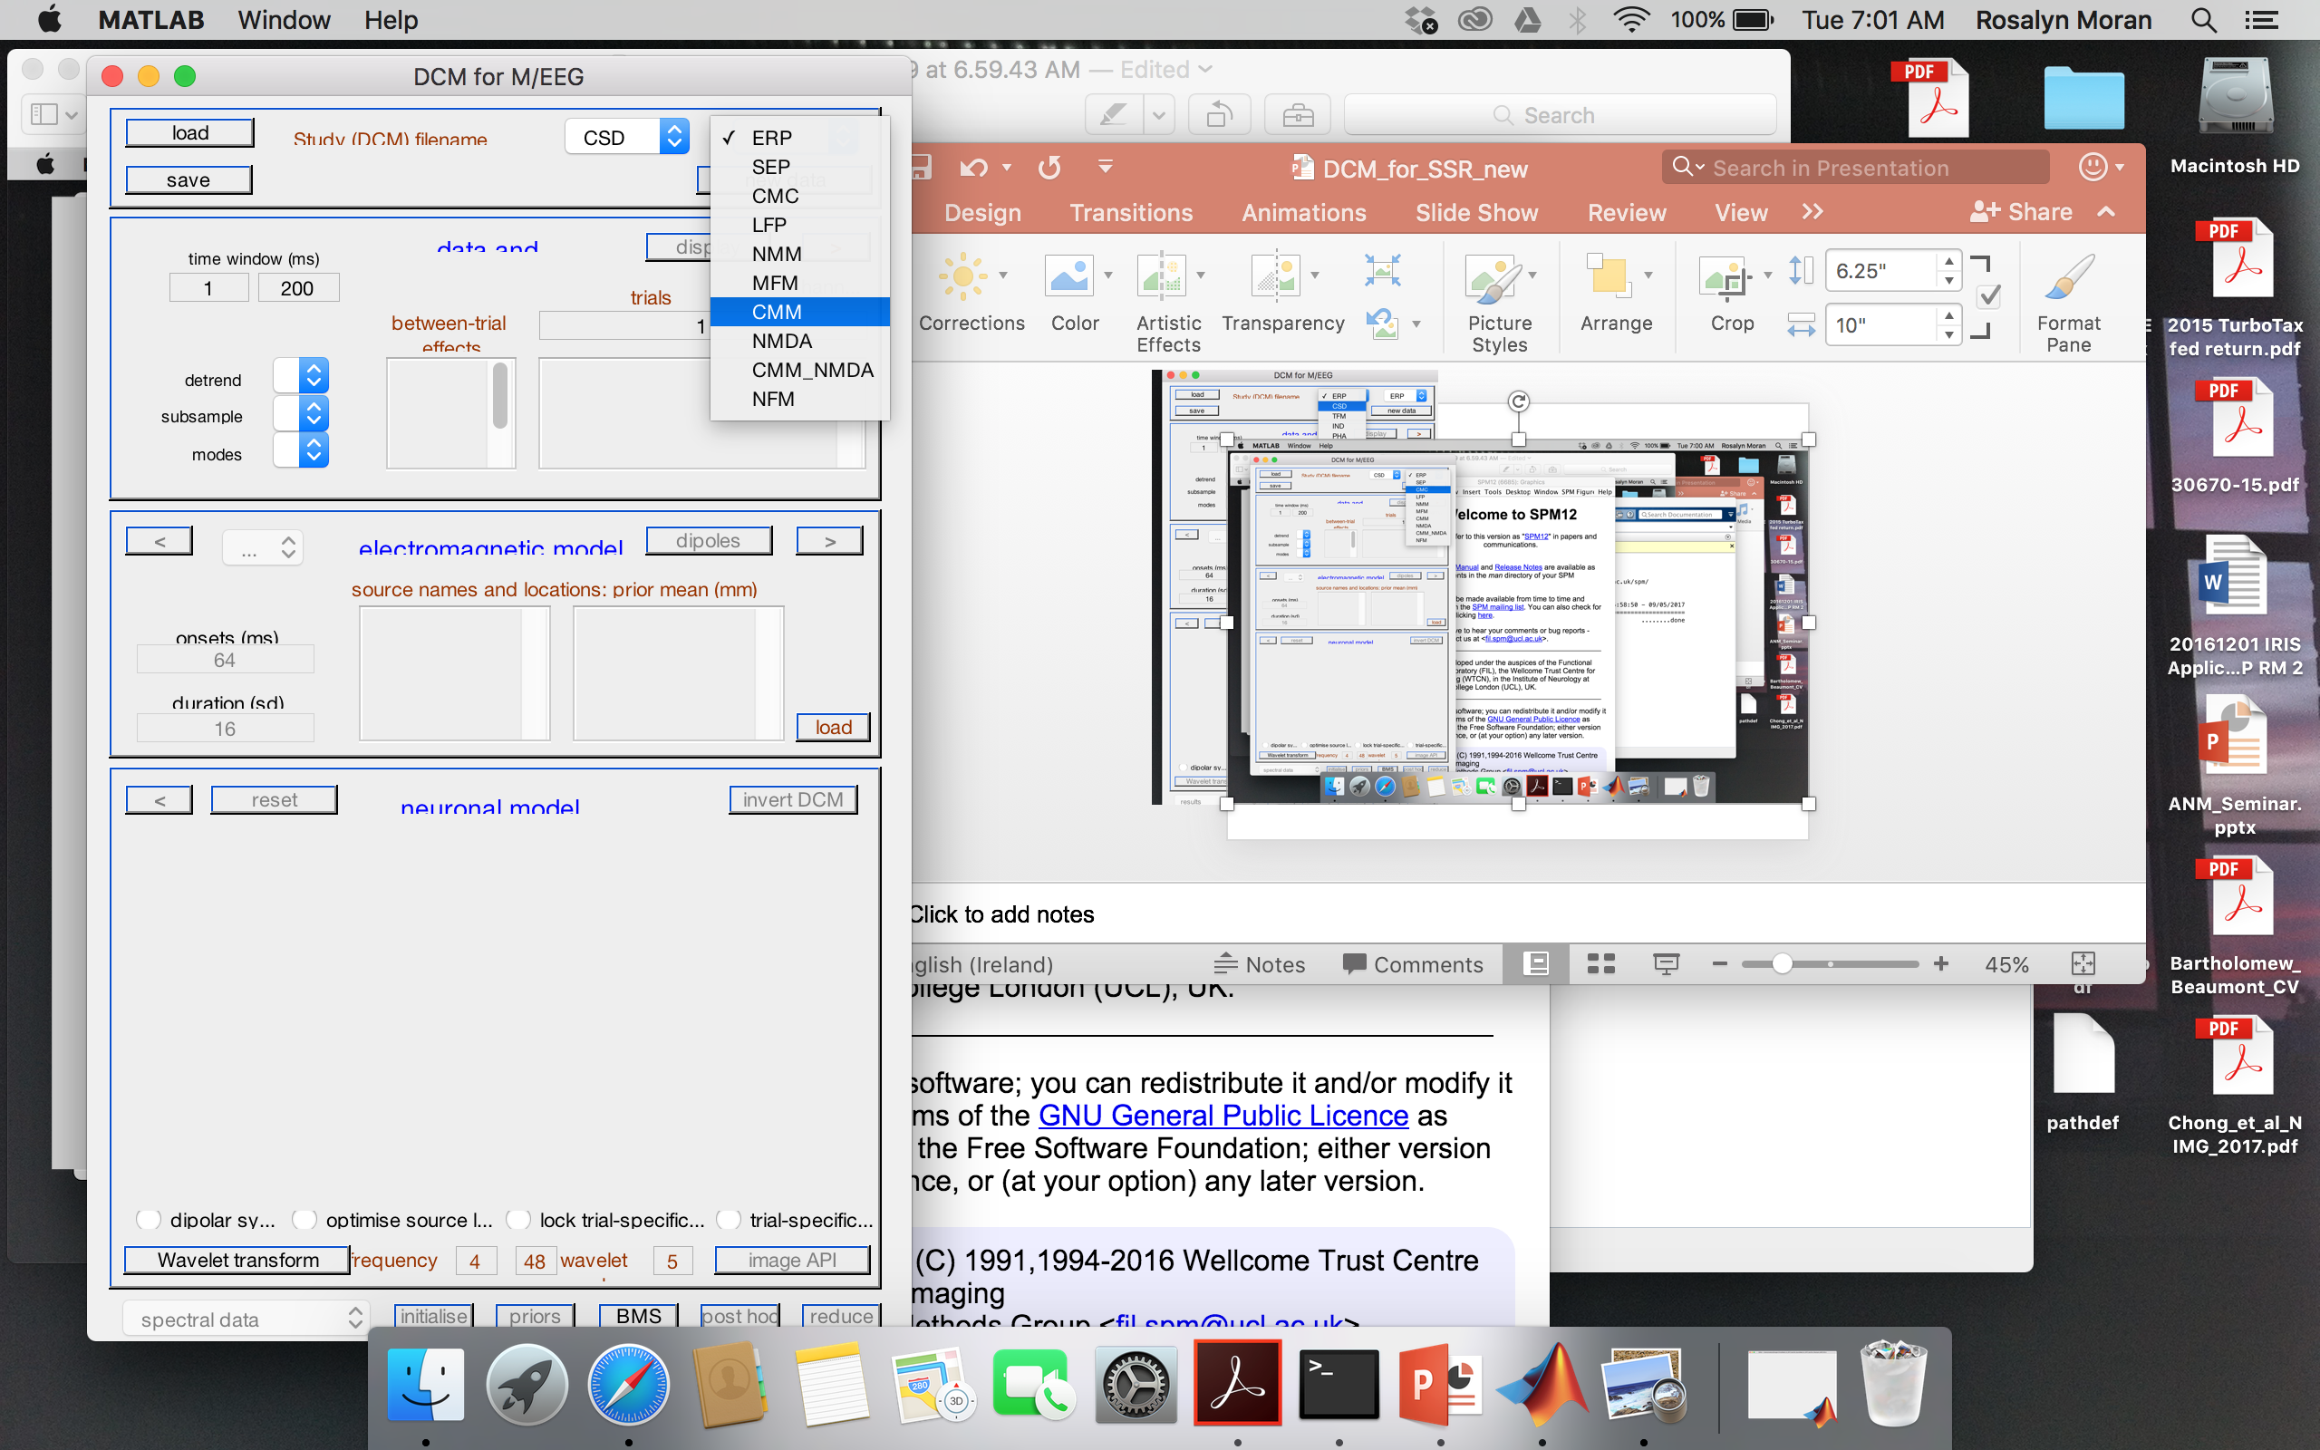

Convolu-
tion
(ERP,LFP,
CMC,NFM)
Condu-ctance
(NMM,
MFM,CMM,…)
Ion Channels
Mass
(ERP,LFP,
CMC)
Field
(NFM)
Spatial Dynamics

Slide 29
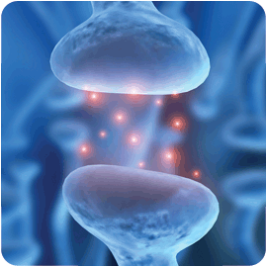
Taxonomy – I
Taxonomy –
With or Without Ion Channels ?
Characterize nonlinear synaptic transmission or linear convolution effects.
Explain the relation between channel-specific conductances and observed cortical responses.
Convolu-
tion
(ERP,LFP,
CMC,NFM)
Condu-ctance
(NMM,
MFM)

Slide 30
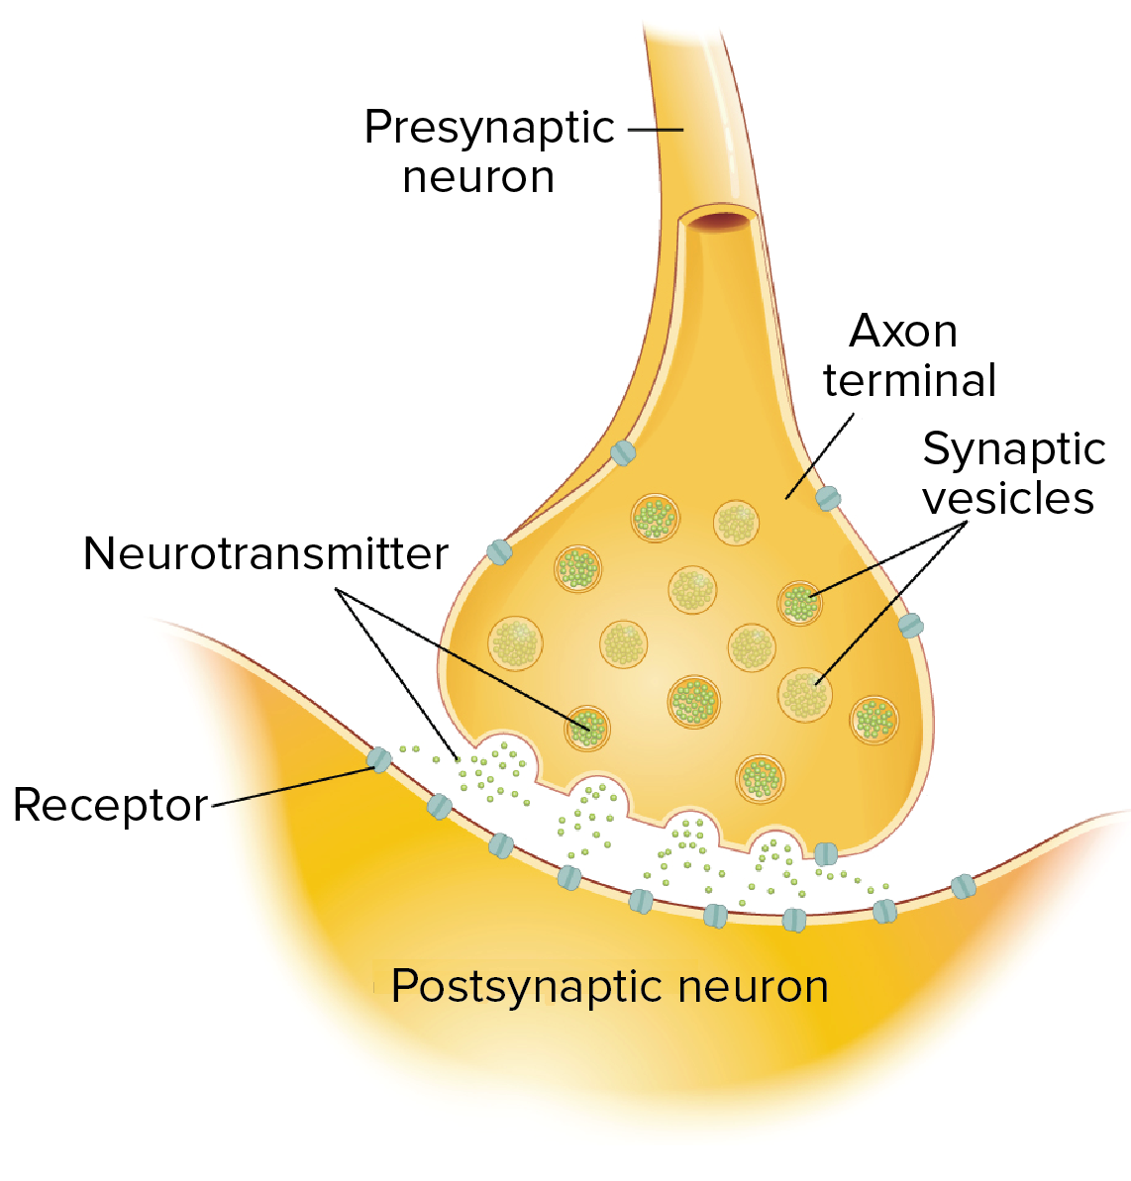
(Dopamine, Glutamate, ...)
(NMDA,AMPA, ...)
OpenStax College, Anatomy & Physiology
Notes:
https://www.khanacademy.org/science/biology/human-biology/neuron-nervous-system/a/neurotransmitters-their-receptors
chemical messengers released from neurons at synapses so that they can “talk” to neighboring cells
stored in synaptic vesicles, get released when \Ca2 enters the axon terminal in response to an action potential, and act by binding to receptors on the membrane of the postsynaptic cell.

Slide 31
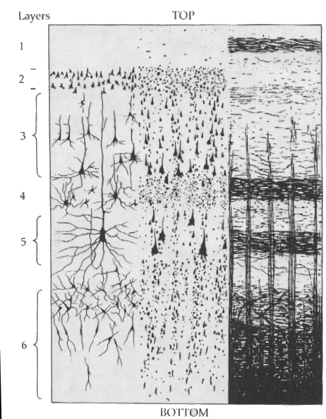


Conductance-based Mass Model (NMM)
More realistic parameterization of synaptic currents
Same architecture
Neural source as a capacitor that
stores electric charges
g=1/R
V=IR (Ohms law) or
V =I/g or
gV=I
$$q(t)=CV(t)$$
$$I(t)=C\dot{V(t)}$$
Current
Conductance
Reversal Pot – Potential Diff
Inhibitory interneuron
Spiny stellate cells
noise
Pyramidal cells
Moran, Pinotsis, Friston,
Frontiers Comp Neuro, 2013
Notes:
http://www.scholarpedia.org/article/Conductance-based_models
biophysical representation of an excitable cell, such as a neuron, in which its protein molecule ion channels are represented by conductances and its lipid bilayer by a capacitor.
equivalent circ
current flow across the membrane is due to charging of the membrane capacitance, IC , and movement of ions across ion channelsuit representation of a cell membrane as first put forth by Hodgkin and Huxley

Slide 32

Conductance-based Mass Model
Pinotsis et al., Frontiers Comp Neuro, 2013
Connectivity
$$\dot{g(t)}=κ[γσ(V\left(t\right))−g\left(t\right)]$$
Conductance
Time Constant
Afferent Firing
No. open channels
Response of each population is determined by a set of synaptic time constants corresponding to opening and closing of channels and receptors
Predicted dynamics are defined over these timescales and non-linear interaction between membrane potential and conductance

Slide 33
Example 3: Ketamine Action
Neuropsychopharmacology (2015) 40, 268–277
& 2015 American College of Neuropsychopharmacology. All rights reserved 0893-133X/15
www.neuropsychopharmacology.org
Losing Control Under Ketamine: Suppressed
Cortico-Hippocampal Drive Following Acute Ketamine in Rats
1₁₁₁
1
Rosalyn J Moran*^{,1,2,6}, Matthew W Jones^{3,6}, Anthony J Blockeel³, Rick A Adams², Klaas E Stephan^{2,4,5} and Karl J Friston²
dCA1
mPFC
Ketamine Dose: 0, 2, 4, 8, 30 mgkg-1
Freely moving rat
5 min
Neural state equations
Sodium
Clorine
Calcium
Theta reduction in the hippocampus and Gamma enhancement in hippocampus and neocortex.
Notes:
See Rosalyn talk
Hippocampal & Prefrontal Recordings
5 mins of recordings from freely moving rat: tetrodes in dCA1 & mPFC
Ketamine Dose: 0, 2, 4, 8, 30 mgkg-1
membrane fluctuations in depolarisation (V) are modelled as dependent upon sodium, chloride, potassium and calcium ion channel conductances. Superficial and deep pyramidal cells and inhibitory interneurons are specified with three dynamic ion channel conductances (sodium, chloride and calcium,
What Cortico-Limbic Connectivity Changes are responsible for theta and gamma changes under ketamine?
What Intrinsic Connectivity Changes are responsible for theta and gamma changes?
What Receptors are involved at these extrinsic & intrinsic synapses

Slide 34
Connectivity changes under Ketamine
Theta Model
Gamma Model
NMDA-mediated input to HPC from mPFC
Parametric effects of ketamine were consistent across theta and gamma ranges
NMDAR-mediated responses decreased parametrically with dose from HPC to mPFC and from mPFC to HPC
AMPAR-mediated forward connection from CA1 to mPFC increased with dose
Moran et al., Neuropsychopharmacology, 2015
100
100
strength (%)
50
50
0
0
NMDA-mediated input to PFC from dCA1
100
100
strength (%)
50
50
Sodium
0
0
Calcium
AMPA-mediated input to PFC from dCA1
200
200
150
150
strength (%)
100
100
50
50
0
0
0
2
4
0
2
4
8
30
Ketamine Dose
Ketamine Dose
Notes:
Reduced Cortico-Limbic Control mediated by NMDA
Enhanced Limbic-Cortico Drive via AMPA:
Runaway bottom-up sensory-driven processing : disorganised cognition & environmental interactions
NMDAR-mediated top-down
dysfunction) deranges the ability’ of neurons to specify priorexpectations about inputs (

Slide 35
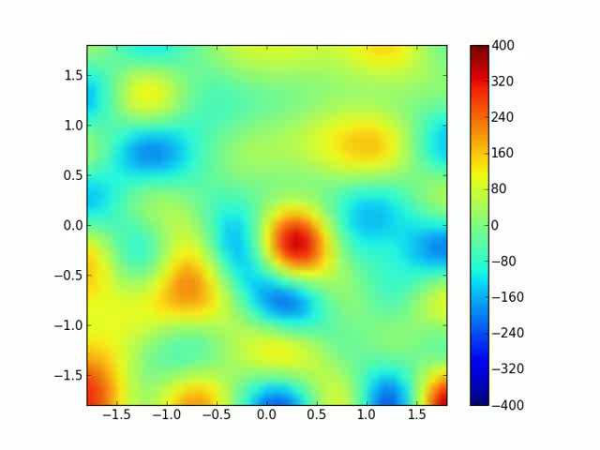
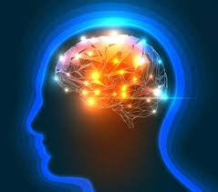
Taxonomy – II
With or Without Spatial Dynamics ?
Characterize point or spatially extended neuronal processes
Explain the relation between temporal or spatiotemporal properties of cortical sources and observed brain dynamics
Estimate lateral connection extent
(visual cortex), conduction speed, ..
Mass
(ERP,LFP,
CMC)
Field
(NFM)
Pinotsis et al.,
Neuroimage, 2012
Notes:
Activity over a patch (topographic organization)

Slide 36
Neural Field Models
Wave equations describing propagation of afferent input
between points on the cortex and equations for voltages
LFP signal
Inhibitory cells in supragranular layers
Pinotsis et al.,
Neuroimage, 2012
Exogenous input
Excitatory spiny cells in granular layers
Excitatory pyramidal cells in supra- and infragranular layers
Notes:
FIGURE 1

Slide 37
Can estimate dispersion, conduction speed on top of connection strengths that are also estimated with masses
Pinotsis et al
Pinotsis et al.,
Neuroimage, 2012

Slide 38
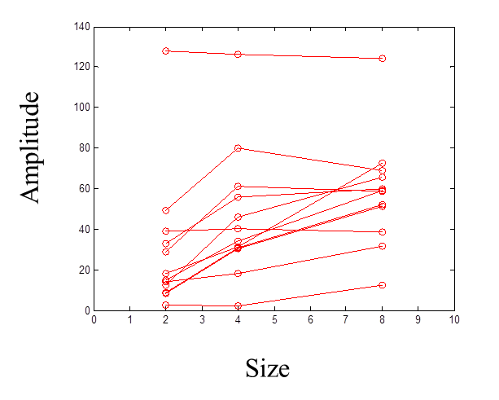
Example 4 : Hierarchical models and PEB with neural fields, cf. also next talk
Size induced intersubject variability of amplitude of
visually induced gamma oscillations
Pinotsis et al.,
Human Brain Mapping, 2016
Gamma oscillations important for visual perception and affected by stimulus properties
Gamma amplitude increases with size, cf. surround suppression , figure background segmentation, contour integration…(Super et al, 2010, Hess…)
Either linear increase or saturation with size
What determines an individual’s spectral response?

Slide 39
Pinotsis et al., 2016

Slide 40
Individual differences in oscillatory power reveal commonalities and differences across subjects
Superficial pyramidal
Spiny stellate
Inhibitory interneurons
Deep pyramidal
Posterior estimates for 2nd level parameters
Pinotsis et al.,
Human Brain Mapping, 2016
Microscopic estimates of cortical function and structure obtained non- invasively
Amplitude differences over subject best explained by individual differences in the intrinsic connectivity to and from inhibitory interneurons
This reflects differences in the excitation to inhibition balance
Cf. PING networks:
local inhibition drives gamma oscillations

Slide 41
Summary
DCM is a generic framework for asking mechanistic questions based on neuroimaging data (e.g. drug-induced changes in the balance of synaptic transmission)
Neural mass models parameterise intrinsic and extrinsic ensemble connections and synaptic measures (time constants, effective connectivity, neuromodulation…)
Bayesian inversion provides parameter estimates and allows model comparison for competing hypothesised architectures
DCM for CSD provides a compact characterisation of multi- channel LFP or M/EEG data in the frequency domain
DCM for CSD uses power spectra to make inferences about hidden neuronal states and parameters. It has been validated using simulations, pharmacological interventions and developmental manipulations
Tests of Predictive Coding: feedforward prediction errors and feedback predictions
Biomarkers for subtyping patient cohorts

Slide 42
Thanks to
…and thank you !
Karl Friston
Rick Adams
Ryszard Auksztulewicz
Gareth Barnes
Guillaume Flandin
Mansoureh Hnazaee
Vladimir Litvak
Chris Mathys
Rosalyn Moran
Will Penny
Richard Rosch
Klaas Stephan
Bernadette van Wijk
Peter Zeidman
WCHN METHODS GROUP

