Slide 1
OPM Demo SPM course for M/EEG 2023
Robert Seymour
rob.seymour@ucl.ac.uk
Built on work by the fantastic OP-MEG Team at UCL ☺

Slide 2
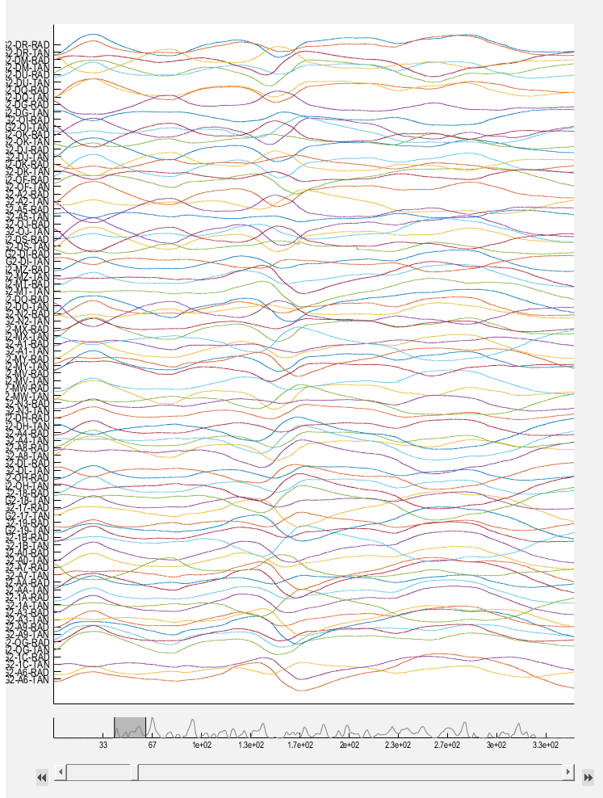
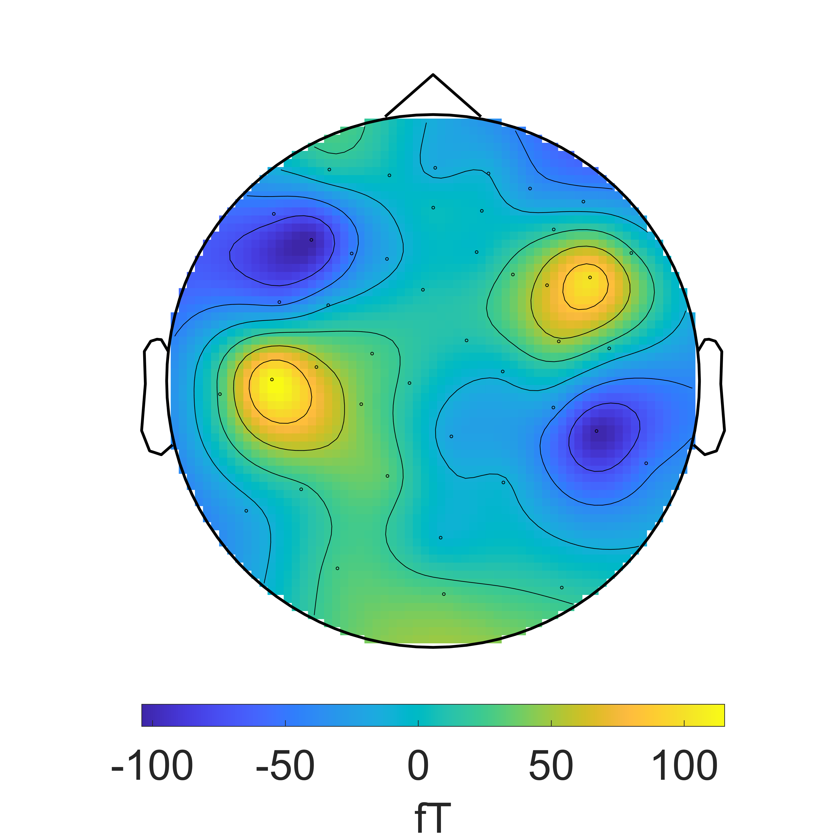
Goal

Slide 3
Outline
1. Loading OPM data with SPM
2. Synchronising with external data (e.g. motion capture)
3. Interference suppression (noise reduction) for OPMs
4. Tutorial

Slide 4
No agreed-upon OPM data format
Brain Imaging Data Structure (BIDS) format
sub-OP00110_ses-001_task-resting_run-001_
Raw OPM data stored in binary file .bin
sub-OP00110_ses-001_task-resting_run-001_meg.bin
Subject
Session
Task
Run

Slide 5
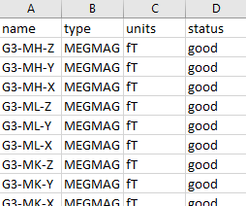
Other Files
sub-OP00110_ses-001_task-resting_run-001_meg.json
sub-OP00110_ses-001_task-resting_run-001_channels.tsv
sub-OP00110_ses-001_task-resting_run-001_positions.tsv
{"TaskName":"resting","InstitutionName":"UCL","Manufacturer":"QuSpin","SamplingFrequency":2000…}
OPM data information
Channel information
Sensor Position information

Slide 6
Importing OPM data using SPM
S =[];
S.data = ‘sub-OP00110_ses-001_task- resting_run-001_meg.bin';
S.channels = ‘sub-OP00110_ses-001_task- resting_run-001_channels.tsv';
S.meg = ‘sub-OP00110_ses-001_task -resting_run-001_meg.json’;
D = spm_opm_create(S);

Slide 7
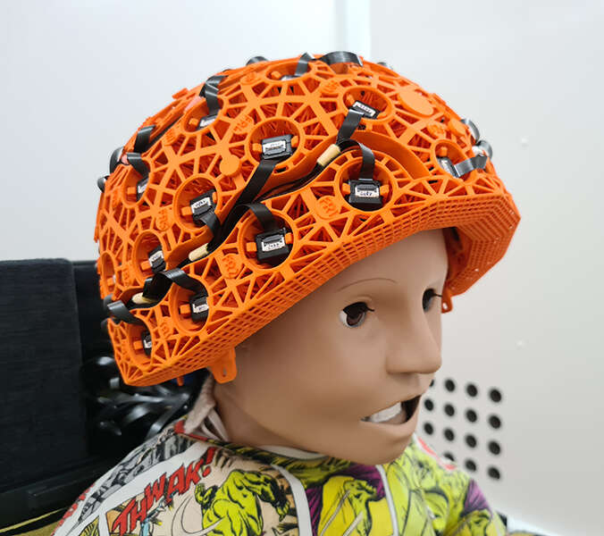
Other Formats
Cerca Magnetics .cMEG
Custom formats – can input a Matlab matrix (nChan x nSamples)

Slide 8
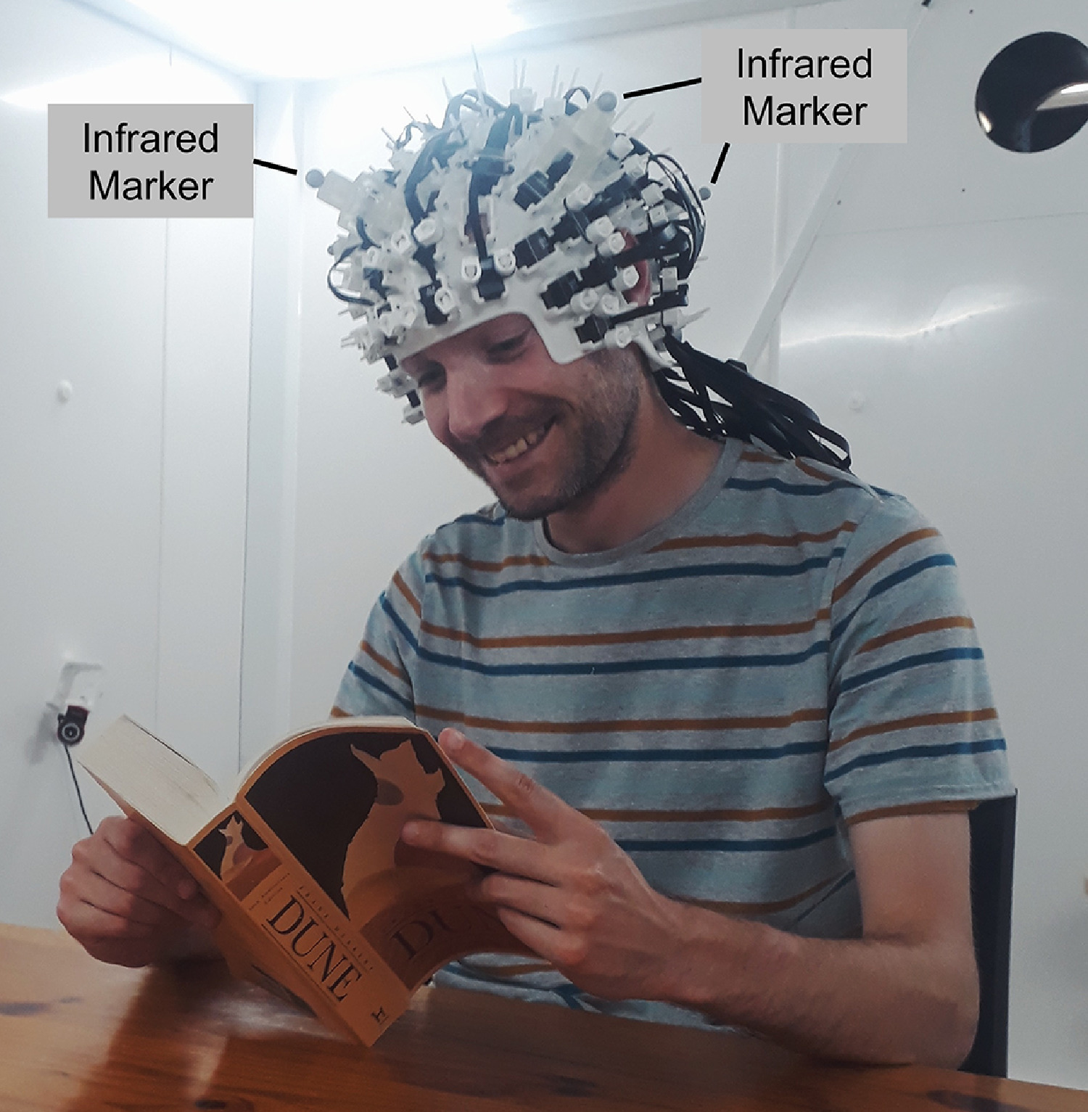
Co-registration
At UCL we currently use 3D-printed scannercasts
→ sensors in same space as structural MRI
Can also specify fiducial landmarks in:
sub-OP00110_ses-001_task-resting_run-001_coordsys.json

Slide 9
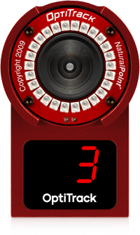
2. Motion Capture
At UCL we use Optitrack to measure the motion of infrared markers attached to the head (and body)
Important we know when and how the person is moving
Synchronised with OPM data using ON/OFF trigger
See: https://github.com/FIL-OPMEG/optitrack

Slide 10
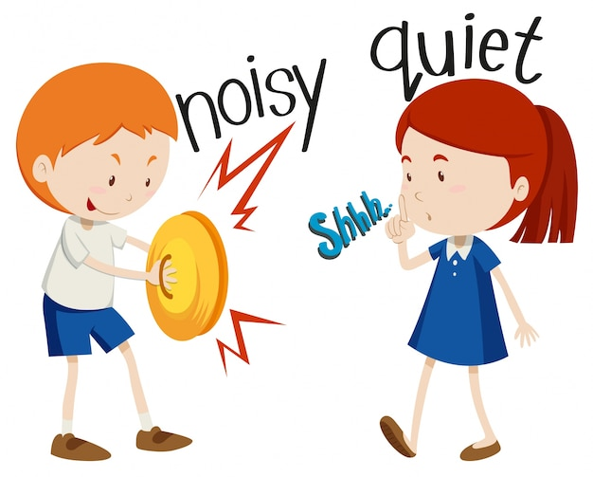
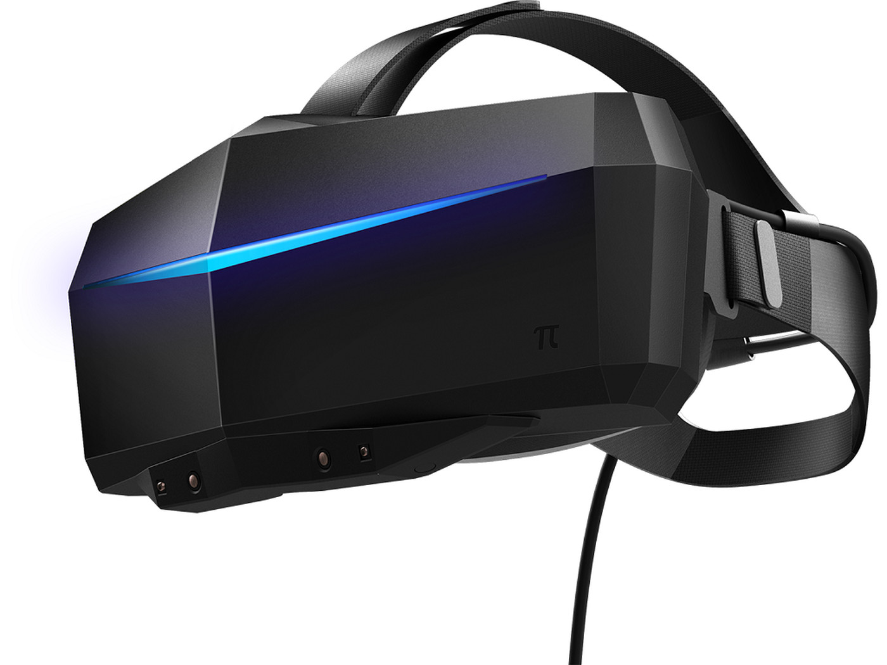
3. Interference Suppression
Gradiometer
Some unique challenges for OPMs:
Magnetometers (measure EVERYTHING!)
Movement → low-frequency interference
Electronic devices within MSR (e.g. cameras, VR etc.)
No spatial over-sampling (yet)
Magnetometer

Slide 11
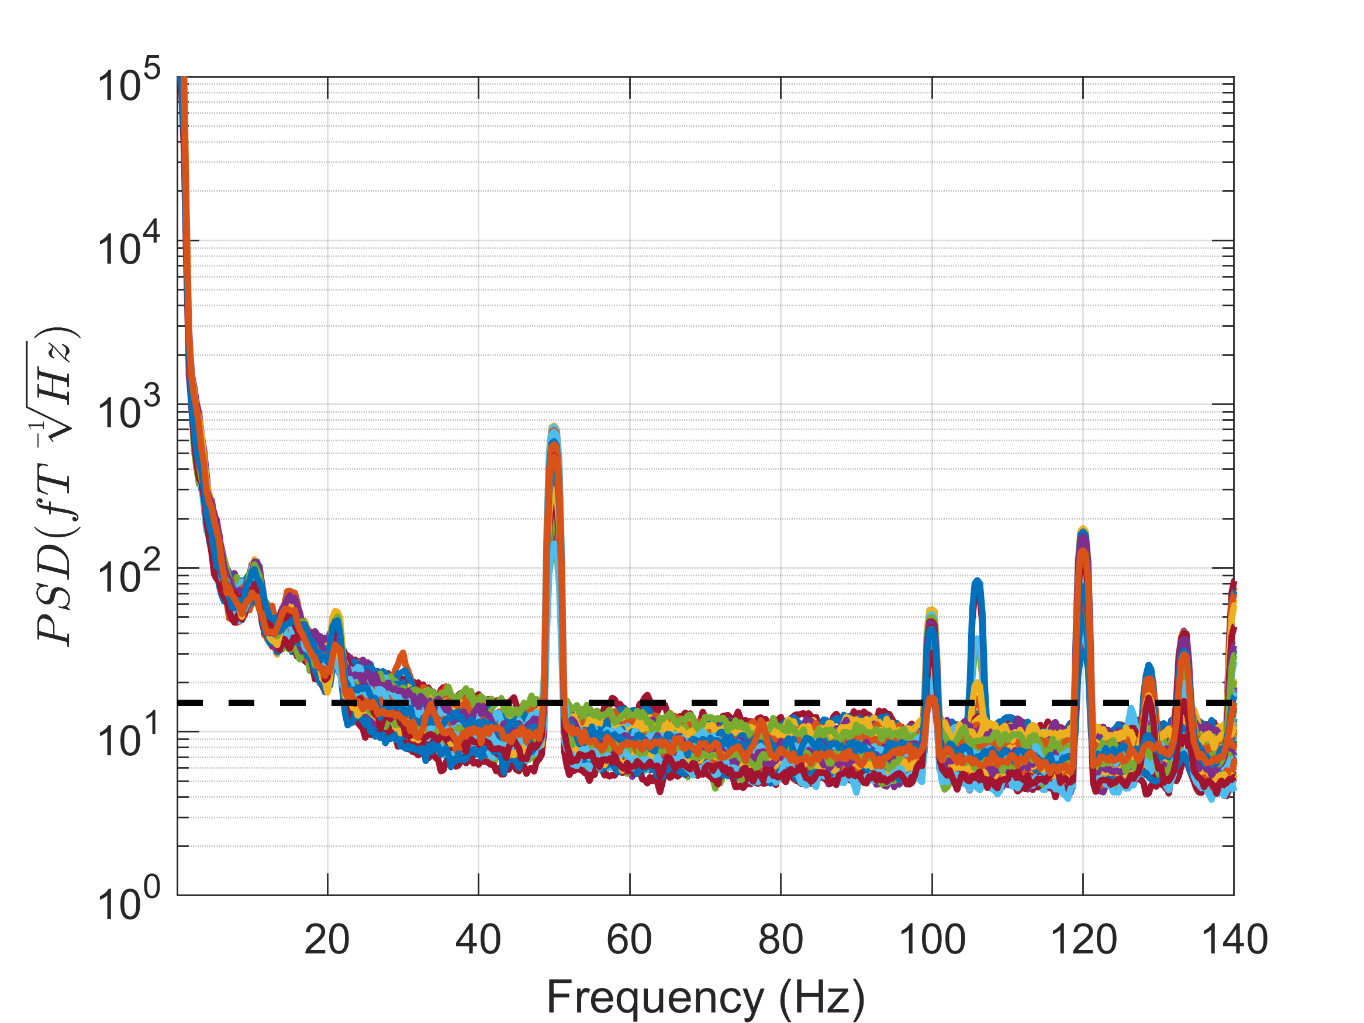
Power Spectral Density
Low-frequency movement
Describes the power present in the signal as a function of frequency
Various sources of interference
Useful for identifying interference / bad-channels
We want to be close to 15fT/√Hz
50Hz line noise
Optitrack Cameras
Vibrations
spm_opm_psd

Slide 12
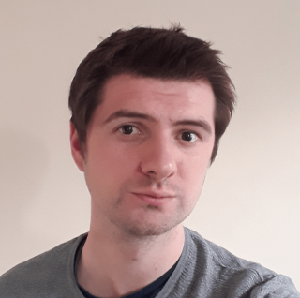
Homogenous Field Correction
Lack of spatial oversampling → SIMPLER modelling and removal of external interference
Homogenous Field Correction
(HFC; Tierney et al., 2021)
Modelling external interference as spatially homogenous field (spherical harmonic order = 1)
Various demonstrations of HFC reducing interference across frequencies (e.g. Hill et al., 2022)
SPM Function:
spm_opm_hfc

Slide 13
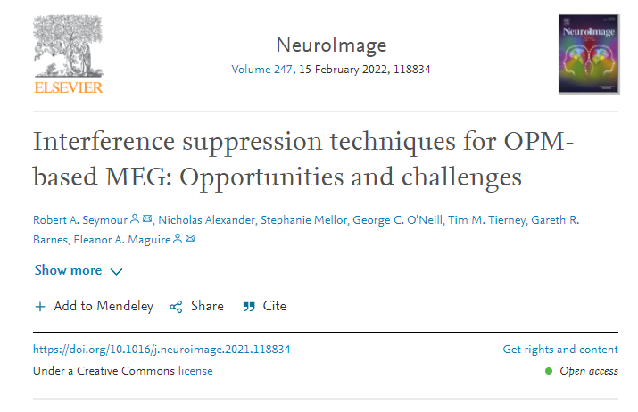
4. Tutorial
Participant standing in MSR
Pure auditory tones every 0.5s
Asked to make large continuous movements of their head
Can we measure classic auditory M100 response?
DATA: https://doi.org/10.5281/zenodo.5539414
CODE: https://github.com/FIL-OPMEG/tutorials_interference/blob/main/pipeline_tutorial_1_SPM.m

Slide 14
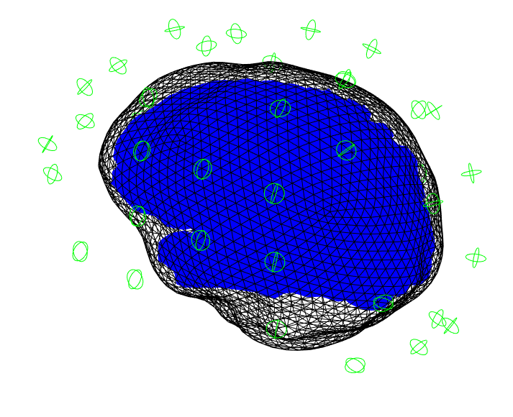
Raw Data + PSD
spm_opm_create
spm_opm_psd
Low-frequency movement
50Hz line noise
Optitrack Cameras
Vibrations

Slide 15
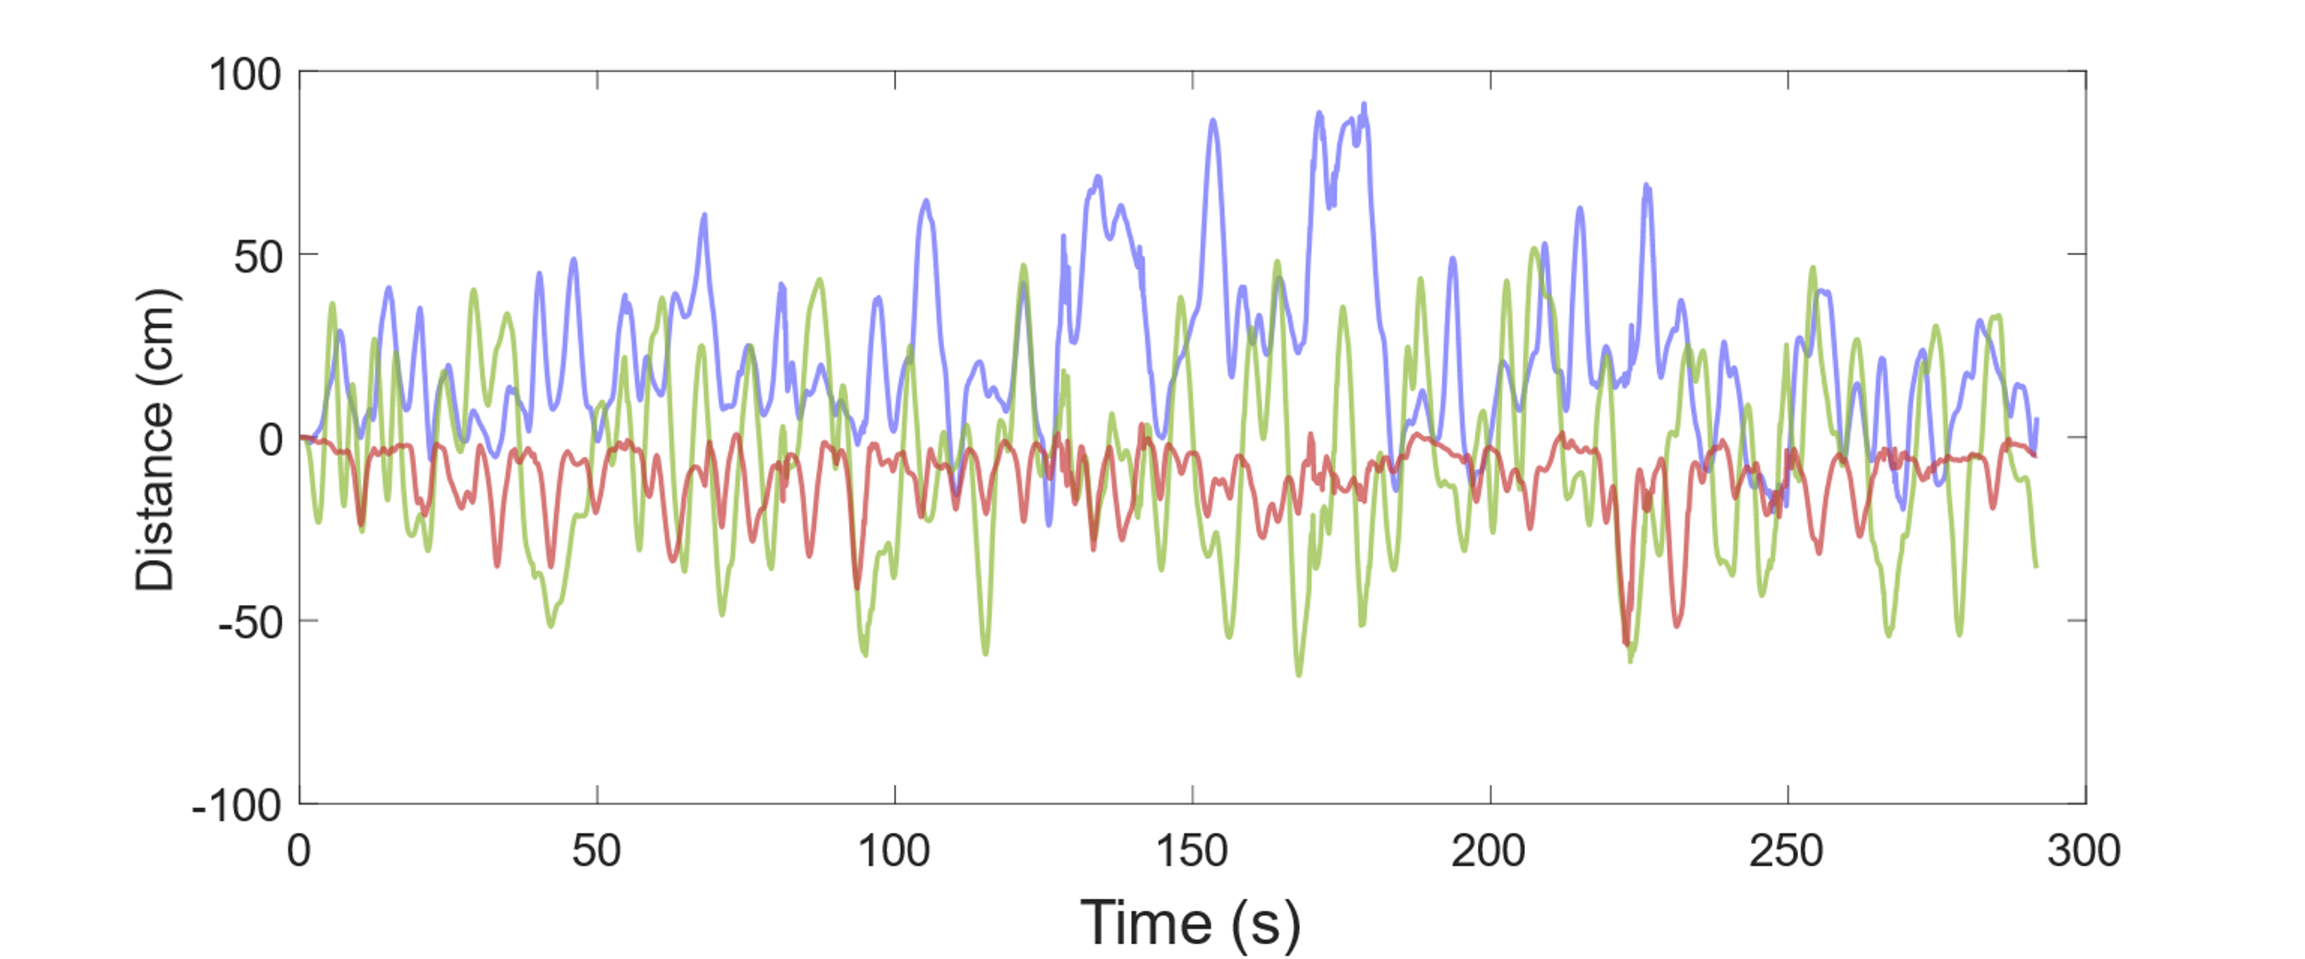
Movement Data
syncOptitrackAndOPMdata
Y: Up-Down
Z: Forward-
Back
X: Right-Left

Slide 16
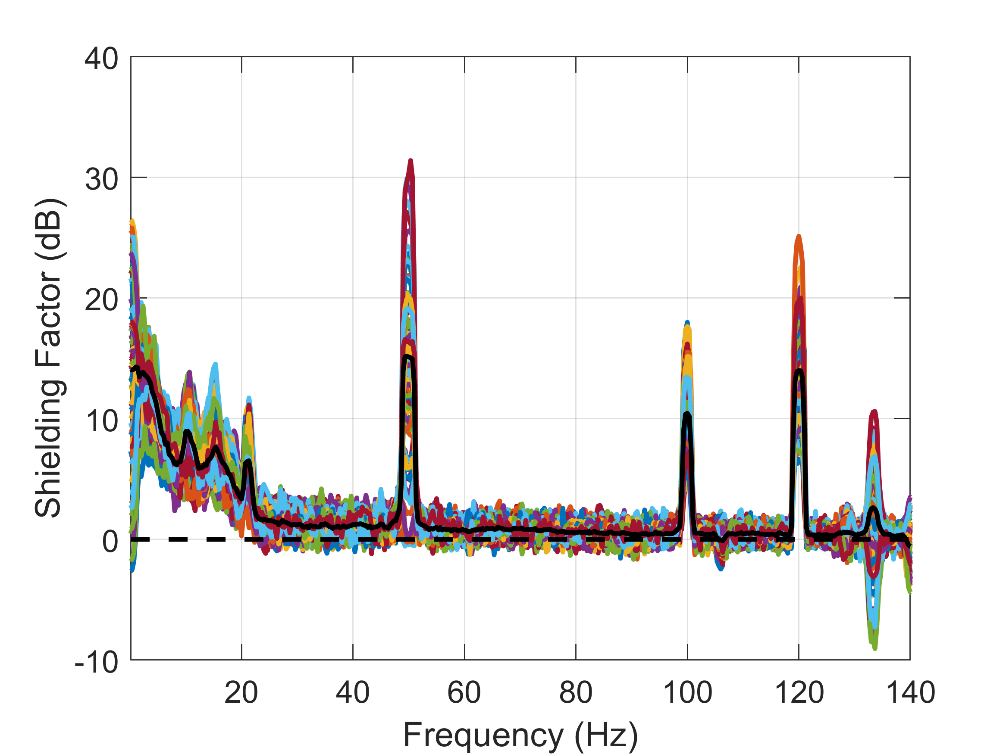
Homogenous Field Correction (HFC)
spm_opm_hfc
Higher = Better Performance
spm_opm_rpsd
%% Homogenous Field Correction
S = [];
S.D = D_new;
S.L = 1;
[hfD] = spm_opm_hfc(S);
With more channels (100+) you can use S.L = 2

Slide 17
Filtering + Epoching
High-Pass Filter
2Hz
Low-Pass Filter
40Hz
Band-stop Filter
50Hz
Epoch
-200ms to 400ms
spm_opm_epoch_trigger
spm_opm_rpsd

Slide 18
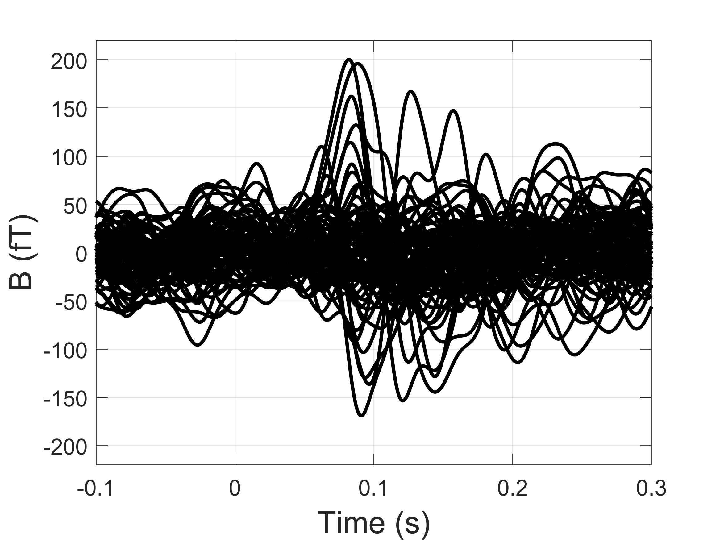
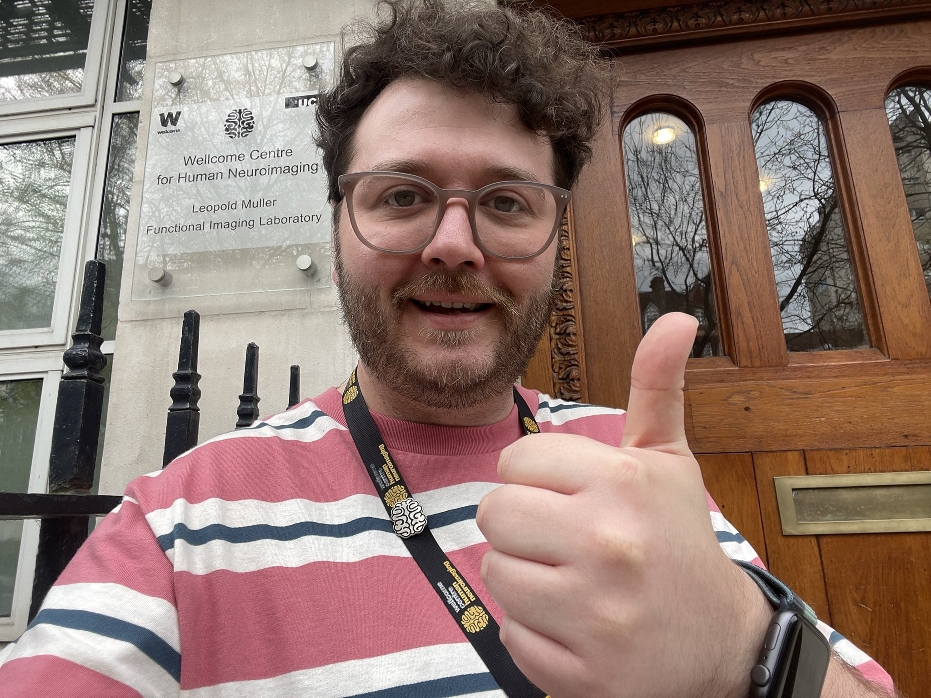
Averaging
spm_eeg_average
Custom Topoplot
Source Localisation?
See George O’Neill’s DAISS tutorial

Slide 19
Further Resources
Seymour et al., (2022). Neuroimage.
SPM Evoked Response Pipeline with Cerca MEG data
https://www.fil.ion.ucl.ac.uk/spm/docs/tutorials/opm_preprocessing/introduction/
More advanced spherical harmonic approaches:
Tierney et al., (2022) Neuroimage
https://github.com/FIL-OPMEG/tutorials_interference

Slide 20
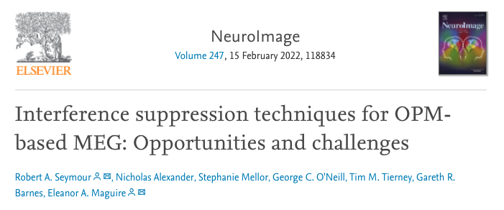
Temporal Filtering
Correct application of filters is crucial for OPM interference suppression
Beware filtering artefacts (!) (de Cheveigné and Nelken, 2019)
Recommendations in the Neuroimage paper

