Slide 1
Introduction to Dynamic Causal Modelling (DCM)
Dr. Edda Bilek
Central Institute for Mental Health
Heidelberg University
Germany

Slide 2
Learning objectives
  What is dynamic causal modelling (DCM)?
  How do we model task related fMRI data (forward model)?
  How are parameters estimated and model evidence inferred
  How is a subject DCM specified in SPM?
  Demo & practical sessions!

Slide 3
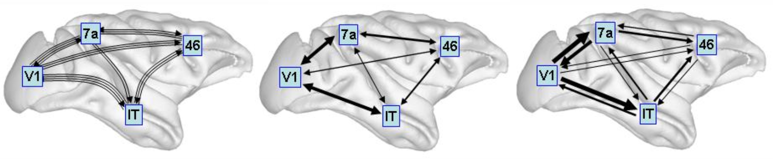
Structural, functional & effective connectivity
structual connectivity functional connectivity effective connectivity
Sporns, 2007, Scholarpedia
Structural connectivity
  Presence of axonal connections / white matter tracks (e.g., DWI)
Functional connectivity
  Statistical dependencies between regional time series (e.g., ICA)
Effective connectivity
  Causal (directed) influences between neuronal populations (e.g., DCM; based on explicit network models)

Slide 4
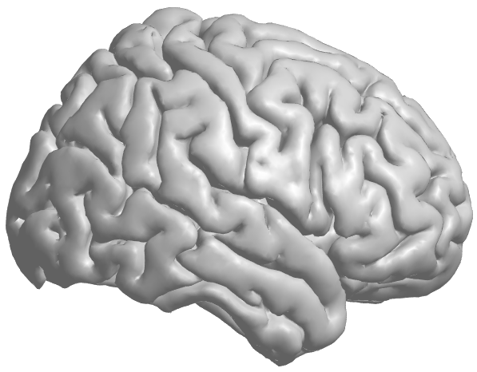
Neural model basics

Slide 5
Neural model basics
  Which regions?
    Z
  Which connections in network?
    A
  U = all input (driving, modulating)
  Where does driving input enter the network?
    C
  Which connections are modulated e.g. by conditions
    B
ROI1
ROI3
ROI2
ROI4

Slide 6
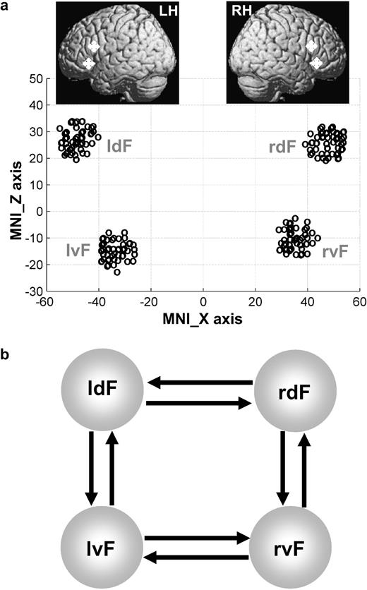
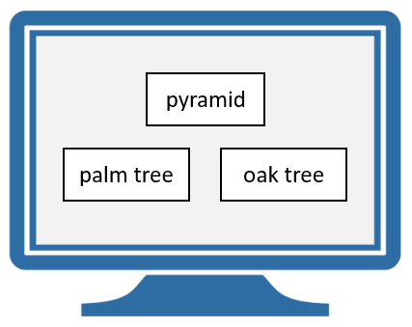
Task (for demo and practicals)
Subject-level GLM (analysis of brain activity)
  Factor 1: Semantic (match meaning of the stimulus) vs. perceptual (match similar looking stimulus)
  Factor 2: simulus pictures vs. words

Slide 7
Task (for demo and practicals)
Subject-level factors
  Factor 1: Semantic (match meaning of the stimulus) vs. perceptual (match similar looking stimulus)
  Factor 2: simulus pictures vs. words
Group-level hypothesis
  Hypothesis: In semantic, some people use left/right hemisphere more. What is the underlying connectivity that causes lateralization?
Group-level factor
  Laterlization index (one value for each subject)
https://www.fil.ion.ucl.ac.uk/spm/docs/tutorials/dcm/dcm_fmri_first_level/
Seghier et al. (2011)

Slide 8
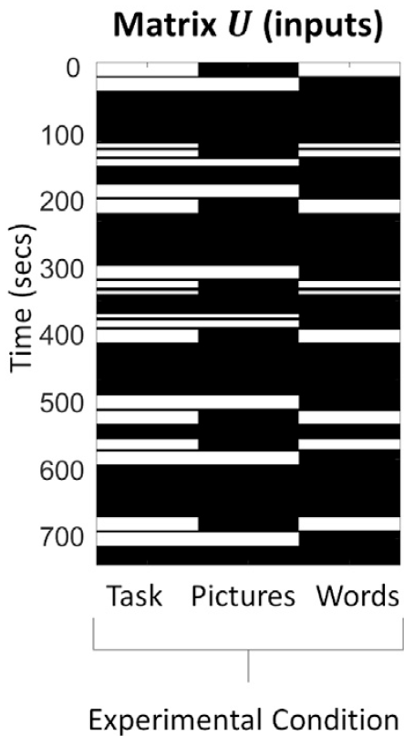
Task (for demo and practicals)
Driving (external) input
  Semantic: pictures and words („task“)
Modulators
  Task condition „pictures“
  Task condition „words“
  Group-level (lateralization index) -> Group-level analysis (PEB)
https://www.fil.ion.ucl.ac.uk/spm/docs/tutorials/dcm/dcm_fmri_first_level/
Seghier et al. (2011)

Slide 9

Neural model specification
  $\text{U}\text{ = }\text{task}\text{, }\text{conditions}\text{, }\text{covariates}\text{ (}\text{subject} \text{level}\text{)}$
  $\text{Z}\text{ = }\text{ROI}\text{1, }\text{ROI}\text{2, }\text{ROI}\text{3, }\text{ROI}\text{4}$
  $A= \left[\begin{matrix}1 & 1 & 1 & 0 \\ 1 & 1 & 1 & 0 \\ 1 & 0 & 1 & 1 \\ 1 & 0 & 1 & 1\end{matrix}\right]$
  ${B_{1}= \left[\begin{matrix}0 & 0 & 0 & 0 \\ 0 & 0 & 0 & 0 \\ 0 & 0 & 0 & 0 \\ 0 & 0 & 0 & 0\end{matrix}\right] B}_{2}=\left[\begin{matrix}1 & 0 & 1 & 0 \\ 0 & 1 & 1 & 0 \\ 1 & 0 & 1 & 0 \\ 1 & 0 & 0 & 1\end{matrix}\right] B_{3}=\left[\begin{matrix}1 & 0 & 1 & 0 \\ 0 & 1 & 1 & 0 \\ 1 & 0 & 1 & 0 \\ 1 & 0 & 0 & 1\end{matrix}\right]$
  $C= \left[\begin{matrix}0 & 0 & 0 \\ 1 & 0 & 0 \\ 0 & 0 & 0 \\ 1 & 0 & 0\end{matrix}\right]$
ROI1
ROI3
from
R1 R2 R3 R4
to
R1 R2 R3 R4
ROI2
ROI4
R1 R2 R3 R4
R1 R2 R3 R4
task pic words
R1 R2 R3 R4
Zeidman et al., 2019a, Neuroimage

Slide 10
Forward model
$θ^{n}$ $θ^{h}$ $θ^{ε}$
  Different forward models depending on the data
  Enables data simulation
  Bayesian model inversion, Bayesian model comparison
Zeidman et al., 2019a, Neuroimage

Slide 11
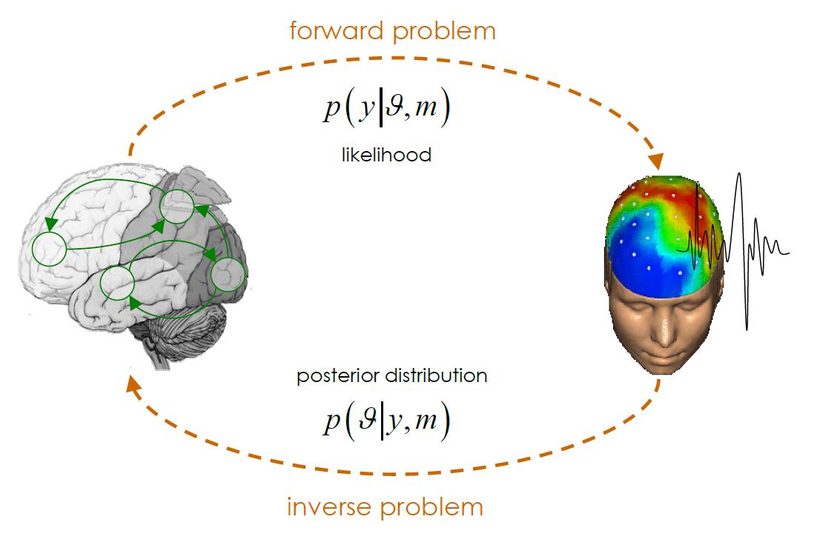
Bayesian inference: forward and inverse model

Slide 12

Bilinear state equation
Neural and non-neural sources
  $\dot{z}=f(z, U, θ^{\left(n\right)})$
  $y=g\left(z, θ^{\left(h\right)}\right)+X_{0}β_{0}+ε$
Neuronal state equation
  $\dot{z}=\left(A+\sum_{j=1}^{m}{u_{j}}B^{j}\right)z+Cu$
Bilinear state equation
state
changes
modulation of
connectivity
system
state
direct
inputs
m external
inputs
connectivity

Slide 13
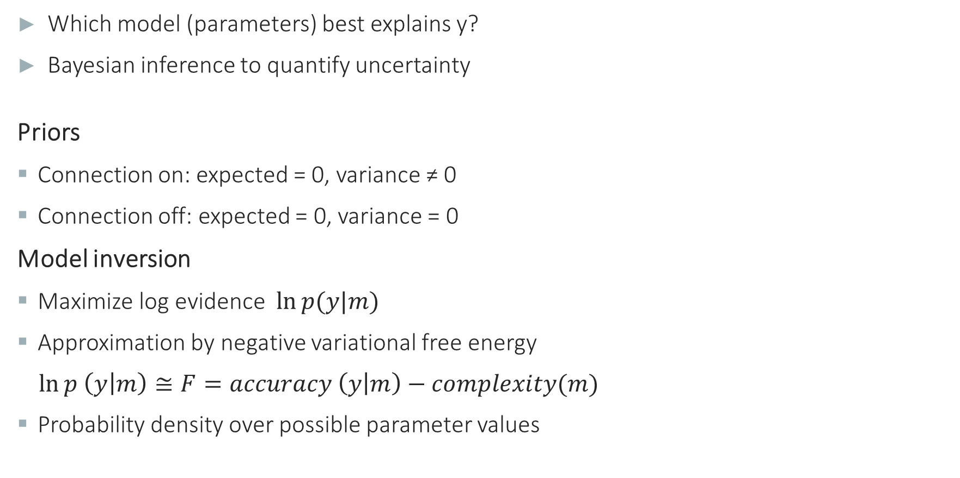
Parameter estimation
  Which model (parameters) best explains y?
  Bayesian inference to quantify uncertainty
Priors
  Connection on: expected = 0, variance ≠ 0
  Connection off: expected = 0, variance = 0
Model inversion
  Maximize log evidence $\ln{p(y|m)}$
  Approximation by negative variational free energy
  $\ln{p \left(y | m\right)≅F=accuracy \left(y | m\right)−complexity(m)}$
  Probability density over possible parameter values

Slide 14
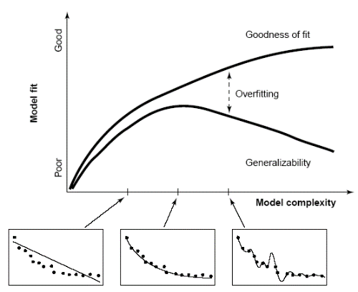

Bayesian model comparison
Overfitting
  construct complex models with excellent or perfect fit, which are mechanistically meaningless and do not generalize
  Bayesian model selection mandatory
Bayes factor
$$\log{ p\left(y | m\right)=accuracy\left(m\right)−complexity(m)}$$
$$B_{ij}= \frac{p(y|m_{i})}{p(y|m_{j})}$$
Bayes Factor
Pitt & Miyung (2002), TICS

Slide 15
Reading
Introduction and tutorials
  K.J. Friston, L. Harrison, and W.D. Penny. Dynamic Causal Modelling. NeuroImage, 19(4):1273–1302, 2003.
  Tutorial papers (Zeidman et al., 2019ab, Neuroimage)
    DCM: doi:10.1016/j.neuroimage.2019.06.031
    PEB: doi:10.1016/j.neuroimage.2019.06.032
  Resources: papers, step-by-step guide, data: https://github.com/pzeidman/dcm-peb-example
Other
  https://en.wikibooks.org/wiki/SPM/Parametric_Empirical_Bayes_(PEB)

Slide 16
Thank you

Slide 17
DCM functions in SPM:
Practical example

Slide 18
DCM in SPM
  Visually presented dots (static, moving; with/out attention)
  3 conditions:
    photic: all conditions with visual input
    motion: all conditions with moving dots
    attention: attention-to-motion condition only
  3 ROIs:
    V1: visual stimulation
    V5: motion (e.g. V5)
    V5 and superior parietal cortex (SPC)

Slide 19
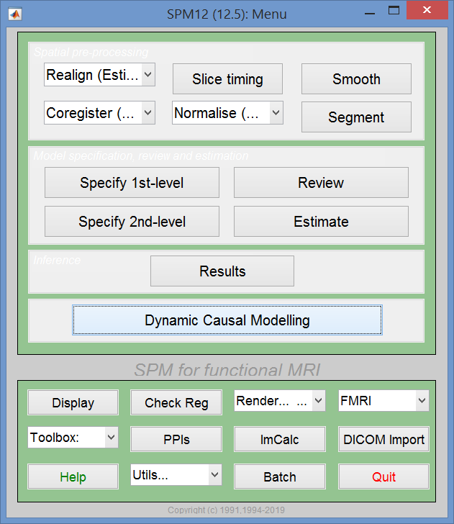
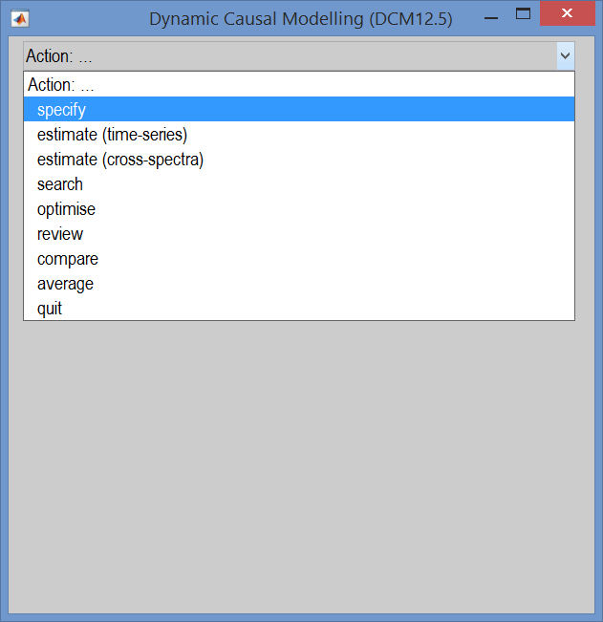
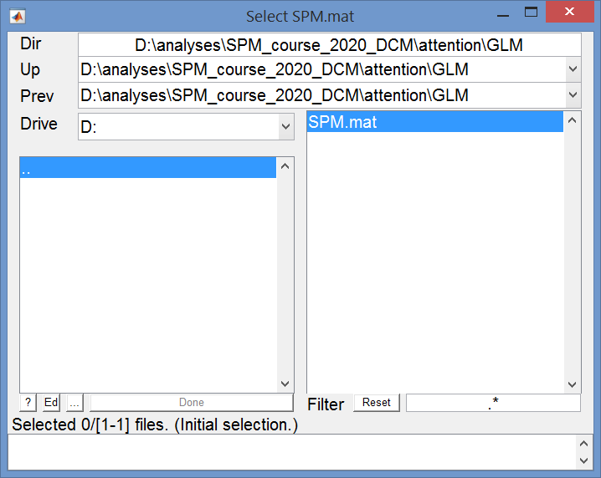
SPM: Choose SPM.mat

Slide 20
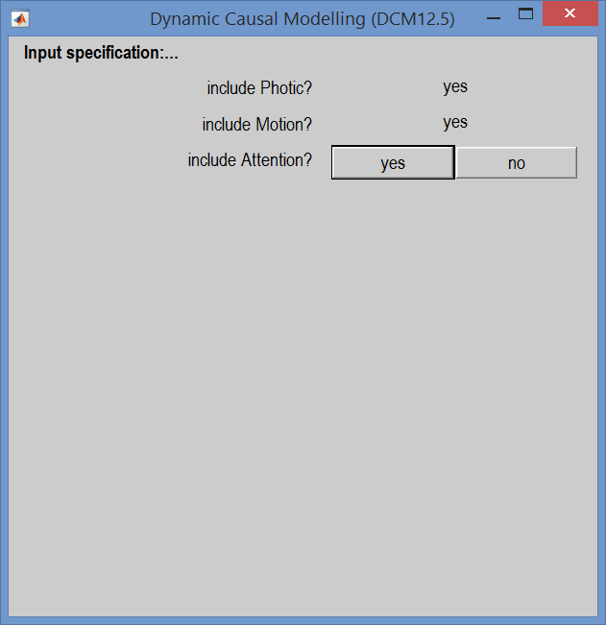
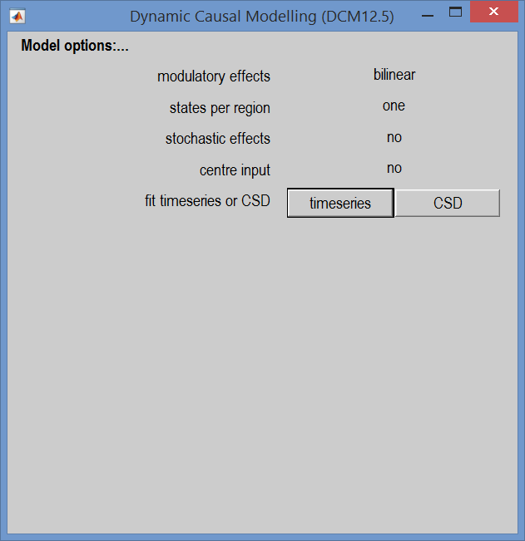
SPM: Select input from SPM.mat & options

Slide 21
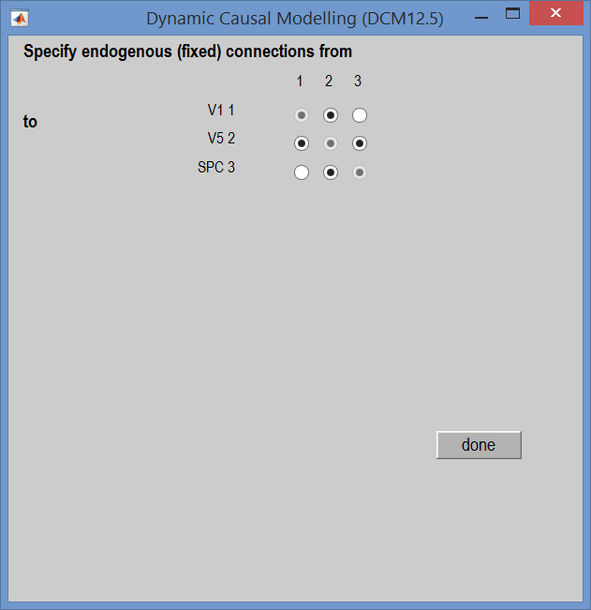
SPM: fixed connections (A-matrix)

Slide 22
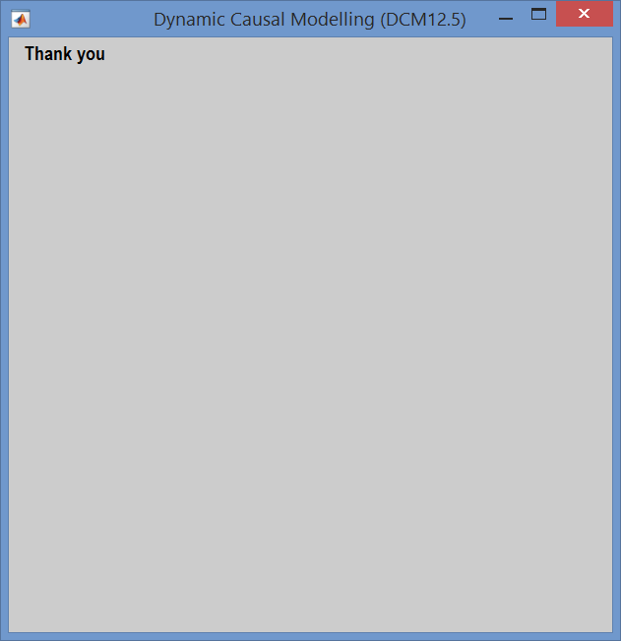
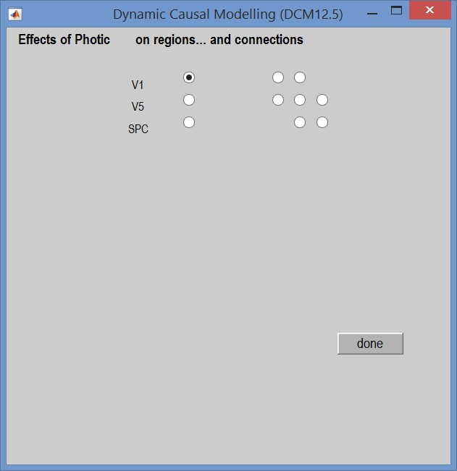
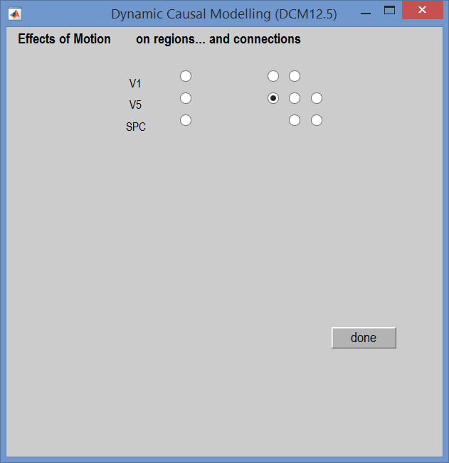
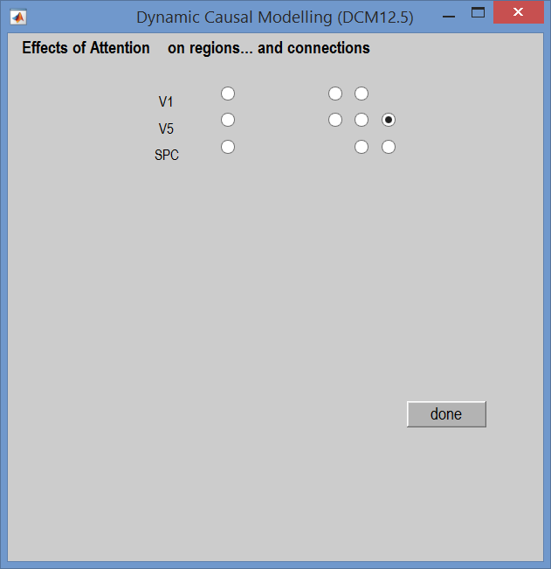
SPM: driving input and modulators (B- and C-matrices)

Slide 24
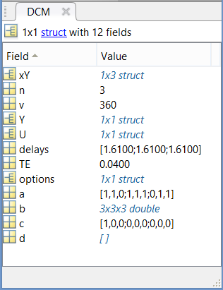
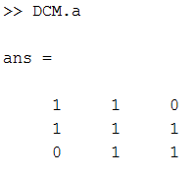
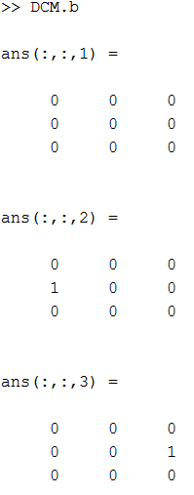
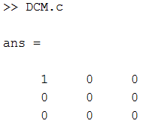
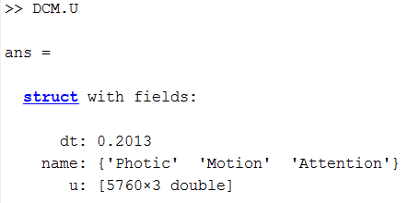
SPM: DCM model

Slide 25
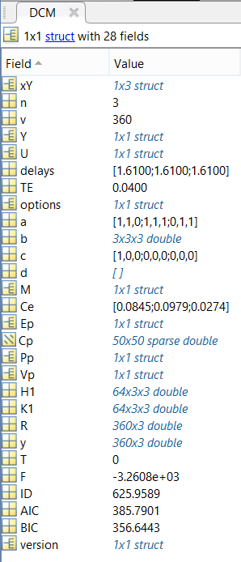
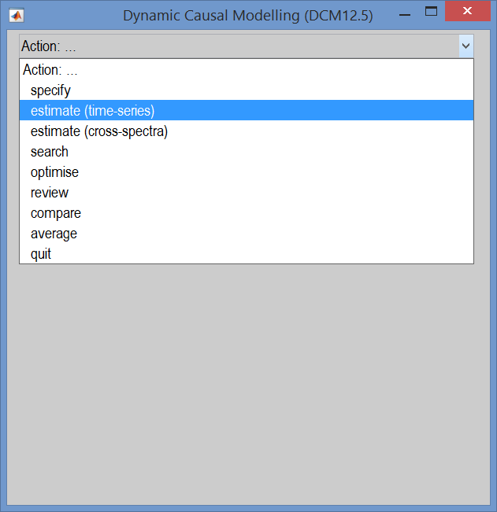
SPM: DCM estimate
►

