Slide 1
Basis of the BOLD signal
Laura Wolf & Peter Smittenaar
Methods for Dummies 2011-12

Slide 2
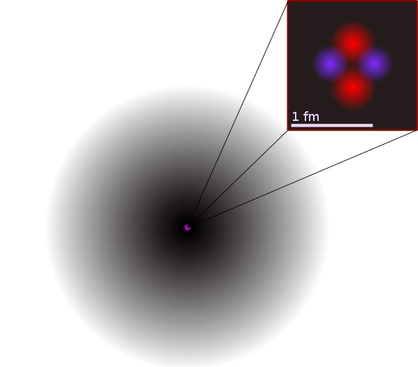
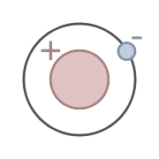
Nuclear magnetic resonance (NMR)
fMRI and MRI are based on NMR
only certain types of nuclei are visible in NMR (¹H, ²H, ¹³C, ¹⁵N, ¹⁷O…)
we are most interested in the hydrogen nuclei, due to the high abundance in the body (water)
¹H:
1 proton & 1 electron:
Nuclear spin = ½
²He:
2 proton & 2 neutrons & 2 electron:
Nuclear spin = 0
Notes:
MRI and fMRI are based on a physical phenomenon, called nuclear magnetic resonance: in which magnetic nuclei in a magnetic field absorb and re-emit electromagnetic radiation.
Only specific types of nuclei can be detected with nuclear magnetic resonance.
If you can remember chemistry in secondary school: atoms consist of protons, neutrons and electrons. If there is an uneven number of protons or neutrons or both, the nuclei possess a nuclear spin, which is necessary for the nuclei to be visible in NMR. Example for these nuclei are: …. We will be most interested in hydrogen, as it is highly abundant in the body water and most organic molecules.

Slide 3
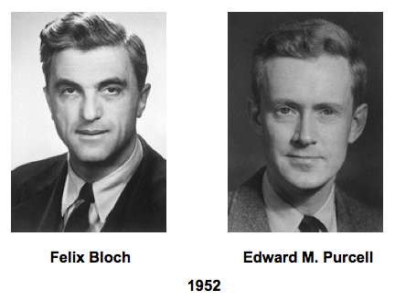
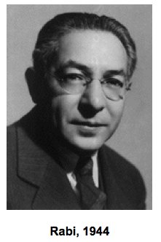
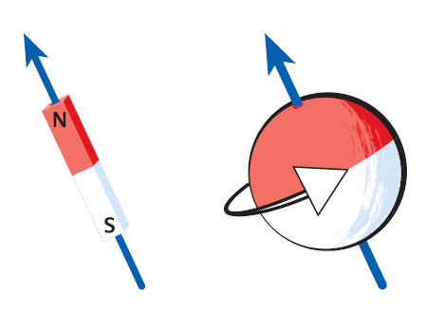
Nuclear spin
Energy
B₀ = 0
B₀ ≠ 0
B₀
Nucleus with a nuclear spin, can be imagined as small rotating magnet
In the absence of an external magnetic field (B₀), hydrogen can exist in two energetically even spin states: spin-up & spin-down
In the presence of B0, the spin-up state is energetically favourable and the nucleus is more likely to be in that state
Energy in the radiofrequency range of the electromagnetic spectrum can induce spin-flips
Notes:
Nuclei that possess a nuclear spin can be pictured as small rotation magnets, which spin around their own axis.
1H has a nuclear spin of ½ (why this is, would go into to much detail) and the nucleus can exist in two energetically equal states: spin-down or spin-up. As these two states are energetically equal, the nucleus is equally likely to be in either of the two states. This is true if there is no external magnetic field (here called B0). However in the presence of external magnetic field, the spin aligns with B0. The presence of the external magnetic field, also leads to the two spin states not being energetically even anymore -> the spin up state energetically more better and more stable whereas the spin down state is energetically unfavorable.
In order for the nucleus to get from the spin-up state to the spin-down state, he needs to overcome a energy barrier, which depend on the properties of the each nucleus. This energy can be fed into the system with a pulse in radio frequency, which will help the nucleus to overcome this barrier. And on the level of a single nucleus: this is the basis of NMR.

Slide 4
Ensemble of spins
Energy
Net magnetization detectable with MR
B₀ = 0
B₀ ≠ 0
In a magnetic field B₀ more spins are in the spin-up state. As a result there is a net magnetization detectable in MR.
The stronger B0 -> the stronger the net magnetization -> the stronger the detected signal
High field strengths (in Tesla) yield stronger signals
Notes:
The last slide demonstrated what happens to a single spin when exposed to an external magnetic field.
If we are looking at an ensemble of spin: in the absence of B0 they are equally likely to be in the spin-up or spin-down state and thus the net magnetization is 0. However in the presence of an B0, the spins get aligned along the axis of the magnetic field. Now there are again two spin states are differ in their energetic level and thus more spins will be in the energetically favorable spin-up state. This leads to an net magnetization of the spins along the axis of the B0. The energy difference between the two spin states, Is proportional to the strength of B0 -> which means, they stronger B0, the more the two spin states differ and the more spins will be in the spin-up state and hence stronger the net magnetization. This is why, we use a very strong magnetic field when scanning!

Slide 5
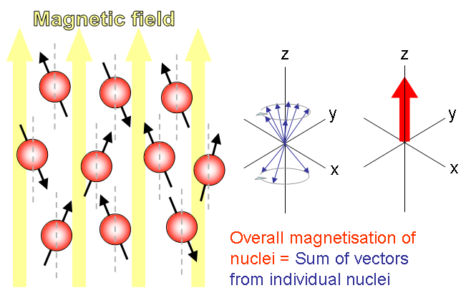

Precession of spins around the z-axis
z
B₀
The spins
precess around the z-axis
ω₀ is Larmor frequency: precession of nucleus at given magnetic field
γ is different for each chemical species with nuclear spin
Larmor frequency Magnetic field (B₀)
Notes:
When I said earlier, that the spins align along the axis of the B0, this wasn’t entirely correct (as you probably have noticed on the pictures): the spins can’t completely align with the axis of B0, which from now on will be the z-axis. While spinning around its own axis, the spins at the same time wobbles about the axis of B0, which means the movement describes a cone shape. This can be probably best pictured with a spinning dreidle. This rotation is called precession. The precession frequency is proportional to the applied field B0.
However, the spins don’t precess in phase around the z axis, hence there is no overall x,y magnetization of the nuclei!
Genauer : ω0 = γ B0.

Slide 6
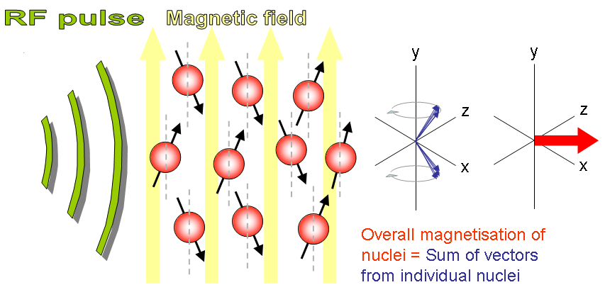
Radiofrequency pulse – Excitation!
Magnetic field B₀
A 90^{O} RF pulse (B₁) induces:
Spin-flip between the two states until there is an equal number in both states -> no net magnetization along the z-axis
Spins are aligned in phase -> net magnetization in the xy-plane
Radiofrequency pulse at Larmor frequency
Magnetic field B₀
z
z
y
y
Notes:
As I mentioned earlier, the energy necessary to allow spins to transfer from the spin-up to the spin-down state, is in the radiofrequency range (they are called in resonance then). If a radiofrequency pulse is applied, energy is added to the system, which allows the spins to transfer between the spin-up and spin-down state until the spins are equally distributed between both states-> thus there is no net magnetization along the z-axis left. At the same time the RF pulse aligns the phase of the spins. If the RF pulse is applied orthogonal to the magnetic field B0, i.e. in the x/y plane -> there will now be net magnetization in the x/y plane as the spins are now in phase.

Slide 7
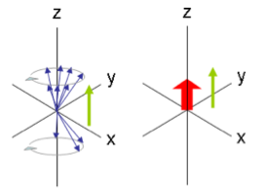
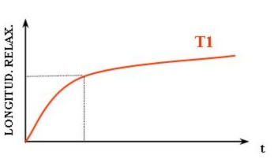
Relaxation – T1 relaxation
T1 relaxation:
Return of the spins to the equilibrium state
Longitudinal relaxation: regain net magnetization along z-axis
Slow
Due to spin-lattice interaction, i.e. energy is partly re-emitted in form of heat to the tissue
Notes:
The second type of relaxation is called T1 relaxation or longitudinal relaxation – this relaxation takes longer than the T2 relaxation. In the absence of the additional energy provided by the RF pulse, the spins return to their equilibrium distribution between the spin-up and spin-down state which leads to the restoration of a net magnetization along the z-axis. T1 is the time point when 63% of the final net magnetization is reached. Within a field strength of 1.5 Tesla, this can take between 300-2000ms
Spin lattice relaxation

Slide 8
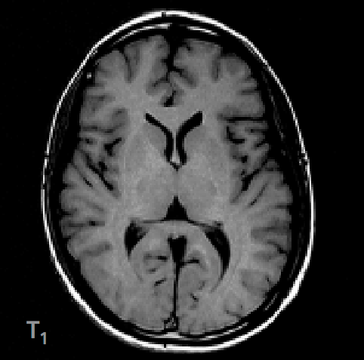
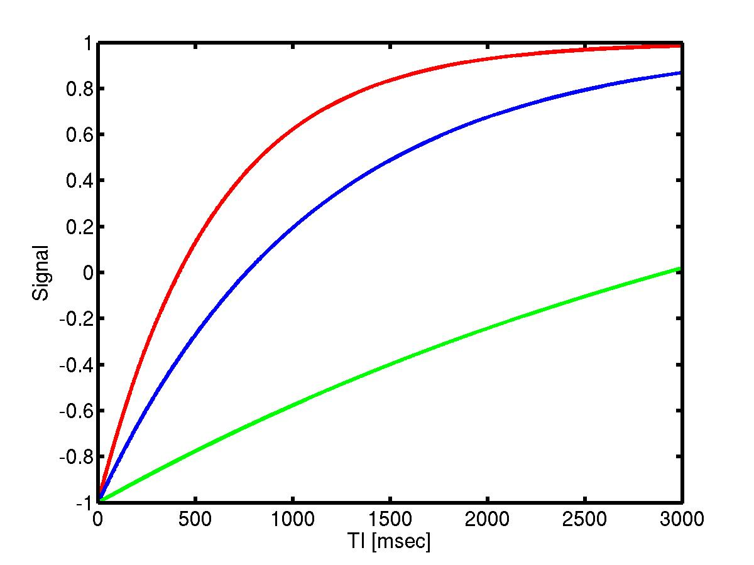
T1 Image
T1 is unique to every tissue. The different T1 values of white and grey matter is at the origin of the difference in signal (image contrast) in MR images (T1w scans).
The long T1 of CSF means that CSF appears dark.
The short T1 of WM means that WM appears bright.
WM
GM
CSF
Notes:
Here you can see the T1 recovery curve for different tissue types. So how should different tissue types show up in the image? You can see in this T1 image that white matter indeed gives us the highest signal, which is shown bright in the image, and CSF a low signal, shown dark in the image.
Because energy of spins partly given to tissue, T1 depends on the tissue type /environment a lot although we are all the time measuring mainly H20!! (hydrogen) – not measuring different things in different tissues!

Slide 9
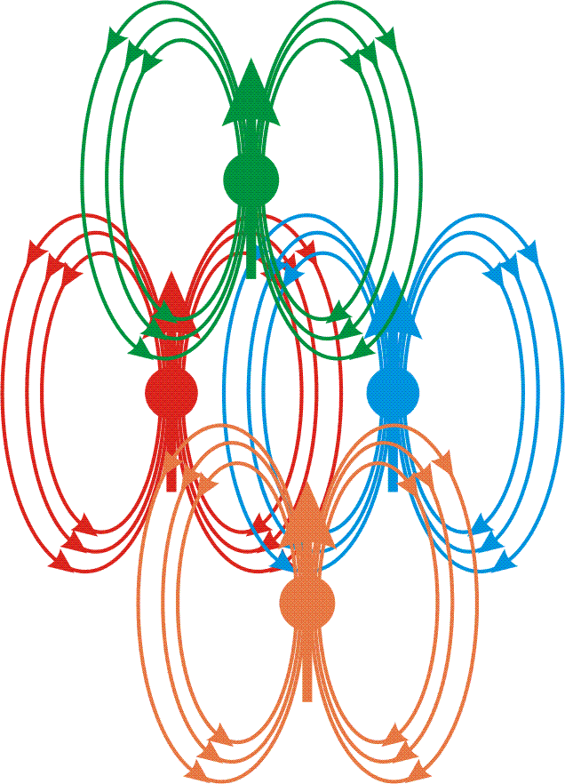
Relaxation – T2 relaxation
B
T2 relaxation:
Each individual spin is a little ‘magnet’ that creates its own magnetic field.
Each spin therefore experiences a specific field due to the influence of its neighbors: spin-spin interactions
Since spins precess at a frequency given by the local value of the magnetic field, they gradually get out of phase: the detected MR signal is reduced with time due to T2 relaxation
B
B
B
Notes:
From this excited state: there are two types of relaxation: the quicker relaxation is the dephasing of the spins within the x-y plane. This leads to an exponential decay of the net magnetization in the x-y-plane. This relaxation is also called transverse relaxation. The spins are getting out of phase, as their magnetic fields interact with each other (spin-spin interaction), which modifies the precession rate of the spins. T2 describes the timepoint when 63% of the original magnetization is lost.

Slide 10
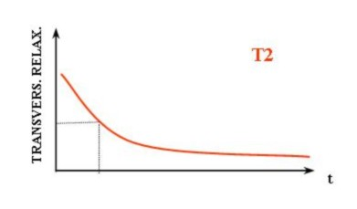
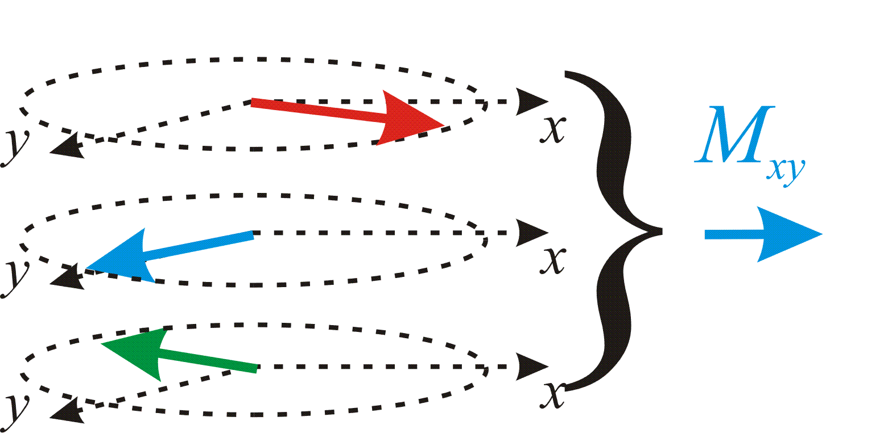
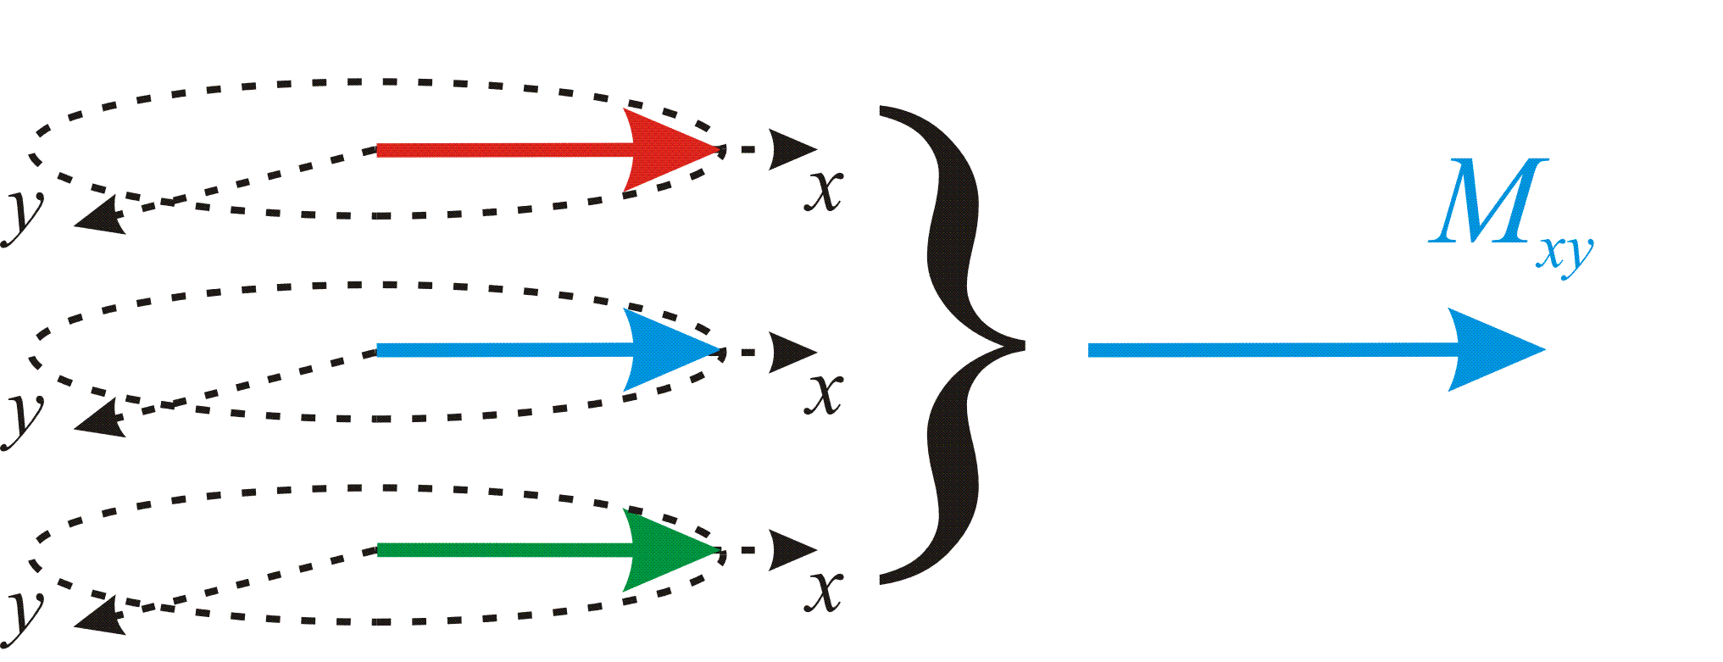
Relaxation – T2 relaxation
Spin dephasing leads to signal reduction over a duration called T2.
Notes:
From this excited state: there are two types of relaxation: the quicker relaxation is the dephasing of the spins within the x-y plane. This leads to an exponential decay of the net magnetization in the x-y-plane. This relaxation is also called transverse relaxation. The spins are getting out of phase, as their magnetic fields interact with each other (spin-spin interaction), which modifies the precession rate of the spins. T2 describes the timepoint when 63% of the original magnetization is lost.

Slide 11
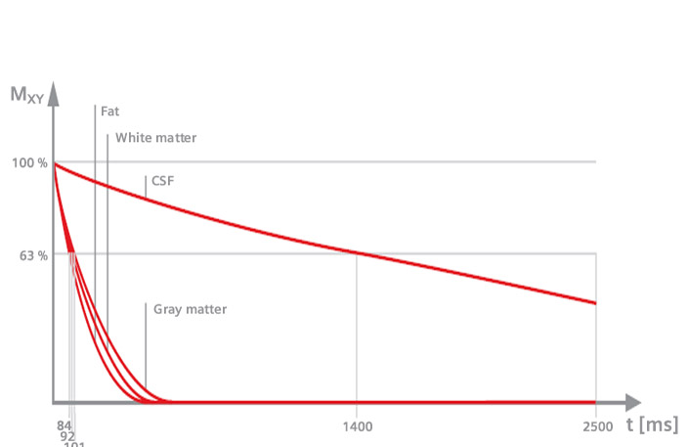
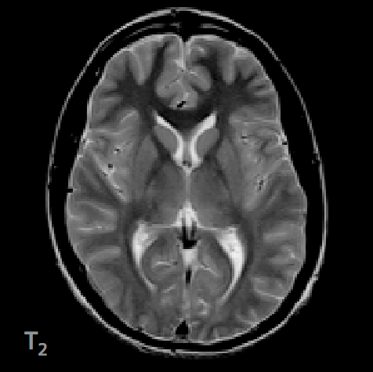
T2 Image
T2 is also unique to every tissue. The similar T2 for WM and GM means that both tissues appear similarly in a typical T2 weighted scan.
The T2 of CSF is much longer and CSF appears brighter in a T2w scan.
Notes:
Here you can see the T2 recovery curve of different tissue types and the resulting T2 image, and because spins dephase slower in CSF, CSF has a higher and brighter value in the T2 image while Gray and white matter have a much lower value.

Slide 12
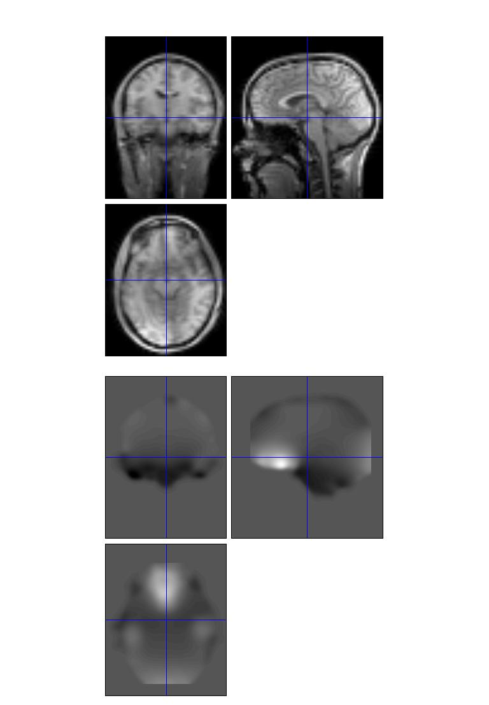
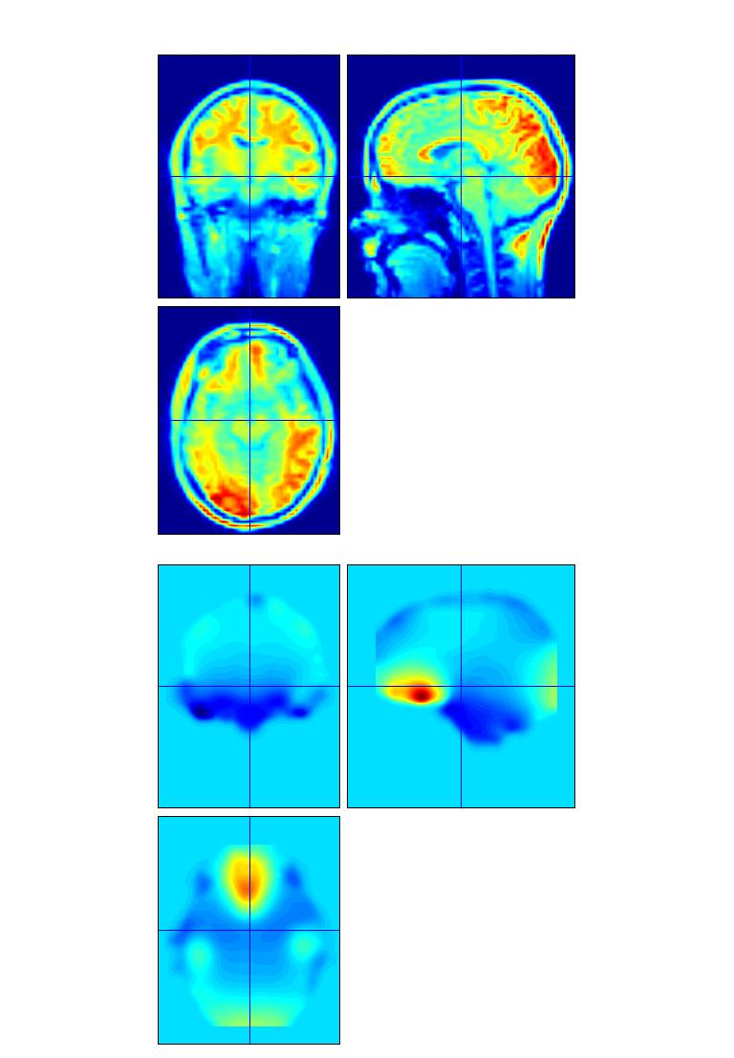
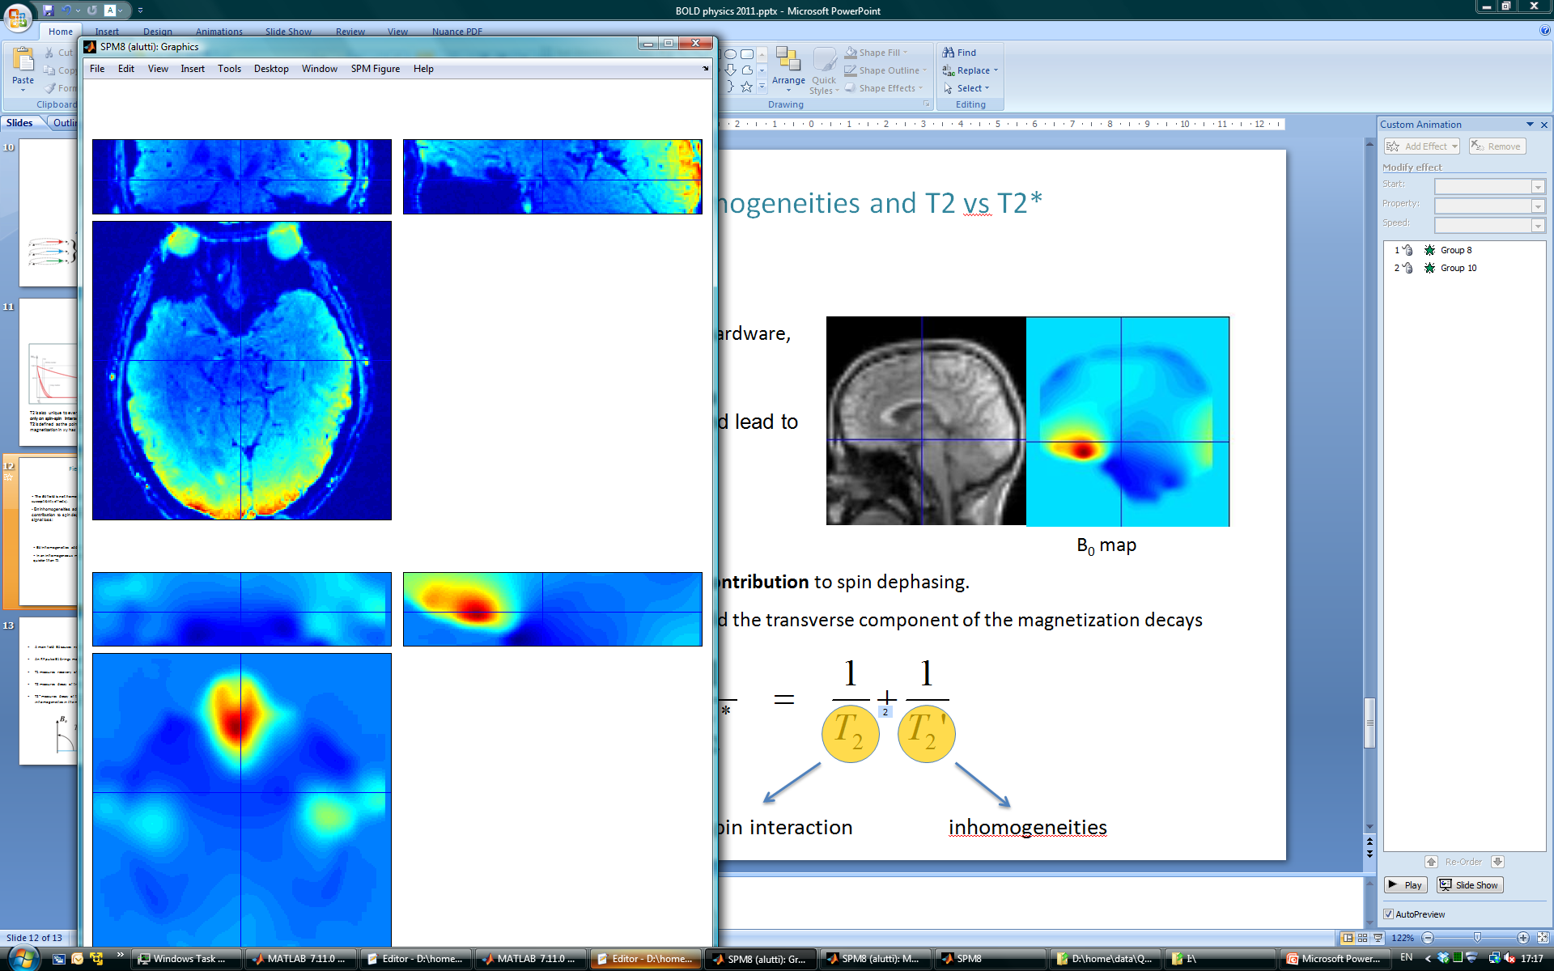
Field Inhomogeneities and T2 vs T2*
The B₀ field is not homogeneous (hardware, susceptibility effects).
B₀ Inhomogeneities add an extra contribution to spin dephasing and lead to signal loss:
B₀ map
EPI image
B0 map
In an inhomogeneous magnetic field the transverse component of the magnetization decays quicker than T₂.
spin-spin interaction
inhomogeneities
Notes:
We can measure both – T2* is suitable to measure BOLD.

Slide 13
T2* and BOLD
Onset of neural activity leads to a local change in B0 (discussed later) and thus to a change in T2* (!but not T2!)
Functional imaging therefore requires techniques that are sensitive to T2* (gradient-echo techniques)
  The most widespread sequence for fMRI is Echo Planar Imaging (EPI), a rapid sequence which enables sampling of the BOLD response.
  EPI comes with problems: drop-outs where the B0 field is highly inhomogeneous (e.g. OFC)
T2 sequences are hardly used for functional imaging as they refocus effects due to local B0 inhomogeneities (‘spin echoes’). Mostly used for lesion detection with/without contrast agent.

Slide 14
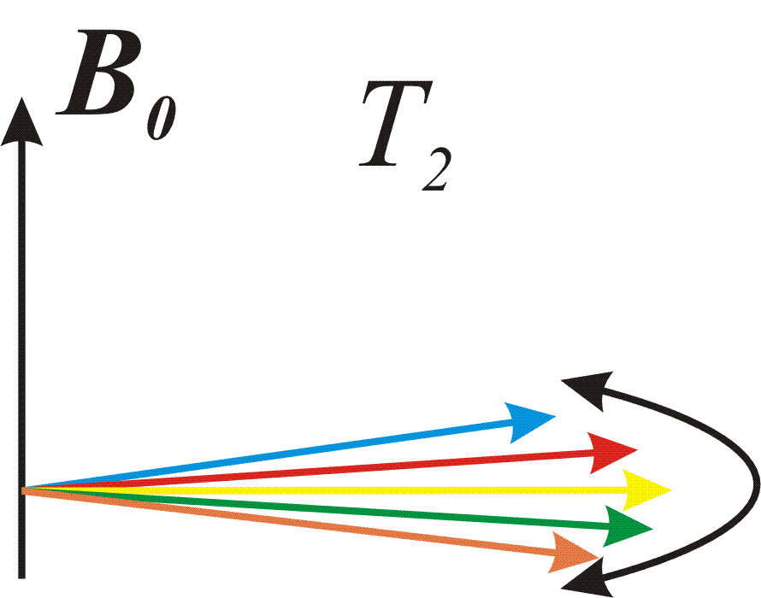
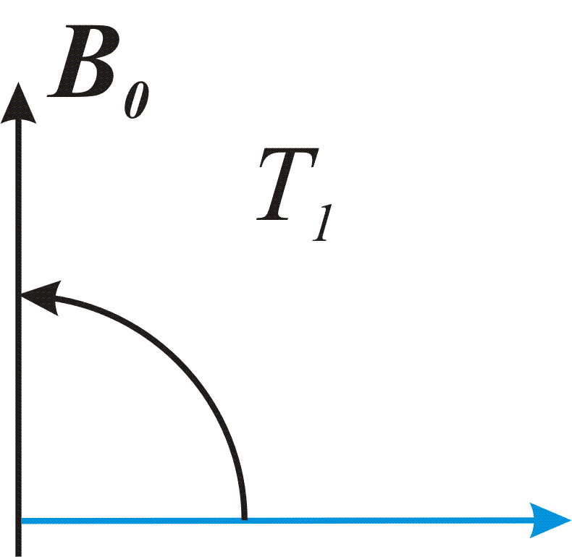
Summary of MR physics
A main field B₀ causes net magnetisation in protons in the body
An RF pulse B₁ brings magnetisation into the xy-plane
T1 measures recovery of longitudinal magnetisation. Yields a good grey-to-white matter contrast and often used for anatomical imaging.
T2 measures decay of transverse magnetisation exclusively due to spin-spin interactions. T2 similar for GM and WM in healthy tissues. Therefore rarely used in standard anatomical but used to image lesions or when contrast agent is used.
T2* measures decay of transverse magnetisation due to both spin-spin interactions and field inhomogeneities. Extensively used for BOLD imaging (EPI) where a sequence sensitive to field changes is required.
Notes:
More or less deoxyhemoglobin distorts the signal more or less, but we still measure protons and their T2* decay. T2* is just decaying faster or slower depending on how much deoxyhemoglobin is around!

Slide 15
Section 1: Basics of MRI Physics Section 2: What does BOLD reflect?

Slide 16
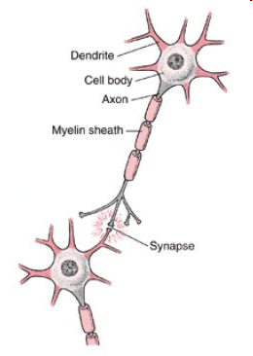
A Typical Neuron

Slide 17
Where does the brain use energy?
maintain and restore ion gradients
recycling of neurotransmitters
Atwell & Iadecola, 2002
ATP: adenosine triphosphate: mainly produced through oxidative glucose metabolism
Notes:
The unit of energy used in the brain is ATP and this is produced through the metabolism of glucose & oxygen
This diagram shows us where the energy is then used
Point out cell body, dendrites, axon, synapses
Resting potential- 2%
Neuron is constantly receiving both excitatory and inhibitory potentials- these are integrated & when a certain threshold of depolarization is reached, an action potential occurs- this uses 10%
Neurotransmitter e.g. glutamate is released- 7%
Postsynaptic processes restore balance by recycling the transmitter & restoring ion gradients
Astrocytes or glial cells- 6%

Slide 18
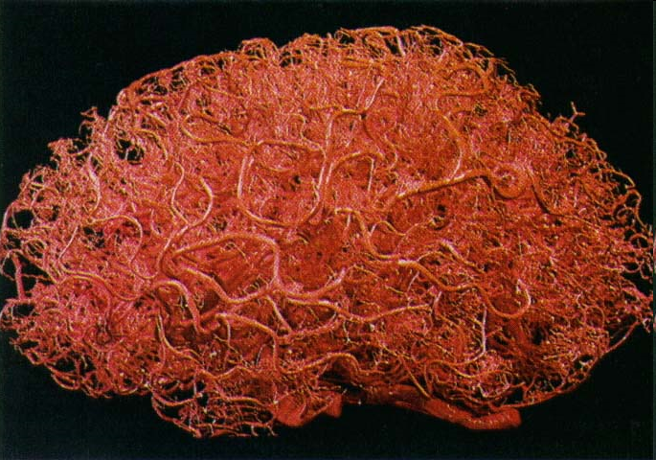
How is the energy supplied?
Zlokovic & Apuzzo, 1998
Capillary networks
supply glucose and oxygen
Notes:
Here is a picture of the brain’s vasculature
We are mainly concerned with the capillary networks, as this is where the exchange of glucose & oxygen takes place

Slide 19
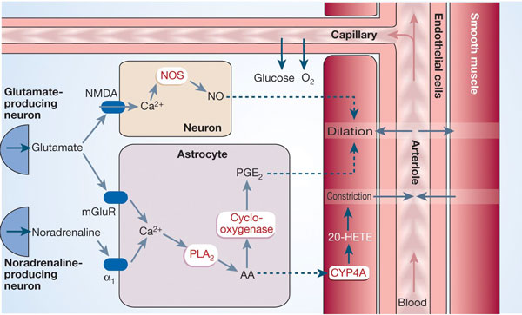
How is cerebral blood flow controlled?
‘feed-forward’ control: incoming activity elicits blood flow changes, rather than waiting for resources to be depleted
by-products of neuronal communication e.g. NO
calcium signalling in astrocytes
Notes:
It is currently generally accepted that blood flow is controlled by two processes which occur in the presynaptic neuron:
Point out neuron, astrocyte and blood vessel in diagram
SO we are really measuring inputs and intra-cortical processing in the area of interest

Slide 20
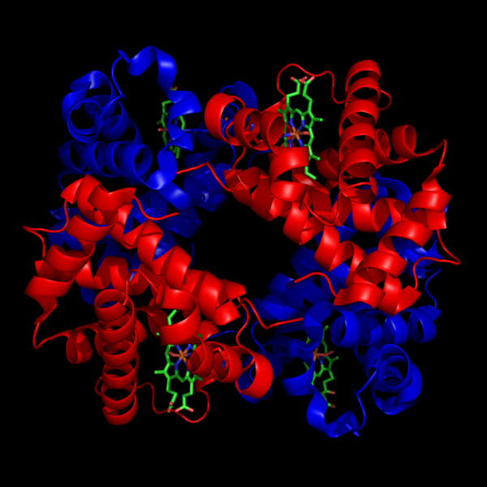
Haemoglobin
Oxyhaemoglobin: diamagnetic (no unpaired electrons)
does not cause local inhomogeneities in magnetic field
Deoxyhaemoglobin: paramagnetic (unpaired electrons)
causes local inhomogeneities
Inhomogeneities cause dephasing of protons in voxel → lower T2* signal when there is more deoxyhaemoglobin
Notes:
Oxygen is carried by haemoglobin in the blood.
Here we can see the haemoglobin is made up of proteins and iron ions. At the pulmonary capillaries in the lungs the oxygen attaches to these iron ions. When oxygen is attached, we have oxyhaemoglobin, which is diamagnetic.
Then the oxygen is dropped off at the cells, and when there is no oxygen attached, we call this deoxyhaemoglobin. This is paramagnetic.
So
Oxyhaemoglobin is NOT very magnetic and doesn’t really affect the magnetic field one way or another
Deoxyhaemoglobin IS magnetic so causes distortions in the magnetic field
Paramagnetism: is attracted to magnetic field when placed in one (but is not magnetic when outside a field). Large magnetic permeability (?). Unpaired electrons
Diamagnetism: creates a slightly opposing magnetic field when placed in one. Low magnetic permeability, opposes magnetic field. No unpaired electrons

Slide 21
What does BOLD measure?
Blood Oxygenation Level Dependent
Changes in magnetic properties of haemoglobin:
low deoxyhaemoglobin increased signal
high deoxyhaemoglobin decreased signal
SO…we are NOT measuring oxygen usage directly
Notes:
Here the red dots represent haemoglobin and the blue dots represent oxygen. We can see that as the blood flows in, the oxygen is released to be metabolised by the cells
When the brain area is activated, there is an increase in both blood flow and volume, and there is a much greater increase in oxygen supply than that which is actually needed for metabolism. So even though the cells are using more oxygen, there is even more than usual in the blood stream.
What we are actuall measuring is changes in magnetic field inhomogeneity caused by the relative amounts of oxygenated and deoxygenated haemoglobin in the blood stream.
More oxyhaemoglobin means less field inhomogeneity in the magnetic field, a slower T2* contrast decay and a stronger signal.
More deoxyhaemoglobin causes greater magnetic field inhomogeneity, the T2* contrast decays quicker and we measure a weaker signal.
SO a stronger BOLD signal indicates that there is an increased concentration of oxyhaemoglobin, corresponding to a decreased concentration of deoxyhaemoglobin in the blood….so we are NOT measuring oxygen usage

Slide 22
M_{xy}
Signal
M_{o} sinθ
T₂* low deoxyhaemoglobin
T₂* high deoxyhaemoglobin
TE_{optimum}
time
So you might think:
Neural activity increase – more oxygen taken from blood – more deoxyhaemoglobin – lower BOLD signal
But you’d be wrong: BOLD goes up with neural activity
Notes:
Experimental task: More oxyhaemoglobin means less field inhomogeneity in the magnetic field, a slower T2* contrast decay and a stronger signal.
Control task: More deoxyhaemoglobin causes greater magnetic field inhomogeneity, the T2* contrast decays quicker and we measure a weaker signal.

Slide 23
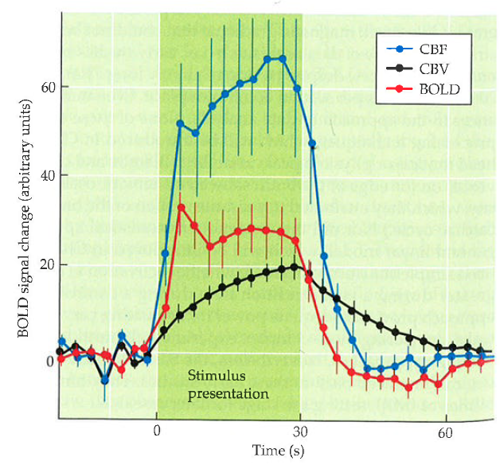
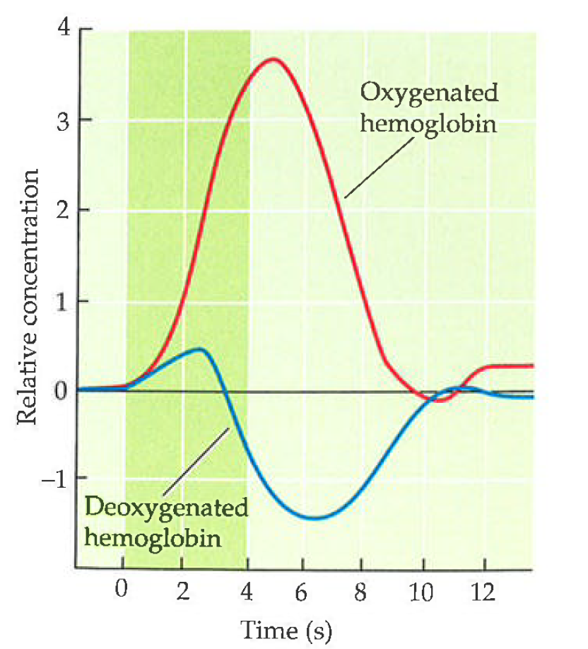
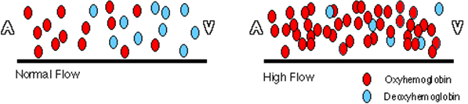
Level of dO₂Hb depends on:
cerebral metabolic rate of oxygen (CMRO₂)
  deoxyhaemoglobin up, BOLD down
cerebral blood flow
  washes away deoxyhaemoglobin, BOLD up
cerebral blood volume
  increases, dO₂Hb up, BOLD down
taken from Huettel et al.
Notes:
Flow refers to the rate; how fast the blood is flowing
The metabolic rate of oxygen refers to how much oxygen is required
Volume refers to the amount of blood

Slide 24
Haemodynamic Response Function
‘initial dip’
oversupply of oxygenated blood
decrease before return to baseline (CBV stays high longer than CBF)
Notes:
The HRF reflects the T2* values measured a couple of times in a row (several RF pulses followed by several measurements → reflects how much ‘oxygen’ was present when measured at 0, 1, 2, 3, ... 25 seconds after stimulus onset
Remember we are measuring the relative amounts of oxyhaemoglobin and deoxyhaemglobin in the blood stream.
The initial dip is caused by oxygen being used from the existing blood supply, leading to an increase in the proportion of deoxyhaemoglobin, and a decreased signal.
Some people think that this may be the best measure of neuronal activity
2)Blood flow increases, providing more oxyhaemoglobin than is required for oxygen metabolism: this means that even though more oxygen than usual is being used, there is still a greater proportion of oxyhaemoglobin in the blood due to the excessive supply- this leads to an increased signal…SO, again, we are not measuring oxygen use per se, rather we are measuring the decrease in the amount of deoxyhaemoglobin relative to oxyhaemoglobin in the blood in response to activation.
3)After the blood flow has returned to normal, it still takes a while for the volume to decrease again. This leads to another increase in the relative level on deoxyhaemoglobin, and a corresponding decrease in the BOLD signal before return to baseline.
Be aware that because the fMRI signal is non-linearly dependent on blood flow, the BOLD signal may saturate at high levels of blood flow, because a moderately strong stimulus could give almost maximal BOLD respone not leaving much space for higher signal- like a ceiling effect.

Slide 25
Task elicits neural activity: less deoxyhaemoglobin; less field inhomogeneity; slower T2* contrast decay; stronger signal at TE
M_{xy}
Signal
M_{o} sinθ
T₂* task
T₂* control
S_{task}
S_{control}
ΔS
TE_{optimum}
time
Control: signal decays at a particular rate. At Echo Time (TE) you measure signal
Notes:
Experimental task: More oxyhaemoglobin means less field inhomogeneity in the magnetic field, a slower T2* contrast decay and a stronger signal.
Control task: More deoxyhaemoglobin causes greater magnetic field inhomogeneity, the T2* contrast decays quicker and we measure a weaker signal.

Slide 26
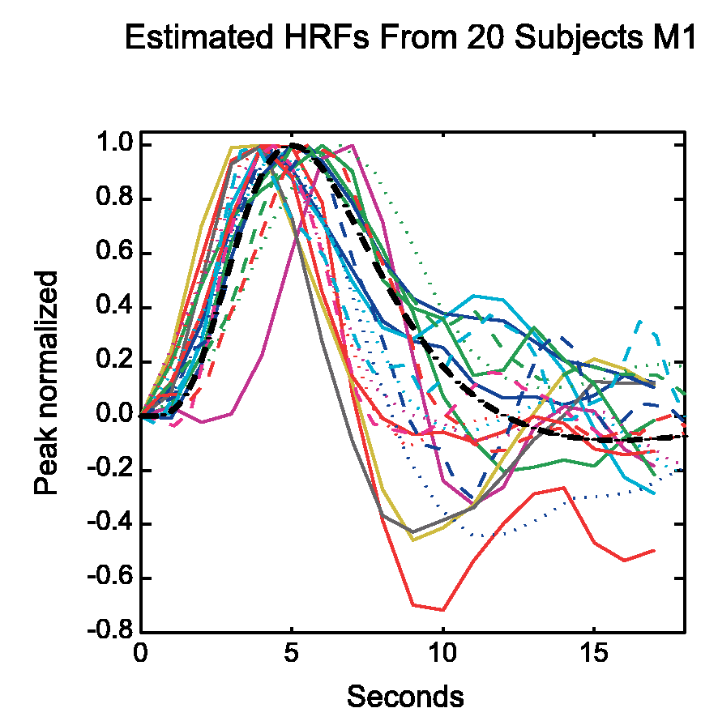
What component of neural activity elicits BOLD?
Local Field Potential or Spiking?
LFP: synchronized dendritic currents, averaged over large volume of tissue
BOLD generally considered to reflect LFP, or inputs into an area (Logothetis et al 2001)
LFP not necessarily correlated with spiking (i.e. output): subthreshold activity would enhance LFP and BOLD, but not spiking
Also possible problems:
- GABA to BOLD (basal ganglia?)
- Comparing activations between regions (different HRF)
- differences between subjects in BOLD
One solution is to fit different versions of the HRF, which is
what SPM can do
Notes:
fMRI: simultaneous activity of MANY neurons in a LARGE region of cortex (millimeters) over a LONG period (seconds). We need to ask what component of the neural activity most predicts the fMRI signal?
There has been much debate around whether we are actually measuring local field potential or firing.
Subthreshold activity: simultaneous excitation and inhibition that would not result in an action potential but would nevertheless deplete blood oxygen.
It is generally thought that we are measuring LFP
This is important for comparisons with animal models because they measure either LFP OR spiking

Slide 27
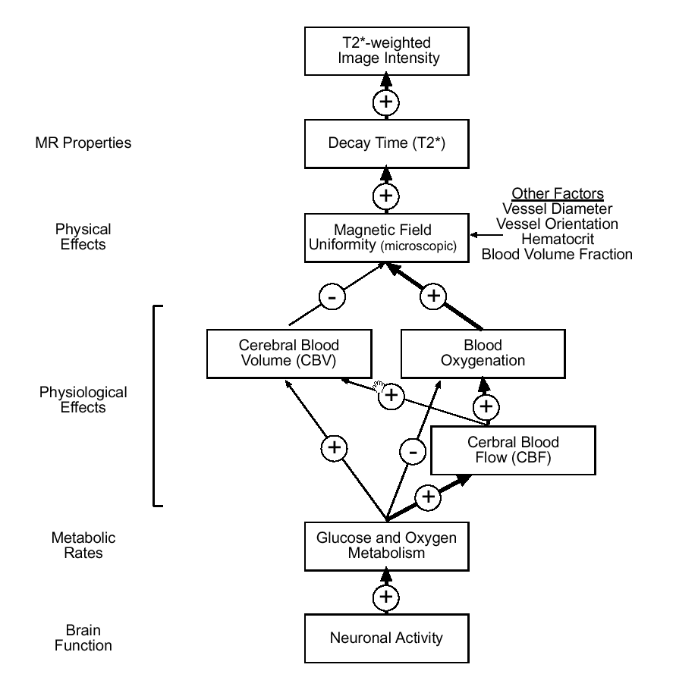
Overview: What are we measuring with BOLD?
the inhomogeneities introduced into the magnetic field of the scanner…
changing quantity of deoxygenated blood...
via their effect on the rates of dephasing of hydrogen nuclei
Notes:
This diagram shows just how far the distance is between neuronal activity, which is what we are trying to measure, and the intensity of the T2* weighted image we record. (Discuss diagram)

Slide 28
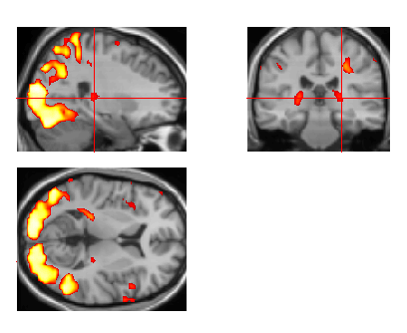
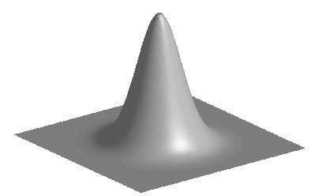
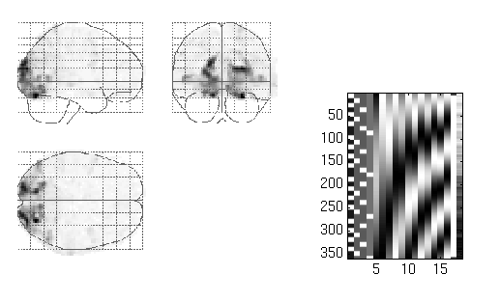
Where are we?
Statistical parametric map (SPM)
Image time-series
Kernel
Design matrix
Realignment
Smoothing
General linear model
Statistical
inference
Gaussian
field theory
Normalisation
Template
p <0.05
Parameter estimates
Notes:
Miriam and I described how we measure the value of each voxel and what this means in terms of physiology. Hopefully you have gained an understanding of the values that we put into our analysis right from the start, which are used for all the steps to follow.
I wanted to mention also that what we know about the shape of the haemodynamic function is used in the design matrix, and we will be having a talk in January about Basis Functions which allow us to vary the timing and width of the HRF to reflect differences in onset and duration of stimuli.

Slide 29
Thanks to...
Antoine Lutti for lots of input and explanations

Slide 30
References:
http://www.cardiff.ac.uk/biosi/researchsites/emric/basics.html
http://www.revisemri.com/ (great Q&A)
http://www.imaios.com/en/e-Courses/e-MRI (animations)
Previous year’s talks http://www.fil.ion.ucl.ac.uk/mfd/page2/page2.html
Physic’s Wiki: http://cast.fil.ion.ucl.ac.uk/pmwiki/pmwiki.php/Main/HomePage
Huettel et al. Functional magnetic resonance imaging (great textbook)
Heeger, D.J. & Ress, D. (2002) What does fMRI tell us about neuronal activity? Nature 3:142.
Attwell, D. & Iadecola, C. (2002) The neural basis of functional brain imaging signals. Trends in Neurosciences 25(12):621.
Logothetis et al (2011) Neurophysiological investigation of the basis of the fMRI signal. Nature

