Slide 1
Dynamic Causal Modelling
Theory and practice
Patricia Lockwood and Alex Moscicki

Slide 2
Theory
  Why DCM?
  What DCM does
  The State Equation
Application
  Planning DCM studies
  Hypotheses
  How to complete in SPM

Slide 3
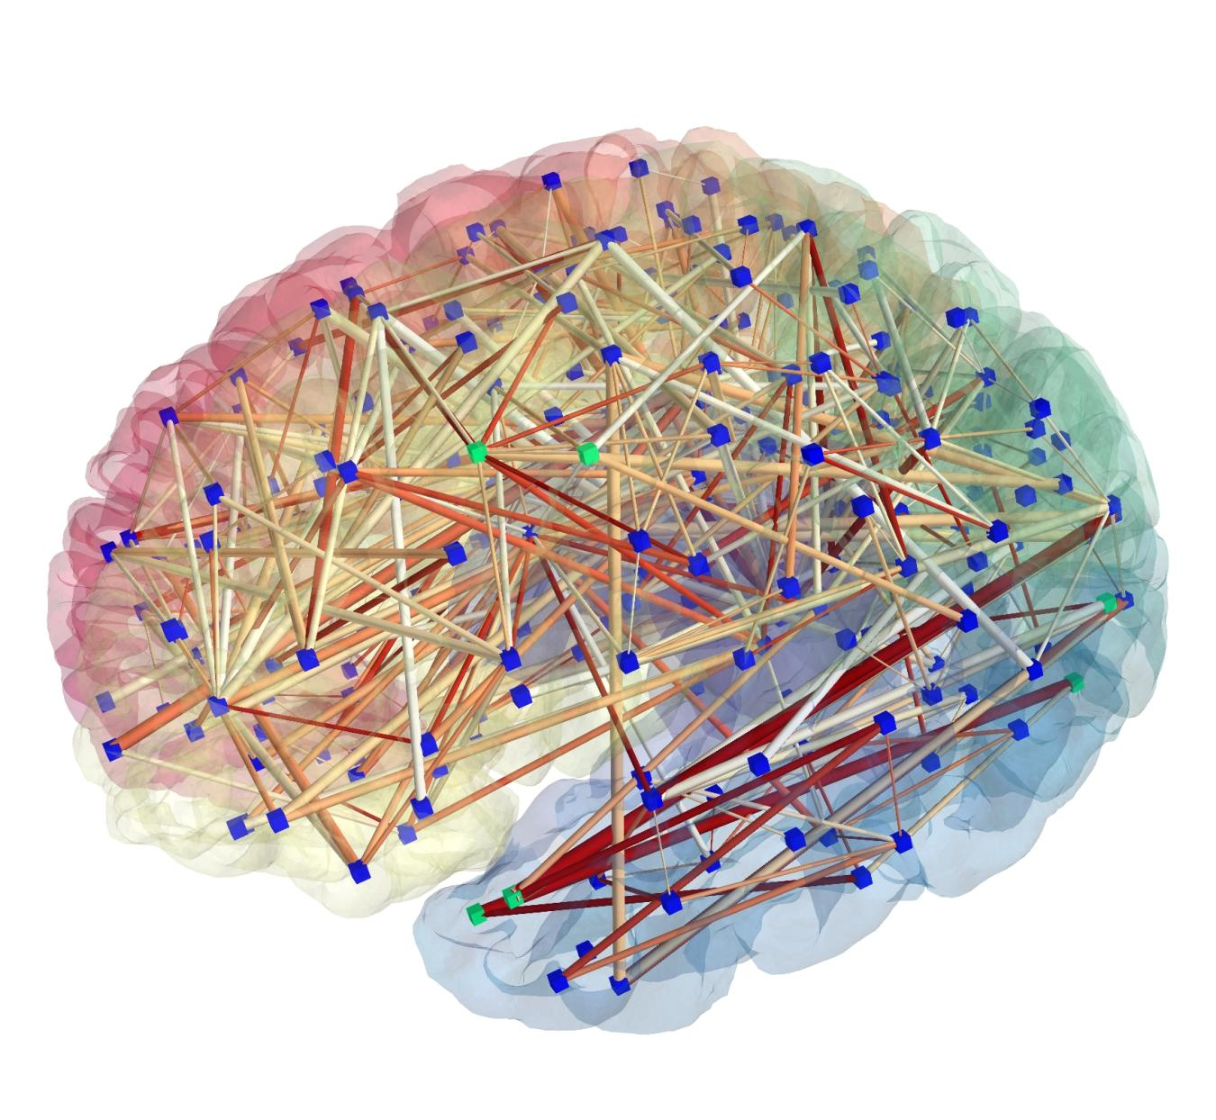
Brains as Systems
Notes:
Brain is not a modular lump with different regions processing information without talking towards one another, and blobs of bran activation working in isolation. DCM says that the brain is a dynamical system with different regions causing activity in other regions, we can use these dynamic causal models in order to describe the brain as a dynamic system

Slide 4
Background to DCM
“DCM is used to test the specific hypothesis that motivated the experimental design. It is not an exploratory technique […]; the results are specific to the tasks and stimuli employed during the experiment.”
[Friston et al. 2003 Neuroimage]
Notes:
Explaining the findings of the glm on the basis of connectivity

Slide 5
Connectivity analyses
Whole time series
Condition specific
Not causal
FUNCTIONAL CONNECTIVITY | PSYCHOPHYSICAL INTERACTIONS
STRUCTURAL EQUATION MODELLING | DYNAMIC CAUSAL MODELLING
Classical inferential
P(Data)
Causal
Bayesian
P(Model)
Model evidence = Model fit – model complexity
Notes:
Probability data was not acquired by chance, test probability of data against probability of null hypothesis
Bayesian you test the probability of the model given the data. So model evidence is model fit- model complexity. Ockham's razor applies, we pick the most parsimonious model that explains the most data. Bayesian is also good as we can interpret null findings.
Functional connectivity: So this is something that is specific to a particular point in time, but is not directional, they are simply correlations (hence the bidirectional errors
PPI: again not directional, just correlating
SEM: not very good for fMRI data
DCM:

Slide 6
Key features of DCM
DCM is a generative model
= a quantitative / mechanistic description of how observed data are generated.
1- Dynamic
2- Causal
3- Neuro-physiologically motivated
4- Operate at hidden neuronal interactions
5- Bayesian in all aspects
6- Hypothesis-driven
7- Inference at multiple levels.
Notes:
They are defined by five key features. First, DCMs are dynamic, using (linear or nonlinear) differential equations for describing (hidden) neuronal
dynamics. Second, they are causal in the sense of control theory, that is, they describe how dynamics in one neuronal population cause
dynamics in another and how these interactions are modulated by experimental manipulations or endogenous brain activity. Third,
DCMs strive for neurophysiological interpretability. Fourth, they use a biophysically motivated and parameterized forward model to link
the modeled neuronal dynamics to specific features of measured data (for example, regional hemodynamic time series in fMRI or spectral
densities of electrophysiological data). Fifth, DCMs are Bayesian in all aspects.

Slide 7
How do we do DCM?
Create a neural model to represent our hypothesis
Convolve it with a haemodynamic model to predict real signal from the scanner
Compare models in terms of model fit and complexity
Notes:
3 . Going back to the equation, the model evidence is the fit of a model for our data minus the model complexity. So if there are two models and one explains the same but with fewer connections that is the one we select.

Slide 8
The Neural Model for the state equation
Recipe
z4
Z - Regions
z2
z3
z1
Notes:
Z are the regions of interest we include in the model

Slide 9
The Neural Model
Recipe
z4
Z - Regions
A - Average
connections
z2
z3
z1
Notes:
A are the connections between regions, averaged over all tasks in our study

Slide 10
The Neural Model
Recipe
Attention
z4
Z - Regions
A - Average
connections
B - Modulatory
Inputs
z2
z3
z1
Notes:
B are the modulatory inputs, which upregulate or downregulate the A connections, for example due to attention.

Slide 11
The Neural Model
Recipe
Attention
z4
Z - Regions
A - Average
Connections
B - Modulatory
Inputs
C - External
Inputs
z2
z3
z1
Notes:
C are the external inputs, for instance the visually presented stimuli, conditions in our study. We would usually create a set of models, in each one varying A, B or C according to the hypotheses we wish to test.

Slide 12
“C”, the direct or driving effects:
- extrinsic influences of inputs on neuronal activity.
“A”, the endogenous coupling or the latent connectivity:
- fixed or intrinsic effective connectivity;
first order connectivity among the regions in the absence of input;
average/baseline connectivity in the system (DCM10/DCM8).
“B”, the bilinear term, modulatory effects, or the induced connectivity:
context-dependent change in connectivity;
- eq. a second-order interaction between the input and activity in a source region when causing a response in a target region.
[Units]: rates, [Hz];
Strong connection = an effect that is influenced quickly or with a small time constant.
Notes:
This is the state equation and is what we put into a DCM. we need to know how a DCM is represented as a matrix.
Perturbing inputs → in C;
Contextual inputs → in B;
the modulation of effective connectivity by experimental
manipulations. Because Bj are second-order derivatives
these terms are referred to as bilinear.

Slide 13
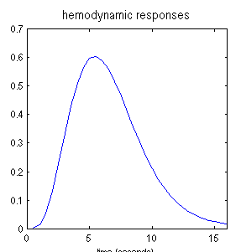
DCM Overview
Neural Model
Haemodynamic Model
4
2
3
x
=
1
e.g. region 2
Notes:
We combine the neural model (left) with the haemodynamic model (right) to give…

Slide 14
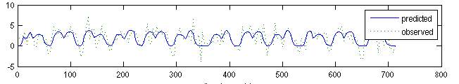
DCM Overview
=
Region 2 Timeseries
Notes:
A prediction for each region’s activity, shown here overlaid on the real signal’s timeseries from the fMRI scan. So that’s how we do DCM and later on Alex is going to show us how to do this in SPM

Slide 15
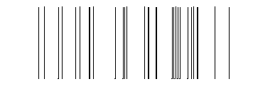
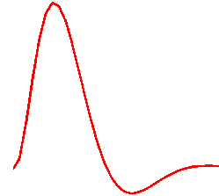
u
inputs
The hemodynamic model
t
6 hemodynamic parameters:
neural state equation
important for model fitting, but of no interest for statistical inference
hemodynamic state equations
Balloon model
Empirically determined
a priori distributions.
Area-specific estimates
(like neural parameters)
→ region-specific HRFs!
[Friston et al. 2003, NeuroImage]
[Stephan et al. 2007, NeuroImage]
BOLD signal change equation
Notes:
The hemodynamic model for DCM is much more sophisticated than the HRF in a standard SPM analysis. In all there are 6 hemodynamic parameters, which we are not interested in, but they are important for the model fit. The values of these parameters are determined based on what we know about the biology of the BOLD. Briefly, activity somehow leads to a vasodilatory signal, which induces increased blood flow. This results in local changes in blood volume and deoxyhemoglobin, from which we can predict the BOLD signal. The parameters are computed separately for each area that is modelled, just like the neural parameters, and thus constitute region-specific HRFs!

Slide 16
DCM: Methods and Practice
Experimental Design and Motivation
  Simulated data
How to conduct DCM in SPM
  A practical example and guide
  Basic steps
  Interpreting results
Bayesian Model Selection
Parameter estimates and group level statistics
Notes:
Hi all I’m Alex
I’ll talk about how the theory patricia discussed translates into the method and practicalities of DCM.
First, I’ll discuss the motivation of DCM and the nature of experimental design in DCM.
Second, I’ll briefly show you how to conduct DCM in SPM with a simple example. I’ll go through the basic steps and how to intepret some of the results.
Lastly, I’ll use the example as a platform to discuss more theoretical conecpts such as Bayesian Model Selection, parameter estimation, and group level statisitics.

Slide 17
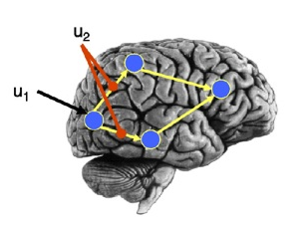
Experimental Design and Motivation
  Can apply DCM to any design used in a GLM analysis
  If the GLM does not detect activation in a given region, there is no motivation to include this region in a (deterministic) DCM
  Deterministic DCM tests
  generative models of
  how the GLM data arose
Notes:
You can apply DCM to any design that is also suitable for the GLM analysis.
Whether using the GLM or DCM, we are simply trying to find an explanation for local BOLD responses. In the GLM, we seek an explanation for activation voxel by voxel
as a linear combination of our predictor variables or experimental inputs. In DCM, these inputs don’t act on all voxels – rather we model them as acting directly on specified regions or as modifying the rate by which one regions acts on another via the neural state equation and heamodynamic model.
DCM is simply a different generative model of how the measured time-series arose, modelled at the neuronal level.
In fact, DCM is specifically motivated by the GLM results. That is, the purpose of deterministic DCM is really to test generative models of how the GLM data arose.
As such, there’s no motivation to include a region in the A matrix, if you haven’t found activation in this region in the GLM. The region would simply lack an explanandum. The exception to this, is stochastic DCM which includes a stochastic component that allows one to account for random neural fluctations or for variance that is not specifically modelled.
So, in summary, the regions you include are guided and really, restricted to your GLM results.
why model the lack of an effect. THE GLM
The reason for this, is because DCM is motivated by GLM results. The purpose of DCM is to test generative models of how the GLM data arose. It seeks to explain the GLM results by modellling experimental perturbation as inputs that act directlyon on regions implicated in the GLM results or act by modulating the connection between these regions.
The GLM and DCM are simply different generative model that
What you can model with the GLM you should in principle be able to model with the DCM if you have a good model. DCM tries to do the same thing as the GLM. That is, it tries to find an explanation for local BOLD responses – the difference being that we don’t try to explain this voxel by voxel but for a selected set of regions. In the GLM, we try to explain any activation in these voxels as a linear combination of our predictor variable or inputs. In DCM these inputs do not act on all voxels – they enter some noeds which have specified connections
DCM is simply a different generative model of how the data arose.
The purpose of DCM is to test multiple models of how the effect shown in the GLM arose. The exception is stochastic DCM, which can be applied to time-series in which you have been unable to find a relationship to experimental manipulations.
Sampe optimization
DCM is dependent on experimental perturbations
Experimental conditions enter the model as inputs that either drive the local responses or change connection strengths.
Use the same optimization strategies for design and data acquisition that apply to conventional GLM of brain activity:
preferably multi-factorial (e.g. 2 x 2)
one factor that varies the driving (sensory) input (eg static/ moving)
one factor that varies the contextual input (eg attention / no attention)

Slide 18
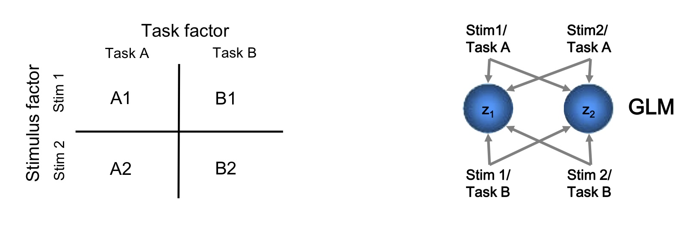
Multifactorial Design
2x2 Design:
One factor that varies the driving (sensory) input (e.g. static or motion)
One factor that varies the contextual or task input (e.g. attention vs. no attention)
Stephan, K. DCM for fMRI (powerpoint presentation). SPM Course, May 13, 2011
Notes:
As is the case in most GLM studies, a multifactorial design is preferable. The multifactorial design allows one to ask clear questions about the effect of different stimulus and contextual inputs and their interaction, which DCM mightoffer a very straightforward explanation.
For example, in this two by two factorial design design, you can imagine that you have two stimulus levels – say motion and static that are crossed with two tasks, say attention and no attention.
In the GLM, we model each voxel as a linear combination of all four regressors, which you can see to the right.

Slide 19
Modeling interactions
The GLM analysis shows a main effect of stimulus in region Z1 and a stimulus x task interaction in Z2
How might we model this using DCM?
Notes:
So say the GLM shows a main effect of stimulus in z1 and a stimulus x task interaction in z2.
How might we explain this effect using DCM? Well we can model the stimuli as inputs to z1 and the tasks as modulators of the connection between z1 and z2. So the degree to which the activity in region 1driven by either stimulus causes activity in region 2 depends on which task is performed.

Slide 20
Simulated data
Task A
Task B
Stephan, K. DCM for fMRI (powerpoint presentation). SPM Course, May 13, 2011
Notes:
So you can see how this model might explain the GLM results using some simulated data. There is a differential sensitivity to stimuls 1 over stimulus 2 in region z1, i.e. the main effect of stimulus in region 1. That differential sensitivity is conveyed to region 2, but the degree to which conveyed depends on the task, with task A providing a stronger facilitation of that interaction. That is, task A positively modulates or gates the connection from region 1 to region 2.

Slide 21
DCM Practical Steps:
Seek an explanation for the GLM results
Specify inputs in design matrix
Extract time series from regions of interest
Specify model architecture (hypothesis driven)
Estimate the model
Repeat steps 2 and 3 for all models in model space
Compare models using Bayesian Model Selection (single subject and group level)
Notes:
So now I’ll go through a practical example. I”ve summarized seven basic steps for DCM in SPM. As I said, the GLM motivates an explanation or hypohtesis, which DCM will model.
Based on these hypohtesies, we need to specify the inputs of our models in the design matrix. Following which, we will extract the times series from our regions of interest. Next we can specify the model architecture based on our hypotheses – the modle architecture is the location of intrinsic connections, driving and modualtory inputs. Once altenrative models are specified (with the same regions in each) we can estimate or invert each model. Lastly and perhaps most importantly we can compare relative models in the model space using Bayesian Model selection.
Once you have found the optimal model, you can review specific parameters of the model such as connection strengths.
In SPM, there are 6 basic steps you can follow. The first we have already done – based on our hypotheses, we have specified our inputs, photic, motion, and attention in the design matrix. Then we can extract time series from a defined set of regions of interest. Then we will specify and estimate all models in our model space. We can then compare our models using Bayesian Model Selection.

Slide 22
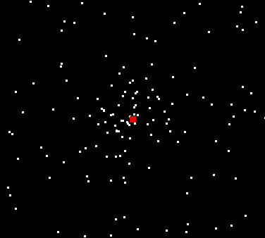
Attention to motion in the visual system
Stimuli 250 radially moving dots
4 Conditions
- fixation only
-observe static dots
-observe moving dots
-task (attention to) moving dots
Parameters:
- blocks of 10 scans
360 scans total
TR= 3.2 seconds
Sensory input
Contextual factor
static
motion
No attent
No motion/ attention
Motion / no attention
Attent.
Motion / attention
SPM Manual (2011)
Notes:
With these steps in mind, I’ll go through an example in the spm manual that illustrates more thoroughly how one can test different generative models of GLM results, especially interactions.
So this experiment involved attention to motion. It was a factorial design with two different stimulus conditions – static and radial motion corssed with two task condition – attention and no attention. It was a block design with a TR=3.2 sec other typical scanning parameters.
Just a quick note about TR in DCM – the smallest possible TR is opitmial in order to have the greatest temporal resolution.,
Typically want TR as small as possible to get greatest temporal resolution.

Slide 23
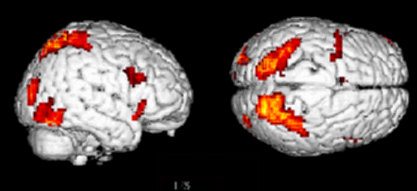
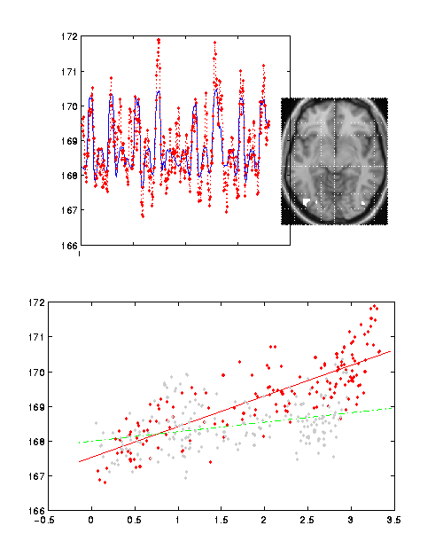
GLM Results
Attention – No attention
PPC
-fixation only – baseline
-observe static dots → V1
-observe moving dots → V5
-attention to moving dots
→ V5 + SPC
V5
GLM analysis showed that motion activated V5, but that attention enhanced this activity.
attention
V5 activity
no attention
V1 activity
Büchel & Friston 1997, Cereb. Cortex
Büchel et al. 1998, Brain
Notes:
In the GLM analysis, static dots elicited activity in V1, passive observation of moving dots showed activity in V5 and attention to moving dots showed activity in V5 and SPC, but the activity in V5 was enhanced during attention relative to passive viewing. So again, there is an interaction between stimulus and task in one region, in this case, V5. Also, you can see that activity in V1 and V5 shows a steeper correlation during attention than in no attention, suggesting that there is possibly a stronger interaction between these two regions during attention.
SO how can we interpret these results mechanistically using DCM?
The question motivates several possible models. Is the effect of attention bottom up or top down, etc? We have to think about how we might model driving and modulatory inputs, the regions we want to explore, and the architecture of connectivity between regions.
these can be based on previoius anatomical work or tms studies,.
the increase in activity of area V5 by attention when motion is physically unchanged?

Slide 24
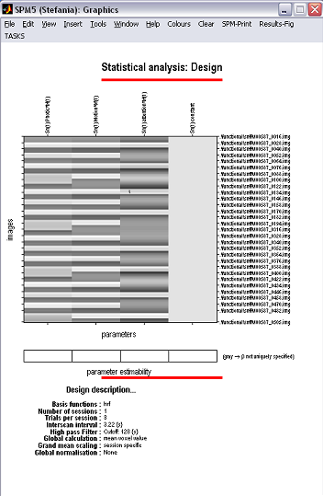
Modeling inputs in DCM analysis
Specify regressors for DCM as driving inputs and modulators:
Driving input
Photic: all visual input – static+ motion+ attention to motion
Modulatory input
Motion
Attention
Photic
Motion
Attention
Notes:
So thinking about the conditions and our GLM results, we can model the driving input as all all the condition combined since they all provide visual input and we can model the two task conditions, motion and attention to motion as modulatory inputs. These inputs are implemented as regressors in the design matrix.
It is also helpful to concatenate sessions so you have one continuous time series.
all the conditions as visual driving input and the two task conditions as contextual modulators, motion and attention to motion. These inputs are modelled as regressors in the design matrix.
Helpful to concatenate sessions so you have one continuous time series.

Slide 25
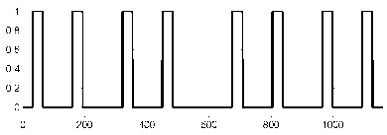

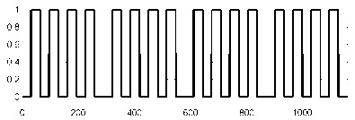
Alternate Dynamic Causal Models
Model 1 (backward):
Model 2 (forward):
Time [s]
Defining models: Hypothesis driven // Compatibility // Size // Plausibility.
[Seghier (powerpoint pres.) ICN SPM Course, 2011; Seghier et al. 2010, Front Syst Neurosci]
Notes:
The results motivate two hypothesis driven models. In the first, attention could modulate the backward connection from SPC to V5 and in the second or forward model attention could modulate the connection between V1 to V5.
One should to define sets of models that are 1. hypothesis driven 2. compatable with GLM results and are restricted to the same regions 3. acknowledge complexity 4. be plausible, and alternative models should vary in a systematic way, given prior knowledge about the system (e.g. anatomical, electrophysiological or TMS studies).
These models are hypothesis driven, suggesting either bottom up or top down modulation of attention.
They are informed by the GLM results and are consistent anatomical connectivity in monkey tractography. They are two very simple but plausible models.
The
Note, however, that DCM allows one to make inferences about changes in effective connection between areas, which do not necessarily correspond to direct anatomical connections but may be via intermediary regions.
Model space should be defined as transparent and systematic manner as possible.
→ Bad models may affect your BMS results (DCM space = a “relative” space)!
Hypothesis driven models: bottom up and top down modulation
Alternat
Two models in our model space.
DCM is hypothesis driven, not exploratory.

Slide 26
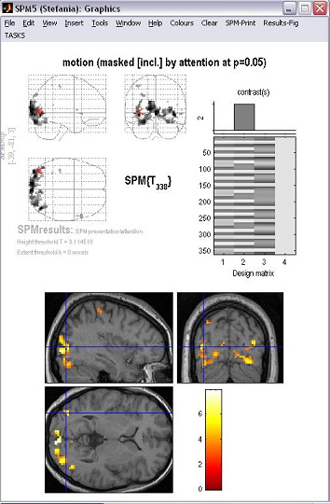
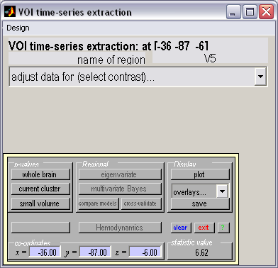
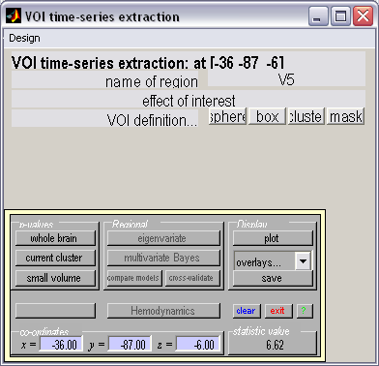
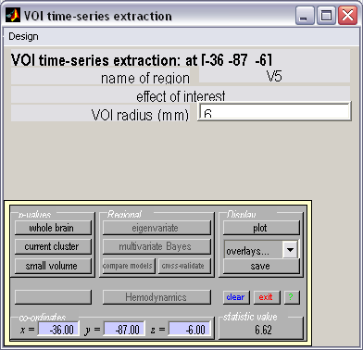
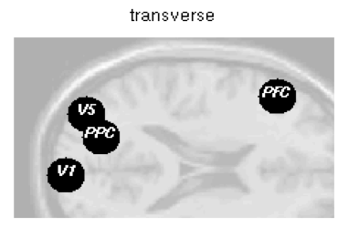
Defining VOIs: time series extraction
V5 VOI
Transverse
Notes:
In our two models we have defined three regions of interest – V1, V5 and parietal cortex.
We can extract the time series from each region in each subject. In group studies, one wants to ensure that the same regional features are selected from subject to subject. The best way to do this is to operationally define the region in each subject by functional or anatomical criteria. In this case, we’ll use a motion masked by attention contrast for the V5 VOI. You can type in some pre-selected coordinates at the bottom of the GUI or pick a local maximum within the functionally defined region to specify the center of your VOI. You then use the principal egenviariate centered on this coordinate to extract the time series. You can adjust for the effects of interest (which will mean center the time series and remove any variance associated with condition not included in effects of interest contrast. You can then specify how you want to define the space of your VOI – sphere, box, mask, ect and then the size of that space.
For the VOI you define, SPM will run a principal component analysis and compute the first eigenvariate which summarizes the time series from all the voxels included in the VOI.
It will aslo tell you how much of the variance from the VOI voxels can be explained.
Not cirucular because DCM is not testing whether any of these regions show an experimental effect. Instead DCM is comparing hypotheses about these effects.
Extract time-series within region of interest using eigenvariate button
What does eigenvariate explain ? EIGENVARIATE!!!! Principal component analysis and will extract the sum BOLD activity for all those voxels within
n.b anatomical & functional standardisation important for group analyses
How do you chose were to extract the time series.

Slide 27
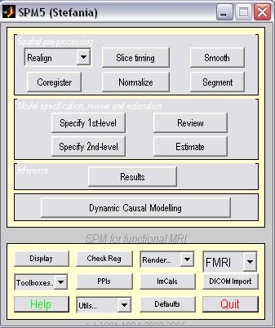
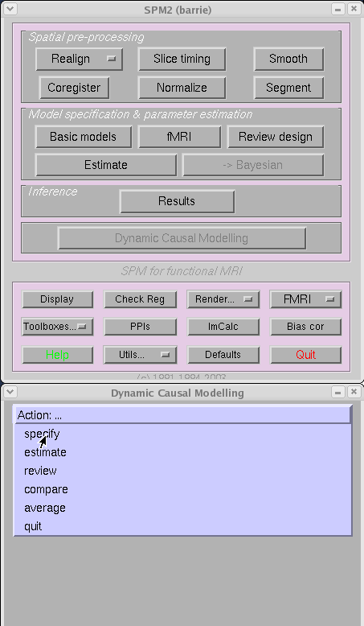
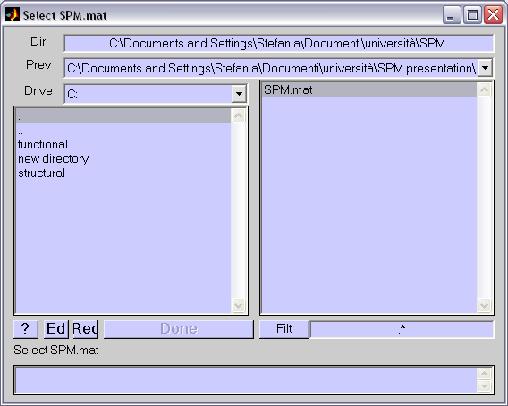
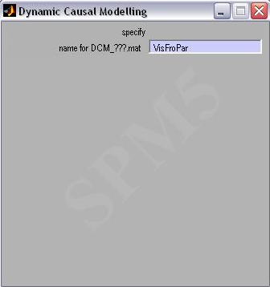
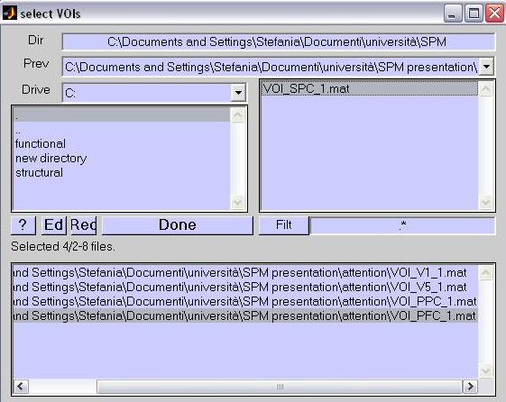
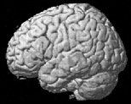
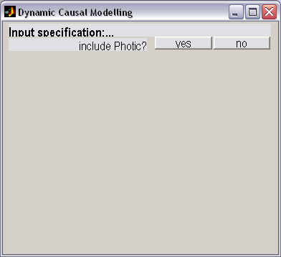


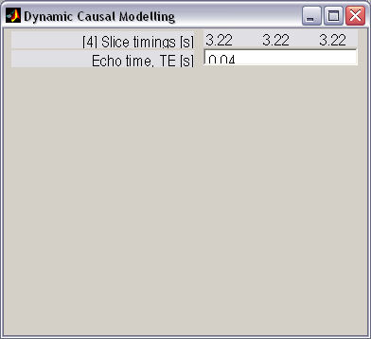
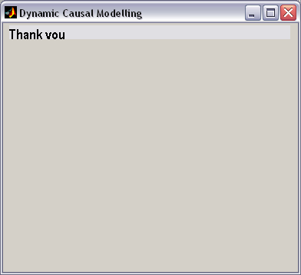
Specifying the model
Timing problems at long TRs
Two potential timing problems in DCM:
  wrong timing of inputs
  temporal shift between regional time series because of multi-slice acquisition
name
DCM button
2
slice acquisition
1
visual
input
In order!
DCM is robust against timing errors up to approx. ± 1 s
  compensatory changes of σ and θ^{h}
Possible corrections:
  slice-timing (not for long TRs)
  restriction of the model to neighbouring regions
  in both cases: adjust temporal reference bin in SPM defaults (defaults.stats.fmri.t0)
  Short TRs are better
In Order!!
In Order!!
Notes:
Slice timing
Two potential timing problems in DCM:
wrong timing of inputs
temporal shift between regional time series because of multi-slice acquisition
DCM is robust against timing errors up to approx. ± 2 s
Regions will be scanned at different times so you can adjust your DCM for this and specify what time each region is scanned, but DCM simulation show that DCM is robust against timing errors up to about plus or minus 2 seconds. You can difeine a middle term V1 defined at 3.20 V5 at 3.21 and SPC at 3.22

Slide 28
Attention
to motion
Motion &
no attention
static
dots
Estimate the model
V1
V5
PPC
observed
fitted
Notes:
We can now estimate and invert the specified model. SPM will show output like this while the inverstion takes place. On the top you can see the predicted and observed times series for the three regions. using variational Bayes, DCM will optimally match the predicted times series to the observed times. Remember The predicted time series is generated by the integrating the differntial equations of the neural state equation and the hemodynamic forward model. During inversion, you can watch the program go through each iteration, maximizing the negative free energy and minimizing the discrepancy between the observed and predicted time series. DCM will optimize the model until it reaches a threshold in which the difference between on iterative stop and the next is miniscule.
On the bottom, you can see the posterior probabilities of the pameters which are run through the same optimization scheme. Usually, the neuronal model parmaters will be on the left hand side, then the hemodynamic parameters (6 or so for each reach).
Fitt it for every variatianal EM step, maximizing the negative free energy (approximation to the model evidence). Trying to optimize this model – fmaximize

Slide 29
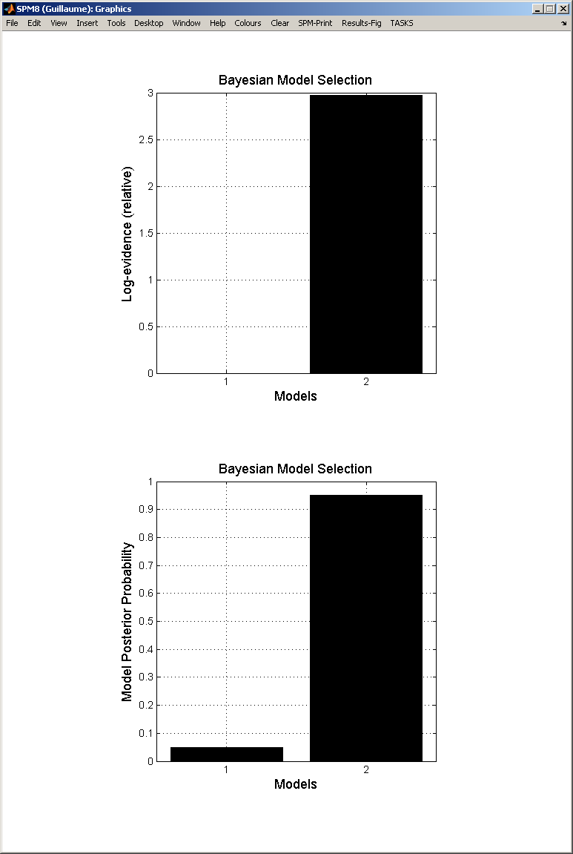
Bayesian Model Comparison
Model evidence:
The log model evidence can be represented as:
Bayes factor:
B₁₂ | p(m₁|y) | Evidence
1 to 3 | 50-75% | weak
3 to 20 | 75-95% | positive
20 to 150 | 95-99% | strong
≥ 150 | ≥ 99% | Very strong
Penny et al. 2004, NeuroImage
Notes:
Once you have estimated the models in you model space, you can perform Bayesian Model Selection, to infer the optimal model relative to other models in your model space. The optimal model is the best fitting yet most parsimonious and generalizable model.
This is done by computing the model evidence of each model, that is, the probability of the data, signified by gamma given the model(m). This is equivalent to the probability of generating the data from parameters sigma that are randomly sampled from the prior p(m). Because the intergral is not analytically solvable, appromations are necessary such as negative variational free energy or the log evidence. The log evidence nicely represents the key features of Bayesian model selection – the most optimal model is a compromise between accuracy and complexity – providing a measure of generalizablity.
The Bayes factor, which is simply the ratio of one model evidence to the other o and is an intuitive comparison between two models. The diffence in log evidence between two models is an equivalent comparison On the right we can see that the difference in log evidence is about 3 between these two models with model 2, the forward model, being favored. Model 2’s posterior probability is about 95 percent showing strong evidence according to this table from Penny et al., which describes the statistical conventions. So in this case, the Bayes factor is about 3 so we have positive evidenc for model 2 over model 1.
You don’t need to know this but DCM
of generating the data signified by gamma and
the posterior probabilities of the parameters given the data is an optimal combination of prior knowledge and new data, weighted by their relative precision.
Model evidence: probability of generating data y from parameters θ that are randomly sampled from the prior p(m).
The “posterior” probability of the parameters given the data is an optimal combination of prior knowledge and new data, weighted by their relative precision.
Some things that restrict you. You can test for families of models,
Bayesian Model Selection
Look at parameter estimates after model comparison

Slide 30
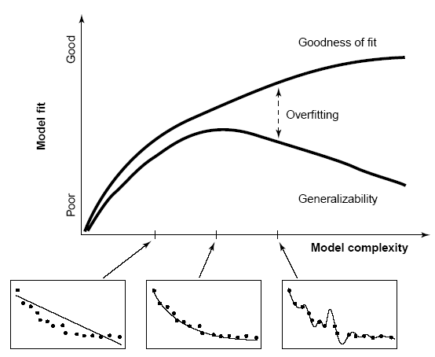
Model evidence and selection
All models are wrong, but some are useful -Box and Draper
[Pitt and Miyung 2002 TICS]
Notes:
Although we already gone over this during the Bayesian talk, I just wanted to remind you that BMS selects the most optimal model based on a compromise between model fit and model coplexity, selecting the most generalizable model. In this case, the middle one is optimal because it is generalizable, while the first is parsimonious but is not genralizable and the third is the most accurate, but it is not generalizable.
Remember that all models are wrong, but some are useful. It’s important to bear in mind for DCM. That is, even if you have individual models that fit poorly, BMS model selection can still be informative by selecting the best out of the options.
You can also compare families of models, partioning the model space into models grouped by collective features and now recently you can compare a large amount of models using a Savage dickey density rationand computationally efficient way to compare models following the inversion of a master model.
Lastly, you can only perform a comparison between models with the same data – that is models that include the same regions.
– the purpose of DCM is simply to select the best model out af a set of given hypotheses about the functional architecture of the system
You can also make
Ask the question using the same Bayesian procedure about the posterior p(y/m)…
Noothing to say about true model – all models are false, but some are useful.

Slide 31
Review Winning Model and Parameters
Model 2:
attentional modulation
of SPC→V5
Parameter estimation
Photic
γ
PPC
0.86 (100%)
η_{θ|y}
1.25 (99%)
γ
-0.15
(100%)
0.89
(99%)
V1
.50
(100%)
0.75 (98%)
V5
Motion
1.50 (90%)
Attention
Maximum a posteriori estimate of a parameter (MAP)
Model 2:
attentional modulation
of V1→V5
Photic
0.85
PPC
0.70
1.36
0.84
V1
0.57
-0.02
V5
Motion
0.23
Attention
Notes:
So typically, after selecting the best model, you can examine the parameter estimates, i.e, the connection strengths.
Again using variational Bayes and biophysical priors, the parameters of the model are estimated such that they optimally match the measured BOLD time series. This Bayesian approach approximates posterior distributions of the parameter estimates, which are characterized by a mean, i.e., the maximum a posteriori (MAP) estimate, and a covariance (Stephan and Friston 2010). Assuming the posterior distribution to be Gaussian, one can calculate the probability that an estimate is significantly different from a chosen value by calculating the area under the curve beyond that chosen threshold, in this case zero.
You can see these estimates of connection strength here as well as their posterior probability. The connection strengths are expressed in Hertz. They can be coneptualized as rate constants, epxressing the rate of change in one region relative to another. A connection strength of .50 from V1 to V5 demonstrates that every unit increase in activity in V1 per second, causes a corresponding 50% increase in activity in V5. Since the parameter estimate during attention is 1.5, you can conceptualize attention as increasing the connection strength between V1 and V5 by nearly 200%.
The estimates are thought to reflect fast synaptic changes in membrane excitability or synaptic placiticity.
Using the cumulative normal distribution, one can test whether an estimate is significantly different from a given threshold
which is typically zero or the expected half-life of a modulatory parameter
Bayesian parameter estimation in DCM: Gaussian assumptions about the posterior distributions of the parameters
Use of the cumulative normal distribution to test the probability by which a certain parameter (or contrast of parameters c^{T} η_{θ|y}) is above a chosen threshold γ:
γ can be chosen as zero ("does the effect exist?") or as a function of the expected half life τ of the neural process: γ = ln 2 / τ

Slide 32
Inference about DCM parameters: Group level
FFX group analysis
Likelihood distributions from different subjects are independent
Subject assumed to use identical systems
One can use the posterior from one subject as the prior for the next
RFX group analysis
Optimal models vary across subjects
Separate fitting of identical models for each subject
Selection of (bilinear) parameters of interest
ANOVA, rmANOVA, etc
one-sample t-test:
parameter > 0 ?
paired t-test:
parameter 1 >
parameter 2 ?
Stephan et al. 2010, NeuroImage
Stephan, K. DCM for fMRI (powerpoint). SPM Course, May 13, 2011
Notes:
One can also examine these parameter estimates at the group level, just as one can examine contrast images at the 2nd level in the GLM. As in the GLM you have tow choices – Fixed effects and Random effects
In fixed effects one assumes that the optimal model is the same for each subject in the population. In Fixed effects you can used Bayesian parameter averaging – that is, you can use the posterior from one subject as the prior for the next and this comunicative – the order doesn’t matter. In Bayesian model comparison with fixed effects – one simply can calculate a group Bayes factor wcich is simply product of the Bayes factors of each subject or one can equivalently look at the sum of the log evidences for each subject.
In a random effects analysis, you assume that optimal models vary across subjects – this will usually be the case for complex tasks where different strategies are adopted. Here you take parameters of interest and harvest them for each subject and plug them into a 2nd level test such as a t-test or ANOVA (multiple sessions per subject).
Fixed effects – can’t make inferences about the population – only takes into account wihtin subject variablity. Random effects takes into account both within and between subject variability.
Same choice as in GLM analysis for fixed effects or random effects.
In Random Effects, you can adopt a frequentestist perpsective. Similar to Take contrasts up to 2nd level.
But remember that these parameter estimates depend on the model you have chose.
One can also plug these parameters into a group level analysis. If you assume
Good for simple low-level models
Variational EM under Laplace approximation
Posterior distribution for each parameter with a Guassusiam assumption.

Slide 33
definition of model space
inference on model structure or inference on model parameters?
inference on
individual models or model space partition?
inference on
parameters of an optimal model or parameters of all models?
optimal model structure assumed to be identical across subjects?
comparison of model families using
FFX or RFX BMS
optimal model structure assumed to be identical across subjects?
BMA
yes
no
yes
no
FFX BMS
RFX BMS
RFX analysis of parameter estimates
(e.g. t-test, ANOVA)
FFX BMS
RFX BMS
FFX analysis of parameter estimates
(e.g. BPA)
Stephan et al. 2010, NeuroImage
Notes:
Here is a nice flowchart about the level of inference in DCM, show a kind of heiarchy of infererence.
showing that one typically decides whether you need inference on model space or just the model paramters. When you have competing models, one typically selects and optimal model first and then reviews that model’s parameters using fixed effects or random effects at each level.
Notice that parameter estimation come at the end of the and model selection has a primary role

Slide 34
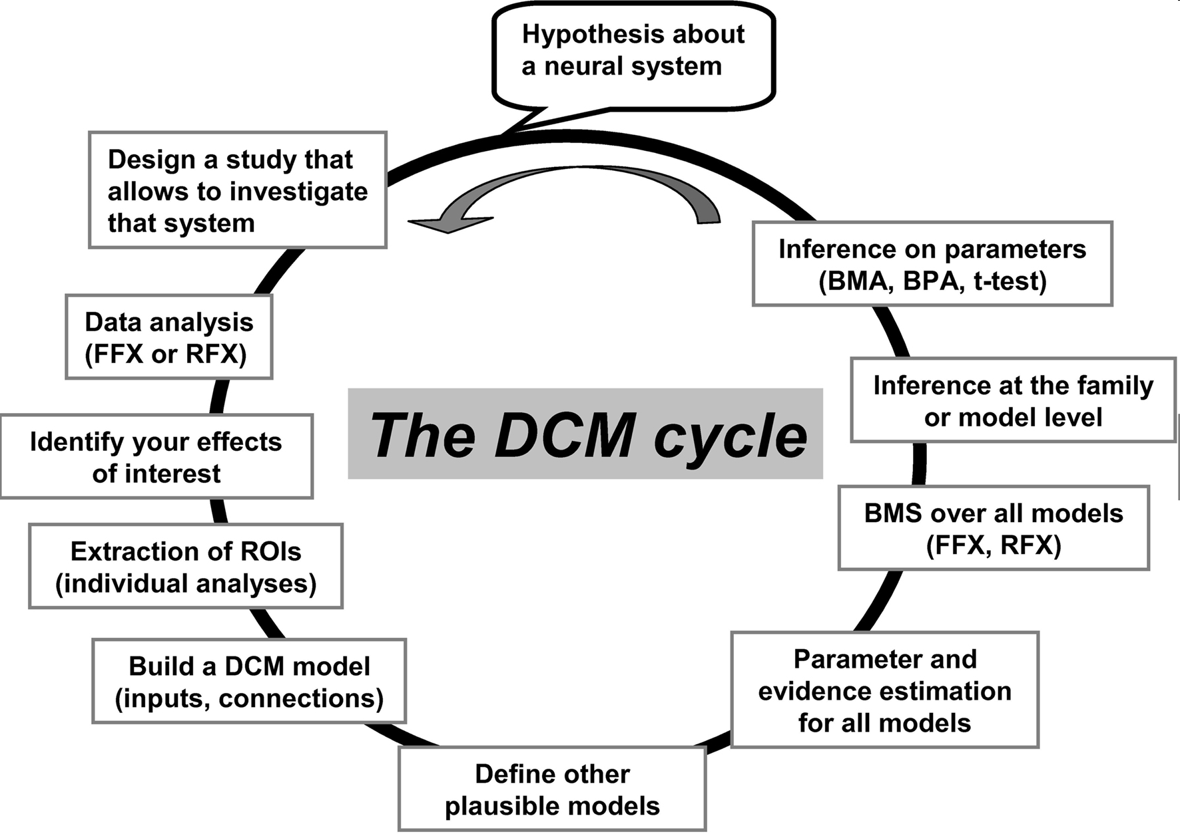
[Seghier et al. 2010, Front Syst Neurosci];
Seghier (powerpoint pres.) ICN SPM Course, 2011
Notes:
Reiterates the 7 basic step I talked about earlier.

Slide 35
DCM Summary
Allows one to test mechanistic hypotheses about observed effects
Generates a predicted time series using set of differential equations to model neuro-dynamics and a forward hemodynamic model
Operates at the neuronal level
Uses a Bayesian framework to estimate model parameters by optimally fitting the model’s predicted time-series to the observed time series
A generic approach to modelling experimentally perturbed dynamic systems.
Notes:
DCM provides a model of how

Slide 36
Thank you to our expert,
Mohamed Seghier!

Slide 37
References
The first DCM paper: Dynamic Causal Modelling (2003). Friston et al. NeuroImage 19:1273-1302.
Physiological validation of DCM for fMRI: Identifying neural drivers with functional MRI: an electrophysiological validation (2008). David et al. PLoS Biol. 6 2683–2697
Hemodynamic model: Comparing hemodynamic models with DCM (2007). Stephan et al. NeuroImage 38:387-401
Nonlinear DCMs:Nonlinear Dynamic Causal Models for FMRI (2008). Stephan et al. NeuroImage 42:649-662
Two-state model: Dynamic causal modelling for fMRI: A two-state model (2008). Marreiros et al. NeuroImage 39:269-278
Group Bayesian model comparison: Bayesian model selection for group studies (2009). Stephan et al. NeuroImage 46:1004-10174
10 Simple Rules for DCM (2010). Stephan et al. NeuroImage 52.
Seghier et al. (2010). Identifying abnormal connectivity in patients using dynamic causal modeling of fMRI responses . Front Syst Neurosc.
Dynamic Causal Modelling: a critical review of the biophysical and statistical foundations. Daunizeau et al. Neuroimage (2010), in press
SPM Manual, SMP courses slides, last years presentations.

