Slide 1

Diffusion Tensor Imaging
Notes:
1

Slide 2
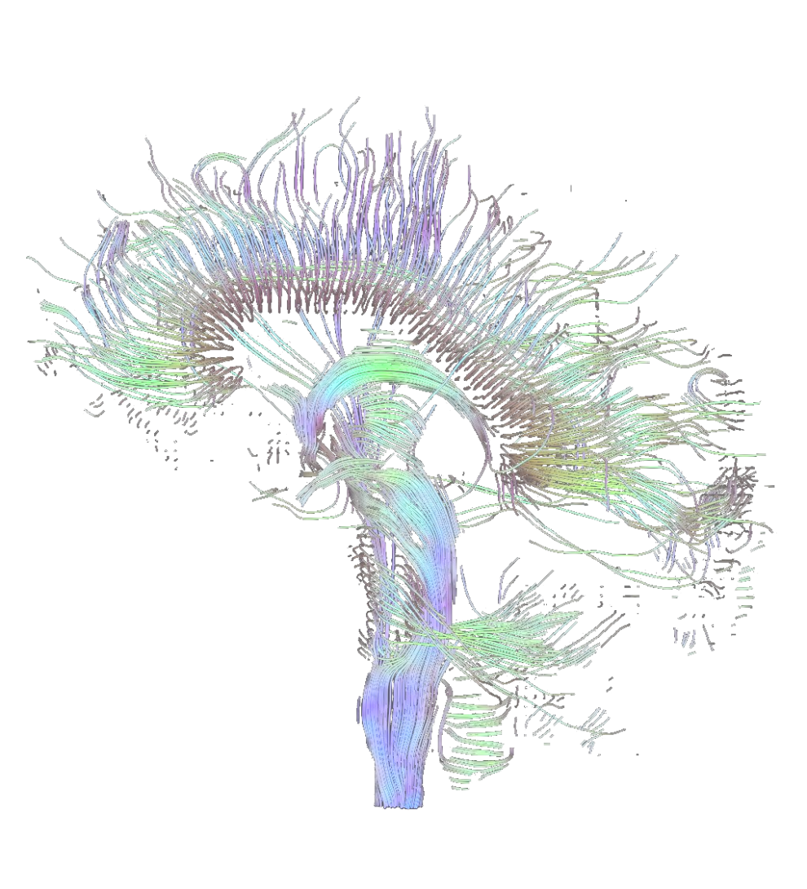
Overview
Theory
Basic physics
Tensor
Diffusion imaging
Practice
How do you do DTI?
Tractography
DTI in FSL and other programs

Slide 3
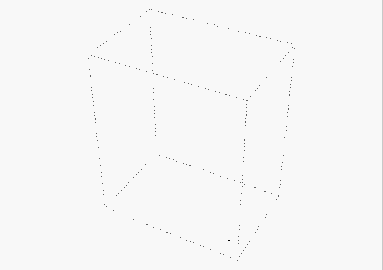
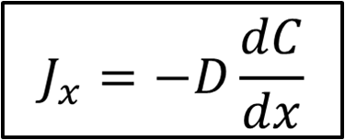
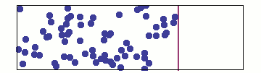

Diffusion Tensor Imaging
Brownian motion
Random drifting of particles in a spatially homogeneous medium
Fick’s Law
J = particle flux density
C = particle concentration
D = diffusion constant
X = position
Notes:
Random drifting of particles in an unimpeding medium
Water molecules in a glass of water
d = derivative
3

Slide 4
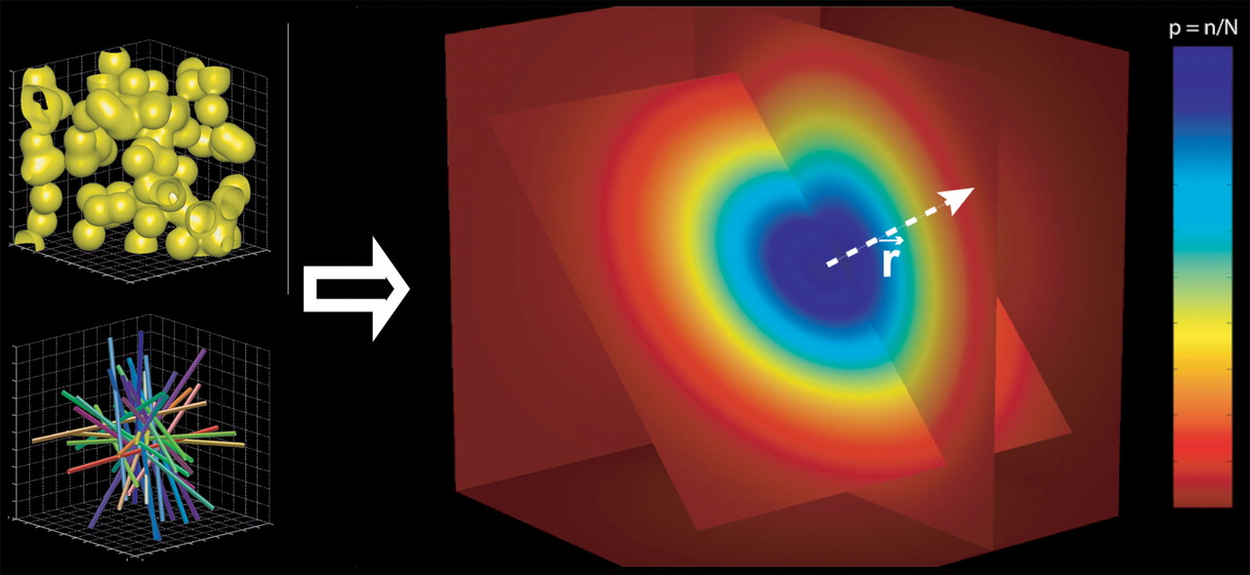
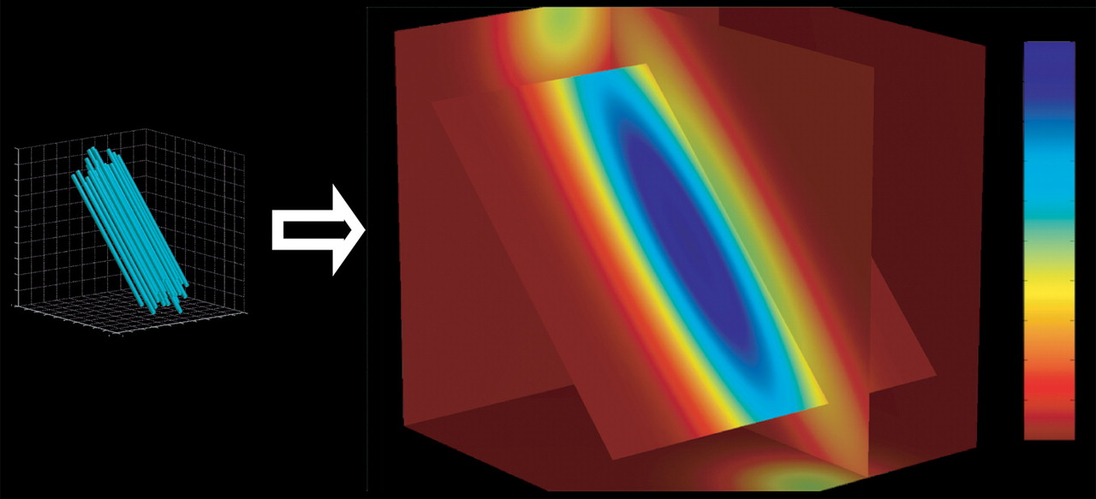
Diffusion Tensor Imaging
Isotropy and anisotropy
In an unrestricted environment, water molecules move randomly
When placed in a constrained environment, they diffuse more easily along the structure
Isotropic voxel
Anisotropic voxel
Hagmann et al., 2006

Slide 5
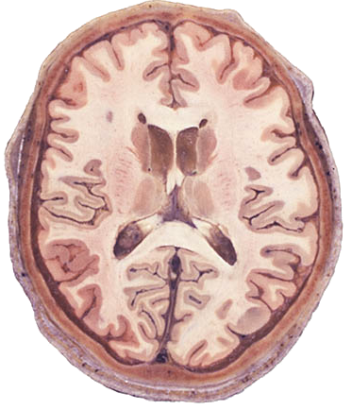
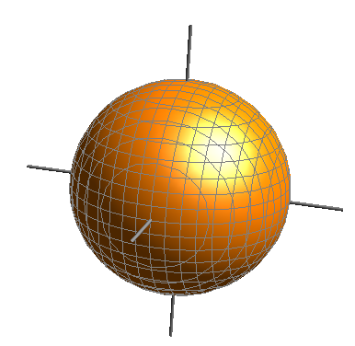
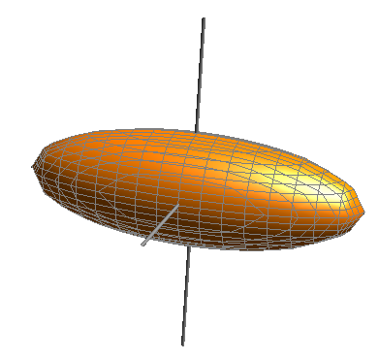
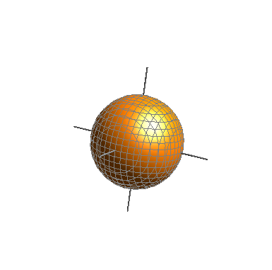
Diffusion Tensor Imaging
CSF
Isotropic
High diffusivity
White matter
Anisotropic
High diffusivity
Grey matter
Isotropic
Low diffusivity

Slide 6
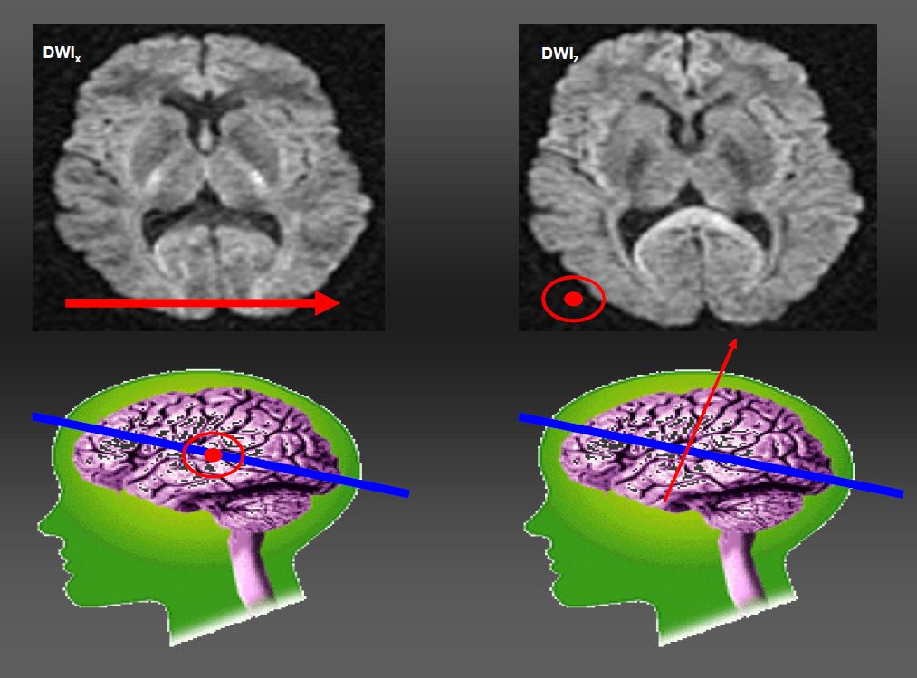
Diffusion Tensor Imaging
Apply diffusion gradients
S. Mohammadi’s ANI slides
Notes:
Gradient along x – sensitive to diffusion along x
6

Slide 7
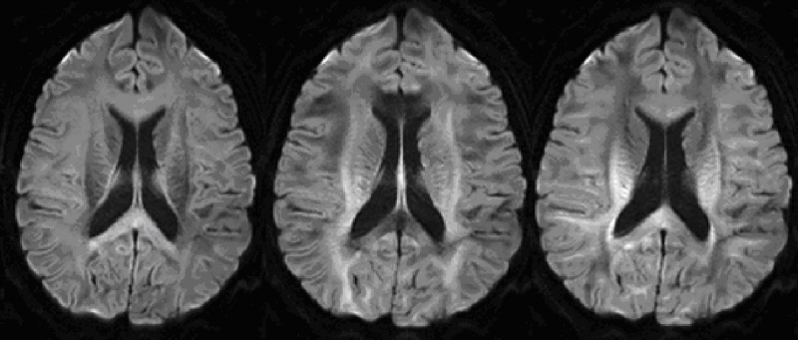
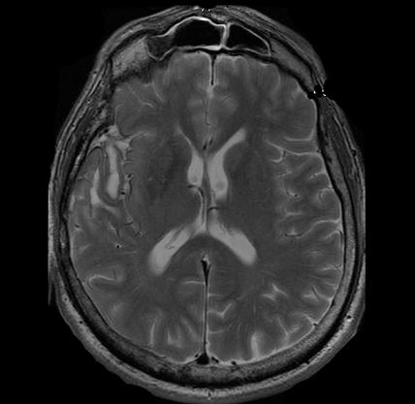
Diffusion Tensor Imaging
Image acquisition
You will need:
at least 6 diffusion weighted images (DWI) at a given b-value
‘b₀’ image (a T2-weighted image)
DWI z DWI x DWI y
b₀
Notes:
T2-weighted spin-echo EPI sensitised to diffusion
B0
B = strength of gradient
7

Slide 8
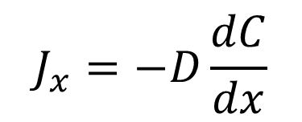
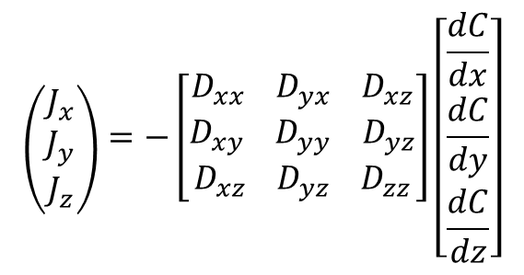
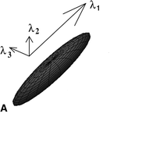
Diffusion Tensor Imaging
How do we describe diffusion?
Diffusion in one dimension
Fick’s Law
(one value)
Diffusion in 3 dimensions
The diffusion tensor
A diffusion coefficient for every direction
Notes:
TENSOR = mathematical description of a set of vectors
1 dimension
3 dimensions
Same as Fick’s law
J, D, C, xyz
Diffusion matrix is symmetrical
Represented as ellipsoid
8

Slide 9
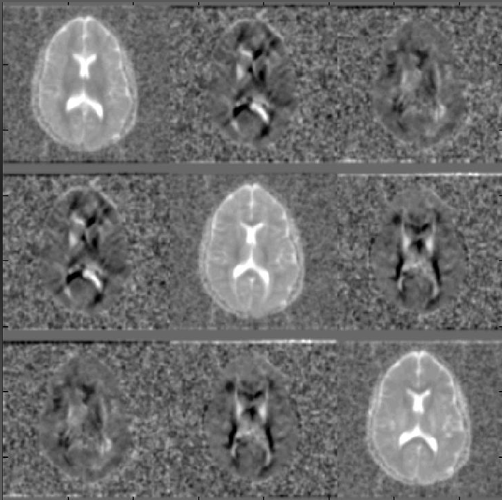
Diffusion Tensor Imaging
Trace
Diagonal terms
Diffusivity along x’, y’, z’
Positive values
Crossterms
Diffusivity along/against crossterm
Positive and negative values

Slide 10
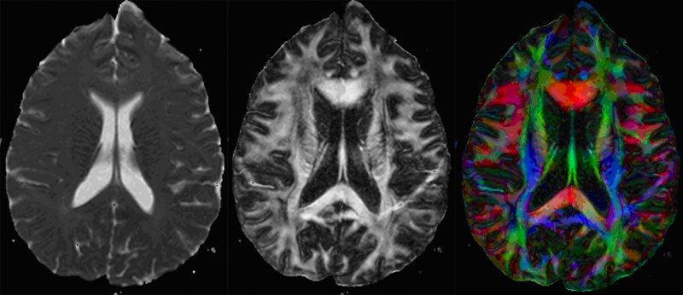
Diffusion Tensor Imaging
Results
Two types of images you can obtain:
Mean diffusivity (MD)
Average of diffusion (D) at every voxel across trace
Independent of direction
Fractional anisotropy (FA)
Degree of diffusion anisotropy at every voxel estimated by tensor
Scalar
Direction independent
Value from 0 (isotropy) to 1 (anisotropy)
Notes:
Mean ADC = Trace = Mean Diffusivity = MD
FA
assess tissue microstructure / structural integrity
10

Slide 11
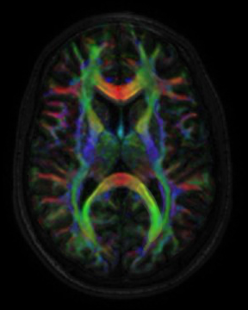
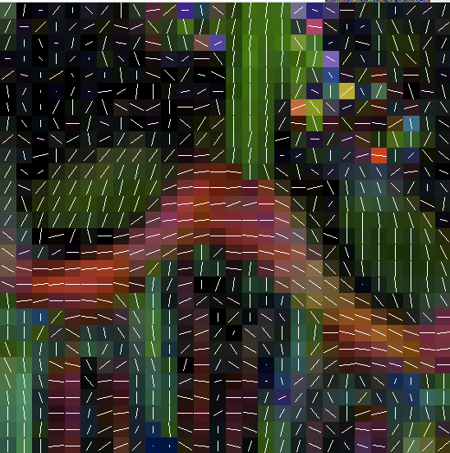
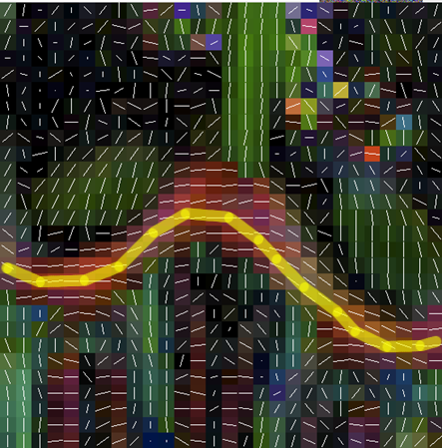
Diffusion Tensor Imaging
Colour FA map
Colour the map based on the principal diffusion direction
Red = left / right
Green = anterior / posterior
Blue = superior / inferior
Vector FA map
Superimpose principal direction vector
Tractography
Following the vectors…
… more on this later
Notes:
Colour FA map
Intensitivy given by FA
Colour given by principal diffusion direction (1st eigenvector)

Slide 12
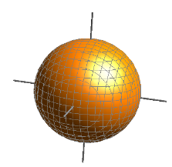


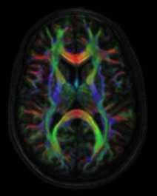
Diffusion Tensor Imaging
Theory summary
Water diffuses isotropically in water, anisotropically in oriented tissue
DTI requires a diffusion-sensitizing gradient and at least 6 acquisitions (+ a B0 image)
Anisotropic diffusion can be described by a mathematical tensor
Diffusion can be summarised as MD or FA maps

Slide 13
Overview
Theory
Basic physics
Tensor
Diffusion imaging
Practice
How do you do DTI?
Tractography
DTI in FSL and other programs

Slide 14
Practice
How do you do DTI?
Preprocessing:
  Realigning
  Coregistration
  Eddy current correction
Analysis:
  Fit the diffusion tensor model to the data
  Calculate maximum diffusion direction, MD & FA
Research Question
  ?
Notes:
14

Slide 15
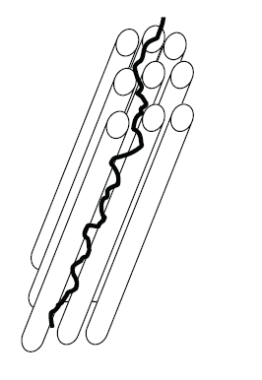
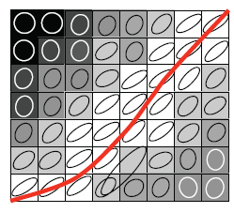
Practice
Tractography
A technique that allows to identify fiber bundle tracts by connecting voxels based on the similiarities in maximal diffusion direction.
Johansen-Berg & Rushworth, 2009
Notes:
The figure illustrates diffusion of a water molecule within a fiber bundle. Diffusion is less restricted along the axis of the fiber bundle than across it.
Tractography is an attempt to connect voxels based on the similarities of their maximal diffusion directions (one of the three measures we get in diffusion images)
Illustration on the right: Simple, streamlining tractography proceeds by tracing a line through the tensor field, following the principal diffusion direction. The schematic shows a grid of voxels; the grayscale reflects FA [ranging from zero (black) to one (white)]. The corresponding tensors are illustrated by the ellipses shown at each voxel.
15

Slide 16
Practice
Tractography
Deterministic:
A point estimate of the principal diffusion direction at each voxel is used to draw a single line.
Probabilistic:
Provides a probability distribution on the diffusion direction at each voxel (the broader the distribution, the higher the uncertainty of connections in that area) which is then used to draw thousands of streamlines to build up a connectivity distribution
  Advantages:
  - Allows to continue tracking in areas of high uncertainty (with very curvy tracts)
  - Provides a quantitative measure of the probability of a pathway being traced between two points

Slide 17
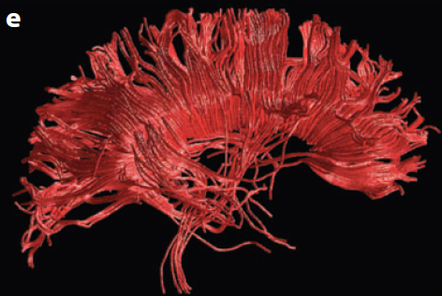
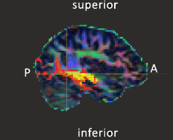
Practice
Tractography
Deterministic Probabilistic
Johansen-Berg & Rushworth, 2009
Notes:
The image on the left is created with a deterministic so-called streamline algorithm. The tracts that are identified look nice and smooth.
Probabilistic tractography on the other hand gives less spatially resolved tracts.
17

Slide 18
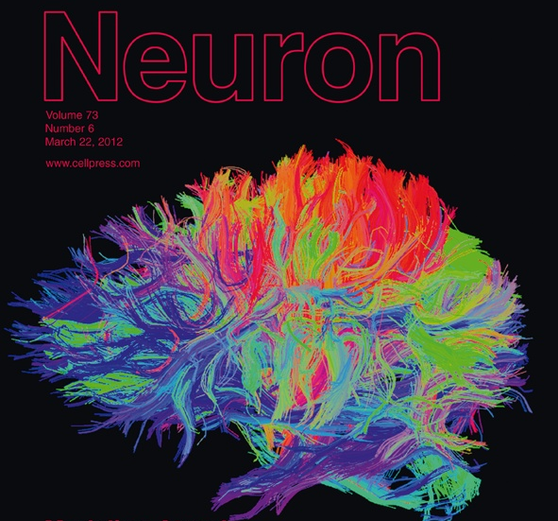
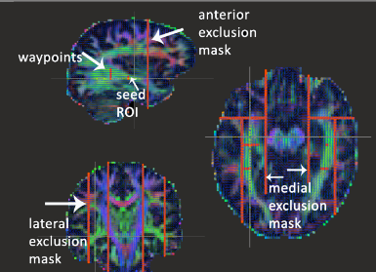
Practice
Tractography
Whole brain versus ROI based approach
(Atlas generation)
Notes:
Maybe only take the left part of the whole brain image?
18

Slide 19
Practice
What do we gain from Diffusion Tensor Imaging?
Applications
Human Connectome; generation of human white matter atlases
Comparing groups (personality traits, diseases, psychological disorders)
Longitudinal studies to investigate age or experience dependent white matter changes
Presurgical planning
etc.
Notes:
Wide range of applications, but do not forget (limitations on next slide)
19

Slide 20
Limitations
Not reflective of individual structures (no measure of individual axons) ➔ rather linked to tracts of structural coherence in the brain
The exact effect of specific structures is not known
No gold standard available

Slide 21
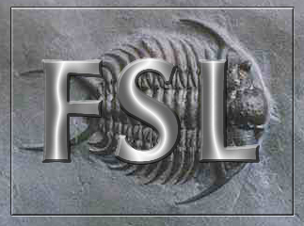
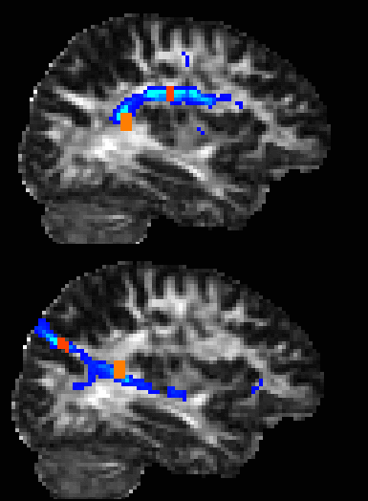
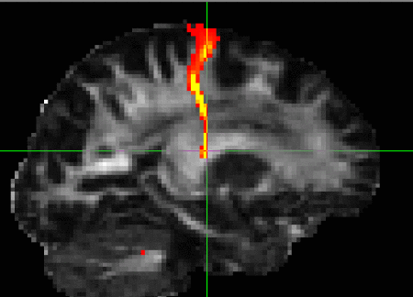
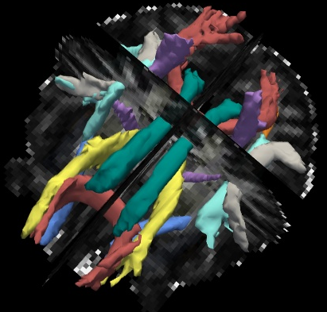
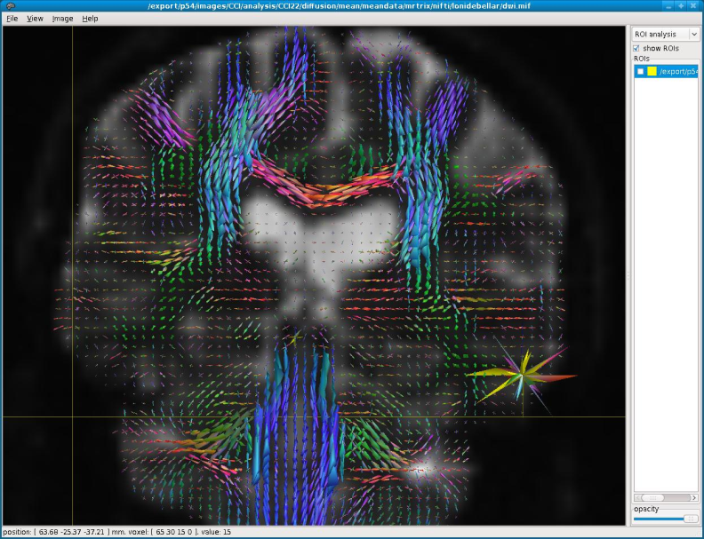
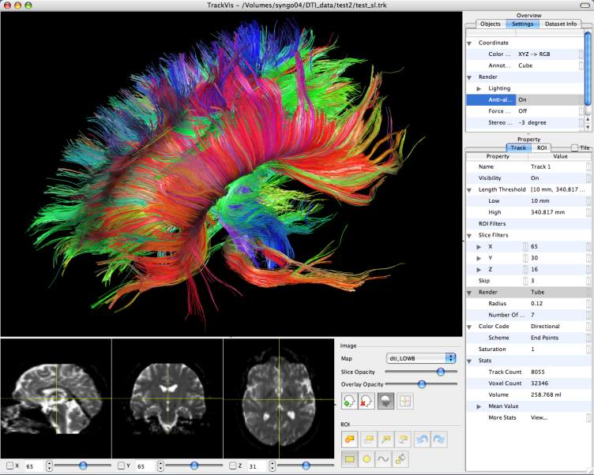
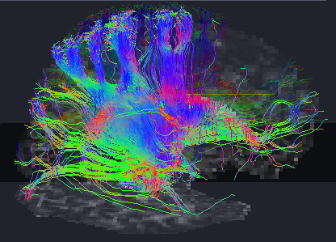
DTI in…
FSL (Oxford)
TrackVis (MGH)
Freesurfer (Harvard)
Mrtrix (BRI, Australia)
Camino (UCL)
… and many more!

Slide 22
Thanks to
Zoltan Nagy (FIL)
Chris Clark (ICH)
Siawoosh Mohammadi (FIL)
References
Hagmann et al., 2006. Understanding diffusion MR imaging techniques: From scalar diffusion-weighted imaging to diffusion tensor imaging and beyond. Radiographics, 26, S205-S223.
Hagmann P, Kurant M, Gigandet X, Thiran P, Wedeen VJ, et al. (2007) Mapping Human Whole-Brain Structural Networks with Diffusion MRI. PLoS ONE 2(7): e597.
Taken from Johansen-Berg and Rushworth: “Using Diffusion Imaging to Study Human connectional Anatomy” in Annu. Rev. Neurosci. 2009. 32:75–94

Slide 23
Software links
FSL’s diffusion toolbox
http://www.fmrib.ox.ac.uk/fsl/fdt/index.html
TrackVis and Diffusion Toolkit
http://trackvis.org/
Freesufer’s TRACULA
http://surfer.nmr.mgh.harvard.edu/fswiki/Tracula
MRTrix
http://www.brain.org.au/software/mrtrix/
Camino Diffusion MRI toolkit
http://cmic.cs.ucl.ac.uk/camino/
TractoR
http://www.homepages.ucl.ac.uk/~sejjjd2/software/

