Slide 1
**please note**
Many slides in part 1 are corrupt and have lost images and/or text. Part 2 is fine. Unfortunately, the original is not available, so please refer to previous years’ slides for part 1.
Thanks,
PS

Slide 2
Random Field Theory
Laurel Morris & Tim Howe
Methods for Dummies
February 2012
Notes:
2

Slide 4
Overview
Part 1
Multiple comparisons
Family-wise error
Bonferroni correction
Spatial correlation
Part 2
Solution = Random Field Theory
Example in SPM
Notes:
4
This is the structure of the talk, we will explain the errors that will have come up in the data so far and how they can be resolved.

Slide 5
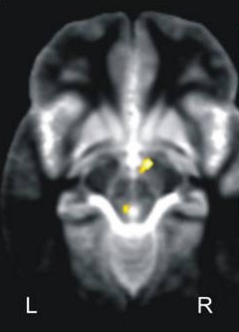
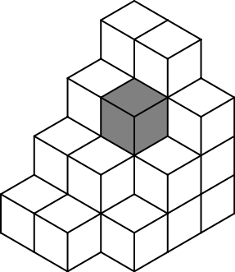
Raw data collected as group of voxels
Calculate a test statistic for each voxel
Many many many voxels…
Notes:
5
So we’ve fit the statistical model to the data giving our model parameters which are used to look for the effect in the data (eg difference between the task and the baseline)
So you know now that to do this we calculate a statistic for each voxel (testing for the effect of interest in that voxel).
This results in a large volume of statistic values! And we need to figure out if this volume shows evidence of the effect.. But, a multiple comparison problem comes up as there are many thousands of voxels and so many thousands of statistcal values! RFT is used to solve this.

Slide 6
Rejecting the null hypothesis
Determine if value of single specified voxel is significant
Create a null hypothesis, H₀ (activation is zero)
= data randomly distributed, Gaussian distribution of noise
Compare our voxel’s value to a null distribution
Notes:
6
So when we calculate a statistic, we generally need to know if that statistic represents convincing evidence of the effect of interest. Usually we test against the null hypothesis which states that there is no effect.
NH = hypothesis that there is no effect ie no change anywhere in the brain – no diff between activation during baseline and during our manipulation

Slide 10
Bonferroni correction
P^{FWE} ≤ nα
PFWE = acceptable Type 1 error rate
α = corrected p-value
n = number of tests
α = P^{FWE} /n
But…
Notes:
10
10
So this just coverts our t values and null t distribution into probability values. So then we use a probability threshold (alpha) to each of our probability values (n), eg alpha in 0.01 and n is 1000. So if the test values are dervied from the null hypothesis then each of our n probability values has a probability alpha of being greater than threshold. Pfwe is the probability that one or more values will be greater than alpha. This is approximated by this simple expression
This allows us to find the single voxel probability threshold alpha that will give us our required family wise error rate so that we have a probability of seeing any voxel above threshold in all of the n values.
The bonferroni procedure gives us a corrected p value.
In many cases though, the bonferroni correction is too conservative because most functional imaging data have some degree of spatial correlation ( ie there is correlation between neightboring statistic vaues meaning there are fewer independent values in the statistic volume than thre are voxels. )
If the unadjusted p-value is less than the Bonferroni-corrected target alpha, then reject the null hypothesis.
If the unadjusted p-value is greater than the Bonferroni-corrected target alpha, then do not reject the null hypothesis.

Slide 11
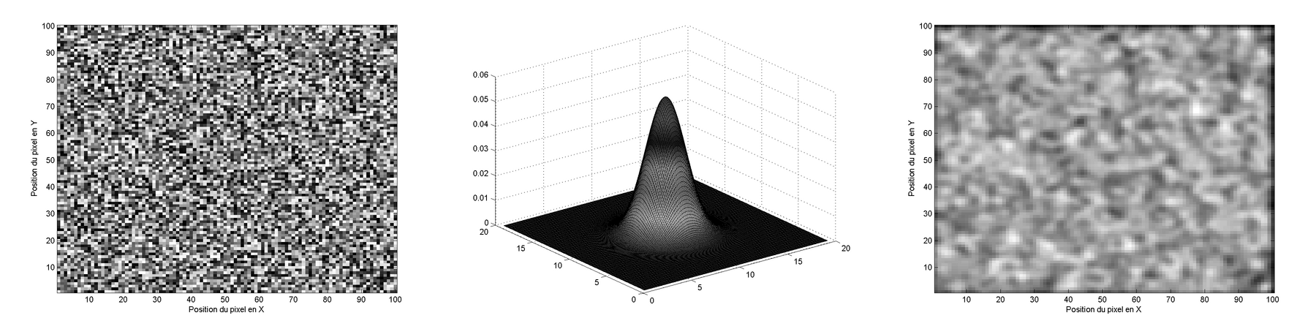
Spatial Correlation
Dependence between voxels : physiological signal
data acquisition
spatial preprocessing
Averaging over one voxel and its neighbours (↓independent observations)
Usually weighted average using a (Gaussian) smoothing kernel
Notes:
11
This brings us on to spatial correlation..
There will usually be some degree of spatial correlation in functional imaging data. Neighborinmg voxels will tend to display similar data which means that errors from the statistic model will be correlated for nearby voxels.
The spatial preprocessing introduces spatial correlation. We realign images for the individual subjects to correct for motion during scanning and may normalize the data to a template to compare between subjects. This creates voxel centres that will be quite different from those of the original image. This resampling requires estimations of of signals of new voxel locations based on values from the original image and there is some degree of averaging between neighboring voxels to produce the new voxel value. The signal of niterest usually extends over several voxels. This can be due to the nature of the neuronal response or the haemodynamic response. Smoothing is done to imrpove the signal to noise ratio, involving averaging over voxels, increasing spatial correlation

Slide 13
FWHM

Slide 14
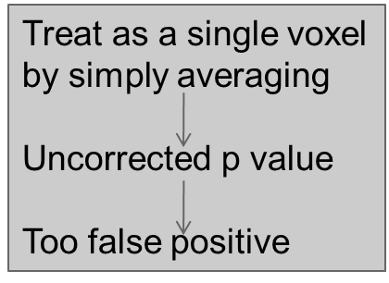
Overview
A large volume of data requiring a large number of statistical measures Creates a multiple comparisons problem
Random field theory (RFT)
α = P^{FWE} ≒ E[EC]
Corrected p value
Bonferroni correction
α=P^{FWE}/n
Corrected p value
Unfeasibly conservative
Too many false negatives
This is NOT
an acceptable
method.
It is because Bonferroni correction
is based on the assuption that all
the voxels are independent.
Notes:
14

Slide 15
Random Field Theory
Part II
Tim Howe
RFT for dummies - Part II
15
15

Slide 16
Definitions
Random field theory (RFT) is a body of mathematics which defines theoretical results for continuously-varying (ie. smooth) topologies [1]. These results can be approximately applied to statistical maps.
The Random field is a continuously varying topology in n dimensions, or in our case an array of random numbers whose values are mapped onto such a space. This mapping implies that the values exhibit some spatial correlation (ie. the value of a given element is dependent on its neighbours in the field). [2].
[1] Brett M., Penny W. and Keibel S. (2003) Human Brain Mapping. Chapter 14: An introduction to Random Field Theory.
[2] http://en.wikipedia.org/wiki/Random_field
RFT for dummies - Part II
16
16

Slide 17
The Random Field resembles our data under the null hypothesis
Our data under the null hypothesis resembles the Random field, in that it is A) random:
but B) spatially correlated:
Firstly because of the smoothing we have applied
but ALSO because neighbouring voxels may share activation due to underlying anatomical connectivity
NULL hypothesis :
all activations were merely driven by chance
each voxel value has a random number
RFT for dummies - Part II
17
17

Slide 18
Why we need RFT
PROBLEM: As described earlier, the Bonferroni correction is too conservative for the spatially correlated data we're interested in.
SOLUTION: under the null hypothesis our data approximate the random field
Therefore any deductions we can make about the RF will also hold for our null hypothesis.

Slide 19
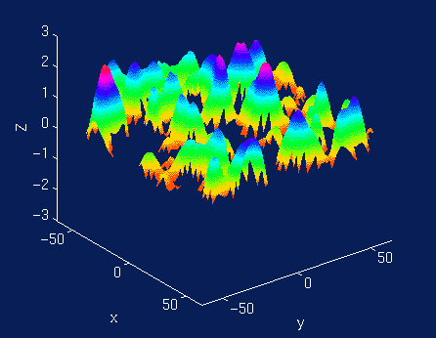
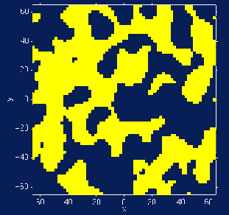
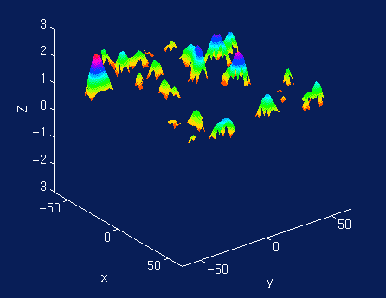
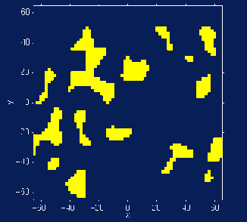
The Euler characteristic (EC):
The Euler characteristic is an invariant topological property of a space.
For our purposes, the EC can be thought of as the
(# blobs - # holes) in the random field after we apply a threshold to it.
Threshold: z = 0
We can calculate this for a random field of a given size and smoothness, and in turn it can help us solve the multiple comparisons problem...
Threshold: z =1
RFT for dummies - Part II
19
19

Slide 20
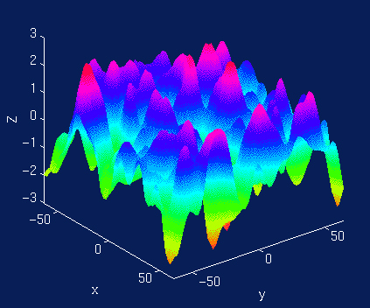
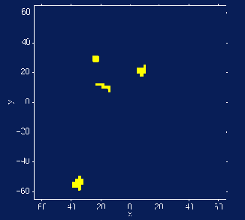
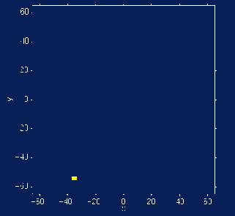
Euler Characteristic and FWE
Euler Characteristic
Topological Measure
#blobs - #holes
At high thresholds, just counts blobs
FWER = P(Max voxel ≥ u | H_{o}) = P(One or more blobs | H_{o}) ≈ P(EC≥ 1 | H_{o}) ≈ E(EC | H_{o})
Threshold
Random Field
No holes
Never more than 1 blob
20
So at high thresholds, expected EC approximates the chance of a blob appearing at random, and so approximates α !
Notes:
20

Slide 21
Process of RFT application:
1. Estimation of smoothness
2. Establish RFT parameters and generate
Euler characteristic (EC)
3. Obtaining P^{FWE}
Notes:
21

Slide 22
1. Smoothness Estimation: Creating a Random field that resembles our data
for the RANDOM FIELD to approximate our DATA, we need to give it an equivalent SMOOTHNESS.
Our data approximate to a random field of a given smoothness. This property can be thought of as the degree of spatial correlation, or intuitively as the variance of gradient in each spatial dimension.
We do not know this a priori. Although we may know the FWHM of our smoothing kernel, we are ignorant of the underlying anatomical correlation between voxels.
RFT for dummies - Part II
22
22

Slide 23
The smoothness is calculated a posteriori by SPM from the observed degree of spatial correlation
It does this by estimating the number of
RESOLUTION ELEMENTS (RESELS)
This is approximately equal to the number independent observations.

Slide 24
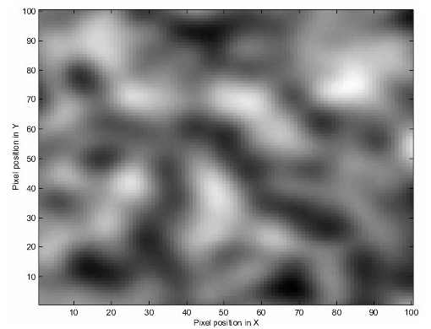
RESEL:
a block of values, e.g. pixels,
that is the same size as the FWHM.
one of a factor which defines p value
in RFT
Example RESEL:
If we have a field of white noise pixels
smoothed with FWHM of 10 by 10 pixels.
Then a RESEL is a block of 100 pixels.
As there are 10,000 pixels in our image,
there are 100 RESELs.
The number of ressels depend on
the FWHM
the number of voxels /pixels/ elements.
Notes:
24

Slide 25
Process of RFT application:
1. Estimation of smoothness
2. Establish RFT parameters and generate
Euler characteristic
3. Obtaining P^{FWE}
Notes:
25

Slide 26
2. Estimating RFT parameters: The Euler characteristic (EC):
The Euler characteristic is an invariant topological property of a space.
For our purposes, the EC can be thought of as the number of blobs in an image after thresholding.
Threshold: z = 0
Threshold: z =1
RFT for dummies - Part II
26
26

Slide 27
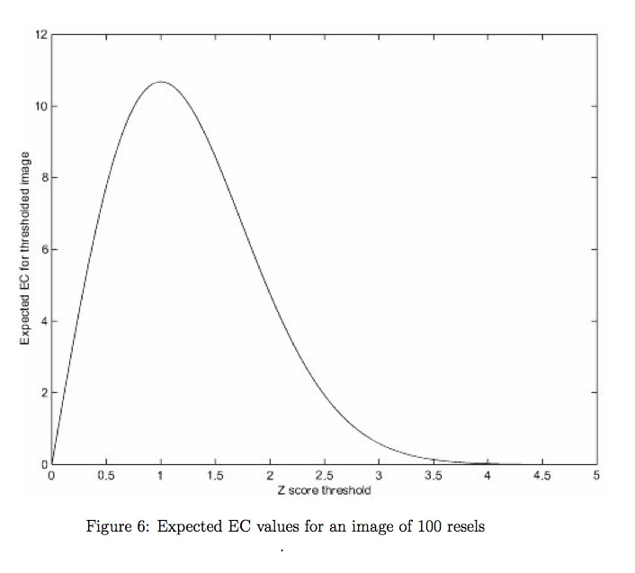
In 2D field,expected EC is:
E[EC] = R (4 ln 2) (2π) ^{-3/2} Zt exp(-Zt²/2)
Where R = # of RESELS and Zt = our threshold value of Z
Might look a bit complicated but basically:
E[EC] = R . K .^{-3/2} z exp(-z²/2)
where the last section just describes this curve:
RFT for dummies - Part II
27
27

Slide 28
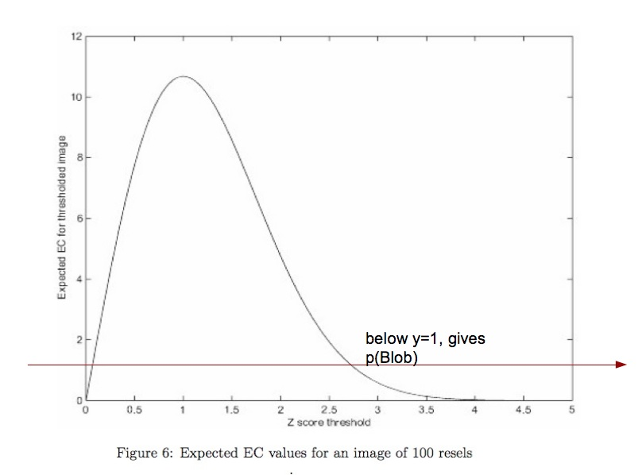
At the high values of Zt we're interested in, E[EC] < 1, and so gives us a probability that a blob will exist by chance.

Slide 29
Process of RFT application:
1. Estimation of smoothness
2. Establish RFT parameters and generate
Euler characteristic
3. Obtaining P^{FWE}
Notes:
29

Slide 30
the average or expected EC: E[EC]
E [EC], corresponds (approximately) to the probability of finding an above threshold blob in our statistic image.
At High Zt, E[EC]=~
The probability of getting a z-score > threshold by chance
α ~ E[EC] = R (4 ln 2) (2π) ^{-3/2} Zt exp(-Zt²/2)
RFT for dummies - Part II
30
30

Slide 31
E[EC] approx = α
given that EC is approximately equal to alpha,
for a given number of resels, we can set E[EC] as our desired alpha, and use the equation to find the appropriate value of Zt.
We then apply that Zt as the threshold for our image, and get a value of threshold that will give us our FWE-corrected p-val.
31
31

Slide 32
Finding the EC value
Our data are of course in 3 dimensions, which makes the equation for the EC a little more complicated, but the principle remains the same.

Slide 33
SPM8 and RFT
RFT for dummies - Part II
33
33

Slide 34
Summery of FWE correction by RFT
RFT stages on SPM:
First SPM estimates the smoothness (spatial correlation) of our statistical map.
R is calculated and saved in RPV.img file.
Then it uses the smoothness values in the appropriate RFT equation, to give the expected EC at different thresholds.
This allows us to calculate the threshold at which we would expect α% of equivalent statistical maps arising under the null hypothesis to contain at least one area above threshold.
RFT for dummies - Part II
34
34

Slide 35
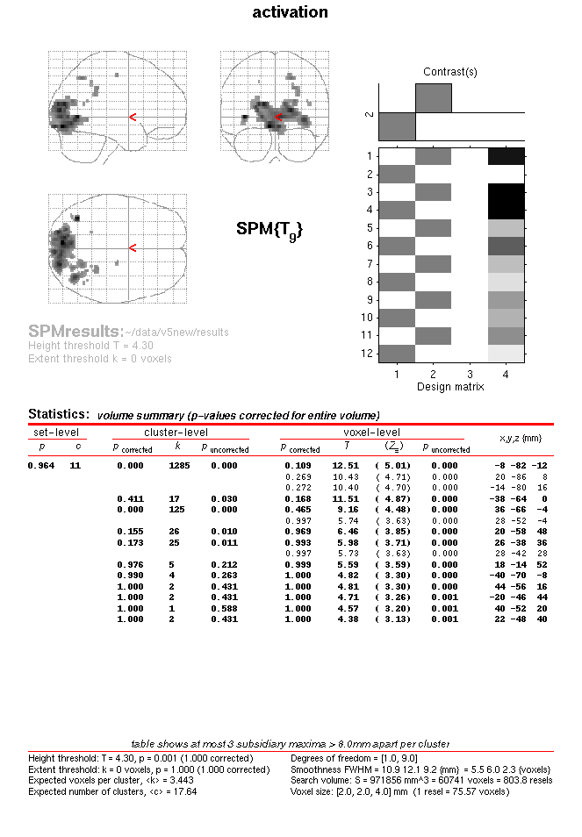
Example
18/11/2009
RFT for dummies - Part II
35
35

Slide 36
RFT for dummies - Part II
36
36

Slide 37
SPM8 and RFT
We can use FWE correction in different ways on SPM8 [1]
1. Using FWE correction on SPM, calculates the threshold over the whole brain image. We can specify the area of interest by masking the rest of the brain when we do the second level statistic analysis.
2. Using uncorrected threshold, none, (usually p= 0.001). Then correcting for the area we specify. (Small Volume Correction (SVC))
[1] SPM manual, http://www.fil.ion.ucl.ac.uk/spm/doc/
RFT for dummies - Part II
37
37

Slide 38
Acknowledgements
The topic expert:
Guillaume Flandin
The organisers:
Rumana Chowdhury
Peter Smittenaar
Suz Prejawa
Method for Dummies 2011/12
(note to self: go to B08A)
RFT for dummies - Part II
38

