Slide 1
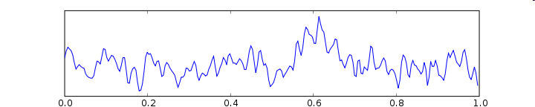
Methods for Dummies
15.02.2012
Basis of the EEG/MEG signal
Marcos Economides
Spas Getov

Slide 2
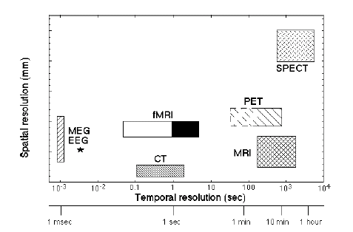
Electroencephalography
Pros
Cons
Good time resolution, ms compared to s with fMRI
Portable and affordable
More tolerant to subject movement than fMRI
EEG is silent and so useful for studying auditory processing
Can be combined with fMRI or TMS
Low spatial resolution
Artifacts / Noise

Slide 3
History
Richard Caton (1842-1926) from Liverpool published findings about electrical phenomena of the exposed cerebral hemispheres of rabbits and monkeys in the British Medical Journal in 1875.
In 1890 Adolf Beck published findings of spontaneous electrical activity and rhythmic oscillations in response to light in the brains of rabbits and dogs.
In 1912 Vladimir Vladimirovich Pravdich-Neminsky published the first animal EEG study described evoked potential in the mammalian brain.
In 1914 Napoleon Cybulski and Jelenska-Macieszyna photographed EEG recordings of experimentally induced seizures.

Slide 4
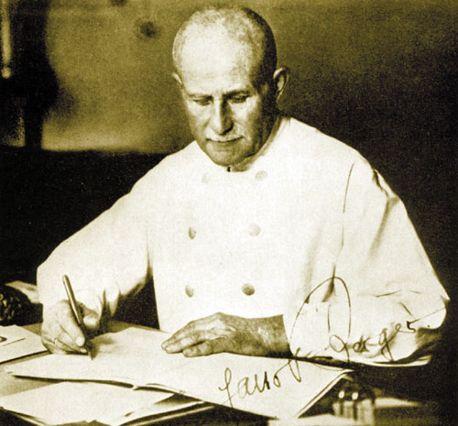
History
1929: Hans Berger developed electroencephalography, the graphic representation of the difference in voltage between two different cerebral locations plotted over time
He described the human alpha and beta rhythms

Slide 5
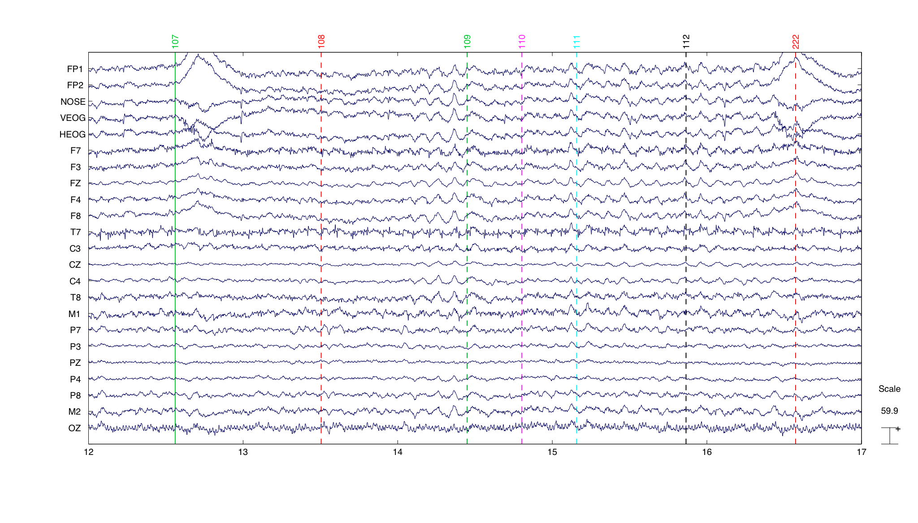
Continuous EEG recording
F = frontal, T = temporal, C = central, etc
Even number = right side of head, Odd number = left side
International 10-20 system – ensures consistency

Slide 6
Digital vs. Analogue
Conventional analogue instruments consist of an amplifier, a galvanometer (a coil of wire inside a magnetic field) and a writing device. The output signal from the amplifier passes through the wire causing the coil to oscillate, and a pen mounted on the galvanometer moves up and down in sync with the coil, drawing traces onto paper.
Digital EEG systems convert the waveform into a series of numerical values, a process known as Analogue-to-Digital conversion. The rate at which waveform data is sampled is known as the sampling rate, and as a rule should be at least 2.5 times greater than the highest frequency of interest. Most digital EEG systems will sample at 240Hz.
The accuracy of digital EEG waveforms can be affected by sampling skew – a small time lag that occurs when each channel is sampled sequentially. This can be reduced using burst mode – reduced the time lag between successive channel sampling.
Be aware of the relationship between sampling rate, screen resolution and the EEG display. If there are more data samples than there are pixels then this will have the effect of reducing the sampling rate and the data displayed will appear incomplete. However, most modern digital EEG systems will draw two data samples per screen pixel.

Slide 7
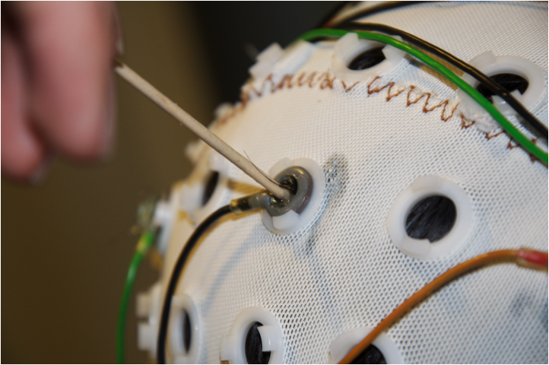
EEG Acquisition
Electrodes: Usually made of silver (or stainless steel) – active electrodes placed on the scalp using a conductive gel or paste. Signal-to-noise ratio (impedance) reduced by light abrasion. Can have 32, 64,128, 256 electrodes. More electrodes = richer data set. Reference electrodes (arbitrarily chosen “zero level”, analogous to sea level when measuring mountain heights) commonly placed on the midline, ear lobes, nose, etc.
Amplification: one pair of electrodes make up one channel on the differential amplifier, i.e. there is one amplifier per pair of electrodes. The amplifier amplifies the difference in voltage between these two electrodes, or signals (usually between 1000 and 100 000 times). This is usually the difference between an active electrode and the designated reference electrode.

Slide 8
EEG records differences in voltage: the way in which the signal is viewed can be set up in a variety of ways called montages
Bipolar montage: Each waveform in the EEG represents the difference in voltage between two adjacent electrodes, e.g. ‘F3-C3’ represents the difference in voltage between channel F3 and neighbouring channel C3. This is repeated across the whole scalp through the entire array of electrodes.
Reference montage: Each waveform in the EEG represents the difference in voltage between a specific active electrode and a designated reference electrode. There is no standard position for the reference, but usually a midline electrode is chosen so as not to bias the signal in any one hemisphere. Other popular reference signals include an average signal from electrodes placed on each ear lobe or mastoid.
Average Reference montage: Activity from all electrodes is measured, summed and then averaged. The resulting signal is then used as a reference electrode and acts as input 2 of the amplifier. The use can specify which electrodes are to be included in this calculation.
Laplacian montage: Similar to average reference, but this time the common reference is a weighted average of all the electrodes, and each channel is the difference between the given electrode and this common reference.

Slide 9
Montages (continued)
In digital EEG setups, the data is usually stored onto computer memory in reference mode, regardless of the montage used to display the data when it is being recorded.
This means that “remontaging”, i.e. changing the montage either ‘on-line’ or ‘off-line’, can be done via a simple subtraction which cancels out the common reference.
-
E.g.
F3 – Reference
F4 – Reference
= F3 – F4

Slide 10
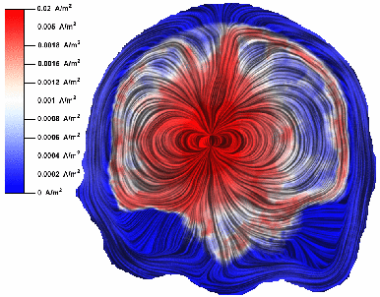
What does the EEG record?
Volume conduction
Ions are constantly flowing in and out of neurons to maintain resting potential and propogate action potentials. Movement of like-charged ions out of numerous neighbouring neurons can create waves of electrical charge, which can push or pull electrons on scalp electrodes, creating voltage differences.
In summary, the EEG signal represents the deflection of electrons on the scalp electrodes, caused by cortical “dipoles” (the summed activity within a specific area of cortex that creates a current flow).

Slide 11
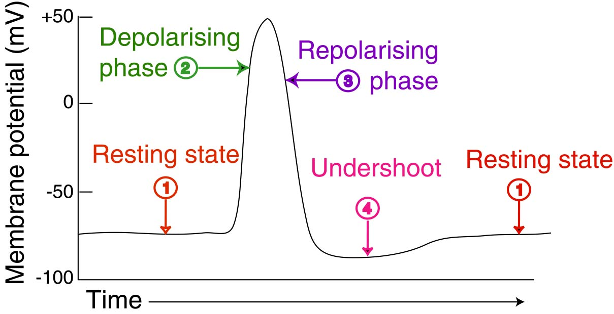
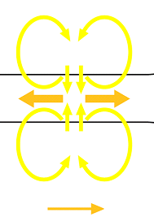
Neural basis of the EEG (1)
Action Potentials
Rapid, transient, all-or-none nerve impulses that flow from the body to the axon terminal of a neuron.
They are generally too short in duration (a few ms) and to “deep” to contribute significantly to the EGG signal.
In addition they create 2 dipoles = quadrupole
Finally, synchronous firing is unlikely preventing the summation of potentials

Slide 12
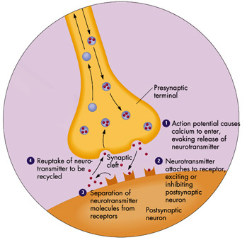
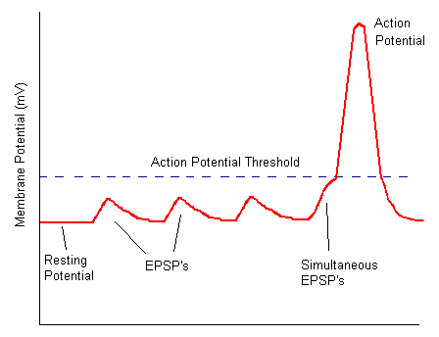
Neural basis of the EEG (2)
Post-synaptic potentials
Scalp EEG is a summation of non-propogating dendritic and somatic post-synaptic potentials which arise relatively slower than action potentials (approx 10ms).
EPSPs – Excitatory Post Synaptic Potentials
IPSPs – Inhibitory Post Synaptic Potentials
Post synaptic potentials summate spatially and temporally – A single pyramidal cell may have more than 10⁴ synapses distributed over its soma and dendritic surface.

Slide 13
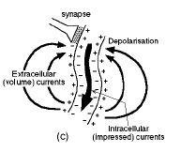
Neural basis of the EEG (3)
-
+
When an EPSP is generated in the dendrites of a neuron, Na⁺ flow inside the neuron’s cytoplasm creating a current sink.
The current completes a loop creating a dipole further away from the excitatory input (where Na⁺ flows outside the cell as passive return current), which can be recorded as a positive voltage difference by an extracellular electrode.
Large numbers of vertically oriented, neighbouring pyramidal neurons create these field potentials.
Thus, EEG detects summed synchronous activity (PSPs) from many thousands of apical dendrites of neighbouring pyramidal cells (mainly).
Dendrites
Synapse
“It takes a combined synchronous electrical activity of approximately 108 neurons in a minimal cortical area of 6cm² to create visible EEG”… Olejniczak, J. Clinical Neurophysiology, 2006.

Slide 14
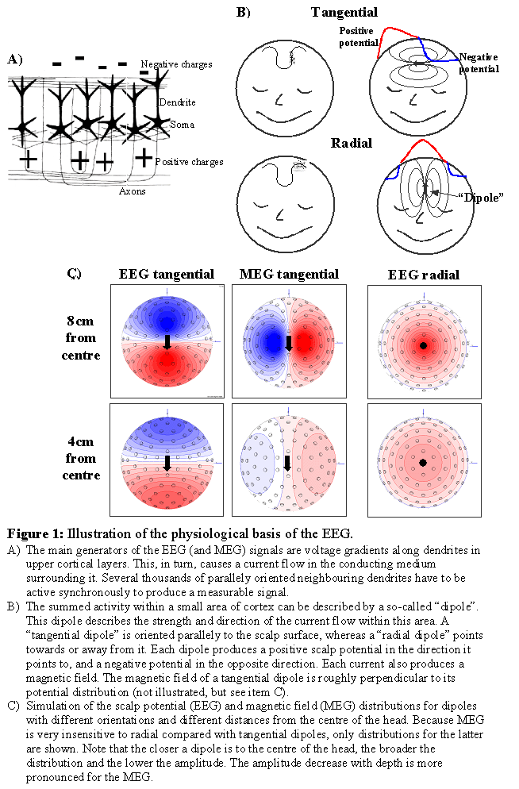
Neural basis of the EEG (4)
“The closer a dipole is to the centre of the head, the broader the distribution and the lower the amplitude”
Introduction to EEG and MEG, MRC Cognition and Brain Sciences Unit, Olaf Hauk, 03-08

Slide 15
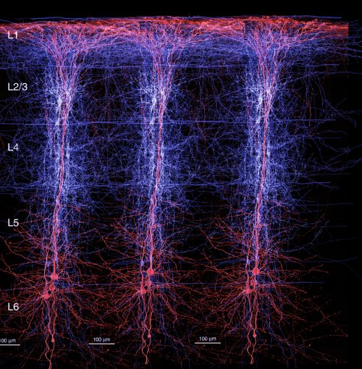
Neural basis of the EEG (5)
Pyramidal neurons, the major projection neurons in the cortex, make up the majority of the EEG signal (particularly layers III, V and VI), because they are uniformly orientated with dendrites perpendicular to the surface, long enough to form dipoles. We can assume that the EEG signal reflects activity of cortical neurons in close proximity to the given electrode.
The thalamus acts as the pacemaker ensuring synchronous rhythmic firing of pyramidal cells.
Activity from deep sources is harder to detect as voltage fields fall off as a function of the square of distance.

Slide 16
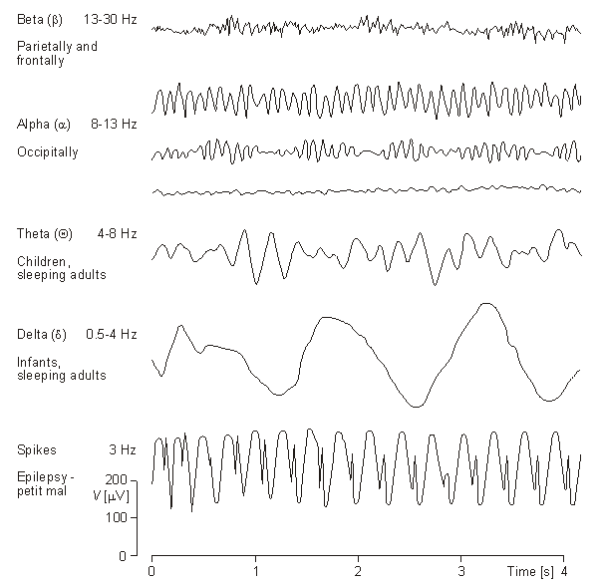
EEG Rhythms:
can characteristically be broken down into
different frequency bands
Attenuated during movement
Seen during alertness, active concentration
Relaxation, closing of the eyes
Control of inhibition
Drowsiness, meditation, action inhibition
Continuous attention, slow wave sleep
Mu (8 – 13 Hz):
Rest state motor neurons
Gamma (30 – 100+ Hz):
Cross-modal sensory processing, short-term perceptual memory

Slide 17
EEG Analysis (1)
Evoked Potentials
stereotyped early responses time and phase-locked to the presentation of a physical stimulus
stereotyped late (?) responses time and phase-locked to stimuli, but often associated with “higher” cognitive processes, e.g. attention, expectation, memory, or top-down control
Event-related
Potentials
Both require averaging the same event over multiple trials (typically 100+), in order to average out noise/random activity, but preserve the signal of interest.
If the signal of interest is roughly known a priori then filters can be applied to suppress noise in frequency ranges where the amplitude is low or are of no interest. E.g. High-pass, low-pass, band-pass…

Slide 18
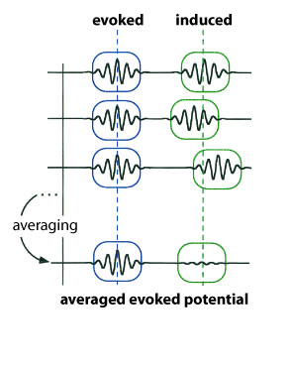
EEG Analysis (2)
Induced Activity
stereotyped responses time but not phase-locked to the presentation of a physical stimulus, i.e. there is some jitter in the response between epochs. Averaging over trials would not be appropriate. Instead, the signal amplitude for different frequency bands is computed for every epoch. This type of analysis only considers frequency amplitude and not phase.

Slide 19
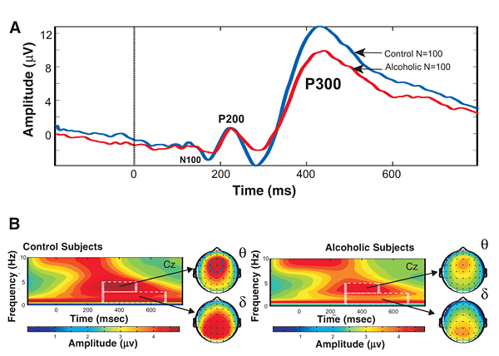
EEG Analysis (3)
Evoked Response / Event – related potential
Grand mean ERP in response to visual oddball paradigm – subjects are asked to react when they see a rare occurrence amongst a series of common stimuli, e.g. rotating arms of a clock
It produces a stereotyped evoked response over parieto-central electrodes at around 300ms (termed P300 component) that is largest after seeing the rare target stimulus
Rangaswamy & Porjesz. From event-related potentials to oscillations. Alcohol Research & Health, 2008

Slide 20
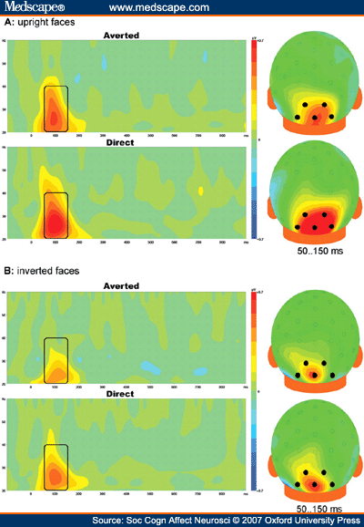
EEG Analysis (4)
Time-Frequency Analysis
Tells you which frequencies are present/dominant in the signal over a given time. Can be for one single electrode or the average across multiple electrodes.
Useful for:
Analysing induced activity that isn’t phase-locked, i.e. that would be averaged out with conventional event-related analysis
Characterising and understanding typical responses to specific events – e.g. significant increase in gamma band activity 20-60 ms following an auditory stimulus

Slide 21
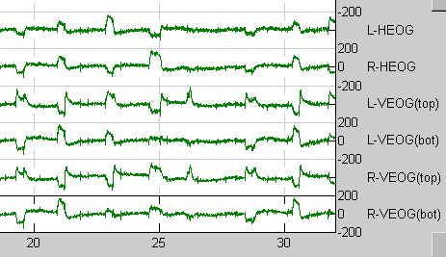
EEG Analysis (3)
Artifacts
Physiological
Eye blinks and eye movements
Muscle artifacts
Heart artifacts
Environmental
Momentary changes in electrode impedance
Dried electrode gel
Electrode wire contact
Poor grounding can give a 50/60 Hz signal
Baseline Correction
the EEG signal can undergo small baseline shifts away from zero due to sweating, muscle tension, or other sources of noise.
Removal of artifacts can be done manually, e.g. epoching the signal and manually removing contaminated trials; OR through automated artifact rejection techniques build into the software.

Slide 22
EEG
Pros
Cons
Good time resolution, ms compared to s with fMRI
Portable and affordable
More tolerant to subject movement than fMRI
EEG is silent and so useful for studying auditory processing
Can be combined with fMRI or TMS
Low spatial resolution
Artifacts / Noise

Slide 23
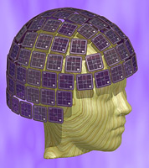
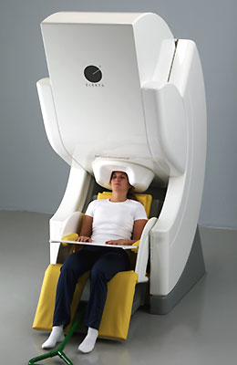
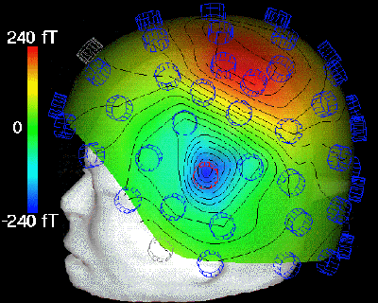
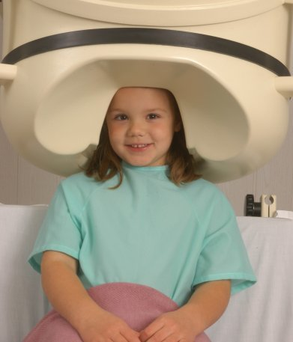
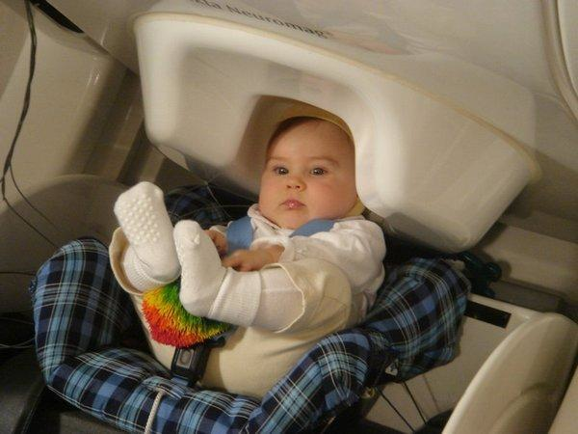
Magnetoencephalography (MEG)
Notes:
Several key discoveries (particularly in field of physics) and technological developments were crucial for development of MEG (first, place in a historical context)

Slide 24
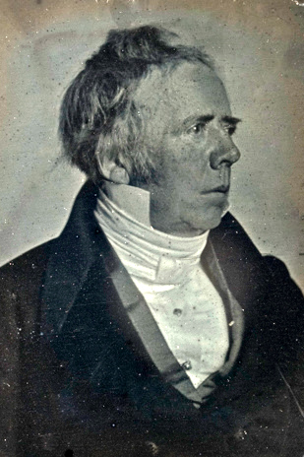
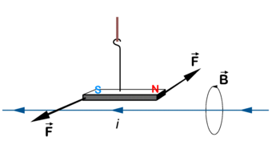
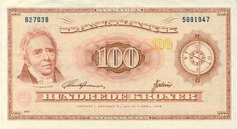
Electromagnetism
Hans Christian Orsted (1777 – 1851)
Current passing through a circuit affects a magnetic compass needle (1819)
Notes:
As we all know, and as exploited by EEG, neurones communicate using electrical impulses
The connection between electricity and magnetism was first discovered by Hans Christian Orsted, a danish physicist.
On 21 April 1820, during a lecture, Ørsted noticed a compass needle deflected from magnetic north when an electric current from a battery was switched on and off, confirming a direct relationship between electricity and magnetism.^{[3]} His initial interpretation was that magnetic effects radiate from all sides of a wire carrying an electric current, as do light and heat. Three months later he began more intensive investigations and soon thereafter published his findings, showing that an electric current produces a circular magnetic field as it flows through a wire. This discovery was not due to mere chance, since Ørsted had been looking for a relation between electricity and magnetism for several years.

Slide 25
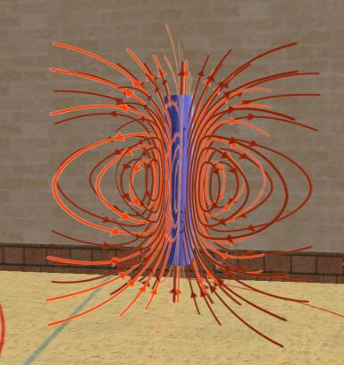
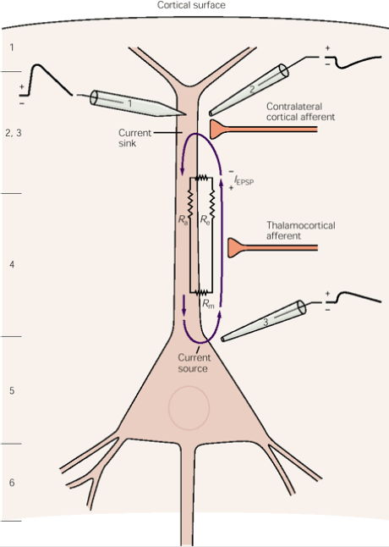
Electromagnetism (2)
An electrical dipole is always surrounded by a corresponding magnetic field
The polarity of the field is determined by the direction of the current
Apical dendrites of pyramidal cells also act as dipoles (more of this later…)

Slide 26
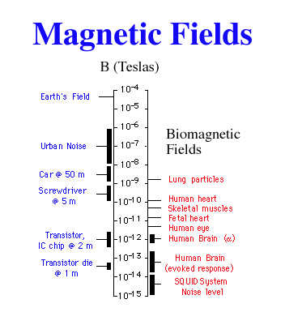
Biomagnetic Fields
But…
The magnetic fields generated by the brain are minute: 100 million times weaker than the earth’s magnetic field, one million times weaker than the magnetic fields generated by the urban environment.
By way of contrast, MRI scanners generate a magnetic field of between 3 to 3.5 tesla.
Notes:
Biomagnetic fields are orders of magnitude smaller than magnetic fields generally around in urban environment and even more tiny compared to the Earth’s magnetic field.
A tesla measures magnetic flux density (1 tesla = 1 weber/square metre).

Slide 27
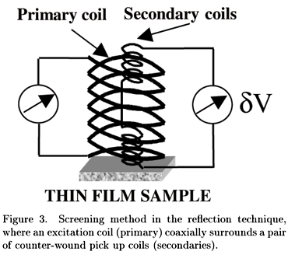
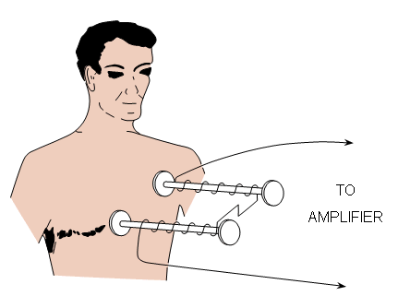
Early Recordings of Biomagnetic Fields
First recording of biomagnetic field generated by the human hart (Gerhard Baule and Richard Mcfee, 1963)
Two copper pick-up coils twisted round a ferrite core with 2 million turns.
The two coils were connected in opposite directions so as to cancel out the background fluctuations. Never the less, they had to conduct their experiment in the middle of a field because the signal was still very noisy.
A group working in the Soviet Union (Safonev et al, 1967) produced similar results but in a shielded room: reduced background noise by a factor of 10.
Thermal noise was limiting in the use of copper.

Slide 28
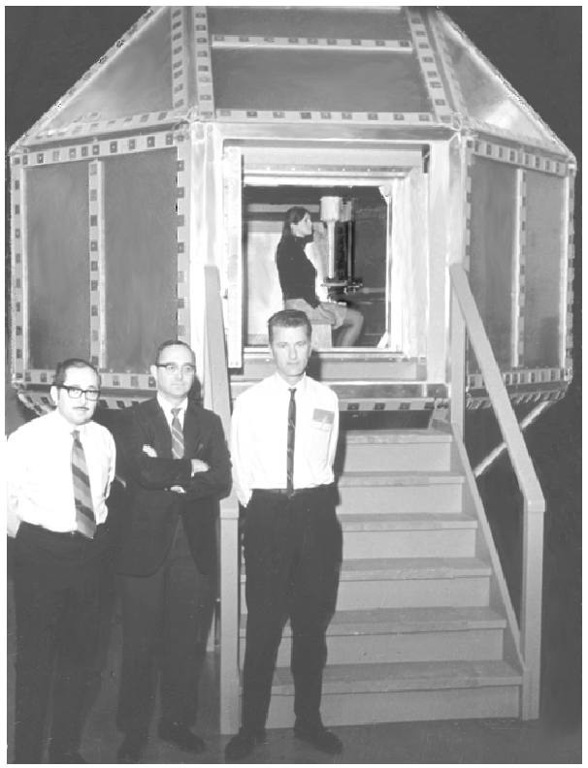
Recording Biomagnetic Fields From the Brain
1968
David Cohen and colleagues make measurements using a copper induction coil in a magnetically shielded room in University of Illinois.
Measurements were too noisy for useful analysis
Two key problems:
Sensors sensitive enough to record tiny changes in magnetic flux
Eliminate ‘noise’ from other environmental fluctuations in flux
Notes:
This is now in an urban environment. Nevertheless, the problem remained that bimagnetic fields are too small and the amount of noise too great. A more sensitive way of detecting biomagnetic fields was necessary.

Slide 29
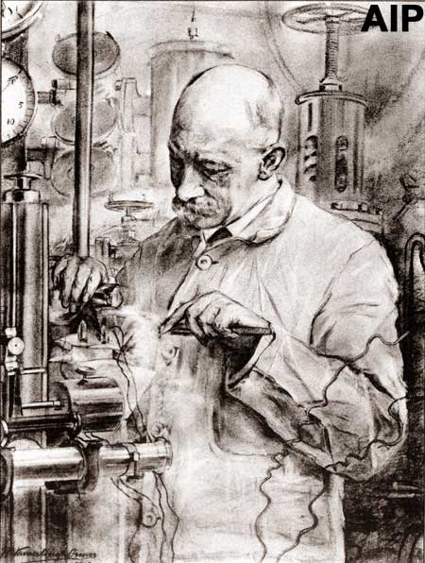
Superconductivity
- When cooled to -269C, solid mercury suddenly lost all resistance to the flow of electric current (Heike Onnes, 1911) .
“Superconductivity”
-Later found in other materials, such as tin and metal alloys.
- When two superconducting materials are separated by a thin insulating layer a ‘tunnel effect’ is produced which enables the flow of electrons - even in the absence of any external voltage. This is a Josephson Junction (Brian Josephson 1962).
Notes:
Heike Onnes is a dutch physicist
There are two types of superconduction, one that completely rejects magnetic fields and the other where superconductivity and magnetism can co-exist.

Slide 30
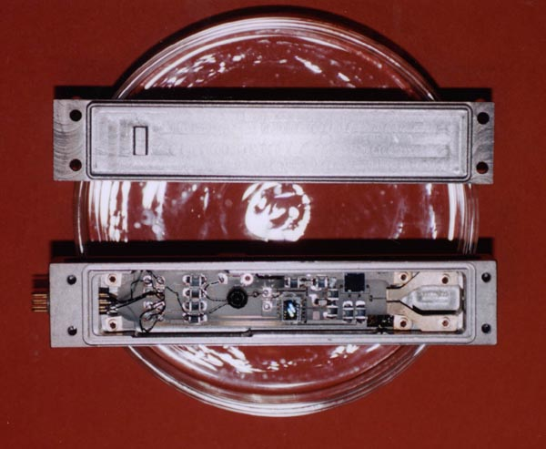
Recording a Weak Signal: SQUIDs
Create a superconducting loop and measure changes in interference of quantum-mechanical electron waves circulating in this loop as magnetic flux in loop changes
Invented at Ford Research Labs in 1964/1965 by Jaklevic, Lambe, Silver, Mercerau and Zimmerman
Two types: DC and RF SQUIDs. RF squids generally used to make measurements of biomagnetism (less sensitive but much cheaper).
Niobium or lead alloy cooled to near absolute zero with liquid helium
Can measure magnetic fields as small as 1 femtotesla (10⁻¹⁵)
Notes:
Superconducting Quantum Interference Devices
RF SQUIDs only need one Josephson junction. They are slightly less sensitive but cheaper.
Drawing shows a prototype SQUID
SQUIDs make use to type II superconductivity
When cooled to very low temperatures, superconductors conduct electricity without resistance. This lack of resistance allows a SQUID to measure the interference of quantum-mechanical electron waves circulating in its superconducting loop as the magnetic flux enclosed by the loop changes. A SQUID can measure magnetic fields as small as 1 femtotesla. Also has temporal resolution far in excess of highest frequencies of signals emitted by brain

Slide 31
Recording Biomagnetic Fields From the Brain
1972
David Cohen, now at MIT, used one of the first SQUIDs to record a cleaner MEG signal.
By now they had designed a better magnetically sheilded room.
Used one SQUID only, which was moved around to different positions
Notes:
I’m not sure which event the picture corresponds to….but it’s a nice picture!

Slide 32
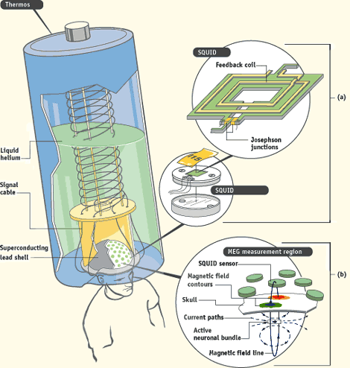
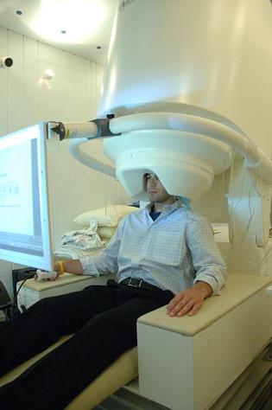
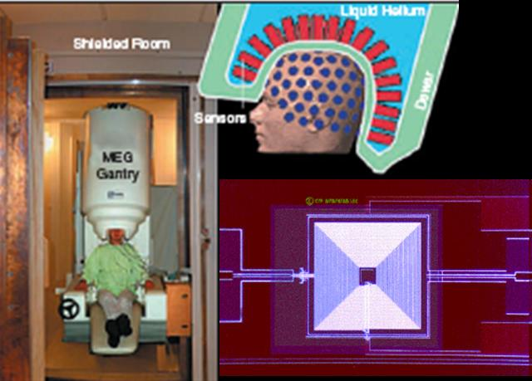
Modern MEG
Since 1980s – multiple SQUIDs arranged in arrays to allow measurement over the whole scalp surface
The helmet-shaped dewar of current systems typically contains around 300 sensors (connected to SQUIDs) and contains liquid helium to keep the sensors cooled enough to superconduct.
Carefully designed and constructed magnetically shielded rooms. Different metals used to shield different frequencies of magnetic interference.
Notes:
A non-invasive neurophysiological technique measuring magnetic fields generated by neuronal activity in the brain.
Modern SQUIDs (Barnes Scholarpedia) These devices convert the sub-quanta changes in magnetic flux into voltage changes. Typically the SQUIDs are coupled to superconducting coils or flux transformers which are situated as close as possible to the subject's head (within 2cm typically). Magnetic field changes in the flux transformers cause a change in superconducting current in the transformer coils that is passed via an input coil to the SQUID itself. The ability to measure such small fields also makes the devices very sensitive to other magnetic field changes in the environment. For example a car at 2km distance would cause a similar change in magnetic flux to that due to brain activity (Weinstock 1996). The next major problem is to separate the brain signal from the external noise.
For example aluminium shielding is relatively inexpensive and attenuates high (>1Hz) frequency magnetic interference, whereas mu metal shielding ([1]) is used to attenuate very low frequency (0.01Hz) interference.
Sources of noise include Earth magn field, electrical equipment, radiofreq signals, low freq magn fields from elevators, cars, trains.

Slide 33
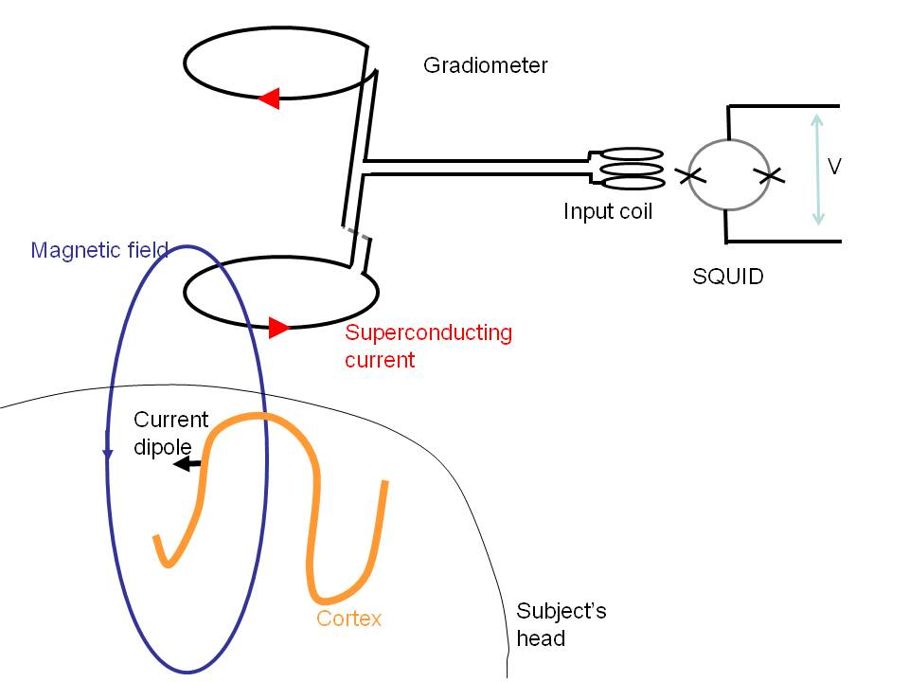
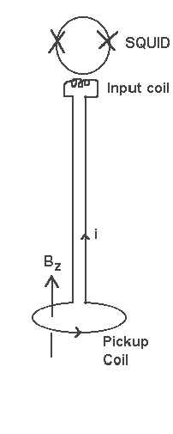
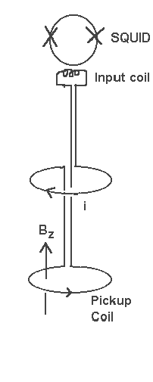
Minimising Noise
Flux Transformers
Convert changes in magnetic flux to changes in current.
Magnetometers: pick up environmental ‘noise’
Gradiometers: two or more coils – magnetic interferance from distant sources uniform across them while interferance from close by isn’t
Changes in output from gradiometer to SQUID are caused mainly by changes in flux close-by (in subject’s brain).
Only a small percentage of the external noise arrives at the SQUID.
Notes:
The sensitivity of the SQUID to magnetic fields may be enhanced by coupling it to a superconducting pickup coil (“flux transformer”) which has greater area and number of turns than the SQUID inductor alone. made of superconducting wire and is sensitive to very small changes in the magnitude of the impinging magnetic flux.
A gradiometer comprises two or more oppositely wound coils separated by a certain distance or baseline (typically 5cm), with the coils separated in the direction perpendical to the coils (radial gradiometer, see Figure), or the coils placed in the plane formed by the coils itself (planar gradiometer).

Slide 34
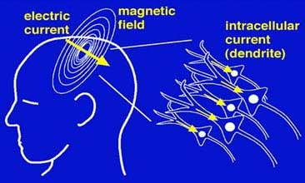
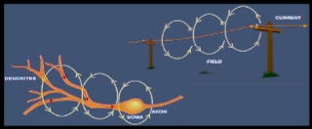
Neural Basis of the MEG Signal
Magnetic fields are produced by same electrical changes recorded by EEG
Again, the main source is post-synaptic currents flowing across pyramidal neurones… as previously described
However, there are some key differences:
1. Magnetic field is perpendicular to current
If the current is running parallel to the scalp the magnetic field exits the head from one side of the dipole and re-enters on the other side and so can be measured.
But if the current is perpendicular to the scalp the magnetic field does not leave the scalp and cannot be measured.

Slide 35
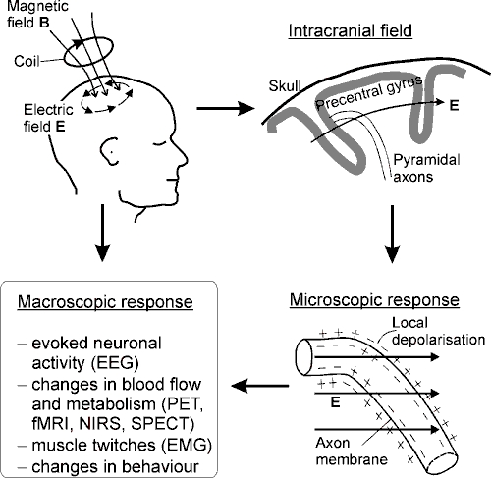
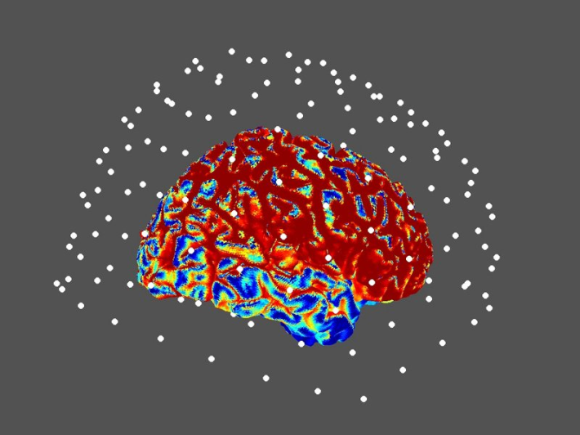
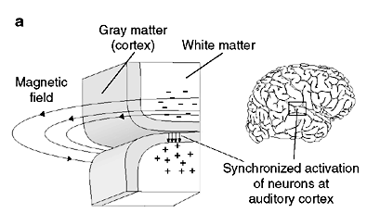
2. Differential sensitivity by brain region
MEG is more sensitive to activity of pyramidal cells in the walls of the sulci.
MEG registers no information from radially aligned axons (unlike EEG)
MEG signal decays more quickly with distance (in proportion to distance²) so problems recording deep (subcortical) areas
http://www.scholarpedia.org/article/MEG
Notes:
MEG signal mainly detectable as result of current running parallel to the scalp, and quite near the scalp.
Relative insensitivity to radial sources of signal compared to EEG.
Dots represent the sensors, red regions are areas MEG is most sensitive to, blue are regions it is least sensitive to.
All figures show how current running between sulci (parallel to scalp) generates magnetic field that is measurable outside scalp. By contrast, EEG signal can be recorded from both gyri and sulci (though much more clearly from former).
One could argue that more of the processes relevant to cognition occur inside the sulci (e.g. Markowitsch & Tulving 1995) but this is a rather broad statement and obviously not applicable to many situations.
THINGS ARE NOT SO CLEAR CUT:
Signals from deep sources including thalamus, amygdala and hippocampus have all been successfully reconstructed using MEG.
Secondly, relative insensitivity to radial sources which theoretically give rise to no external magnetic field (Sarvas 1987) in a perfect spherically symmetric volume conductor (but do produce volume currents, the effect of which are measurable with EEG). Simulation studies have shown that, even if one takes the head to be perfectly spherical, the regions of cortex that are most radial (the crests of the gyri) are also closest to the sensors and surrounded by off-radial cortex to which the MEG system is extremely sensitive. Given that the MEG signal is due to the spatial summation of neuronal currents over at least a few square millimeters, at least part of such gyral sources remain highly visible (Hillebrand and Barnes 2002).

Slide 36
3. MEG signal is less distorted by skull/scalp anatomy
Bone is transparent to magnetism and magnetic fields are not smeared by the resistance of the skull.
Accurate reconstruction of the neuronal activity that produced the external magnetic fields therefore requires simpler models than with EEG
Notes:
Electrical impedance of tissues around brain is high. This effects current but not the magnetic field.

Slide 37
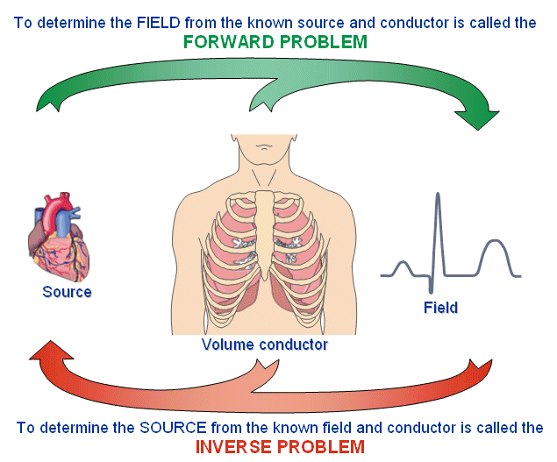
4. Different problems of source localisation
Differences discussed in last slide mean that we can make stronger inferences about the origin of the signals in MEG.
The Forward and Inverse Problems

Slide 38
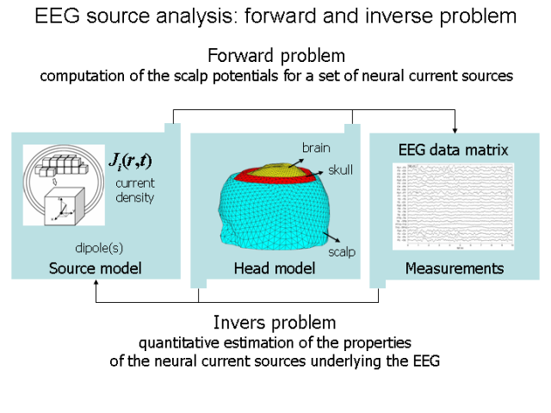
The Forward and Inverse Problems
Forward modelling generates expected signal
Compare model to actual recorded signal
Use difference between the two to work backwards and refine understanding of where signal comes from
Forward Modelling:
Dipolar source models – can explain many configurations of electrical current caused by groups of neurones and measured at ~ 2cm
Volume conductor models – modelling effects of cranial anatomy (simpler for MEG).
Notes:
Just an overview….
In SPM one implements a forward model, taking account of (amongst other things) where signal is expected to come from, as well as taking account of brain head anatomy/physiology (more complex for EEG). Essentially modelling how a dipole at a given point would look in terms of signal recorded at the EEG/MEG sensor.
Then compare with actual data. Use the difference to work backwards and refine understanding of where signal is coming from. This is the inverse problem.
1. Dipolar source models
Assume MEG signal comes from pyramidal cell dendrites perpendicular to cortical surface
Electrical current due to groups of adjacent pyramidal cells can be modeled as a current dipole
Many current configurations at a typical measuring distance of 2cm look dipolar.
Multipolar expansion models may be needed for larger areas of cortex
2. Volume conductor models
Simple models compared to EEG as MEG is not distorted by skull anatomy
Approximating outer skull surface with small spheres works as well as much more complex modelling methods

Slide 39
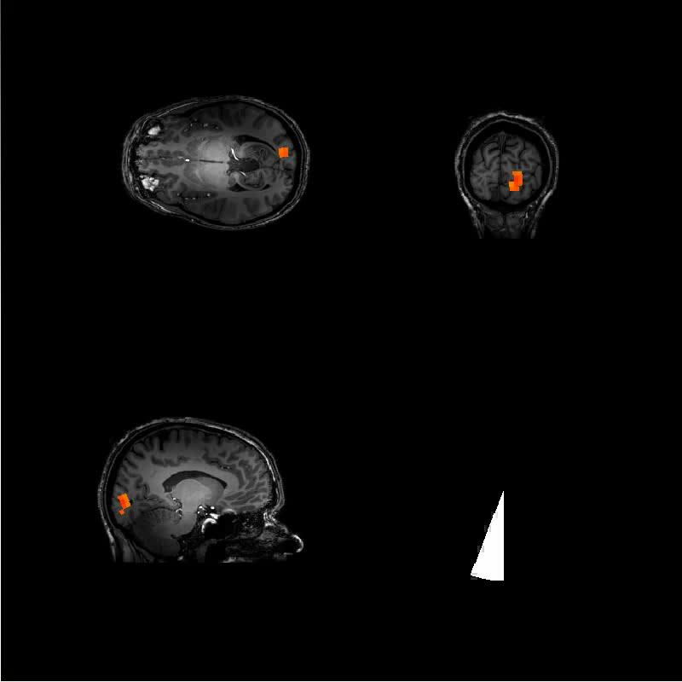
The Inverse Problem
A given magnetic field recorded outside head could have been created by an enormous number of possible electrical current distributions
→ Theoretically ill-posed as there are many possible solutions
Source localisation models require assumptions about brain physiology to make the problem soluble
Many algorithms of source reconstruction exist. This will be covered in a future talk…
Dipole Fitting
Minimum norm approaches
Beamforming
Brookes et al 2010 (http://www.scholarpedia.org/article/MEG)
Notes:
Forward and inverse problems are tackled by construction of models of the EEG/MEG data in time and space. This is done through SPM and will be discussed in more detail in the next couple of talks.
Movie shows MEG beamformer images of electrical changes in the 18-22Hz band in response to a flickering 10Hz rotating checkerboard wedge in a single recording session from one subject (data from Brookes et al. 2010). As the stimulus moves from left to right, upper to lower, visual field the evoked electrical activity in primary visual cortex traverses from right to left and inferior to superior, respectively, consistent with known human retinotopy. That is, although the inverse problem is theoretically impossible to solve, the set of assumption used here produce empirically plausible results.
So we have strong prediction, given knowledge about retinotopy, that a visual stimulus moving from left upper to right lower, evoked activity in V1 should go in the opposite direction (right lower to left upper).

Slide 40
MEG: Overview
http://web.mit.edu/kitmitmeg/whatis.html
Notes:
The magnetic field passes unaffected through brain tissue and the skull, so it can be recorded outside the head (upper middle). The magnetic field is extremely small, but can be detected by sophisticated sensors that are based on superconductivity (upper right). By analyzing the spatial distributions of magnetic fields (lower left), it is possible, by using a model such as a single equivalent current dipole (lower middle), to estimate the intracranial localization of the generator source and superimpose it on an MRI (lower right).

Slide 41
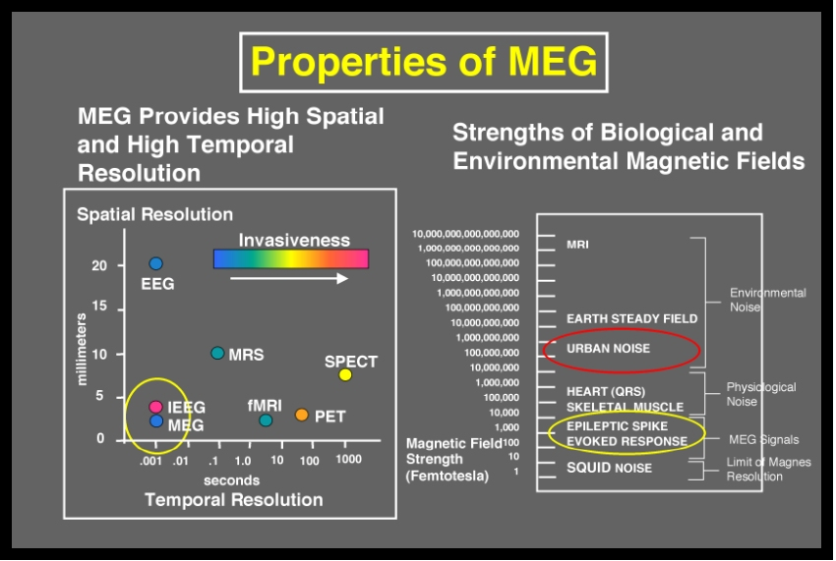
Advantages/Disadvantages of MEG
http://web.mit.edu/kitmitmeg/whatis.html
Notes:
The spatial and temporal properties of MEG are illustrated in the left panel of Figure 5. Only MEG has extremely high temporal and spatial resolution, as represented in the lower left section of the graph. Other functional modalities, except invasive EEG (iEEG), have either poor temporal or spatial resolution. Clearly iEEG has the distinct disadvantage of being invasive.
The main drawback of MEG is shown on the right panel of Figure 5. The MEG signals of interest are extremely small, several orders of magnitude smaller than other signals in a typical environment that can obscure the signal. Thus, specialized shielding is required to eliminate the magnetic interference found in a typical urban clinical environment.

Slide 42
EEG vs. MEG
EEG
MEG
Cheap
Large Signal (10 mV)
Signal distorted by skull/scalp
Spatial localization ~1cm
Sensitive mostly to radial dipoles (neurones on gyri)
Allows subjects to move
Sensors attached to head
Can be done anywhere
Expensive
Tiny Signal(10 fT)
Signal unaffected by skull/scalp
Spatial localization ~1 mm
Sensitive mostly to tangential dipoles (neurons in sulci)
Subjects must remain still
Sensors in helmet
Requires special laboratory with magnetic shielding
Good temporal resolution (~1 ms)
Problematic spatial resolution (forward & inverse problems)
No structural or anatomical information

Slide 43
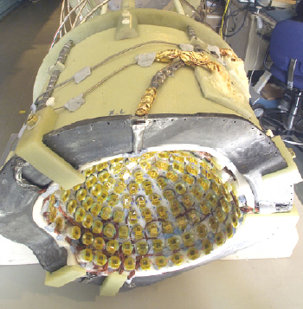
EEG vs. MEG
The sensors do not need to come into direct contact with the scalp. Unlike EEG, MEG does not mess up your hair!
Less preparation time, more child-friendly.

Slide 44
MEG/EEG and Other Experimental Approaches
Notes:
Direct measure of neural activity
Excellent temporal resolution and not unreasonable spatial resolution (esp for MEG).
Safe
Relatively cheap

Slide 45
ADVANTAGES OF M/EEG
Non-invasive (records electromagnetic activity, does not modify it).
More direct measure of neuronal function than metabolism-dependent measures like BOLD signal in fMRI
Can be used with adults, children, clinical population.
High temporal resolution (up to 1 millisecond or less, around 1000x better than fMRI) => ERPs study dynamic aspects of cognition.
Allow quiet environments.
Subjects can perform tasks sitting up- more natural than in MRI scanner
DISADVANTAGES OF M/EEG
Problematic source localisation (forward & inverse problems)
Limited spatial resolution (especially EEG)
Anatomical information not provided

Slide 46

Multimodal Imaging
http://www.neuroscience.cam.ac.uk/directory/profile.php?RikHenson
Notes:
Combining different imaging modalities enables one to make use of all of their strengths.
Combining with fMRI maximises on temporal resolution of one and spatial resolution of the other.
Also helps overcome EEG/MEGs source estimation problems.
More on this in later talks…

Slide 47
References/suggested reading
Andro,W. and Nowak, H, (eds) (2007) Magnetism in Medicine. Wiley - VCN
Handy, T. C. (2005). Event-related potentials. A methods handbook. Cambridge, MA: The MIT Press.
Luck, S. J. (2005). An introduction to the event-related potential technique. Cambridge, Massachussets: The MIT Press
Rugg, M. D., & Coles, M. G. H. (1995). Electrophysiology of mind: Event-related brain potentials and cognition. New York, NY: Oxford University Press.
Hamalainen, M., Hari, R., Ilmoniemi, J., Knuutila, J. & Lounasmaa, O.V. (1993). MEG: Theory, Instrumentation and Applications to Noninvasive Studies of the Working Human Brain. Rev. Mod. Phys. Vol. 65, No. 2, pp 413-497.
Olejnickzac, P., (2006). Neurophysiologic basis of EEG. Journal of Clinical Neurophysiology, 23, 186-189.
Silver, A.H. (2006). How the SQUID was born. Superconductor Science and Technology. Vol.19, Issue 5 , pp173-178.
Sylvain Baillet, John C. Mosher & Richard M. Leahy (2001). Electromagnetic Brain Mapping. IEEE Signal Processing Magazine. Vol.18, No 6, pp 14-30.
Basic MEG info:
http://www1.aston.ac.uk/lhs/research/facilities/meg/introduction/
http://web.mit.edu/kitmitmeg/whatis.html
http://www.nmr.mgh.harvard.edu/martinos/research/technologiesMEG.php
http://www.scholarpedia.org/article/MEG
Notes:
The next two talks are:
Preprocessing and experimental design
Contrasts, inference and source localisation

Slide 48
References/suggested reading - EEG
Speckmann & Elger. Introduction to the Neurophysiological Basis of the EEG and DC Potentials. 2005
Williams & Wilkins. Electroencephalography: basic principles, clinical applications, and related fields. 15-26, 1993
Introduction to EEG and MEG, MRC Cognition and Brain Sciences Unit, Olaf Hauk, 03-08
Olejniczak, J. Clinical Neurophysiology, 2006
Davidson, RJ, Jackson, DC, Larson, CL. Human electroencephalography. In: Cacioppo, JT, Tassinary, LG, Bernston, GG, editors.
Nunez, PL. Electric fields of the brain. 1st ed. New York, Oxford University Press, 1981.
Introduction to quantitative EEG and neurofeedback. Evans, James R. (Ed);Abarbanel, Andrew (Ed) San Diego, CA, US: Academic Press. (1999). xxi 406 pp.
Goldman et al. Acquiring simultaneous EEG and functional MRI. Clinical Neurophysiology, 2000
Handy, T.C. (2004) Event-Related Potentials: A Methods Handbook. MIT Press.
Engel AK, Fries P, Singer W. (2001) Dynamic predictions: oscillations and synchrony in top-down processing. Nature Reviews Neuroscience. 2(10):704-16.
Lachaux JP, Rodriguez E, Martinerie J, Varela FJ. (1999) Measuring phase synchrony in brain signals. Human Brain Mapping. 8(4):194-208.
http://www.ebme.co.uk/arts/eegintro/index.htm
http://psyphz.psych.wisc.edu/~greischar/BIW12-11-02/EEGintro.htm
http://www.psych.nmsu.edu/~jkroger/lab/EEG_Introduction.html
Notes:
The next two talks are:
Preprocessing and experimental design
Contrasts, inference and source localisation

Slide 49
EP vs. ERP / ERF
evoked potential
  short latencies (< 100ms)
  small amplitudes (< 1μV)
  sensory processes
event related potential / field
  longer latencies (100 – 600ms),
  higher amplitudes (10 – 100μV)
  higher cognitive processes
Notes:
49
ERP = change in electrical activity due to some internal or external event

