Slide 1
Methods for Dummies
Coregistration and Spatial Normalization
Jan 11th
Emma Davis and Eleanor Loh

Slide 2
fMRI
fMRI data as 3D matrix of voxels repeatedly sampled over time.
fMRI data analysis assumptions
  Each voxel represents a unique and unchanging location in the brain
  All voxels at a given time-point are acquired simultaneously.
    These assumptions are always incorrect, moving by 5mm can mean each voxel is derived from more than one brain location. Also each slice takes a certain fraction of the repetition time or interscan interval (TR) to complete.
Issues:
- Spatial and temporal inaccuracy
- Physiological oscillations (heart beat and respiration)
- Subject head motion

Slide 3
Preprocessing
Computational procedures applied to fMRI data before statistical analysis to reduce variability in the data not associated with the experimental task.
Regardless of experimental design (block or event) you must do preprocessing
Remove uninteresting variability from the data
  Improve the functional signal to-noise ratio by reducing the total variance in the data
2. Prepare the data for statistical analysis

Slide 4
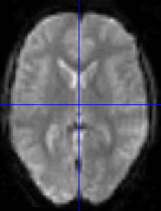

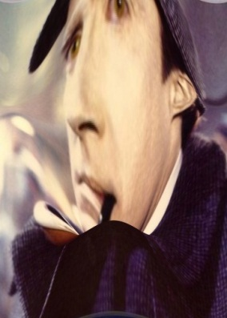
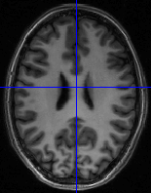
Overview
Func. time series
Coreg + Spatial Normalization
Smooth
Realign
Unwarp
Motion corrected

Slide 5
Coregistration
Coregistration
Aligns two images from different modalities (i.e. Functional to structural image) from the same individual (within subjects).
Similar to realignment but different modalities.
How does activity map onto anatomy? How consistent is this across subjects?
Functional Images have low resolution
Structural Images have high resolution (can distinguish tissue types)
Allows anatomical localisation of single subject activations; can relate changes in BOLD signal due to experimental manipulation to anatomical structures.
Achieve a more precise spatial normalisation of the functional image using the anatomical image.

Slide 6
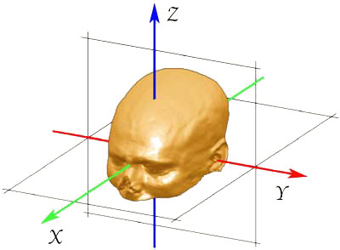
Coregistration
Steps
Registration – determine the 6 parameters of the rigid body transformation between each source image (i.e. fmri) and a reference image (i.e. Structural) (How much each image needs to move to fit the source image)
Rigid body transformation assumes the size and shape of the 2 objects are identical and one can be superimposed onto the other via 3 translations and 3 rotations
Z
X
Y

Slide 7
Realigning
Transformation – the actual movement as determined by registration (i.e. Rigid body transformation)
Reslicing - the process of writing the “altered image” according to the transformation (“re-sampling”).
Interpolation – way of constructing new data points from a set of known data points (i.e. Voxels). Reslicing uses interpolation to find the intensity of the equivalent voxels in the current “transformed” data.
Changes the position without changing the value of the voxels and give correspondence between voxels.

Slide 8
Coregistration
Different methods of Interpolation
1. Nearest neighbour (NN) (taking the value of the NN)
2. Linear interpolation – all immediate neighbours (2 in 1D, 4 in 2D, 8 in 3D) higher degrees provide better interpolation but are slower.
3. B-spline interpolation – improves accuracy, has higher spatial frequency
(NB: NN and Linear are the same as B-spline with degrees 0 and 1)
NB: the method you use depends on the type of data and your research question, however the default in SPM is 4th order B-spline

Slide 9
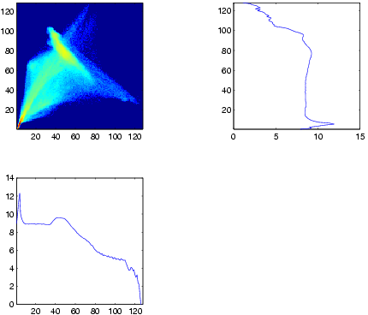
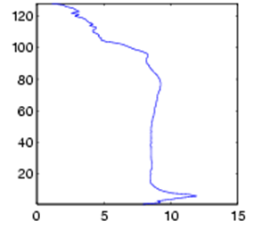
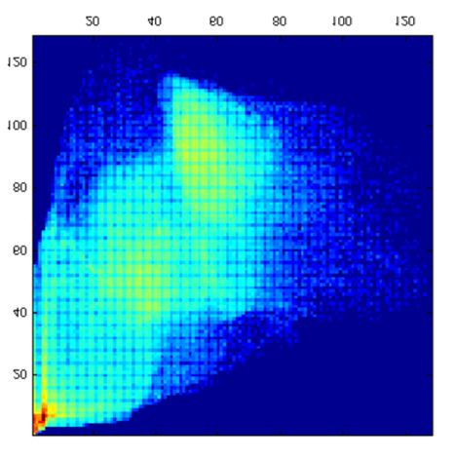
Coregistration
As the 2 images are of different modalities, a least squared approach cannot be performed.
To check the fit of the coregistration we look at how one signal intensity predicts another.
The sharpness of the Joint Histogram correlates with image alignment.

Slide 10
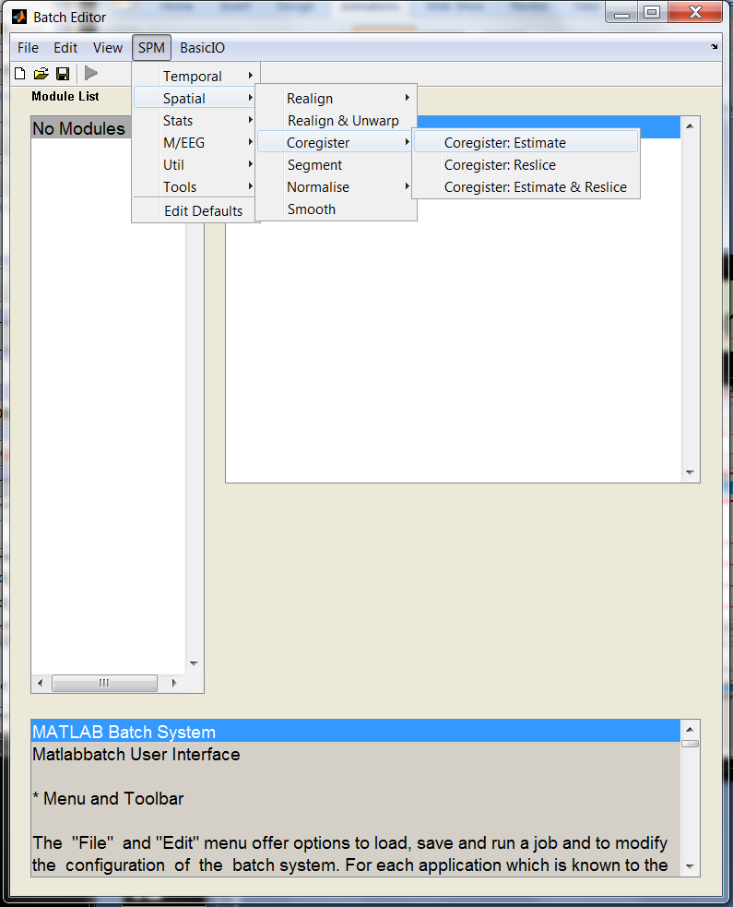
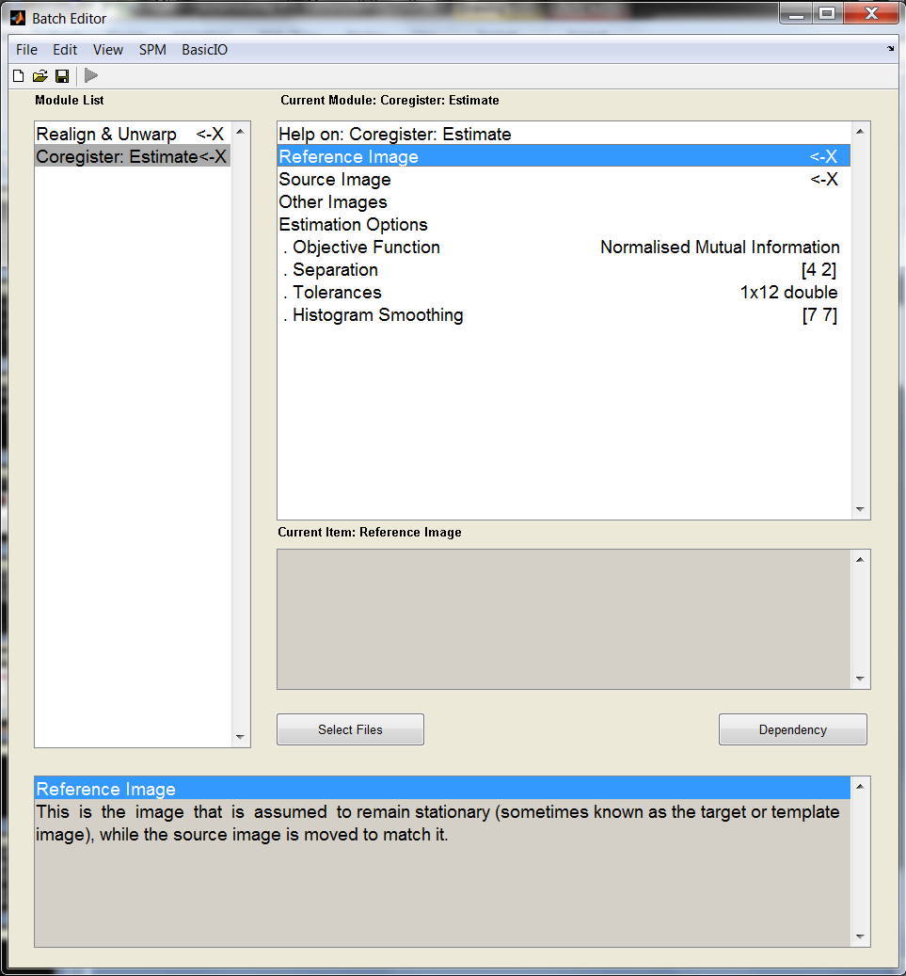
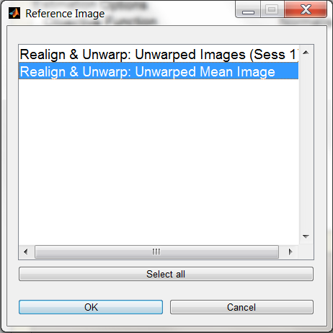
Coregistration
Coregister: Estimate; Ref image use dependency to select
Realign & unwarp: unwarped mean image
Source image use the subjects structural
Coregistration can be done as Coregistration:Estimate; Coregistration: Reslice; Coregistration Estimate & Reslice.
NB: If you are normalising the data you don’t need to reslice as this “writing” will be done later

Slide 11
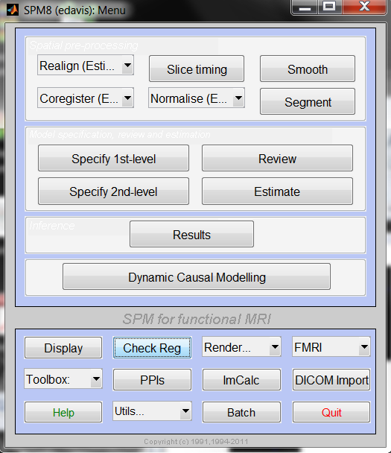
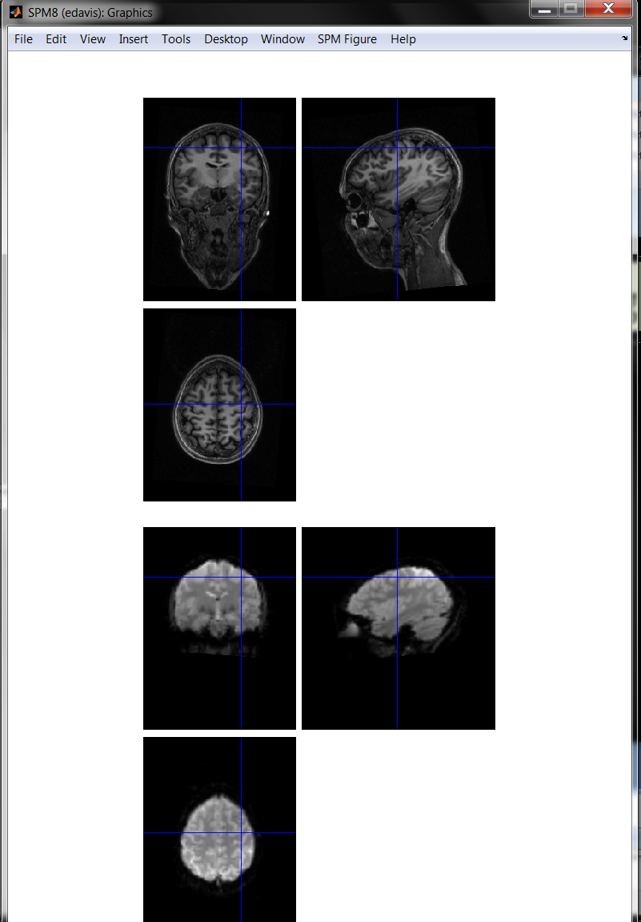
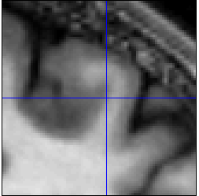
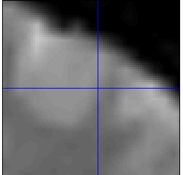
Check Registration
Check Reg – Select the images you coregistered (fmri and structural)
NB: Select mean unwarped functional (meanufMA...) and the structural (sMA...)
Can also check spatial normalization (normalised files – wsMT structural, wuf functional)

Slide 12


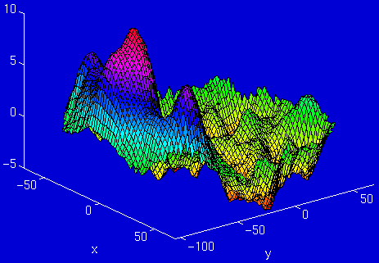
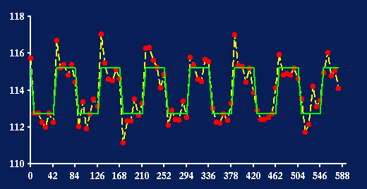
Overview
fMRI time-series
kernel
Design matrix
Statistical Parametric Map
Motion
correction
Smoothing
General Linear Model
(Co-registration and) Spatial
normalisation
Parameter Estimates
Standard
template

Slide 13
Preprocessing Steps
Realignment (& unwarping)
  Motion correction: Adjust for movement between slices
Coregistration
  Overlay structural and functional images: Link functional scans to anatomical scan
Normalisation
  Warp images to fit to a standard template brain
Smoothing
  To increase signal-to-noise ratio
Extras (optional)
  Slice timing correction; unwarping

Slide 14
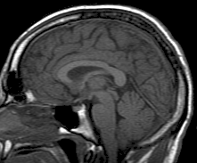
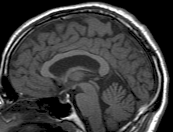
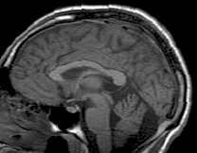
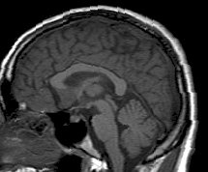
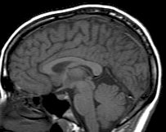
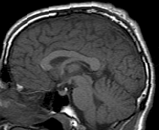
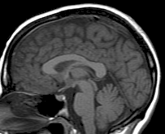
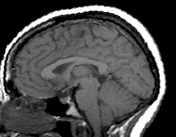
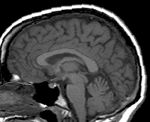
Within Person vs. Between People
Co-registration: Within Subjects
Spatial Normalisation: Between Subjects
PET
T1 MRI
Problem:
Brain morphology varies significantly and fundamentally, from person to person
(major landmarks, cortical folding patterns)
Notes:
Between-subjects: includes all subjects that you’ve tested, as well as (more broadly) the overall population

Slide 15
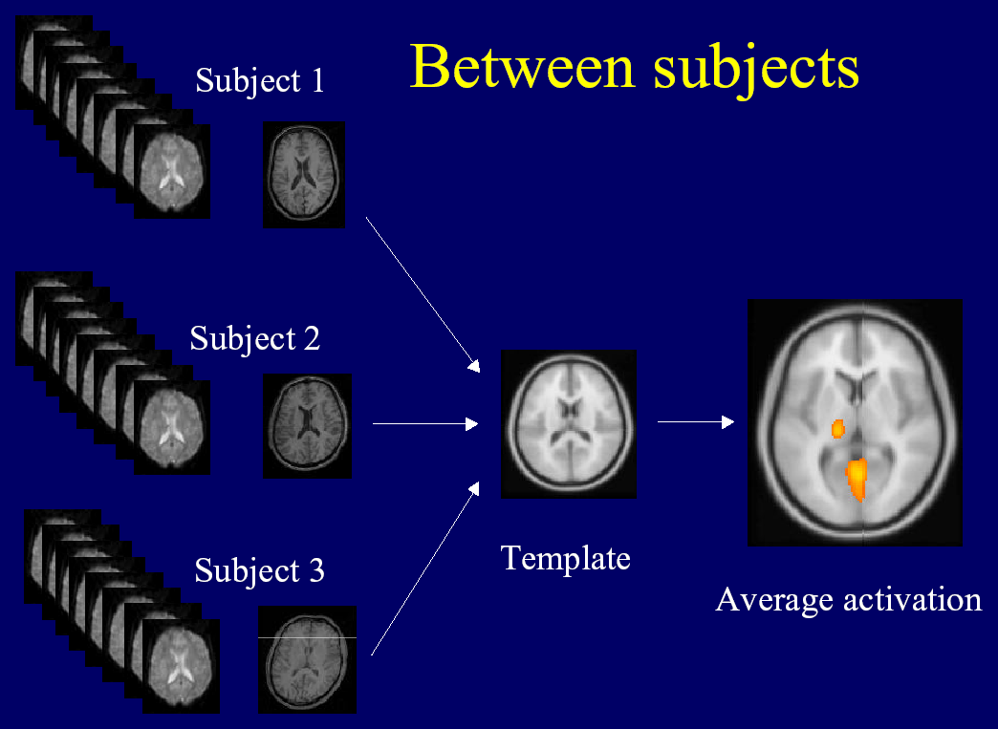
What is Normalisation?
Solution:
Match all images to a template brain.
A kind of co-registration, but one where images fundamentally differ in shape
Template fitting: stretching/squeezing/warping images, so that they match a standardized anatomical template
➔ Establishes a voxel-to-voxel correspondence, between brains of different individuals

Slide 16
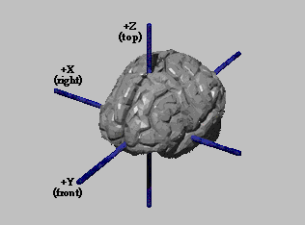
Why Normalise?
Matching patterns of functional activation to a standardized anatomical template allows us to:
Average the signal across participants
Derive group statistics
Improve the sensitivity/statistical power of the analysis
Generalise findings to the population level
Group analysis: Identify commonalities/differences between groups (e.g. patient vs. healthy)
Report results in standard co-ordinate system (e.g. MNI) → facilitates cross-study comparison
Notes:
If you only have a few images per subject, you may HAVE to combine data from different subjects in order to find your effect statistically
With many functional images from one subject, you may have enough statistical power to produce findings. BUT you want to ensure that your findings are representative, rather than an isolated neurological quirk
- Even if you’re only looking at one subject (e.g. with a particular lesion), aligning to standardized space/normalizing enables you to communicate your findings in a way that is easily interpreted by other researchers

Slide 17
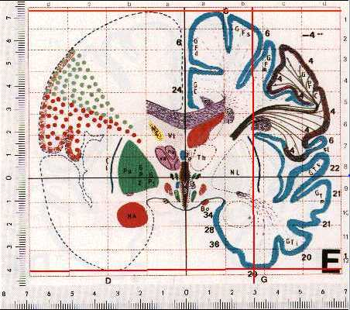
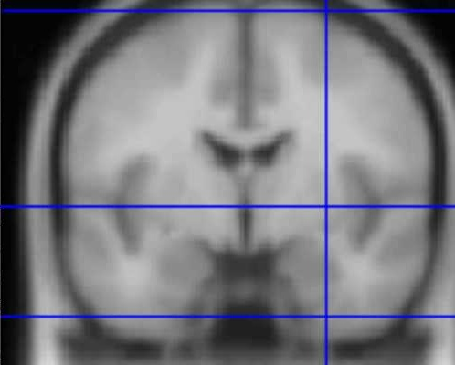
Standard spaces
(What are we normalizing our data to)
The Talairach Atlas
The MNI/ICBM AVG152 Template
Talairach:
  Not representative of population (single-subject atlas)
  Slices, rather than a 3D volume (from post-mortem slices)
MNI:
  Based on data from many individuals (probabilistic space)
  Fully 3D, data at every voxel
SPM reports MNI coordinates (can be converted to Talairach)
Shared conventions: AC is roughly [0 0 0], xyz axes = right-left, anterior-posterior, superior-inferior

Slide 18
Spatial normalization as a process of optimization
In a functional study, we want to match functionally homologous regions between different subjects
(i.e. we want to make our functional (& structural) images look like the template)
  Structure-function relationship varies from subject to subject
    Co-registration algorithms differ (due to fundamental structural differences)
    → fundamentally, standardization/full alignment of functional data is not perfect
  Normalization involves a flexible warp
    Flexible warp = thousands of parameters to play around with
    Even if it were possible to match all our images perfectly to the template, we might not be able to find this solution
    The challenge of spatial normalization is optimization
Optimization/compromise approach in SPM:
  Correct for large scale variability (e.g. size of structures)
  (Smoothing) smooth over small-scale differences (compensate for residual misalignments)
Notes:
Optimization= aim to match images to template as much as possible
BUT: constrained by anatomical plausibility of results (see over-fitting)
Flexible warp
- Thousands of parameters, but they are not arbitrarily chosen. The parameters chosen as starting estimates are deemed reasonable on the basis of past literature (i.e. have emerged historically, empirically, through other methods of spatial normalization that have used more anatomical approaches). SPM starts with these starting estimates, and then attempts to improve the model by changing the parameters, and observing the results (i.e. observing how well the images match the template, index by looking at the sum of squares)

Slide 19
Types of Spatial Normalisation
Label based (anatomy based)
  Identify homologous features (points, lines) in the image and template
  Find the transformations that best superimpose them
  Limitation: Few identifiable features, manual feature-identification (time consuming and subjective)
Non-label based (intensity based)
  Identifies a spatial transformation that optimizes voxel similarity, between template and image measure
    Optimization = Minimize the sum of squares, which measures the difference between template and source image
  Limitation: susceptible to poor starting estimates (parameters chosen)
    Typically not a problem – priors used in SPM are based on parameters that have emerged in the literature
    Special populations
SPM uses the intensity-based approach
  Adopts a two-stage procedure:
    12-parameter affine (linear transformation)
    Warping (Non-linear transformation)
Notes:
Priors/parameters – refer to the affine transformations (step 1) and the weights of the basis functions (step 2)

Slide 20
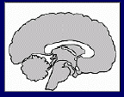
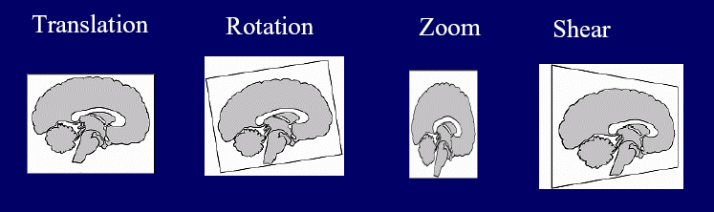
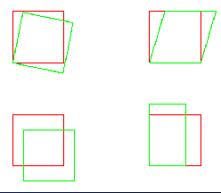
Step 1: Affine Transformation
Determines the optimum 12-parameter affine transformation to match the size and position of the images
12 parameters =
  3df translation
  3 df rotation
  3 df scaling/zooming
  3 df for shearing or skewing
Fits the overall position, size and shape
Rotation
Shear
Translation
Zoom
Notes:
Linear transformation is not enough to make the brains look even remotely similar

Slide 21
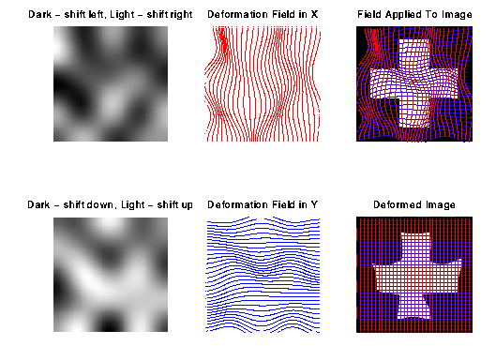
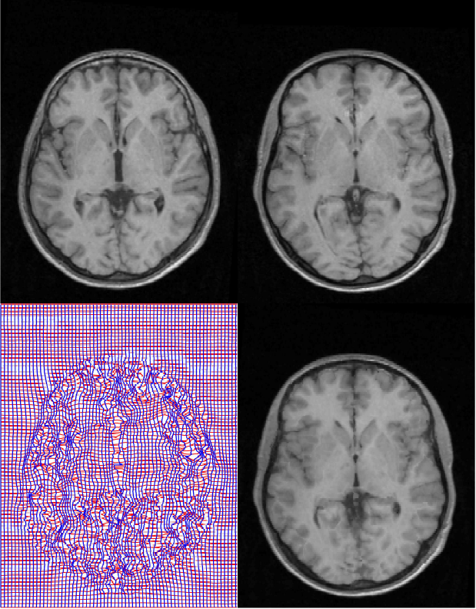
Step 2: Non-linear Registration (warping)
Warp images, by constructing a deformation map (a linear combination of low-frequency periodic basis functions)
  For every voxel, we model what the components of displacement are
Gets rid of small-scale anatomical differences
Notes:
Image
Image on top = original
To get it to fit the template, we warp it ➔ deformed cross, deformed relative to original, but now fits template
How to do this:
For every point in the image (every voxel in 3D), we model what the components of displacement are.
Dark/light image: deformation map? Displacement field, we need to parsimonously model this
To parsimonously model the deformation field, we use a combination of smooth basis functions

Slide 22
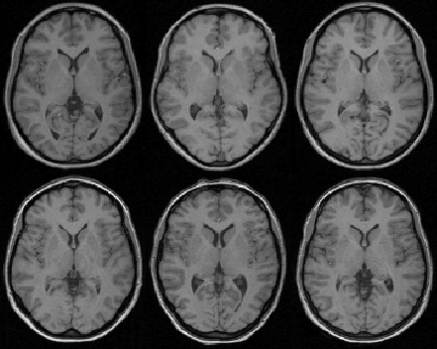
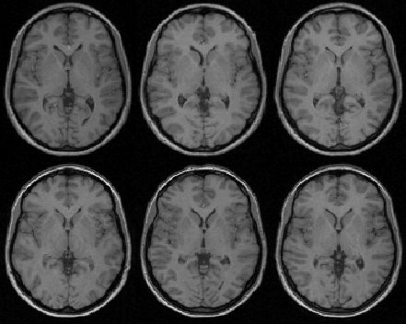
Results from Spatial Normalisation
Affine registration
Non-linear registration
Notes:
After Affine registration, size of ventricles is still markedly difference across subjects
After warping, things look a lot more similar – not identical though
Smoothing to get rid of other small scale differences- or use more complicated things like DARTEL

Slide 23
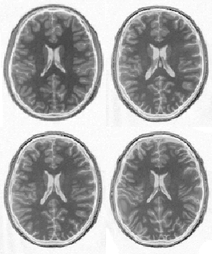
Risk: Over-fitting
Affine registration.
( χ² = 472.1)
Template
image
Non-linear
registration
without
regularisation.
( χ² = 287.3)
Over-fitting: Introduce unrealistic deformations, in the service of normalization
Notes:
More preferable to have a slightly less-good match, that is still anatomically realistic

Slide 24
Risk: Over-fitting
Affine registration.
( χ² = 472.1)
Template
image
Non-linear
registration
using
regularisation.
( χ² = 302.7)
Non-linear
registration
without
regularisation.
( χ² = 287.3)
Notes:
More preferable to have a slightly less-good match, that is still anatomically realistic

Slide 25
Apply Regularisation
(protect against the risk of over-fitting)
Regularisation terms/constraints are included in normalization
Ensures voxels stay close to their neighbours
Involves
  Setting limits to the parameters used in the flexible warp (affine transformation + weights for basis functions)
Manually check your data for deformations
  e.g. Look through mean functional images for each subject - if data from 2 subjects look markedly different from all the others, you may have a problem

Slide 26
Unified Segmentation
(So far) We’ve matched to a template that contains information only about voxel image intensity
Unified segmentation:
  Matched to (probabilistic) model of different tissue classes (white, grey, CSF)
    Theoretically similar issues (e.g. overfitting, optimization), but ‘template’ has much more information
  The SPM-recommended approach!

Slide 27
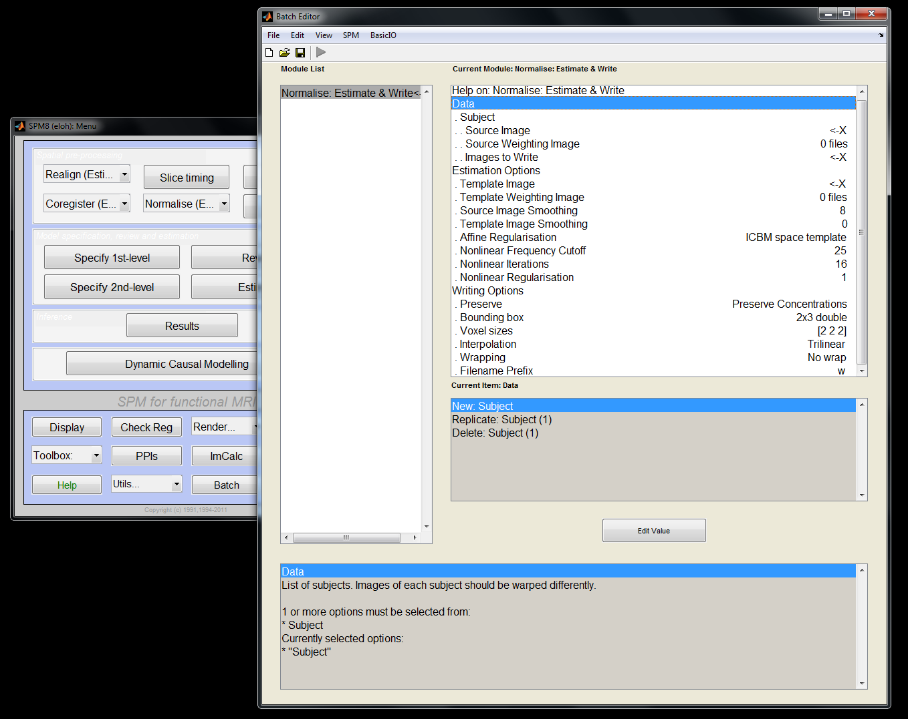
How to do normalisation in SPM

Slide 28
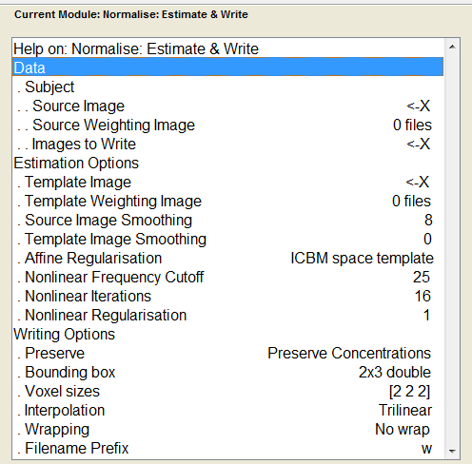
SPM: (1) Spatial normalization
Data for a single subject
Double-click ‘Data’ to add more subjects (batch)
Source image = Structural image
Images to Write = co-registered functionals
Source weighting image = (a priori) create a mask to exclude parts of your image from the estimation+writing computations (e.g. if you have a lesion)
See presentation comments, for more info about other options
Notes:
Other options (just if anyone was curious)
Source Image Smoothing & Template Image Smoothing – Template is smoothed (8mm), while source image (i.e. your structural) at this stage is not. Setting Source smoothing to 8 matches its smoothness to the Template.
Affine Regularisation – ICBM space template is used, because MNI tends to be bigger than raw data – this just accounts for this.
Nonlinear Frequency Cutoff – How many basis function cycles are included (sets a maximum). This determines how detailed you want your spatial normalization to be, and there is a tradeoff with overfitting and the time taken to run the analysis
Nonlinear Iterations – Model starts with prior estimates, and then tries to improve the fit 16 times

Slide 29
SPM: (1) Spatial normalization
Template Image = Standardized templates are available (T1 for structurals, T2 for functional)
Bounding box = NaN(2,3) → Instead of pre-specifying a bounding box, SPM will get it from the data itself
Voxel sizes = If you want to normalize only structurals, set this to [1 1 1] – smaller voxels
Wrapping = Use this if your brain image shows wrap-around (e.g. if the top of brain is displayed on the bottom of your image)
w for warped

Slide 30
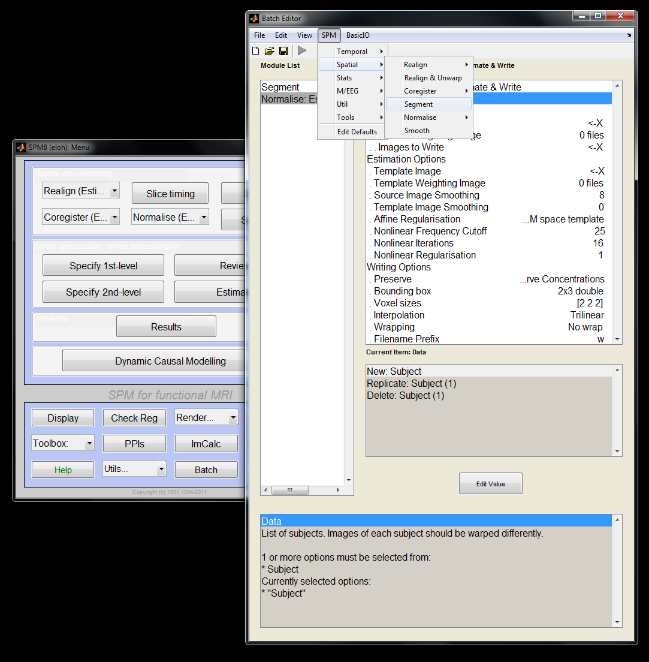
SPM: (2) Unified Segmentation
Batch
SPM → Spatial → Segment
SPM → Spatial → Normalize → Write

Slide 31
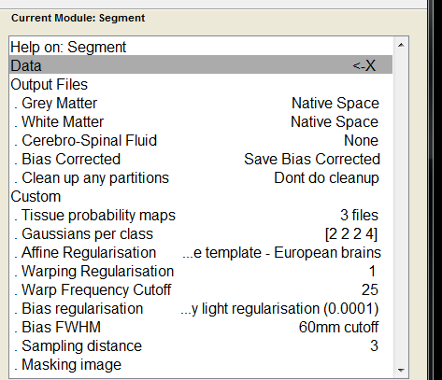
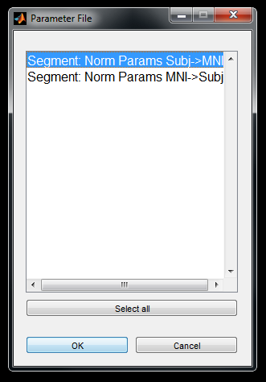
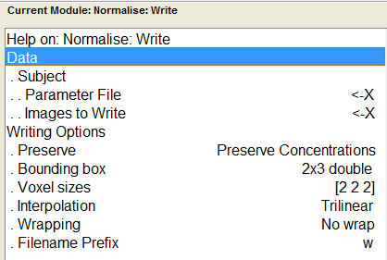
SPM: (2) Unified Segmentation
Data = Structural file (batched, for all subjects)
Tissue probability maps = 3 files: white matter, grey matter, CSF (Default)
Masking image = exclude regions from spatial normalization (e.g. lesion)
Parameter File = Click ‘Dependency’ (bottom right of same window)
Images to Write = Co-registered functionals
(same as in previous slide)
Notes:
Warp Regularisation and Warp Frequency Cutoff – same as Nonlinear Frequency Cutoff and Nonlinear Regularisation, in previous slides.

Slide 32
References for spatial normalization
SPM course videos & slides: http://www.ucl.ac.uk/stream/media/swatch?v=1d42446d1c34
Previous MfD Slides
Rik Henson’s Preprocessing Slides: http://imaging.mrc-cbu.cam.ac.uk/imaging/ProcessingStream

Slide 33
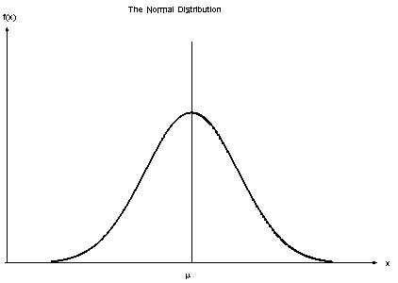
Smoothing
Why?
Improves the Signal-to-noise ratio therefore increases sensitivity
Allows for better spatial overlap by blurring minor anatomical differences between subjects
Allow for statistical analysis on your data.
    Fmri data is not “parametric” (i.e. normal distribution)
How much you smooth depends on the voxel size and what you are interested in finding. i.e. 4mm smoothing for specific anatomical region.

Slide 34
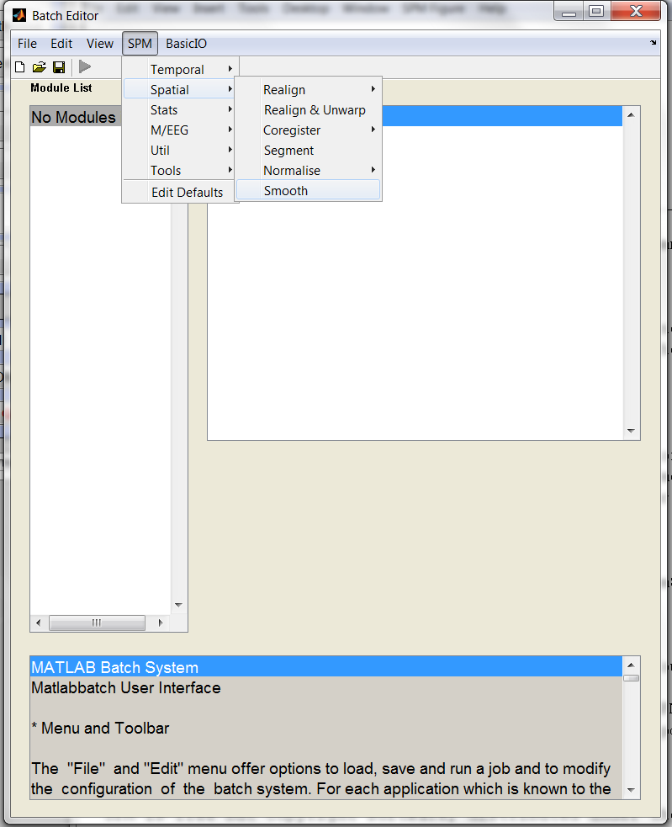
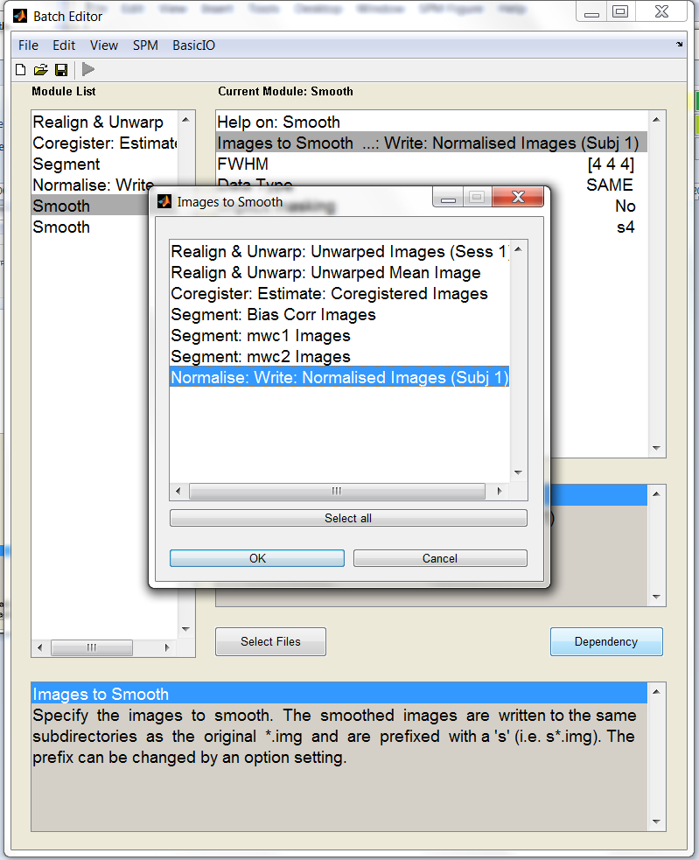
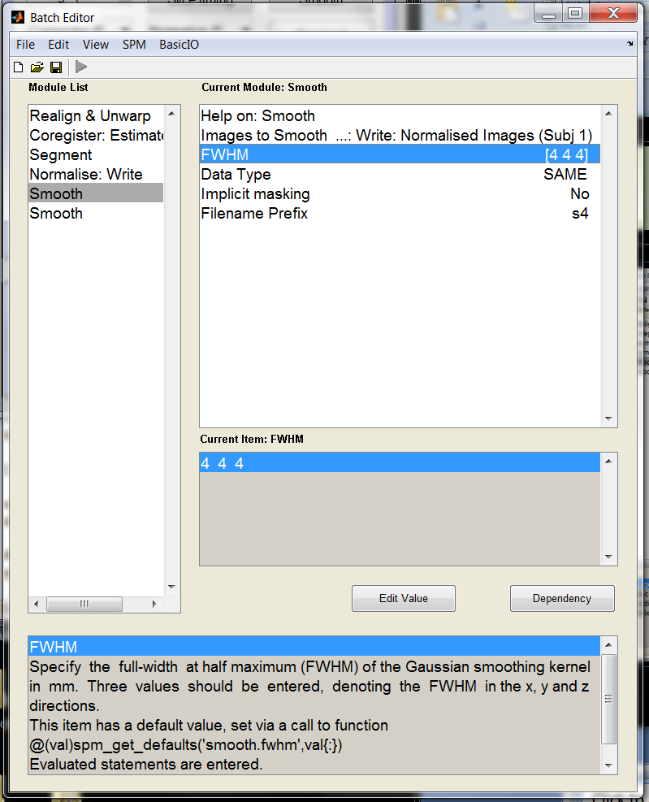
Smoothing
Smooth; Images to smooth – dependency – Normalise:Write:Normalised Images
4 4 4 or 8 8 8 (2 spaces) also change the prefix to s4/s8

Slide 35
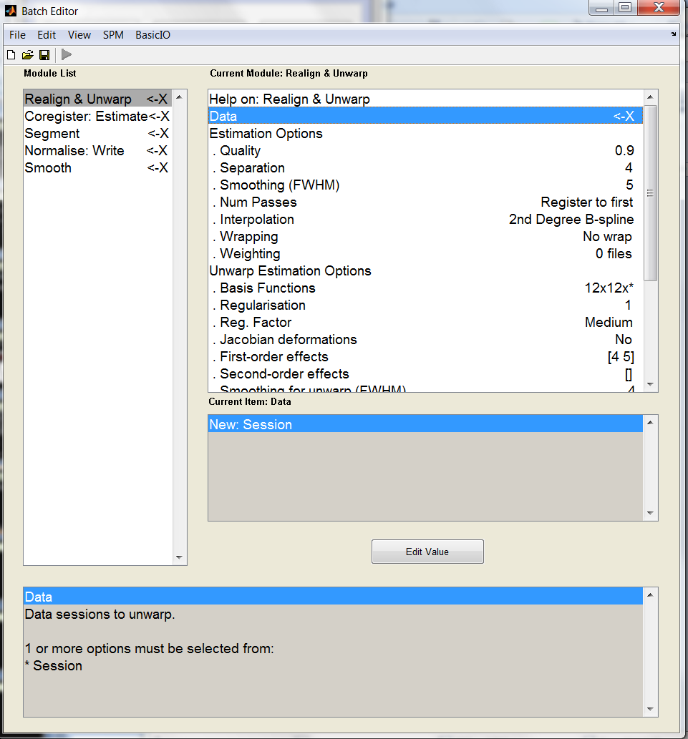
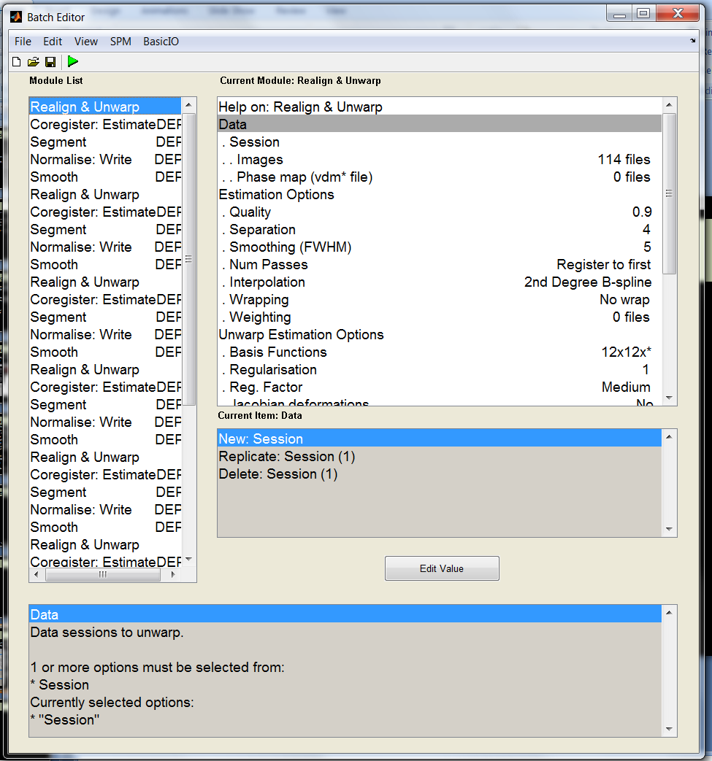
Preprocessing - Batches
To make life easier once you have decided on the preprocessing steps make a generic batch
Leave ‘X’ blank, fill in the dependencies.
Fill in the subject specific details (X) and SAVE before running.
Load multiple batches and leave to run.
When the arrow is green you can run the batch.

