Slide 1
1st level analysis: basis functions, parametric modulation and correlated regressors.
1st of February 2012
Sylvia Kreutzer
Max-Philipp Stenner

Slide 2
First Level Analysis
Data analysis with SPM
  Pre-processing of the data (Alignment, smoothing etc.)
  First Level Analysis
    Basis Functions (Sylvia)
    Experimental design and correlated regressors (Max)
    Random Field theory (next talk)
  Second Level Analysis

Slide 3
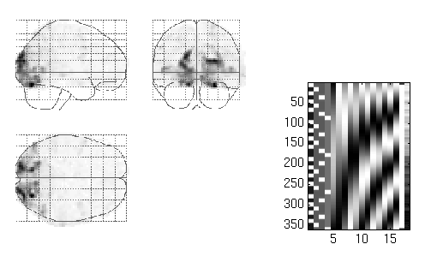
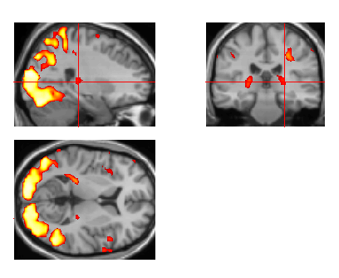
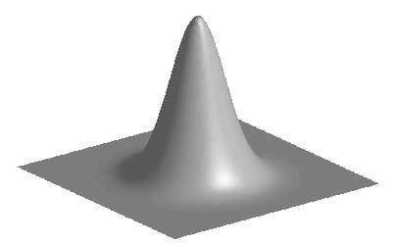
Image time-series
Spatial filter
Design matrix
Statistical Parametric Map
Realignment
Smoothing
General Linear Model
Statistical
Inference
RFT
Normalisation
Anatomical
reference
p <0.05
Parameter estimates
Notes:
3
1st Level analysis: Temporal basis functions

Slide 4
Basis Functions
Temporal basis functions are used to model a more complex function
Function of interest in fMRI
  Percent signal change over time
How to approximate the signal?
  We have to find the combination of functions that give the best representation of the measured BOLD response
Default in SPM: Canonical hemodynamic response function (HDRF)

Slide 5
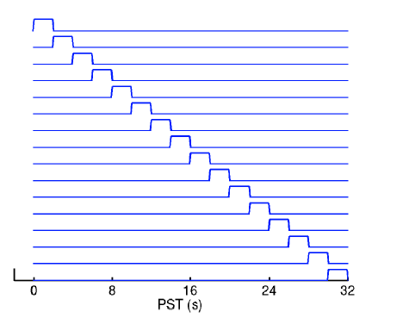
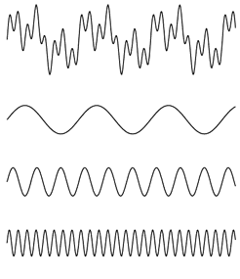
Basis Functions
Many different possible functions can be used
f(t)
h1(t)
h2(t)
h3(t)
Fourier analysis
The complex wave at the top can be decomposed into the sum of the three simpler waves shown below.
f(t)=h1(t)+h2(t)+h3(t)
Finite Impulse Response (FIR)
Notes:
We tell SPM what signal to expect so that the model generated by SPM fits the data optimally
If we use FT, we are very flexible, because we can use many sinusoidal functions and chose the ones we want, but we have to – more or less – guess the parameters by looking at our data first which can pose problems.
The FIR is able to model a delay in the response over time.
This does not implement any biological knowledge that we have about the signal that we are measuring with fMRI.
So if you have no biological knowledge, it would make sense to use one of those functions

Slide 6
Hemodynamic Response Function (HRF)
Since we know the shape of the hemodynamic response, we should use this knowledge and find a similar function to model the percentage signal change over time.
This is our best prediction
of the signal.
Peak
Brief
Stimulus
Undershoot
Initial
Undershoot
Hemodynamic response function
Notes:
But we have biological knowledge, thus we can use this to get a better model fit!
The impulse response function we see here is the best prediction we can give for our percent signal change over time.

Slide 7
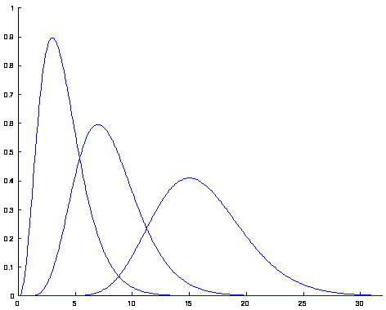
Hemodynamic Response Function
(HRF)
Two gamma functions added together form a good representation of the haemodynamic response, although they lack the initial undershoot!
Gamma functions Two Gamma functions added
Notes:
To model the impulse response function, SPM uses then two gamma functions.
In the right picture the two gamma functions are added, with one representing the peak of the hemodynamic response and one the undershoot

Slide 8
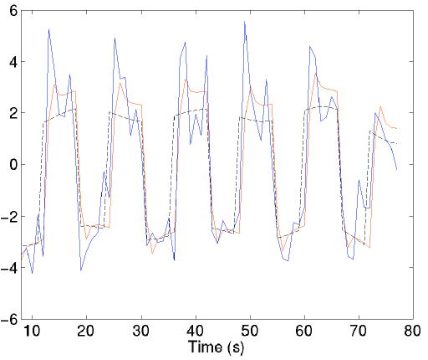
HRF versus boxcar
Fits of a boxcar epoch model with (red) and without (black) convolution by a canonical HRF, together with the data (blue).
Notes:
This shows a boxcar model without convolution in black: This can for example represent the blocks in a blocked design. So we expect the neural activity to take place within these blocks.
But the actual fMRI signal is not a block, we do not pick up the electrical signal, but the BOLD response.
So to model the data in a better, more plausible way, we perform convolution between the block function and the canonical HRF function. The result of the convolution is the red line which then is closer to the actual data – here in blue.

Slide 9
Limits of HRF
General shape of the BOLD impulse response similar across early sensory regions, such as V1 and S1.
Variability across higher cortical regions.
Considerable variability across people.
These types of variability can be accommodated by expanding the HRF...

Slide 10
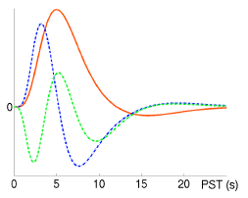
Informed Basis Set
Canonical HRF
Temporal derivative
Dispersion derivative
Canonical HRF (2 gamma functions) plus two expansions in:
  Time: The temporal derivative can model (small) differences in the latency of the peak response
  Width: The dispersion derivative can model (small) differences in the duration of the peak response.
Notes:
We expand the canonical HRF thus by adding two more derivatives
The temporal derivative allows the peak response to be a little bit earlier, so actually would shift the whole HRF a little bit to the left
The dispersion derivative allows the width of the response to vary a little bit, more specific to be a little narrower.
SPM will look for every single voxel how much each of the three functions contributes to the signal change

Slide 11
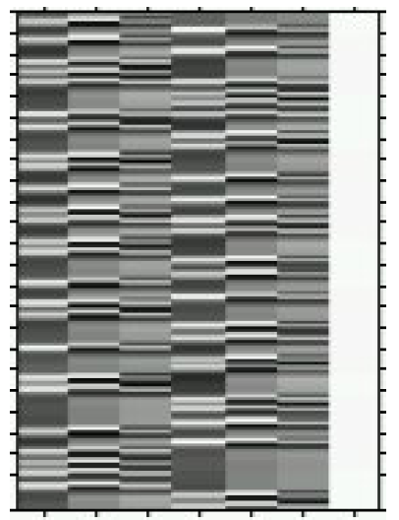
Design Matrix
Left Right Mean
3 regressors used to model each condition
The three basis functions are:
1. Canonical HRF
2. Derivatives with respect to time
3. Derivatives with respect to dispersion
Notes:
Then, the design matrix is created
Here we see for the two conditions (let it be left and right button press), we have each three regressors that can be used to model the signal change each representing on of the functions of the informed basis set we just saw
For the statistical tests, in the end, only the canonical HRF will be used
SPM makes the derivatives both orthogonal to the HRF so that there will be no overlap in what percent signal change they account for

Slide 12
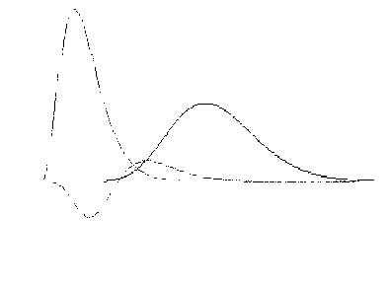
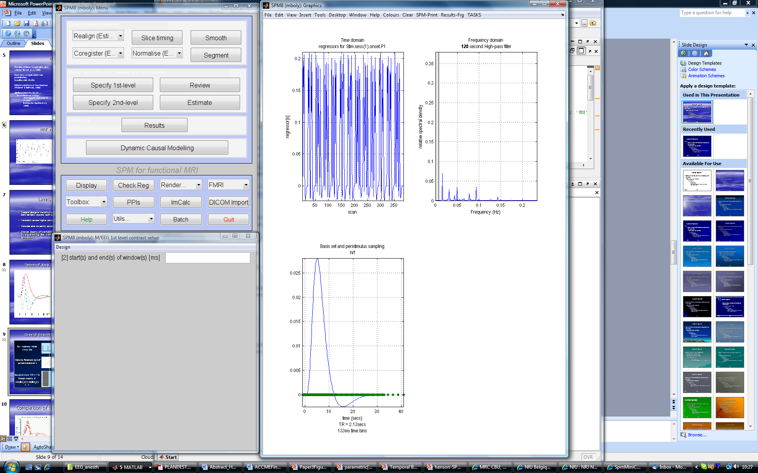
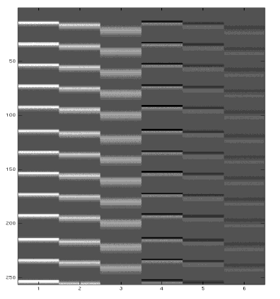
General (convoluted) Linear Model
Ex: Auditory words
every 20s
Gamma functions ƒ_{i}(τ) of
peristimulus time τ
SPM{F}
Sampled every TR = 1.7s
Design matrix, X
[x(t)⊗ƒ₁(τ) | x(t)⊗ƒ₂(τ) |...]
…
0 time {secs} 30
REVIEW DESIGN

Slide 13
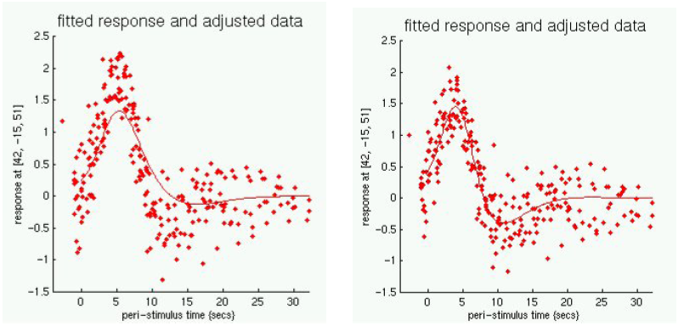
Comparison of the fitted response
Haemodynamic response in a single voxel.
Left: Estimation using the simple model
Right: More flexible model with basis functions
Notes:
Illustration of how the informed basis set gives a better approximation of our data, a better model fit

Slide 14
Summary
SPM uses basis functions to model the hemodynamic response using a single basis function or a set of functions.
The most common choice is the `Canonical HRF' (Default in SPM)
By adding the time and dispersion derivatives one can account for variability in the signal change over voxels

Slide 15
Sources
www.mrc-cbu.cam.ac.uk/Imaging/Common/rikSPM-GLM.ppt
http://www.fil.ion.ucl.ac.uk/spm/doc/manual.pdf
And thanks to Guillaume!

Slide 16
Part II: Correlated regressors parametric/non-parametric design

Slide 17
Multicollinearity
y_{i} = ß₀ + ß₁x_{i1} + ß₂x_{i2} +… + ß_{N}x_{iN} + ε
Coefficients reflect
an estimated change in y
with every unit change in x_{i}
while controlling for all other regressors

Slide 18
Multicollinearity
{
y_{i} = ß₀ + ß₁x_{i1} + ß₂x_{i2} +… + ß_{N}x_{iN} + ε
x_{i1} = λ₀ + λx_{i2} + v
low variance of v
high variance of v
X_{i1}
(e.g. age)
X_{i1}
x
x
x
x
x
x
x
x
x
x
x
x
x
x
x
x
x
x
x
x
x
x
X_{i2}
X_{i2}
(e.g. chronic disease duration)

Slide 19
Multicollinearity and estimability
y
OLS minimizes e by
Xe = 0
with
e = Y – (Xβ_{estim})⁻¹
which gives
  β_{estim} = (X^{T}X)⁻¹X^{T}Y
e
x₂
x₁
(SPM course Oct. 2010, Guillaume Flandin)
high multicollinearity
(i.e. variance of v small)
inaccuracy of individual β_{estim}, high standard error
perfect multicollinearity
(i.e. variance of v = 0)
det(X) = 0
(X^{T}X) not invertible
β_{estim} not unique
cf
covariance matrix

Slide 20
Multicollinearity
(t- and [unidimensional] F-) testing of a single regressor (e.g. R₁) =̂ testing for the component that is not explained by (is orthogonal to) the other/the reduced model (e.g. R₂)
multicollinearity is contrast specific
“conflating” correlated regressors by means of (multidimensional) F-contrasts permits assessing common contribution to variance
(X_{i}β_{estim} = projection of Y_{i} onto X space)
R₁’
X_{i}β_{estim}
R₁
R₂

Slide 21
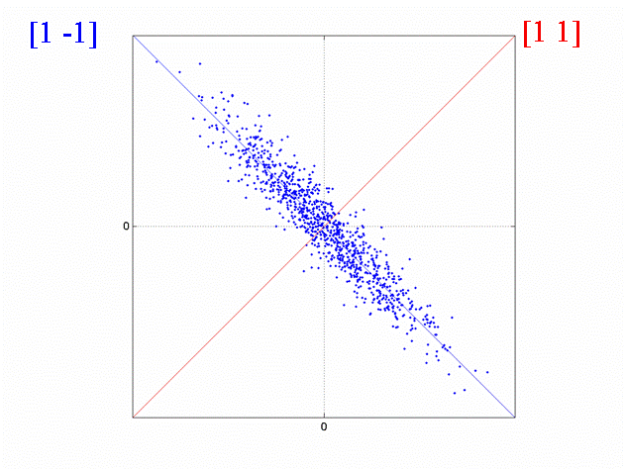
Multicollinearity
(relatively) little spread after projection onto
x-axis,
y-axis or
f(x) = x
reflecting reduced efficiency for detecting dependencies of the observed data on the respective (combination of) regressors
regressor 2 x hrf
regressor 1 x hrf
(MRC CBU Cambridge,
http://imaging.mrc-cbu.cam.ac.uk/imaging/DesignEfficiency)

Slide 22
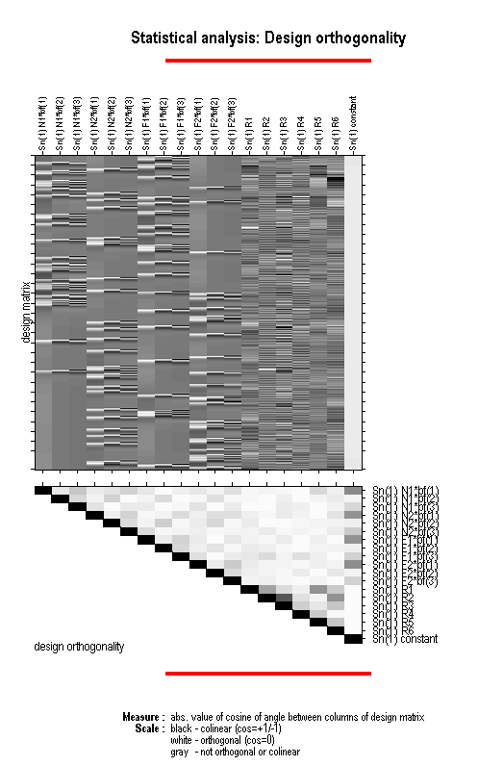
Orthogonality matrix
reflects the cosine of the angles
between respective pairs of columns
(SPM course Oct. 2010, Guillaume Flandin)

Slide 23
Orthogonalizing
leaves the parameter estimate of R₁ unchanged but alters the estimate of the R₂ parameter
assumes unambiguous causality between the orthogonalized predictor and the dependent variable by attributing the common variance to this one predictor only
hence rarely justified
Xβ_{estim}
R₁^{orth}
R₁
R₂
R₂^{new}

Slide 24
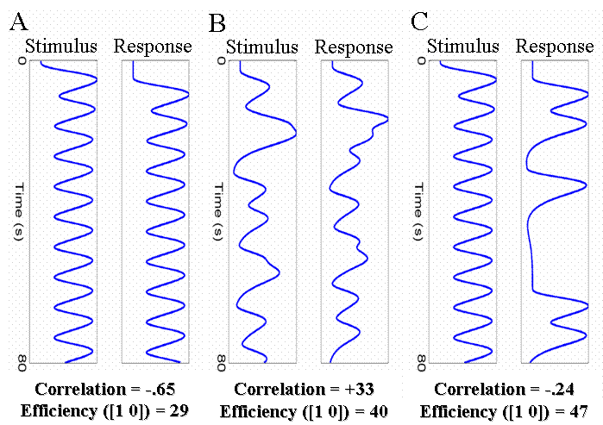
Dealing with multicollinearity
Avoid.
(avoid dummy variables; when
sequential scheme of predictors
(stimulus – response) is inevitable:
inject jittered delay (see B) or use a
probabilistic R₁-R₂ sequence (see C))
Obtain more data to decrease standard error of parameter estimates
Use F-contrasts to assess common contribution to data variance
Orthogonalizing might lead to self-fulfilling prophecies
(MRC CBU Cambridge,
http://imaging.mrc-cbu.cam.ac.uk/imaging/DesignEfficiency)

Slide 25
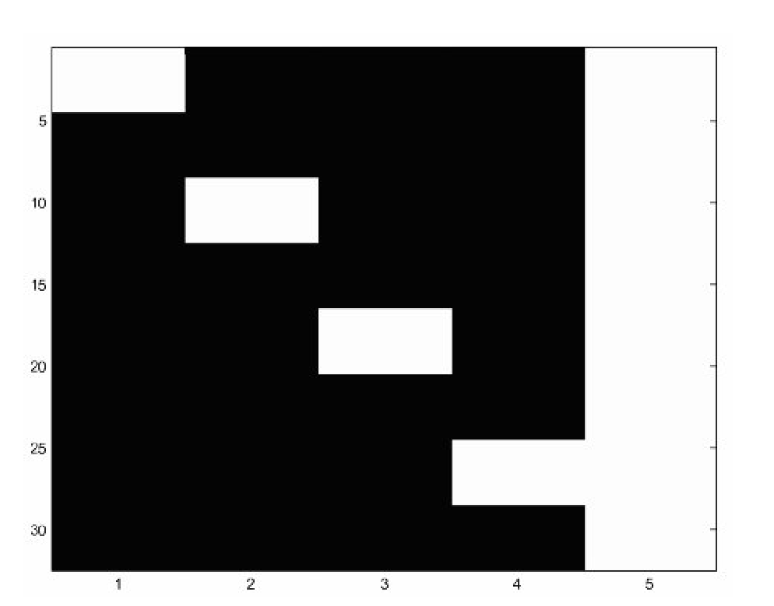
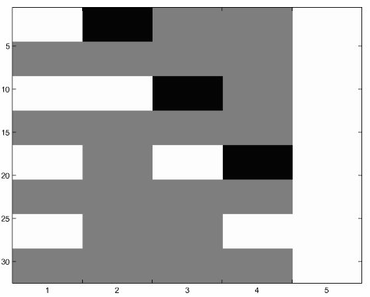
Parametric vs. factorial design
Widely-used example
(Statistical Parametric Mapping,
Friston et al. 2007)
Four button press forces
factorial
parametric

Slide 26
Parametric vs. factorial design
Which – when?
Limited prior knowledge, flexibility in contrasting beneficial (“screening”):
Large number of levels/continuous range:
factorial
parametric

Slide 27
Happy mapping!

