Slide 1
Methods for Dummies
Preprocessing
Realigning and unwarping
Jan 4th
Emma Davis and Eleanor Loh

Slide 2
fMRI
fMRI data as 3D matrix of voxels repeatedly sampled over time.
fMRI data analysis assumptions
Each voxel represents a unique and unchanging location in the brain
All voxels at a given time-point are acquired simultaneously.
These assumptions are always incorrect, moving by 5mm can mean each voxel is derived from more than one brain location. Also each slice takes a certain fraction of the repetition time or interscan interval (TR) to complete.
Issues:
- Spatial and temporal inaccuracy
- Physiological oscillations (heart beat and respiration)
- Subject head motion

Slide 3
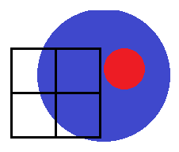
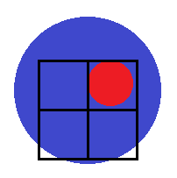
Preprocessing
For various reasons, image corresponding to Region A may not be in the same location on the image, throughout the entire time series.
These preprocessing steps aim to ensure that, when we compare voxel activation corresponding to different times (and presumably different cognitive processes), we are comparing activations corresponding to the same part of the brain.
Voxel A: Inactive
Subject
moves
Very important because the movement-induced variance is often much larger than the experimental-induced variance.
Voxel A: Active
Notes:
Overview of the preprocessing steps covered in today’s session, and where they fit in the process
4 preprocessing steps: realignment, unwarping, co-registration, spatial normalization
Realignment and unwarping ensure that the same unit of brain matter is being compared with itself (i.e. to see how activation in this area changes), over time
Distinct from: comparing how activation in area A is different with activation in area B
Co-registration: combining functional and anatomical images, for the same subject
This is a linear transformation, because you’re combining two images for the same brain (different types of images, but should roughly look the same)
Spatial normalization: combining images from multiple subjects, and finding out which anatomical locations the activations correspond to
This is a non-linear transformation, because you will have substantial small-scale variations in brain structure → you want to fit all of this into a standardized anatomical space (e.g. MNI)

Slide 4
Preprocessing
Computational procedures applied to fMRI data before statistical analysis to reduce variability in the data not associated with the experimental task.
Regardless of experimental design (block or event) you must do preprocessing
Remove uninteresting variability from the data
Improve the functional signal to-noise ratio by reducing the total variance in the data
2. Prepare the data for statistical analysis

Slide 5
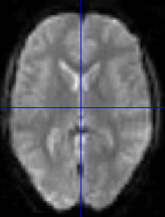
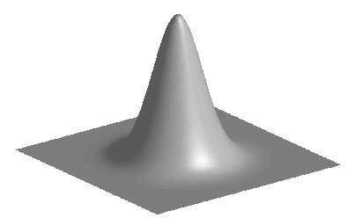
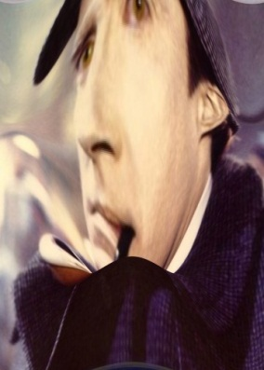
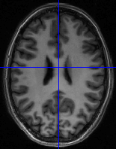
Overview
Func. time series
Coreg + Normalise Write
Smooth
Realign
Unwarp
Motion corrected

Slide 6
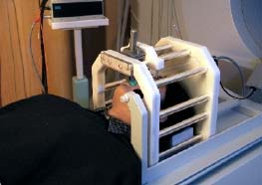
Motion Correction
Head movement is the LARGEST source of variance in fMRI data.
Steps to minimise head movement;
Limit subject head movement with padding
Give explicit instructions to lie as still as possible, not to talk between sessions, and swallow as little as possible
Try not to scan for too long* – everyone will move after while!
Make sure your subject is as comfortable as possible before you start.

Slide 7
Realigning (Motion Correction)
Motion Correction
Realigns a time-series of images acquired from the same subject (fmri)
As subjects move in the scanner, realignment increases the sensitivity of data by reducing the residual noise of the data.
NB: subject movement may correlate with the task therefore realignment may reduce sensitivity.
Motion corrected
Mean functional

Slide 8
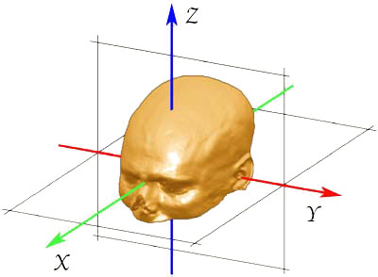
Realigning
Steps
Registration – determine the 6 parameters of the rigid body transformation between each source image and a reference image (i.e. How much each image needs to move to fit the source image)
Rigid body transformation assumes the size and shape of the 2 objects are identical and one can be superimposed onto the other via 3 translations and 3 rotations

Slide 9
Realigning
Transformation – the actual movement as determined by registration (i.e. Rigid body transformation)
Reslicing - the process of writing the “altered image” according to the transformation (“re-sampling”).
Interpolation – way of constructing new data points from a set of known data points (i.e. Voxels). Reslicing uses interpolation to find the intensity of the equivalent voxels in the current “transformed” data.
Changes the position without changing the value of the voxels and give correspondence between voxels.

Slide 10
Realigning
Different methods of Interpolation
1. Nearest neighbour (NN) (taking the value of the NN)
2. Linear interpolation – all immediate neighbours (2 in 1D, 4 in 2D, 8 in 3D) higher degrees provide better interpolation but are slower.
3. B-spline interpolation – improves accuracy, has higher spatial frequency
(NB: NN and Linear are the same as B-spline with degrees 0 and 1)
NB: the method you use depends on the image properties, i.e. Voxel dimensions, however the default in SPM is 4th order B-spline

Slide 11
Realigning
Further points
Adjusts for individual head movement → Creates a spatially stabilised image
(So the brain is in the same position for each image).
Algorithms are used to determine the best match to the reference image. (Usually this is the sum of squared intensity differences).
How well one image matches the other = the similarity measure or Cost Function.
Realignment alone is not enough, there are residual errors → need unwarping
Realign can be done alone, but in SPM you can do realign and unwarp in one step.

Slide 12
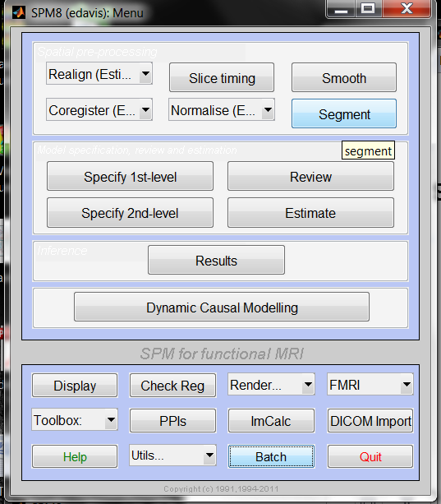
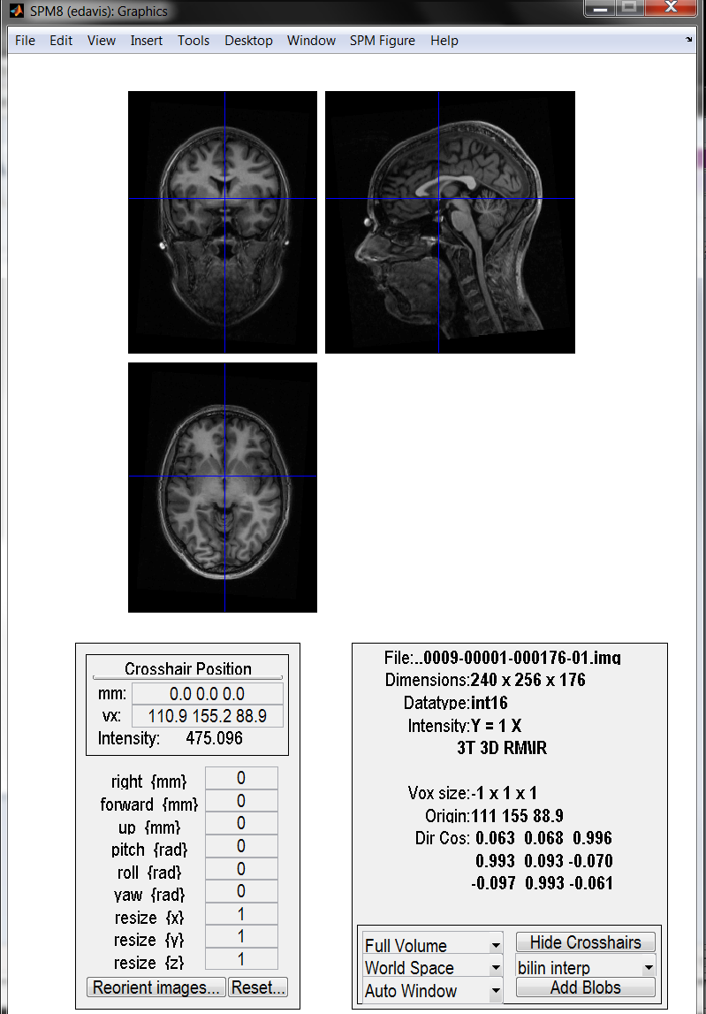
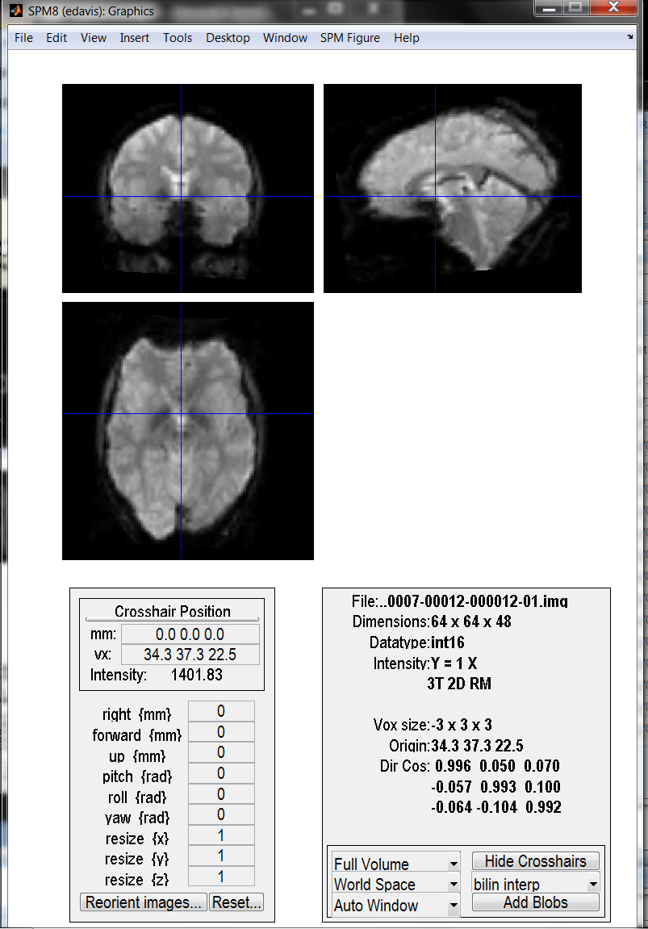
Manual reorientation
Align the cross hairs so they touch the anterior and posterior commissure.

Slide 13
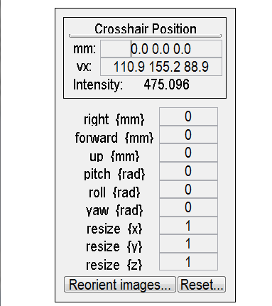

Manual reorientation SPM
Right = along x axis
Forward = along y axis
Up = along z axis
(large numbers i.e. 1,5,10)
Pitch = rotate around x axis
Roll = rotate around y axis
Yaw = rotate around z axis
(small values i.e. 0.02)
Z
Reorient images – select all images to be reoriented i.e. All functional scans.
NB: stroke lesions might need to be flipped.
Resize x to -1
X
Y

Slide 14
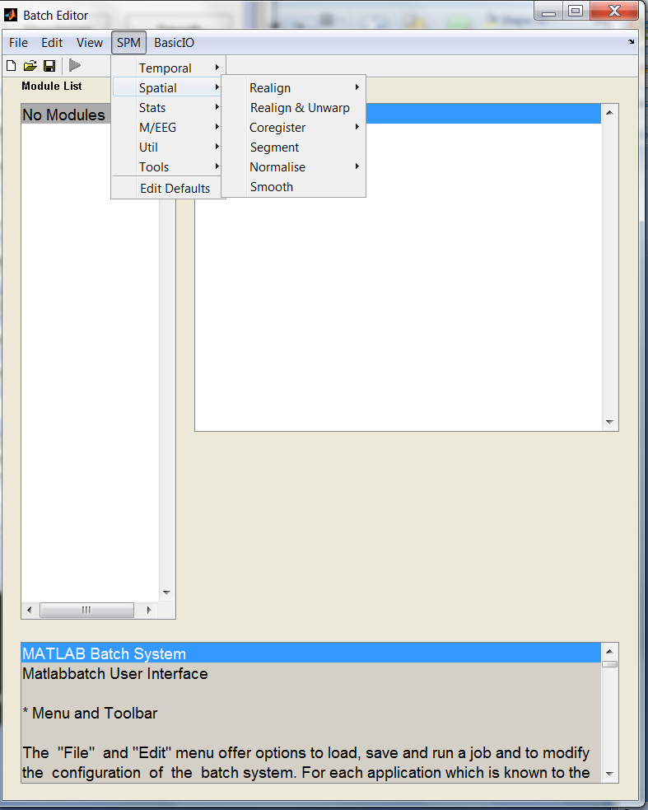
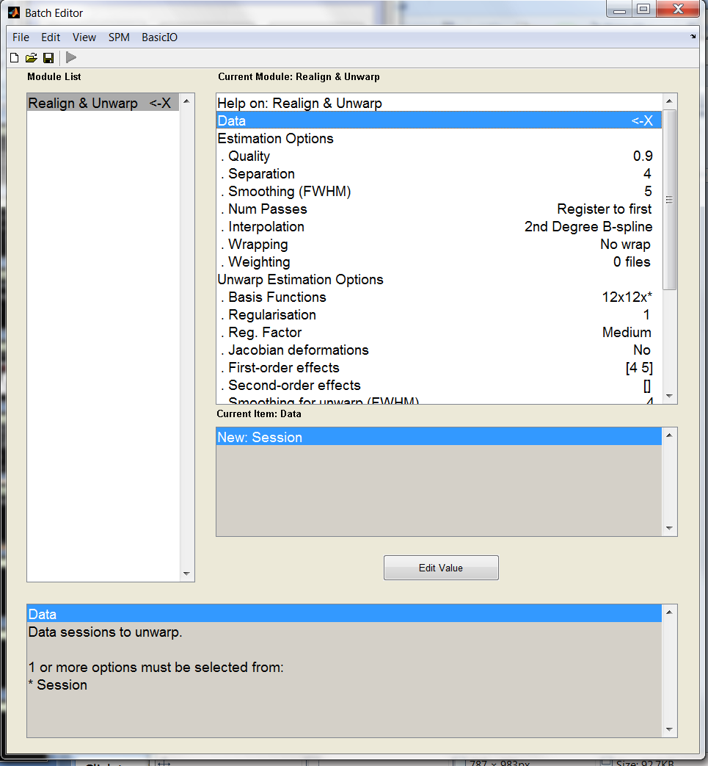
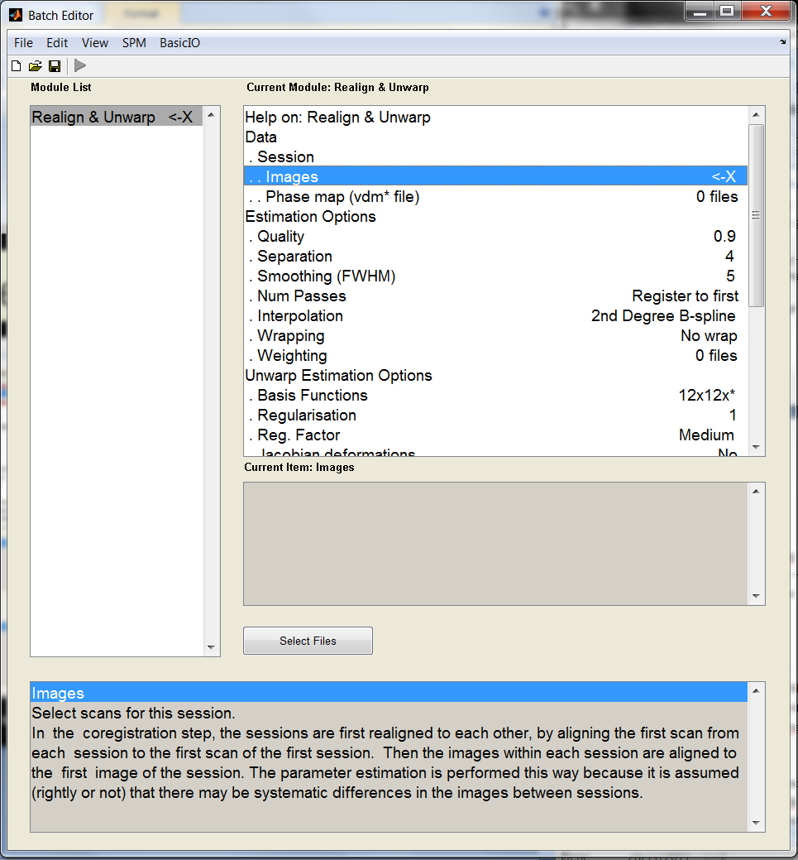
Realign and Unwarp
Realign & unwarp; Data – all the functional scans
“if in doubt, simply keep the default values.”
General practice now to do Realign & Unwarp, however, you can do the realign stages seperately;
Realign: Estimate (registration);
Realign: Reslice;
Realign: Estimate and Reslice
NB: as the magnetic field becomes stronger, i.e. 3T, unwarping becomes more important.
NB: remove the dummy scans (i.e. first 6/7)

Slide 15
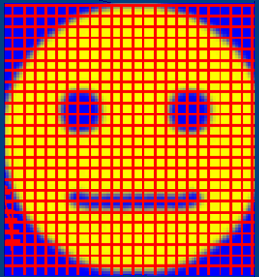
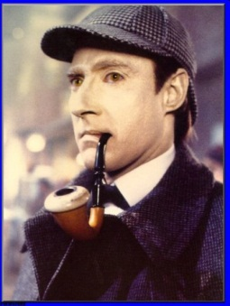

Unwarping
Realignment removes rigid transformations
(i.e. purely linear transformations)
Unwarping corrects for deformations in the image that are non-rigid in nature

Slide 16
Unwarping: The problem
1) Different substances in the brain are differentially susceptible to magnetization
2) Inhomogeneity of the magnetic field
3) Distortion of the image

Slide 17
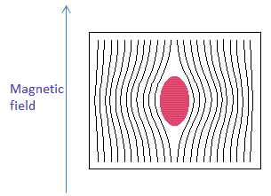
1: Different materials are differentially susceptible to magnetization
i.e. Different substances modify the strength of the magnetic field passing through it, to different degrees
Material | Magnetic susceptibility (ppm=parts per million, with respect to external field)
Air | 0.4
Water | -9.14
Fat | -7.79
Bone | -8.44
Grey Matter | -8.97
White matter | -8.80
Magnetic field is modified to different extents, by different substances at different locations → inhomogeneity in the magnetic field
Notes:
Magnetic susceptibility: How ‘magnetized’ a substance gets, when placed in a magnetic field
(extent to which the substance modifies the strength of the magnetic field passing through it)

Slide 18
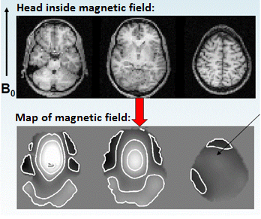
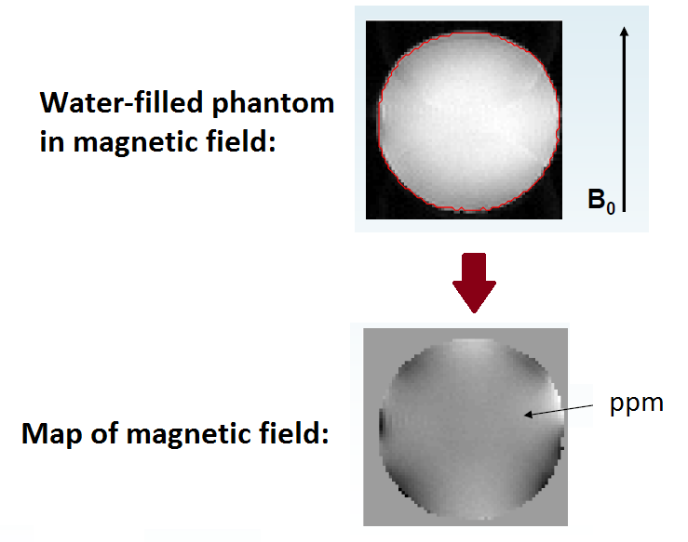
2: These differences in magnetic susceptibility produce inhomogeneity of the magnetic field
Human tissue exhibits differences in magnetic susceptibility (of about 1-2 ppm), introduces a fair bit of inhomogeneity to the magnetic field
A uniform object produces little inhomogeneity in the magnetic field
Field homogeneity indicated by the more-or-less uniform colouring inside the map of the magnetic field (aside from the dark patches at the borders)
Notes:
Uniform object: composite substances are not different, in magnetic susceptibility
Top image: anatomical image of the phantom
Bottom image: Field map, measures how the image will be distorted (you can think of this as the deformation field – see later for elaboration on what these are!)
Grey = 0, Black = deformation in one direction, White = deformation in another direction
e.g. grey uniform image inside the phantom, similar to the grey uniform image of the background → indicates that there is no distortion within the centre of the phantom, much like there is no distortion in the blank space of the scanner!

Slide 19
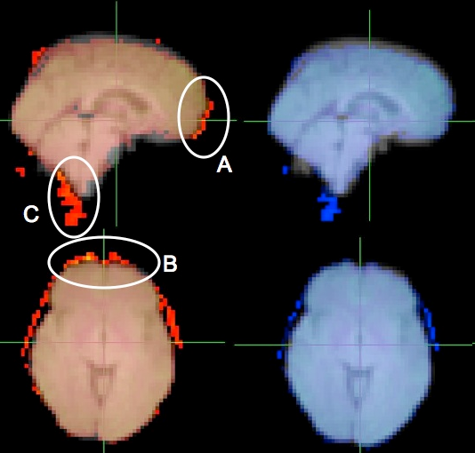

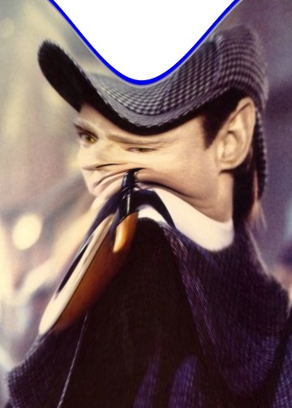
3. Inhomogeneity of the magnetic field distorts the image
How is the image distorted?
Locations on the image are ‘deflected’, with respect to the real object
Non-rigid deformation!
Original EPI
Unwarped EPI
Most noticeable near air-tissue interfaces (e.g. OFC, anterior MTL)
Notes:
Brain images:
Images (right) show the typical effect of unwarping on EPI data. Original (red) and unwarped (blue) EPI images are overlaid on top of the fieldmap structural image. Original EPI shows stretching of data in the anterior direction near the frontal pole (A, B), and a movement of the cerebellum and spinal cord in the posterior direction (C). These are corrected in the unwarped version (blue)
(from http://www.cubric.cf.ac.uk/mri/analysis/correcting-image-distortions-in-epi-data/epi-unwarping-with-fieldmaps/)

Slide 20
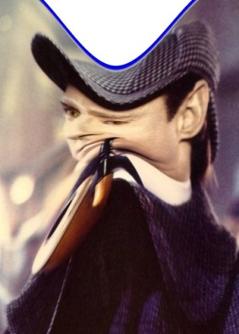
Data can help with your data
The image we obtain is distorted (due to magnetic susceptibility differences)
There will be subject movement within the scanner
Susceptibility and movement effects interact
Susceptibility effects
Susceptibility
x Movement
Like a funhouse mirror!
➔ Rigid and non-rigid deformations!
The distortion from movement may NOT follow the rigid body assumption (the brain may not alter as it moves, but the images do)
Field inhomogeneities change, as subject moves in the scanner
Notes:
Because field inhomogeneities change as subject moves, we have to take subject movement into account as well when we unwarp
In a homogeneous field we can locate a signal source consistently in exactly the same voxel, over and over again, in the same voxel, esp after we have realigned all slices to the same source image
But our field is WONKY!
Because of Magnetic Field Inhomogeneities-
Which means that the signal will NOT change linearly
Chloe Hutton explains this step by step in the physics wiki:
http://cast.fil.ion.ucl.ac.uk/documents/physics_lectures/Hutton_epi_distortion_300408.pdf

Slide 21
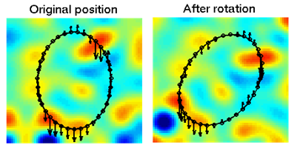
How do we control for these susceptibility x movement deformations?
Explicitly measure field inhomogeneity (using a field map)
=how the image is distorted due to susceptibility only
Use this to estimate how the images are distorted at each point in time
Combine info about susceptibility distortions with info about movement distortions (i.e. movement parameters, from realignment)
Estimate/quantify (via iteration) how the deformation field changes
How does the deformation field change, with respect to how the subject has moved?
‘With respect to subject movement’ because we are already correcting for subject movement (in realignment)
‘Undo’ these deformations = unwarp!
Note: Amount of distortion is proportional to the absolute value of the field inhomogeneity, and the readout time
EPI = long TR, particularly sensitive to deformation from field inhomogeneity
High resolution scans = more voxels acquired, longer readout tome → more warping
(Vectors indicating distance & direction)
Notes:
Deformation field=indicates the directions and magnitudes of ‘location deflections’ throughout the magnetic field (i.e. how is the image moved, at each location, with respect to the real object)
→ We want to find out: how does deformation field change over time, taking into account subject movement?
Distinction between deformation field and field map:
Deformation field = a mathematical operation, description of how the image (at each location) is distorted
Field map = measurable entity, that we use to derive the deformation field
Serves as a reference image – when subject is in this position, this is what the field inhomogeneities look like.
Using this reference + movement parameters, we predict what the field inhomogeneities would be like (and thus what the deformation field would look like) at each time point

Slide 22
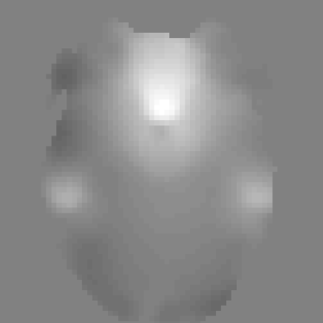
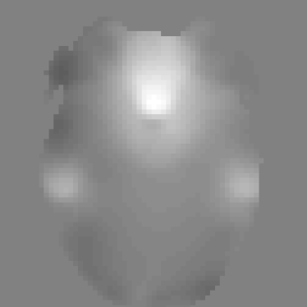
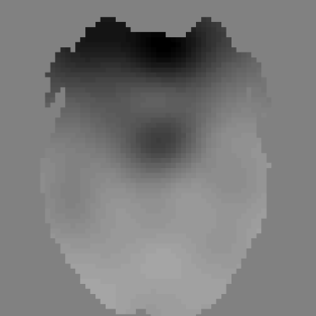
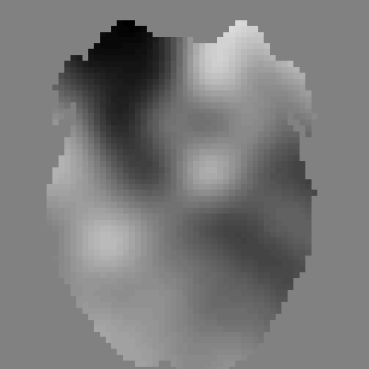
Estimating/modelling how the deformation field changes
Estimated change in deformation field wrt change in pitch (x-axis)
Estimated change in deformation field wrt change in roll (y-axis)
Deformation field at time t
Measured deformation field
=
+Δϕ
+Δθ
Changes in the deformation field, due to subject movement (estimated via iteration procedure in UNWARP)
Apply the inverse of this to your raw image, to unwarp
Static deformation field
(calculated using field map)
Notes:
From: www.fil.ion.ucl.ac.uk/~mgray/Presentations/Unwarping.ppt
Given the derivative of the field with respect to subject movement, and the movement parameters estimated from realignment, one can predict the non-rigid deformation in the scan series.

Slide 23
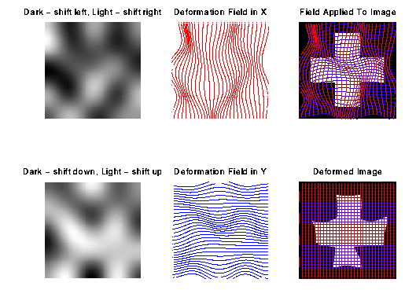
Applying the deformation field to the image
Once the deformation field has been modelled over time, the time-variant field is applied to the image.
The image is therefore re-sampled, with the new assumption that voxels (representing the same bits of brain tissue) occur at different locations over time.
Outcome: re-sliced copies of your image, corrected for subject movement (realigned) and corrected for movement-by-susceptibility interactions (unwarped) (appended u in front of image file names)

Slide 24
Quick summary/recap
The problem:
Different substances differentially modify the magnetic field
Inhomogeneity in the magnetic field (which interacts with subject movement)
Distortion of image
The solution:
1) Measure the field inhomogeneities (with the field map), given a known subject position.
2) Use this info about field inhomogeneities to predict how the image is distorted/deflected at each time point (the ‘deformation map’).
3) Using subject movement parameters, estimate the deformation map for each time point (since the deformation map changes with subject movement)
4) Re-slices your data, using the deformation map to ensure that the same portion of the brain is always found in the same location of the image, throughout all your scans.

Slide 25

Measure deformation field (using Field Map)
Unwarp over entire time series
(apply deformation fields to all your scans)
Estimate new deformation fields for each image:
(by estimating the rate of change of the distortion field with respect to the movement parameters)
Estimate movement parameters
Δϕ
+Δθ
Notes:
This is just a schematic that describes the steps of unwarping

Slide 26
Unwarping: Step-by-step instructions
Step 1: (During scanning) acquire 1 set of field maps for each subject
See the physics wiki for detailed how-to instructions(reference at end)
Field map files will either be in the structural directories, or in the same subject folders as the fMRI data
Step 2: (After scanning) Convert fieldmaps (prefixed with ‘sMT’) into .img files (DICOM import in SPM menu)
Which files: prefixed with ‘s’, if acquired at the FIL, but generally you should keep track of the order in which you perform your scans (e.g. if you did field maps last, it’ll be the last files)
You should end up with 3 files, per field map (phase and magnitude files – see wiki for identification)
File names: sXXXXX-YYYYY -- XXX is scan number, YYY is series number
There will be 2 files with the same series number – these are the magnitude images, 1 for short TE and 1 for long TE (short TE one is the first one)
1 file will have a different series number= phase image
Step 3: (Using the Batch system) Use fieldmap toolbox to create .vdm (voxel displacement map) files for each run for each subject.
vdm map = deformation map! Describes how image has been distorted. This is what is applied to the EPI time series.
You need to enter various default values in this step, so check the physics wiki for what’s appropriate to your scanner type and scanning sequence. OR, there are some default files you can use, depending on your scanner & sequence.
Step 4
Feed the vdm file into the Realign & Unwarp step
Batch → SPM → Spatial → Realign & Unwarp
Or: Batch → File: Load Batch → Select the appropriate values for your scanner & sequence (consult physics wiki) → RUN

Slide 27
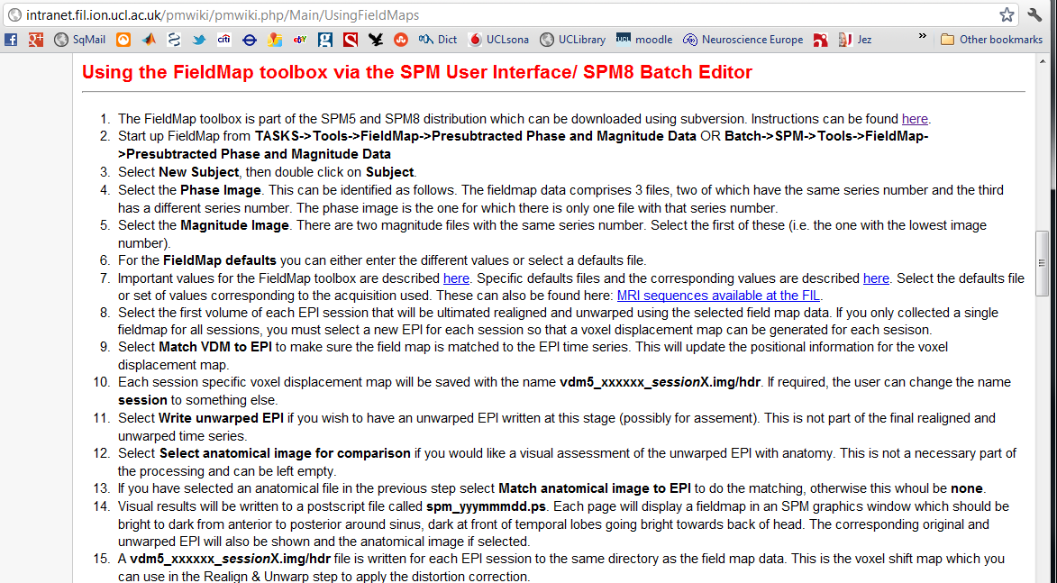
Unwarping instructions: Creating VDM file (Step 3)
Consult the physics wiki: everything is documented!
Note: You may get .nii files instead of .img files – this is normal, everything will still work

Slide 28
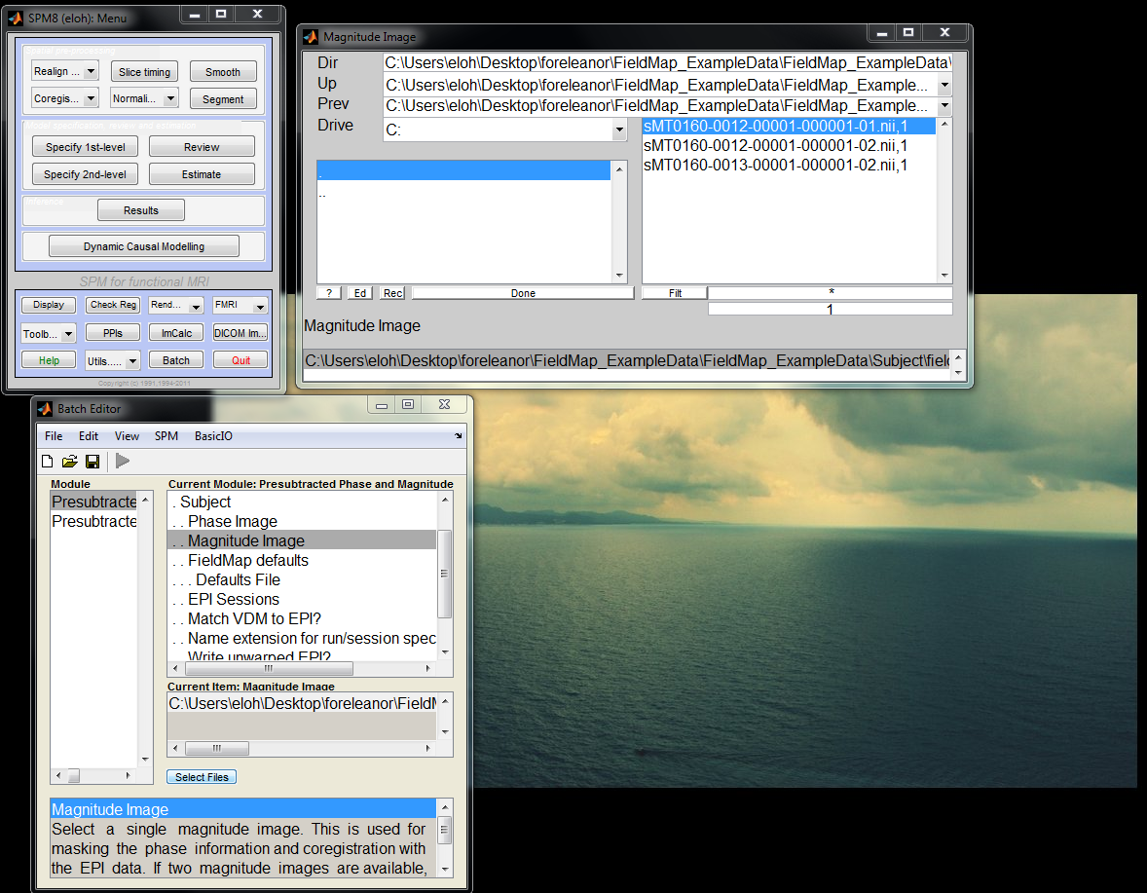
Unwarping instructions: Creating VDM file Phase and magnitude images
Red: Buttons referred to in the physics wiki
Green: If you want to, you can unwarp individually for each run (see presentation comments for instructions)
Notes:
Red circles: buttons identified in the physics wiki (just in case you can’t find them!)
Green circles: If you want to, you don’t have to unwarp via the batch system – you can do this individually for each run (e.g. if something different is done for a particular subject)
Alternative step 3 and 4:
You can create the vdm files via the fieldmap toolbox, individually for each run and each subject (on the main SPM menu page – under the Toolbox tab, click Fieldmap and enter the appropriate files and default there). Then, enter the appropriate vdm file with your EPI images, into the ‘realign & unwarp’ step (also from the SPM main menu, under the option at the top, on the left)

Slide 29
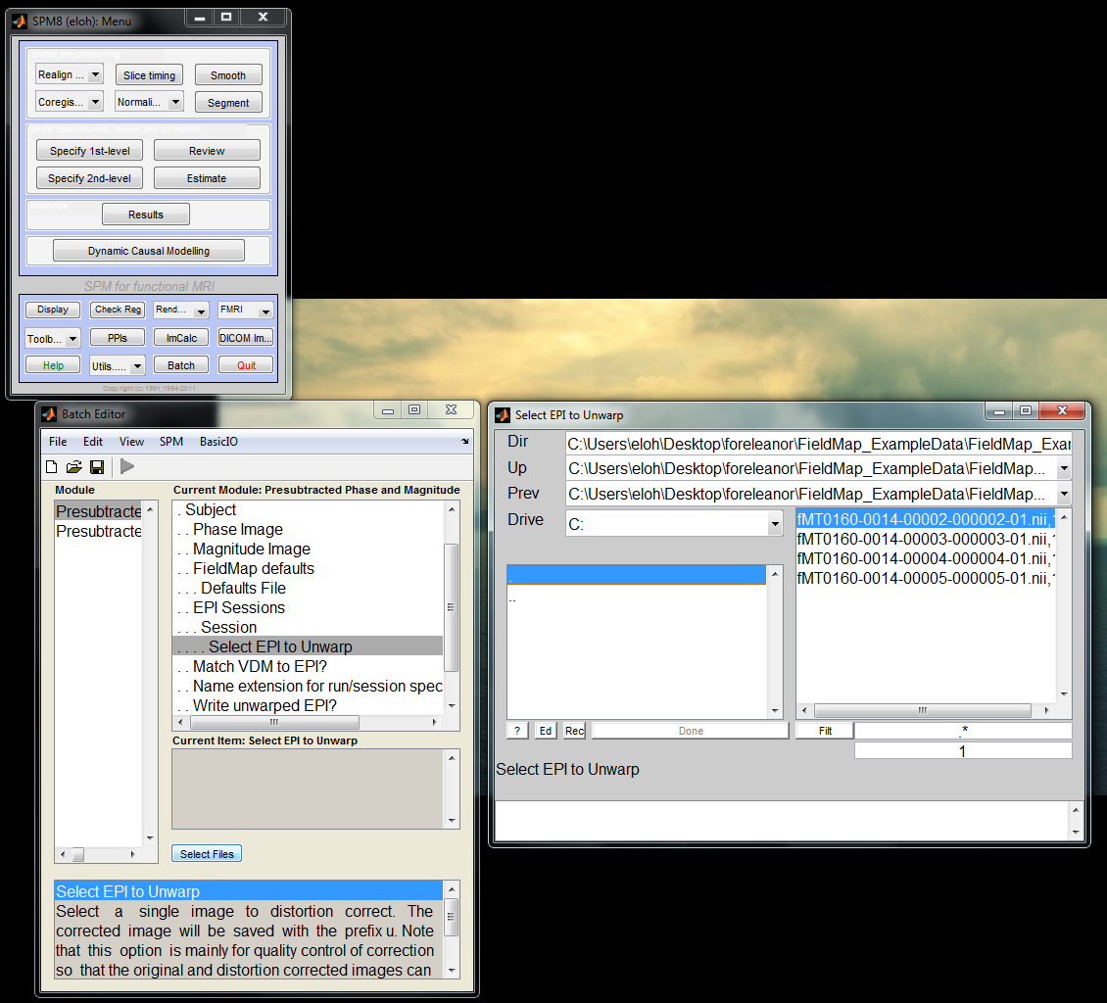
Unwarping instructions: Creating VDM file Select the first EPI that you want to unwarp
If you follow all the instructions in the wiki, but SPM won’t let you RUN, check that you have fully selected FieldMap default file. Alternatively, you might have to update your version of SPM and SPM toolbox.
Note: Make sure you choose the right default file - SPM will let you run this with the wrong file, but your results will be wrong.
This creates a vdm file (prefixed ‘vdm5’), which you then include in the next step: Realign & Unwarp
Notes:
Select ONLY the first EPI!

Slide 30
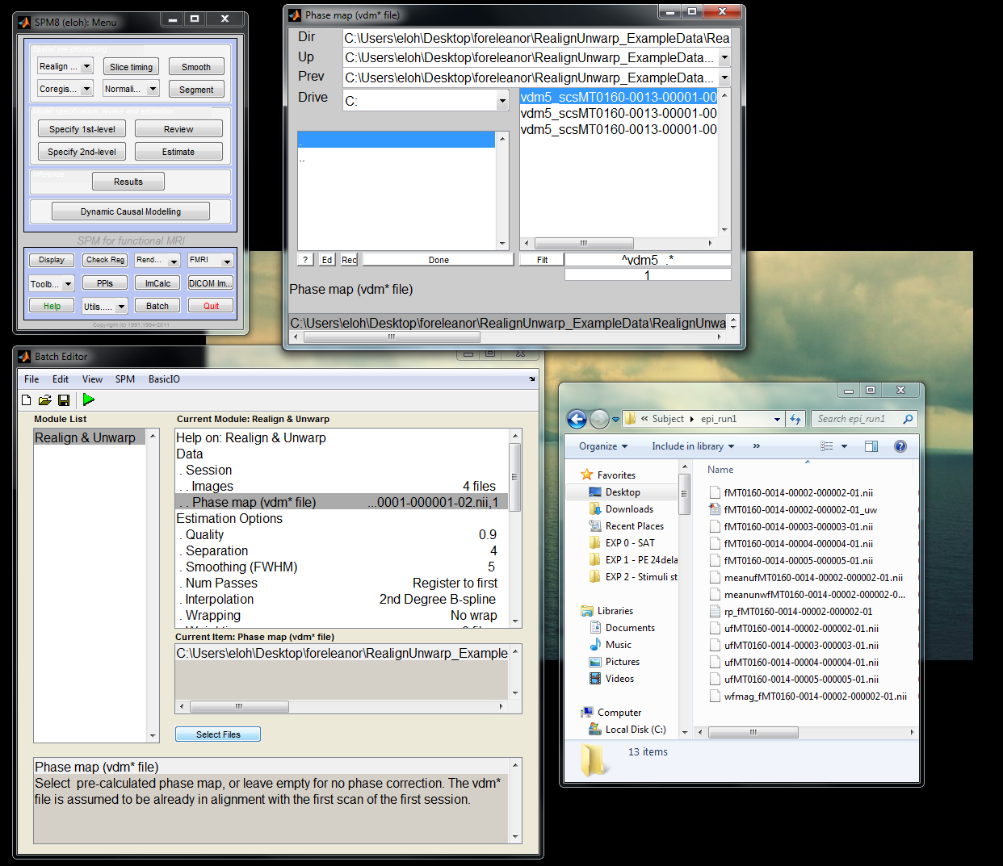
Unwarping instructions: Realign & unwarp
1) Realign & Unwarp
3) Load your vdm file (prefixed ‘vdm5’)
Which vdm file? SPM will create one overall vdm file, as well as one for each scanning session (i.e. each set of EPIs you have), labelled ‘session 1’ etc. Use the appropriate vdm for the appropriate session of EPIs.
4) Run
2) Load your EPI images (prefixed ‘fMT’)
5) These are your unwarped images (prefixed with’u’)
Notes:
Order of steps, 1-5 (colour coded)
Coloured ellipses indicate where these steps need to be executed
Note: You might have to double click on Data, to get to Step 2

Slide 31
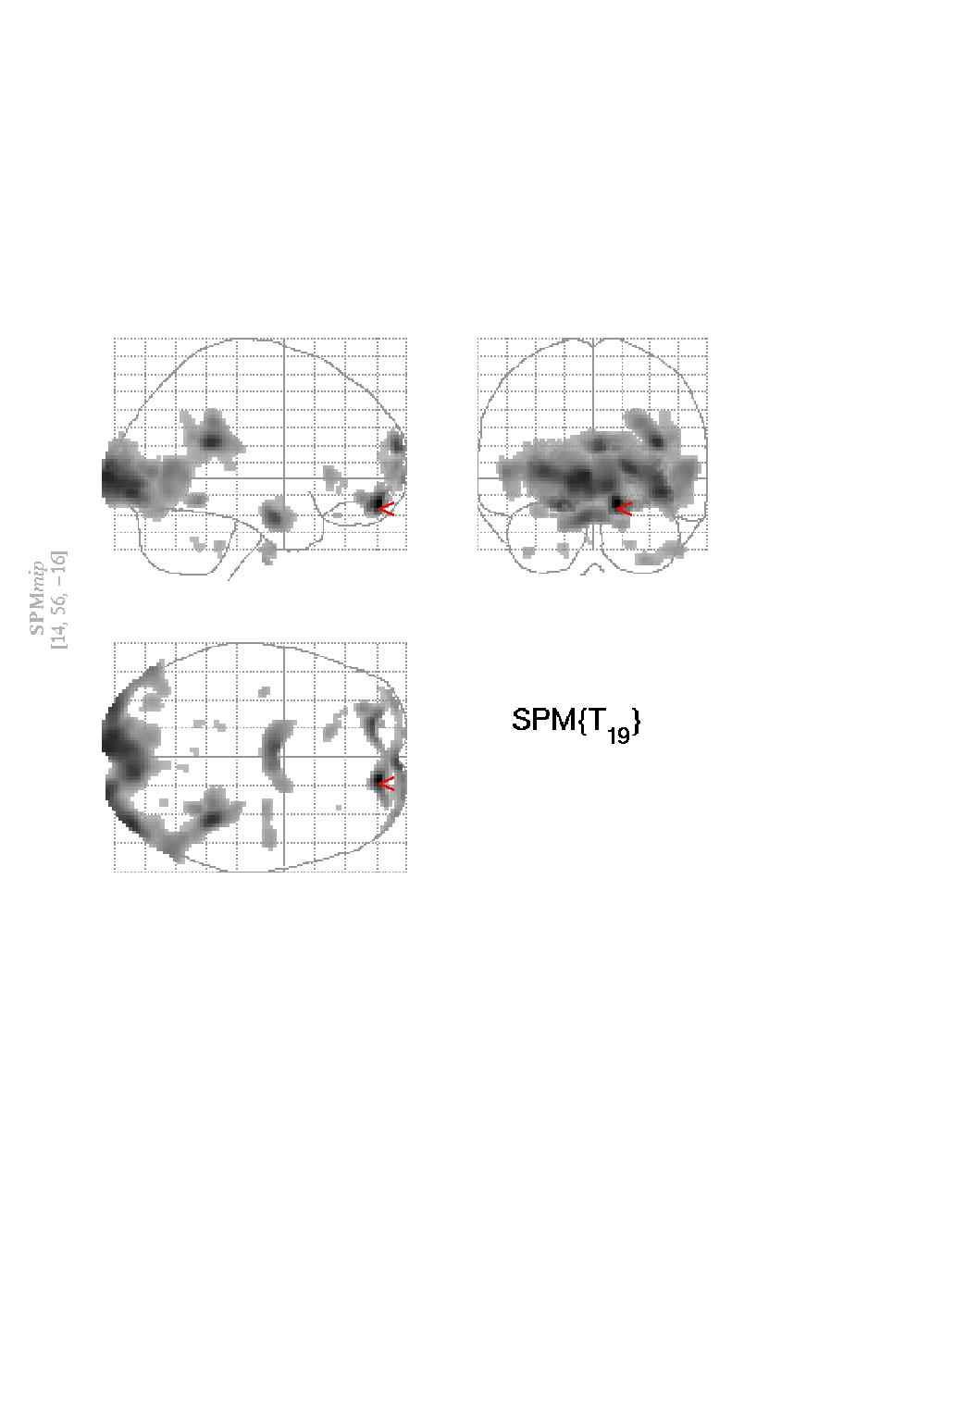
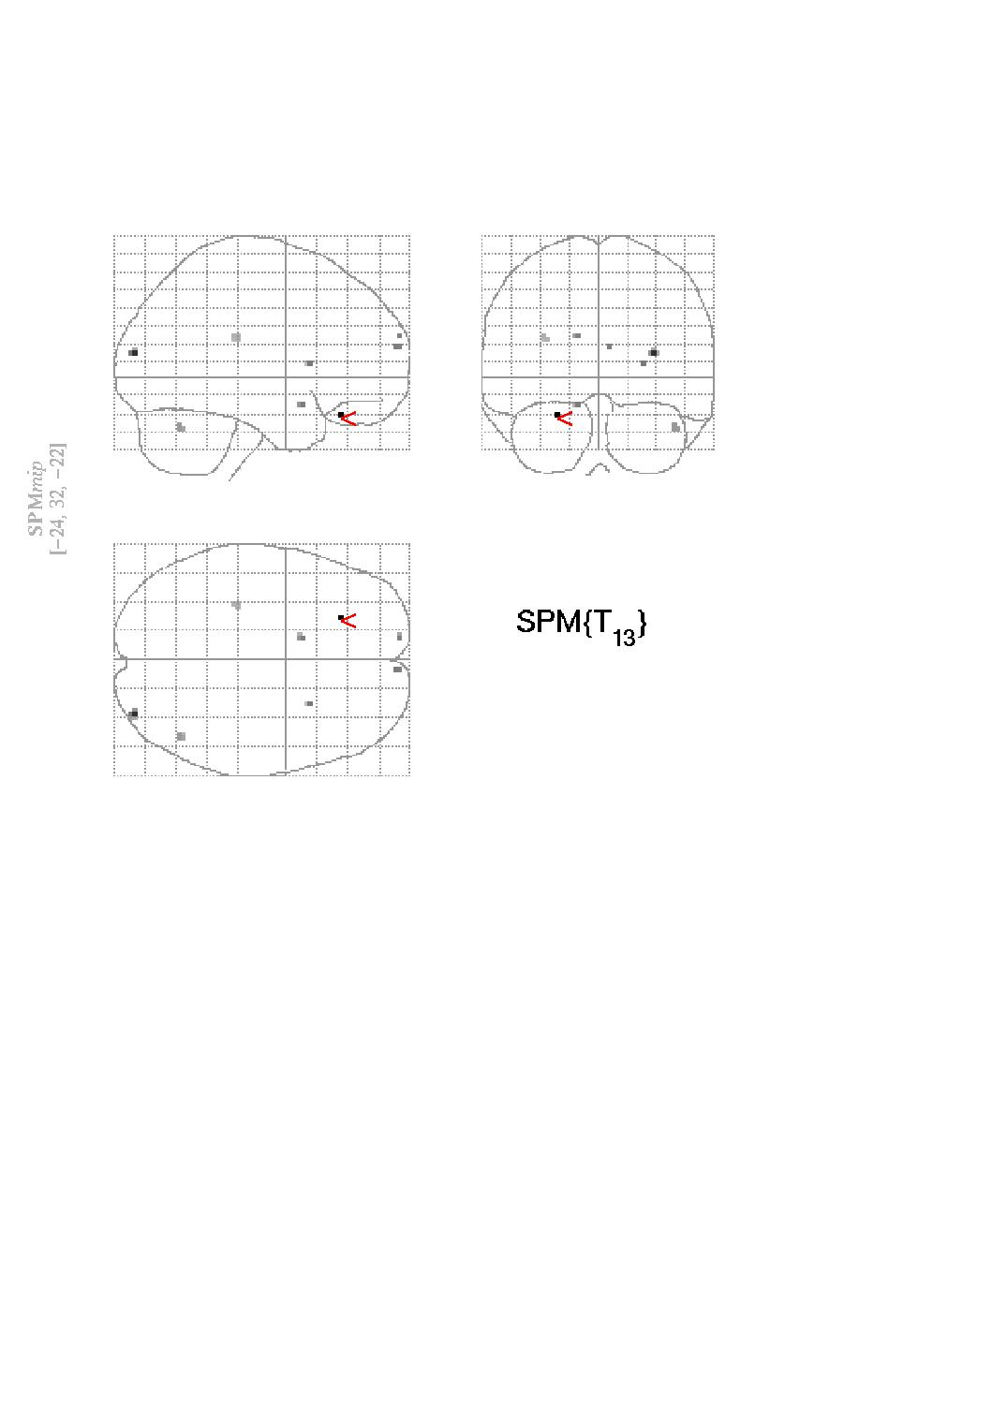
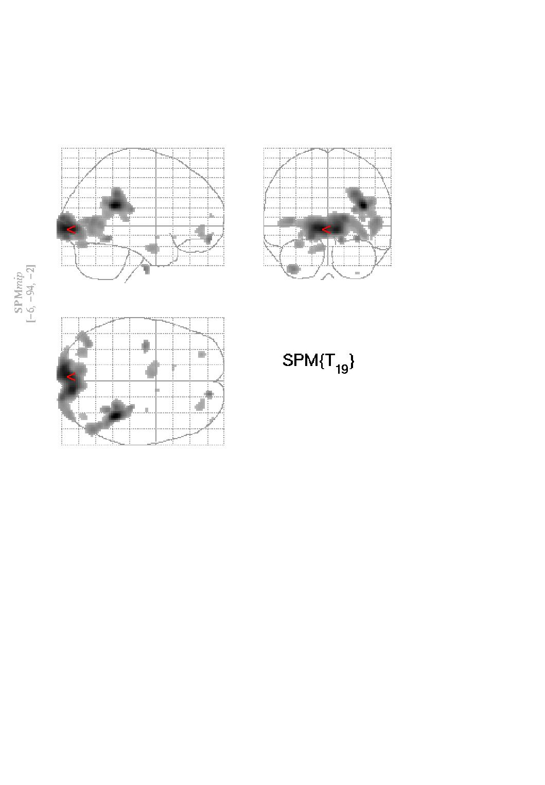
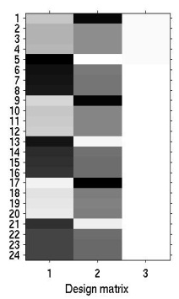
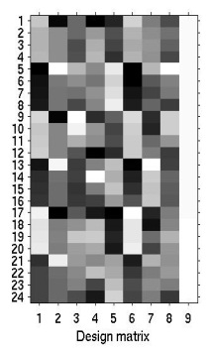

Advantages of unwarping
Recall: movement-induced variance is usually much greater than the variance that we’re interested in
One could include the movement parameters as confounds in the statistical model of activations.
However, this may remove activations of interest if they are correlated with the movement.
No correction
Correction by covariation
Correction by Unwarp
t_{max}=13.38
t_{max}=5.06
t_{max}=9.57
Notes:
You could get rid of movement-induced variance by ‘covariation’, but this reduces sensitivity, especially if the variance of interest is correlated with movement

Slide 32

Practicalities
Unwarp is of use when variance due to movement is large.
Particularly useful when the movements are task related as can remove unwanted variance without removing “true” activations.
Can dramatically reduce variance in areas susceptible to greatest distortion (e.g. orbitofrontal cortex and regions of the temporal lobe).
Useful when high field strength or long readout time increases amount of distortion in images.
Can be computationally intensive… so take a long time (but not that bad, really)
Should I always do unwarping? Highly advised

Slide 33
References
A detailed explanation of EPI distortion (the problem):
ww.fil.ion.ucl.ac.uk/~mgray/Presentations/Unwarping.ppt
http://cast.fil.ion.ucl.ac.uk/documents/physics_lectures/Hutton_epi_distortion_300408.pdf
SPM material on unwarping (rationale, limitations, toolbox, sample data set) http://www.fil.ion.ucl.ac.uk/spm/toolbox/unwarp/
http://www.fil.ion.ucl.ac.uk/spm/data/
The physics wiki: step-by-step instructions on how to go about everything
http://intranet.fil.ion.ucl.ac.uk/pmwiki/ (only accessible to FIL/ICN)
SPM manual: http://www.fil.ion.ucl.ac.uk/spm/doc/manual.pdf
Last year’s MFD slides
Chloe Hutton

