Slide 1
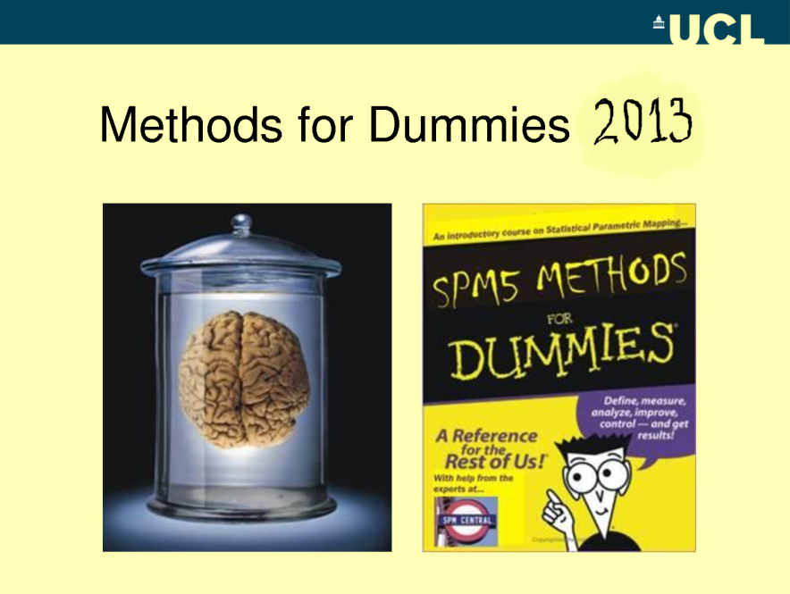
BASIS OF M/EEG SIGNAL
Maciej Cosilo
Panagiotis Papagiannopoulos

Slide 2
Electroencephalography
(EEG)

Slide 3
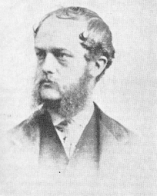
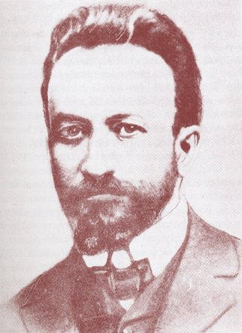
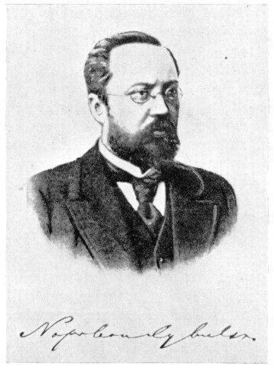
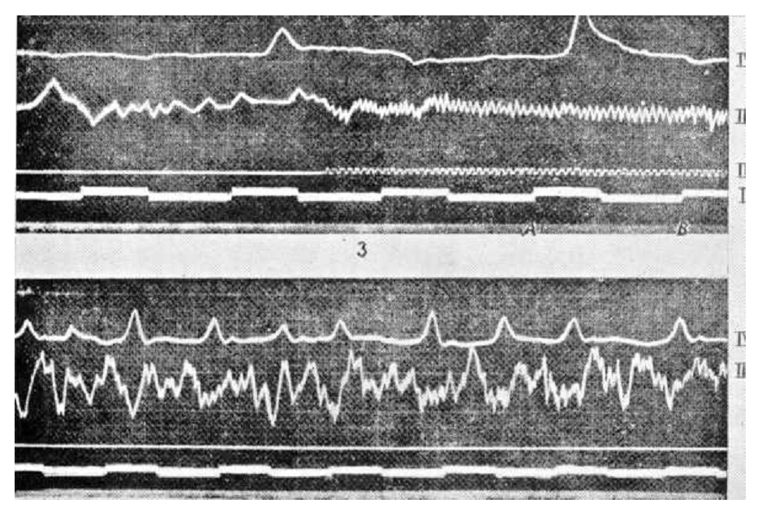
History
Richard Caton (1842-1926) from Liverpool, in the British Medical Journal in 1875 reported:
„ Feeble currents of varying direction pass through the multiplier when electrodes are placed on two points of the external surface [of the brain], or one electrode on the grey matter and one on the surface of the skul...”
In 1890 Adolf Beck: spontaneous electrical activity in response to light in rabbits and dogs- not really knowing about Caton’s findings.
In 1912 Vladimir Vladimirovich Pravdich-Neminsky published the first animal EEG study on evoked potential in the mammalian brain.
In 1914 polish physiologist Napoleon Cybulski (Beck’s collaborator) and Jelenska-Macieszyna photographed EEG recordings of experimentally induced seizures.

Slide 4
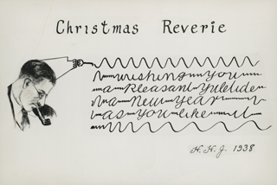
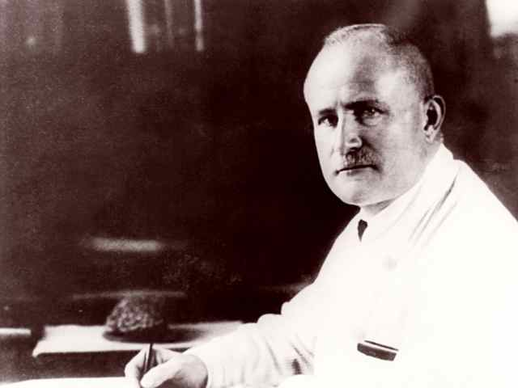
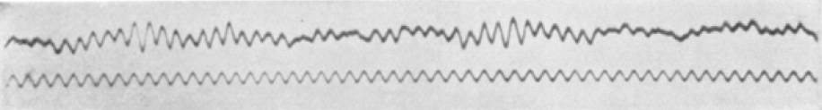
History

Slide 5
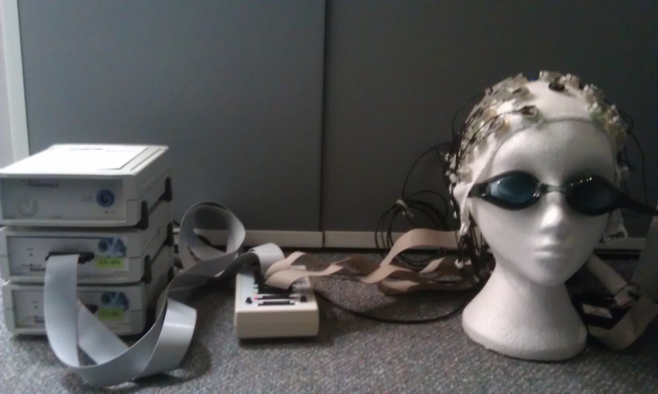
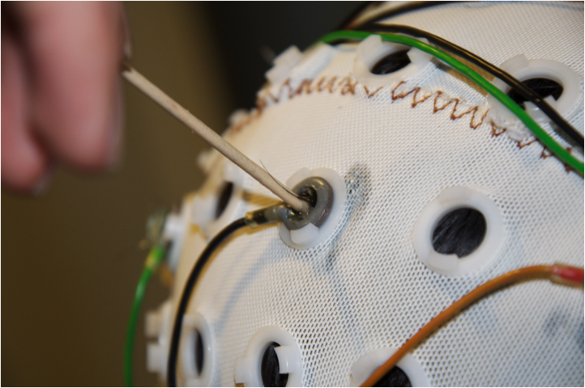
Instrumentation
Active electrodes placed on scalp.
Arrangement: 10-20 system (by Herbert Jasper)

Slide 6
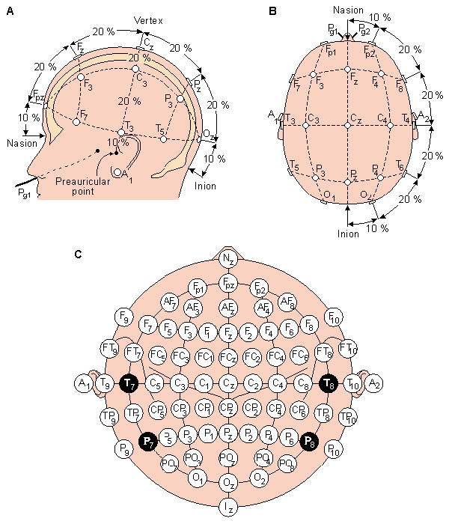

Slide 7
Instrumentation
Active electrodes placed on scalp.
Arrangement: 10-20 system (by Herbert Jasper)
Number of electrodes can vary: 32, 64 ,128 or 256 electrodes (richer data, but not necessarily better?)
Signal is amplified and converted to digital form.
Voltage is a potential for current to move from one point to another.

Slide 8
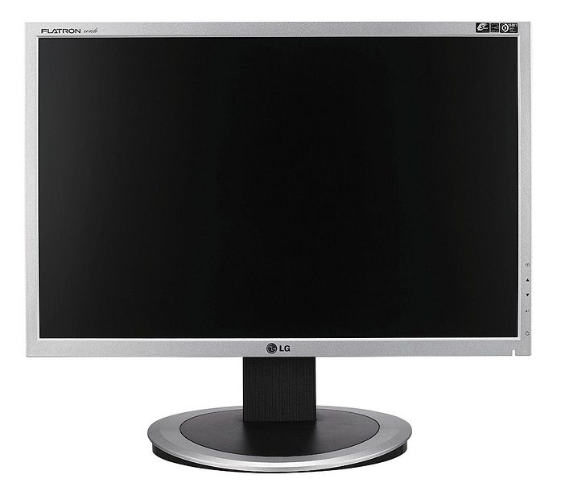
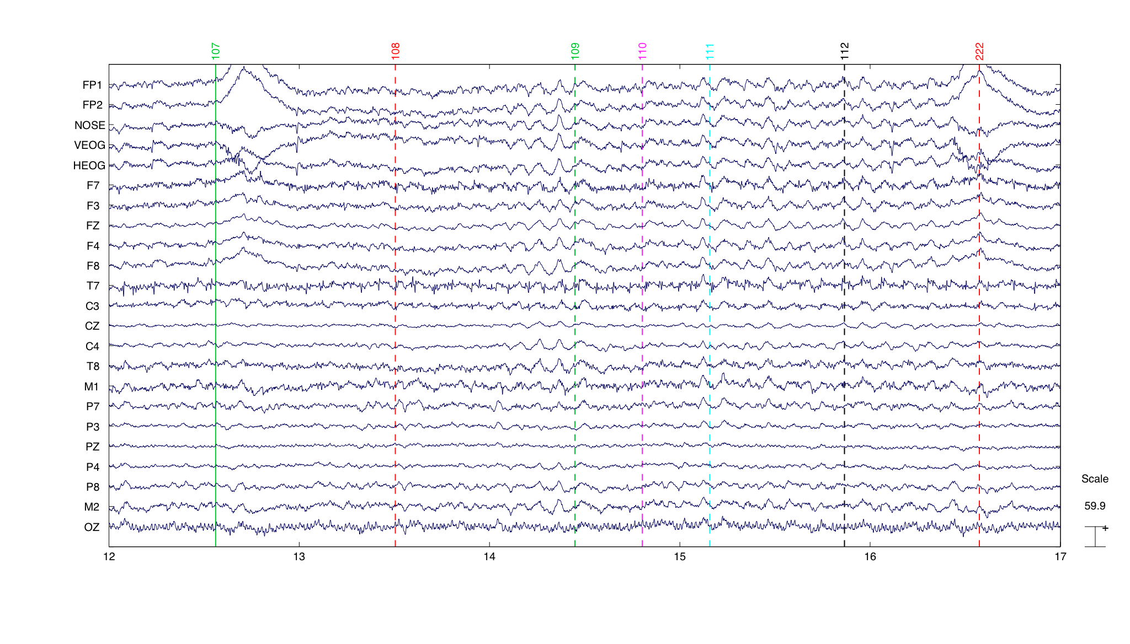
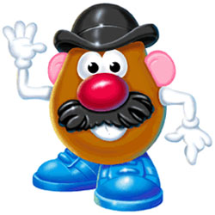
Instrumentation
You can’t really say you’re measuring voltage at a single site.
EEG reflects a potential for current to pass between two electrodes.
Electrode Input 1
Electrode Input 2
EEG waveform=
Input1 – Input 2
Amplifier
Reference montage: EEG represents a difference in voltage between an active electrode and a reference electrode.
  Cz, ear lobes, mastoids,
  tip of the nose, toe (!).
Average Reference montage: Averaged voltage of all the electrodes used as a reference. Need a high density of electrodes for this.

Slide 9
Continuous, spontaneous EEG
Graphic representation of voltage difference between two cortical areas, plotted against time.

Slide 10
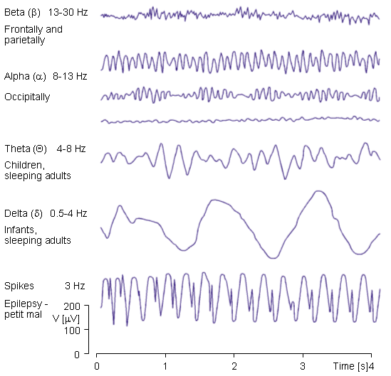

Slide 11
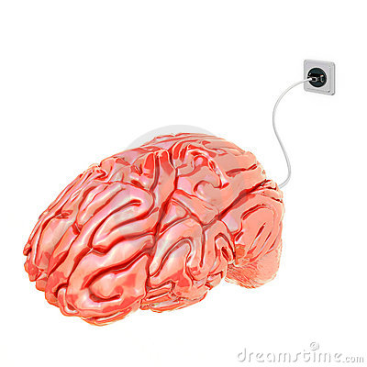
Electrical activity in the brain
Two main sources of electrical activity:
  Action potentials
  Post-synaptic potentials

Slide 12
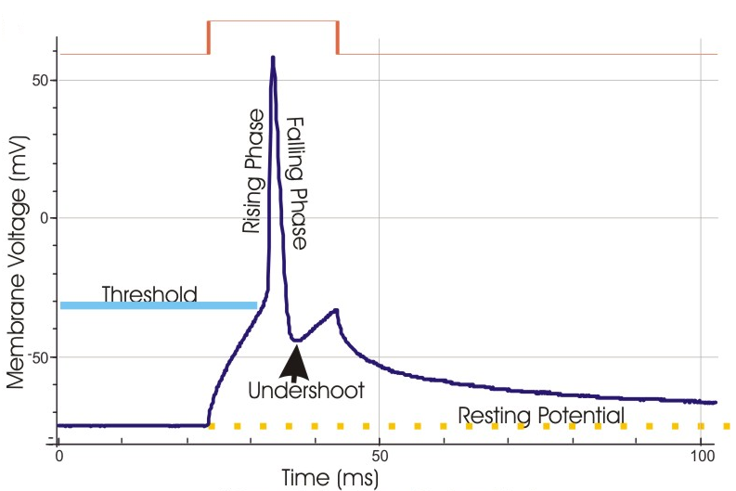
Action Potentials
Action potentials
  Discrete, rapid voltage spikes.
  If two neurons fire at the same time, the voltages will summate and the voltage recorded at electrodes will be twice as large.
  Timing issue:
  If a neuron 1 fires after neuron 2, the current at a given location will be flowing into one axon at the same time that it is flowing out of the other axon. In effect, they “cancel” each other, and the recorded voltage is much smaller.
  Neurons rarely fire at the same time.

Slide 13
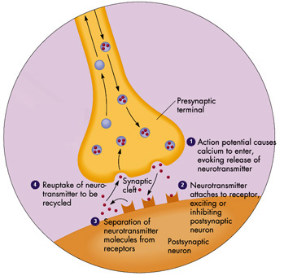
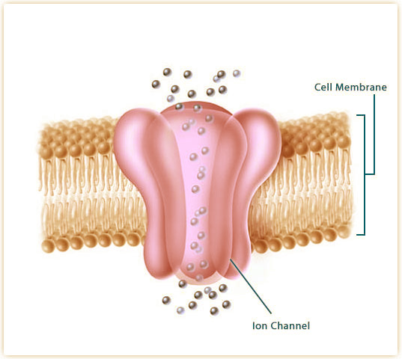
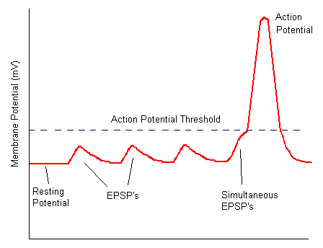
Post- synaptic potentials
Membrane equilibrium (resting) potential of about -70mV
Ion channels on the post- synaptic membrane open or close in response to neurotransmitters binding to the receptors.
Flow of Na+ inward the cell depolarizes postsynaptic neuron.
Flow of Cl- inward hyperpolarizes postsynaptic neuron.

Slide 14
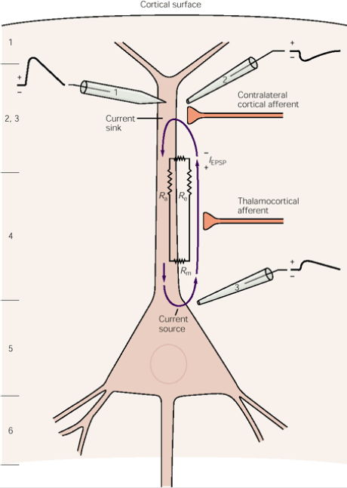
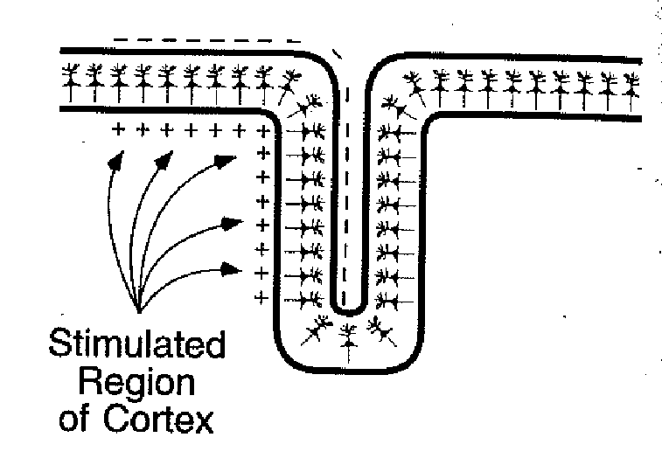
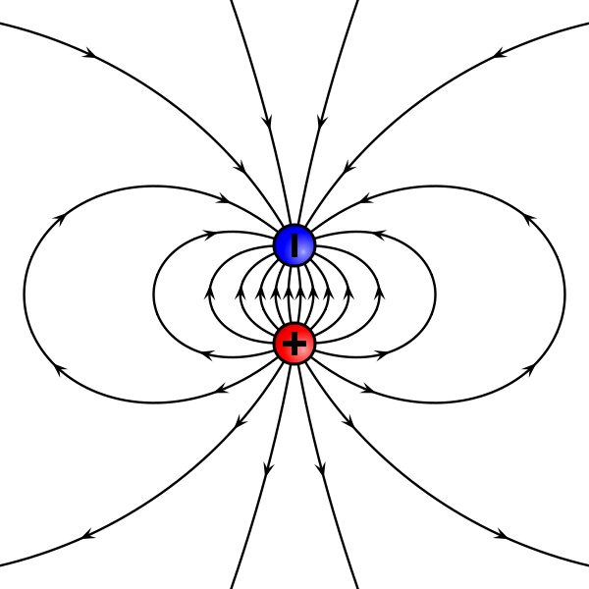
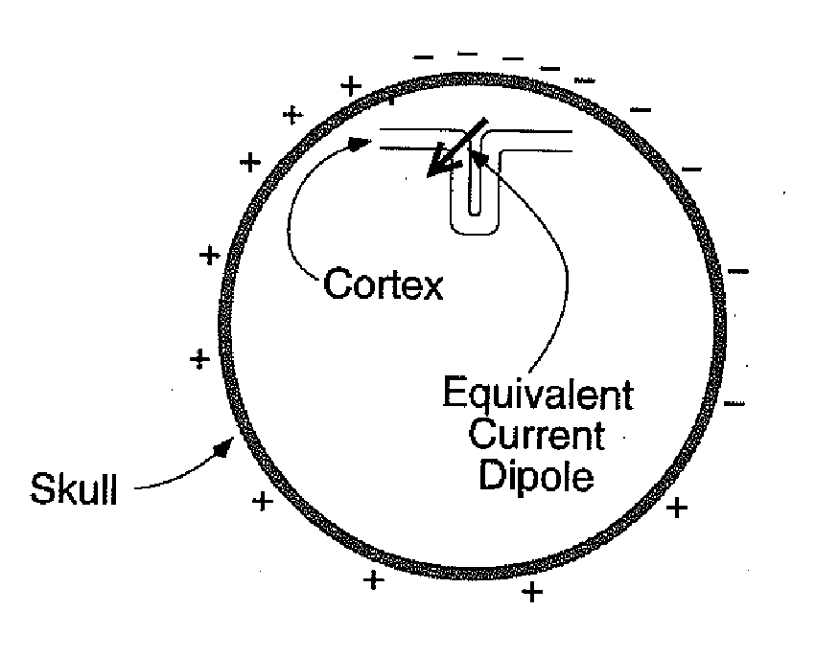
Post- synaptic potentials
Excitatory Post- Synaptic Potential:
Due to the flow of ions, extracellular electrode detects negative voltage difference (current sink is generated)
The current flows further down the cell, completing a loop, where Na+ flow outside the cell.
Extracellular electrode detects positive voltage difference
A dipole is generated

Slide 15
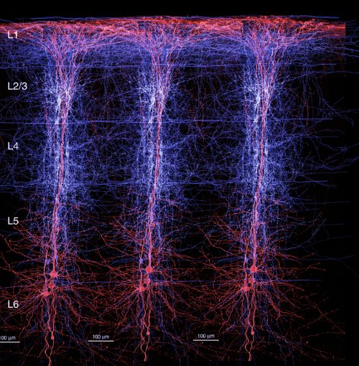
Pyramidal neurons are spatially aligned and perpendicular to the cortical surface.
Similar orientation, receiving similar input.
Ideal candidate for a current generator

Slide 16
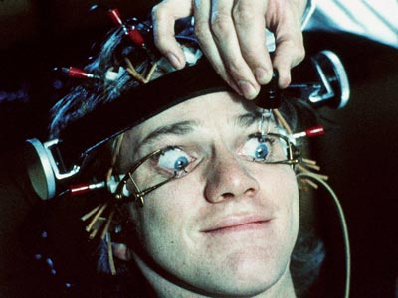
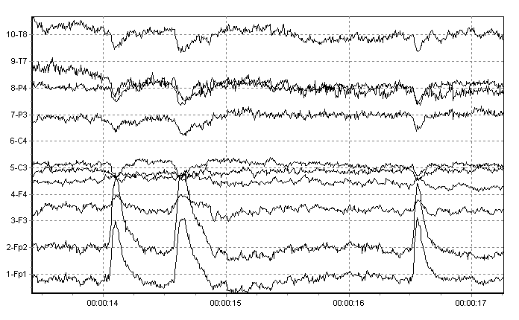
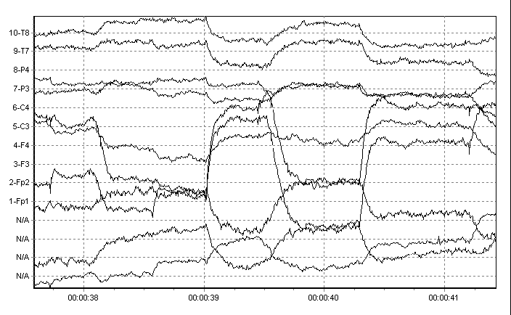
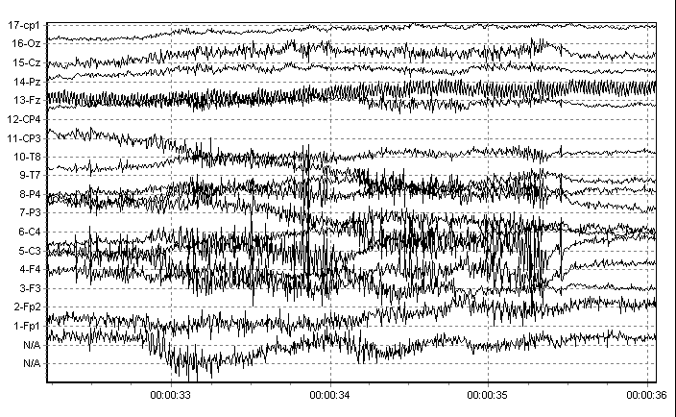
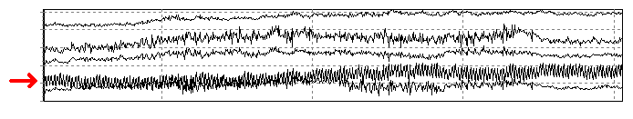
Artifacts
Environmental artifacts
  Changes in electrode impedance
  External electrical noise
Physiological artifacts
  Blinks
  Eye movements
  Muscle artifacts

Slide 17
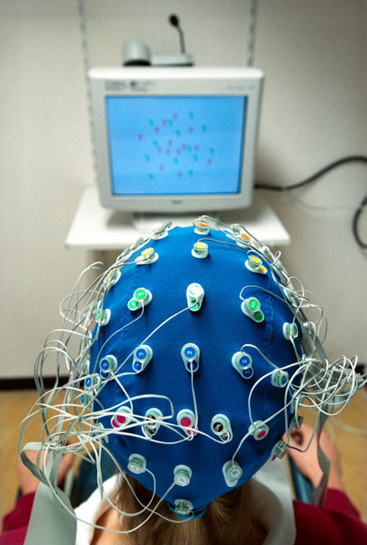
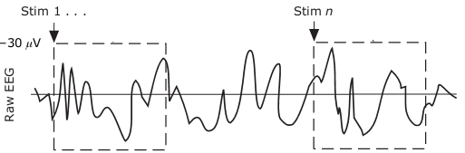
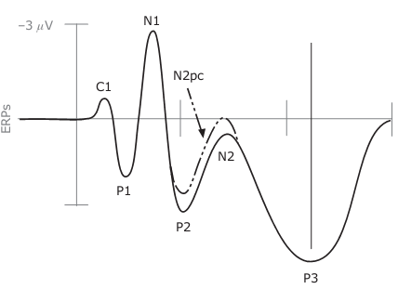
EEG analysis: Event- related potentials
Averaging
Notes:
Talk:
Just to quickly explain what EEG for those who are less familiar with this technique, EEG picks up small electrical currents which are generated as neurons “talk to each other”. However, what we get is seemingly random and complex. How do we make sense of it? By applying an ERP technique. We average the EEG signal time- locked to some external event, and as the “noise”, the random patterns even out, we are left with Event Related Potential- an ERP. This is the activity associated with the event at hand. There are several ERP components recognised and described, for example an P1 component, occuring at about 100ms after stimulus onset, which has been related to very early perceptual processes.

Slide 18
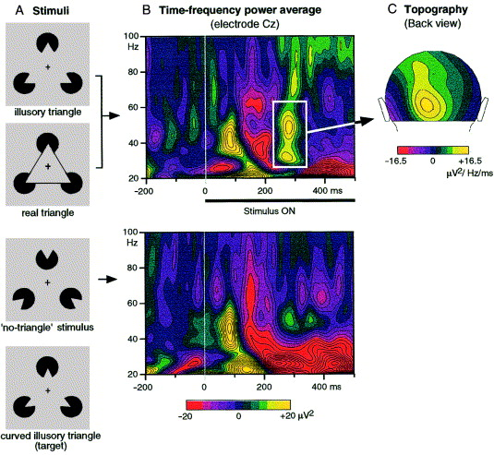
Time- Frequency Analysis
Neurons oscillate at different frequencies
Time- frequency analysis allows to tell which frequencies contribute to the recorded activity, and how they change over time
Example: induced gamma-band frequency related to perceptual binding
C. Tallon- Baundry & O. Bertrand, Trends Cogn. Sci, 1999

Slide 19
Volume conduction & The inverse problem
Volume conduction: transmission of electrical current from its source, through the conductors (brain tissue) towards measurement device (EEG electrodes)
Measured voltage will depend on the orientation of the dipole and resistance of brain, skull, scalp, eye holes.

Slide 20
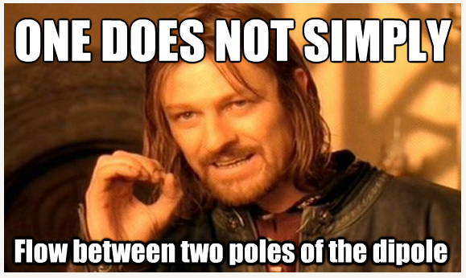

Slide 21
Volume conduction & The inverse problem
Volume conduction: transmission of electrical current from its source, through the conductors (brain tissue) towards measurement device (EEG electrodes)
Measured voltage will depend on the orientation of the dipole and resistance of brain, skull, scalp, eye holes.
Current does not simply flow between two poles of the dipole
Rather, it spreads throughout the conductor
Thus, activity is “blurred”- potentials generated in one part of the brain are recordable at distant parts of the scalp as well.

Slide 22
Volume conduction & The inverse problem
This creates a problem- if you give me a voltage distribution, I will not be able to tell the location of the dipoles, because there is an infinite number of dipoles that can produce any given voltage distribution (The “Inverse Problem”).
We can try to solve the Inverse Problem by trying to go the other way around!
We can place a source of activity in a specific place in a brain model, and calculate how the distribution would look like for that given dipole. Then, we can compare it with the actual activity to see if it matches our model.
Thus, we can solve the inverse problem by applying a forward model.
(Not as easy as it sounds, especially for the EEG!)

Slide 23
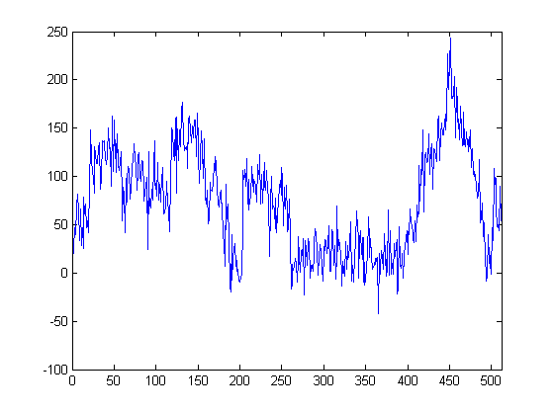
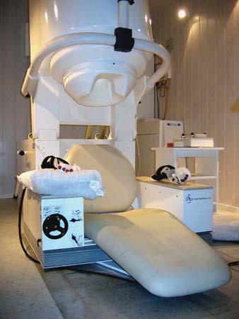
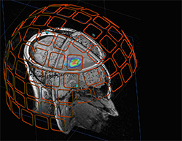
BASIS OF MEG SIGNAL

Slide 24
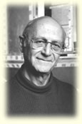
A brief history
1968: David Cohen measures the first (noisy)
magnetic brain signal
1970: James Zimmerman invents the ‘Superconducting Quantum Interference Device (SQUID)
1972:Cohen performs the first (1 sensor) MEG recording based on one SQUID detector
80s: Multiple sensors into arrays to cover a larger area
Present–day: typically contain 300 sensors, covering most of the head
Notes:
1968: Used a copper induction coil as the detector. In a magnetically shielded room, to reduce the magnetic background noise. Results not encouraging. Poor, noisy MEG measurements that were difficult to use.
1970: researcher at Ford Motor Company, invents = develops
1972: Signals as clear as those of EEG. At first a single detector to successively measure the magnetic field around the head. But, cumbersome… sensors set into a helmet (122 sensors in the first helmet-type-whole-scalp)
Key Words: detect, measure, cumbersome (αργό, δυσκίνητο), typically, MEG system, a new system was introduced,

Slide 25
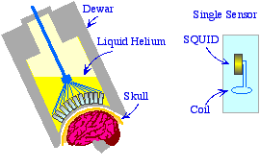
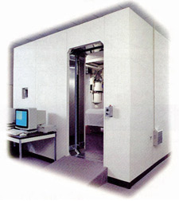
MEG Instrumentation
Insulating storage vessel
Acts as refrigerant
Shielded room
?????????
Notes:
“Here, we can see the standard technology used in modern EEG systems”.
“SQUID is the core of all modern MEG systems”.
Reservoir = vessel

Slide 26
What is this?
Superconducting
Quantum
Interference
Device
A very sensitive magnetometer used to measure extremely subtle magnetic fields
It is sensitive enough to measure fields as low as 5x10⁻⁸ T
A small ring (2-3mm) of superconducting material
What does it look like…?
Notes:
Harnessing the power of tiny magnetic fields…

Slide 27
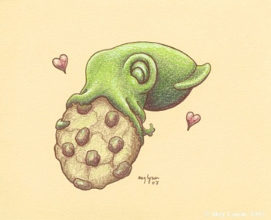
SQUID

Slide 28

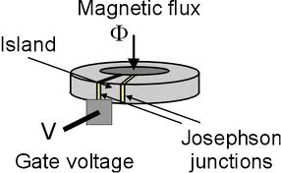
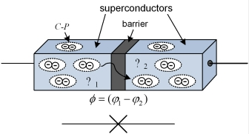
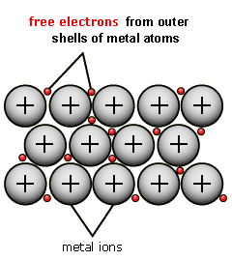
How does it work?
When the SQUID is immersed in liquid helium (4.2K), it becomes superconducting.
As a consequence, current can flow across the junction via the process of conducting tunneling
The current is modulated in a very sensitive fashion by the external magnetic field threading the loop.
This makes the SQUID the most sensitive magnetic field detector known!!!!!!!!
Notes:
The current is modulated in a very sensitive fashion by the external magnetic threading the loop. This makes the SQUID the most sensitive magnetic field detector known, and it is certainly sensitive enough to measure neuromagnetic fields.
Josephson junctions are insulating breaks.
Superconducting material: When we cool these materials in very low temperatures (critical temperature) then happens a phase transition. The metal goes from a normal state (with electrical resistance) to the superconducting state (with essentially no resistance) to the flow of electrical current. So, what happens is that the electrons in the metal become paired. Above the critical temperature we have a repulsive interaction between electrons and below the critical temperature the overall interaction between electrons become very slighly attractive. So this slight attraction allows them to drop into a lower energy state, opening an energy “gap”. Because of this gap electrons can move (so current can flow) without being scattered by the ions of the lattice. When the ions scatter electrons, this causes electrical resistance in metals, but in our case, I mean in superconductors, there is no electrical resistance and therefore energy loss. There is a maximum current that can flow and this is called the critical current. Now, we have a specific property here, that when a metal goes into the superconducting state, it expels all magnetic fields, as long as the magnetic fields are not too large.
Explaining how the junctions work: the non-superconducting barrier separates the two superconductors. It must be very thin. Until a critical current (supercurrent) is reached, this flows (tunnel) across the barrier without any resistance.
Key word: drop into, flow across, tunnel across the barrier/junction. When the critical current is exceeded, another voltage will develop (will be created, formed, shaped) across the junction. So, the bottom line is that when the current through the junction is < than the critical current, the voltage is 0. When the current exceeds the critical current, the voltage is not zero but oscillates in time. That’s how through junctions we detect and measure the change from one state to the other.

Slide 29
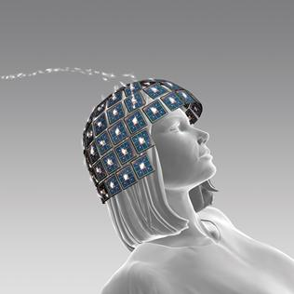
…and what’s the role of pick-up coils?
The squid is very small to collect much of magnetic flux.
Larger pick-up coils are used to collect the magnetic field over a relatively large area.
By means of inductive coupling, the coils funnel the measured flux into the SQUID ring.
Notes:
Inductive coupling: In electrical engineering, two conductors are referred to as mutual-inductively coupled or magnetically coupled ^{[1]} when they are configured such that change in current flow through one wire induces a voltage across the ends of the other wire through electromagnetic induction. The amount of inductive coupling between two conductors is measured by their mutual inductance.
The coupling between two wires can be increased by winding them into coils and placing them close together on a common axis, so the magnetic field of one coil passes through the other coil. The two coils may be physically contained in a single unit, as in the primary and secondary sides of a transformer, or may be separated. Coupling may be intentional or unintentional.
Larger pick-up coils are used to collect the magnetic field over a relatively large area and, by means of inductive coupling, funnel the measured flux into the small SQUID ring. All pick-up coils and connecting wires need to be made of a superconducting material (niobium) so that the currents generated in the pick-up coils can be transported to the SQUID without any sensitive losses. Once the SQUID voltage has been formed, however, there is no further need for superconductivity. Conventional electronics can be used to further process the signal.
Key word: extended = large, capture = collect = pick up, funnel = pass = transport, housed = are set

Slide 30
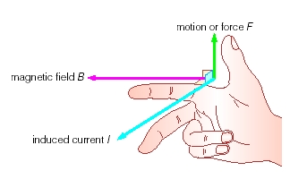
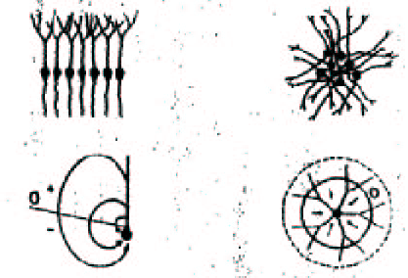
What do we measure with MEG?
Electromagnetic activity (magnetic component)
1. Synchronous activation
2. Specific geometry
3. Strength of the field (decreases with square distance)
But… is it possible for the action potentials to fire in a synchronous fashion?
Notes:
In mathematics and physics, the right-hand rule is a common mnemonic for understanding notation conventions for vectors in 3 dimensions. It was invented for use in electromagnetism by British physicist John Ambrose Fleming in the late 19th century.
Action potentials are temporally brief spikes.
Go away from = απομακρύνομαι, decrease = fall off, generate = produce, synchronous activity, summated activity, happen = occur (συμβαίνει)
Satisfy preconditions
*** neuroelectric activity in a discrete region of the cortex will be a mixture of
transient (temporally brief) spikes action potentials and slower synaptic potentials in the dendrites.
Right-hand rule (John Ambrose Fleming)
Some neural populations generate electromagnetic activity
Dendritic processes have to be spatially aligned.
Prerequisites = requirements

Slide 31
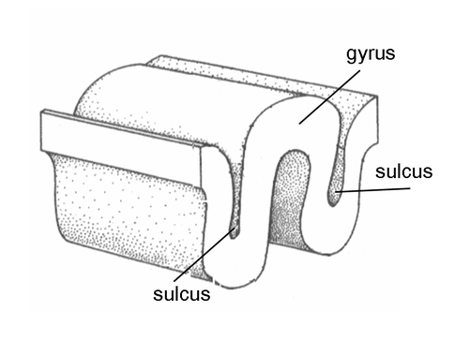
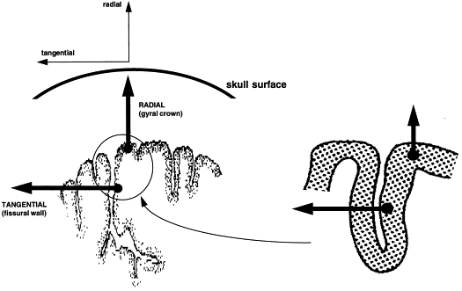

What do we measure with MEG?
primary currents/secondary currents
MEG is more sensitive to primary currents
Notes:
Apical dendrites of pyramidal cells… are aligned/oriented in a similar fashion, perpendicular to the gray matter surface
Gyral convexities
Sulcus: walls, fissures (in the surface of the brain)
But the proportion of grey matter radially aligned is likely to be quite small.

Slide 32

MEG Sensitivity to depth
Hung et al. 2010; Cornwell et al. 2007, 2008
Cornwell et al. 2008; Riggs et al. 2009
RMS Lead field
Over subjects and voxels
Parkonen et al. 2009
Supp_Motor_Area
Parietal_Sup
Frontal_Inf_Oper
Occipital_Mid
Frontal_Med_Orb
Calcarine
Heschl
Insula
Cingulum_Ant
ParaHippocampal
Hippocampus
Putamen
Amygdala
Caudate
Cingulum_Post
Brainstem
Thalamus
STN
Timmerman et al. 2003

Slide 33

The forward Problem
WHAT IS THE FORWARD PROBLEM FOR?
The first step for the reconstruction of the spatial-temporal activity of the neural sources of the MEG (and EEG) data.
Notes:
The ill-posed inverse problem (which source generates the current, the location of the electric activity) is beyond the scope of this presentation…
Since the lead field is a vector quantity, dipole orientation is important.
Linearity: additivity, homogeneity, additivity implies the homogeneity, the case where α is a natural number by mathematical induction and then extending the result to arbitrary rational numbers. In this definition, x is not necessarily a real number, but can in general be a member of any vector space. The word linear comes from the Latin word linearis, which means pertaining to or resembling a line. Nonlinear equations and functions are of interest to physicists and mathematicians because they can be used to represent many natural phenomena, including chaos. In physics, linearity is a property of the differential equations governing many systems; for instance, the Maxwell equations or the diffusion equation.
Unique solution: only one possible magnetic field distribution can be generated by a given current configuration.

Slide 34

How do we solve the forward problem?
Computing the external magnetic fields at a finite set of sensor locations and orientations (channel configuration)… given a predefined set of source positions and orientations (source configuration).
Using simple conductivity models – “head” models (geometry)

Slide 35

1. Computing the external magnetic field…
A convenient algebraic formulation of the MEG forward model (Mosher et al., 1999)
n, orientation
r, location
Θ, orientation
r_{q,} location
q , magnitude
SENSOR
SOURCE
B, data
L, Lead field (matrix), the forward solution in each source, field distribution across all M channels
S, source

Slide 36



2.Using different “head” models
(conductivity & geometry)
Finite Element Method (FEM)
Boundary Element Method (BEM)
Multiple Spheres
Single Sphere
Simpler
models
Notes:
FEM: allows realistic representation of the complicated head volume
What we need is the generation of a mesh (represents the geometric and electric properties of the volume conductor (meshing strategy).
Why an effective meshing strategy: accuracy, reasonably computation times, memory usage.
MEG: The magnetic field outside the head is completely independent of the conductivity profile if the conductor is spherically symmetric.

Slide 37

2.Using different “head” models
(conductivity & geometry)
Single Sphere model
Assumptions:
1. Head as a set of nested concentric spheres
(brain, CSF, skull, scalp)
2. Each layer has uniform and constant conductivity
* The analytic approach for the forward problem

Slide 38

2.Using different “head” models
(conductivity & geometry)
Boundary Element Method
Real geometry and conductivity
Usage of MRI, X Ray give anatomical information
Accurate conductivity parameters required
Hundred megabytes
A lot of time… and money!
* The numerical approach for the forward problem

Slide 39

EEG MEG
Electrical signal
Deep & shallow: radial and tangential sources
Tricky to localize
A relatively cheap technique
Magnetic signal
Mostly shallow: tangential sources
Easier to obtain and localize
But expensive
Both: excellent temporal resolution

Slide 40

Thank you!

