Slide 1
Introduction to Connectivity: resting-state and PPI
Katharina Ohrnberger & Lorenzo Caciagli
Slides adapted from MfD 2014 by
Josh Kahan
(Thanks Josh!)
Wednesday 18th February 2015

Slide 2
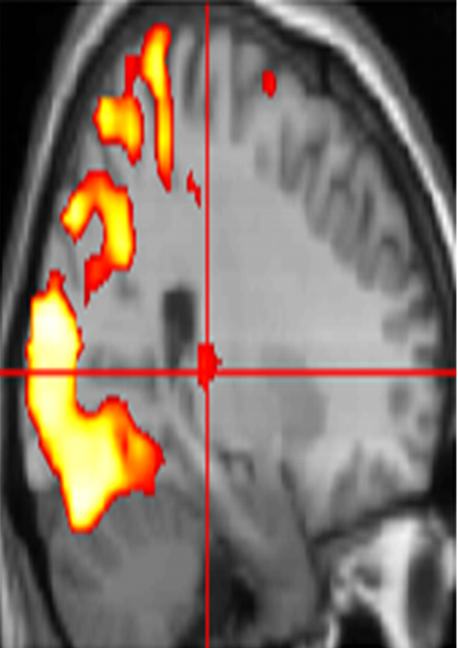
Two fundamental properties of brain architecture
Functional Segregation
Functional Integration
What is the neural correlate of… ?
How do cortical areas interact … ?
‘Connectivity’ analysis
Standard SPM

Slide 3
Types of Connectivity
Structural/Anatomical Connectivity: physical presence of axonal projection from one brain area to another, axon bundles detected e.g. by DTI
Functional Connectivity: statistical dependency in the data such that brain areas can be grouped into interactive networks, e.g. temporal correlation of activity across different brain areas in resting state fMRI
Effective Connectivity: moves beyond statistical dependency to measures of directed influence and causality within the networks constrained by further assumptions, e.g. PPI and DCM
r = 0.78
Definitions from Roerbroek, Seth, & Valdes-Sosa (2011)

Slide 4
“Resting-state” fMRI
Notes:
Katharina

Slide 5
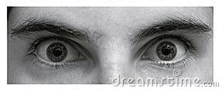
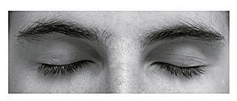
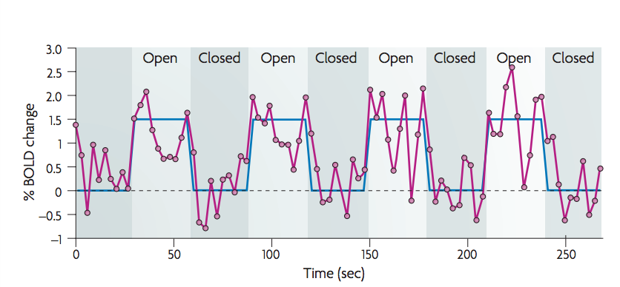
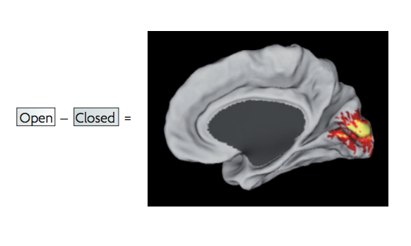
Task-evoked fMRI paradigm
task-related activation paradigm
  changes in BOLD signal attributed to experimental paradigm
  brain function mapped onto brain regions
Fox et al., 2007

Slide 6
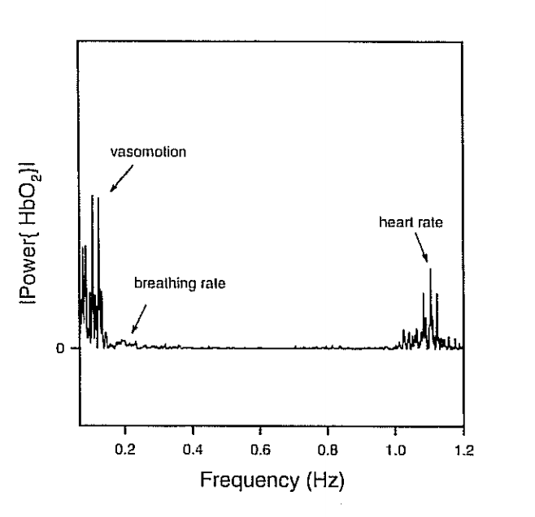
Spontaneous BOLD activity
the brain is always active, even in the absence of explicit input or output
  task-related changes in neuronal metabolism are only about 5% of brain’s total energy consumption
what is the “noise” in standard activation studies?
  faster frequencies related to respiratory and cardiac activities
  spontaneous, neuronal oscillations between 0.01 – 0.10 Hz
< 0.10 Hz
Changes in reflected and scattered light signal (indicating neuronal activity) at a pervasive low-frequency (0.1-Hz) oscillation correlate with vasomotion signals (Mayhew et al., 1996)

Slide 7
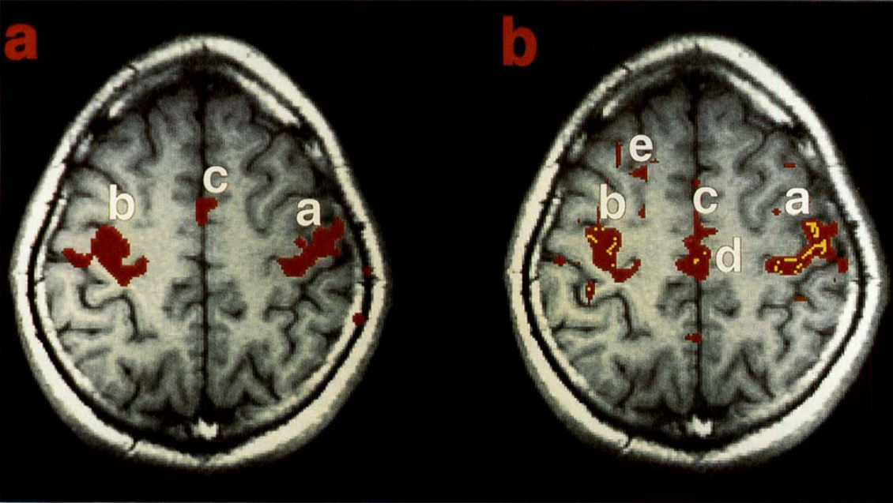
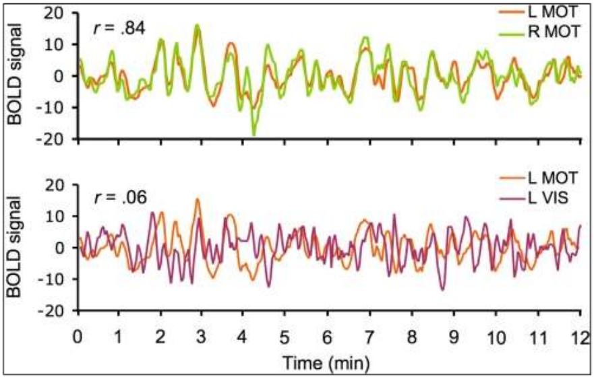
Spontaneous BOLD activity
occurs during task and at rest
  intrinsic brain activity
“resting-state networks”
  correlation between spontaneous BOLD signals of brain regions thought to be functionally and/or structurally related
More accurately: Endogenous brain networks
Biswal et al., 1995
Van Dijk et al., 2010

Slide 8
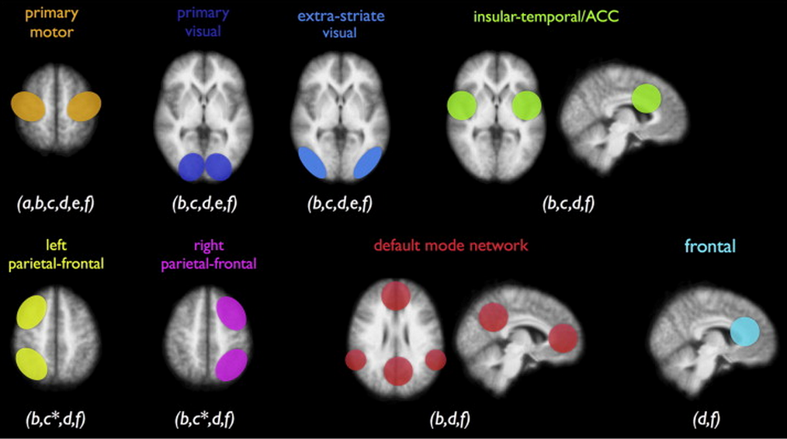
Resting-state networks (RSNs)
multiple resting-state networks (RSNs) have been found
  all show activity during rest and during tasks
  one of the RSNs, the default mode network (DMN), shows a decrease in activity during cognitive tasks

Slide 9
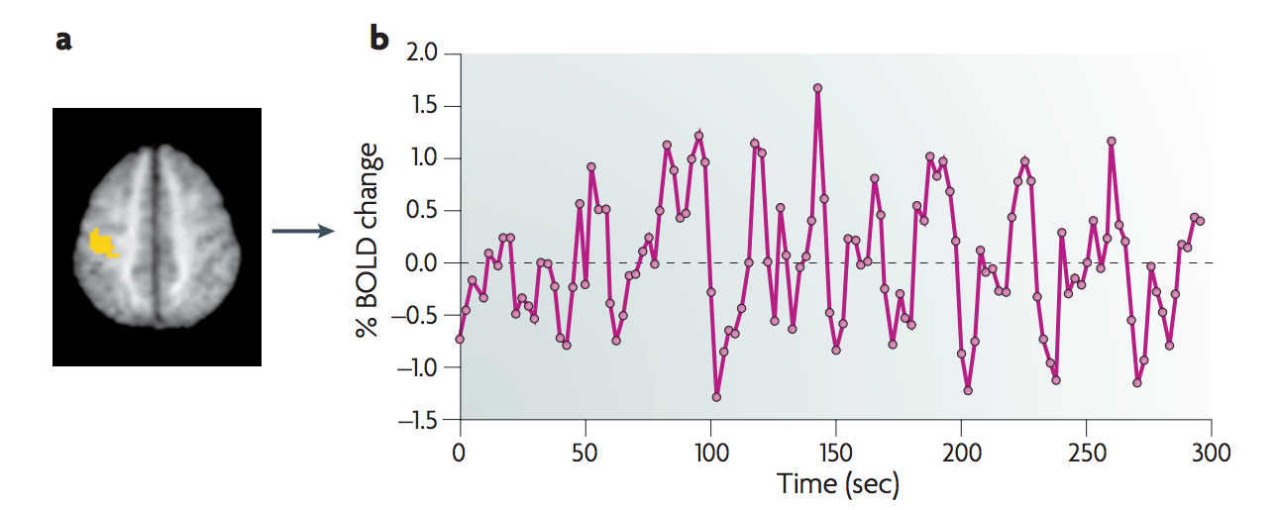
Resting-state fMRI: acquisition
resting-state paradigm
  no task; participant asked to lie still
  time course of spontaneous BOLD response measured
Fox & Raichle, 2007

Slide 10
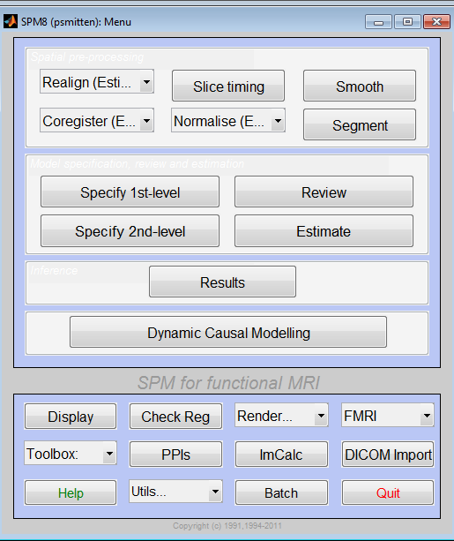
Resting-state fMRI: pre-processing
…exactly the same as other fMRI data!

Slide 11
Methods of Analysis
Seed-based analysis (SPM compatible)
Independent component analysis (cannot be done in SPM)
Principal Component Analysis
Graph theory
Clustering algorithms
Multivariate pattern classification
For a review see Lee et al. (2013)

Slide 12
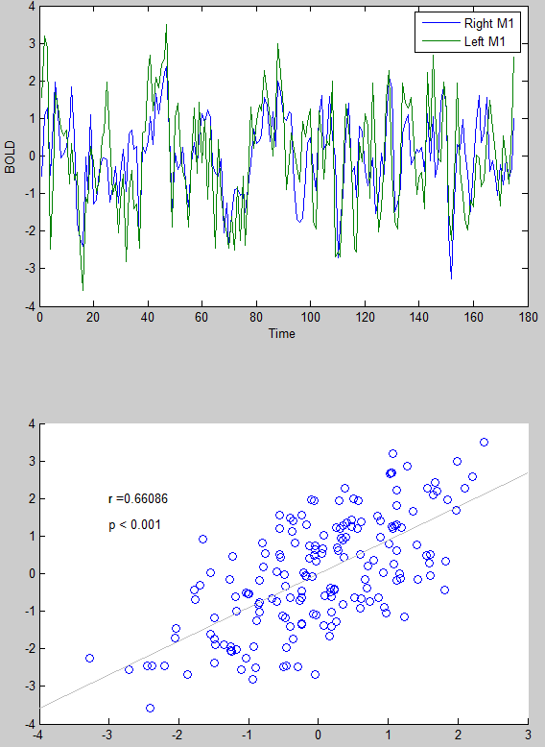
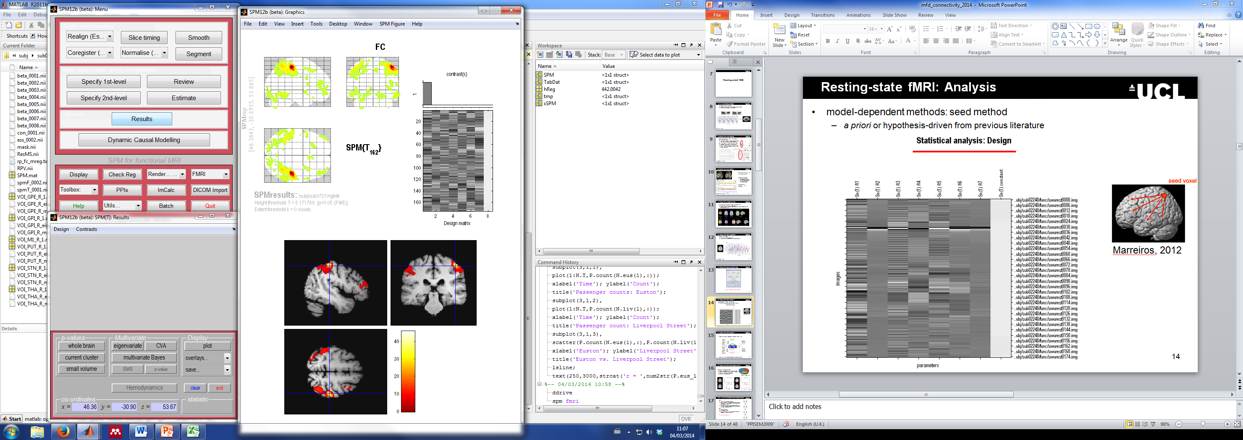
Resting-state fMRI: Analysis
Hypothesis-driven: seed method
  a priori or hypothesis-driven from previous literature
Data from:
Single subject, taken from the FC1000 open access database. Subject code: sub07210

Slide 13
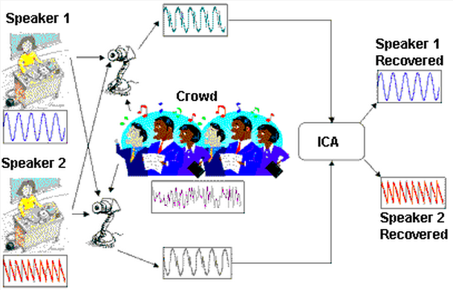
Resting-state fMRI: Analysis
Hypothesis-free: independent component analysis (ICA)
http://www.statsoft.com/textbook/independent-components-analysis/
“The aim of ICA is to decompose a multi-channel or imaging time-series into a set of linearly separable ‘spatial modes’ and their associated time course or dynamics” (Friston, 1998)

Slide 14
Pros & Cons of Resting state fMRI
pros
cons
easy to acquire
ideal for patients who cannot do longer (demanding) tasks
one data set allows to study different functional networks in the brain
good for exploratory analyses
(potentially) helpful as a clinical diagnostic tool (e.g. epilepsy, Alzheimer’s disease)
source of the spontaneous 0.1 Hz oscillations in BOLD signal debatable (a more general fMRI problem)
experimental paradigm eyes open/closed
establishes correlational, not causal, relationships
→ Effective connectivity

Slide 15
Psychophysiological Interactions
Notes:
Lorenzo

Slide 16
Correlation vs. Regression
Continuous data
Assumes relationship between two variables is constant
Pearson’s r
No directionality
Are two datasets related?
Continuous data
Tests for influence of an explanatory variable on a dependent variable
Least squares method
Directional
Is dataset 1 a function of dataset 2?
i.e. can we predict 1 from 2?
FUNCTIONAL CONNECTIVITY
EFFECTIVE CONNECTIVITY
Adapted from D. Gitelman, 2011

Slide 17
Psychophysiological Interaction
Way to explain the response in a brain area in terms of an interaction between:
(a) sensory-motor/cognitive process (experimental parameter)
(b) activity in another part of the brain
  Example: Is there a brain area whose responses can be explained by the interaction between
  Attention to visual motion
  (b) V1/V2 (primary visual cortex) activity?
PSYCHOLOGICAL VARIABLE
PHYSIOLOGICAL VARIABLE
Friston et al., Neuroimage 1997; Dolan et al., Nature 1997

Slide 18
Psychophysiological Interaction
Way to explain the response in a brain area in terms of an interaction between:
(a) sensory-motor/cognitive process (experimental parameter)
(b) activity in another part of the brain
Models “effective connectivity”: how the coupling between two brain regions changes according to psychological variables or external manipulations
In practical terms: a change in the regression coefficient between two regions during two different conditions determines significance
Friston et al., Neuroimage 1997; Dolan et al., Nature 1997

Slide 19
PPI: how it works?
  Is there a brain area whose responses can be explained by the interaction between attention and V1/V2 (primary visual cortex) activity?
Attention
Which parts of the brain show a significant attention-dependent coupling with V1/V2?
Activity in region Y
No Attention
V1/V2 activity

Slide 20
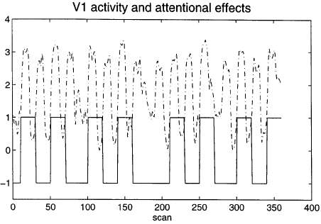
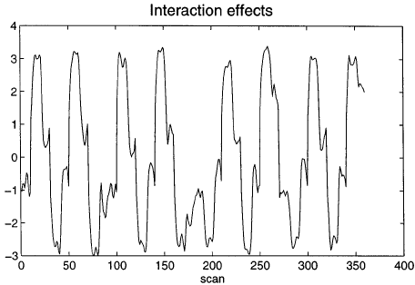
PPI: how it works?
PHYSIOLOGICAL VARIABLE
PSYCHOLOGICAL VARIABLE
Now - Remember the GLM equation for fMRI data?
Y = X1 * β1 + X2 * β2 + β0 + ε
Observed BOLD response
Regressor 1
Coefficient 1
Regressor 2
Coefficient 2
Constant
Error

Slide 21
PPI: how it works?
Observed BOLD response
In this case…
Y = (V₁) β₁ + (Att-NoAtt) β₂ + [(Att-NoAtt) * V1] β₃ + β0 + ε
Physiological Variable:
V1/V2 Activity
Psychological Variable:
Attention – No attention
Interaction: the effect of attention vs no attention on V1/V2 activity

Slide 22
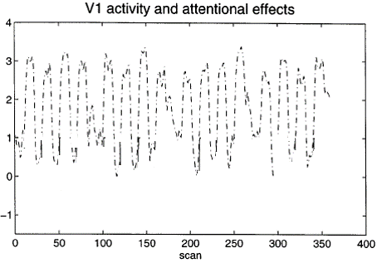
PPI: how it works?
Y = (V₁) β₁ + (Att-NoAtt) β₂ + [(Att-NoAtt) * V1] β₃ + β0 + ε
= β₁ + β₂ + β₃ + β0 + ε

Slide 23
PPI: how it works?
Y = (V₁) β₁ + (Att-NoAtt) β₂ + [(Att-NoAtt) * V1] β₃ + β0 + ε
CONTRAST VECTOR:
[
0
0
1
0
]

Slide 24
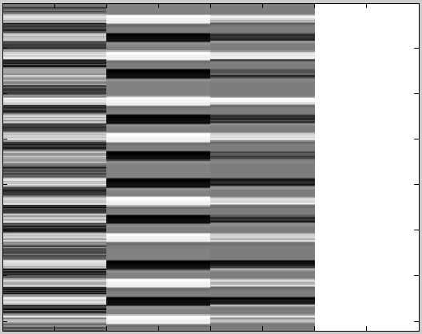
PPI: how it works?
Now taking a step back… How do we get
?

Slide 25
PPI: Experimental Design
  Is there a brain area whose responses can be explained by the interaction between attention and V1/V2 (primary visual cortex) activity?
  Before starting ‘playing around’, we need:
  Factorial Design: two different types of stimuli (eg., motion/no-motion), two different task conditions (attention vs. non-attention)
  Plausible conceptual anatomical model or hypothesis: I would think that V5 (human equivalent of MT) might show an attention-dependent coupling with V1/V2…

Slide 26
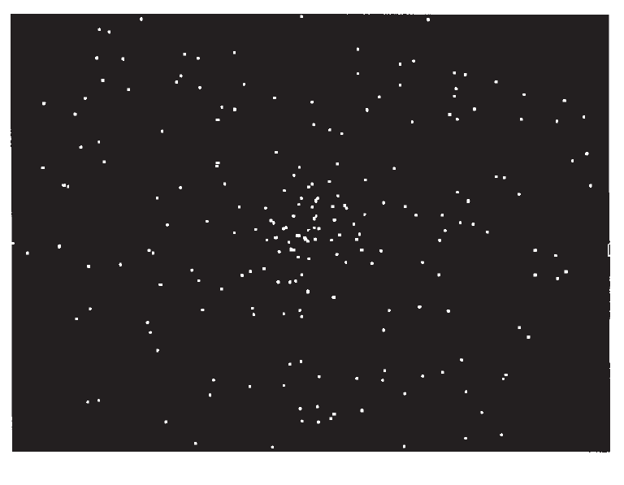
PPIs in SPM
Plan your experiment carefully! (you need 2 experimental factors, with one factor preferably being a psychological manipulation)
Stimuli:
SM = Radially moving
dots
SS = Stationary dots
Task:
TA = Attention: attend to
speed of the moving
dots
TN = No attention:
passive viewing of
moving dots
Buechel and Friston, Cereb Cortex 1997

Slide 27
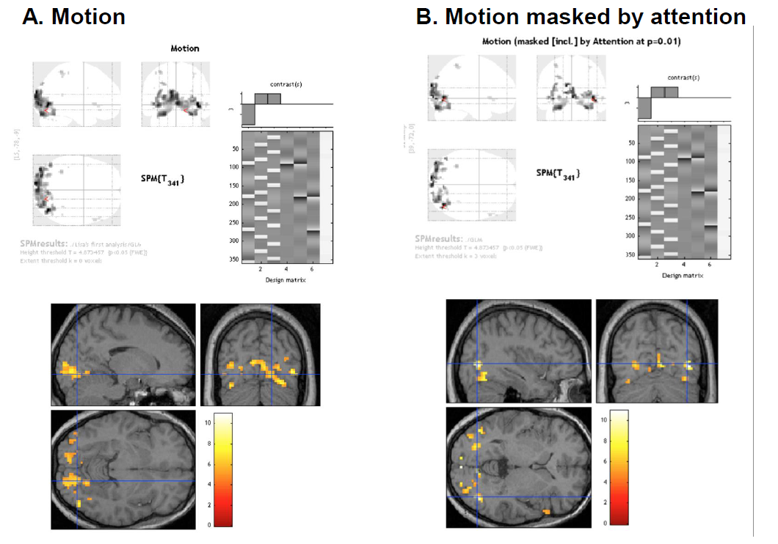
PPIs in SPM
2. Perform Standard GLM Analysis to determine regions of interest and interactions

Slide 28
PPIs in SPM
3. Define source region and extract BOLD SIGNAL time series (e.g. V2)
  Use Eigenvariates (there is a button in SPM) to create a summary value of the activation across the region over time.

Slide 29
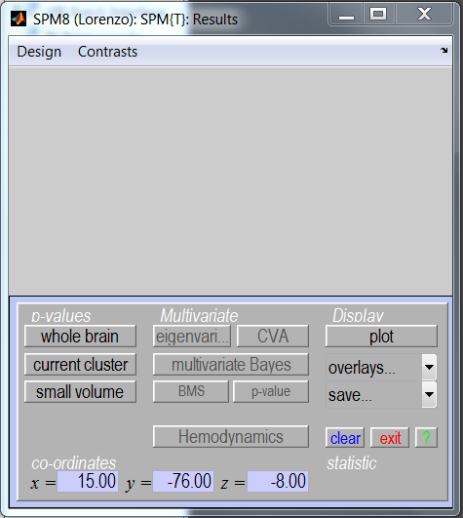
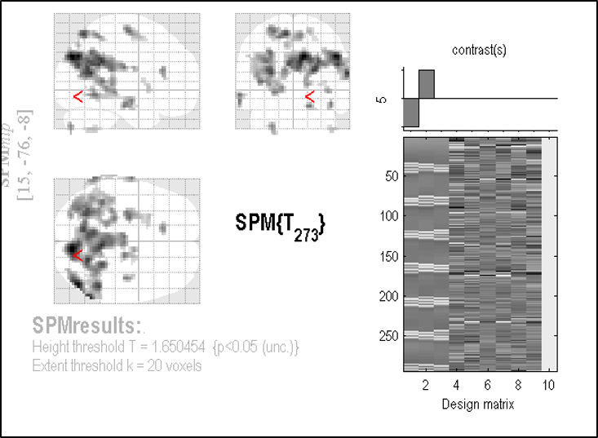
PPIs in SPM
3. Define source region and extract BOLD SIGNAL time series (e.g. V2)
  Use Eigenvariates (there is a button in SPM) to create a summary value of the activation across the region over time.

Slide 30
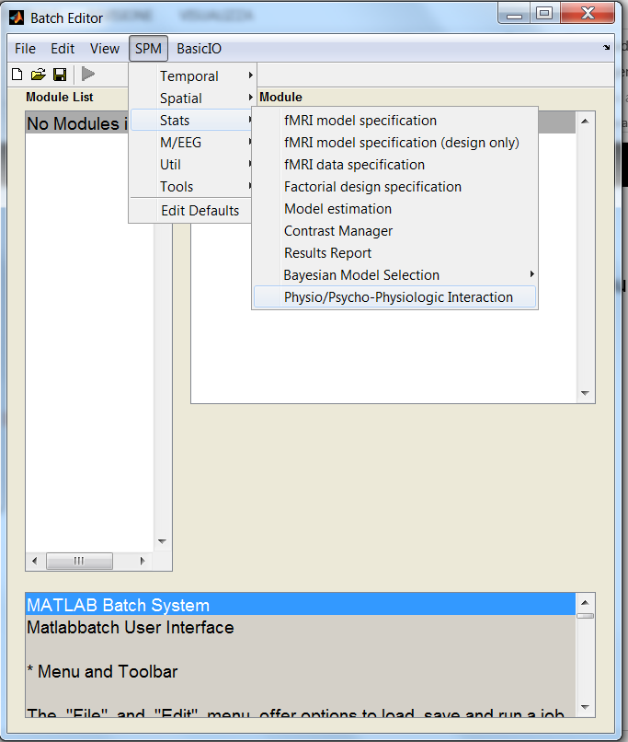
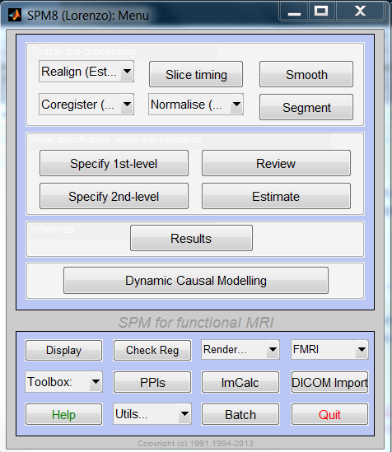
PPIs in SPM
4. Select PPI in SPM…

Slide 31
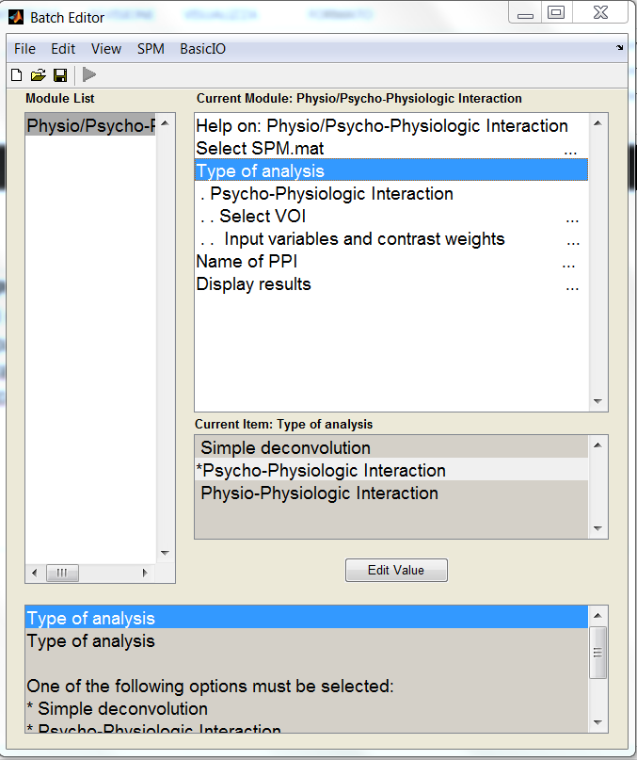
PPIs in SPM
4. Select PPI in SPM and form the Interaction term (source signal x experimental manipulation)
• Select the parameters of interest from the original GLM
• Physiological condition: Activity in V2
• Psychological condition: Attention vs. No attention

Slide 32
PPIs in SPM
4. Select PPI in SPM and form the Interaction term (source signal x experimental manipulation)
• Select the parameters of interest from the original GLM
• Physiological condition: Activity in V2
• Psychological condition: Attention vs. No attention
Deconvolve & Calculate & Convolve

Slide 33
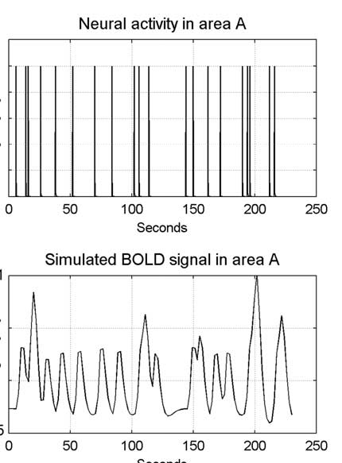
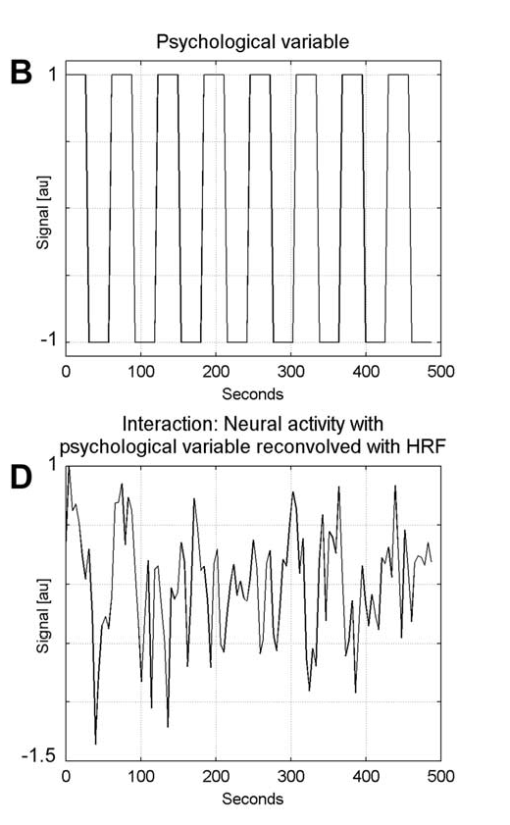
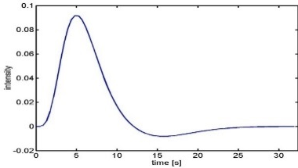
PPIs in SPM
4.
(a) Deconvolve physiological regressor (V1/V2) → transform BOLD signal
into neuronal activity
(b) Calculate the interaction term V1/V2x (Att-NoAtt)
(c) Convolve the interaction term V1/V2x (Att-NoAtt) with the HRF
BOLD signal in V1/V2
Neural activity in V1/V2
X
Psychological variable
Interaction term reconvolved
HRF

Slide 34
PPIs in SPM
5. Create PPI-GLM using the Interaction term – seen before!
Y = V1 β₁ + (Att-NoAtt) β₂ + (Att-NoAtt) * V1 β₃ + β_{i}Xi + e
H₀: β₃ = 0
0 0 1 0
6. Determine significance!
Based on a change in the regression
slopes between source region and another region during
condition 1 (Att) as compared to condition 2 (NoAtt)
V1/V2 Att-NoAtt V1 * Att/NoAtt Constant

Slide 35
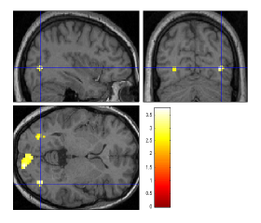
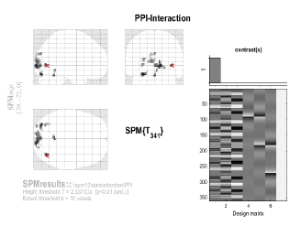
PPI results

Slide 36
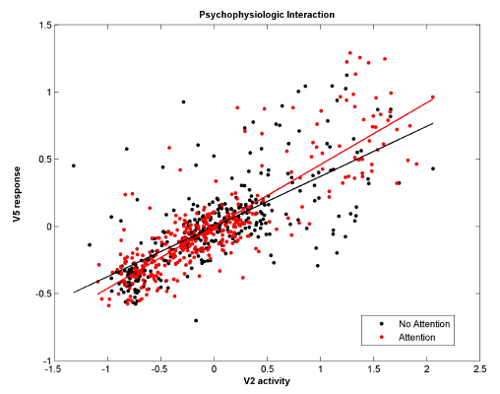
PPI plot

Slide 37
PPI: How should we interpret our results?
Two possible interpretations:
  The contribution of the source area to the target area response depends on experimental context
    e.g. V2 input to V5 is modulated by attention
  Target area response (e.g. V5) to experimental variable (attention) depends on activity of source area (e.g. V2)
    e.g. The effect of attention on V5 is modulated by V2 input
attention
1.
V2
V5
V1
attention
2.
Mathematically, both are equivalent!
But… one may be more neurobiologically plausible
V1
V5
V2

Slide 38
Pros & Cons of PPIs
Pros:
  Given a single source region, PPIs can test for regions exhibiting context-dependent connectivity across the entire brain
  “Simple” to perform
  Based on regressions and assume a dependent and independent variables (i.e., they assume causality in the statistical sense).
Cons:
  Very simplistic model: only allows modelling contributions from a single area
  Ignores time-series properties of data (can do PPIs on PET and fMRI data)
    Interactions are instantaneous for a given context
Need DCM to elaborate a mechanistic model!
Adapted from D. Gitelman, 2011

Slide 39

The End
Many thanks to Sarah Gregory!
& to Dana Boebinger, Lisa Quattrocki Knight and Josh Kahan for previous years’ slides!
thanks for your attention!

Slide 40
References
previous years’ slides, and…
Biswal, B., Yetkin, F.Z., Haughton, V.M., & Hyde, J.S. (1995). Functional connectivity in the motor cortex of resting human brain using echo-planar MRI. Magnetic Resonance Medicine, 34(4), 537-41.
Buckner, R. L., Andrews-Hanna, J. R., & Schacter, D. L. (2008). The brain’s default network: anatomy, function, and relevance to disease. Annals of the New York Academy of Sciences, 1124, 1–38. doi:10.1196/annals.1440.011
Damoiseaux, J. S., Rombouts, S. A. R. B., Barkhof, F., Scheltens, P., Stam, C. J., Smith, S. M., & Beckmann, C. F. (2006). Consistent resting-state networks, (2).
De Luca, M., Beckmann, C. F., De Stefano, N., Matthews, P. M., & Smith, S. M. (2006). fMRI resting state networks define distinct modes of long-distance interactions in the human brain. NeuroImage, 29(4), 1359–67. doi:10.1016/j.neuroimage.2005.08.035
Elwell, C. E., Springett, R., Hillman, E., & Delpy, D. T. (1999). Oscillations in Cerebral Haemodynamics. Advances in Experimental Medicine and Biology, 471, 57–65.
Fox, M. D., & Raichle, M. E. (2007). Spontaneous fluctuations in brain activity observed with functional magnetic resonance imaging. Nature reviews. Neuroscience, 8(9), 700–11. doi:10.1038/nrn2201
Fox, M. D., Snyder, A. Z., Vincent, J. L., Corbetta, M., Van Essen, D. C., & Raichle, M. E. (2005). The human brain is intrinsically organized into dynamic, anticorrelated functional networks. Proceedings of the National Academy of Sciences of the United States of America, 102(27), 9673–8. doi:10.1073/pnas.0504136102
Friston, K. J. (2011). Functional and effective connectivity: a review. Brain connectivity, 1(1), 13–36. doi:10.1089/brain.2011.0008
Greicius, M. D., Krasnow, B., Reiss, A. L., & Menon, V. (2003). Functional connectivity in the resting brain: a network analysis of the default mode hypothesis. Proceedings of the National Academy of Sciences of the United States of America, 100(1), 253–8. doi:10.1073/pnas.0135058100
Greicius, M. D., Supekar, K., Menon, V., & Dougherty, R. F. (2009). Resting-state functional connectivity reflects structural connectivity in the default mode network. Cerebral cortex (New York, N.Y. : 1991), 19(1), 72–8. doi:10.1093/cercor/bhn059
Marreiros, A. (2012). SPM for fMRI slides.
Smith, S. M., Miller, K. L., Moeller, S., Xu, J., Auerbach, E. J., Woolrich, M. W., Beckmann, C. F., et al. (2012). Temporally-independent functional modes of spontaneous brain activity. Proceedings of the National Academy of Sciences of the United States of America, 109(8), 3131–6. doi:10.1073/pnas.1121329109
Friston, K. (1998). Modes or models: a critique on independent component analysis for fMRI, TICS, 373-375.
Lee, M.H., Smyser, C.D., & Shominy, J.S. (2013). Resting-state fMRI: A review of methods and clinical applications. American Journal of Neuroradiology, 1866-1872.
Roerbroek, A., Seth, A., & Valdes-Sosa, P. (2011). Causal Time Series Analysis of functional Magnetic Resonance Imaging Data. JMLR: Workshop and Conference Proceedings 12 (2011) 65–94 .
Friston KJ, Buechel C, Fink GR et al. Psychophysiological and Modulatory Interactions in Neuroimaging. Neuroimage (1997) 6, 218-229.
Büchel C, Friston KJ, Modulation of connectivity in visual pathways by attention: cortical interactions evaluated with structural equation modelling and fMRI. Cereb Cortex (1997) 7, 768-78.
Dolan RJ, Fink GR, Rolls E, et al., How the brain learns to see objects and faces in an impoverished context, Nature (1997) 389, 596-9.
Gitelman DR, Penny WD, Ashburner J et al. Modeling regional and neuropsychologic interactions in fMRI: The importance of hemodynamic deconvolution. Neuroimage (2003) 19; 200-207.
http://www.fil.ion.ucl.ac.uk/spm/data/attention/
http://www.fil.ion.ucl.ac.uk/spm/doc/manual.pdf
http://www.neurometrika.org/resources
Graphic of the brain is taken from Quattrocki Knight et al., submitted.
Several slides were adapted from D. Gitelman’s presentation for the October 2011 SPM course at MGH

