Slide 1
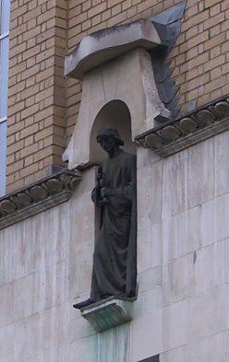
Image Processing for Voxel-based Morphometry
John Ashburner
Wellcome Trust Centre for Neuroimaging,
12 Queen Square, London, UK.

Slide 2
Overview
Voxel-Based Morphometry
  Morphometry in general
  Volumetrics
  VBM preprocessing followed by SPM
Tissue Segmentation
Diffeomorphic Registration
Longitudinal Registration

Slide 3
Measuring differences with MRI
What are the significant differences between populations of subjects?
What effects do various genes have on the brain?
What changes occur in the brain through development or aging?
A significant amount of the difference (measured with MRI) is anatomical.

Slide 4
There are many ways to model differences.
Usually, we try to localise regions of difference.
  Univariate models.
  Using methods similar to SPM
  Typically localising volumetric differences
Some anatomical differences can not be localised.
  Need multivariate models.
  Differences in terms of proportions among measurements.
  Where would the difference between male and female faces be localised?
Need to select the best model of difference to use, before trying to fill in the details.

Slide 5
Voxel-Based Morphometry
Based on comparing regional volumes of tissue.
Produce a map of statistically significant differences among populations of subjects.
  e.g. compare a patient group with a control group.
  or identify correlations with age, test-score etc.
The data are pre-processed to sensitise the tests to regional tissue volumes.
  Usually grey or white matter.
Suitable for studying focal volumetric differences of grey matter.

Slide 6
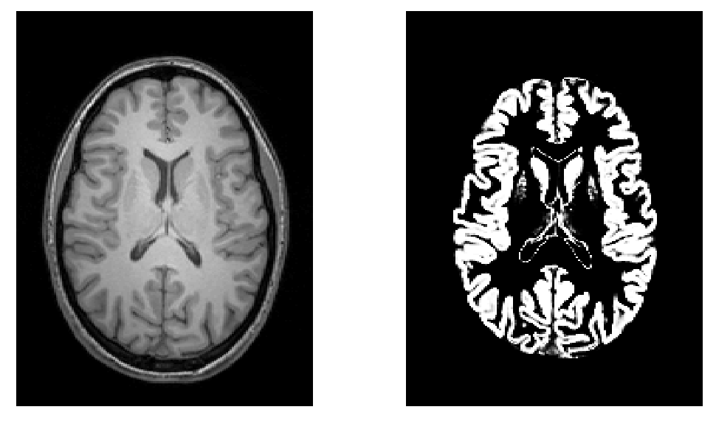
Volumetry
T1-Weighted MRI
Grey Matter

Slide 7
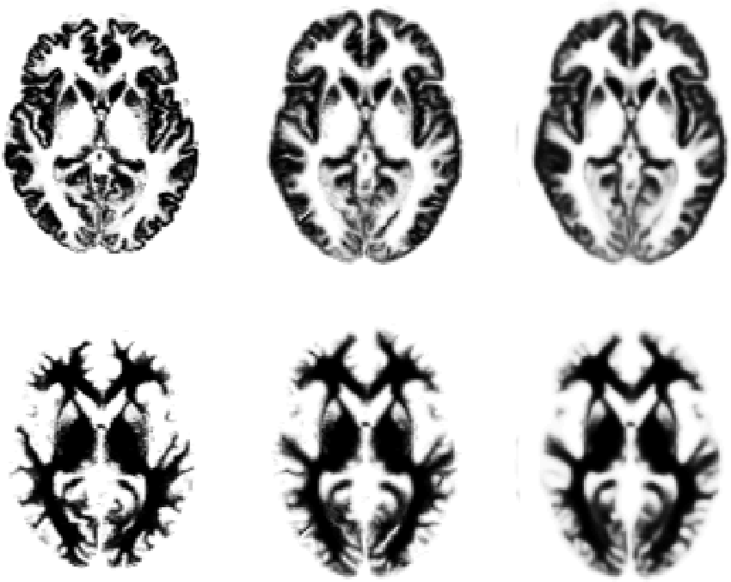
Original
Warped
Template

Slide 8
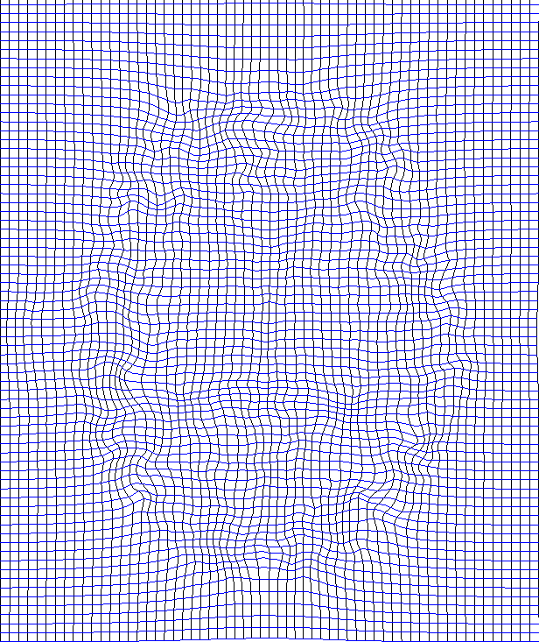
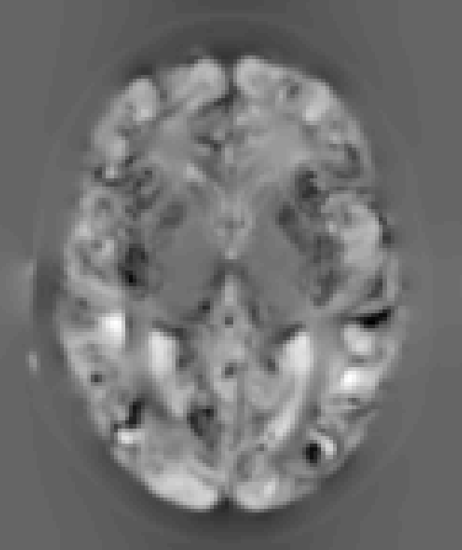
“Modulation” – change of variables.
Deformation Field
Jacobians determinants
Encode relative volumes.

Slide 9

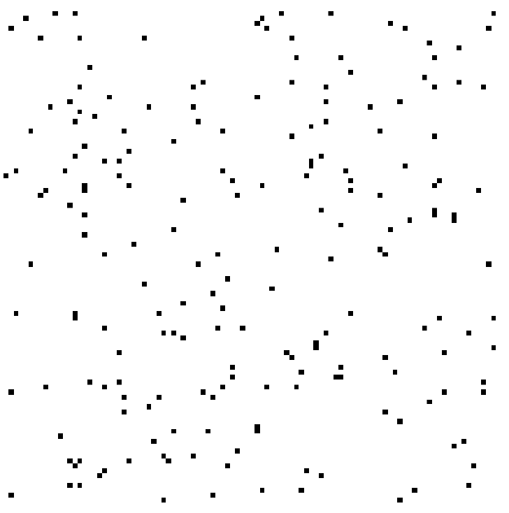

Smoothing
Each voxel after smoothing effectively becomes the result of applying a weighted region of interest (ROI).
Before convolution
Convolved with a circle
Convolved with a Gaussian

Slide 10
VBM Pre-processing in SPM12
Use Segment for characterising intensity distributions of tissue classes, and writing out “imported” images that Dartel can use.
Run Dartel to estimate all the deformations.
Dartel warping to generate smoothed, “modulated”, warped grey matter.
Statistics.

Slide 11
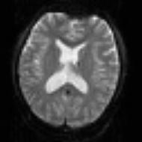
SPM for group fMRI
Group-wise
statistics
fMRI time-series
Preprocessing
Spatially Normalised
“Contrast” Image
spm T
Image
Analysis
fMRI time-series
Preprocessing
Spatially Normalised
“Contrast” Image
fMRI time-series
Preprocessing
Spatially Normalised
“Contrast” Image

Slide 12
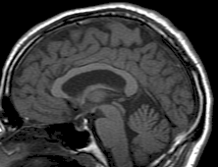
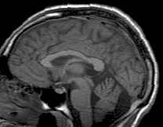
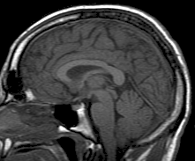
SPM for Anatomical MRI
Group-wise
statistics
Anatomical MRI
Preprocessing
Spatially Normalised
Grey Matter Image
Anatomical MRI
Preprocessing
Spatially Normalised
Grey Matter Image
Anatomical MRI
Preprocessing
Spatially Normalised
Grey Matter Image

Slide 13
“Globals” for VBM
Shape is really a multivariate concept
  Dependencies among different regions
SPM is mass univariate
  Combining voxel-wise information with “global” integrated tissue volume provides a compromise
  Either ANCOVA or proportional scaling.
(ii) is globally thicker, but locally thinner than (i) – either of these effects may be of interest to us.
Total intracranial volume (TIV) integrates GM, WM and CSF, or attempts to measure the skull-volume directly
  Can still identify global brain shrinkage (skull is fixed!)
  Can give more powerful and/or more interpretable results
  See also Pell et al (2009) doi:10.1016/j.neuroimage.2008.02.050
Notes:
Note globals don’t help distinguish the thickened or folded cortex...

Slide 14
Some Explanations of the Differences
Mis-classify
Mis-register
Folding
Thinning
Thickening
Mis-register
Mis-classify

Slide 15
Selected References
Wright, McGuire, Poline, Travere, Murray, Frith, Frackowiak & Friston (1995). “A voxel-based method for the statistical analysis of gray and white matter density applied to schizophrenia”. Neuroimage 2(4):244-252.
Ashburner & Friston (2000). “Voxel-based morphometry-the methods”. Neuroimage 11(6):805-821.
Mechelli et al. (2005) “Voxel-based morphometry of the human brain: Methods and applications”. Current Medical Imaging Reviews 1(2):105-103.
Ashburner (2009). “Computational Anatomy with the SPM software”. Magnetic Resonance Imaging 27(8):1163-1174.

Slide 16
Overview
Voxel-Based Morphometry
Tissue Segmentation
  Gaussian mixture model
  Intensity non-uniformity correction
  Deformed tissue probability maps
Diffeomorphic Registration
Longitudinal Registration

Slide 17
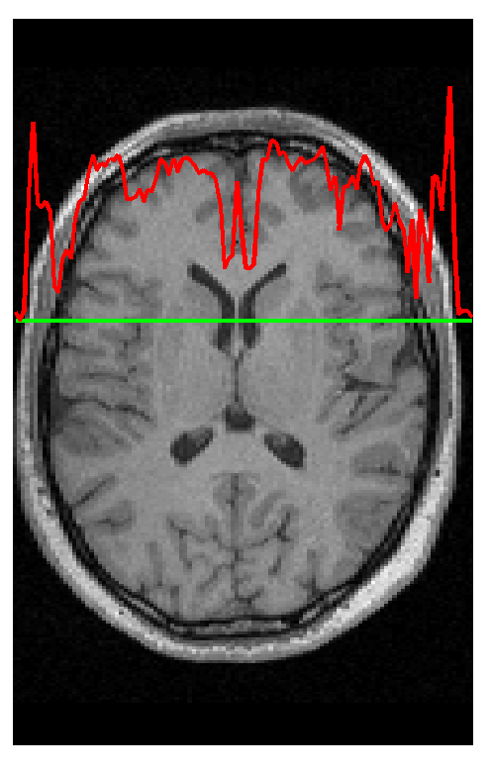
Segmentation
Segmentation in SPM12 also estimates a spatial transformation that can be used for spatially normalising images.
It uses a generative model, which involves:
  Mixture of Gaussians (MOG)
  Bias Correction Component
  Warping (Non-linear Registration) Component

Slide 18
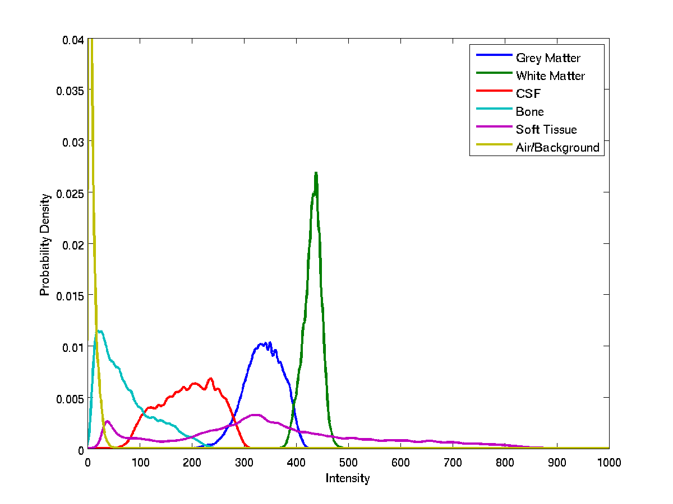
Image Intensity Distributions (T1-weighted MRI)

Slide 19
Mixture of Gaussians (MOG)
Classification is based on a Mixture of Gaussians model (MOG), which represents the intensity probability density by a number of Gaussian distributions.
Frequency
Image Intensity

Slide 20
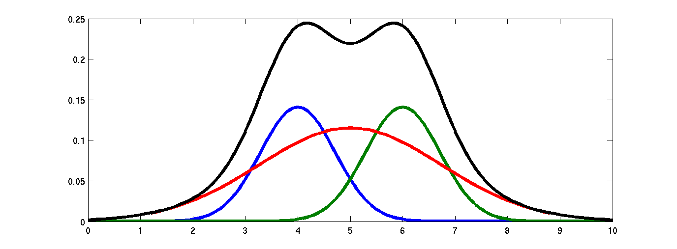
Belonging Probabilities
Belonging probabilities are assigned by normalising to one.

Slide 21
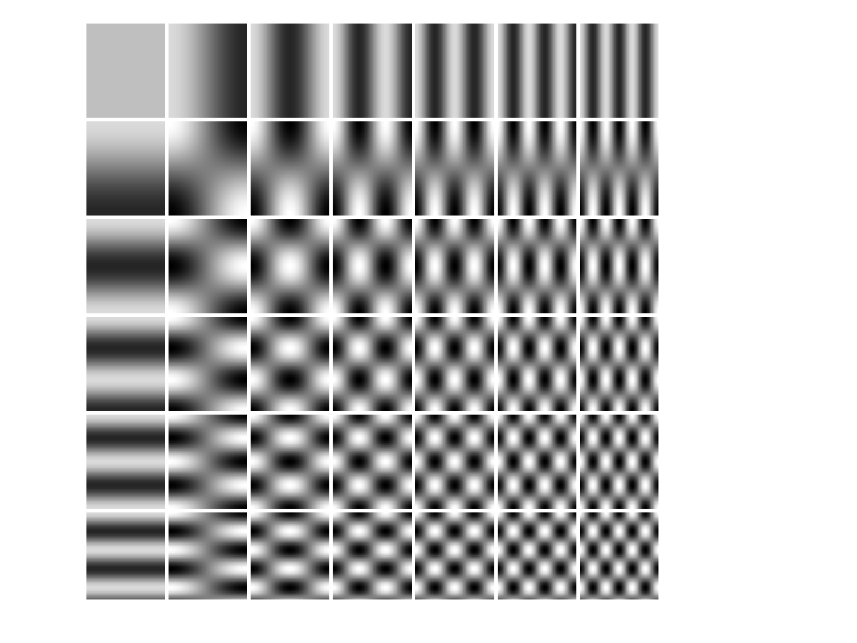
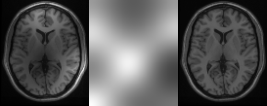
Modelling a Bias Field
A bias field is modelled as a linear combination of basis functions.
Corrupted image
Bias Field
Corrected image

Slide 22
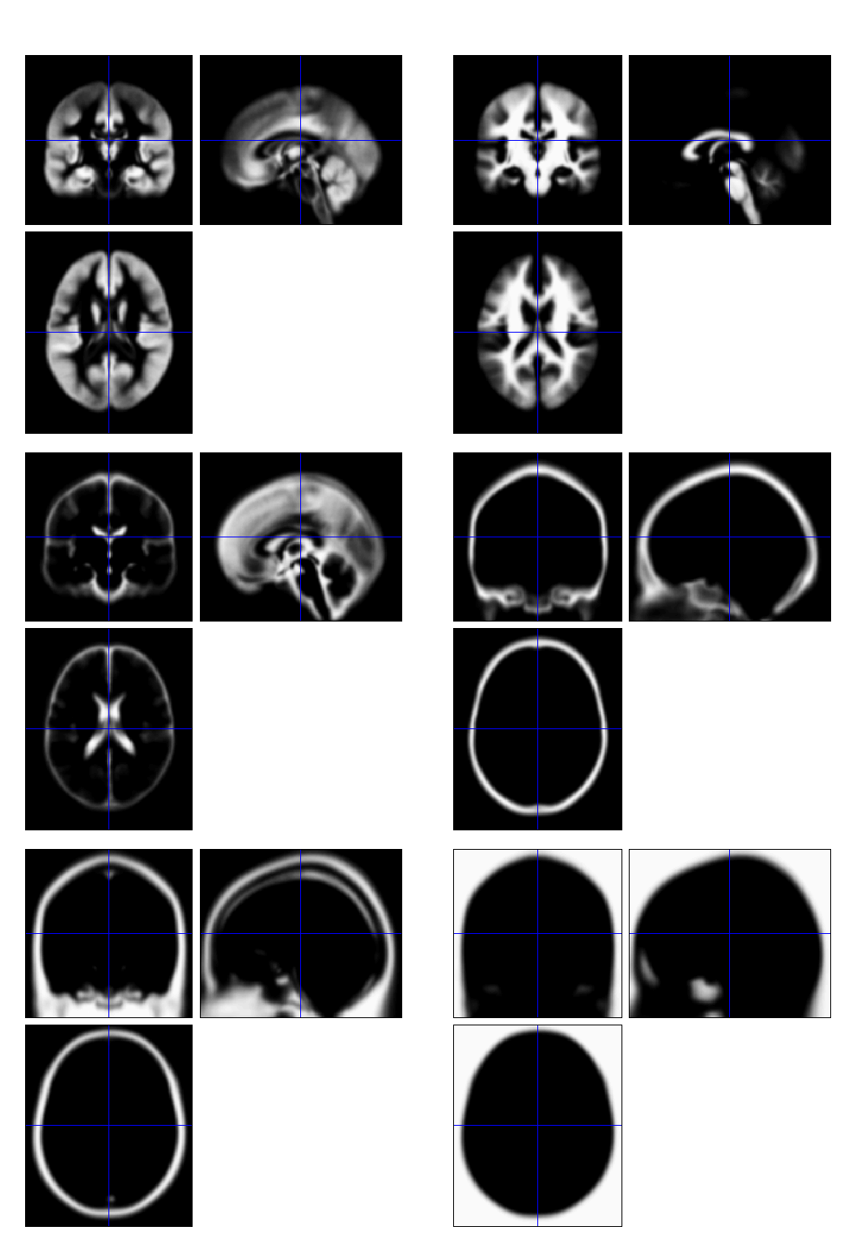
Tissue Probability Maps
Includes additional non-brain tissue classes (bone, and soft tissue)

Slide 23
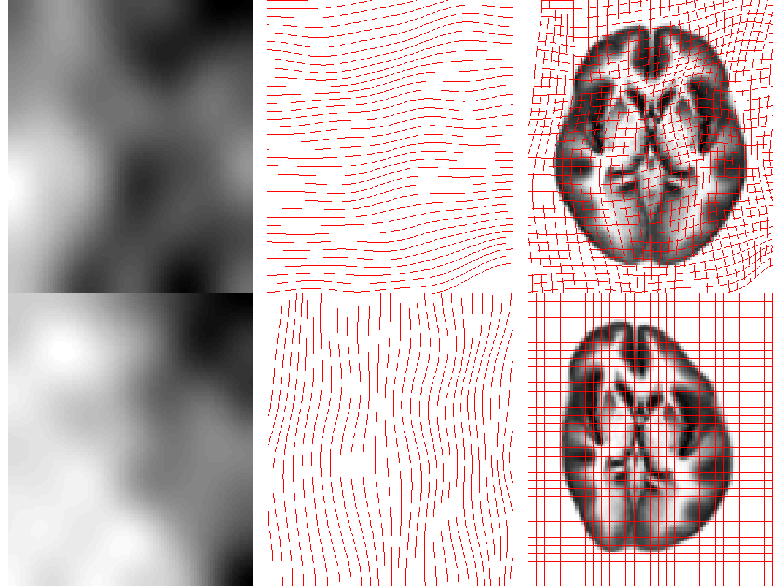
Deforming the Tissue Probability Maps
Tissue probability images are deformed so that they can be overlaid on top of the image to segment.

Slide 24
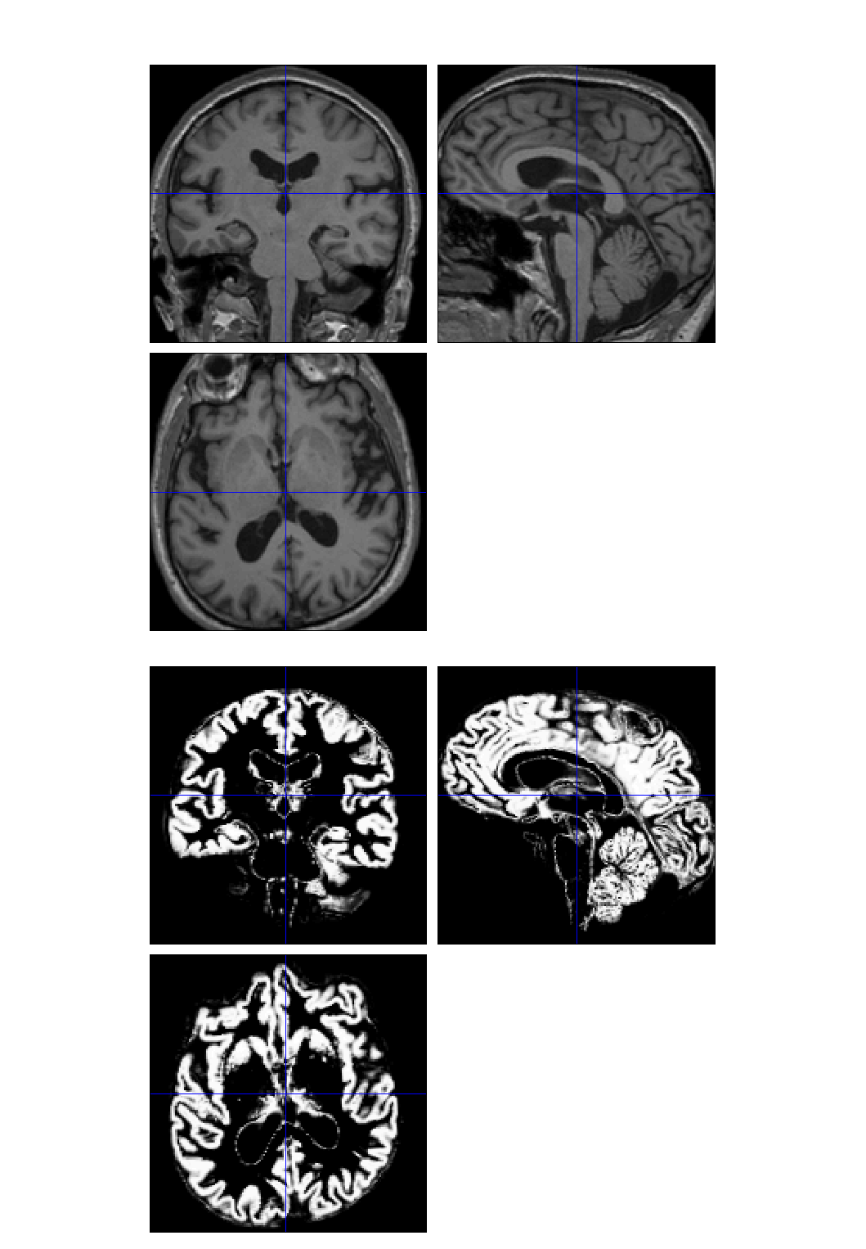
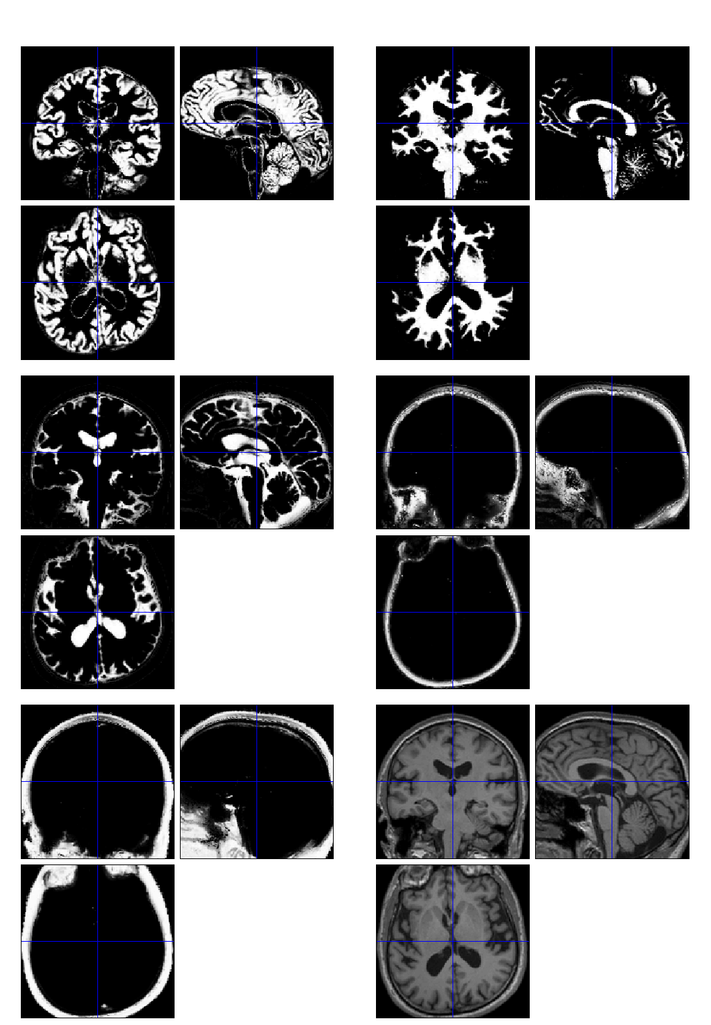

Slide 25
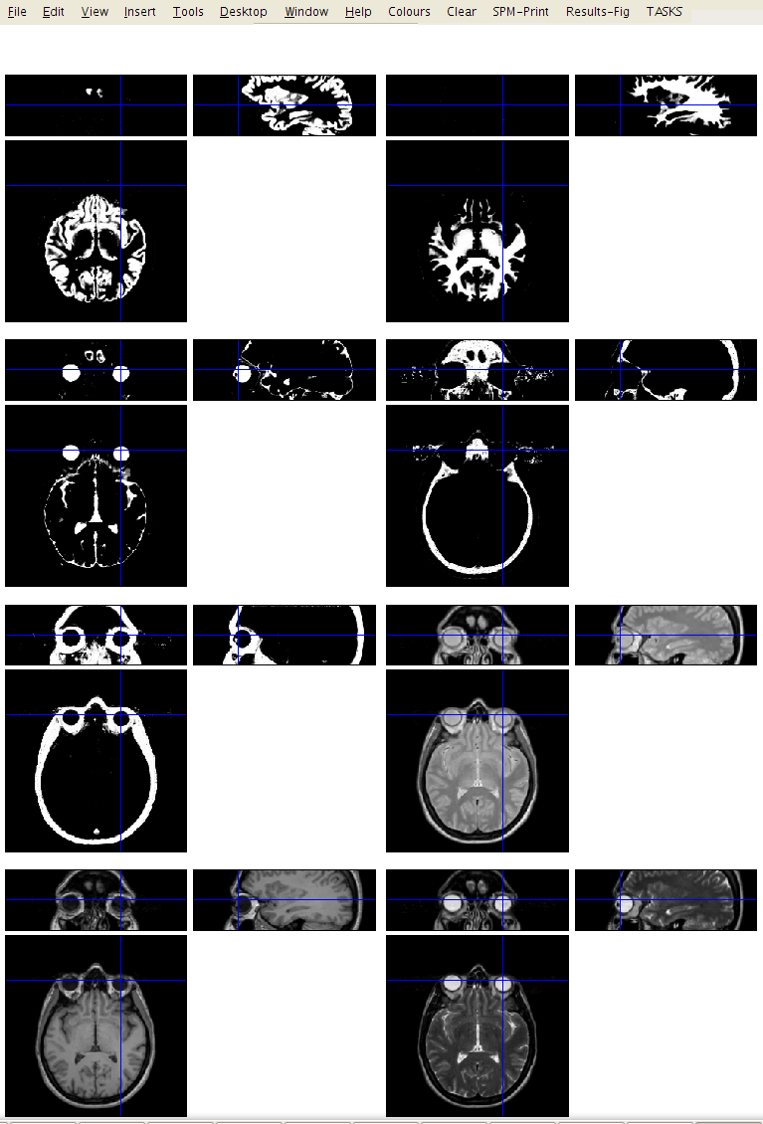

Multi-spectral

Slide 26
Limitations of the current model
Assumes that the brain consists of only the tissues modelled by the TPMs
  No spatial knowledge of lesions (stroke, tumours, etc)
Prior probability model is based on healthy brains (IXI dataset from London).
  Less accurate for subjects outside this population
Needs reasonable quality images to work with
  No severe artefacts
  Good separation of intensities
  Reasonable initial alignment with TPMs.

Slide 27
Selected References
Ashburner & Friston (2005). “Unified Segmentation”. NeuroImage 26:839-851.

Slide 28
Overview
Morphometry
Voxel-Based Morphometry
Tissue Segmentation
Diffeomorphic Registration
  Compositions
  Objective function
  Template creation
Longitudinal Registration

Slide 29
Diffeomorphic Deformations

Slide 30
Composition

Slide 31
Small Deformation Approximation
The composition:
ϑ ° φ
Would be approximated with:
Id +((ϑ-Id) + (φ-Id))
The inversion:
φ⁻¹
Would be approximated with:
Id -(φ-Id)
Not good approximations for large deformations.

Slide 32
Diffeomorphic Image Registration
Minimises two terms:
A measure of distance between images
A measure of the amount of distortion.
Because we can not simply add displacement fields, large deformations are generated by composing many small deformations.
The amount of distortion is computed by summing up the distortion measures from the small displacements.

Slide 33
Effect of Different Distortion Measures

Slide 34
Two diffeomorphic approaches in SPM
Dartel.
Geodesic Shooting
Uses the same small deformation composed multiple times.
Faster than Geodesic Shooting.
Gives similar deformations to Geodesic Shooting.
Currently more additional utilities.
Uses the optimal series of small deformations, which are composed together.
More mathematically correct than Dartel.
Gives nicer maps of volume change than Dartel.
Likely to replace Dartel in future.

Slide 35
In case anyone asks for equations
Dartel
Geodesic Shooting

Slide 36
Dartel & GS Compared
Dartel
Geodesic Shooting

Slide 37
Simultaneous registration of GM to GM and WM to WM
Grey matter
Subject 1
White matter
Grey matter
White matter
Subject 3
Grey matter
White matter
Grey matter
Template
Grey matter
White matter
White matter
Subject 2
Subject 4

Slide 38
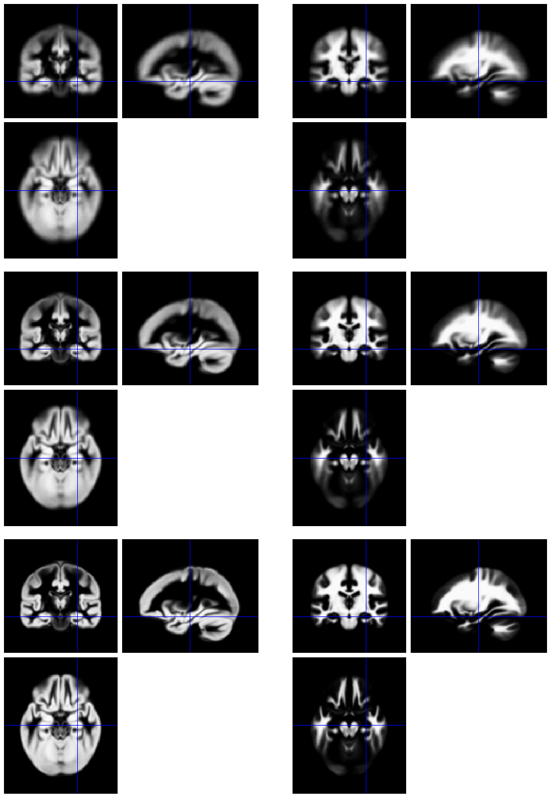
Template
Initial Average
Iteratively generated from 471 subjects
Began with rigidly aligned tissue probability maps
Used an inverse consistent formulation
After a few iterations
Final template

Slide 39
Grey matter average of 452 subjects – affine

Slide 40
Grey matter average of 471 subjects - nonlinear

Slide 41
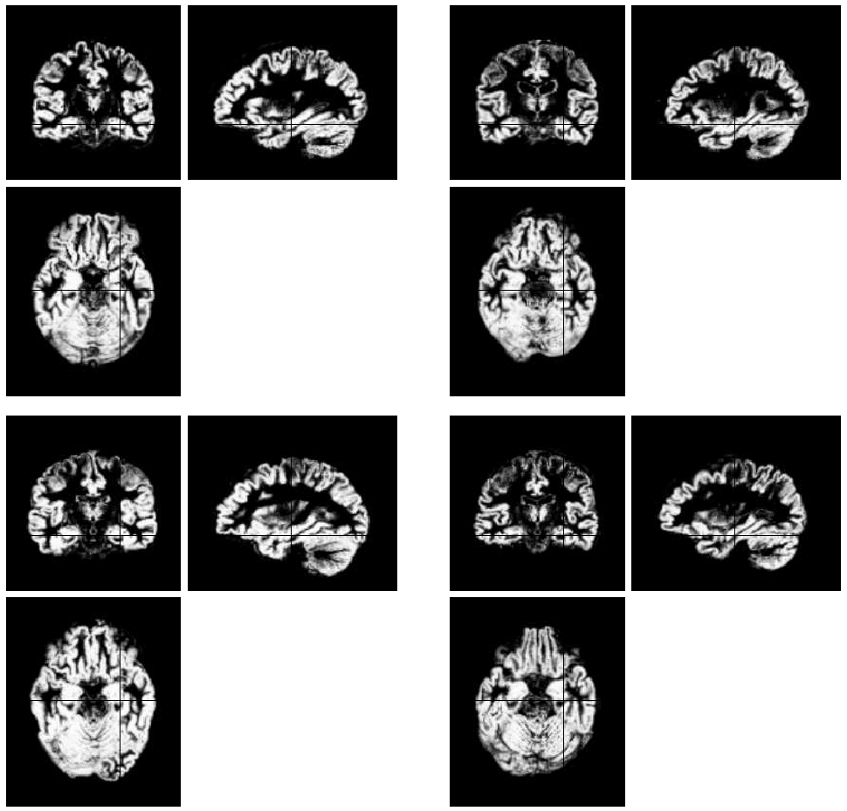
Initial
GM images

Slide 42
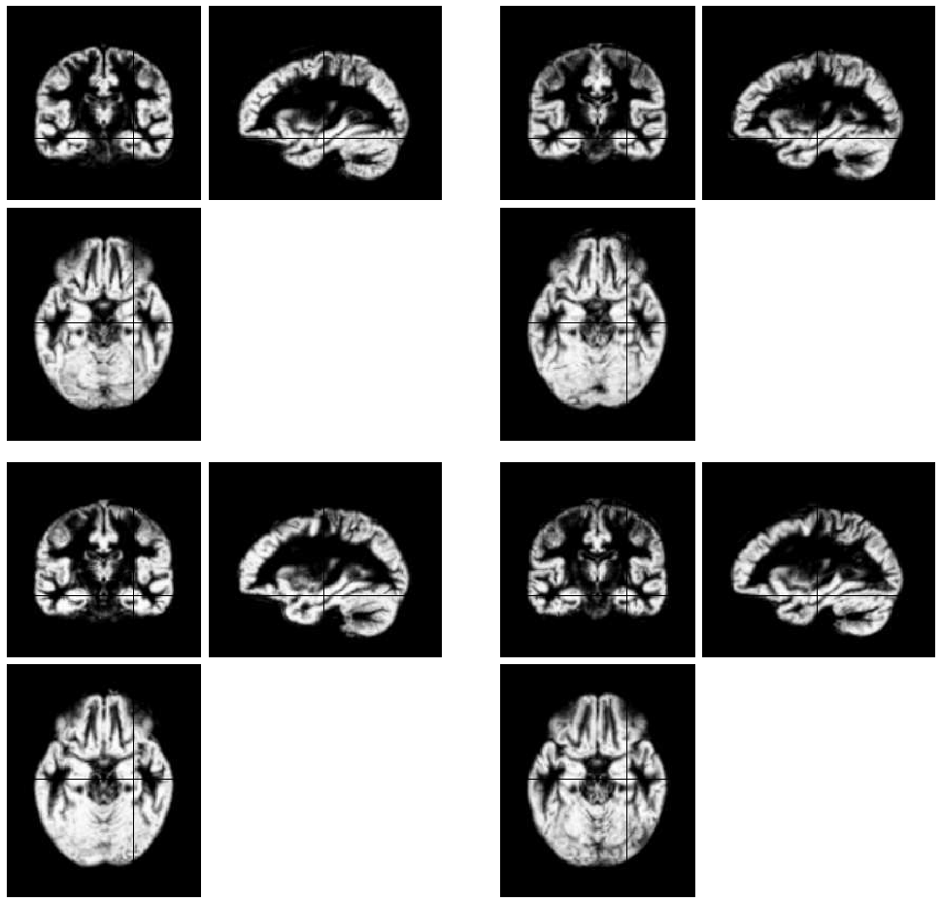
Warped
GM images

Slide 43
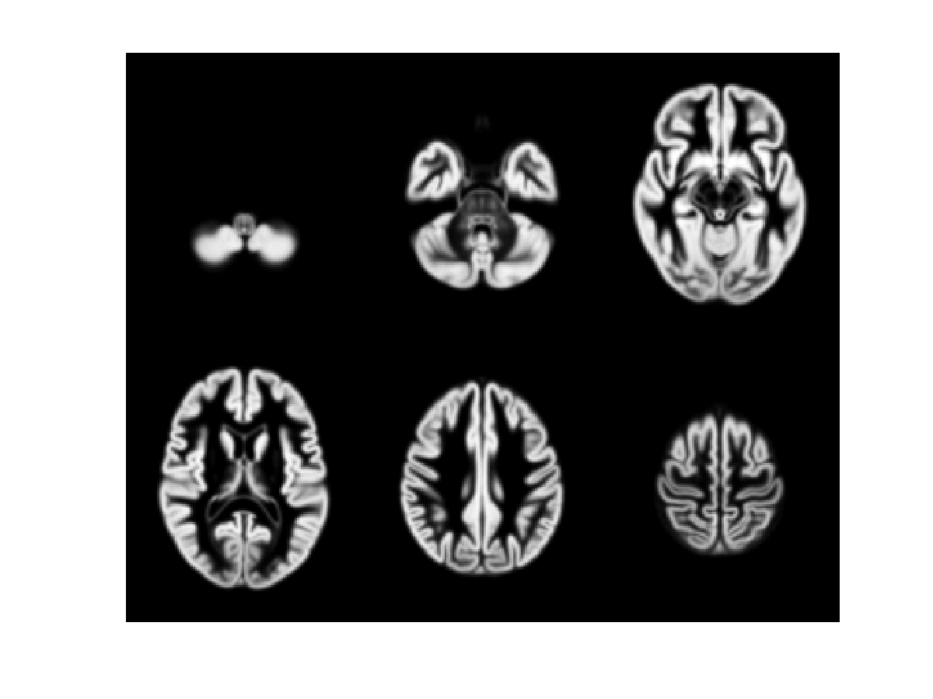
471 Subject Average

Slide 44
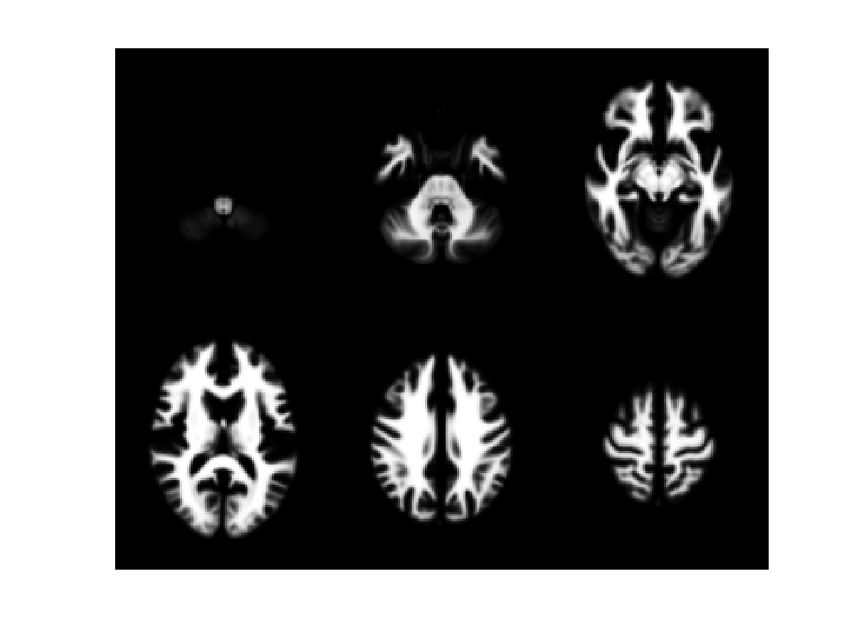
471 Subject Average

Slide 45
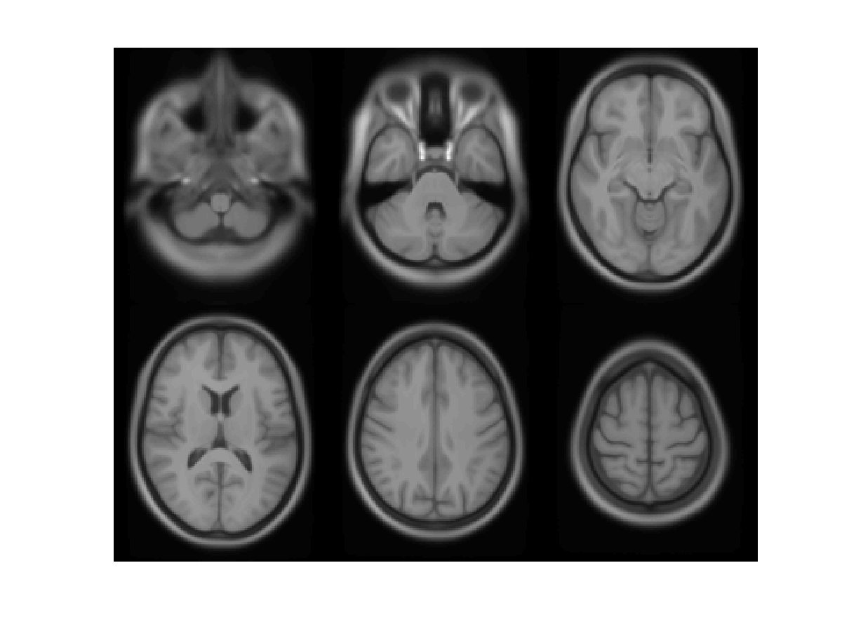
471 Subject Average

Slide 46
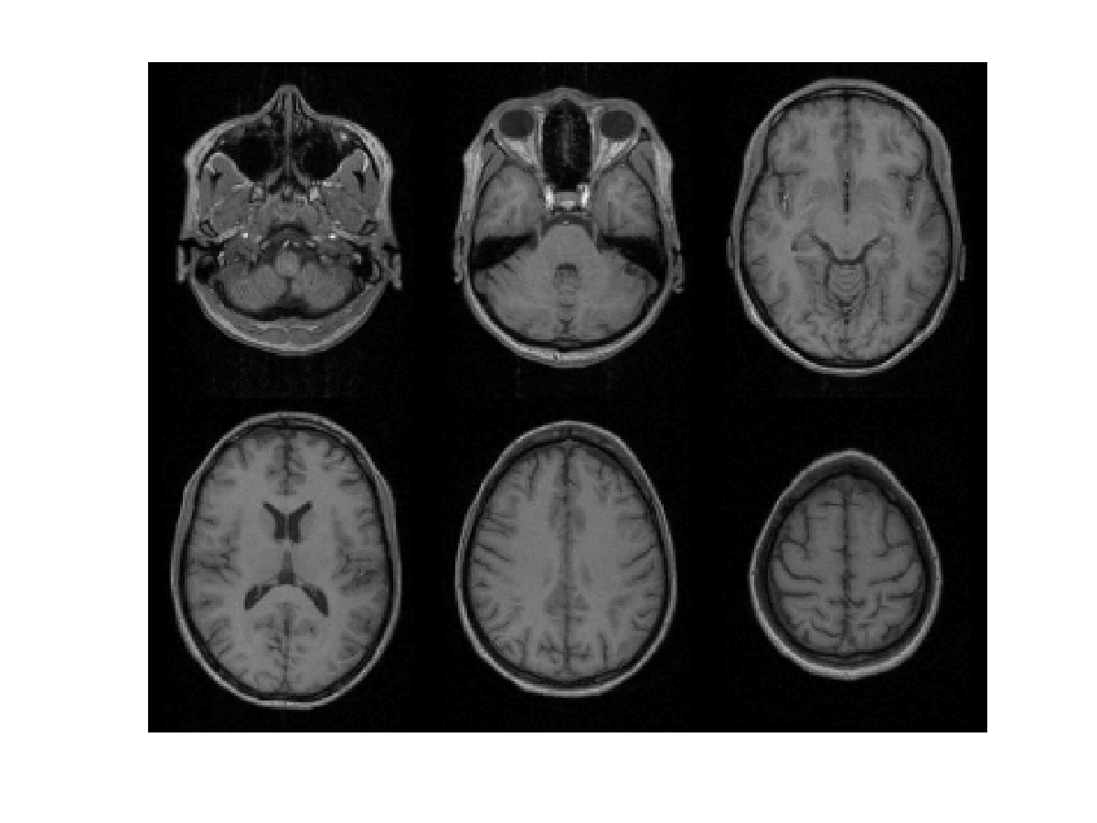
Subject 1

Slide 47
471 Subject Average

Slide 48
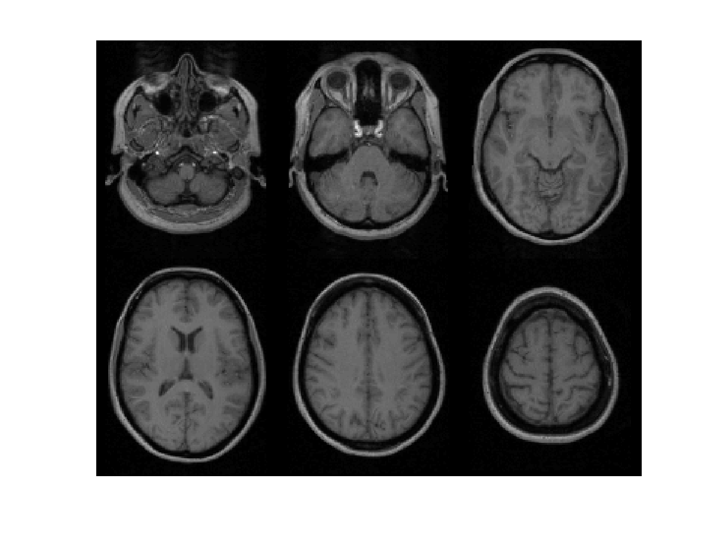
Subject 2

Slide 49
471 Subject Average

Slide 50
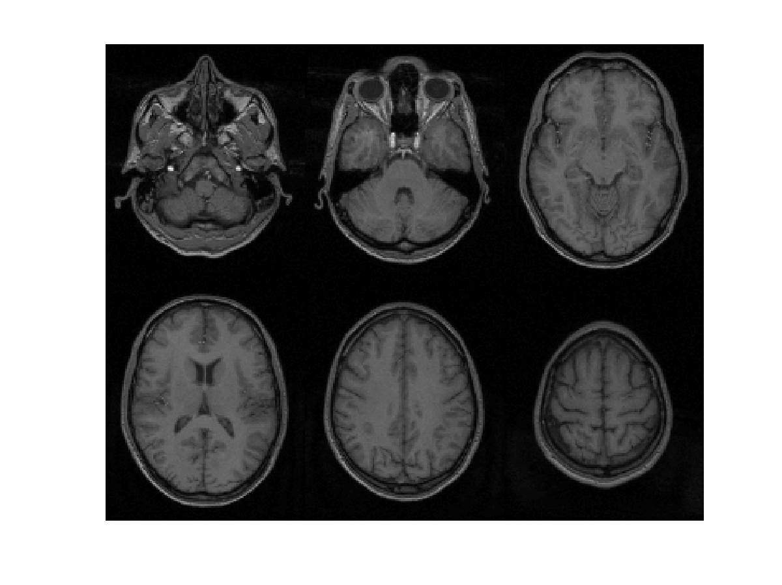
Subject 3

Slide 51
471 Subject Average

Slide 52
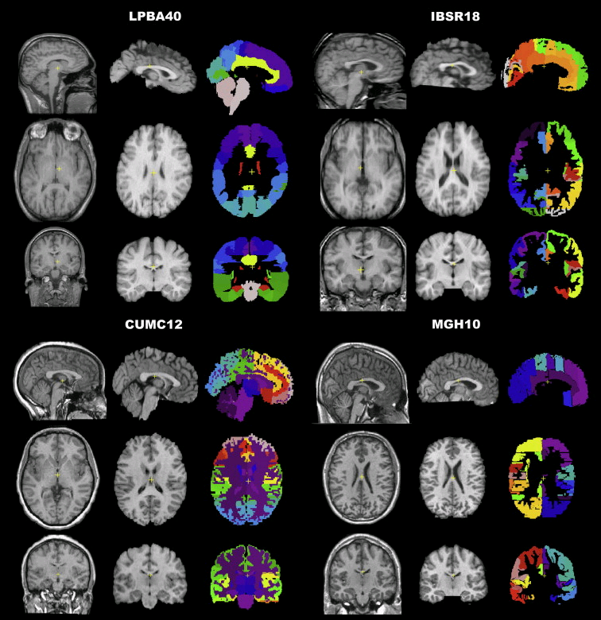
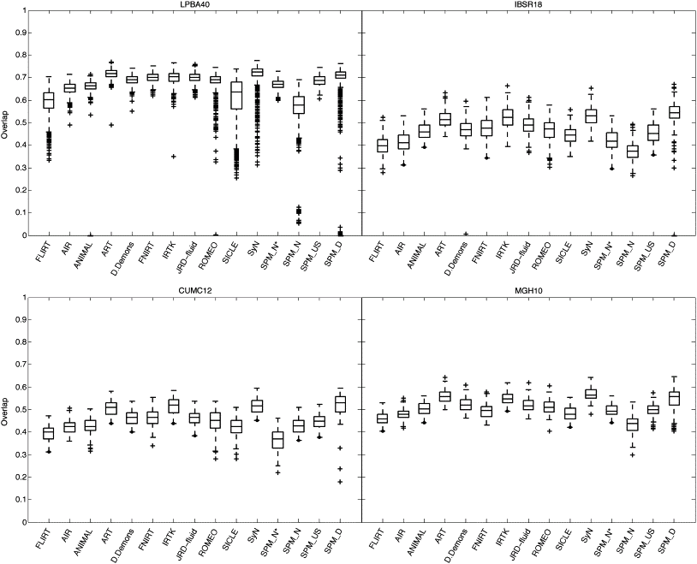
Evaluations of nonlinear registration algorithms

Slide 54
Selected References
Beg, Miller, Trouvé & Younes (2005). “Computing large deformation metric mappings via geodesic flows of diffeomorphisms.” International journal of computer vision 61(2):139-157.
Ashburner (2007). “A Fast Diffeomorphic Image Registration Algorithm”. NeuroImage 38:95-113.
Ashburner & Friston (2009). “Computing Average Shaped Tissue Probability Templates”. NeuroImage 45:333-341.
Klein et al (2009). “Evaluation of 14 nonlinear deformation algorithms applied to human brain MRI registration”. NeuroImage 46(3):786-802.
Ashburner & Friston (2011). “Diffeomorphic registration using geodesic shooting and Gauss-Newton optimisation”. NeuroImage 55(3):954-967

Slide 55
Overview
Morphometry
Voxel-Based Morphometry
Tissue Segmentation
Diffeomorphic Registration
Longitudinal Registration

Slide 56
Longitudinal Registration
Unified model combines:
  Nonlinear diffeomorphic registration.
  Rigid-body registration.
  Intensity inhomogeneity correction.

Slide 57
Two Longitudinal Scans
Two scans taken 6 years apart (after rigid registration).
Average and difference images.
Shape average and map of expansion/contraction
(after nonlinear registration)

Slide 58
Oasis Data
OAS2 0002
75 year old male, with MCI (MMSE=22, CDR=0.5).

Slide 59
Oasis Data
OAS2 0002
75 year old male, with MCI (MMSE=22, CDR=0.5).

Slide 60
Oasis Data
OAS2 0048
66 year old male, with MCI (MMSE=19, CDR=1).

Slide 61
Oasis Data
Data from first 82 subjects (OAS2 0001 to OAS2 0099).
Computed average expansion/contraction rates for each subject.
Warped all data to common anatomical space.
Generated averages.
Mean image intensity
Control subjects
Dementia subjects

Slide 62
Selected References
Fox, Ridgway & Schott (2011). “Algorithms, atrophy and Alzheimer's disease: cautionary tales for clinical trials”. Neuroimage 57(1):15-18.
Ashburner & Ridgway (2013). “Symmetric diffeomorphic modelling of longitudinal structural MRI”. Frontiers in Neuroscience 6(197).

Slide 63
