Slide 1


Ananysis of Anatomical MRI using SPM.
John Ashburner Ph.D.
Wellcome Centre for Human Neuroimaging, UCL Institute of Neurology.
12 Queen Square, London, UK.

Slide 2
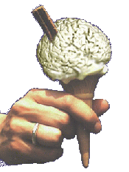
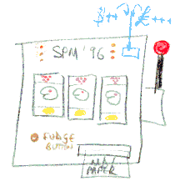
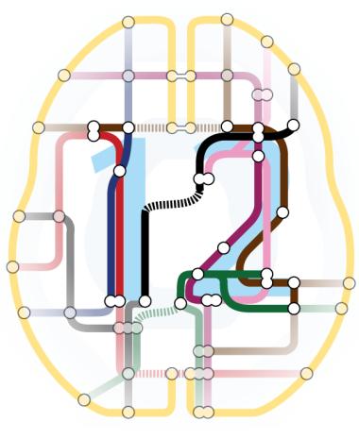
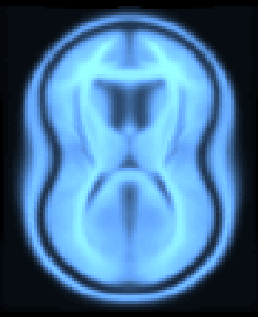
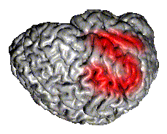
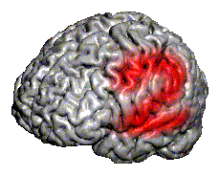
SPM: Software
“The SPM software was originally developed by Karl Friston for the routine statistical analysis of functional neuroimaging data from PET while at the Hammersmith Hospital in the UK, and made available to the emerging functional imaging community in 1991 to promote collaboration and a common analysis scheme across laboratories.”
SPMclassic, SPM’94, SPM’96, SPM’99, SPM2, SPM5, SPM8 and SPM12 represent the ongoing theoretical advances and technical improvements of the original version.
John Ashburner | UCL

Slide 3


SPM: SPM12 Version
Free and Open Source Software
(GPL)
Requirements:
  MATLAB: 7.4 (R2007a) to 9.4 (R2018a)
  no MathWorks toolboxes required
  Supported platforms:
  Linux, Windows and Mac
Standalone version available.
John Ashburner | UCL

Slide 4
Voxel-based Morphometry
Morphometrics
Volumetrics
VBM preprocessing
John Ashburner | UCL

Slide 5
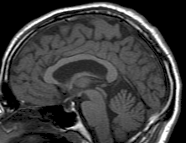
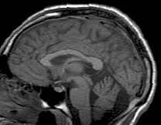
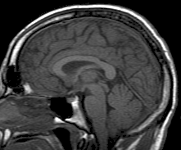
Voxel-based Morphometry: Overview
Statistical
analysis
Subject 1
Preprocessing
Spatially Normalised
Grey Matter Image
Subject 2
Preprocessing
Spatially Normalised
Grey Matter Image
Subject 3
Preprocessing
Spatially Normalised
Grey Matter Image
John Ashburner | UCL

Slide 6
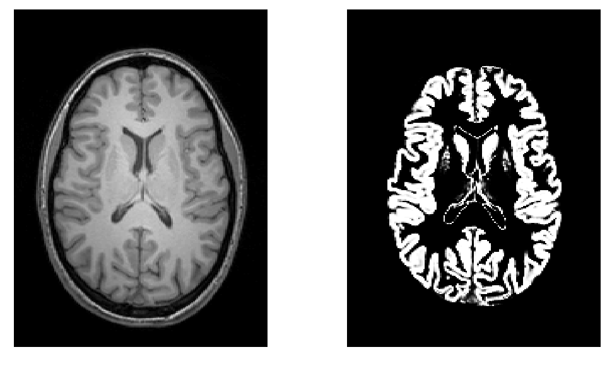
Voxel-based Morphometry: Volumetry
T1-Weighted MRI
Grey Matter
John Ashburner | UCL

Slide 7
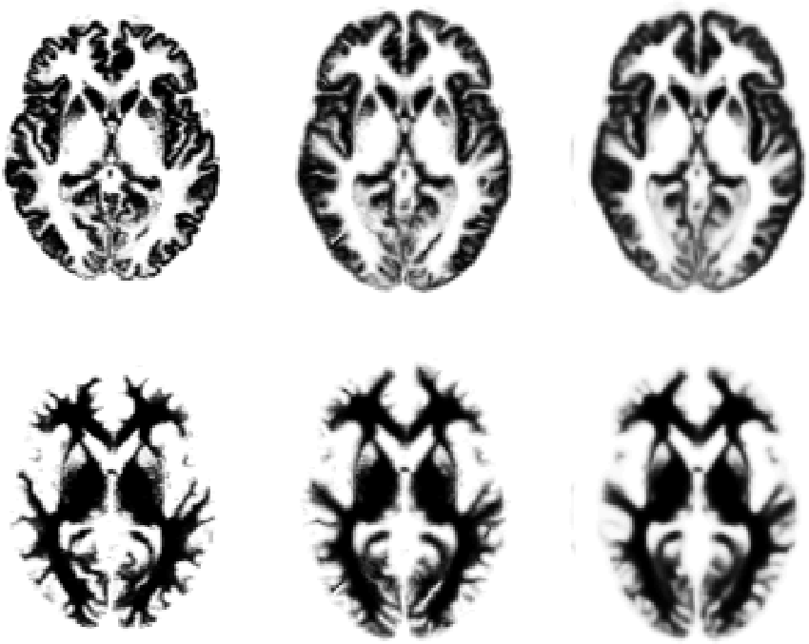
Voxel-based Morphometry: Spatial Normalisation
Original
Warped
Template
John Ashburner | UCL

Slide 8
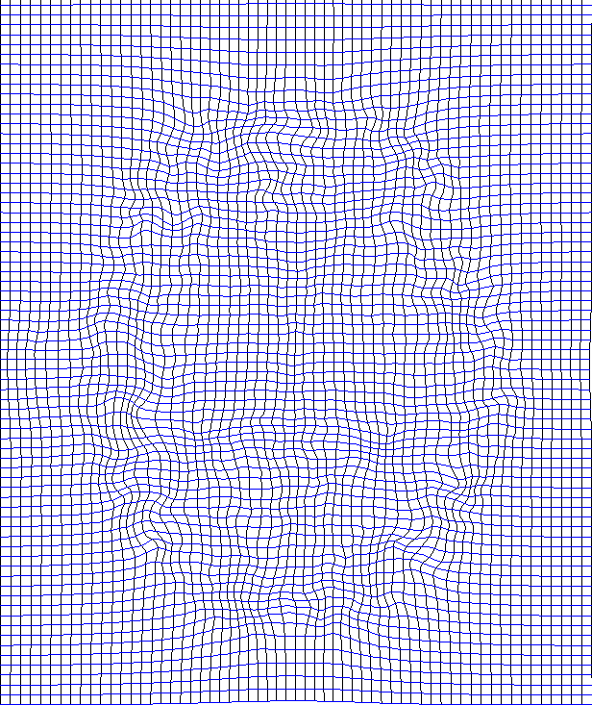
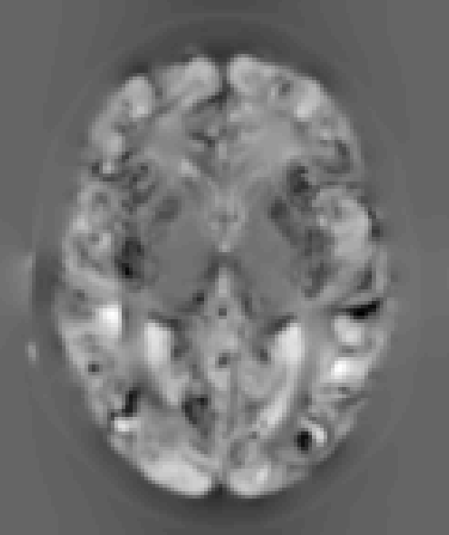
Voxel-based Morphometry:“Modulation”
Jacobians determinants
Encode relative volumes.
Deformation Field
John Ashburner | UCL

Slide 9



Voxel-based Morphometry: Smoothing
Each voxel after smoothing effectively becomes the result of applying a weighted region of interest (ROI).
Before convolution
Convolved with a circle
Convolved with a Gaussian
John Ashburner | UCL

Slide 10
Voxel-based Morphometry: Explanations of Findings
Mis-classify
Mis-register
Folding
Thinning
Thickening
Mis-register
Mis-classify
John Ashburner | UCL

Slide 11
Segmentation
Gaussian mixture
Intensity nonuniformity
Registration
John Ashburner | UCL

Slide 12
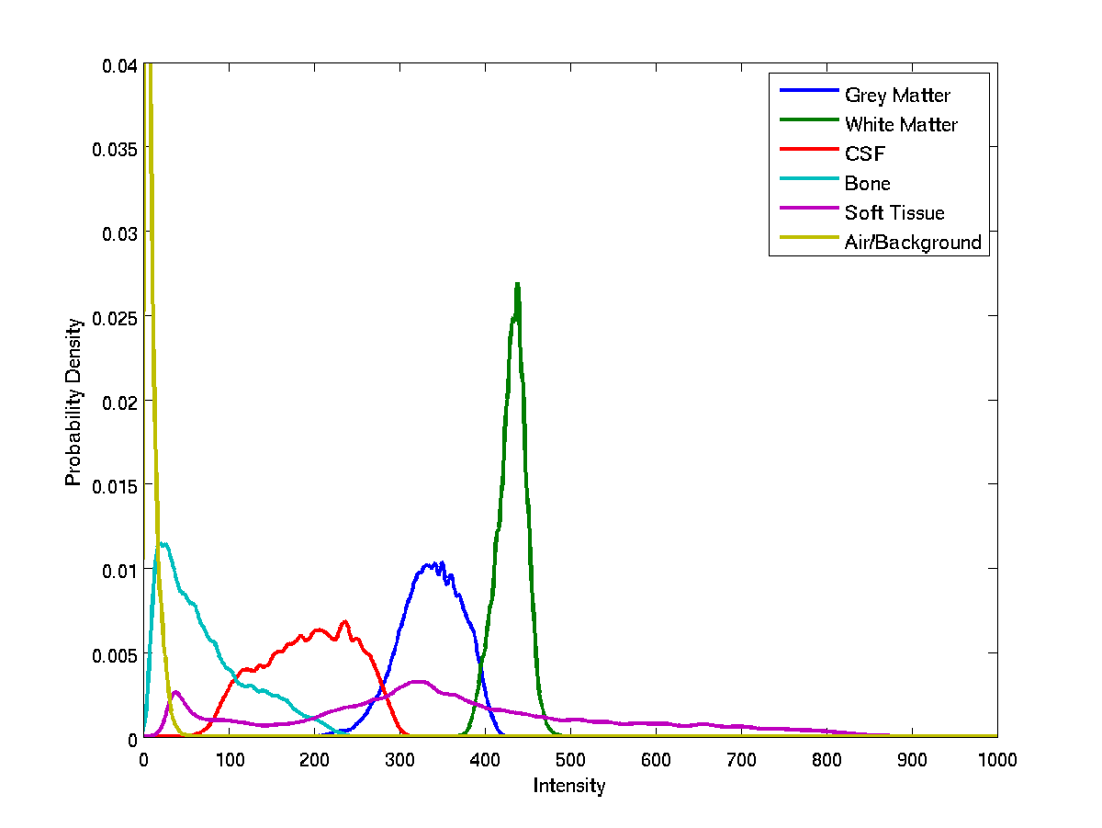
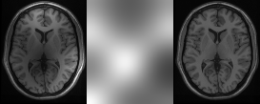
Segmentation: Intensity Distribution Model
John Ashburner | UCL

Slide 13
Segmentation: Bias Field Model
Corrupted image
Bias Field
Corrected image
John Ashburner | UCL

Slide 14
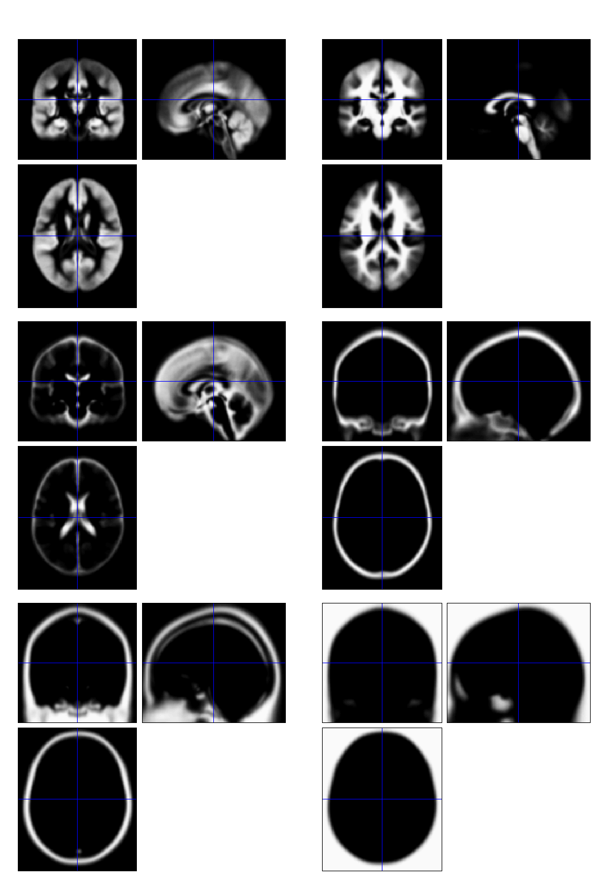
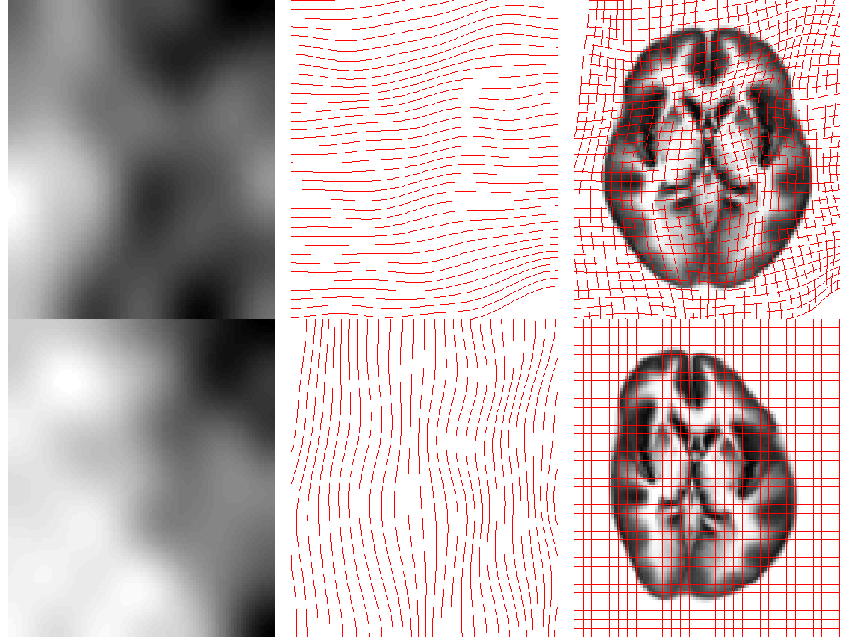
Deformable Tissue Priors
Segmentation: Deformable Tissue Priors
John Ashburner | UCL

Slide 15
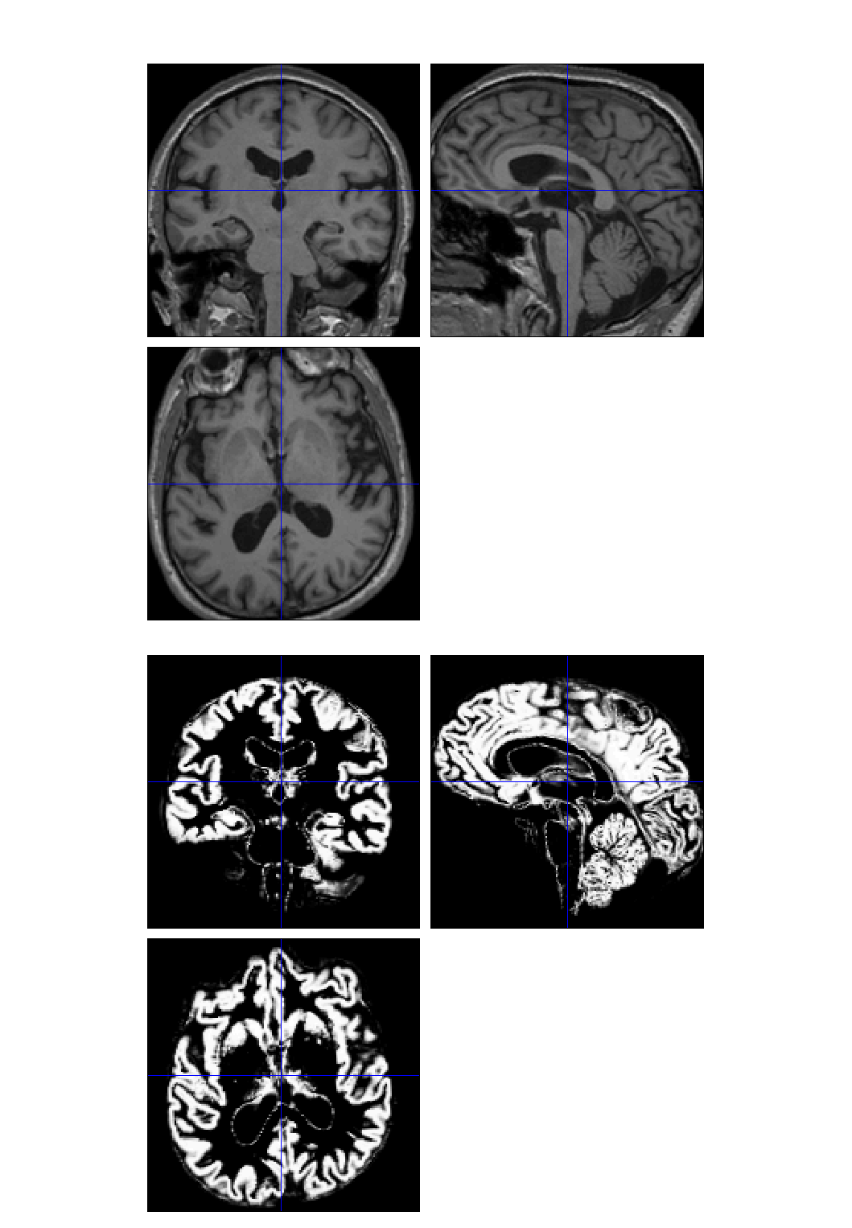
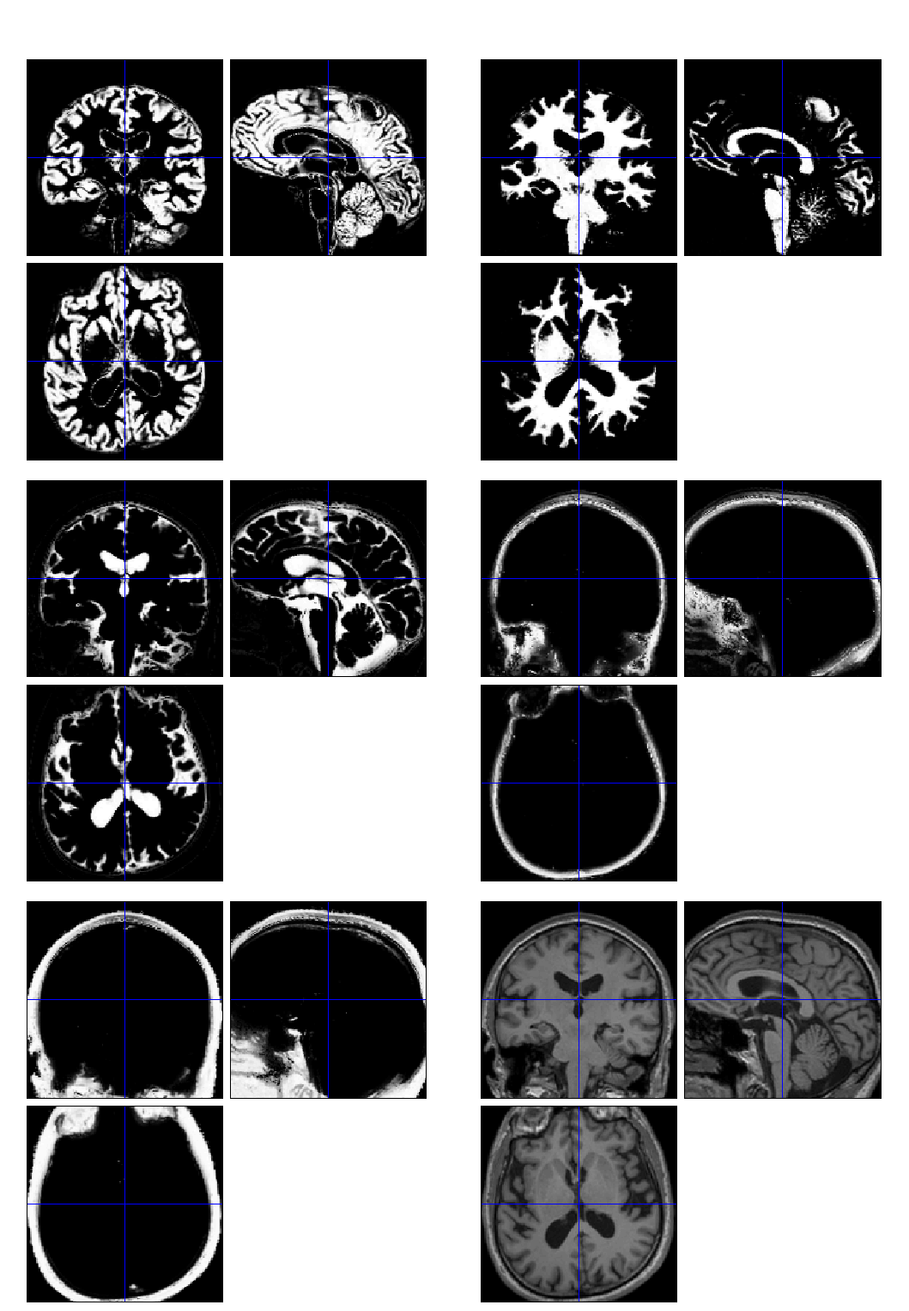
Segmentation: T1-weighted Example
John Ashburner | UCL

Slide 16
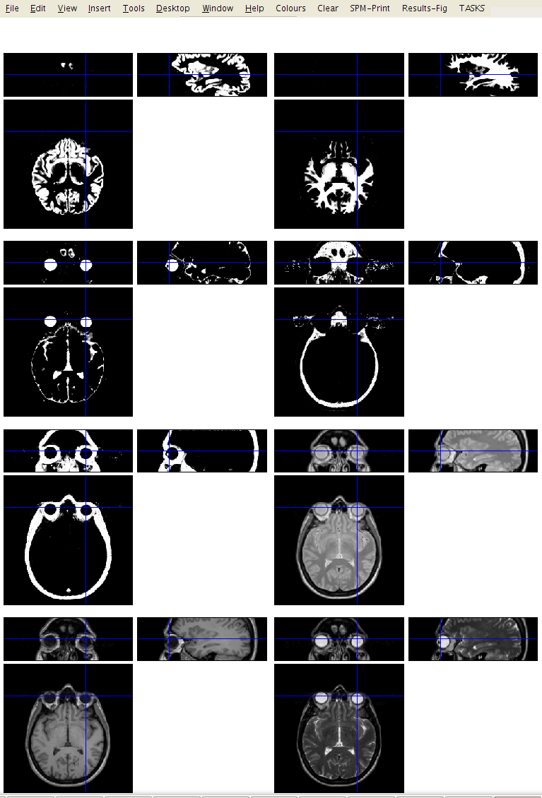
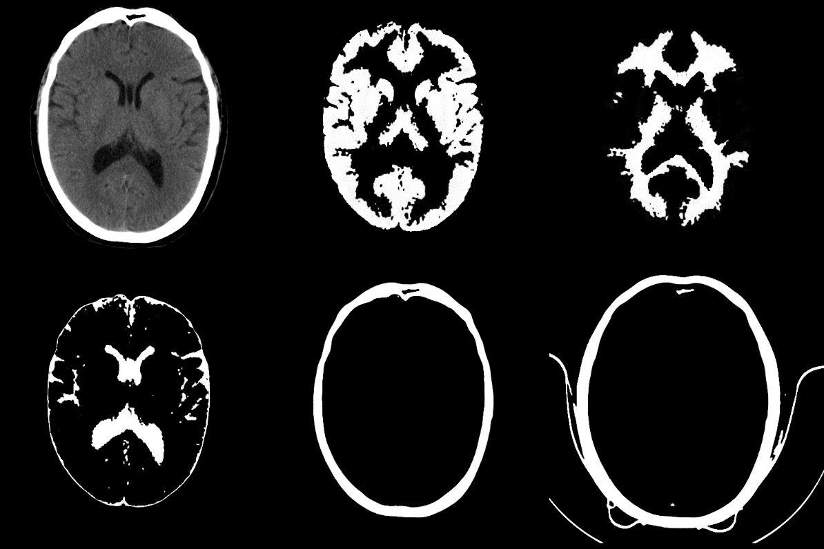
Segmentation: Other Examples
Multi-spectral segmentation
CT attempt
John Ashburner | UCL

Slide 17
Diffeomorphic
Registration
Dartel
Shoot
John Ashburner | UCL

Slide 18
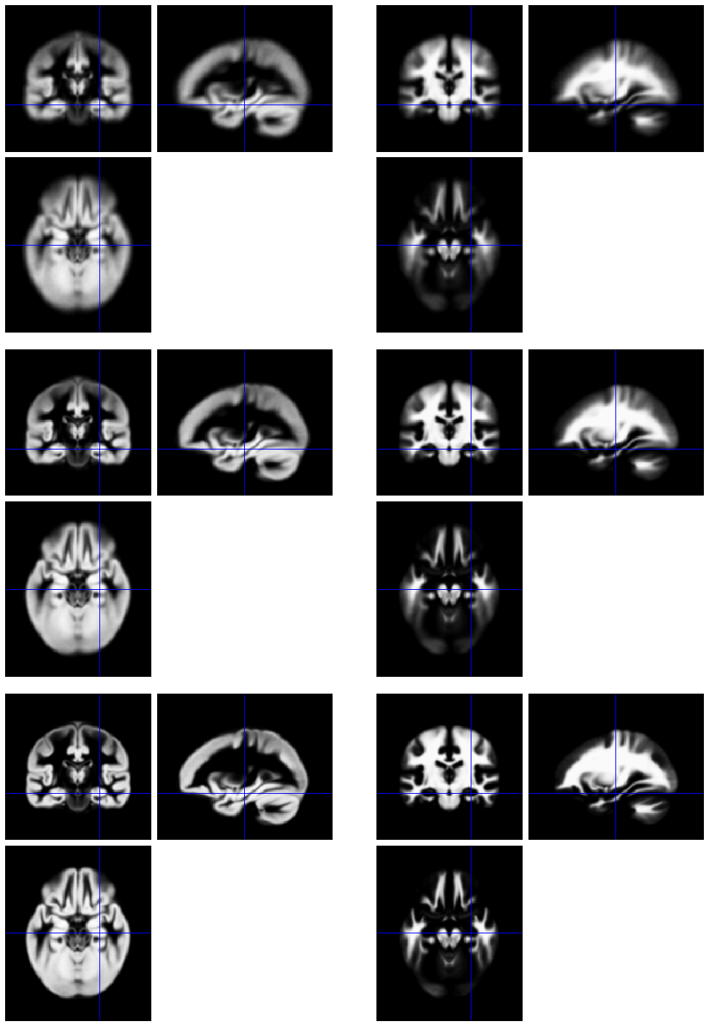
Diffeomorphic Registration: Template
Initial Average
Construct template from average GM & WM
After a few iterations
Align all GM & WM images with template
Final template
John Ashburner | UCL

Slide 19
Diffeomorphic Registration:“Dartel” and “Shoot” compared
Shoot
Dartel
John Ashburner| UCL

Slide 20
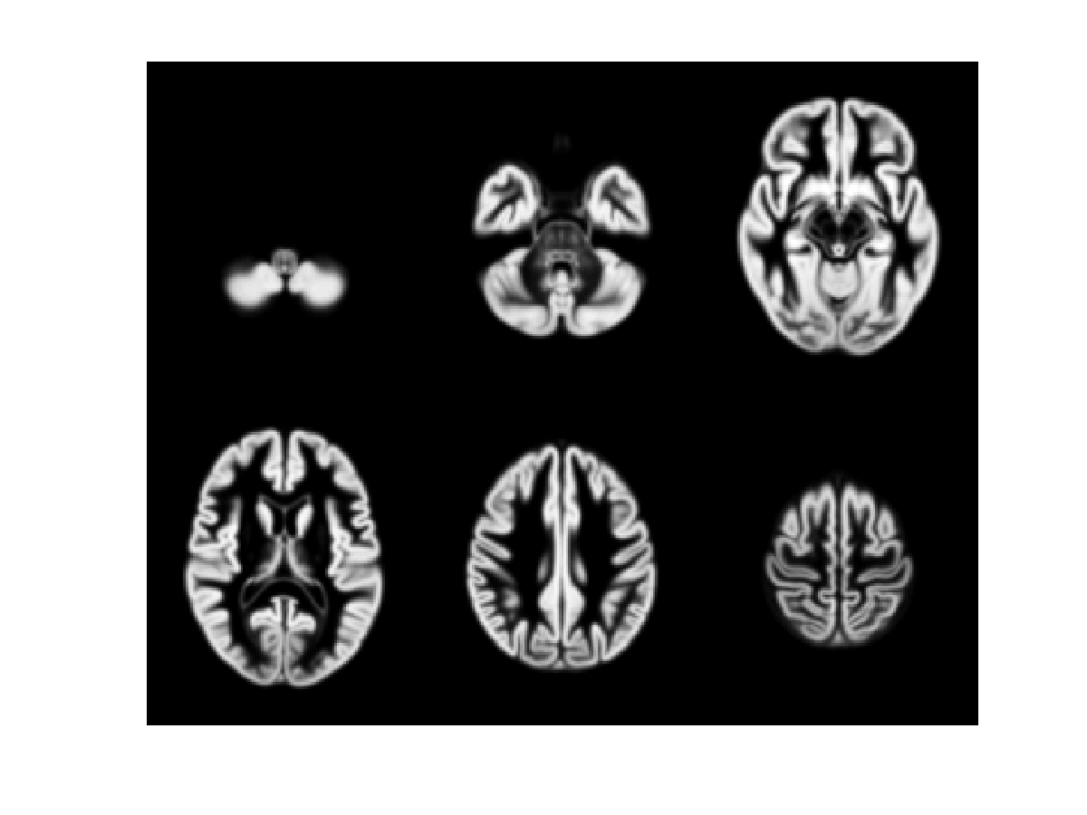
471 Subject Average
John Ashburner| UCL

Slide 21
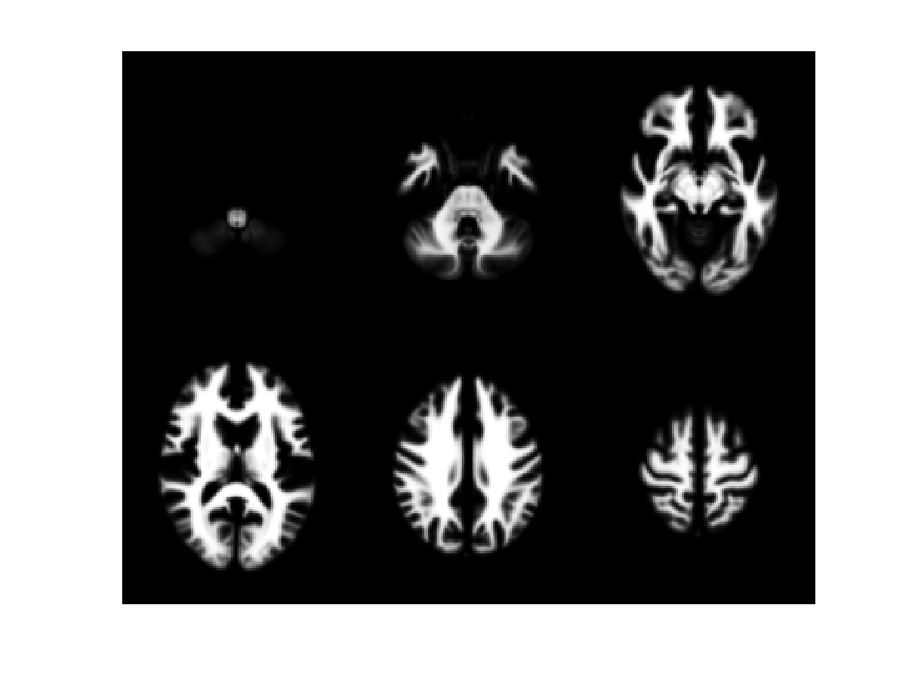
471 Subject Average
John Ashburner| UCL

Slide 22
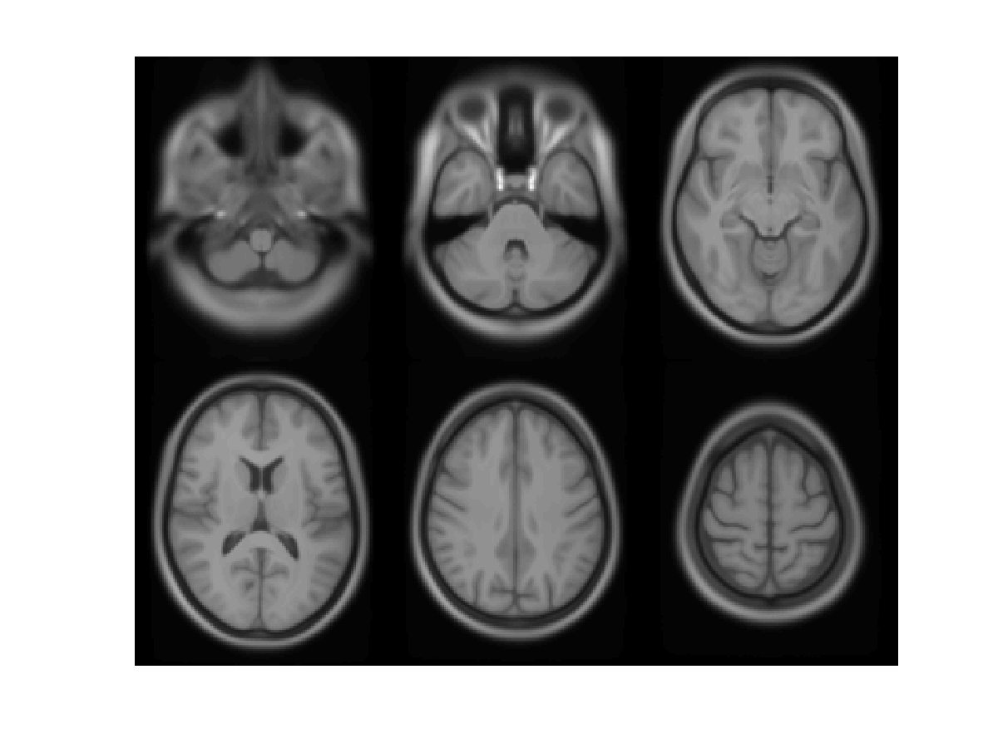
471 Subject Average
John Ashburner| UCL

Slide 23
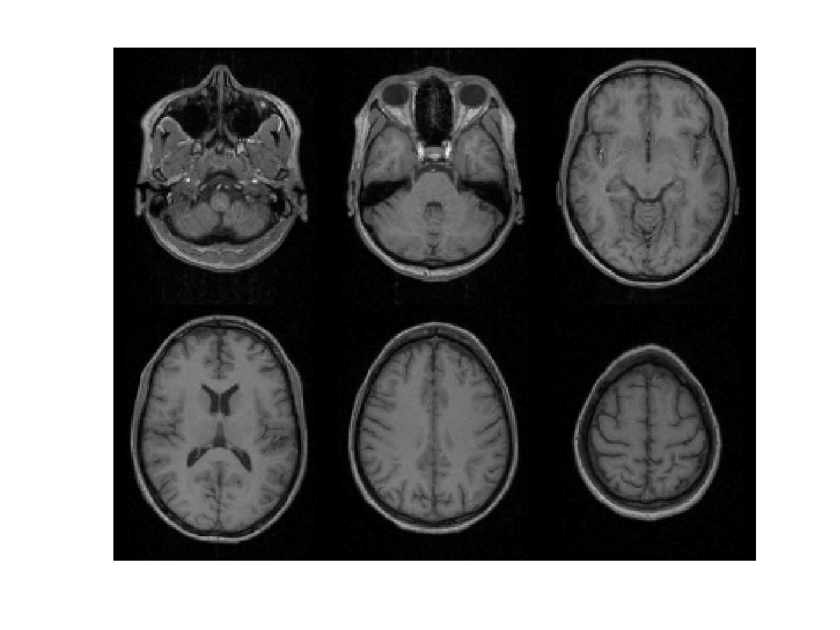
Subject 1
John Ashburner| UCL

Slide 24
471 Subject Average
John Ashburner| UCL

Slide 25
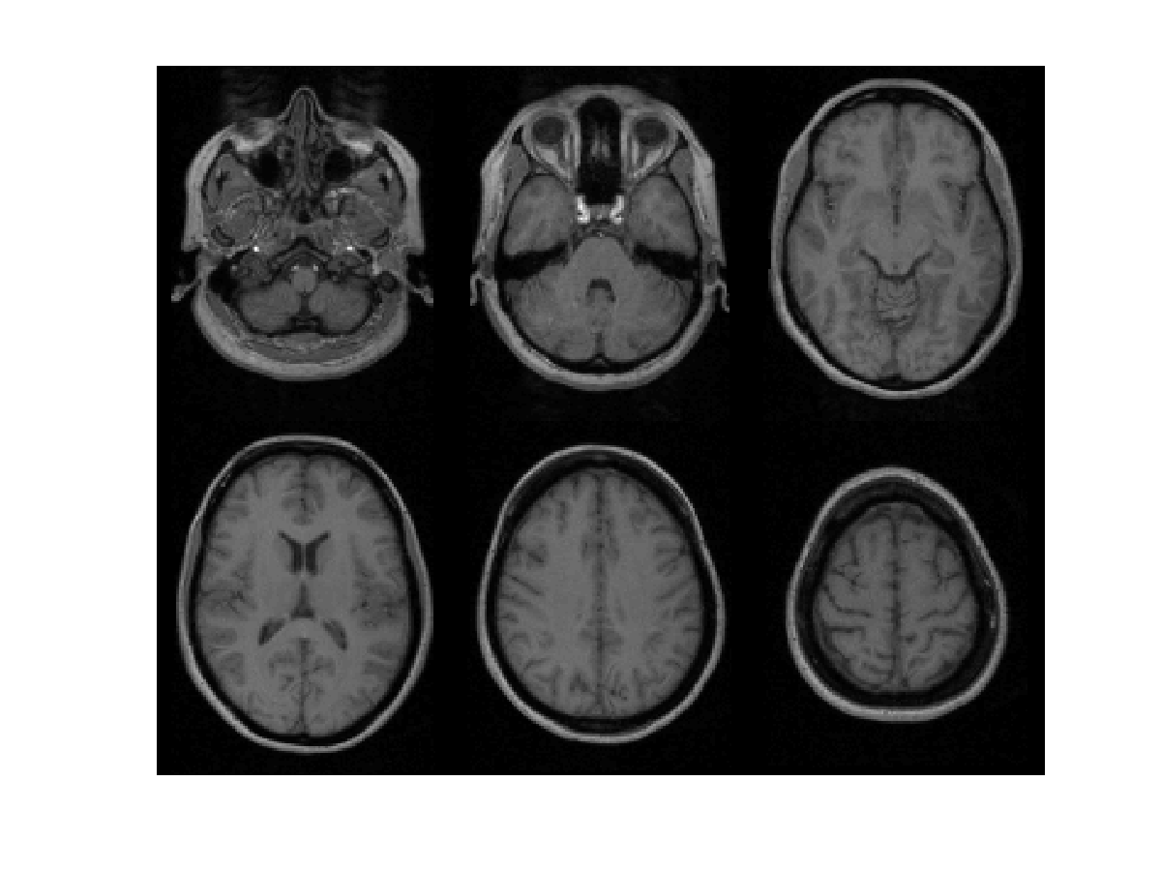
Subject 2
John Ashburner| UCL

Slide 26
471 Subject Average
John Ashburner| UCL

Slide 27
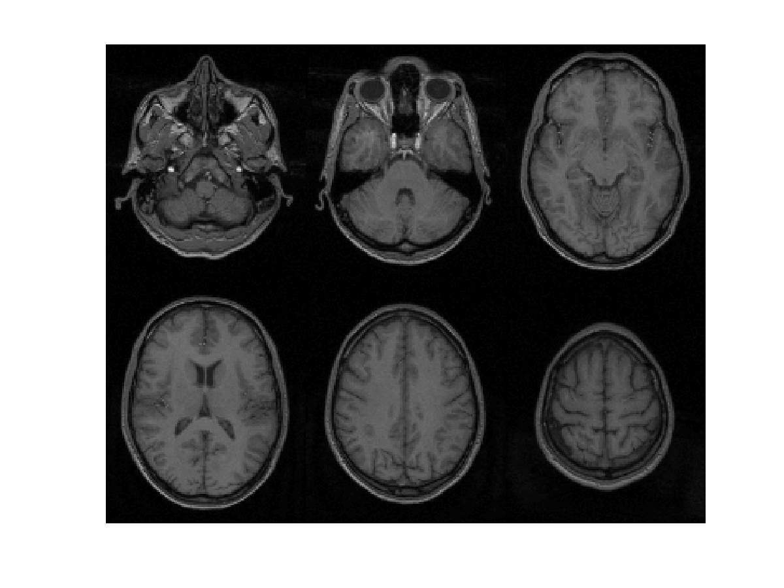
Subject 3
John Ashburner| UCL

Slide 28
471 Subject Average
John Ashburner| UCL

Slide 29
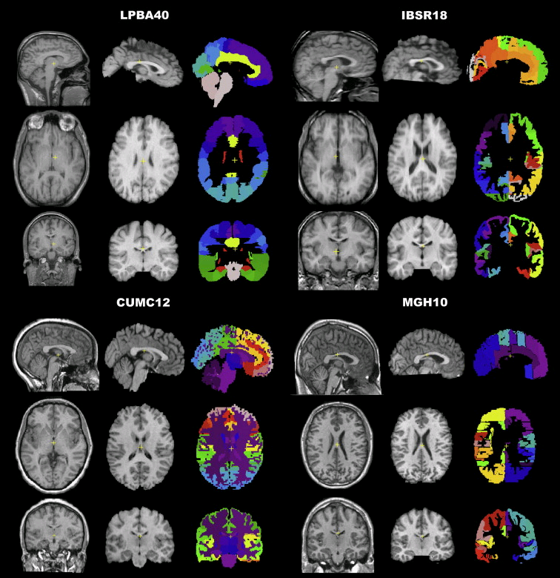
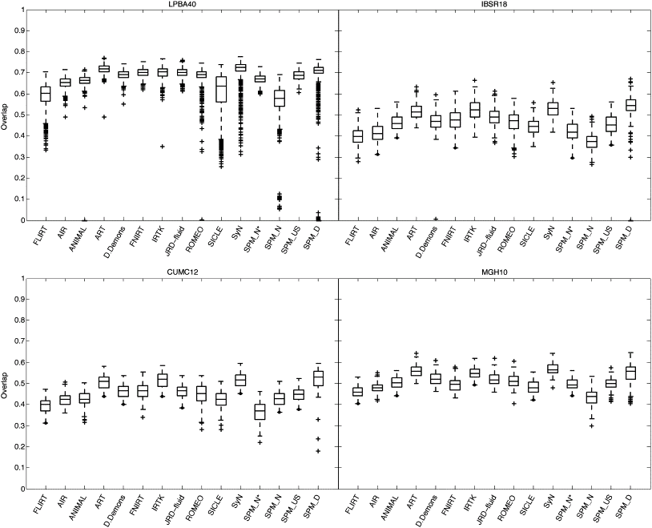
Evaluations of nonlinear registration algorithms
John Ashburner| UCL

Slide 30
Longitudinal
registration
Rigid and nonlinear registration
Bias correction
Inverse-consistent
John Ashburner| UCL

Slide 31
Longitudinal Registration: Intro
Two scans taken 6 years apart (after rigid registration).
Average and difference images.
Shape average and map of expansion/contraction
(after nonlinear registration)
http://www.oasis-brains.org/
John Ashburner| UCL

Slide 32
Longitudinal Registration: OASIS Data
75 y.o. male with MCI.
MMSE=22 CDR=0.5
John Ashburner| UCL

Slide 33
Longitudinal Registration: OASIS Data
75 y.o. male with MCI.
MMSE=22 CDR=0.5
John Ashburner| UCL

Slide 34
Longitudinal Registration: OASIS Data
66 y.o. male with MCI. MMSE=19 CDR=1.0.
John Ashburner| UCL

Slide 35
OASIS Data
Average expansion/contraction from first 82 subjects.
Mean image intensity
Control subjects
Dementia subjects
John Ashburner| UCL

Slide 36
References
Wright et al. (1995). “A voxel-based method for the statistical analysis of gray and white matter density applied to schizophrenia”. Neuroimage 2(4):244-252.
Ashburner & Friston (2000). “Voxel-based morphometry-the methods”. Neuroimage 11(6):805-821.
Mechelli et al. (2005) “Voxel-based morphometry of the human brain: Methods and applications”.
Current Medical Imaging Reviews 1(2):105-103.
Ashburner & Friston (2005). “Unified Segmentation”. NeuroImage 26:839-851.
Ashburner (2007). “A Fast Diffeomorphic Image Registration Algorithm”. NeuroImage 38:95-113.
Ashburner & Friston (2009). “Computing Average Shaped Tissue Probability Templates”.
NeuroImage 45:333-341.
Klein et al (2009). “Evaluation of 14 nonlinear deformation algorithms applied to human brain MRI registration”. NeuroImage 46(3):786-802.
Ashburner (2009). “Computational Anatomy with the SPM software”.
Magnetic Resonance Imaging 27(8):1163-1174.
Ashburner & Friston (2011). “Diffeomorphic registration using geodesic shooting and Gauss-Newton optimisation”. NeuroImage 55(3):954-967
Ashburner & Ridgway (2013). “Symmetric diffeomorphic modelling of longitudinal structural MRI”. Frontiers in Neuroscience 6(197).
John Ashburner| UCL

Slide 37
John Ashburner, PhD
Wellcome Centre for Human Neuroimaging, UCL Institute of Neurology
John Ashburner| UCL

