Slide 1



Conceptual and Mathematical Foundations of Embodied Intelligence
February 27 - March 01, 2013 Max Planck Institute for Mathematics in the Sciences
Embodied inference and free energy
Karl Friston, UCL
How much about our interactions with – and experience of – our world can be deduced from basic principles? This talk reviews recent attempts to understand the self-organised behaviour of embodied agents, like ourselves, as satisfying basic imperatives for sustained exchanges with the environment. In brief, one simple driving force appears to explain many aspects of perception, action and the perception of action. This driving force is the minimisation of surprise or prediction error that – in the context of perception – corresponds to Bayes-optimal predictive coding (that suppresses exteroceptive prediction errors) and – in the context of action – reduces to classical motor reflexes (that suppress proprioceptive prediction errors). In what follows, we look at some of the phenomena that emerge from this single principle; such as the perceptual encoding of spatial trajectories that can both generate movement (of self) and recognise the movements (of others). These emergent behaviours rest upon prior beliefs about itinerant states of the world – but where do these beliefs come from? We will focus on recent proposals about the nature of prior beliefs and how they underwrite the active sampling of a spatially extended sensorium. Put simply, to minimise surprising states of the world, it is necessary to sample inputs that minimise uncertainty about the causes of sensory input. When this minimisation is implemented via prior beliefs – about how we sample the world – the resulting behaviour is remarkably reminiscent of searches of the sort seen in exploration or measured, in visual searches, with saccadic eye movements.

Slide 2
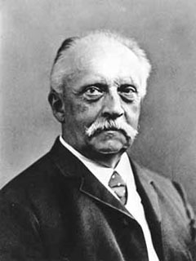
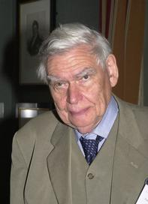
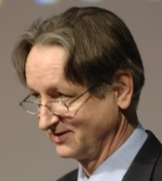
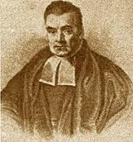

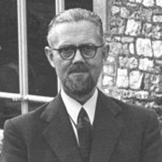
“Objects are always imagined as being present in the field of vision as would have to be there in order to produce the same impression on the nervous mechanism” - von Helmholtz
Hermann von Helmholtz
Richard Gregory
Geoffrey Hinton
From the Helmholtz machine to the Bayesian brain and self-organization
Thomas Bayes
Richard Feynman
Ross Ashby

Slide 3






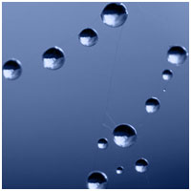
What is the difference between a snowflake and a bird?
Phase-boundary
temperature
…a bird can act (to avoid surprises)
Notes:
3

Slide 4
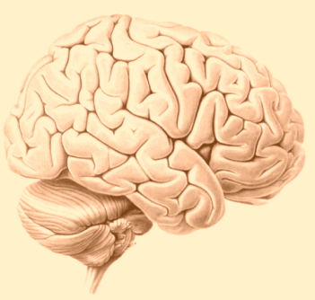
The basic ingredients
Hidden states in the world
Sensations
Internal states of the agent
Fluctuations
Posterior expectations
External states
Action

Slide 5
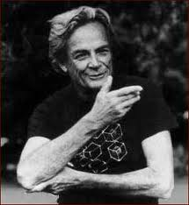
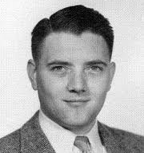
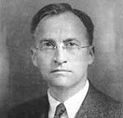
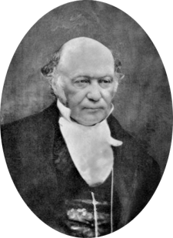
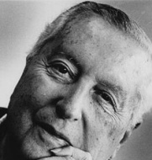
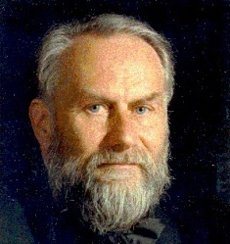
The principle of least free energy (minimising surprise)
Maximum entropy principle
Ergodic theorem
Minimum entropy principle
Self organisation and the principle of least action

Slide 6

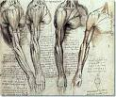
How can we minimize surprise (prediction error)?
sensations – predictions
Prediction error
Change sensations
Change
predictions
Action
Perception
…action and perception minimise free energy

Slide 7

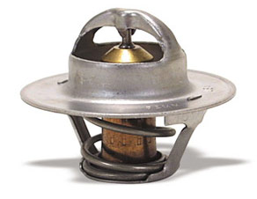
Action as inference – the “Bayesian thermostat”
Posterior distribution
Prior distribution
Likelihood distribution
20
40
60
80
100
120
temperature
Perception:
Action:

Slide 8
How might the brain minimise free energy (prediction error)?
Hidden states in the world
Sensations
Internal states of the agent
Fluctuations
Posterior expectations
External states
Action
By using predictive coding (and reflexes)

Slide 9
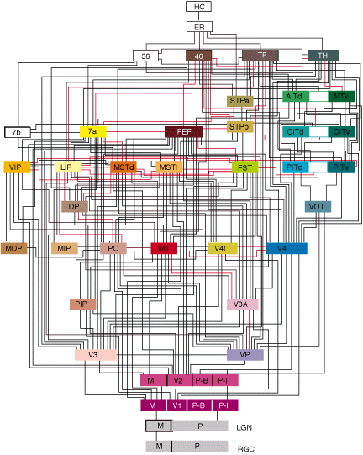
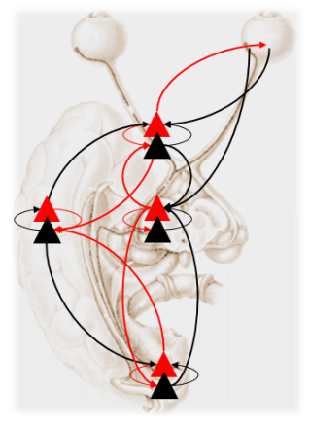
Free energy minimisation
Generative model
Predictive coding with reflexes

Slide 10
From prediction to perception
A simple hierarchy
Generative model
Outward prediction stream
Model inversion (inference)
Expectations:
Inward error
stream
Predictions:
Prediction errors:

Slide 11

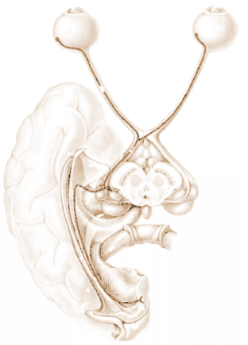
David Mumford
Predictive coding with reflexes
Action
oculomotor signals
reflex arc
proprioceptive input
pons
Perception
retinal input
Attention
Prediction error (superficial pyramidal cells)
occipital cortex
geniculate
Top-down or backward predictions
Conditional predictions (deep pyramidal cells)
Bottom-up or forward prediction error
visual cortex

Slide 12

Biological agents resist the second law of thermodynamics
They must minimize their average surprise (entropy)
They minimize surprise by suppressing prediction error (free-energy)
Prediction error can be reduced by changing predictions (perception)
Prediction error can be reduced by changing sensations (action)
Perception entails recurrent message passing in the brain to optimize predictions
Action makes predictions come true (and minimizes surprise)

Slide 13

Action as inference – the “Bayesian thermostat”
Prior distribution
20
40
60
80
100
120
temperature
Perception:
Action:

Slide 14
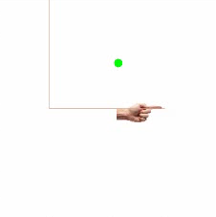


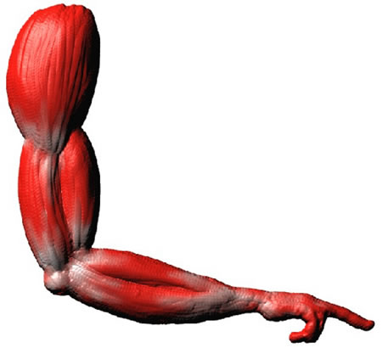
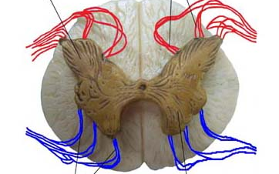
Action with point attractors
visual input
Exteroceptive predictions
Descending
proprioceptive predictions
proprioceptive input

Slide 15
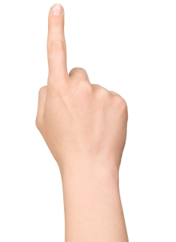
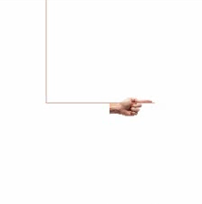
Heteroclinic cycle (central pattern generator)
Descending
proprioceptive predictions
action
observation
0.4
0.6
0.8
position (y)
1
1.2
1.4
0
0.2
0.4
0.6
0.8
1
1.2
1.4
0
0.2
0.4
0.6
0.8
1
1.2
1.4
position (x)
position (x)

Slide 16
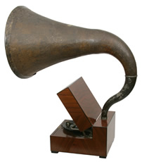
Where do I expect to look?

Slide 17
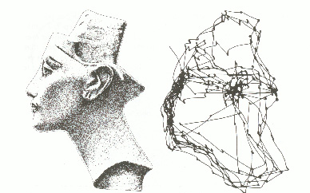
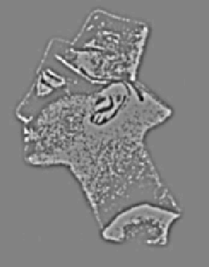
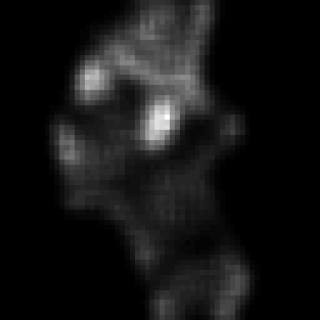
Sampling the world to minimise uncertainty
Free energy principle
minimise uncertainty
stimulus
visual input
salience
sampling
Perception as hypothesis testing – saccades as experiments

Slide 18
Hidden states in the world
Sensations
Internal states of the agent
Fluctuations
Posterior expectations
External states
Prior expectations
Action

Slide 19
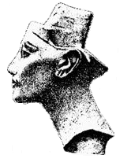
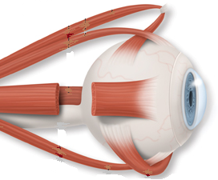
Parietal (where)
Frontal eye fields
Visual cortex
Fusiform (what)
Pulvinar salience map
oculomotor reflex arc
Superior colliculus

Slide 20
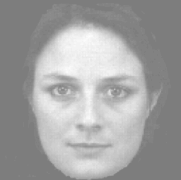
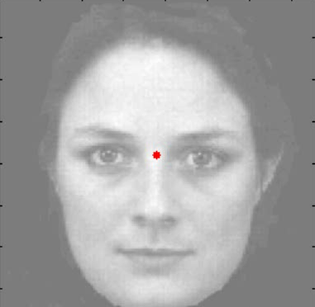
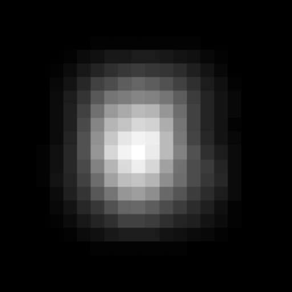
Saccadic eye movements
Saccadic fixation and salience maps
Hidden (oculomotor) states
Visual samples
Conditional expectations about hidden (visual) states
And corresponding percept

Slide 21
Thank you
And thanks to collaborators:
Rick Adams
Andre Bastos
Sven Bestmann
Jean Daunizeau
Mark Edwards
Harriet Brown
Lee Harrison
Stefan Kiebel
James Kilner
Jérémie Mattout
Rosalyn Moran
Will Penny
Klaas Stephan
And colleagues:
Andy Clark
Peter Dayan
Jörn Diedrichsen
Paul Fletcher
Pascal Fries
Chris Frith
Geoffrey Hinton
James Hopkins
Jakob Hohwy
Henry Kennedy
Paul Verschure
Florentin Wörgötter
And many others

Slide 22
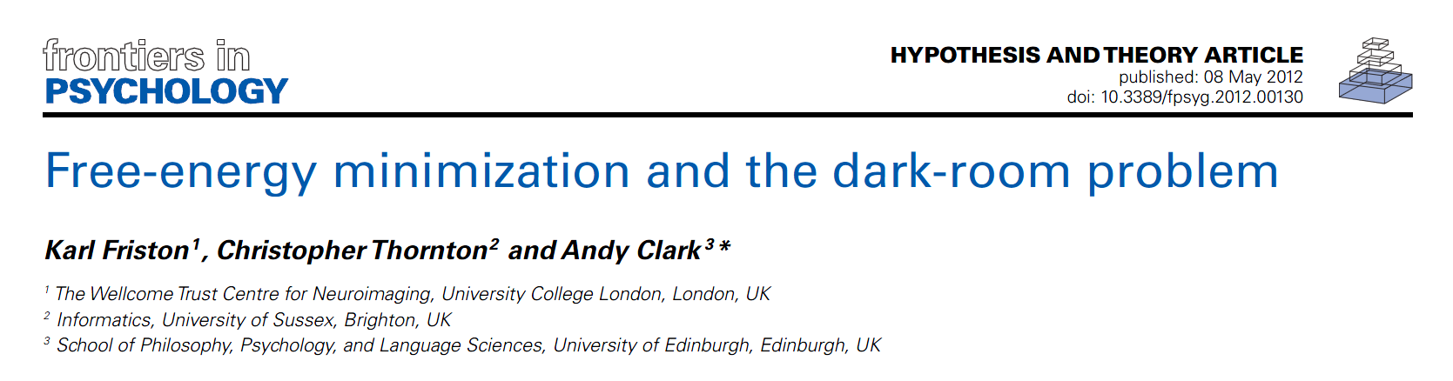

Searching to test hypotheses – life as an efficient experiment
Free energy principle
minimise uncertainty

Slide 23
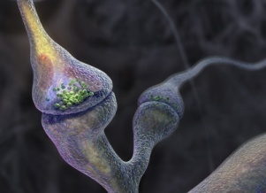
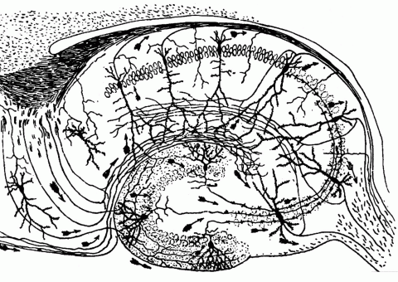
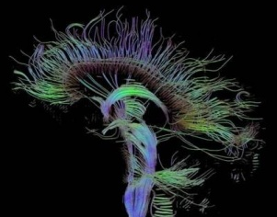
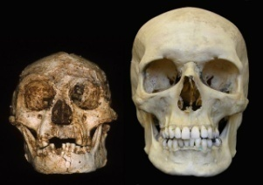
Time-scale
Free-energy minimisation leading to…
Perception and Action: The optimisation of neuronal and neuromuscular activity to suppress prediction errors (or free-energy) based on generative models of sensory data.
Learning and attention: The optimisation of synaptic gain and efficacy over seconds to hours, to encode the precisions of prediction errors and causal structure in the sensorium. This entails suppression of free-energy over time.
Neurodevelopment: Model optimisation through activity-dependent pruning and maintenance of neuronal connections that are specified epigenetically
Evolution: Optimisation of the average free-energy (free-fitness) over time and individuals of a given class (e.g., conspecifics) by selective pressure on the epigenetic specification of their generative models.

